Slide 1
Comments on Dual Readout Calorimeter
Tianchi Zhao
IHEP, Beijing
tianchi@u.washington.edi
Sept. 20, 2017

Slide 2
2017-04-20
Richard Wigmans
Finer sampling
Finer sampling
RD52 approaches with finer sampling granularity and therefore better performance
But module and projective tower construction more difficult

Slide 3
~5 m
1.5 m
Projection in θ and φ
2.5 m
2 m
1.8 m
Tracker
TPC, Silicon, DC
Assumed parameters in this talk

Slide 4
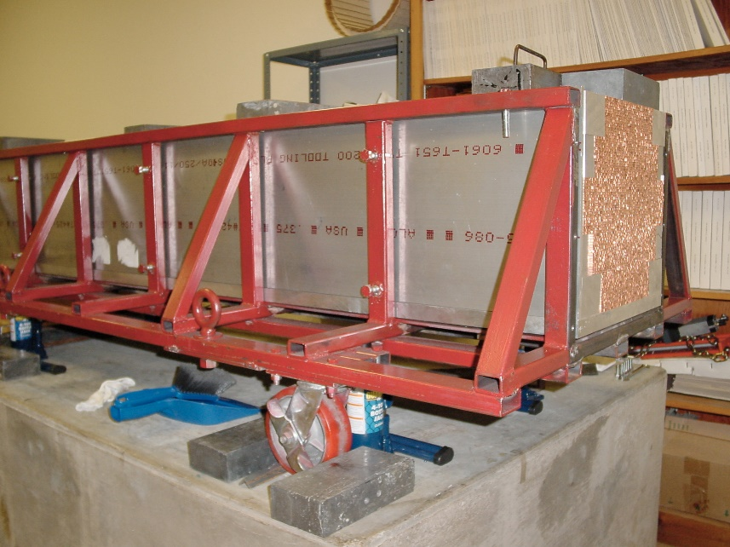
Main Issues to be Addressed for CDR
Projective towers ?
Depth of calorimeter?
Prototypes are 2 – 2.5 m long
Pre-shower detector?
Readout method?
SiPMs (or other method)
Segmentation size
Total number of readout channels

Slide 5

A Projective Tower of Dual Readout Calorimeter
Short fibers
Full length fibers
1.5 m
Total area to be covered by PMT determined by OD and barrel length of calorimeter
2（ 6 x 6 ）PMTs
5 cm
OD = 7 m, L = 6 m
Total area = 190 m²
Barrel = 130 m²
End caps = 2 x 30 m²
Total PMTs = 2 x 400 x 190 = 152000

Slide 6
An Alternative Readout Scheme
Ternary Readout
Scintillating light
Cherenkov light
Shower time profile
Correct light attenuation
Correct sampling ratio change
Correct e/h change
PFA friendly?
Fast PMTs
(C-fibers)
Fast PMTs
(UV-fiber)
Cu/Fiber module (6-10 λ)
All full length fiber
Sampling ratio changes
plastic scintillator plate/light guide
plastic scintillator plate/light guide

Slide 7
Forward particle speed ~ 30 cm/ns
Backward scintillation light speed ~ 17 cm/ns
Effective light speed ~ 11 cm/ns
15
10
5
0
5 Gs/s waveform digitization
200 ps ~ 2.2 cm
13.8 ns
Light to PMT (ns)
The meaning and usefulness of timing information needs to be understood
Scintillation light arrival time (ns)
Scintillation light start time (ns)
0 30 60 90 120 150
Depth in calorimeter tower (cm)

Slide 8
Cu~60%
Fiber~ 35%
Air~5%
RD52 coper module (2012)
1.5 mm
1 mm
X₀ ~ 2.4 cm
1.5 mm
λ_{int} ~ 25 cm
1 mm
1.5 mm
Front
1.5 mm
A possible Cu unit
(average λ~ 20 cm)
1 mm
2.0 mm
Rear
2.0 mm

Slide 9
Another RD 52 Dual Readout Calorimeter Cell
Front
2.0 mm
1.0 mm
1.0 mm
Back
1.0 mm
3.0 mm
1.5 mm

Slide 10
Area to be Covered Determine by
Inner surface area of the calorimeter barrel and two end caps
Readout segmentation
Take
R_{in} = 2 m
Barrel Length = 5 m
Crude estimation：2 x (65 m² + 2 x 12.5 m²) = 180 m²
Barrel area
End cap area
5 cm x 5 cm → 72,000 PMTs
2.5 cm x 2.5 cm → 288,000 PMTs

Slide 11
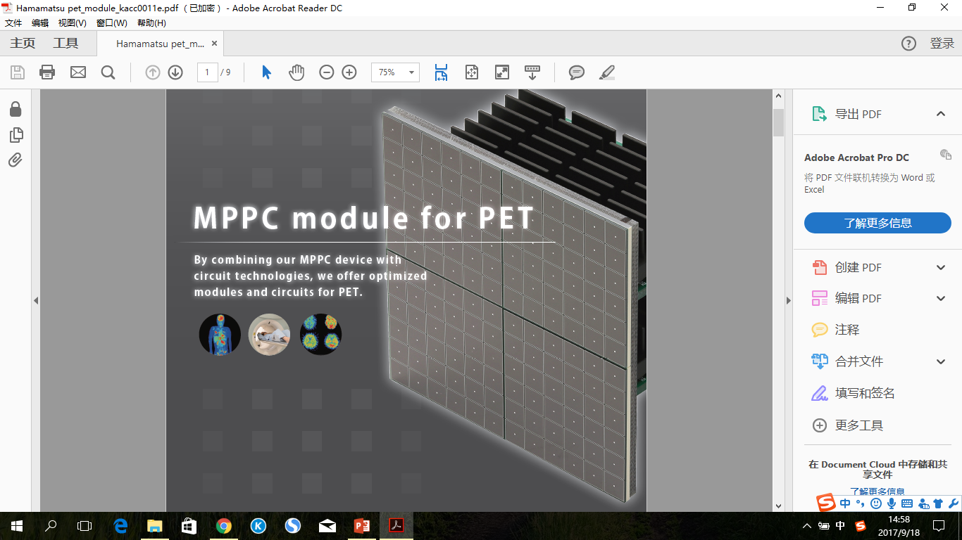
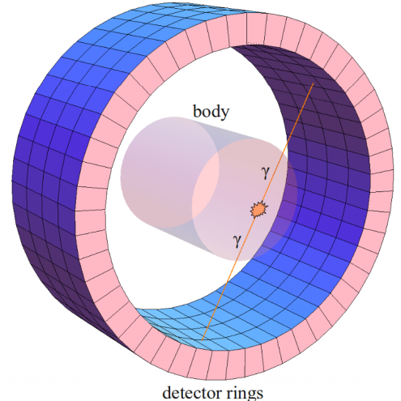
SiPMs
For TDR, we do not have time to do prototypes. We need a scheme that is likely to work
A PET ring typically ~0.2 m²
One CEPC calorimeter ≈
1000 to 2000 medical PET scanners
SiPM modules used in TOF-PET
25 mm
25 mm
PMT size: 25 mm x 25 mm
Pixel size: 3 mm x 3 mm
or 4 mm x 4 mm

Slide 12
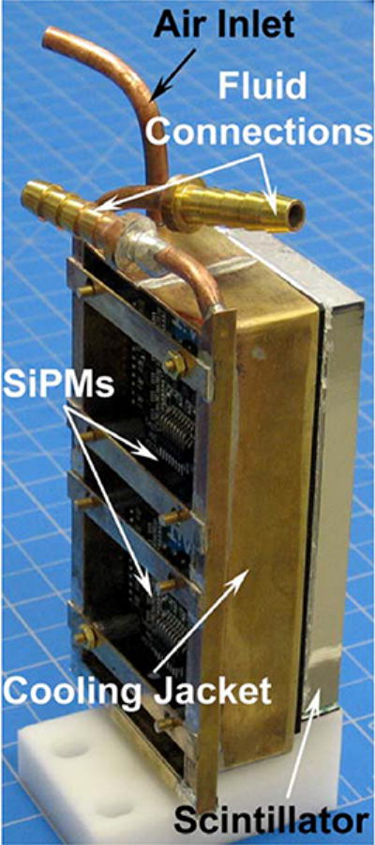
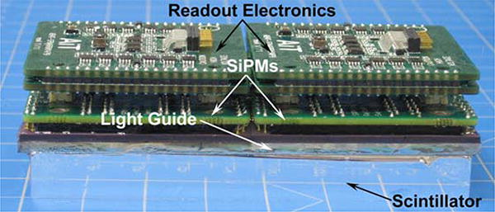
Example of SiPM Modules used in TOF-PET

Slide 13
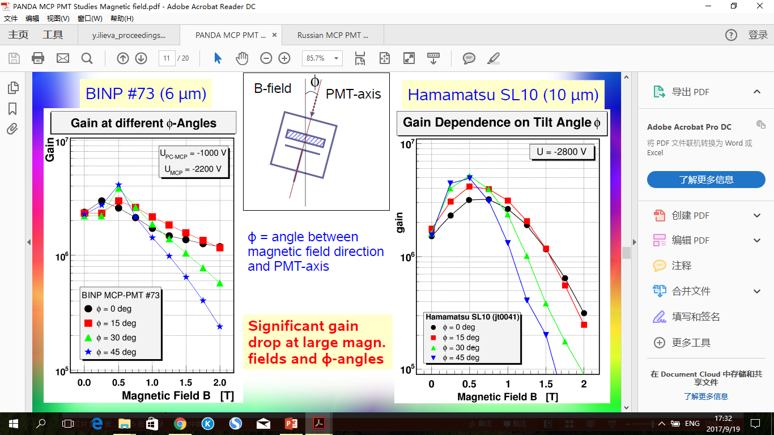
MCP-PMT
We believe we can develop and make MCP-PMTs at an affordable cost in China
MCP-PMTs that work in 2 T magnetic field and in all directions may not be possible

Slide 14
B > 2 T
Using MCP-PMT in barrel region is difficult
End caps probably OK

Slide 15
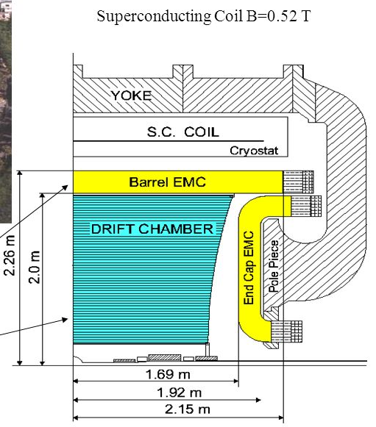
Go back to KLOE EMCal configuration
Fibers along the barrel
MCP-PMTs at two ends
Will it work in high energy collider?

