Slide 1
Vertex optimization with full simulation
Wu Zhigang
2017.9.20

Slide 2
outline
optimization of material budget
Impact parameter resolution
For comparisons
optimization of distance to IP
optimization of spatial resolution

Slide 3
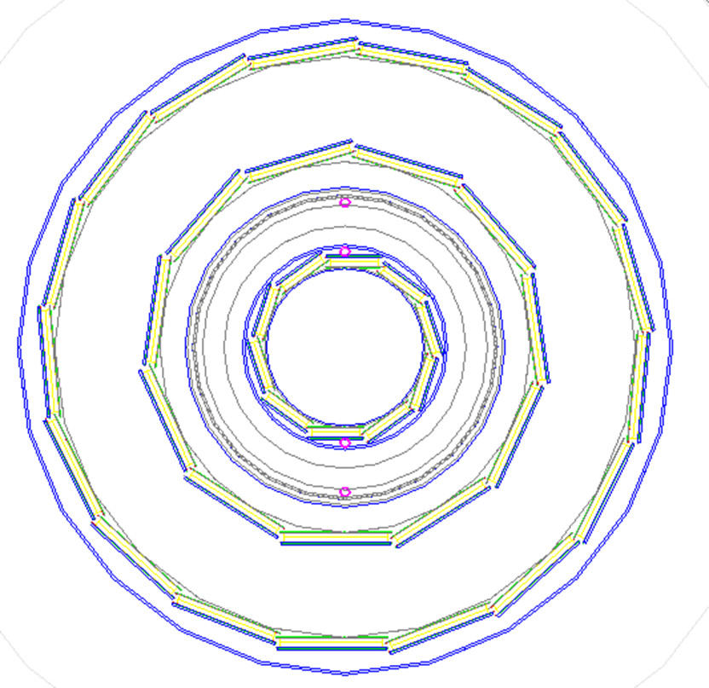
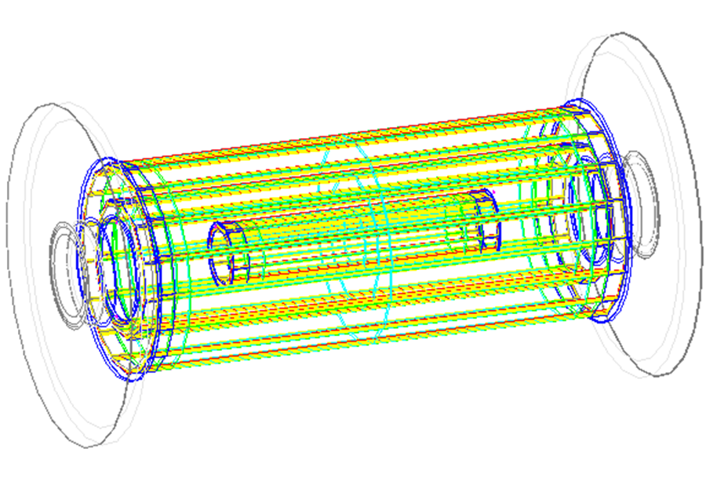
VXD structure
Material budget (baseline)
  Silicon: 0.000534 X/X0@50um
  Support: 0.000986 X/X0@1mm

Slide 4
method
Change material budget in Mokka (by C. Fu)
  /Mokka/init/globalModelParameter VXDSupportScale x
  /Mokka/init/globalModelParameter VXDSiliconScale x
  Change X from 0.4 to 1.6

Slide 5
Method
Event
  50000 z->bb, 50000 z->cc, 50000 z->ll(uds pairs)
generator
Mokka
Marlin
reconstruction
JetClustering
Detector simulation
Digitial
train

Slide 6
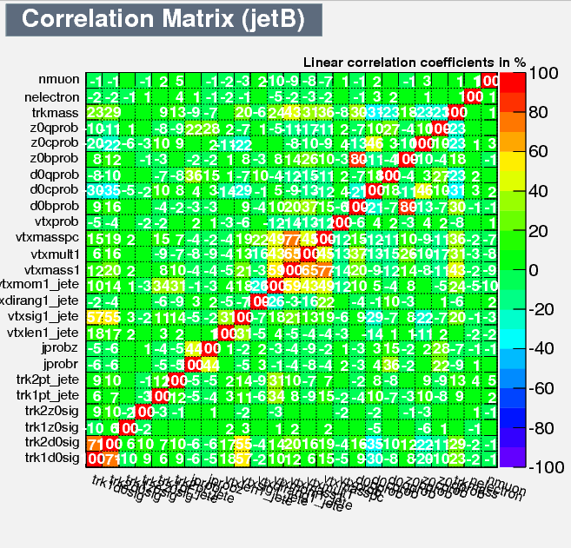
result
CorrelationMatrix

Slide 7
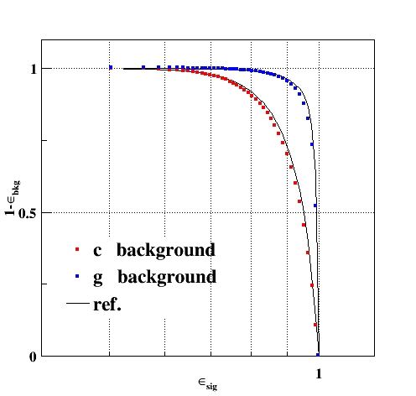
result
Training (baseline)
train
test

Slide 8
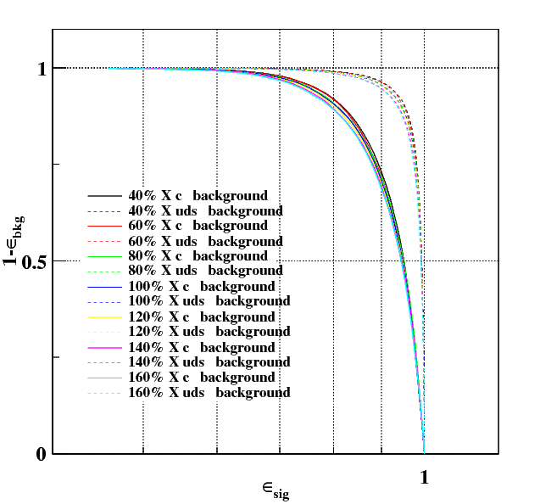
result
BROC

Slide 9
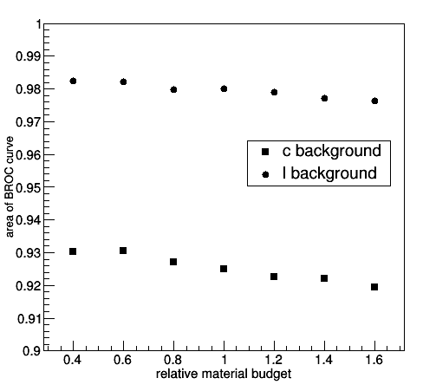
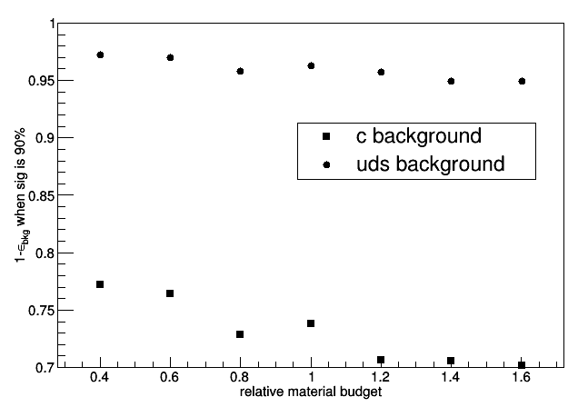
result
BROC
  The reduce of material is inefficient to b-tagging

Slide 10
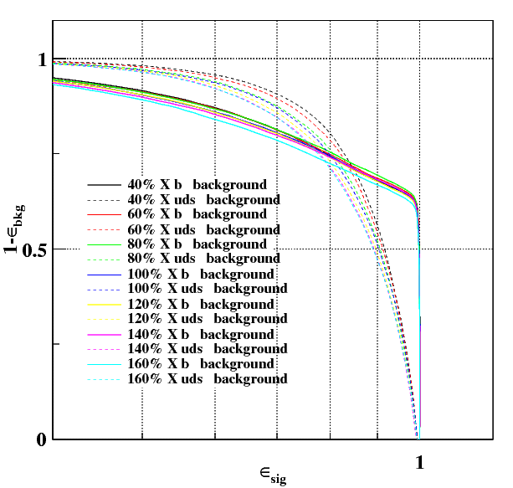
result
CROC

Slide 11
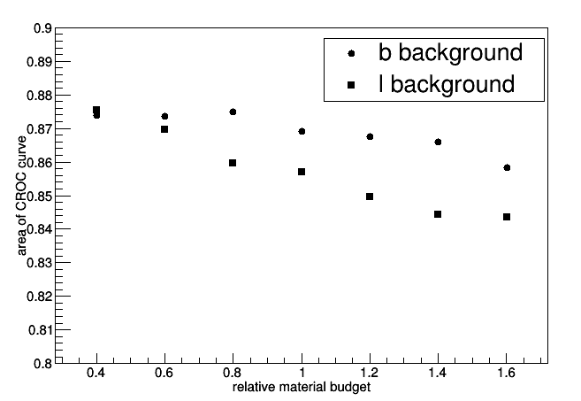
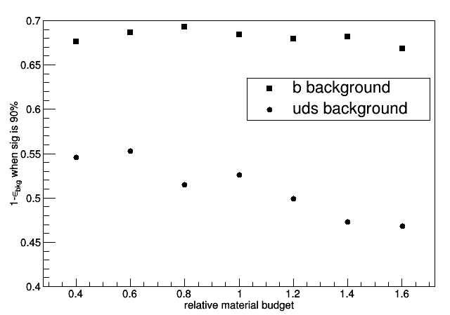
result
CROC
  The reduce of material is efficient to c-tagging (especially uds background)

Slide 12
For comparison
pushing vertex to IP (by Li.gang)
  pushing vertex to IP improve Ctag significantly
Btag: ROC
Ctag : ROC

Slide 13
For comparison
Change resolution (by Li.gang)

Slide 14
For comparison
Change resolution
B-tagging

Slide 15
For comparison
Change resolution
C-tagging

Slide 16
conclusion
The optimization of vertex improves c-tagging significantly, while has little influence on b-tagging

Slide 17

transverse impact parameter resolution
Definition
  The resolution of impact parameter in R-φ
    The closest distance from IP to track
Theoretical formula (pre-CDR)
when a=5,b=10

Slide 18
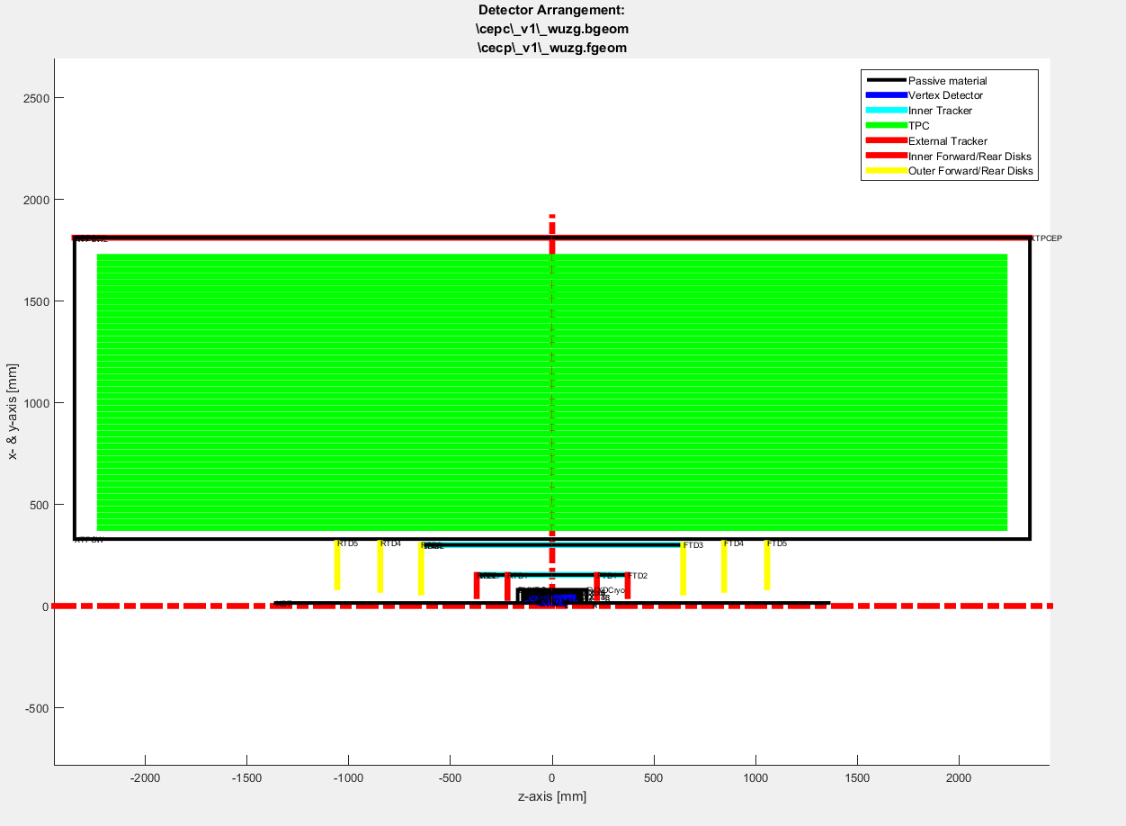
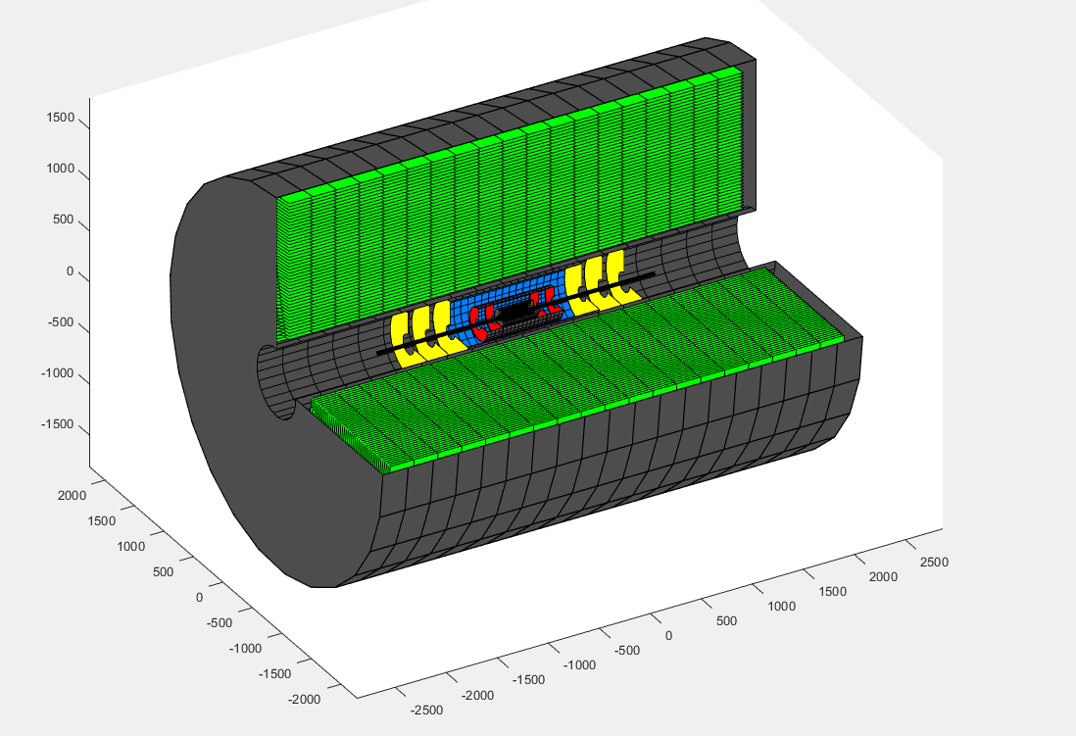
Fast simulation
Based on MatLab (by Liu.Beijiang)
  Include VXD FTD SIT SET TPC support cooling
  Change the detector structure to CEPC_V1

Slide 19
Full simulation
Based on Mokka and Marlin
  Method: TrackImpl.h--->getD0()--->impact parameter
Collection name | algorithm
SiTracks | SiliconTracking_MarlinTrk(VXD、SIT、FTD)
ForwardTracks | ForwardTracking(FTD)
SubsetTracks | Combine SiTracks and ForwardTracks
MarlinTrkTracks | Combine SubsetTracks and TPC

Slide 20
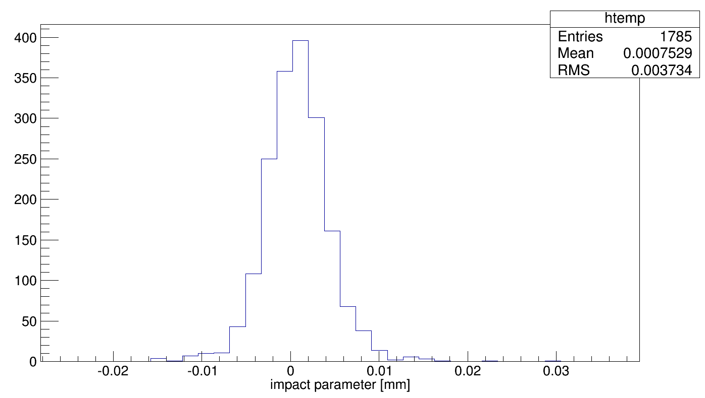
Full simulation
Event
  2000 u- : momentum from 1GeV to 100GeV
  Cut: impact parameter from -0.1mm to 0.1mm
50GeV u-

Slide 21
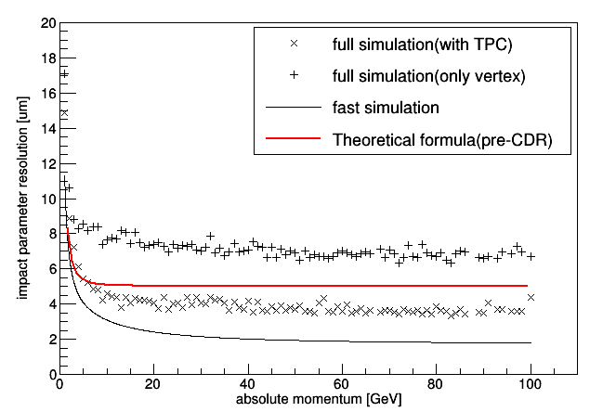
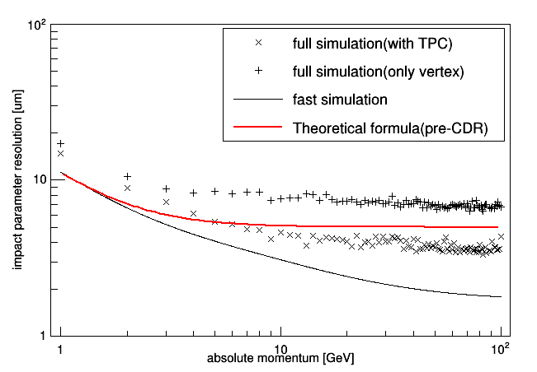
result
Simulation based on u-, θ = 90，Vertical incidence

