Slide 1
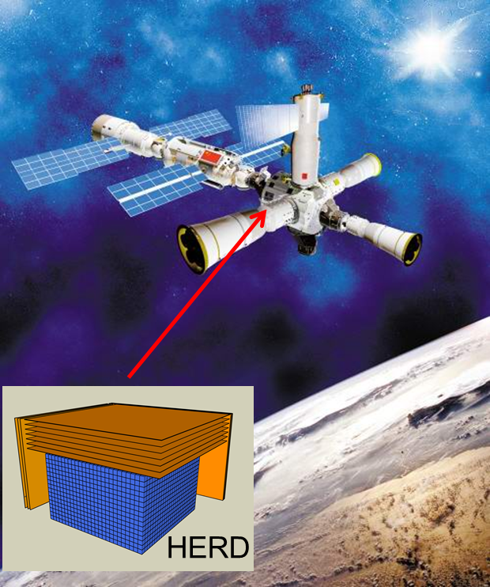
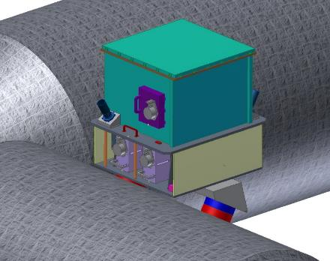
HERD Sciences & General Progress
Shuang-Nan Zhang
IHEP, CAS

Slide 2
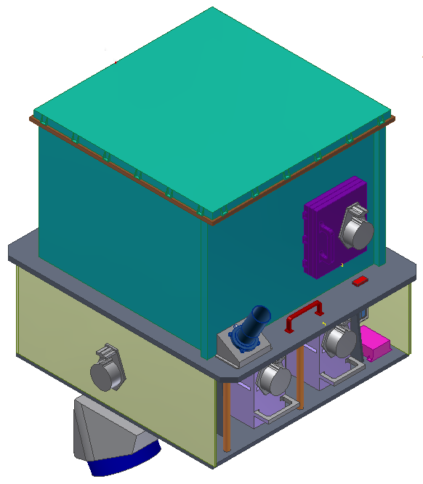
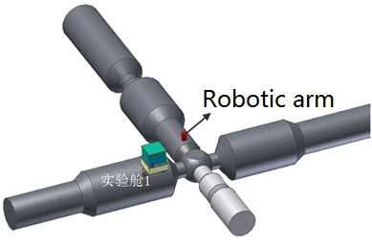
HERD concept
HERD: a flagship and landmark scientific experiment onboard the China's Space Station
Sciences
  Indirect dark matter search with unprecedented sensitivity
  Precise cosmic ray spectrum and composition measurements up to the knee energy
  Gamma-ray monitoring and survey
Unique capabilities
  Direct PeV CR observation with best energy resolution
  Low energy gamma ray observation
  Largest geometric factors for electrons and cosmic rays
Planned launch ~2025; 10+ years lifetime

Slide 3
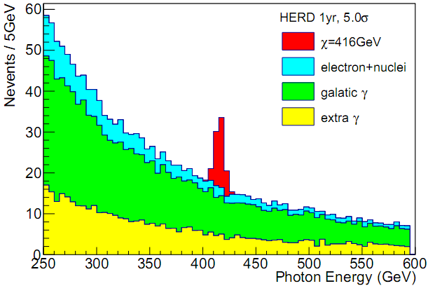
Signal of monochromatic gamma-ray from DM annihilation

Slide 4
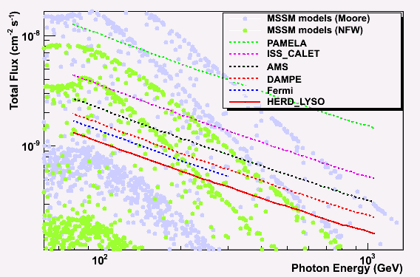
Expected gamma-ray line sensitivity
HERD 1 yr
PAMELA: 2006-2016 CALET: 2015-2020; AMS: 2011-2024; DAMPE: 2015-2020; Fermi: 2008-2018; HERD: 2023-

Slide 5
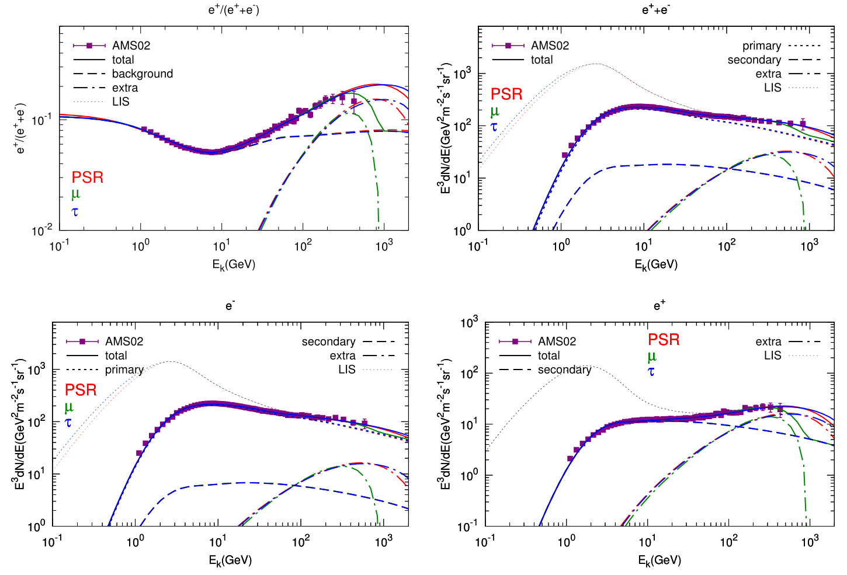
Positron/electron excess from DM annihilation or nearby pulsars
Lin SJ et al. PRD91.063508, 2015
Notes:
Pulsar and DM are two typical benchmark model.

Slide 6
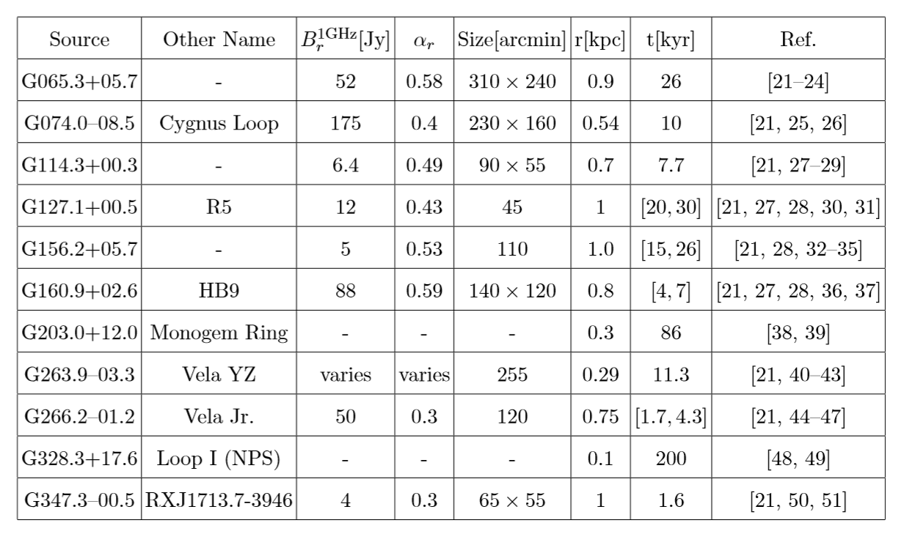
Contributions from nearby pulsars
Fang,k. Wang, B. et al. APJ 2017

Slide 7
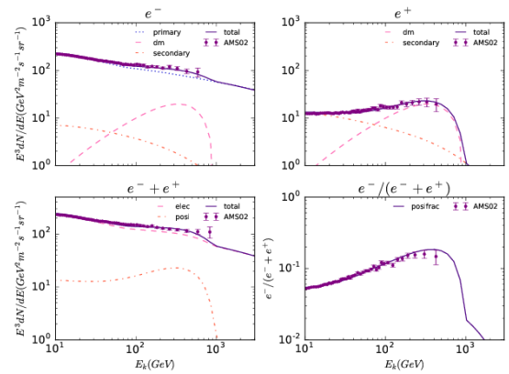
AMS02 data consistent with DM model…

Slide 8
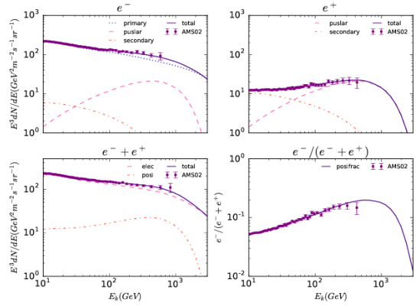
And also consistent with Pulsar model

Slide 9
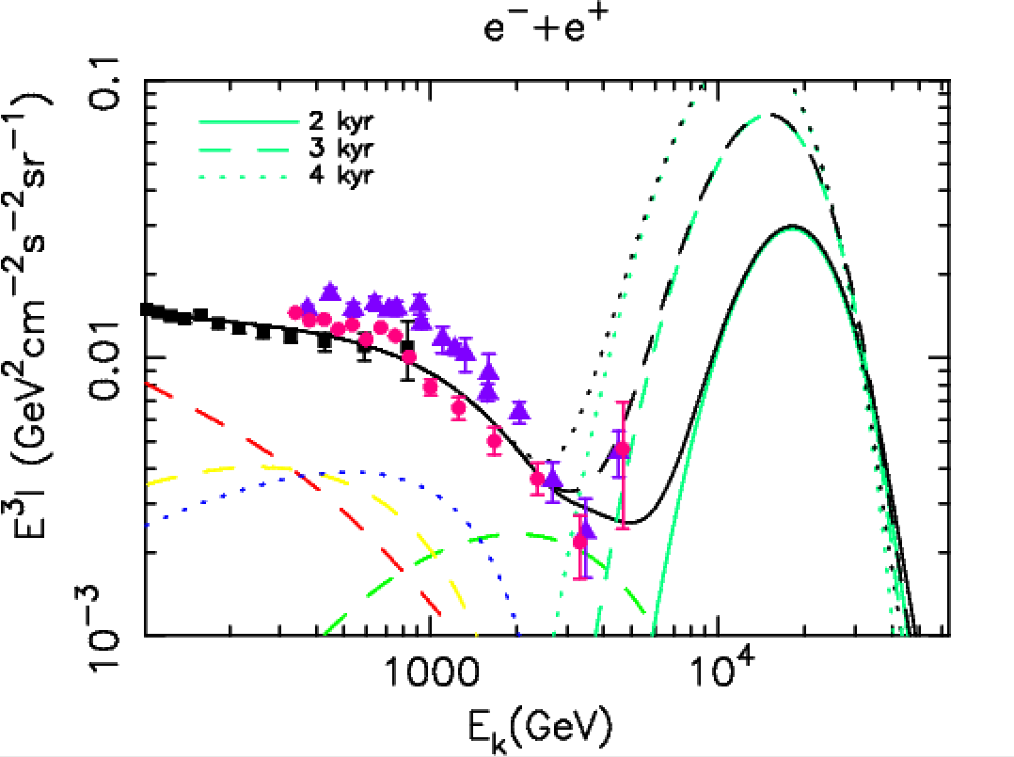
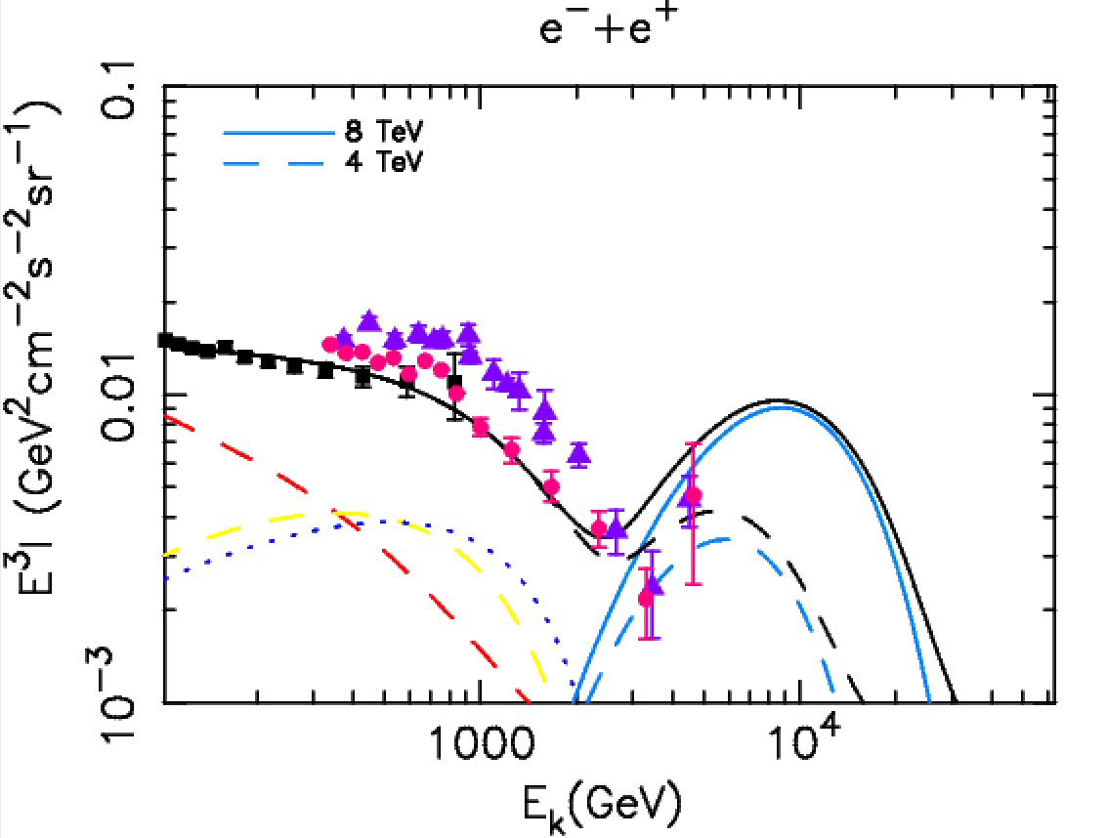
Spectra of nearby sources：Vela-X, Cygnus loop
Time of e emission
HERD can probe the bump around tens TeV from the local sources. If this bump is detected it strongly favors a pulsar origin of positron excess

Slide 10
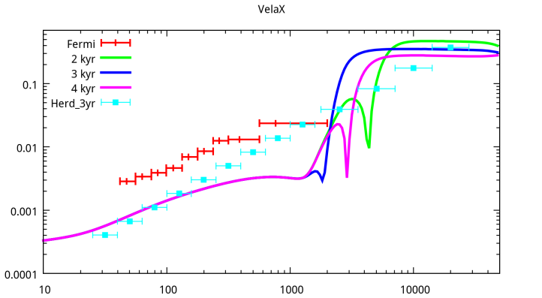
Anisotropy of nearby high energy
CR sources: Vela-X
Time of e emission
anisotropy
HERD can detect the anisotropy at high E clearly.
Electron energy (GeV)

Slide 11
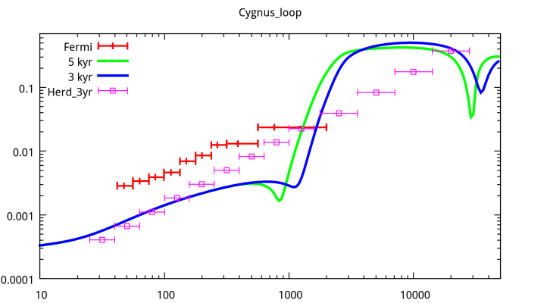
Anisotropy of nearby high energy
CR sources：Cyg Loop
Time of e emission
anisotropy
HERD can detect the anisotropy at High E clearly.
Electron energy (GeV)

Slide 12
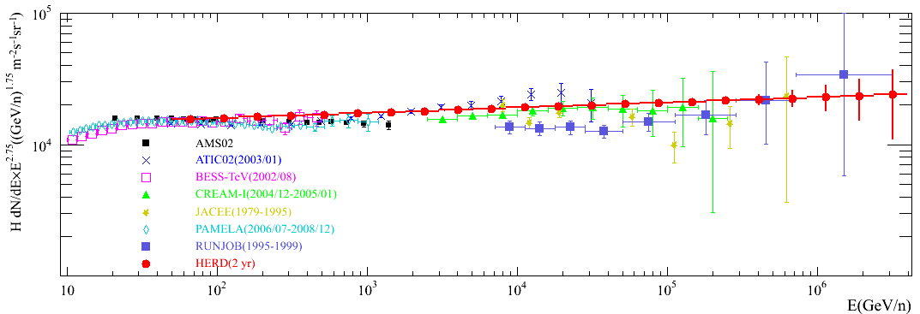
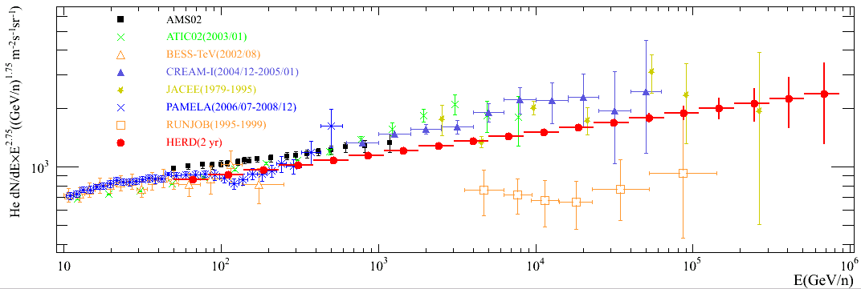
Expected HERD Proton and He Spectra
Horandel model as HERD input
Only statistical error
Protons
He

Slide 13
B/C measurement at HERD
To determine the CR propagation parameters

Slide 14
Iron nucleon and super-iron elements
HERD can detect or set very stringent limit on super-iron elements
Notes:
假设镍核比铁核低两个量级，那么镍核最高能量将可以测量至100 TeV以上。

Slide 15
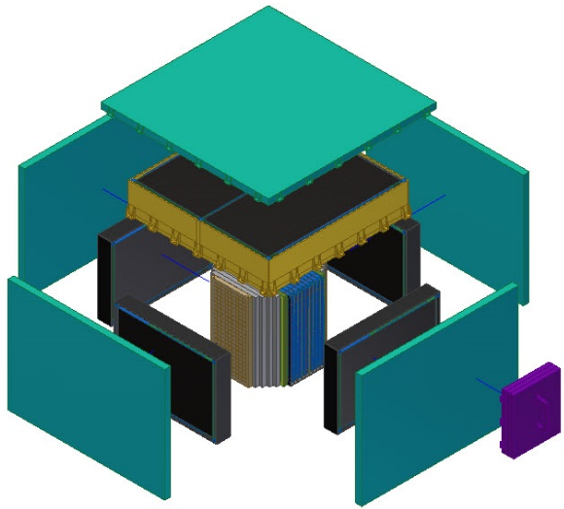
HERD payload
PSD, five sides
LE Gamma identification
Charge
STK(SSD),five sides
Charge
Trajectory
Gamma tracking
TRD
TeV proton calibration
LYSO array
Trigger sub-system
ISCMOS sub-system
CALO, 3-d
e/G/CR energy
e/p discrimination

Slide 16
Scientific requirements
Item | Value | Payload | Requirement
Energy range(e/γ) | 10 GeV - 10 TeV (e/γ) 0.5GeV - 10 GeV(γ) | CALO PSD&CALO | 55 R.L.; 10⁷ DR 99.9% veto effi.
Energy range (CR) | 30 GeV - PeV | CALO | 3 N.I.L; 10⁷ DR
Angle resolution | 0.1 deg.@10 GeV | STK | At least 3 layers, distance in between > 3cm
Charge meas. | 0.1-0.15 c.u | STK; PSD
Energy reso.(e) | 1%@200 GeV | CALO
Energy reso.(p) | 20%@100 GeV-PeV | CALO | 3 N.I.L
e/p discri. | ~10⁻⁶ | CALO | 3-D crystal array
G.F. (e) | >3 m²sr@200 GeV | CALO | 3-D crystal array
G.F. (p) | >2 m²sr@100 TeV | CALO | 3-D crystal array

Slide 17
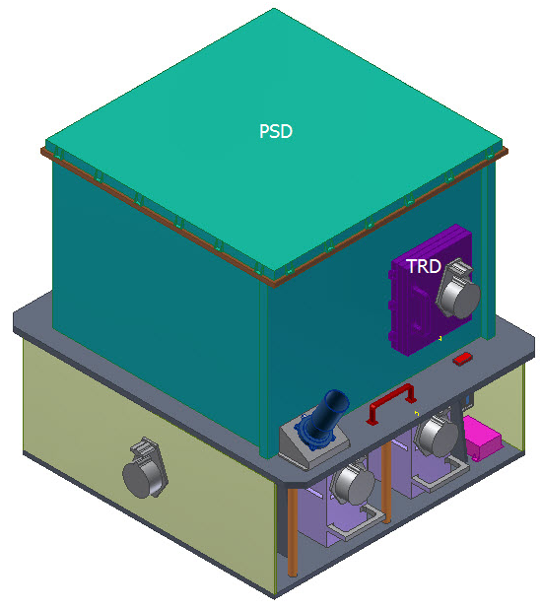
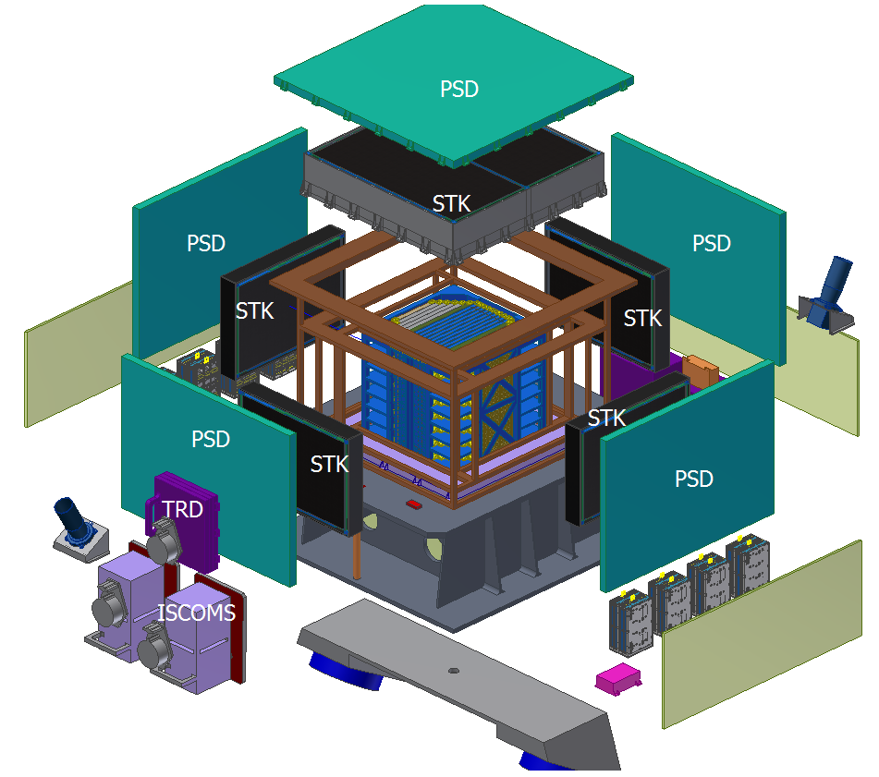
Summary of novel design of HERD payloads
3-D calorimeter to significantly increase Geometric Factor
WLSF + ISCMOS to read out LYSO crystals
Active gamma converter to improve energy resolution of low energy gamma rays
PS bars to real-time identify low energy gamma rays
TRD to calibrate TeV protons for the first time in space

Slide 18
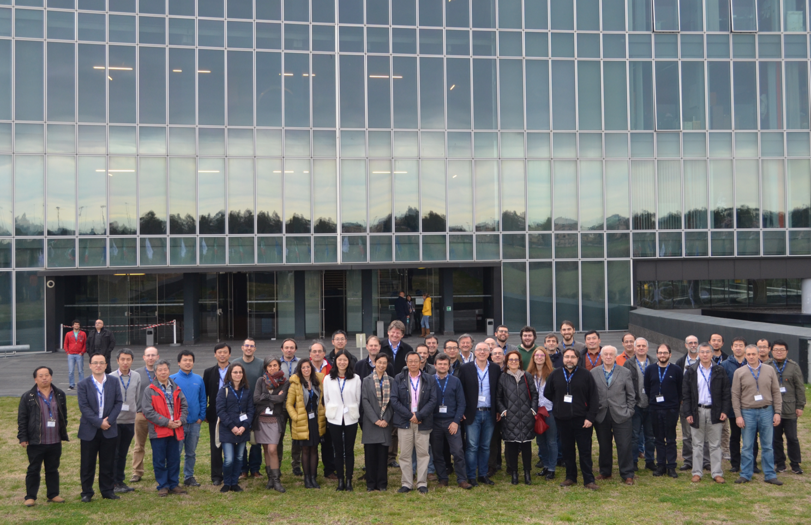
International collaboration (120+ colleagues)
China: CSU, IHEP, XIOPM, PMO, USTC, IGG, XAO, NAOC, TSU, GXU, PKU, NJU, YNU, NBU, SYSU, University of Hong Kong (HKU), National Central University (NCU)
Italy：INFN Perugia, University & INFN Firenze, University & INFN Bari, University & INFN Pisa, University & INFN Trento, University of Salento and INFN Lecce, IAPS/INAF, University & INFN Catania, University & INFN Napoli, University & INFN Trieste
Switzerland: University of Geneva；Sweden: KTH；Spain: CIEMAT
Germany: KIT；Russia: Lebedev Physical Institute
Japan: University of Tokyo
4th HERD workshop
ASI HQs, Roma, Italy 2017.2.9

Slide 19
International collaboration
Joint HERD working group including CSU, IHEP, INFN sections, etc. was established in Jan. 2017.
Agreement between the Italian Space Agency and the China Manned Space Agency was signed in Feb. 2017
Italy INFN
  Jointly working on optimization of sciences and payload configuration
  Help on HERD beam test at CERN
  Leading the development of HERD STK payload
  Data analysis of HERD science data
Letter of Intent for the collaboration on the design and implementation of the HERD scientific instrument between IHEP and INFN
  Signed during the 2017-May IHEP-INFN bilateral meeting

Slide 20
HERD instrument teams -- tentative
Subsystem | Led by | Participated by
CALO | IHEP | XIOPM
STK | INFN | UoG, CIEMAT, KTH, KIT
TRD | THU | GXU (RWTH Aachen)
PSD (+ND) | IHEP | PMO, USTC, IMP
Ground MIP cali. | GXU | IHEP
SPS cali. | INFN | UoG, IHEP
Payload AIT | IHEP

Slide 21
Status and Plan
CSU intends to approve HERD by end of 2017
Prototype beam test at CERN in progress
  Electron and proton tests finished on Oct. 10th, performance as expected, to be reported later at this meeting
Plan to do the 3rd beam test in 2018
Further design optimization based on new results from DAMPE, AMS02, CALETS, HESS, Fermi, CREAM-ISS, etc.
Several options to be chosen ASAP: Fiber, active converter, Si-PM for some crystals

Slide 22
Summary
HERD, as a China-led mission with a large international collaboration, is a flagship and landmark scientific experiment onboard China's Space Station
Advanced scientific objectives in DM search, CR observation and gamma-ray astronomy
  May confirm the pulsar origin of positron/ electron excess measured at AMS-02
Novel design of 3-D calorimeter, verified in two beam tests at CERN
Expected launch time before 2025

