Slide 1
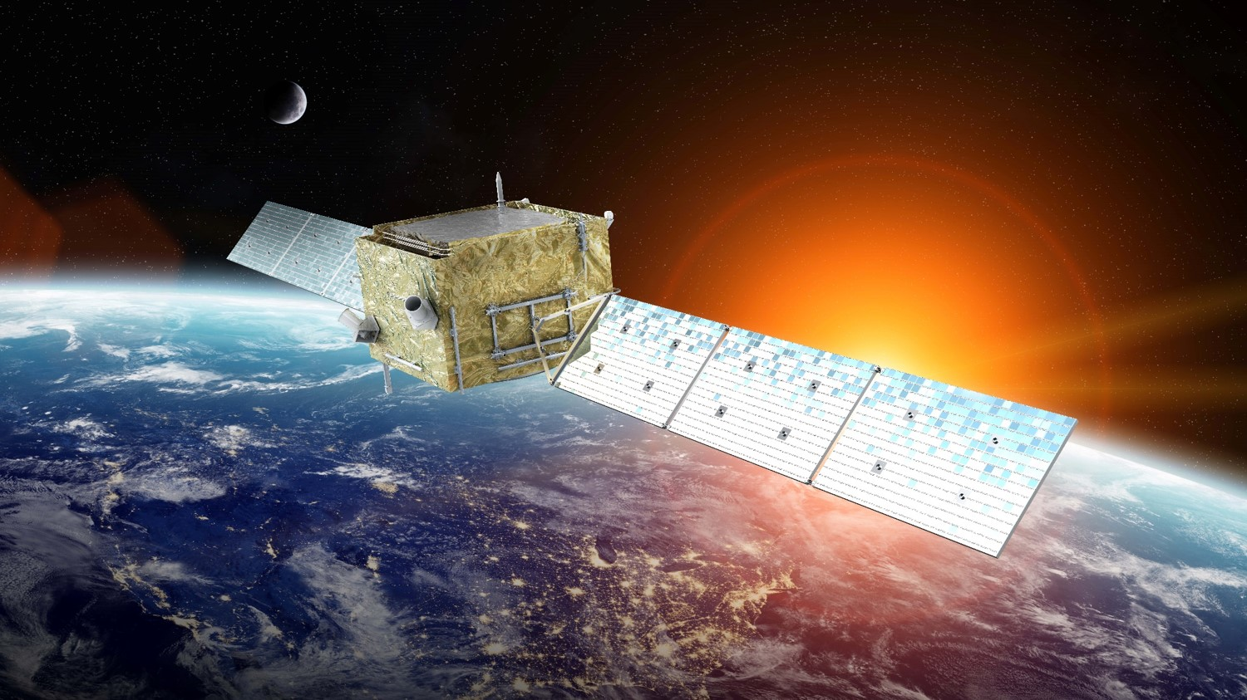
Interpretations of the DAMPE electron data
Lei Feng from Purple Mountain Observatory
2018.6.22@Shang Hai

Slide 2


提纲
Backgrounds
Interpretations of the DAMPE electron data

Slide 3
The Evidence of Dark Matter
Rotation Curve
Gravitational lensing
The Observation of cosmology
Large scale structure
…… and so on

Slide 4
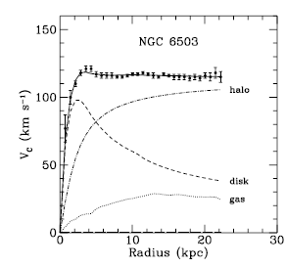

Rotation Curve & Gravitational Lensing

Slide 5
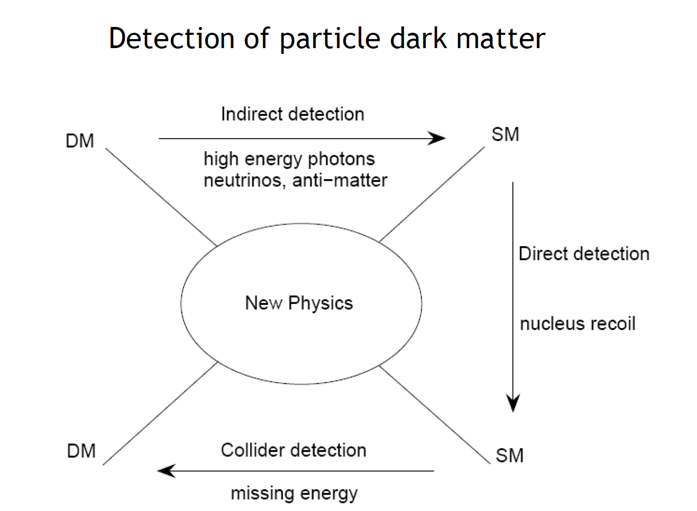
The methods of detecting Dark Matter

Slide 6
The cosmic ray propagation equation
sources (SNR, nuclear reactions…)
diffusion
convection (Galactic wind)
diffusive reacceleration (diffusion in the momentum space)
E-loss
fragmentation
radioactive decay
  ψ(r,p,t) – density per total momentum
+ boundary conditions

Slide 7
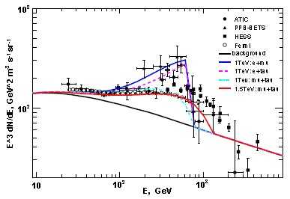
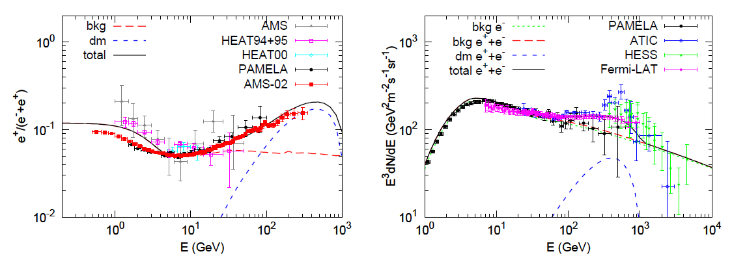
DARK MATTER INDIRECT DETECTION
Yuan and Bi PhLB 727 (2013)
Different DM annihilation channel produce different ‘excess’

Slide 8

DAMEP（悟空）

Slide 9
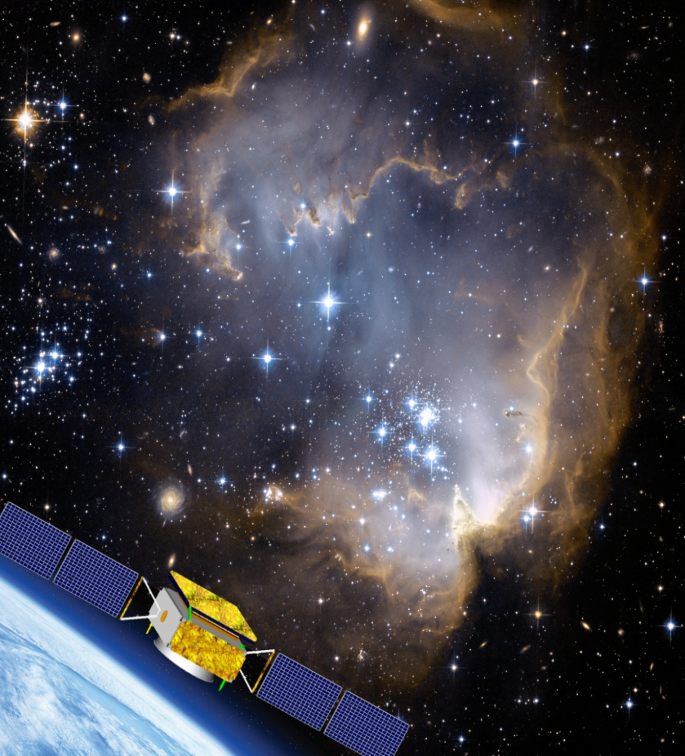
暗物质粒子探测卫星项目
Dark Matter Particle Explorer(悟空)
Advantages of DAMPE：
Best energy resolution(1%)
Lowest background
Largest energy range(>TeV)
Scientific Goals ：
(a)Indirect detection of dark matter particles
(b)Cosmic ray physics
(c)High energy gamma ray astrophysics
http://www.space.pmo.cas.cn/

Slide 10
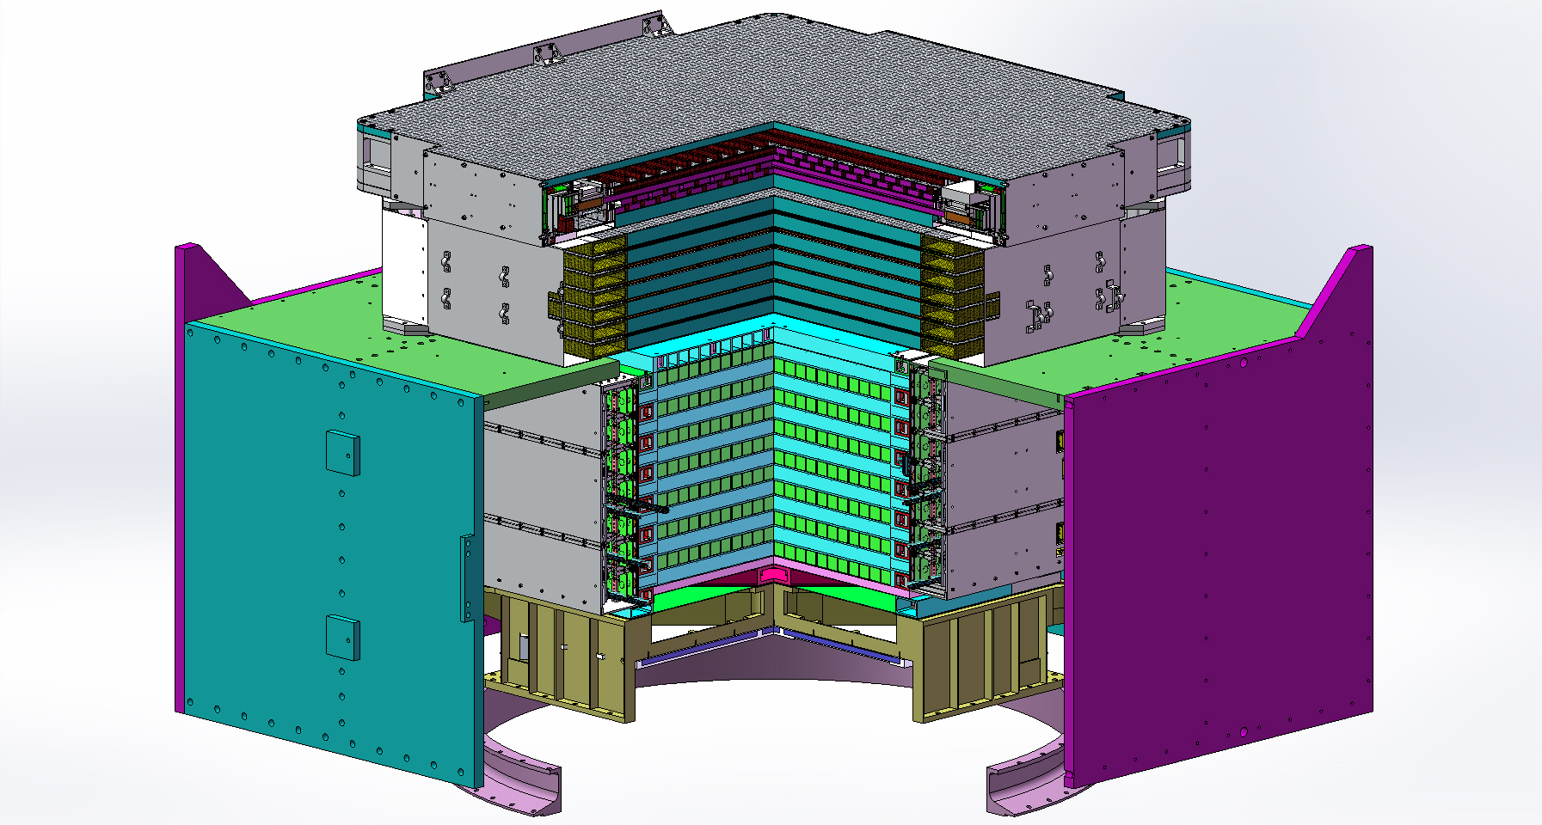
Detector
Plastic Scintillator Detector
Silicon-Tungsten Tracker
BGO Calorimeter
Neutron Detector

Slide 11
Functions of Each Component
Measurement | Detector
Charge | Silicon-Tungsten Tracker & Plastic Scintillator Detector
Direction | Silicon-Tungsten Tracker
Energy | BGO Calorimeter
Particle Identification | BGO Calorimeter、Neutron Detector

Slide 12
Comparisons Between DAMPE 、AMS-02、Fermi
 | DAMPE | AMS-02 | Fermi LAT
e/γ Energy | 5 – 10⁴ | 0.1 - 10³ | 0.02 - 300
e/γ Energy res.@100 GeV (%) | 1.5 | 1.5 | 7
e/γ Angular res.@100 GeV (°) | 0.1 | 0.3 | 0.1
e/p discrimination | 210⁵ | 10⁵ - 10⁶ | 10³
Calorimeter thickness (X₀) | 34 | 17 | 8.6
Geo. accep. (m²sr) (electrons) | 0.4 | 0.06 | 0.15
Geo. accep. (m²sr) (gamma ray) | 0.16 | 0.09 | 1.0

Slide 13
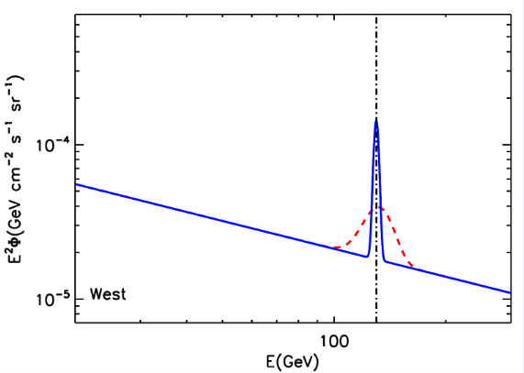
Gamma ray line detected by DAMPE
Ye Li and Qiang Yuan (2015)

Slide 14
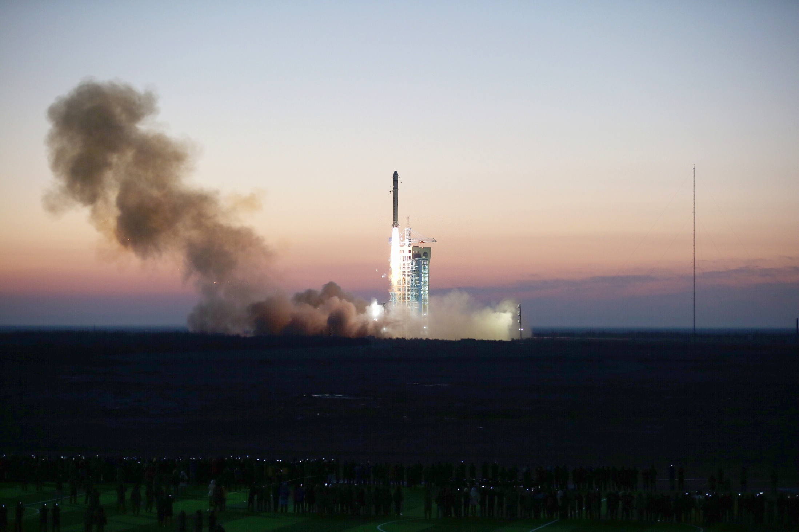
Launched at Dec 17 2015

Slide 15
The DAMPE Electron Data
local significance：
~3.6σ
global significance：
~2.3σ
arXiv:1712.05089

Slide 16
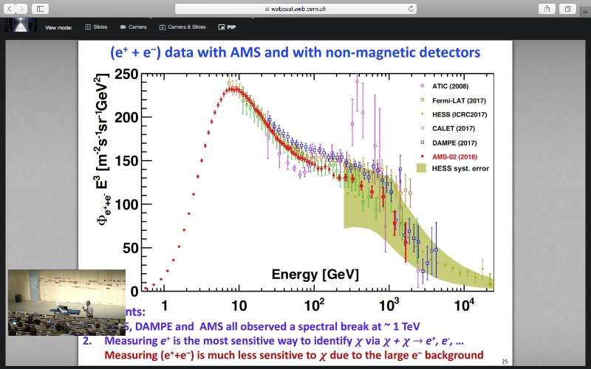
The New Result of AMS-02

Slide 17
The cooling of CR electrons
L3
L2
L1
L3> L2> L1

Slide 18
Fitting the Bump with Pulsar
Qiang Yuan, Lei Feng et al., arXiv:1711.10989

Slide 19
Fitting the Bump with Dark Matter
Qiang Yuan, Lei Feng et al., arXiv:1711.10989

Slide 20
Fitting the Peak with Pulsar
Qiang Yuan, Lei Feng et al., arXiv:1711.10989

Slide 21
Fitting the Peak with Dark Matter
Qiang Yuan, Lei Feng et al., arXiv:1711.10989

Slide 22
The gamma-ray of Mark Matter Subhalo
Qiang Yuan, Lei Feng et al., arXiv:1711.10989

Slide 23
Models：Leptonic Dark matter
Lepton
Mediator
DM
DM or Mediator carry lepton number

Slide 24
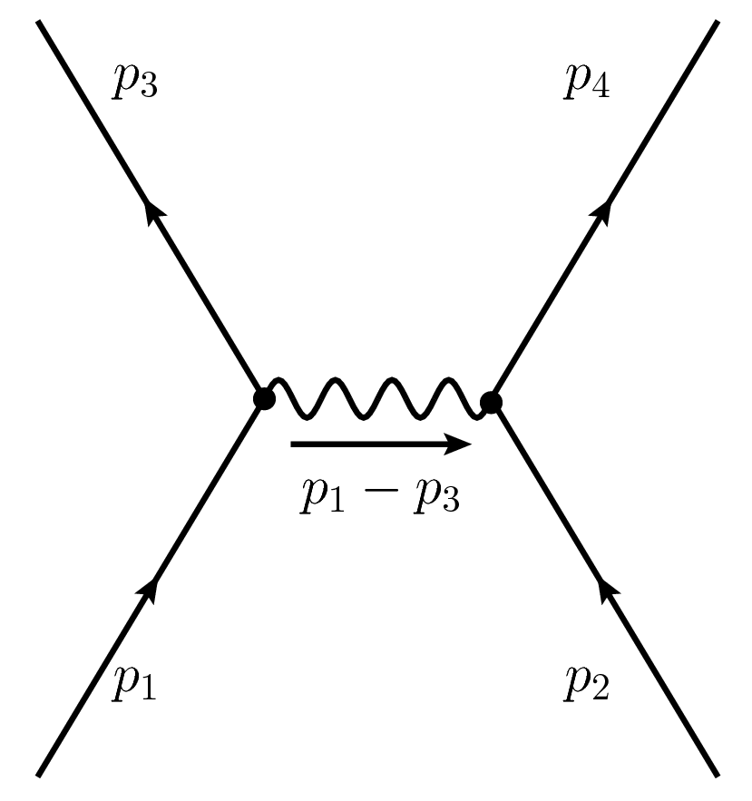
Models： Z-prime
DM
lepton
Zꞌ
DM
lepton
Zꞌ model：just break the gauge symmetry of leptons

Slide 25
Conclusions
DAMPE has three advantages: large energy range, high energy revolution and strong background distinction.
DAMPE got the high accuracy spectrum of CR electron from 25GeV to
A spectral softening at ∼ 0.9 TeV and a tentative peak at ∼ 1.4 TeV have been reported
Dark Matter and Pulsars could interpret what DAMP found

Slide 26

THE END
THANK YOU

