Slide 1
γ-jet fragmentation function & jet-induced medium excitation
Wei Chen(IOPP)
T.Luo, LG.Pang, SS.Cao, XN.Wang
Based on Phys.Lett. B777 (2018) 86-90
arXiv:1704.03648
中国物理学会高能物理分会第十届全国会员代表大会暨学术年会
Shanghai, 20-24 June 2018

Slide 2
1
Introduction
Outlines
2
Model description
Linear Boltzmann transport model(LBT)
3+1D hydrodynamic model(CLVisc)
CoLBT-hydro model for jet transport and jet-induced medium excitation.
3
Results
Medium modification of γ-triggered fragmentation function at RHIC
γ-hadron azimuthal correlation at RHIC
Medium modification of γ-triggered fragmentation function at LHC
4
Summary and outlook

Slide 3
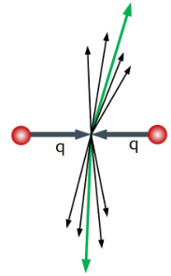
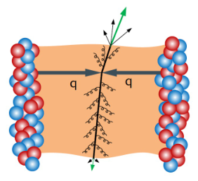
Motivation
Jet tomography for the study of QGP
QGP medium effect:
Interaction with medium constituents
Induced gluon radiation
Jet quenching
Leading partons energy loss
p+p
A+A
Modification of jet structure
Where does the lost energy go?

Slide 4
Motivation
Jet tomography for the study of QGP
QGP medium effect:
Interaction with medium constituents
Induced gluon radiation
Thermal recoil partons excited from medium
Energy-momentum deposition into medium
Jet quenching
Leading partons energy loss
Enhancement of hadrons emission from medium along jet axis
Modification of jet structure

Slide 5
Motivation
Jet tomography for the study of QGP
QGP medium effect:
Interaction with medium constituents
Induced gluon radiation
Thermal recoil partons excited from medium
Energy-momentum deposition into medium
Jet quenching
Leading partons energy loss
Enhancement of hadrons emission from medium along jet axis
Modification of jet structure
Jet-induced medium responce

Slide 6
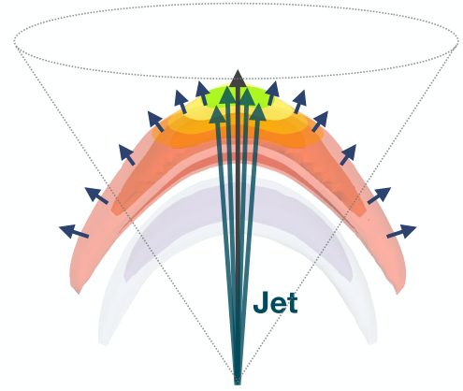
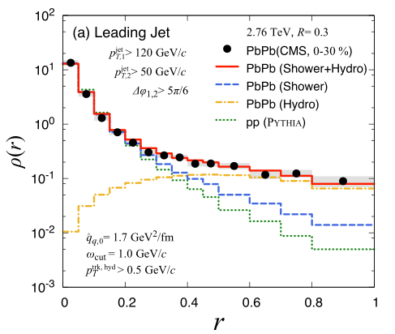
Motivation
The modified jet can be determined by:
Energy loss of the leading jet shower partons.
The redistribution of the lost energy and momentum in the medium.
Medium response contributes to many jet-observables:
Energy redistribution in reconstructed full jet(jet shape)
Gamma-hadron and jet-hadron fragmentation function & gamma-hadron azimuthal distribution.
and so on.
Yasuki Tachibana, N-Bo Chang ,G-Y Qin(17)

Slide 7
Motivation
Frameworks for the study of whole jet quenching pictures(including medium responce):
Full Boltzmann transport approach
in the same Monte-Carlo transport(cross section)
jet plus hydrodynamics approach
No recoil partons contribution
Neglect the effect of medium response on the subsequent evolution of hard jets
No concurrent
CoLBT-hydro model
Linear Boltzmann Transport model
(LBT)
+
3+1D hydrodynamic model
(CLVisc)

Slide 8
Linear Boltzmann Jet Transport Model
Linear Boltzmann Jet Transport Model(LBT)
Monte Carlo jet transport model based on pQCD calculation:
Jet transport is simulated according to linear Boltzmann equation
Consider both elastic and inelastic processes
Keep track of jet shower parton and thermal recoil parton
Take into account of back reaction and denote initial thermal partons in each scattering as “negative” partons

Slide 9
Linear Boltzmann Jet Transport Model
Linear Boltzmann Jet Transport Model(LBT)
Monte Carlo jet transport model based on pQCD calculation:
Jet transport is simulated according to linear Boltzmann equation
Consider both elastic and inelastic processes
Keep track of jet shower parton and thermal recoil parton
Take into account of back reaction and denote initial thermal partons in each scattering as “negative” partons
Jet-induced medium partons

Slide 10
Research method
3+1D hydrodynamic model(CLVisc model)
Hydrodynamic evolution of bulk medium
to solve $T^{μν}$=0 with a parameterized equation of state(Eos) s95p-pce by KT algorithm + the second Runge-Kutta method.
T
EOS:s95p-pce
220MeV
QGP phase
Calculate hadron spectrum from freeze-out hypersurface.
Cooper-Frye formular:
Hadron resonance decay
mixed phase(crossover)
184MeV
hadron resonance gas phase
(chemical equilibrium)
165MeV
hadron resonance gas phase
(chemical non-equilibrium)
137MeV
free hadrons

Slide 11
CoLBT-hydro model
CoLBT-hydro model
LBT
CLVisc
+
Linear Boltzmann Transport model
(LBT)
3+1D hydrodynamic model
(CLVisc)
Jet Evo.
Hydro Evo.
Δτ
formulated in Milne coordinates
simulated in sync with each other
$$τ_{1}$$
$$τ_{1}$$
Jet Evo.
Hydro Evo.
Δτ
$$τ_{2}$$
$$τ_{2}$$

Slide 12
CoLBT-hydro model
CoLBT-hydro model
LBT
CLVisc
+
Linear Boltzmann Transport model
(LBT)
3+1D hydrodynamic model
(CLVisc)
Jet Evo.
Hydro Evo.
Δτ
formulated in Milne coordinates
simulated in sync with each other
$$τ_{1}$$
$$τ_{1}$$
Jet Evo.
provide medium info (T, u) to jet partons
carry out jet shower partons’ transport according to medium info.
soft( ) and ‘negative’( ) partons deposited into medium as source term
hard( ) partons propagate in LBT frame
update the medium info through solving
Hydro Evo.
Δτ
3
$$τ_{1}$$
$$τ_{1}$$
2
$$τ_{2}$$
$$τ_{2}$$
4
1
5
Δτ

Slide 13
Hydrodynamic equations with source term
Assumption: Instantaneous local thermalization of deposited energy and momentum
Hydrodynamic equation with source term
Energy-momentum tensor of QGP fluid
Energy and momentum deposited from jet
source term:

Slide 14
Hydrodynamic equations with source term
Assumption: Instantaneous local thermalization of deposited energy and momentum
Hydrodynamic equation with source term
Energy-momentum tensor of QGP fluid
Energy and momentum deposited from jet
source term:
soft partons
( )
negative partons
( )

Slide 15
Hydrodynamic equations with source term
Assumption: Instantaneous local thermalization of deposited energy and momentum
Hydrodynamic equation with source term
Energy-momentum tensor of QGP fluid
Energy and momentum deposited from jet
source term:
soft partons
( )
negative partons
( )
Gaussian approximation:

Slide 16
Initial condition
LBT
CLVisc
Jet Evo.
Hydro Evo.
Initial condition
Δτ
Pythia8
AMPT
Energy-momentum of jet partons
$$τ_{1}$$
$$τ_{1}$$
Energy density distribution
Production position of jet partons
Jet Evo.
Hydro Evo.
Δτ
AMPT:
Energy density distribution includes transverse and longitudinal fluctuation.
Production positions of jet partons: sampled from spatial distribution of binary hard processes.
Pythia8:
Energy-momentum of jet partons
different in each event.
$$τ_{2}$$
$$τ_{2}$$

Slide 17
Hadronization
LBT
CLVisc
Jet Evo.
Hydro Evo.
Hadronization
Δτ
Cooper-Frye formula
Recombination model
+
$$τ_{1}$$
$$τ_{1}$$
Hadron resonance decay
Jet Evo.
Hydro Evo.
Δτ
Hadron spectrum
Hadron list
Momentum spectrum of hadrons
$$τ_{2}$$
$$τ_{2}$$
Recombination model from Texas A-M group

Slide 18
GPU parallel computation
We need to increase calculation efficiency of the CoLBT-hydro model:
the final observables needs abundant event statistics
one event calculation in single core of CPU takes long time (6-7 hours/event)
single core(CPU)
Hydrodynamics evolution of medium
30-40 min
Hadron spectrum calculation in FO hypersurface
Almost 2 h
Hadron resonance decay
3-4 h

Slide 19
GPU parallel computation
We need to increase calculation efficiency of the CoLBT-hydro model:
the final observables needs abundant event statistics
one event calculation in single core of CPU takes long time (6-7 hours/event)
GPU parallel computation + GPU cluster
CoLBT-hydro for event-by-event simulations
single core(CPU)
GPU
Hydrodynamics evolution of medium
30-40 min
20-30 sec
Hadron spectrum calculation in FO hypersurface
Almost 2 h
1-2 min
Hadron resonance decay
3-4 h
2-3 min
More than 100 times faster

Slide 20
Jet transport and jet-induce medium excitation

Slide 21
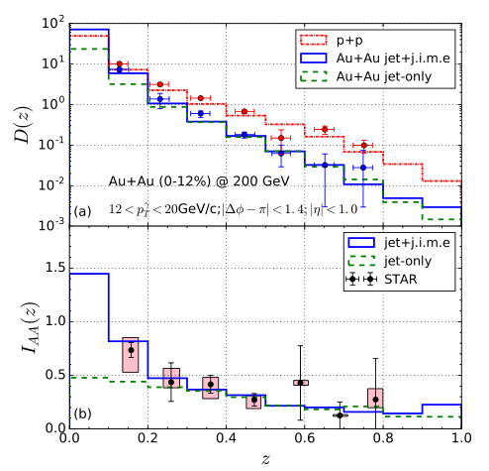
Medium modification of γ-triggered fragmentation function
$$z=\frac{p_{T}^{h}}{p_{T}^{γ}}$$
$$D\left(z\right)=\frac{1}{N_{event}}\frac{dN}{dz}$$
$$I_{AA}\left(z\right)=\frac{D_{AA}(z)}{D_{pp}(z)}$$
γ
In our calculation:
p+p results :
jet partons from Pythia8 + recombination model
Au+Au results：

Slide 22
Medium modification of γ-triggered fragmentation function
$$z=\frac{p_{T}^{h}}{p_{T}^{γ}}$$
$$D\left(z\right)=\frac{1}{N_{event}}\frac{dN}{dz}$$
$$I_{AA}\left(z\right)=\frac{D_{AA}(z)}{D_{pp}(z)}$$
γ
In our calculation:
p+p results :
jet partons from Pythia8 + recombination model
Au+Au results：
background

Slide 23
Medium modification of γ-triggered fragmentation function
$$z=\frac{p_{T}^{h}}{p_{T}^{γ}}$$
$$D\left(z\right)=\frac{1}{N_{event}}\frac{dN}{dz}$$
$$I_{AA}\left(z\right)=\frac{D_{AA}(z)}{D_{pp}(z)}$$
γ
In our calculation:
p+p results :
jet partons from Pythia8 + recombination model
Au+Au results：
background
Medium response by energy-momentum deposition

Slide 24
Medium modification of γ-triggered fragmentation function
$$z=\frac{p_{T}^{h}}{p_{T}^{γ}}$$
$$D\left(z\right)=\frac{1}{N_{event}}\frac{dN}{dz}$$
$$I_{AA}\left(z\right)=\frac{D_{AA}(z)}{D_{pp}(z)}$$
γ
In our calculation:
p+p results :
jet partons from Pythia8 + recombination model
Au+Au results：
background
Remnant recoil parton contribution
Medium response by energy-momentum deposition

Slide 25
Medium modification of γ-triggered fragmentation function
$$z=\frac{p_{T}^{h}}{p_{T}^{γ}}$$
$$D\left(z\right)=\frac{1}{N_{event}}\frac{dN}{dz}$$
$$I_{AA}\left(z\right)=\frac{D_{AA}(z)}{D_{pp}(z)}$$
γ
In our calculation:
p+p results :
jet partons from Pythia8 + recombination model
Au+Au results：
background
Remnant recoil parton contribution
Medium response by energy-momentum deposition
jet-induced medium excitation(j.i.m.e)

Slide 26
Medium modification of γ-triggered fragmentation function
$$z=\frac{p_{T}^{h}}{p_{T}^{γ}}$$
$$D\left(z\right)=\frac{1}{N_{event}}\frac{dN}{dz}$$
$$I_{AA}\left(z\right)=\frac{D_{AA}(z)}{D_{pp}(z)}$$
γ
The suppression of leading hadron yield at the intermediate and high z
energy loss of jet partons due to
interaction with hot medium

Slide 27
Medium modification of γ-triggered fragmentation function
$$z=\frac{p_{T}^{h}}{p_{T}^{γ}}$$
$$D\left(z\right)=\frac{1}{N_{event}}\frac{dN}{dz}$$
$$I_{AA}\left(z\right)=\frac{D_{AA}(z)}{D_{pp}(z)}$$
γ
The suppression of leading hadron yield at the intermediate and high z
energy loss of jet partons due to
interaction with hot medium.
The enhancement of soft hadrons yield at small z
jet-induced medium excitation.

Slide 28
Medium modification of γ-triggered fragmentation function
$$z=\frac{p_{T}^{h}}{p_{T}^{γ}}$$
$$D\left(z\right)=\frac{1}{N_{event}}\frac{dN}{dz}$$
$$I_{AA}\left(z\right)=\frac{D_{AA}(z)}{D_{pp}(z)}$$
γ
The suppression of leading hadron yield at the intermediate and high z
energy loss of jet partons due to
interaction with hot medium.
The enhancement of soft hadrons yield at small z
jet-induced medium excitation.
$α_{s}=0.3 and p_{cut}^{0}$=2 GeV/c

Slide 29
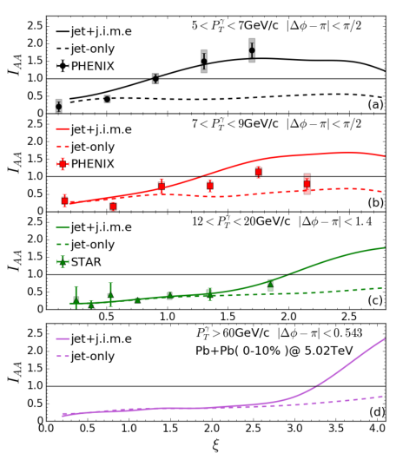
Medium modification of γ-triggered fragmentation function
$$z=\frac{p_{T}^{h}}{p_{T}^{γ}}$$
$$ε=log\frac{1}{z}$$
$$I_{AA}\left(ε\right)=\frac{D_{AA}(ε)}{D_{pp}(ε)}$$
γ
The suppression of leading hadron at small $ε$
The enhancement of soft hadrons at large$ε$
High $p_{T}^{h}$
Low $p_{T}^{h}$

Slide 30
Medium modification of γ-triggered fragmentation function
$$z=\frac{p_{T}^{h}}{p_{T}^{γ}}$$
$$ε=log\frac{1}{z}$$
$$I_{AA}\left(ε\right)=\frac{D_{AA}(ε)}{D_{pp}(ε)}$$
γ
The suppression of leading hadron at small $ε$
The enhancement of soft hadrons at large$ε$
When $p_{T}^{γ}$ range increases:
Transition point($I_{AA}=1$) from relative enhancement to suppression shift to large$ε$.
High $p_{T}^{h}$
Low $p_{T}^{h}$

Slide 31
Medium modification of γ-triggered fragmentation function
$$z=\frac{p_{T}^{h}}{p_{T}^{γ}}$$
$$ε=log\frac{1}{z}$$
2.0~2.8
$$I_{AA}\left(ε\right)=\frac{D_{AA}(ε)}{D_{pp}(ε)}$$
1.9~2.4
γ
The suppression of leading hadron at small $ε$
The enhancement of soft hadrons at large$ε$
1.7~2.9
When $p_{T}^{γ}$ range increases:
Transition point($I_{AA}=1$) from relative enhancement to suppression shift to large$ε$.
Transition point corresponds to the fixed $p_{T}^{h}$ range
($p_{T}^{h}$~2 GeV/c at RHIC, $p_{T}^{h}$~3 GeV/c at LHC)
2.0~3.2
High $p_{T}^{h}$
Low $p_{T}^{h}$

Slide 32
Medium modification of γ-triggered fragmentation function
$$z=\frac{p_{T}^{h}}{p_{T}^{γ}}$$
$$ε=log\frac{1}{z}$$
2.0~2.8
$$I_{AA}\left(ε\right)=\frac{D_{AA}(ε)}{D_{pp}(ε)}$$
1.9~2.4
γ
The suppression of leading hadron at small $ε$
The enhancement of soft hadrons at large$ε$
1.7~2.9
When $p_{T}^{γ}$ range increases:
Transition point($I_{AA}=1$) from relative enhancement to suppression shift to large$ε$.
Transition point corresponds to the fixed $p_{T}^{h}$ range
($p_{T}^{h}$~2 GeV/c at RHIC, $p_{T}^{h}$~3 GeV/c at LHC)
soft hadrons from j.i.m.e. carry an average thermal energy that is independent of the jet energy
2.0~3.2
High $p_{T}^{h}$
Low $p_{T}^{h}$

Slide 33
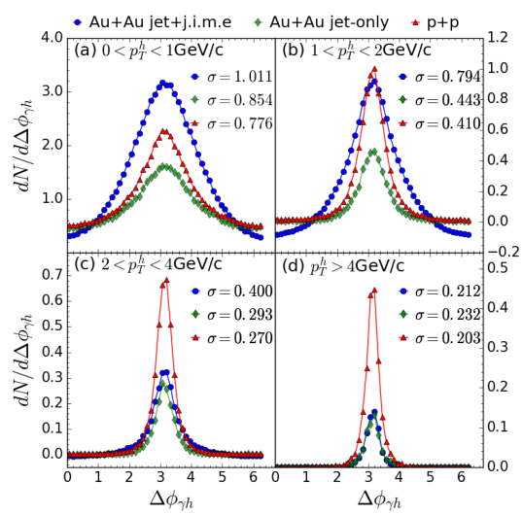
γ-hadron azimuthal correlation in RHIC
$$∆ϕ_{γh}$$
σ: half gaussian width
γ
Large $p_{T}$ hadron yield are suppressed in Au+Au and the width of their angular distribution remain approximately unchanged from p+p

Slide 34
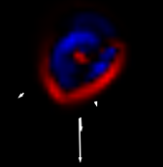
γ-hadron azimuthal correlation in RHIC
$$∆ϕ_{γh}$$
σ: half gaussian width
γ
Large $p_{T}$ hadron yield are suppressed in Au+Au and the width of their angular distribution remain approximately unchanged from p+p
The angular distributions for the enhanced soft hadrons in Au+Au are significantly broadened.
soft hadrons from j.i.m.e propagate at
large angle relative to the jet direction
~4.0

Slide 35
γ-hadron azimuthal correlation in RHIC
$$∆ϕ_{γh}$$
σ: half gaussian width
γ
Large $p_{T}$ hadron yield are suppressed in Au+Au and the width of their angular distribution remain approximately unchanged from p+p
The angular distributions for the enhanced soft hadrons in Au+Au are significantly broadened.
soft hadrons from j.i.m.e propagate at
large angle relative to the jet direction
soft hadrons yield in Au+Au collision along gamma direction become smaller than one in pp collision.
the effect of diffusion wake caused by
the deposition of energy-momentum
into the medium

Slide 36
Fragmentation function at RHIC and LHC
jet
$$γ$$
$$z=\frac{p_{T}^{h}}{P_{T}^{γ}}$$
$$z=\frac{p_{||}^{h}}{p^{jet}}$$
STAR(PHENIX)
Photon-hadrons FF, no reconstructed jets
Take hadrons away from the triggering object(photon)
Look at the fraction of hadron $p_{T}$ in photon $p_{T}$
CMS
jet+hadrons FF, reconstructed jets
Take hadrons in side the jet cone
Project $p_{T}^{h}$($p^{h}$) onto jet axis and look at the fraction in $p_{T}^{jet}$($p^{jet}$)

Slide 37
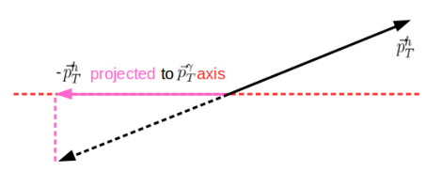
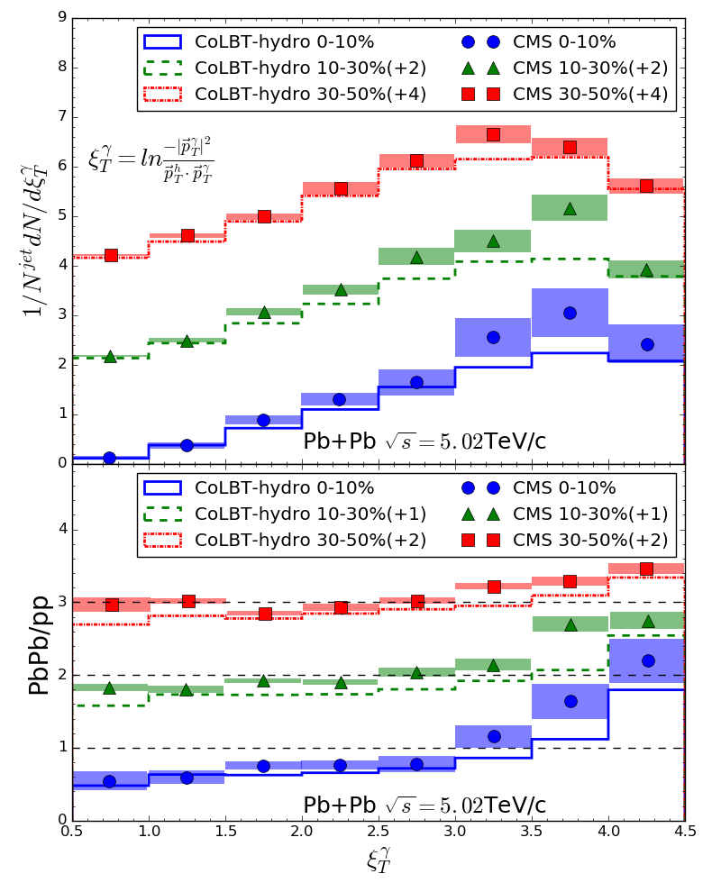
Fragmentation function at LHC
Based on photon energy, proxy for the parton energy before jet quenching.
High $p_{T}^{h}$
Low $p_{T}^{h}$

Slide 38
Fragmentation function at LHC
Based on photon energy, proxy for the parton energy before jet quenching.
Centrality dependence:
Enhancement of low $p_{T}^{h}$ hadrons
Suppression of high $p_{T}^{h}$ hadrons
path length and temperature different
High $p_{T}^{h}$
Low $p_{T}^{h}$

Slide 39
Fragmentation function at LHC
Based on photon energy, proxy for the parton energy before jet quenching.
Centrality dependence:
Enhancement of low $p_{T}^{h}$ hadrons
Suppression of high $p_{T}^{h}$ hadrons
path length and temperature different
No(slightly) centrality dependence:
Transition point ($I_{AA}=1$) from relative enhancement to suppression.
$ε_{T}^{γ}≈3.5→p_{T}^{h}≈2\sim 3$ GeV
High $p_{T}^{h}$
Low $p_{T}^{h}$

Slide 40
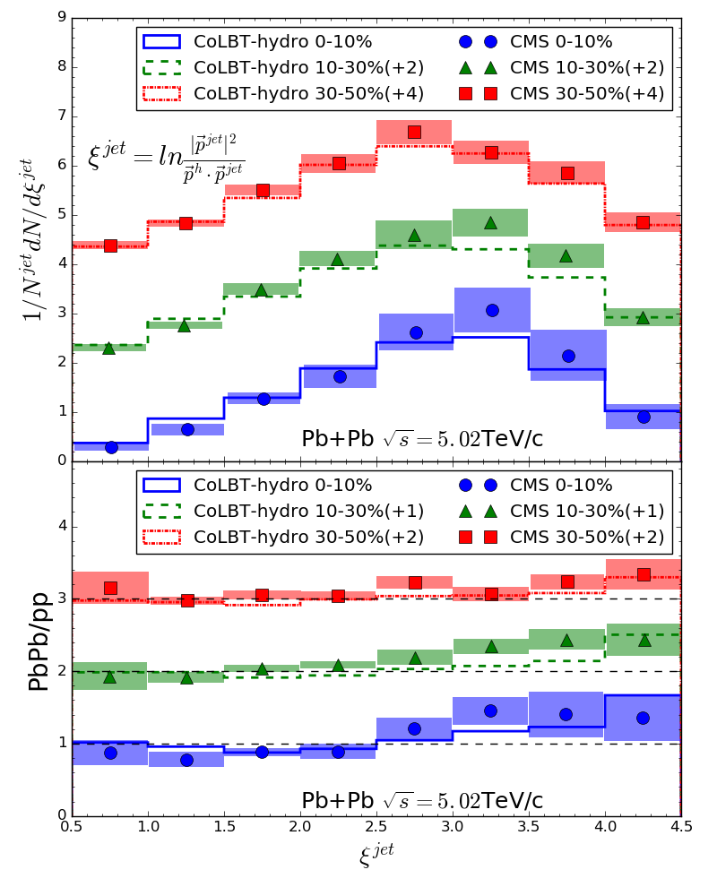
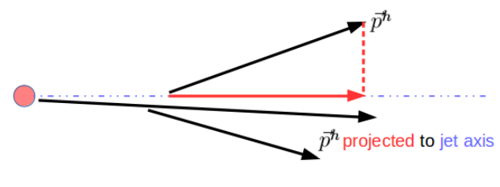
Fragmentation function at LHC
Based on reconstructed jet energy
Centrality dependence:
Enhancement of low $p_{T}^{h}$ hadrons
Suppression of high $p_{T}^{h}$ hadrons
path length and temperature different
No(slightly) centrality dependence:
Transition point ($I_{AA}=1$) from relative enhancement to suppression.
$ε^{jet}≈2.5→p_{T}^{h}≈2\sim 3$ GeV
High $p_{T}^{h}$
Low $p_{T}^{h}$

Slide 41
Summary
We develop CoLBT-Hydro model for simultaneous event-by-event simulations of jet propagation and hydrodynamic evolution of the bulk medium including jet-induced medium excitation.
CoLBT-hydro describes well both the suppression of leading hadrons due to parton energy loss and enhancement of soft hadrons due to jet-induced medium excitation
The onset of soft hadron enhancement at a constant $p_{T}^{h}$with broadened angular distribution and depletion of soft hadrons in the γ direction
Summary

Slide 42
Outlook
The model needs to be improved in
The model can be used to calculate
Ideal hydrodynamic
Neglect hadronization between jet shower partons and thermal partons
Neglect the interaction between hadrons
Only use AMPT as initial condition for medium hydrodynamic evolution
Light quark on shell
……………
Nuclear modification factor $R_{AA}$
dihadron correlation
jet shape
dijet correlation
and many other observables

