Slide 1


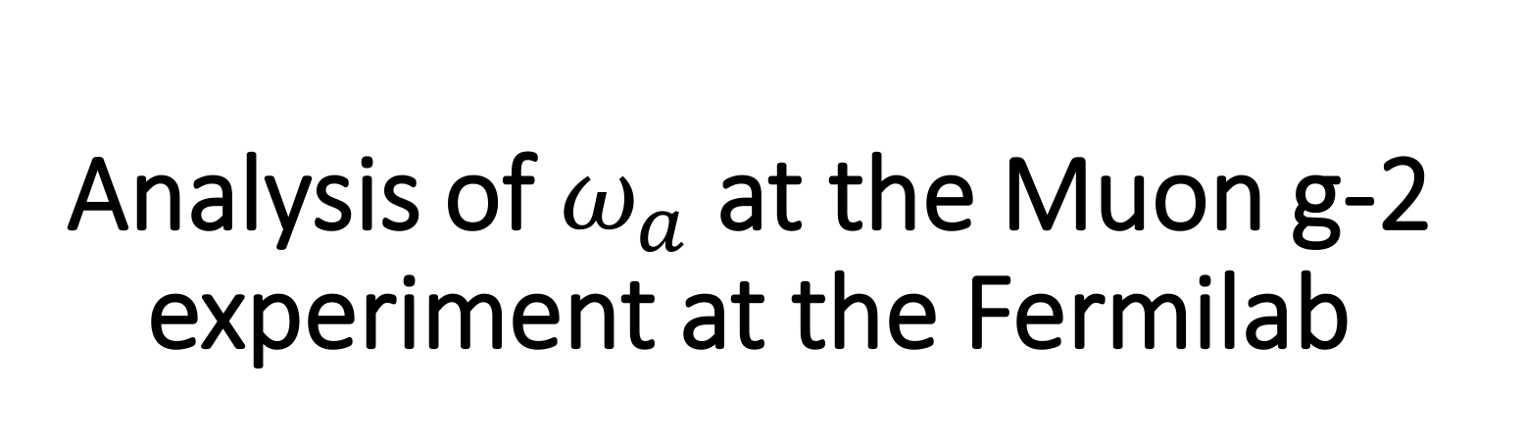
Analysis of $ω_{a}$ at the Muon g-2 experiment at the Fermilab
Dikai Li¹², Liang Li¹, Bingzhi Li¹, Changbo Fu¹
¹Shanghai Jiao Tong University
²China University of Geosciences(Wuhan)

Slide 2
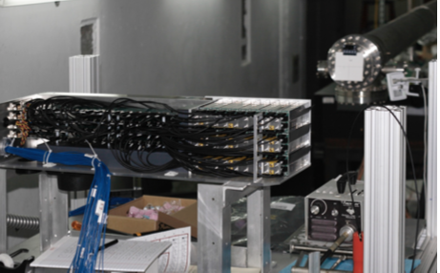
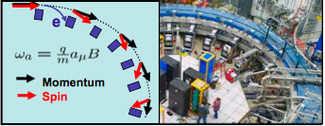
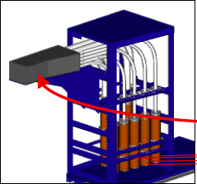
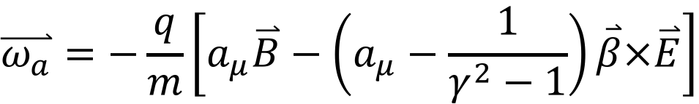


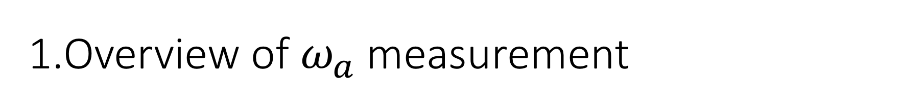
1.Overview of $ω_{a}$ measurement
$$\overset{⃑}{ω_{a}}=−\frac{q}{m}\left[a_{μ}\overset{⃑}{B}−\left(a_{μ}−\frac{1}{γ^{2}−1}\right)\overset{⃑}{β}×\overset{⃑}{E}\right]$$
Magic $γ$ ~ 29.3
$$e^{+}$$
4X4 SiPM per crystal
9X6 PbF₂ Cerenkov crystal
provided by SJTU/SICCAS ,Shanghai, China)

Slide 3
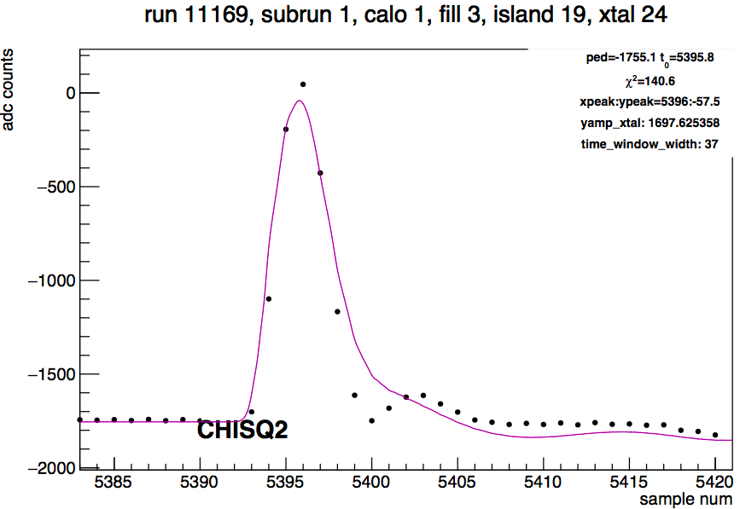
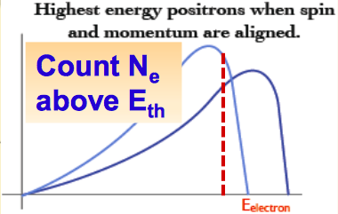
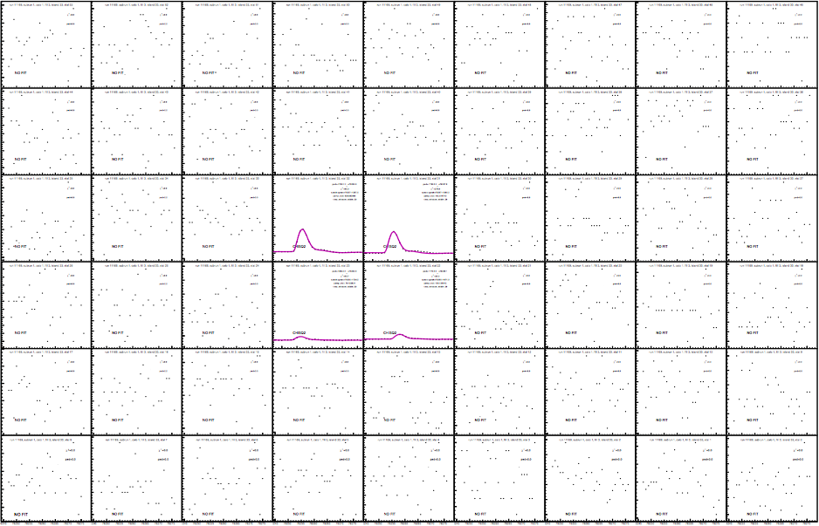
1.Overview of $ω_{a}$ measurement
$$\overset{⃑}{ω_{a}}=−\frac{q}{m}\left[a_{μ}\overset{⃑}{B}−\left(a_{μ}−\frac{1}{γ^{2}−1}\right)\overset{⃑}{β}×\overset{⃑}{E}\right]$$
Magic $γ$ ~ 29.3
(E,t)
The number of observed positrons from muon decay oscillates with the ωa frequency due to spin precession
This figure was accumulated from 60 hours of data from 22 - 25 Apr 2018 and has approximately 0.95 billion positrons. The number of wiggles is similar to the one achieved by BNL in 1999.
Cluster(E,t)
The fit looks good by eye, but the point is what precision level that is, ppm or ppb?

Slide 4
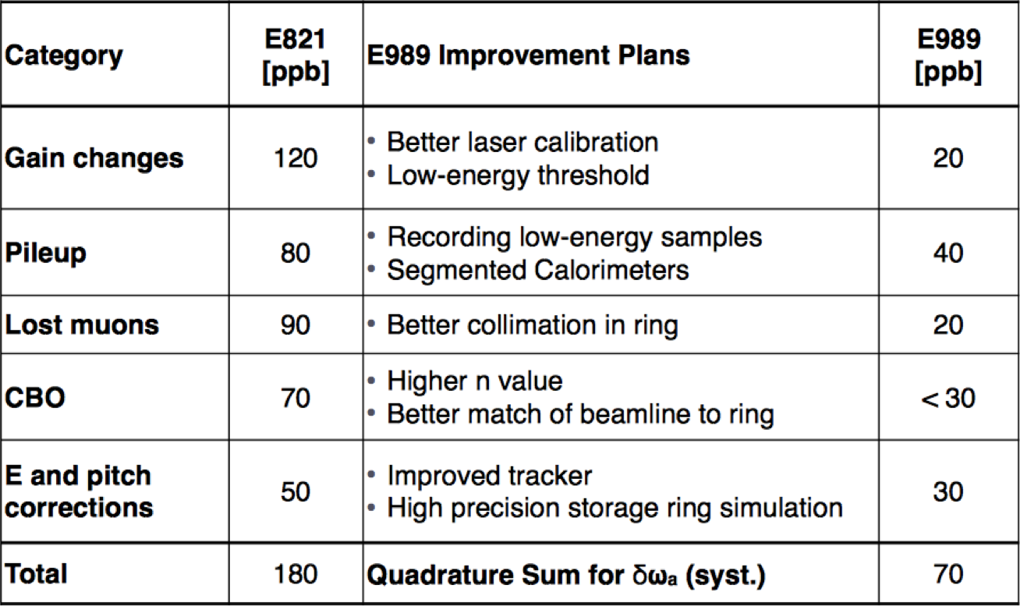
2.Main systematics
BNL
FNAL

Slide 5
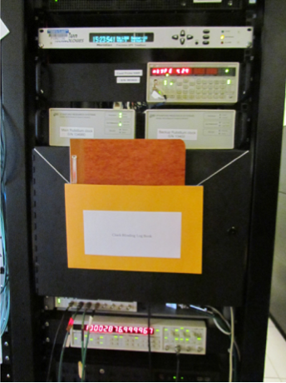
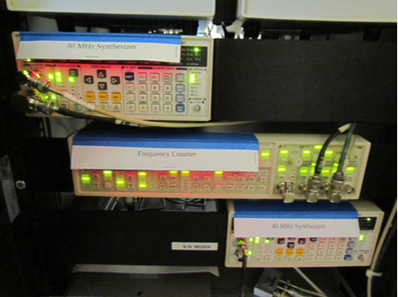
2.1 Strategy for blinding analysis
Hardware Blinding
  perturb the clocks so ticks → seconds conversion remains unknown during analysis
Software Blinding
  package to apply personal offsets to fit results to ensure independence of analyses
  allows more flexible (software) unblinding (in stages)

Slide 6
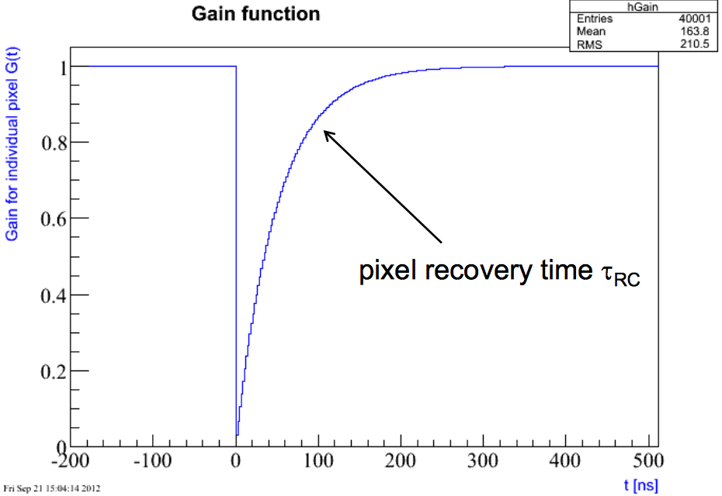
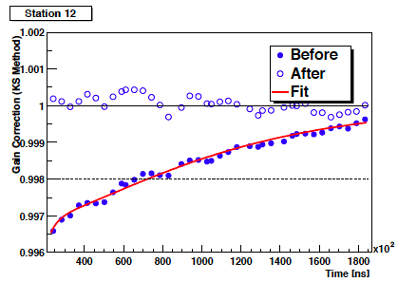

2.2 In-fill SiPM Gain correction
Ideally: $G\left(t\right)≡1$ at all the time
Due to electronics, SiPM needs recovery time
Construct gain function
Fit wiggle plot corrected with gain function

Slide 7
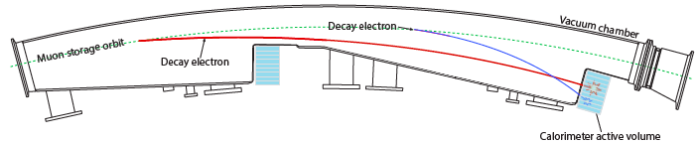
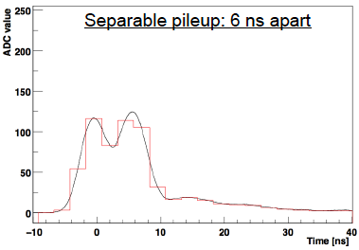
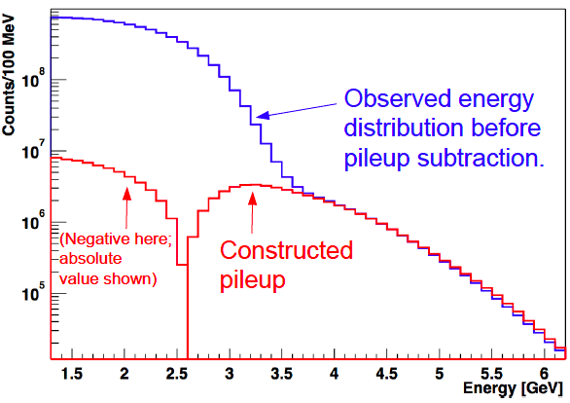
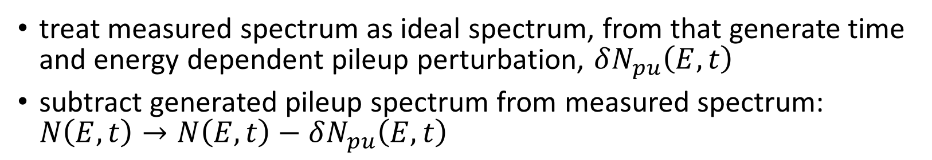
2.3 Overlapping pulses(“pile up”)
treat measured spectrum as ideal spectrum, from that generate time and energy dependent pileup perturbation, $δN_{pu}\left(E,t\right)$
subtract generated pileup spectrum from measured spectrum: $N\left(E,t\right)→N\left(E,t\right)−δN_{pu}\left(E,t\right)$

Slide 8
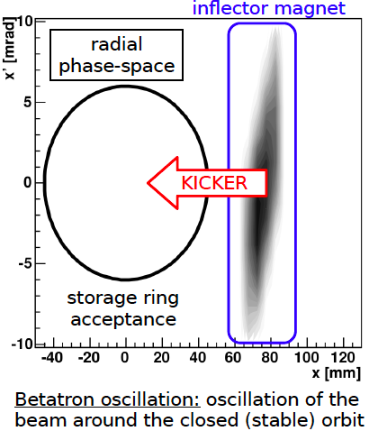
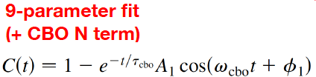

2.4 Coherent Betatron Oscillation (CBO)
Initial Number of positrons
cbo lifetime
lifetime of muon
cbo frequency
cbo phase
assymetry
phase
cbo assymetry
Dikai Li, SJTU/CUG, omega_a analysis at Muon g-2

Slide 9
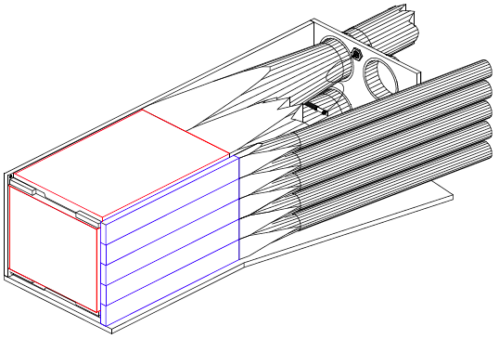
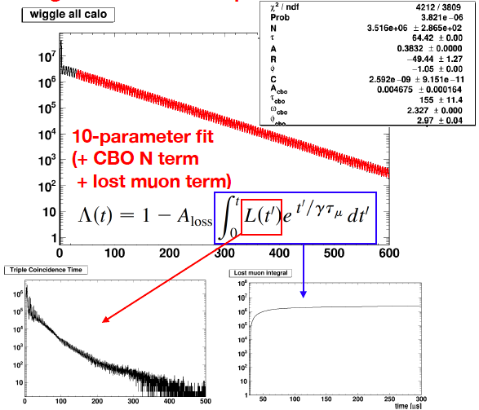
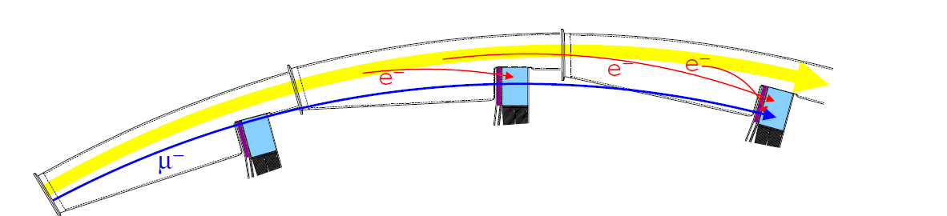
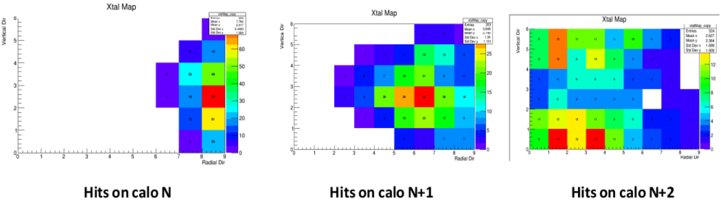
2.5 Lost muon
Lost muons arise from interactions with materials in the storage region that cause the muon to lose energy and spiral in towards the detectors.
In the front scintillating detector(FSD) scintillators the muons and decay electrons are both minimum-ionizing particles (MIP), and therefore produce comparable signals.

Slide 10
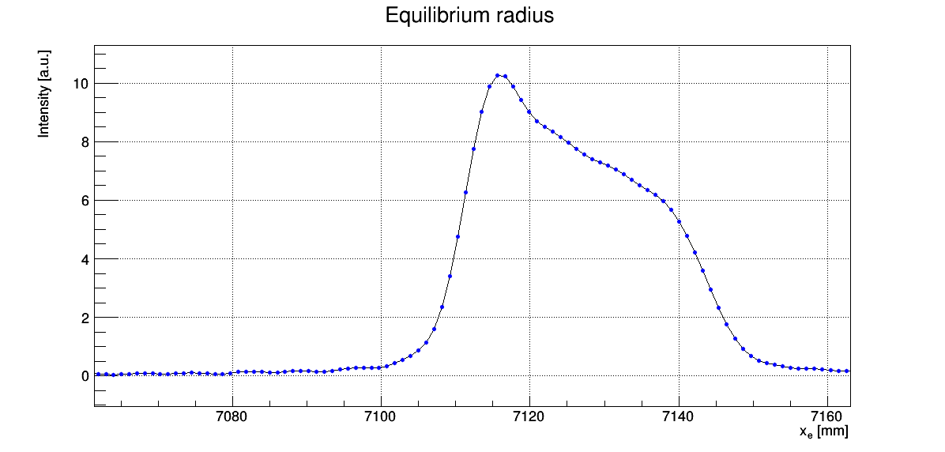
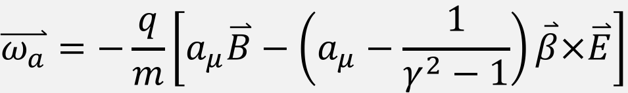
2.6 E-field correction (fast rotation)
$$\overset{⃑}{ω_{a}}=−\frac{q}{m}\left[a_{μ}\overset{⃑}{B}−\left(a_{μ}−\frac{1}{γ^{2}−1}\right)\overset{⃑}{β}×\overset{⃑}{E}\right]$$
Magic $γ$ ~ 29.3
Fast rotation analysis: use a model of the time evolution of the bunch structure to obtain the momentum (radial) distribution of decayed muons.

Slide 11
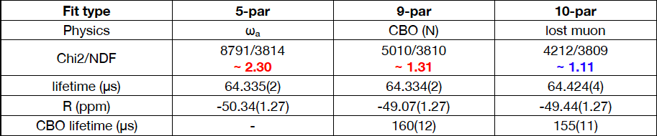

3. Latest dataset
Run numbers: 15921 to 15991
Datetime: 2018-04-22 13:13:52 to 2018-04-25 02:00:40
Statistical uncertainty equivalent to BNL 1999 dataset : 1.2 ppm
$$ω_{a}$$
blinded
blinded
blinded

Slide 12
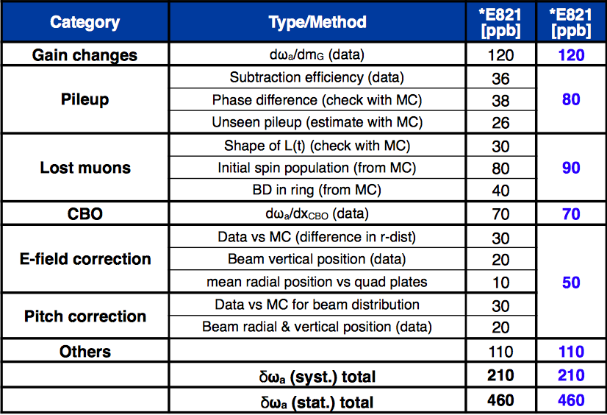
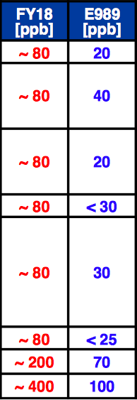
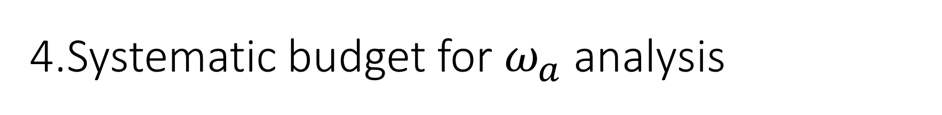
4.Systematic budget for $ω_{a}$ analysis

Slide 13
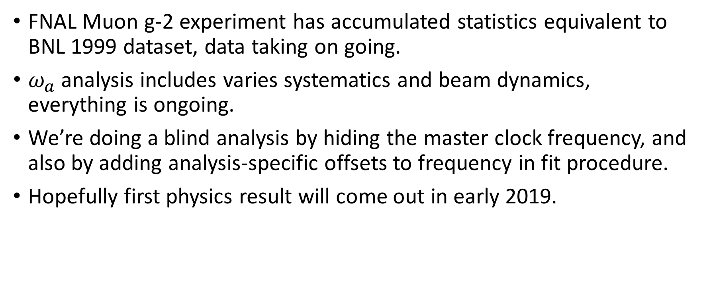
5. Summary
FNAL Muon g-2 experiment has accumulated statistics equivalent to BNL 1999 dataset, data taking on going.
$ω_{a}$ analysis includes varies systematics and beam dynamics, everything is ongoing.
We’re doing a blind analysis by hiding the master clock frequency, and also by adding analysis-specific offsets to frequency in fit procedure.
Hopefully first physics result will come out in early 2019.

