Slide 1

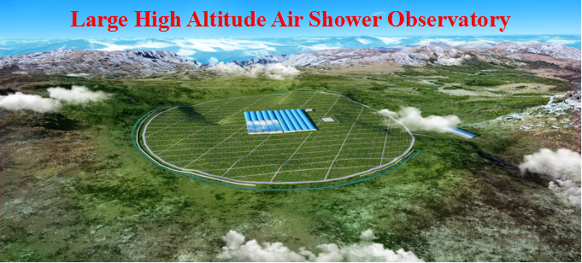
LHAASO experiment and its progress
Xiangdong Sheng
IHEP, CAS
中国物理学会高能分会第十 届全国会员代表大会暨学术年会
上海 2018 年 6月 20日至 6月 24日

Slide 2
Outline
1. LHAASO and its physical motivations
2. Detector arrays and their prospects
  Different detector arrays；
  Physical prospects
3. Progress status of LHAASO
Summary

Slide 3
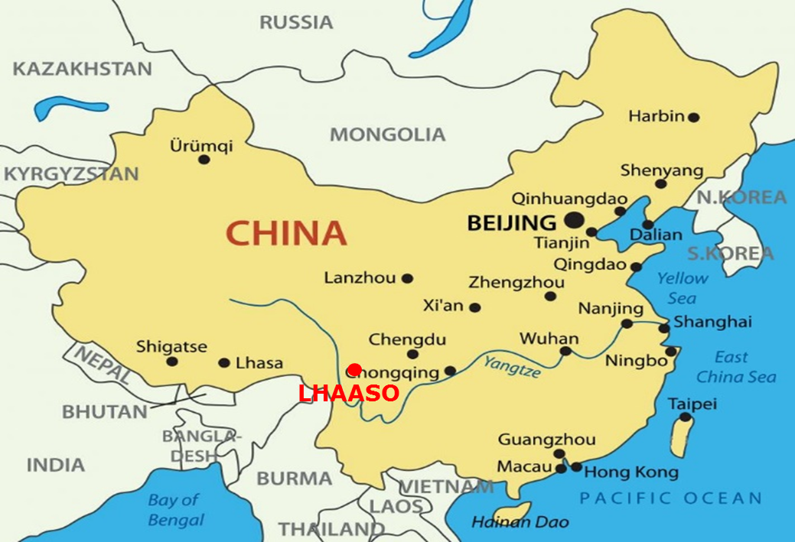
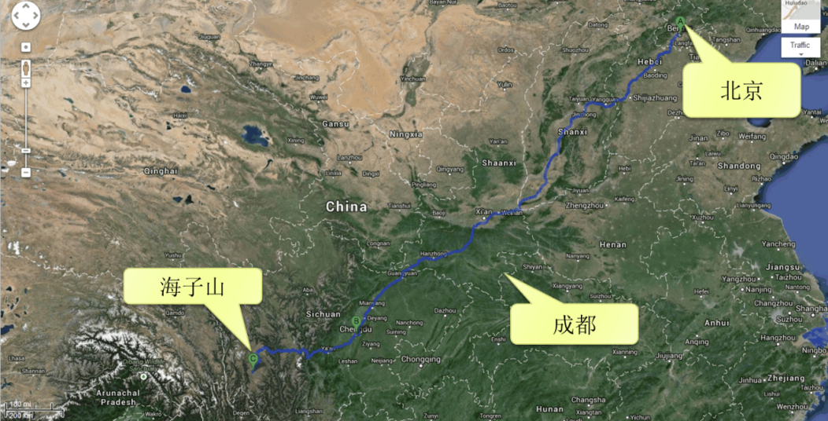
1. LHAASO and its physical motivations
LHAASO Site
Location: 29°21’27.6”N, 100°08’19.7”E, 4400 m a.s.l;
8 km to Daocheng-Yading Airport (4411 m a.s.l.);
50 km to Daocheng City, Sichuan Province.

Slide 4
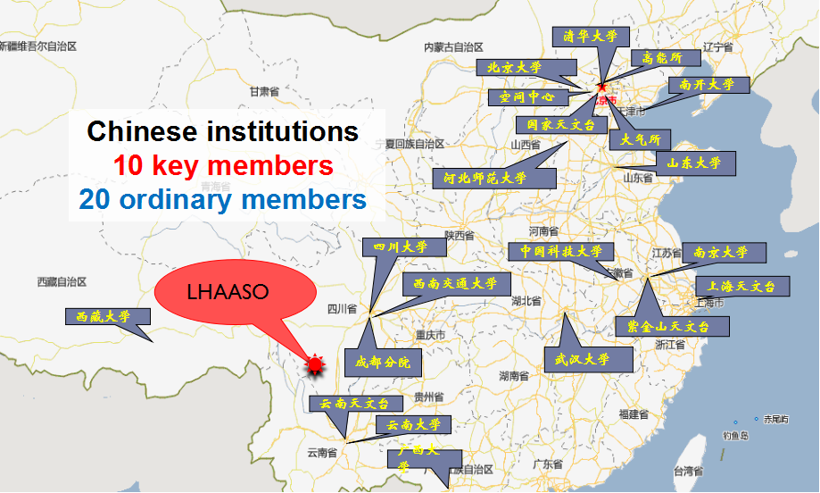
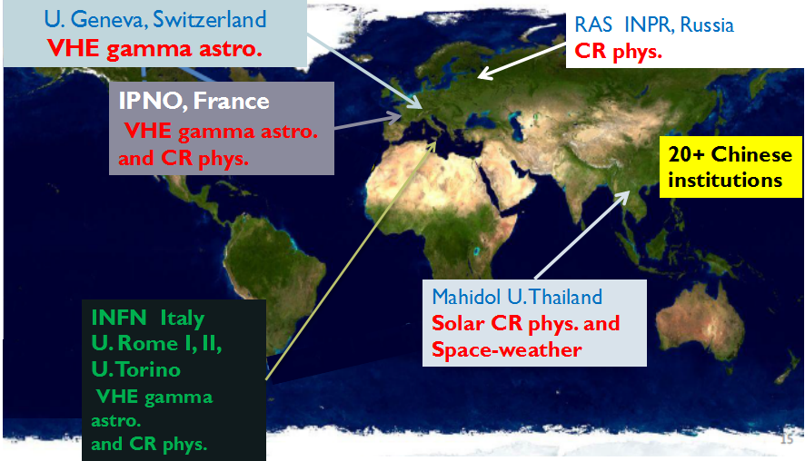
LHAASO Collaboration
(growing)

Slide 5
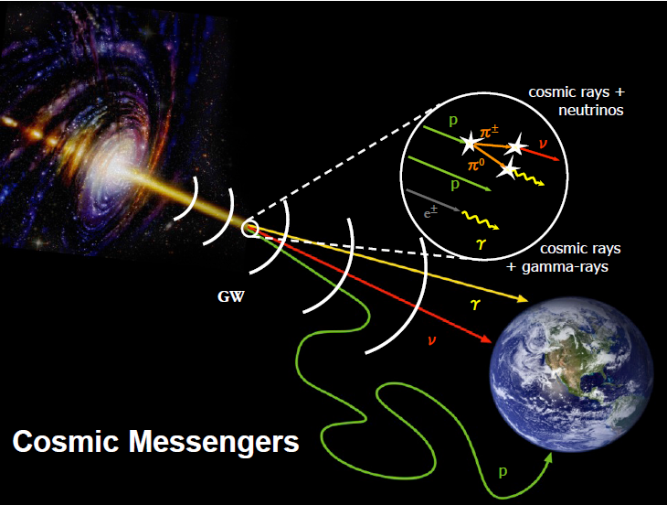
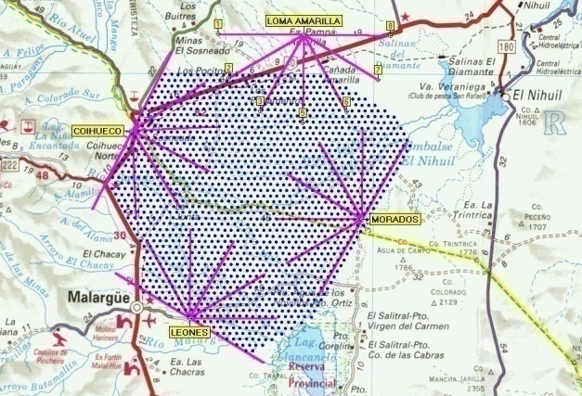
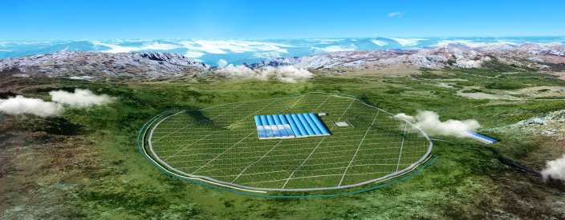
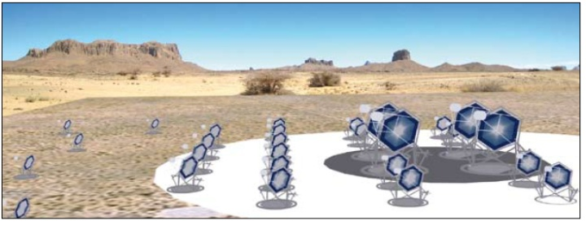
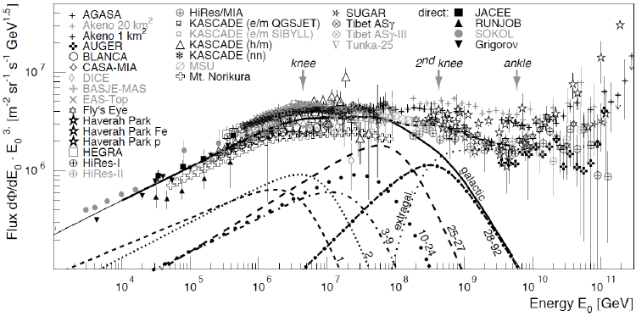
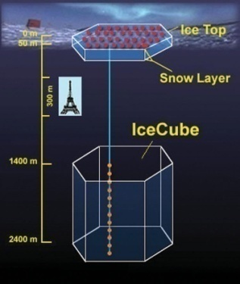
Multi-messenger
50km
The question
EHE CR Astronomy
TA, AUGER
JEM-EUSO
CTA
VHEγ Astronomy
LHAASO
CTA
What’s the origin of Cosmic ray?
CR Features: knees
AMS02,Iss-CREAM,DAMPE,LHAASO……
5km
VHE/UHE Neutrinos
IceCube Gen2，KM3net
ARIANA ……
in space
on the ground

Slide 6
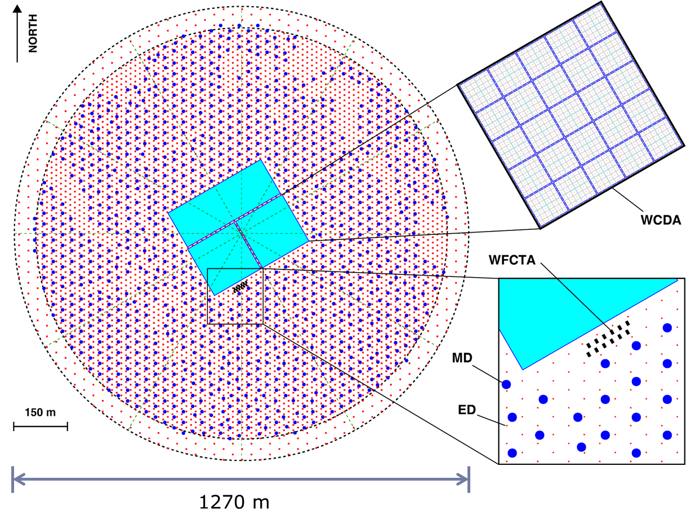
Hybrid detector arrays
KM2A - one square Kilometer extensive air shower array
    ED – Electromagnetic particle Detector
      5195 EDs
    MD - Muon Detector
      1171 MDs
WCDA - Water Cherenkov Detector Array
  3120 cells
WFCTA - Wide Field-of-view Cherenkov Telescope Array
  18 telescopes

Slide 7
Physics of LHAASO
VHE gamma sky survey (100 GeV-1 PeV):
  Galactic sources;
  Extragalactic sources & flares;
  VHE emission from Gamma Ray Bursts;
  Diffused Gamma rays.
Spectrum measurement at the high end:
  Nature of the acceleration: leptonic or hadronic;
  Origin of cosmic rays – 100 years’ mystery.
Cosmic rays
  Spectra of CR Species;
  Anisotropy of VHE cosmic rays;
  Cosmic electrons / positrons;
Miscellaneous:
  Gamma rays from dark matter;
  Sun storm & IMF.

Slide 8
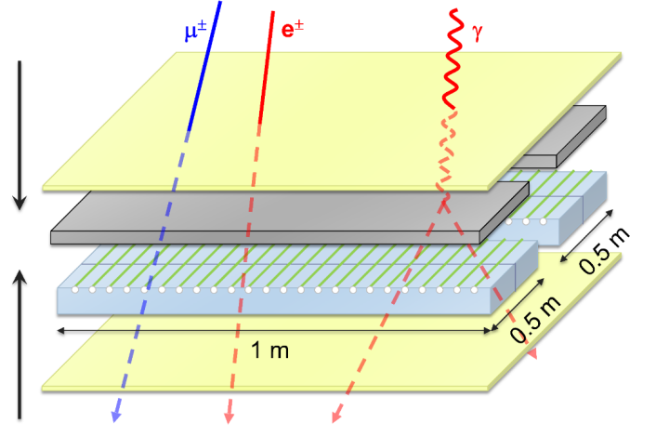
2. Detector arrays and their prospects
（1）Different detector arrays
KM2A -ED
5195 EDs in total,
Central array：4901 EDs，15m spacing；
Guarding ring array： 294 EDs ，30m spacing；
One kind of scintillator detector,
Secondary particles to detect: μ±, e±, γ
To measure the densities and arrival times of the secondary particles in EAS fronts;

Slide 9
ED Specifications
Item | Value
Effective area | 1 m²
Thickness of tiles | 1 cm
Number of WLS fibers | 24/tile×4 tile
Detection efficiency (> 5 MeV) | >95%
Dynamic range | 1-10,000 particles
Time resolution | <2 ns
Particle counting resolution | 25% @ 1 particle 5% @ 10,000 particles
Spacing | 15 m/30m
Total number of detectors | 5195

Slide 10
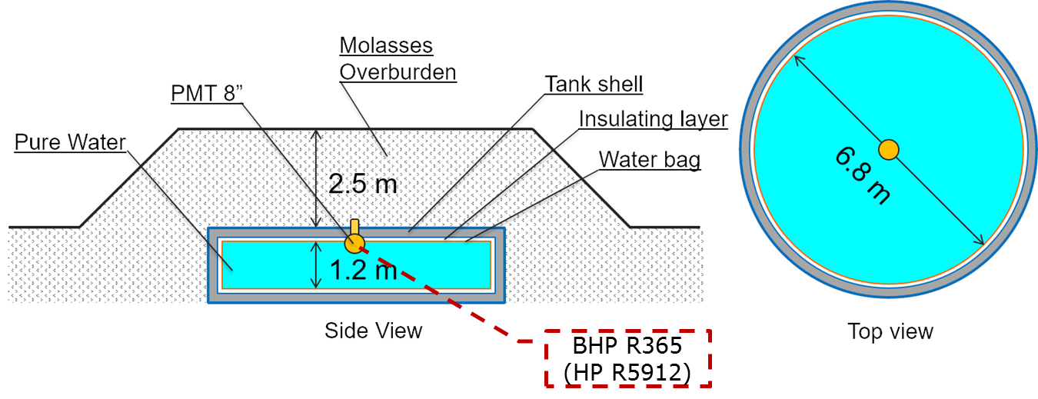
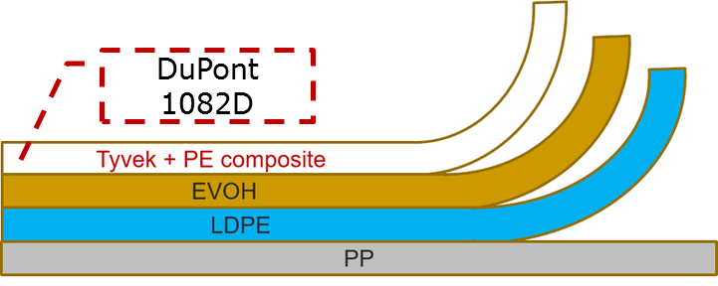
2) Muon Detector （MD）
To detect the secondary muon density and arrival times in EAS fronts;
To reach a fine purity of muons preventing the others shower electromagnetic components.
Multilayer composite technique

Slide 11
MD Specifications
Item | Value
Area | 36 m²
Depth | 1.2 m
Molasses overburden | 2.5 m
Water transparency (att. len.) | > 30 m (400 nm)
Reflection coefficient | >95%
Time resolution | <10 ns
Dynamic range | 1 – 10,000 particles
Particle counting resolution | 25% @ 1 particle 5% @ 10,000 particles
Lifetime | >20 years
Spacing | 30 m
Total number of detectors | 1171

Slide 12
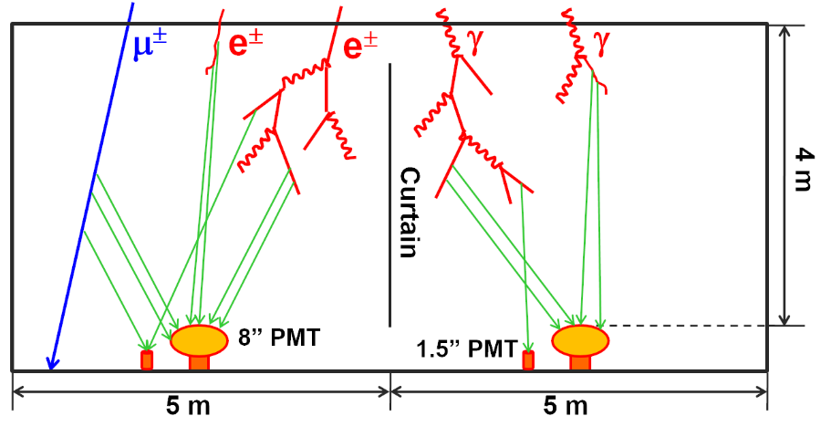
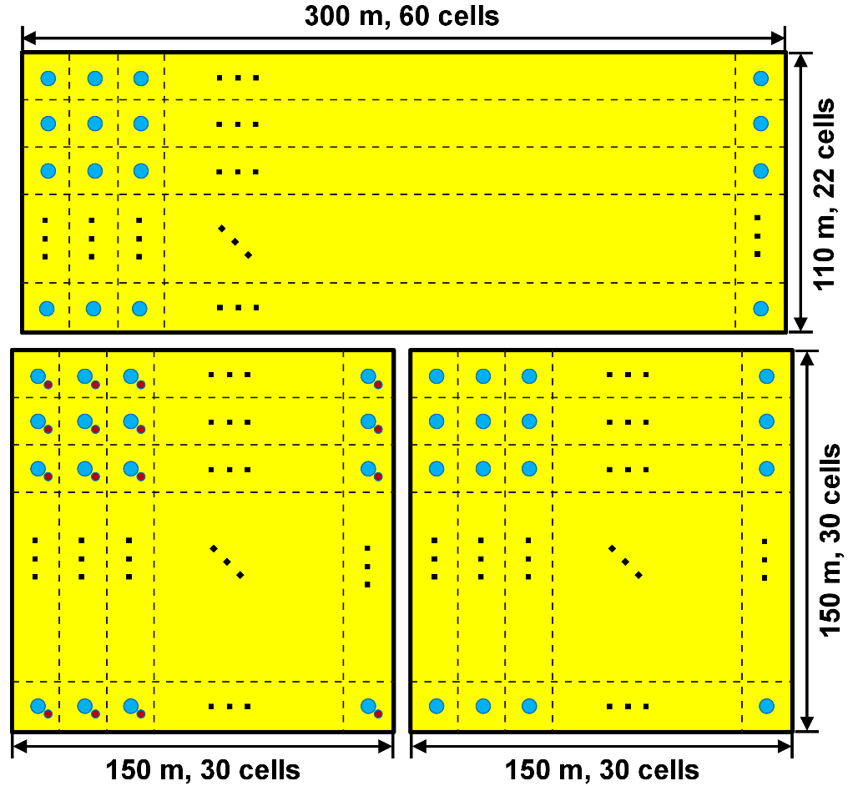
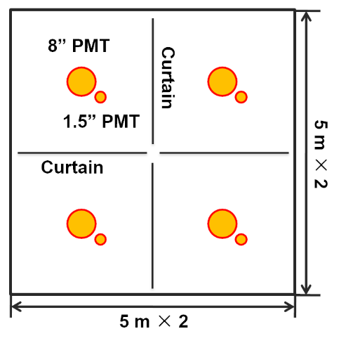
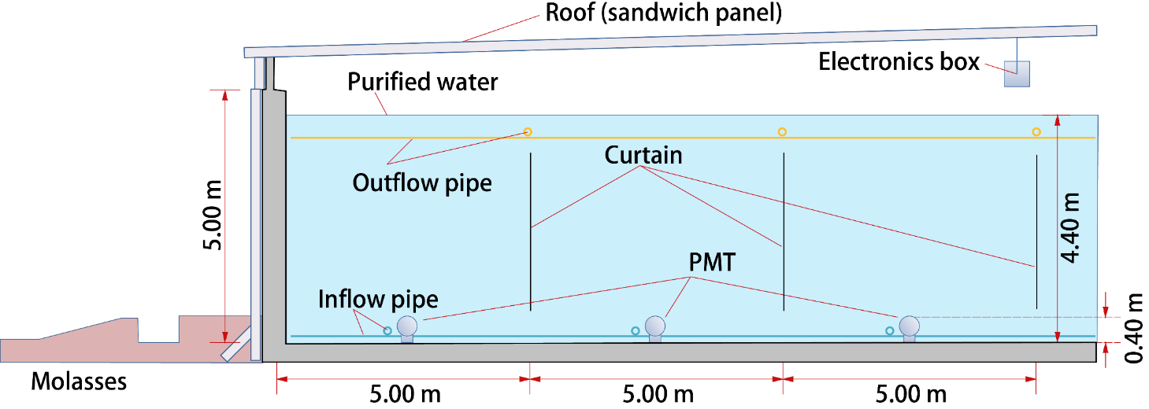
3) WCDA —— 3 pools
BHP R365
(HP R5912)
HZC XP3960
Electronics:
USTC + SCU

Slide 13
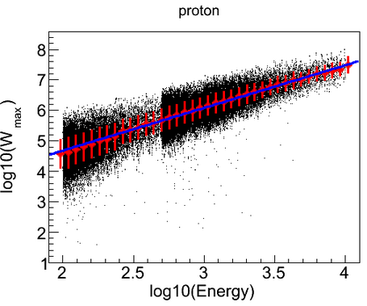
  The dynamic range extension system for WCDA experiment.
  Motivation:
  To measure the shower cores from 100 TeV to 10 PeV (~knee region)
The dynamic range
of the large PMT
Notes:
LHAASO项目不仅有地面粒子探测器阵列，也有切伦科夫探测器阵列，可以对EAS进行多参数测量。为了更好的区分原初宇宙线成份，针对100TeV-10PeV能区，我们设计了动态范围扩展系统（简称WCDA++），用于测量高能宇宙线的芯区信息。具体探测器布局是在WCDA第一个水池内大管子的旁边添加了一个1.5英寸的PMT，该系统覆盖面积2万多平米，由900个探测器单元构成，动态范围是20到20万个光电子信号，有效水深也是4米。

Slide 14
WCDA Specifications
Item | Value
Cell area | 25 m²
Effective water depth | 4 m
Water transparency | > 20 m (400 nm)
Precision of time measurement | 0.5 ns
Dynamic range | 1-4000 PEs
Time resolution | <2 ns
Charge resolution | 40% @ 1 PE 5% @ 4000 PEs
Accuracy of charge calibration | <2%
Accuracy of time calibration | <0.2 ns
Total area | 78,000 m²
Total cells | 3120

Slide 15
WCDA++ Specifications
Item | Value
Cell area | 25 m²
Effective water depth | 4 m
Dynamic range | 20-20,000 PEs
Total area | 22,500 m²
Total cells | 900

Slide 16
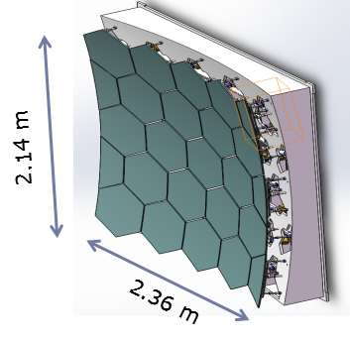
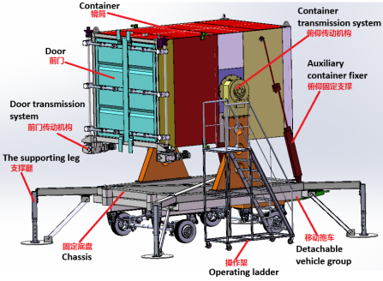
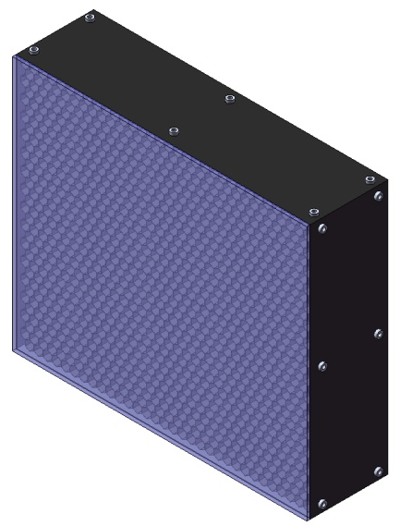
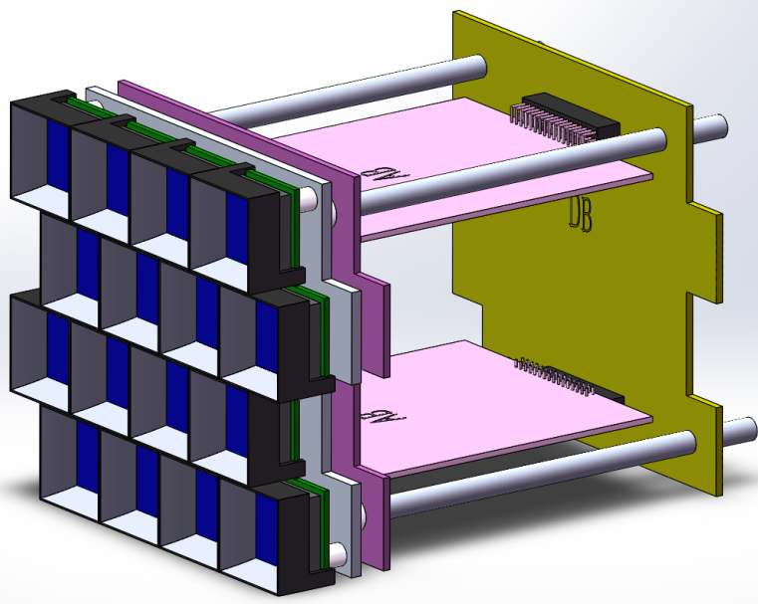
4）WFCTA
5m² spherical mirror
SiPM camera: 64 sub-clusters;
One Sub-cluster: 16 SiPM pixel
Portable design: easy to switch the array configurations
SiPM Camera
sub-clusters

Slide 17
WFCTA Specifications
Item | Value
Mirror size | 5 m² / telescope
Pixel size | 0.5°
Number of Pixels | 1024 / telescope
FOV / telescope | 14°×16° / telescope
Dynamic range | 10-32000 PE / pixel (<10% nonlinearity)
Photo detection efficiency | >28%@400 nm, >22%@350 nm, >17%@310 nm
Time resolution | <10 ns
Charge resolution | <50%@10 PE <5%@>1000 PE
Accuracy of charge calibration | <8%
Pointing accuracy | <0.1°
Number of telescopes | 16 (18)

Slide 18
Other supplementary Systems
Precision Time Distribution System
DAQ
Slow control
Data storage & processing
Offline software framework
Water supply
  for MDA (purified water) & WCDA (cleaned water, circulating during operation).
Civil construction
  field, road, building, electricity power, …

Slide 19
Precision Time Distribution System
U. Tsinghua
White Rabbit Protocol
Switches and fiber connections employed for clock distribution and data transferring.
Precise synchronization
<0.3 ns for all nodes (or FEEs) in the distance of at least >1 km.
Fine verification
Realized in different kinds of tests, including its first application in High Altitude.

Slide 20
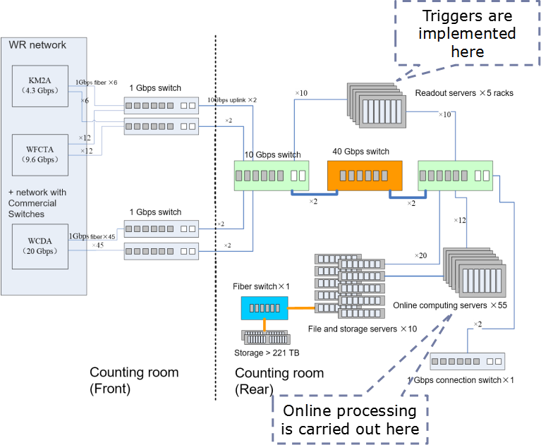
DAQ
DAQ: IHEP
Software: based on TDAQ

Slide 21
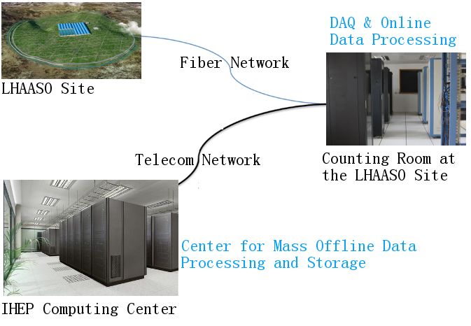
Data Storage & Computing
Data:
  transferred to a computing center at IHEP (or other site) via commercial network links, and stored in disk & tape.
  can be accessed and processed in IHEP or other sites.
  Control:
  The detectors can be monitored and controlled at Daocheng and other remote sites.

Slide 22
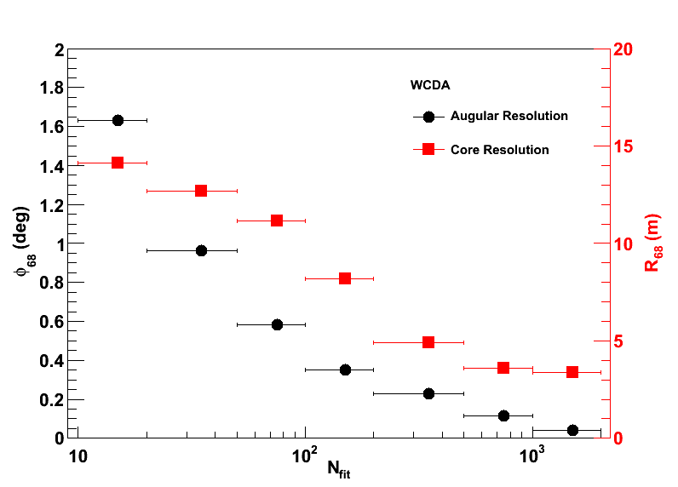
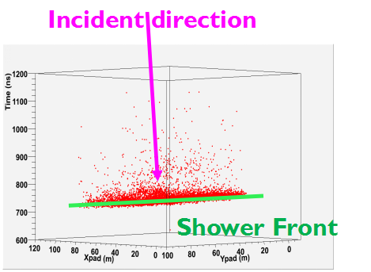
(3) Physical prospects
WCDA：3 Pools
Measuring shower direction and location;
Catching muon signals in showers for γ/p

Slide 23
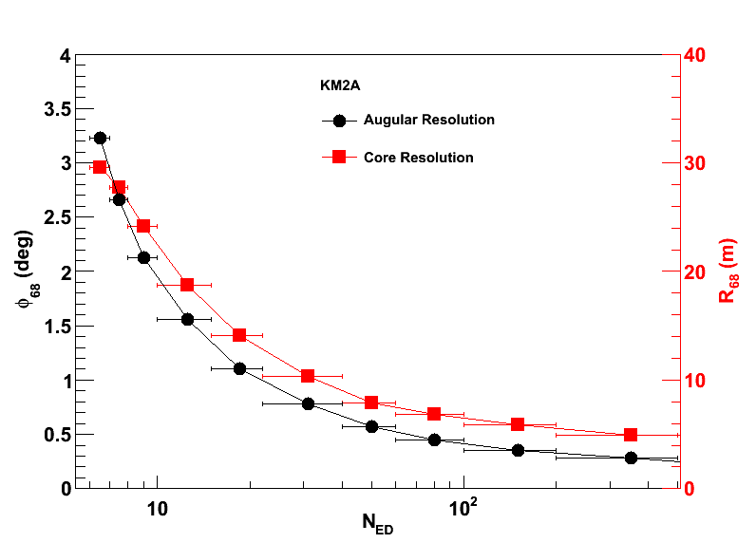
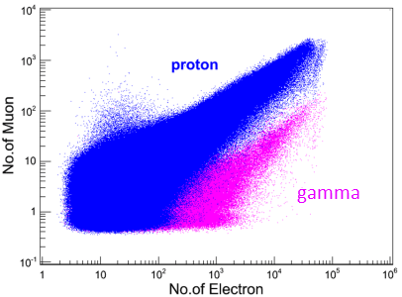
KM2A: ED + MD arrays
Measuring shower direction and location
Measuring μ–content with the largest MD array ever
Clean γ selection

Slide 24
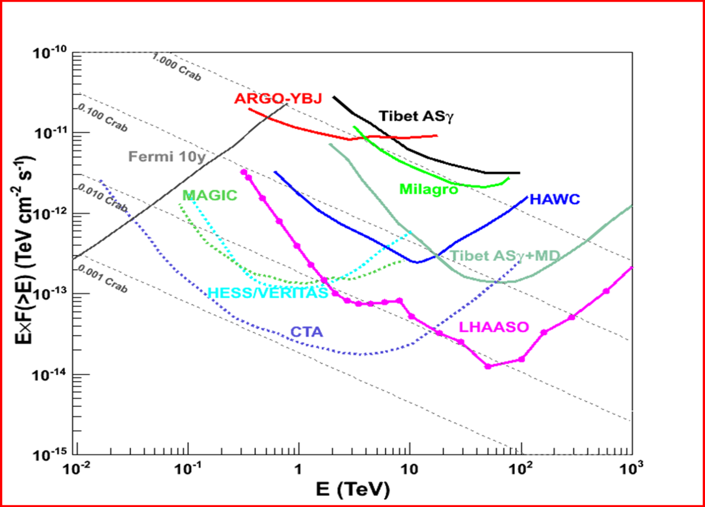
Sensitivity to gamma ray sources
High Integral Sensitivity（1 year）: 1% Crab unit @3TeV & 50TeV；
Wide FoV: 1/7 of the sky at any moment；60% of the sky in every day
(Cui,S.W. et al, APP, 54, 86 (2014) & He, H. H., ICRC, 236, 1010 (2015) )

Slide 25
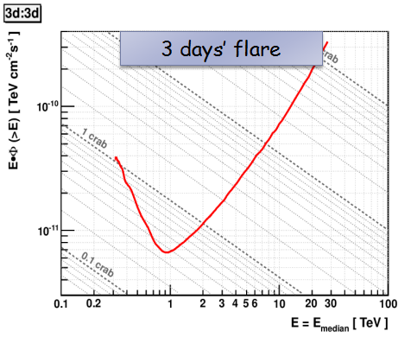
Sensitivity to Flares of WCDA
Duration | Sensitivity (Crab)
1 year | 0.0066
6 months | 0.0094
3 months | 0.013
1 month | 0.039
10 days | 0.10
3 days | 0.36
1 day | 1.0
2 hours | 3.5
1 hour | 5.4
30 minutes | 13
10 minutes | 67
3 minutes | 410
1 minute | 2100
Requirements:
  30 events;
  5 s.d.;
  Calculation based on a power law spectrum (λ=-2.62).
Partly limited by statistics.
Need large area or low energy threshold

Slide 26
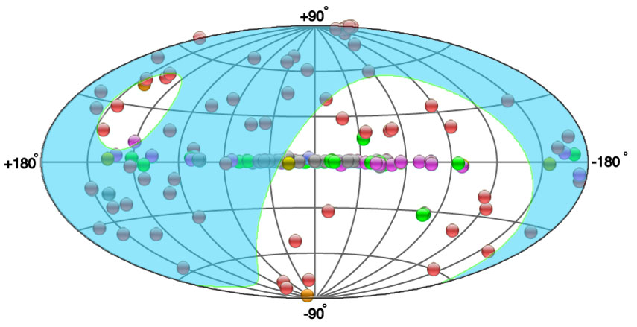
Survey over 300 GeV-1 PeV for gamma ray sources
208 sources in TeV bend
119 in LHAASO FoV (θ<40°)
~60% Galactic
~40% extragalactic
~1/3 unidentiﬁed
active galactic nuclei
~1/3 pulsar wind nebulae (PWN)
~1/3 supernova remnants, compact binary systems and massive star clusters
Notes:
LHASO视场里已知的TeV源，

Slide 27
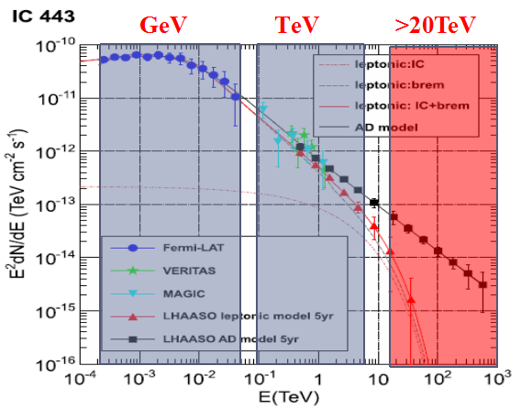
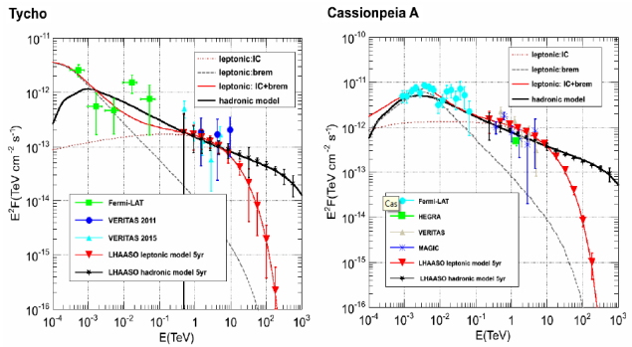
Observations of γ-ray emission from SNRs
To obtain the expectant Energy spectrum, >TeV
High energy spectrum (>100 TeV) to discriminate the leptonic/hadronic origins
(Liu Ye et al, ApJ，826:63(2016))

Slide 28
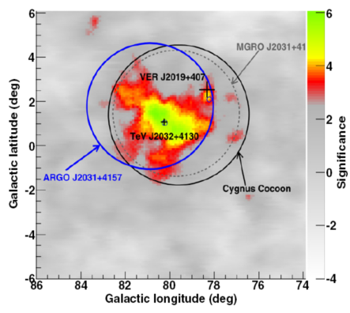
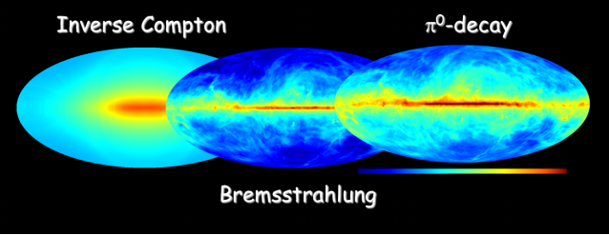
Energy Spectra of gamm rays
in Cygnus Cocoon and Galactic plane
Galactic plane diffuse gamma-ray
B. Bartoli,et al.2014,APJ
GCR spectrum and density
Cosmic rays interacted with the interstellar gas and radiation fields, which provide a tool to study cosmic ray origin and propagation.

Slide 29
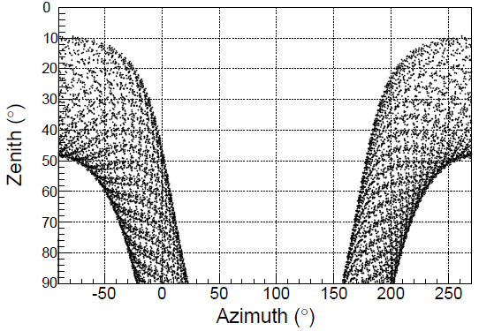
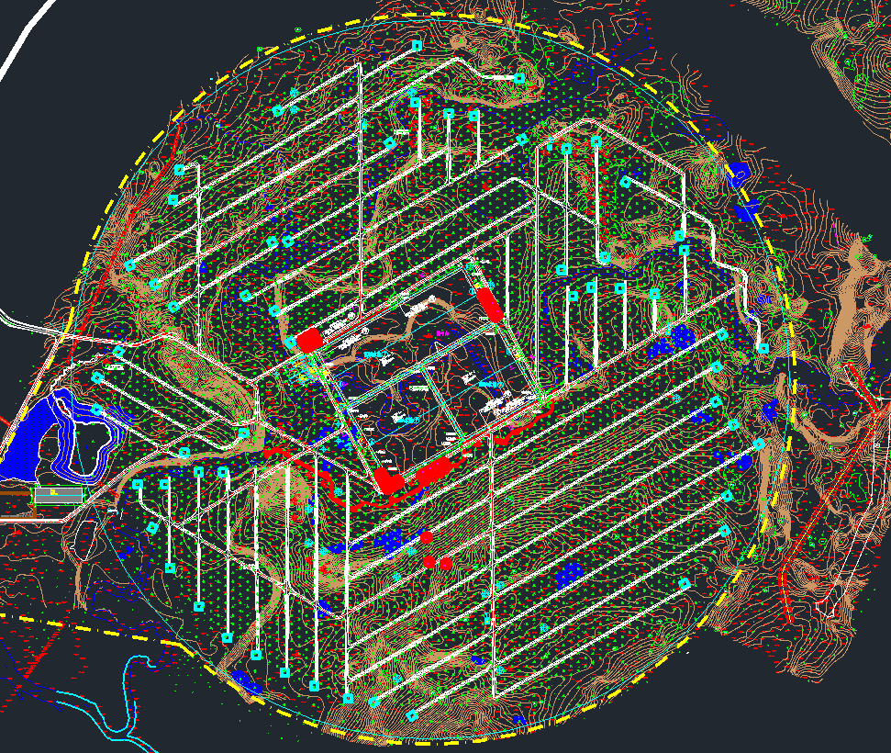
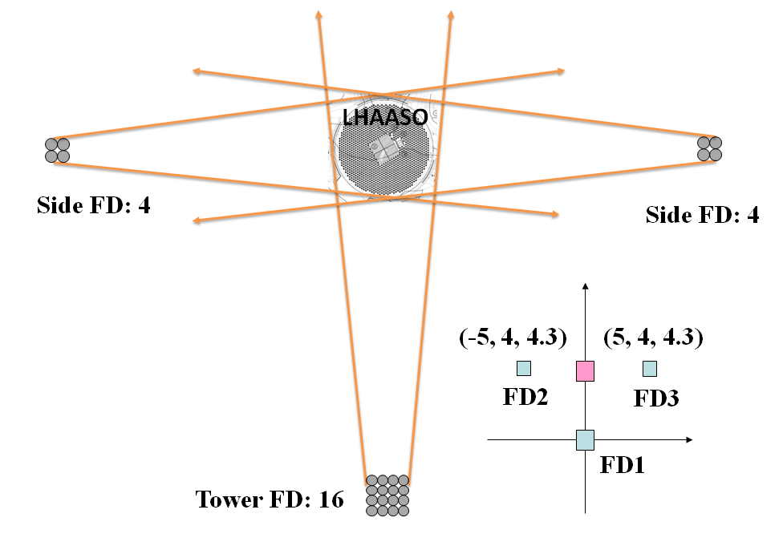
Layout for Three Energy Range
0.1-10 PeV in 2019
  pure proton and pure Helium spectra
  6 C-Tel’s (60° in elevation) + No.1 pool
1- 100 PeV in 2021
  Pure iron or heavy nuclei (MgAlSi+Fe) spectra
  18 C-Tel’s (45° in elevation)+ KM2A
>100 PeV in 2023
  2nd knee
  20 F-tel’s + MD array
6 Tel. FoV
2
2
2
2

Slide 30
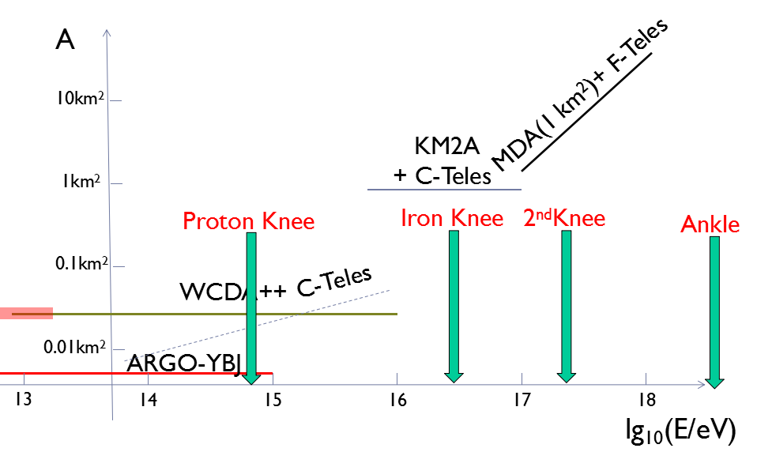
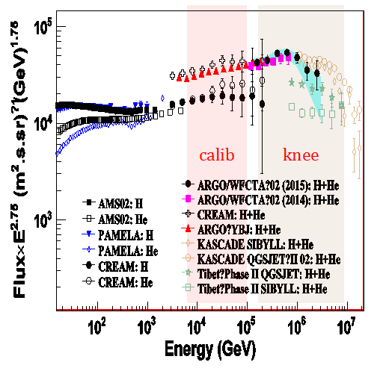
Aperture of LHAASO for CR events
Cosmic Ray Physics:
Charged Nuclei knees of spectra of individual species
Spectrum of Light Nuclei with ARGO data
E_{knee}—700 TeV,
Phys. Rev. D 92092005 (2015)

Slide 31
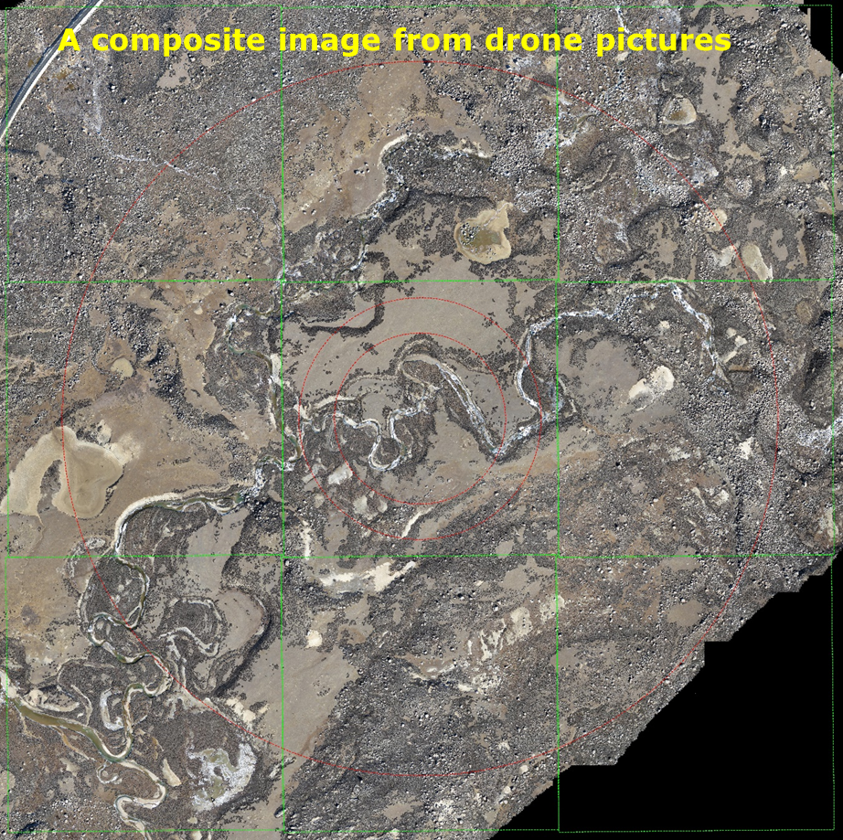
3. Progress status of LHAASO
Typical Landscapes
Sand & gravel
Grass & bush (partly alpine azalea)
Boulders
Rivers & marshland
Hills & ridges
Field: Oct. 2013 (Before Any Construction)

Slide 32
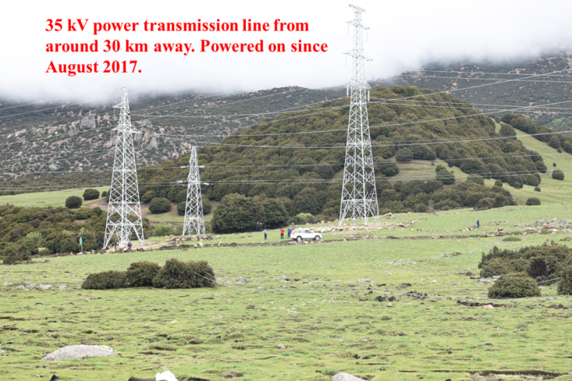
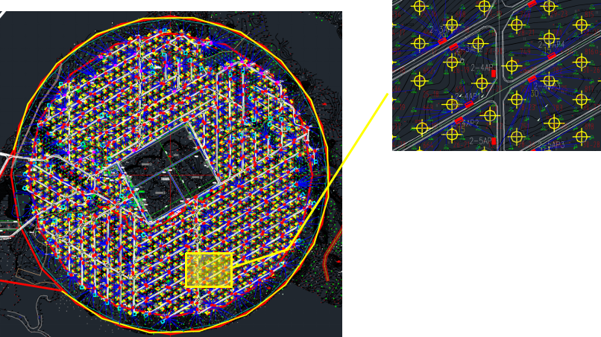
(1) Construction Status
Electricity & WR Network Cables
Roads:Total length of roads in the site: ~21.5 km
Photoelectric composite cable (armored): 195 km;
Optical cable (armored): 155 km;
Huge laying effort.
Field & infrastructure, including: land lease, field preparation, ecological protection, ditches for flood control, roads,power supply, home base construction in Daocheng city, are supported by the local government, and executed via a construction agent.

Slide 33
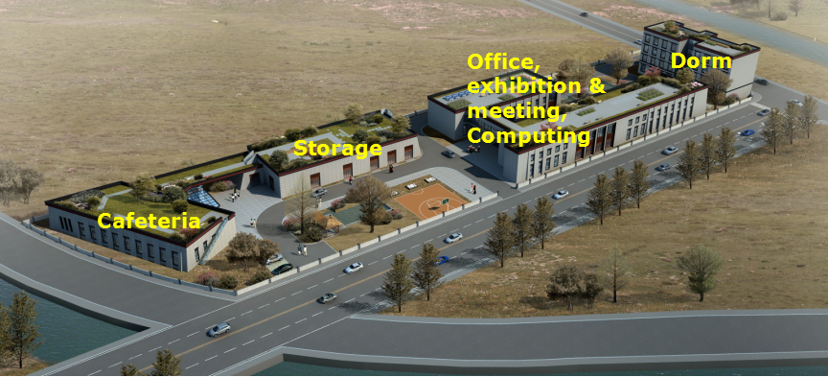
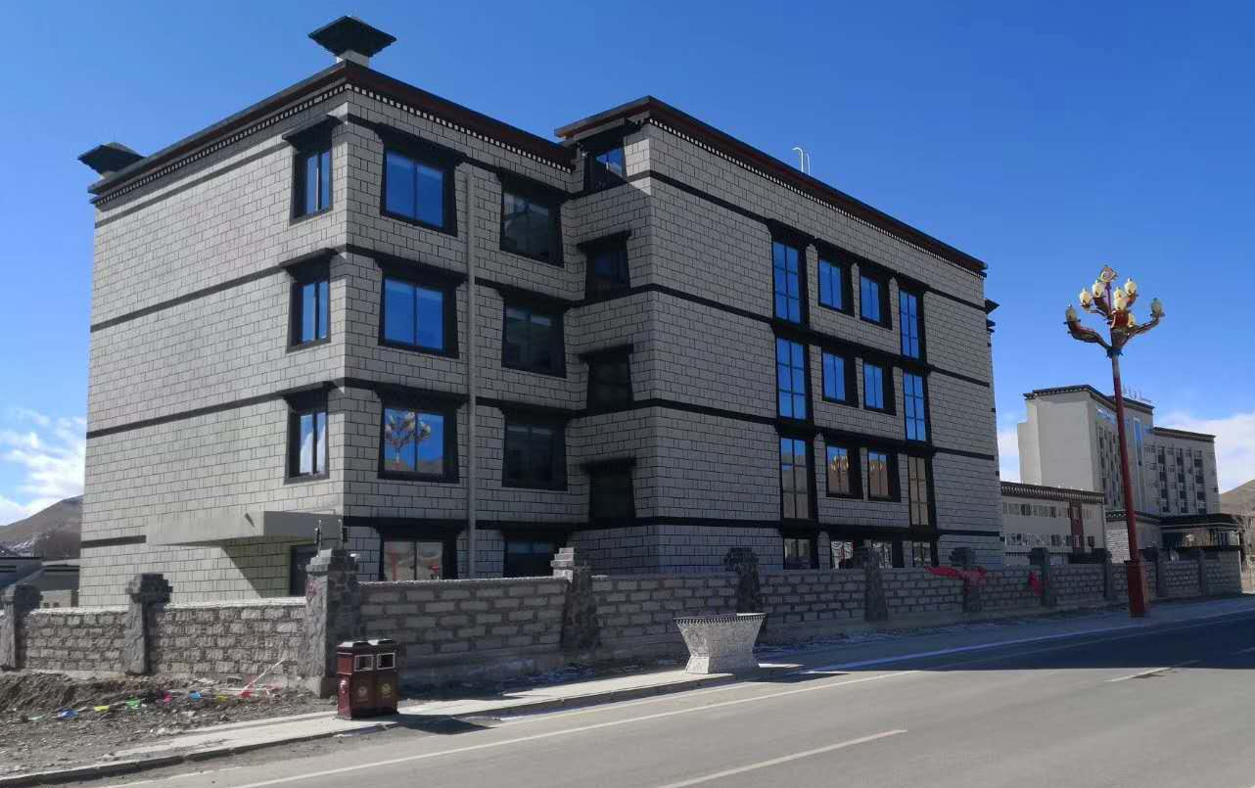
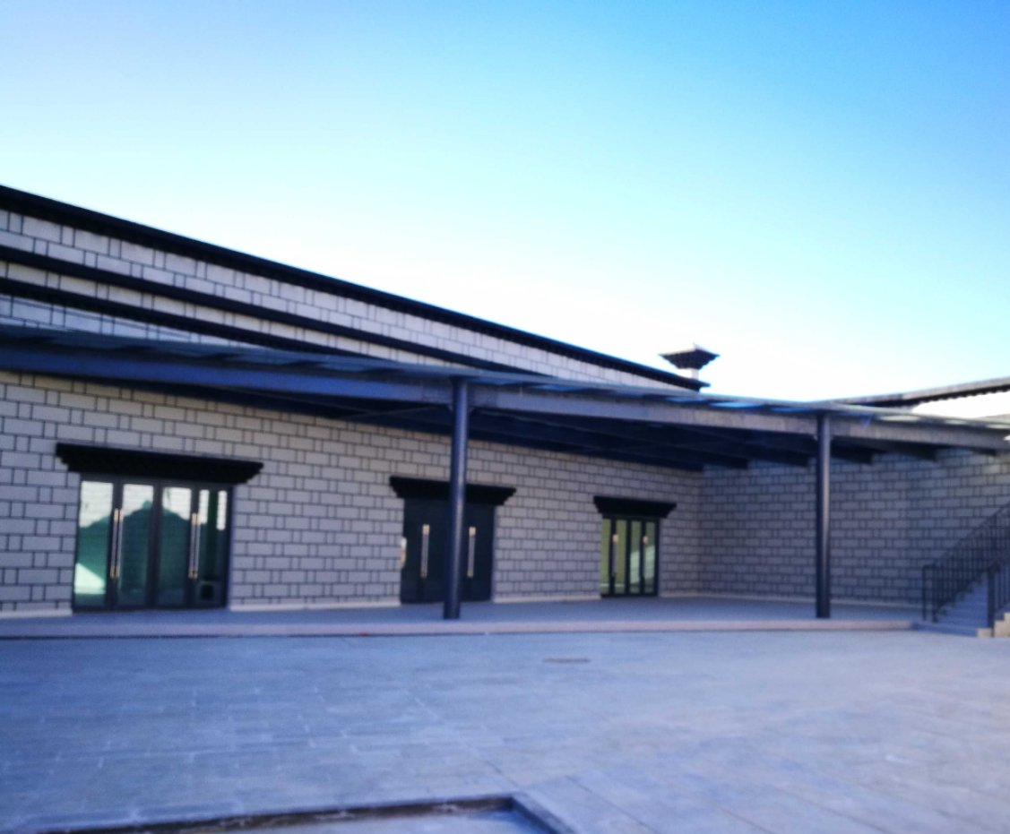
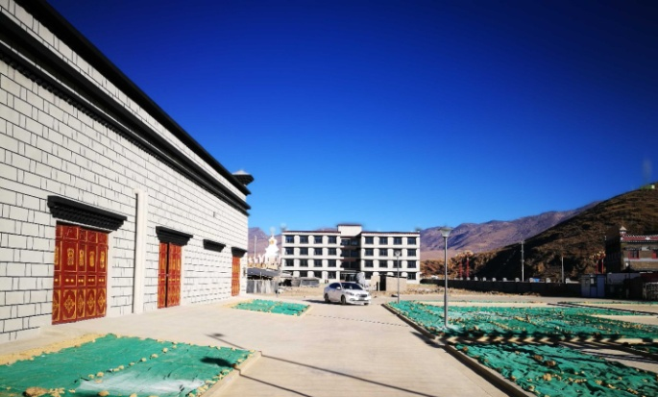
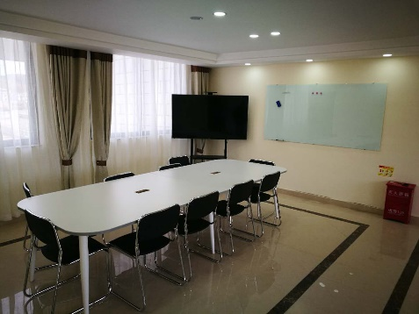
Home Base in Daocheng

Slide 34
(2) Detector assignments
  including manufacturing, assembling, testing, transporting, installing the detectors, …
  Via a biding procedure, govern by the government procurement law.More than 50 contracts have been signed with universities, corporations, companies and factories;
  The products will be examined and accepted in a well-designed manner.
  Installation Schedule:
  ED:1383 (2018), 1800 (2019), 2008 (2020).
  MD: 300 (2018), 415 (2019), 456 (2020).
  WCDA: 1st pool (2018.11), 2nd pool (2018.9), 3rd pool (2020.7).
  WFCTA: 1st telescope (2018.8), up to 4 telescopes (2018.10), up to 10 telescopes (2020.1), up to 18 telescopes (2020.12).
  By the end of 2018: a quarter of LHAASO detectors are scheduled to operate.

Slide 35





1) ED progress
Sensitive detection units
PMT
4 Scintillator Unit(SGC BC408): 1 cm thickness, 4 tiles (1 m × 0.25 m)
24 fibers (SGC BCF92) for each tile,
One 1.5-in PMT (HZC XP3960)
Lead: 0.5 cm
Iron case: 0.1 cm
Electronics (IHEP),
Power supply
Power supply
ED electronics

Slide 36



ED electronics
Charge measuremeng: charge integration
Time measurement: TDC base on FPGA
Low temperature coefficient;
Fiber readout;
Temperature /humidity monitoring;
HV controlling

Slide 37





33 detectors has been installed in the site by Feb. 2018

Slide 38




2) MD progress
MD electronics
Large dynamic range and high precision charge measurement at high altitude wild environment, and real time waveform digitization

Slide 39


Slide 40





MD Installation in the site.
3.5MD/day

Slide 41



3) WCDA Progress
Engeering Schedule of No.1 pool,
1) Jul. 2018, Installation of the detectors
2) Oct. 2018, Water flooding
3) Nov. 2018, data taking will begin
Inner structure
WCDA No.1 Pool (Jun. 19)

Slide 42




PMT testing
WCDA electronics

Slide 43



Installation schedule of No.1 pool
A. Dec. 2017 Inner positions measured；
B. Jun. 30 —Jul. 20 Inner cleaning and water-holding testing;
C. Jul. 21 — Sep. 30 Detectors installation and performence tests;
PMTs, Cables, High Power supplies, Electronics, Timing calibration system, Slow controlling system, position measurement and inner cleaning, etc.
Timing calibration system
High Power supply

Slide 44


Status of the WCDA++
Waterproof design has been completed
PMT（SDU）
  XP3960 （HZC）
  Gain：~2×105
  Anode & the 7th Dynode readout
Electronics（SCD）
  Charge resolution：
  10%@1.28pC，<5%@>12.8pC
  Accuracy of charge calibration：
  5%@<12.8pC，<2%@12.8pC
the Charge calibration ：
  based on an array of LEDs and plastic optical fiber bundle is designed
XP3960（HZC）
Waterproof design
Electronics test
Notes:
WCDA++的实验进展情况是：（1）完成了防水封装的设计和研制；（2）正在进行PMT的批量性能测试，这个工作是由山东大学承担的，管子型号为HZC生产的XP3960，工作增益为2×10^5，采用阳极+打拿极双读出设计；（3）电子学是由四川大学承担的，已经完成了鉴定件的设计验收，正在进行批量生产测试；（4）电荷标定系统是基于LED光源组和光纤束进行设计的，目前也已经完成了鉴定件验收。

Slide 45



4) WFCTA progress
Telescope system Assemblies

Slide 46


>40 sub-clusters have been assembled in Yunnan Univ.
The first SiPM-based camera will be built this June

Slide 47


Dynamic range and resolution

Slide 48


4) Others progress
WR Switch
Qsinghua U.
~600 WR switches;
“Fanless” design;
Manufactured in China.
JUNO 20in PMTs, with good performances, such as high collection efficiency (>98%), will be chosen to use in LHAASO-WCDA.

Slide 49


China-Russia coorperation
new type thermal neutron detection technology
Hadrons in the EAS are very sensitive to primary composition.
Hadrons in EAS interacting with media on the ground, amount of evaporation neutrons would be generated in MeV, which could be moderated to thermal neutrons.
The thermal neutron detectors have higher specification-price ratio, which would be used in LHAASO experiment.

Slide 50

R&D of thermal neutron detector array
16 detectors: from 2017 to now at Tibet University
JINST 2017 12 P12028
64 detectors: will be finished soon and will be moved to LHAASO for data taking.

Slide 51

高海拔宇宙线观测站设备安装正式开工
2018年6月19日
参加单位：
中国科学院成都分院；
中国科学院高能物理研究所；
四川省科学技术厅；
四川省发展和改革委员会；
甘孜州委、人民政府；
中国科学院成都文献情报中心；
天府新区成都管委会等

Slide 52
Summary
LHAASO is a powerful tool to observe the VHE gamma ray astronomy and UHE cosmic ray physics，which can elevate the capability of discovering the hadronic origin of cosmic rays
Detector construction started June 2017 and infrastructure May 2016. ¼ of the detector array is scheduled to take data by the end of 2018. The whole construction will be finished in 2021.
LHAASO has been funded mainly by China with 20+ domestic institutions. The International Coll. is growing……
Thank you!

