Slide 1
NNLO QCD corrections to Quarkonium production and decay
Yu Jia (贾宇)
Institute of High Energy Physics
中国物理学会高能物理分会第十届全国会员代表大会暨学术年会，上海，松江，2018年6月20日-24日

Slide 2
Contents
Brief review of NRQCD factorization to quarkonium production/decay
NNLO QCD correction to γγ* → η_{c} form factor and confront BaBar data
NNLO QCD correction to η_{c} → γγ (including “light-by-light”)
NNLO QCD correction to η_{c} → light hadrons and Br[η_{c} → γγ], then confront the PDG data
Supplementary materials: Search for graviton via J/Ψ → γ+Graviton
Summary

Slide 3
Nonrelativistic QCD (NRQCD): Paradigm of EFT, tailored for describing heavy quarkonium dynamics: exploiting NR nature of quarkonium
Caswell, Lepage (1986); Bodwin, Braaten, Lepage (1995)
NRQCD factorization is viewed as
being first principle of QCD
This scale separation is
usually referred to as
NRQCD factorization.
The NRQCD short-dist.
coefficients can be computed in perturbation theory, order by order

Slide 4



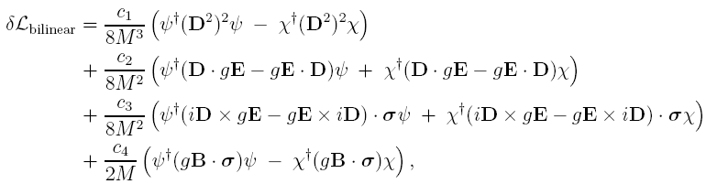
NRQCD Lagrangian (characterized by velocity expansion)
Identical to HQET, but with different power counting

Slide 5




NRQCD is the mainstream tool in studying quarkonium (see Brambilla et al. EPJC 2011 for a review)
Nowadays, NRQCD becomes standard approach to tackle various quarkonium production and decay processes:
Charmonia: not truly non-relativistic to some extent
Bottomonia: a better “non-relativistic” system
^{Exemplified by}
at B factories (exclusive charmonium production)
^{Unpolarized/polarized} production at hadron colliders (inclusive)
Very active field in recent years (Chao’s group, Kniehl’s group, Wang’s group, Bodwin’s group, Qiu’s group …) marked by a plenty of PRLs

Slide 6
The strategy of determining the NRQCD short-distance coefficients (NRQCD SDCs)
In principle, NRQCD short-distance coefficients can be computed via the standard perturbative matching procedure:
Computing simultaneously amplitudes in both perturbative QCD and NRQCD, then solve the equations to determine the NRQCD SDCs.
Threshold phenomenon is signaled by four relevant modes: hard (k^{μ} ~ m),
potential (k⁰~mv²,|k|~ mv), soft (k^{μ}~ mv), ultrasoft (k^{μ}~ mv²).
Elucidated by the Strategy of region by Beneke & Smirnov 1997
The NRQCD SDCs is associated with the contribution from hard region
Practically, one often directly extract the hard-region contribution in an arbitrary multi-loop diagrams
We then lose track of IR threshold symptom such as Coulomb singularity

Slide 7
The ubiquitous symptom of NRQCD factorization: often plagued with huge QCD radiative correction
Most of the NRQCD successes based on the NLO QCD predictions.
However, the NLO QCD corrections are often large:
Zhang et.al.
Gong et.al.
Campbell et.al.
Mackenzie et.al.
… …

Slide 8
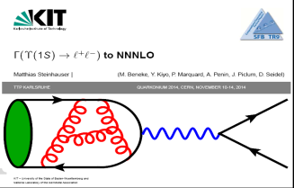
The existing NNLO corrections are rather few: all related to S-wave quarkonium decay
1. Υ(J/Ψ) → e⁺ e⁻
NNLO corrections were first computed by two groups in 1997:
Czarnecki and Melkinov; Beneke, Smirnov, and Signer;
N3LO correction available very recently: Steinhausser et al. (2013)
2. η_{c} → γγ
NNLO correction was computed by Czarnecki and Melkinov (2001) : (neglecting light-by-light)
3. B_{c} → l ν:
NNLO correction computed by Onishchenko, Veretin (2003);
Chen and Qiao, (2015)

Slide 9
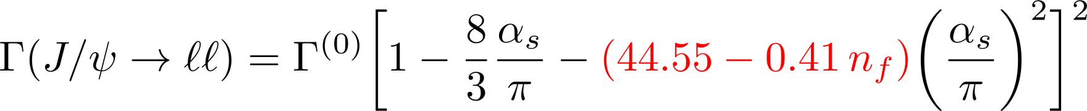
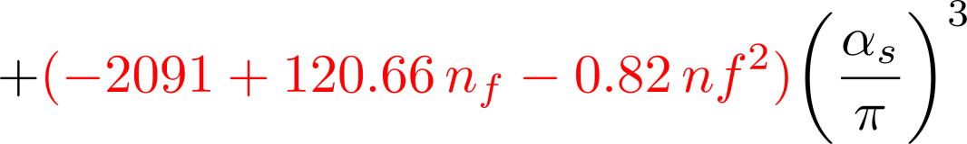
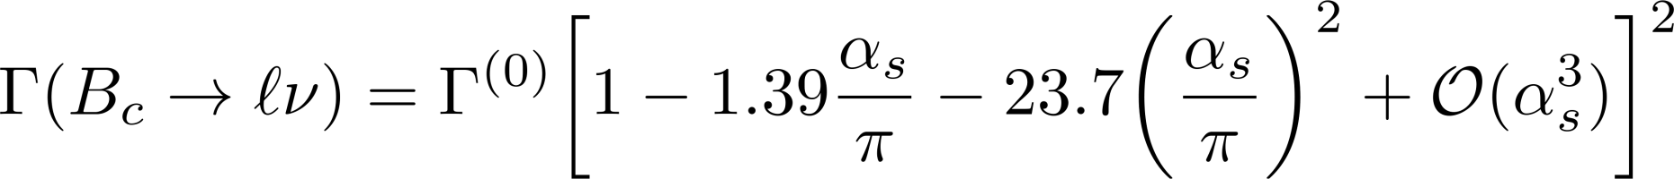
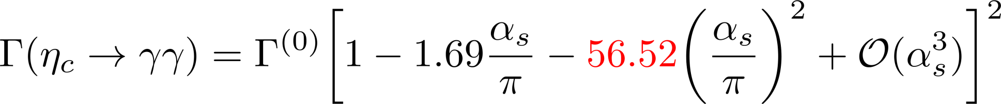
Perturbative convergence of these decay processes appears to be rather poor
So calculating the higher order QCD correction is imperative to test the usefulness of NRQCD factorization!

Slide 10
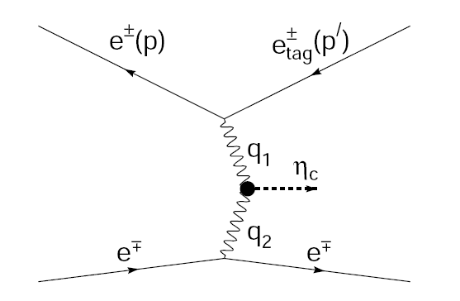
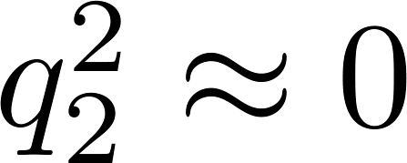
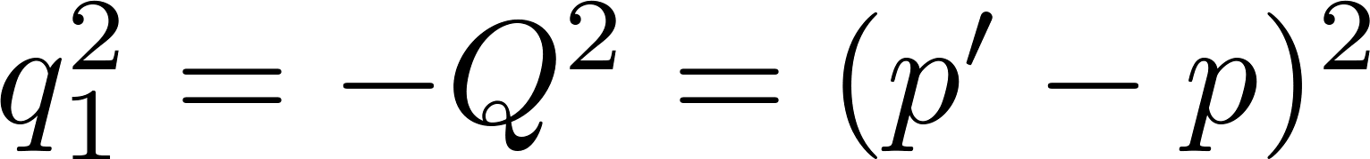
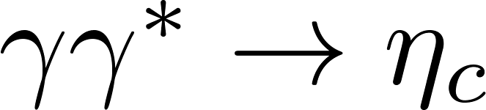
Investigation on γγ* → η_{c} form factor
Experiment
BaBar Collaboration: Phys.Rev. D81 (2010) 052010
Babar measures the transition form factor in the momentum transfer range from 2 to 50 GeV².

Slide 11
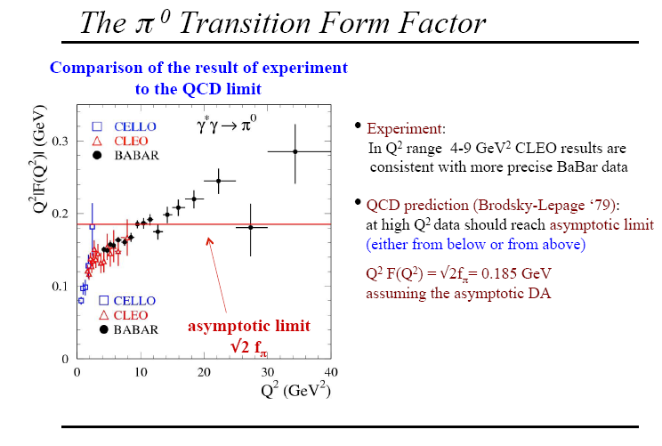
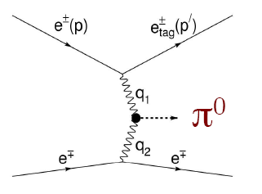
Digression: recall the surprise brought by BaBar two-photon experiment on γγ* → π⁰

Slide 12
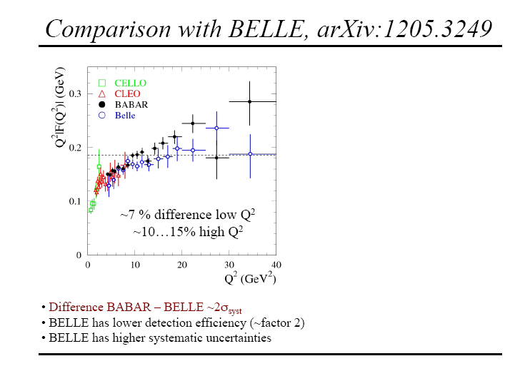
Belle did not confirm BaBar measurement on γγ* → π⁰ ! Situation needs clarification

Slide 13
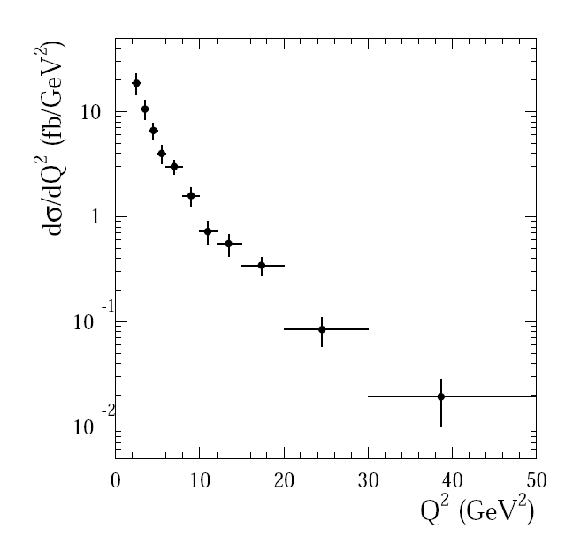
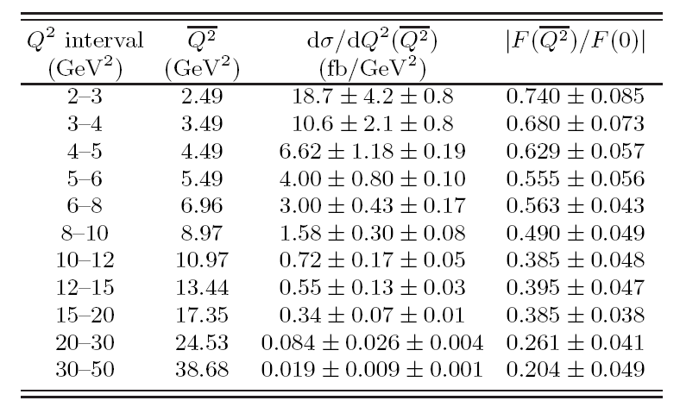
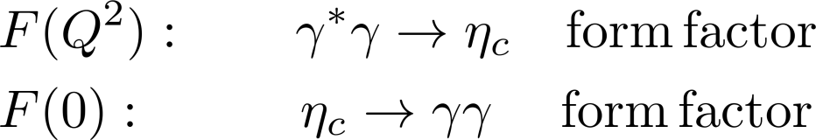

Investigation on γγ* → η_{c} form factor:
There also exists BaBar measurements!
BaBar Collaboration: Phys.Rev. D81 (2010) 052010

Slide 14
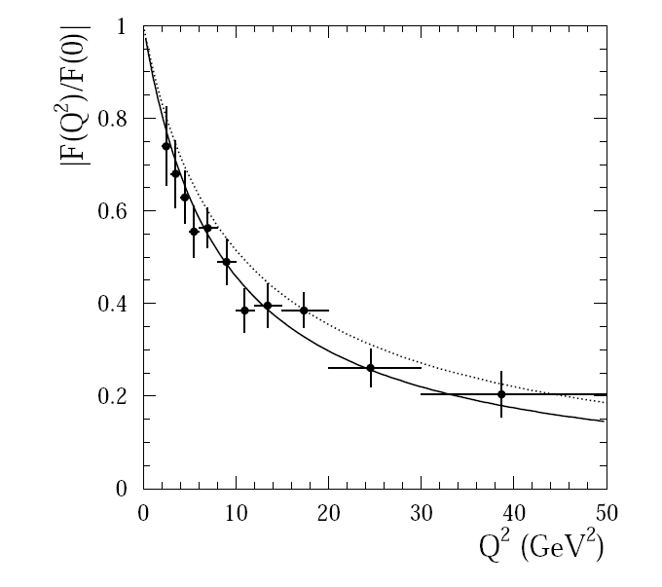
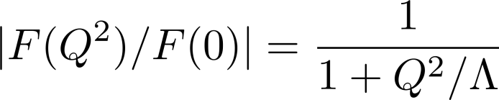
Investigation on γγ* → η_{c} form factor
Experiment
BaBar Collaboration: Phys. Rev. D81 (2010) 052010
The solid curve is from a simple monopole fit:
The dotted curve is from pQCD prediction
Feldmann and Kroll, Phys. Lett. B 413, 410 (1997)

Slide 15

Investigation on γγ* → η_{c} form factor
Previous investigation
factorization: Feldmann et.al., Cao and Huang
Lattice QCD: Dudek et.al.,
J/ψ -pole-dominance: Lees et.al.,
QCD sum rules: Lucha et.al.,
light-front quark model: Geng et.al.,
Dyson-Schwinger approach: Chang, Chen, Ding, Liu, Roberts, 2016
All yield predictions compatible with the data, at least in the small Q² range.
So far, so good. Unlike γγ* → π⁰ , there is no open puzzle here

Slide 16
Investigation on γγ* → η_{c} form factor
Motivation
Model-independent method is always welcome.
(NRQCD is the first principle approach from QCD)
In the normalized form factor, nonperturbative NRQCD matrix element cancels out. Therefore, our predictions are free from any freely adjustable parameters!
Is LO/NLO NRQCD prediction sufficient?
The momentum transfer is not large enough, we are not bothered by resumming the large collinear logarithms.

Slide 17
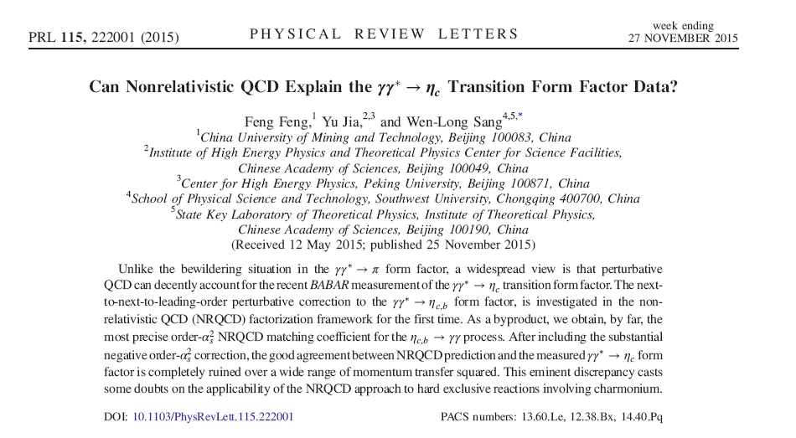
The first NNLO calculation for (exclusive) quarkonium production process
Feng, Jia, Sang, PRL 115, 222001 (2017)

Slide 18
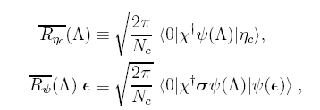
Investigation on γγ* → η_{c} form factor
Definition for form factor:
NRQCD factorization demands:
Factorization scale
Short-distance coefficient (SDC)
We are going to compute it to NNLO

Slide 19
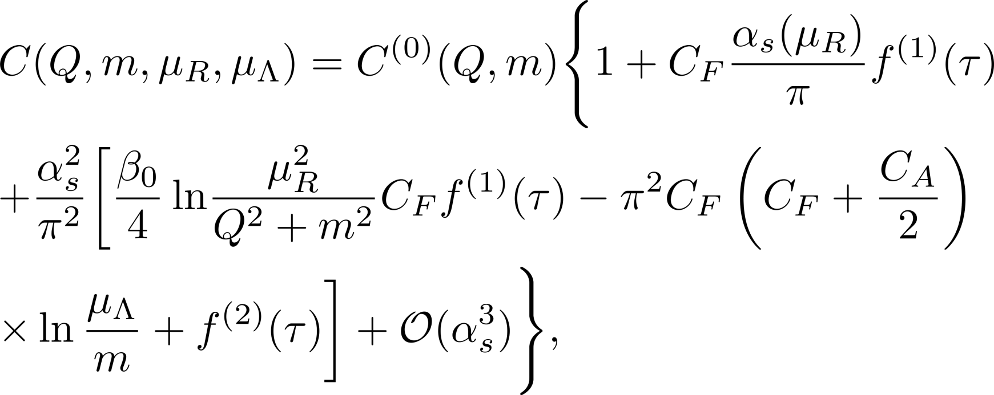
Investigation on γγ* → η_{c} form factor
Perturbative series for NRQCD SDCs
Upon general consideration, the SDC can be written as
IR pole matches anomalous dimension of NRQCD pseudo-scalar density
RG invariance

Slide 20
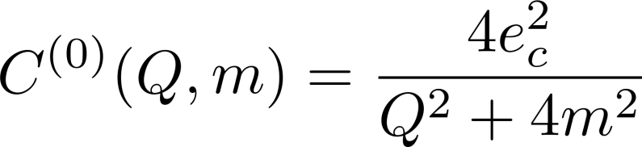
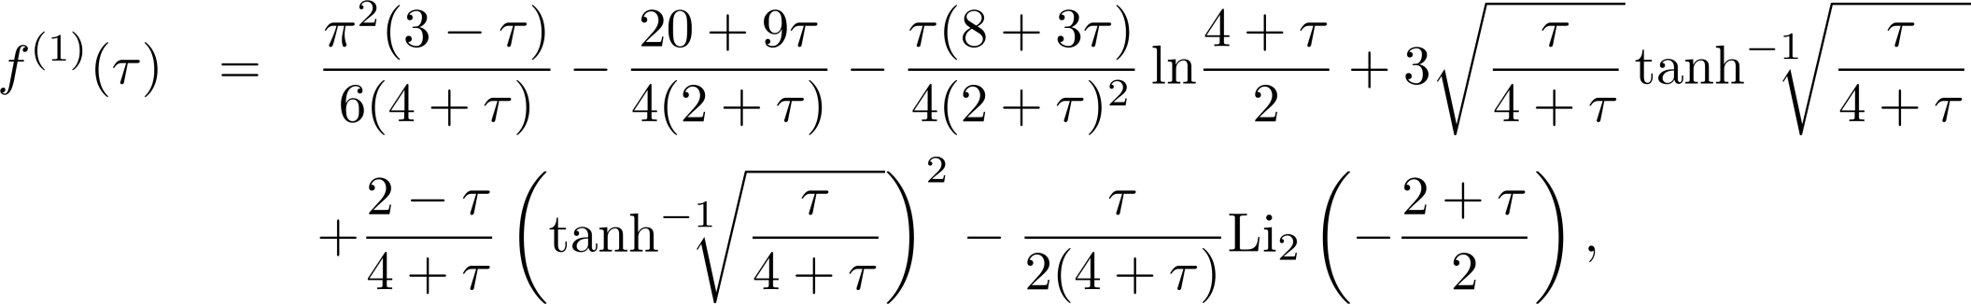
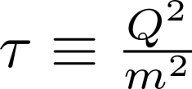
Investigation on γγ* → η_{c} form factor
Theoretical calculation
Tree-level SDC
NLO QCD correction

Slide 21
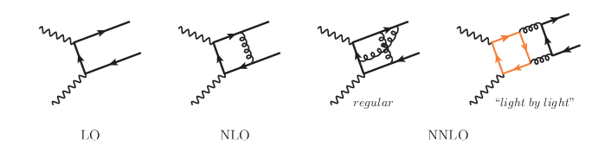
Investigation on γγ* → η_{c} form factor
Feynman diagrams
Numer of diagrams
2
8
108
12

Slide 22
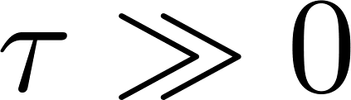

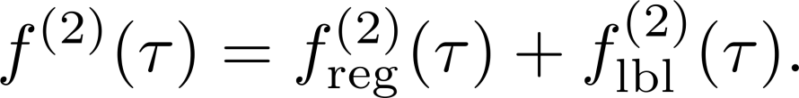

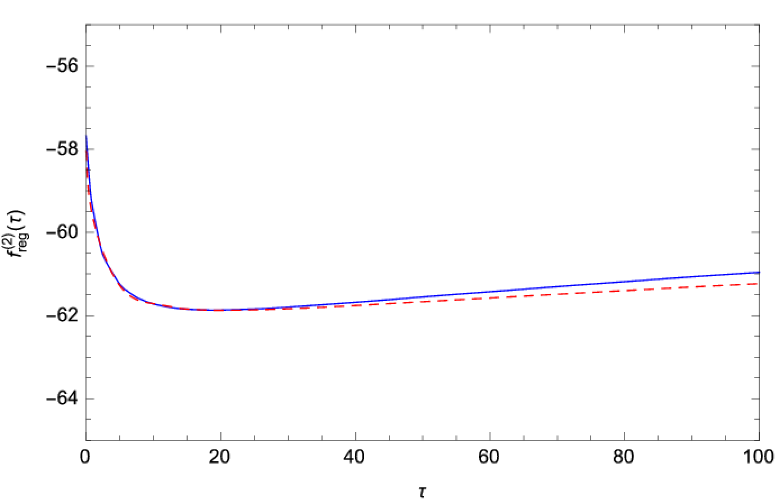
Investigation on γγ* → η_{c} form factor
NNLO corrections
At , the value of is compatible with asymptotic behavior Jia, solving ERBL equation by Yang, NPB 2009
regular
Light-by-light
UV/IR finite
Reproduce
known NNLO
corr. to ηc->γγ
Czarnecki et al. 2001

Slide 23
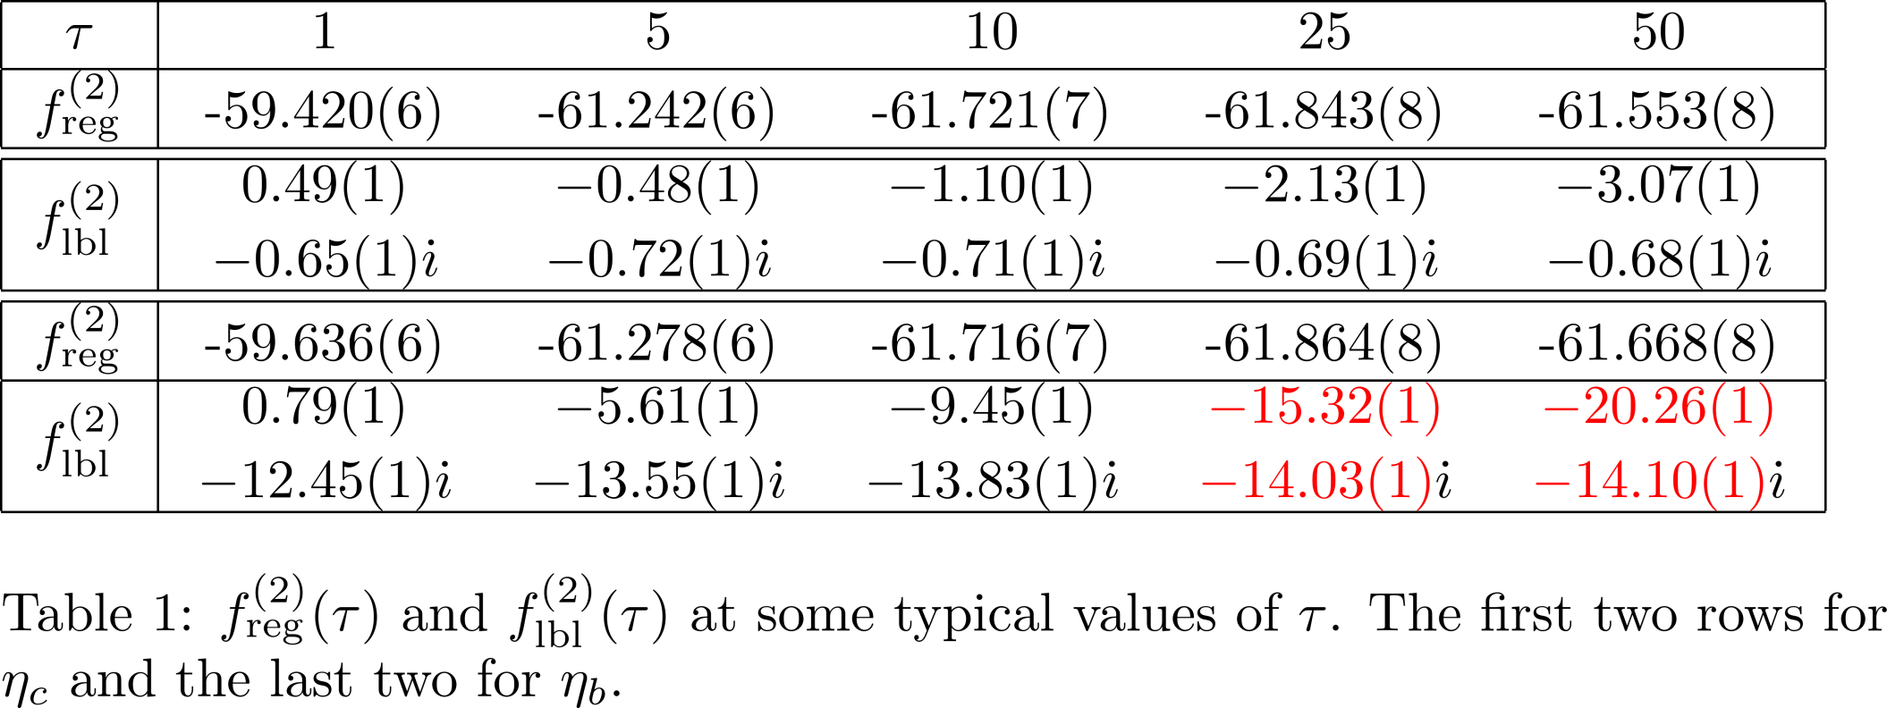
Investigation on γγ* → η_{c} form factor
NNLO corrections
Contribution from light-by-light is not always negligible!

Slide 24
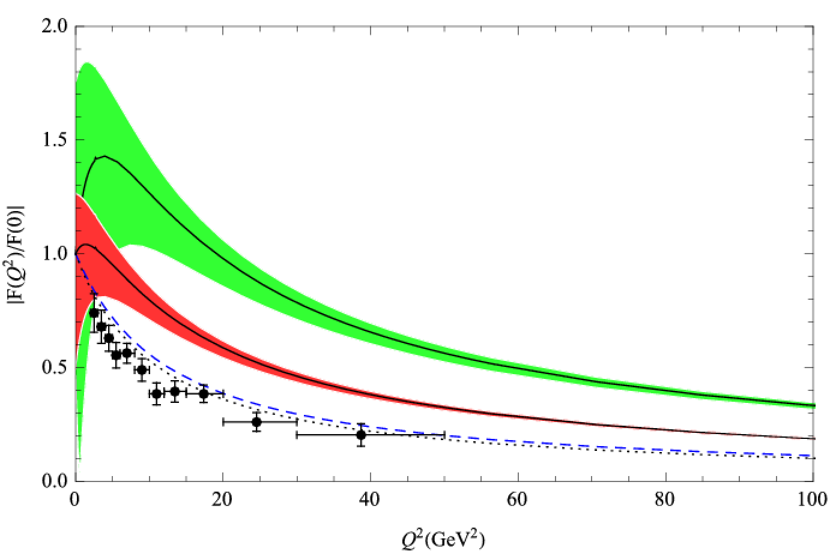
γγ* → η_{c} : NNLO predictions seriously fails to describe data!
Investigation on γγ* → η_{c} form factor
Theory vs Experiment
Our Prediction is free of nonperturbative parameters!

Slide 25
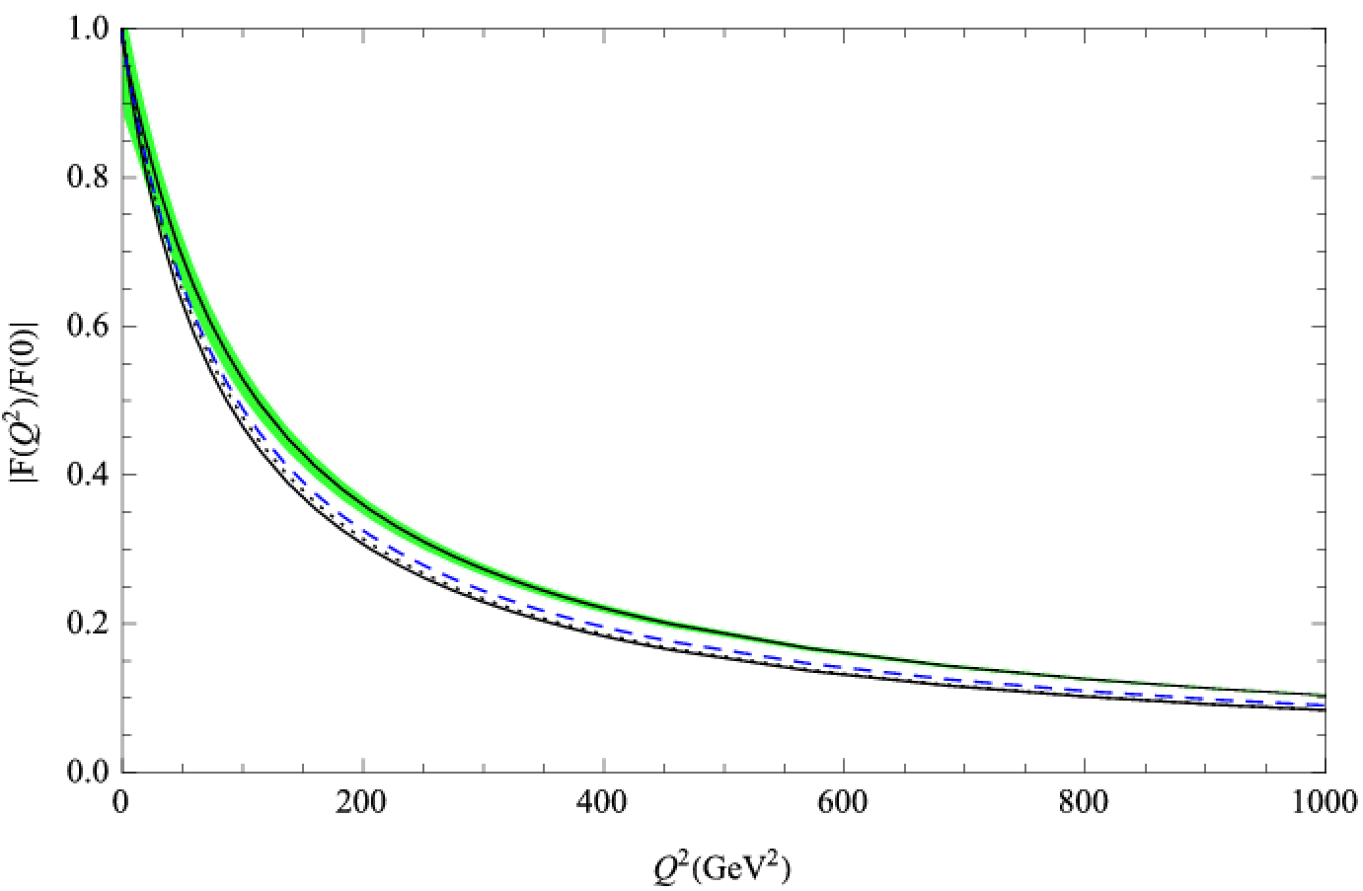
Prediction to γγ* → η_{b} form factor
Convergence of perturbation series is reasonably well.
Await CEPC/ILC to test our predictions?

Slide 26
As a by-product, we also have a complete NNLO prediction for η_{c} → 2γ (including “light-by-light” diagrams)
We can focus on form factor at Q² =0:

Slide 27
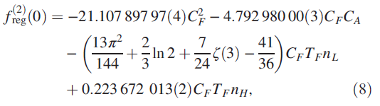
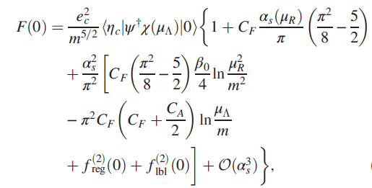
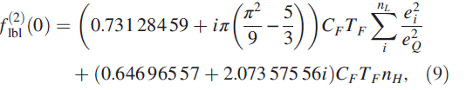

Updated NNLO predictions to η_{c}→ 2γ
NNLO correction was previously computed by Czarnecki and Melkinov (2001) (neglecting light-by-light);
Here we present a complete/highly precise NNLO predictions
Form factor at Q² =0:
NRQCD factorization
scale dependence
Г(η_{c} → 2γ) =

Slide 28
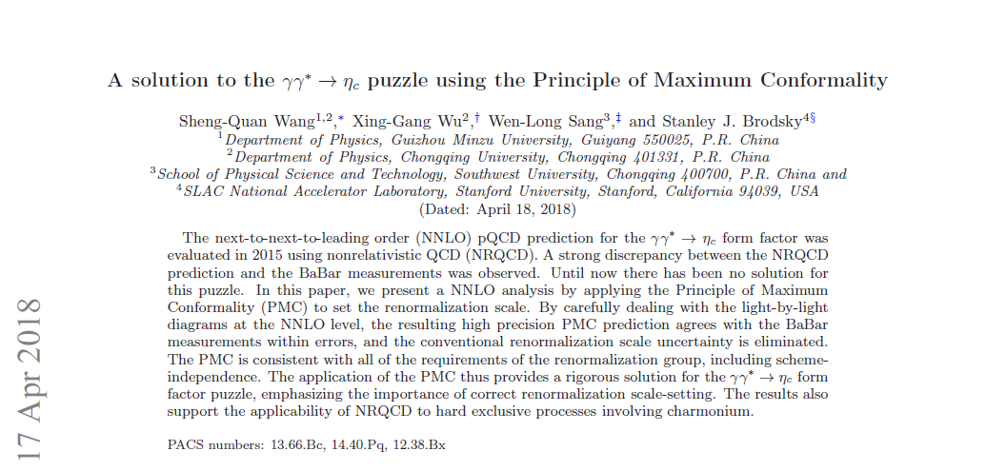
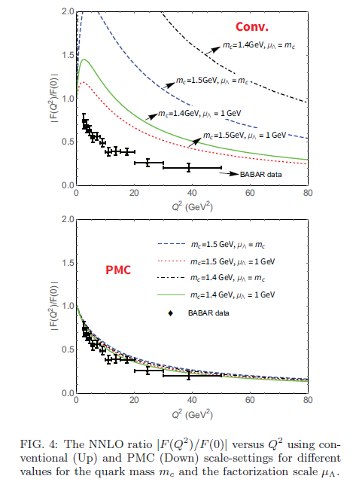
A recent paper by Wu, Brodsky et al. (1804.06106) claims that PMC+fixed NNLO can resolve this puzzle.

Slide 29
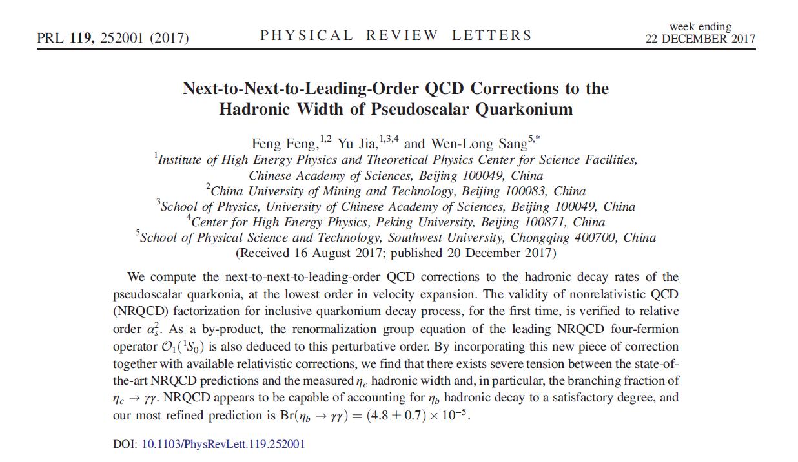
Complete NNLO correction to η_{c} → light hadrons
(first NNLO calculation for inclusive process involving quarkonium) Feng, Jia, Sang, PRL 119, 252001 (2017)
NLO perturbative corr. 1979/1980
40 years lapsed from NLO to NNLO;
Another ??? years to transition into NNNLO QCD corrections?
Promising only if Alpha-Loop takes over?

Slide 30
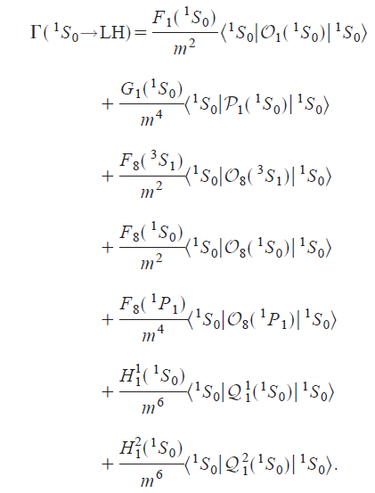
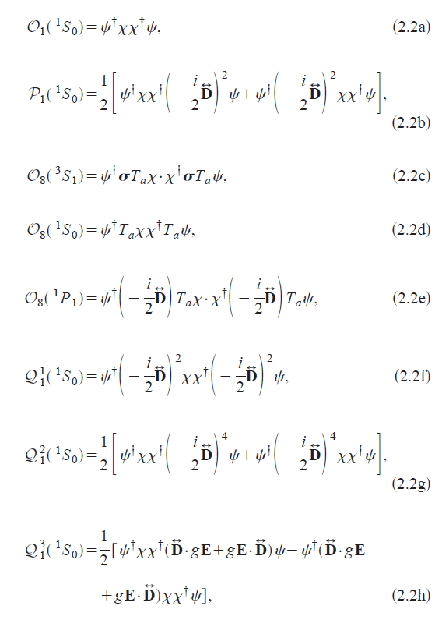
NRQCD factorization for η_{c} → light hadrons – up to relative order-v⁴ corrections
Bodwin, Petrelli PRD (2002)

Slide 31
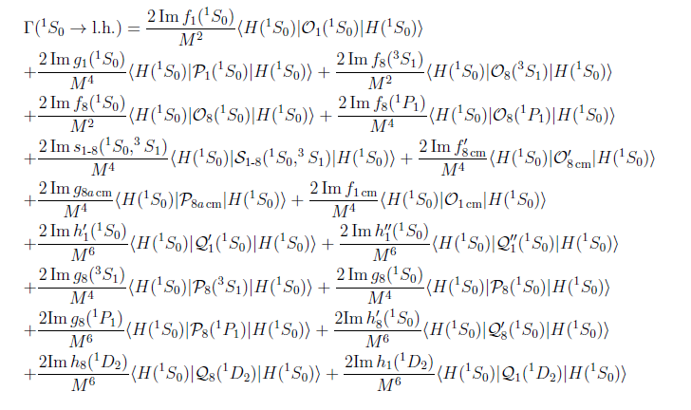

NRQCD factorization for η_{c} → light hadrons – up to relative order-v⁴ corrections
Brambilla, Mereghetti, Vairo, 0810.2259
Notice the explosion of number of higher-dimensional operators!

Slide 32

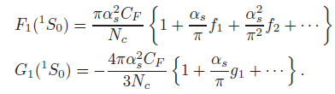
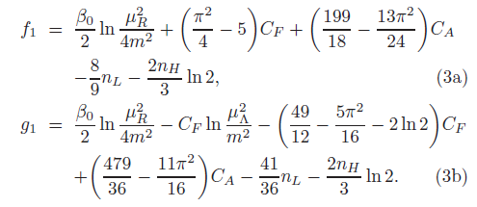
NRQCD factorization for η_{c} → light hadrons – Current status of radiative corrections
To warrant predictive power,
we only retain terms through
relative order-v²
W.Y.Keung, I. Muzinich, 1983
Barbieri et al., 1979
Hagiwara et al., 1980
Guo,Ma,Chao, 2011

Slide 33
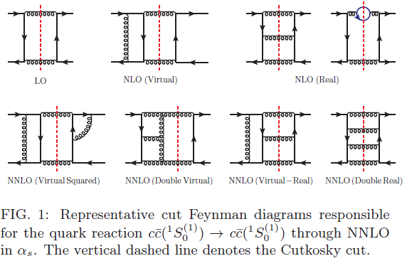
Our calculation of short-distance coefficient utilizes Method of Region (Beneke and Smirnov 1998) to directly extract the hard region contribution from multi-loop diagrams
Roughly 1700 3-loop forward-scattering diagrams, divided into 4 distinct cut topologies; Cutkosky rule is imposed

Slide 34

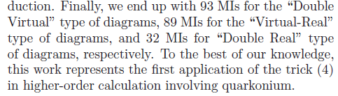
Employ a well-known trick to deal with phase-space type integrals
Key technique: using IBP to deal with phase-space integral

Slide 35
The nontrivial aspects of the calculation
Encounter some rather time-consuming MIs using sector decomposition method (Fiesta)
Roughly speaking, 10⁵ CPU core hour is expensed; Run numerical integration at the GuangZhou Tianhe Supercomputer Center/China Grid.
Explicitly verify the cancellation of IR poles among the 4 types of cut diagrams. Starting from the 1/ε⁴ poles，observe the exquisite cancelation until 1/ε

Slide 36
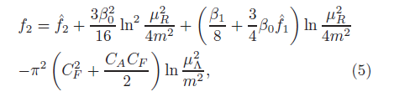
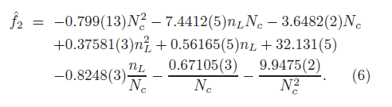
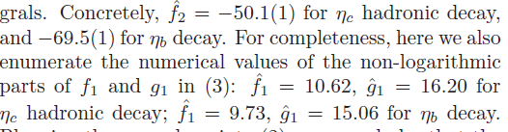
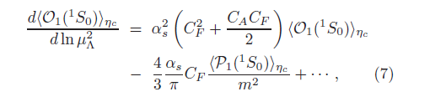
Our key results
NNLO SDC
Same IR divergence as η_{c} → 2γ!
Validate the NRQCD factorization for S-wave onium inclusive decay at NNLO!
We also obtain the following RGE for the leading 4-fermion NRQCD operator:

Slide 37
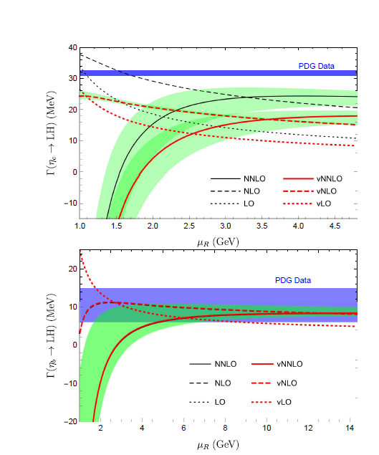

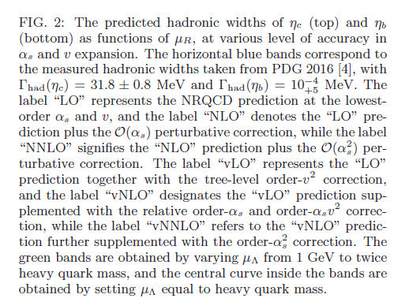
Phenomenological study: hadronic width
Input parameters:
PDG values:

Slide 38



Phenomenological study of Br(η_{c,b} → γγ),
Non-Perturbative matrix elements cancel out
For η_{c} more than 10σ discrepancy！
To date most refined prediction
for η_{b} → γγ

Slide 39
Summary
Investigated NNLO QCD corrections to γγ* → η_{c} ， (χ_{c0,2}→ 2γ)，η_{c} → LH。Observe significant NNLO corrections. Alarming discrepancy with the existing measurements.
Perturbative expansion seems to have poor convergence behavior for charmonium
Perturbative expansion bears much better behavior for bottomonium

Slide 40
Personal biased perspectives
Maybe Nature is just not so mercy to us:
The charm quark is simply not heavy enough to warrant the reliable application of NRQCD to charmonium, just like one cannot fully trust HQET to cope with charmed hadron
Symptom: mc is not much greater than Λ_{QCD}
Bigger value of α_{s} at charm mass scale
But we should still trust NRQCD to be capable of rendering qualitatively correct phenomenology for charmonium
We may need be less ambitious for soliciting precision predictions

Slide 41

Digression: graviton search in quarkonium decay at BESIII experiments
Gravitational wave was finally seen by LIGO in 2015, after 100 years birth of General Relativity by Einstein
Recall, miraculously, both classical EW wave and photo-electric effect
were discovered by Hertz in 1887
Unfortunately, searching for quantum graviton looks hopeless

Slide 42





General Relativity (GR) should be regarded as the low-energy EFT of quantum gravity (Donoghue 1994)
Einsein-Hilbert action
Weak field expansion:

Slide 43


Combining GR+NRQCD to account for quarkonium decay J/Ψ → γ+G Bai, Chen, Jia, 2017
LO
Including
NLO QCD
correction
It is fun that all nature’s four forces are united in those diagrams!

Slide 44


Predicted partial widths
Massless graviton: LO prediction accidently vanishes!
Have to proceed to the NLO in α_{s} and v:
Massive graviton: nonzero prediction at LO in v at tree level
Manifestation of famous vDVZ discontinuity: helicity zero graviton doesn’t decouple in the M_{G}->0 limit

Slide 45


Numerical values
This decay is a golden channel to discriminate whether
Graviton mass is strictly zero or not!
Not too much suppressed relative to μ→ e γ, with BR ~ 10⁻³⁴
Practically speaking, these channels are much rarer than
the dominant SM background J/Ψ → γ ν ν, with BR ~ 10⁻¹⁰

Slide 46
Thanks for your attention!

