Slide 1

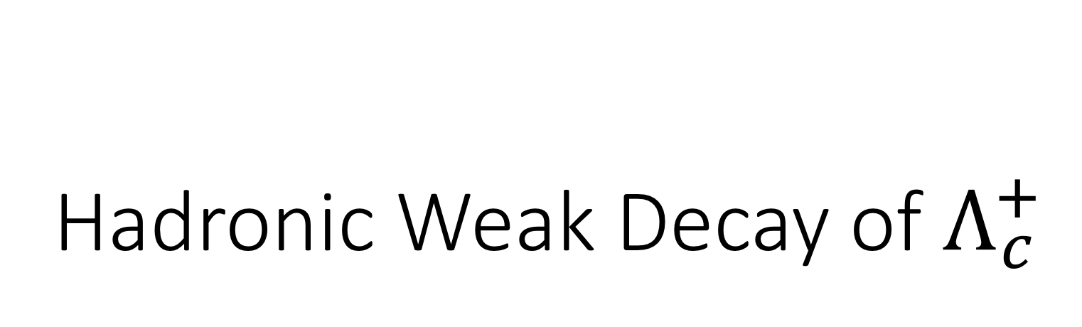
Hadronic Weak Decay of $Λ_{c}^{+}$
中国物理学会高能分会第十次全国会员代表大会暨学术年会
CHEP-10
徐繁荣
暨南大学
上海交通大学 李政道研究所
2018 年 6月22日

Slide 2
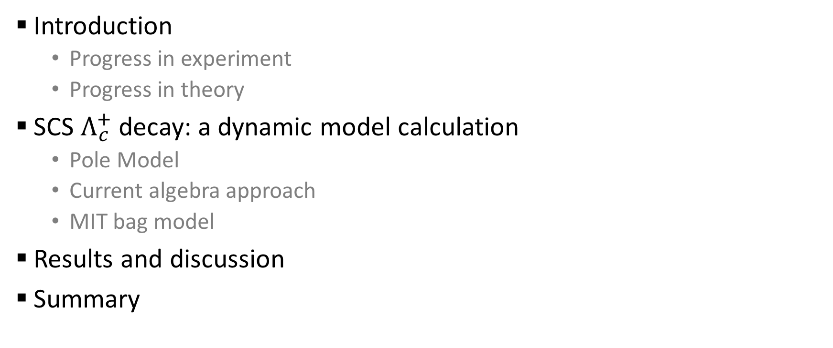
Outline
Introduction
  Progress in experiment
  Progress in theory
SCS $Λ_{c}^{+}$ decay: a dynamic model calculation
  Pole Model
  Current algebra approach
  MIT bag model
Results and discussion
Summary
Based on Hai-Yang Cheng, Xian-Wei Kang, FRX, PRD 97, 074028 (2018)

Slide 3
Introduction

Slide 4
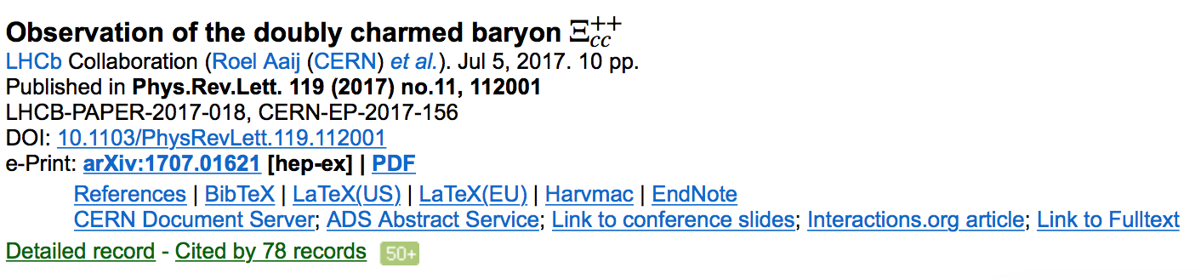
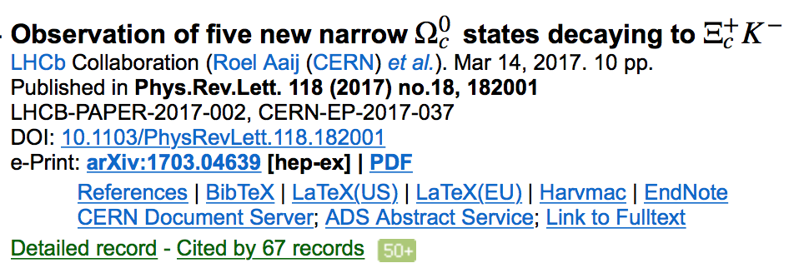
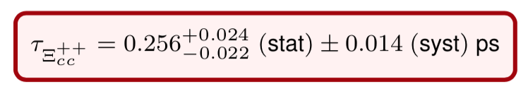
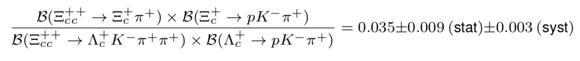

Introduction
Charmed baryon becomes red
  2017: $Ξ_{cc}^{++}$ discovered， five excited $Ω_{c}^{0}$ states discovered
  2018: $Ξ_{cc}^{++}$ lifetime measured, $Ξ_{cc}^{++}→Ξ_{c}^{+}π^{+}$measured
    LHCb-PAPER-2018-019, -026
--Liang Sun’s talk
--Fu-Sheng Yu’s talk

Slide 5
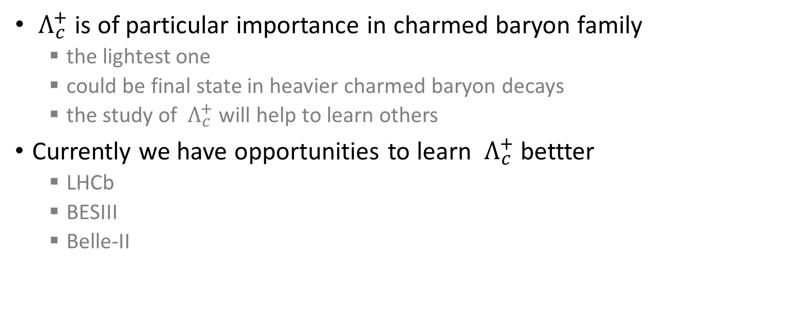
${ Λ}_{c}^{+}$ is of particular importance in charmed baryon family
  the lightest one
  could be final state in heavier charmed baryon decays
  the study of ${ Λ}_{c}^{+}$ will help to learn others
Currently we have opportunities to learn ${ Λ}_{c}^{+}$ bettter
  LHCb
  BESIII
  Belle-II
--Pei-Rong Li’s talk

Slide 6
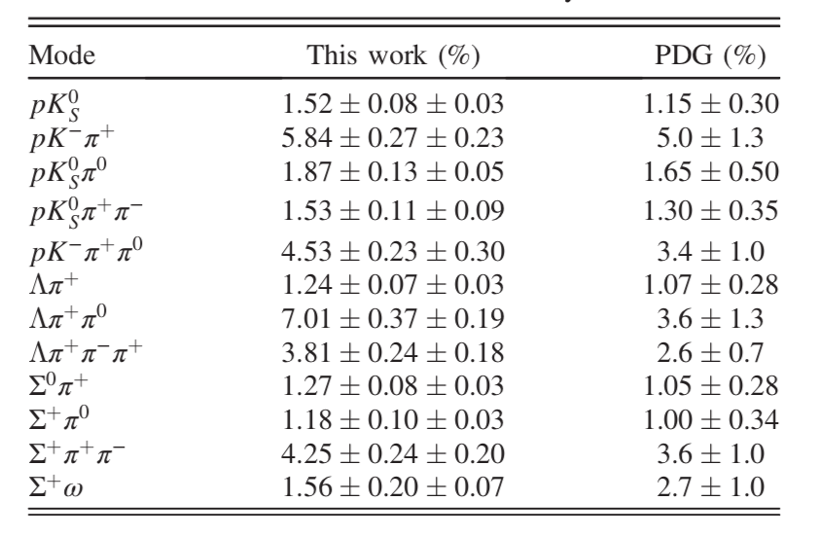
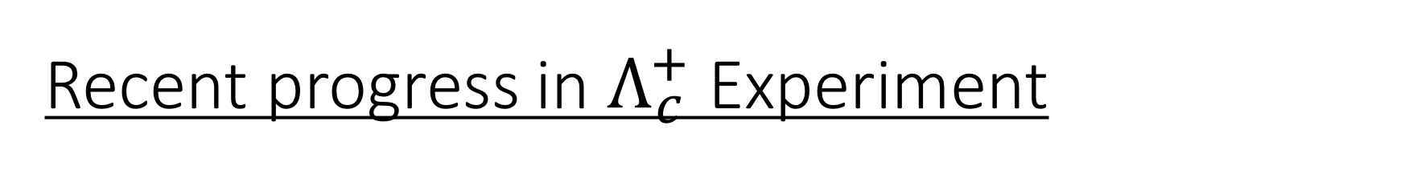


Recent progress in $Λ_{c}^{+}$ Experiment
$ℬ(Λ_{c}^{+}→pK^{−}π^{+}$)
  ARGUS + CLEO :$(5.0±1.3)\%$
  Belle: $(6.84±{0.24}_{−0.27}^{+0.21})\%$
  BESIII: $(5.84±0.27±0.23)\%$
12 modes measured by BESIII
PDG 2014
Belle, PRL 113 （2014), 042002
BESIII, PRL 116（2016）, 052001
  PDG 2016: $(6.35±0.33)\%$
PDG values for $Λ_{c}^{+}$ decay BFs before 2016 version become obsolete
Notes:
model dependence
model independence

Slide 7

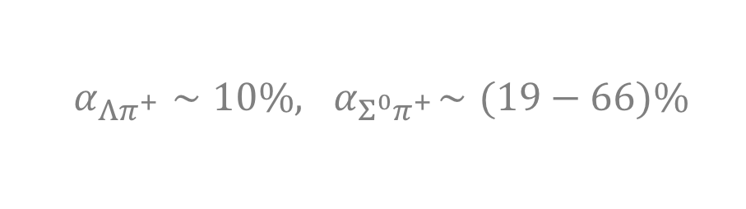
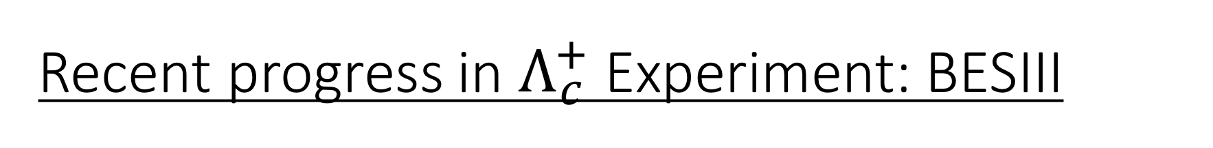
Recent progress in $Λ_{c}^{+}$ Experiment: BESIII
Singly-Cabbibo-suppressed decay has been measured
Neutral mode can be measured
The sensitivity of decay asymmetry will be improved
BESIII, PRD 95（2017), 111102
BESIII, PRL 118（2016), 112001
  $$α_{Λπ^{+}}∼10\%,{ α}_{Σ^{0}π^{+}}∼(19−66)\%$$
D. Wang, R.-G. Ping, L. Li, X.-R. Lyu, Y.-H. Zheng , Chin. Phys. C 41 (2017) 023106

Slide 8
Hadronic weak decay theory
Diagrammatic scheme (Chau, Cheng, Tseng; Kohara)
Two distinct internal W emission diagrams, three different W exchange diagrams
Need information of decay asymmetry to extract s-wave and p-wave amplitudes separately

Slide 9
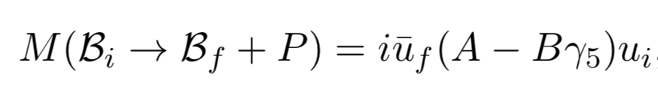
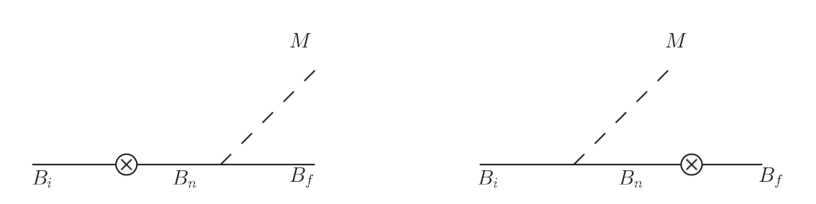
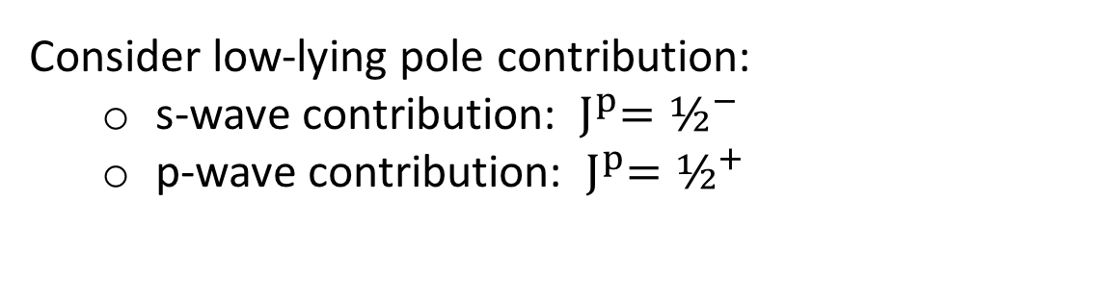
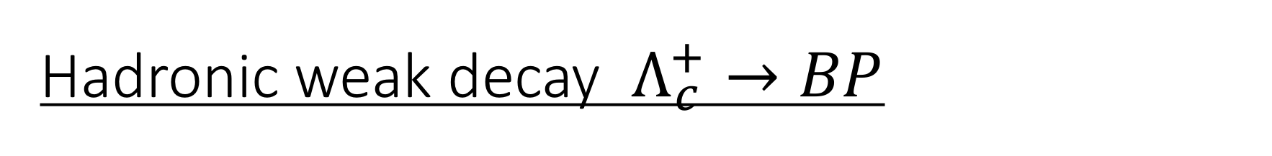
Hadronic weak decay $Λ_{c}^{+}→BP$
Dynamic model calculation
  Pole model
  Relativistic QM: Korner, Kramer, Ivanov…
Consider low-lying pole contribution:
  s-wave contribution: ${ J}^{p}=½^{−}$
  p-wave contribution: ${{ J}^{p}=½}^{+}$

Slide 10
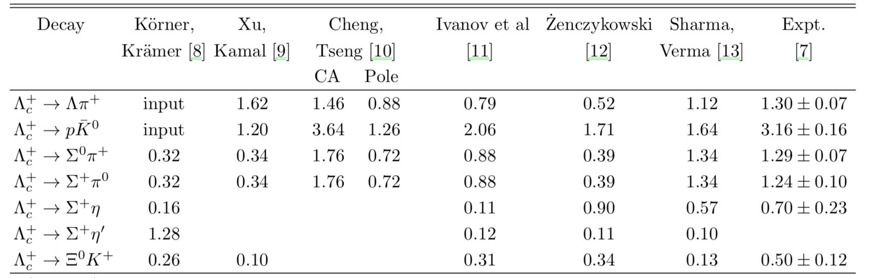
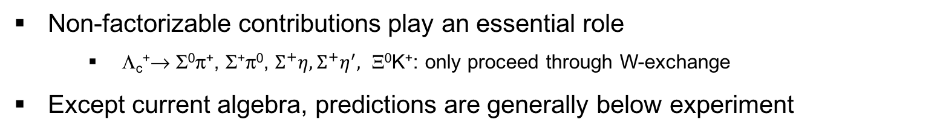
BF of Cabbibo-favored decays in 1990s
RQM Pole Pole RQM Pole C.A.
Non-factorizable contributions play an essential role
  Λ_{c}⁺→ Σ⁰π⁺, Σ⁺π⁰, $Σ^{+}η, Σ^{+}η^{′},$ Ξ⁰K⁺: only proceed through W-exchange
Except current algebra, predictions are generally below experiment

Slide 11
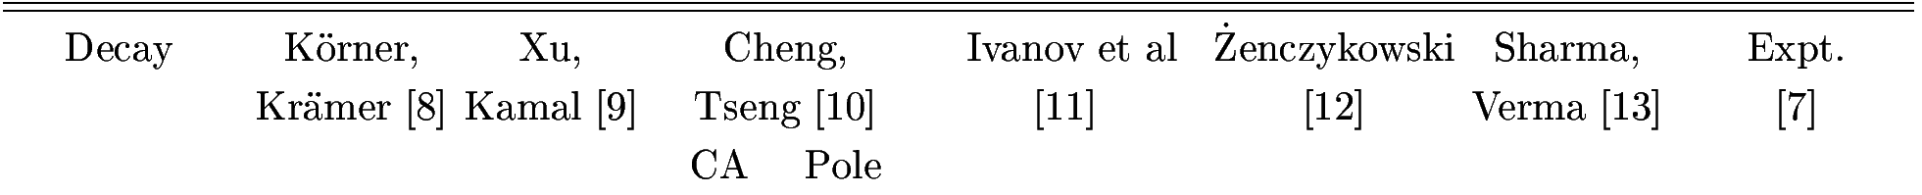

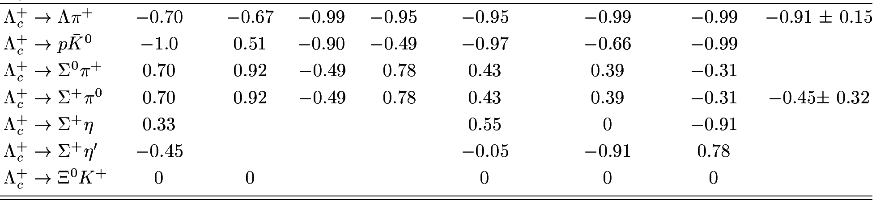
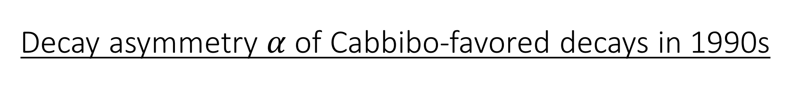
Decay asymmetry $α$ of Cabbibo-favored decays in 1990s
RQM Pole Pole RQM Pole C.A.
Λ_{c}⁺→ Σ⁺π⁰:
  CLEO (’95) measured α = -0.45±0.31±0.06
  Pole model & RQM predict positive α
  Current algebra leads to negative α
    -0.49 by H.-Y. Cheng et al.,
    -0.76 by Zenczykowski (hep-ph/9309265),
    -0.47 by Datta (hep-ph/9504428),
    -0.31 by Sharma et al.
Λ_{c}⁺→ Ξ⁰ K⁺
  theory: small s-wave ⇒ α = 0
  experiment ?

Slide 12
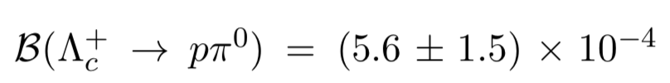
Some recent progress in theory
SU(3) approach gives useful guidance
  C.D. Lu, W. Wang, F.-S. Yu, PRD 93 (2016), 056008
  Geng, Hsiao, Liu, Tsai, JHEP 1711, 147 (2017)
Some aspects need to be more careful
Calling for a dynamical calculation for SCS process!!
SU(3)
How about decay asymmetry?
BESIII:

Slide 13
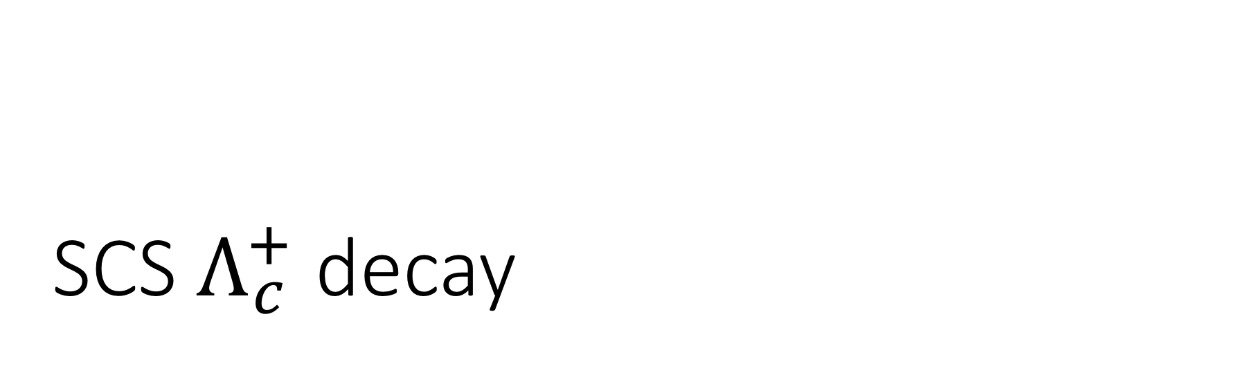
SCS $Λ_{c}^{+}$ decay
A dynamical model calculation

Slide 14
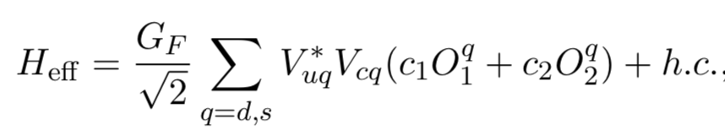
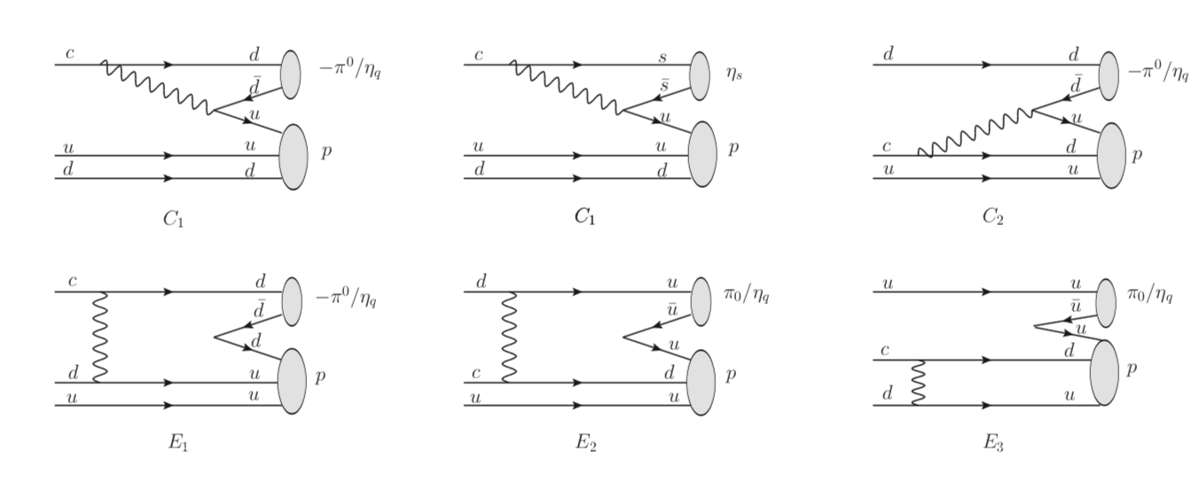
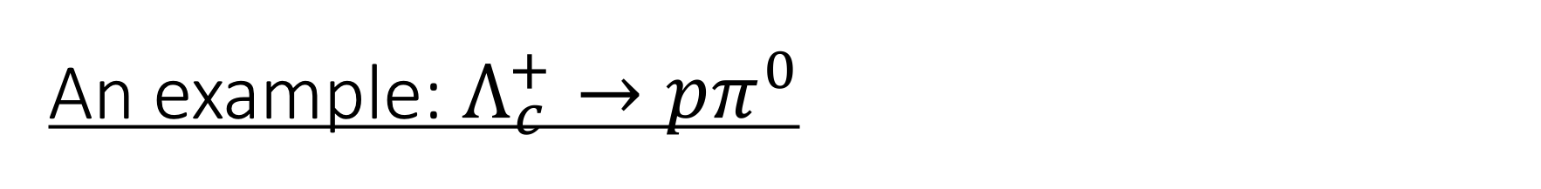
An example: $Λ_{c}^{+}→pπ^{0}$
internal W emission 1
internal W emission 2
W-exchange

Slide 15
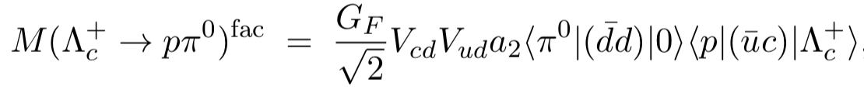
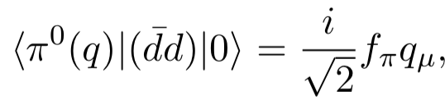
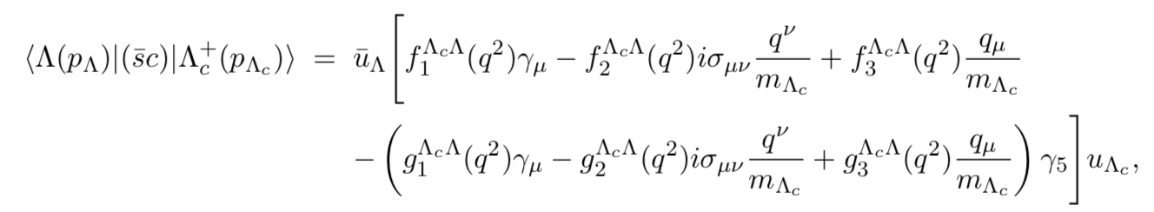

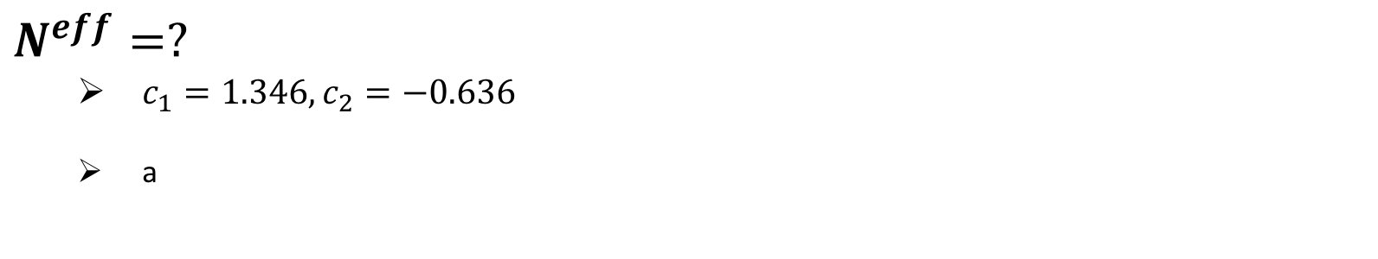

Factorizable contribution
$$a_{2}=c_{2}+c_{1}/N^{eff}$$
$$N^{eff}=?$$
  $c_{1}=1.346, c_{2}=−0.636$
  a
$${|a}_{2}|=0.45±0.03, N^{eff}=7$$
internal W-emission governed
BESIII, PRD 95（2017), 111102

Slide 16
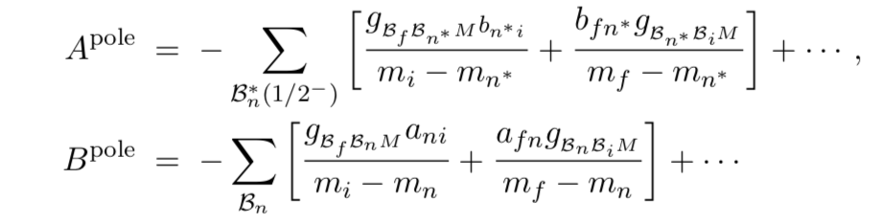
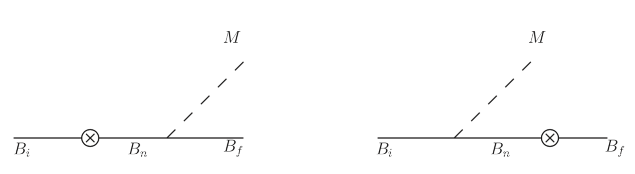
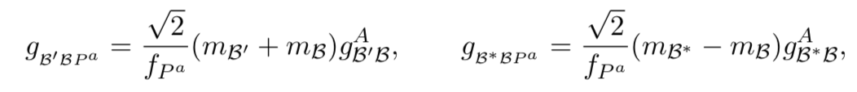
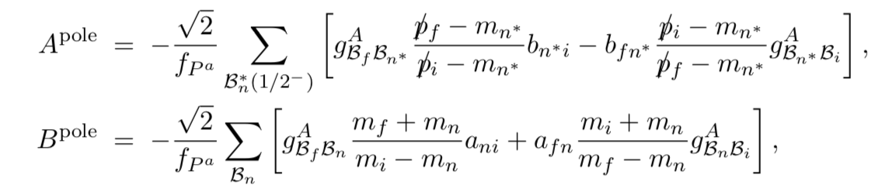
Non-factorizable contribution: Pole model
GT relation

Slide 17
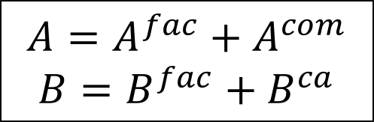
Current Algebra Approach
soft pseudoscalar-meson limit
s-wave, p-wave amplitudes
$$A={A^{fac}+A}^{com}$$
$$B=B^{fac}+B^{ca}$$

Slide 18
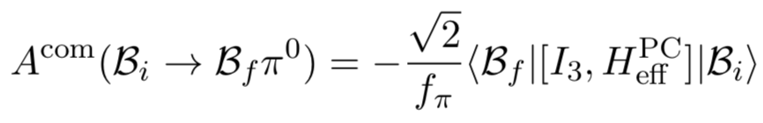
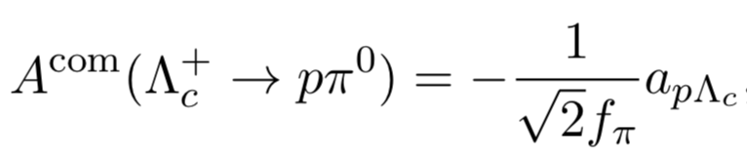

s-wave, p-wave contribution
Calculation of commutator

Slide 19
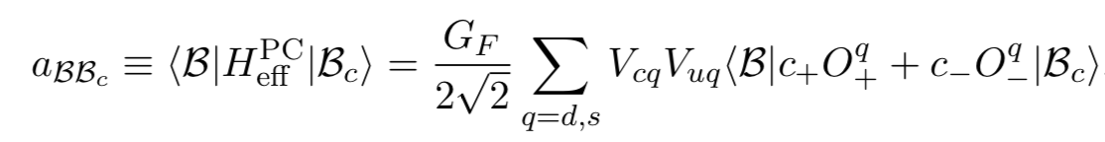
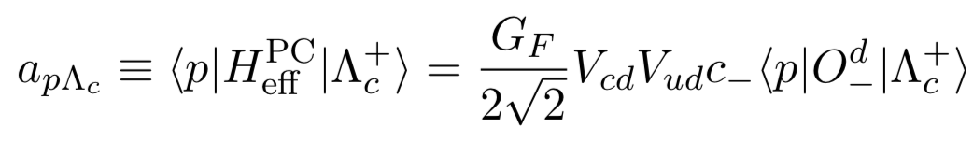

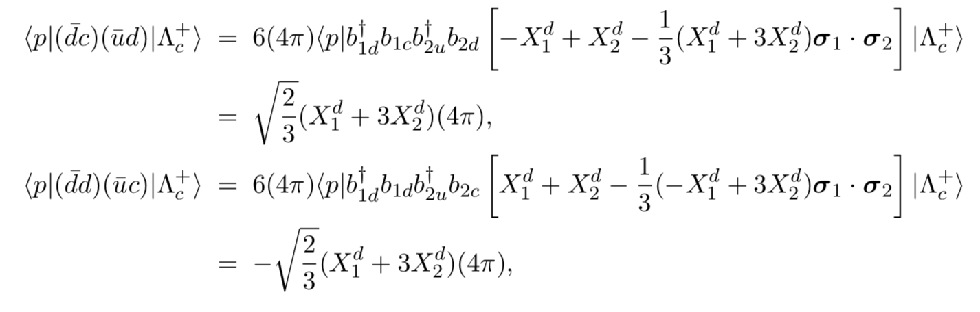
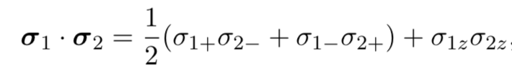
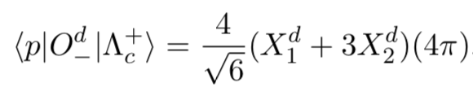
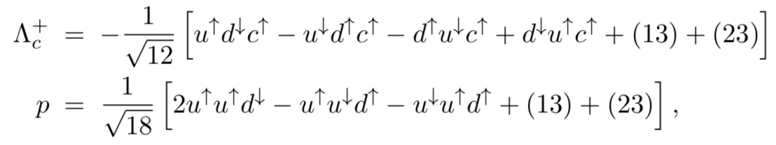
Baryon Matrix element:
MIT bag model calculation

Slide 20
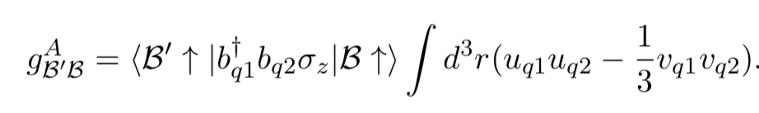
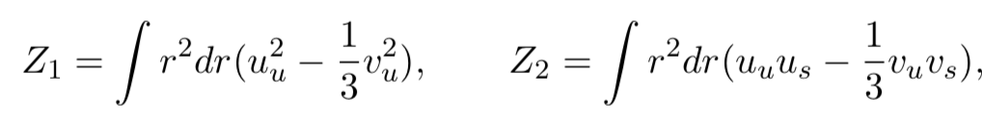
Strong coupling:
MIT bag model calculation
axial-vector form factor
GT relation

Slide 21
Results and Discussion

Slide 22
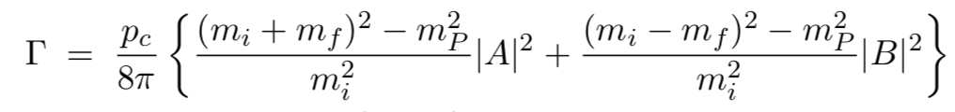
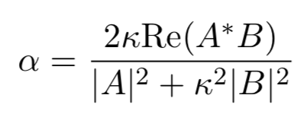
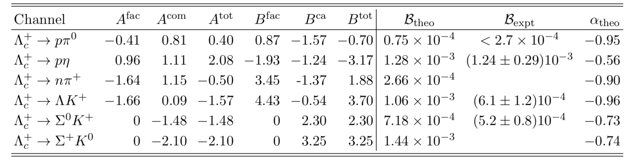
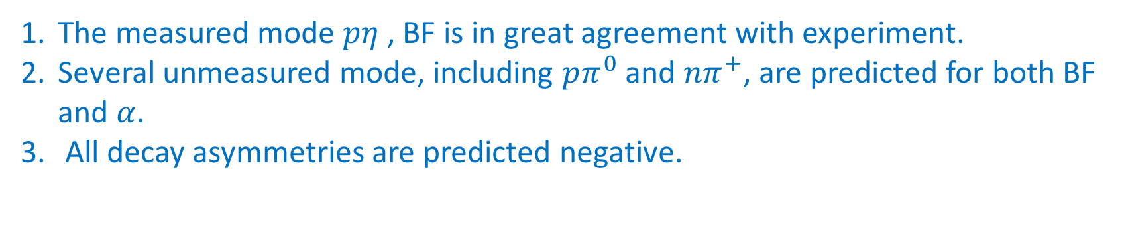
Numerical results
The measured mode $pη$ , BF is in great agreement with experiment.
Several unmeasured mode, including $pπ^{0}$ and ${nπ}^{+}$, are predicted for both BF and $α$.
All decay asymmetries are predicted negative.

Slide 23

Comparison of BF with different groups
(10⁻³ )
SU(3) QM Fac. SU(3) SU(3) C.A.

Slide 24




$$Λ_{c}^{+}→pπ^{0}, nπ^{+}$$
SU(3) approach: assumption of sextet 6 ($O_{−}$) dominance over 15 ($O_{+}$)
$pπ^{0}$ exceeds experiment limit!
⇒ $Γ\left(Λ_{c}^{+}→nπ^{+}\right)=2Γ(Λ_{c}^{+}→pπ^{0})$
Such relation is not hold for factorizable amplitude (consider both $O_{−}$ and $O_{+}$ contribution)

Slide 25


$$Λ_{c}^{+}→pπ^{0}, pη$$
The reason for $B\left(pη\right)>B(pπ^{0})$
Nonfactorizable terms contribute
constructively to $pη$
destructively to $pπ^{0}$

Slide 26

Summary
$Λ_{c}^{+}$ SCS decays have been calculated in a dynamic model.
$pη$ finds in great agreement with experiment.
$pπ^{0} , nπ^{+}$ and some other modes have been predicted;
$pπ^{0}$ satisfies current BESIII experiment limit.
All decay asymmetries are calculated to be negative, testable by BESIII.
Especially, BESIII has the capability to confirm the prediction of $pπ^{0} , nπ^{+}$ soon.

Slide 27

To be continued
$Λ_{c}^{+}→BV$ needs to be developed.
The correction to soft pseudoscalar meson limit requires a more general pole model calculation.
Updated calculation in a more reasonable quark model, instead of MIT bag model, is expected.
Probably CP asymmetries will be analyzed in the future.

Slide 28
Backup

Slide 29

Comparison of decay asymmetries

