Slide 1
Electronics and DAQ for PandaX-4T
XiangXiang Ren, Qibin Zheng, Xun Chen, Yong Yang
ShangHai Jiao Tong University
06/22/2018

Slide 2
PandaX-I&II Hardware, Trigger and Control System
2016 JINST 11 T04002, arXiv: 1602.00858
2017 JINST 12 T08004, arXiv: 1707.02134

Slide 3
PandaX-I&II Software Readout System

Slide 4
PandaX Read-out and Triggers
PandaX DM experiments | Number of channels | Maximum drift time (us) | Digitizer | S2-threholds (PE) | Read-out mechanism | Trigger
PandaX-I | 183 | ~90 | V1724 (8ch) | 100 | Single optical link and server | External global
PandaX-II | 158 | ~350 | V1724 (8ch) | 50 | Single optical link and server | External Global
PandaX-4T | 512 | ~700 | V1725B (16ch) | ? | Multiple links and servers | Triggerless and external global
Benefits of low-threshold DAQ:
  Light-mediator DM models
  S2-only analysis
  very low-energy calibration
  High-rate calibration

Slide 5
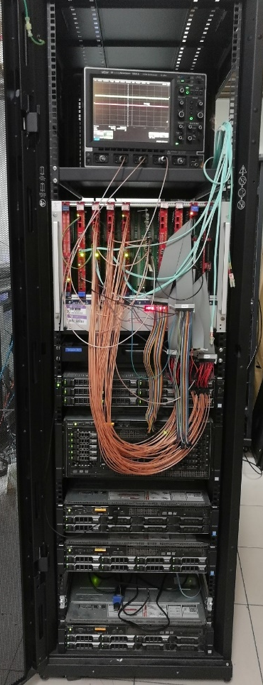
PandaX-4T Electronics and DAQ System
Small system
in the Lab

Slide 6
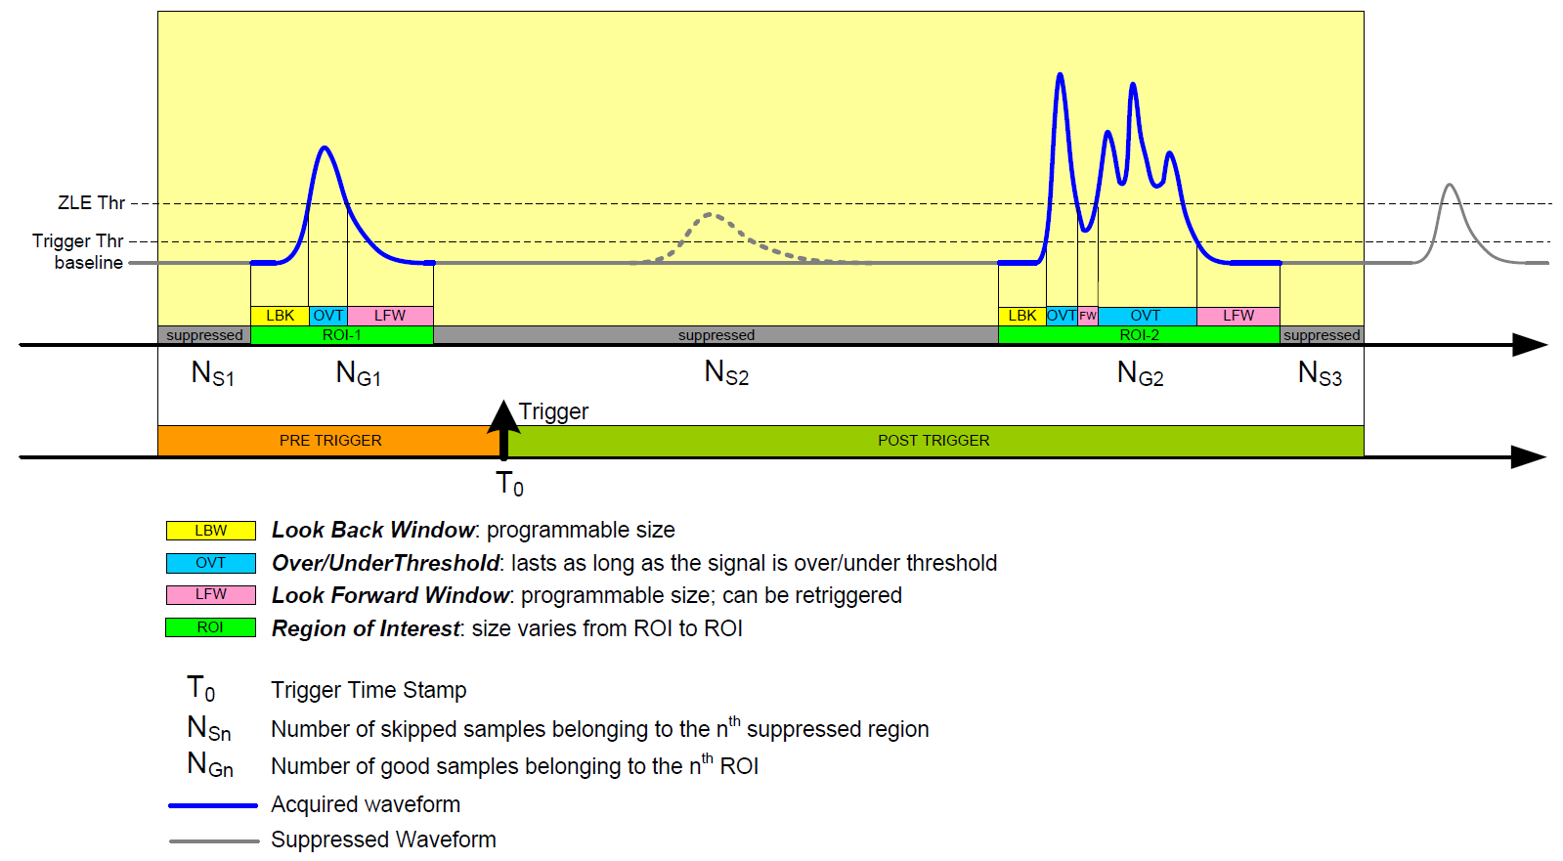
PandaX-4T Global Trigger with ZLE Mode
ZLE: Zero-Length-Encoding

Slide 7
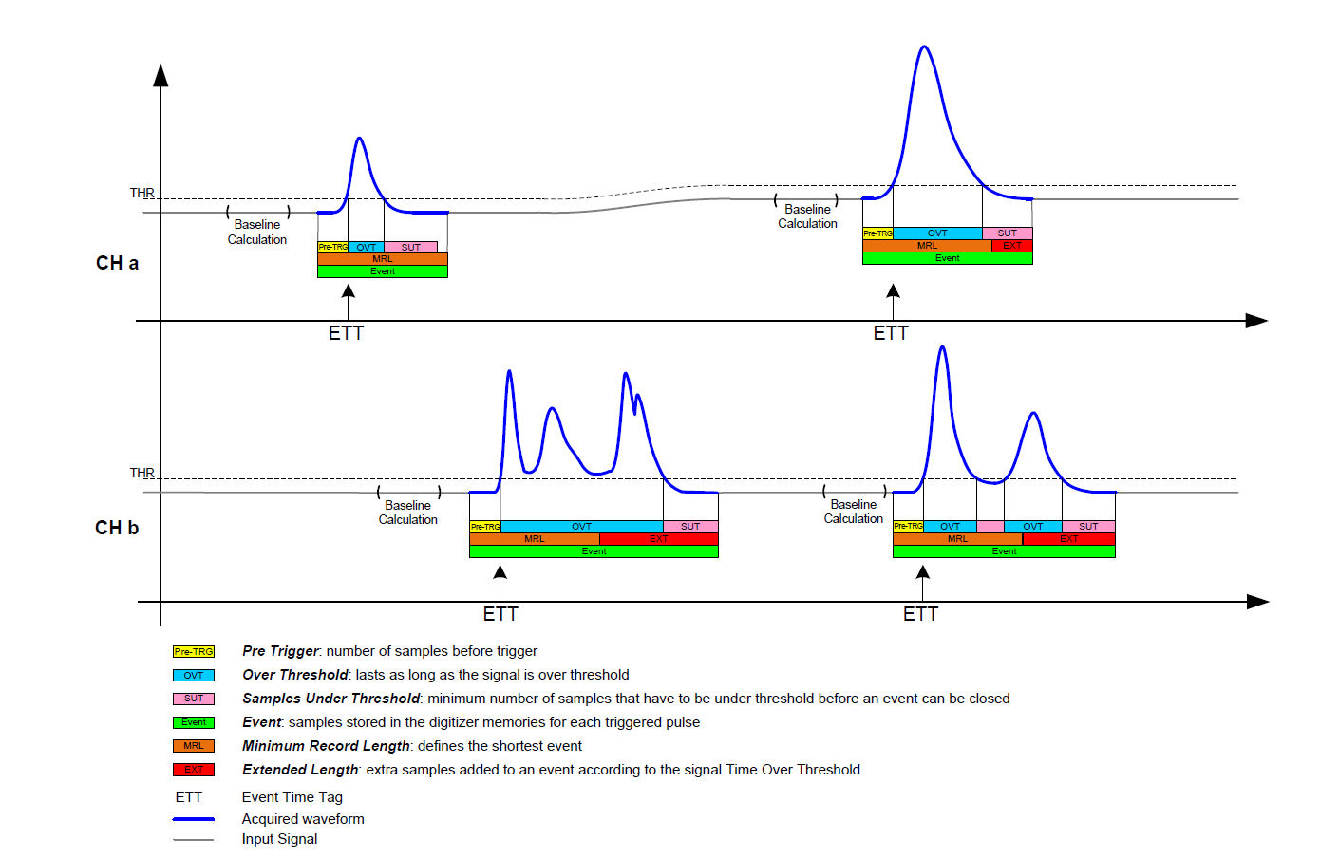
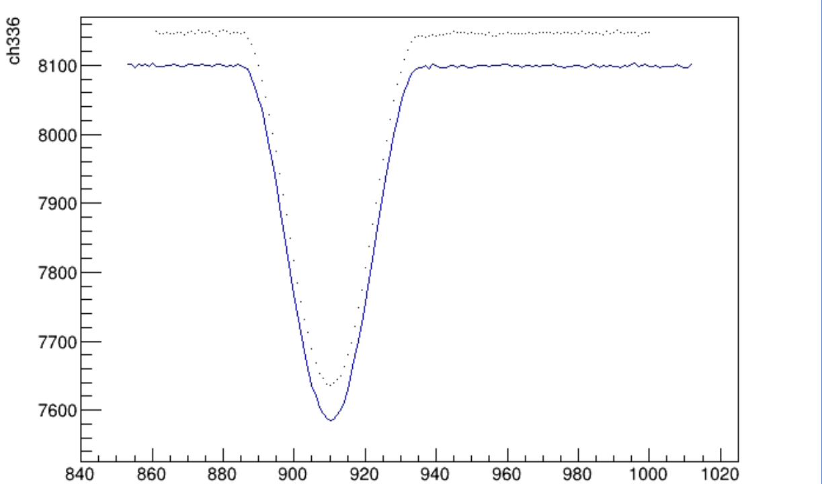
PandaX-4T Self-Trigger with DAW Mode
DAW: Dynamic Acquisition Window
ADC Count ()0.12mv/LSB
Time(4ns)

Slide 8
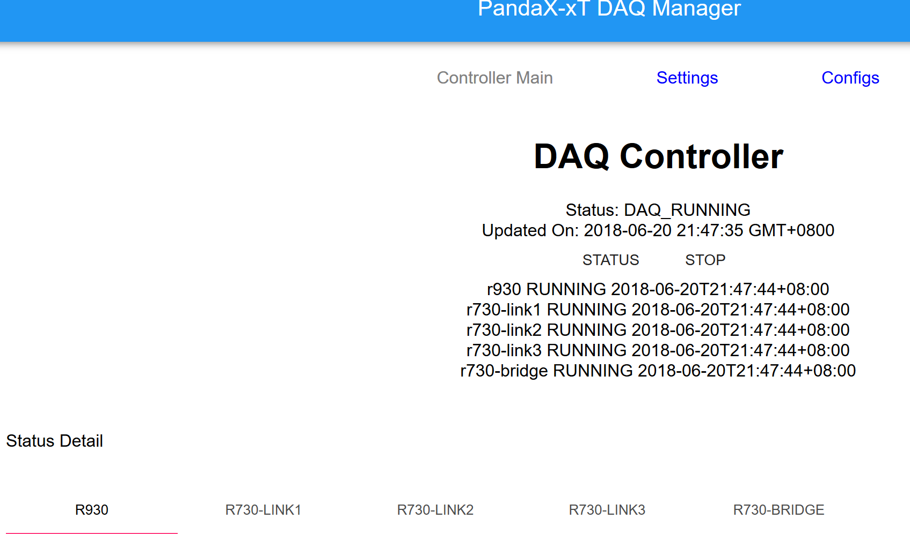
PandaX-4T DAQ Infrastructure and Controller

Slide 9
PandaX-4T Bandwidth Test
Three-board Test (48 channels) with channel-by-channel Random Pulse
Single-channel random pulse rate (Hz) | # of Samples/ channel | Net-work bandwidth usage for three boards
60 | 100 | 1.3 MB/s
60 | 1000 | 5 MB/s
450 | 100 | 8 MB/s
450 | 1000 | 38 MB/s

Slide 10
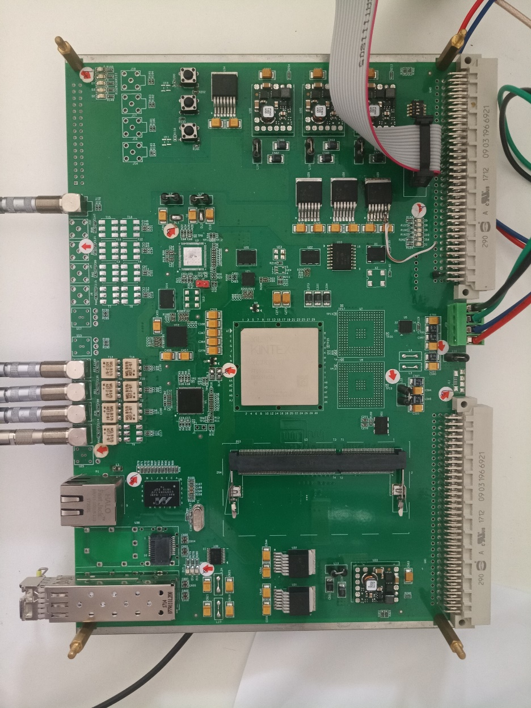
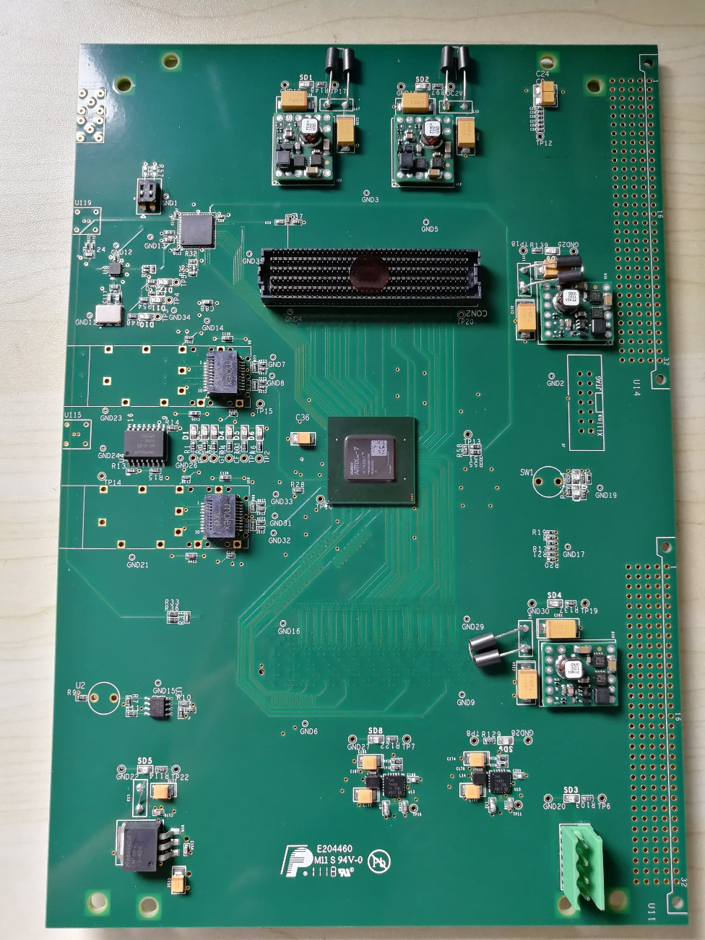
Home-made FADC + Trigger Board

Slide 11
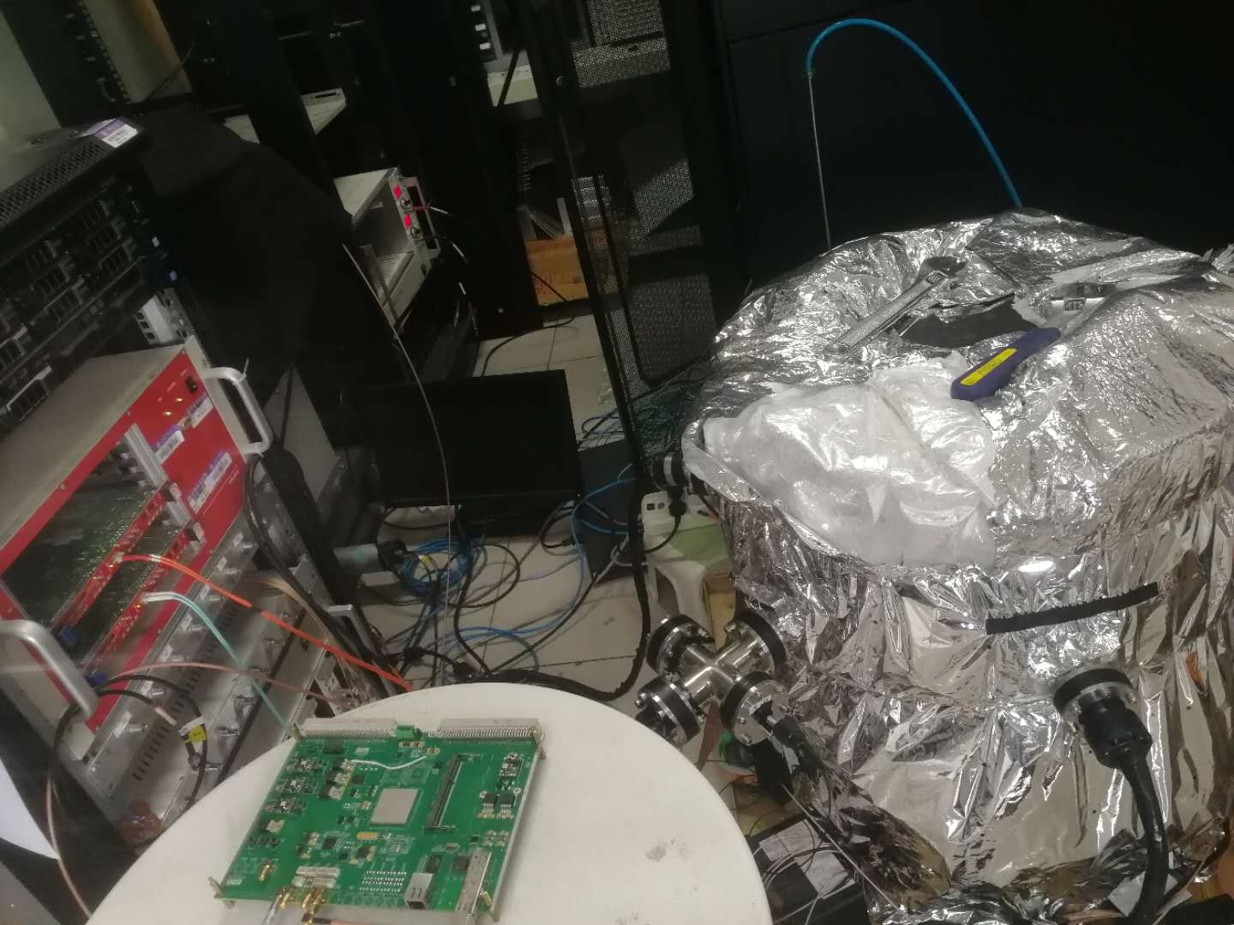
Preliminary Test of the home-made FADC
PMT + low-intensity LED
See tomorrow’s talk in T5 (Qibin Zheng)
our FADC (500MS/s, 1.8Vpp, 14-bit)
V1725B Fit (36.80%)
our FADC Fit (34.62%)
V1725B (250MS/s, 2Vpp, 14-bit)

Slide 12
Summary
New electronics system for PandaX-4T with triggerless read-out, and high-bandwidth DAQ infrastructure has been set up and tested.
  Dynamic Acquisition Window
  Parallel Readout with multiple-server and high-speed switch
Preliminary test of a home-made FADC with PMT using single-photon data shows better Peak-to-valley ratio, SPE resolution.

Slide 13
Thanks！

