Slide 1
PandaX-4T Vessels
Tao Zhang
On behalf of PandaX collaboration
2018-6-22

Slide 2
Outline
Lab overview
PandaX-4T vessels requirements and design
PandaX-4T vessels manufacture
SS background
Summary

Slide 3
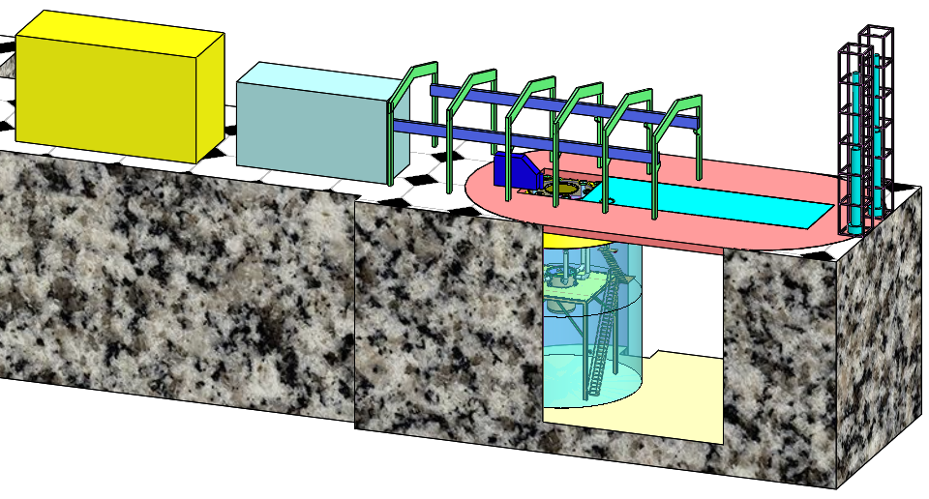
Lab layout
Distillation tower
Clean room 10000 Class
Fresh air： 1500m³/h
Xenon storage
And Rn free instrument
Rn free room
Fresh air: 300m³/h

Slide 4
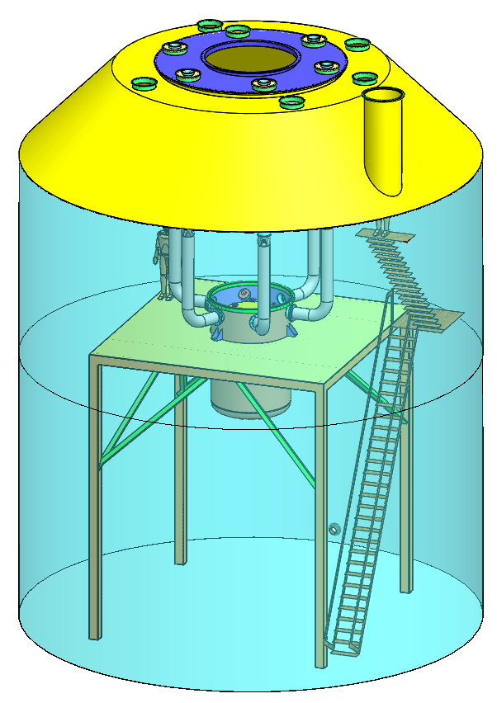
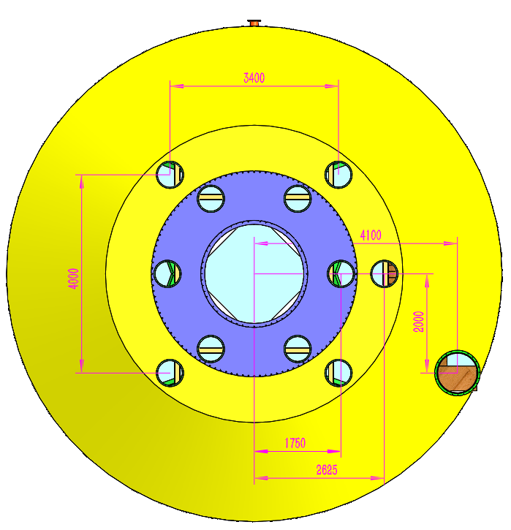
Water shield tank

Slide 5
PandaX-4T Vessels requirements
Liquid xenon Target volume Φ1200mm×1200mm
Inner overflow chamber
Detector operation temperature: -100℃
PMT cables: 25×Kyocera feedthrough
Top PMT array 169×3 R11410, 423pins
Bottom PMT array 199×3 R11410, 360 pins
Veto PMT array 96×1 R8520, 288 pins
Sensors, 48 pins
Vacuum port
Liquid xenon inlet and outlet
Optical fiber calibration
Cathode & gate
Liquid level adjustment
Water shield，about 6m water depth

Slide 6
PandaX-4T detector nozzles list
暗物质探测器需求 | 内罐接管法兰 | 外罐接管法兰
PMT 信号电缆 | 4×CF100* | DN250
 | CF35
内罐气体接口、内真空接口 | CF100 | DN250
液氙进口 | CF35
液氙出口 | CF35
外真空 |  | DN250
-50kV高压线 | CF35 | DN250
液位调节 | CF35 | DN250
光纤刻度 | CF35 | DN250
-10kV高压线 | CF35
内罐内液位计、温度传感器电缆，共25芯 | CF35
内罐外温度传感器电缆，共15芯
刻度管
备用 | CF35
Liquid xenon dimension Φ1200mm×1200mm

Slide 7
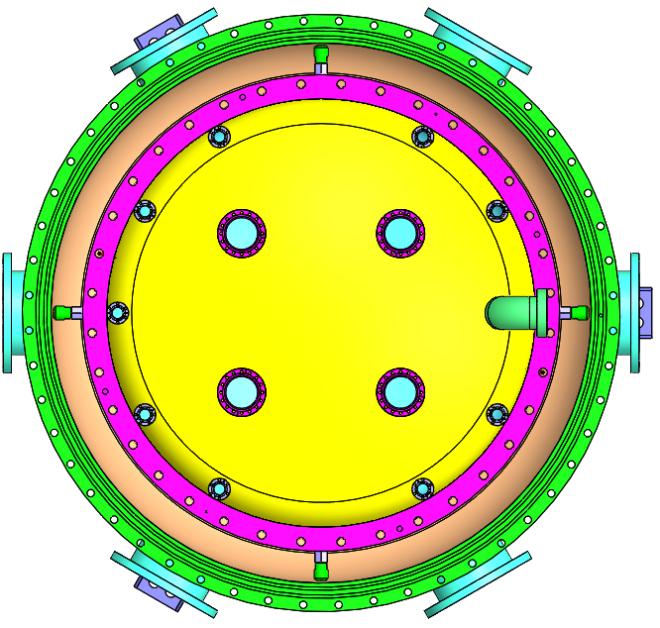
PandaX-4T vessel nozzles design
HV: -50kv
PMT cables
Fixed parts
HV: -10kv
Backup CF35
Optical fiber
Lxe inlet
Calibration,
-10kv cable,
Optical fiber,
T sensor cables,
Level meter cable,
Inner Vacuum and to cooling bus CF100
T sensor,
level meter cables
Lxe outlet
PMT cable 4×CF100
With 24×CF35
Step motor
heating tubes
PMT cable CF35
Liquid Xe level adjustment
Out vacuum

Slide 8
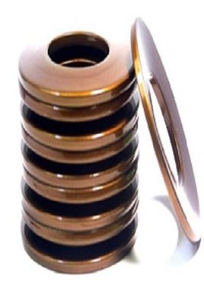
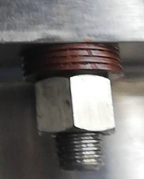
Inner vessel sealing design
Nozzles flange: CF35, CF100, Cu gasket
Vessel flange: indium sealing
Without standard design code, gasket factor and Seal specific pressure are meaningless.
Without springback
Optimal design
Disk spring for bolts can counteract about 80% thermal stress

Slide 9
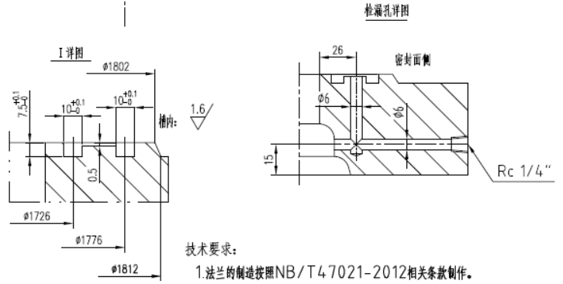
Outer Vessel sealing——Double O ring
Better sealing reliability
Reduce leakage
Facilitate vacuum leakage check

Slide 10
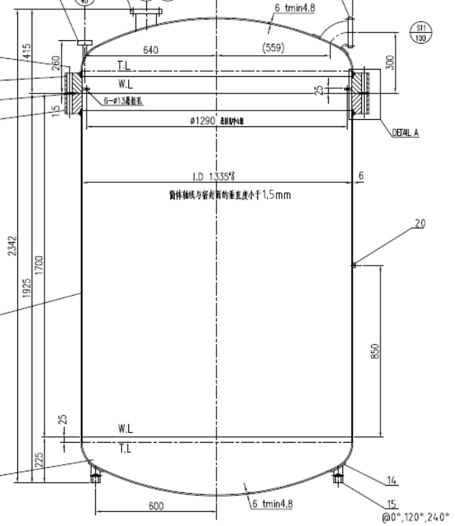
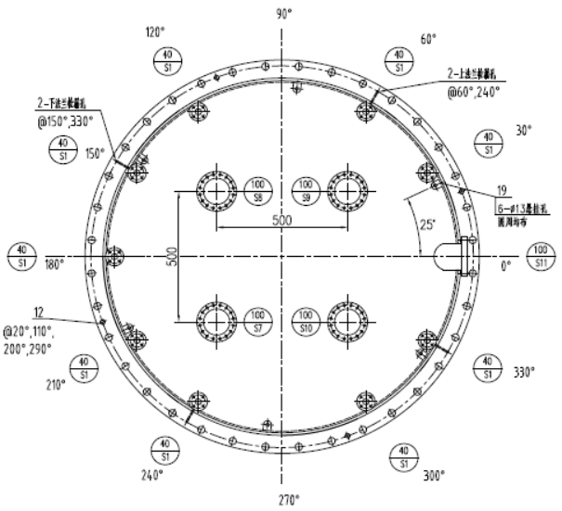
PandaX-4T inner vessel drawing
Barrel thickness： 6mm
Weight: about 1100kg

Slide 11
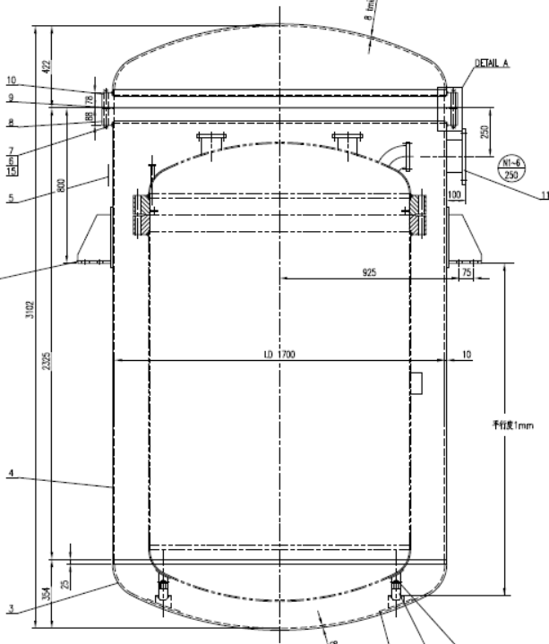
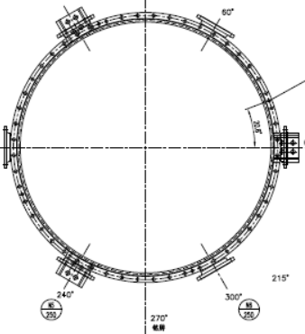
PandaX-4T outer vessel drawing

Slide 12
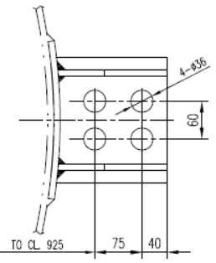
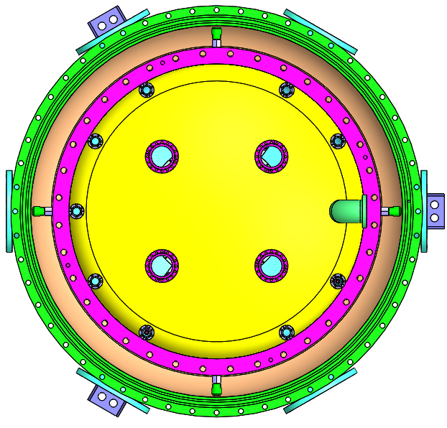
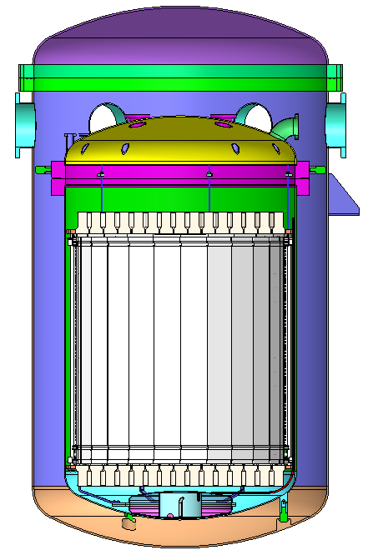
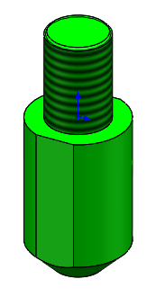
Fixed parts
Both weight and buoyance are considered
100mm
Gas pressure force is less than 3000N
Torlon4203L, Heat lost<1W

Slide 13
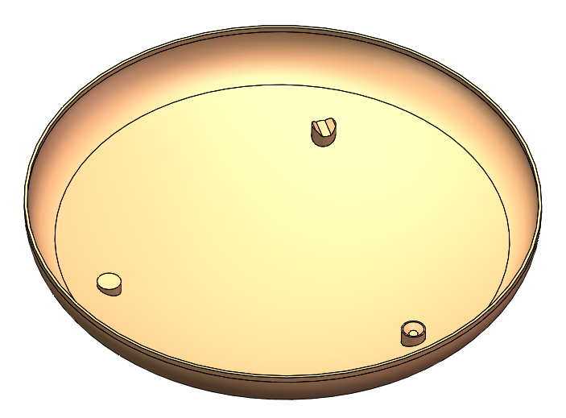
Inner vessel location design
Outer vessel bottom endcap
The same with PandaX-II location design

Slide 14
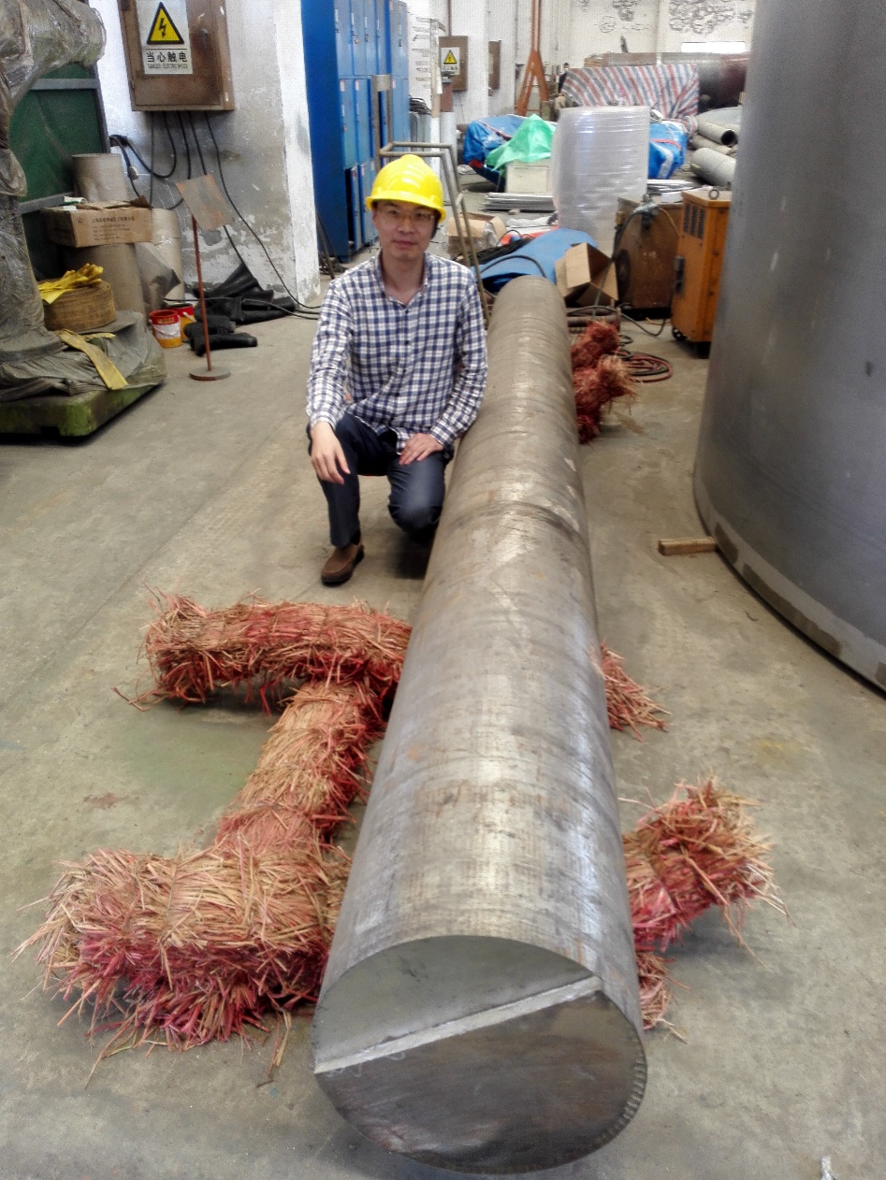
PandaX-4T vessels forge parts
Φ400×4700mm

Slide 15
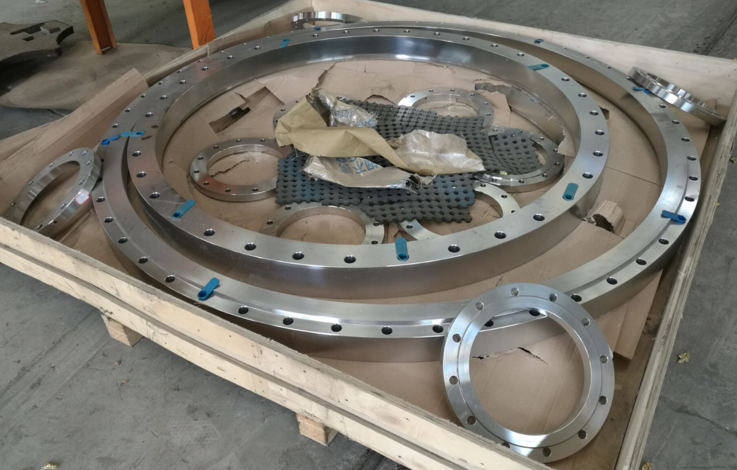
PandaX-4T vessel flanges

Slide 16
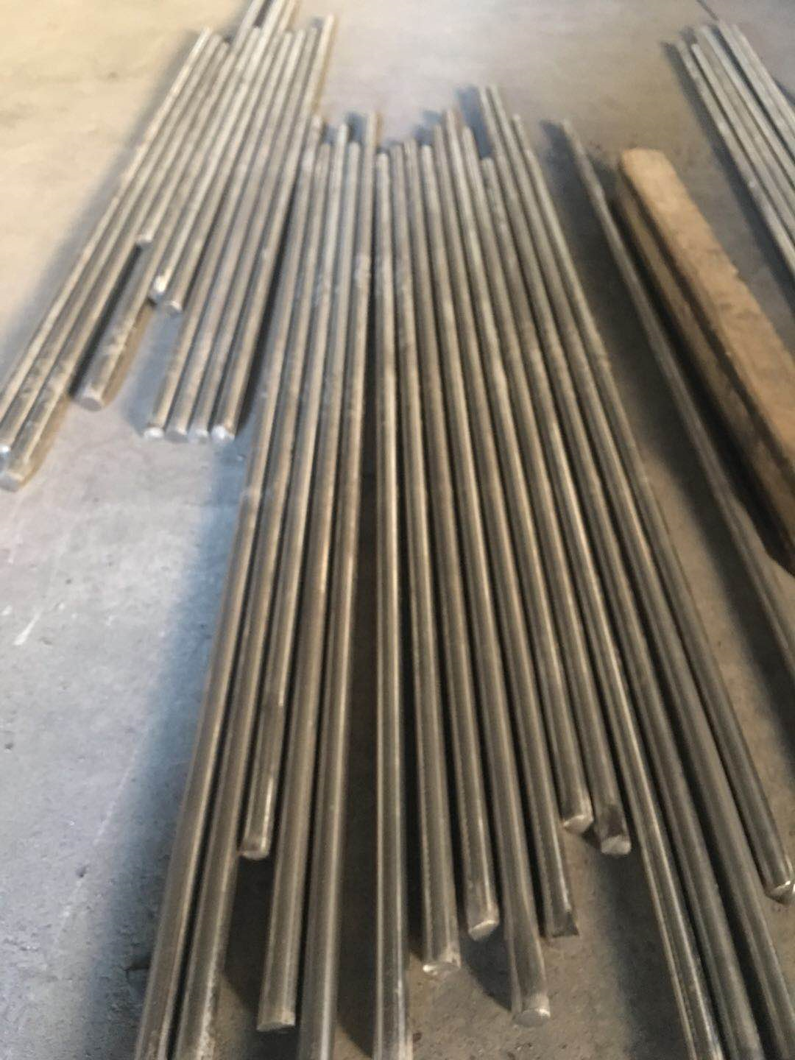
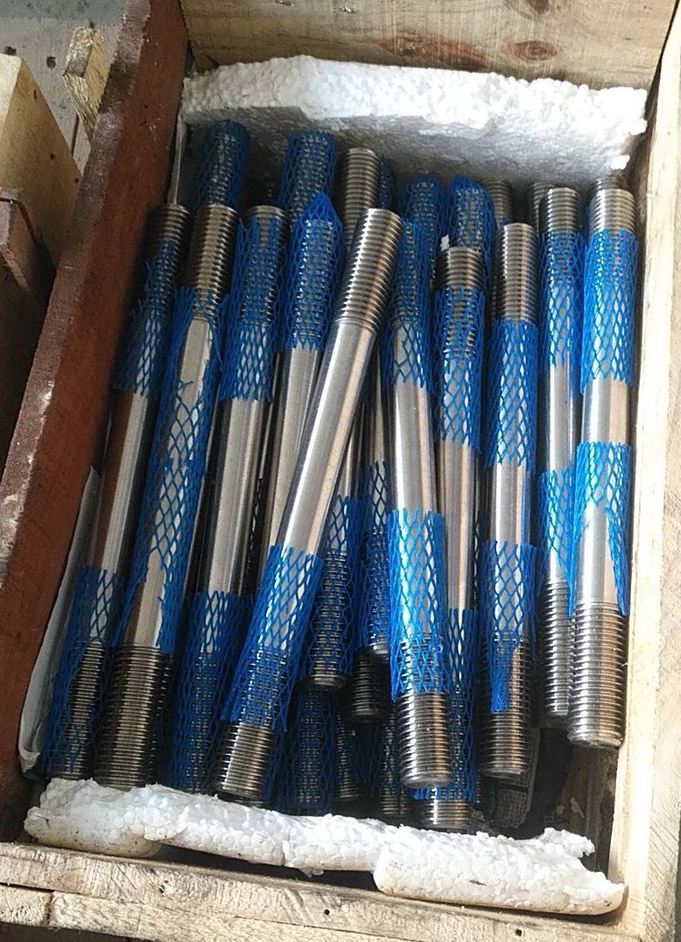
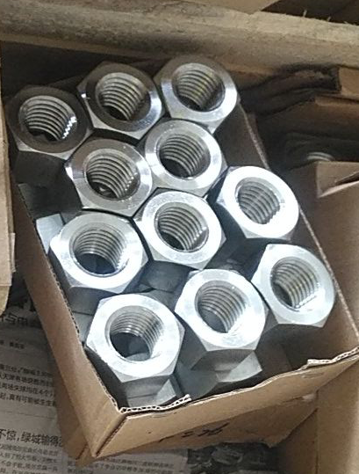
Bolts and nuts
Φ20mm、Φ24mm rod，solid solution temperature 1050℃，quenching in water
Cold drawing and thread rolling process for bolts
Yield strength for ordinary SS304L 250MPa
The bolts yield strength 450MPa， break strength 650MPa
A2-70 bolts，yield strength 600MPa，break strength 800MPa

Slide 17
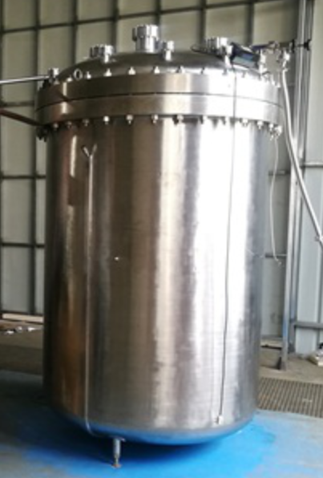
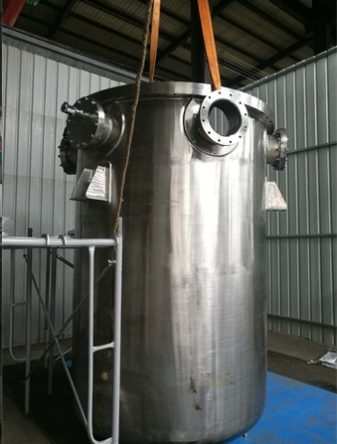
PandaX-4T vessels photo

Slide 18
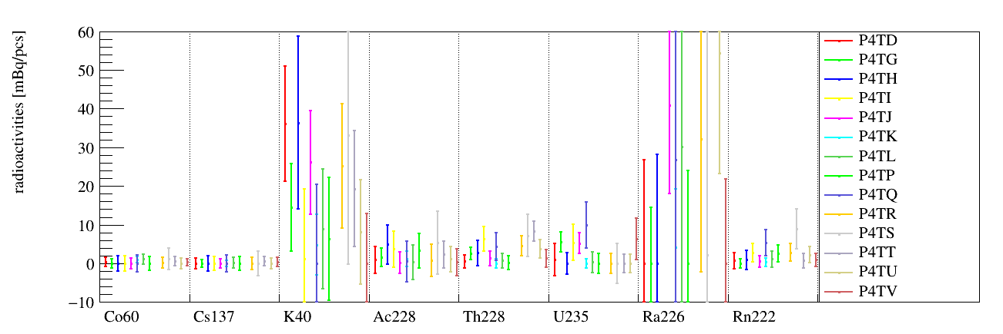
PandaX-4T vessel sample count result
 | P4TD | P4TG | P4TH | P4TI | P4TJ | P4TK | P4TL | P4TP | P4TQ | P4TR | P4TS | P4TT | P4TU | P4TV
Co60 | 0.4(1.1) | 0(1.1) | 0(2.0) | 0(1.9) | 0(1.3) | 1.0(0.8) | 1.1(1.3) | 0(1.7) | 0(2.1) | 0.2(1.3) | 1.2(2.7) | 0.6(1.2) | 0(1.3) | 0.3(0.9)
Cs137 | 0(1.4) | 0(1.0) | 0(1.9) | 0(1.8) | 0(1.2) | 0(0.8) | 0.2(1.3) | 0(1.7) | 0(2.1) | 0(1.5) | 0(3.1) | 0.6(1.1) | 0(1.3) | 0.4(1.2)
K40 | 36(15) | 15(11) | 36(22) | 1(18) | 26(13) | 5(8) | 9(16) | 6(16) | 0(20) | 25(16) | 33(33) | 19(15) | 8(14) | 0(13)
Ac228 | 0.9(3.4) | 1.6(2.4) | 4.9(5.0) | 3.7(4.7) | 0.2(2.8) | 1.2(2.0) | 0.3(4.4) | 3.3(4.4) | 0.5(5.2) | 0.8(4.1) | 5.4(8.1) | 2.3(3.4) | 1.1(3.3) | 0.3(3.4)
Th228 | 0.5(1.6) | 2.5(1.6) | 2.7(3.2) | 6.3(3.2) | 1.3(1.8) | 0(1.2) | 0.7(1.8) | 0.2(1.7) | 4.4(3.6) | 4.6(2.6) | 7.2(5.5) | 8.3(2.6) | 3.7(2.4) | 1.3(2.2)
U235 | 1.0(4.1) | 5.6(2.6) | 0(2.7) | 5.4(4.7) | 5.2(2.7) | 0(1.1) | 0.3(2.7) | 0(2.6) | 9.9(5.9) | 0(2.5) | 0(5.2) | 0(2.4) | 0(2.3) | 6.4(5.4)
Rn222 | 0.7(2.0) | 0(1.1) | 0.9(2.4) | 2.7(2.4) | 0.5(1.4) | 0.3(1.1) | 1.1(2.0) | 2.6(2.2) | 5.3(3.4) | 2.8(2.3) | 8.9(5.1) | 0.9(1.7) | 2.2(2.1) | 0.9(1.7)
Mn54 |  |  |  |  |  |  |  |  |  |  |  |  |  | 7.7(3.9)

Slide 19
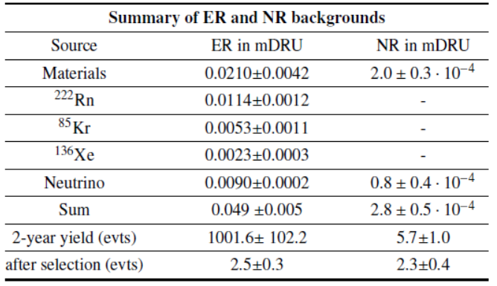
PandaX-4T background budget
IV 0.0064±0.0013，1100kg
OV 0.0088±0.0018，2550kg

Slide 20
Summary
PandaX-4T vessels is almost finished
Mass production of low background is possible
Accumulating experience for the next generation detector vessels

Slide 21
Thanks!

