Slide 1

Study of readout electronics for CMOS pixel sensors
董家宁,张亮,刘剑,李龙,王萌
jndong@sdu.edu.cn
2018-06-22

Slide 2
Outline
Progress of CMOS pixel sensor in SDU
Readout system for the prototype chip
Beam telescope proposal in SDU
Readout electronics for the beam telescope
Summary

Slide 3
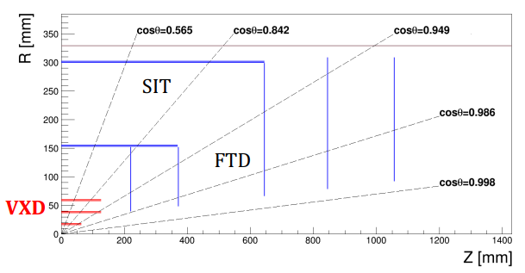
CMOS pixel sensor
Basic sensor for the CEPC silicon tracker
  Silicon microstrip sensors
    P⁺-on-n technology
    Area of 10 cm × 10 cm
    Pitch of 50 µm, σ_{sp} < 7 µm
    Thickness < 200 µm
  Pixel detectors as VXD for the two innermost FTD
Alternative option
  Pixelated silicon sensors based on CMOS technology
    Thickness ~ 50 µm
Notes:
from preCDR
Cern atlas resolution：14um*115um

Slide 4
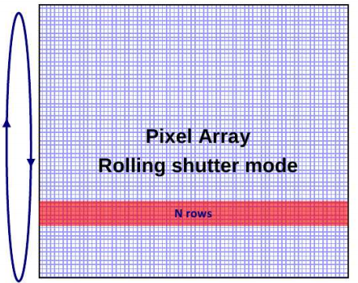
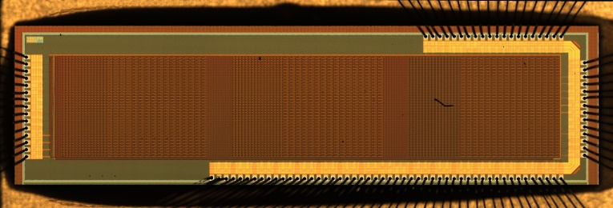
CMOS pixel sensor prototype
The chip contains: 9 submatrices
  Each matrix: 16 × 64
  Rolling shutter readout mode
  32 µs integration time at 2 MHz clock frequency
  16 parallel analog outputs
  Sensitive area: 2 mm × 7.88 mm

Slide 5
Readout system for the prototype chip
DUT
SE
Main Board
SE
FPGA board
PCIe
PC
LVDS
LVDS
RS232
SE: Single Ended
External power
Oscilloscope
The test setup consists of:
DUT board: carry the chip, bias the chip, buffer the output
Main board: supply the power to the chip, sample the output signals, buffer the control signals
FPGA board (Xilinx KC705 Evaluation Board): communicate with PC via PCIe, control the data loading/receiving
Notes:
ADC:LTC323 16bit 5MSPS

Slide 6
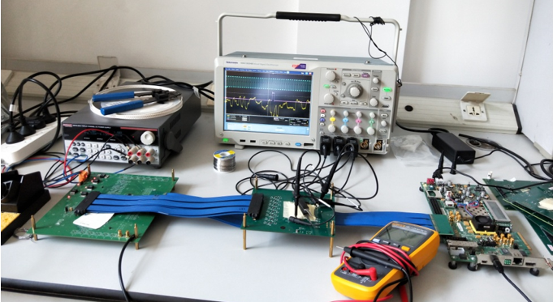
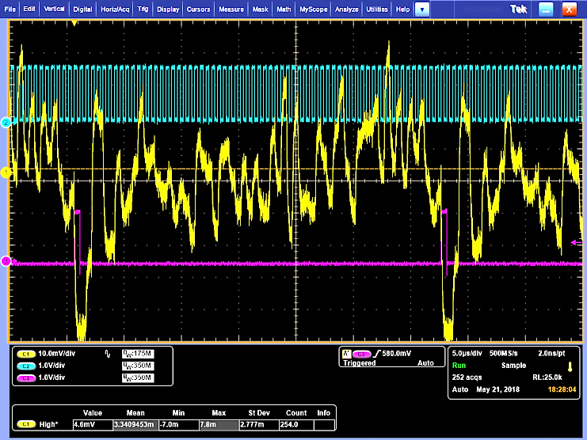
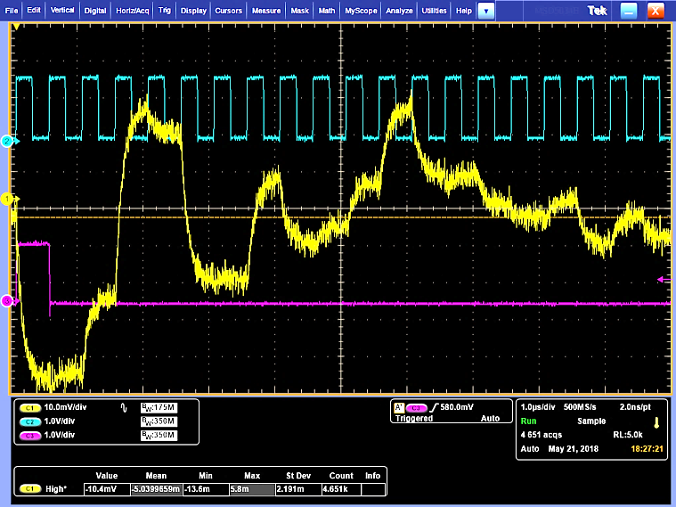
Prototype chip test
Main board
DUT board
FPGA board
The chip was provided with a 2MHz clock through the FPGA board.
Frame out: the signal from the DUT chip when 64 rows of pixels have been read out.
DC output : output of the pixels without particle.
Clock
DC output
Frame out

Slide 7
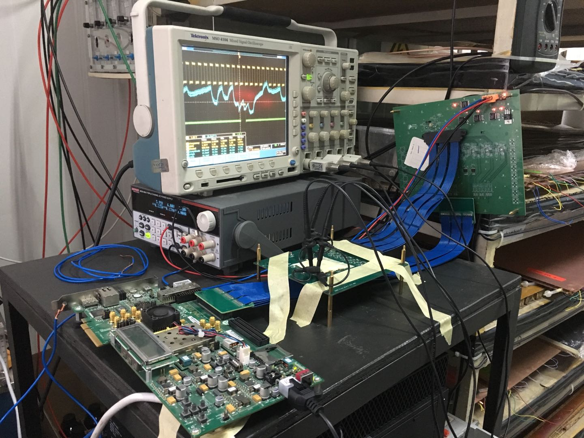
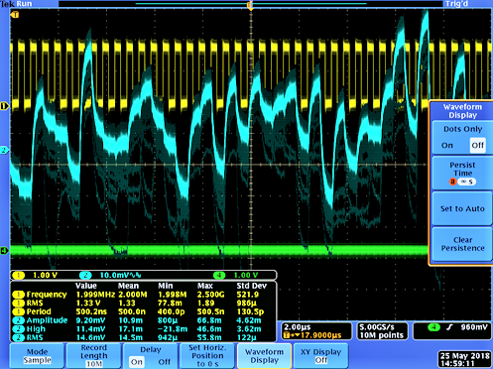
Prototype chip test
Main board
DUT board
FPGA board
Output signals
Test with Co-60 source
The signal was acquired by oscilloscope using persistence mode
It can be observed that the chip works with Co-60, since the DC value drops
Next step: do the calibration with Fe-55 source, charge collection efficiency (CCE), spatial resolution, detection efficiency etc.

Slide 8
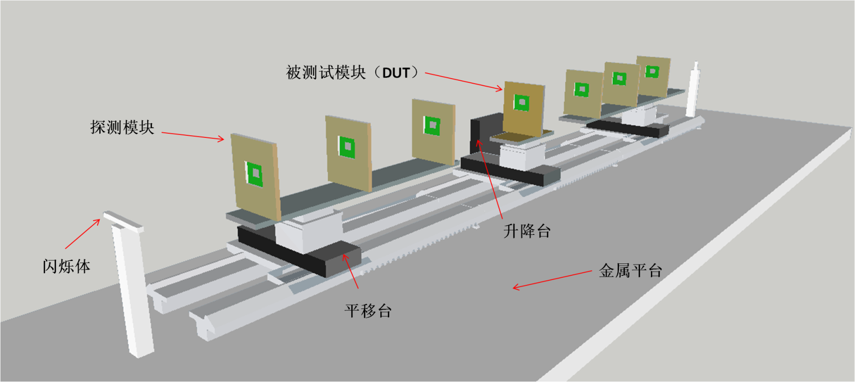
Beam telescope proposal in SDU
Beam telescopes tracking charged particles to determine the spatial resolution and the detection efficiency have been proven to be a useful tool for the characterization of the position sensitive detectors.
The position requirements for the next generation collider experiments will reach a level of a few microns, for instance, CEPC (3-5µm).
A new beam telescope which could offer the spatial resolution of 3 µm with a 1.5 GeV electron test beam (BEPC test beam) is under R&D.

Slide 9
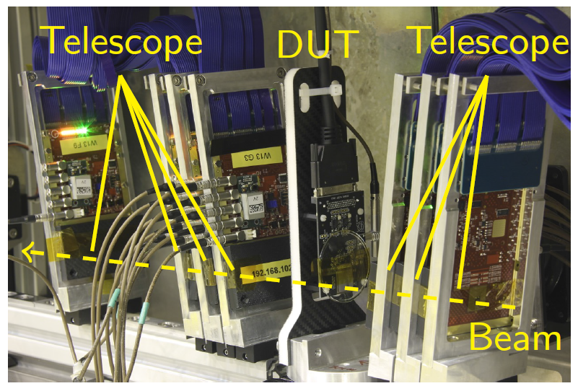
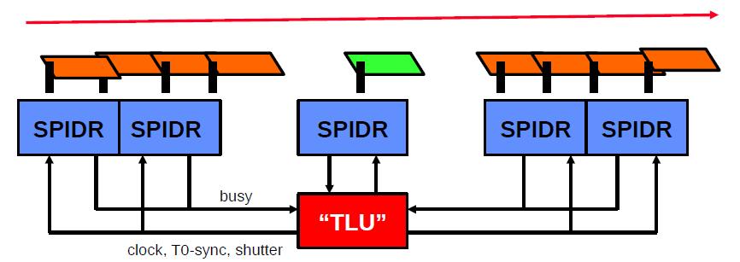
Readout electronics for beam telescopes
Timepix3 chip
Pixel size 55 µm × 55 µm
256 × 256 pixels, 16.8 mm×20.2 mm
Zero suppressed readout
Hit rate max 40 Mhits/cm²/s
130nm CMOS process
Timepix3 telescope
Timepix3 module
Timepix3 module

Slide 10
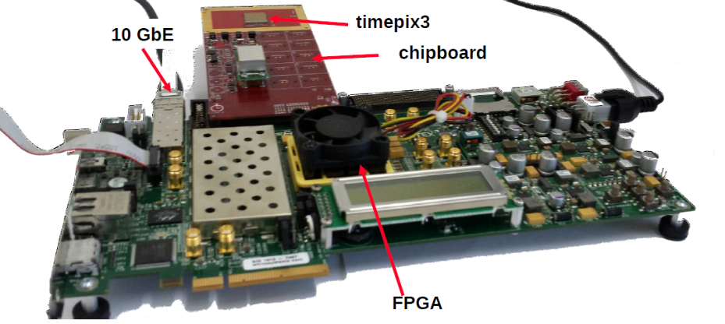
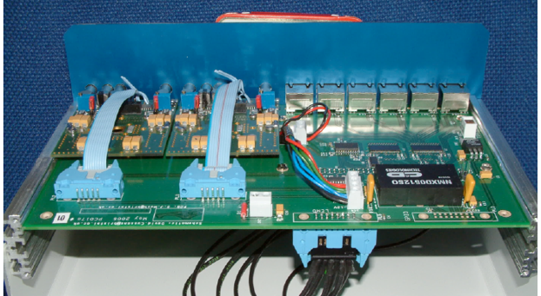
Readout electronics for Timepix3 telescope
Speedy PIxel Detector Readout (SPIDR)
developed on Xilinx VC707 evaluation board
acquire data from the Timepix3 modules
connected to the DAQ PC via 10 Gbit Ethernet
Trigger Logic Unit (TLU)
developed by Bristol university
provides clock, handles busy/shutter handshake
6 RJ45 connectors providing trigger, busy and reset signals
Notes:
V7 XC7VX485T-2FFG1761C，37Mb-700IOs

Slide 11
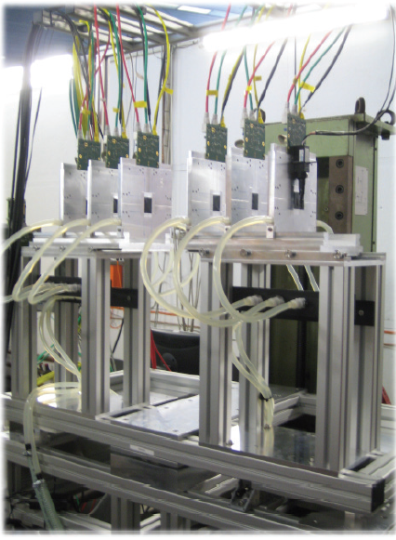
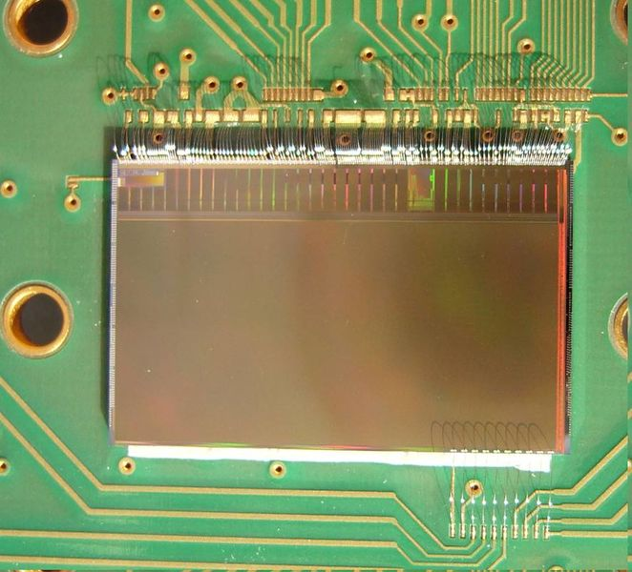
Readout electronics for beam telescopes
Mimosa26 chip
Pixel size 18.4 µm × 18.4 µm
576 × 1152 pixels, 224 mm² active area
Zero suppressed readout
Readout clock 80 MHz
0.35 μm CMOS process
EUDET telescope

Slide 12
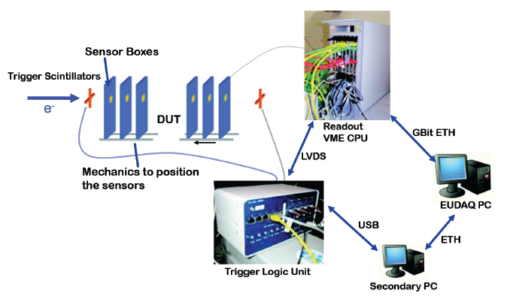
Readout electronics for EUDET telescope
The pixel sensors are read out by custom made data reduction boards (EUDET Data Reduction Board - EUDRB), and data are sent via VME64x block transfer to a VME CPU.
The data are packaged and sent over Gigabit Ethernet to the main DAQ PC.
The Trigger Logic Unit (TLU) receives signals from scintillators in front of and behind the telescope, and generates triggers that it distributes to the telescope and any DUT.

Slide 13
Readout electronics for EUDET telescope
The EUDRB is developed at INFN-Ferrara.
The EUDRB is built on 6U VME64X card, with the main processing being carried out by an Altera Cyclone II FPGA.
RJ45
The TLU incorporates a Xilinx Spartan-3 FPGA and a USB 2.0 port.
DUTs can connect either via the RJ45 connectors using LVDS, or via the LEMO connector using either NIM or TTL levels.
LEMO
Notes:
NIOS II 微处理器
The TLU is based on a ZestSC1 card manufactured by Orange Tree Technology Ltd.

Slide 14
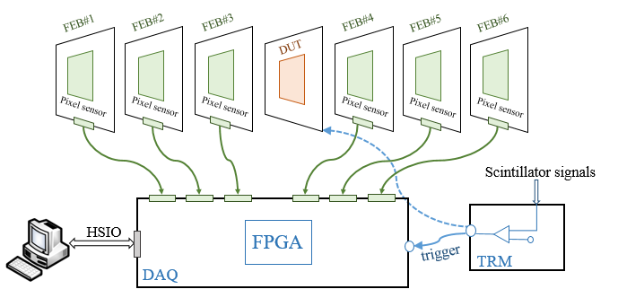
Readout electronics for SDU beam telescope
6 Front-end boards (FEB) carry the sensors, put out the readout signal.
Data acquisition board (DAQ) configure the sensor, package the data and sent it to the PC via the high speed IO (HSIO).
Trigger module (TRM) receives signals from scintillators in front of and behind the telescope, and generates triggers for the system.
Notes:
The sensor is mounted via wire-bonding on a PCB featuring a beam hole to reduce the material budget.
Kapton foils to protect sensor surface
The PCB is fixed by a thin metal jig, which is placed on a aluminium movable arm.

Slide 15
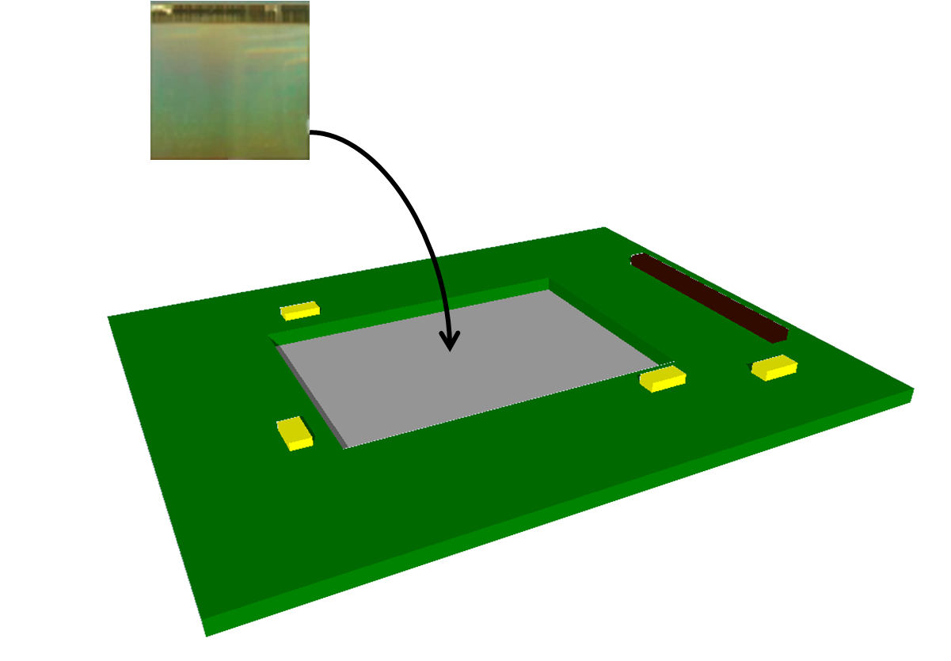
Readout electronics : FEB
Each telescope plane equipped with a pixel sensor wire-bonded to the FEB.
  Signal readout
  Data buffer
  Data transmission to DAQ
Each module carries one pixel sensor
Sensor specification:
  ~2 cm × 2 cm
  Pixel pitch 16 μm × 16 μm => ~ 3 μm spatial resolution
  Rolling-shutter readout mode with zero-suppression
  Readout Clock 100MHz
Notes:
The sensor is mounted via wire-bonding on a PCB featuring a beam hole to reduce the material budget.
Kapton foils to protect sensor surface
The PCB is fixed by a thin metal jig, which is placed on a aluminium movable arm.

Slide 16
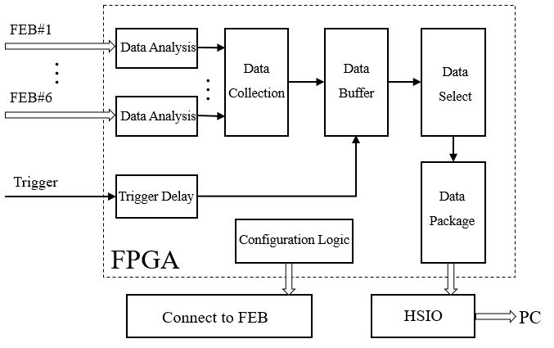
Readout electronics : DAQ
Data acquisition board (DAQ) receives (sends) data from (to) the FEB.
  Sensor configuration, data analysis, data buffer and data package
  Data transmission to the PC over HSIO (PCI express)
    The readout frequency of the pixel sensor is ~100MHz, 16 banks in a chip, 6 chips in the beam telescope, so the readout rate is 100 Mb/s/bank ×16 bank/chip ×6 chip = 1.2 GB/s
Notes:
The sensor is mounted via wire-bonding on a PCB featuring a beam hole to reduce the material budget.
Kapton foils to protect sensor surface
The PCB is fixed by a thin metal jig, which is placed on a aluminium movable arm.

Slide 17
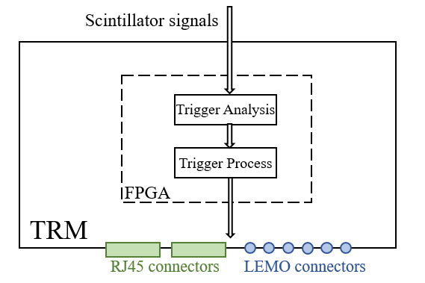
Readout electronics : TRM
The TRM receives signals from scintillators in front of and behind the telescope, and generates triggers that it distributes to the telescope and any DUT.
DUT can connect either via the RJ45 connectors using LVDS, or via the LEMO connector.
Notes:
The sensor is mounted via wire-bonding on a PCB featuring a beam hole to reduce the material budget.
Kapton foils to protect sensor surface
The PCB is fixed by a thin metal jig, which is placed on a aluminium movable arm.

Slide 18
Summary
A CMOS pixel sensor prototype has been designed in SDU. There are 9 submatrices in the prototype chip, with 16 × 64 pixels in each matrix.
The readout system has been designed and built for the chip test, and the prototype performs well in the test with Co-60 source.
A feasible design of readout electronics is proposed for the beam telescope.
  6 Front-end boards (FEB) carry the sensors.
  Data acquisition board (DAQ) configure the sensor, package the data and sent it to the PC.
  Trigger module (TRM) receives signals from scintillators, and generates triggers for the system.
Notes:
The sensor is mounted via wire-bonding on a PCB featuring a beam hole to reduce the material budget.
Kapton foils to protect sensor surface
The PCB is fixed by a thin metal jig, which is placed on a aluminium movable arm.

Slide 19
Thank you!

Slide 20
Back slides
Pixel | P1 P2 P3 | P4 P5 P6 | P7 P8 P9
Pitch(x)(µm) | 21 42 84 | 21 42 84 | 21 42 84
N(D) | 1 1 1 | 1 1 1 | 1 1 1
F(D)(um²) | 11 11 11 | 5 18 18 | 15 44 50
S(D)(um²) | 8 8 8 | 4 12 12 | 6 20 20
N(D) = number of diodes in each pixel (1 )
F(D) = footprint of diode (diode area + pwell opening): 5, 11, 15, 18, 44 & 50 µm²
S(D) = surface of diode: 4, 6, 8, 12 & 20 µm²

Slide 21
Back slides
3T pixel structure
  The reset transistor is connected in permanent reloading (similar behavior of a diode)
  50 µA current load in each column
  Diode is staggered in large pixel
    Improve charge collection efficiency (charge sharing)
  Gate-enclosed NMOS transistors
    Improve radiation tolerance
  P+ guide ring

