Slide 1
宇宙线热中子探测技术及PRISMA-LHAASO实验介绍
崔树旺 ¹，陈天禄²，马欣华³，刘茂元³，周荣⁴，Yuri Stenkin⁵
1. 河北师范大学，2. 西藏大学，3. 中科院高能物理研究所，
4. 四川大学，5. Institute for nuclear Research, RAS
第十届高能物理分会全国会员代表大会 上海
2018.06.22

Slide 2
内容摘要
背景知识
宇宙线热中子探测器工作原理
从PRISMA-YBJ到PRISMA-LHAASO
实验进展与未来计划
丰富的研究内容
总结

Slide 3
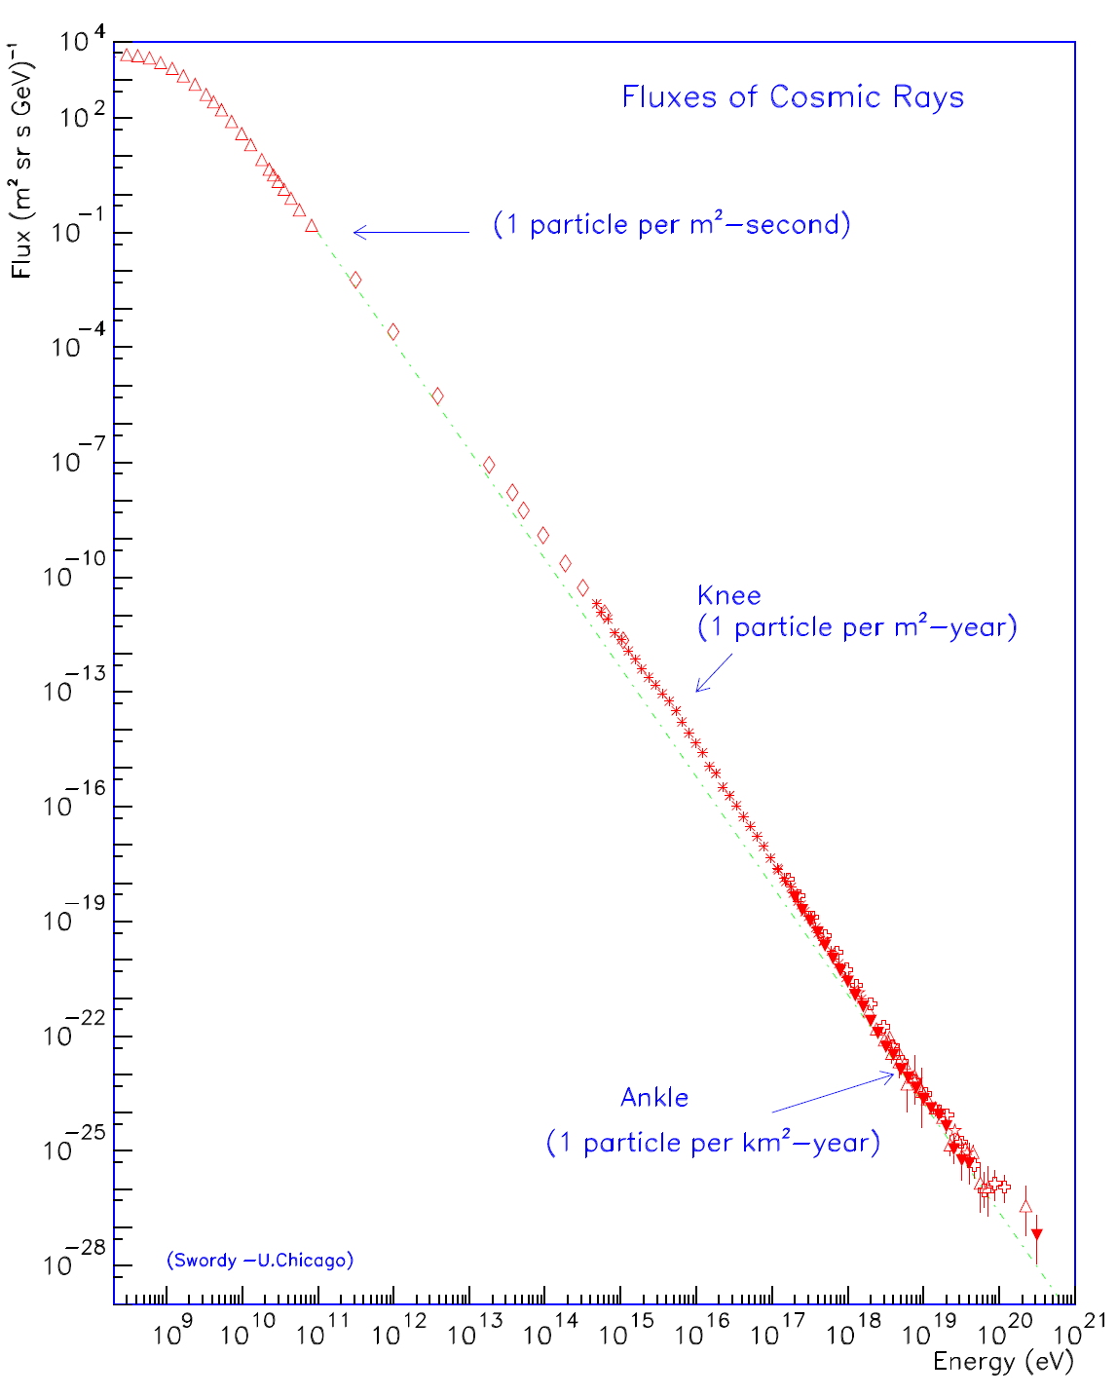
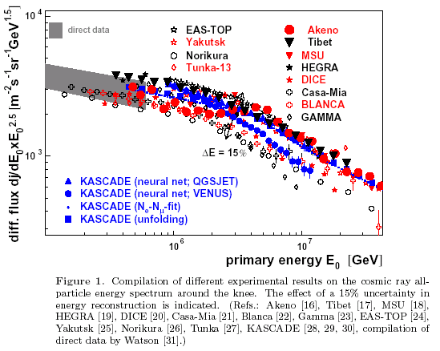
宇宙线全粒子能谱：膝区

Slide 4
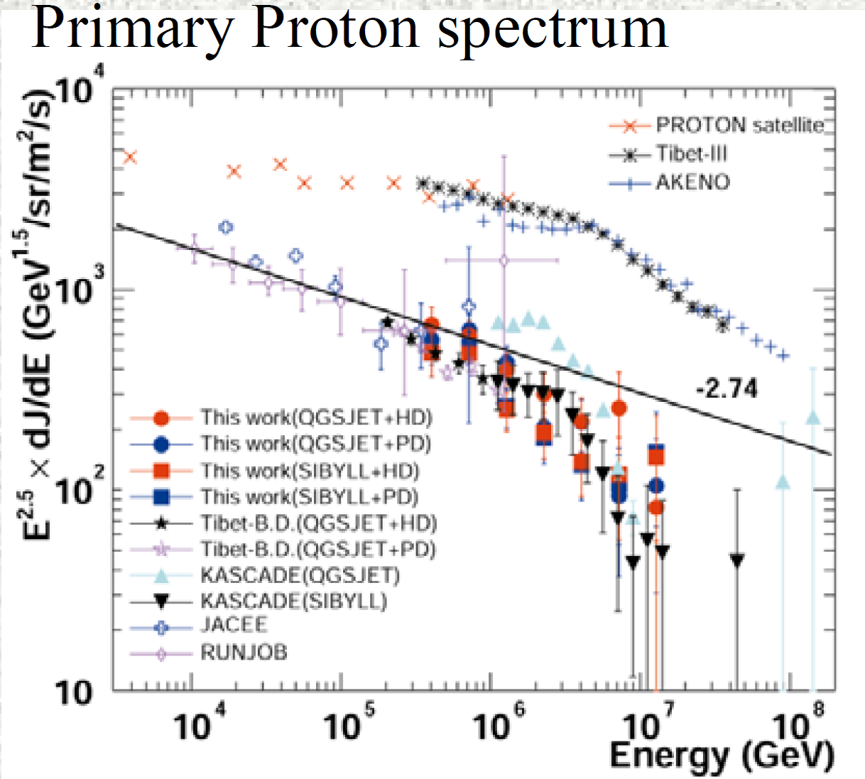
现有探测结果的典型差异30%，以质子为例：
KASCADE: 拐折在2-3PeV(模型依赖)，尖锐的，模型依赖
ASgamma：拐折在~400TeV，缓慢的

Slide 5
LHAASO：
KM2A : e,μ
WCDA: e,μ
WFCTA: Č/F
WCDA++: γ family at core →π0
⊕ PRISMA: thermal neutrons →π+π-
→ Full particle measurement of cosmic showers!
→ significant capability of component separation!
Budget of neutron detector array is only 2% of LHAASO.
PRISMA
PRISMA-----PRImary Spectrum Measurement Array

Slide 6
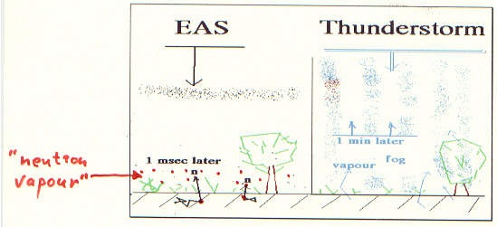
强子是宇宙线簇射的“骨架”，对成份十分敏感。
簇射中少量的强子与周围环境中的物质（土壤、建筑物、探测器材料、空气等）发生核反应产生大量MeV量级的蒸汽中子，蒸汽中子经过周围环境中的物质的慢化而产生热中子
EAS热中子探测器可以确定EAS芯区强子，比昂贵的强子量能器有更强的规模优势，有更高的性能-价格比。

Slide 7
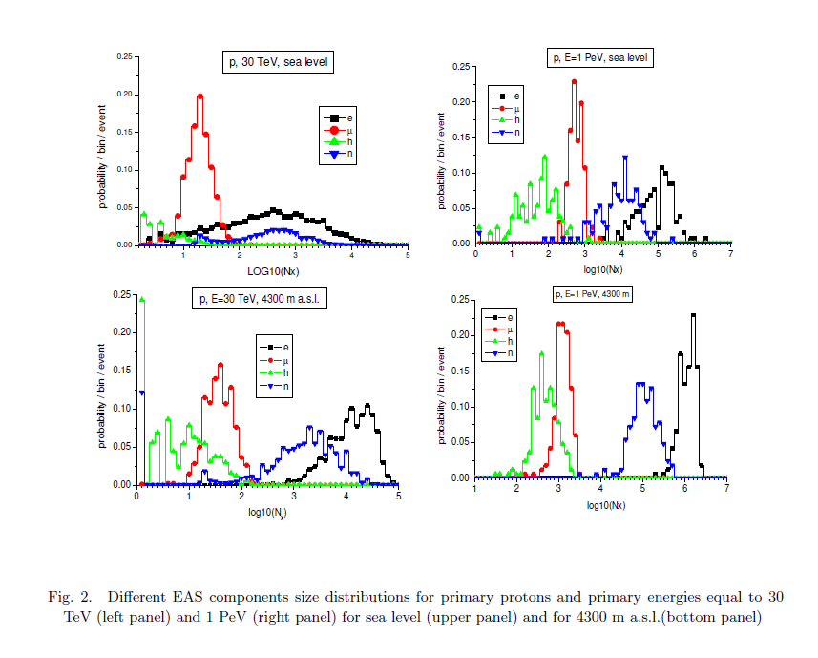
EAS热中子探测技术的优势
河北师大、高能所、俄罗斯合作发表的文章 Thermal neutron flux produced by EAS at various altitudes, Yu.V. Stenkin, V.V. Alekseenko, D.M. Gromushkin, LIU Ye ,MA Xin-Hua, ZHAO Jing, Chinese Physics C Vol. 37, No. 1 (2013) 015001
EAS中少量的强子成分能够产生大量的热中子，其数量比强子多2-3个数量级。高海拔要比海平面高1-2个数量级

Slide 8
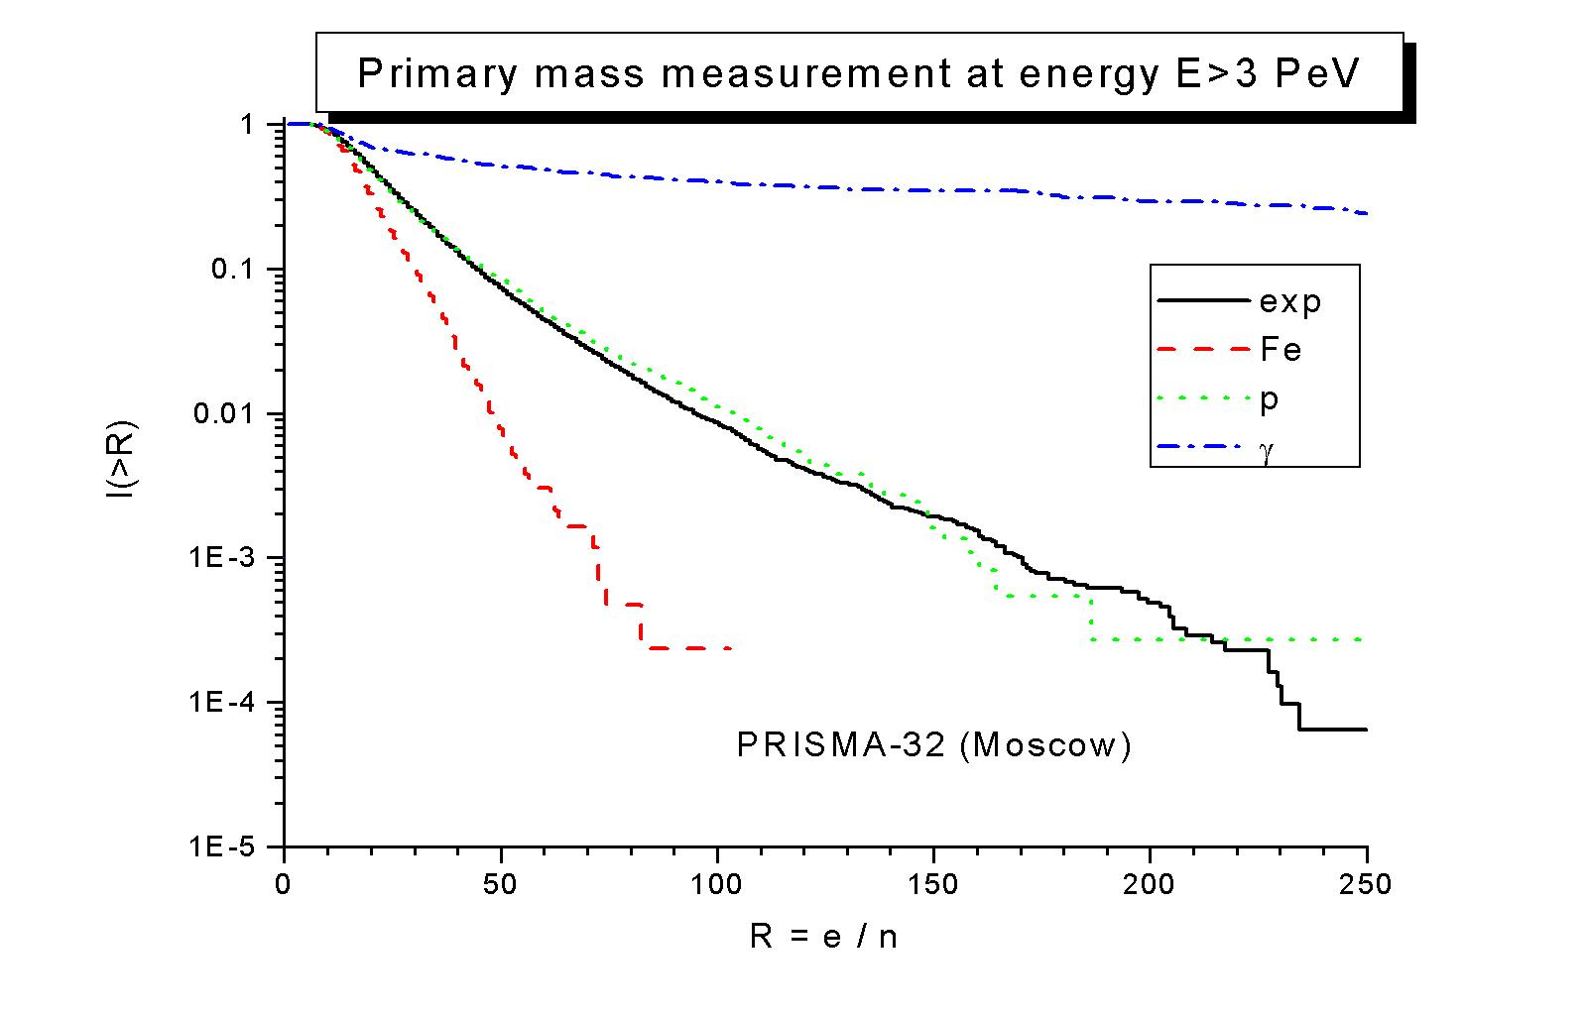
Good component separation
Single detector rate ~ 7Hz.

Slide 10
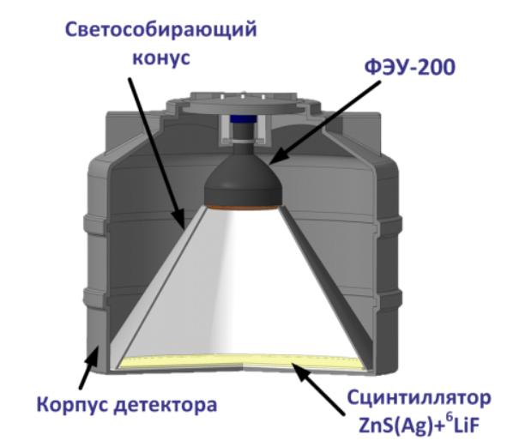
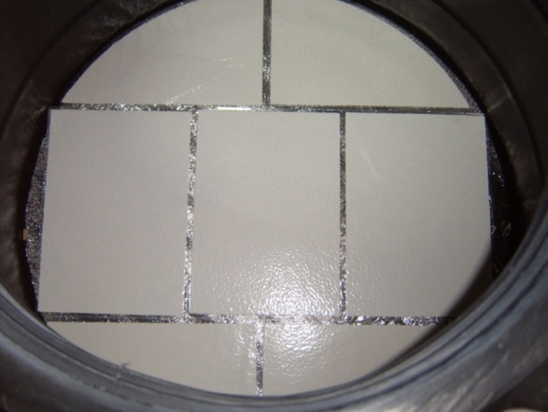
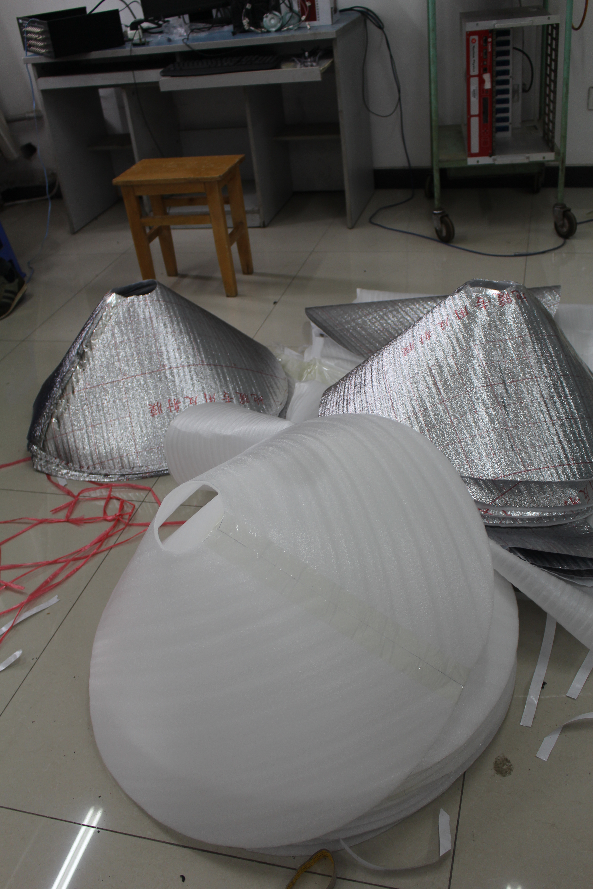
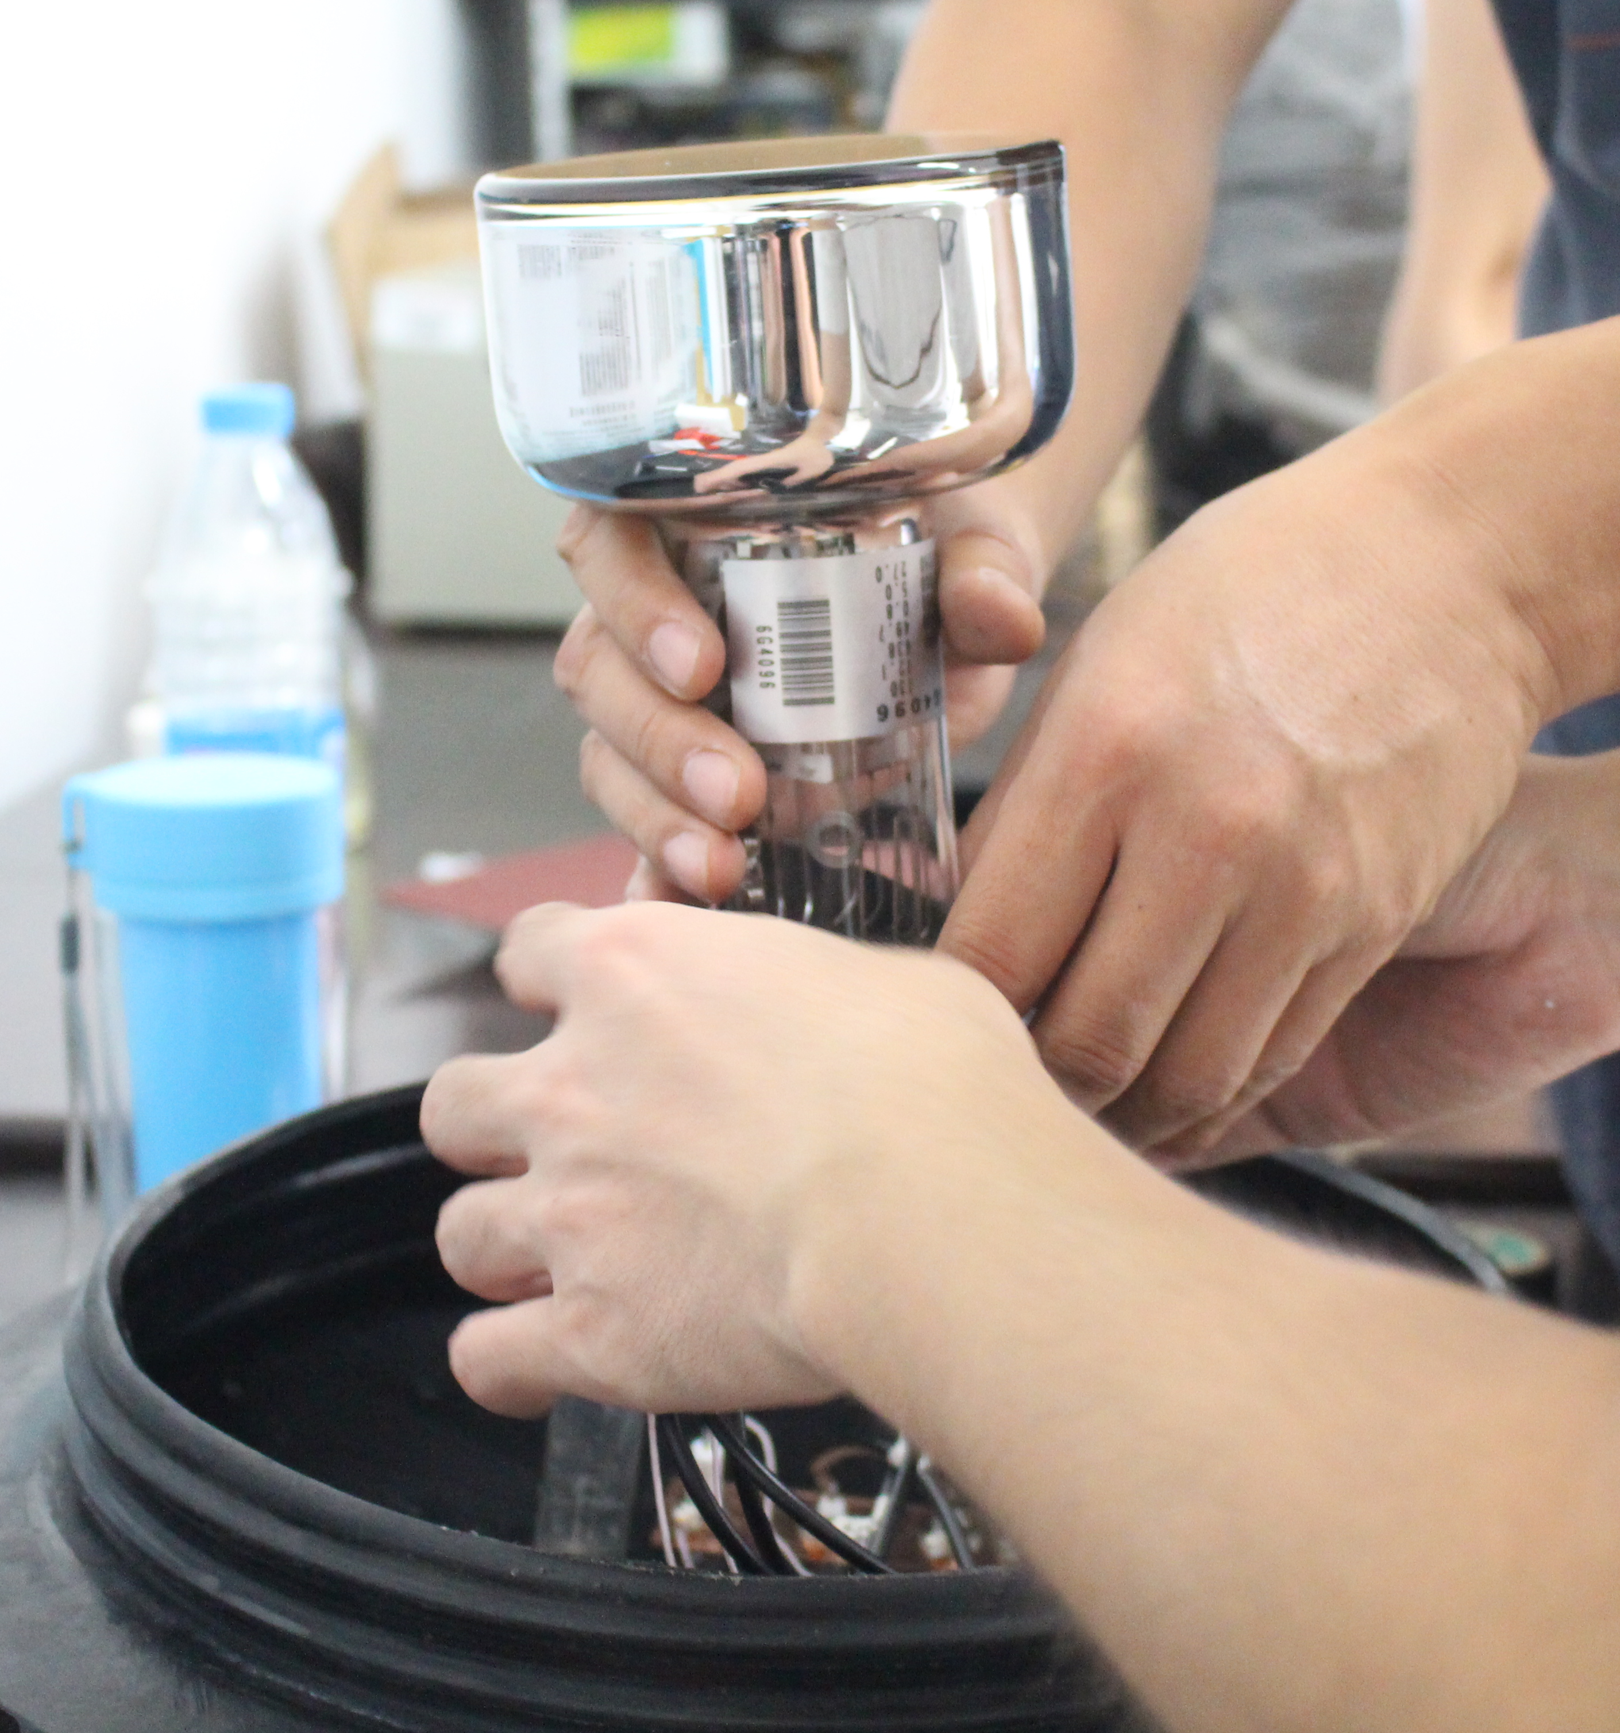

en-探测器设计
闪烁体
reflector
PMT
scintillator 0.4m²
ZnS(Ag)+⁶LiF
tank
反射层
北京滨松CR165
ZnS(Ag)+¹⁰B

Slide 11
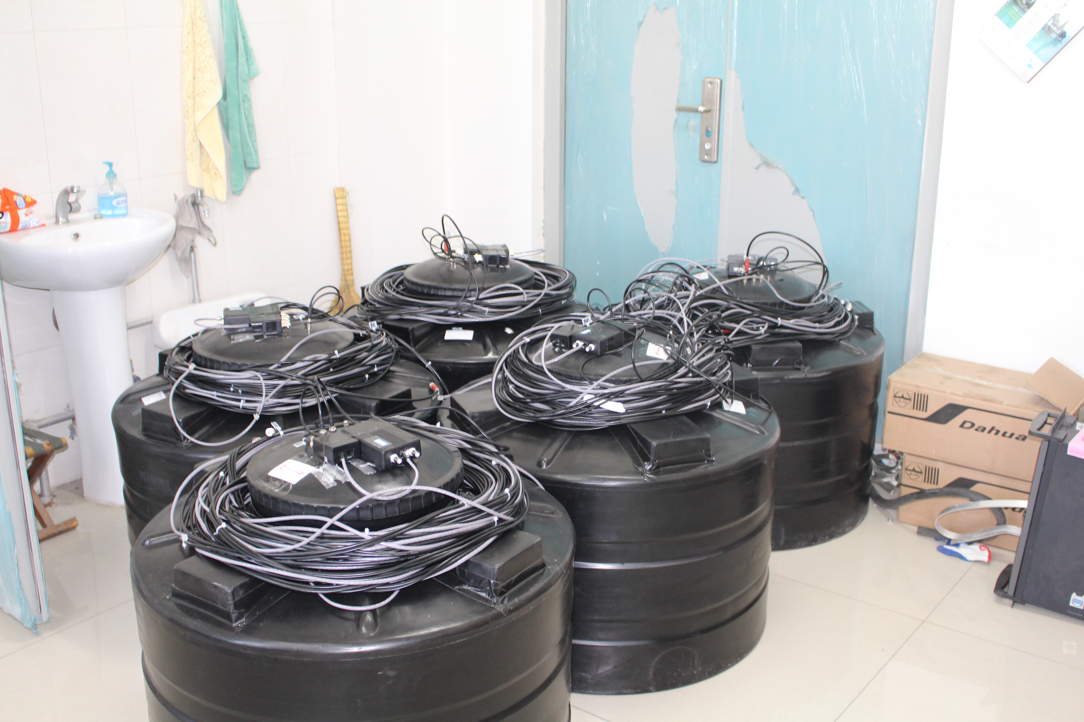
Neutron capture efficiency with thickness of scintillator by using neutron source Cf252.
→ 50mg/cm2, 22.5%
实验室装配探测器单元
50mg/cm2

Slide 12
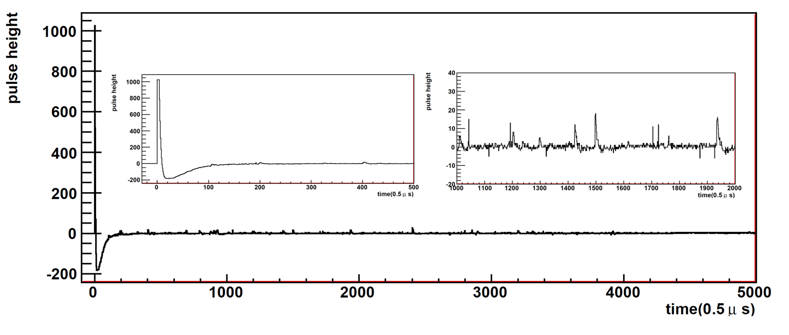
宇宙线簇射事例：得到电磁成分和中子，包含时序
中子
电磁成分

Slide 13
探测器电子学系统

Slide 14
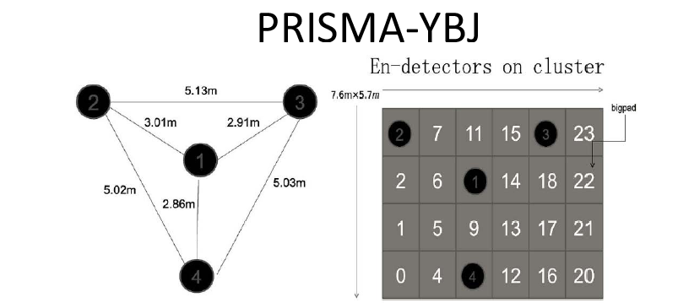
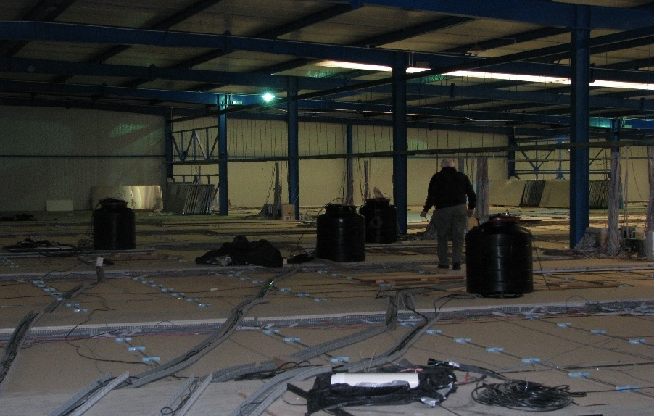
Running time: 2013.11——2017.05
PRISMA-YBJ+ARGO-YBJ：高海拔联合观测
闪烁体采用：ZnS(Ag)+⁶LiF
“Detection of thermal neutrons with the PRISMA-YBJ array in extensive air showers selected by the ARGO-YBJ experiment”
Astroparticle Physics 81 (2016) 49–60

Slide 15
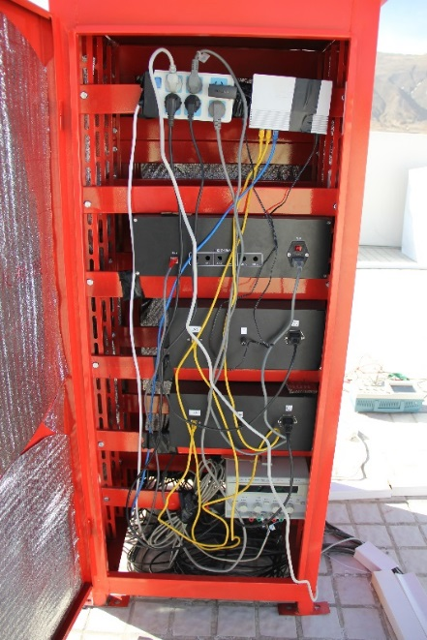
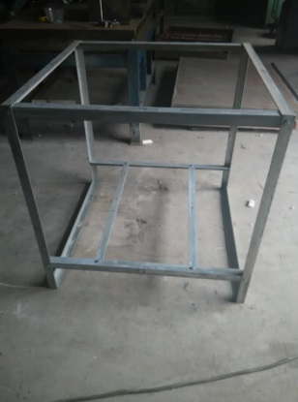
PRISMA-LHAASO-16
EAS thermal neutron detection with the PRISMA-LHAASO-16 experiment, 2017 JINST 12 P12028
Detectors are housed against raining.

Slide 16
序号 | 名称 | 单位 | 数量 | 规格
1 | 模拟电路 | 块 | 2 | 16路信号输入输入输出
2 | ADC电路 | 块 | 1 | 32路、50MHz、14位ADC
3 | 数据采集电路 | 块 | 1 | 最大数据传输率60Mbits/s
4 | 低压直流电源 | 块 | 1 | 220V AC输入
5 | 仪器机箱 | 个 | 1 | 1U标准机箱
6 | 随机软件 | 套 | 1 | Windows平台
FADC: 四川大学
DAQ-50-32
SB
AB
DB
PB
NB
Switch Board
Analog Board
Digital Board
Net Board
16
Channels
ADC
Amplifier
FPGA
FPGA
RJ45
Computer
16
Channels
ADC
BNC to SMB
Power Board

Slide 17
Specification of detector
Threshold of PMT is 3mV.
50-100 photoelectrons per neutron capture
The efficiency for thermal neutron detection is ~20%.
Pulse shapes of electrons in dynode 8 and dynode 5 are recorded in 500μs after trigger (the 8th bin is trigger time). Time bin width of the first 64 bins are 20ns, and others are 1 μs.
Pulse shapes of neutrons are recorded in 20ms time gate after trigger

Slide 18
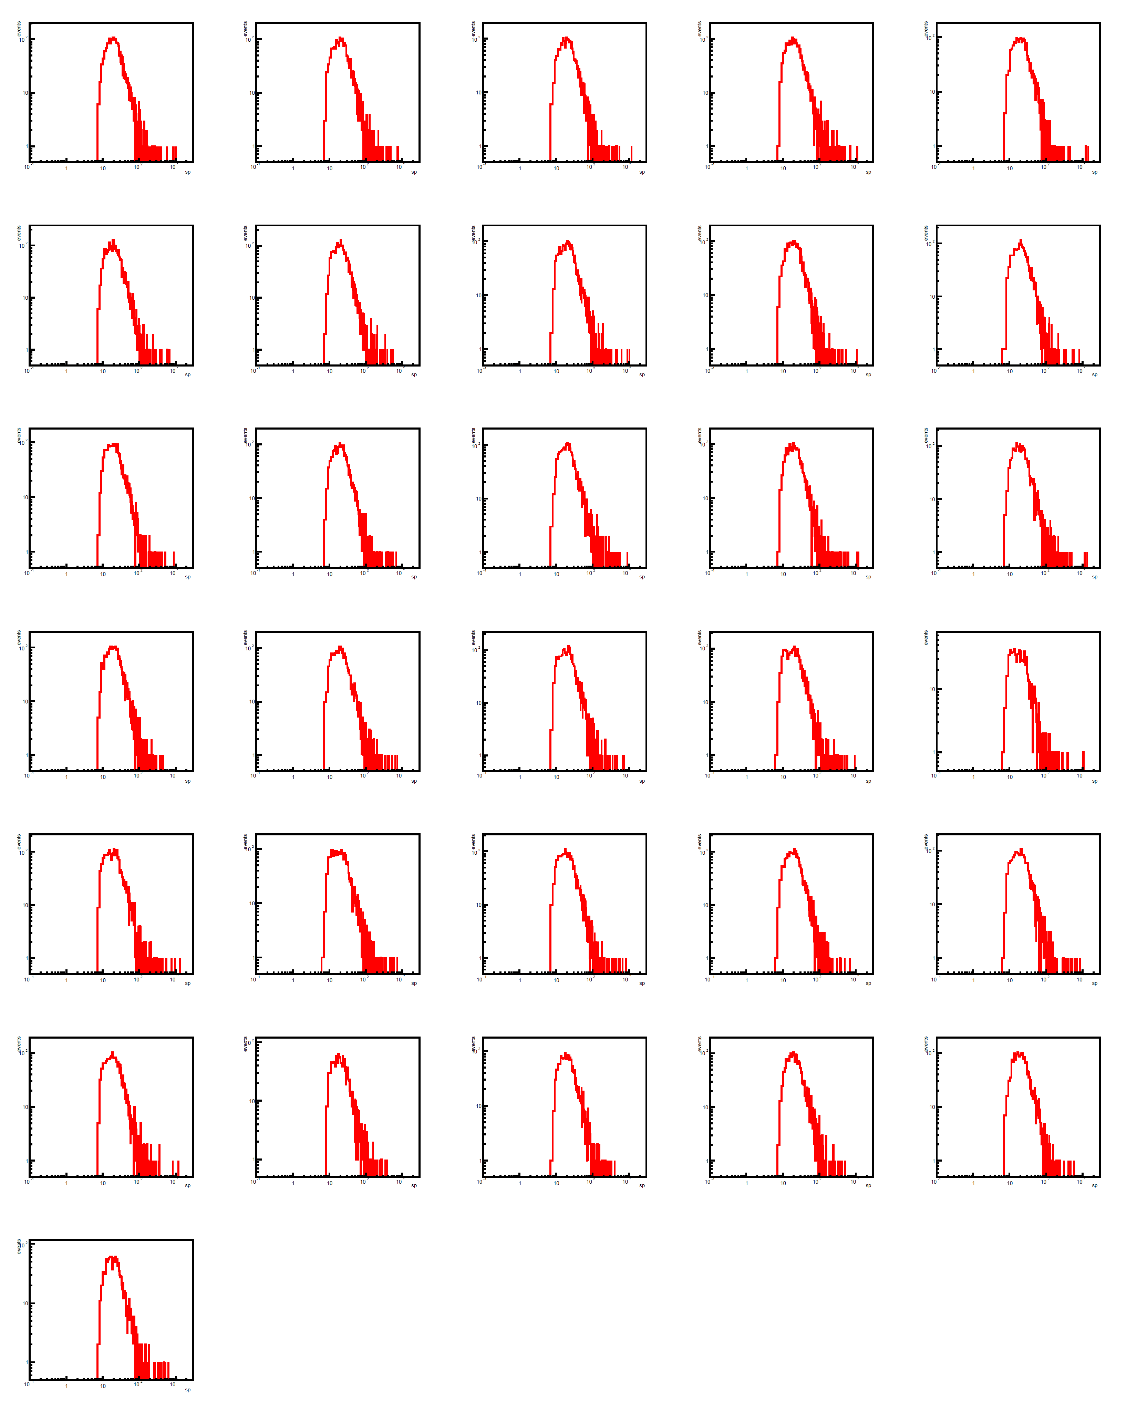
Sp: charged spectrum
阵列运行良好
180510
Detector 2
PRISMA-LHAASO-16:
2018/05/10-180609
All detectors in all days are stable (D16 is stopped)
180609

Slide 19
Sp
Mean value
RMS
Detector 1
Detector 1
days
days
Detector 15
Detector 15

Slide 20
Nm
Raining cover of D2 was blew off
Mean value
RMS
Detector 1
Detector 1
days
days
Detector 15
Detector 15

Slide 21
d8信号幅度(mV)
到达时间(ns)
2017/12/20
event 9623
Core (14.8m,6.4m)
Zen. 43.0°
Azi.-77.5°
d5信号幅度(mV)
中子数
Too few neutrons on the roof

Slide 22
计划进行中
 | PRISMA-LHAASO-16 | PRISMA-LHAASO-64 | PRISMA-LHAASO-400
detectors | 4×4=16 | 8×8=64 | 20×20=400
clusters | 1 | 4 | 25
Array Area(m²) | 15×15=225 | 35×35=1225 | 95×95=9025
Trigger rate (2-fold) (Hz) | 0.14 | 0.56 | 3.5
Data (GB/day) (trigger + scaler) | 0.036+0.0002=0.0362 | 0.144+0.0008=0.1448 | 0.9+0.005=0.905

Slide 23
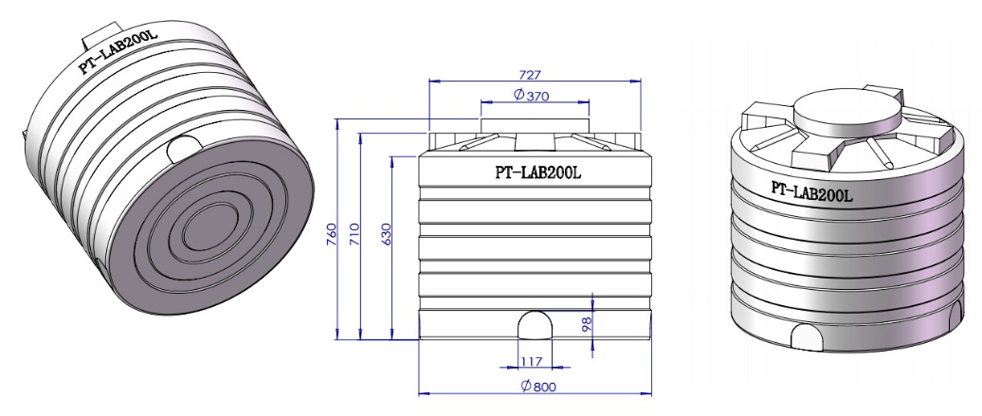
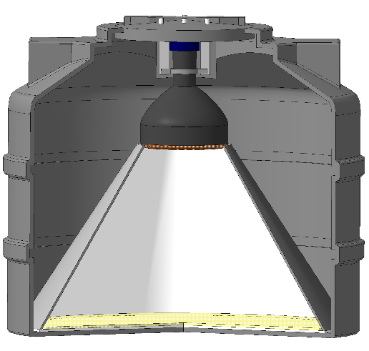
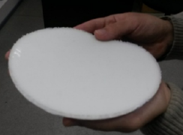
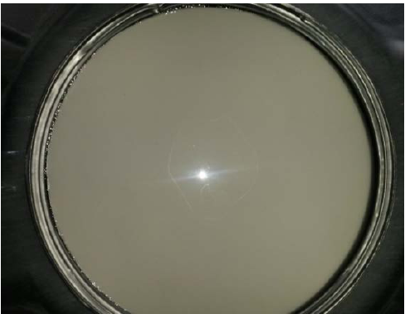
16 en-detectors in cluster,
25 clusters,
400 en-detectors
探测器单元
16个探测器1个CLUSER(2016)
64个探测器4个CLUSER(2017-2018)——目标
未来目标PRISMA-LHAASO
建设400个探测器构成的10000平米阵列(20？？)
100m
Boron scintillator
ZnS(Ag)+B₂O₃
5m
4” PMT CR165 (Beijing Hamamtsu)
100m

Slide 24
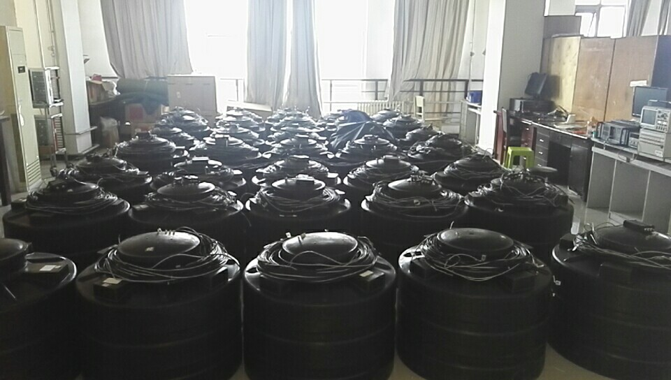
64个探测器装配调试正在进行中。。。
河北师范大学 热中子探测器实验室

Slide 25
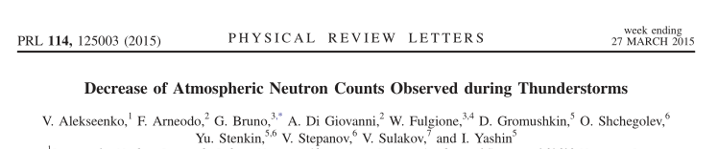
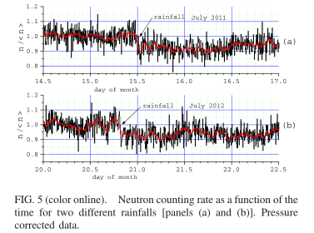
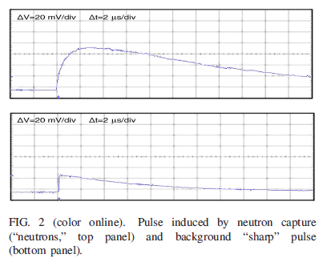
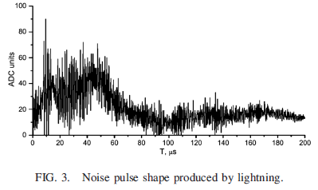
可开展的相关物理研究
大气物理：暴风雨，rain – yes, lightning - no
Summary: no any neutron excess during thunderstorms but instead sometimes we see
decrease of neutron flux

Slide 26
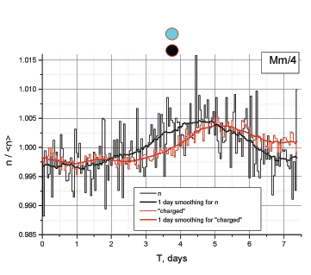
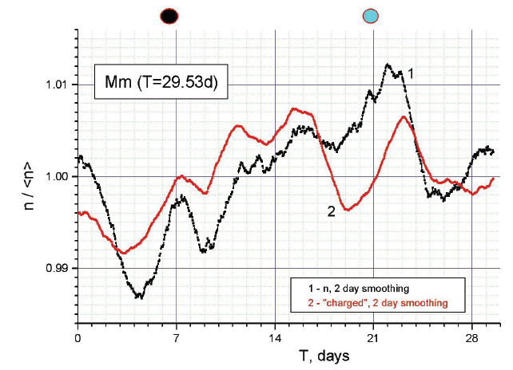
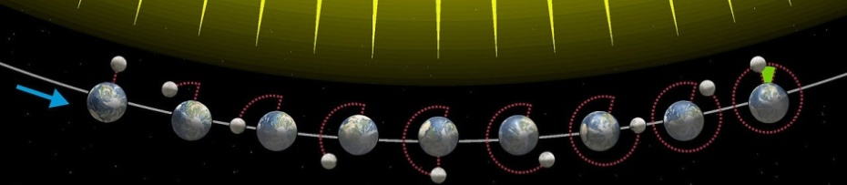
地球物理：lunar tidal effect
在独立运行的1年半中测到了热中子周期性变化←日月地系统引力引起地壳变形的潮汐效应。发表SCI文章 Pure Appl. Geophys. 174 (2017) 2763–2771。
如此微弱的效应都能测到，说明这种探测器可用来监测地壳突发变化。
月周期
周周期
New moon
full moon

Slide 27
地球物理：地震活动
V.V.Alekseenko et al. Tidal effect in the radon-due neutron flux from the Earth’s crust. J. of Physics: Conference Series. 203, 012045 (2010)
Abnormal behavior of neutron flux on 2, May 2004
BAKSAN
Local North Caucasus seismic activity and full Moon

Slide 28
太阳物理
the solar maximum was ~ 4 years ago. in these 2.5 years, solar activity becomes weaker to cause cosmic ray flux and then neutron flux increasing.
Long-Term Variations in the Natural Thermal Neutron Flux at 4300 m above Sea Level， Bulletin of the Russian Academy of Sciences: Physics, 2017, Vol. 81, No. 2, pp. 160–161.

Slide 29
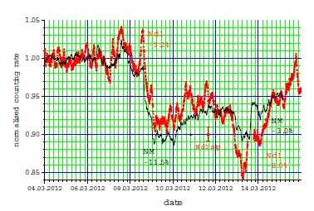
太阳物理：Forbush 下降
One Forbush decrease on March 8, 2012 detected by (from top to bottom) (1) Moscow neutron monitor, (2) Gran Sasso (Italy), (3) MEPhI (Moscow Engineering Physics Institute) and (4) Obninsk (Moscow).
V. Alekseenko, et al. Registration of Forbush decrease 2012/03/08 with a global net of the thermal neutron scintillation en-detectors. Journal of Physics:Conference Series 409 (2013) 012190

Slide 30
总结：
1.EAS热中子探测技术方案作为LHAASO实验新技术研发和拓展正在不断完善和成熟
2.希望在科学家和各基金部门的认可、帮助和大力支持下推进项目规模化发展。
谢谢！

