Slide 1
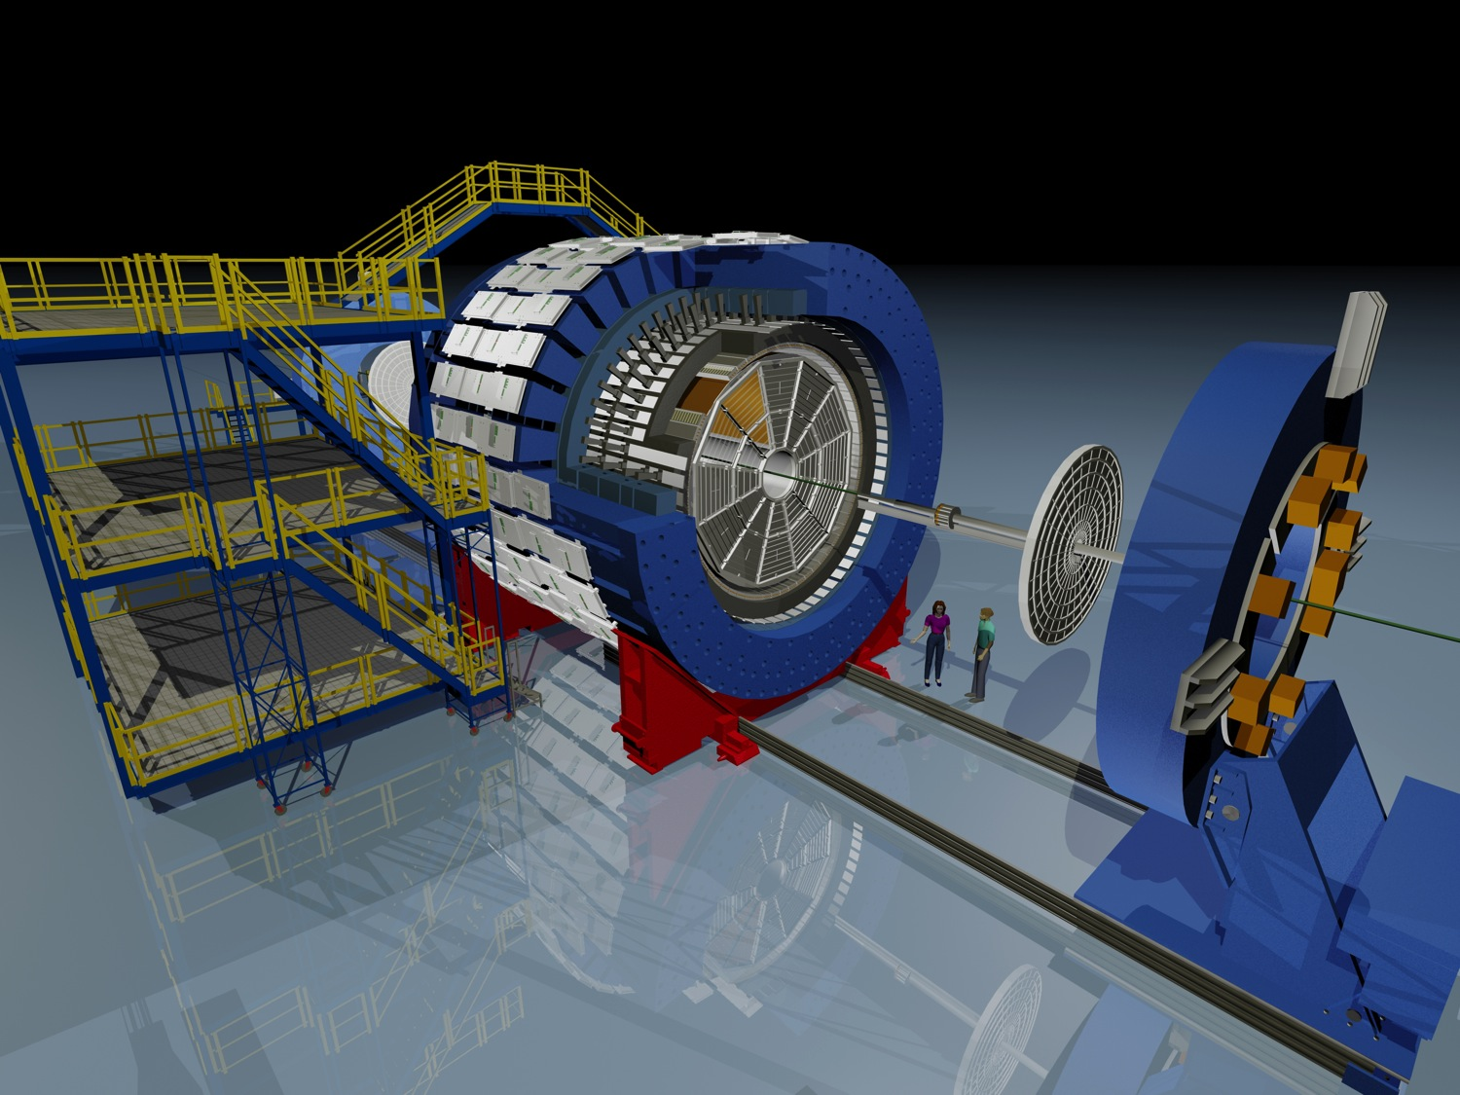
The STAR
Event Plane Detector
Upgrade
Ming SHAO
USTC
Physics Motivation
EPD Design
Construction/Commission/Performance
Summary

Slide 2
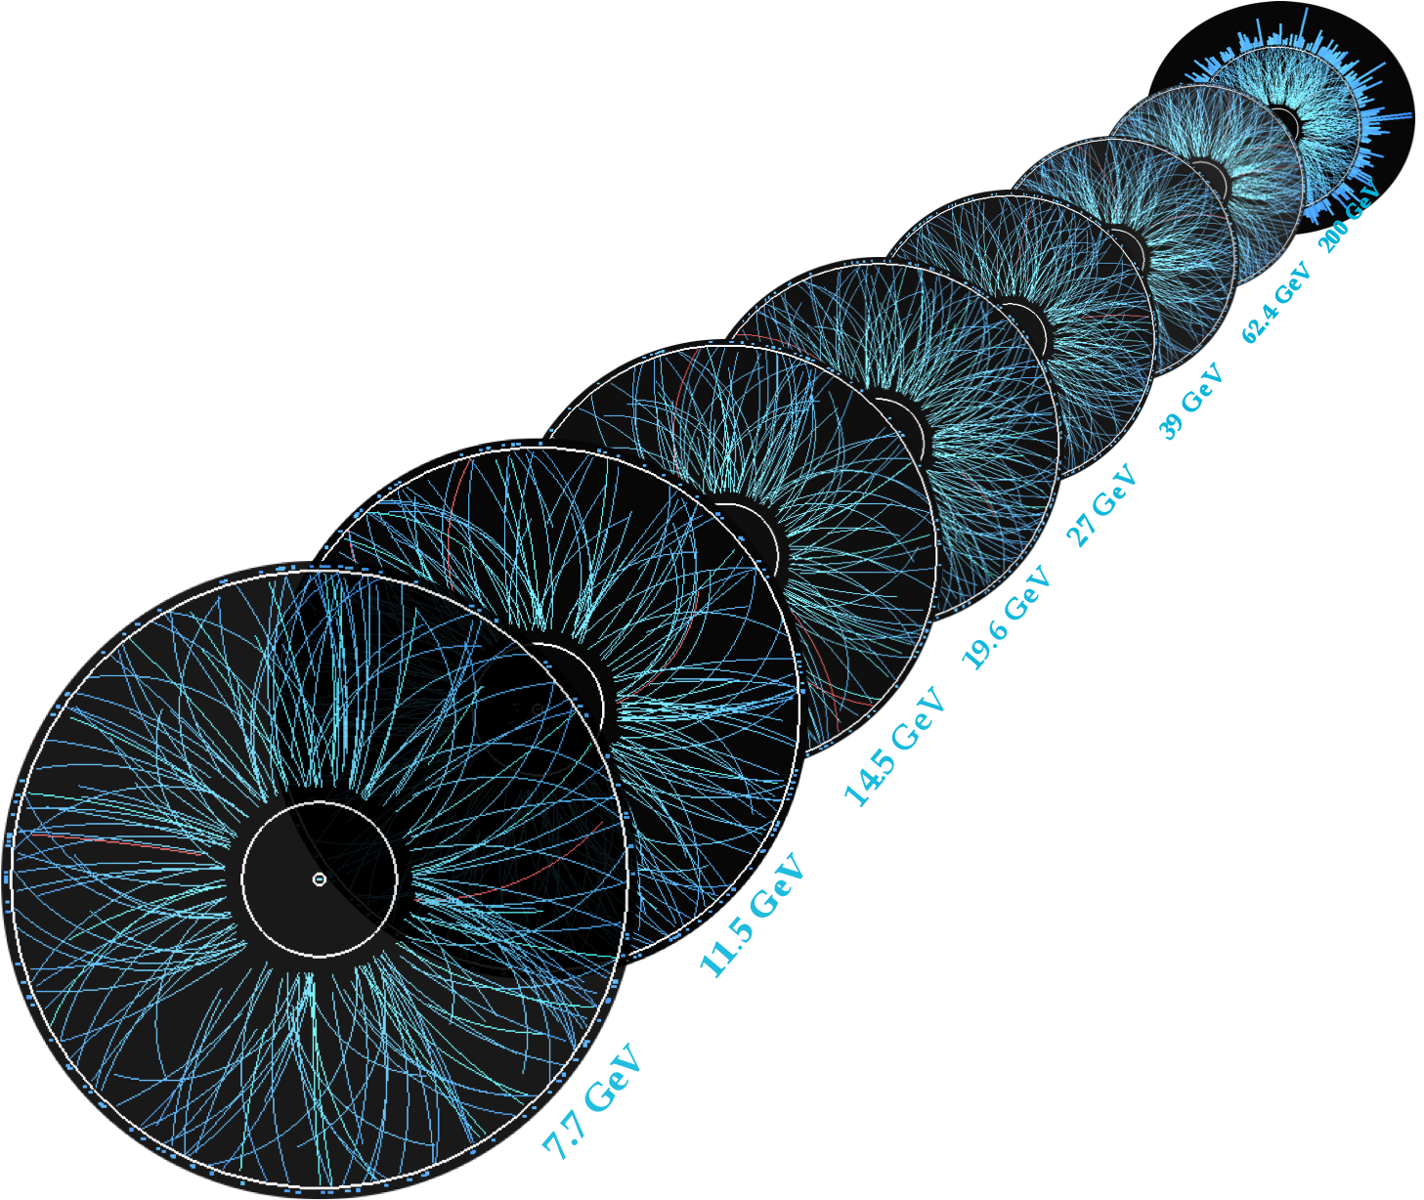
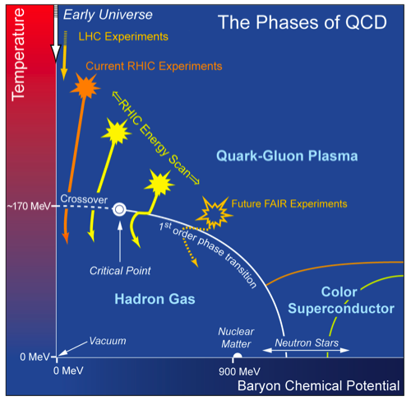
RHIC Beam Energy Scan
Key measurements and goals:
Location of critical point and first order phase transition
Notes:
Explain QCD phase diagram first, then fly in the RHIC beam energy scan project (STAR), and shrink the QCD phase diagram into the bottom-right corner.

Slide 3
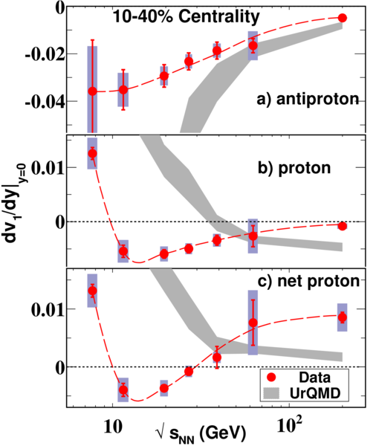
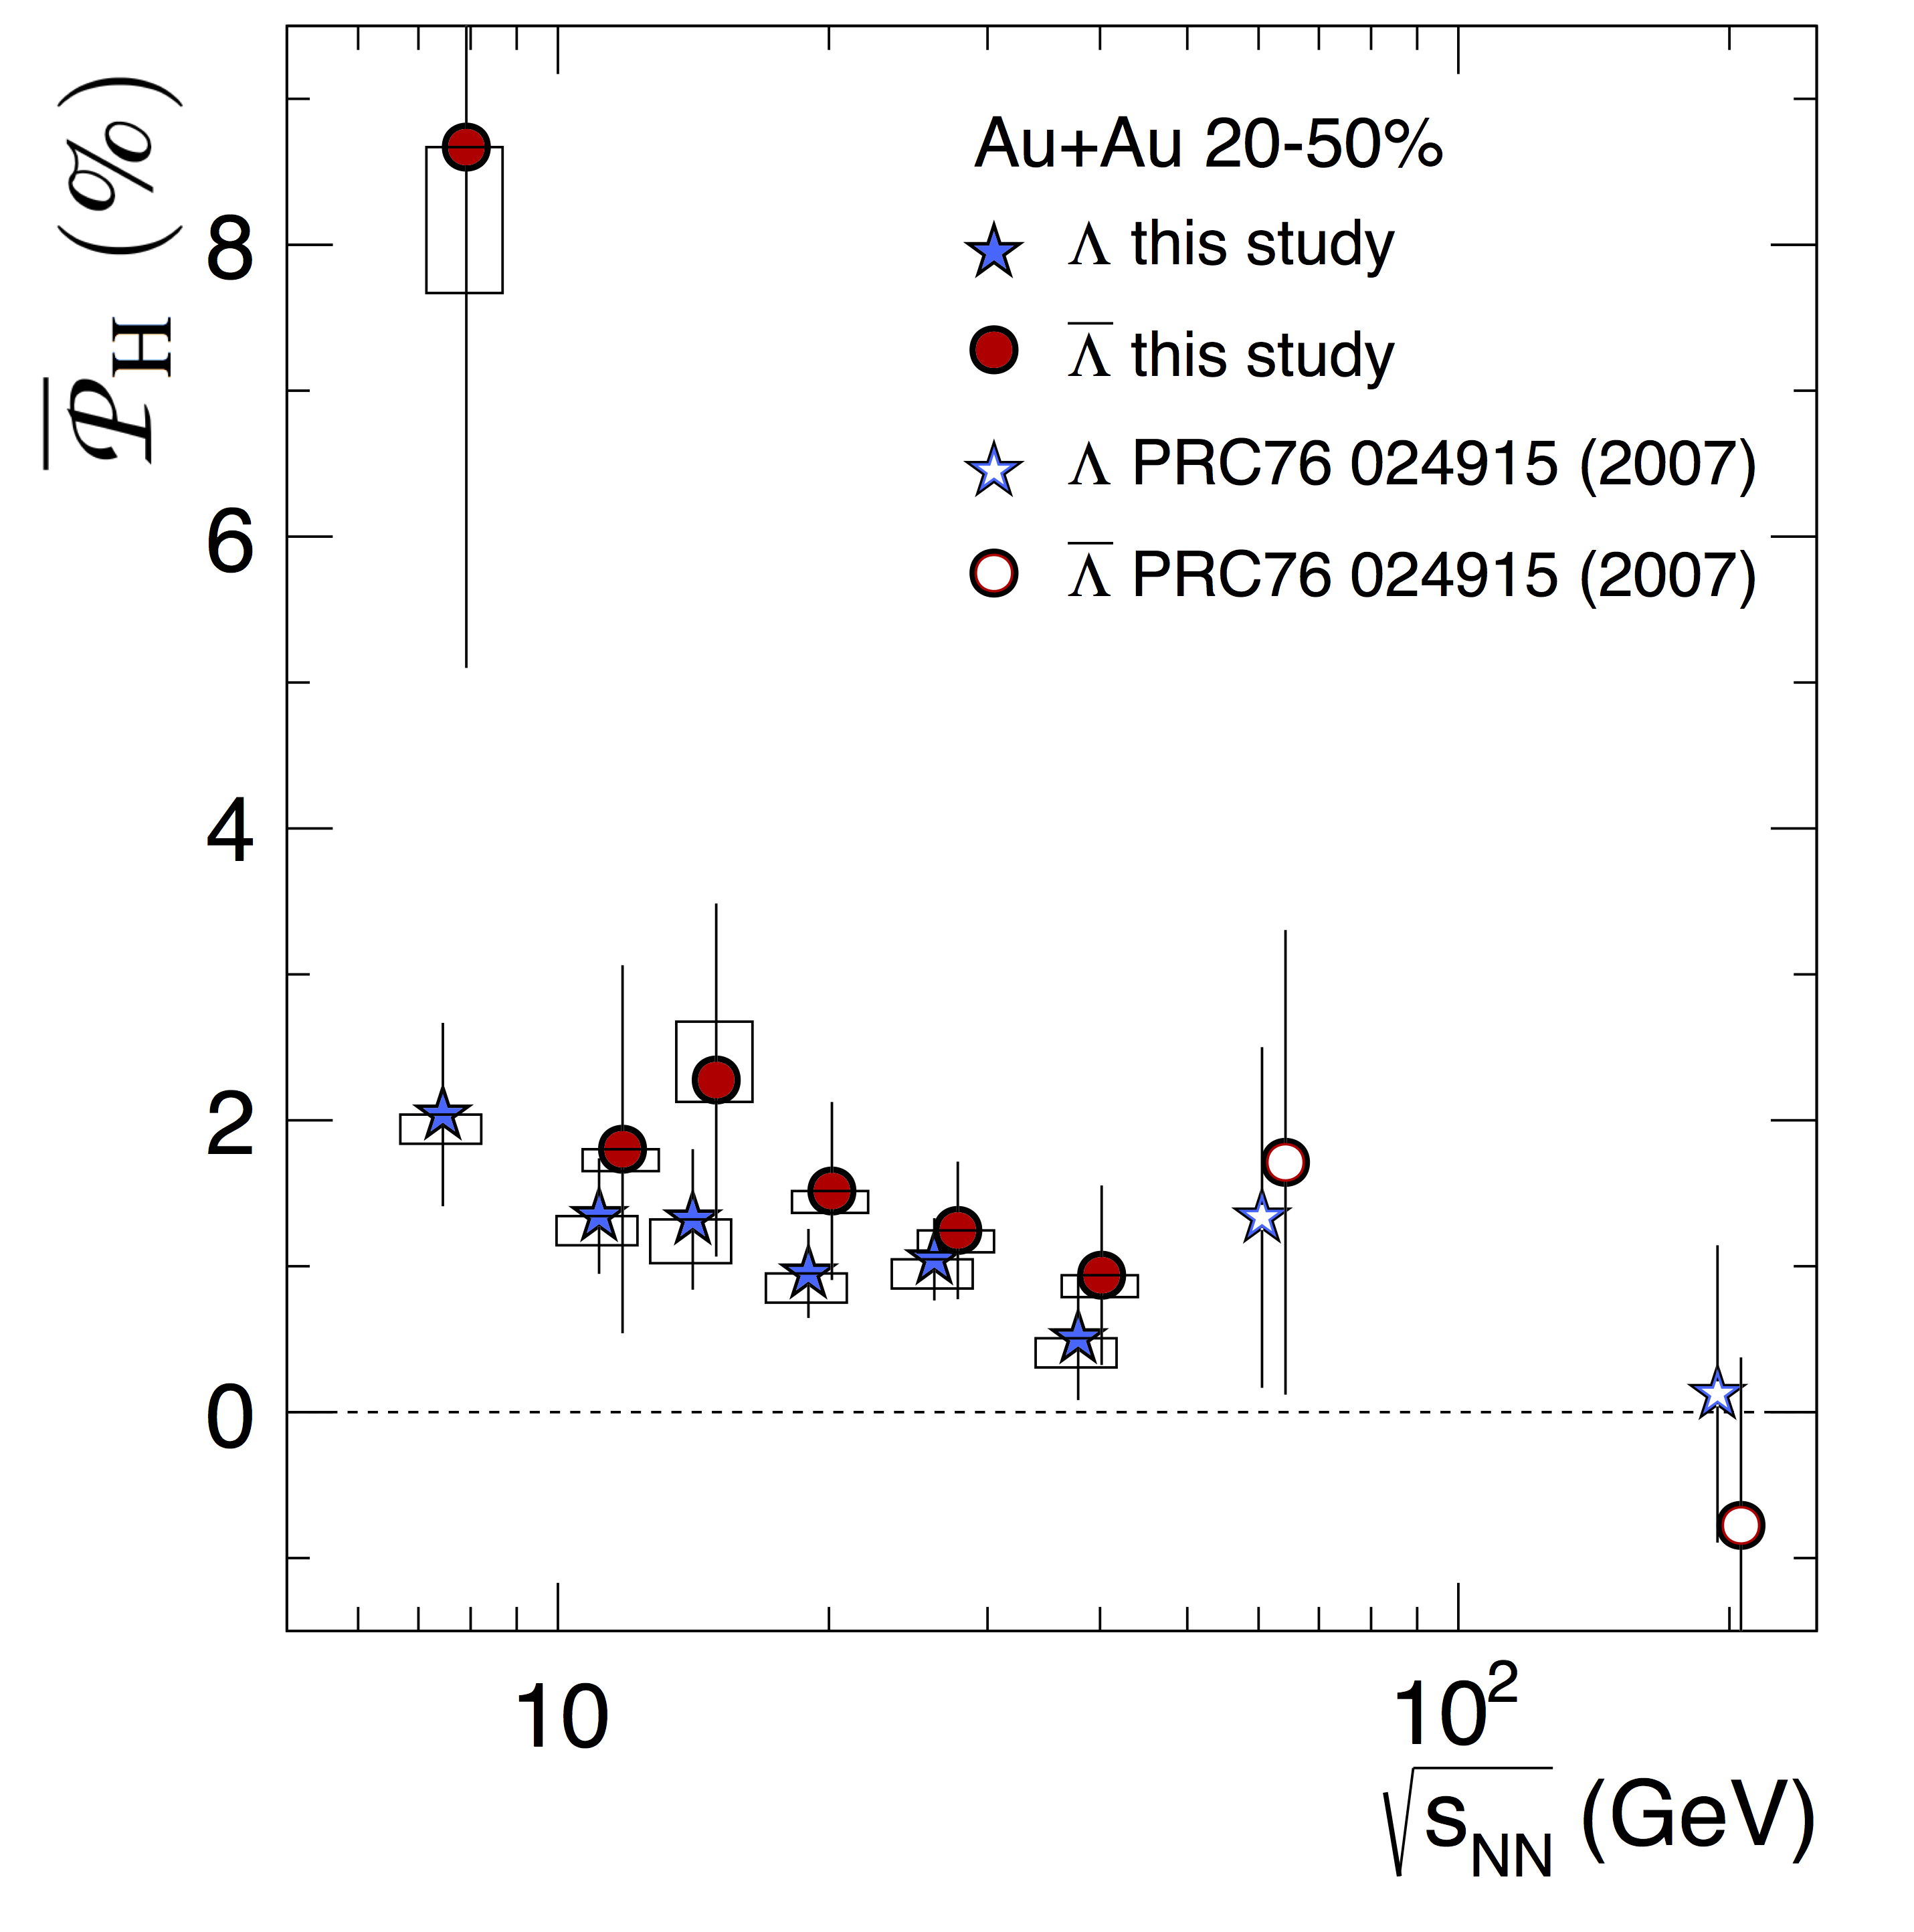

Collision Geometry and Physics
Some examples:
polarization
fluctuation analyses
flow measures & correlations
high sensitivity to collision geometry selection
  physics?
  volume fluctuations?
  auto-correlations?
  want a separate reference, an unit of rapidity away!
z
Reaction
plane
y
STAR PRL 2014
x
STAR PRL 2014
  STAR Nature 2017

Slide 4
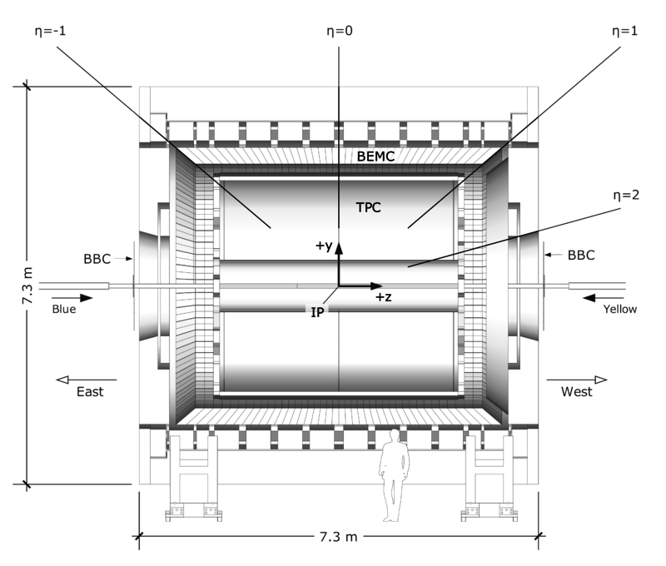
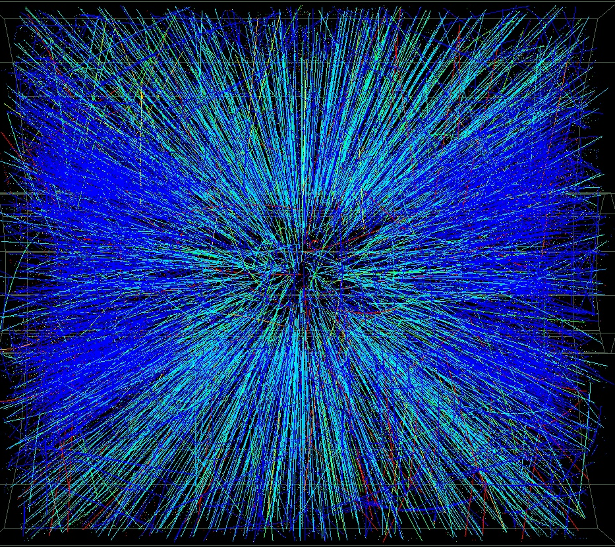
EPD Location
EPD
EPD
The EPD will allow us to measure the centrality and event plane with high precision!

Slide 5
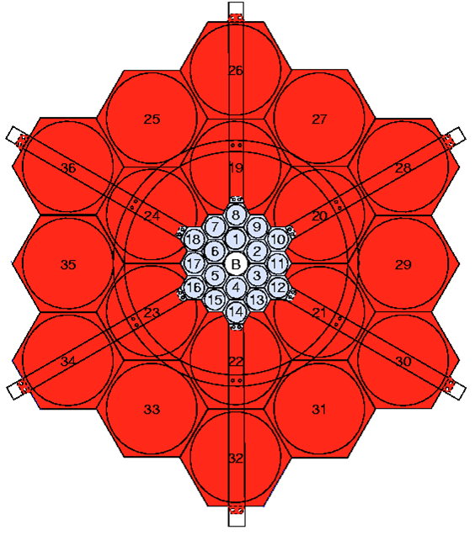
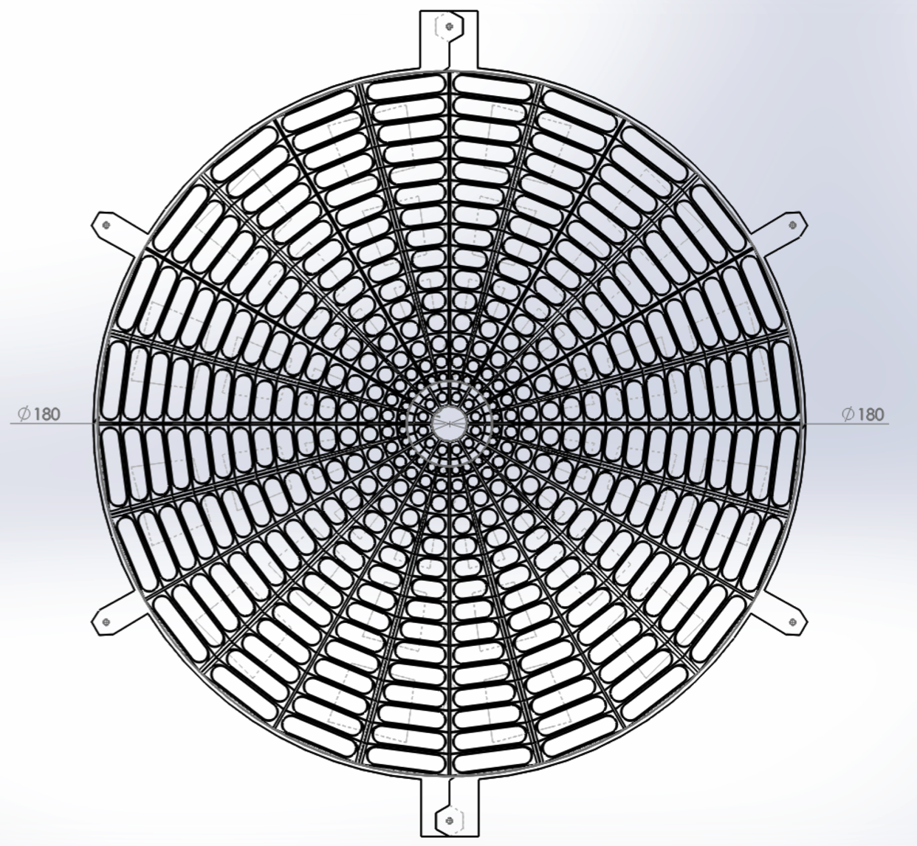
EPD vs BBC
BBC – 36 tiles but only 18 inner tiles used
has served STAR extremely well so far
EPD – 372 tiles
16 eta segments
24 phi segments (12 at highest eta)
BBC inner:
18 tiles
1 BBC tile ~ 5-7 EPD tiles
快度覆盖增加1倍
通道数增加10倍
本底抑制提升10倍
触发能力提高100倍

Slide 6
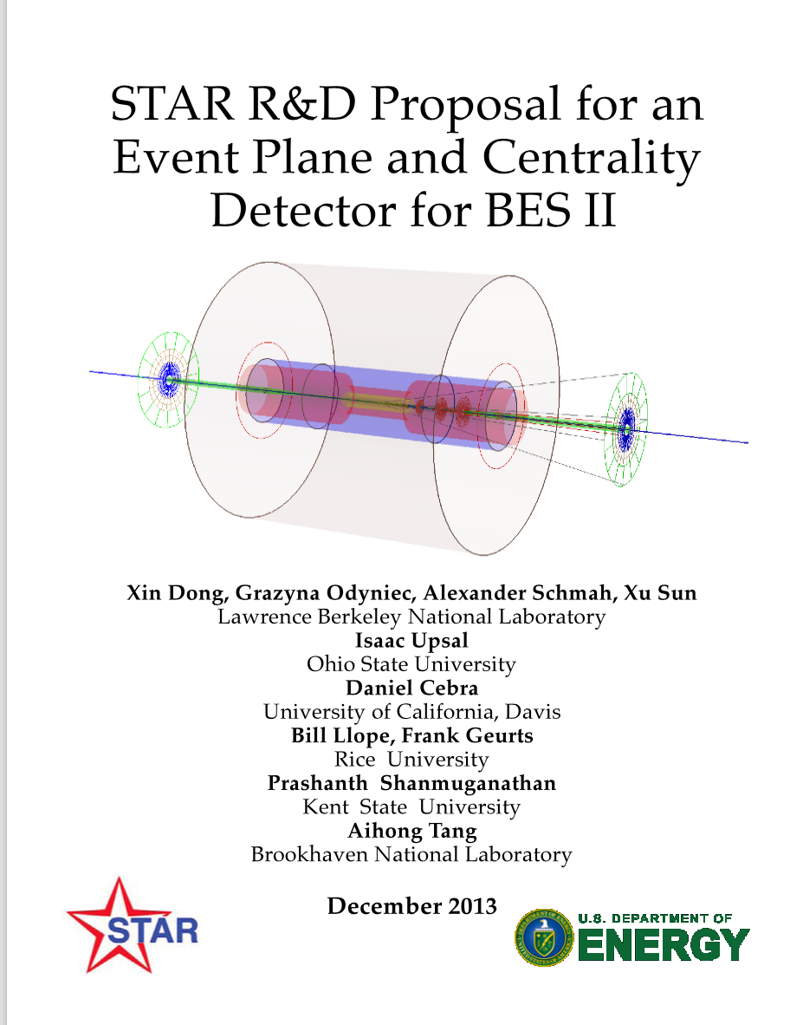
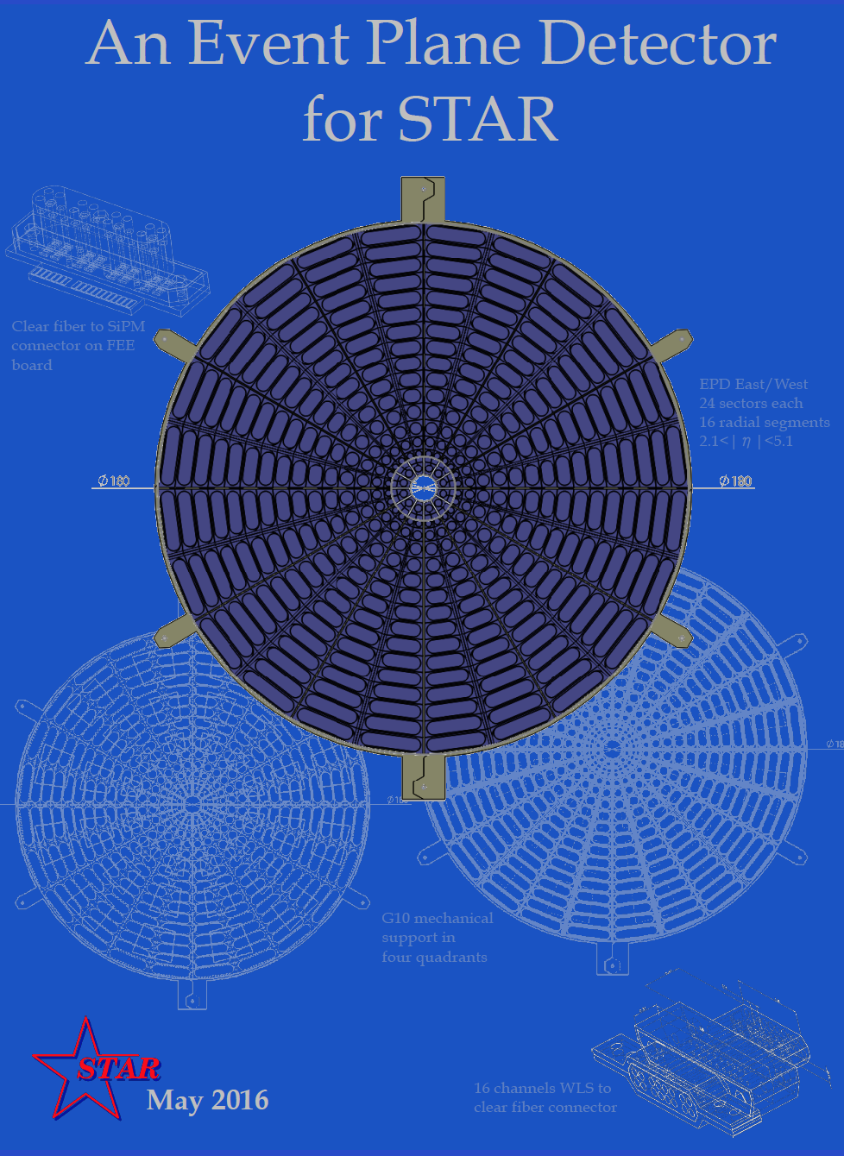
Timeline
2013 – R&D proposal submitted
2014 – R&D (LBNL)
2015
  Pre-prototype (EEMC tiles + FPS electronics) run in STAR
  Prototype construction
2016
  Prototype run in STAR (behind BBC)
  Construction proposal of 1/8 EPD approved
  Analysis of 2016 data
  Install 1/8 EPD in STAR behind BBC
2017
  Commissioning run in STAR of 1/8 EPD behind BBC
  Full EPD construction proposal approved
  Analysis of 2017 data
  completion of EPD & installation at STAR
2018
  Commissioning run in STAR of full EPD
  Analysis of 2018 data
beyond 2018
– EPD as trigger and physics detector

Slide 7
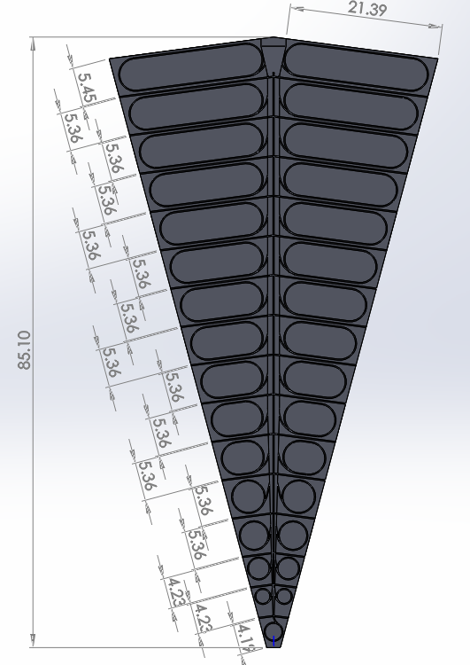
Design 2017 (final)
2 Wheels of 12 supersectors with 31 optically-isolated tiles
  1.2-cm-thick scintillator
  3 turns of Wavelength shifting (WLS) fiber
Total of 12x31x2=744 channels
  Optical signal transported 5.5 m on clear fiber
  Coupled to SiPM
Read out by STAR electronics
Custom-built connector components
  3D-printed

Slide 8
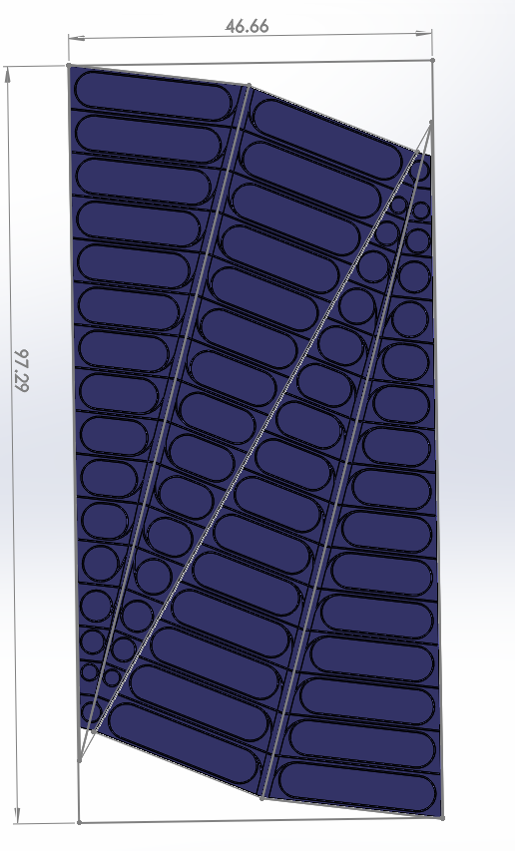
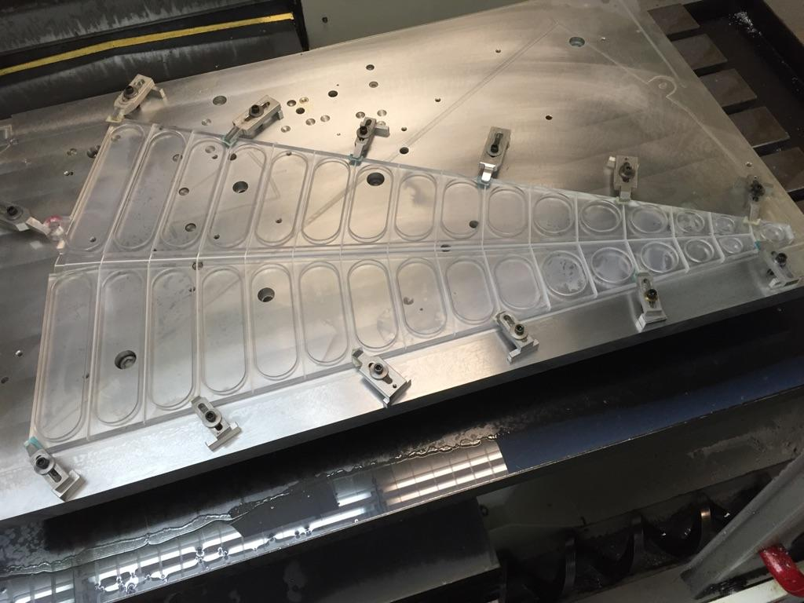
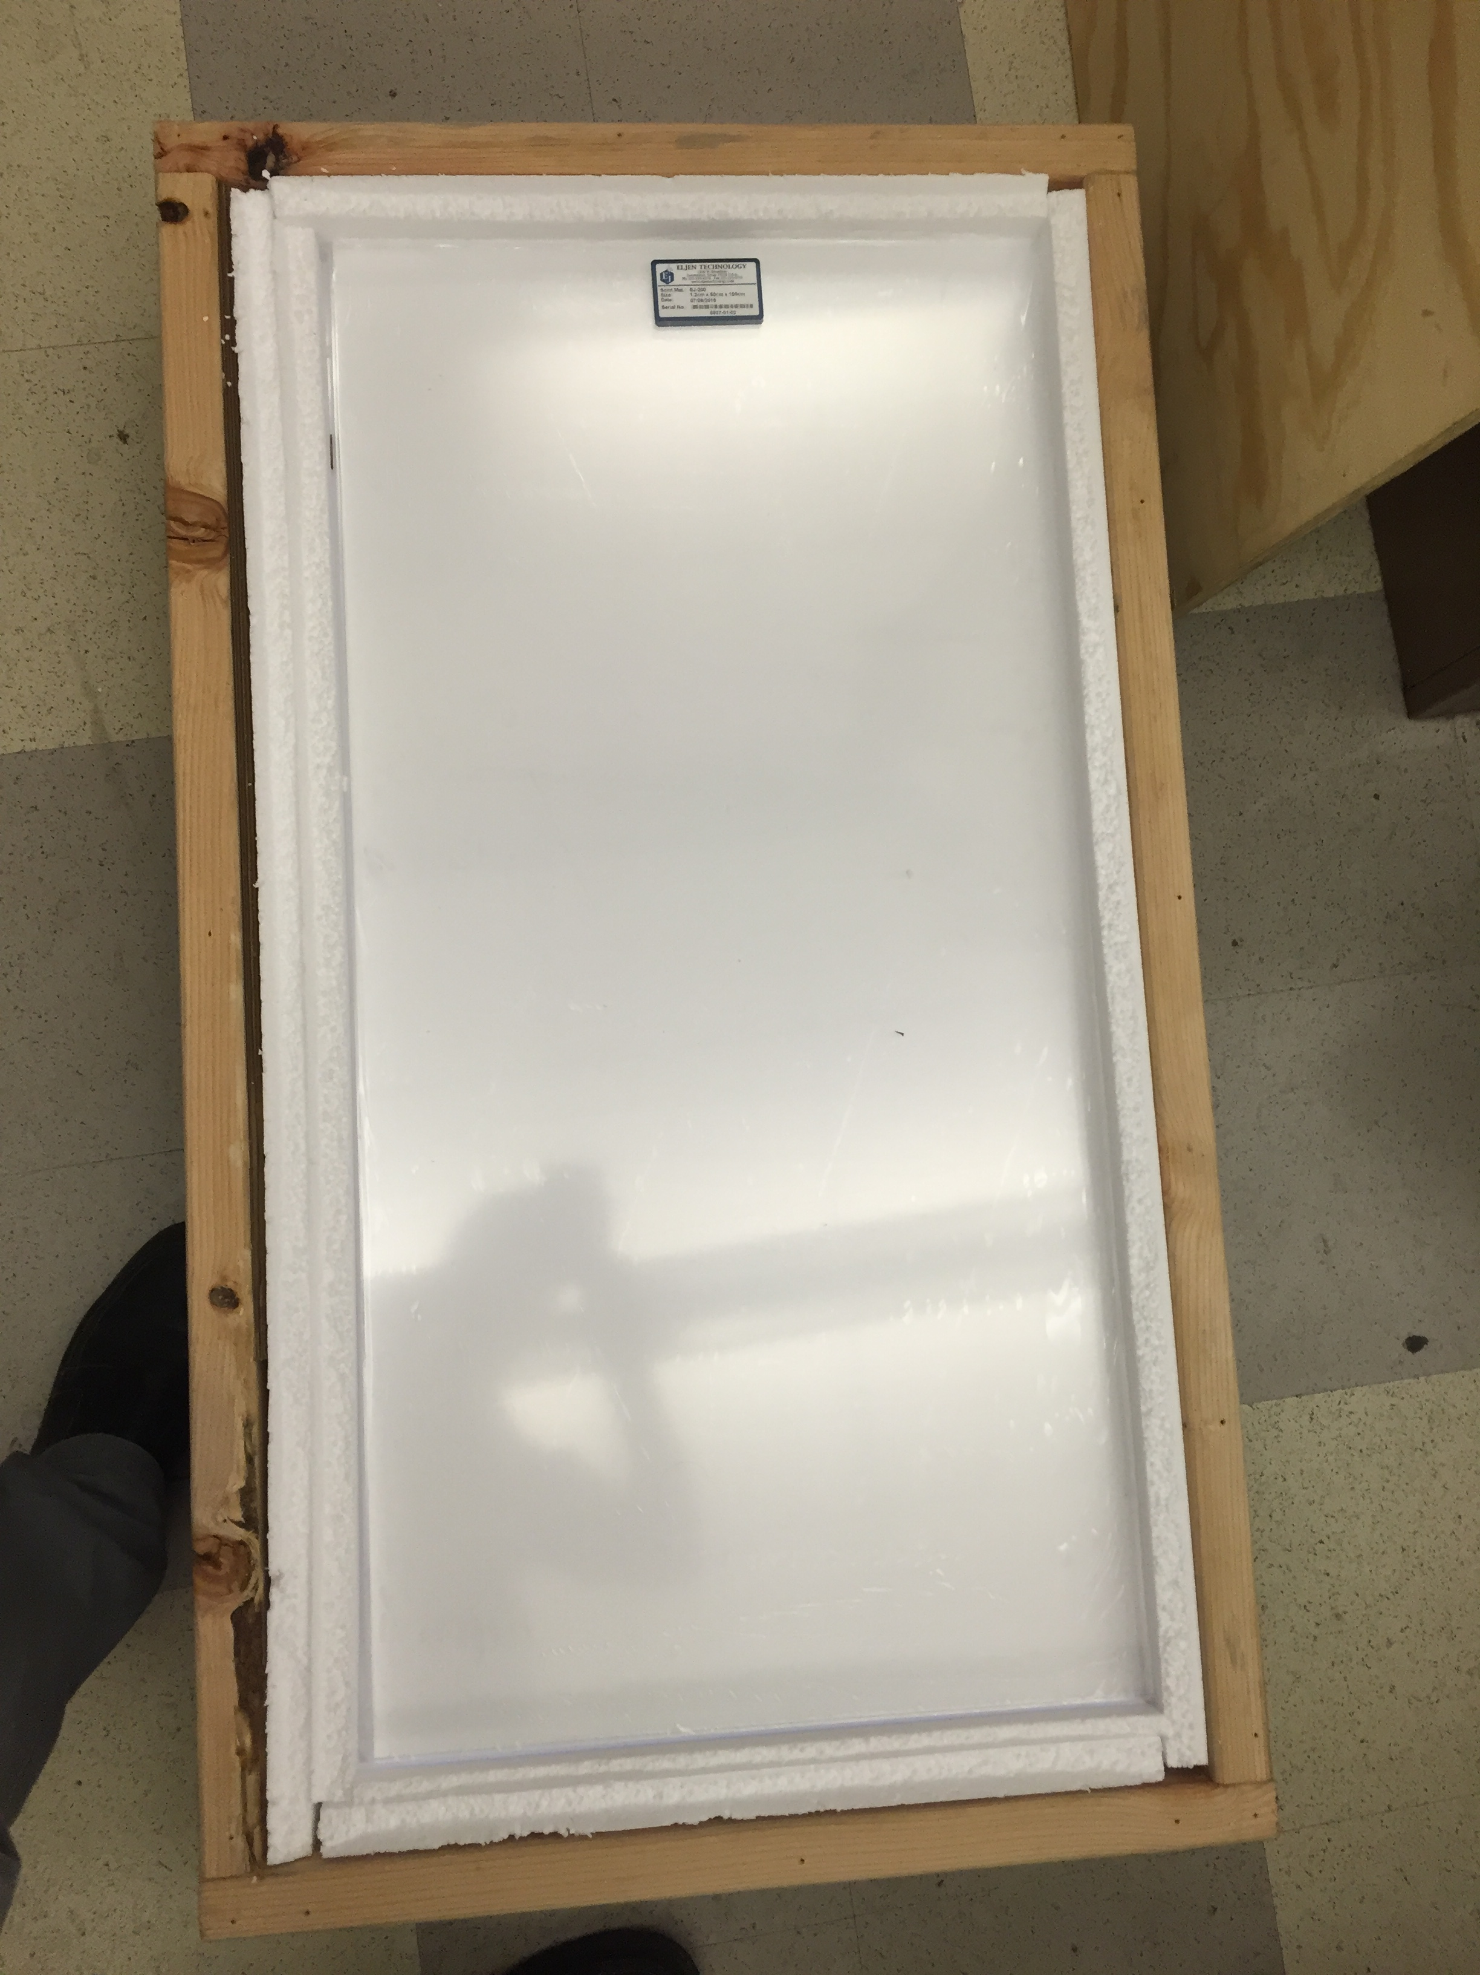
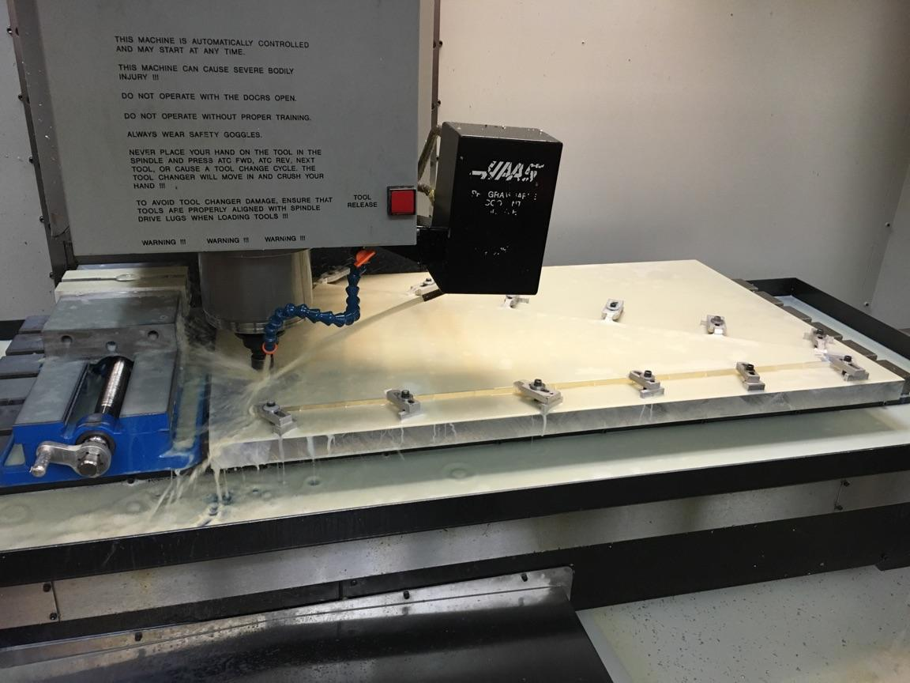
Machining
50”x20” mill platform @OSU
CNC milling high volume water/oil for cooling, debris

Slide 9
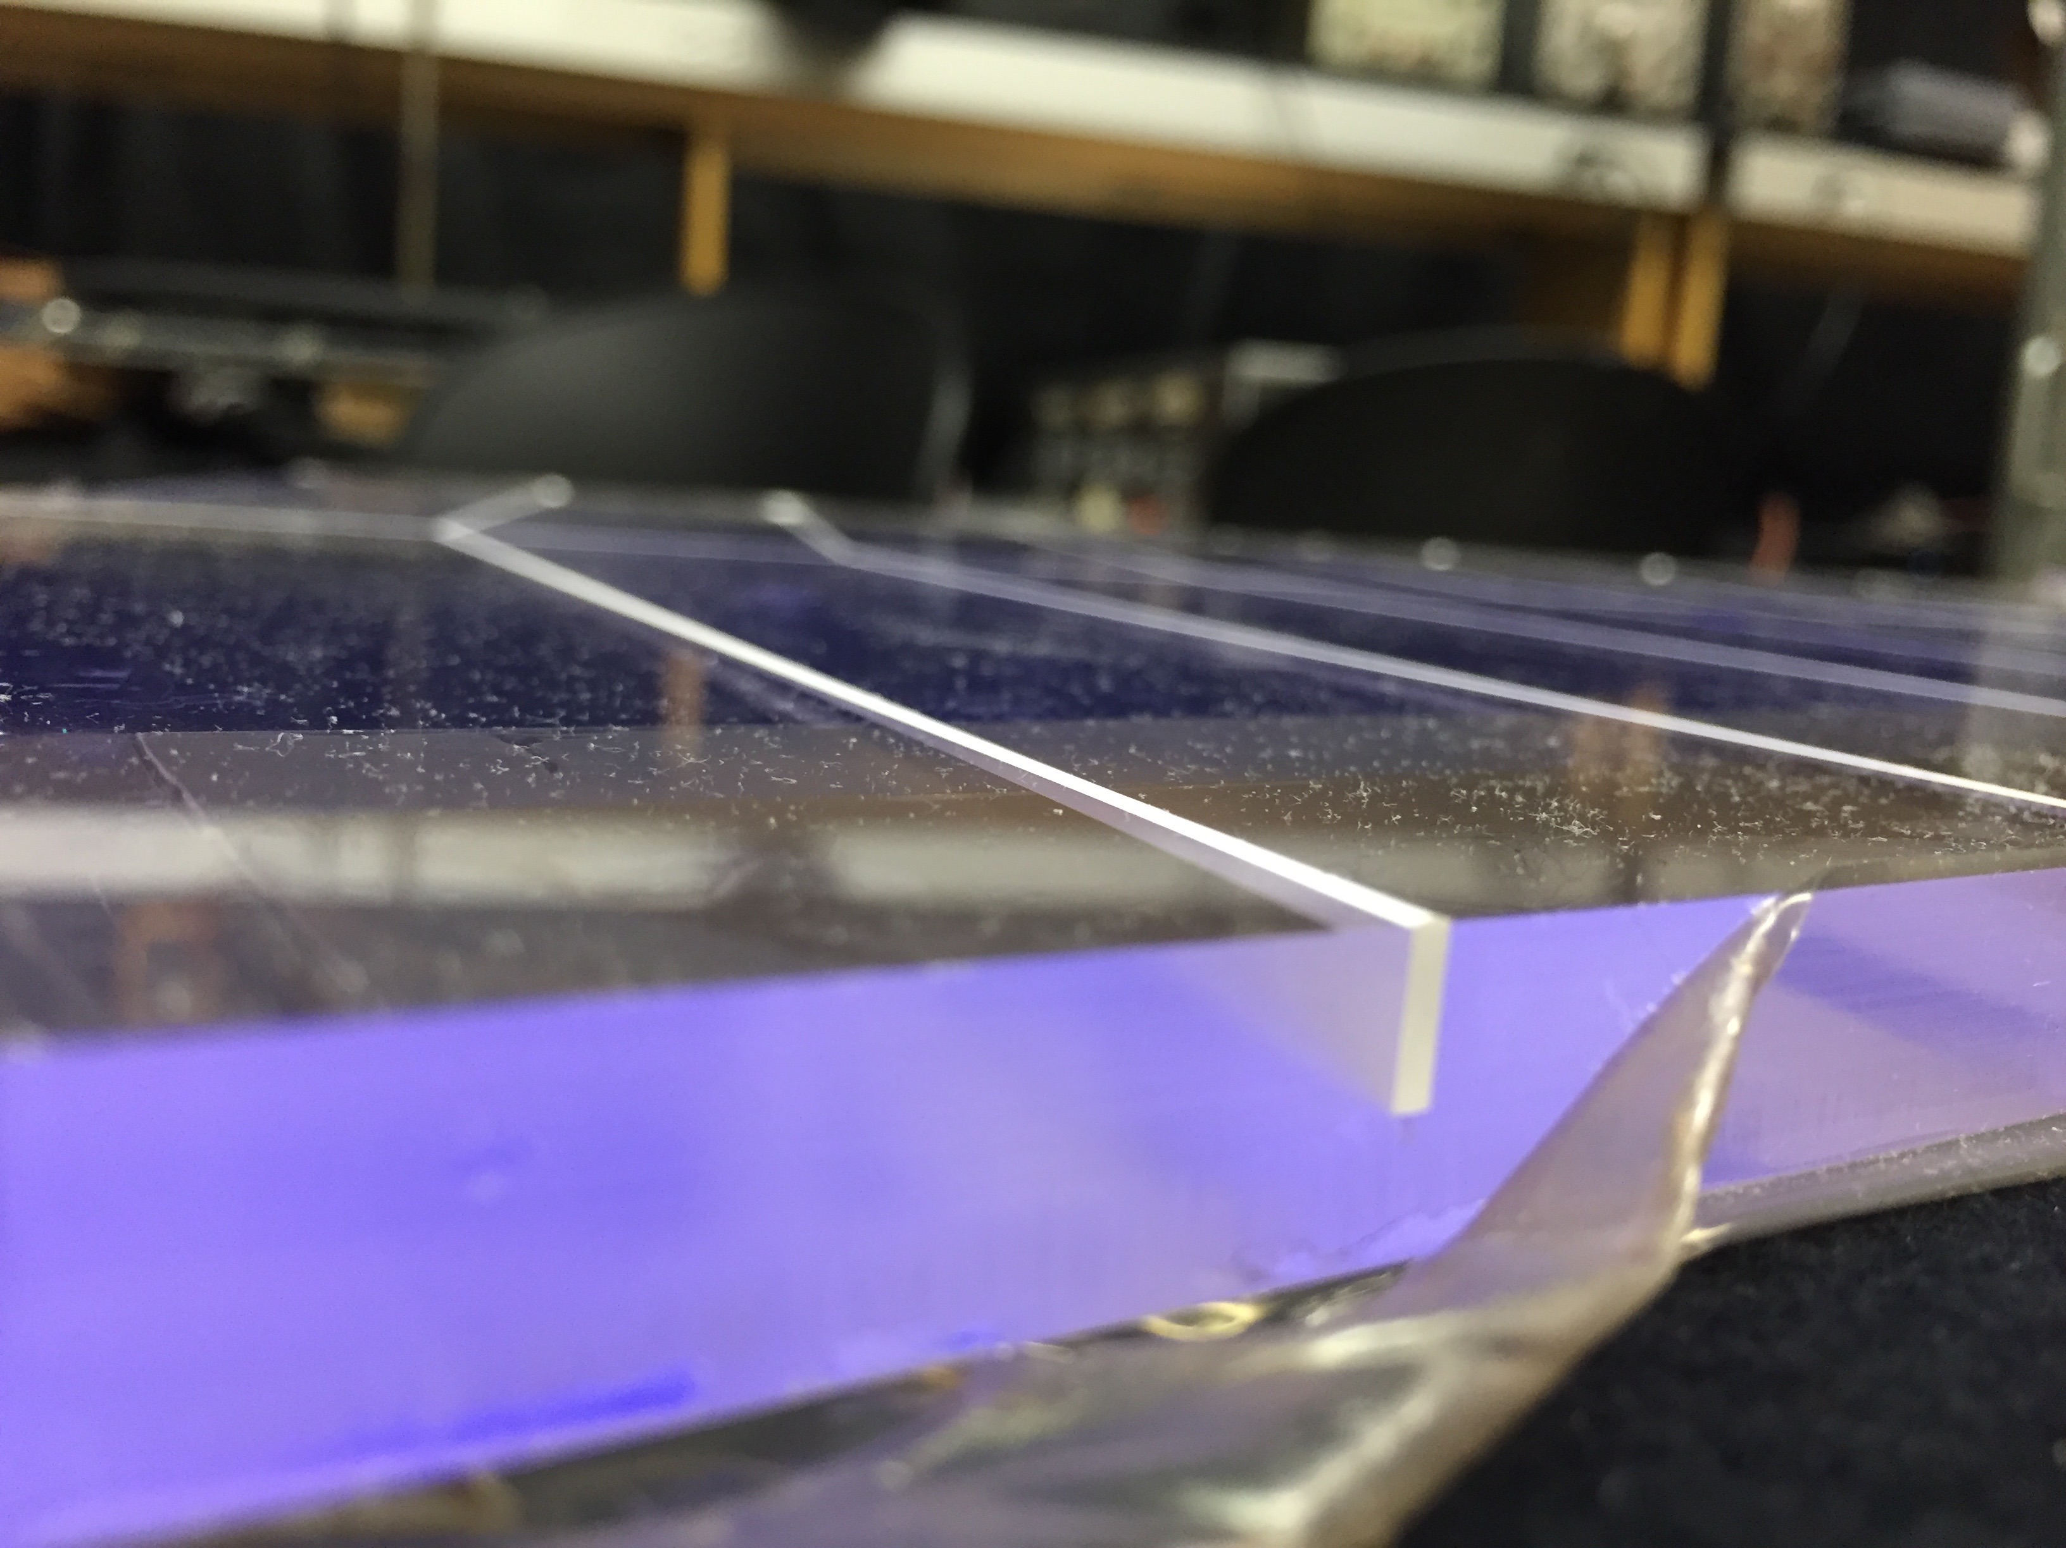
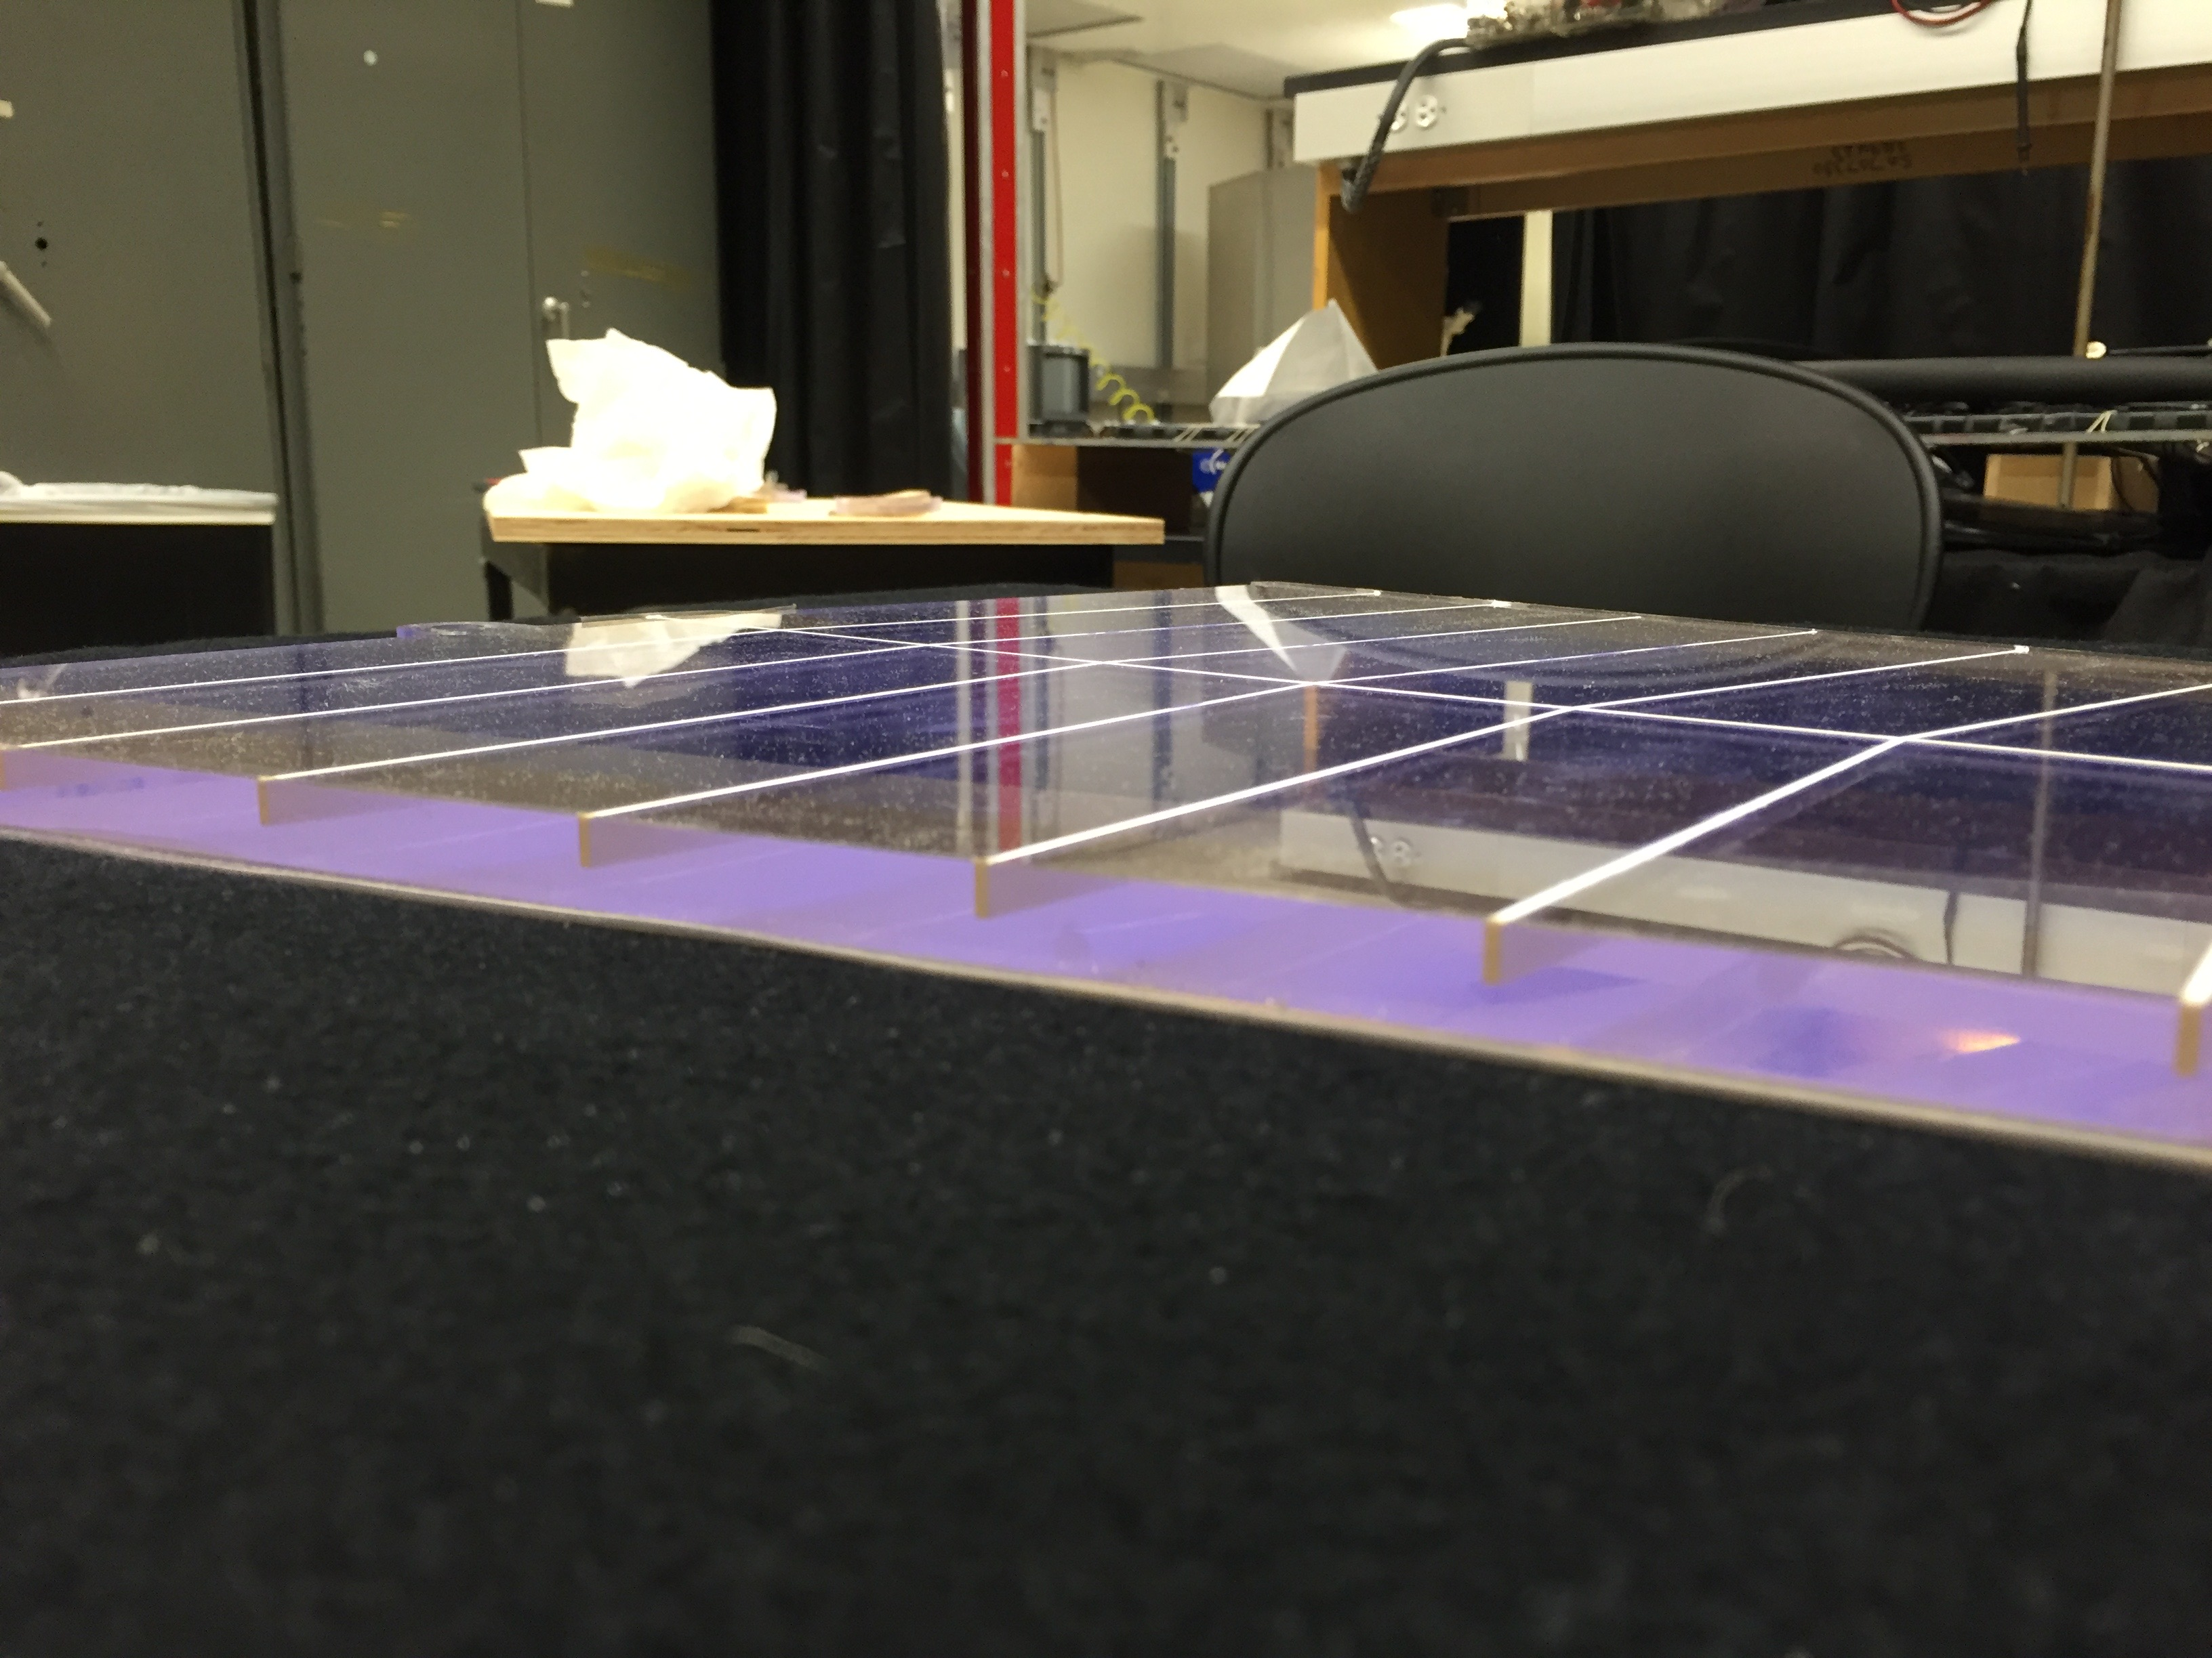
Rear isolation grooves
Mill “half-way” and fill groves with TiO₂ + epoxy mixture
Mill another “half-way” and fill groves again
Optical isolation!

Slide 10
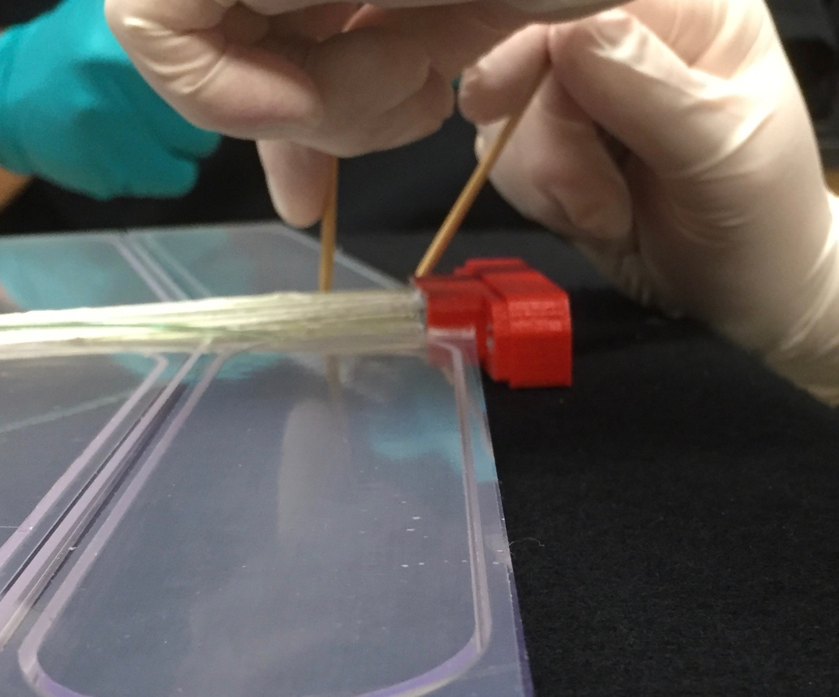
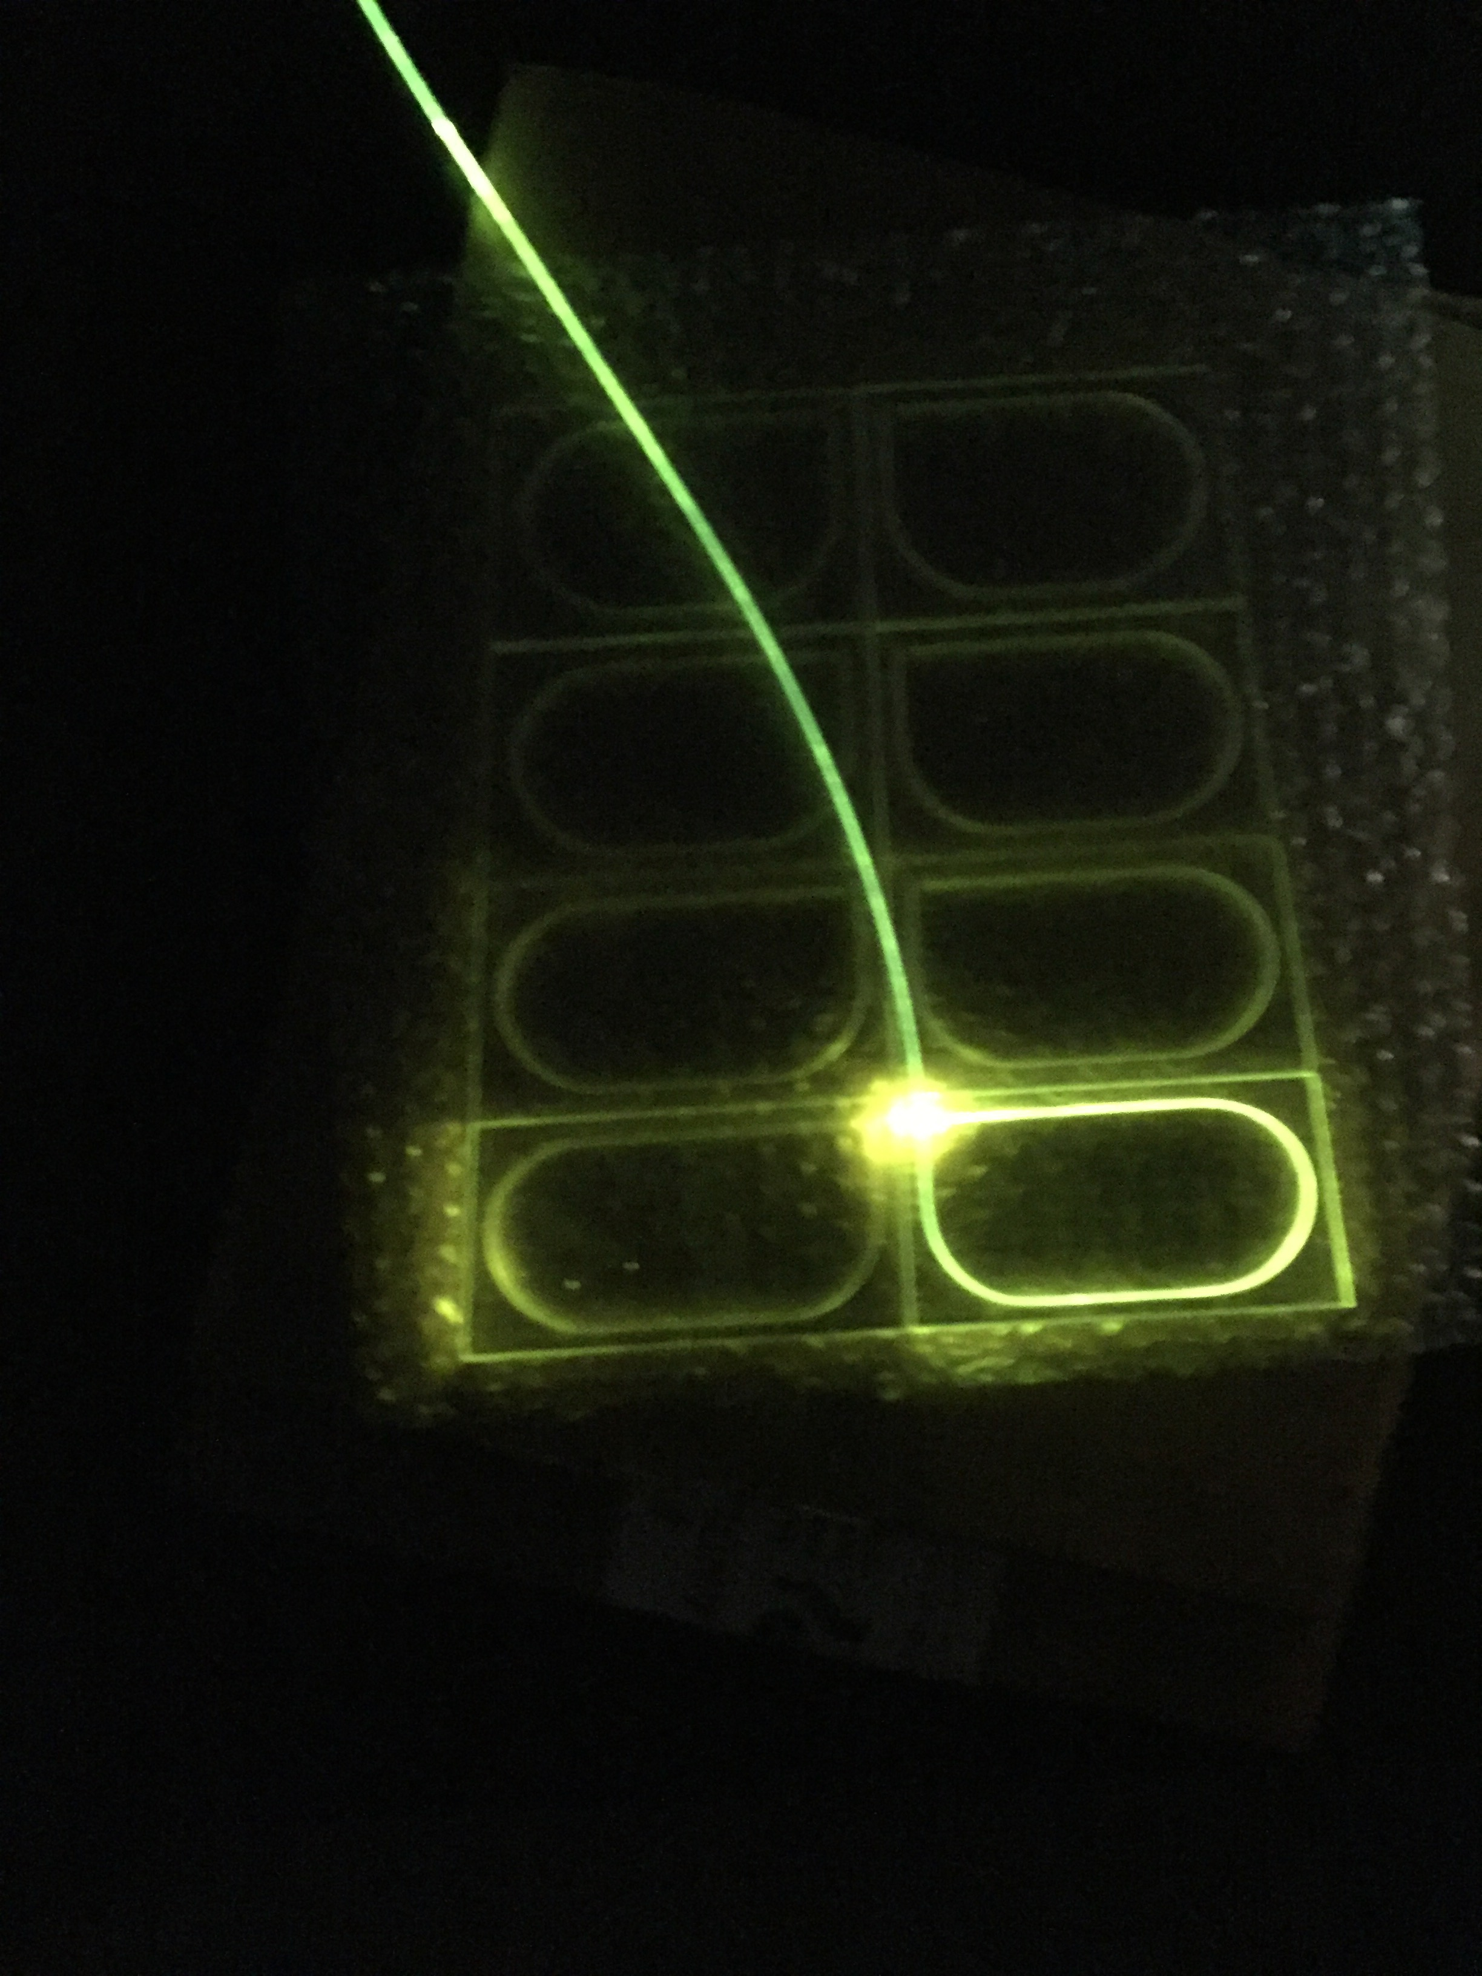
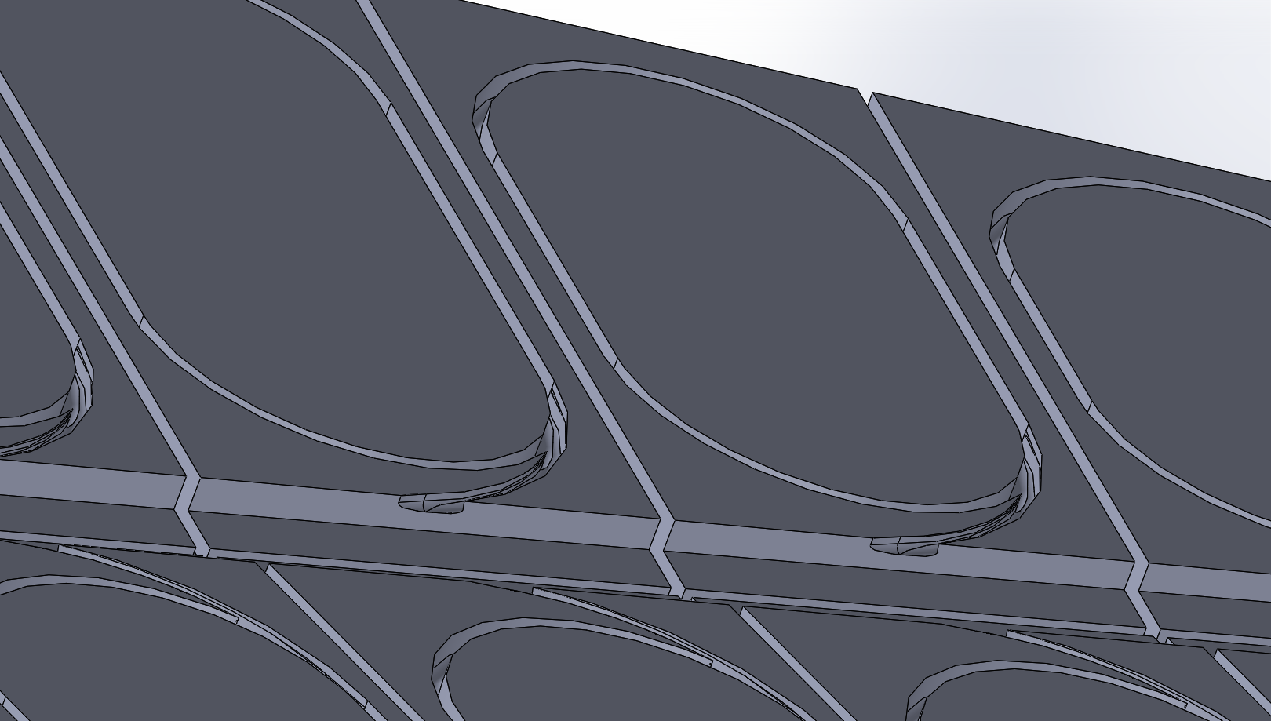
Front WLS grooves
WSL fibers glued in with optical glue
Front isolation grooves glued with reflexive epoxy
Notes:
SolidWorks ramp design

Slide 11
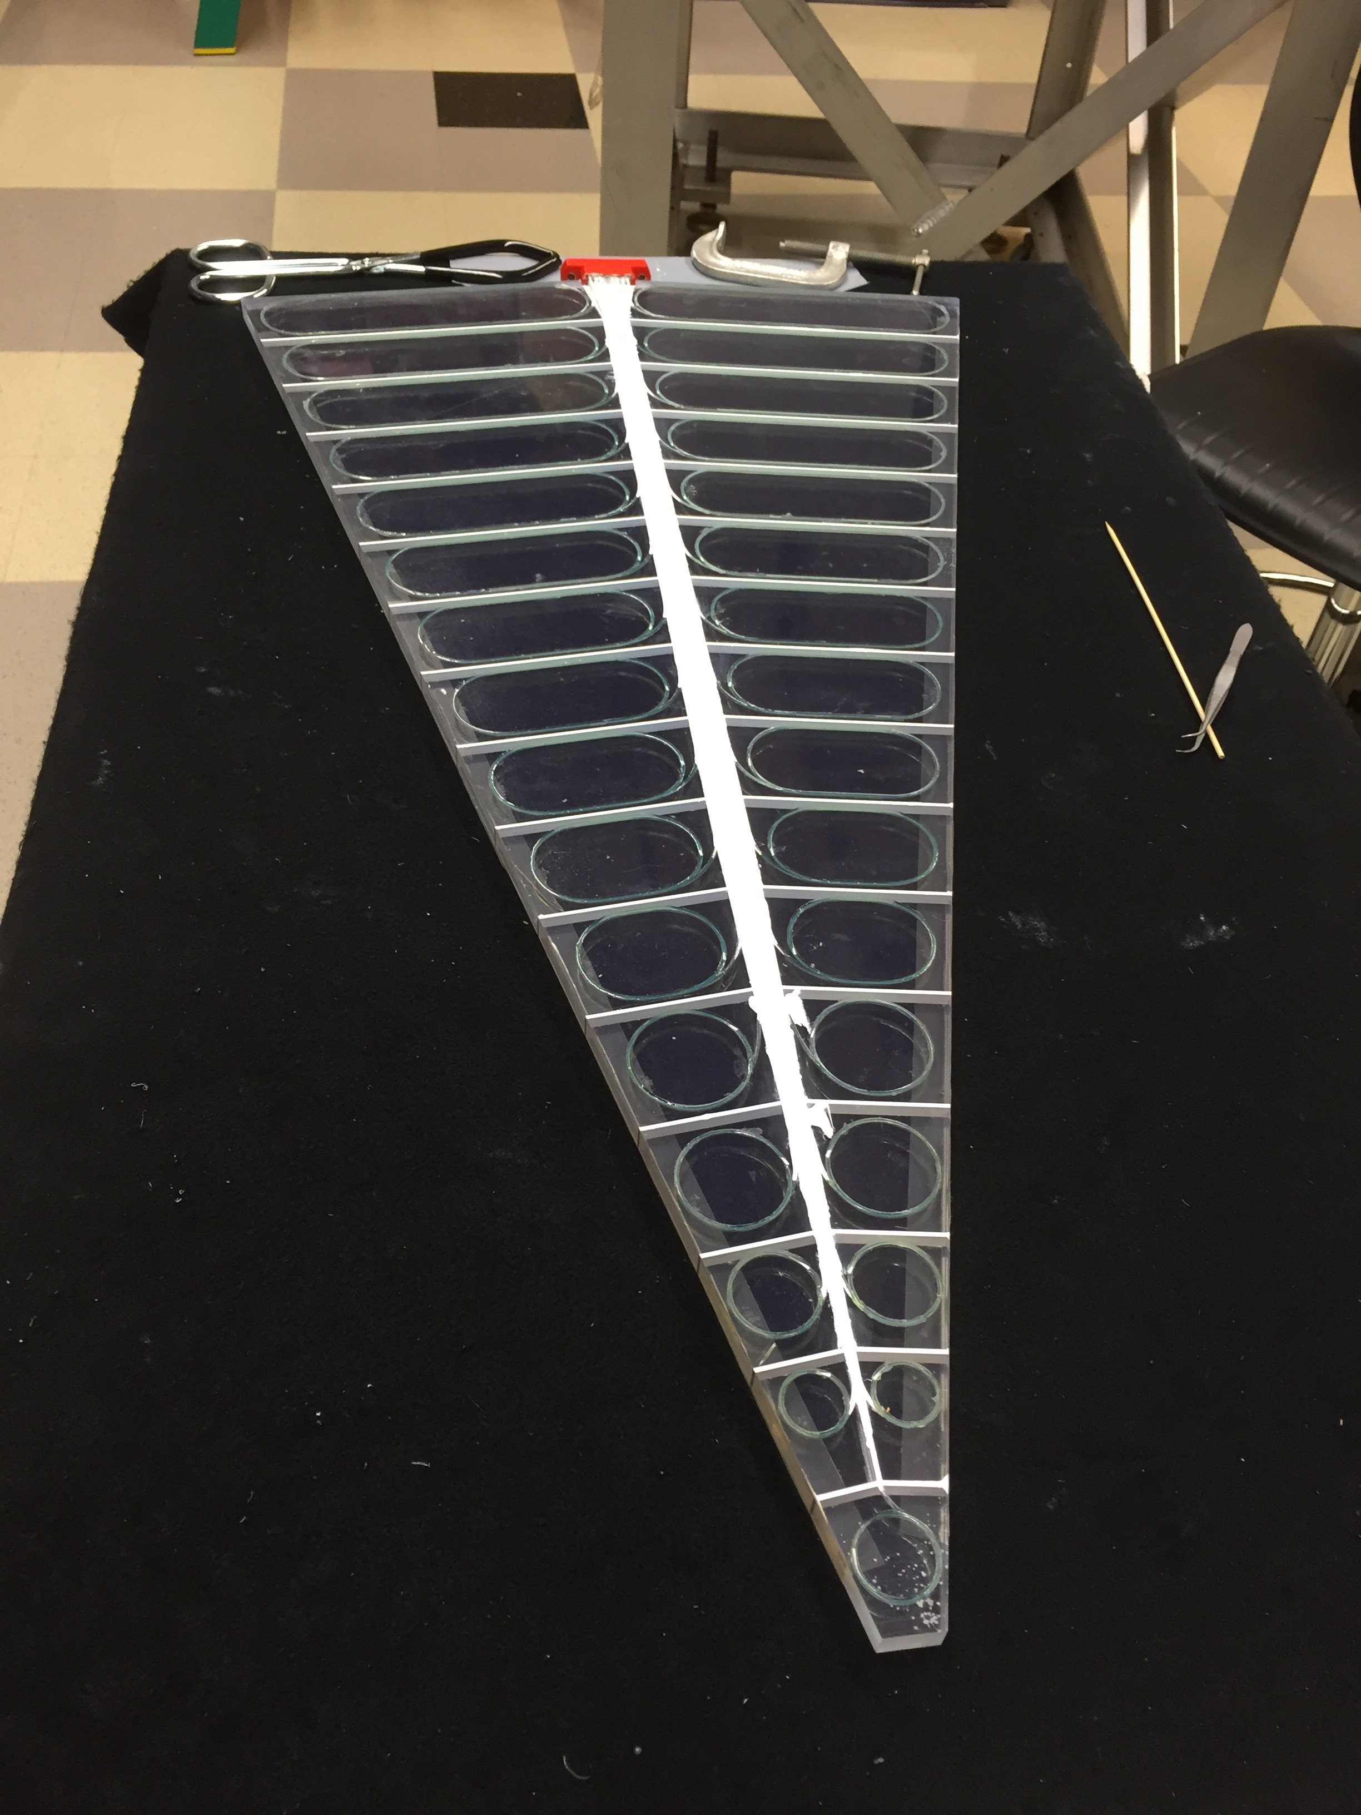
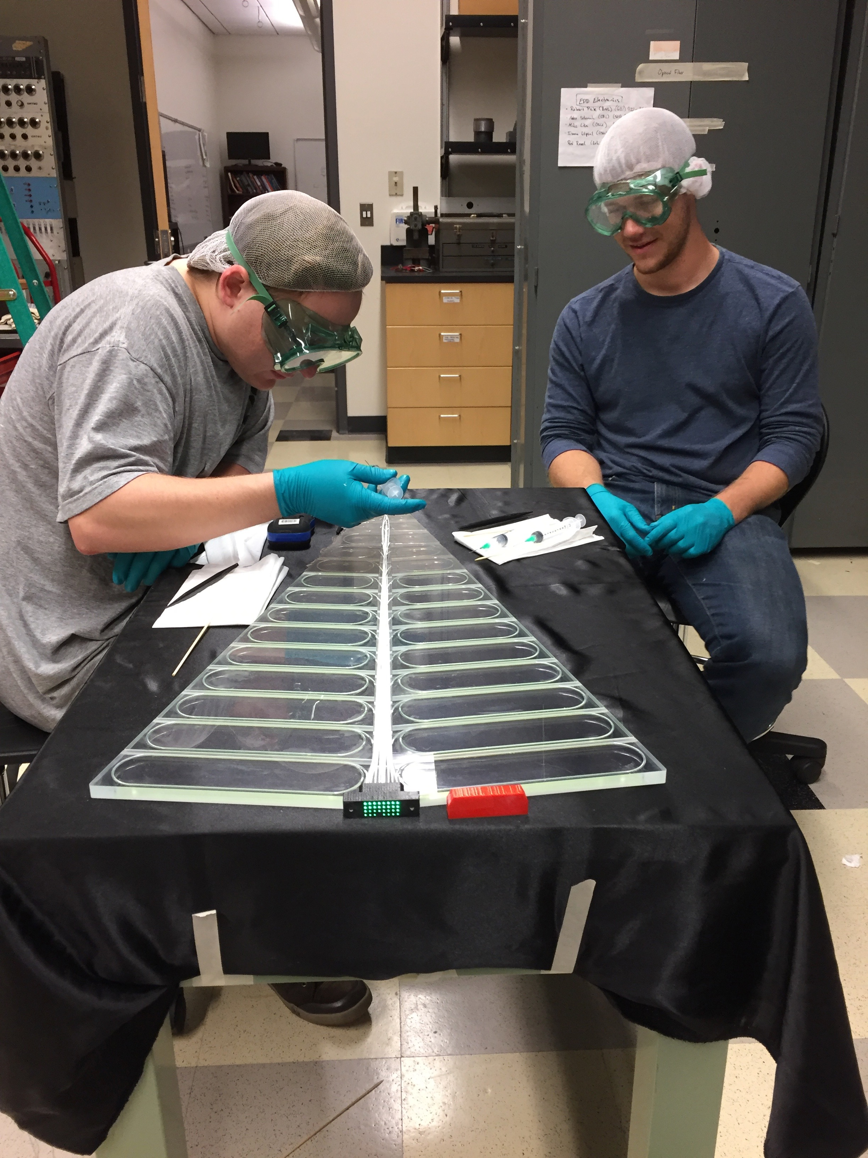
Front isolation grooves

Slide 12
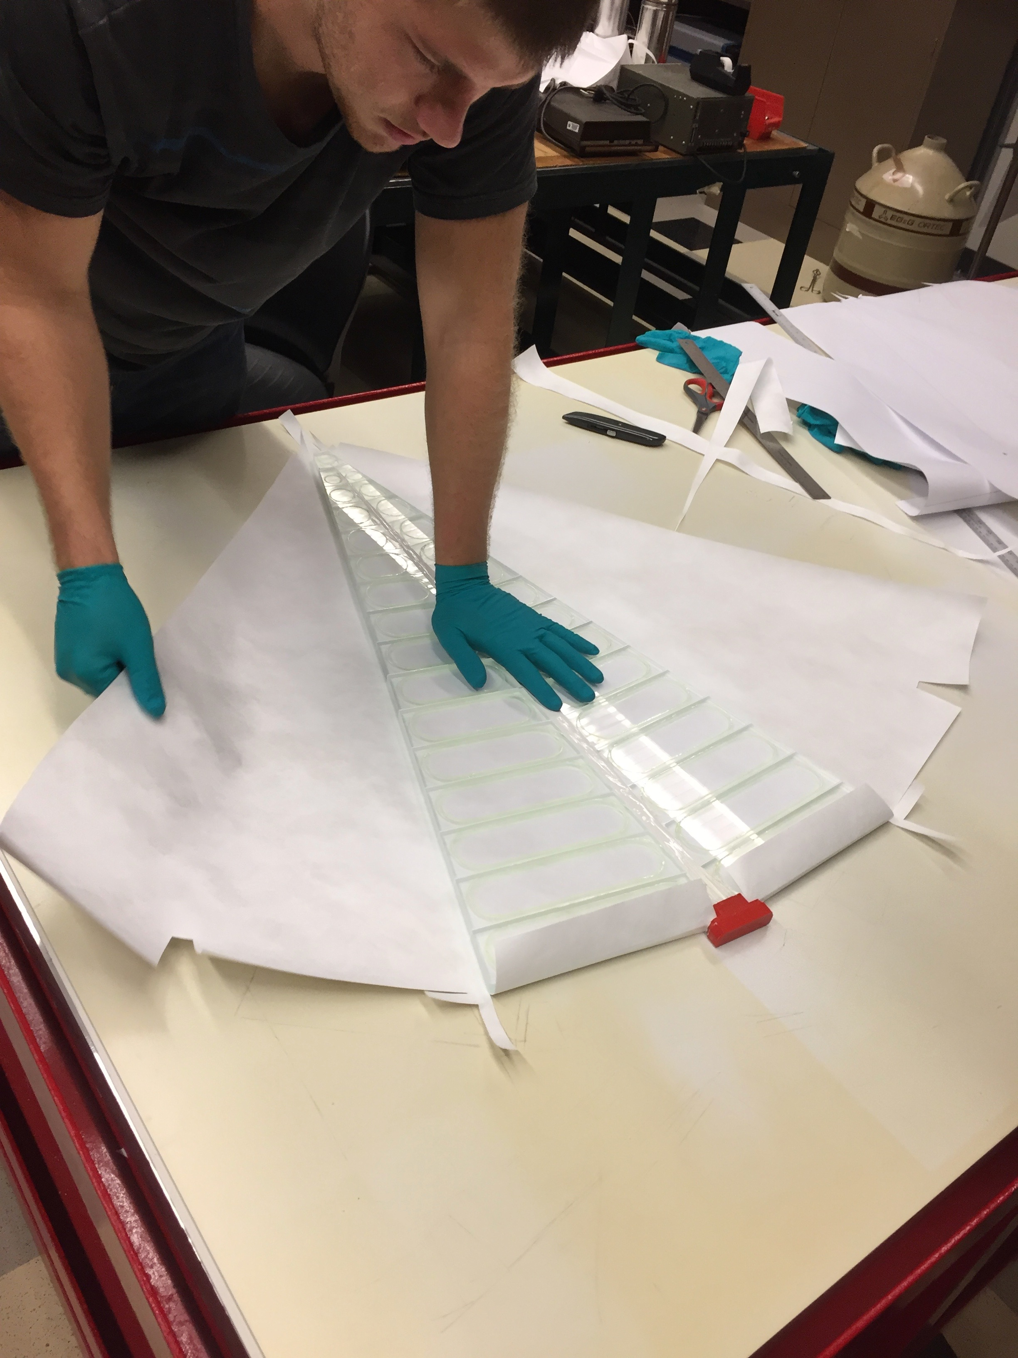
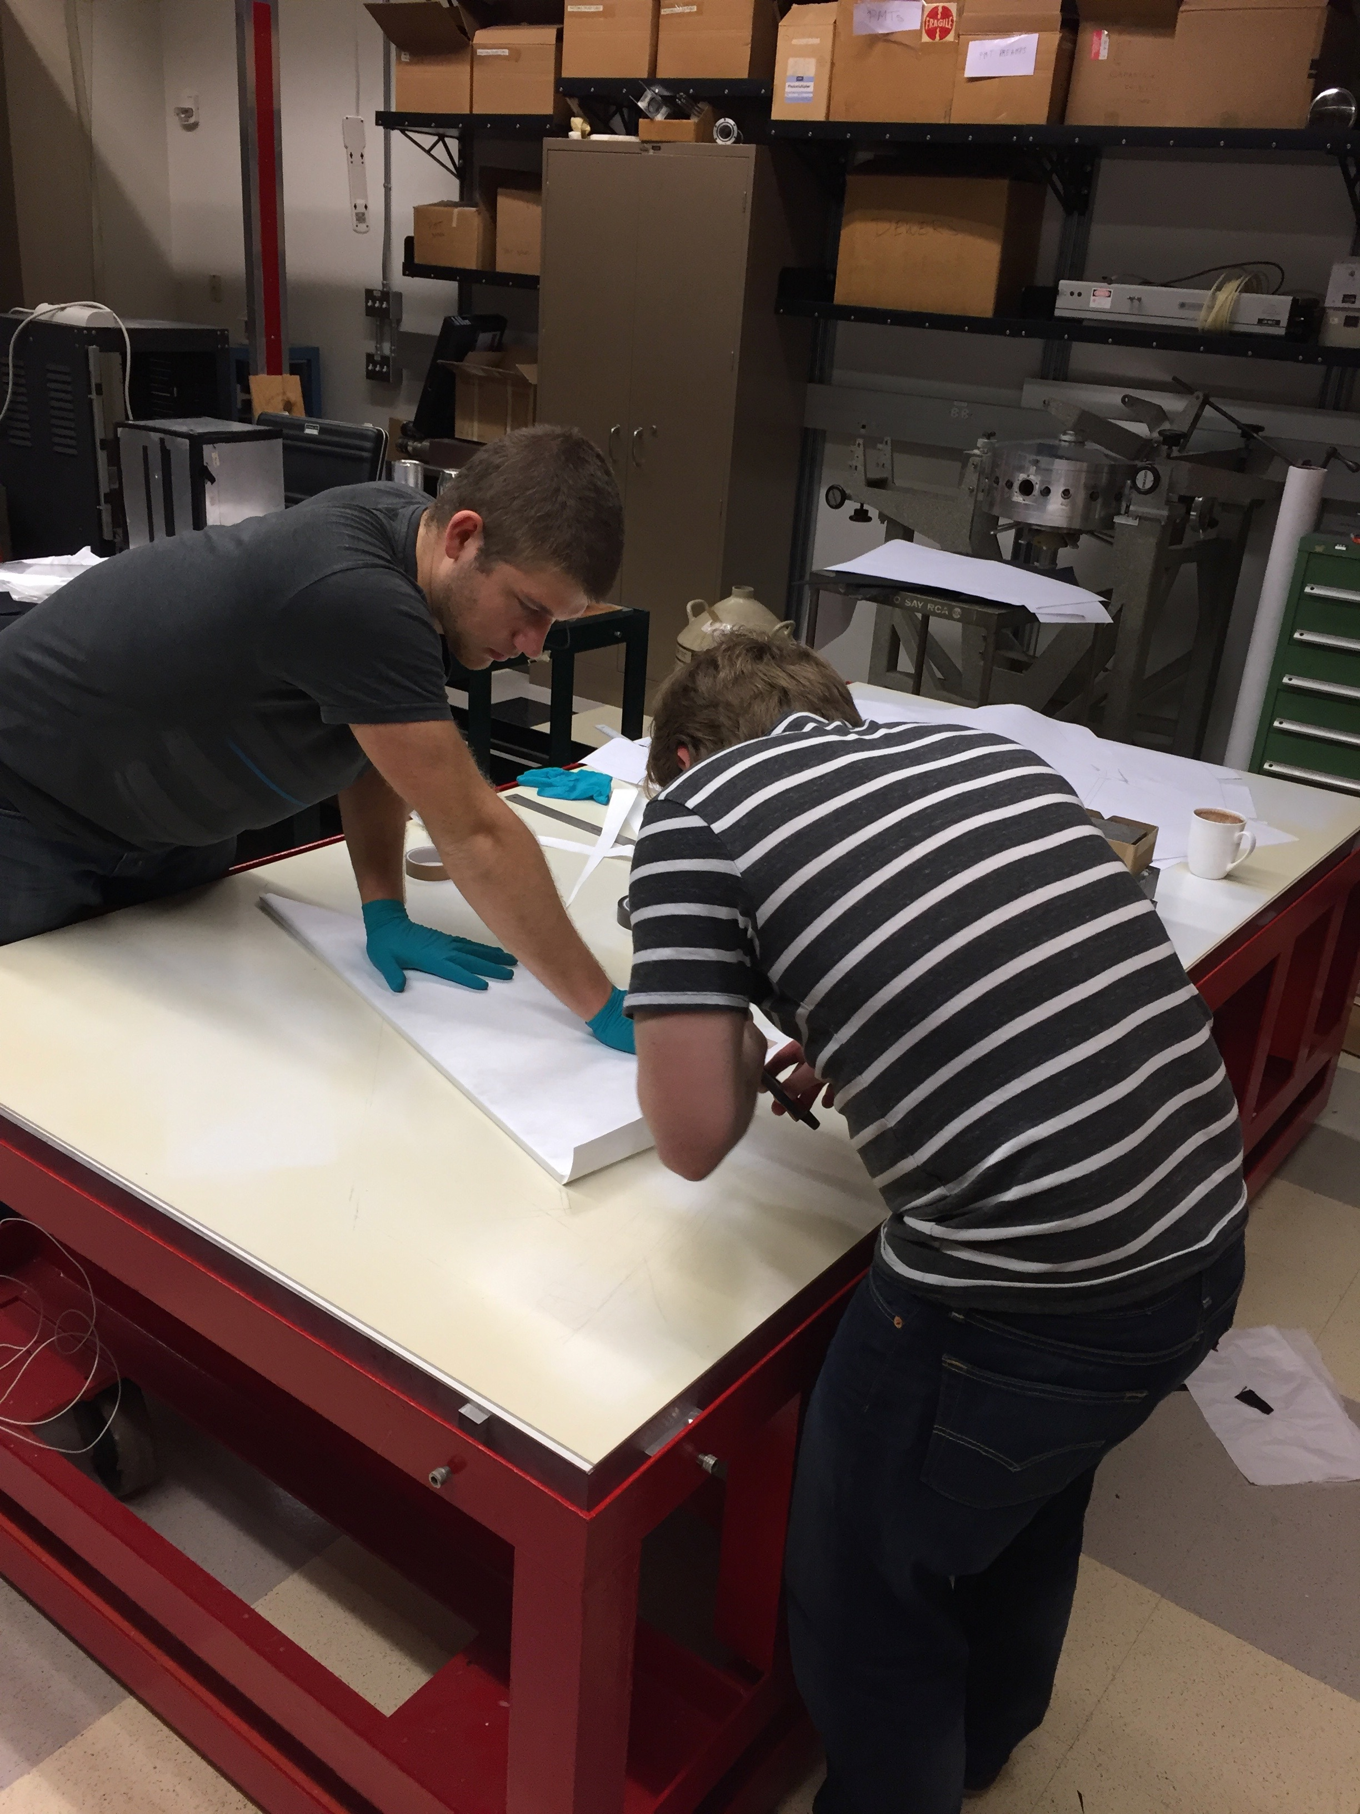
Wrapping
One layer of Tyvek (for reflectivity) & 2 layers of thick black paper (for light tightness)

Slide 13
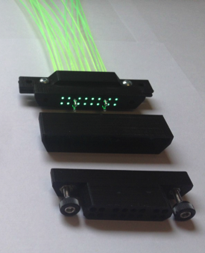
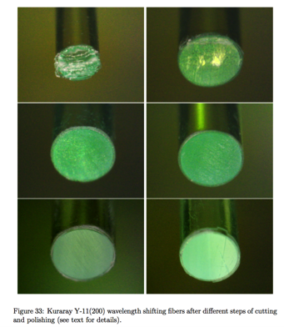
Fiber connectors
Connected to 5 meters of clear fiber with 3D-printed custom connectors – WLS attenuation is too high
Fibers must be polished for optimal coupling

Slide 14
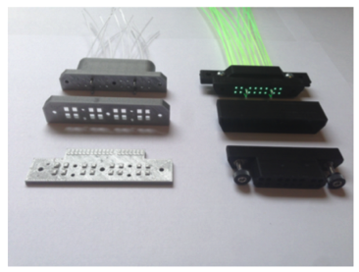
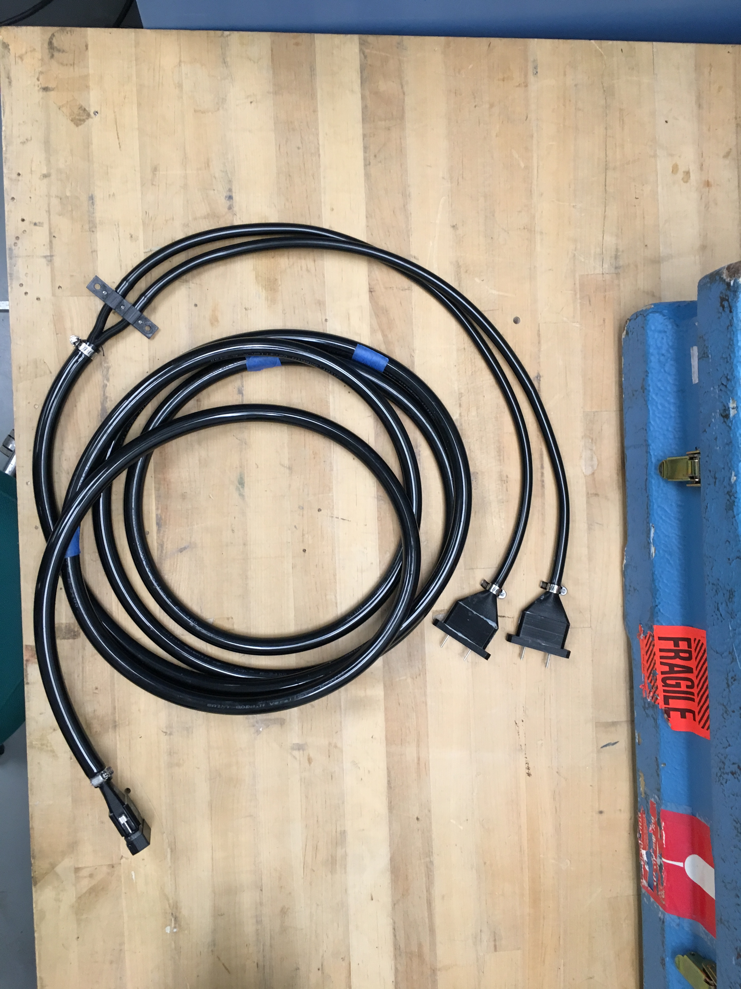
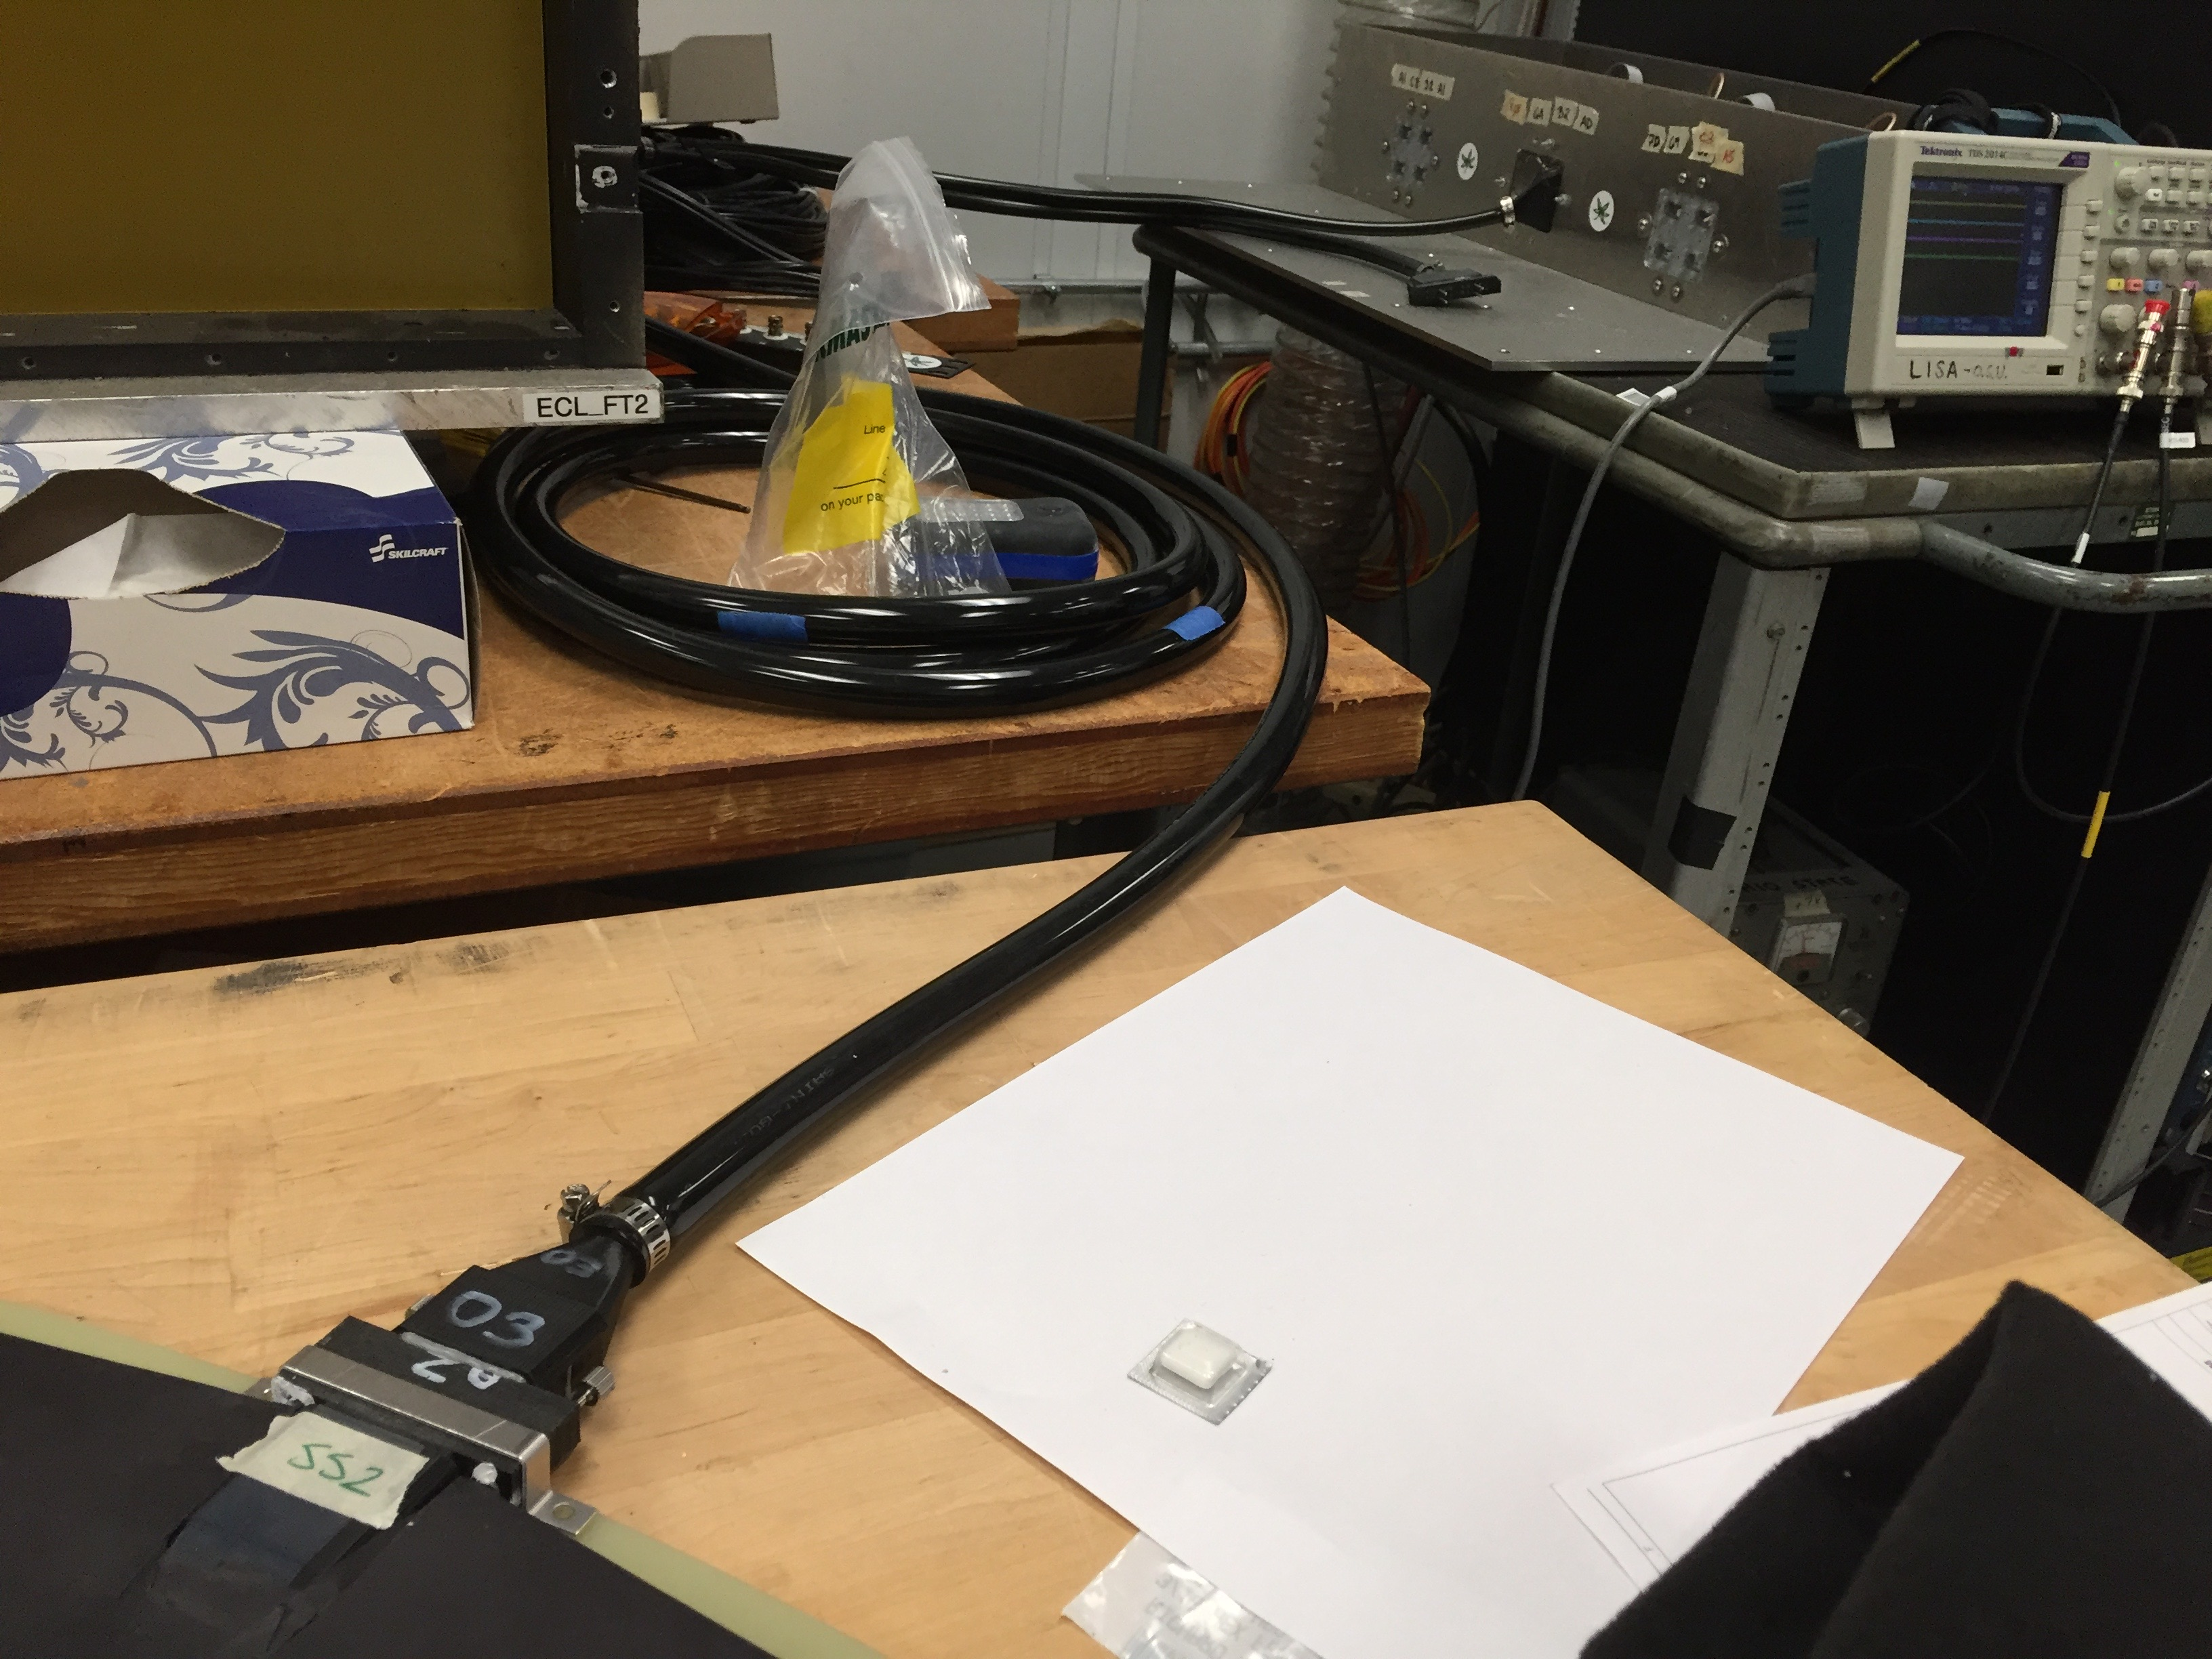
5.5-m-long Clear fiber bundles
All connector components custom-designed and 3D printed
Fiber-to-SiPM

Slide 15
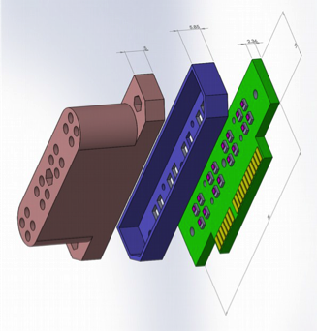
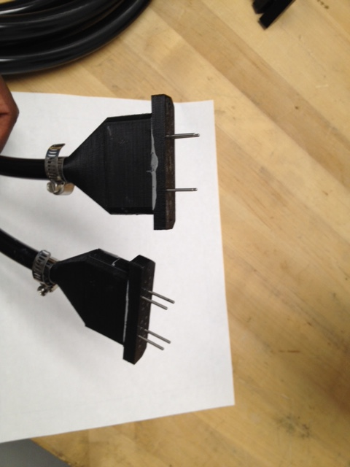
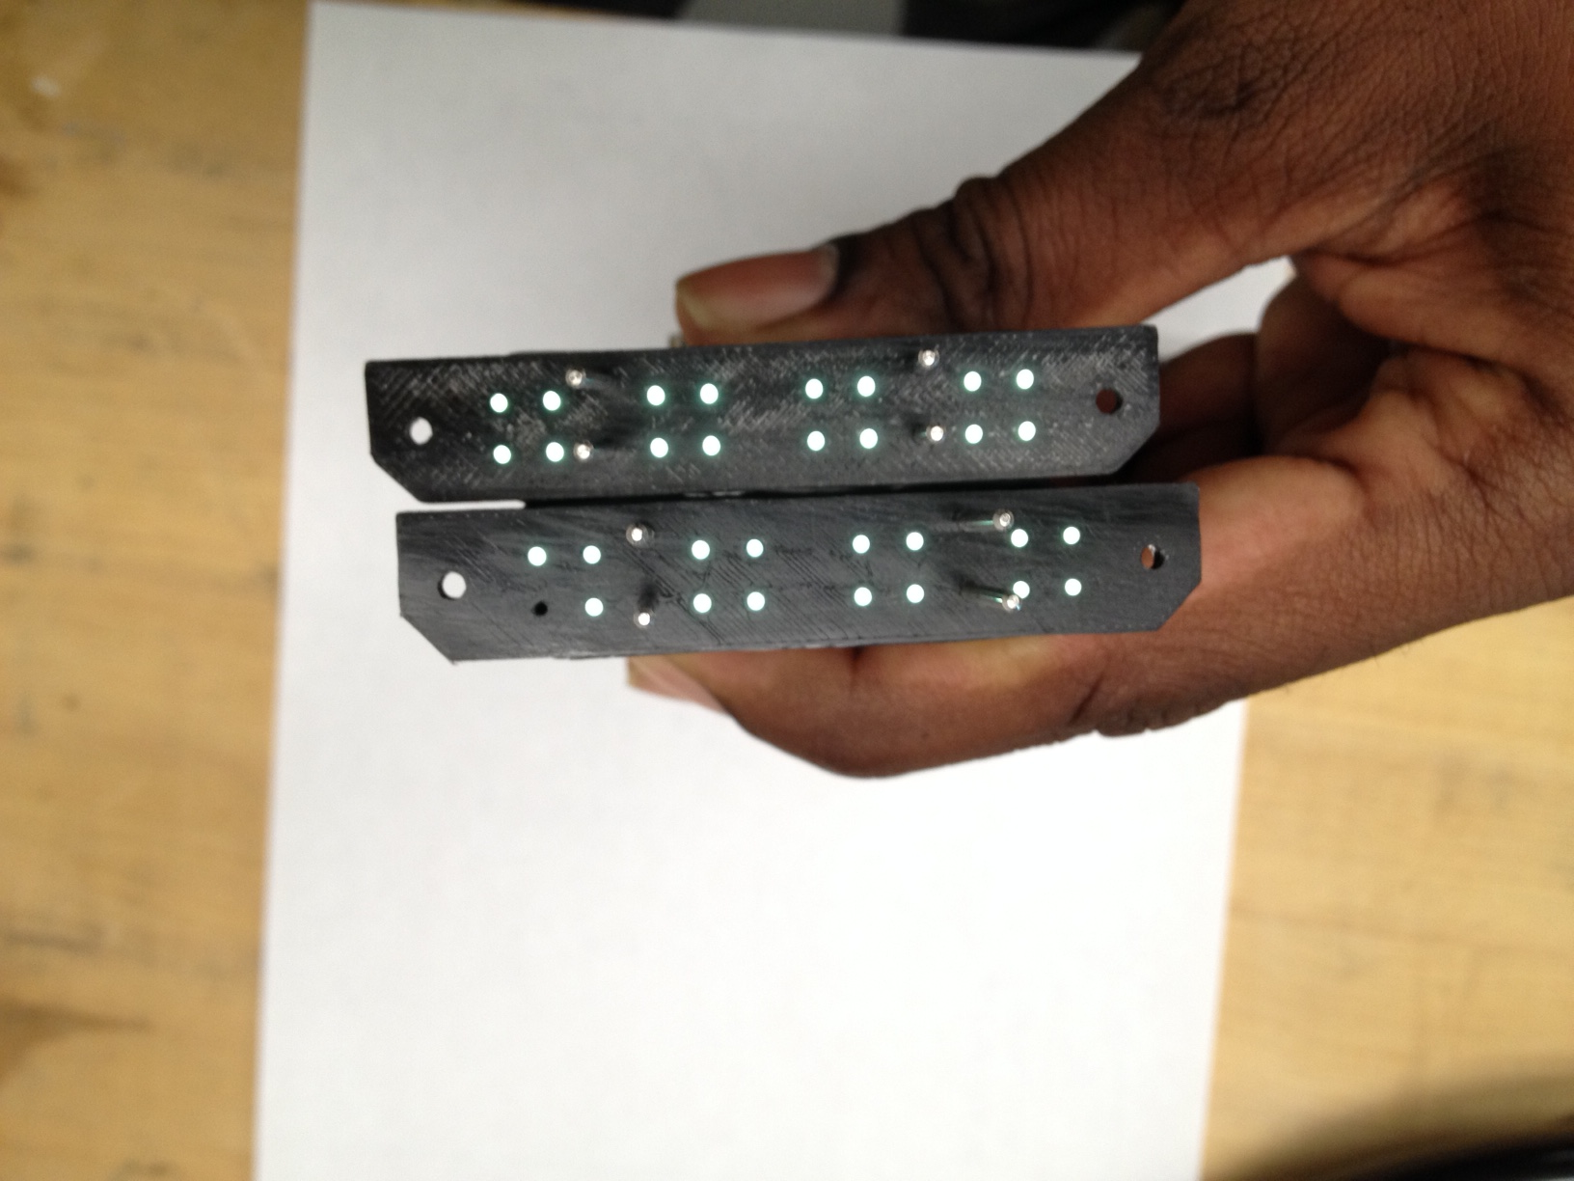
Fiber-SiPM coupling
Fiber-to-SiPMconnector (FSC)

Slide 16
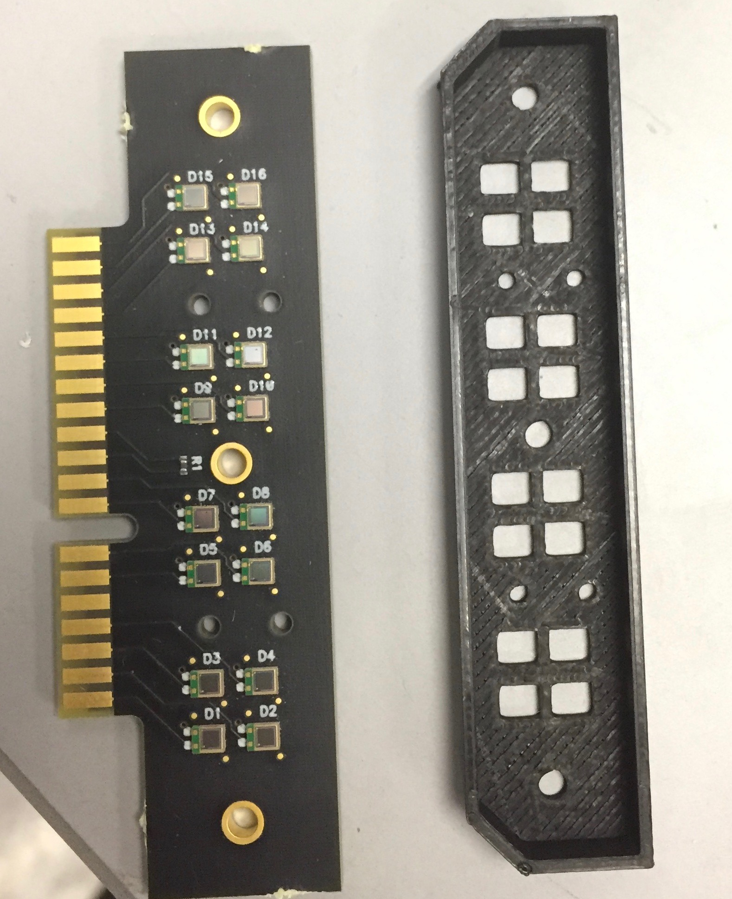
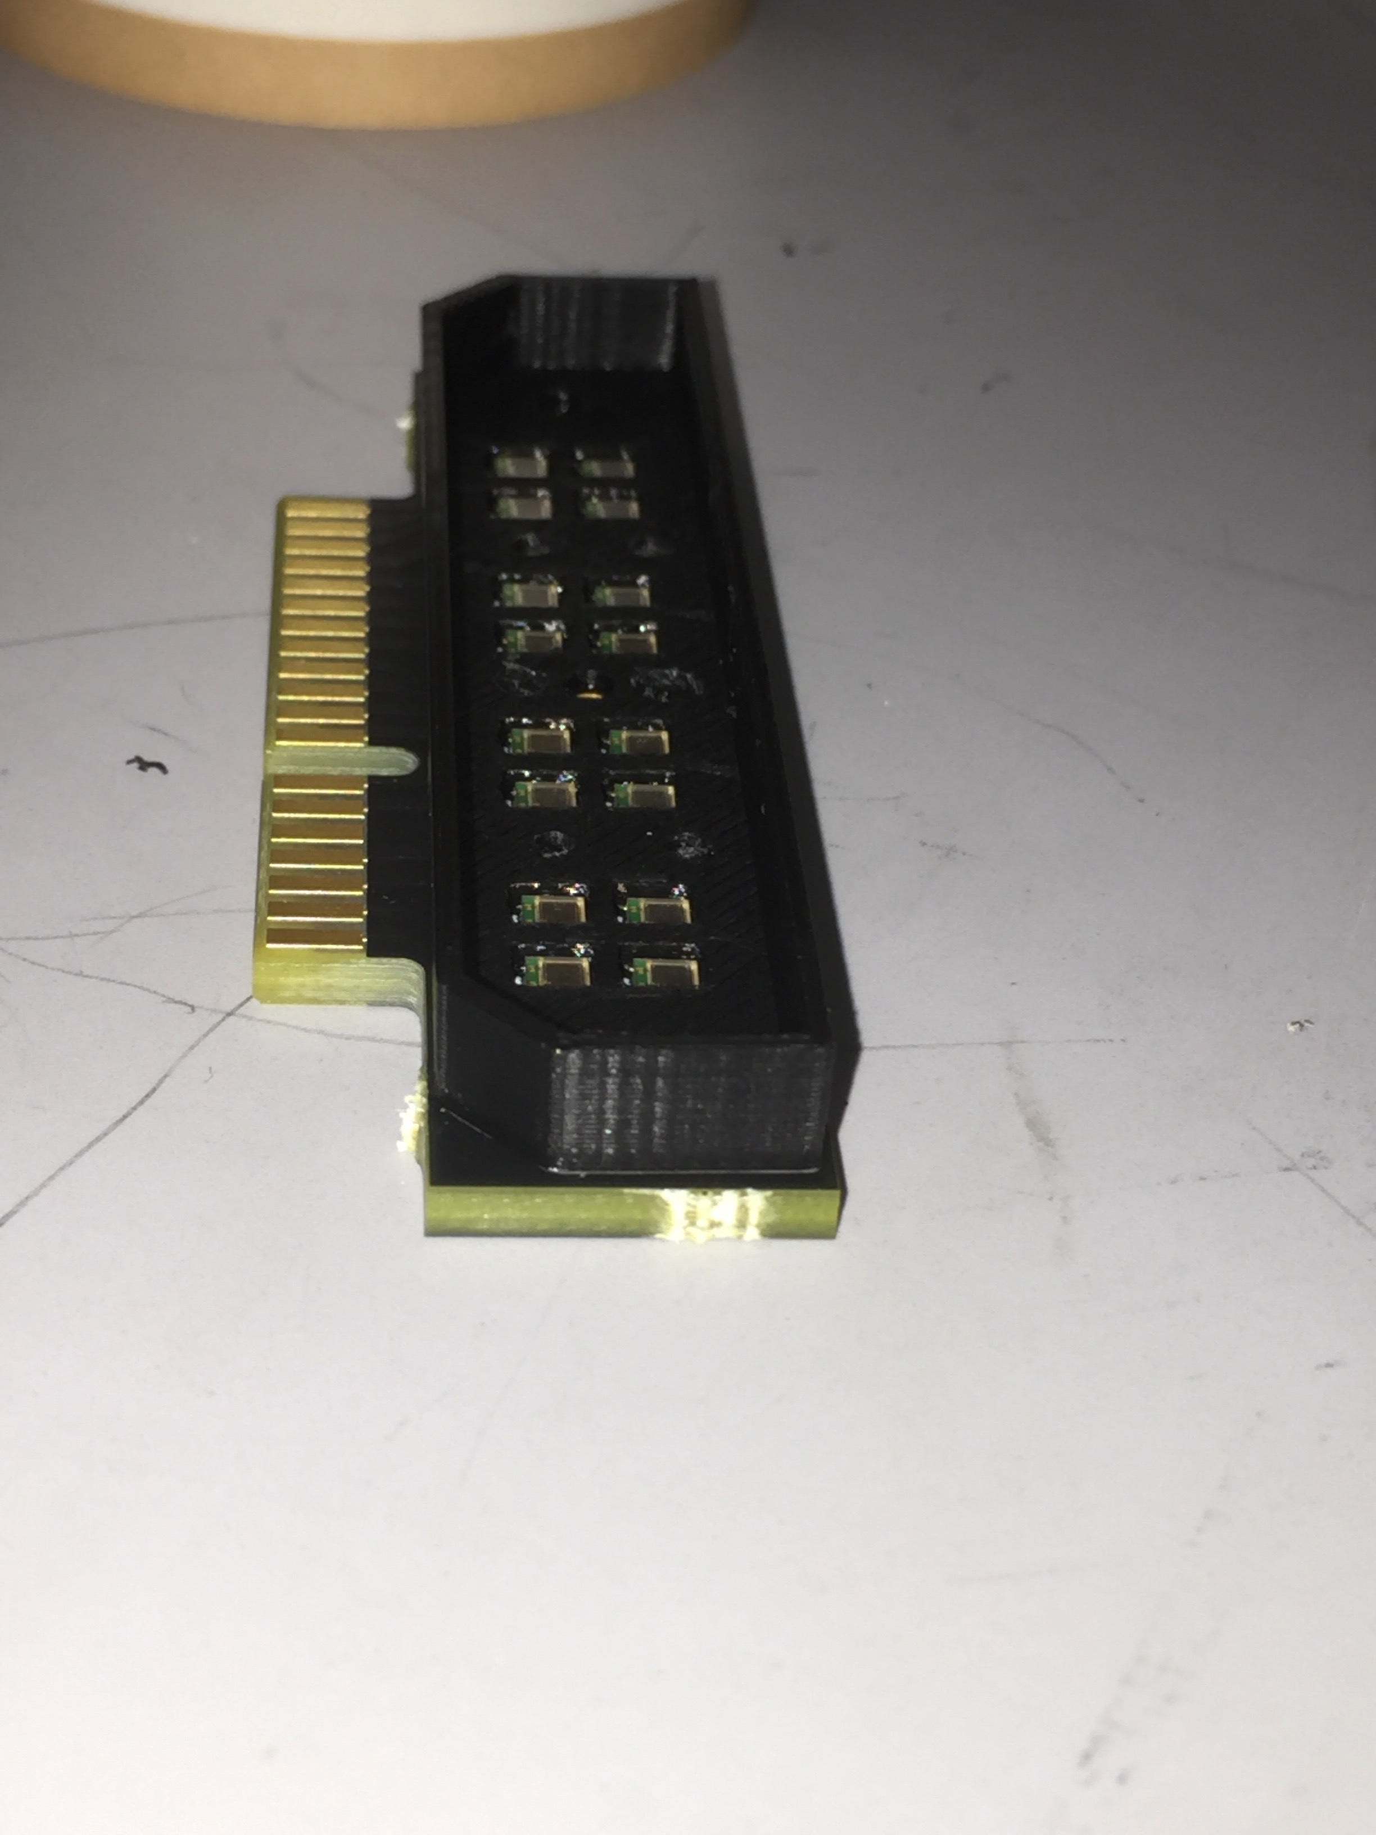
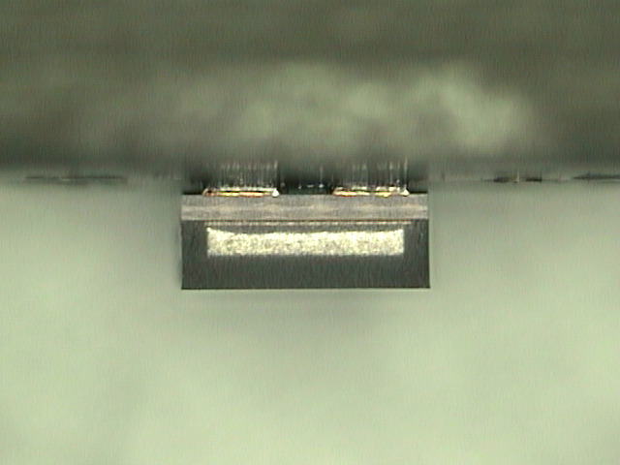
Clear fiber bundle meets readout electronics
EPD SiPM card
Edge connector plugs
into EPD FEE card
EPD FSC spacer block (3D printed)
SiPM assembly monitored by micrometer

Slide 17
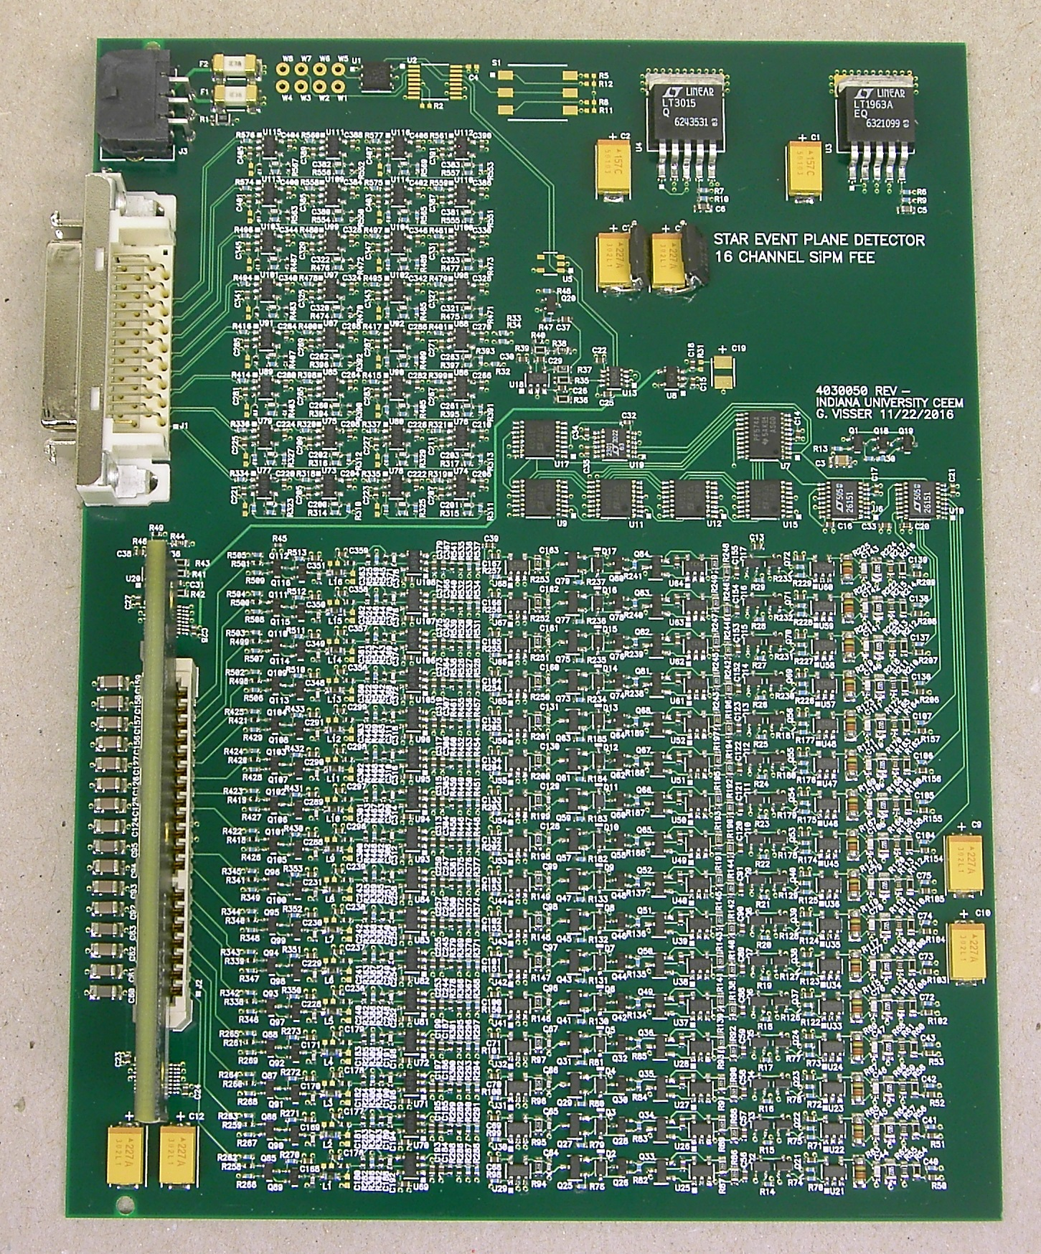
Coupling to FEE
Far end of optical bundles
16-channel FEE
contact (air gap) connection to SiPMs
~ 2 inches

Slide 18
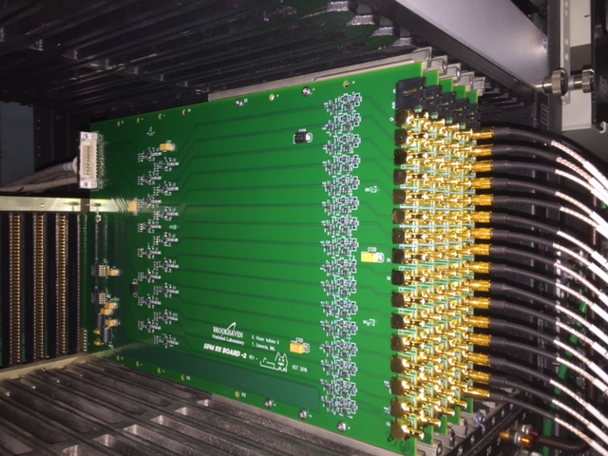
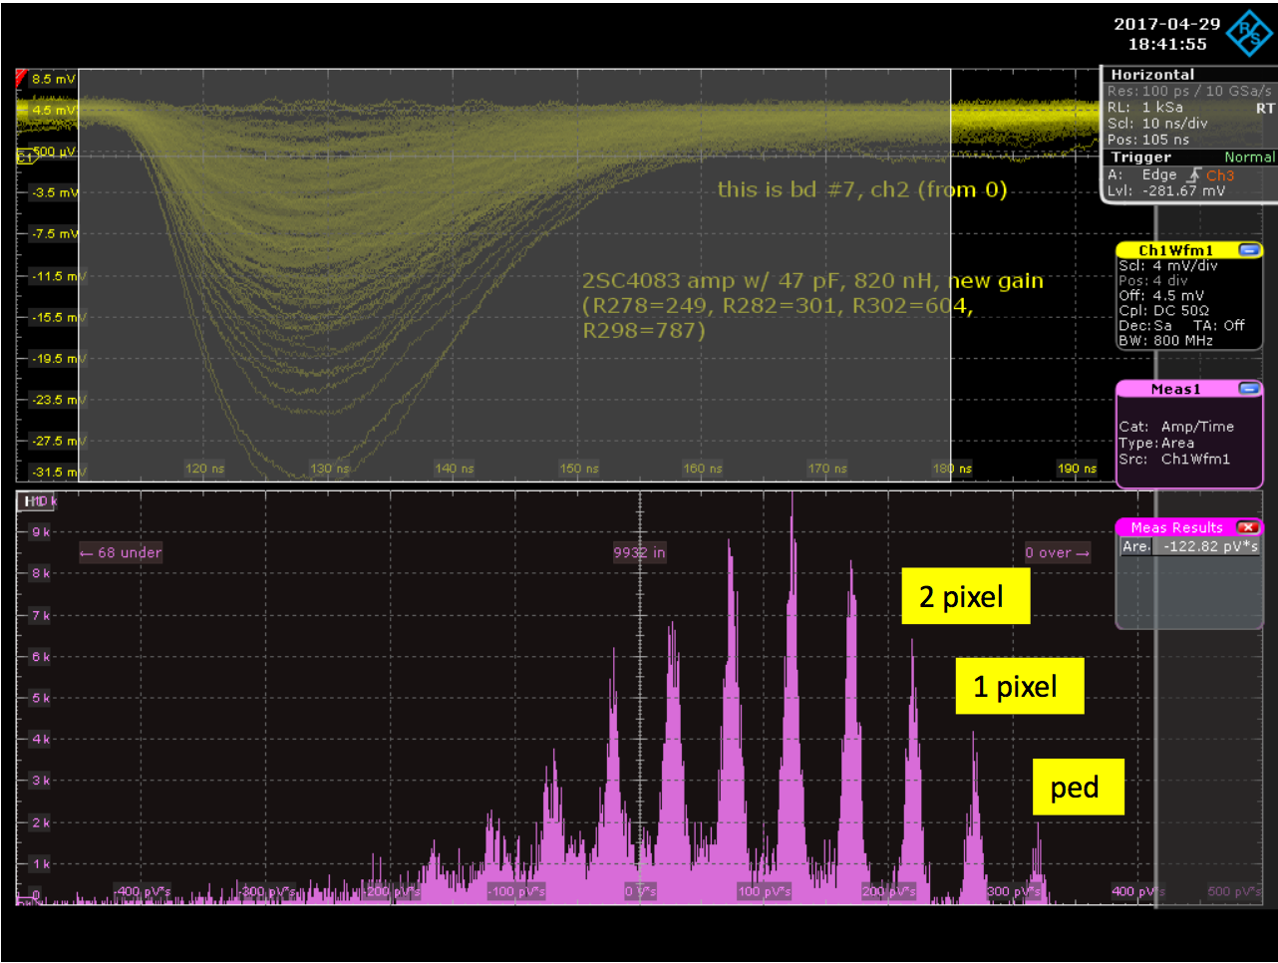
FEE → RX → QT → STAR DAQ
Rx and QT boards cabled and mapped
Digital signals
Test stand set up at OSU and BNL
Key performance verified by cosmic-ray test
EPD FEEs designed by G. Visser (IU)
Dedicated for SiPM
Excellent resolution and linearity

Slide 19
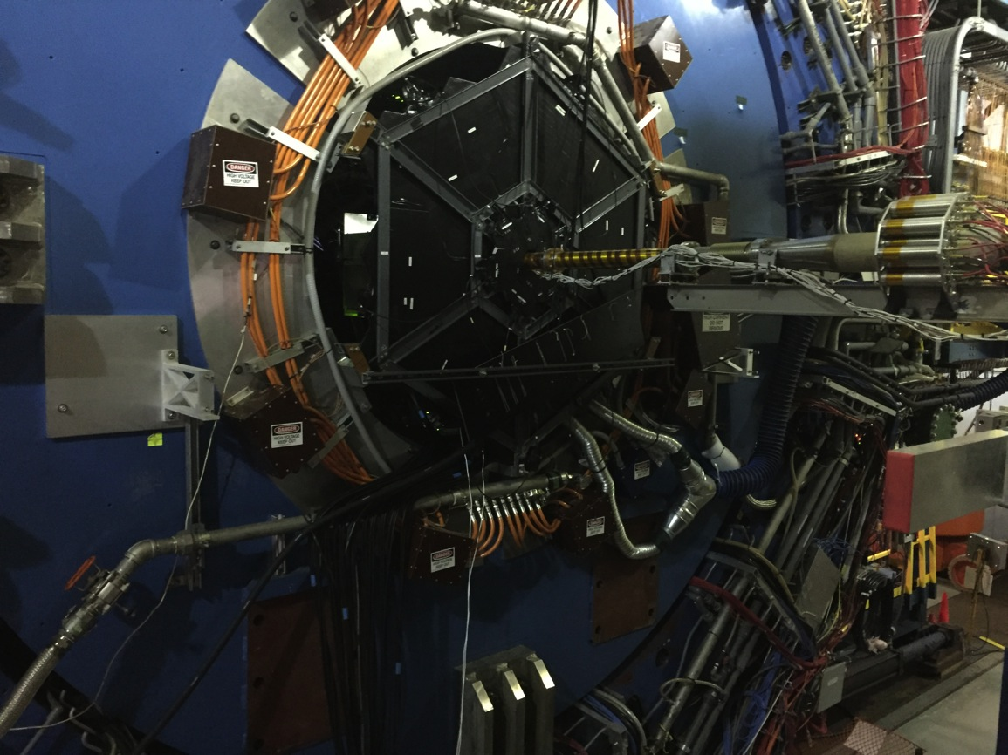
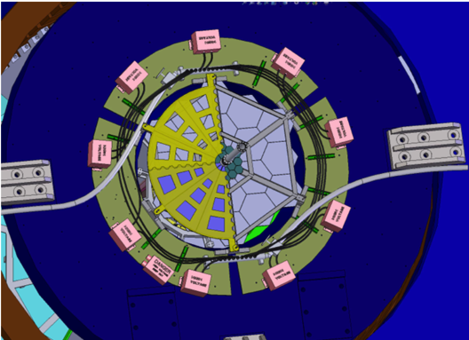
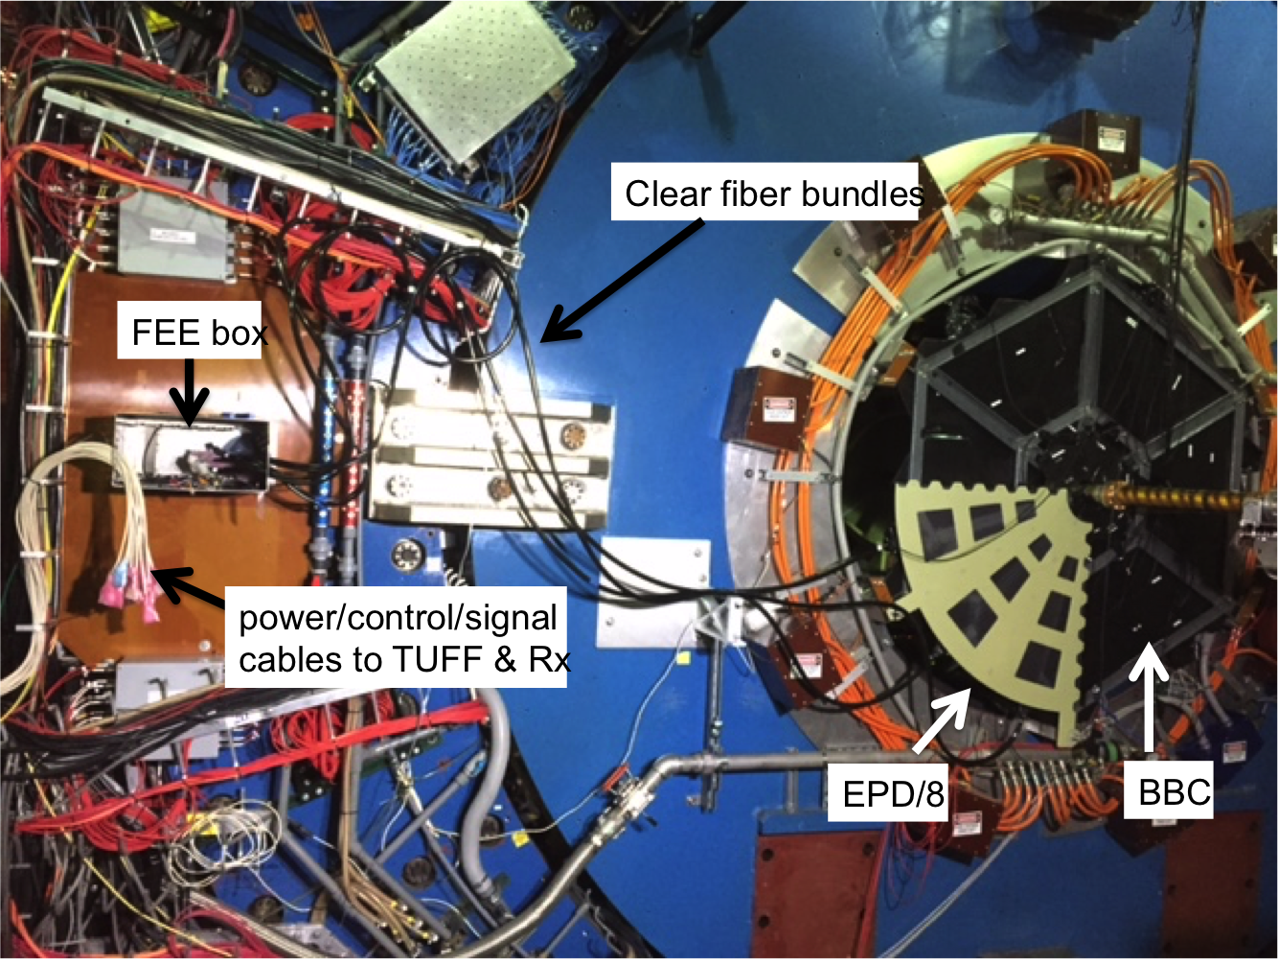
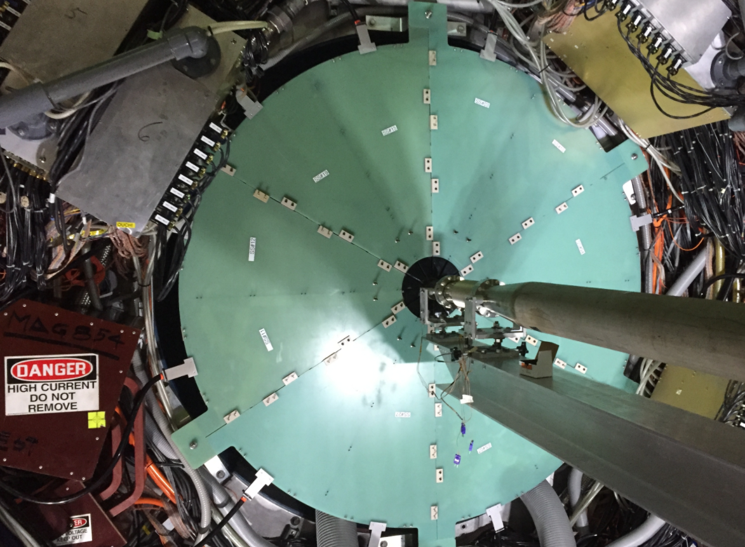
Mechanical: Super-Sector mount
BBC
pEPD
2016
2017
2018

Slide 20
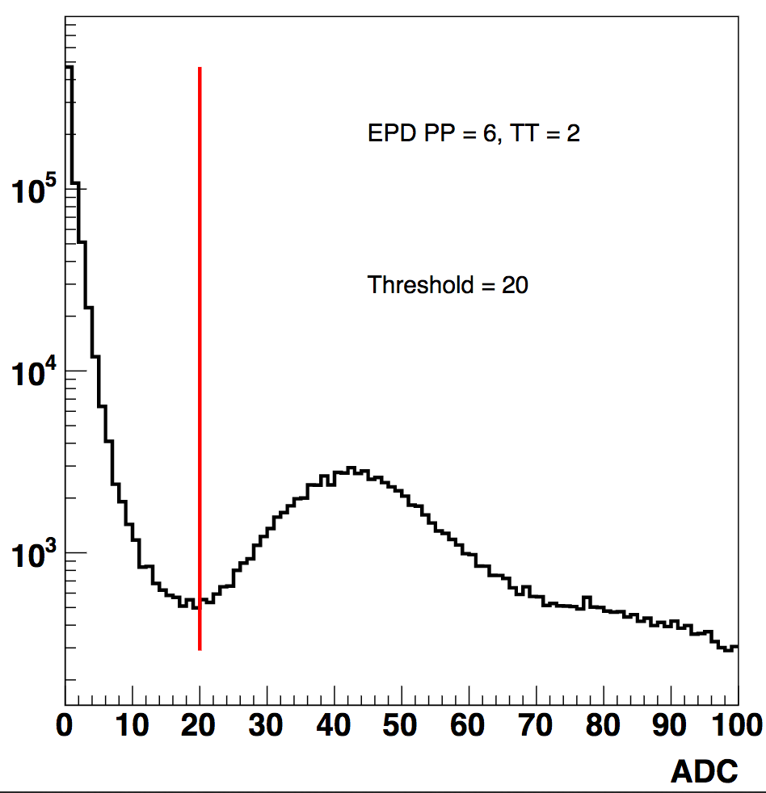
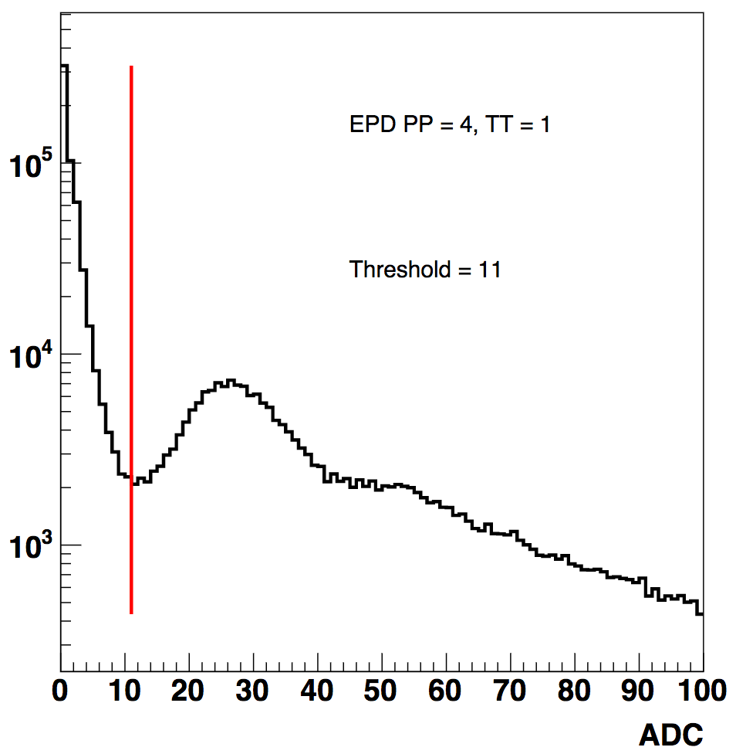
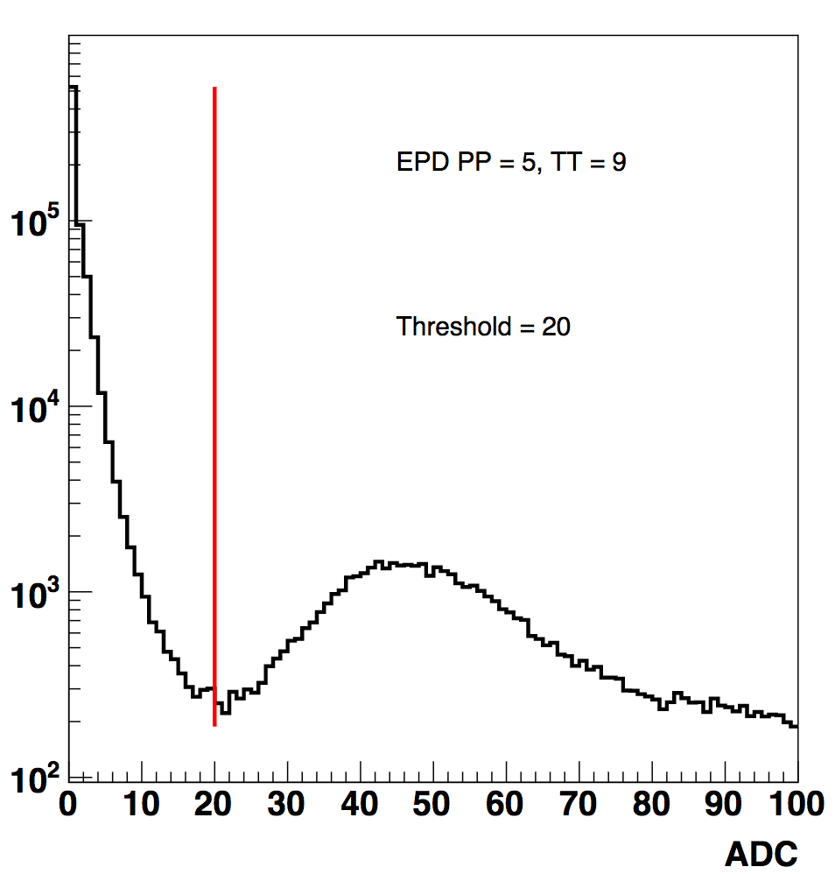
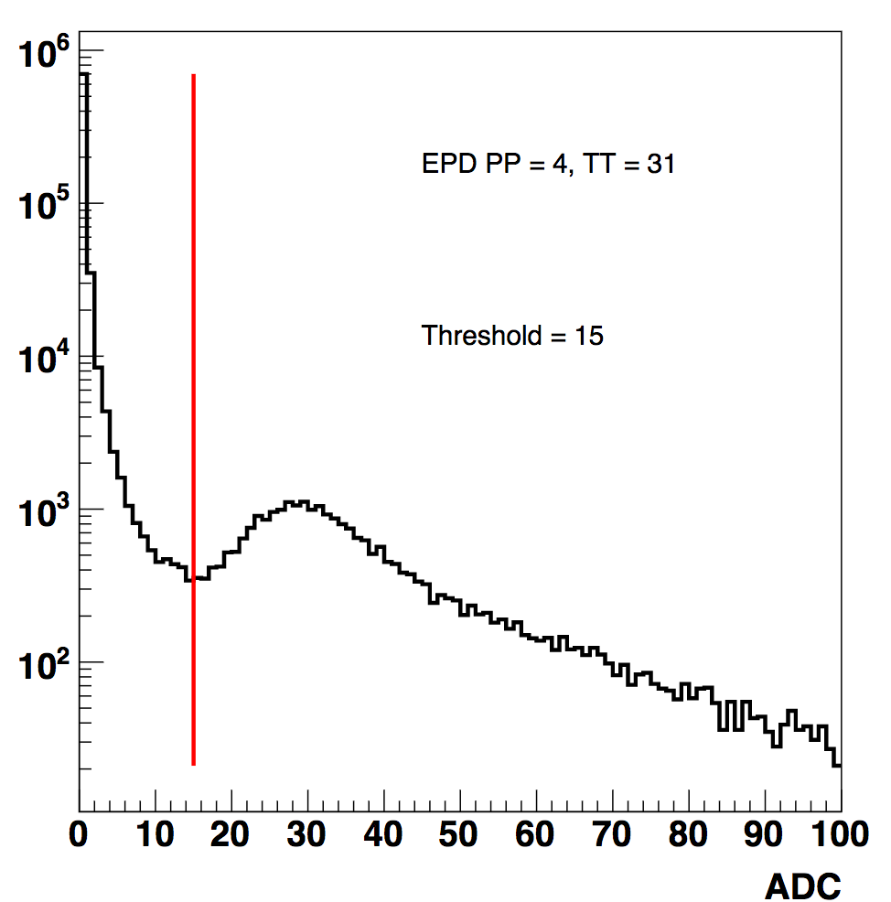
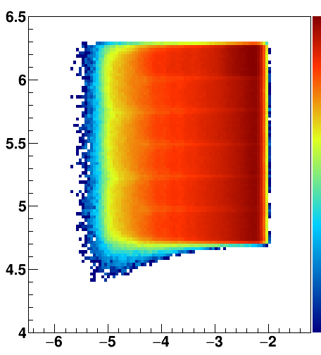
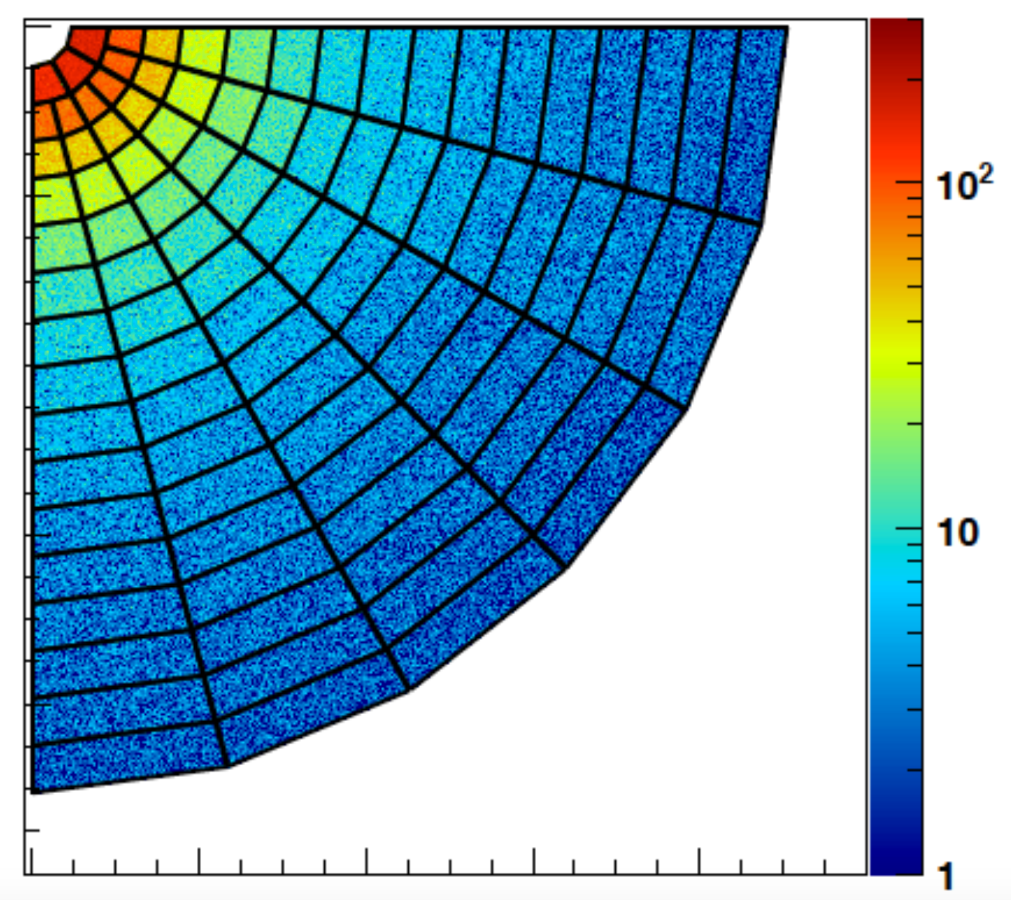
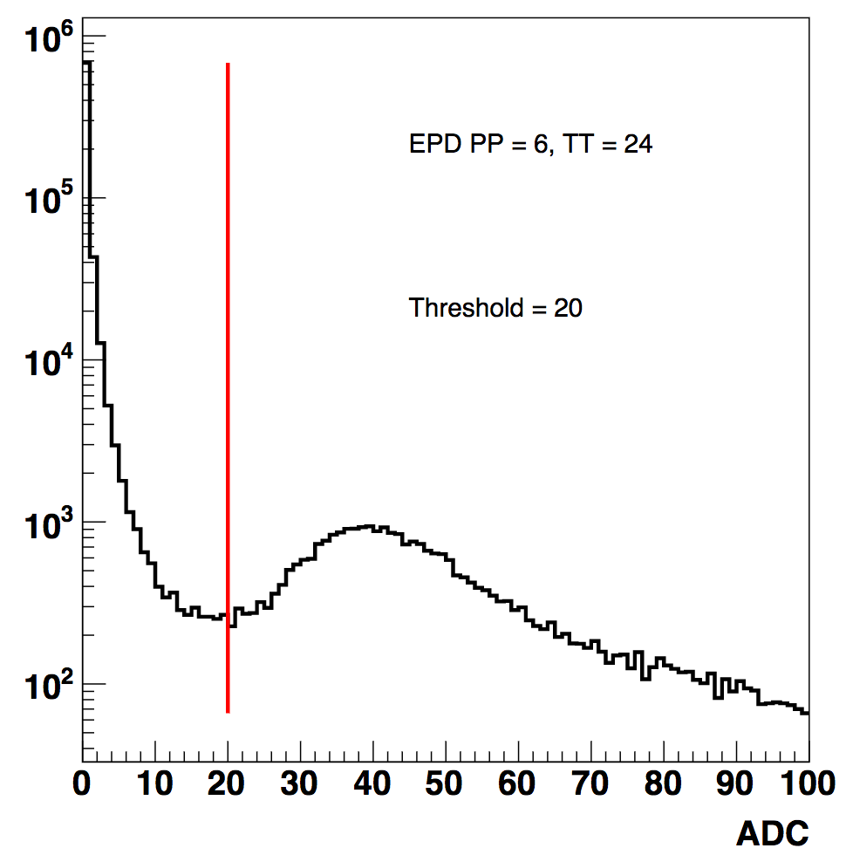

Hit/No-hit
We have been blind here, until now
Φ
η
All 93 channels show good signals
Very nice uniformity
p+p 500 GeV (2017)

Slide 21


Correlation with Other detectors
TOF (|η|<1)
EPD (<2η<5)

Slide 22


EPD - ADC Spectra
Extremely uniform performance across all 744 channels
1MIP
2MIP
3MIP
4MIP
200 GeV RuRu + ZrZr

Slide 23
EPD – Timing performance
ADC vs TDC for 1 tile
Average TDC east vs west
200 GeV RuRu + ZrZr
Difference between offline z_Vertex reconstructed by TPC and EPD.
The spatial resolution of EPD is 11.8cm, corresponding to ~0.4ns time resolution.

Slide 24



Forward Event Plane Determination
Basic analysis methods tested on isobar data
The EPD is a significant improvement on the BBC

Slide 25

Centrality Determination
only 1/8 EPD (η>0, 3π/2 < φ < 2π)
The spectators and produced particles have opposite correlations, they have
characteristically different rapidity ranges
By weighting the multiplicitl of the 16 rings of EPD tiles differently
No models describe forward rapidity well, instead use neural network (NN)
The improvement must be done on an energy-by-energy basis

Slide 26
Summary
Granular coverage at 2<|η|<5 crucial to BES-II physics mission
  opens up phasespace & reduces centrality-related systematics for fluctuation analyses
  improved EP resolution allows statistical reach of EP-dependent studies (flow, polarization, CME, ...)
  new flow-correlation analyses over wide eta range
EPD upgrade
  highly segmented detector of straightforward design, with some new aspects
  two prototype runs (2015, 2016) & 1/8 “engineering” run in 2017
  Full EPD “commissioning” run in 2018
Performance
  744/744 tiles: response understood, very uniform response
  operates well under conditions exceeding design requirements
  physics results anticipated from “commissioning” run
  radiation damage acceptable
EPD analysis underway
  Ready for 2018+ (BES-II) trigger and physics

Slide 27
People
LBNL: SS design, R&D, early production
SSL: Trigger/RDO electronics & algorithms
Ohio State: SS construction, design, FEE mechanics, testing, coordination
Lehigh U: Fiber bundles, online QA
Indiana U: Front-end electronics design
BNL: Electronics, mechanical, DAQ
USTC: Electronics production and testing; SS construction & testing
Kent State: Simulations
Tsukuba: Simulations, and....
Fudan U: SS construction, online QA
NCKU: SS construction & testing
Thank you !

Slide 28
Backup slides

Slide 29

SiPM radiation damage in high-luminosity pp
beam on (“light current”)
beam off (“dark current”)
Vbias changes
present I_{d}~ 1 μA
we are okay if I_{d} < ~15 μA
SiPMs good for equivalent of
12 more pp runs ✓
(H.I. running much less radiation)

