Slide 1
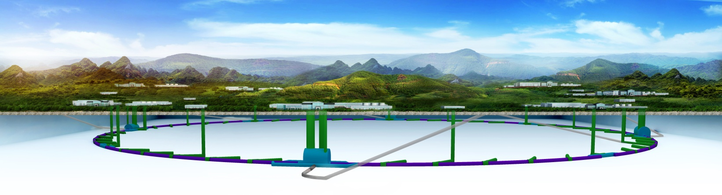
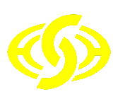
CEPC-SppC
Site investigation
YELLOW RIVER ENGINEERING CONSULTING CO., LTD.
NOVEMBER 2017

Slide 2
CONTENTS
YREC
Working Process
Site Investigation
Project Layout and Scheme Design
Preliminary Understanding
1
2
3
4

Slide 3
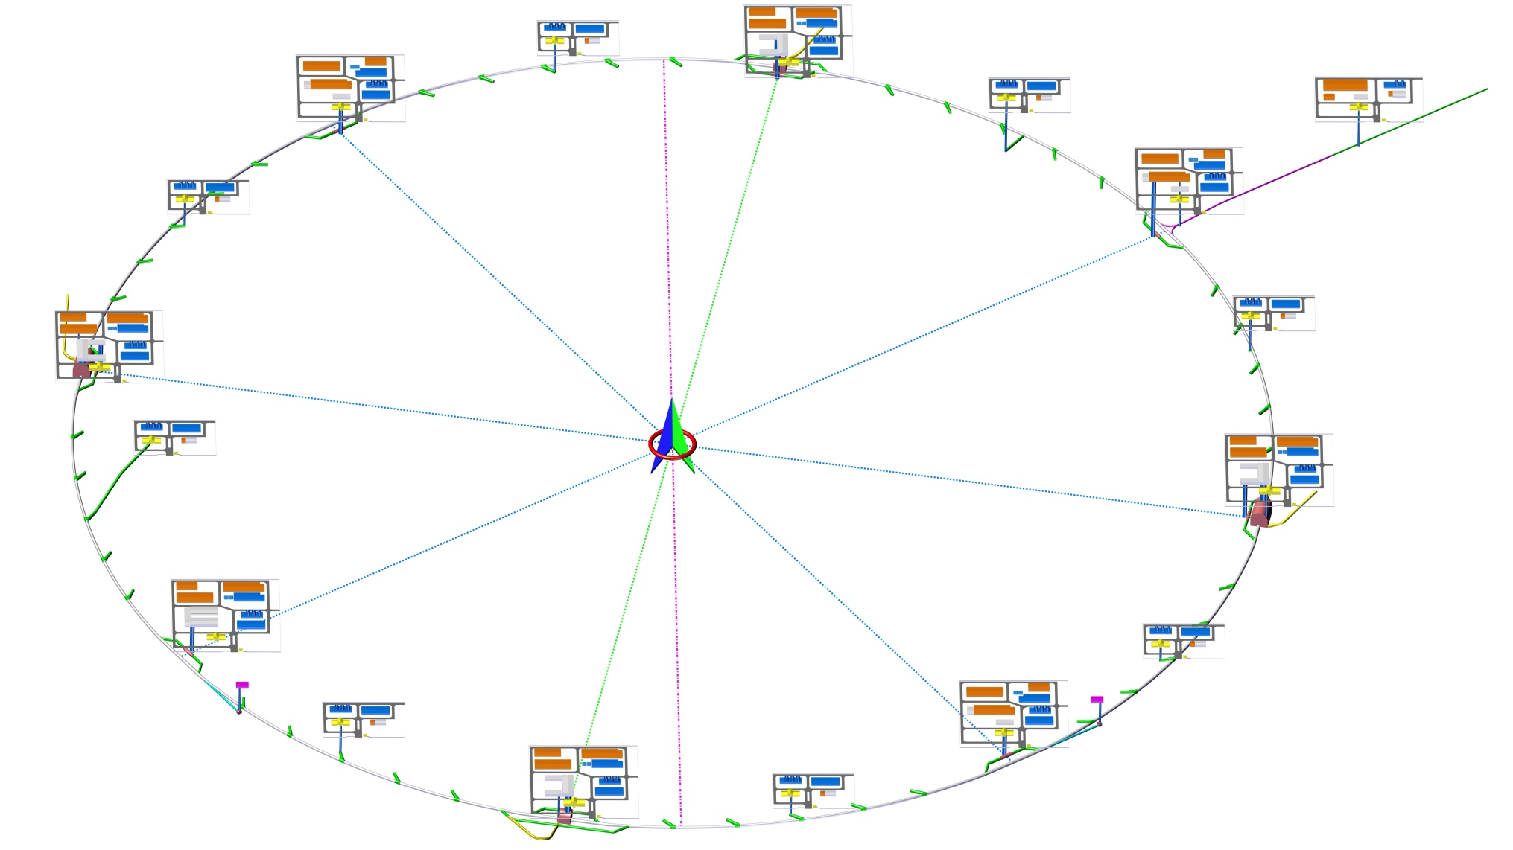
1 Working Process

Slide 4
Design Process
YREC
1 Working Process
Pre-CDR
2014.4~2015.3 Site selection in Hebei
2014.5~2016.8 Site selection in Guangdong
CDR
Sep., 2017 to now, 100km design of Funing, Qinhuangdao City
2014.6~2017.7 Site selection in Shaanxi
2016.9 Site selection in Jiangsu
2017.9 Site selection in Zhejiang
2017.7~8 Site selection in Baoding City, Hebei Province
Notes:
4
4

Slide 5
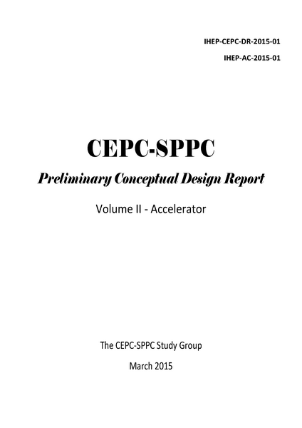
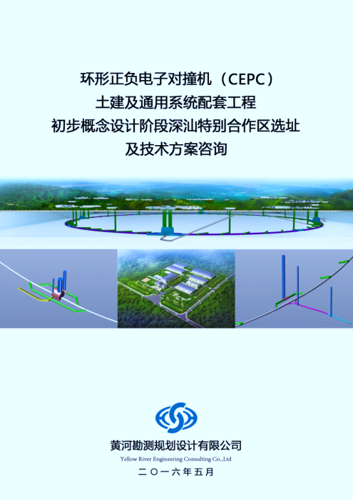
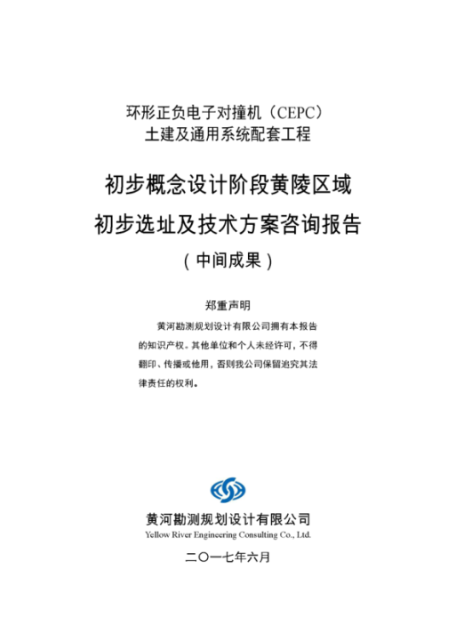
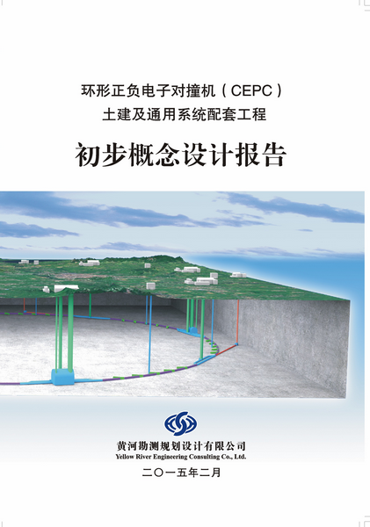
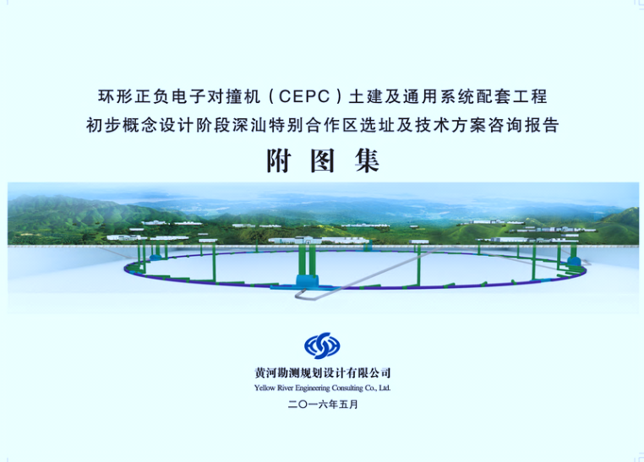
Design Results
YREC
1 Working Process
2015
2016
2017
Notes:
5
5
2015，抚宁场址，54km
2016，深汕，86km
2017，黄陵，100km

Slide 6
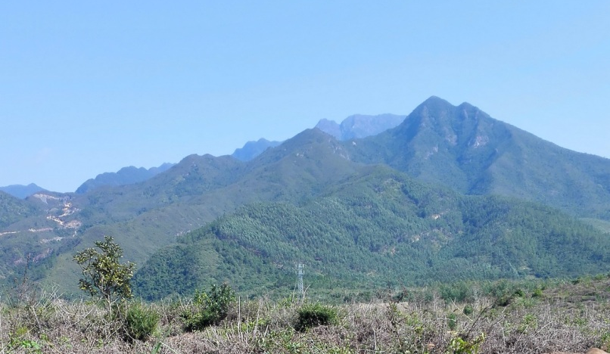
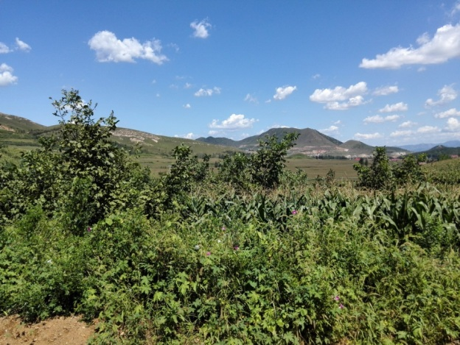
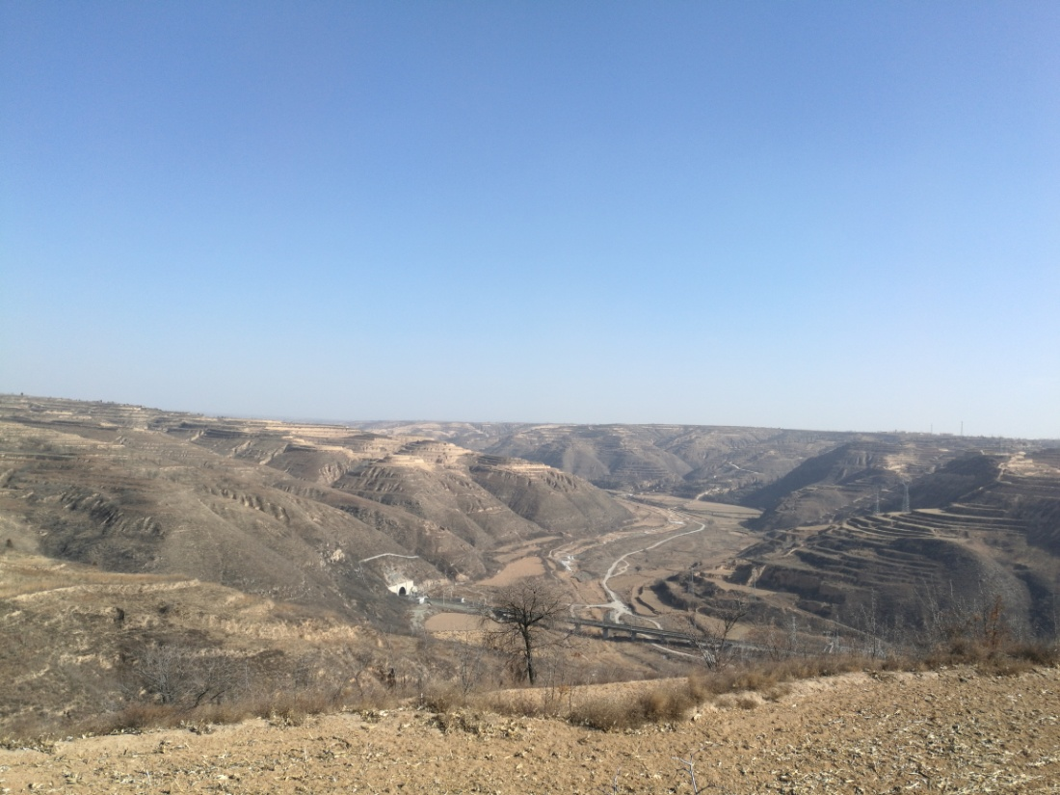
2 Site Investigation

Slide 7
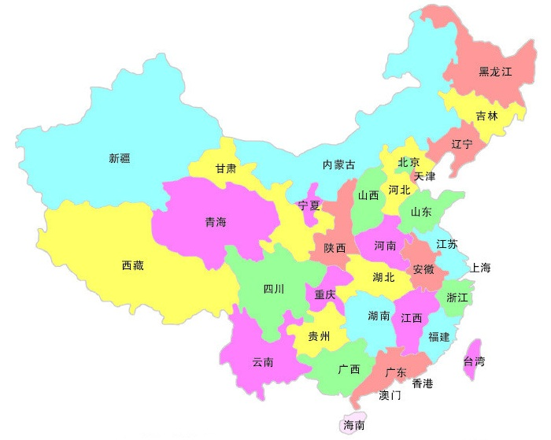
2.1 Introduction of Site Selection
YREC
2 Site Investigation
Site Investigation and Selection in Pre-CDR
For this stage, we made preliminary comparison and selection of the project sites in the provinces of Hebei, Guangdong, Shaanxi, Jiangsu and Zhejiang, and conducted field investigation in Hebei, Guangdong and Shaanxi.
Notes:
7
7

Slide 8
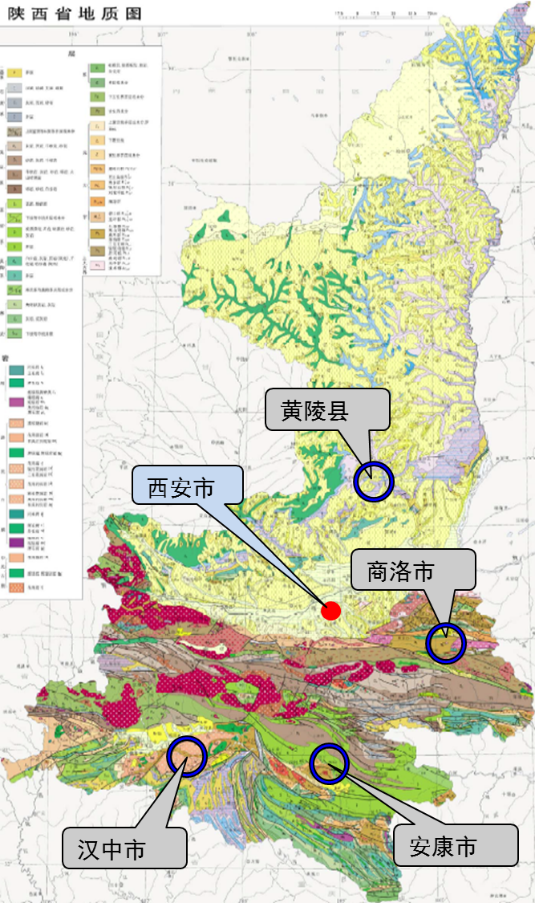
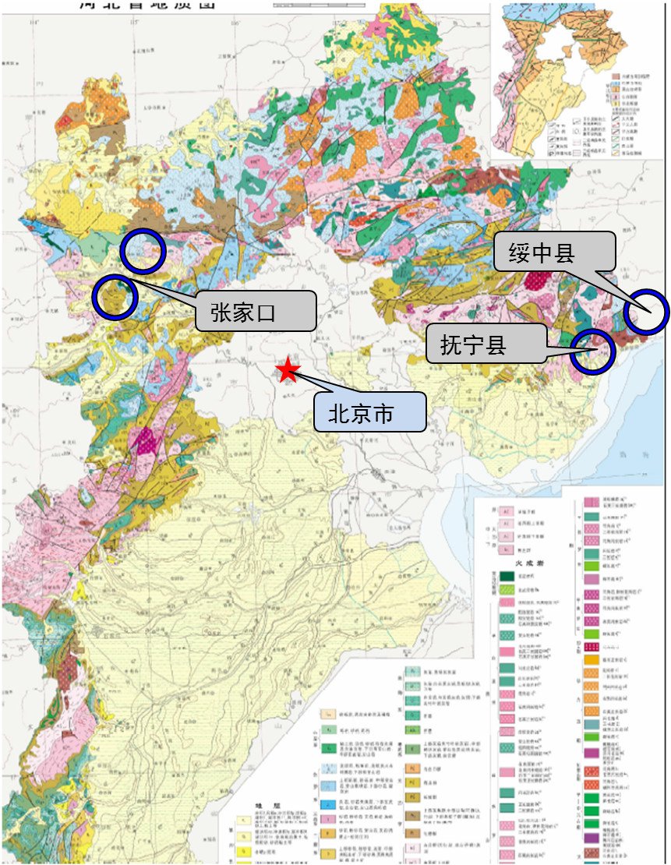
Site Selection in Hebei, Shaanxi
YREC
2 Site Investigation
Hebei
Shaanxi
Notes:
从地形地质条件上选择了张家口盆地、抚宁县附近和山海关—绥中地区作为可供选址的比选区域。
With respect to the topographical and geological conditions, Zhangjiakou basin, the area nearby Funing County and the area of Shanhaiguan–Suizhong County are studied and compared.
初步选择了黄陵县南部区、商洛市东北部、汉中东部区、安康北部区作为选址区域。
Southern Huangling County, Northeastern Shangluo City, Eastern Hanzhong City, Northern Ankang City are studied.

Slide 9
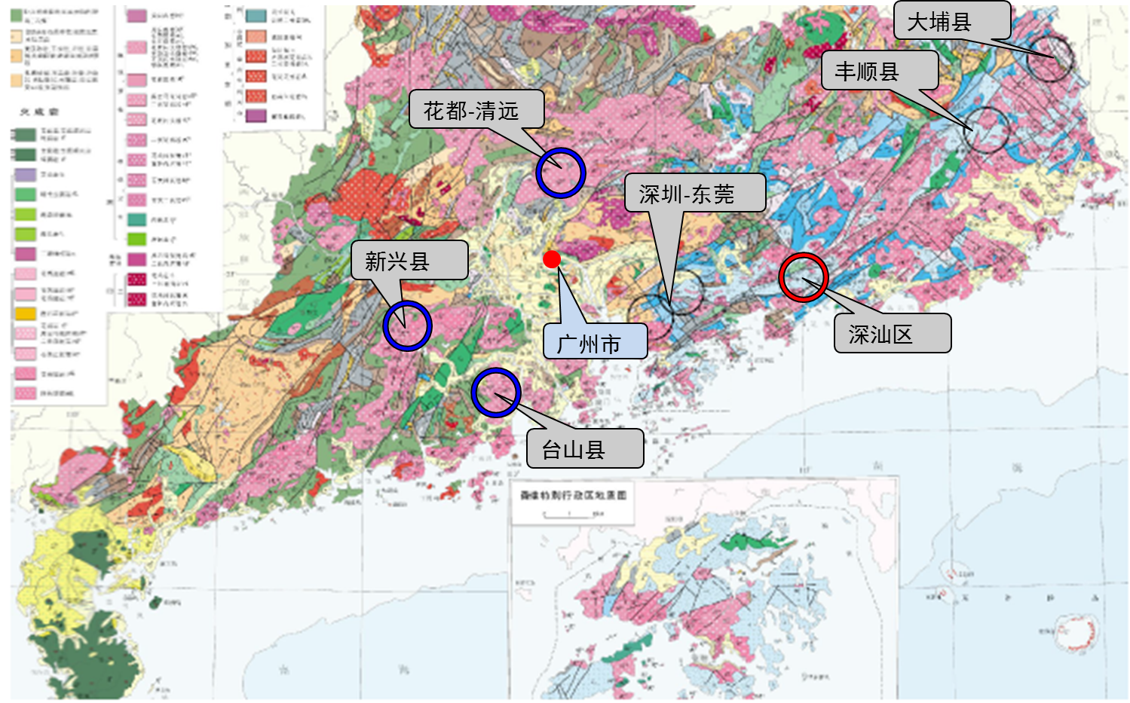
Site Selection Guangdong
YREC
2 Site Investigation
Guangdong
Notes:
With respect to topographical and geological conditions in Guangzhou, the areas of north of Huadu-east of Qingyuan, the area surrounding Taishan, the area of east of Xinxing County are compared; Dapu County of Meizhou, north of Fengshun County and the area of Shenzhen-Dongguan are also compared. From September of 2015 to August of 2016, as required by Shen-Shan District and IHEP, Shen-Shan Special Cooperation District was selected for site comparison.

Slide 10
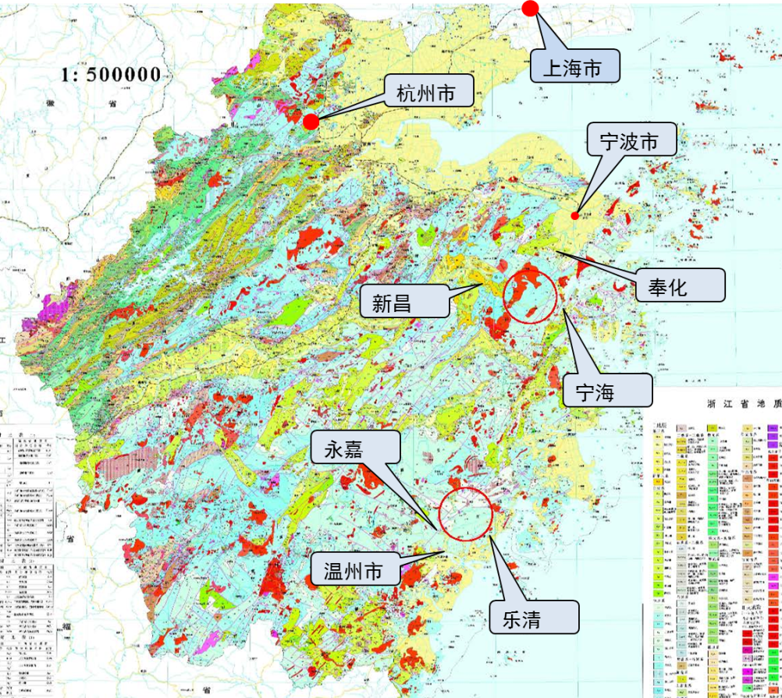
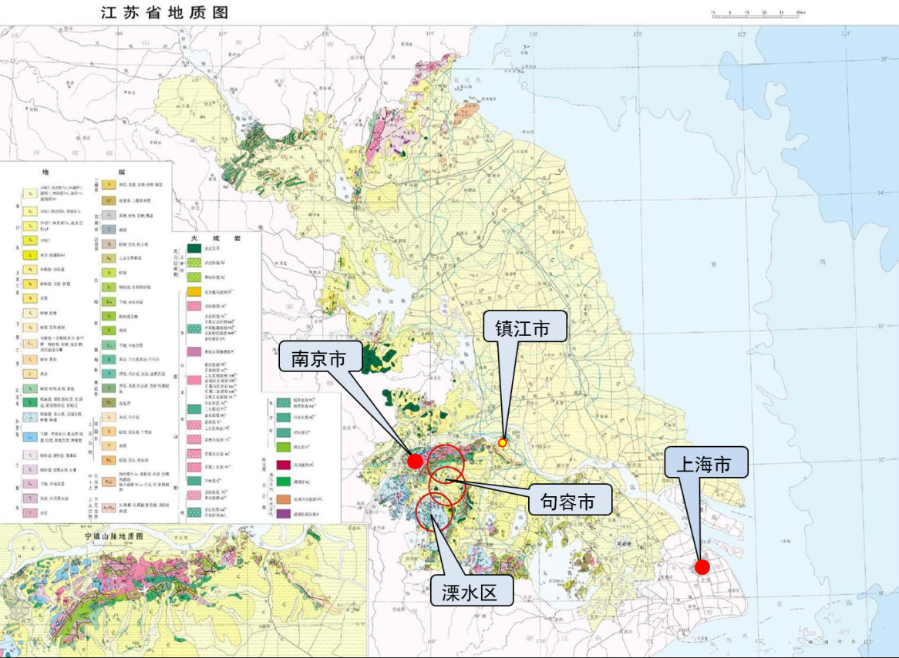
Site Selection in Jiangsu and Zhejiang
YREC
2 Site Investigation
Jiangsu
Zhejiang
Notes:
初步选择了南京市紫金山东部-句容市-溧水区一带作为选址区域。Areas along Eastern Zijin Mountain– Jurong City – Lishui District were chosen to be the location areas.
初步选择了浙江省东部的奉化-宁海-新昌之间和永嘉-乐清北部一带作为选址区域。The initial selection of Fenghua - Ninghai - Xinchang in the eastern part of Zhejiang Province and the northern area of Yongjia - Yueqing as the location area.

Slide 11
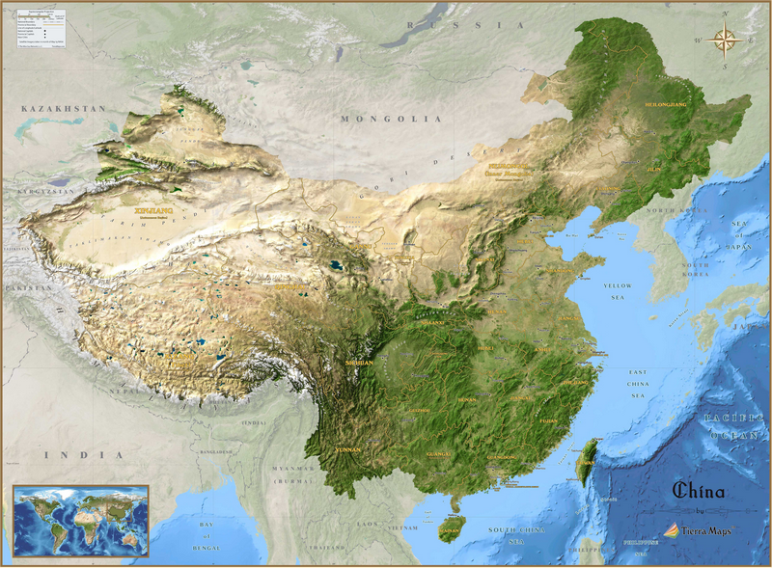
Site Selection
YREC
2 Site Investigation
Finally as per the requirements of IHEP and various local government, Funing, Shen-Shan and Huangling were selected for site comparison.

Slide 12

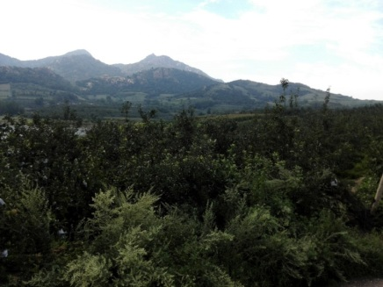
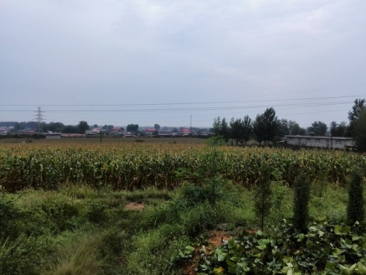
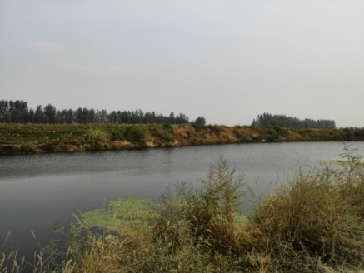
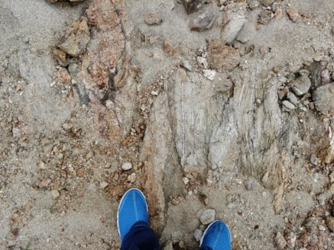
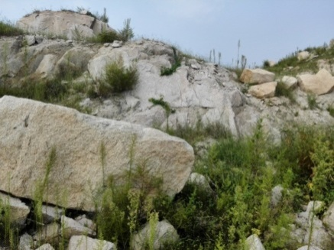
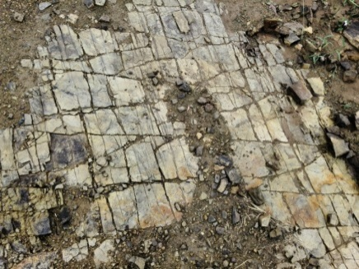
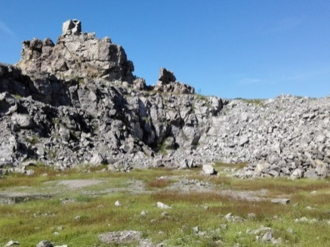
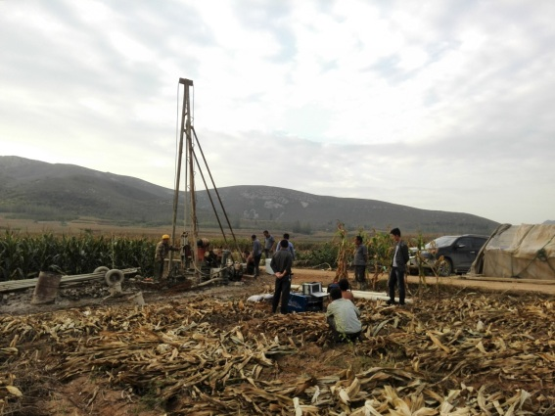
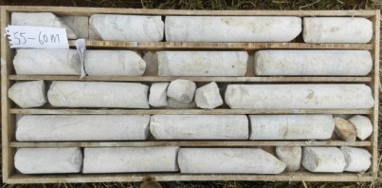
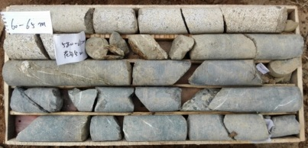
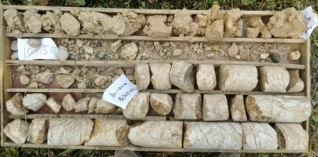
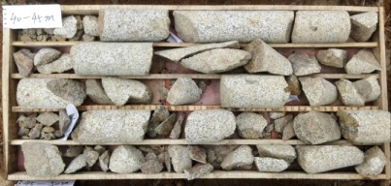
Funing, Qinhuangdao City, Hebei Province
YREC
2 Site Investigation
Topography and landforms
Stratum Lithology
Drill Holes

Slide 13
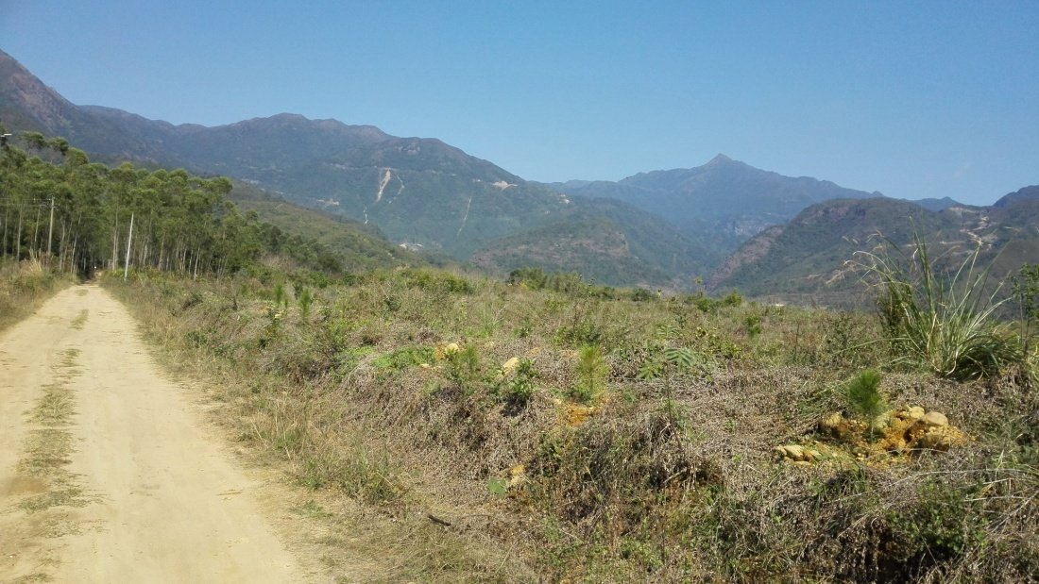
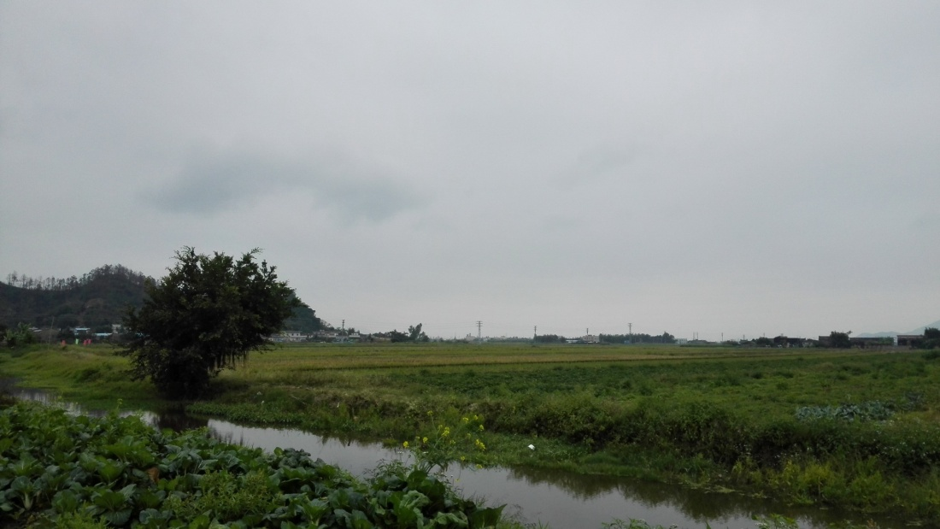
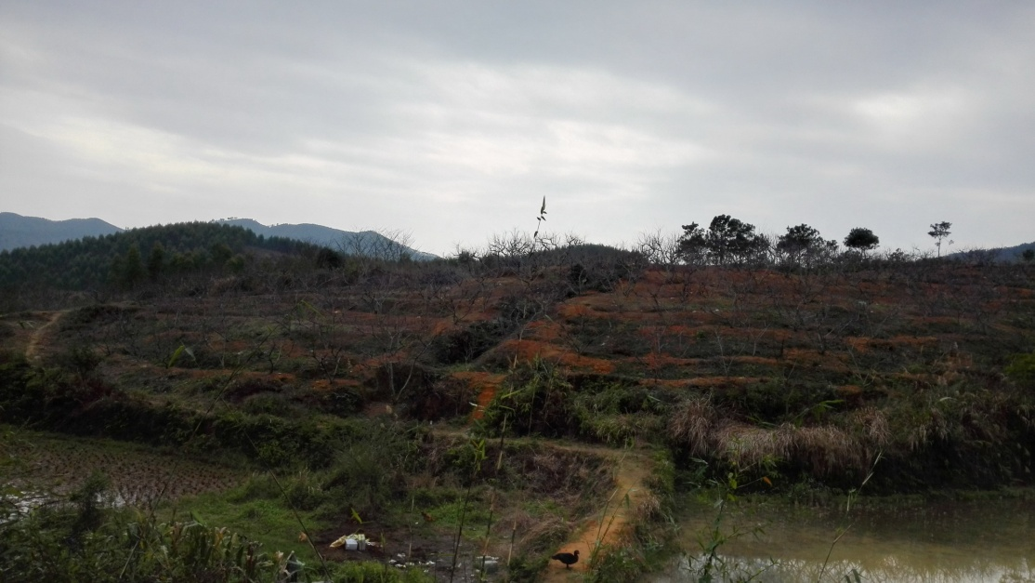
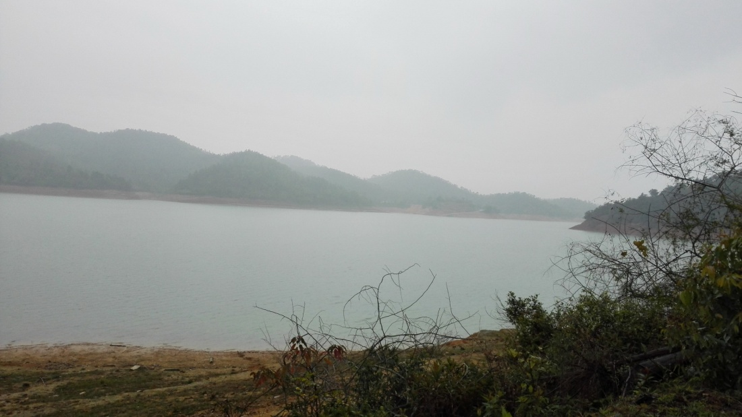
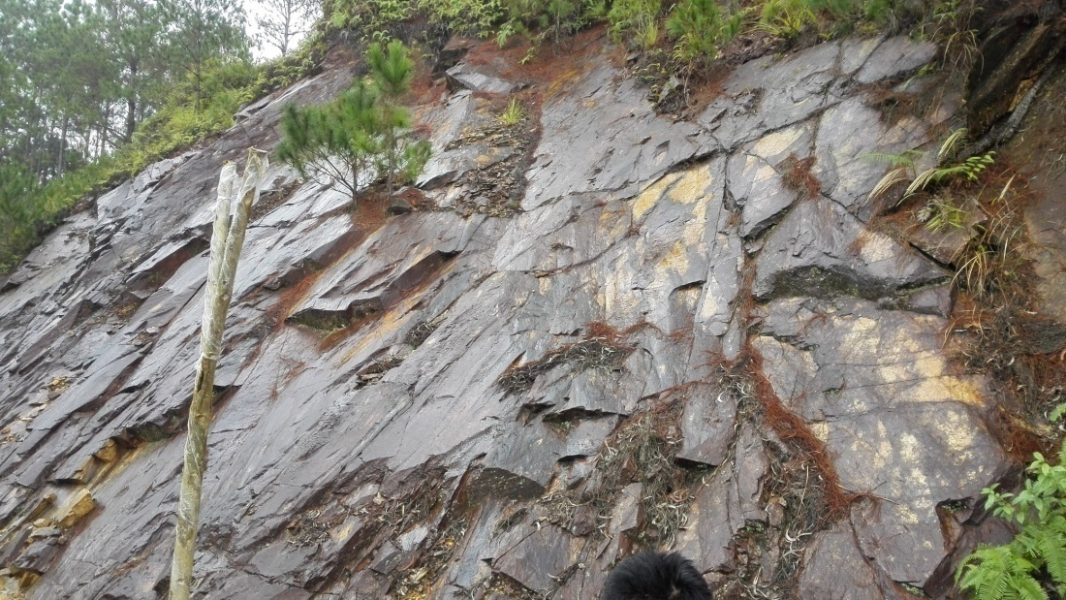
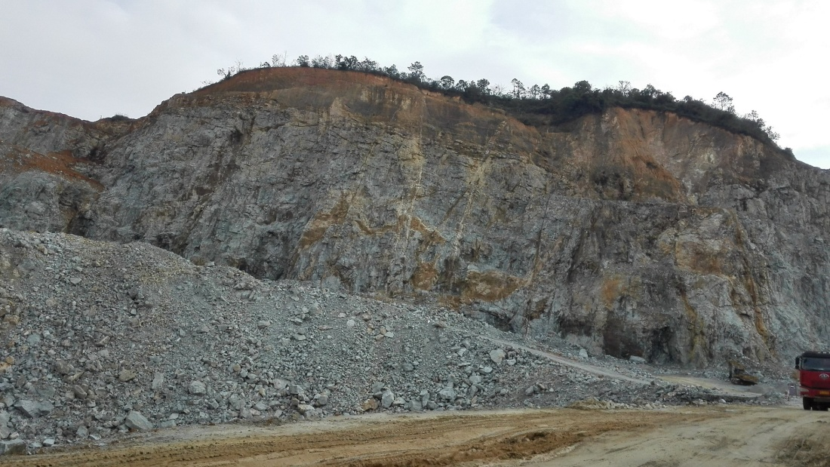
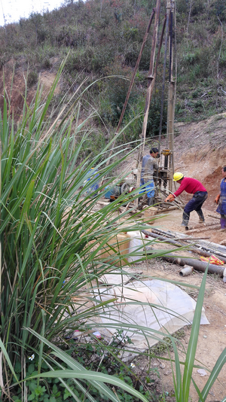
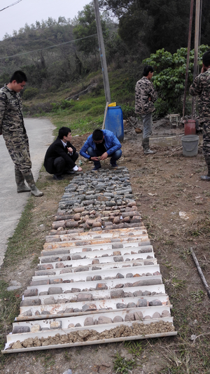
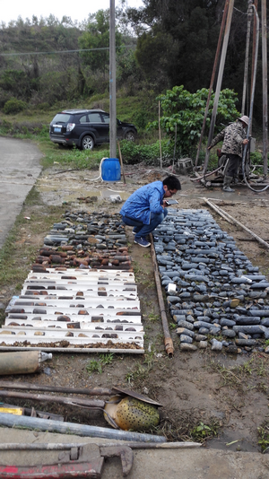
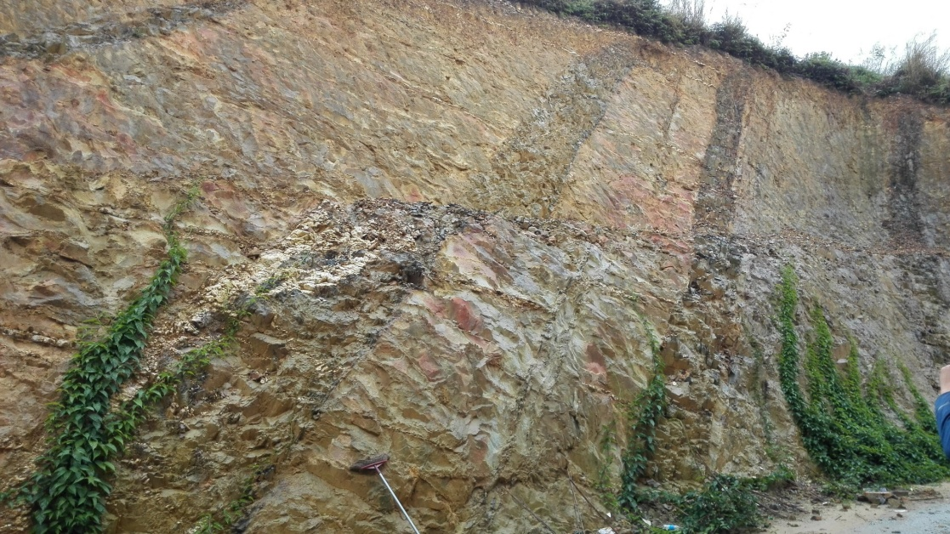
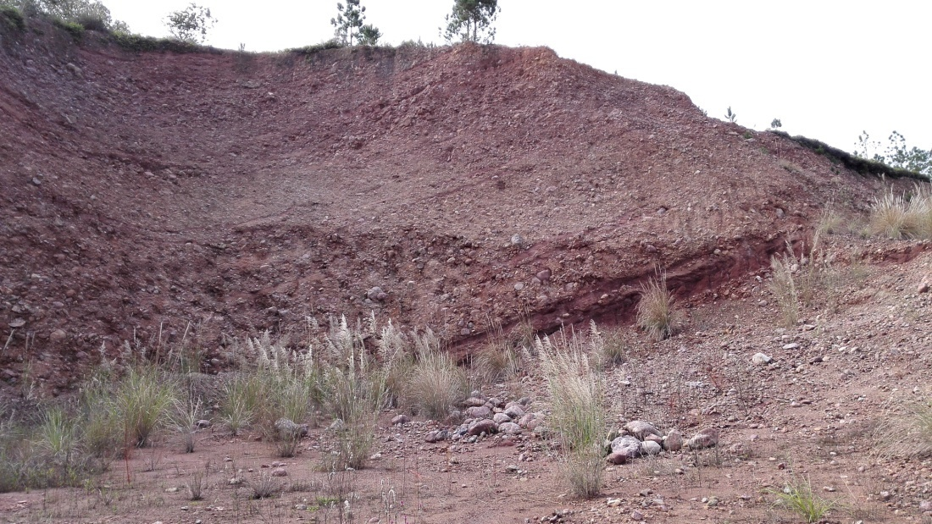
Shen-Shan, Guangdong
YREC
2 Site Investigation
Topography and landforms
Stratum Lithology
Drill Holes

Slide 14
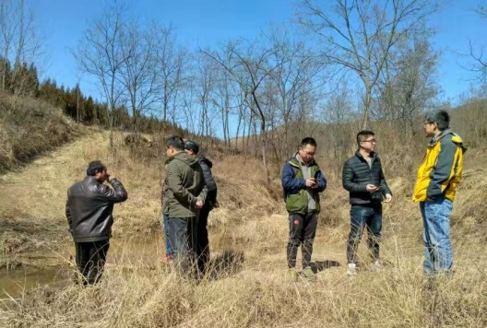
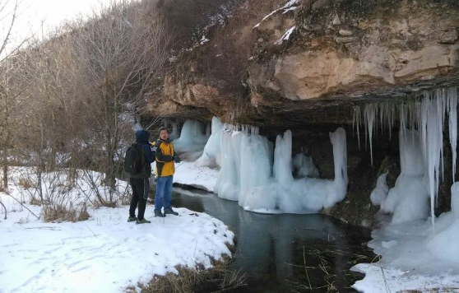
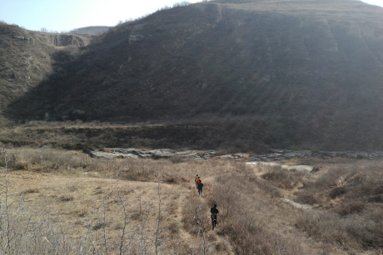
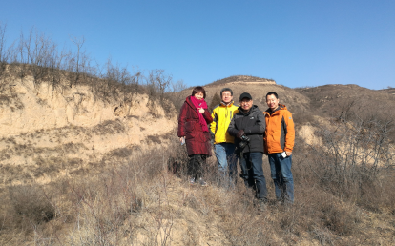
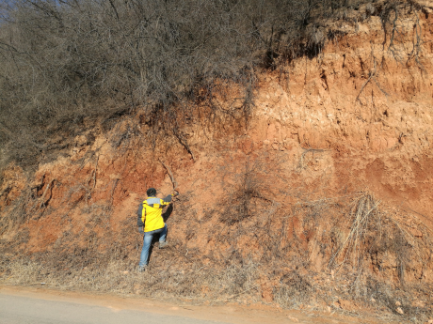
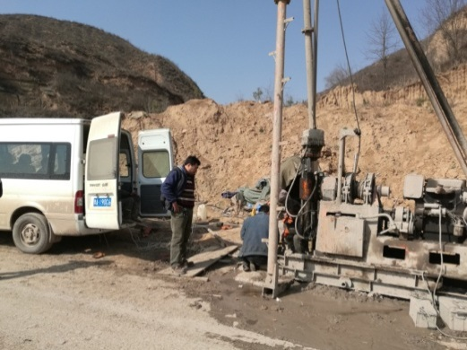
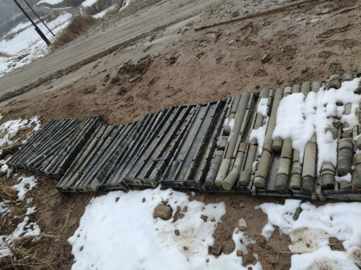
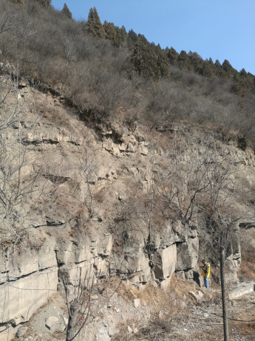
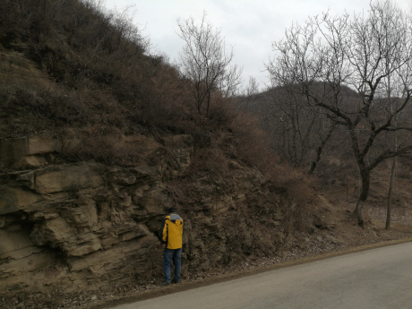


Huangling, Shaanxi
YREC
2 Site Investigation
Topography and landforms
赤石河中游桥
Drill Holes
Stratum Lithology

Slide 15
2.2 Preliminary comparison of various sites
Item |  | Huangling | Shen-Shan | Funing
Construction conditions | Location
Notes:
黄陵-北京1000km，,驾车11h，火车7h
Huangling to Beijing 1000km, it takes 11 hours to drive or 7 hours by train.
深汕-北京2800km,飞机2.5h
Shen-shan to Beijing 2800km, it takes 2.5 hours by plane.
抚宁-北京260km
Funing to Beijing 260km.
各地交通均较便利
All sites have convenient transportation.
各地场址附近均有变电站，河流、水库众多，供水、供电条件较好。
There are transformer substations, rivers and reservoirs near all sites which could provide good water and electricity supply conditions.
黄陵文化旅游及煤化工产业发达
Well-developed cultural tourism and coal chemistry industry in Huangling.

Slide 16






Item |  | Huangling | Shen-Shan | Funing
Geological and topographical conditions | Topography and landforms | The site is in the gully area of loess plateau and the overall terrain is generally high in west and low in east with an elevation of 600~1600m. The terrain relative maximum height difference is about 1000m, so the terrain is broken. | The site is located in the Valley geomorphic area. The middle is high and the north and south are lower. The ground elevation varies largely, generally 20~800m. The highest peak of Mount Lianhua is up to 1336m. | The site is in hilly area. The elevation of most places is 20~200m. The highest elevation is 695m.

Slide 17








Item |  | Huangling | Shen-Shan | Funing
Geological and topographical conditions | Stratum Lithology
Rhyolite
Gneiss
Bed rock covered with loess
Granite
Sandstone Intercalated with shale
Granite
Alternative layers of sandstone and shale
Sandy Gravel
Notes:
黄陵：主要岩性为砂岩、泥岩、粉砂岩与页岩互层，局部夹有煤线和薄层油页岩。上部覆盖有黄土和棕红色泥岩或红土。
Huangling: The main part is interbedding between lithology sandstone, mudstone, siltstone and shale, while some local parts are mixed with coal and thin layer of oil shale. Top is covered with loess and brown red mudstone or laterite.
深汕：岩性复杂。
Shen-shan: Complex lithology.
抚宁：岩性较单一，主要为片麻岩和花岗岩。
Funing: Single lithology.

Slide 18



Item |  | Huangling | Shen-Shan | Funing
Geological and topographical conditions | Geological structure
Earthquakes
There are no active faults and earthquake activity that is over magnitude-4.75 within 25km of the site. | There are no active faults and earthquake activity that is over magnitude-4.75 within 25km of the site. | There are no active faults within 5km of the site, and there is seismic activity at moderate intensity level but without strong earthquake activity.
Seismic peak acceleration
0.05g | 0.05~0.10g | 0.10~0.15g
Basic seismic intensity
<VI | VI~VII | VII

Slide 19

Item |  | Huangling | Shen-Shan | Funing
Geological and topographical conditions | Geological structure | The geological structure is simple within the selected site area. | The Mount Lianhua fault zone goes across the site from northeast to southwest. The fault zone is composed of multiple fractures. | There is no large fault zones in the site area.

Slide 20

Item |  | Huangling | Shen-Shan | Funing
Geological and topographical conditions | Hydrogeology
Annual mean precipitation
577~709mm | 2214mm | 684mm
Rock mass perviousness
Most slightly weathering-fresh rock mass is mainly slightly pervious. | Slightly weathering-fresh rock mass is mainly slightly pervious. The perviousness is controlled by fractures. | Slightly weathering - fresh rock mass is mainly slightly pervious. The perviousness is controlled by fractures.

Slide 21
Item |  | Huangling | Shen-Shan | Funing
Geological and topographical conditions | Surrounding rock classification | The surrounding rock are mainly Class III; the local sandstone is mainly Class II; the surrounding rock mainly consist of the shale and mudstone are Class IV; the surrounding rock in the fault zones and joints are Class V. | The fresh granite is mainly Class II, the volcanic rocks are Classes II and III; the clastic surrounding rock is mainly Class III; the surrounding rocks of the red rock are preliminarily classified as Classes IV-V. | The classification of fresh granite, gneiss and tuff rock are mainly Class II, and some sandstone are mainly Class III. The tunnel is dominated by Class II surrounding rock, and the main hall is Class II surrounding rock.

Slide 22







Item |  | Huangling | Shen-Shan | Funing
Geological and topographical conditions | Main engineering geological problems |  |  | Gushing water while across Yanghe River
Water inflow
Local sandstone contains oil.
High geostress
High ground temperature
Noxious gas
Soft rock

Slide 23


Item | Huangling | Shen-Shan | Funing
Project layout
Construction difficulty | Moderate | Relatively difficult | Relatively easy
Huangling（100km）
Shen-Shan（100km）
Funing（100km）
Notes:
Huangling: The site is mainly on the loess plateau. The buried depth of the tunnel and the depth of the shafts are quite different. The construction access layout is relatively simple.
Shen-Shan: The site is mainly the low mountain area. The buried depth of the tunnel and the depth of the shafts are large, and the construction access layout is relatively complicated.
Funing: The site is generally the low hilly areas; underground burial depth is not big; the construction site conditions are better; the construction access layout is relatively simple.

Slide 24
Item | Huangling | Shen-Shan | Funing
Cost Estimation
100km:
10.92 billion RMB
100km:
13.64 billion RMB
100km:
10.06 billion RMB
Notes:
Water burst

Slide 25

3 Project Layout and Preliminary Scheme

Slide 26
3.1 Scope of the Work
YREC
3 Project Layout and Preliminary Scheme
Circular tunnel and auxiliary tunnels
Preliminary type selection of lifting equipment, means of equipment transportation, electrical system, water supply and drainage, ventilation & air conditioning system, communication, evacuation, supervisory control and fire protection
Underground experimental hall and ancillary caverns, sump pump house, evacuation rooms
Access to experimental hall, including inclined and vertical shafts and emergency exit
Surface buildings in the shaft portal area, transformer substation, distribution substation, refrigerator house, ventilator house, etc.
Main construction material storage and spoil dump area

Slide 27

3.2 Preliminary Scheme (Funing 100km)
YREC
3 Project Layout and Preliminary Scheme
General Layout of 100km Scheme
IP1(IR)
Collider ring tunnel
IP2(RF)
LINAC
Notes:
IP1和IP3直线段（IR段），在实验大厅位置设置物资运输兼人员运输竖井2个（一个位于实验大厅附近，探测器安装兼顾一部分管线；一个位于booster旁路隧道附近，探测器、加速器设备安装，兼顾人员、管线通道），D=20m；设置紧急逃生竖井1个，D=5m；在Booster旁路隧道设置设备检修兼人员运输竖井1个，D=8m；共计8座；For IP1 and IP3 straight sections (IR section) two shafts were set up in the experimental hall for transportation of goods and personnel transportation (one near the experimental hall, for the installation of detector and also used for some pipeline; the other is near the booster bypass tunnel, for the installation of the detector, booster equipment installation, and access for personnel and pipeline), D = 20m; Set up an escape shaft, D = 5m; set up the equipment maintenance and personnel transport shaft in the booster bypass tunnel , D = 8m; there are total 8 shafts.
IP2和IP4直线段（RF段），在实验大厅位置设置运输兼交通井（加速器设备安装。管线及人员通道），D=20m；设置紧急逃生竖井，D=2.5m；共计4座；For IP2 and IP4 straight line section (RF section), set up transport and access shaft (booster installation, pipeline and personnel access) in the experimental hall, D = 20m; set up an escape shaft, D=2.5; there are total 4 shafts.
STR（LSS）直线段，在中部设置运输兼交通井（加速器设备安装通道、人员通道、管线通道共用），D=10m，共计4座；For STR (LSS) straight section, set up transportation and access shaft in the middle (booster device installation channel, personnel access, pipeline channel), D = 10m, a total of four;
弧线段：根据通风和施工要求设置竖井，每个弧线段设置2个排风井，D=8m；设置1个进风兼交通井（设备通道、人员通道、管线通道），D=8m；共计24座。Arc segment: set up the shaft according to the requirements of ventilation and construction, set up 2 ventilation shafts for each arc segment, D = 8m; set up one air inlet and traffic well (equipment channel, personnel access and pipeline channel), D = 8m, A total of 24.

Slide 28

3.2 Preliminary Scheme (Funing 100km)
YREC
3 Project Layout and Preliminary Scheme
Possible major geological problems include inflow, geostress, etc.; Surrounding rocks of Classes II account for 74%, Classes III for 18%, Classes Ⅳ~Ⅴ for 8%.
Experimental hall buried depth is 90~190m and the main surrounding rock is Class II.

Slide 29

3.2 Preliminary Scheme (Funing 100km)
YREC
3 Project Layout and Preliminary Scheme
IP1 / IP3
CEPC Experimental Hall
30×30×30m
Transport shaft 1
Collider ring tunnel
Escape shaft
Booster bypass tunnel
Access shaft
Transport shaft 2
Notes:
对撞区位于IP1/IP3，长度为3282m。在对撞区中部布置有CEPC实验大厅、1#运输竖井、2#运输竖井、加速器旁路隧道交通竖井、紧急逃生竖井及交通隧道。主环隧道在对撞区范围内先分为2条隧道后合并为一条并穿过CEPC实验大厅，加速器辅助隧道从主环隧道分叉后从主环内侧越过实验大厅，对撞区还分布有2条辅助短隧道。主环隧道和加速器旁路隧道的设计根据探测器主环设备和加速器设备的Lattice实验数据， 并结合土建一般要求确定。The (interaction region) IR is located at IP1/IP3 with a length of 3282m. CEPC Experiment Hall, 1# transport shaft, 2# transport shaft, booster bypass tunnel, escape shaft and access tunnel are arranged in the middle of the IR region. The collider ring tunnel in the IR is divided into two tunnels and then is merged into one and it passes through the CEPC Experiment Hall. After the booster bypass tunnel is bifurcated from the collider ring tunnel, it will cross the Experimental Hall from the inside of the collider ring. IR is also arranged with 2 auxiliary tunnels. The design of the collider ring tunnel and the booster bypass tunnel is based on the Lattice experimental data of the detector for the collider ring device and the booster device, and it is determined according to the general requirements of civil engineering.
在对撞区中部布置有CEPC实验大厅、1#运输竖井、2#运输竖井、加速器旁路隧道交通竖井、紧急逃生竖井及交通隧道。其中1#运输竖井主要负责探测器安装兼顾一部分管线通道；2#运输竖井主要负责探测器、加速器设备安装，兼顾人员、管线通道；紧急逃生竖井用于紧急情况下人员逃生时使用，加速器旁路隧道交通竖井主要负责加速器管线及人员交通；交通隧道用于常规人员进出实验大厅及部分检修维护设备的运输。The middle of the IR area is equipped with SPPC experiment hall, 1# transport shaft, 2# transport shaft, , booster bypass tunnel, escape shaft and access tunnel. The 1# transport shaft is responsible for the installation of detectors and access of partial pipeline; 2# transport shaft is responsible for the installation of detectors and boosters, as well as access of personnel and pipeline. The escape shaft is used for escape of personnel in emergency situations. The booster bypass tunnel access shaft is used for the booster pipeline and personnel access. The access tunnel is used for transportation of regular personnel into and out of the experimental hall and some overhaul and maintenance of equipment.

Slide 30

3.2 Preliminary Scheme (Funing 100km)
YREC
3 Project Layout and Preliminary Scheme
IP2 / IP4
Low level and solid-state amplifier hall
RF auxiliary tunnel
Access tunnel
Cryogenic hall
Transport shaft
Cooling water hall
Power source hall
Collider ring tunnel
SppC Experimental Hall
60×40×40m
Escape shaft
Notes:
高频区位于IP2/IP4，与对撞区呈90°夹角，长度为2842m。在高频区中部布置有高频辅助隧道、SPPC实验大厅、运输竖井、紧急逃生竖井及交通隧道，高频辅助隧道包含功率源厅、低温厅、水冷厅及低电平固放厅，主环隧道穿过SPPC实验大厅，高频区还分布有2条辅助短隧道。其中运输竖井负责设备运输、检修、人员进出并兼顾管线通道；紧急逃生竖井用于紧急情况下人员逃生时使用；交通隧道用于常规人员进出实验大厅及部分检修维护设备的运输。HF area is located in IP2/IP4 with 90° angle to the IR with a length of 2842m. The middle of the HF area is equipped with RF auxiliary tunnel, SPPC experiment hall, transport shaft, escape shaft and access tunnel. The HF auxiliary tunnel includes power source hall, cryogenic hall, cooling water hall and low level and solid-state amplifier hall. The collider ring tunnel passes through the SPPC experiment hall and there are also two auxiliary tunnels distributed in the high frequency area. The transport shaft is responsible for equipment transportation, overhaul and personnel entry and exit as well as the pipeline access. The escape shaft is used for escape of personnel in emergency situations. The access tunnel is used for transportation of regular personnel into and out of the experimental hall and some overhaul and maintenance of equipment.

Slide 31

3.2 Preliminary Scheme (Funing 100km)
YREC
3 Project Layout and Preliminary Scheme
Collider ring tunnel and short auxiliary tunnel
RF
IR
Notes:
主环在顺时针45°、135°、225°、315°四个方向各有一段直线段，长度为1125m，其他区域主环为弧线，半径根据Lattice实验结果确定。在主环上，每隔1km设置辅助短隧道一条，长度为30m，用于本地站设备安置。主环在每个弧线段设置3条竖井，其中中部的为送风兼交通竖井，其他两个为排风竖井。直线段中部设置一个竖井，用于交通兼送风及部分设备管线送出。
The collider ring has a straight line segment in four directions along 45 °, 135 °, 225 °, 315 ° clockwise with a length of 1125m. In other areas, the collider ring is arc whose radius is determined according to Lattice experimental results. On the collider ring, an auxiliary tunnel is set at a distance of 1km, with a length of 30m for local equipment installation. The collider ring sets up three shafts in each arc segment , of which the middle is the air supply and access shaft and the other two are exhaust shafts. A vertical shaft is arranged in the middle of the straight line segment for sending both the traffic and the supply air and some equipment pipelines.

Slide 32

3.2 Preliminary Scheme (Funing 100km)
YREC
3 Project Layout and Preliminary Scheme
Straight Line Accelerator Tunnel & Transport Tunnel
Notes:
在主环顺时针225°的位置设置直线加速器隧道及输运隧道，直线加速器长度1200m，位于地表，然后斜向下通过输运隧道送入与主环平面相同的高程后分叉为2条输运隧道，分别从正负两个方向注入主环隧道。在输运隧道末端设置检修兼设备竖井。A linear booster tunnel and a transport tunnel are arranged at clockwise 225 ° on the collider ring . The linear booster is 1200m in length and is located on the ground. Then it is transported obliquely downwards through the transport tunnel into the same elevation as the plane of the collider ring. After that it is diverged into 2 access tunnels respectively from the positive and negative directions feeding into the collider ring tunnel. In the end of the access tunnel the maintenance and equipment shaft is set up.

Slide 33

3.2 Preliminary Scheme (Funing 100km)
YREC
3 Project Layout and Preliminary Scheme
Tunnel Cross Section – Collision Area
Booster bypass tunnel
Collider ring tunnel
对撞区横剖面
Notes:
主环隧道 = Main ring tunnel， 请改为对撞环隧道=Collider ring tunnel.
高频辅助隧道 = HF Auxiliary Tunnel, 请改为RF auxiliary tunnel.
低温厅 = Cryogenic hall

Slide 34

3.2 Preliminary Scheme (Funing 100km)
YREC
3 Project Layout and Preliminary Scheme
Tunnel Cross Section – RF
Power source hall
Collider ring tunnel
高频区横剖面

Slide 35

3.2 Preliminary Scheme (Funing 100km)
YREC
3 Project Layout and Preliminary Scheme
IP1 Surface Buildings
。
Notes:
Control / duty rooms、Power converter for magnets、RF、110 kV electric substation、10 kV electric substation、HVAC、Cryogenic (helium compressor)、Cooling water system、Experimental assembly work、Magnet assembly and calibration、Unloading equipment、Compressed air、Chilled water、Electronics room、Other
IP1~IP4、LSS1~LSS4、Collider ring tunnel（Arc，total=24）、LINAC、BT
IP1：15750m2
Total：140450m2

Slide 36
3.2 Preliminary Scheme (Funing 100km)
YREC
3 Project Layout and Preliminary Scheme
General Construction Schedule
The total construction period is 58 months, including preparatory work of 10 months, main works of 45 months and completion work of 3 months.
The critical activities are :
Preparation 3 months
Construction shafts 7 months
Main tunnel excavation 30 months
Tunnel lining & water prevention 12 months
Ventilation installation in shafts 3 months
Completion work 3 months
The surface buildings and electrical installation are carried out in parallel and not on the main path.
Notes:
The total construction period is 58 months, including preparatory work of 10 months, main works of 45 months and completion work of 3 months. The critical activities are in the construction of the main tunnel between IP3 and RF3. The path consists of 3-month preparation, 7-month shaft construction, 30-months main tunnel excavation, 12-month tunnel lining and water prevention, 3-month installation of ventilation in shafts and 3-month completion work. The construction of surface buildings and electrical installation are carried out in parallel and not on the main path.

Slide 37

4 Understanding of the Project

Slide 38


YREC
4 Understanding of the Project
（1）Critical technical problems
Comprehensive exploration technology for long distance complicated underground projects.
Prevention and treatment technology study for underground water of long distance complicated underground projects.
The design and construction of long distance tunnel under complicated geographical conditions and large-span underground caverns.
The construction management of complicated underground projects.
Ventilation of long distance tunnel, integration of ventilation and air conditioning system and smoke control system.
The development, manufacturing and application of special-shaped TBM.
Notes:
1、世界最长隧道：瑞士圣哥达隧道，全长57.1km；
2、中国最长隧道：青藏铁路新关角隧道，全长32.6km；
3、规划中总长最长的隧道：西线一期工程输水隧道总长约321km（单洞），最大埋深约1160m，隧道最长约71km；
4、世界及中国跨度最大的地下洞室：已建的向家坝水电站地下厂房跨度33.4m；在建的江门中微子实验站实验大厅（圆拱直墙型洞室），开挖跨度49.5m。
与国际上常规的圆形盾构机不同，异形盾构机不仅是断面的“变形”，更是工法、技术的“变形”。比圆形截面减少20%—30%的开挖面积，最大程度地提高空间利用率，同时通过底部找平，节省大量的工期和后期施工成本。
1. The world's longest tunnel: Switzerland Gotthard tunnel, a total length of 57.1km;
2. The longest tunnel in China: the Qinghai-Tibet Railway Xin Guanjiao tunnel, a total length of 32.6km;
3. The longest total length of the planned tunnel: West pipeline Phase I project with a total length of about 321km (single hole), the maximum depth of about 1160m, the longest tunnel about 71km;
4. The largest span underground cavern in the world and in China: the finished span of the underground workshop of the Xiangjiaba hydropower station is 33.4m; the experimental hall of Jiangmen Neutrino Experimental Station is under construction (dome-type straight wall cavern) with an excavation span of 49.5 m.
Different from the conventional circular shield machine in the world, the special-shaped shield machine is not only a "deformation" of the cross section, but also a "deformation" of workmanship and technology. A 20% -30% reduction in excavation area over a circular cross section maximizes space utilization while leveling through the bottom, saving significant construction and post-construction costs.

Slide 39
YREC
4 Understanding of the Project
（2）Based on the terrain and geological conditions, Funing site is the best among current three, followed by Huangling and Shen-Shan. But in general, all the sites are suitable for the underground construction of such a large extent. The main geological problems encountered can be solved by engineering measures.
（3）There are no limitation factors for engineering construction and project operation from all the sites considering the conditions of external access, water and electricity supply, social service, hydrology and meteorology, etc. However, the tunnel routes are located in the areas of farmland and villages, the construction of experimental hall, shafts and access may conflict with the activities of local people, coordination is required.

Slide 40
YREC
4 Understanding of the Project
（4）CEPC underground structures consist of collider ring tunnel, auxiliary tunnels, experimental halls and shafts. The engineering design and construction will adopt the mature technology widely used in hydraulic engineering, road, railway or mining sectors. The site conditions are good enough to meet the requirements for construction arrangement.
（5）The shafts are set every 3km along the tunnel (transportation, ventilation and evacuation, and transportation access to the experimental hall), which will be utilized for drill and blast construction with multiple working faces proceeding at the same time. The total period of drill and blast construction is 58 months, which is similar as TBM. With comprehensive comparison from construction technology, construction period and project cost, the drill and blast method is recommended at present.

Slide 41
YREC
4 Understanding of the Project
（6）CEPC-SppC is the national major scientific infrastructure facilities, and the site selection shall be compared and determined comprehensively considering the factors of social environment, ecological environment, engineering design and project cost, etc.

Slide 42

The End
Thanks！

