Slide 1
粒子物理前沿卓越中心2017年度考评报告
（CEPC加速器物理设计）
王逗
高能物理研究所
2017年12月1日

Slide 2
个人简介
♦部门： 加速器中心 ♦职称：副研究员
♦研究方向：CEPC & ILC加速器物理
♦岗位职责：自2015年以来，任CEPC加速器物理系统召集人之一，主要负责CEPC加速器总体方案选择及加速器物理设计。
2006-2011 高能物理研究所，博士
（博士课题：ILC加速器物理设计与关键技术实验研究）
- 2007.09 BEPCII对撞区超导磁铁测量
- 2007∼2011 参加BEPCII储存环运行调束
2011-2015 高能物理研究所， 助理研究员
- 2011∼2012 参加BEPCII直线注入器运行调束
- 2012.08 BEPCII加速器准直测量
2015- 今 高能物理研究所，副研究员

Slide 3
提纲
CEPC 总体参数选择
CEPC 动力学孔径优化及算法开发
CEPC 主环新lattice探索性设计
tt 能量下CEPC lattice 改造方案设计
其他工作

Slide 4
方向一：CEPC总体参数设计
总体参数选择引领整个加速器的设计 ⎯ 宏观把握
未来高能环形对撞机参数优化设计方法
-- 从设计目标出发，例如能量、亮度、对撞点个数…
-- 考虑核心的物理限制，例如束束作用、crab waist的增益及束致辐射效应…
-- 还有经济和技术的限制，例如同步辐射功率和超导腔中的高次模功率…
-- 综合所有限制，以一种解析的方式给出了一套自洽的高能正负电子对撞机的优化方法
张开参数空间，对CEPC未来的技术创新及建造打下关键的设计基础
-- 50 km，65km，100km
-- Higgs，W，Z （tt）
-- 单环，局部双环，先进局部双环，双环
将crab waist理念应用于CEPC，以提高亮度同时降低束流功率
CEPC总体参数与MDI、超导高频系统、增强器、直线等多个系统的沟通
-- 加速器物理设计与硬件之间的技术匹配复杂而艰难

Slide 5
CEPC CDR Parameters（βy*=2mm）
 | tt | Higgs | W | Z
Number of IPs | 2
Energy (GeV) | 175 | 120 | 80 | 45.5
Circumference (km) | 100
SR loss/turn (GeV) | 7.61 | 1.68 | 0.33 | 0.035
Half crossing angle (mrad) | 16.5
Piwinski angle | 0.91 | 2.58 | 4.39 | 12.8 | 9.03
N_{e}/bunch (10¹⁰) | 24.15 | 15 | 3.6 | 4.8
Bunch number | 34 | 248 | 5220 | 8334
Beam current (mA) | 3.95 | 17.9 | 90.3 | 192.3
SR power /beam (MW) | 30 | 30 | 30 | 6.7
Bending radius (km) | 10.9
Momentum compaction (10⁻⁵) | 1.14
β_{IP} x/y (m) | 1.2/0.0037 | 0.36/0.002
Emittance x/y (nm) | 2.24/0.0068 | 1.21/0.0037 | 0.54/0.0018 | 0.17/0.0029
Transverse σ_{IP} (um) | 51.8/0.16 | 20.9/0.086 | 13.9/0.060 | 7.91/0.076
ξ_{x}/ξ_{y}/IP | 0.077/0.105 | 0.031/0.116 | 0.009/0.055 | 0.0084/0.062 | 0.017/0.088
V_{RF} (GV) | 8.93 | 2.14 | 0.465 | 0.053 | 0.1
f _{RF} (MHz) (harmonic) | 650 (217500)
Nature bunch length σ_{z} (mm) | 2.54 | 2.72 | 2.98 | 3.67 | 2.38
Bunch length σ_{z} (mm) | 2.87 | 3.26 | 3.7 | 6.16 | 4.33
HOM power/cavity (kw) | 0.53 (5cell) | 0.56 (2cell) | 0.32(2cell) | 0.7(2cell)
Energy spread (%) | 0.14 | 0.098 | 0.066 | 0.037
Energy acceptance requirement (%) | 1.57 | 1.52
Energy acceptance by RF (%) | 2.67 | 2.06 | 1.48 | 0.75 | 1.7
Photon number due to beamstrahlung | 0.19 | 0.29 | 0.11 | 0.25
Lifetime due to beamstrahlung (hour) | 1.0 | 1.0
Lifetime (hour) |  | 0.33 (20 min) | 3.5 | 7.4
F (hour glass) | 0.89 | 0.93 | 0.96 | 0.986
L_{max}/IP (10³⁴cm⁻²s⁻¹) | 0.38 | 2.49 | 4.1 | 5.83 | 8.26

Slide 6
CEPC CDR Parameters（βy*=1mm）
 | Higgs | Z
Number of IPs | 2
Energy (GeV) | 120 | 45.5
Circumference (km) | 100
SR loss/turn (GeV) | 1.68 | 0.035
Half crossing angle (mrad) | 16.5
Piwinski angle | 2.58 | 17.2 | 12.1
N_{e}/bunch (10¹⁰) | 15 | 4.8
Bunch number | 248 | 8334
Beam current (mA) | 17.9 | 192.2
SR power /beam (MW) | 30 | 6.7
Bending radius (km) | 10.9
Momentum compaction (10⁻⁵) | 1.14
β_{IP} x/y (m) | 0.36/0.001 | 0.2/0.001
Emittance x/y (nm) | 1.21/0.0037 | 0.17/0.0029
Transverse σ_{IP} (um) | 20.9/0.061 | 5.9/0.054
ξ_{x}/ξ_{y}/IP | 0.031/0.082 | 0.0047/0.044 | 0.0094/0.0626
V_{RF} (GV) | 2.14 | 0.053 | 0.1
f _{RF} (MHz) (harmonic) | 650 (217500)
Nature bunch length σ_{z} (mm) | 2.72 | 3.67 | 2.38
Bunch length σ_{z} (mm) | 3.26 | 6.16 | 4.33
HOM power/cavity (kw) | 0.56 (2cell) | 0.7(2cell) | 0.83(2cell)
Energy spread (%) | 0.098 | 0.037
Energy acceptance requirement (%) | 1.52
Energy acceptance by RF (%) | 2.06 | 0.75 | 1.7
Photon number due to beamstrahlung | 0.29 | 0.33
Lifetime due to beamstrahlung (hour) | 1.0
Lifetime (hour) | 0.33 (20 min)
F (hour glass) | 0.81 | 0.97
L_{max}/IP (10³⁴cm⁻²s⁻¹) | 3.1 | 8.13 | 11.54

Slide 7
CEPC亮度限制
Luminosity of H & W limited by the SR power 30 MW.
-- Luminosity @ H: ~3.0×10³⁴ cm⁻²s⁻¹, 248 bunches
-- Luminosity @ W: ~4.1×10³⁴ cm⁻²s⁻¹, 5220 bunches
Luminosity of Z limited by impedance and electron cloud instability.
-- 7.7nC/bunch → single bunch instability
-- Luminosity @ Z: ~1.1×10³⁵ cm⁻²s⁻¹, 8334 bunches
-- The minimum bunch separation for Z due to electron cloud effect is 40 ns.
Luminosity of ttbar limited by the SR power and IR hardware for Higgs.
-- Luminosity @ tt: ~4.0×10³³ cm⁻²s⁻¹, 34 bunches

Slide 8
进一步提升亮度的途径
提升束流功率至50MW
减小发射度
βy* 2mm → 1mm
扩大束管尺寸
抑制电子云
Z能量下更换超导腔，反馈系统
tt能量下更换对撞区超导四极铁

Slide 9
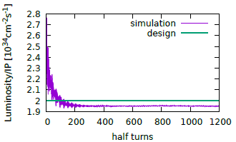
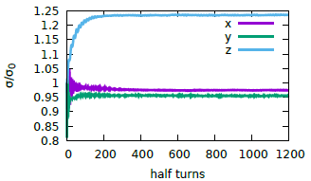
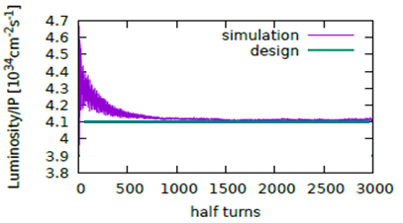
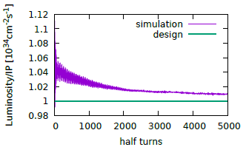
束束模拟检验
Beam-beam simulations agree well with the parameter design.
H
H
W
Z

Slide 10
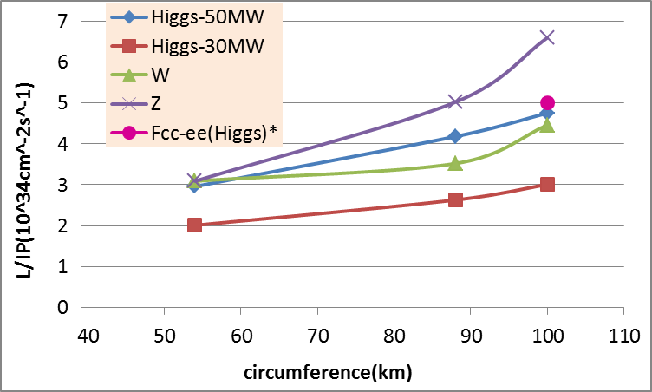
CEPC 不同周长下的亮度潜力
* Fabiola Gianotti, Future Circular ColliderDesign Study, ICFA meeting, J-PARC, 25-2-2016.

Slide 11
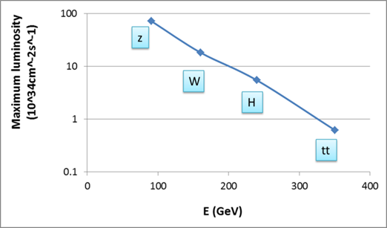
100km CEPC 不同能量下的亮度潜力
(1mmβy+50MW/beam)

Slide 12
方向二：CEPC动力学孔径优化
动力学孔径是CEPC主环物理设计的核心问题，决定亮度
超过4组六极铁变量的最优动力学孔径无法理论求解，必须依赖计算机优化
已为CEPC项目发展了两种动力学孔径自动优化算法 → 检验lattice设计的重要工具
Downhill Simplex, K. Oide@KEK
MODE (Multi-Objective optimization by Differential Evolution), Y. Zhang@IHEP
两种算法对比
Downhill: local search, quick convergence, need less cpu.
MODE: global search, time consuming, need strong computers.
两种方法具有相同的优化效果
两种算法互为补充，互相验证，缺一不可

Slide 13
Objective function modification in downhill
Case I: wth ≥ 0, optimize the energy bandwidth
-- t: Touschek lifetime → modified Touschek lifetime
-- Bandwith(n): DA bandwidth according to n*σ DA reference
-- w & w1: weight for the DA bandwidth
Case II: wth < 0, optimize the total DA value
-- DA_{j}(i): DA for i*σ_{δ} energy deviation with the j^{th} initial phase (totally 6 phases)
-- w(i) : DA weight for i*σ_{δ} energy deviation

Slide 14
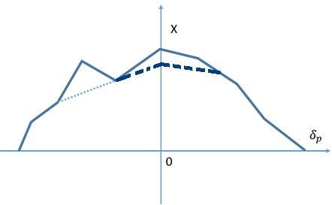
Downhill Simplex modification
DA results not stable while opening fluctuation
Cancel the noise due to fluctuation
Two methods：
Scan whole DA list (5 seeds) → Minimum
Scan DA at center energy (10 seeds) → Minimum → Clip
So far, we used method 2 to save computer time.

Slide 15
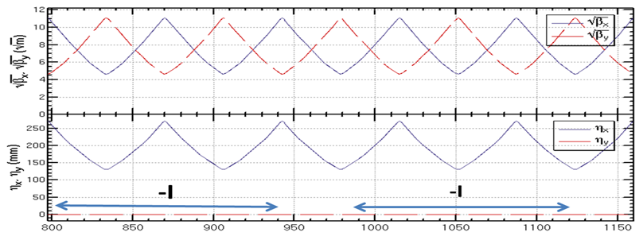
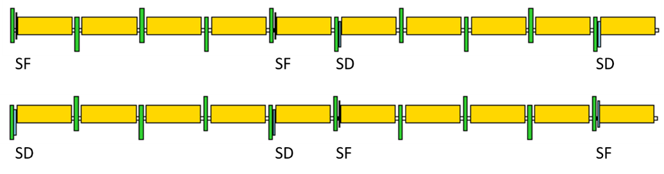
CEPC CDR lattice - arc
  FODO cell, 90°/90°, non-interleaved sextupole scheme
  224 sextupole pairs in the half ring

Slide 16
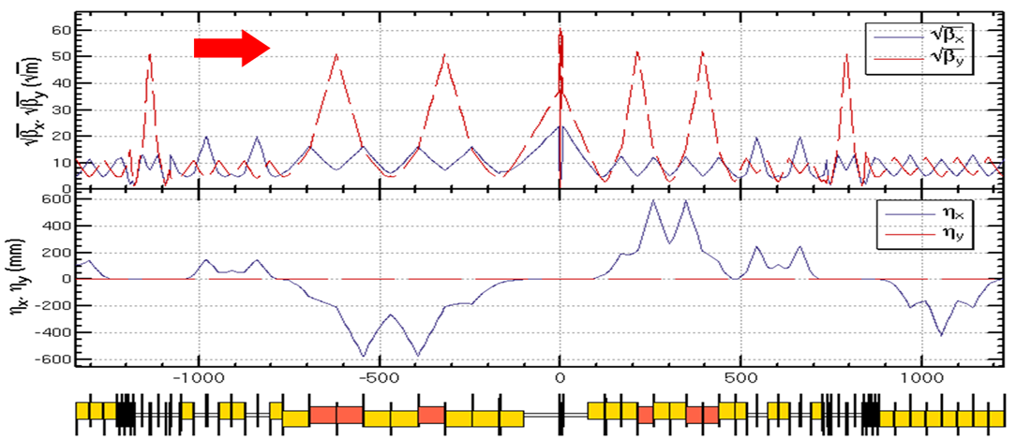
CEPC CDR lattice - IR
  Final Telescope + CCY + CCX + Matching + crab section
  10 sextupole pairs in the half ring
CCY: 4 pairs → linear chromaticity + sextupole length effect
CCX: 4 pairs → linear chromaticity + sextupole length effect
Image points: 2 pairs → third order chromaticity (vertical)
- Ι
- Ι
- Ι
- Ι

Slide 17
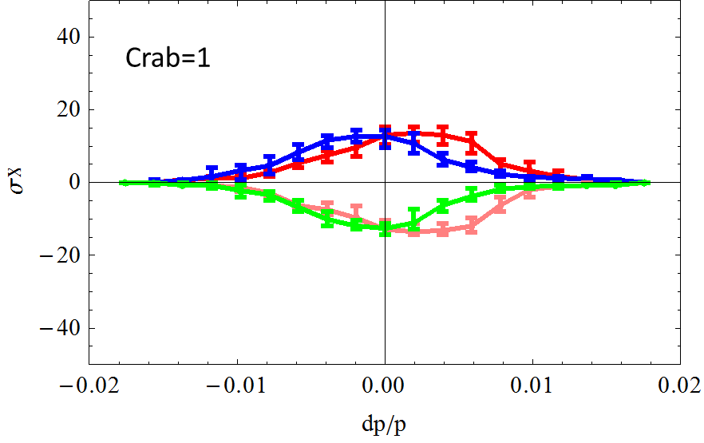
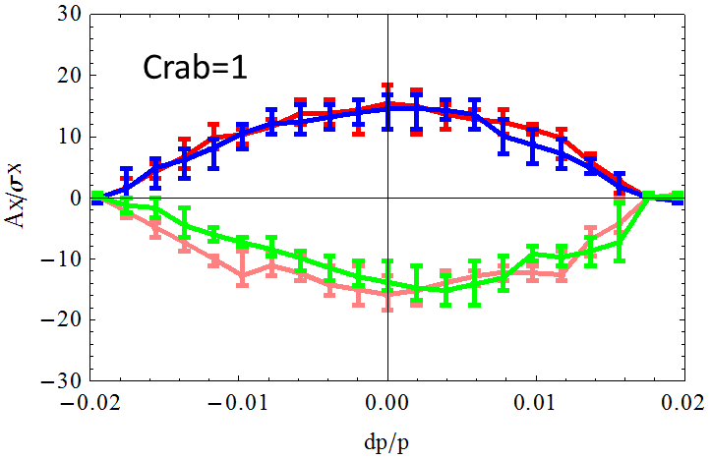
DA optimization
234 sextupole knobs (no check for variable redundancy)
Optimization with additional K1 knobs give ~20% DA enlargement.
Downhill can give almost same results as MODE.
w/o optimization
w optimization
Downhill 已成功应用于CEPC⎯ 不可缺少的工具。
项目推动算法的研发，反过来促进项目的进步。

Slide 18
方向三：CEPC主环新lattice探索
基于组合铁的新lattice设计
Higgs能量下类ILC型对撞区lattice探索性设计
Z能量下大发射度参数及lattice设计尝试
双环0.7m间距的弧区lattice设计
新对撞区survey设计（更好的解决CEPC与SPPC兼容性问题）

Slide 19
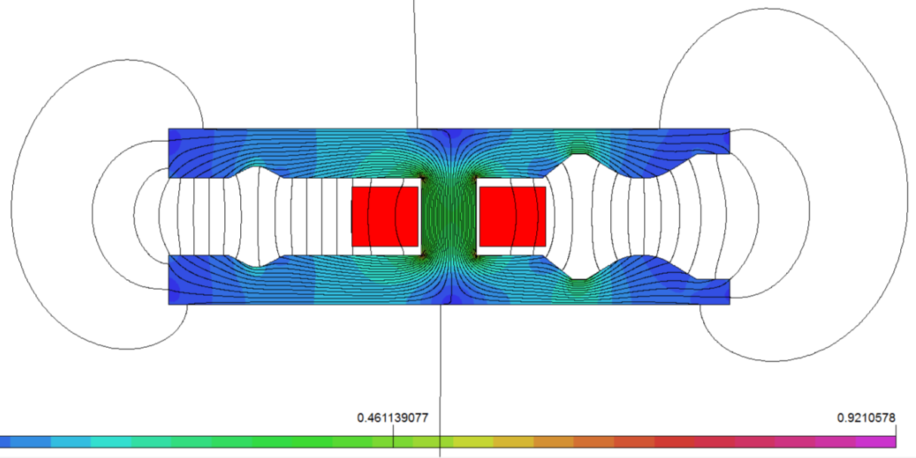
基于组合铁的新lattice设计
六极铁电源功率非常大，设计不合理
六极铁 : 16.7 MW (copper coils)
二极铁: 6.5 MW (Al coils)
减小独立六极铁积分强度
二极铁集成六极铁分量: 校正线性色品
独立六极铁: 校正高阶色品
不增加额外六极铁电源，原六极铁功率直降75%甚至更多
SF
SD
超前FCC-ee的原创性亮点设计

Slide 20
New lattice with combined D+S
Five dipoles between two quadrupoles in the arc
Combined sextupoles are on the first and fifth dipoles (β_{x,y} >>β_{y,x})
-- one dipole is cut into 6 slices
-- 7 thin sextupoles are insert in one dipole
No additional power sources for SF and SD
SF
SD
SD
SF

Slide 21
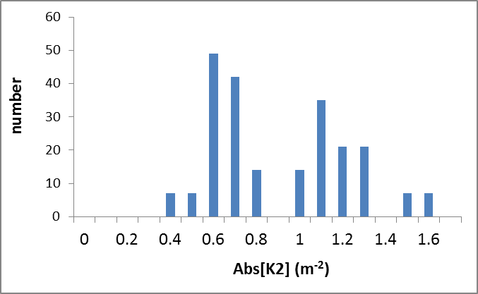
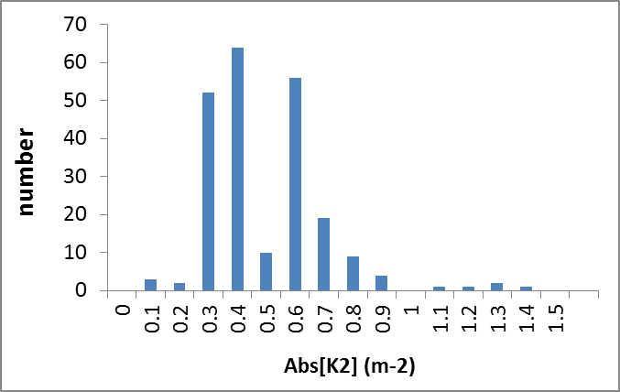
组合铁方案动力学孔径及六极铁强度
动力学孔径更大
六极铁功率降75%
六极铁强度降50%
w/o combined D+S
w combined D+S (75% reduction)

Slide 22
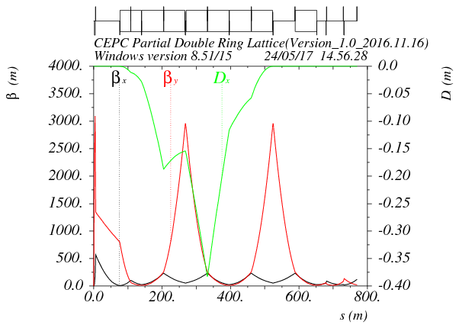
Alternative 对撞区设计
类ILC型对撞区 ⎯ 非对称色散
主六极铁与crab六极铁共享
第一块六极铁校对撞点的色品，第二块六极铁抵消第一块六极铁的几何效应
- 解除两块六极铁之间的色品绑定
- 降低对撞区磁铁的误差容忍度
- 在更低βy*时具有更佳表现
Crab sextupole
Ec < 100 keV within 800m
Betax=0.171m
Betay=0.002m
L*=2.2m
K1(QD0)=150T/m

Slide 23
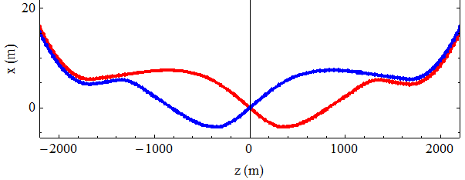
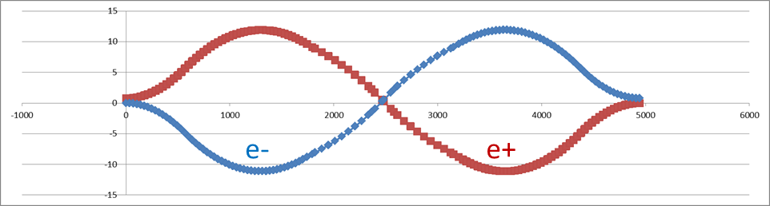
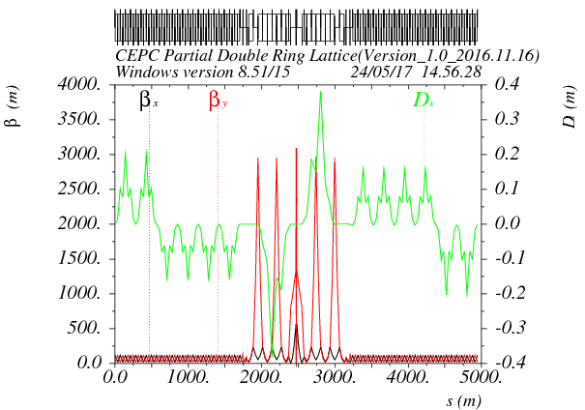

主环对撞区新survey设计
Two kinds of IR design
- left: asymmetrical , right: symmetrical
SPPC need a long straight for collimation at two IR.
Another possibility for IR survey and lattice

Slide 24
主环新lattice DA 结果
Separation of two ring: 0.7m
DA optimization with 234 sex knobs.
Tracking 100 turns
50 seeds
phase=0
phase=π/2
phase= π
phase=3π/2
Emittance: 1.33 nm
Coupling: 0.3%
新lattice动力学孔径与CDR lattice相当

Slide 25
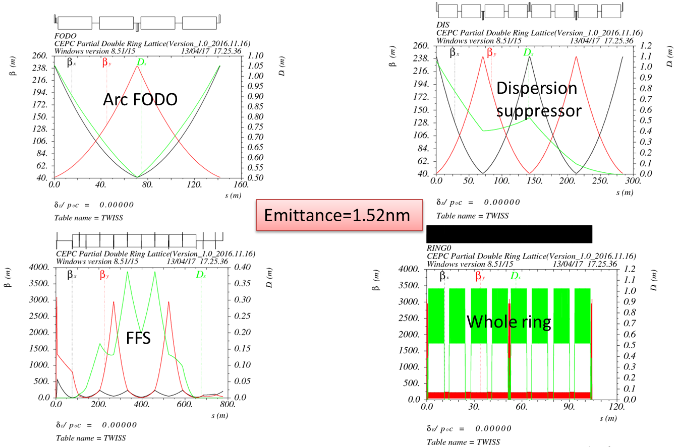
Z能量下大发射度Lattice设计
大发射度有助于提高单束charge → 进一步提高Z亮度的潜力
Z模式采用Higgs相同的lattice，只需关掉一半的四极铁
真实的lattice数据与参数表误差小于3%

Slide 26
方向四：CEPC tt能量lattice升级改造
CEPC的设计目标：在tt能量下运行无瓶颈；
CEPC目前的加速器设计优化在Higgs能量；
对撞点超导聚焦铁强度在Higgs能量下已到达上限，只能降能量，无法提升；
现有Higgs lattice在tt能量下不工作，对撞区±2km必须全新lattice；
tt lattice不能移动原有磁铁位置，只能改变四六极铁强度；不能改变二极铁强度，否则会改变几何；
对撞区色品校正六极铁及crab六极铁必须满足严格的相位要求；
tt 的束流清晰区不能超过Higgs 束管尺寸；
tt 新lattice设计是tt参数及亮度潜力估算的前提。

Slide 27
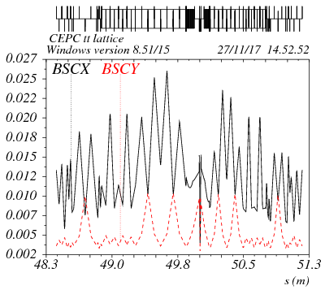
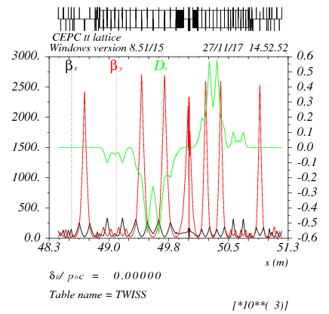
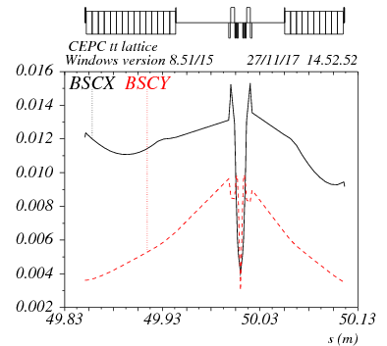
New IR @ ttbar
Strength of FD quadrupoles are limited by the maximum value for Higgs
batax*=1.2m, betay*=0.0037m

Slide 28
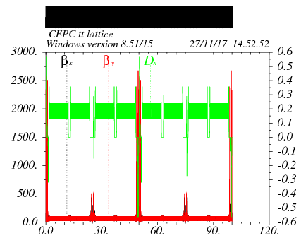
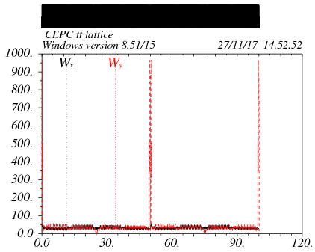
Whole ring lattice

Slide 29
DA without optimization
Crab=0
Tracking 100 turns
50 seeds
Emittance (SAD)=2.57nm

Slide 30
DA after optimization
Crab=0
DA：18σ_{x} ×50 σ_{y}
能量接收度>2.2%
动力学孔径好于Higgs的水平

Slide 31
其他工作
ILC降能后（250GeV）中方参数方案，新阻尼环设计考虑；
CEPC直线注入器正电子阻尼环及束长压缩器设计；
CEPC三个能量模式下束流寿命估算（束致辐射、辐射巴巴、Touschek、量子）；
CEPC束晕理论计算（真空度需求，MDI本底评估）；
CEPC新型基于等离子体尾场加速注入器方案中正电子阻尼环及束长加速/压缩系统设计；
CEPC新英文网站设计讨论，撰写网页加速器介绍部分，向科研处吴亚茹提供日常信息；
撰写CEPC 黄皮书(CEPC-SPPC progress report)参数、IR lattice及阻尼环相关部分；
撰写CEPC CDR 总体参数、阻尼环、附录I&II，负责CEPC CDR booster系统内容的二次撰写；
CEPC加速器国际预评审会专家意见的收集及整理；
撰写CEPC 973课题一的年度进展总结及年度科技报告；
撰写CEPC自然科学基金及院重点项目年度总结相关内容若干。

Slide 32
承担科研项目
项目名称 | 项目类别 | 项目经费 | 本人角色 | 起止时间
CEPC对撞区最终聚焦系统的设计研究 | 自然科学基金青年 | 24万 | 主持 | 2016.1~2018.12
高能环形正负电子对撞机相关的物理和关键技术预研究（课题一:加速器物理） | 科技部973项目 | 388万 | 参加 | 2016.7~2021.6
未来大型环形对撞机关键加速器物理研究 | 自然科学基金面上 | 95.4万 | 参加 | 2016.1~2019.12
未来高能前沿正负电子对撞机设计与加速器关键物理问题研究 | 中科院前沿科学重点项目 | 300万 | 参加 | 2016.8~2020.12
未来正负电子环形对撞机的若干束流物理效应研究 | 自然科学基金面上 | 84万 | 参加 | 2018.1~2021.12

Slide 33
Activities
Recorder of CEPC accelerator physics meeting and reports collection every week since 2015 ( http://indico.ihep.ac.cn/category/350/)
Give a lecture in the Stanford/PKU Center seminar: “Introduction to future energy frontier e+e- colliders”. (Peking University, July 2017)
Youth forum in IHEP accelerator center: Design of CEPC Accelerator Physics. (Apr. 2017)
Oral presentation in the CEPC-SppC Study Group Meeting (Wuhan, Apr. 2017)
Oral & paper presentation in the IAS Conference (Hong Kong, Jan. 2017)
Oral presentation in the second program progress meeting of CEPC-MOST (Mar. 2017)
Oral presentation in the FCPPL2017 (Beijing, Mar. 2017)
Poster & paper presentation in the 8th International Particle Accelerator Conference (Denmark, May 2017)
Oral & poster presentation in the 9th Joint Meeting of Chinese Physicists Worldwide (Beijing, July 2017)
Oral & paper presentation in the 13th Symposium on Accelerator Physics (Jishou, Aug. 2017)
Oral presentation in ICFA Mini-workshop on DA of circular accelerators (Nov. 2017)
Oral presentation in CEPC accelerator CDR mini-review (Nov. 2017)
Oral presentation in International Workshop on High Energy Circular Electron Positron Collider (Nov. 2017)

Slide 34
文章发表-期刊
Dou Wang, Jie Gao et al, “CEPC partial double ring scheme and crab-waist parameters”, International Journal of Modern Physics A, Vol. 31 (2016) 1644016
Dou WANG et al, “Beam halo study on the electron storage ring”, Laser and Particle Beams, 2017 0263-0346/17
Dou Wang et al, “100 km CEPC Parameters and Lattice Design”, Journal of Physics: Conference Series, 874 (2017) 012009
Dou Wang, et al., “CEPC parameters and main ring lattice design”, International Journal of Modern Physics A, 2017 (accepted).
Feng Su, Jie Gao, Dou Wang et al, “CEPC partial double ring lattice design and SPPC lattice design”, International Journal of Modern Physics A, Vol. 31 (2016) 1644017.
Yiwei Wang, …, Dou Wang, et al., “Optics design for CEPC double ring scheme”, International Journal of Modern Physics A, 2017 (accepted).
Feng Su, …, Dou Wang et al., “SPPC/CEPC parameters Lattice Design and Beam Dynamics Study” , International Journal of Modern Physics A, 2017 (accepted).
Yiwei Wang, Dou Wang, et al., “CEPC lattice design and Dynamic Aperture study”, ICFA beam dynamics newsletter, Aug. 2017.

Slide 35
文章发表-会议
D. Wang , et al., “Design study on CEPC positron damping ring and bunch compressor”, IPAC2017
D. Wang, J. Gao, et al., “100 km CEPC parameters and lattice design”, IPAC2017.
D. Wang, et al., “CEPC parameter choice”, 13th Symposium on Accelerator Physics, MOBH3.
Y. Wang, …, D. Wang, et al., “Optics design for CEPC double ring scheme”, IPAC2017.
C. Meng, ..., D. Wang, et al., “CEPC Linac design and beam dynamics”, IPAC2017.
H. Geng, …, D. Wang, et al., “Sawtooth effect in CEPC”, IPAC2017.

Slide 36
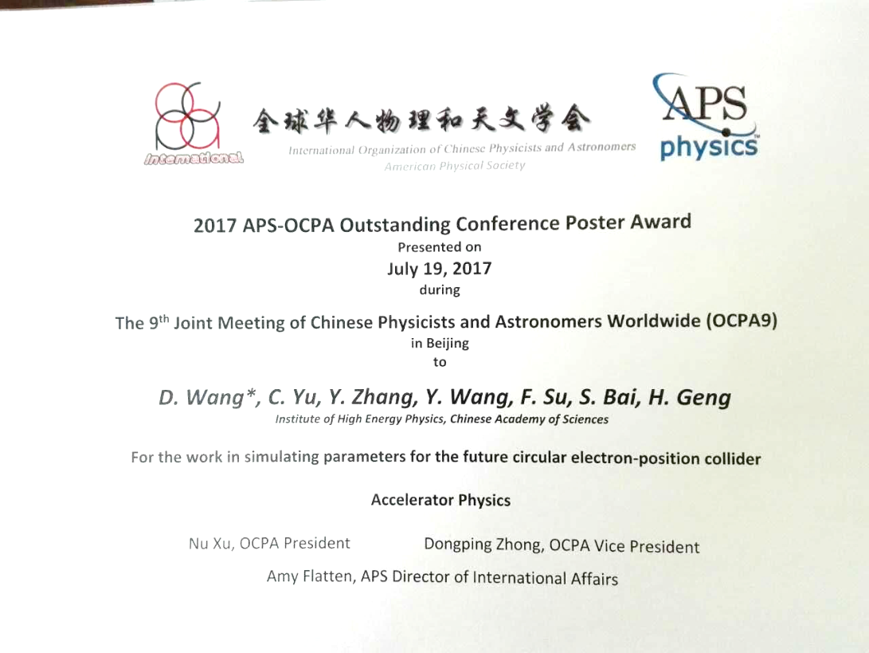
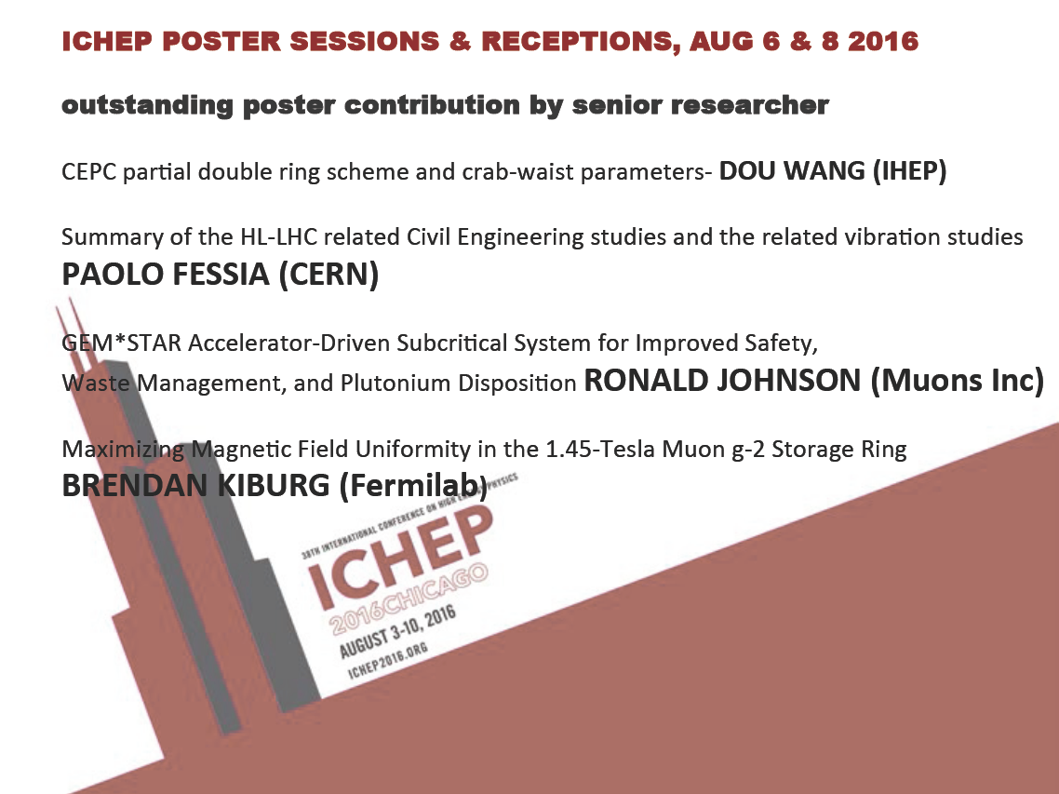
获奖情况
Outstanding Conference Poster Award, 全球华人物理大会 (OCPA9).
Outstanding poster contribution by senior researcher，全球高能物理大会 （ICHEP16），芝加哥.

Slide 37
未来工作设想
CEPC
继续CEPC总体参数优化的工作，研究进一步提升亮度的可能；
继续CEPC对撞区lattice设计的工作，研究进一步减小主环发射度的可能，探索将βy*由2mm降至1mm的可能；
继续对动力学孔径先进优化算法的研究，在downhill 里加入调节四极铁及八极铁功能，继续扩大动力学孔径；
开展CEPC booster及相关注入引出加速器物理设计的工作，配合booster对应高频、磁铁、电源等硬件系统的工作；
开展对CEPC主环及booster的误差研究，把握误差效应对两系统尤其是对主环的影响程度，发展适用于CEPC的未来先进误差校正手段。
ILC
持续关注和学习ILC的新进展新理念，积极参与国际合作。
新加速原理
配合CEPC等离子体尾场加速注入器的预研工作。

Slide 38
Back up

Slide 39
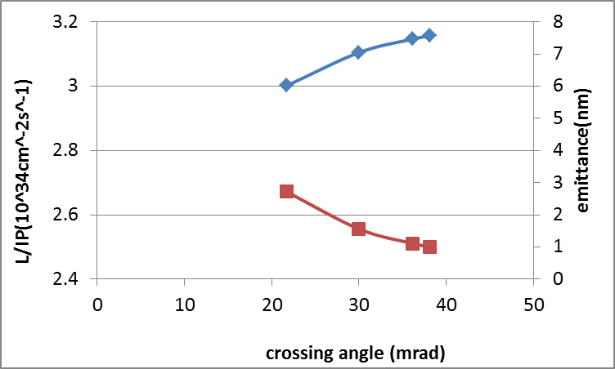
Higgs 亮度与交叉角的关系
Keep beamstrahlung life time constant (52min)
50MW/beam
100km
luminosity
emittance

Slide 40
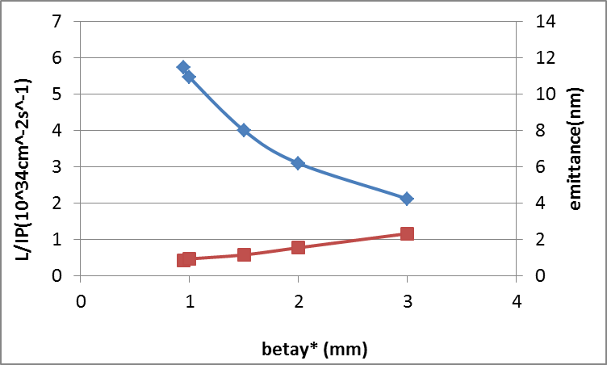
Higgs 亮度与对撞点βy的关系
Keep beamstrahlung life time constant (52min)
50MW/beam
100km
luminosity
emittance

Slide 41
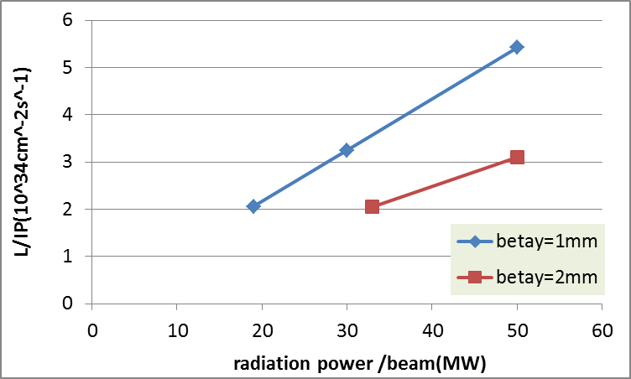
Higgs 亮度与束流功率的关系
100km
goal

Slide 42
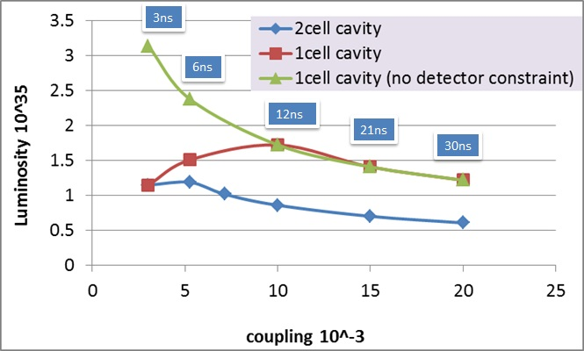
Z luminosity vs. coupling

Slide 43
Beamstrahlung effect @Higgs
Typical issue for energy-frontier e+e− colliders
During collision, the deflected particles will lose part of its energy due to the synchrotron radiation.
Extra energy spread
Beam loss for large energy deviation → life time reduction
Detector background (photons, hadrons…)
Divergence angle → interfere the detection of small-angle events
Constraint for energy spread
Nature energy spread: 0.098%
Beamstrahlung energy spread: ~0.019%
Total energy spread: 0.1%
Constraint for life time
Large energy acceptance is essential!
Requirement for energy acceptance: ~1.2%

Slide 44
CEPC amplitude-tune dependence
βx=0.22 βy=0.002 | C_{xx} (m⁻¹) | C_{xy} (m⁻¹) | C_{yy} (m⁻¹)
Kinematic effects | 3.7 | 271 | 44762
Fringe field (QD0+QF1) | 2.0+1.4 | 5788+2444 | 21.3+4.0
βx=0.144 βy=0.002 | C_{xx} (m⁻¹) | C_{xy} (m⁻¹) | C_{yy} (m⁻¹)
Kinematic effects | 8.6 | 414 | 44762
Fringe field (QD0+QF1) | 3.0+2.0 | 8558+3450 | 21.3+3.7
Larger βx* give help to on-momentum DA.
* Nonlinear effect of sextupole pairs can be corrected by the attached weak sextupole pairs.

Slide 45
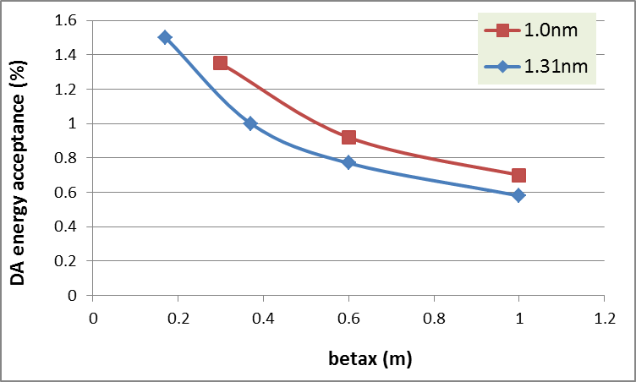
Energy acceptance vs. βx*
Larger βx* reduce the requirement of energy acceptance.

Slide 46

β_{x}* choice – 0.36 m
Parameter modification for β_{x}*: 0.171m→ 0.36m
-- larger β_{x}* reduced the amplitude-tune dependence ⎯ on mumentum DA
-- larger β_{x}* reduced the horizontal chromaticity both for linear and nonlinear term ⎯ off mumentum DA
-- larger β_{x}* reduce the requirement of energy acceptance ⎯ easier DA
Balance between DA and coherent beam-beam instability
-- smaller β_{x}* help suppress the coherent beam-beam instability

Slide 47
Hour glass effect with crab waist collison
Effective bunch length: overlap area of colliding bunches
Hour glass factor:

Slide 48
Cross-section for radiative Bhabha scattering

Slide 49
ILC Beam parameter design @250GeV
 | Nominal RDR | Higgs mode-low background | Higgs mode-high lum. | Yokoya
E_{cm} (GeV) | 500 | 250 | 250 | 250
Ne | 2×10¹⁰ | 2.0×10¹⁰ | 1.97×10¹⁰ | 2.0×10¹⁰
F_{rep} (Hz) | 5 | 5 | 5 | 5
N_{b} | 2625 | 1436 | 1332 | 1312
P_{b} (MW)/beam | 10.5 | 2.87 | 2.62 | 2.65
β_{x} (mm) | 20 | 15.4 | 11.0 | 13.0
β_{y} (μm) | 400 | 335 | 464 | 410
γε_{x} (μm) | 10 | 5.1 | 5.1 | 5.0
γε_{y} (nm) | 40 | 28.8 | 37.5 | 35
σ_{x} (nm) | 639 | 566.7 | 477 | 515.5
σ_{y} (nm) | 5.7 | 6.3 | 8.4 | 7.66
σ_{z} (μm) | 300 | 231 | 318 | 300
δ_{B} | 0.031 | 0.0255 | 0.0255 | 0.024
n_{γ} | 1.3 | 1.45 | 1.7 | 1.62
Dy | 19.0 | 30 | 36 | 34.5
H_{D} | 1.74 | 2.01 | 2.8 | 2.43
Disruption angle θ (rad) | 0.00036 | 0.0008 | 0.00084 | 0.00088
N_{had} | 1.1 | 1.58 | 2.6 | 2.1
θx/θy (urad) | 45.2/20.2 | 36.7/18.7 | 43.3/18.2 | 39.7/18.7
L₀ (cm⁻²s⁻¹) | 2.0×10³⁴ | 1.285×10³⁴ | 1.432×10³⁴ | 1.285×10³⁴

Slide 50
ILC AC Power estimation
 | Nominal RDR | Higgs mode-low background | Higgs mode-high lum. | Yokoya
Bunch separation (ns) | 356 | 554 | 546 | 554
Pulse length for beam (us) | 934.5 | 796 | 727 | 726.8
Filling time (us) | 597 | 929.7 | 929.3 | 929
I_{b} (mA) | 9 | 5.77 | 5.8 | 5.8
Efficiency form RF to beam | 61% | 46.1% | 44% | 44%
AC power for beam (MW) | 61 | 21.8 | 21 | 21.2
AC power for cavity wall (MW) | 9 | 5.4 | 5.2 | 5.2
Total AC power (MW) | 70 | 27.2 | 26.2 | 26.4

Slide 51
Principles for ILC high-lum. mode
Advantages:
Higher luminosity keeping the cost
Larger βy* → easier FFS design
Slightly larger vertical emittance → helpful to beam
dynamics of ML
Slightly longer bunch length → easier BC
Disadvantages:
Larger N_{had}, n_{γ} → stronger background for detector
Larger Dy → colliding instability, tighter tolerance for
feedback system
Smaller βx* and larger Dx → may not negligible

Slide 52
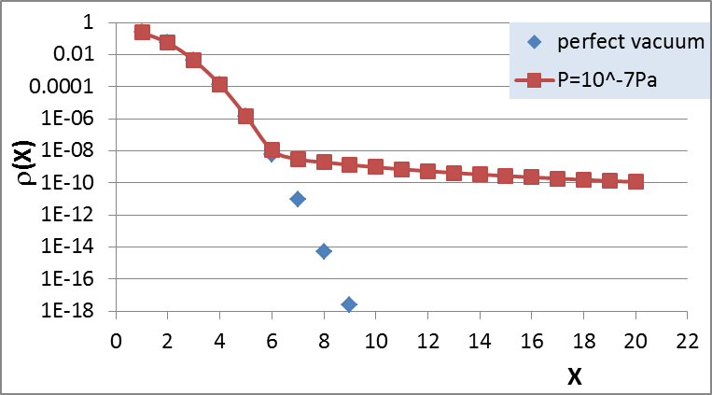
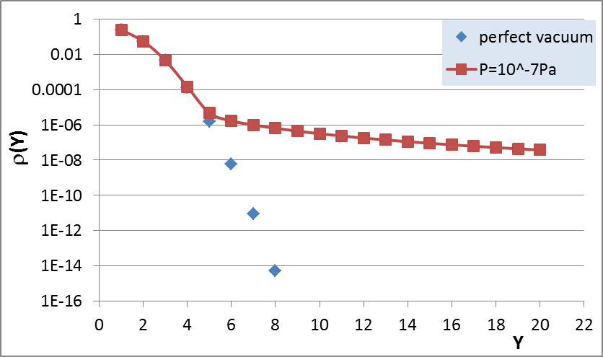
CEPC beam halo due to beam-gas scattering
Average beta function was used.
Here and hereafter, the effect of local low beta insertion (FFS) was not included.
Coordinates were normalized by RMS beam size under zero current.
Horizontal emittance growth: 7E-6
Vertical emittance growth: 0.14%

Slide 53
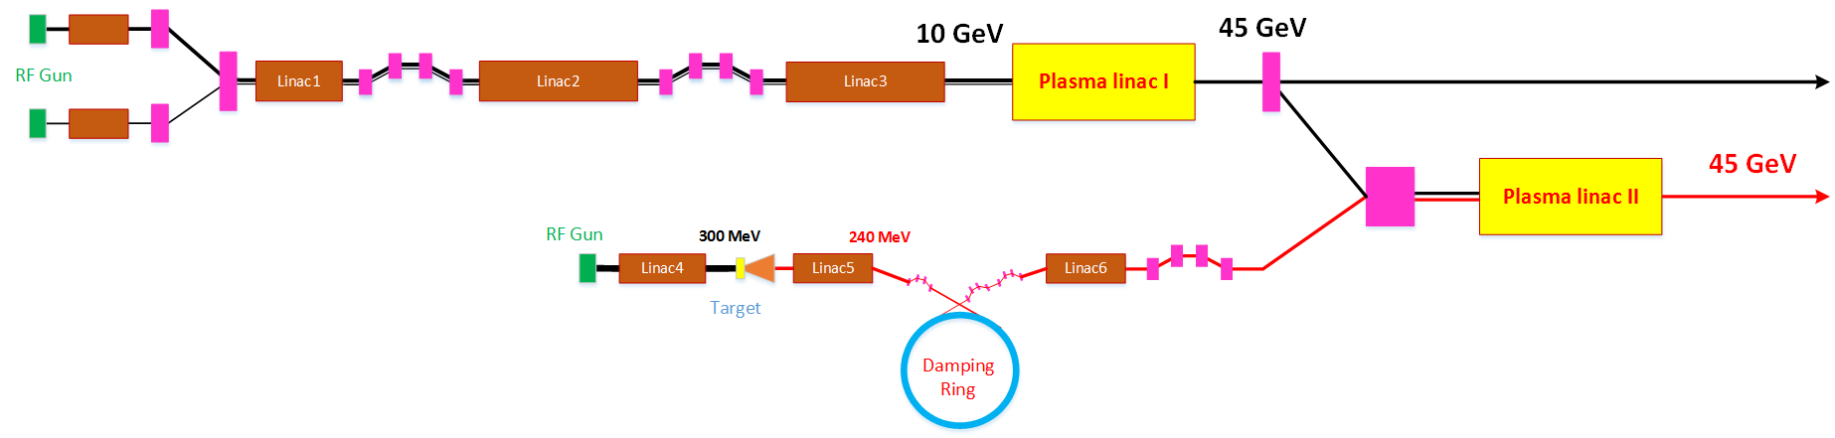
CEPC Injector Based on Plasma Wakefield Acceleration
Energy: 10GeV → 45GeV

Slide 54
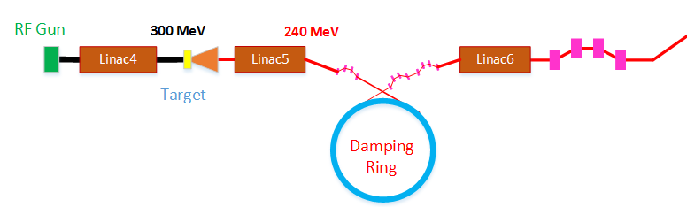
Positron damping ring design
Damping ring | DR V1.0
Energy (MeV) | 240
Circumference （m） | 20
Bending radius (m) | 1.7
B0 (T) | 0.47
U0 (keV/turn) | 0.17
Damping time x/y/z (ms) | 185/185/93
δ0 (%) | 0.016
ε0 (mm.mrad) | 6
Nature σz (mm) | 3
Extract σz (mm) | 1.8
εinj (mm.mrad) | 2400
εext x/y (mm.mrad) | 819/815
δinj /δext (%) | 1 /0.13
Storage time (ms) | 100
RF parameters
RF frequency (MHz) | 500
RF voltage (MV) | 0.8
Energy acceptance by RF(%) | 1.8
harmonic | 33
Lattice parameters
FODO length (m) | 1.2
Phase per cell | 60°
Dipole length (m) | 0.46
Dipole strength (T) | 0.47
Quadrupole length (m) | 0.11
Quadrupole strength (m⁻²) | 15

Slide 55
Positron compression
 | BC I | BC II | BC III
Initial energy (MeV) | 240 | 240 | 1300
δinj (%) | 0.13 | 1.95 | 1.58
Initial σz (um) | 1800 | 220 | 50
f_{RF} (MHz) | 2856 | 2856 | 5712
Voltage(GV) | 0.14 | 5.0 | 36
φ_{RF} (度) | 90 | 77.8 | 86.6
R₅₆ (mm) | 92 | 13.9 | 2.5
Final energy(MeV) | 240 | 1300 | 3400
δext (%) | 1.95 | 1.58 | 2.0
final σz (um) | 220 | 50 | 15
Compression ratio：
BCI：8.2
BCII：4.4
BCIII: 3.3

