Slide 1

Status of CEPC HCAL CDR
Tao Hu, Jianbei Liu, Haijun Yang, Boxiang Yu
For the CEPC-Calo Group
CEPC CDR Mini-Review
November 11, 2017

Slide 2
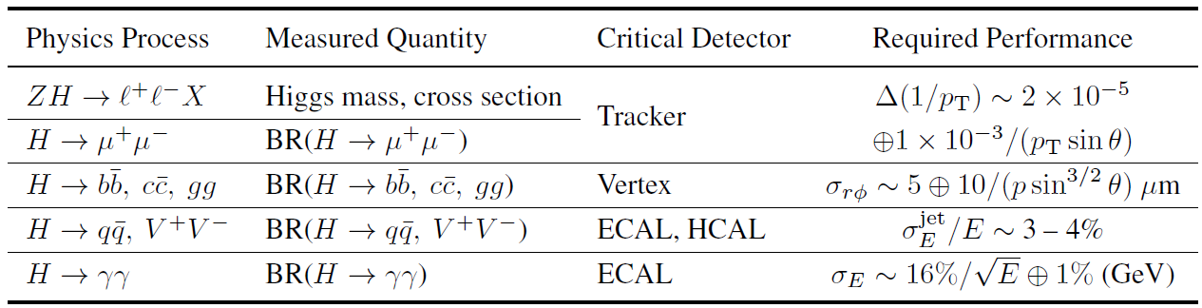
Requirements for CEPC Detector Design
Critical Physics Benchmarks for CEPC Detectors design.
Goal: Jet Energy Resolution 3 – 4 % or 30% / √E @ 100GeV
based on Particle Flow Algorithm (PFA)

Slide 3
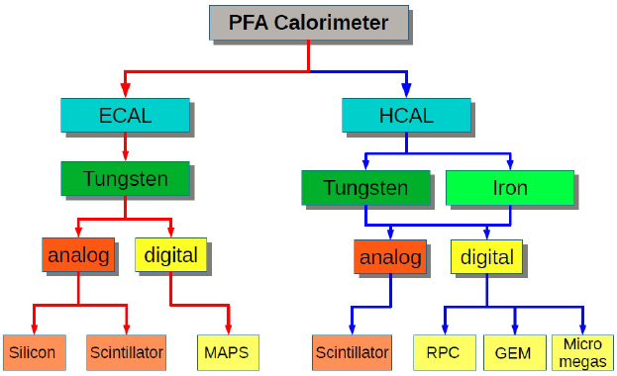

Calorimeter Options
ECAL with Silicon and Tungsten (LLR, France)
ECAL with Scintillator+SiPM and Tungsten (IHEP + USTC)
SDHCAL with RPC and Stainless Steel (SJTU + IPNL, France)
HCAL with ThGEM/GEM and Stainless Steel (IHEP + UCAS + USTC)
AHCAL with Scintillator+SiPM and Stainless Steel (IHEP+U.Mainz+BNU)
Dual readout calorimeters (INFN, Italy)
https://twiki.cern.ch/twiki/bin/view/CALICE/CalicePapers

Slide 4
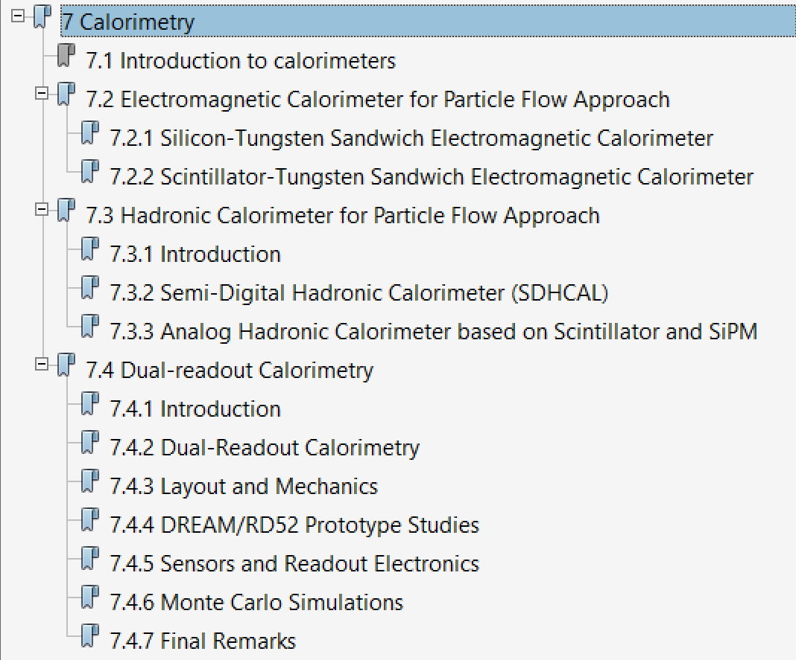
Outline of CEPC Calorimeters CDR

Slide 5
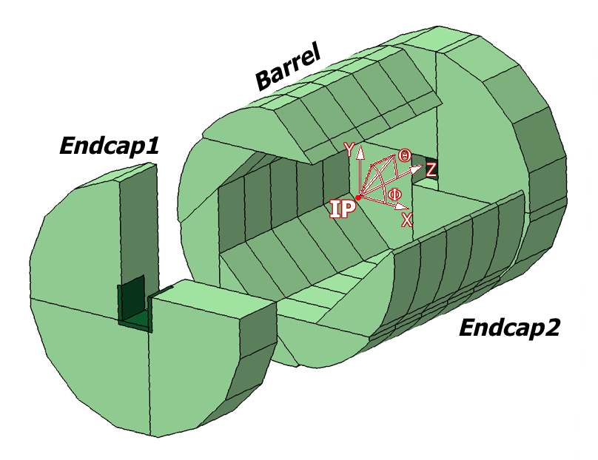
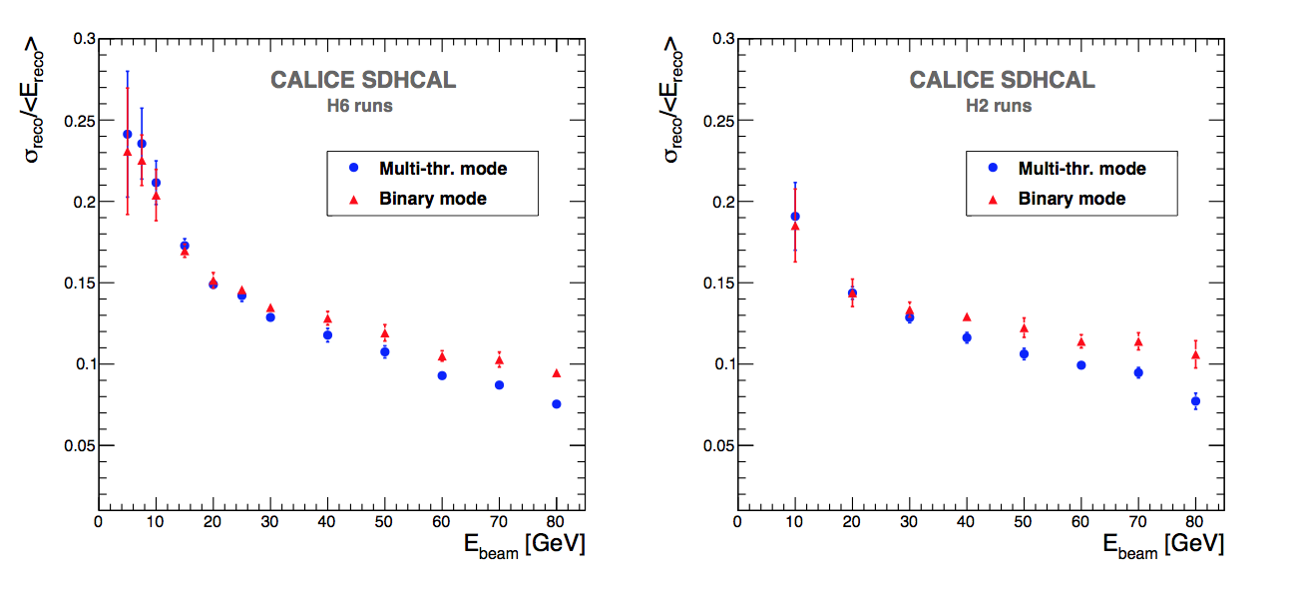
DHCAL with RPC
The SDHCAL-GRPC is one of the two HCAL options based on PFA and proposed for ILD. Modules are made of 48 RPC chambers (6λ_{I}), equipped with semi-digital, Hardroc2 readout and placed in self-supporting mechanical structure (stainless steel) to serve as absorber.
Cell size: 1x1 cm²
➔ Substantial improvement for beam energy > ∼ 40 GeV

Slide 6
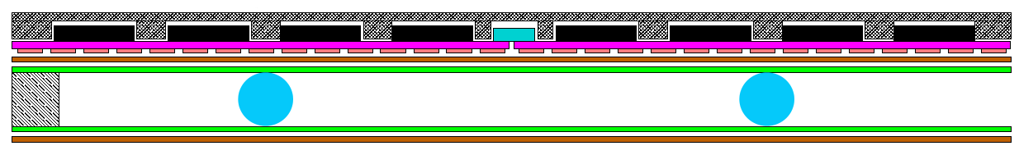
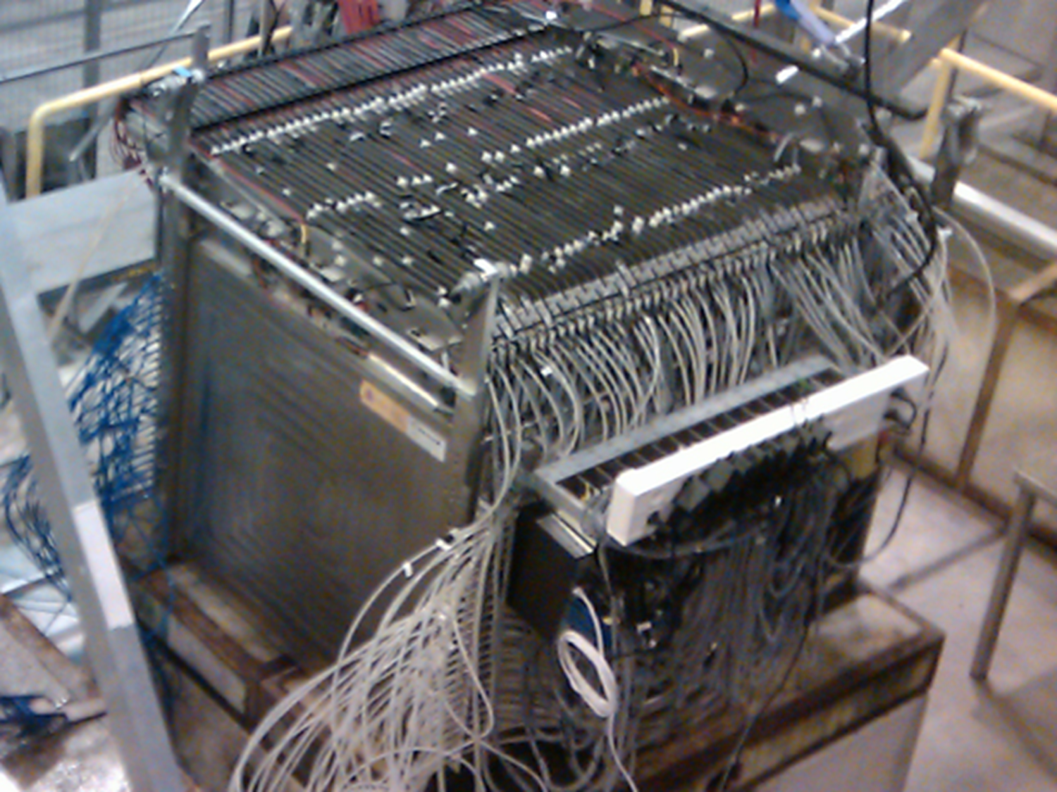
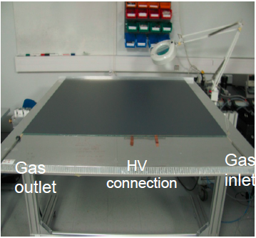
Schematic of RPC
Assembling procedure
Mylar layer (50μ)
Readout pads
(1cm x 1cm)
PCB interconnect
PCB (1.2mm)+ASICs(1.7 mm)
Readout ASIC
(Hardroc2, 1.6mm)
PCB support (polycarbonate)
Gas gap
Mylar (175μ)
Cathode glass (1.1mm)
+ resistive coating
Ceramic ball spacer (1.2mm)
Glass fiber frame (≈1.2mm)
Anode glass (0.7mm)
+ resistive coating
Large area gRPC:
Negligible dead zone
(tiny ceramic spacers)
Large size: 1 × 1 m²
Cost effective
Efficient gas distribution system
Homogenous resistive coating
6mm(active area) + 5mm(steel) =
11 mm thickness
6
Notes:
6

Slide 7
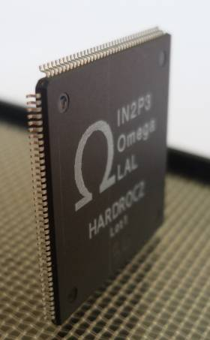
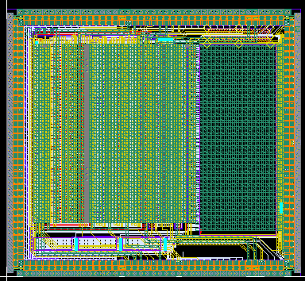
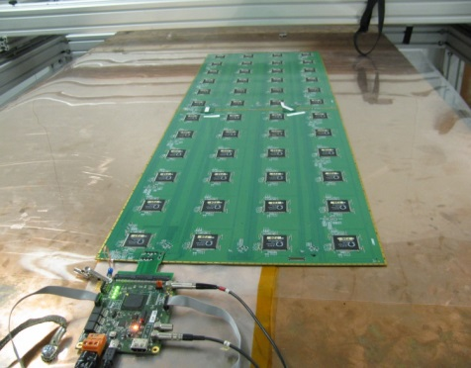
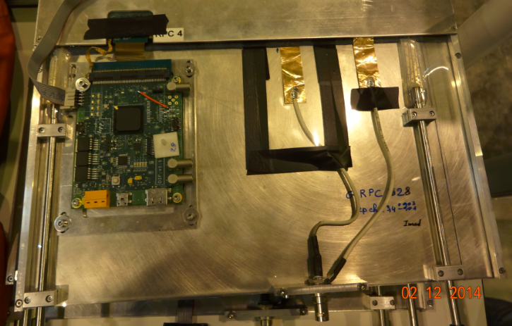
Readout Electronics for RPC
Assembling procedure
4.7 mm
ASICs : HARDROC2
64 channels
Trigger less mode
Memory depth : 127 events
3 thresholds
(115fC, 5pC, 15pC)
Range: 10 fC-15 pC
Gain correction → uniformity
4.3mm
Printed Circuit Boards (PCB) were designed to reduce the cross-talk with 8-layer structure and buried vias.
Tiny connectors were used to connect the PCB two by two so the 24X2 ASICs are daisy-chained. 1×1m² has 6 PCBs and 9216 pads.
DAQ board (DIF) was developed to transmit fast commands and data to/from ASICs.
6mm(active area) + 5mm(steel) =
11 mm thickness
Notes:
7

Slide 8
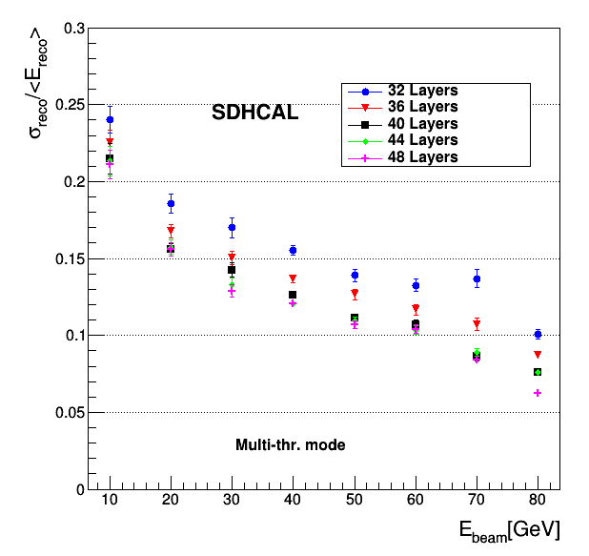
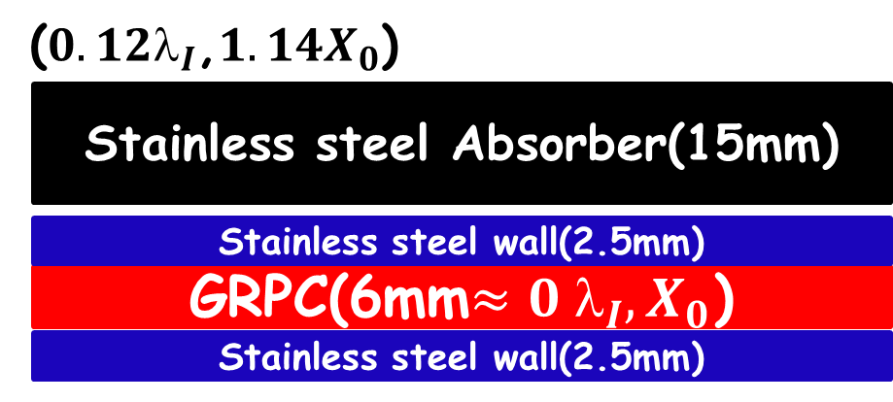
Energy Resolution vs No. of Layers
➔SDHCAL has 48 layers which
aims for ILC Detector
6mm gRPC + 20mm absorber
Optimization no. of layers for CEPC at 240GeV
➔40-layer SDHCAL yields decent
energy resolution.

Slide 10
DHCAL based on THGEM

Slide 11
Analog Hadronic Calorimeter
- 32 super modules
- 40 layers per module
Active layer 4-5mm
Absorber 20mm
Total thickness 100cm

Slide 12
Analog Hadronic Calorimeter

Slide 13
Analog Hadronic Calorimeter

Slide 14
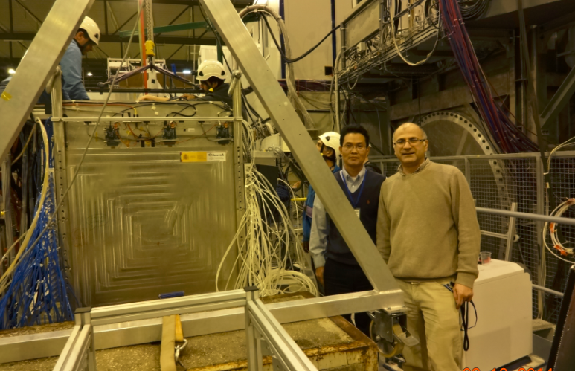
Join the CALICE Collaboration
THU and SJTU joined the CALICE Collaboration
Collaborating with Imad Laktineh (IPNL) on SDHCAL R&D.
We have a joint Ph.D student via CSC program (2years). CAN-059 about using BDT to improve pi/e/mu separation is under review process.
SJTU will host the CALICE collaboration meeting on Sept. 19-21, 2018. https://agenda.linearcollider.org/event/7799/
IHEP and USTC plan to join the CALICE to work on ScW ECAL and AHCAL.
IHEP/USTC/SJTU received MOST grant (2017-2021) for CEPC Calo R&D, we are currently applying for MOST funding (2018-2022) to build HCAL prototype based on Scintillator + SiPM.

Slide 15
Some open issues
Performance from SiW-ECAL and SDHCAL combined TB (2017.9)
Optimization of cell size/layers for CEPC to reduce channels/power
Cooling system, water vs CO2 cooling? Design of low power ASIC, FEE.
For SDHCAL-RPC, plan to build larger RPC (1x3m2), new gas circulation system, new electronics (HARDROC3), additional timing info? (MRPC).
For AHCAL based on Scintillator+SiPM, we plan to build a prototype in next 5 years. How to collaborate within CALICE collaboration.
Temperature distribution in an active layer of the SDHCAL operated with no power-pulsing.
The cooling system is made of a circulating water inside copper tubes in contact with the
ASICs. ΔT ~ 2.6 degrees

Slide 16
Dual-readout Calorimeter
The independent sampling of hadronic showers, through scintillator and Cerenkov light
Emission, allows to fully reconstruct energy and f_{em} on event-by-event basis.

Slide 20
Backup Slides

Slide 21
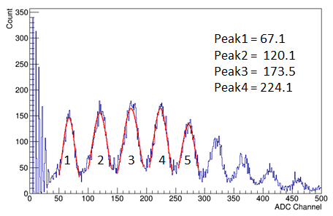
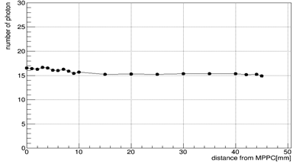
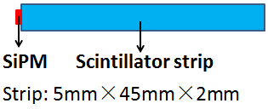
SiPM light output
SiPM type No.: S12571-010C
Light output of 45mm strip coupled with 10um SiPM
Pulse height spectrum
Photon detection efficiency of 10um SiPM is about
23% photon detection efficiency from the 25um SiPM

Slide 22
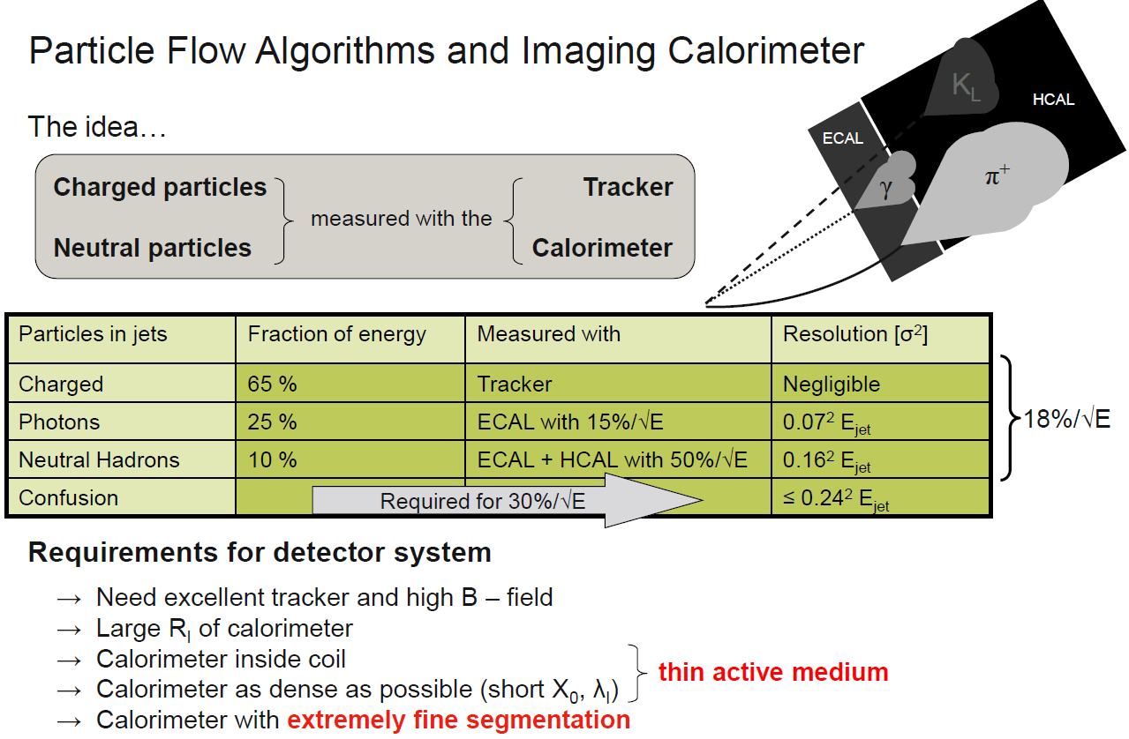
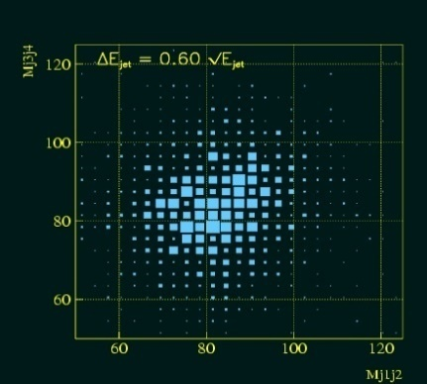
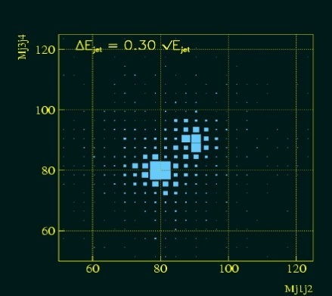
PFA and Imaging Calorimeter
60%/√E
30%/√E
Simulation of W, Z reconstructed masses in hadronic mode.

