Slide 1
CDR and R&D of CEPC Detector Magnet
Ning Feipeng
On behalf of magnet team
Institute of High Energy Physics
2017.9.6

Slide 2
outline
1, CDR of the magnet
2, R&D progress
3, Future plan

Slide 3
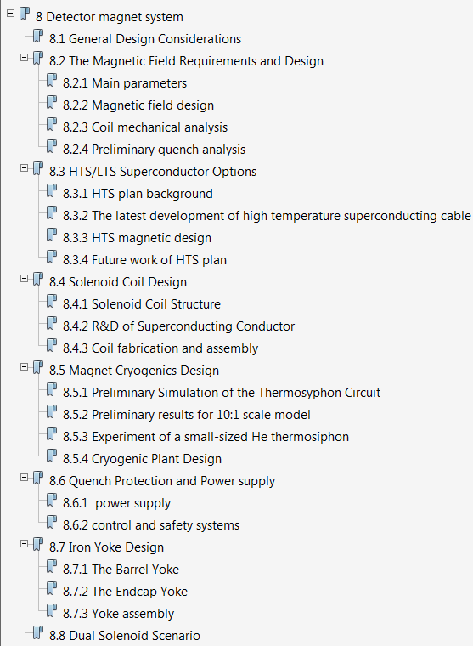
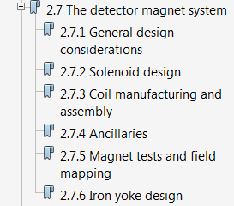
CDR of the magnet
From Pre CDR to CDR
10 pages to 36 pages

Slide 4
Main changes between Pre CDR and CDR
The central magnetic field: 3.5T 3T
Add two chapters:
  HTS plan options
  Active shielding Scenario
All sections add more details.

Slide 5
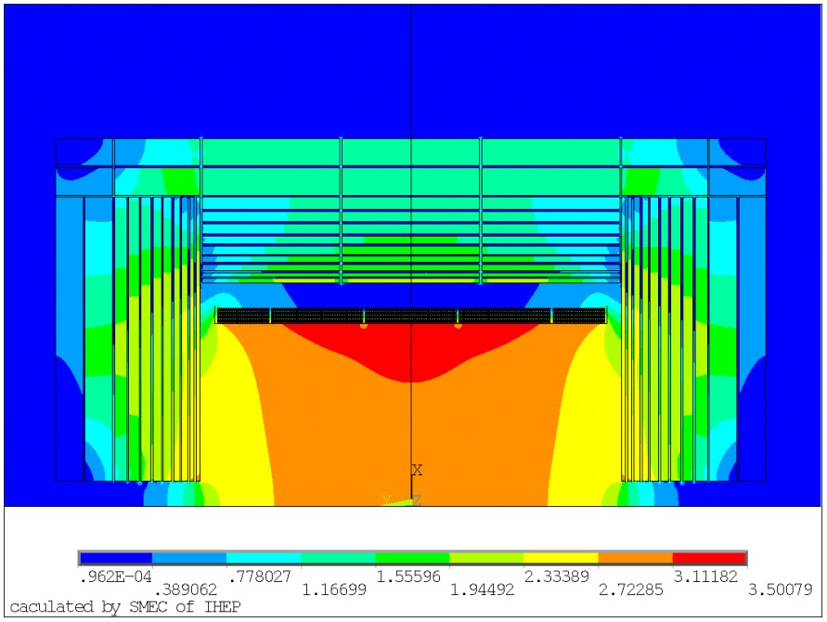
The Magnetic Field Requirements and Design
Ning Feipeng
main parameters of the solenoid coil
The central magnetic field: From 3.5T to 3T
The solenoid central field (T) | 3 | Working current (kA) | 15779
Maximum field on conductor (T) | 3.485 | Total ampere-turns of the solenoid (MAt) | 20.323
Coil inner radius (mm) | 3600 | Inductance (H) | 10.46
Coil outer radius (mm) | 3900 | Stored energy (GJ) | 1.3
Coil length (mm) | 7600 | Cable length (km) | 30.35
Field map of the magnet (T)

Slide 6
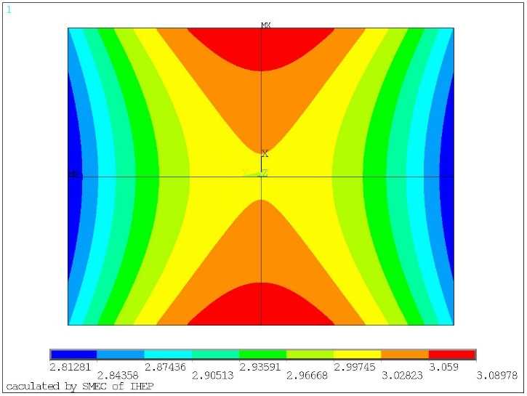
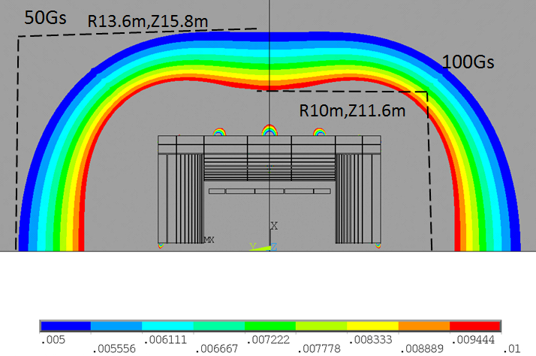
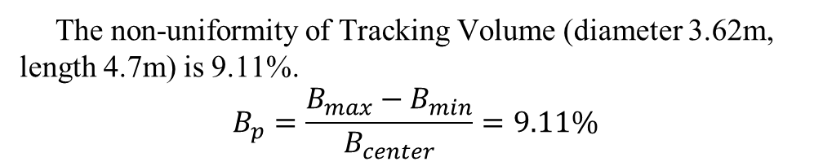
The Magnetic Field Requirements and Design
Ning Feipeng
The non-uniformity of Tracking Volume (diameter 3.62m, length 4.7m) is 9.11%.
$$B_{p}=\frac{B_{max}−B_{min}}{B_{center}}=9.11\%$$
Stray field |  | 3 T
50 Gs | R direction | 13.6 m
 | Z direction | 15.8 m
100 Gs | R direction | 10 m
 | Z direction | 11.6 m
2.8
3.0
Stray field distribution outside the magnet (the field is given in T)
magnetic field distribution of the Tracking Volume.

Slide 7
  HTS option
Ning Feipeng
Compared with low temperature superconducting (LTS), the high temperature superconducting (HTS) detector has the following highlights:
1. Three HTS supplier existed in China;
2. It is possible HTS cost 10 times cheaper in 5 years;
3. Working at a relatively high temperature (20 K), cooling get easier ;
4. More stability, HTS magnet not easy to quench ;
5. Cost maybe comparable with the LTS magnet especially in the case of active shielding design(without iron yoke) ;
6. Push the development of full HTS high field solenoid magnet .

Slide 8
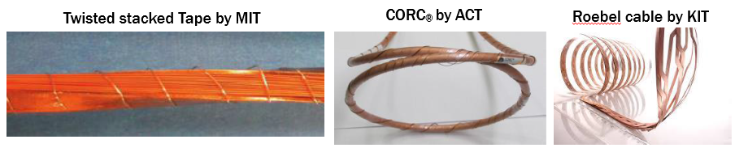
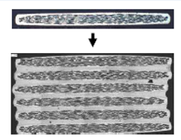
HTS option
Ning Feipeng
Which conductor is suitable for CEPC detector magnet?
HTS stack cable
Parameters of CEPC detector magnet based on HTS stack cable:
Central magnetic field | 3 T | Working current | 7970 A
Maximum vertical field on cable | 2.7 T | Ampere-turns | 20*10⁶
Inner diameter of coil | 3.6 m | Inductance | 38.36 H
Outer diameter of coil | 3.7 m | Stored energy | 1.2 GJ
Length of the coil | 7.5 m | Operating temperature | 20 K
Future work of HTS plan:
I) YBCO cable research. Select proper HTS cable or develop new cable for large detector magnet.
II) Study the quench detection, transmission and protection of the HTS coil.
III) Prototype HTS coil development.

Slide 9
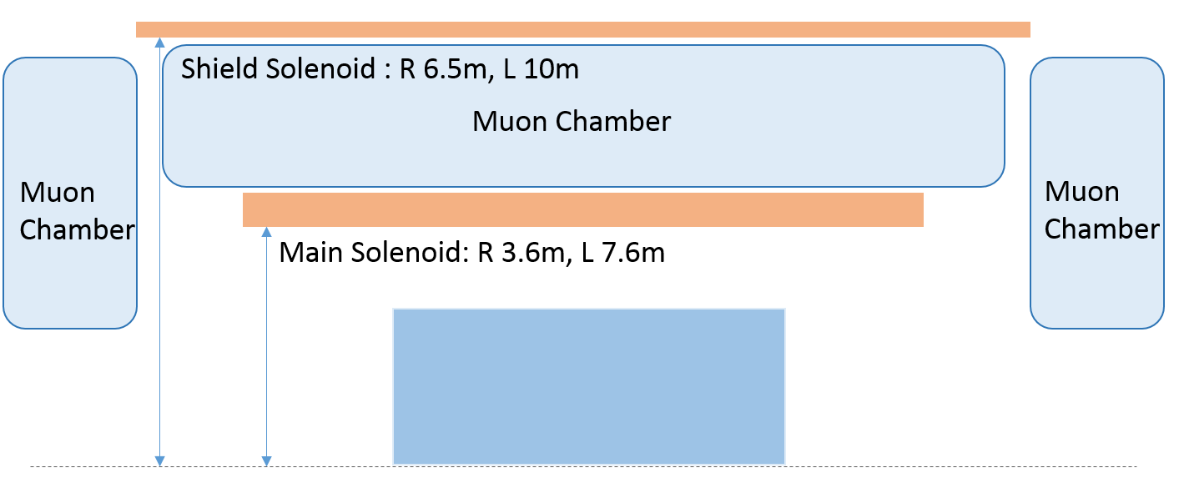
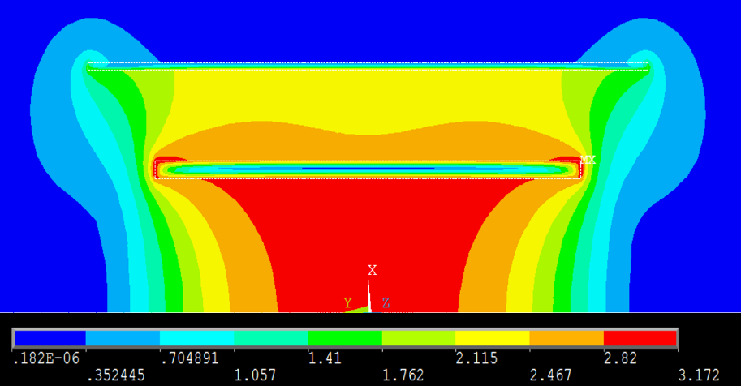
Active shielding Scenario
Zhao Wei
The active shielding design has been applied widely for commercial MRI magnets. Comparing to the one solenoid and yoke design, this design achieves a similar performance while being much lighter and more compact, which has been improved by FCC previous studies .
The main solenoid provides 5 T central field over an obstruction-free room temperature bore of 7.2 m and a length of 7.6 m. The outer solenoid provides -2 T central field, with a radius of 6.5 m and a length of 10 m.
Sketch figure for the half cross section of the active shielding magnet, with the available areas for muon chambers.
Field map of the active shielding magnet

Slide 10
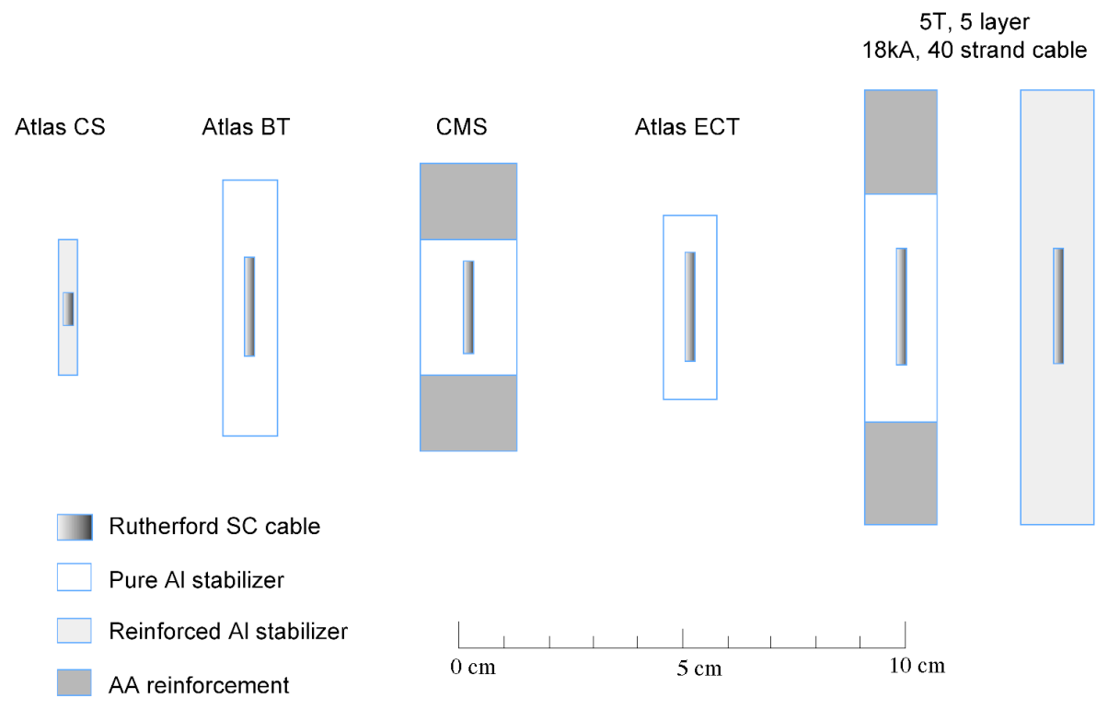
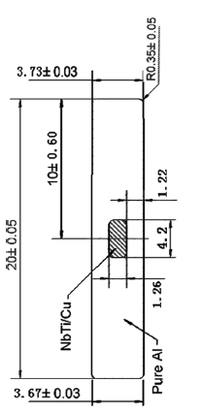
Progress of the Rutherford cable
Zhao Ling
Development progress of Al-based SC conductors in China
  Al-based Superconducting conductor was mainly used for large detector magnets, such as BESIII, CMS. In CEPC Pre-conceptual design report, the detector magnet also adopt Al-based Superconducting conductor.
Cross sections of Al stabilized and reinforced conductors previously used and will be used

Slide 11
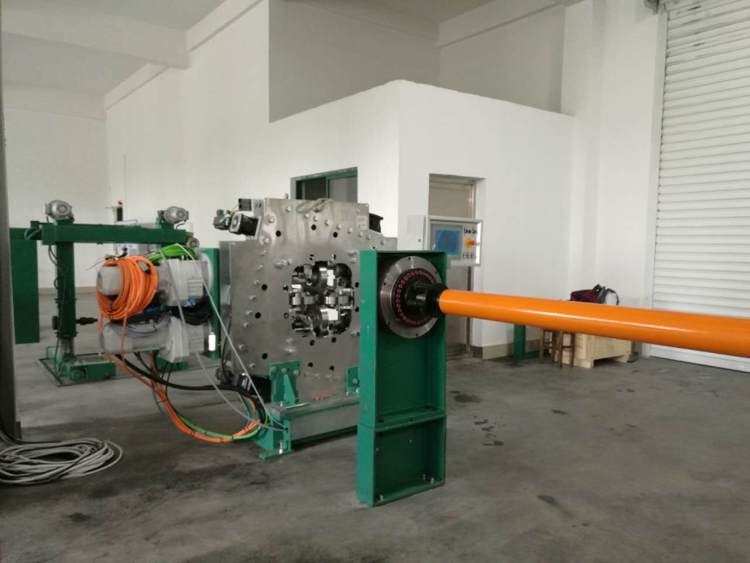

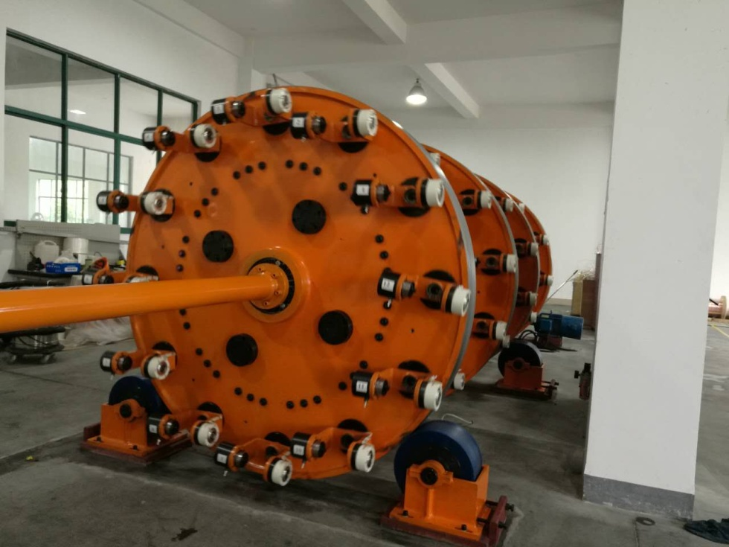
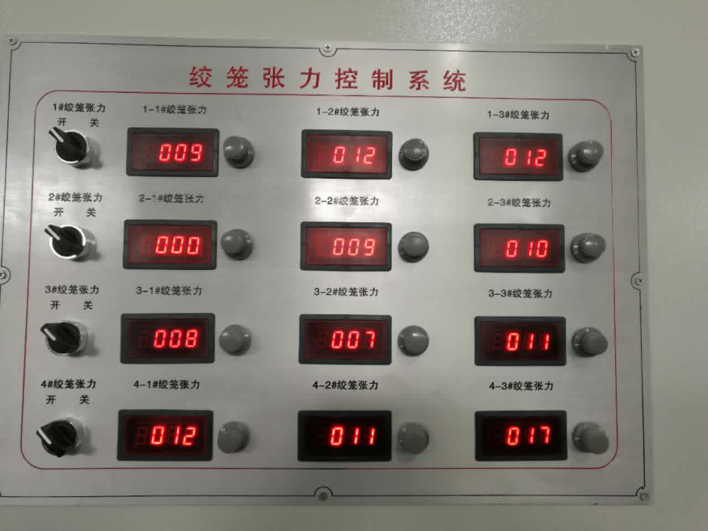
Progress of the Rutherford cable
Ling Zhao
2015.6，Cooperation agreement with Toly Electric and began the development of Rutherford cable.
New cabling machine and tension control system of strands were put into use this year.

Slide 12
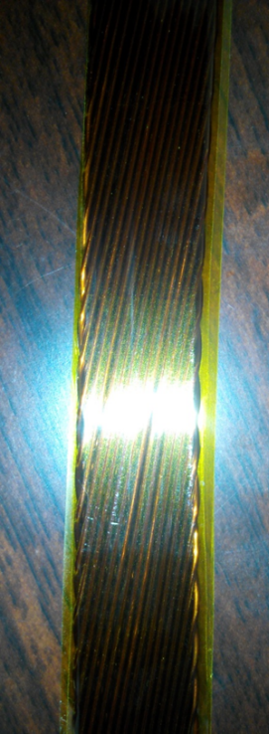
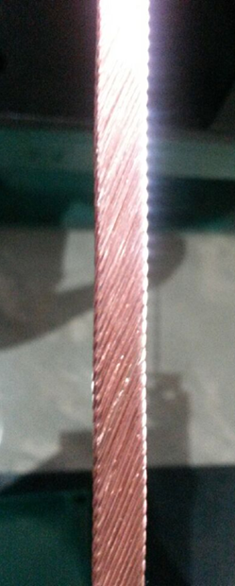
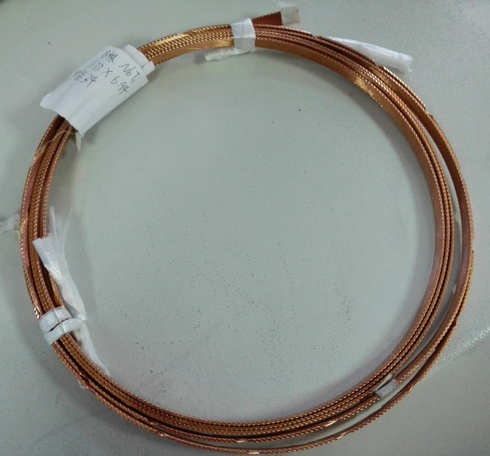
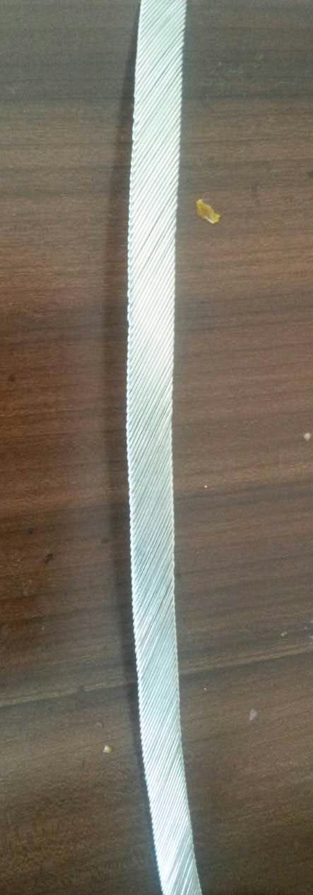
Progress of the Rutherford cable
Ling Zhao
Number of strands ：32
Strand diameter ：1.2mm
Materiel :Nb/Ti
Tangle：17.32
Length：》100m
RRR： 》100
Complete time:2016.5
Number of strands：20
Strand diameter：1.0mm
Materiel: Copper
Complete time:2015.5
Number of strands ：17
Strand diameter ：0.727mm
Materiel :Nb/Ti
Complete time:2015.7
Number of strands ：24
Strand diameter ：0.727mm
Materiel :Nb/Ti
Complete time:2015.8
Number of strands ：18
Strand diameter ：1.2mm
Materiel :Nb/Ti
Complete time:2016.2

Slide 13
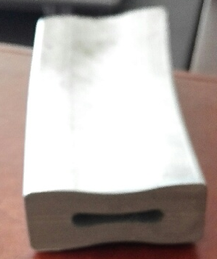
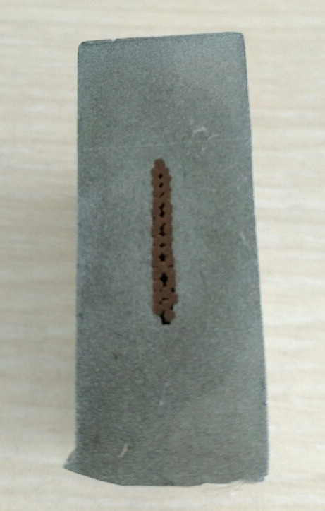
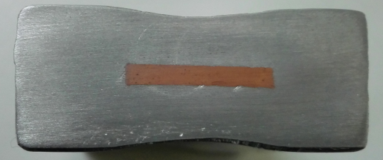
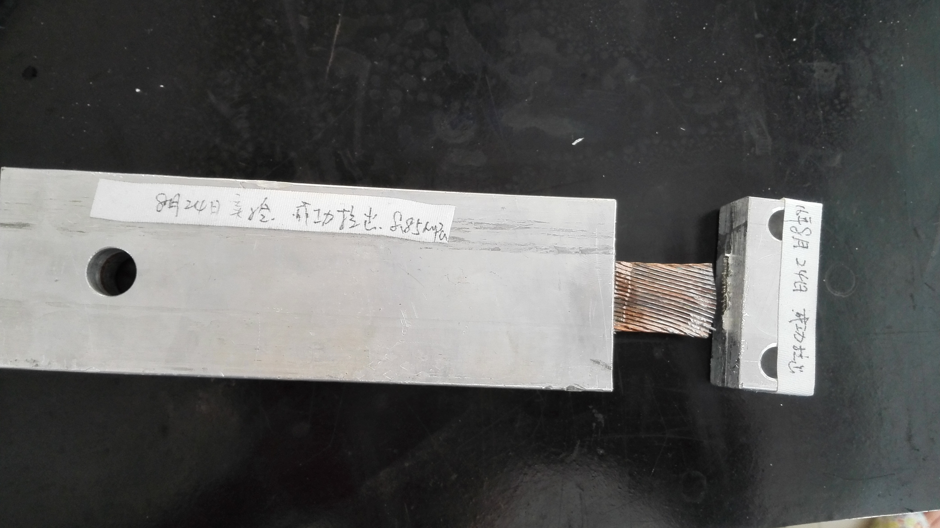
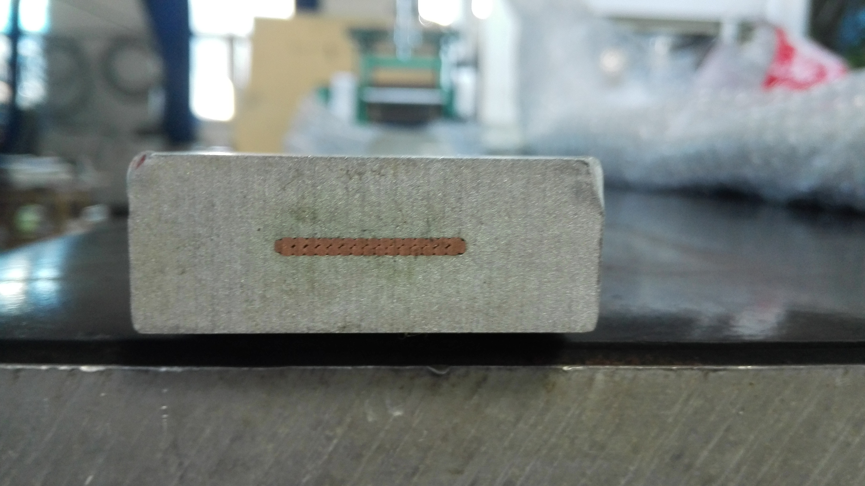
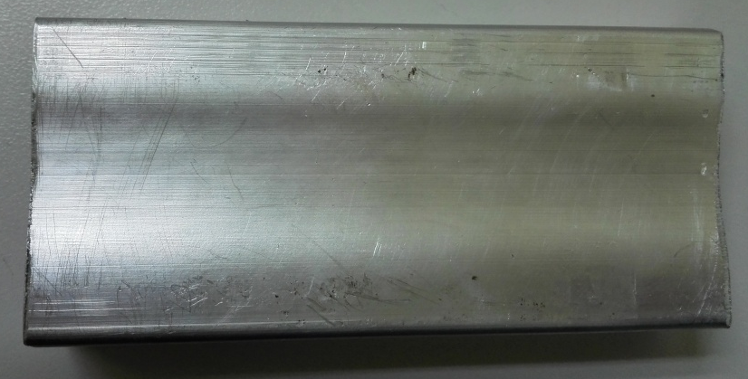
Insert progress
Ling Zhao
Completed two rounds of insert process:
Hollow aluminum alloy, Aluminum alloy + copper cable
Result: Depression in the middle and the tooling needs to be improved.(2016.4)
The strands of the cable are separate after the tooling improvement.
There is a great improvement. But the shear stress is 8 MPa, is not reach 20 MPa.
2016.1
Hollow aluminum alloy
2016.5~6：
Aluminum alloy + copper cable
2016.2
Aluminum alloy + copper cable
2016.8：
Aluminum alloy + copper cable

Slide 14
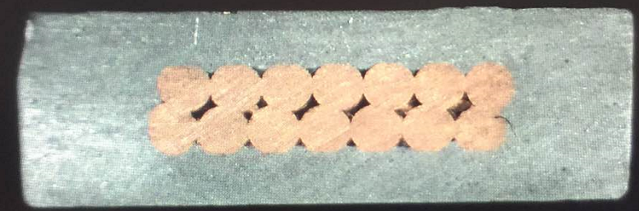
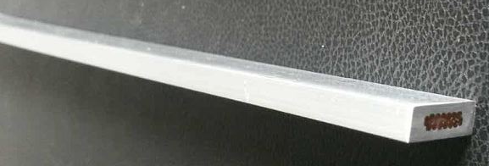
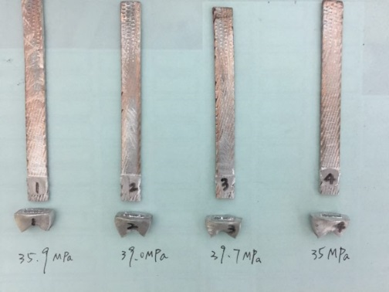
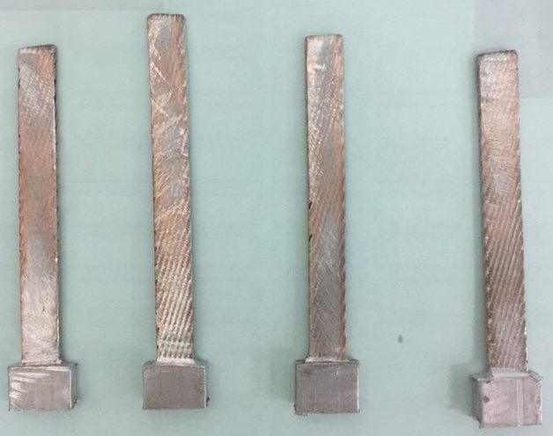
Zhao Ling
Progress of the Rutherford cable
Shear strength test between aluminum alloy and copper cable
  The shear strength is larger than the required (20MPa) in the latest test. We used 99.99% aluminum material to improve the shear strength.
Dimensions: 15*4.7mm²
Number of strands ：14
Materiel : COPPER+Al(99% purity)
Complete time:2017.4
Shear strength（COPPER &Al）：10 MPa
Number of strands ：32
Strand diameter ：1.2mm
Materiel :COPPER+Al
Length：1m
Complete time:2016.8
Shear strength（copper &Al）：8.85 MPa
Dimensions: 15*4.7mm²
Number of strands ：14
Materiel : COPPER+Al(99.99% purity)
Complete time:2017.8
Shear strength（COPPER &Al）：>35MPa

Slide 15
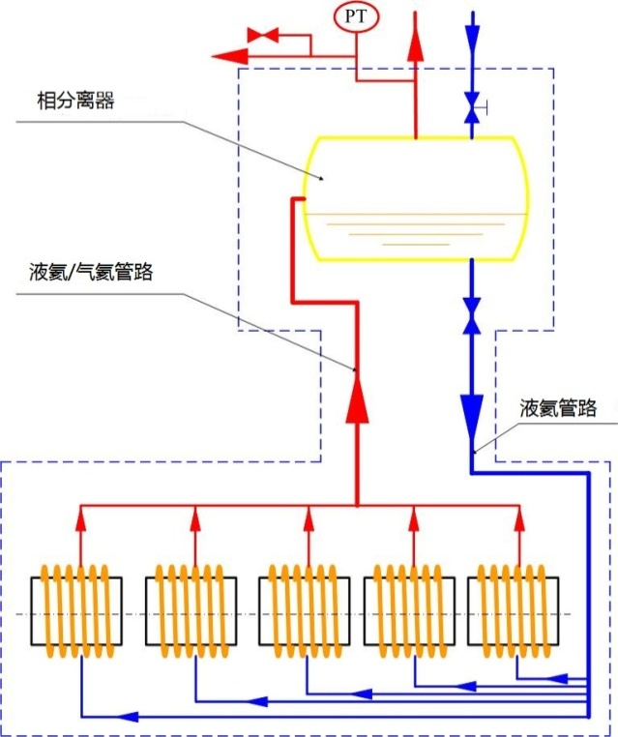
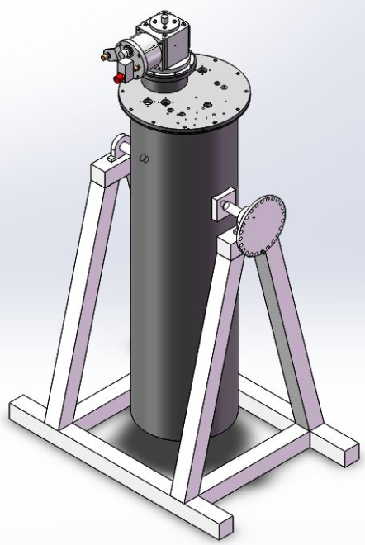
Magnet Cryogenic Design
Meifen Wang
phase separator
The coils will be cooled by conductive method.
A thermal siphon principle experiment platform was built based on liquid nitrogen.
Liquid/Gas helium line
Liquid helium line

Slide 16
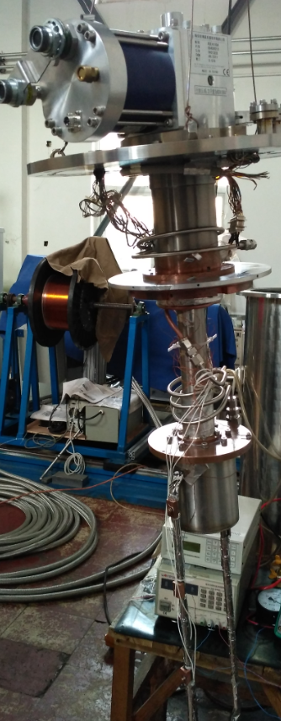
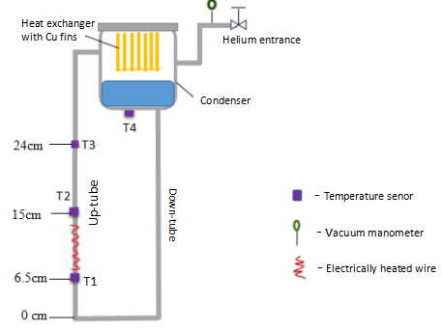
Magnet Cryogenic Design
Baotang Zhang, Meifen Wang
A thermal siphon principle experiment platform based on liquid helium.
Building a two-phase natural circuit loop, helium was used as the working fluid;
Investigate the heat and mass transfer characteristics experimentally;
Obtain temperature profile with heat flux and critical heat flux(CHF);
Numerical modelling of mass flow rate in a thermal siphon.
G-M cryocooler
Thermosyphon loop
Fig.1. Schematic of the circuit loop
Fig.2 Experimental apparatus

Slide 17
Summary
Several designs have been completed on the requirements of different central field and different thickness of yokes, compared the key parameters such as homogeneity/stray field/cost etc.
Some progress in the development of specific LTS superconductor, thermal siphon cooling
HTS option was initially proposed
We keep iron yoke structure as the default option in the CDR, and the Active Shielding scenario as an candidate option
Next Steps
1. Further development of long Al-based NbTi conductor (>100m, RRR/Ic measurement)
2. Study of thermal siphon cooling system
3. Study of HTS option

Slide 18
Thanks
Ning Feipeng ningfp@ihep.ac.cn

