Slide 1

R&D Introduction to Remote Vacuum Connection (RVC) device of MDI Project
Address： Tangzi street 11#,Dadong District, Shenyang, China
        Tel : +86 (024) 24323981
        Fax： +86 (024) 24323982
        Web： www.syhyzk.com
        Mail : sales@syhyzk.com
沈阳慧宇真空技术有限公司
Shenyang Huiyu Vacuum Technology CO,LTD

Slide 2
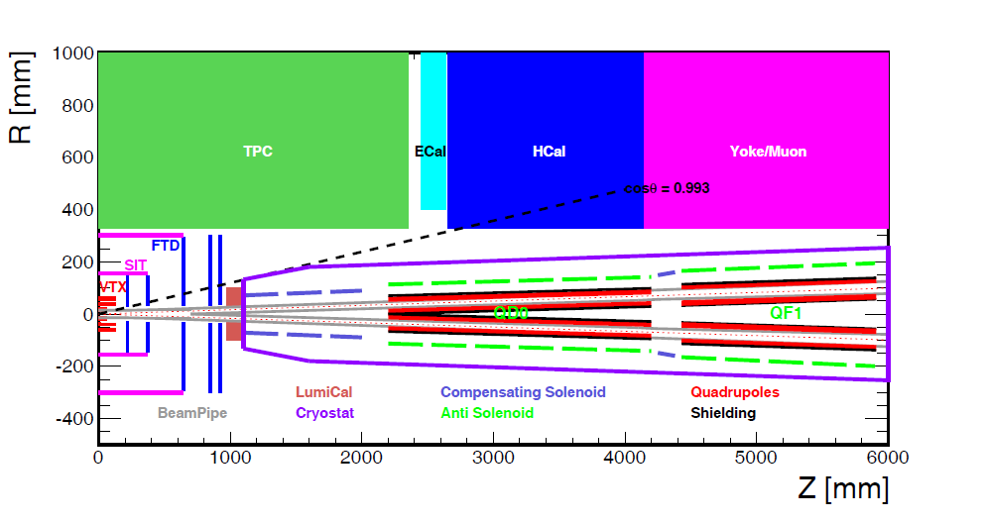
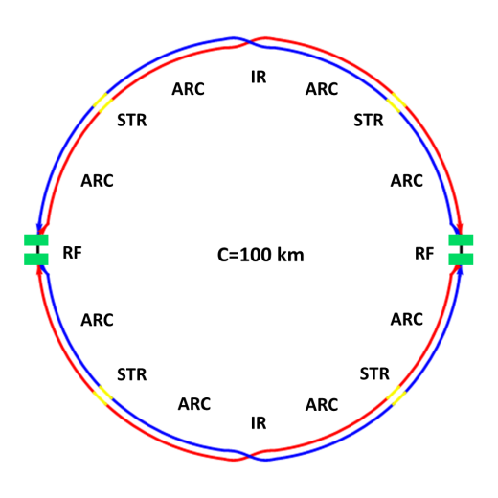
MDI layout
With Detector solenoid
The length of Machine Detector Interface (MDI) of CEPC double ring scheme from the IP is about ±7m.
The CEPC detector superconducting solenoid with 3T magnetic field and the length of 7.6m.
The last pair of flanges to be sealed are far deep inside the MDI area.
How to seal them, that is a question.

Slide 3
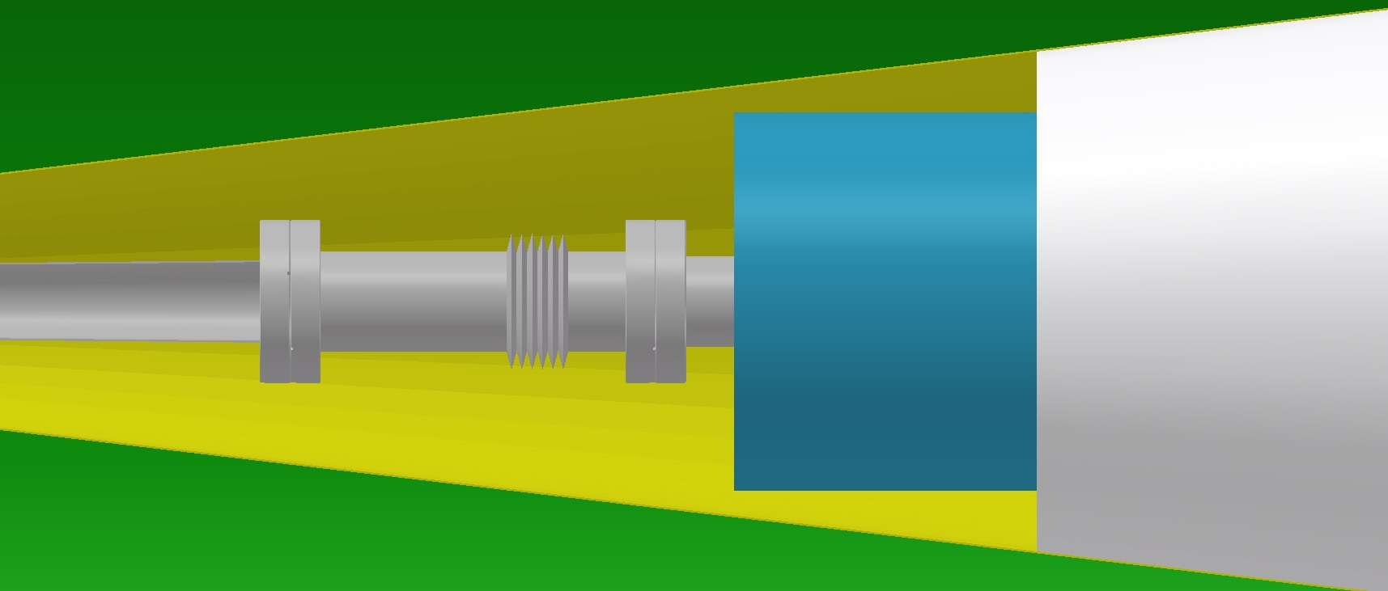

Sketch map of RVC Sealing position
The last sealing position
The vacuum connection flanges are fully surrounded by the detector and the cryostat .
6m

Slide 4
Problems to be absolved
1、Connection and sealing between the detector and the accelerator
2、Remote control for vacuum sealing from 6m away
3、All-metal seal consisted with high radiation and high vacuum

Slide 5
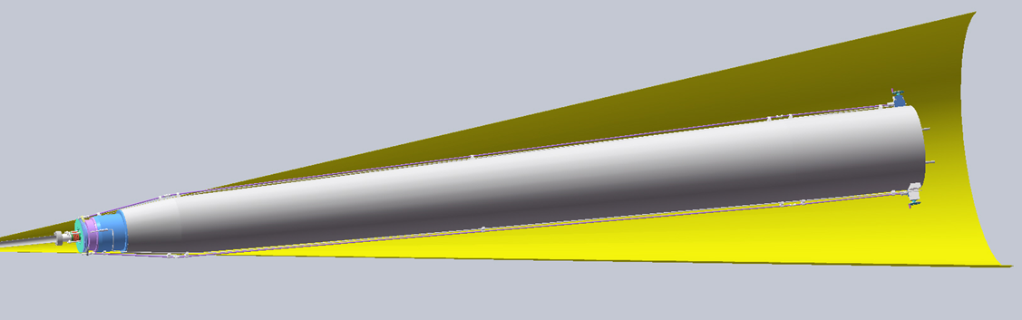
General Layout of RVC System

Slide 6
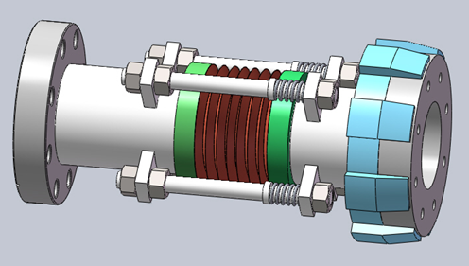
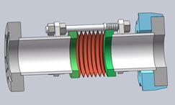
IP side vacuum chamber

Slide 7
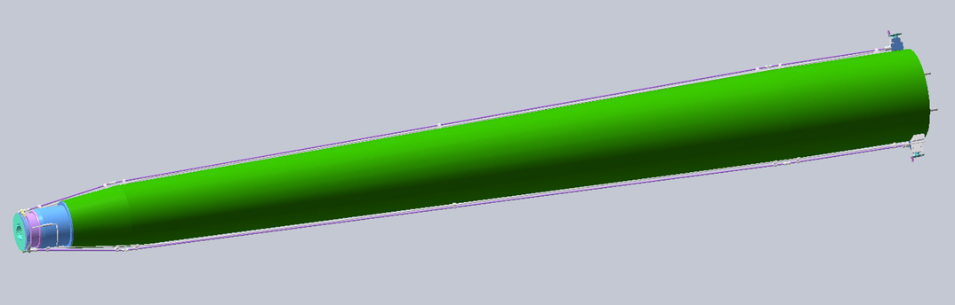
Facility distribution at accelerator side

Slide 8
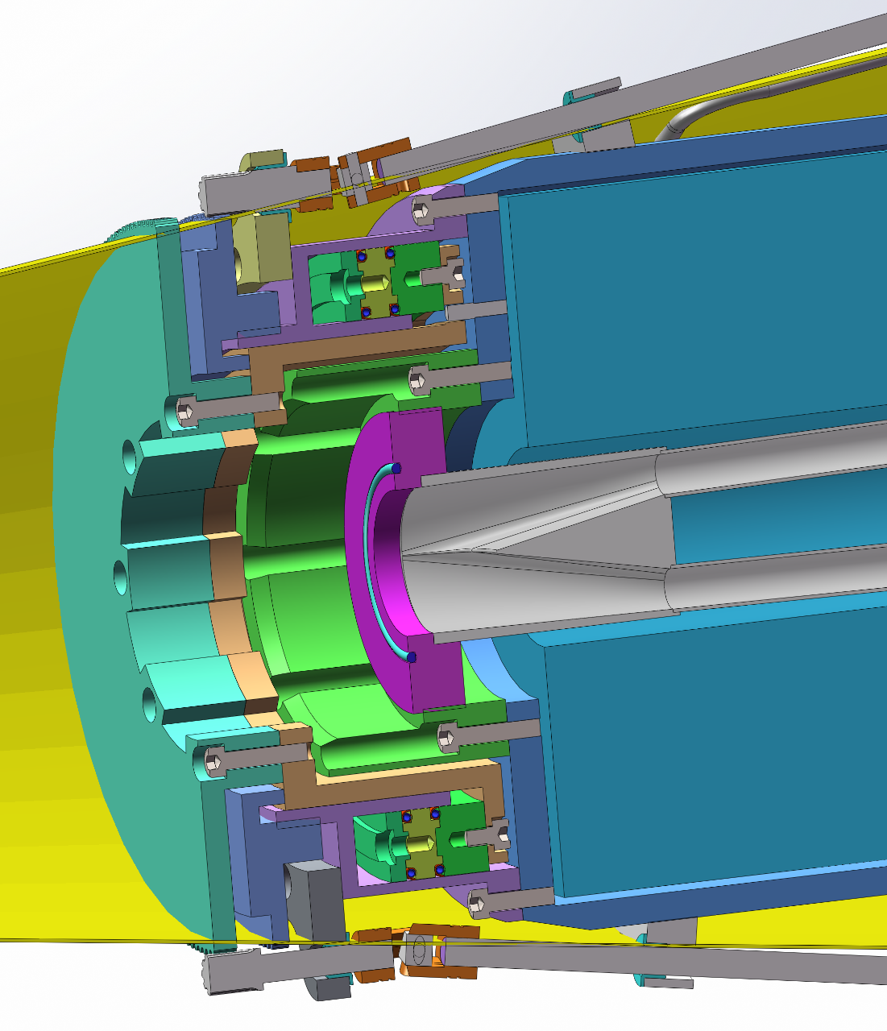
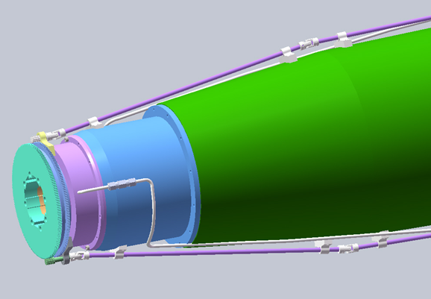
Sketch map of RVC nose
Fixed
base
Ring
piston
Actuator
Guider
Locker
Ring cylinder

Slide 9
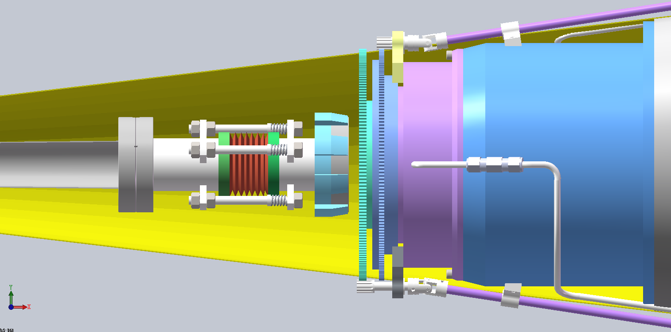
RVC working process I – Approach

Slide 10
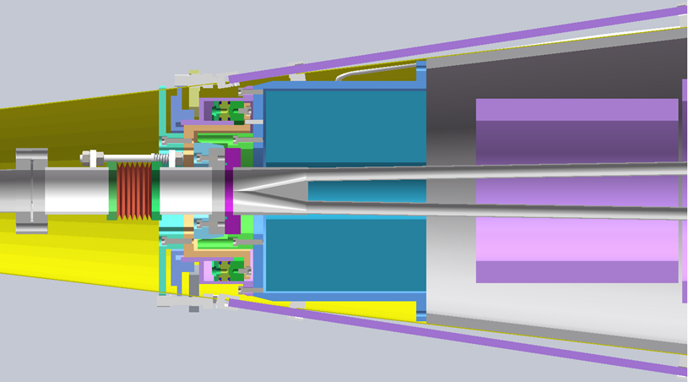
RVC working process II – Bite

Slide 11
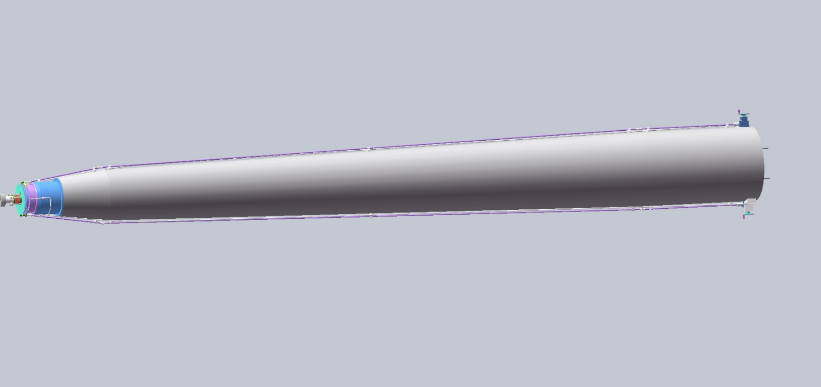
RVC working process II – Swallow

Slide 12

Sealing Principle of Helicoflex®
The sealing principle of the HELICOFLEX® is based on the plastic deformation of a jacket that has greater ductility than the flange materials.
This occurs between the sealing face of a flange and an elastic core composed of a close-wound helical spring. The spring is selected to have a specific compression resistance.
During compression, the resulting specific pressure forces the jacket to yield and ensures positive contact with the flange sealing faces.
Each coil of the helical spring acts independently and allows the seal to conform to irregularities on the flange surface.

Slide 13
Calculation for sealing force
F_{sealing}
P：50bar
r_{out}(outside radius of cylinder)：Ф18cm
r_{in}(inside radius of cylinder ：Ф14cm
F_{sealing}=(r_{out}² - r_{in}²) · π · P
=(9²-7²) · 3.14 · 50
=6597Kgf

Slide 14
Instruction of sealing structure
1、Using Helicoflex( sealing ring （spring reinforced sealing ring）for ultrahigh vacuum sealing.
2、The required force is generated by the cylinder compressed at 50bar，which can provide 6500Kgf force, equal to the force produced by 8 M8 screws(class 8.8) under 3Kg.m torque.
According to experience, such pressing force is sufficient for high vacuum sealing with Helicoflex.
3、 Use cone positioning is adopted to ensure the concentricity of the two sealing flanges.
4、Mechanical locking is deployed after pneumatic compress to guarantee the reliability of sealing.

Slide 15
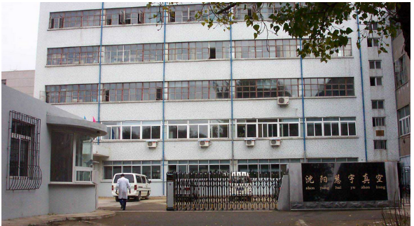

About Us
Shenyang Huiyu Vacuum Technics Co.Ltd (HYVAC) , which is a leading manufacture of UHV application in China, was founded in 1999.
HYVAC provides products
and services on accelerator
field.
Probe / detector of beam parameters
(design and manufacture)
Beam modulation equipment
(design and manufacture)
UHV / HV chambers
(design and manufacture)
Installation service
Maintenance service
…………

Slide 16
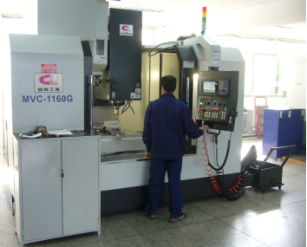
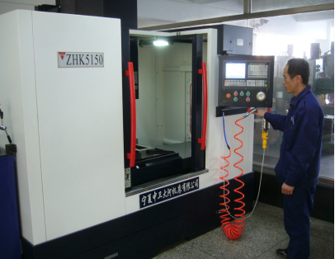
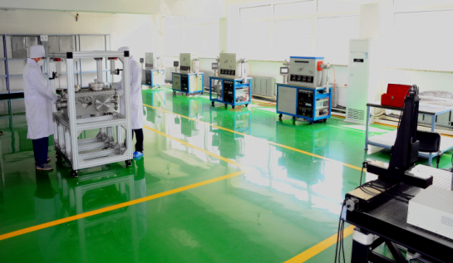
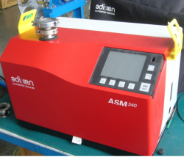
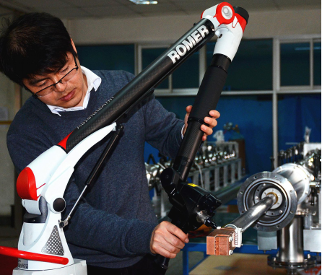
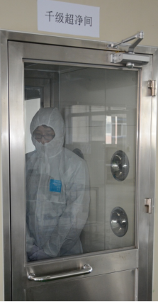
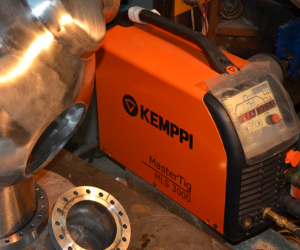
Manufacture & Quality Controller equipment
1
Precision CNC Machine
Assembly workshop-clean room
2
& Clean room with Class 6
Romer Absolute arm-7Axis brand HEXAGON made in American
3
&High sensitivity Adixen Helium Leak Detector
Kempact Pulse 3000
4
&Ultrasonic cleaning machine

Slide 17
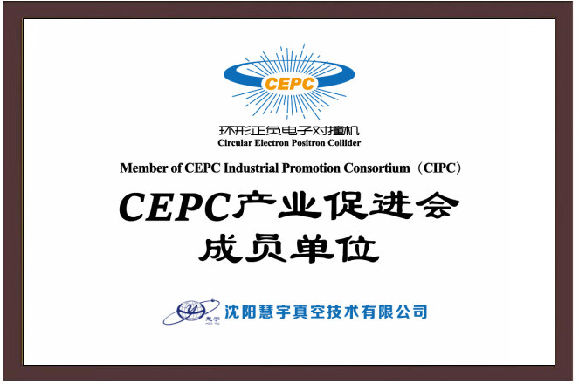
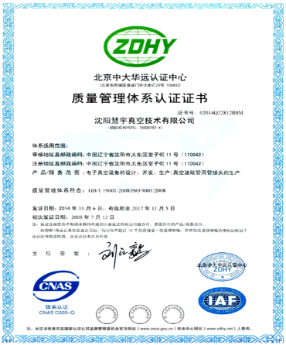
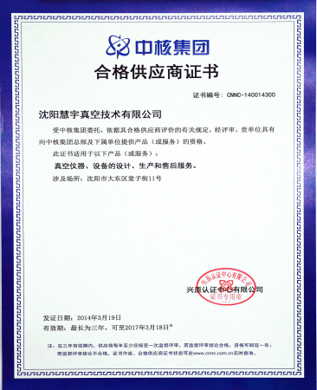
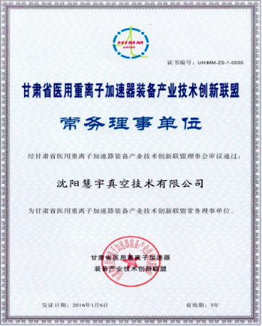
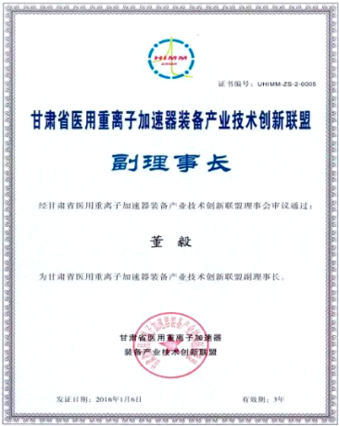
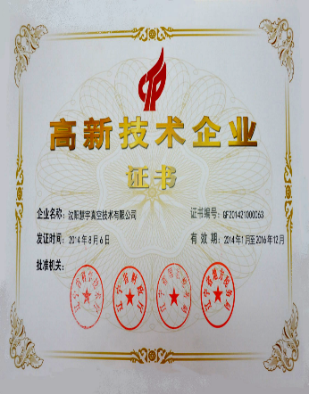
Our Qualifications
ISO9001-2008
Nuclear Industry
HIMM
HIMM
National High-tech Enterprises
The company have got ISO9001-2015 Quality System aproval.
Qualified supplier for Nuclear Industry
Huiyu is the Standing director company of HIMM Industrial Technology Innovation Alliance
General manager Mr DongYi is the Vice Chairman of HIMM Alliance
National High-tech Enterprises

Slide 18














Our Clients
HYVAC has close cooperation with many famous institutes and universities in China, which contributes a lot in R&D.
Institutes:
Institute of High Energy Physics， CAS
Insititute of Semiconductors, CAS
Institute of Modern Physics, CAS
Changchun institute of optics ,
Fine Mechanic and Physics, CAS
Technical Institute of Physics and Chemistry CAS
.........................................
Universities:
Tsinghua University,
Nanjing University,
Peking University,
Shenzhen University,
Xiangtan University,
Wuhan University,
Sun yat-sen university, F
Fudan University,
China Science&Technology University,
Hong Kong Baptist University etc.
..................................
◎

Slide 19
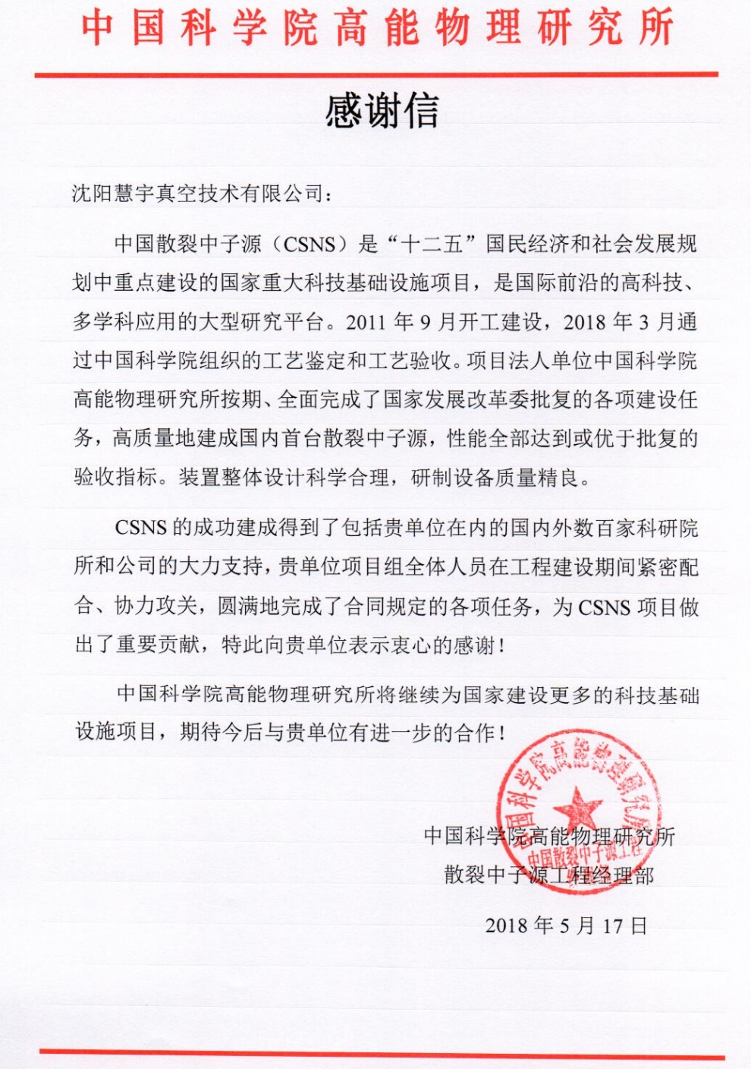
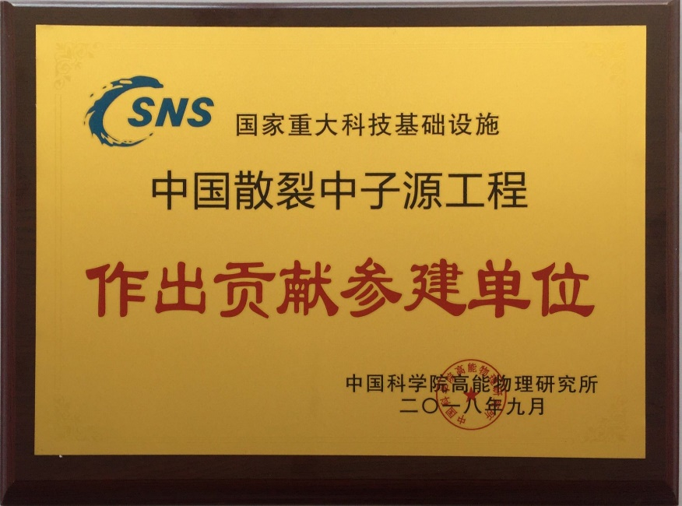
Cooperation with IHEP

Slide 20
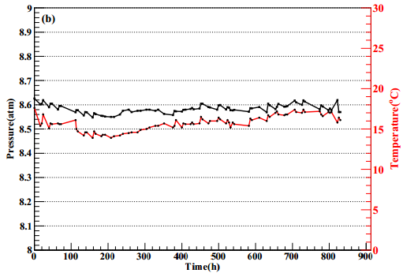
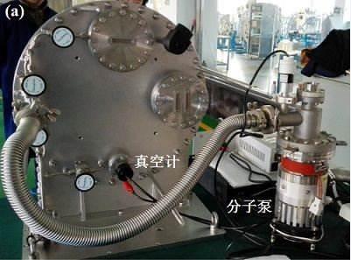
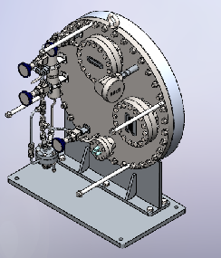
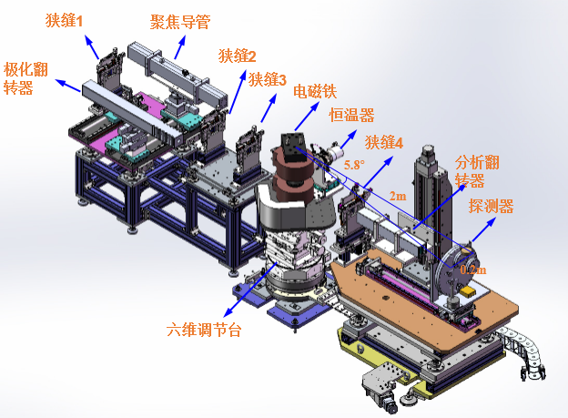
High pressure chamber for CSNS (IHEP)
  Performance：after evacuation，nitrogen of 99.999% purity was filled in up to 8.6 atm; the pressure in the chamber as well as the surrounding environment was monitored for 900 hours successively. Estimated leakage for 10-yearleakage was 1.7 bar was estimated, which satisfies CSNS detector standards.

Slide 21
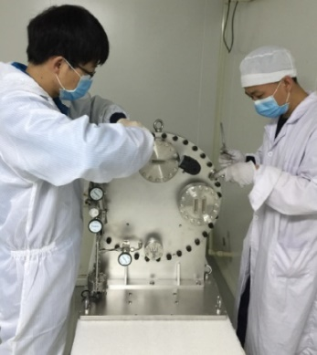
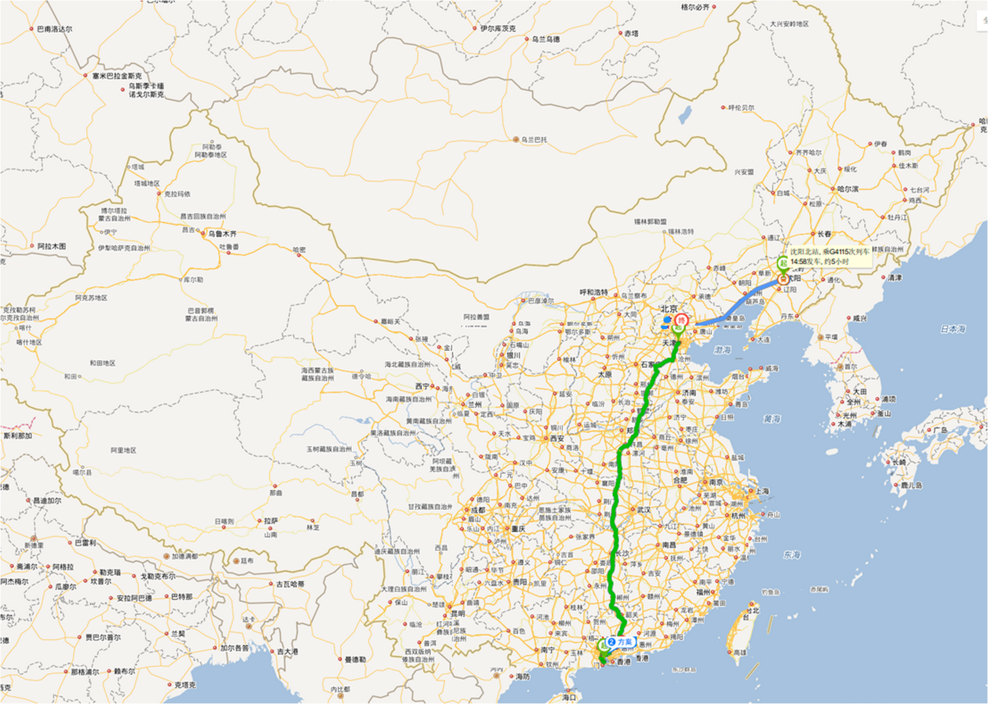
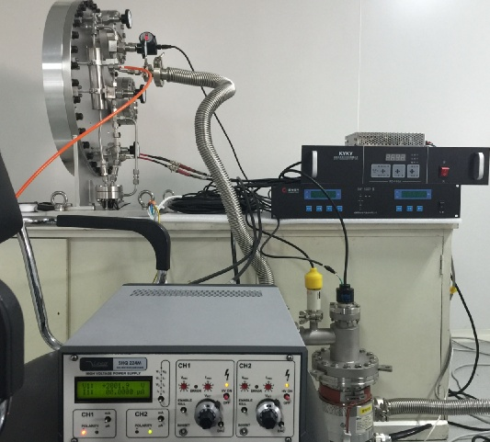
Long distance transportation of CSNS high pressure chamber
Long distance transportation at low pressure, vibration isolated.
Multi-wire detector chamber is well protected.
The detector window is well protected for high performance.
From HYVAC to Tianjin, under
1.2atm
Filled again and pressure is maintained for 14days. Then transported from Tianjin to Zhuhai, under 1.2 atm
From Zhuhai to CSNS under 8.6atm.

Slide 22
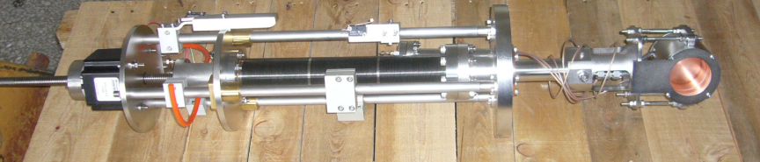
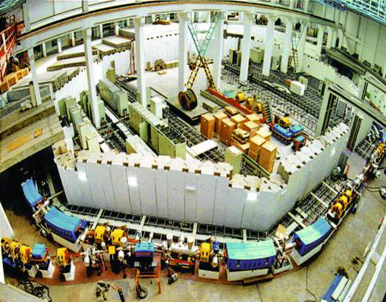
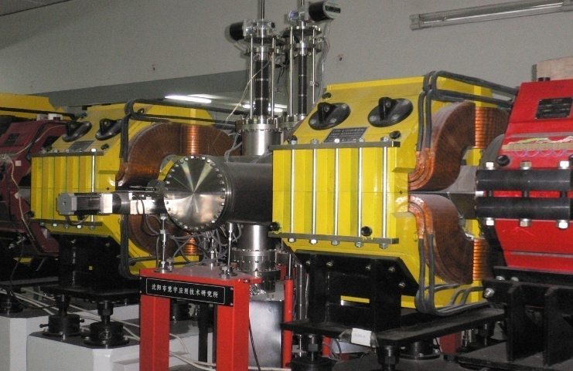
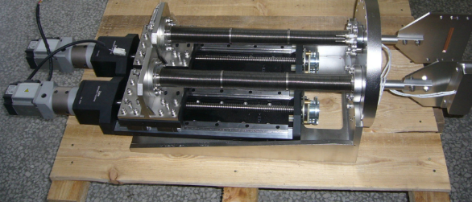
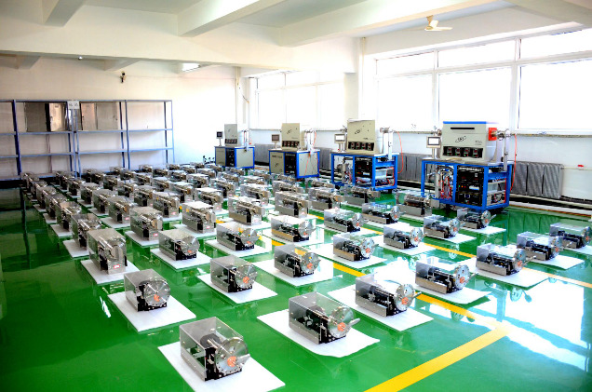
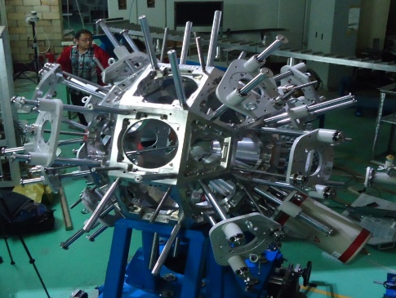
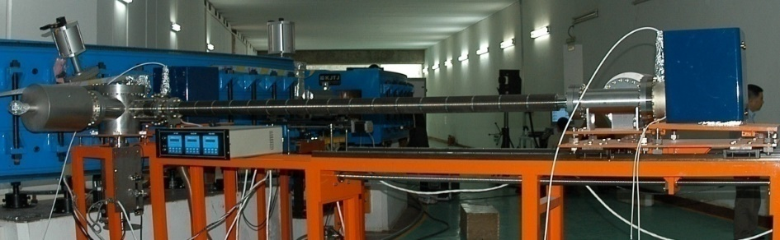
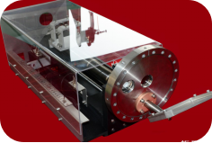
Products in Modern Physics Institute(CAS)
Various beam probes, Faraday Cup, single-wire detectors, twin-wire detectors, air detectors, position detectors, phase probes, radial probes, stripping targets, various slit, beam stopper etc.
…
Various
slit
Beam
stoppers
Air detectors
Faraday cup
Position detectors
Various beam probes

Slide 23
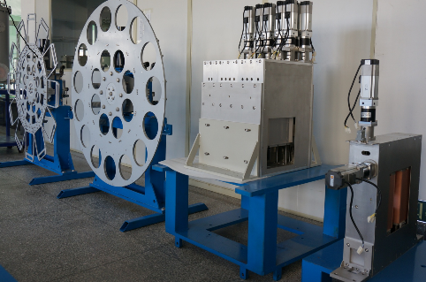
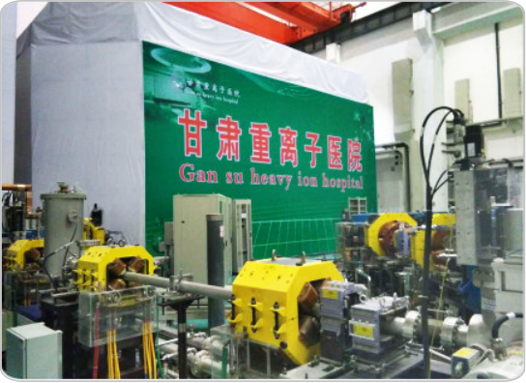
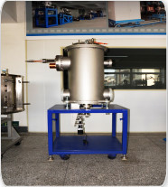
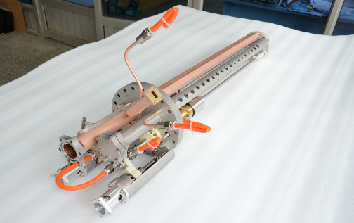
For HIMM-Heavy ion medical machine
China's first HIMM
Treatment Terminal Equipment
Debunch Chamber
Ion source
Ridge filter,Beam collimators ,Range shifter,
Scatterer ,Ion source
PET.CT high frequency chamber, Debuncher high frequency chamber;

Slide 24
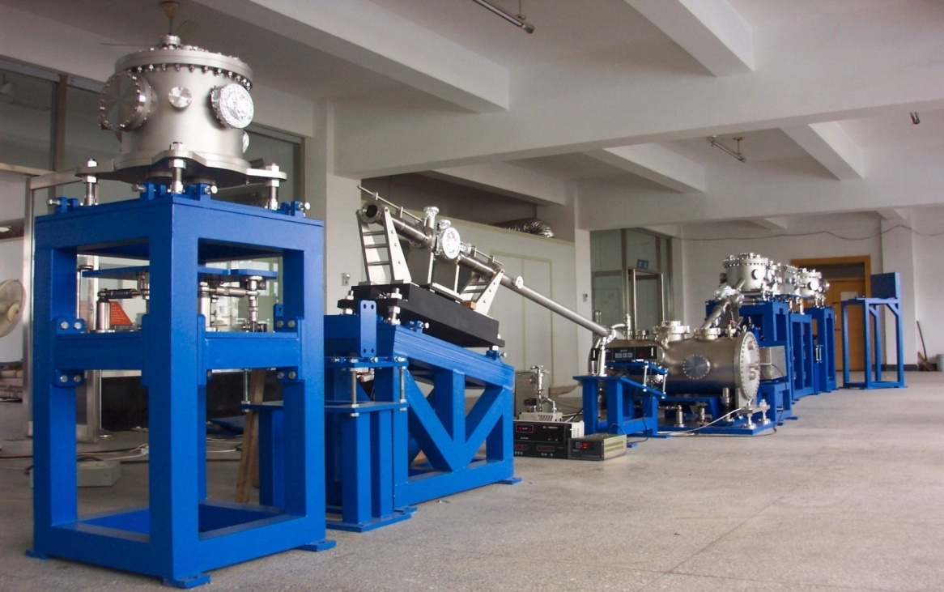
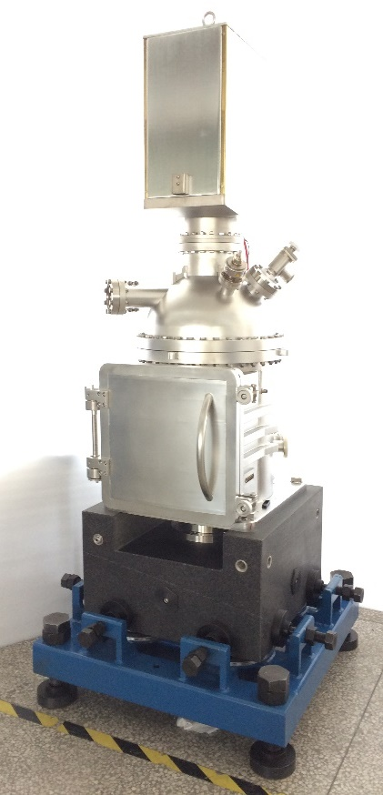
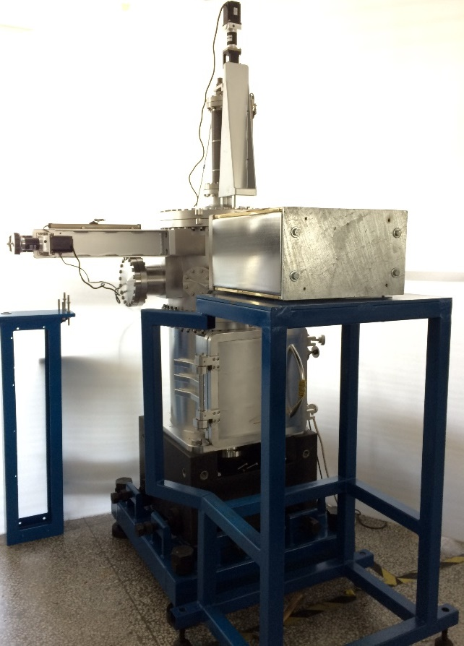

For National Synchrotron Radiation Laboratory
Beam line system
Ion beam lithography apparatus
Optical Resonant Cavity

Slide 25







Engineer and produce ITER-GDC electrode
GDC electrodes for Glow Discharge
Cleaning System
Experiment platform
High Temperature irradiation creep research device
GDC-Permanent electrode

Slide 26







Sublimation purifying facility for next generation OLED OPV PTFT
This series of small molecular purificaiton system are based on ultrahigh vacuum technics, precision machining technicsm and automatic control system are under our own intellectual property.

Slide 27







Magnetron sputtering deposition system
This magnetron sputtering deposition system was designed for deposition of metal films, dielectrical films, and other laboratory research on new materials.
Options: Film thickness monitoring; Reaction sputtering ; Ion beam assistant sputtering

Slide 28

专业
专注
专心
Thank you！
SHEN YANG HUIYU VACUUM TECHNICS CO., LTD

