Slide 1
New Ideas about Calorimetry
Low Mass Gas Tracking
High Resolution Calorimetry
Full Silicon Tracker
High Granularity Calorimeter
November 12-14, 2018
Institute of High Energy Physics, Beijing, China
Chris Tully
(Princeton University)
Notes:
It’s an honor for me to be here today and to be able to share some ideas I have with my old colleagues. I became fascinated five years ago with the suggestion – I believe
from Yifang – of building a collider that encircled a city. And I hope that vision becomes a reality.

Slide 2
Balancing Jets and EM particle resolutions
For HZ production, all Z recoils matter
  ~70% of Z decay are hadronic
Particle Flow Principle
  Optimal use of measurement information applied to each reconstructed particle
    Charged hadrons (~65%)
      Replaced by track (~0.1%)
    Neutral hadron (~10%)
      HCAL (~45%/√E)
    Photons/EM (~25%)
      ECAL (~15%/√E)
~4.5%/√E
~3.8%/√E
Z Jets ~ 3.5 - 5.5% (Limited by HCAL & EM)

Slide 3
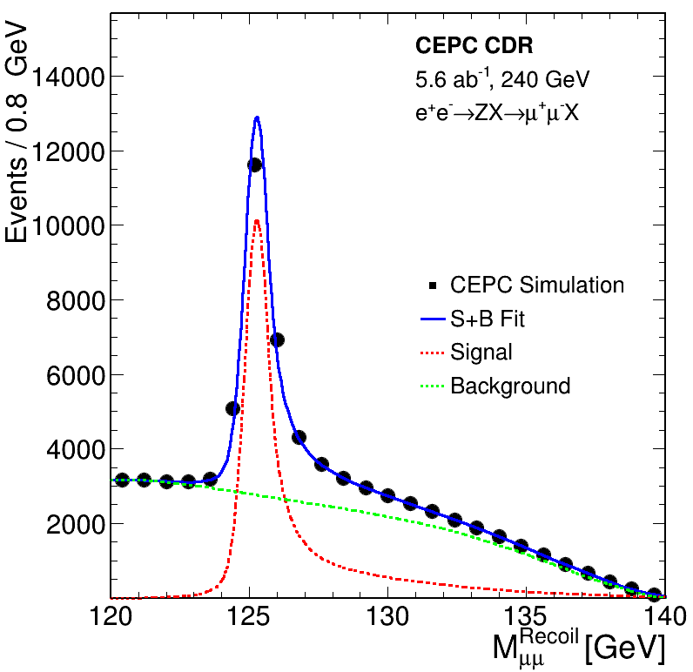
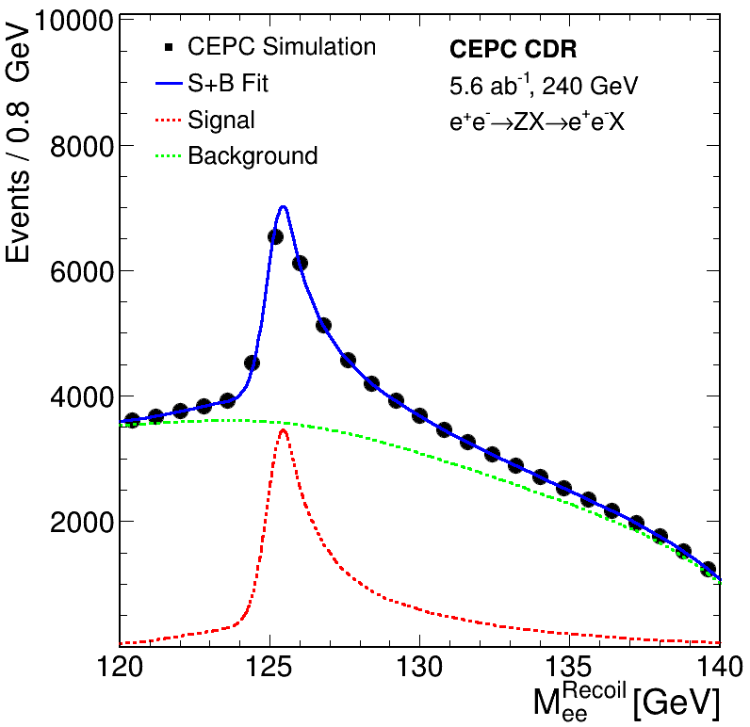
Electron should be done well at e⁺e⁻ Collider
Muons
Electrons
From track
Not yet there w/ CDR reference design
(needs Brem. recovery w/ EM res.)
~2-4%*15%/√E → ~0.3-0.6%

Slide 4
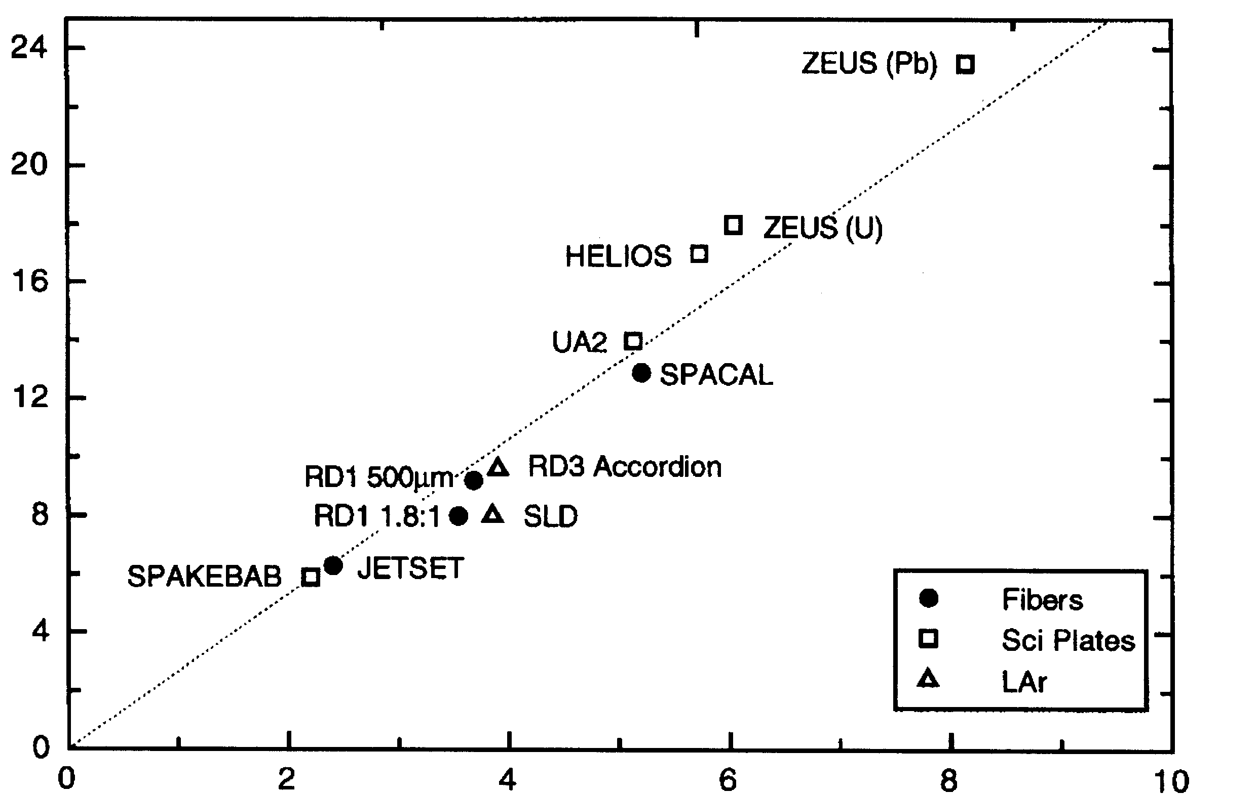
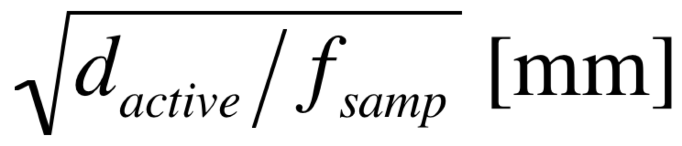
Three Regimes of EM Resolution
For EM showers in a sampling calorimeter, the energy resolution is dominated by the sampling fluctuations:
Silicon
* Si-W (100μm - HGC)
* Si-W (300μm - HGC)
X₀(Si)/X₀(W)=27
Segmented
Crystal?
(σ_{Ε} /E)_{EM} *√E [%]
Plastic/Quartz
Fiber
(Courtesy of R. Wigmans)
Homogeneous crystals

Slide 5
Imaging Capabilities of High Granularity
CO₂ (-35 C)
Fluctuations driven by counting statistics
(one event can look like many)

Slide 6
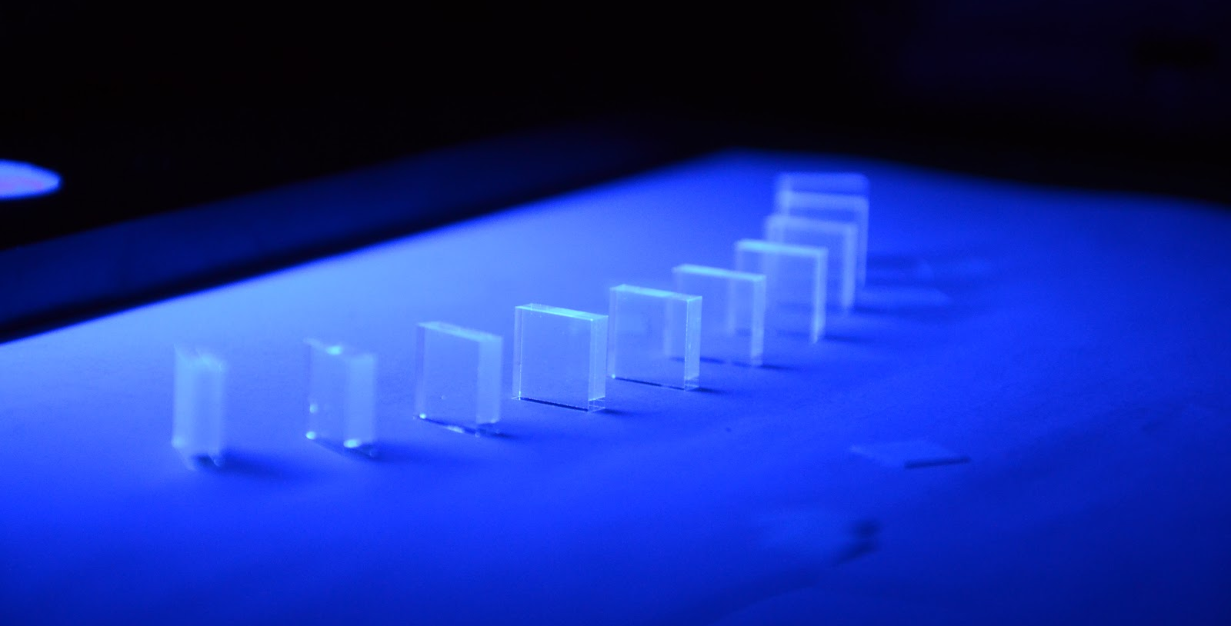
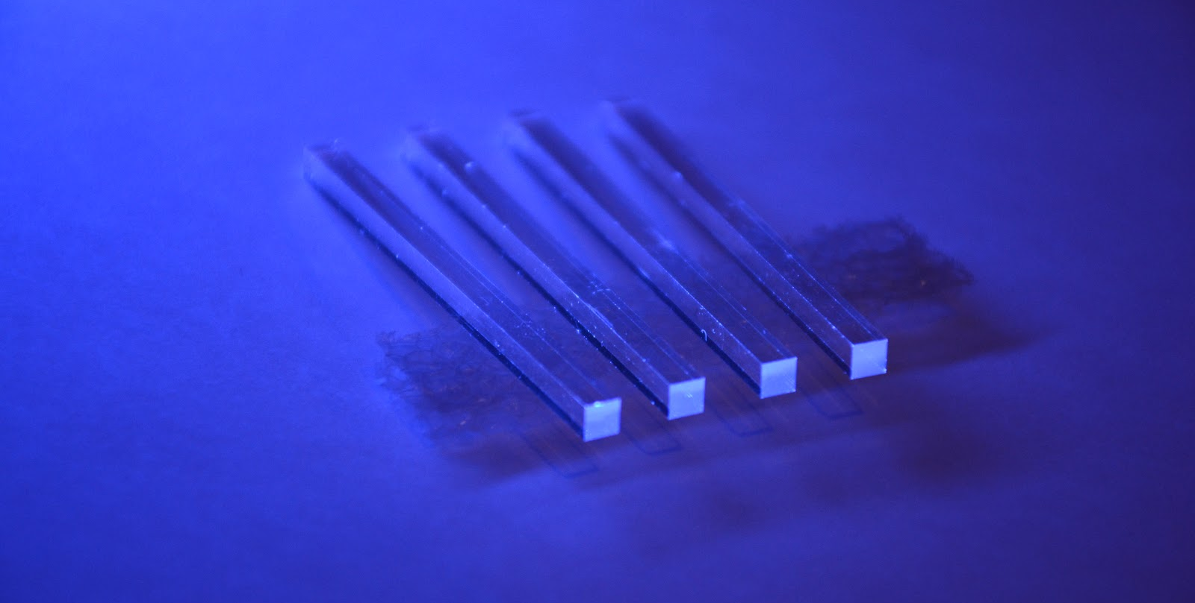
Small Crystal Geometries for Timing Detectors
Tiles and Bars (few mm thick w/ area of ~1cm²)
  Single layer ~500,000 channels
  Stereo readout for bars (L/R) ~25ps timing resolution
3x10x10mm³
3x3x50mm³
Fully segmented crystal EM calorimeter:
Low occupancy timing layer timing for ~1 X0
Transverse orientation w/ stereo readout
Ultra-high EM resolution (~5%/√E)
Pointing geometry (fine transverse granularity)
5-10cm bars of ~1cm² area for ~20 X0
Yuexin Wang (poster)
Still w/ PFA capabilities? Or with S/C crystal fibers?

Slide 7
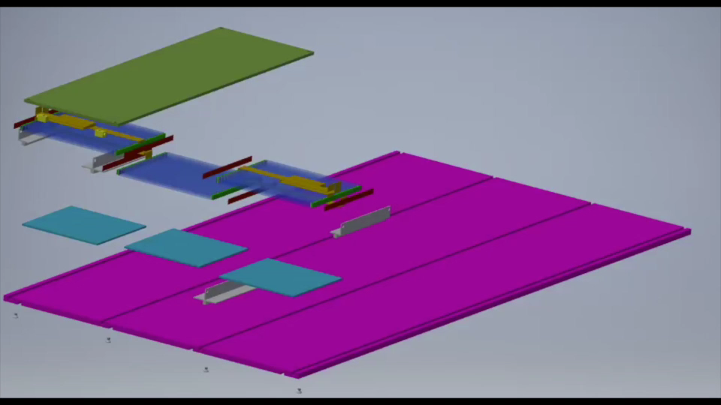
CMS MTD Tray Assembly (Concept)

Slide 8
Silicon Photomultiplier (SiPM) Cells
Typical dynamic range customization for SiPM
  More (small) SPADS to count more photons (50→15μm)
  Bright crystal (LYSO, GAGG) and high photodetection efficiency (PDE) and light collection efficiency (LCE)
Currently:
Large device ~6x6mm²
CMS MTD ~4.5 m² of SiPMs
(of 3x3mm²)
Segmented Crystal ECAL:
~200 m² of crystal surface
(3-4 layers)
Which SiPM device?
Notes:
One of the technical challenges of precision timing with crystals is to maximize the photon flux. One doesn’t wait for the exponential decay of the light from a signal, we
care only about the step function of light flux relative to the dark count rate – and apply thresholds within the first 20 pe recorded by our photodetectors. That imposes
a minimum flux rate for the timing precision and beyond having bright crystals we have to be clever and efficient about how we collect light.
These are views of the micro-structure of SiPMs for different features sizes and one of the features of these detectors is that each individual SPAD needs it’s own bias
line and quench resistor and that blocks photosensitivity.

Slide 9
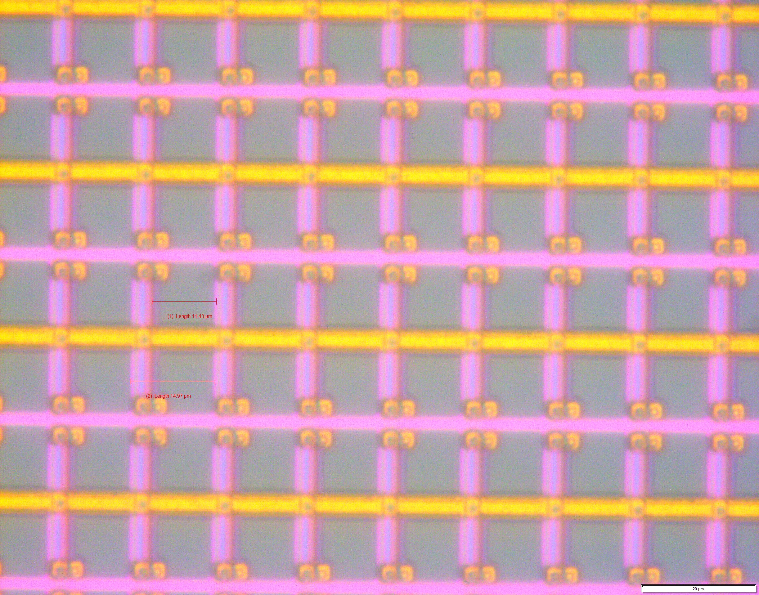
Large Area Light Collection Techniques
Winston Cone is a light collector in the shape of an off-axis parabola of revolution with a reflective inner surface.
SiPM: Each SPAD (15μm x 15μm)
Optical image: 100X

Slide 10
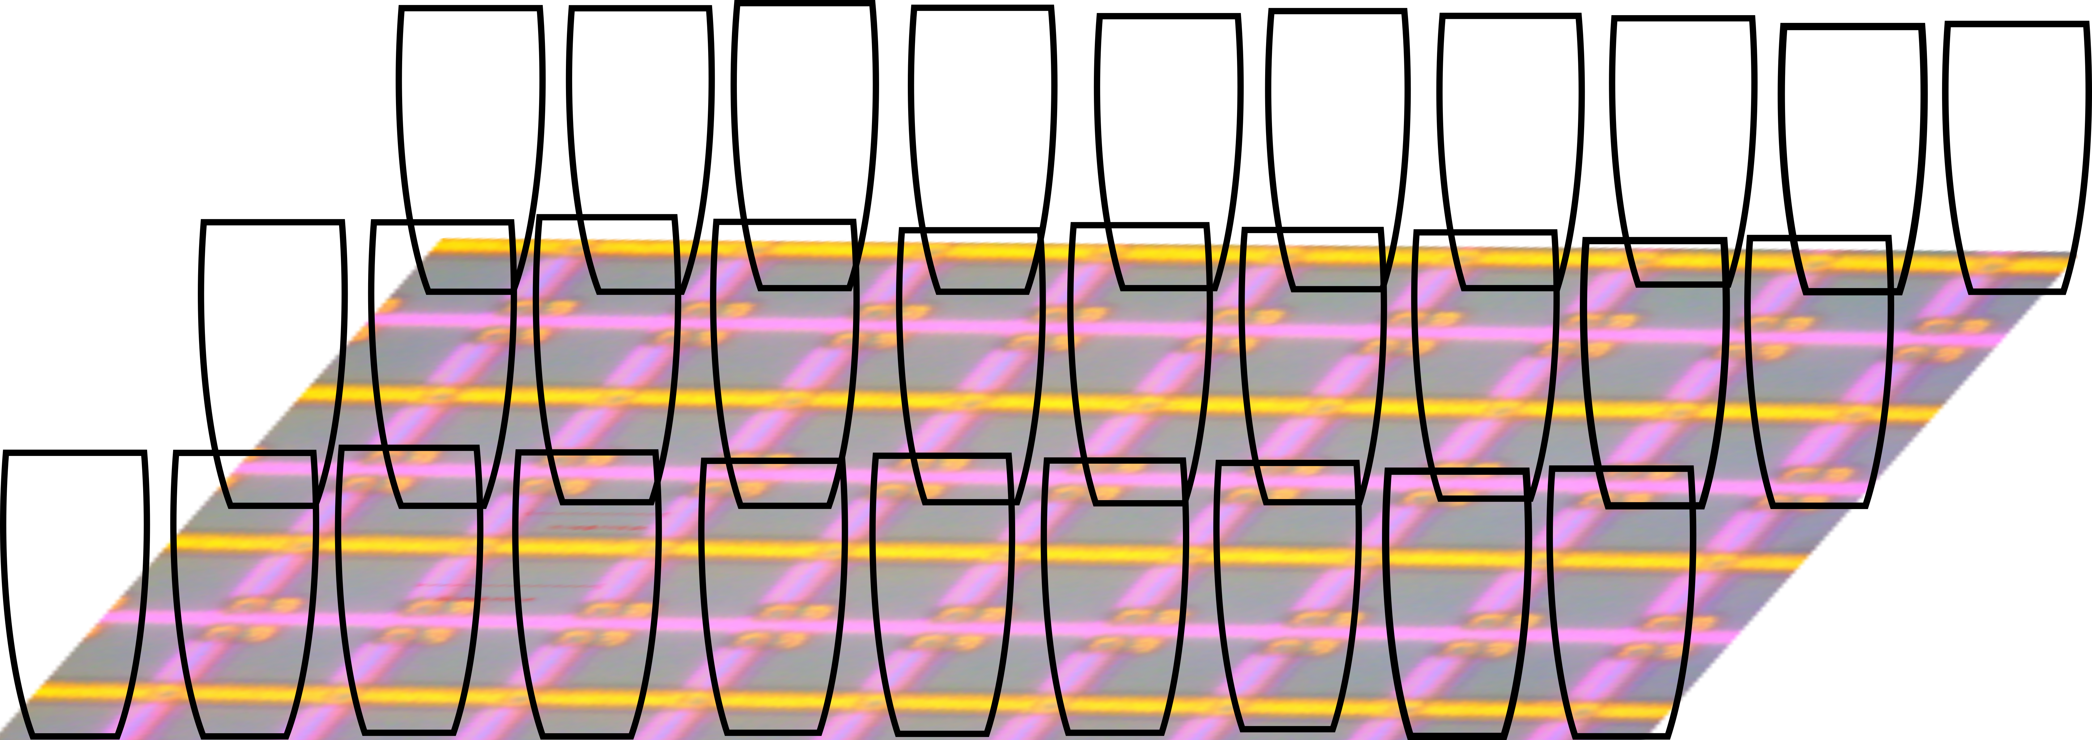
Winston Cone on each SPAD
SiPM PDE micro-scanner
(15 micron)
TIFR Group
S. Dugad
Increase Photo Detection Efficiency by adding a metalized mini Winston Cones on top of SiPM array.

Slide 11





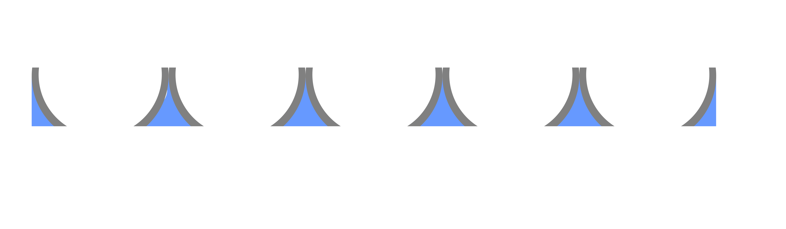

Fabrication Process
1.Heidelberg greyscale Photolithography Writing
  By BMP and DXF flies
2. Transfer Winston cones pattern to PDMS
  Spin coat PDMS first time (20um)
  Dissolve photoresist
  Transfer on glass carrier slides
  Cr metal coating as a sacrificial layer
  Spin coat PDMS second time
  Transfer on a Si or glass substrate
3. Deposit the Al reflective metal layer on Winston cones structures by Sputter
4. Laser dicing tool to drill holes in the bottom center of Winston cone to create opening windows for SiPM
5. Transfer on target substrates
6. Fill the Winston cones by Parylene (reflective index 1.65-1.7)
12um<L(Top)<15um
Step 1
Photoresist
Si
Spin coat PDMS
PDMS
Step 2
Dissolve photoresist
Glass
Cr metal deposition
spin coat PDMS
Glass
Al deposition
Step 3
Glass
Laser drill windows
Transfer on targets
Step 4
Target
Fill Parylene
Step 5
Target

Slide 12
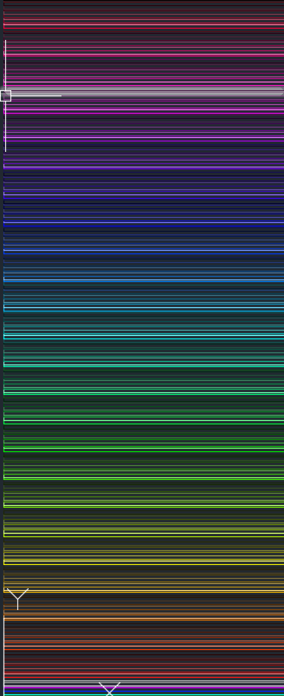

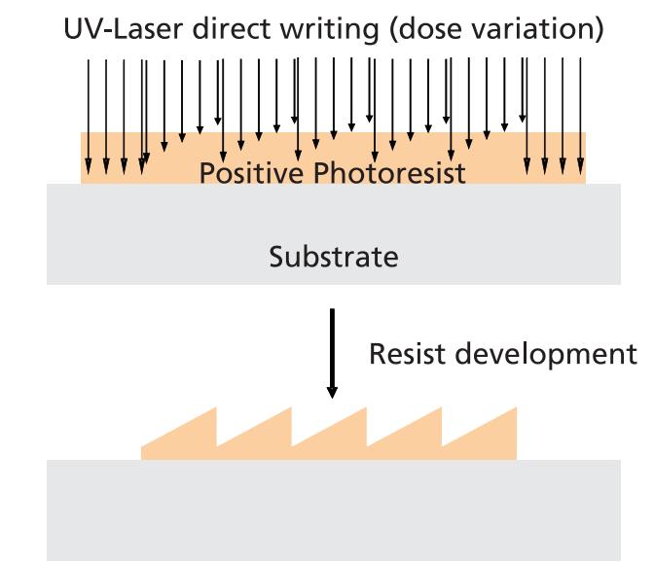
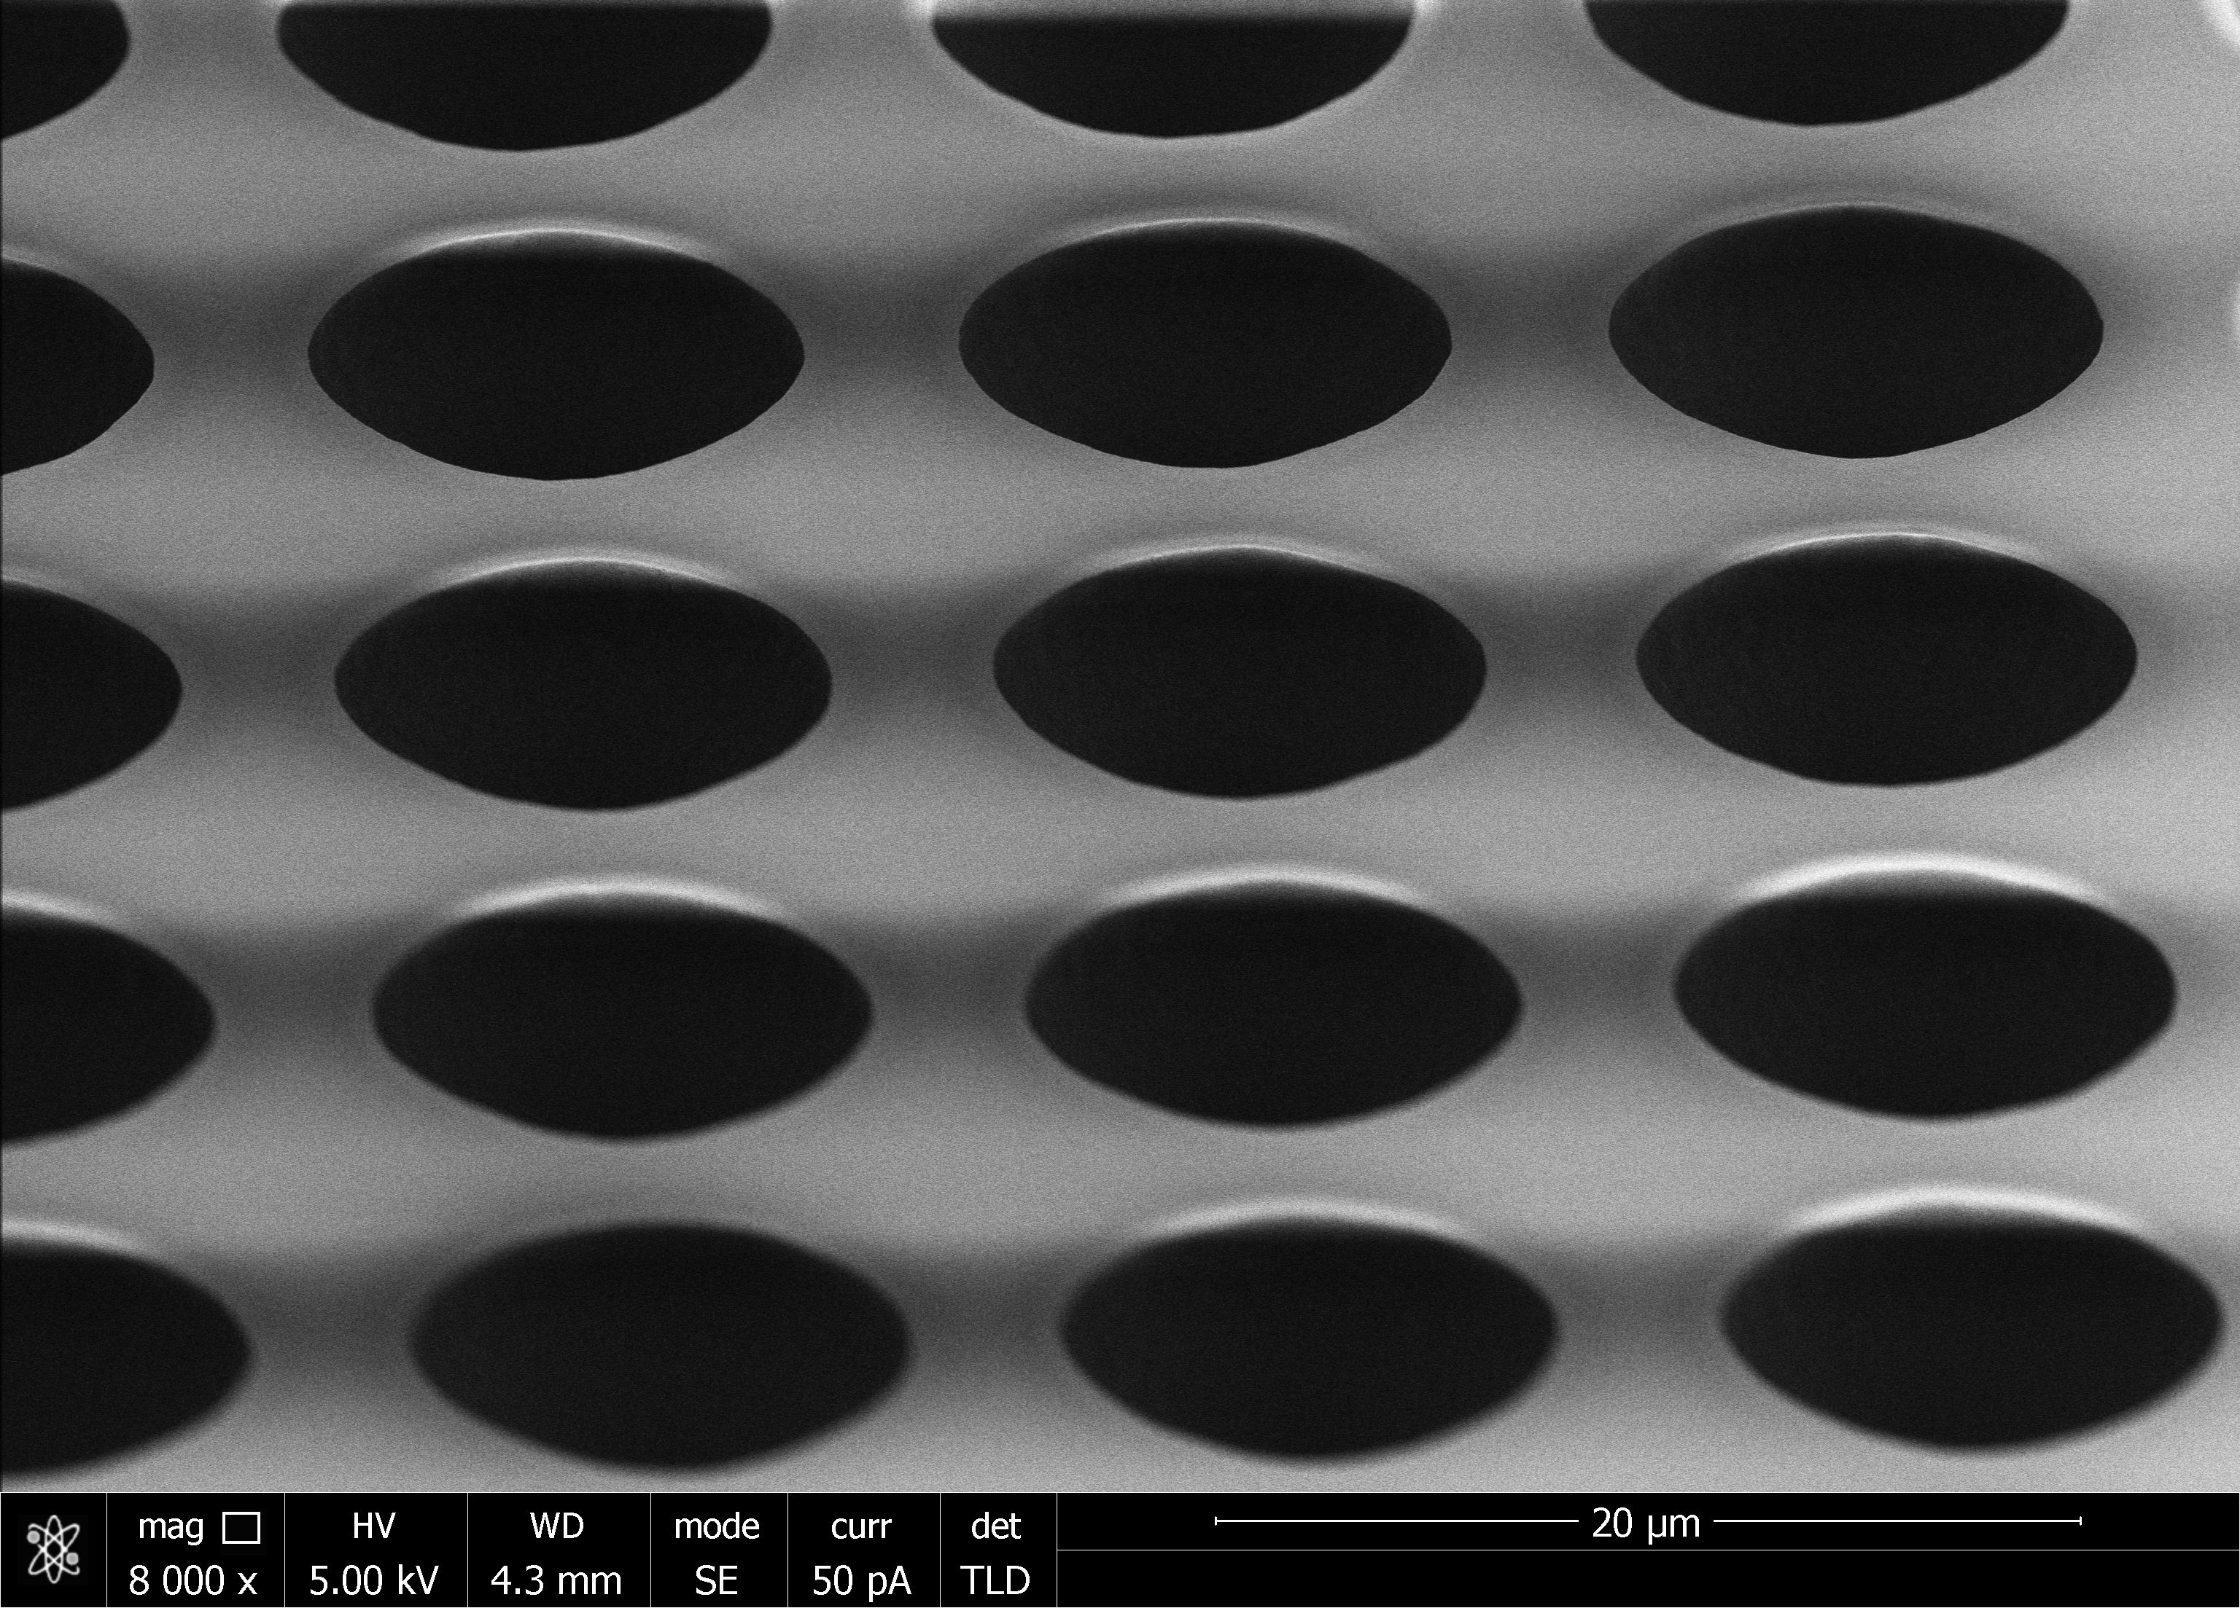
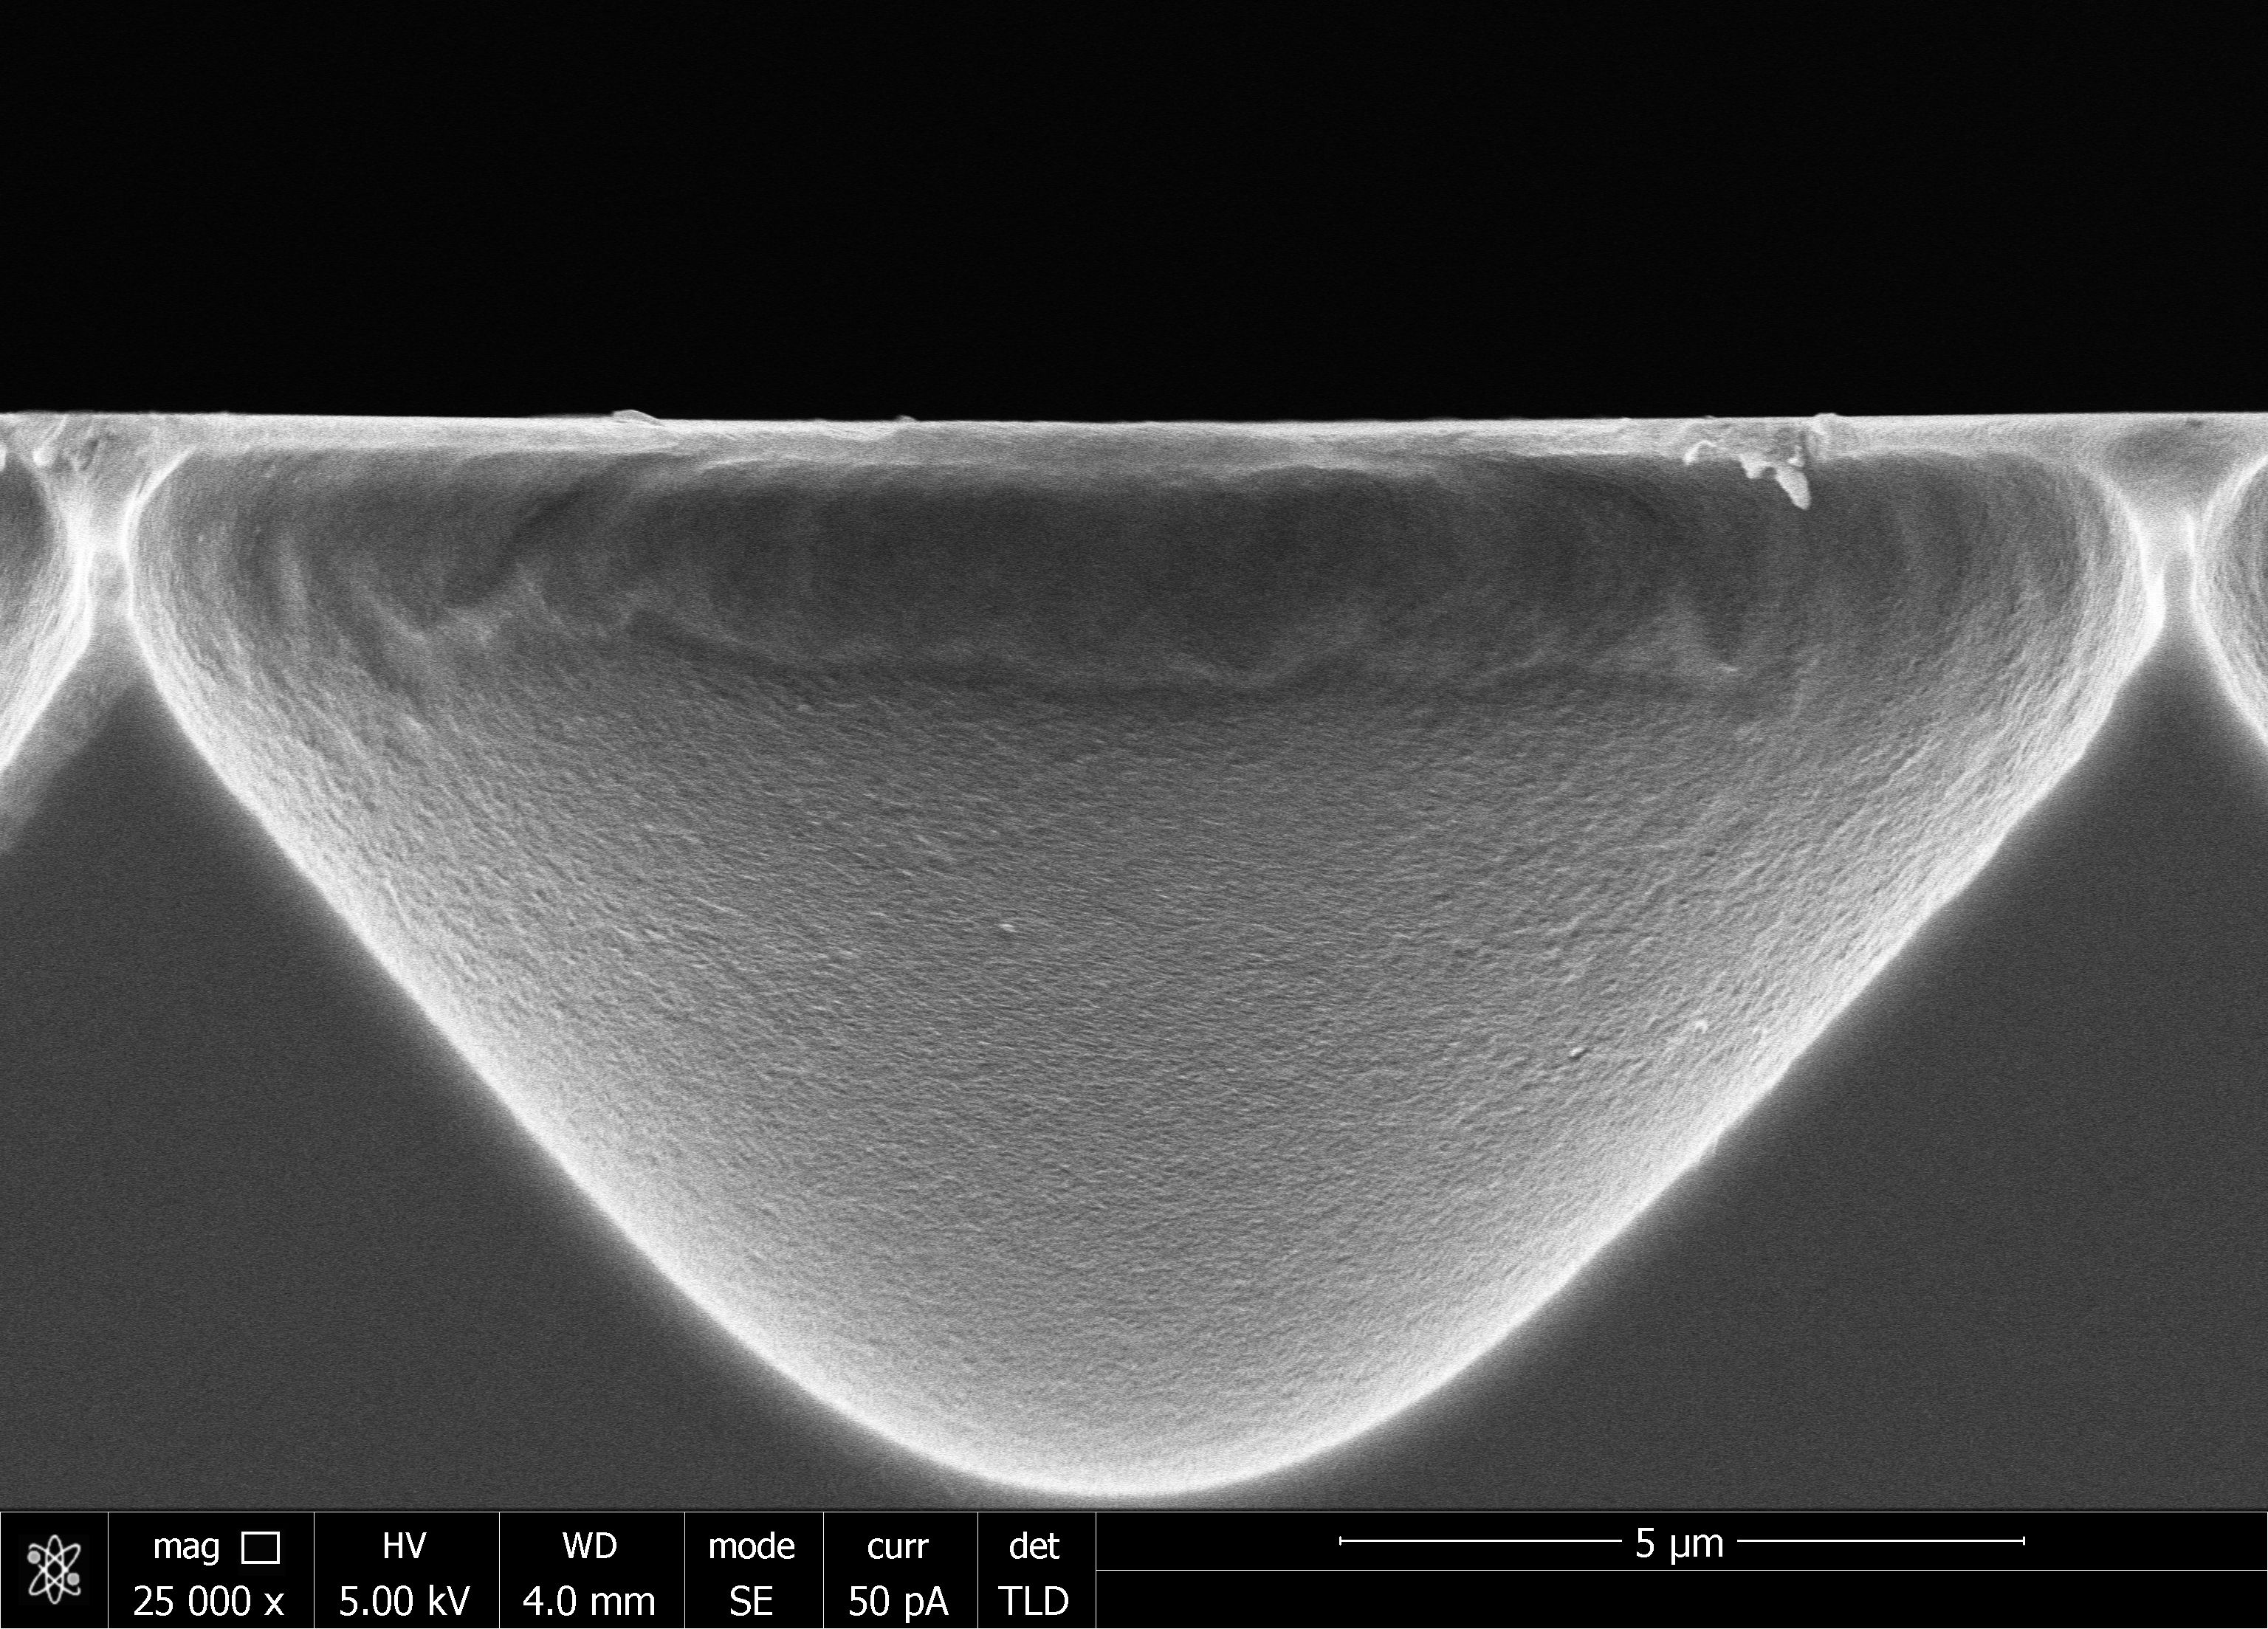
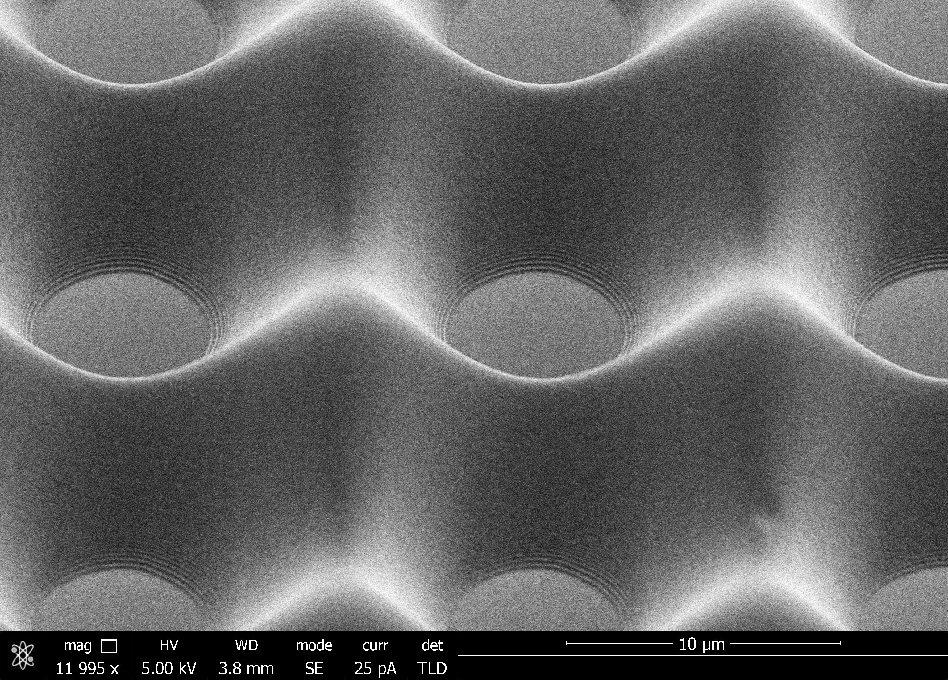
Greyscale Writing
BMP image
DXF greyalue file
Greyscale writing:
SEM of grayscale writing

Slide 13
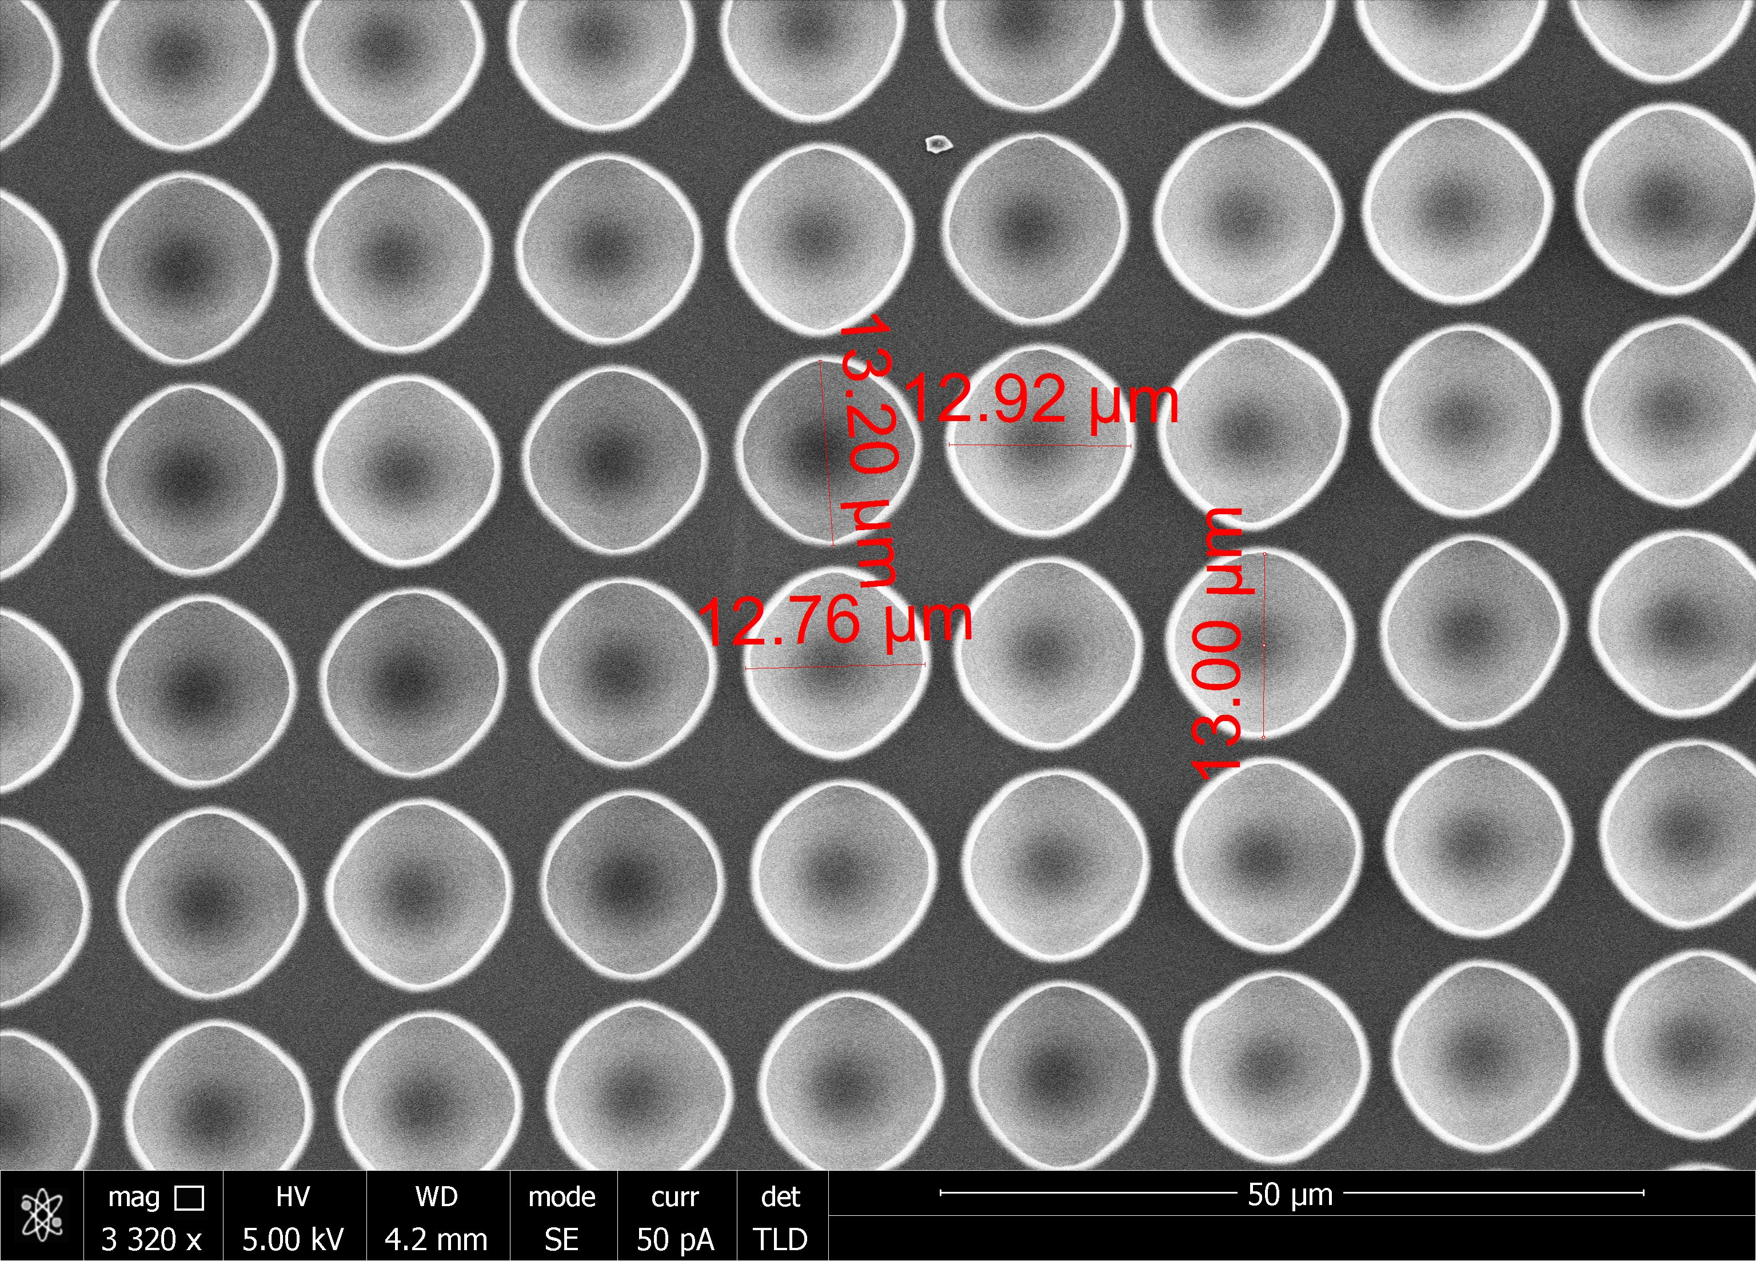
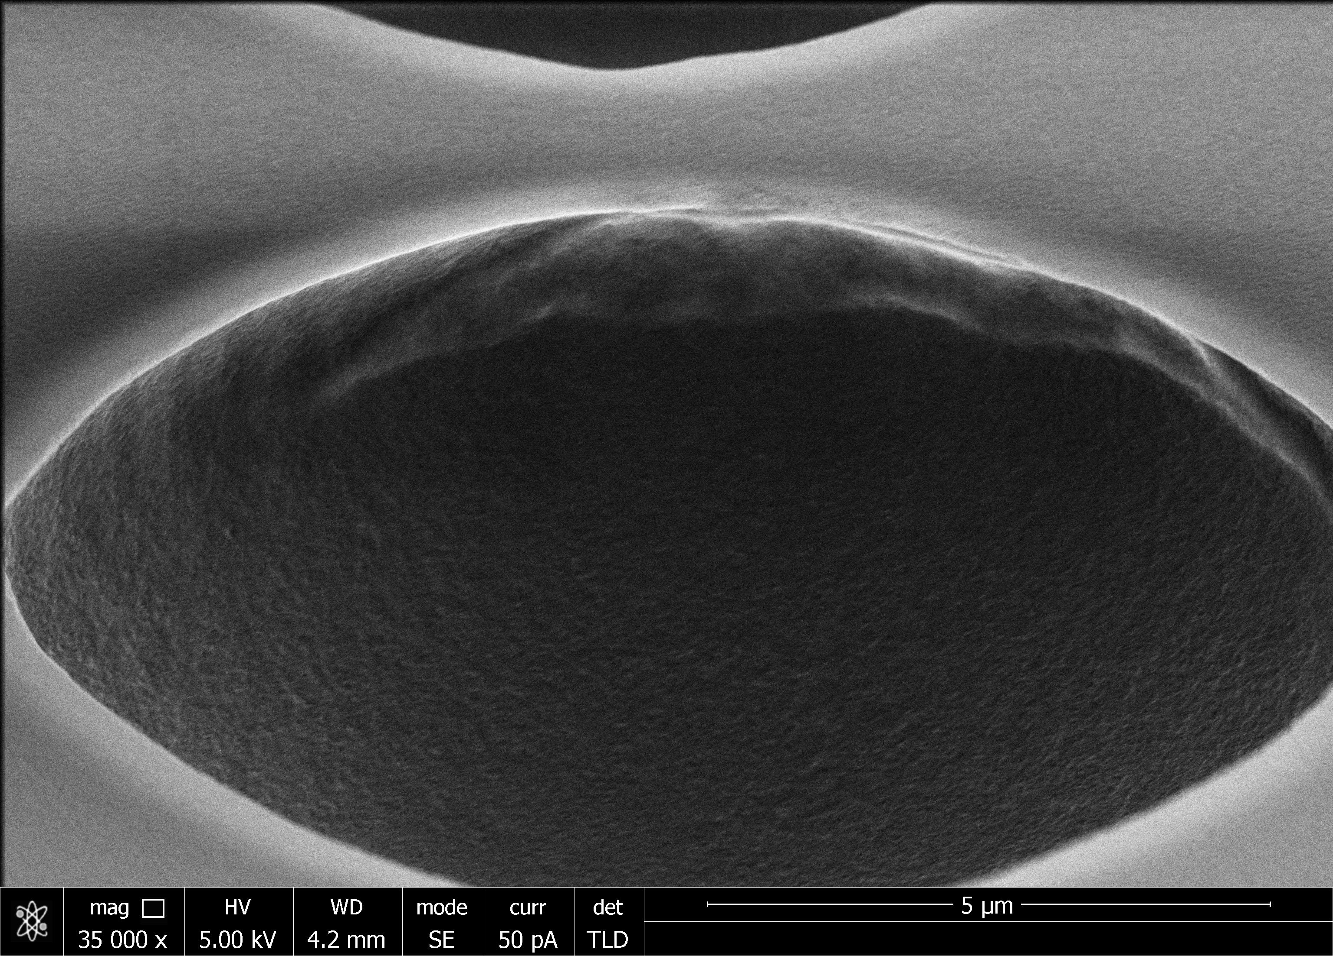
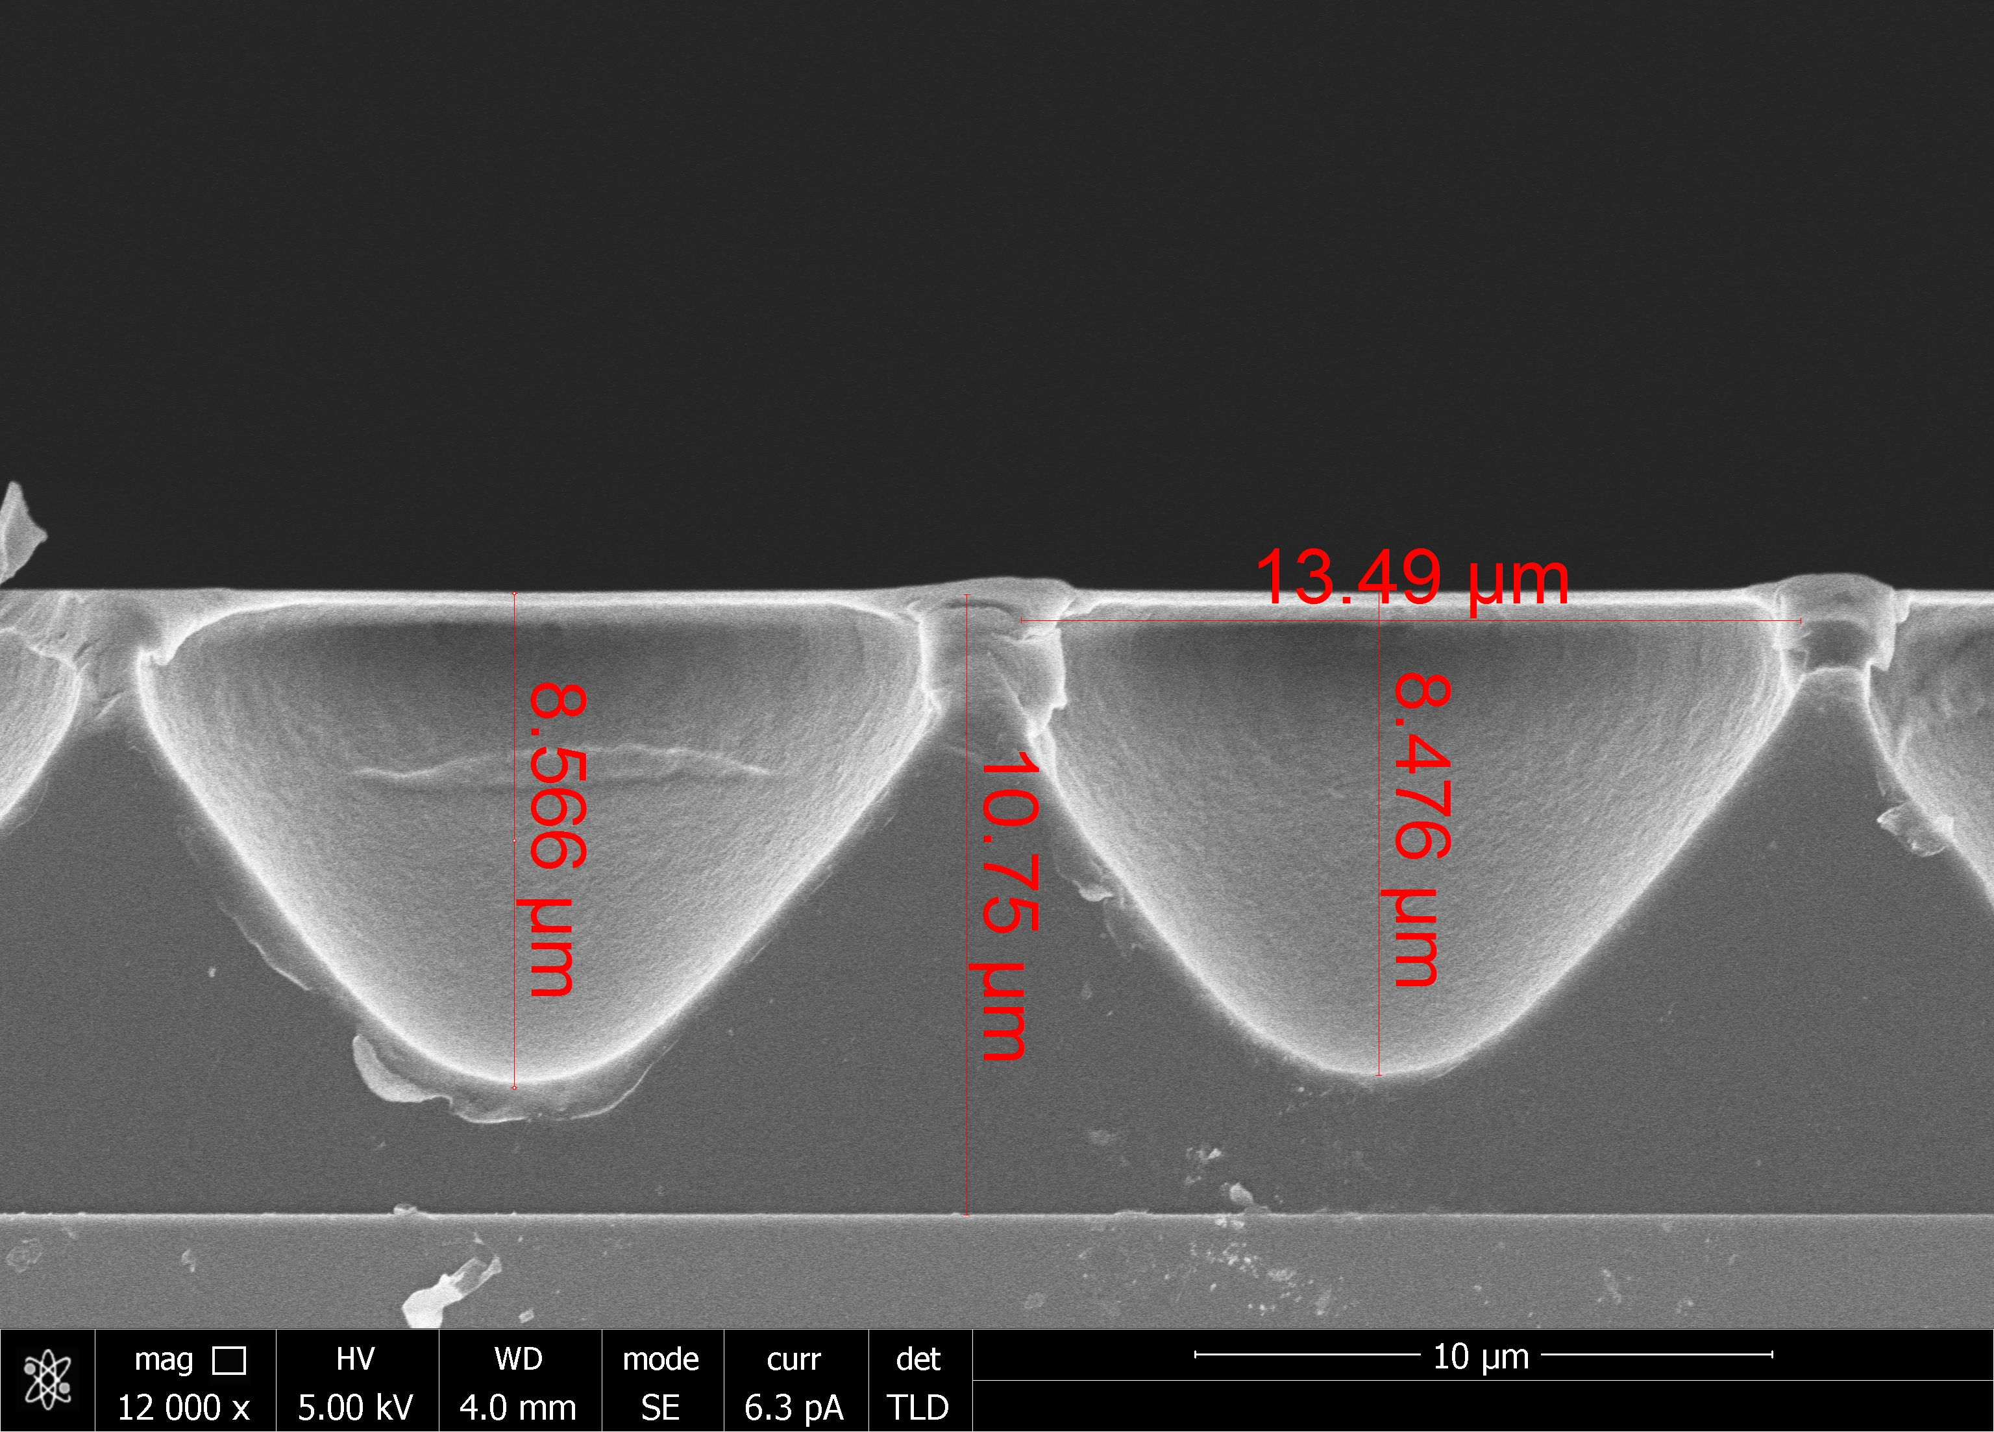
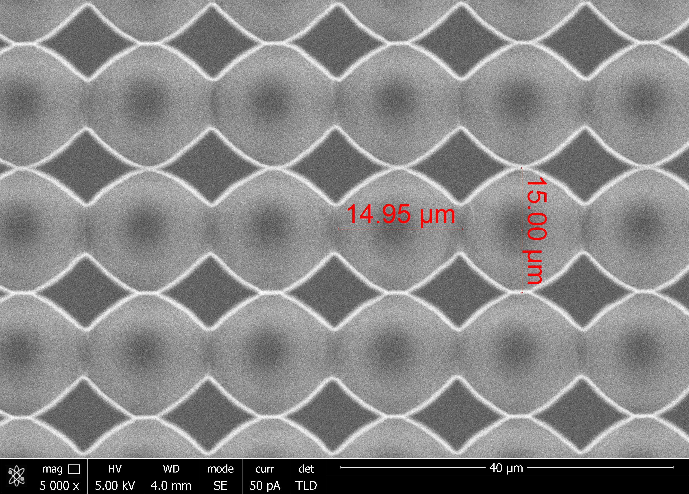
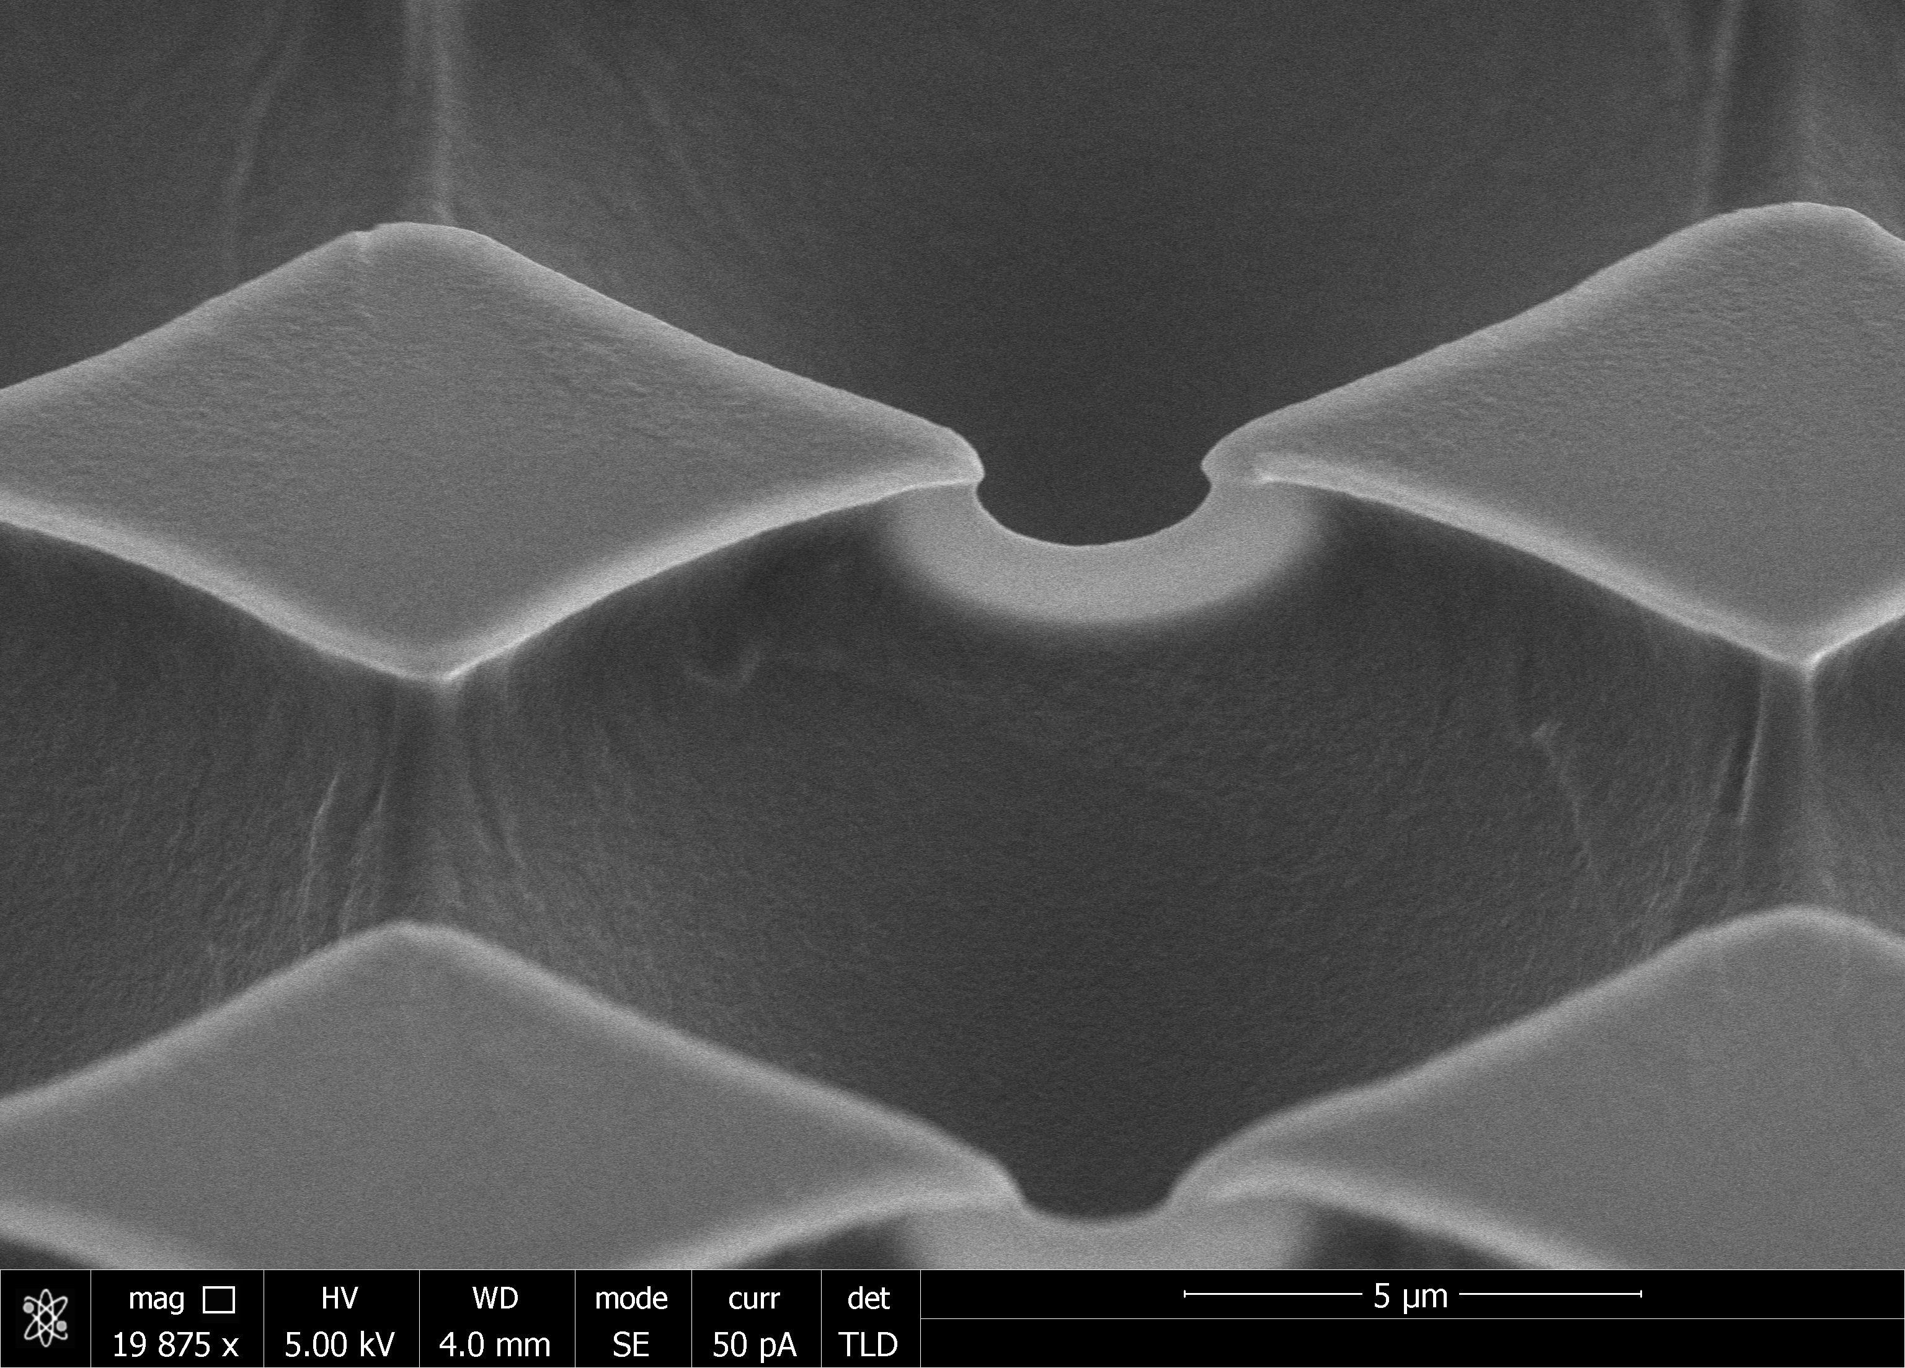
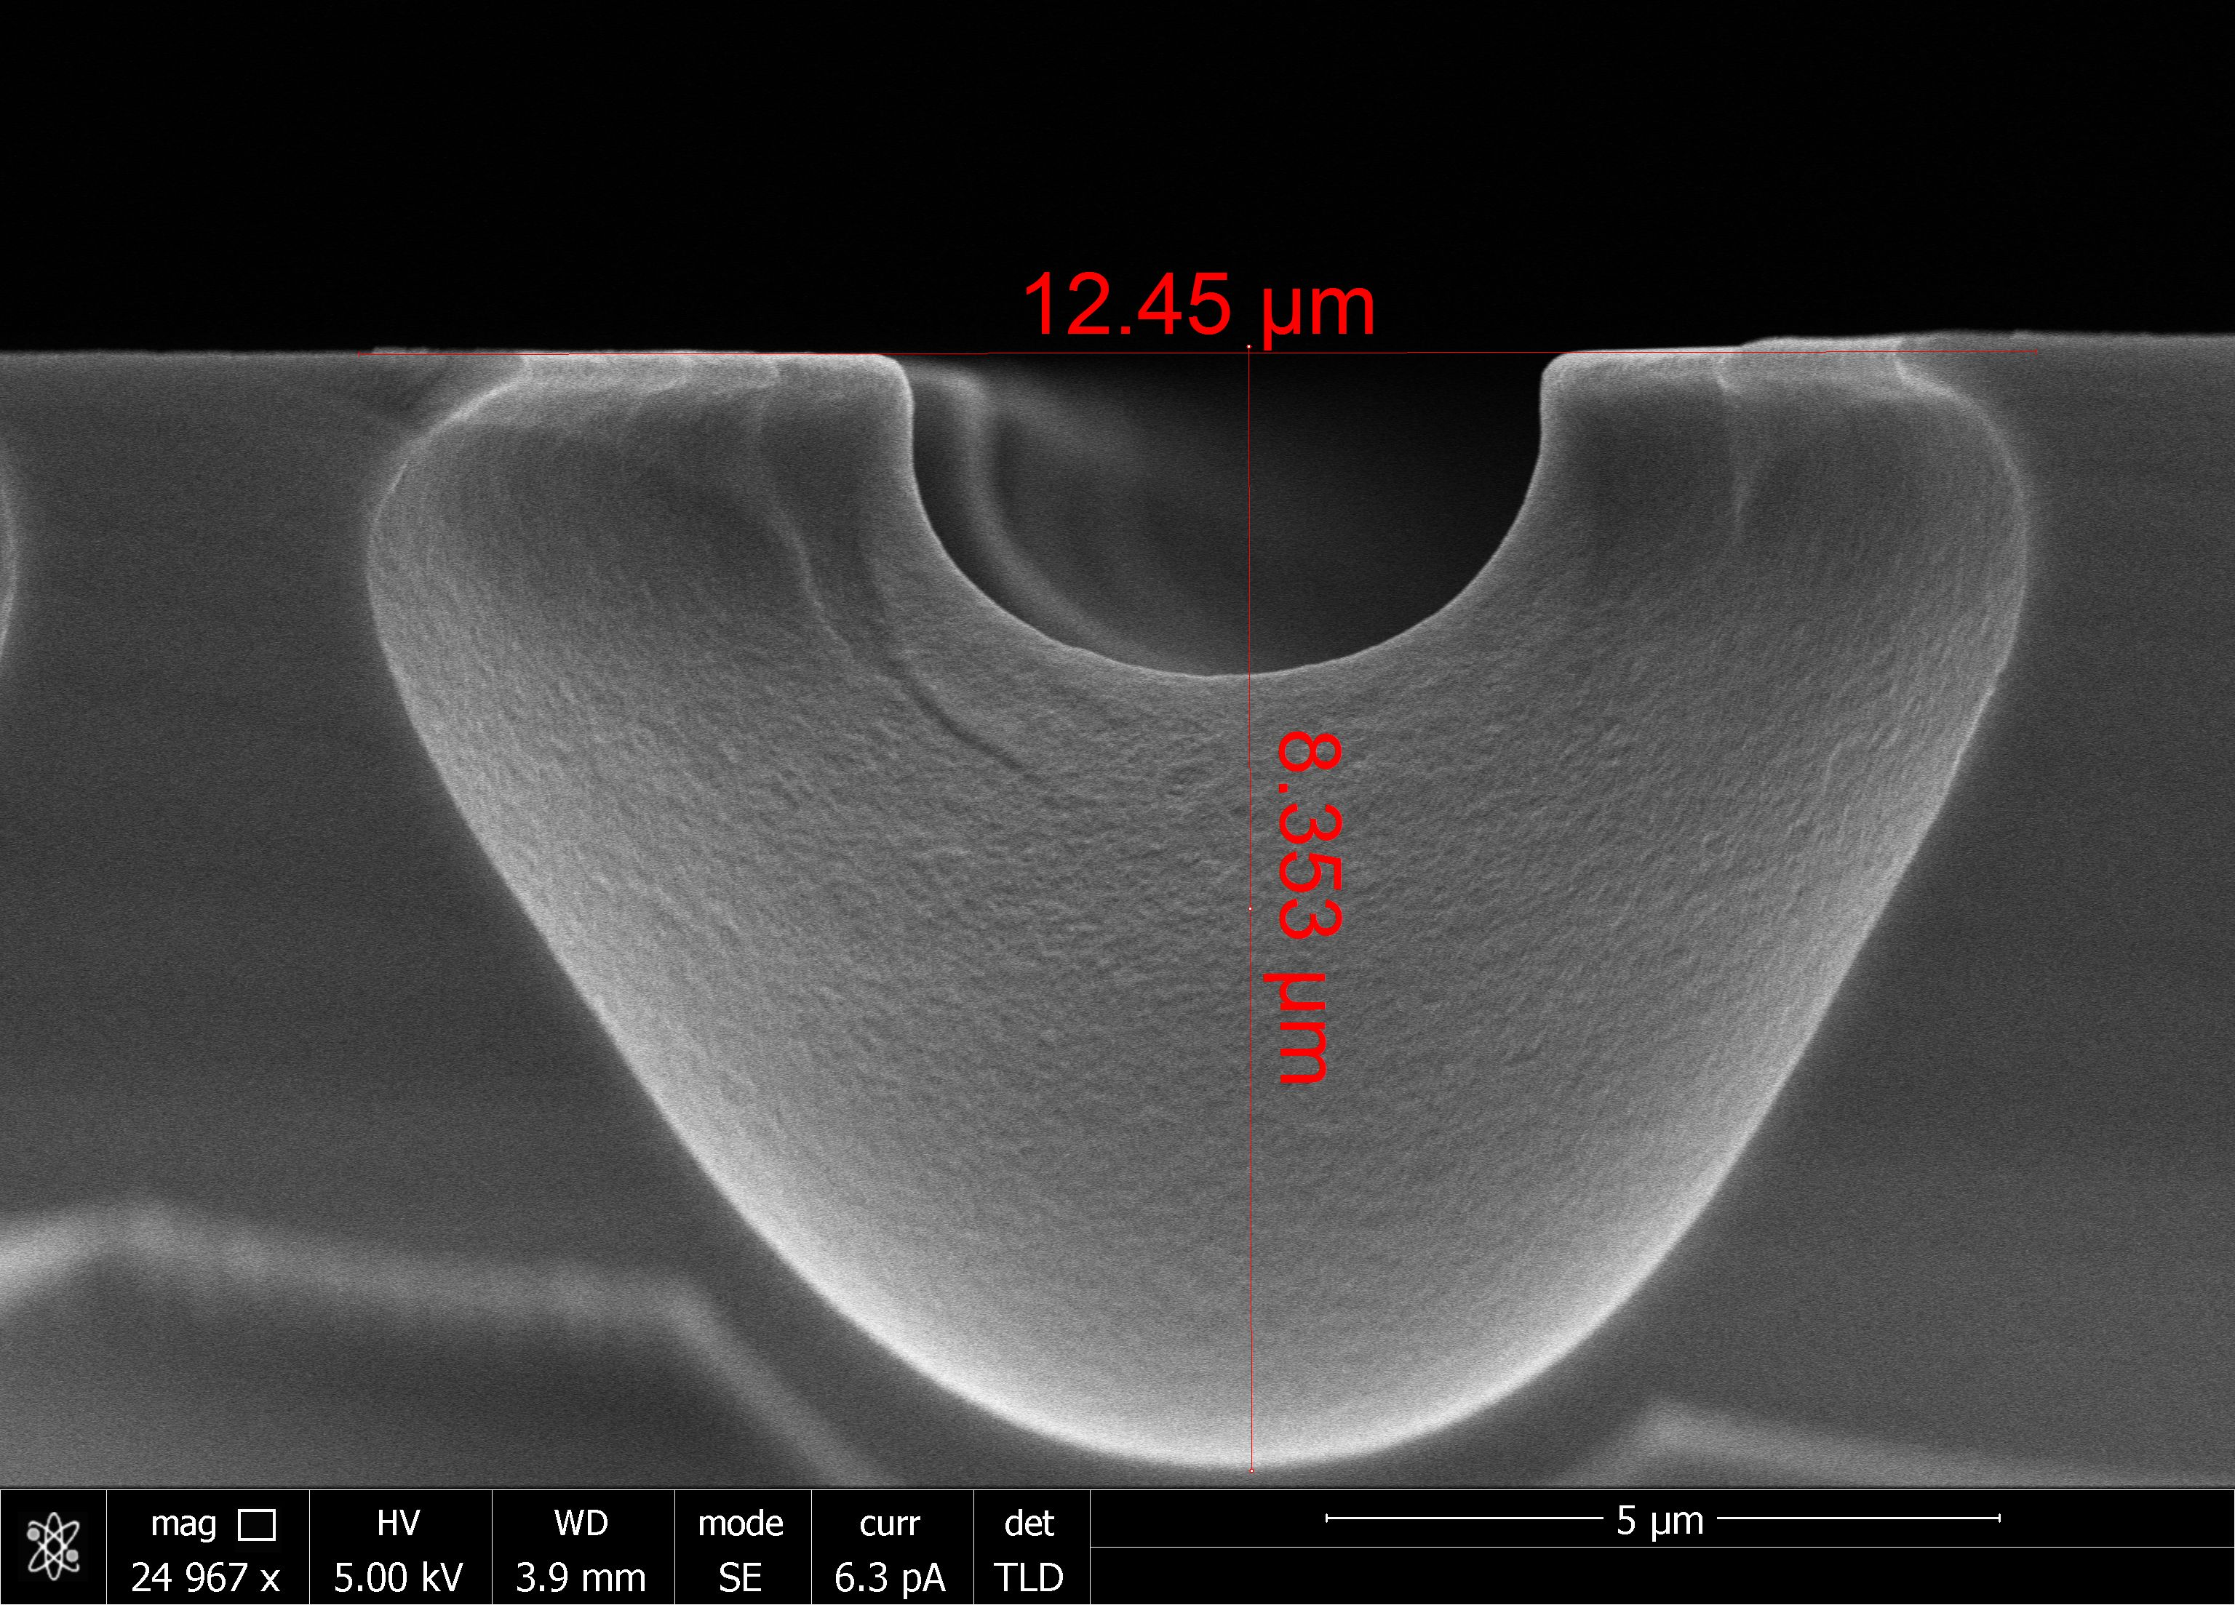
SEM images of Greyscale Writing
Greyscale writing tests by different laser parameters: Intensity, Filter and Focus
Top View
View of the stage tilted 60º
Cross-section View
SEM 1
SEM 2

Slide 14
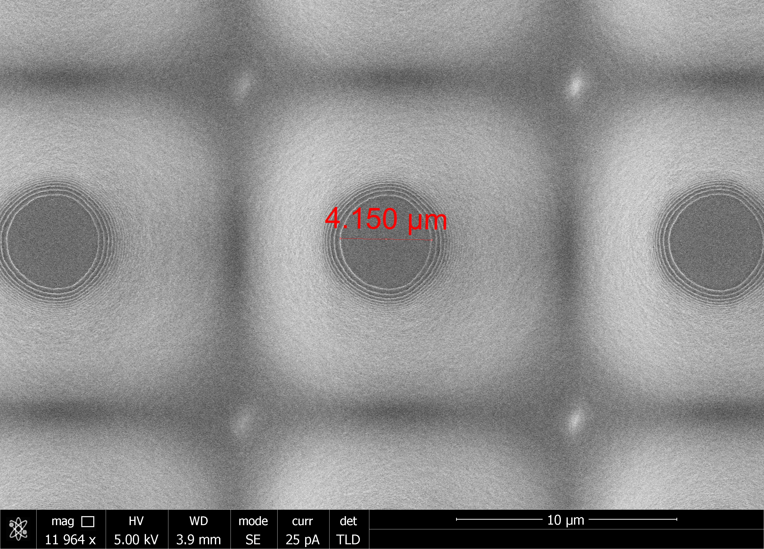
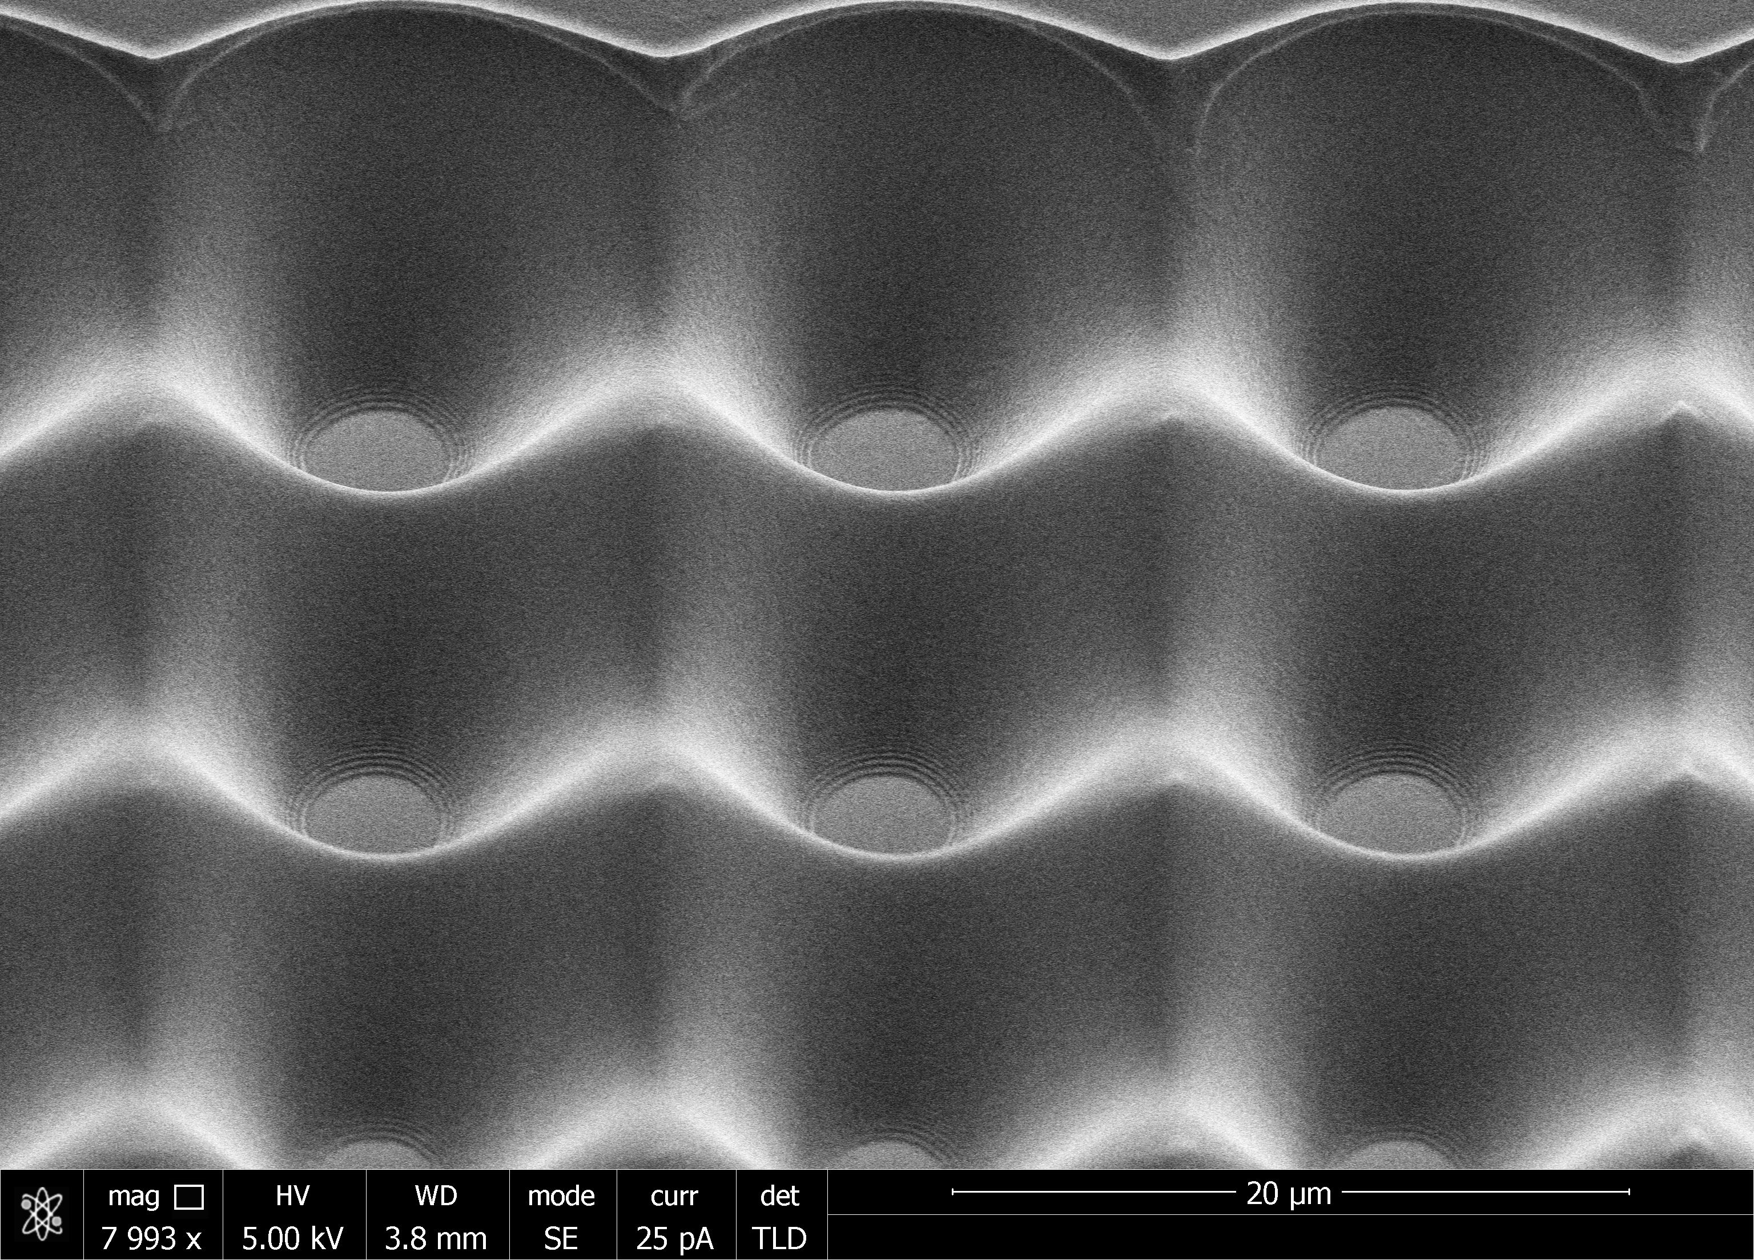
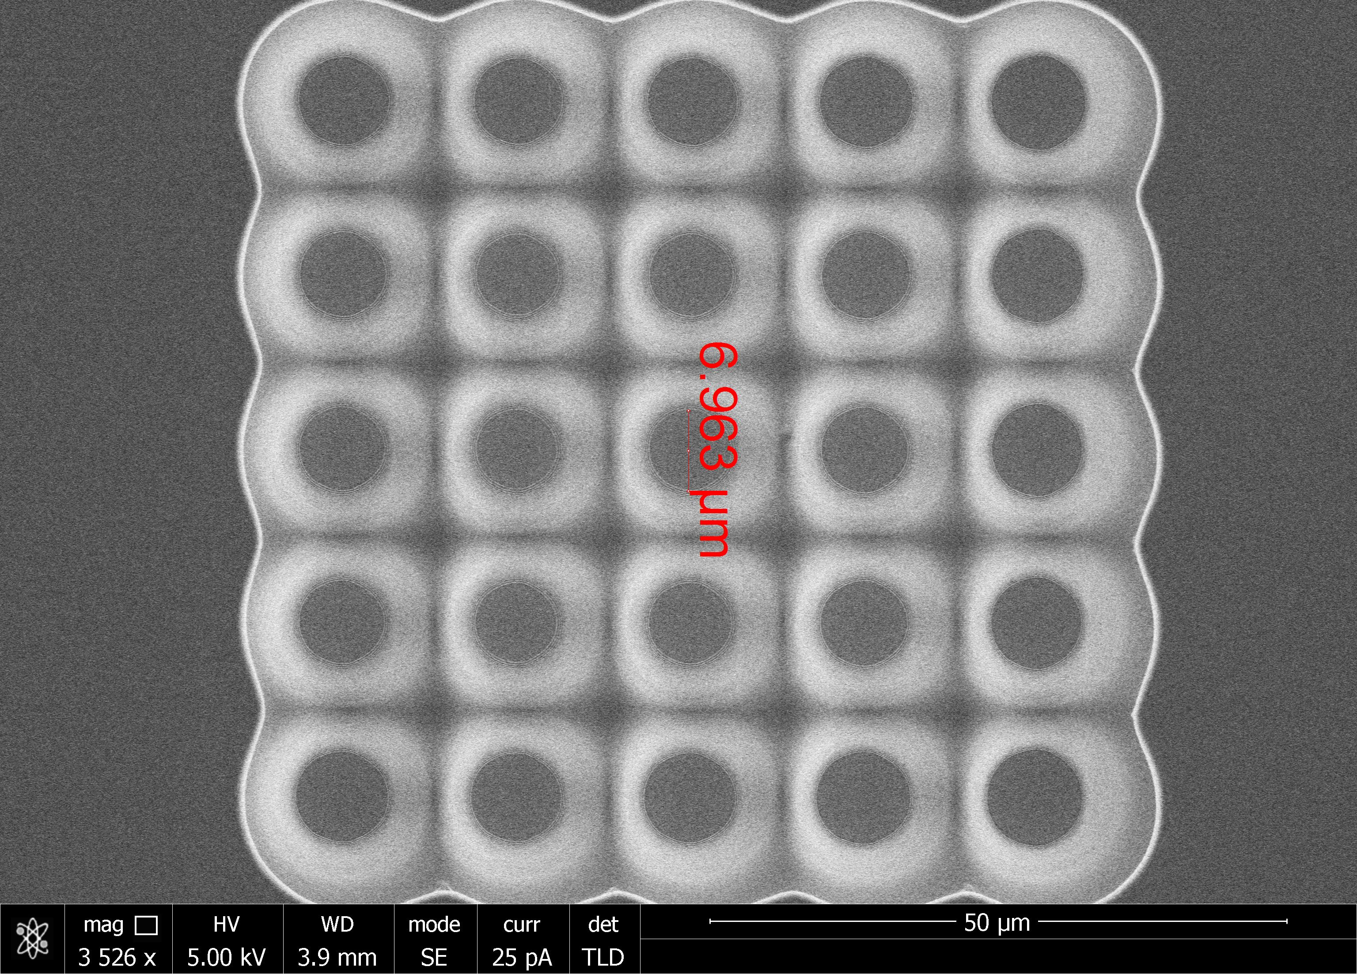
SEM images with n-over20 writing
Tilt 45º
Tilt 45º

Slide 15
Dynamic Range and Packing Density
Large pixel count w/ large gain leads to current output limitations for large area devices
  Multiple analog outputs per device
    Regional lumped analog sums - split output currents per region and sum (1/128, 1/32,1/8,1/2)
    Multi-gain SPADs (5, 15, 50μm) for different cell sizes and fill factors – dynamic range built into SPAD layout
  On-chip ADC with regional serializers
  Commercial market for LIDAR advances is growing rapidly – many new developments expected
Notes:
Technological development – when involving timing impacts
LIDAR
and TOFPET medical imaging

Slide 16
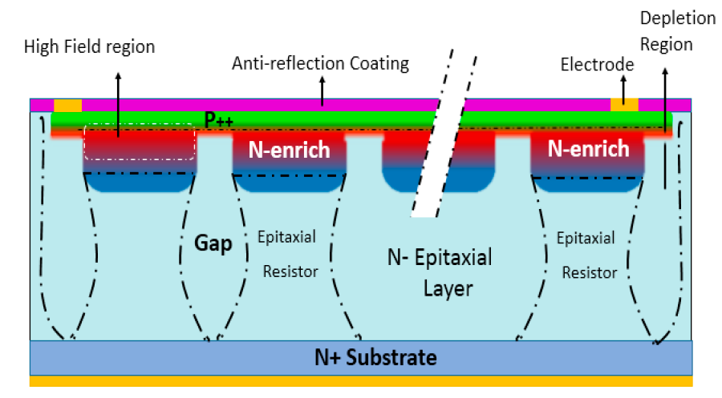
New Advances in SiPMs (included in CDR)
EQR-SiPM from Novel Device Laboratory (NDL, China)
  Possibilities to further develop new structures for CEPC
Backside Illumination (LFoundry subs. SMIC)
  Higher PDE
  Integrated CMOS on back of each SPAD
  Adjustable fill-factor

Slide 17
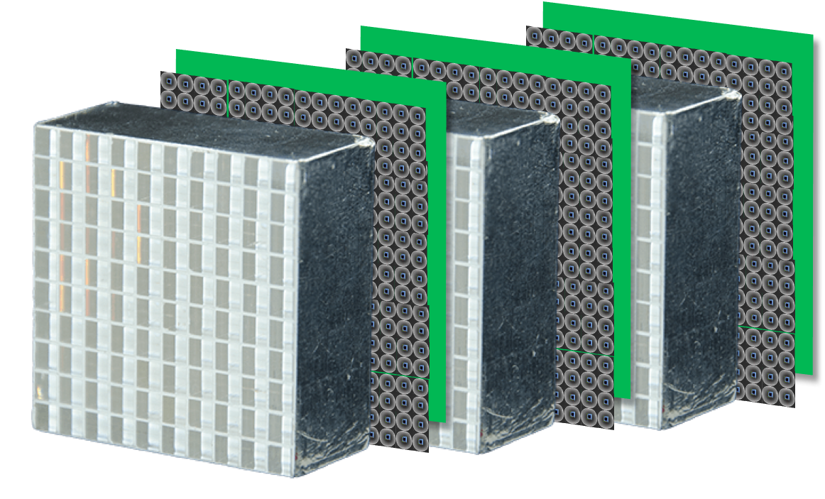
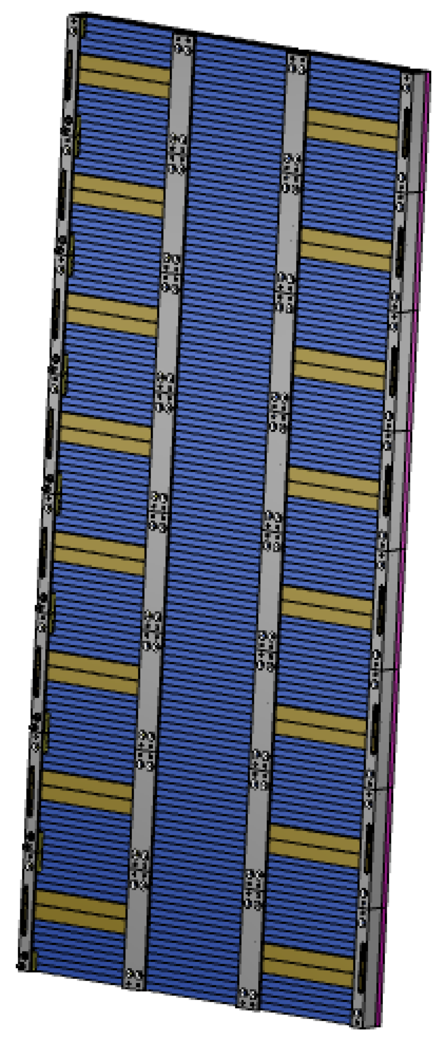
Front-end Engineering
~6 M channels w/ CO₂ cooling and highly granular total absorption technology w/ precision timing (sampling fraction O(1))
  Example layout
High
Resolution
w/
4D Granular
DATA
Front
Timing Layer

Slide 18
EM Resolution and Photon Counting
EM Resolution also improves angular measurements and resolves N𝛄 counting
Recoil photons (~8% of full √s collision rate)
    New Physics Searches and Neutrino Counting
Improved Syst.
(A. Blondel)
E. Bartos et al., “2γ and 3γ annihilation as calibration processes for high energy e+e− colliders,”
https://arxiv.org/abs/0801.1592

Slide 19
Future
Future is in our hands
  Assess the physics performance goals
    Z Jet resolution not limited by EM resolution
    Z→e⁺e⁻ recoil resolution w/ Brem. recovery methods
    Counting statistics for PFA shower separation
    Photon counting with high fidelity/angular resolution
  SiPM development with vendors is an active area
    Large area photodetection methods
    High dynamic range for calorimeters
    Dedicated front timing layers
  Applications across particle physics and beyond

