Slide 1
Progress and plans, Mechanics system of CEPC
Haijing Wang
On behalf of mechanics group
November 12-14, 2018, IHEP
The 2018 International Workshop on High Energy circular Electron Positron Collider

Slide 2
outline
Progress and Plans
Regular supports
Transport vehicles
Equipment layout
Support system of MDI
Movable collimators
Summary

Slide 3
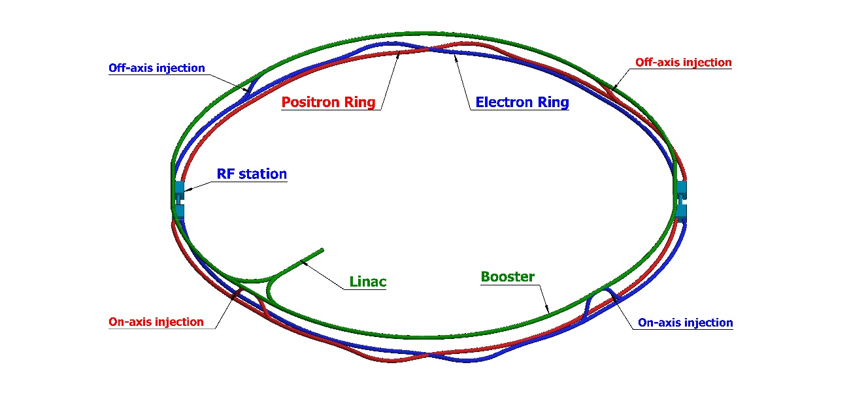
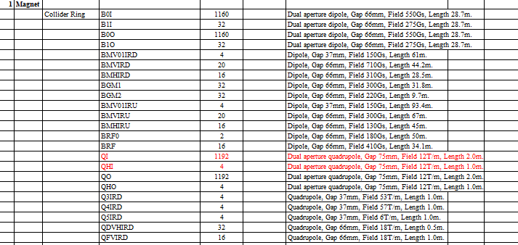
Regular supports
CEPC is composed by the double ring Collider, the Booster, the Linac and Transport lines.
Over 80% of the length is covered by magnets of about 138 types, each magnet needs to be supported.
Accelerating tubes, vacuum tubes, instruments…, all need supports.
Aims
Simple & flexible structure: plates or standard elements
Small deformation & good stability: multi-point support, optimization
Low cost: concrete or steel frames, adjusted manually

Slide 4
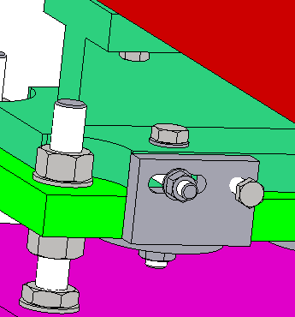
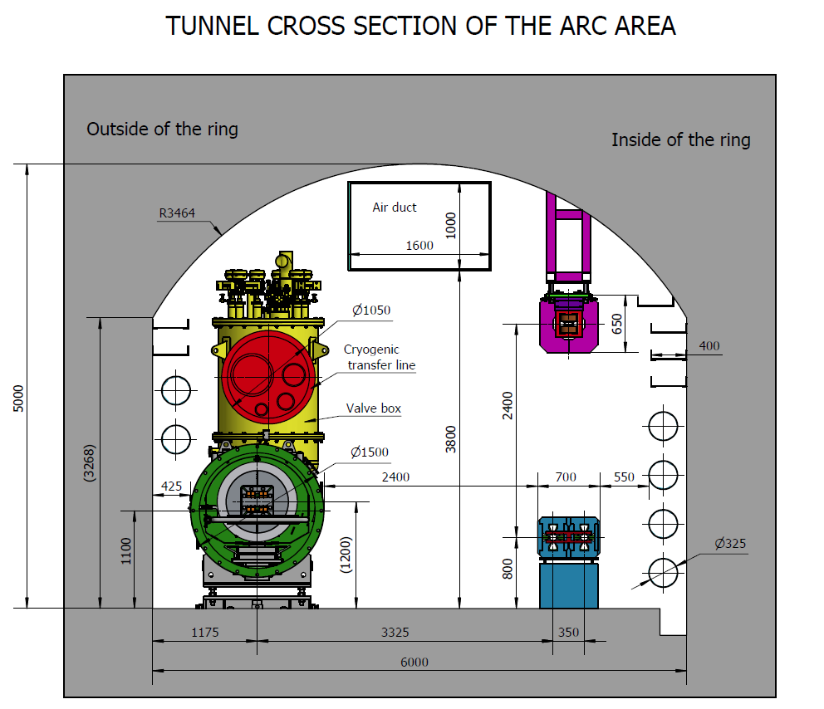
Regular supports
Adjusting methods
Bolts & push-pull bolts
simple and low cost
Adjusting ranges
Support method
Magnets in Collider, Linac, Damping Ring: supported to the ground by concrete.
Magnets in Booster: hanged on the wall of the tunnel by steel frame
Magnets in Transport Line: due to the location of the magnet
Range of adjustment
X | ≥±20 mm | Δθx | ≥±10 mrad
Y | ≥±30 mm | Δθy | ≥±10 mrad
Z | ≥±20 mm | Δθz | ≥±10 mrad
Booster
Collider

Slide 5
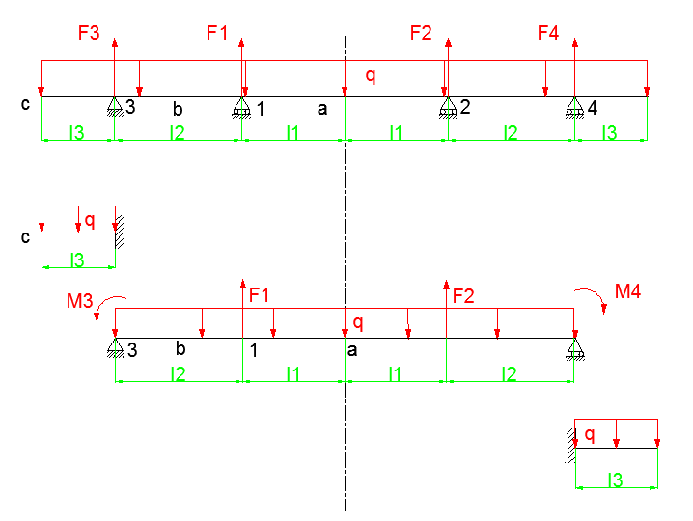
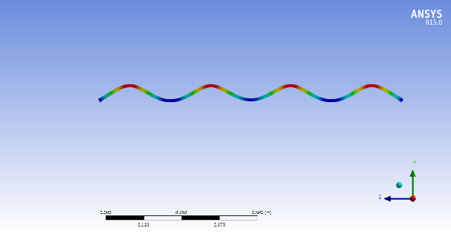
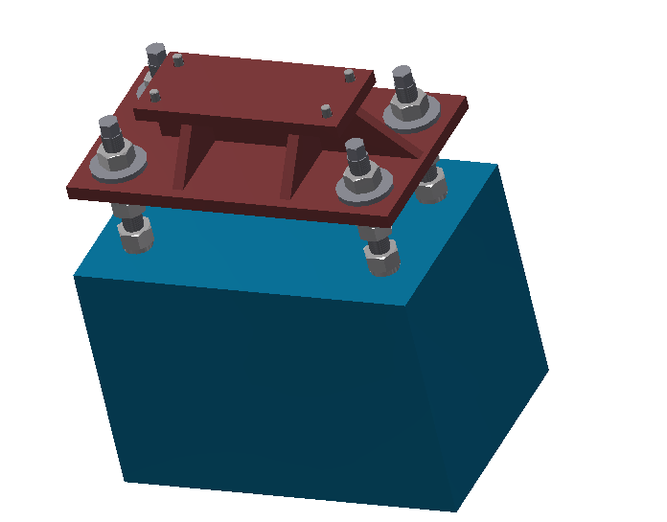
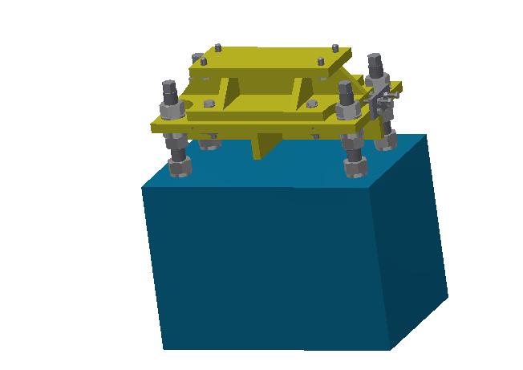
Magnet supports
Supports for dipoles
Four supporting points: Response Surface design & Theoretical calculation using MATLAB for the distribution.
Main support: 6 DOFs; Auxiliary support: 1 DOFs.
Mounting plate
Adjusting mechanism
Pedestal
or steel frame
Main support
Auxiliary support

Slide 6
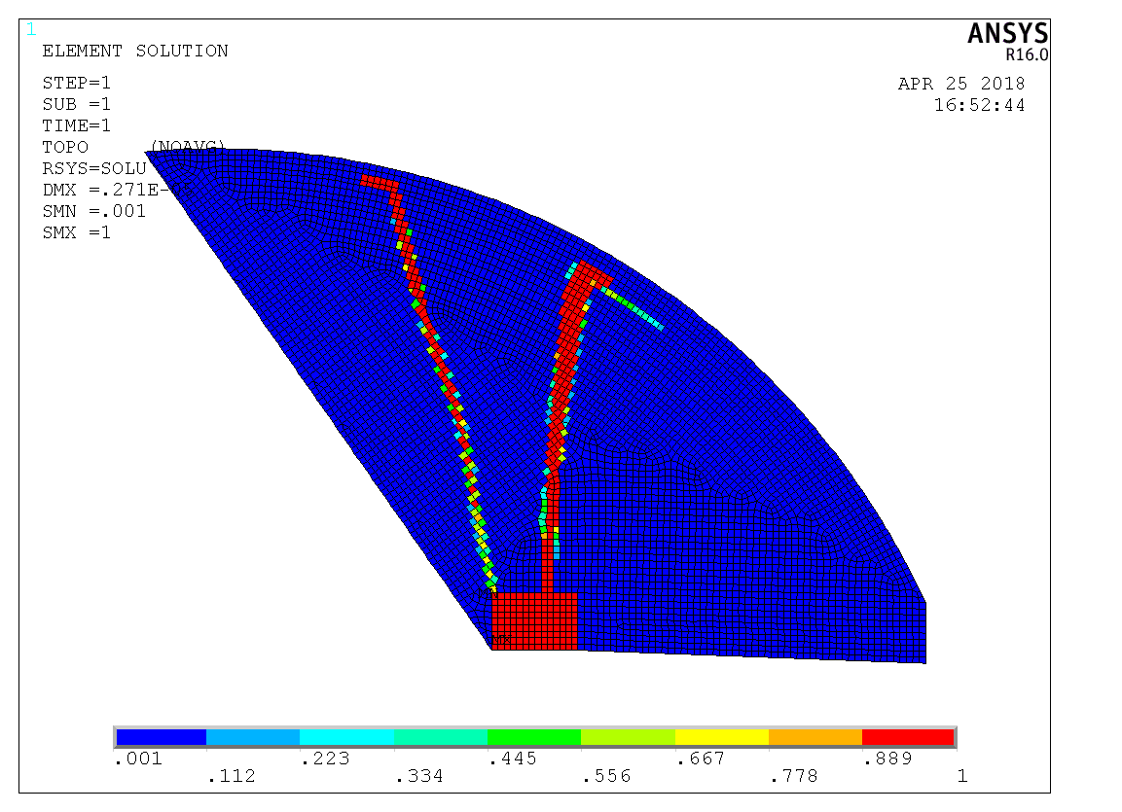
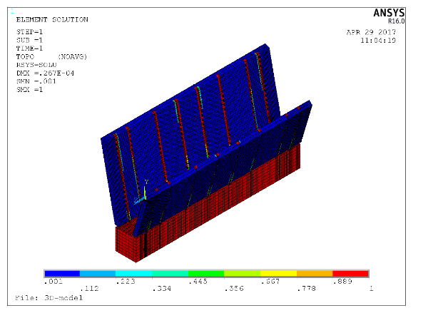
Magnet supports
Supports in Booster
Magnets in Booster: 2.4 meters above the Collider
Topology optimization is used
Aim: minimum degree of flexibility (best static stability)
Steel frame is designed vertical due to the results

Slide 7
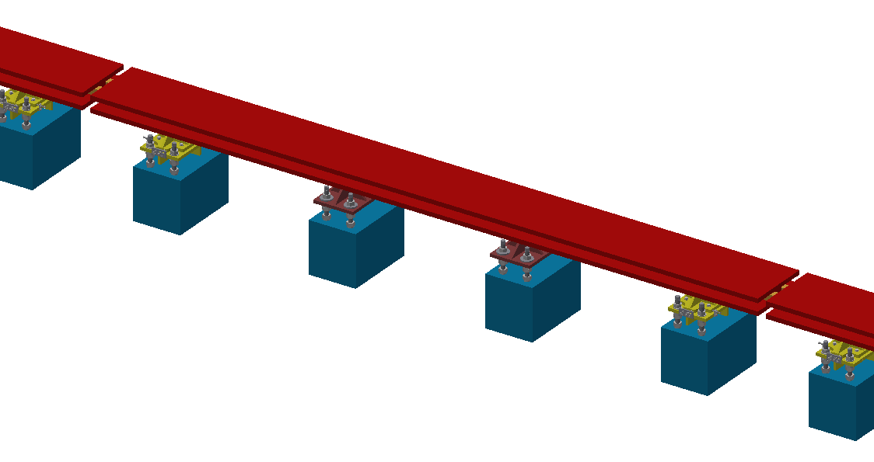
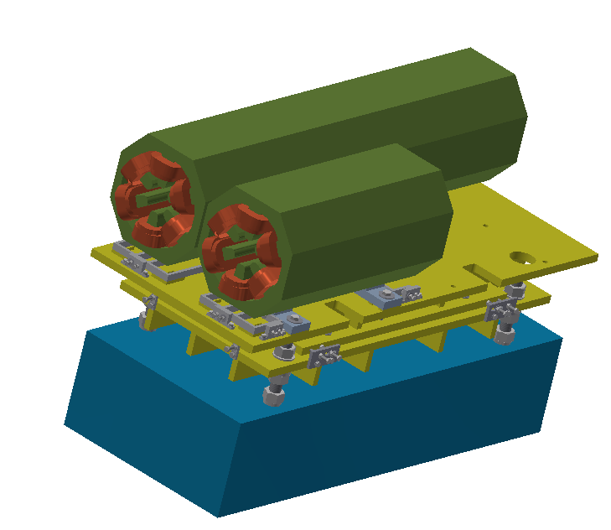
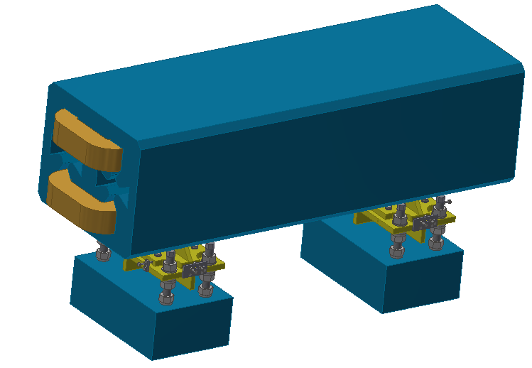
Magnet supports
Dipole in Collider and its support：
4 support points，5670mm
图需换
Sextupole in Collider and its support：
2 support points，1400mm
Quadrupole in Collider and its support：
2 support points，2000mm

Slide 8
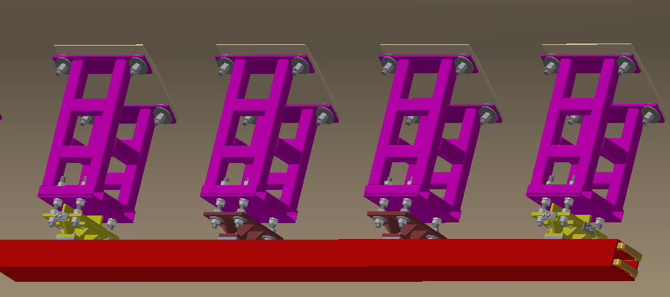
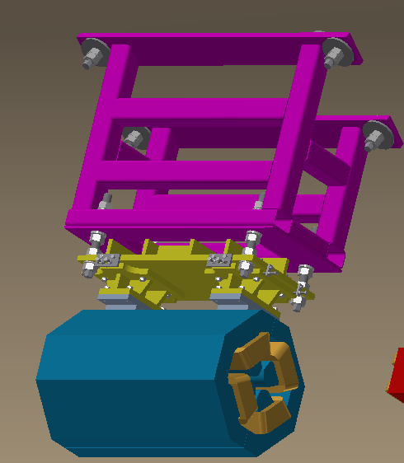
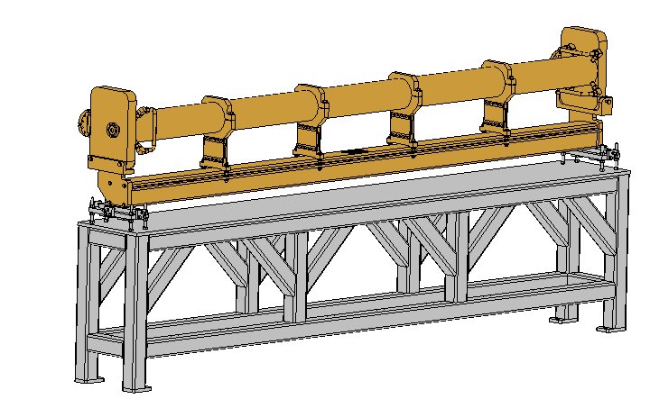
Magnet supports
Dipole in Booster and its support：
4 support points，5445mm
Quadrupole in Booster and its support：
2 support points，940 mm
Accelerating tube in Linac and its support:
2 support points，3000 mm

Slide 9
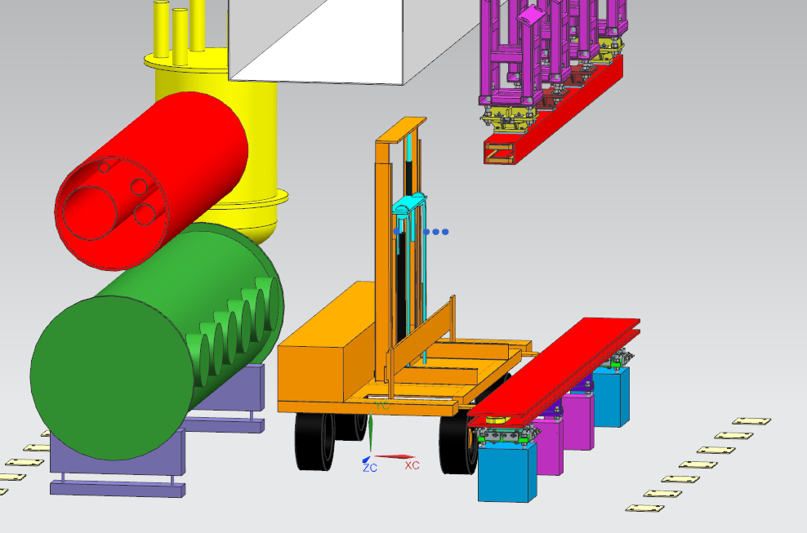
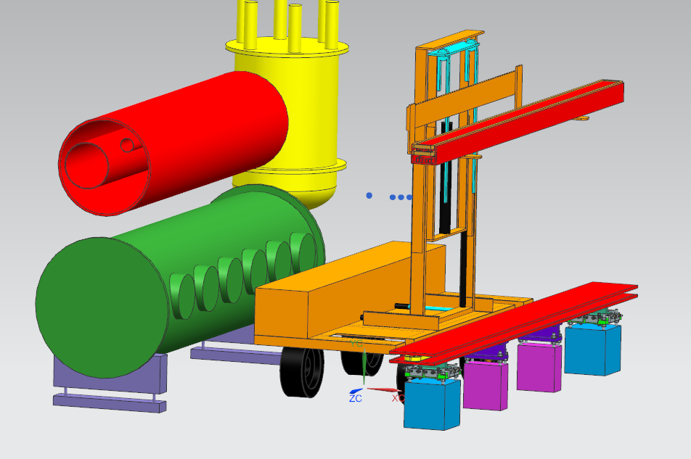
Transport vehicles
Two types of vehicles
One for “long” magnets and the other for “short” magnets.
Transport, adjustment (horizontal and vertical)
Uneven ground is considered.

Slide 10
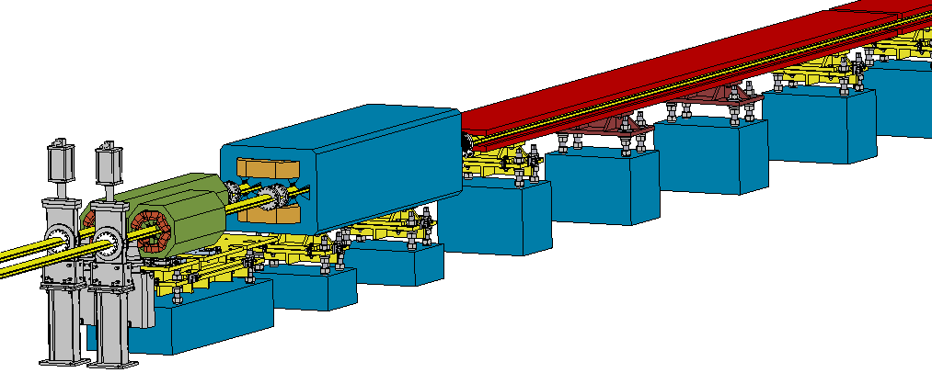
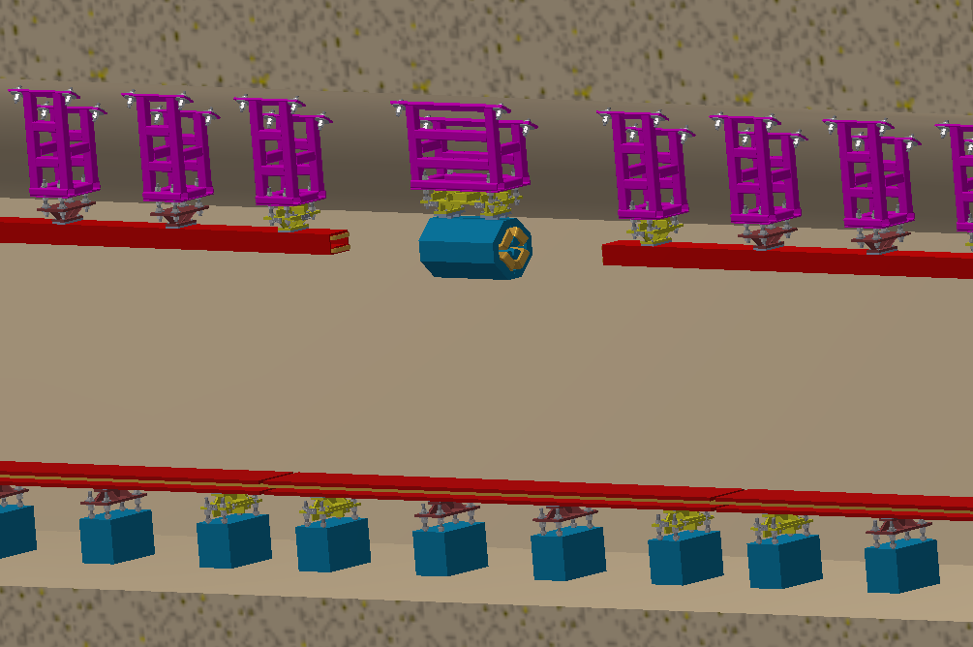
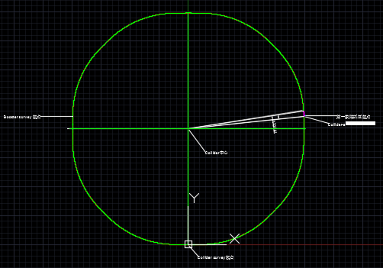
Equipment layout
Arc section layout: 2D and 3D model

Slide 11
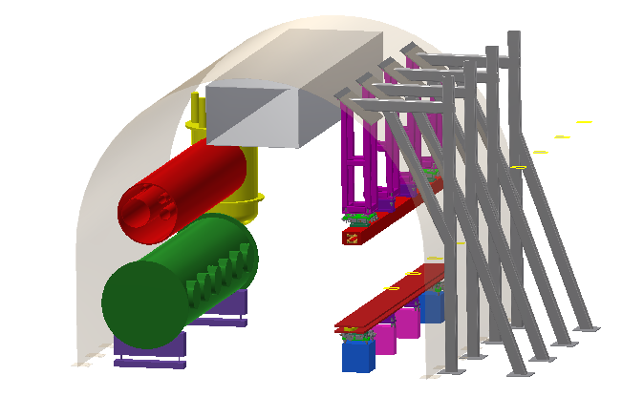
Equipment layout
Primary design of tunnel mockup (Arc section)
Interface checking of the equipment placement, installation, alignment and transportation.
Air duct
Equipment for SPPC
Booster dipole magnet and their supports
Collider dipole magnet and their supports

Slide 12
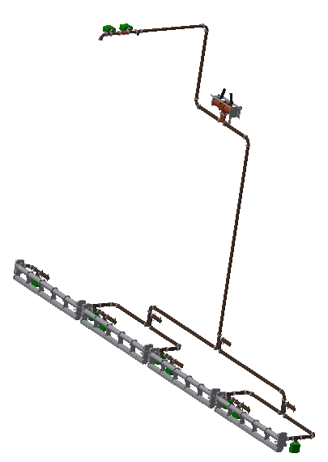
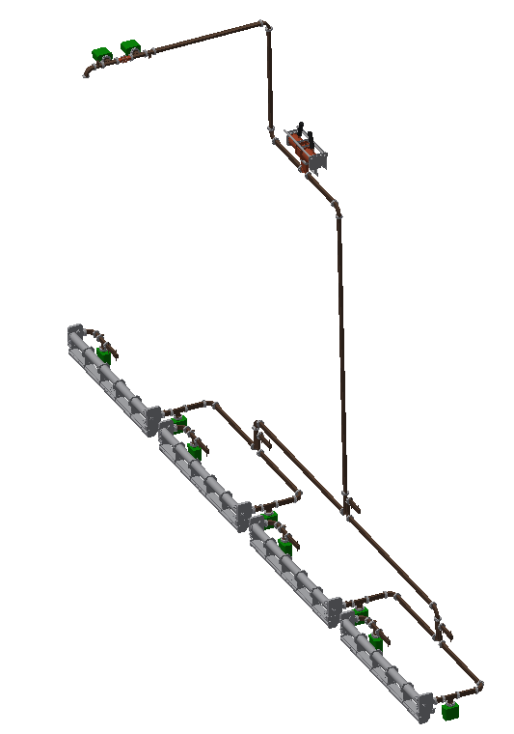
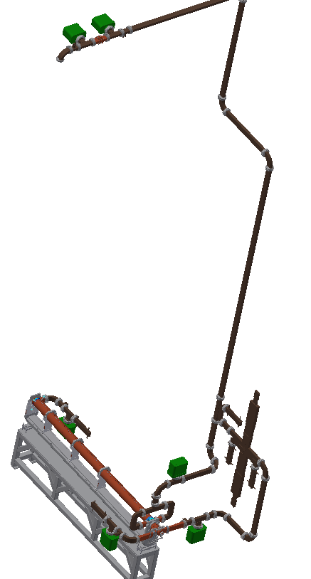
Equipment layout
Linac: 3D Model assembly of different accelerating tubes, wave guides, bunchers…

Slide 13
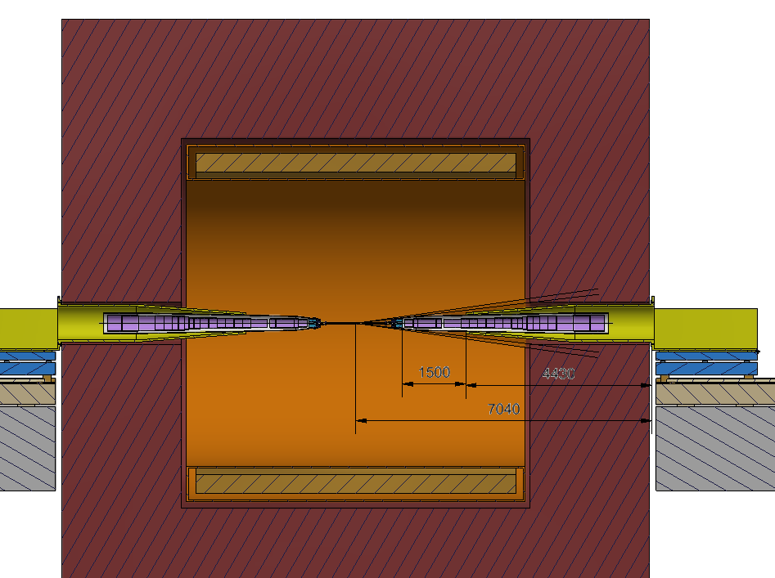
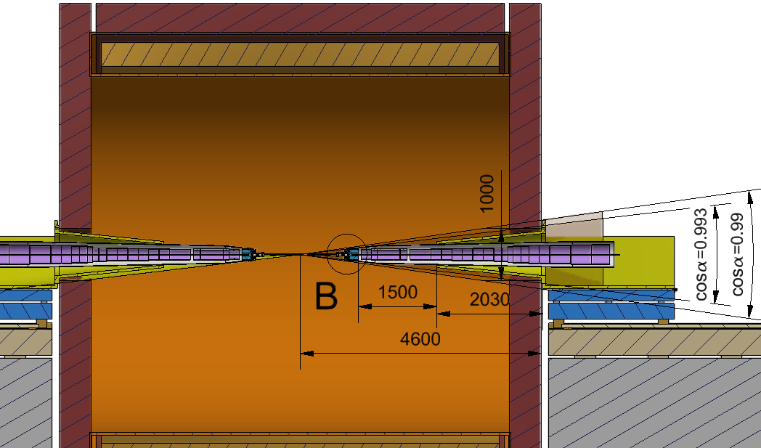
Equipment layout
Draft layout design at MDI
Yoke
IP
Solenoid in detector
SC magnets in Accelerator
Support system
Scheme 1: small yoke
Scheme 2: big yoke

Slide 14
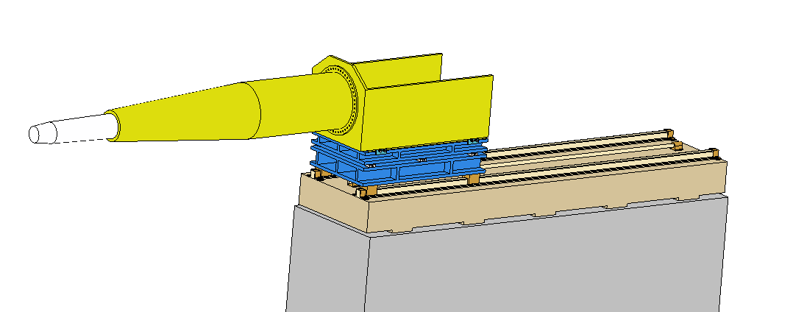
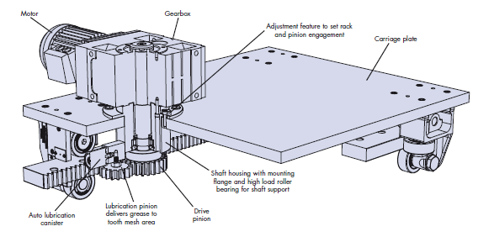
Support system of MDI
Adjustment mechanism: push-pull bolts for horizontal, wedge jacks for vertical.
Movement mechanism: tracks & screw rod for baseline, tracks & pinions also under consideration.
Adjustment mechanism
SC magnets
Support for SC magnets
Movement mechanism
Pedestal
Tracks & pinions from HepcoMotion

Slide 15
Support system of MDI
TDR plan
Design the structure for SC magnets support and adjustment scheme.
Design the long distance movement mechanism with high precision.
Do the FEA and structure optimization, especially for the natural frequency and displacement, to meet the physical requirement.
Design the assembly process of relative devices at MDI.
Fabrication and test.

Slide 16
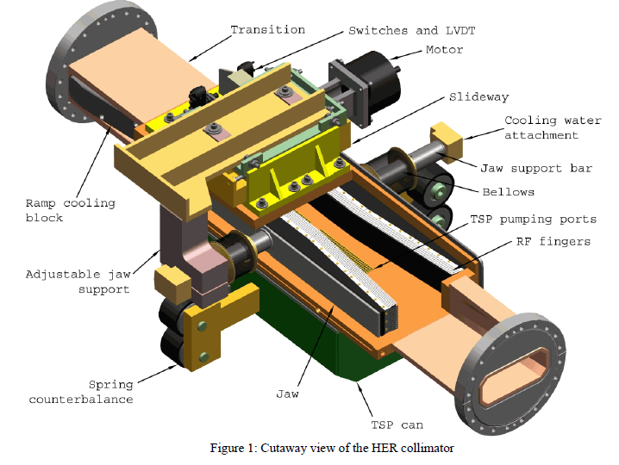
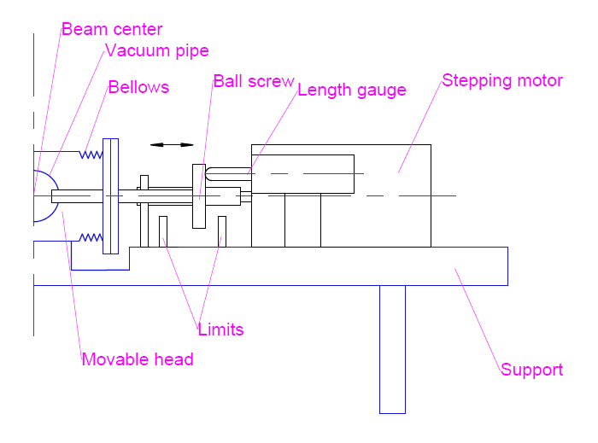
Movable collimators
Two types of collimators.
Movable and fixed. TDR stage mainly focus on movable collimators.
Collimator of SKEKB
Collimator of PEPII
Collimator of LEP
Sketch of movable collimator of CEPC

Slide 17
Movable collimators
TDR plans:
Design the collimators with simple and flexible structure.
Design the inner section of the collimator according to the physical requirements. Optimize the profile to obtain low impedance.
Calculate the thermal and mechanical stress and optimize the structure and materials to improve performance.
Fabrication and test.

Slide 18
Summary
Primary design of supports for typical magnets and accelerating tubes have been done, and is on-going for other devices and refining. The primary 3D model layout has been done for some typical equipment, and will be updated according to the design progress.
The in-depth study for support system of MDI and movable collimators will be done in the future.

Slide 19
Thanks for your attention!

