Slide 1
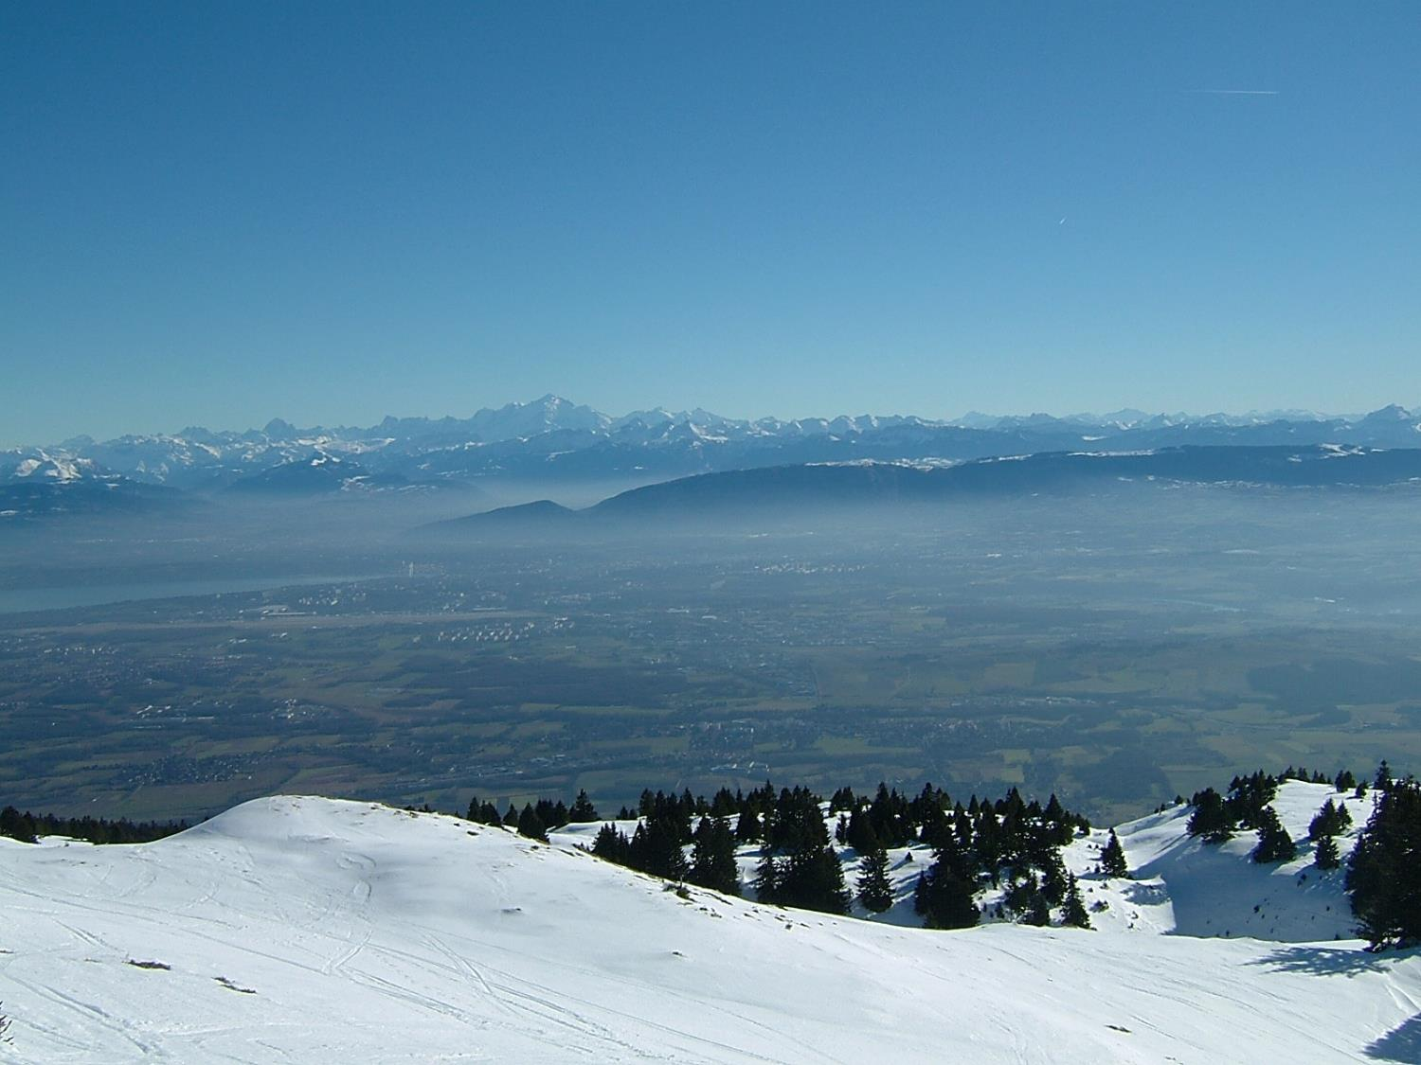
Status of FCC-ee
see recent metings:
FCC physics workshops
2017 https://indico.cern.ch/event/550509/
2018 https://indico.cern.ch/event/618254/
FCC week in Amsterdam
https://indico.cern.ch/event/656491/
Alain Blondel, University of Geneva
with many thanks to the FCC collaborators!
Photo J. Wenninger

Slide 2
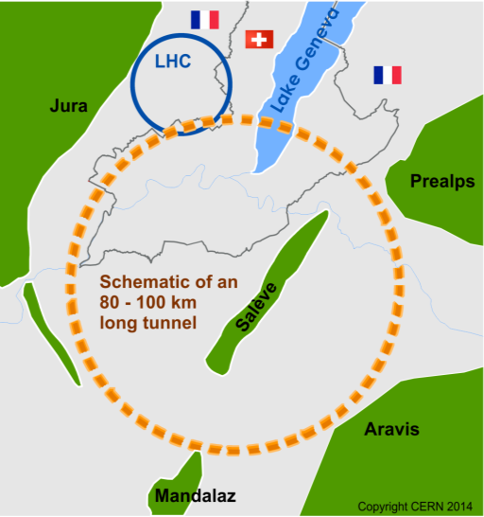
The Future Circular Colliders
CDR and cost review to appear Q4 2018 for ESU
International collaboration to Study Colliders fitting in a new ~100 km infrastructure, fitting in the Genevois
Ultimate goal:
100 TeV pp-collider (FCC-hh)
→ defining infrastructure requirements
Two possible first steps:
e⁺e⁻ collider (FCC-ee)
High Lumi, E_{CM} =90-400 GeV
HE-LHC 16T ⇒ 27 TeV
in LEP/LHC tunnel
Possible addition:
p-e (FCC-he) option
~16 T magnets
The way by FCC-ee is the fastest and cheapest way to 100 TeV,
also produces the most physics.
Preferred scenario presented in CDR.
https://cerncourier.com/cern-thinks-bigger/
Its also a good start for a μμC!

Slide 3
Status of FCC CDR
First ideas in 2010-11 Study kicked off in 2014
Draft CDR circulating for authorship and last substantial comments
CDR Publication date : 10/12/2018 for ESPP Update
Vol.1 : Physics Opportunities
Vol.2 : The lepton collider (FCC-ee)
Vol.3 : The hadron collider (FCC-hh) (includes e-h option)
Vol.4: HE-LHC
Common ~100 km infrastructure @ CERN
Civil engineering, electricity, cooling, ventilation, cryogenics
R&D for SC magnets (up to highest affordable field)
To be approved and initiated a.s.a.p.
Staged approach for collider and physics
1st step: high-luminosity and precision e+e- collider (FCC-ee)
Phase A: 88 → 240 GeV (Z, W, Higgs)
Phase B: 345 → 365 GeV (Higgs, top) (significant RF upgrade)
2nd step : high-energy pp collider (FCC-hh, 100 - 150 TeV?) e-p option (FCC-eh)
At least 60 years of the most sensitive and versatile search for solutions to the mysteries of Universe (BAU, Dark matter & Energy, Neutrino masses, Flavour etc.)
From European Strategy in 2013: “ambitious post-LHC accelerator project”

Slide 4
SYNERGY

Slide 5
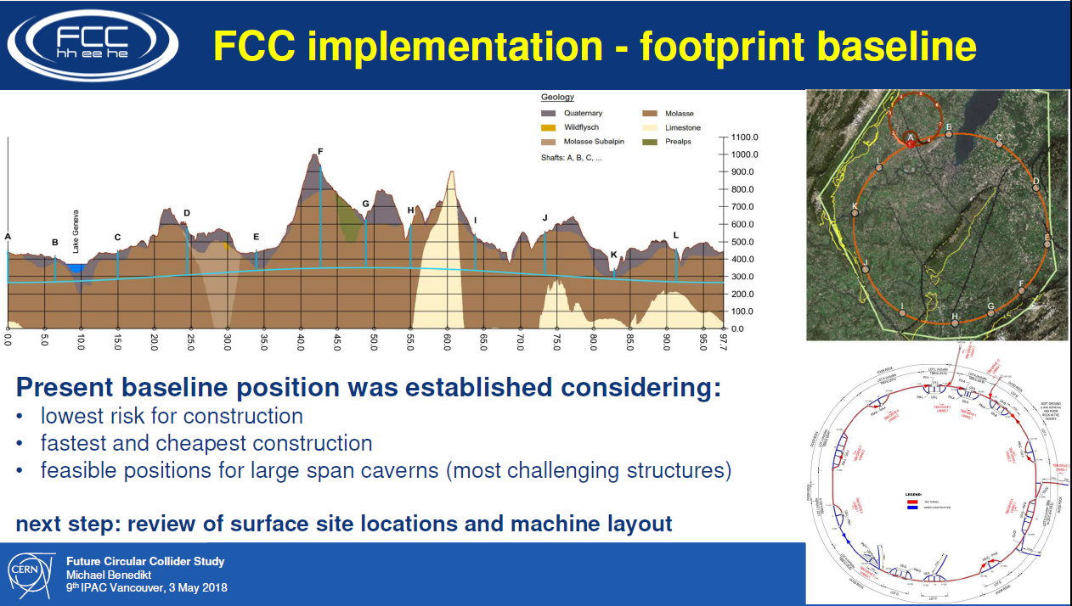
Sharing the same tunnel

Slide 6

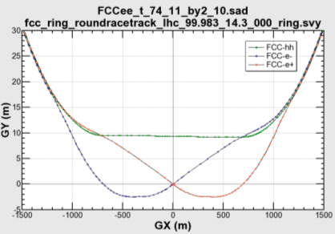

common layouts for hh & ee
11.9 m
IP
30 mrad
FCC-hh/
ee Booster
9.4 m
0.6 m
Lepton beams must cross over through the common RF to enter the IP from inside.
Only a half of each ring is filled with bunches.
Common
RF (tt)
Common
RF (tt)
Max. separation of 3(4) rings is about 12 m:
wider tunnel or two tunnels are necessary around the IPs, for ±1.2 km.
IP
FCC-ee 1, FCC-ee 2,
FCC-ee booster (FCC-hh footprint)
Asymmetric IR for ee, limits SR to expt
2 main IPs in A, G for both machines
Notes:
Check with Katsunobu to have latest layout.
Check with detector people if 9 m offset is acceptable for ee detector

Slide 7
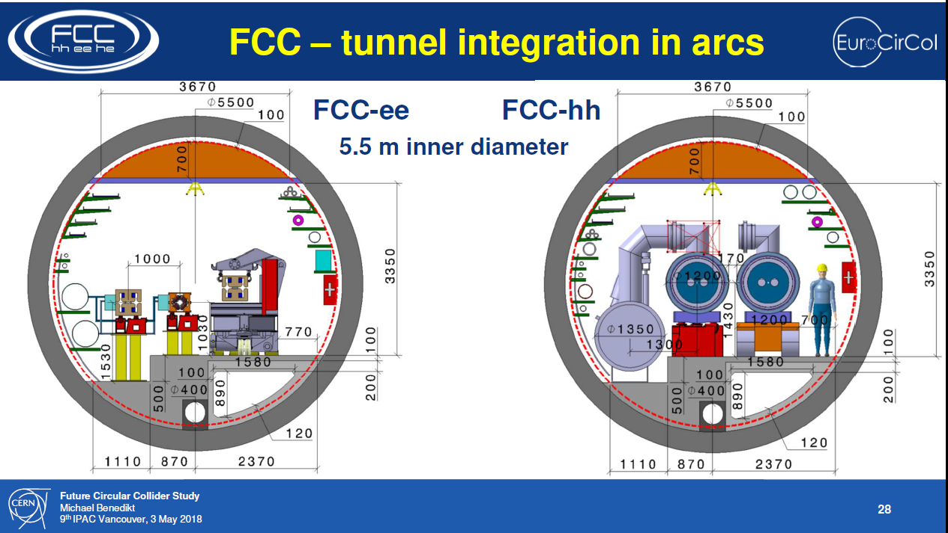

Slide 8
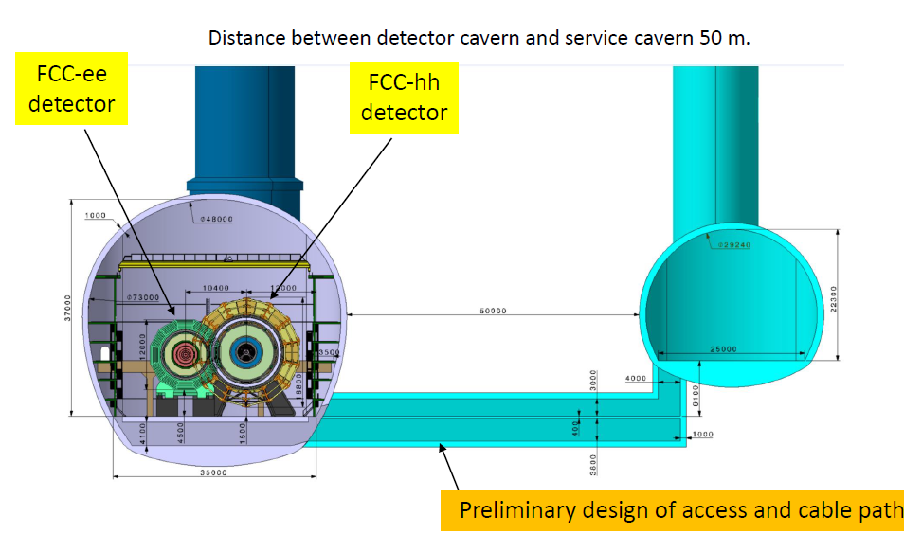
The same caverns

Slide 9
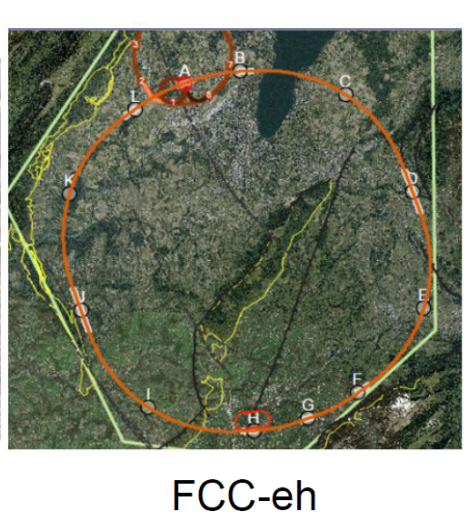
LHeC or FCC-eh function as an add-on to LHC or FCC-hh respectively:
additional 10km cicumference
Electron Reciculating Linac ERL.
The possibility to collide FCC-ee with FCC-hh is not considered in the framework of the study
In the case of FCC-eh it could profit from the -- then existing -- FCC-hh,
and, perhaps, from considerable RF of the -- then dismantled -- FCC-ee

Slide 10
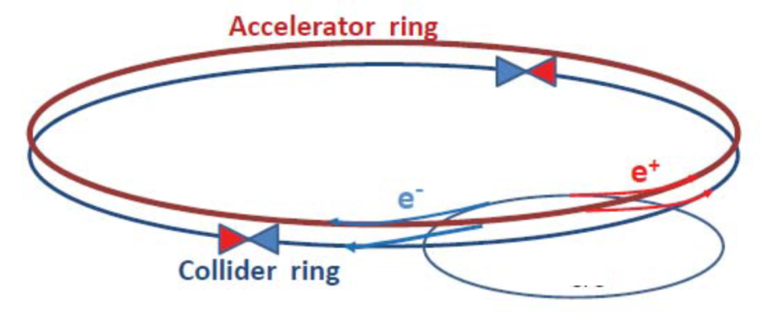
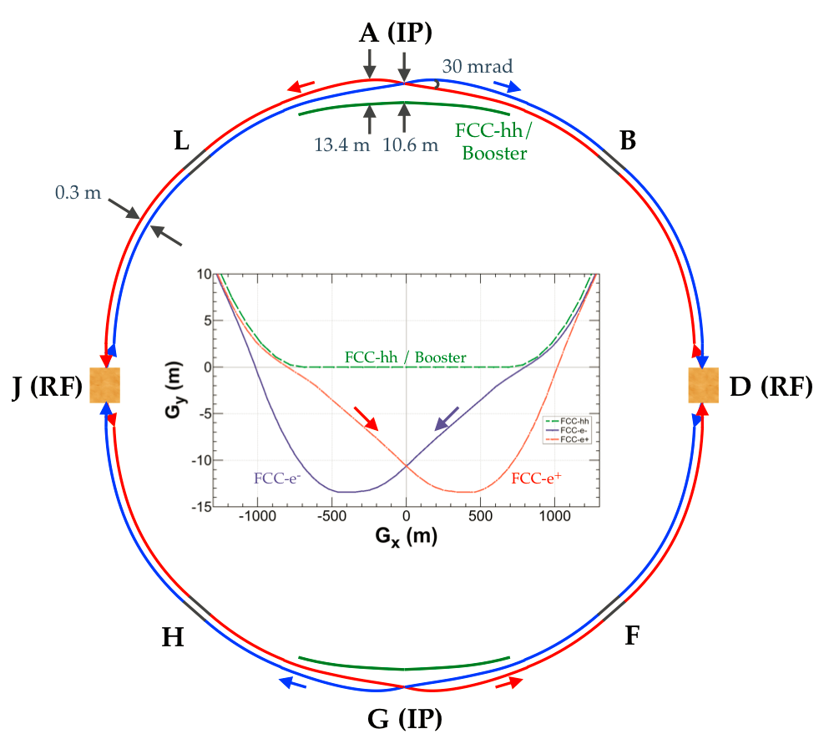
Dec. 2011
Design Study
FCC-ee baseline design choices
-- Follows footprint of FCC-hh, except around IPs
-- ~100 km to reach‾tt production
-- Double ring (e+, e-) collider, multi-bunch
-- Top-up injection for high efficiency
→ high-energy injector in collider tunnel
-- Crab-waist optics to maximize luminosity @Z, W, H
30 mrad crossing angle
-- Asymmetric interaction region layout and optics
Limits synchrotron radiation in the detector
-- Two interaction points (IP) in A and G
4 IPs to be studied -- major layout changes.
-- 50 MW/beam Synchrotron Radiation power :
at all energies
-- Continuous E_{CM} calibration at Z and W (100 keV)
based on resonant transverse depolarization
polarimeter, wigglers, RF kicker
Only one RF section at these energies.
Nov 2018

Slide 11
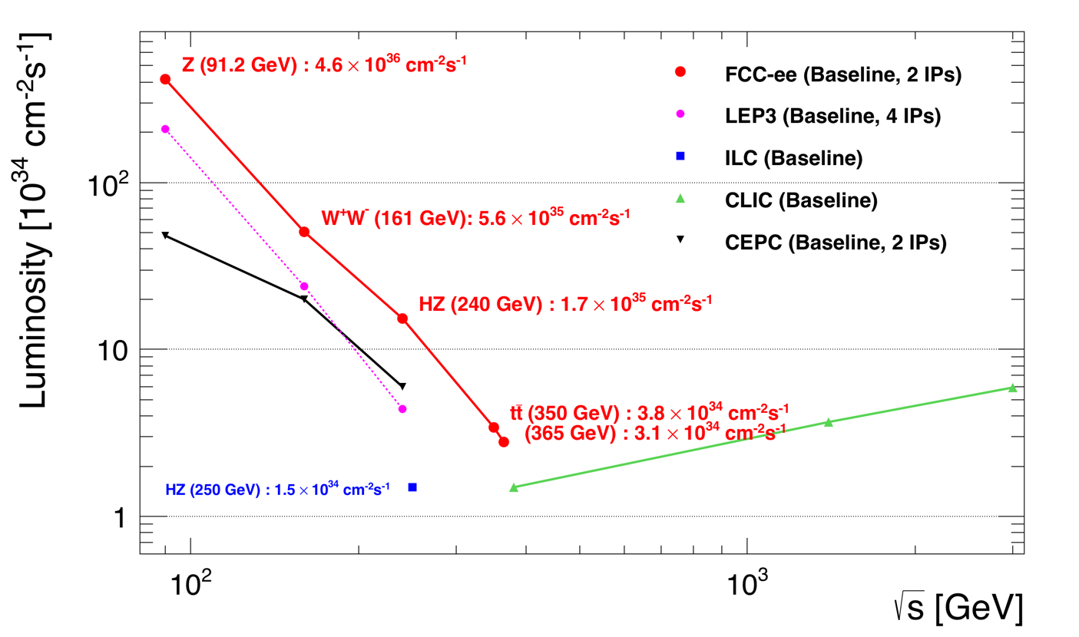
Z WW HZ tt
FCC-ee
LEPx10⁵!
Event statistics :
E_{CM} errors:
Z peak E_{cm} : 91 GeV 5 10¹² e+e- → Z
WW threshold E_{cm} : 161 GeV 10⁸ e+e- → WW
ZH threshold E_{cm} : 240 GeV 10⁶ e+e- → ZH
‾tt threshold E_{cm} : 350 GeV 10⁶ e+e- →‾tt
LEP x 10⁵
LEP x 2.10³
Never done
Never done
100 keV
300 keV
1 MeV
2 MeV
Great energy range for the heavy particles of the Standard Model.

Slide 12
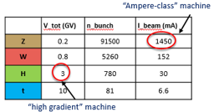
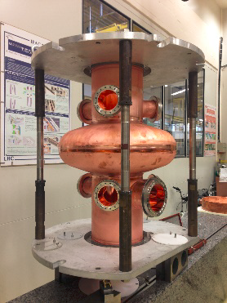
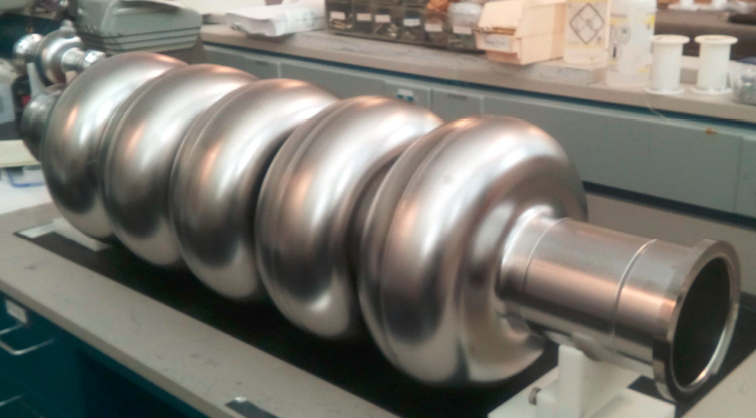
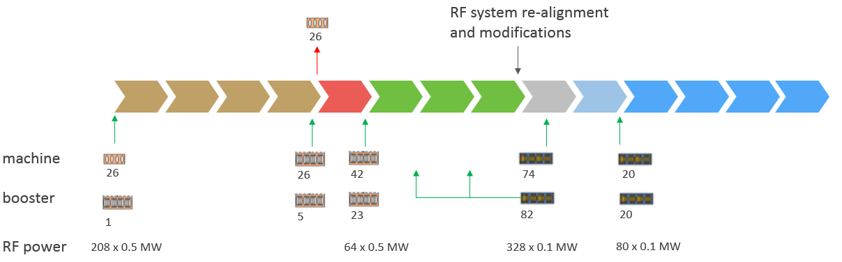
IMPLEMENTATION – Run Plan
Three sets of RF cavities for FCCee & Booster:
-- high intensity (Z, FCC-hh):
400 MHz mono-cell cavities,
-- high energy (W, H, tt):
400 MHz 4-cell cavities,
-- booster and tt -dedicated:
800 MHz 4-cell cavities
-- RF distribution system, high efficiency adaptable
100MW, 400MHz
indicative: total ~15 years
800kHz prototype at JLAB
HL-LHC
Z 150 ab⁻¹
W 10 ab⁻¹
ZH thresh 5ab⁻¹
tt thresh + tt 365 1.5ab⁻¹
4 years
2 yr
3 years
5 years
-- Installation as LEP ( ≈30 CM/winter)
➔ Spreads the funding profile

Slide 13

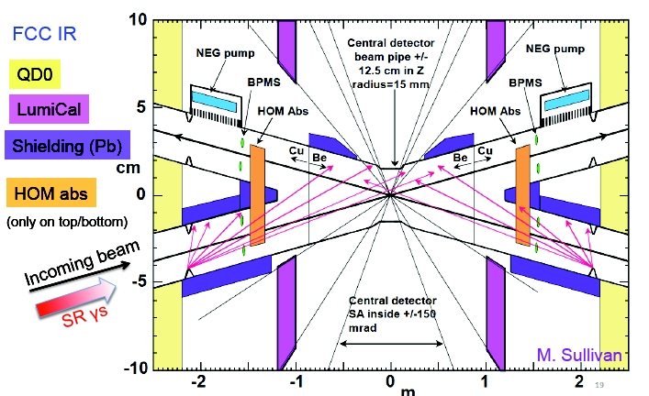
Detailed layout of the Interaction Region
Beam pipe radius at IP is 15mm ☺

Slide 14
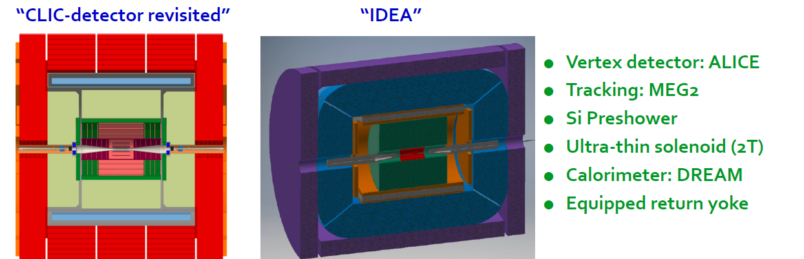
FCC-ee Detectors
Two integration, performance and cost estimates ongoing:
-- Linear Collider Detector group at CERN has undertaken the adaption of
CLIC-SID detector for FCC-ee
-- IDEA, detector specifically designed for FCC-ee (and CEPC)
MAPS

Slide 15
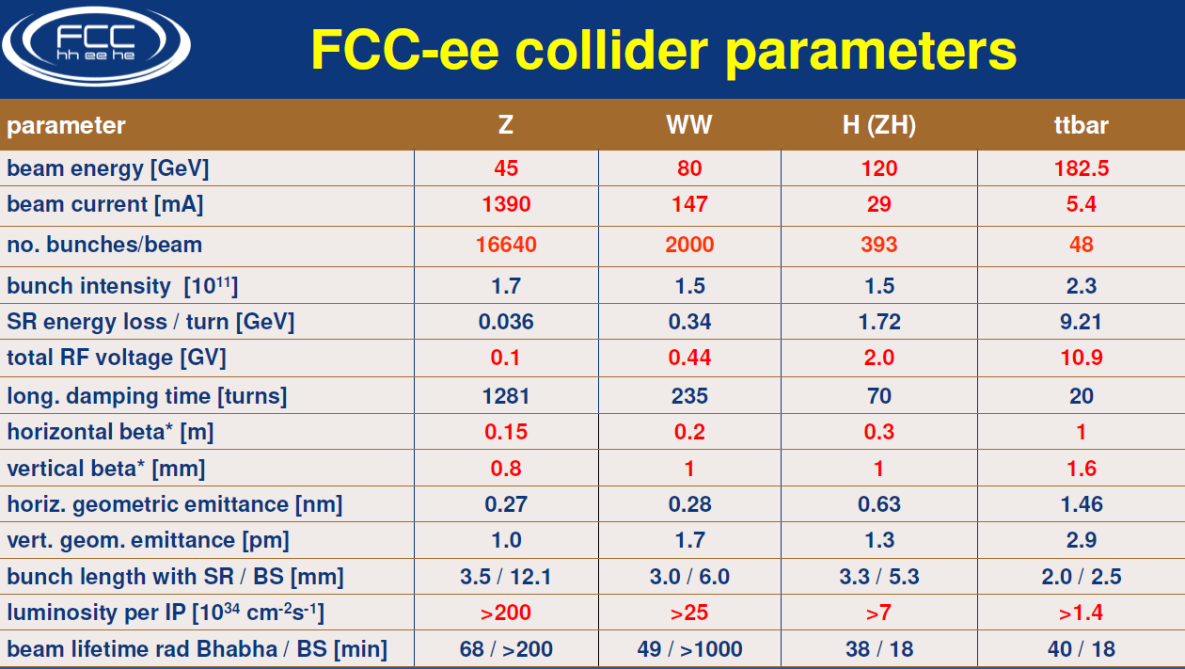

Slide 16
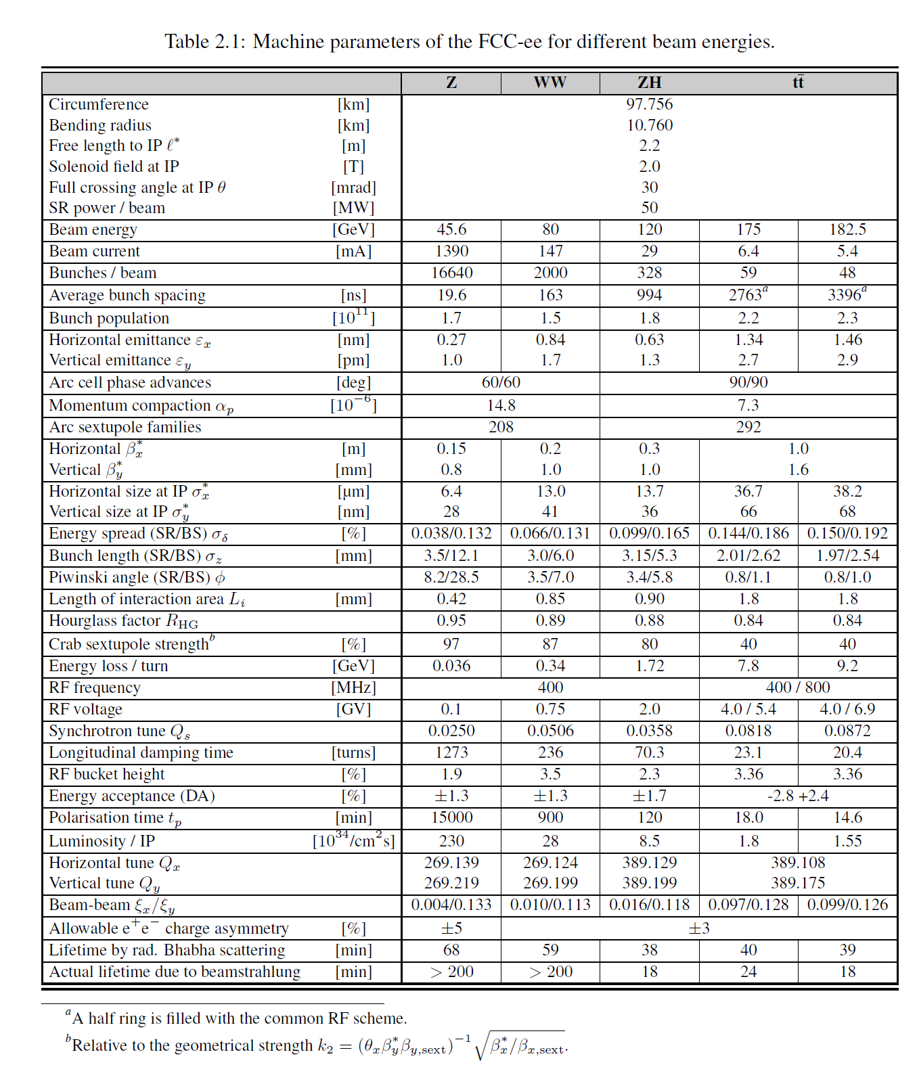
from the CDR

Slide 17
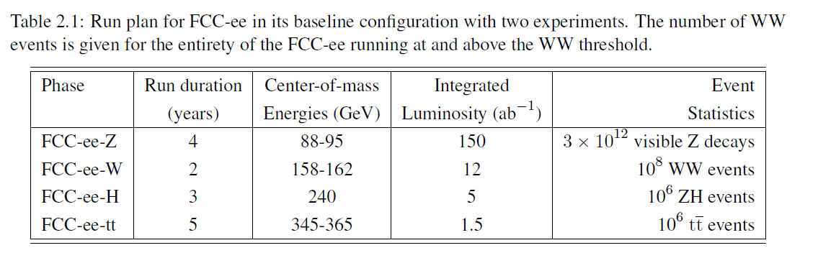
from the CDR

Slide 18

FCC-ee discovery potential
Today we do not know how nature will surprise us. A few things that FCC-ee could discover :
EXPLORE 10-100 TeV energy scale (and beyond) with Precision Measurements
(stat 300…)
-- ~20-50 fold improved precision on many EW quantities (equiv. to factor 5-7 in mass)
m_{Z,} m_{W}, m_{top} , sin² θ_{w}^{eff} , R_{b} , α_{QED} (m_{z}) α_{s} (m_{z} m_{W} m_{τ}), Higgs and top quark couplings
possibly 5σ discovery of Higgs self coupling
DISCOVER a violation of flavour conservation or universality and unitarity of PMNS @10⁻⁵
-- ex FCNC (Z --> μτ , eτ) in 5 10¹² Z decays and τ BR in 2 10¹¹ Z→ τ τ
+ flavour physics (10¹² bb events) (B→s τ τ etc..)
DISCOVER dark matter as «invisible decay» of H or Z (or in LHC loopholes)
DISCOVER very weakly coupled particle in 5-100 GeV energy scale
such as: Right-Handed neutrinos, Dark Photons etc…
+ and many opportunities in – e.g. QCD (H→ gg) etc….
NB Not only a «Higgs Factory», «Z factory» and «top» are important for ‘discovery potential’
“First Look at the Physics Case of TLEP”, JHEP 1401 (2014) 164 CDR frozen today

Slide 19

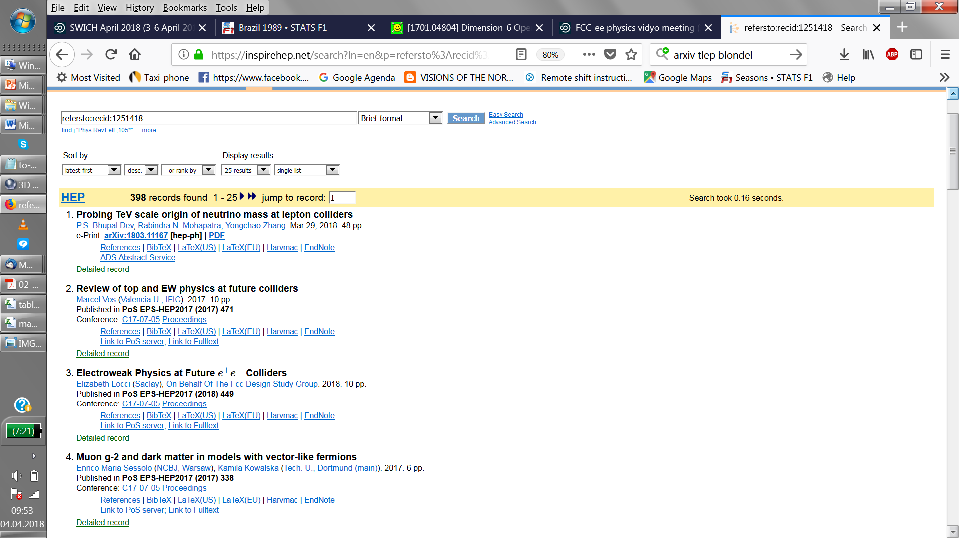
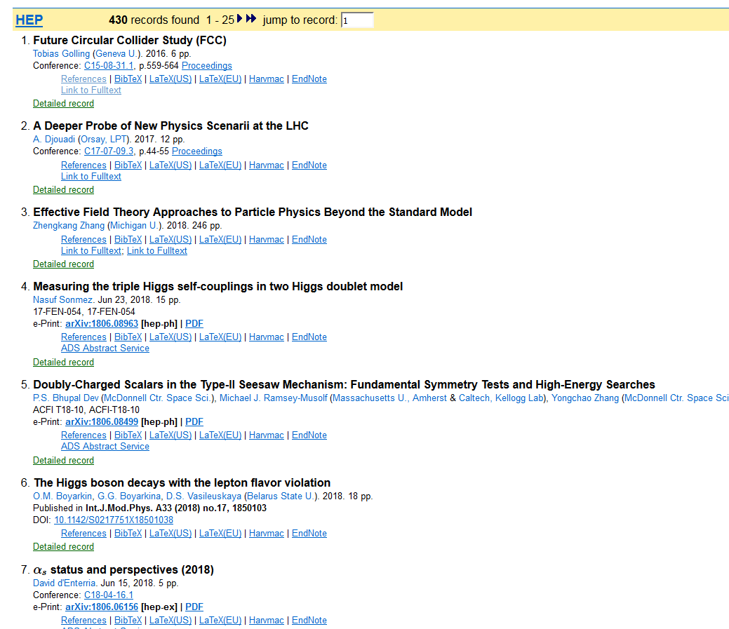
«First look of the physics case of TLEP» (original name of FCC-ee): 451 quotes today
Much more than a Higgs factory!

Slide 20
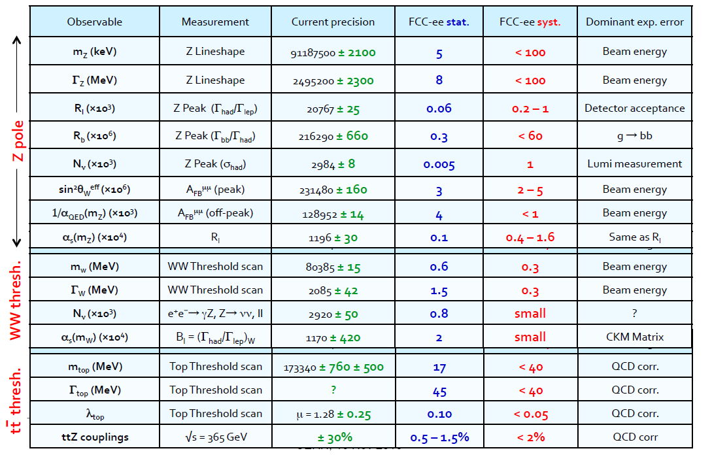
A sample of precision observables.

Slide 21
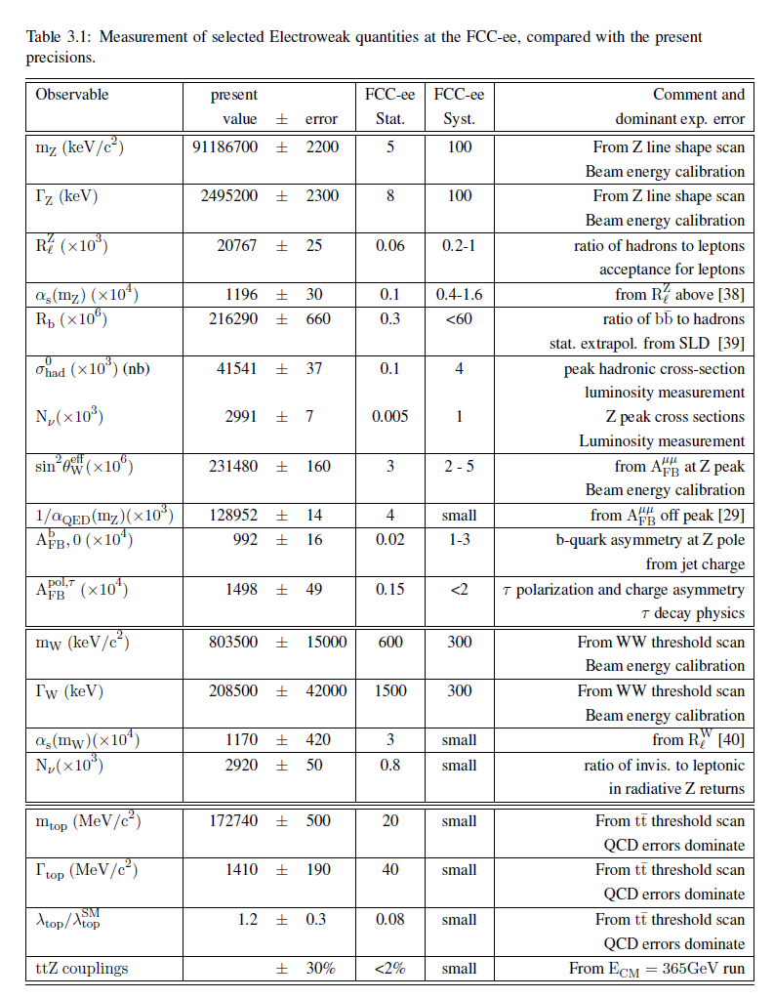
table from the CDR
simulations reveal
experimentation
is very clean
-- vtx detector can
be brought close to IR
to d=1.2cm

Slide 22
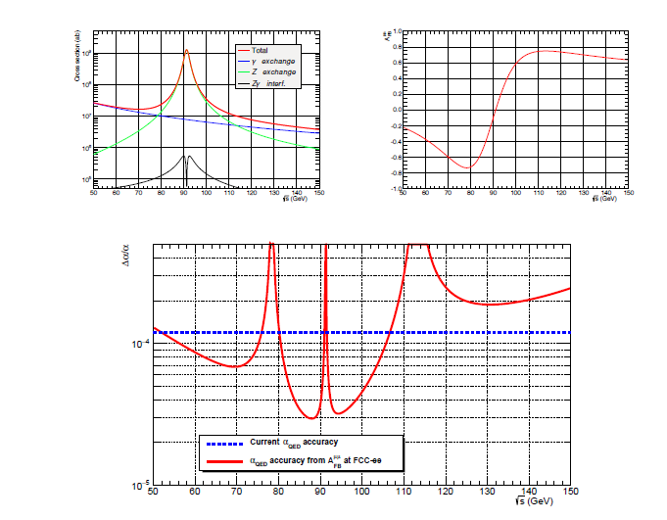
scan points : ‘peak’ -4 ‘peak’ ‘peak’ +4
measurement of
α_{QED} (m_{Z} ) from
Z-γ interference

Slide 23
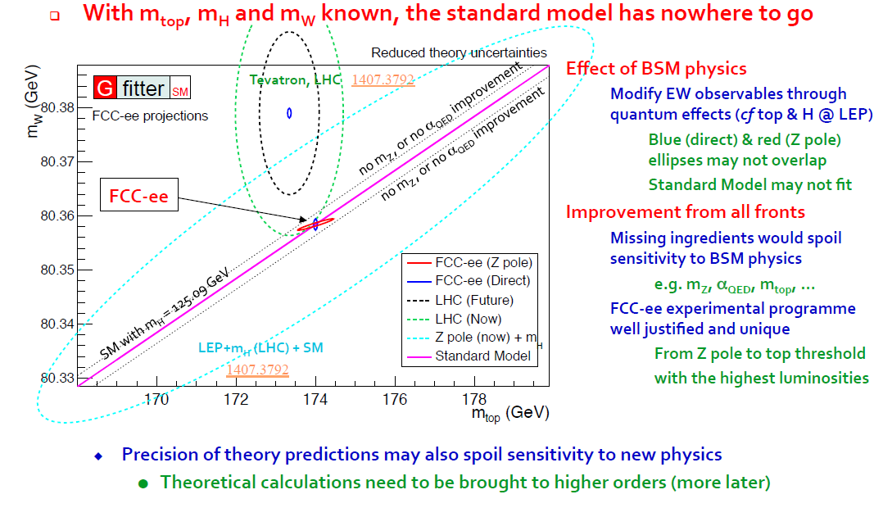

Slide 24
HIGGS FACTORY
Higgs provides a very good reason why we need a lepton (e+e- or μμ) collider

Slide 25
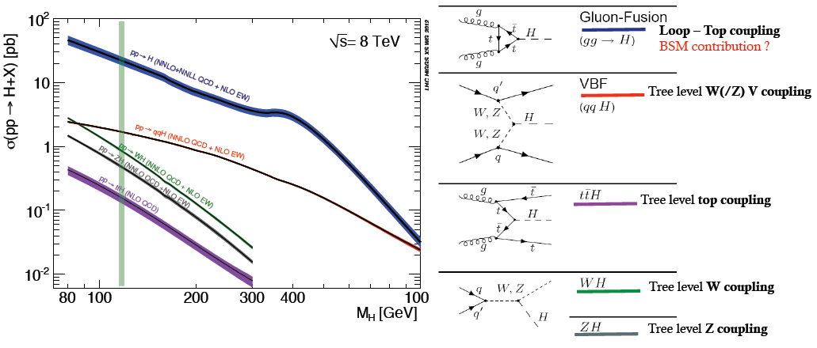
THE LHC is a Higgs Factory…BUT
several tens of Million Higgs already produced… > than most Higgs factory projects.
difficult to extract the couplings because σ_{prod} uncertain and Γ_{H} is unknown (invisible channels) → must do physics with ratios.
σ_{i→f} ^{observed} ∝ σ_{prod} (g_{Hi} )²(g_{Hf})²
Γ_{H}
relative error scales with
1/purity and 1/√efficiency of signal

Slide 26
Higgs production mechanism
“higgstrahlung” process close to threshold
Production xsection has a maximum at near threshold ~200 fb
10³⁴/cm²/s ➔ 20’000 HZ events per year.
e⁻
H
Z – tagging
by missing mass
Z*
e⁺
Z
For a Higgs of 125GeV, a centre of mass energy of 240-250 GeV is optimal
➔ kinematical constraint near threshold for high precision in mass, width, selection purity

Slide 27
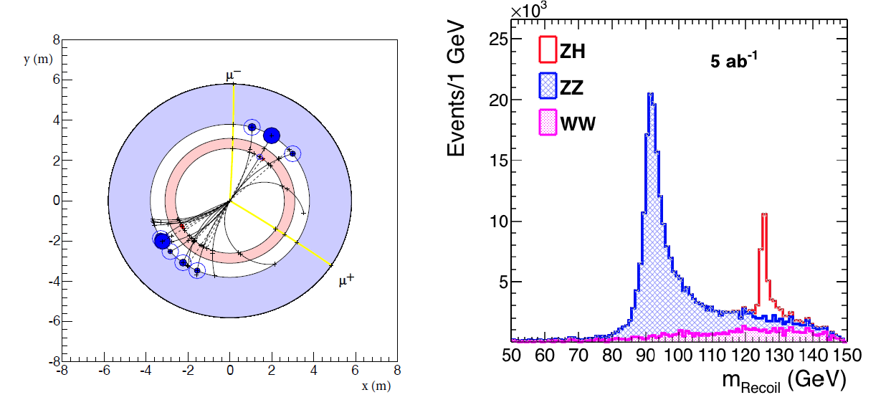
e+e- : Z – tagging by missing mass
total rate ∝ g_{HZZ}²
ZZZ final state ∝ g_{HZZ}⁴/ Γ_{H}
measure total width Γ_{H}
g_{HZZ} to ±0.2% and many other partial widths
empty recoil = invisible width
‘funny recoil’ = exotic Higgs decay
easy control below theshold
e⁻
H
Z*
e⁺
Z

Slide 28
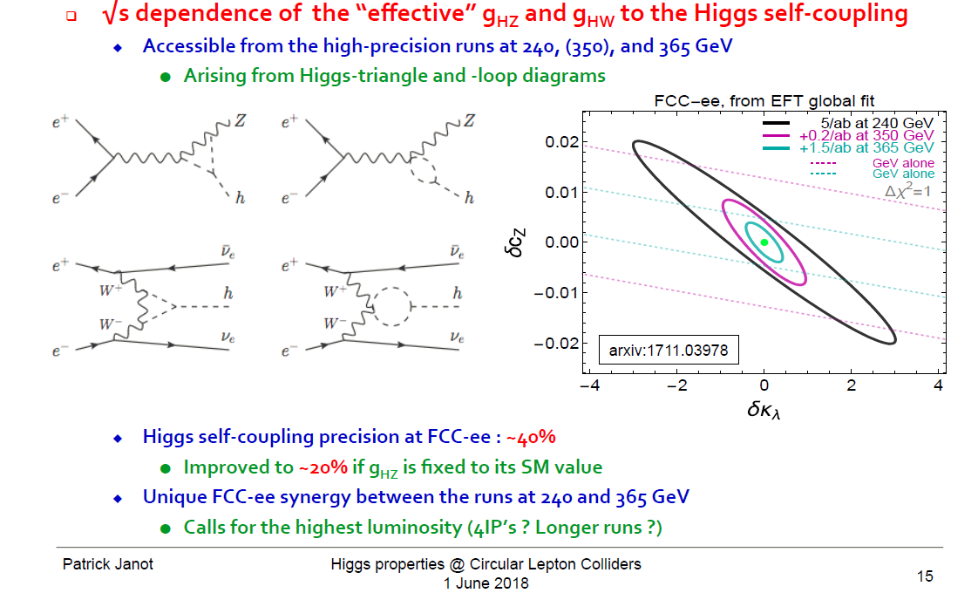
Higgs self-coupling λ_{H} (How H, W, Z get masses…)
The FCC-ee does not produce pairs of Higgses from which one can extract λ_{H}
but the ZH cross-section receives a E_{cm} - dependent correction from it.
investigating now : the possibility
of reaching 5σ observation of
Higgs self coupling at FCC-ee:
need 4 detectors
+ recast of running scenario
«Beyond the baseline»
arXiv:1809.10041v1

Slide 29
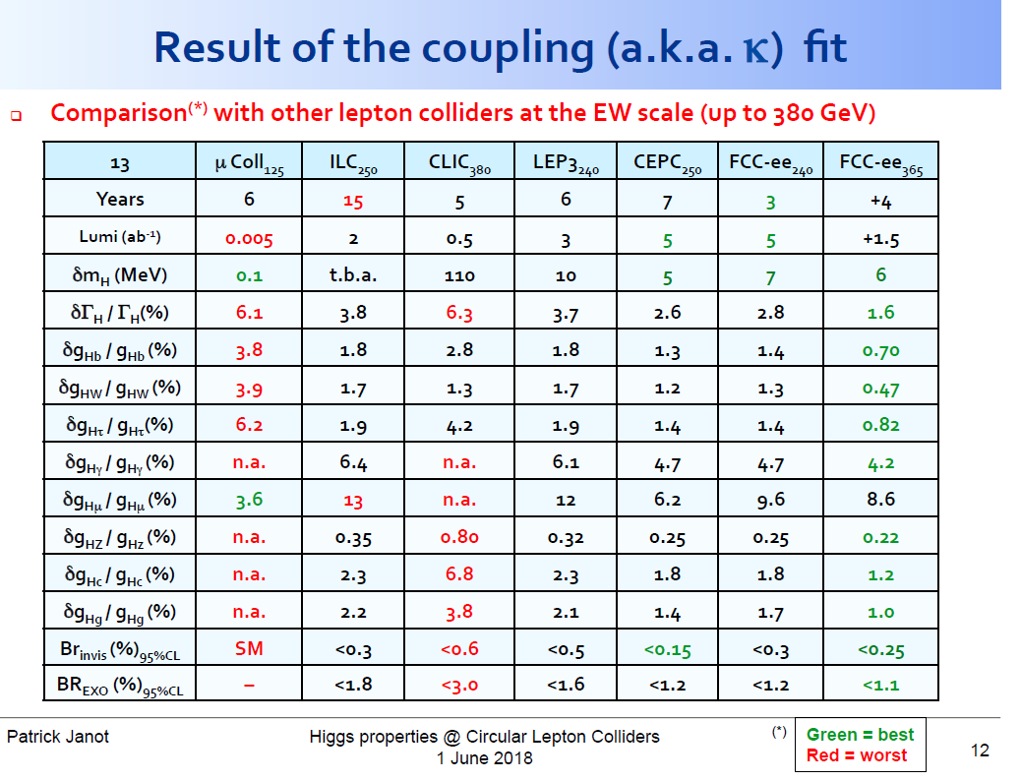

Slide 30
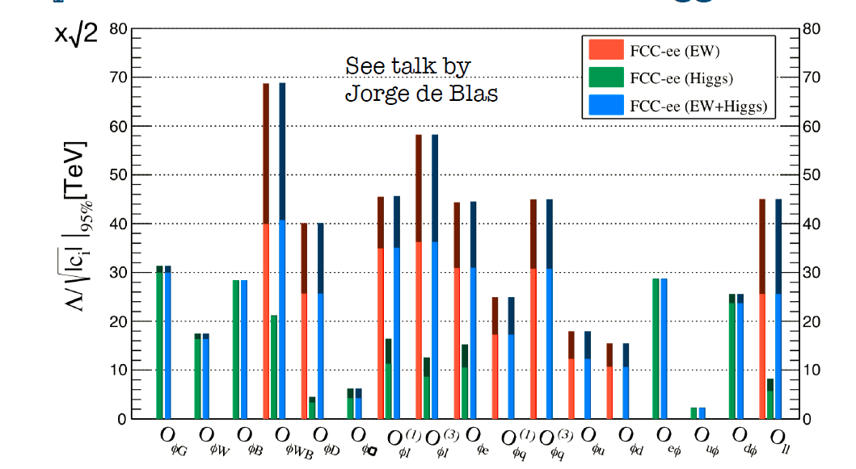
many EFTs !
Λ (TeV)
w/o theory uncertainties
with current
theory uncertainties
J. De Blas, Jan. 2017
Conclusion from Precision Calculations Mini-Workshop in January 2018:
The necessary theoretical work is doable in 5-10 years perspective, due to steady progress in methods and tools, including the recent completion of NNLO SM corrections to EWPOS. This statement is conditional to a strong support by the funding agencies and the overall community. Appropriate financial support and training programs for these precision calculations are mandatory.
1809.01830
Several EFTs will achieve sensitivity exceeding 50 TeV (decoupling physics!)
junction with FCC-hh EFTs under progress by Jorge de Blas → CDR

Slide 31
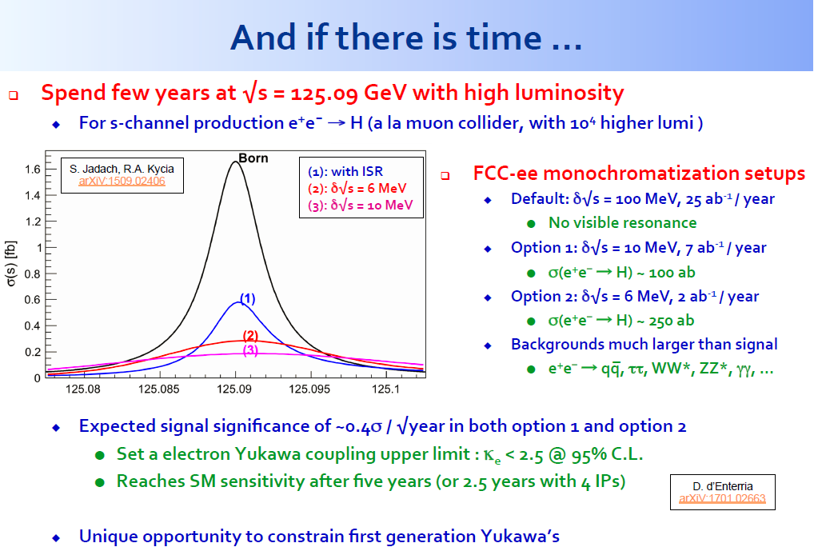
(Beyond the baseline) electron Yukawa coupling

Slide 32
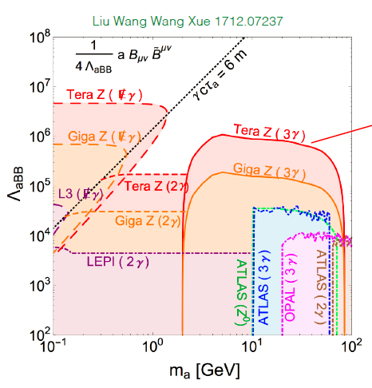


Direct discovery of Very rare events

Slide 33
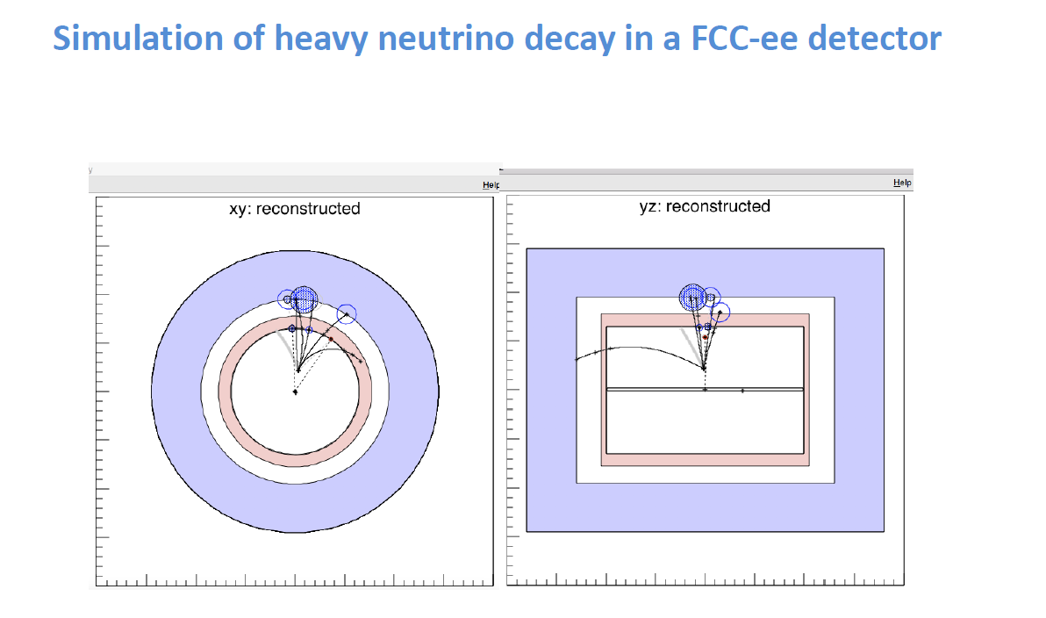

Slide 34
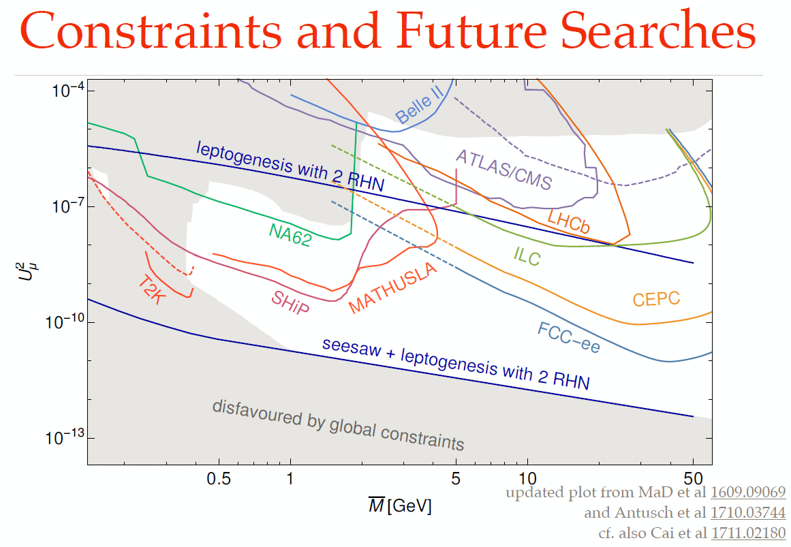

Slide 35
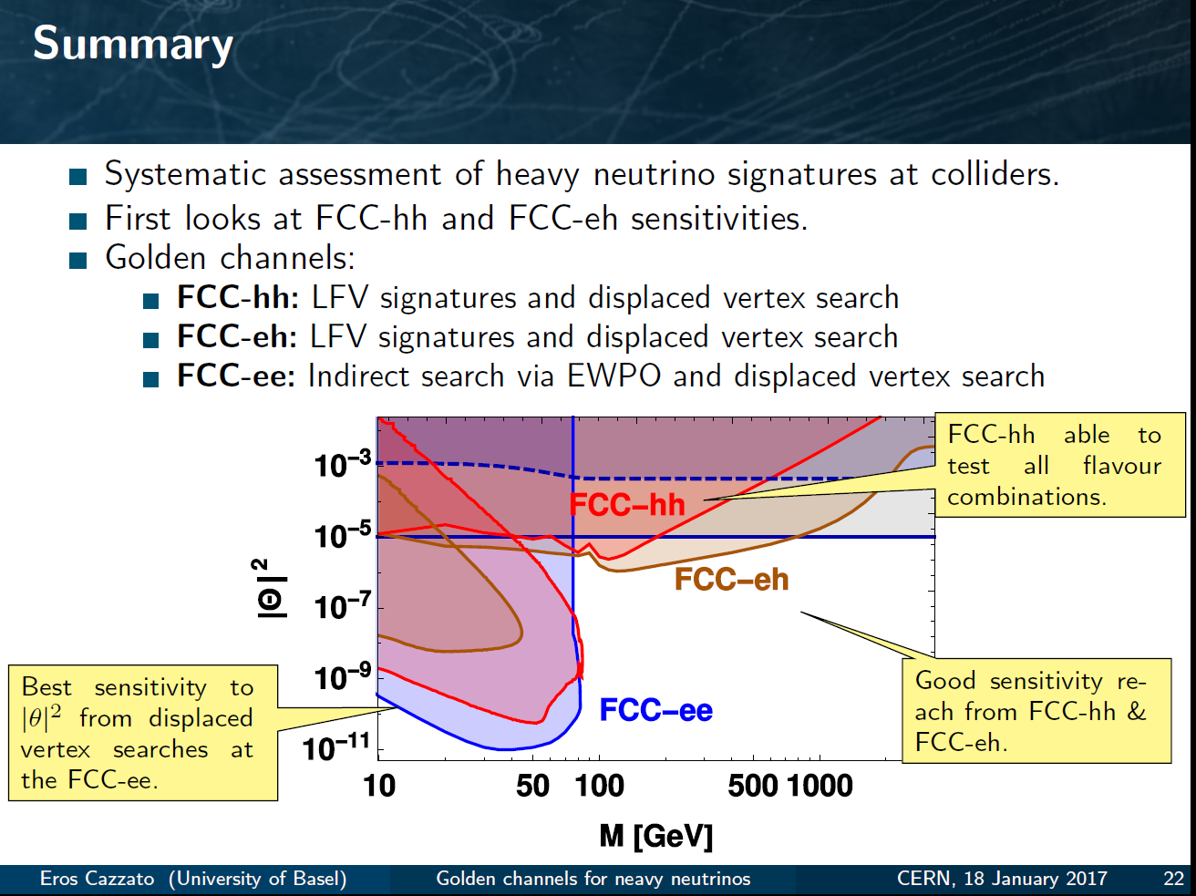
Another example of Synergy and complementarity
while ee covers a large part of space very cleanly ,
its either ‘white’ in lepton flavour or the result of EWPOs etc
Observation at FCC –hh or eh would test flavour mixing matrix!
EWPO
sensitivity
up to very high mass scales
detailed study required for all FCCs – especially FCC-hh to understand feasibility at all

Slide 36
COMPLEMENTARITY

Slide 37
PHYSICS COMPLEMENTARITY
Some examples
Higgs Physics -- ee → ZH fixes Higgs width and HZZ coupling , (and many others)
-- FCC-hh gives huge statistics of HH events for Higgs self-coupling and ttH
and rare decays, including invisible.
Search for Heavy Physics
-- ee gives precision measurements (m_{Z} m_{W} to < 0.6 MeV, m_{top} 10 MeV, etc…)
sensitive to heavy physics up to … 100 TeV (for weak couplings)
-- FCC-hh gives access to direct observation at unprecedented energies
Also huge statistics of Z,W H and top → rare decays
QCD -- ee gives α_{s} ± 0.0002 (R_{had} at Z, W and taus)
also H→gg events (gluon fragmentation!)
-- ep provides structure functions and α_{s} ± 0.0002
-- all this improves the signal and background predictions
for new physics signals at FCC-hh
Heavy Neutrinos -- ee: very powerful and clean, but flavour-blind
-- hh and eh more difficult, but potentially flavour sensitive
NB this is very much work in progress!!

Slide 38
g_{Hxx} | FCC-ee | FCC-hh | FCC-eh
ZZ | 0.22 % | < 1% *
WW | 0.47%
Γ_{H} | 1.6%
γγ | 4.2% | <1%
Zγ | -- | 1%
ttH | 13% | 1%
bb | 0.7% |  | 0.5%
ττ | 0.8%
cc | 0.7% |  | 1.8%
gg | 1.0%
μμ | 8.6% | 1-2%
uu,dd | H→ ργ? | H→ ργ?
ss | H→ φγ ? | H→ φγ ?
ee | ee → H
HH | 40% | ~3-5% | 20%
inv, exo | <0.55% | 10⁻³ | 5%
HIGGS PHYSICS
Higgs couplings g_{Hxx} precisions
hh, eh precisions assume
SM or ee measurements
FCC-hh : H→ ZZ to serve
as cross-normalization
for ttH, combination of
±4% (model dependent)HL-LHC
with FCC-ee will lead to
ttH coupling to ± 3%...
model independent!
for g_{HHH} investigating : the possibility of reaching 5σ observation at FCC-ee:
4 detectors
+ recast of running scenario

Slide 39
CONCLUSIONS
CONCLUSIONS
-- The FCC design study is establishing the feasibility or the path to feasibility of an ambitious set of colliders after LEP/LHC, at the cutting edge of knowledge and technology. The CDR is on its way
-- Both FCC-ee and FCC-hh have outstanding physics cases
-- each in their own right
-- the sequential implementation of FCC-ee, FCC-hh, FCC-eh
maximises the physics reach
-- Attractive scenarios of staging and implementation (budget!) cover more than 60 years of exploratory physics, taking full advantage of the synergies and complementarities.
FCC (ee) can start seamlessly at the end of HL-LHC

Slide 40
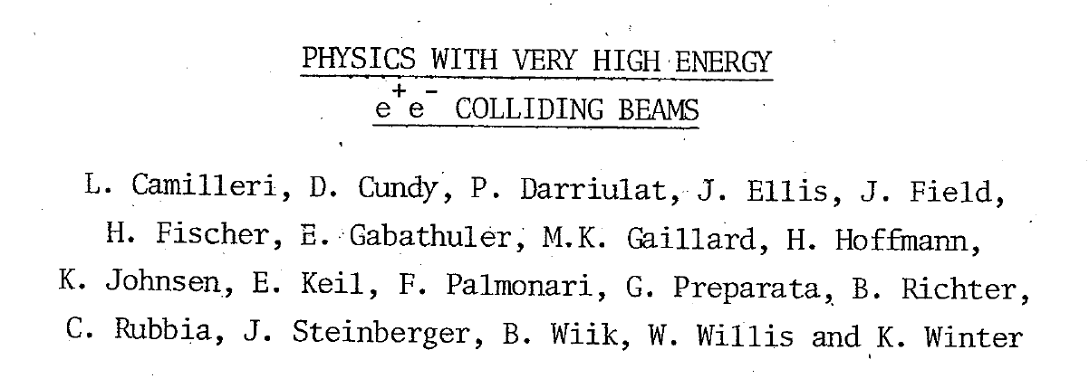
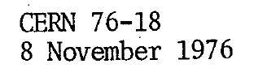
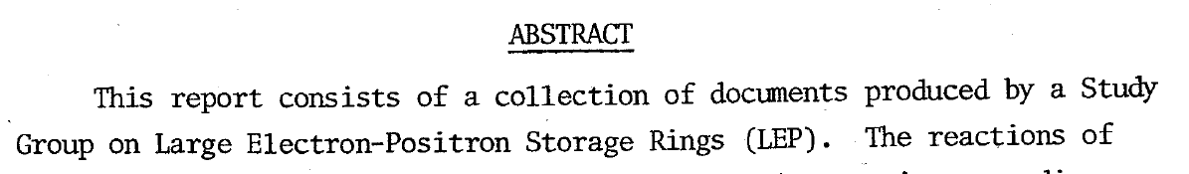
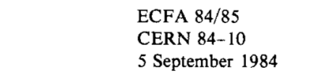
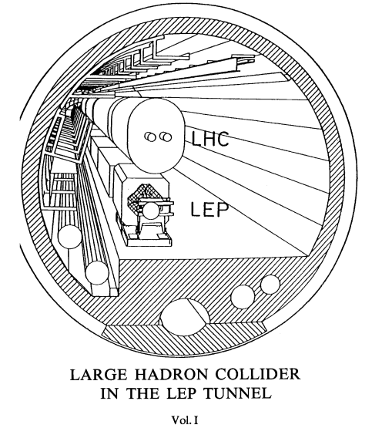
A successful model!
Did these people know that we would be running HL-LHC in that tunnel >60 years later?
e+e- 1989-2000
p p 2009-2039
Let’s not be SHY!

Slide 41
100 TeV

Slide 42
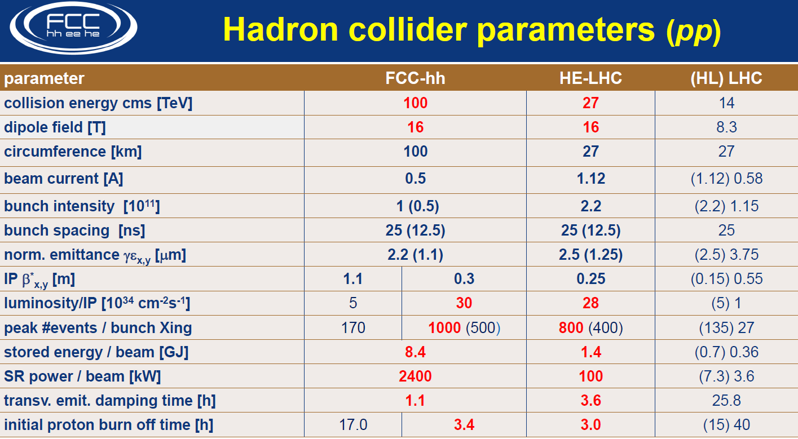

Slide 43
FCC-hh discovery potential
Highlights
FCC-hh is a HUGE discovery machine (if nature …), but not only.
FCC-hh physics is dominated by three features:
-- Highest center of mass energy –> a big step in high mass reach!
ex: strongly coupled new particle up to >30 TeV
Excited quarks, Z’, W’, up to ~tens of TeV
Give the final word on natural Supersymmetry, extra Higgs etc.. reach up to 5-20 TeV
Sensitivity to high energy phenomena in e.g. WW scattering
-- HUGE production rates for single and multiple production of SM bosons (H,W,Z) and quarks
-- Higgs precision tests using ratios to e.g. γγ/μμ/ ττ/ZZ, ttH/ttZ @<% level
-- Precise determination of triple Higgs coupling (~3% level) and quartic Higgs coupling
-- detection of rare decays H→ Vγ (V= ρ,ϕ,J/ψ,ϒ,Z…)
-- search for invisibles (DM searches, RH neutrinos in W decays)
-- renewed interest for long lived (very weakly coupled) particles.
-- rich top and HF physics program
-- Cleaner signals for high Pt physics
-- allows clean signals for channels presently difficult at LHC (e.g. H→ bb)

Slide 44
FCC-hh discovery potential
Physics at a 100 TeV pp collider: CERN Yellow Report (2017) no.3
1) Standard Model processes: https://arxiv.org/pdf/1607.01831v1.pdf
2) Higgs and EW symmetry breaking studies: https://arxiv.org/pdf/1606.09408v1.pdf
3) Βeyond the Standard Model phenomena: https://arxiv.org/abs/1606.00947
4) Heavy ions at the Future Circular Collider: https://arxiv.org/abs/1605.01389
Now proceeding to ascertain these cross-section calculations with real detector and simulations…

Slide 45
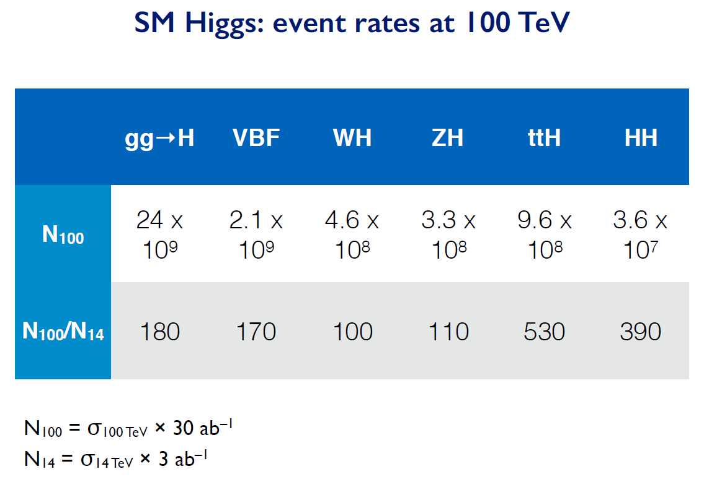

Slide 46
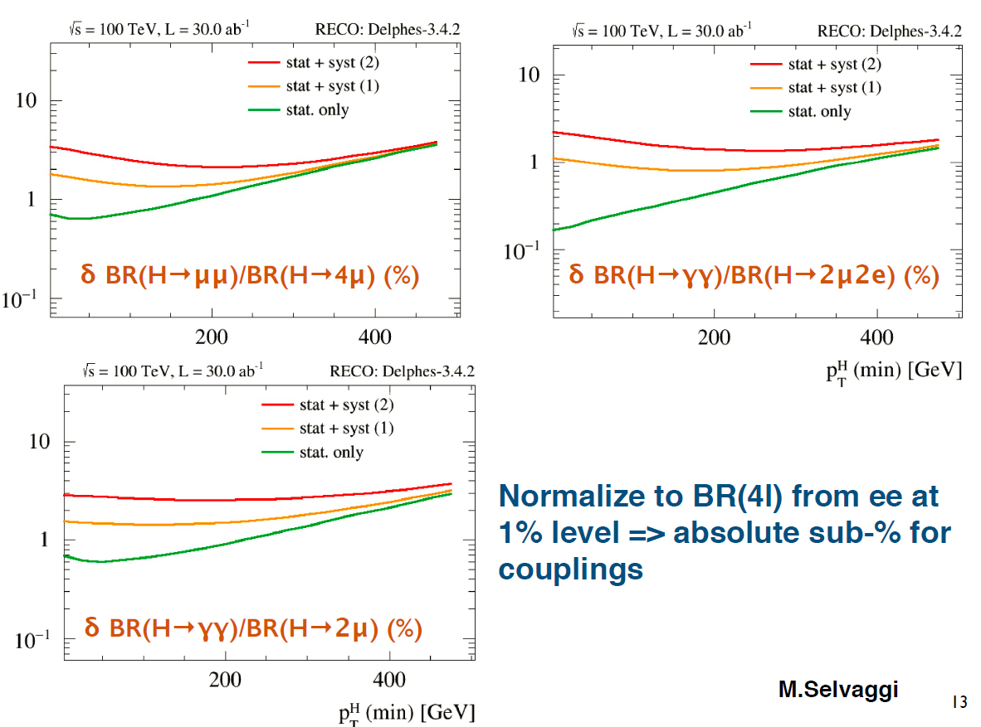
For rare decays (μμ, γγ, γZ) normalize to H→ ZZ well measured at FCC-ee

Slide 47
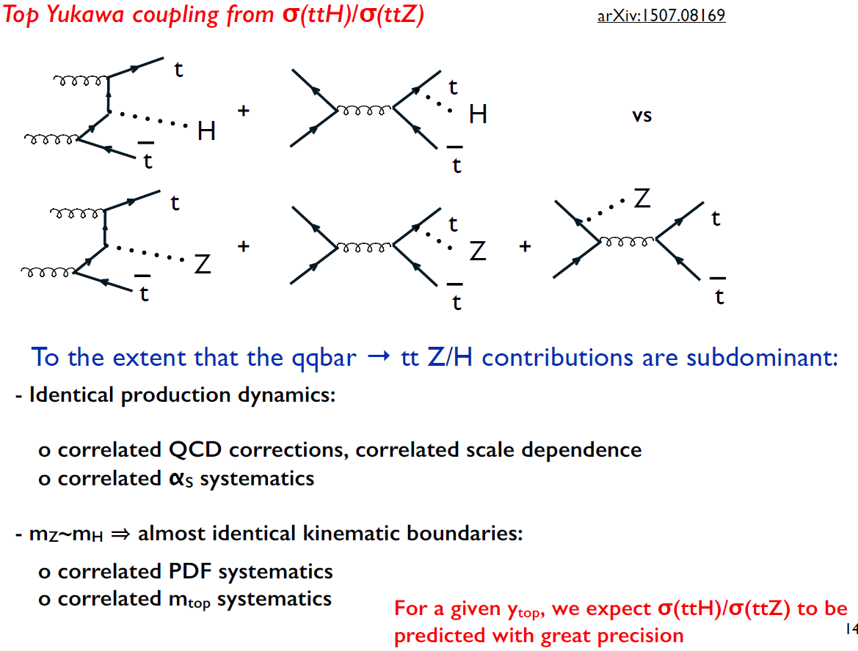


Slide 48
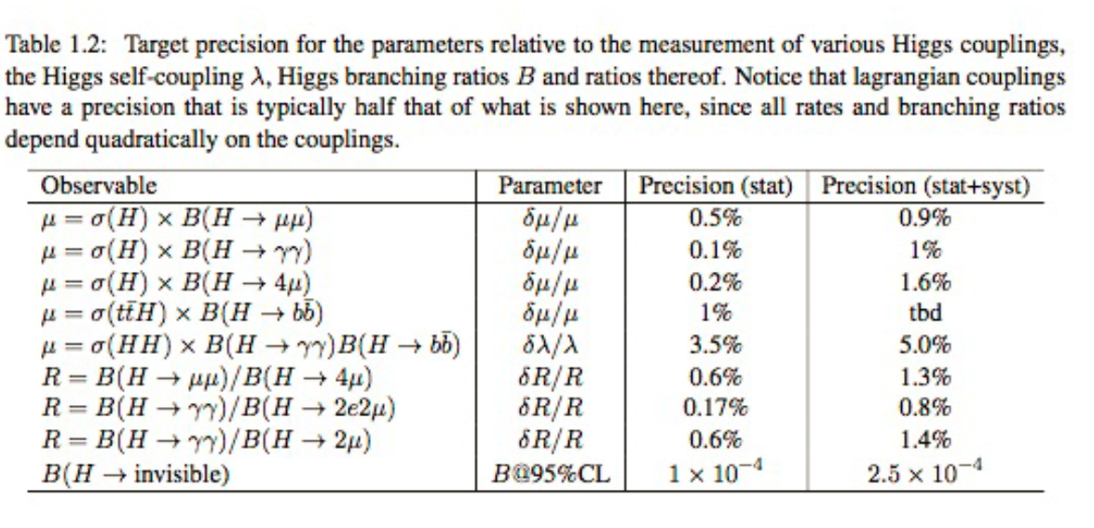
Higgs at FCC-hh
λ_{H} at the few percent level
To reach a precision on λ_{H} at the few percent level requires a linear collider of at least 3TeV
(ILC 500 GeV can obtain a ±30% indication and CLIC 3TeV estimate is ±10%)

