Slide 1
Green CEPC
Zhenchao LIU
On behalf of CEPC working group
2018.11.14

Slide 2
Content
Why Green CEPC
Green Technology for large colliders
Green CEPC
More collaboration is needed with industries and institutes

Slide 3
Why Green CEPC
China is reducing energy pollution, promoting green travel and boosting unit energy GDP
Huge energy is needed for modern large colliders such as LHC, ILC, CEPC…
Huge energy means huge cost and huge pollution!!!
Power consuming: CEPC is about 1.5LHC
Green CEPC ~ lower cost for unit data! Exciting!!!
Saving power=lower pollution=lower operation cost!!!

Slide 4
Power for Large Colliders
300MW is the upper limit for wall plug power of such large projects
Operation cost: 1kWh~0.5RMB，266MW x 24h x 200day x 0.5RMB = 638.4MRMB = 96.67M US dollar

Slide 5
Green Technology for large colliders

Slide 6
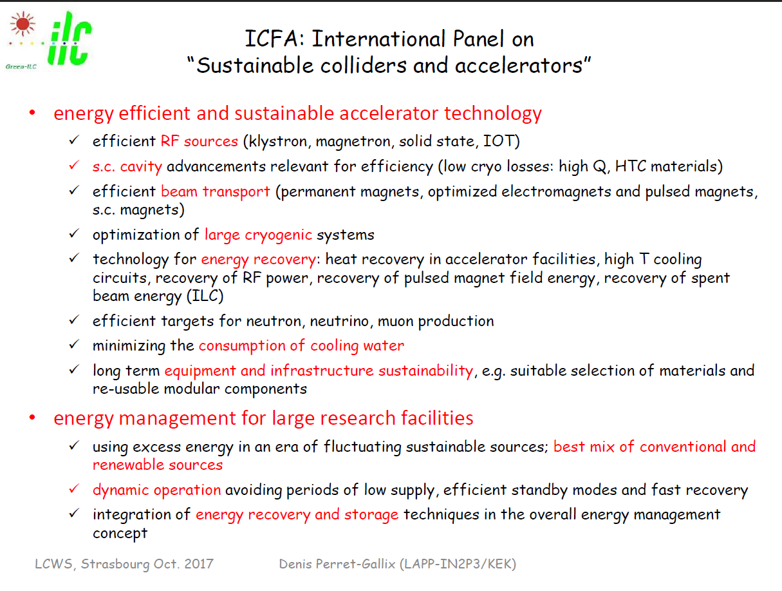

Slide 7
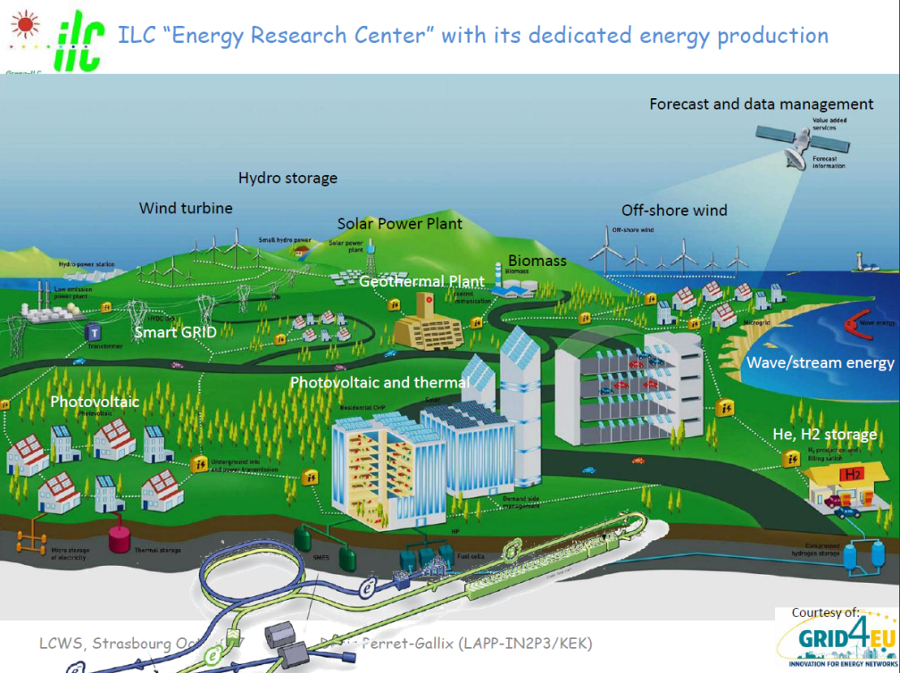
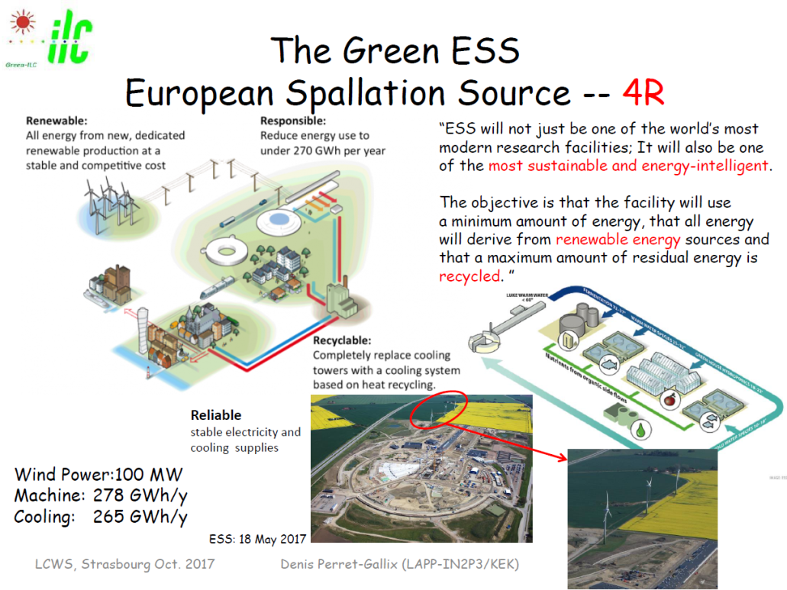
Renewable Energy
ILC, ESS

Slide 8
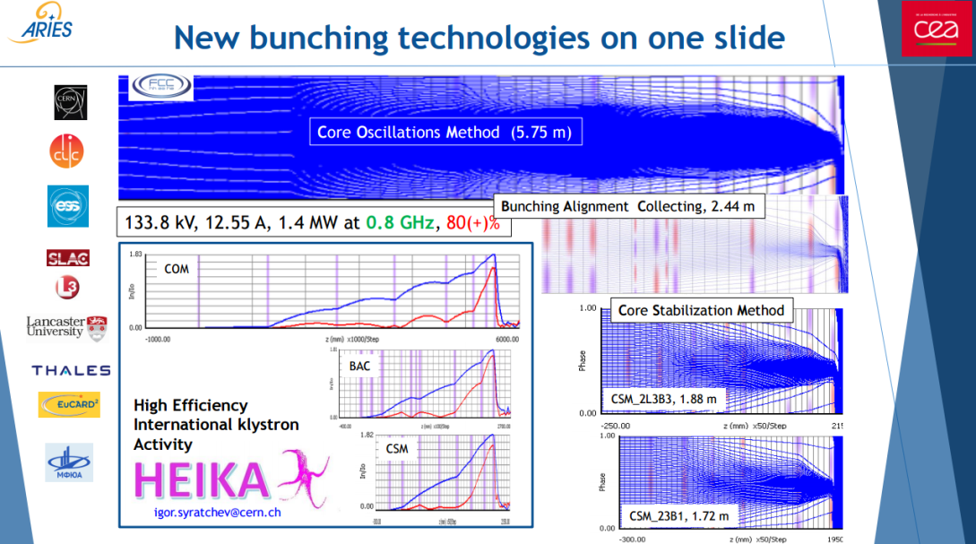
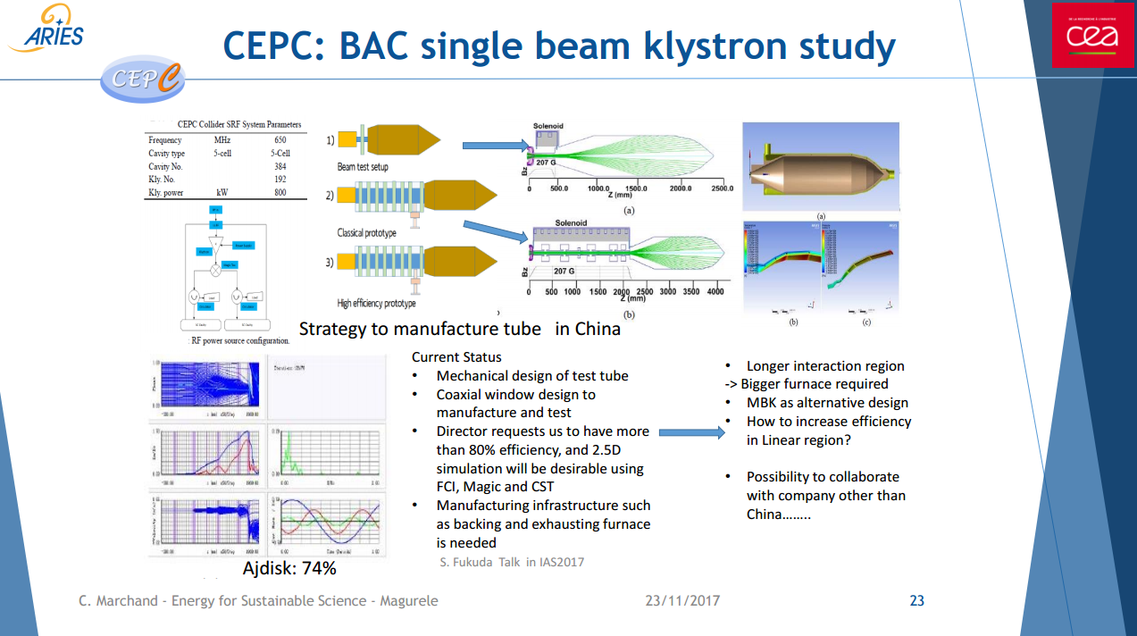
High efficiency klystron
70% can be reached, 80% still need to develop

Slide 9
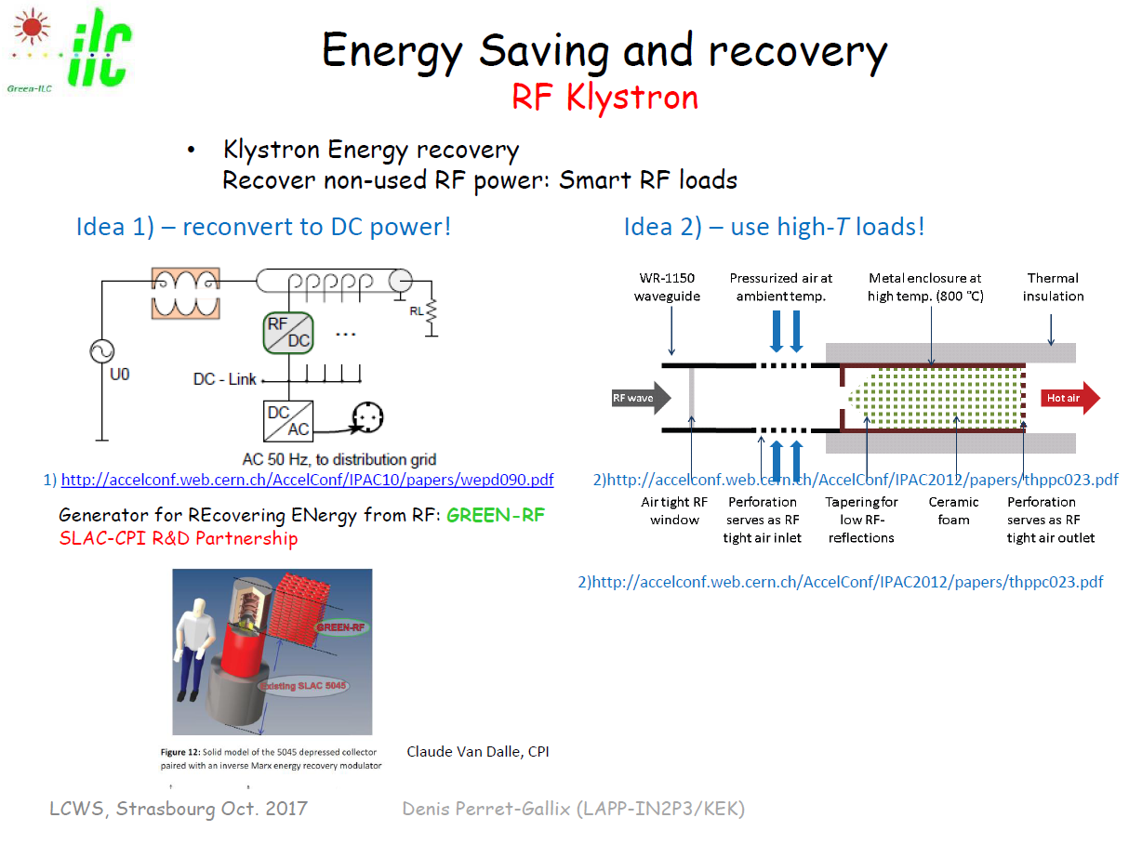
Reuse of klystron waste power

Slide 10
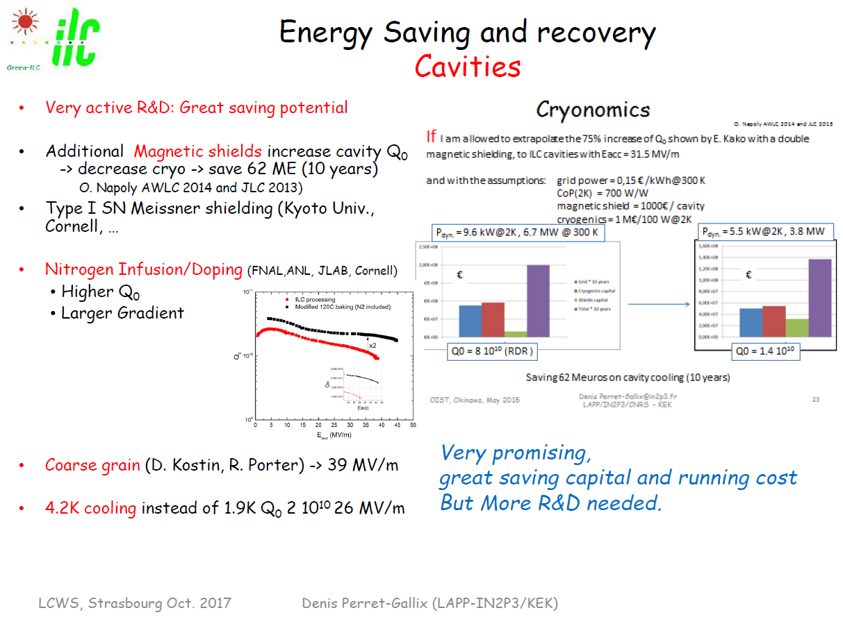
High Q₀ cavity

Slide 11
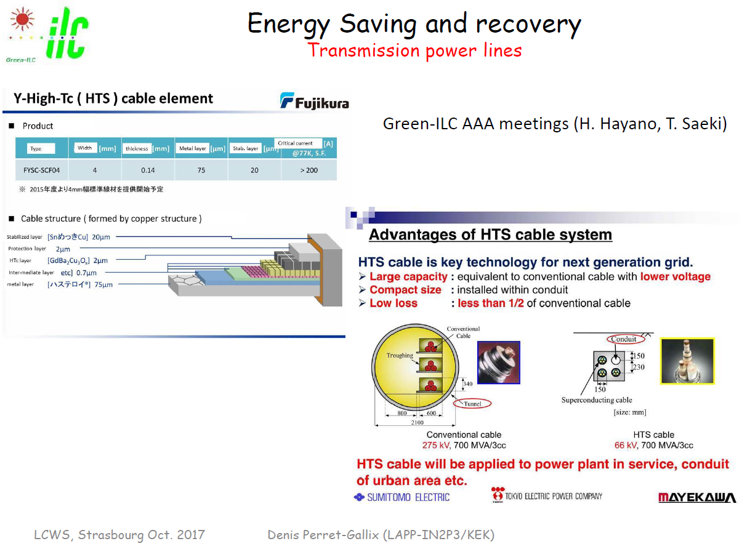
HTS cable

Slide 12
Green CEPC
Renewable energy
High efficiency power supply
High Q₀ cavity
Reuse of waste heat
Cooling by environment

Slide 13
CEPC power budget（H）
 | System for Higgs （30MW） | Location and electrical demand(MW) |  |  |  |  |  | Total (MW)
 |  | Ring | Booster | LINAC | BTL | IR | Surface building
1 | RF Power Source | 103.8 | 0.15 | 5.8 |  |  |  | 109.75
2 | Cryogenic System | 11.62 | 0.68 |  |  | 1.72 |  | 14.02
3 | Vacuum System | 9.784 | 3.792 | 0.646 |  |  |  | 14.222
4 | Magnet Power Supplies | 47.21 | 11.62 | 1.75 | 1.06 | 0.26 |  | 61.9
5 | Instrumentation | 0.9 | 0.6 | 0.2 |  |  |  | 1.7
6 | Radiation Protection | 0.25 |  | 0.1 |  |  |  | 0.35
7 | Control System | 1 | 0.6 | 0.2 | 0.005 | 0.005 |  | 1.81
8 | Experimental devices |  |  |  |  | 4 |  | 4
9 | Utilities | 31.79 | 3.53 | 1.38 | 0.63 | 1.2 |  | 38.53
10 | General services | 7.2 |  | 0.2 | 0.15 | 0.2 | 12 | 19.75
 | Total | 213.554 | 20.972 | 10.276 | 1.845 | 7.385 | 12 | 266.032

Slide 14
CEPC power budget（W）
 | System for W | Location and electrical demand(MW) |  |  |  |  |  | Total (MW)
 |  | Ring | Booster | LINAC | BTL | IR | Surface building
1 | RF Power Source | 103.8 | 0.15 | 5.8 |  |  |  | 109.75
2 | Cryogenic System | 5.94 | 0.41 |  |  | 1.72 |  | 8.07
3 | Vacuum System | 9.784 | 3.792 | 0.646 |  |  |  | 14.222
4 | Magnet Power Supplies | 23.35 | 5.52 | 1.75 | 0.5 | 0.12 |  | 31.24
5 | Instrumentation | 0.9 | 0.6 | 0.2 |  |  |  | 1.7
6 | Radiation Protection | 0.25 |  | 0.1 |  |  |  | 0.35
7 | Control System | 1 | 0.6 | 0.2 | 0.005 | 0.005 |  | 1.81
8 | Experimental devices |  |  |  |  | 4 |  | 4
9 | Utilities | 26.24 | 2.92 | 1.38 | 0.58 | 1.2 |  | 32.32
10 | General services | 7.2 |  | 0.2 | 0.15 | 0.2 | 12 | 19.75
 | Total | 178.464 | 13.992 | 10.276 | 1.235 | 7.245 | 12 | 223.212

Slide 15
CEPC power budget（Z）
 | System for Z-pole | Location and electrical demand(MW) |  |  |  |  |  | Total (MW)
 |  | Ring | Booster | LINAC | BTL | IR | Surface building
1 | RF Power Source | 57.1 | 0.15 | 5.8 |  |  |  | 63.05
2 | Cryogenic System | 2.91 | 0.31 |  |  | 1.72 |  | 4.94
3 | Vacuum System | 9.784 | 3.792 | 0.646 |  |  |  | 14.222
4 | Magnet Power Supplies | 9.52 | 2.14 | 1.75 | 0.19 | 0.05 |  | 13.65
5 | Instrumentation | 0.9 | 0.6 | 0.2 |  |  |  | 1.7
6 | Radiation Protection | 0.25 |  | 0.1 |  |  |  | 0.35
7 | Control System | 1 | 0.6 | 0.2 | 0.005 | 0.005 |  | 1.81
8 | Experimental devices |  |  |  |  | 4 |  | 4
9 | Utilities | 19.95 | 2.22 | 1.38 | 0.55 | 1.2 |  | 25.3
10 | General services | 7.2 |  | 0.2 | 0.15 | 0.2 | 12 | 19.75
 | Total | 108.614 | 9.812 | 10.276 | 0.895 | 7.175 | 12 | 148.772

Slide 16
CEPC power budget
Some power can use the renewable power such as wind, water, solar…
20% of wind power is wasted in China each year, price of wind power is the same as coal power at 2020.
 | System for Higgs （30MW） | Location and electrical demand(MW) |  |  |  |  |  | Total (MW)
 |  | Ring | Booster | LINAC | BTL | IR | Surface building
1 | RF Power Source | 103.8 | 0.15 | 5.8 |  |  |  | 109.75
2 | Cryogenic System | 11.62 | 0.68 |  |  | 1.72 |  | 14.02
3 | Vacuum System | 9.784 | 3.792 | 0.646 |  |  |  | 14.222
4 | Magnet Power Supplies | 47.21 | 11.62 | 1.75 | 1.06 | 0.26 |  | 61.9
5 | Instrumentation | 0.9 | 0.6 | 0.2 |  |  |  | 1.7
6 | Radiation Protection | 0.25 |  | 0.1 |  |  |  | 0.35
7 | Control System | 1 | 0.6 | 0.2 | 0.005 | 0.005 |  | 1.81
8 | Experimental devices |  |  |  |  | 4 |  | 4
9 | Utilities | 31.79 | 3.53 | 1.38 | 0.63 | 1.2 |  | 38.53
10 | General services | 7.2 |  | 0.2 | 0.15 | 0.2 | 12 | 19.75
 | Total | 213.554 | 20.972 | 10.276 | 1.845 | 7.385 | 12 | 266.032 (86.522, 32.5%)

Slide 17
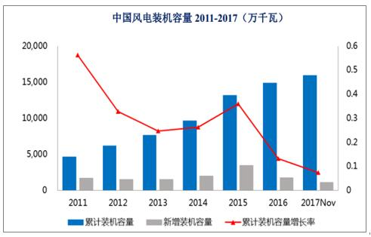
Wind power in China
In 2017, the total installed capacity of wind power in China reached 159 million kilowatts, accounting for 9.50% of the total installed power of the country. The on-grid power was 271.7 billion kilowatt hours, accounting for 4.76% of the country's total power generation.

Slide 18
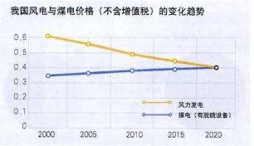
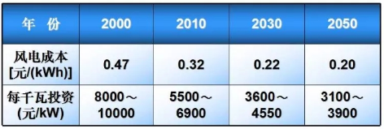
Wind power cost
Price of wind power will decrease year by year as technology development
266MW wind power station will cost 957.6MRMB~1.5year operation cost(638.4MRMB)
The construction period is short. A 10,000-kilowatt wind farm is built less than one year
No resources, no pollution
Installed capacity flexible, Actual footprint is small
图片来源：电气专业混编

Slide 19
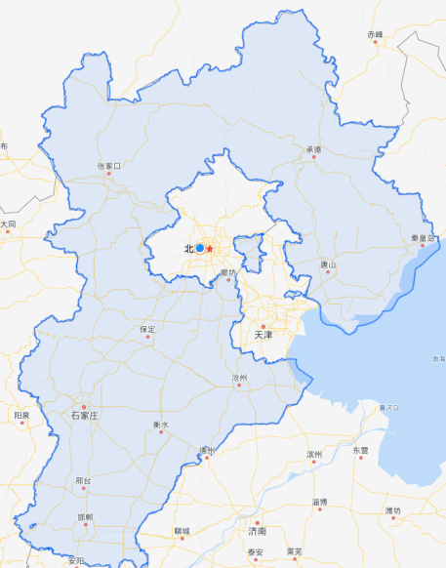
Wind power in Hebei
河北省发改委网站发布《河北省2018—2020年分散式接入风电发展规划》，确定了11市重点发展区域
  2018—2020年，全省规划开发分散式接入风电430万千瓦；展望至2025年，力争累计达到700万千瓦。
  石家庄：根据土地、电网条件落实情况，规划开发规模46.6万千瓦，2020年前开发规模41.1万千瓦，晋州、深泽、无极等县为重点开发区域，其余5.5万千瓦2025年前开发。
  保定：根据土地、电网条件落实情况，分散接入风电规划开发规模25.4万千瓦，2020年前开发规模19.2万千瓦，高阳、博野、安国、涞源等县（市）可作为重点开发区域，其余6.2万千瓦2025年前开发。
  沧州：根据土地、电网条件落实情况，分散式接入风电规划开发规模138万千瓦，2020年前开发规模103.8万千瓦，其余34.2万千瓦2025年前开发。
  衡水：根据土地、电网条件落实情况，分散式接入风电规划开发规模71.5万千瓦，2020年前开发规模42.7万千瓦，景县、枣强、武邑、饶阳、安平、武强等县可作为重点开发区域，其余28.8万千瓦2025年前开发。

Slide 20
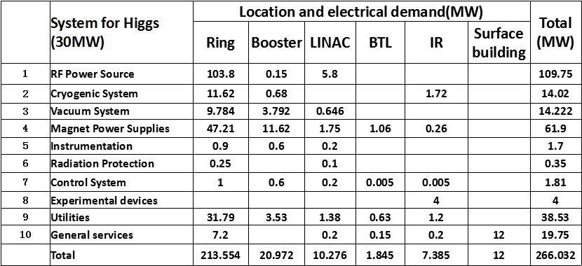
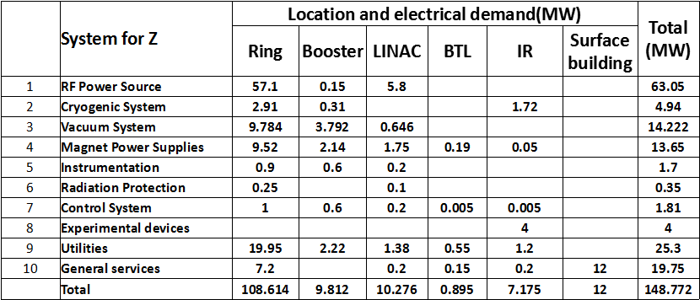
CEPC Power for Higgs & Z
266MW
149MW
The maximum power consumption is RF power source system.

Slide 21
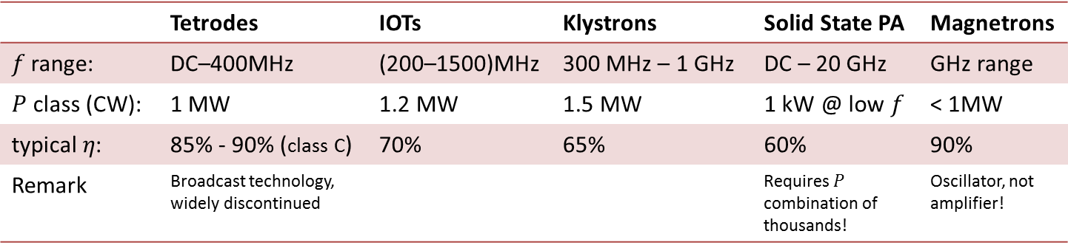
Power consumption
The Collider beam power is more than 60 MW. Wall plug power consumption is more than 100MW. The increase in efficiency of RF power sources is considered a high priority issue.
RF power sources - efficiencies
 | Tetrodes | IOTs | Klystrons | SSA | Magnetrons
 | DC–400MHz | (200–1500)MHz | 300 MHz – 1 GHz | DC – 20 GHz | GHz range
 | 1 MW | 1.2 MW | 1.5 MW |  | < 1MW
 | 85% - 90% (class C) | 70% | 65% | 60% | 90%
Remark | Broadcast technology, widely discontinued |  |  |  | Oscillator, not amplifier!
High power klystrons are the more attractive choice because of their high eﬃciency, low cost and more stable than IOT and SSA for CEPC collider.

Slide 22
Power consumption
Efficiency impact on operation cost (Only considering operation efficiency of klystrons)
CEPC at 800 RMB/MWh and 6000 hours/year
Save Money
130M RMB
1 year
90 M RMB
Excessive electricity bill, M RMB
NOW
Efficiency, %
COMING
FUTURE

Slide 23
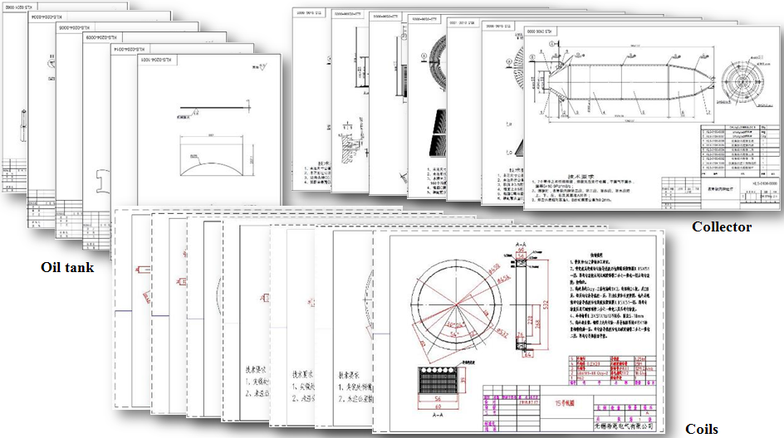
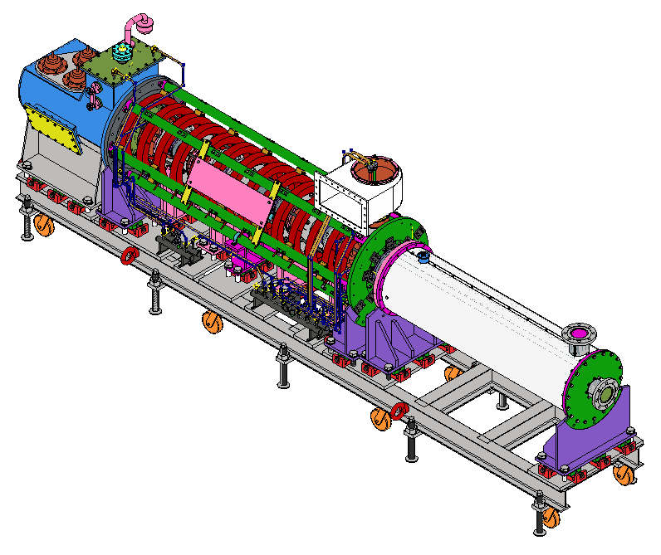
R&D Progress on High efficiency klystron
1st tube: All drawings of the 1st prototype has finished and it has been processed and manufactured in the machine shop.
The three different schemes for the high efficiency klystron design are ongoing simultaneously.
The manufacturing of the 2nd prototype will be started based on the most mature scheme as soon as possible.
23

Slide 24
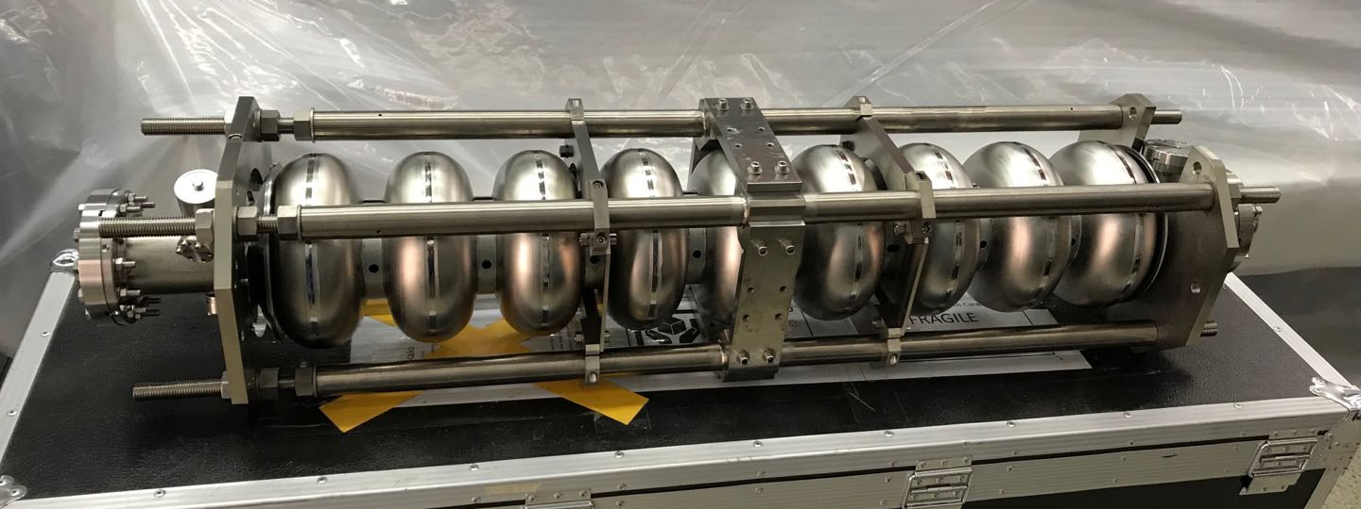
SRF cavities for CEPC：High Q (= Low Power Loss & Energy-saving!)
 | Cavity amount | Gradient (MV/m) | Q for long period | Gradient in horizontal test (MV/m) | Q in horizontal test | Gradient in vertical test (MV/m) | Q in vertical test
650 MHz 2-cell cavity | 240 | 19.7 | 1.5E10 | 22 | 2E10 | 22 | 4E10
1.3 GHz 9-cell cavity | 96 | 19.8 | 1E10 | 22 | 2E10 | 24 | 3E10
1.3 GHz 9-cell cavity
24
650 MHz 2-cell cavity

Slide 25
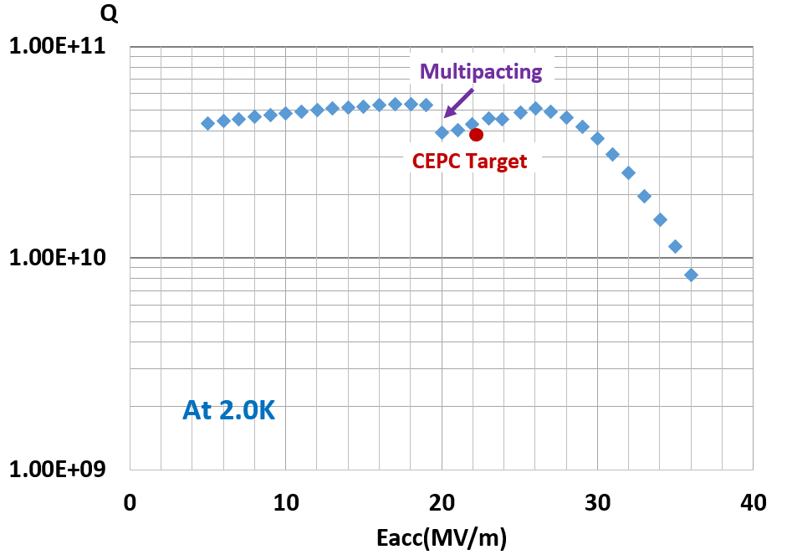
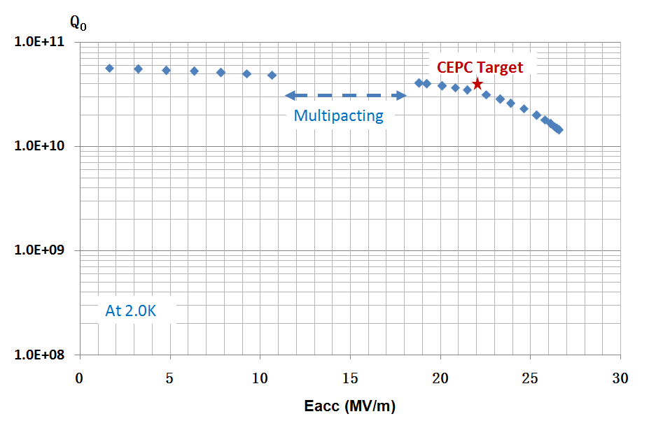
High Q achieved in the vertical test!
650 MHz 1-cell cavity (only BCP, no EP)
650 MHz 2-cell cavity (only BCP, no EP)
Vertical test result: Q₀=4.0E10@19.2MV/m，which is close to the CEPC target (Q₀=4.0E10@22.0MV/m).
Vertical test result: Q₀=5.1E10@26.0MV/m，which exceed the CEPC target (Q₀=4.0E10@22.0MV/m).
25

Slide 26
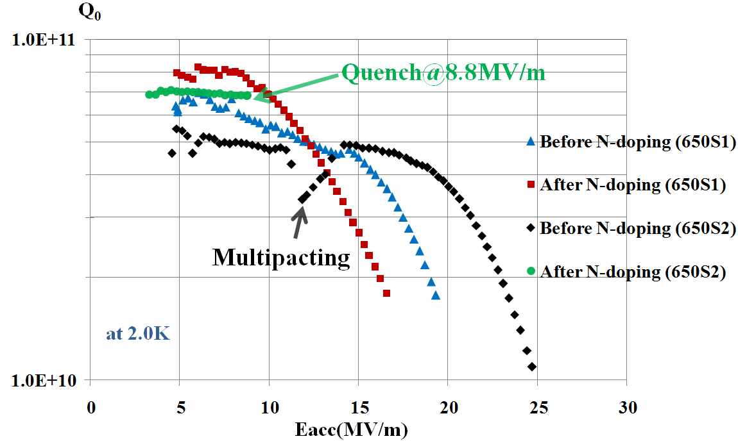
N-doping: increase Q further!
After N-doping, Q₀ increased obviously at low field for both 650 MHz 1-cell cavities (650S1#, 650S2#).
650S1: Q₀=7e10@Eacc=10MV/m. But Q₀ decreased quickly at high field (>10 MV/m) because of no BCP/EP after N-doping.
650S2: Quench at Q₀=6.9e10@Eacc=8.8MV/m.
Next, increase Q at high field for CEPC TDR.
CEPC Target
26

Slide 27
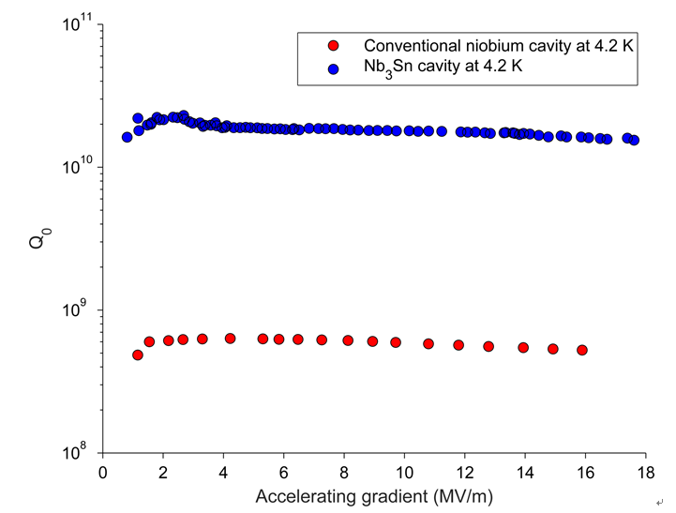
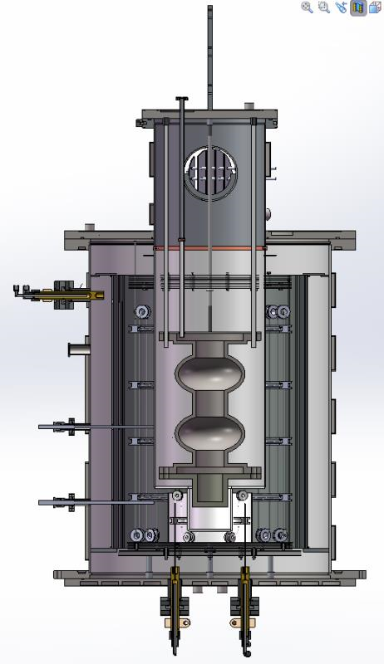
Nb₃Sn film: Lower cavity loss significantly——Effort to TDR!
Nb₃Sn: high Tc, much higher Q than Nb at 4.2K, higher gradient (120MV/m in theory) than Nb (50 MV/m). Nb cavity coating with Nb₃Sn film is promising in future. Related research has begun at IHEP. The furnace for Nb₃Sn coating is under fabrication now.
Parameters | Value
Min vacuum | 5.0E-5 Pa
Max temperature | 1400℃
Min vacuum@1400℃ | 9.0E-4 Pa
Uniform temperature area | Φ300mm×500mm
Q of Nb₃Sn: 30 times higher than Nb !
Vertical test results of 1.3GHz @ Cornell
Furnace for Nb₃Sn coating
27

Slide 28
More collaboration with industries and institutes

Slide 29
Energy R&D
The development of accelerator is limited by energy consumption, or say as the cost.
Energy design should be included in the accelerator design for the huge accelerator projects.
Energy source, recycle, efficiency, reuse should be consider together.
Waste water, gas, heat and the environment…

Slide 30
CEPC power budget（H）
 | System for Higgs （30MW） | Location and electrical demand(MW) |  |  |  |  |  | Total (MW)
 |  | Ring | Booster | LINAC | BTL | IR | Surface building
1 | RF Power Source | 103.8 | 0.15 | 5.8 |  |  |  | 109.75
2 | Cryogenic System | 11.62 | 0.68 |  |  | 1.72 |  | 14.02
3 | Vacuum System | 9.784 | 3.792 | 0.646 |  |  |  | 14.222
4 | Magnet Power Supplies | 47.21 | 11.62 | 1.75 | 1.06 | 0.26 |  | 61.9
5 | Instrumentation | 0.9 | 0.6 | 0.2 |  |  |  | 1.7
6 | Radiation Protection | 0.25 |  | 0.1 |  |  |  | 0.35
7 | Control System | 1 | 0.6 | 0.2 | 0.005 | 0.005 |  | 1.81
8 | Experimental devices |  |  |  |  | 4 |  | 4
9 | Utilities | 31.79 | 3.53 | 1.38 | 0.63 | 1.2 |  | 38.53
10 | General services | 7.2 |  | 0.2 | 0.15 | 0.2 | 12 | 19.75
 | Total | 213.554 | 20.972 | 10.276 | 1.845 | 7.385 | 12 | 266.032 (171.65, 64.5%)

Slide 31
Major power consumption area
RF and Magnet power supply consume 64.5% of the total power!!!
The energy transmit efficiency is very important for such power supplies.
Institute and industry should work together to develop the related technology.
RF power supply >80%
Magnet power supply???

Slide 32
Thanks!

