Slide 1
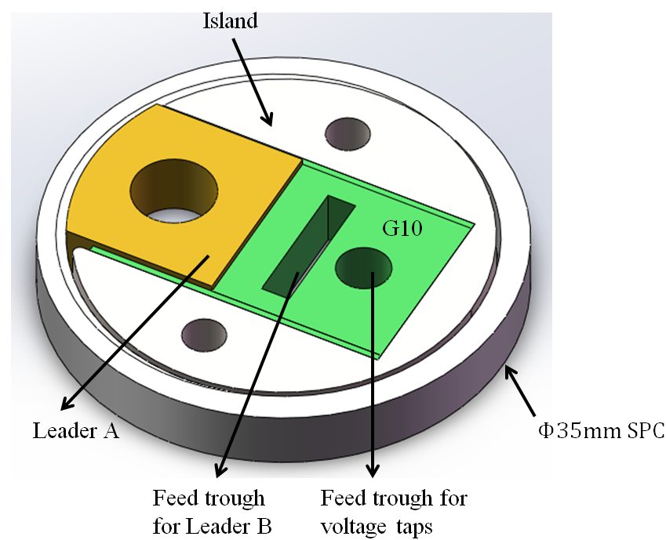
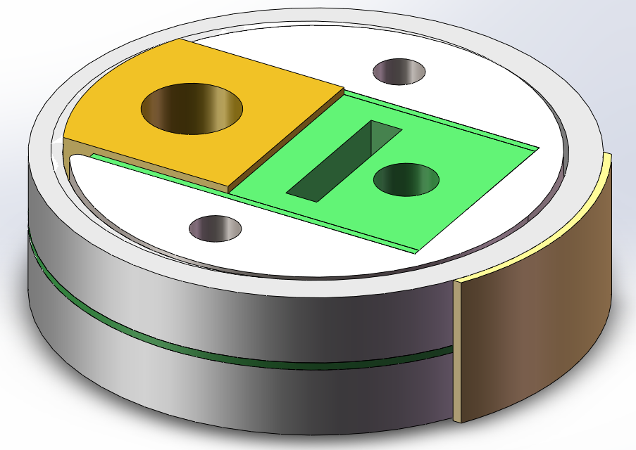
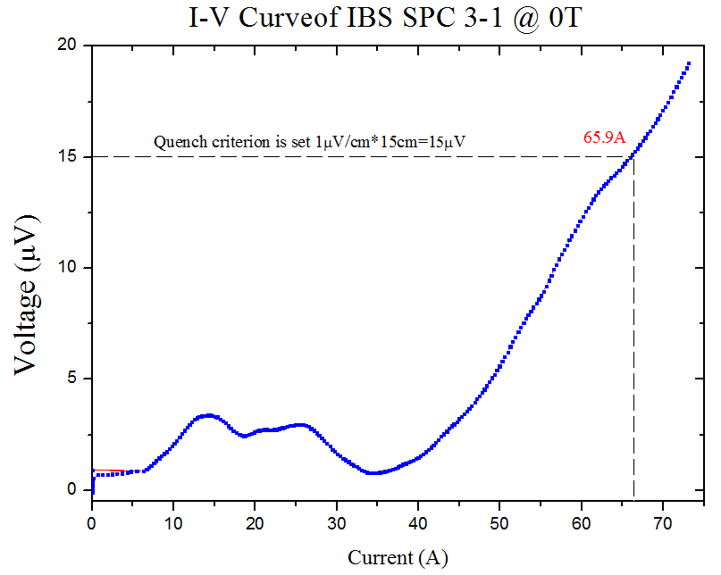
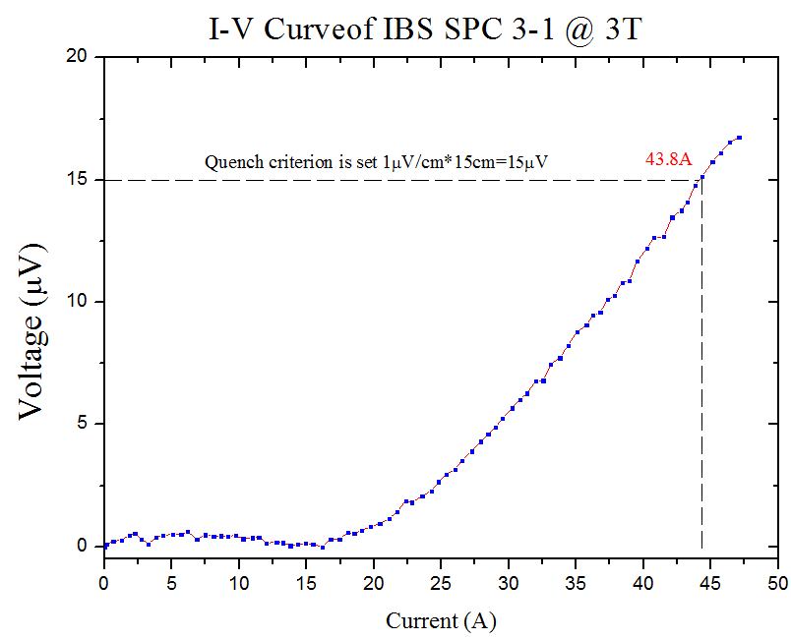
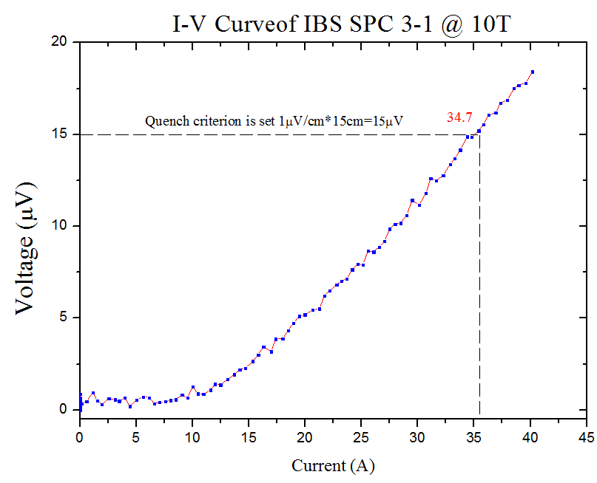
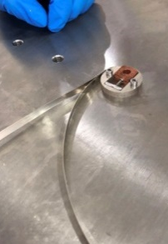
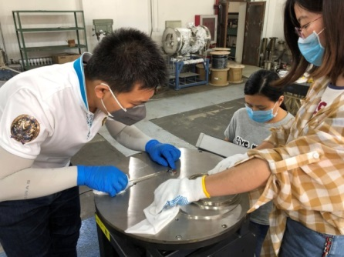
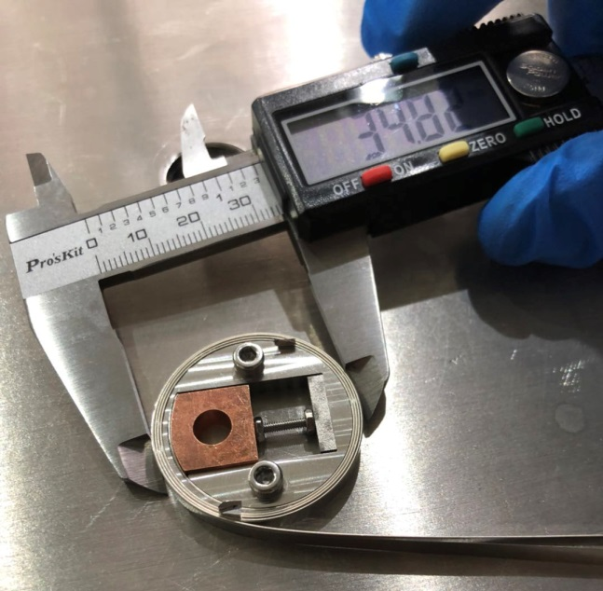
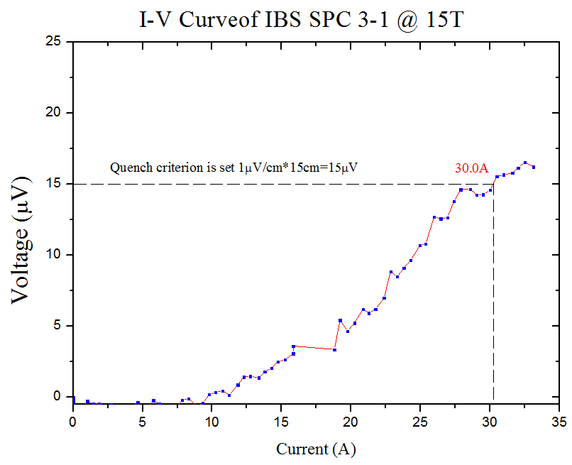
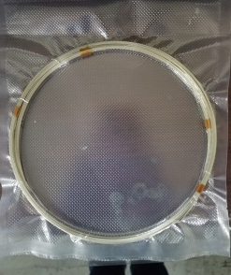
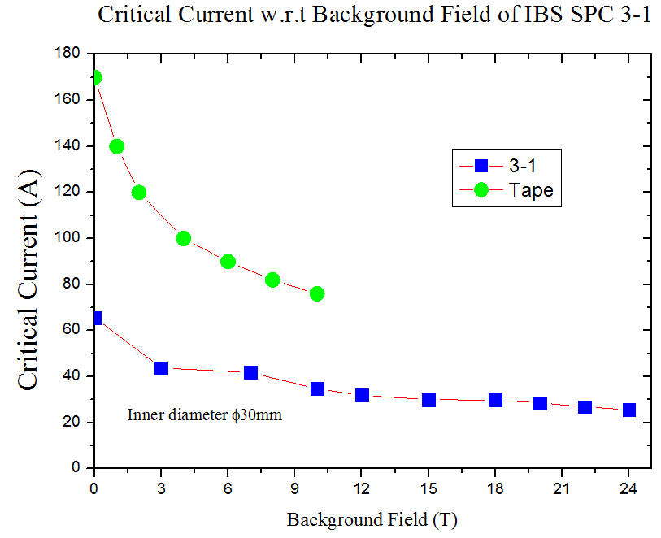
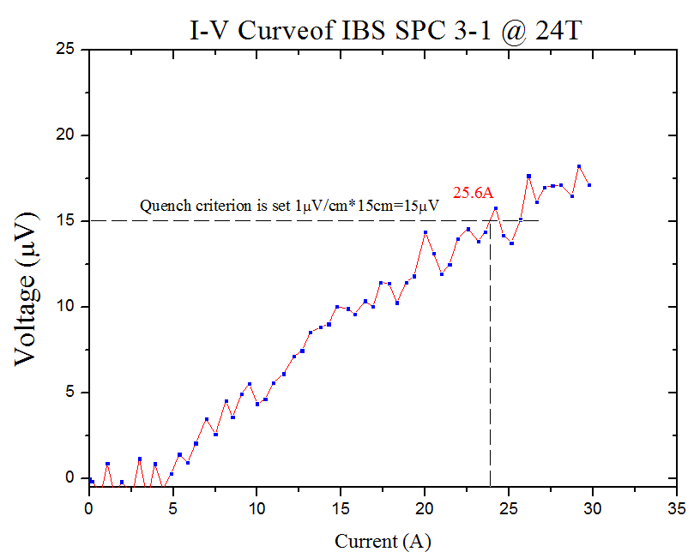
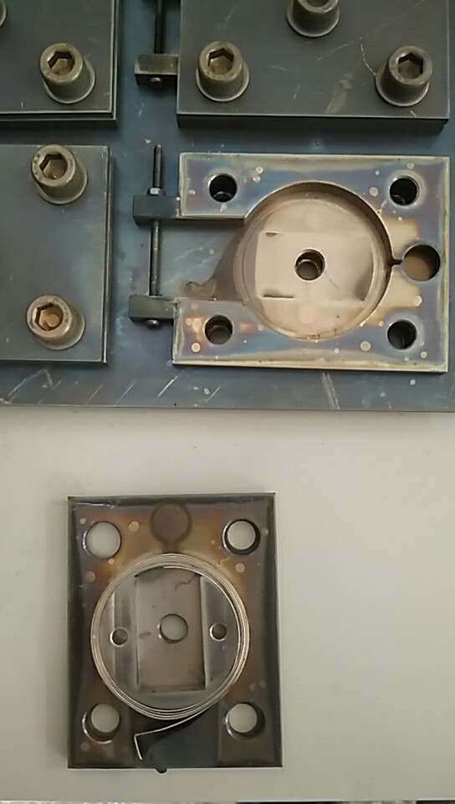
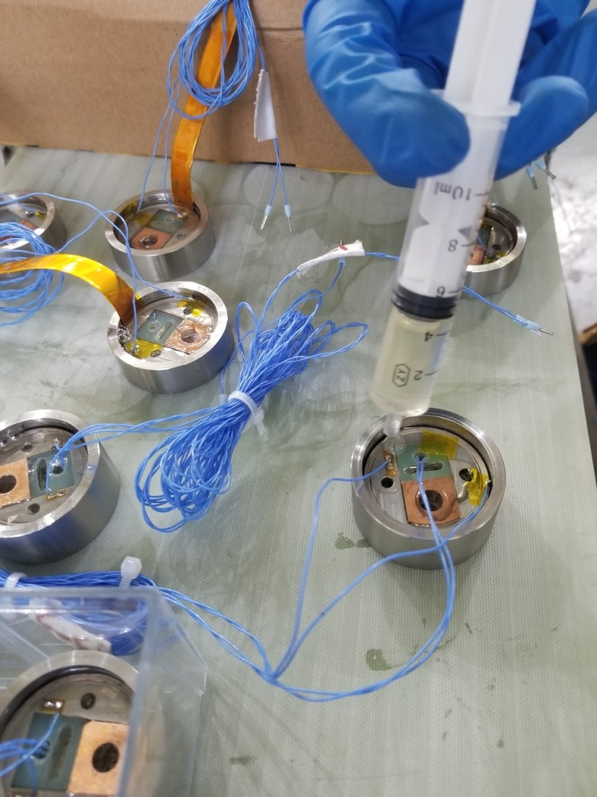
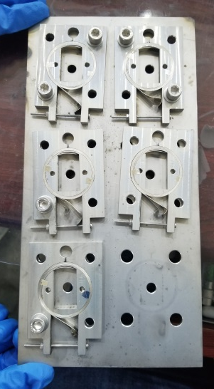
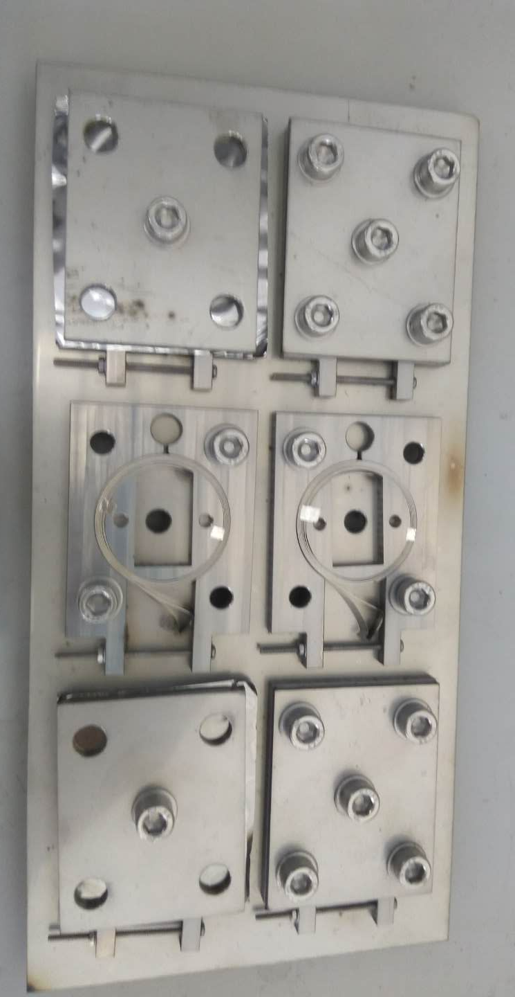
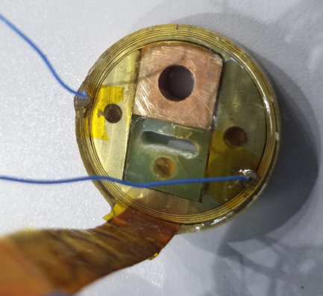
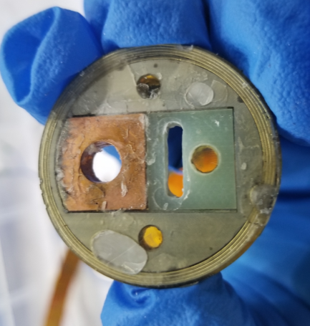
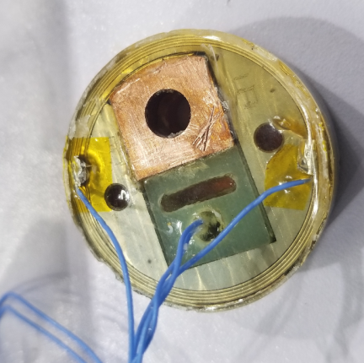
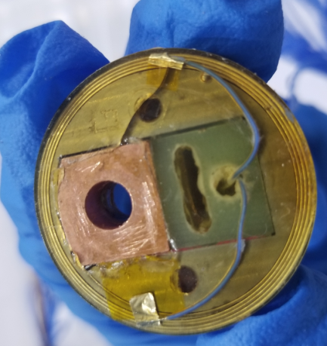
Fabrication and Test of ϕ35mm Iron Base Superconductor Solenoid
Zhan(Peter) Zhangª, Yingzhe Wangª, Shaoqing(Haley) Weiª, Lingling Gongª, Zhen Zhangª, Dongliang wang^{b}, Xianping Zhang^{b}, Qingjin Xuª
ªInstitute of High Energy Physics, Chinese Academy of Sciences,Beijing
^{b}Institute of Electrical Engineering, Chinese Academy of Sciences,Beijing
Introduction
 | Tantalum foil | Top plane | Oxidation | Voltage tap | Easy disassembly | Pancakes | Appearance
1-1 | N | Y | Y | Melted | N | SPC(1-1) | Ordinary
1-2 |  |  |  |  |  | DPC(1-3,4) | Bad
1-3
1-4 |  |  |  |  |  | DPC(1-5,6) | Bad
1-5
1-6 |  |  |  |  |  | Damaged | -
2-1 | Y | Y | N | Melted | N | DPC(2-1,2) | Ordinary
2-2 |  | Y | N | Existed | Y
2-3 |  | N | N | Existed | Y | SPC(2-3) | Damaged
2-4 |  | N | N | Existed | Y | SPC(2-4) | Ordinary
2-5 |  | Y | N | Melted | N | DPC(2-5,6) | Ordinary
2-6 |  | Y | N | Existed | Y
3-1 | Y | N | N | Existed | Y | SPC(3-1) | Ordinary
3-2 |  |  |  |  |  | SPC(3-2) | Ordinary
3-2 |  |  |  |  |  | DPC(3-3,4) | Good
3-4
3-5 |  |  |  |  |  | DPC(3-5,6) | Good
3-6
Iron-base super conductor(IBS) placed high hopes on the next generation high temperature superconductor is hotly studied. In 2017, the world first 100-m IBS tape was made by using the powder-in-tube technique in Institute of Electrical Engineering, Chinese Academy of Sciences^{[1-2]}.
From then on, the IBS was developed into the stage of application technology exploration. High field application is the tendency of superconductor application in the further. Therefor, it is significance to discuss the high field characteristic of IBS taps.
This study focus on verifying the high magnetic field characteristics of iron base superconductors. The authors made several IBS pancake coil and tested at high field. The detail of fabrication process and test result were presented in this paper.
The Φ35mm SPC was design as shown in Fig.1(a). Two SPCs were connected in series to make a DPC as shown in Fig.1(b).
The fabrication process was shown in Fig.2. The silver voltage taps were placed at the 2nd turn and 3.5th turn. The distance between two taps is about 150 mm. 18 SPC were made. The details of fabrication were listed in the following table.
Finally, 4 SPCs and 6 DPCs in all for testing.
Design
(a)
(b)
Results
 | Pancakes | Appearance | Voltage signal | Quench (0T)
1-1 | SPC(1-1) | Ordinary | N | -
1-2 | DPC(1-2,3) | Bad | Y | 36.2A
1-3 |  |  | N(up) | -
1-4 | DPC(1-4,5) | Bad | N | -
1-5 |  |  | N | -
1-6 | Damaged | - | - | -
2-1 | DPC(2-1,2) | Ordinary | Y | 39.0A
2-2 |  |  | N(up) | -
2-3 | SPC(2-3) | - | - | -
2-4 | SPC(2-4) | Ordinary | Y | 57.1A
2-5 | DPC(2-5,6) | Ordinary | N(up) | -
2-6 |  |  | N | -
3-1 | SPC(3-1) | Ordinary | Y | 65.9
3-2 | SPC(3-2) | Ordinary | Y | 48.4
3-2 | DPC(3-3,4) | Good | Y | Testing
3-4 |  |  | N(up) | -
3-5 | DPC(3-5,6) | Good | Y | Testing
3-6 |  |  | Y | Testing
(a)
Fig. 1. Conceptual design of Φ35mm IBS Solenoid : (a) SPC, (b) DPC
(b)
Pancake parameter | Value
Insider diameter | 30.0 mm
Out diameter | 34.2 mm
Height | 4.62 mm
Turns | 4.5
Total length of IBS wire | 910 mm
Fabrication
(c)
(d)
(f)
(e)
IBS tape
Winding process
Fig. 3. Test result of 3-1: (a) 0T, (b) 3T, (c) 10T, (d) 15T, (e) 24T, and (f) B-I curve.
Conclusion
The test result shows that iron-base superconductor can be applied at high magnetic field. The result has proven further the application prospect of iron-base superconductor as the next generation high temperature superconductor.
The fabrication technology of IBS coil was developed. The work is significance in further the IBS large application.
The voltage signal in some of sample pancakes jittered violently. It could be cost by coil or wire fabrications. To improve the reliability of IBS at high magnetic field, it would be the next work in the further.
Heat Treatment
Soldering
Epoxy Hardener
Reference
SPC
DPC
[1] Xianping Zhang, et al., “Superconducting Properties of 100-m Class Sr0.6K0.4Fe2As2 Tape and Pancake Coils Xianping”, IEEE TRANSACTIONS ON APPLIED SUPERCONDUCTIVITY, VOL. 27, NO. 4, JUNE 2017
[2] Satoshi Awaji, et al.,, “Anomalous anisotropy of critical currents in (Sr, K)Fe2As2 tapes”, Supercond. Sci. Technol. 30 (2017) 035018 (5pp).
[3] Chiheng Dong , et al., "Calorimetric evidence for enhancement of homogeneity in high performance Sr1-xKxFe2As2 superconductors", Scripta Materialia 138 (2017) 114–119.
Fig. 2. Fabrication process of Φ35mm IBS Solenoid

