Slide 1


Lattice Design of the Collider Ring toward TDR
Yiwei Wang
for the CEPC Accelerator Physics Group
The Institute of High Energy Physics, Chinese Academy of Sciences
The 2018 International Workshop on High Energy Circular Electron Positron Collider
12-14 November 2018

Slide 2


Outline
Introduction
Lattice design of the collider ring
Performance with errors
Summary

Slide 3
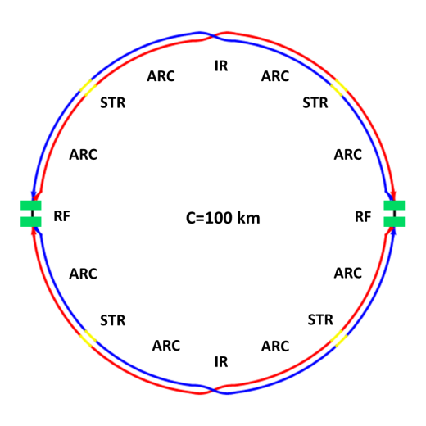
Introduction
The circumference of CEPC collider ring is 100 km.
In the RF region, the RF cavities are shared by two rings for H mode.
Twin-aperture of dipoles and quadrupoles is adopt in the arc region to reduce the their power. The distance between two beams is 0.35m.
Compatible optics for H, W and Z modes
  For the W and Z mode, the optics except RF region is got by scaling down the magnet strength with energy.
  For H mode, all the cavities will be used and bunches will be filled in half ring.
  For W & Z modes, bunches will only pass half number of cavities and can be filled in full ring.
Notes:
2 fold symmetry

Slide 4
by D. WANG
 | Higgs | W | Z（3T） | Z（2T）
Number of IPs | 2
Beam energy (GeV) | 120 | 80 | 45.5
Circumference (km) | 100
Synchrotron radiation loss/turn (GeV) | 1.73 | 0.34 | 0.036
Crossing angle at IP (mrad) | 16.5×2
Piwinski angle | 3.48 | 7.0 | 23.8
Number of particles/bunch N_{e} (10¹⁰) | 15.0 | 12.0 | 8.0
Bunch number (bunch spacing) | 242 (0.68μs) | 1524 (0.21μs) | 12000 (25ns+10%gap)
Beam current (mA) | 17.4 | 87.9 | 461.0
Synchrotron radiation power /beam (MW) | 30 | 30 | 16.5
Bending radius (km) | 10.7
Momentum compact (10⁻⁵) | 1.11
β function at IP β_{x}* / β_{y}* (m) | 0.36/0.0015 | 0.36/0.0015 | 0.2/0.0015 | 0.2/0.001
Emittance ε_{x}/ε_{y} (nm) | 1.21/0.0024 | 0.54/0.0016 | 0.18/0.004 | 0.18/0.0016
Beam size at IP σ_{x} /σ_{y} (μm) | 20.9/0.06 | 13.9/0.049 | 6.0/0.078 | 6.0/0.04
Beam-beam parameters ξ_{x}/ξ_{y} | 0.018/0.109 | 0.013/0.123 | 0.004/0.06 | 0.004/0.079
RF voltage V_{RF} (GV) | 2.17 | 0.47 | 0.10
RF frequency f _{RF} (MHz) (harmonic) | 650 (216816)
Natural bunch length σ_{z} (mm) | 2.72 | 2.98 | 2.42
Bunch length σ_{z} (mm) | 4.4 | 5.9 | 8.5
HOM power/cavity (2 cell) (kw) | 0.46 | 0.75 | 1.94
Energy spread (%) | 0.134 | 0.098 | 0.080
Energy acceptance requirement (%) | 1.35 | 0.90 | 0.49
Energy acceptance by RF (%) | 2.06 | 1.47 | 1.7
Photon number due to beamstrahlung | 0.082 | 0.050 | 0.023
Beamstruhlung lifetime /quantum lifetime* (min) | 80/80 | >400
Lifetime (hour) | 0.43 | 1.4 | 4.6 | 2.5
F (hour glass) | 0.89 | 0.94 | 0.99
Luminosity/IP L (10³⁴cm⁻²s⁻¹) | 2.93 | 10.1 | 16.6 | 32.1

Slide 5
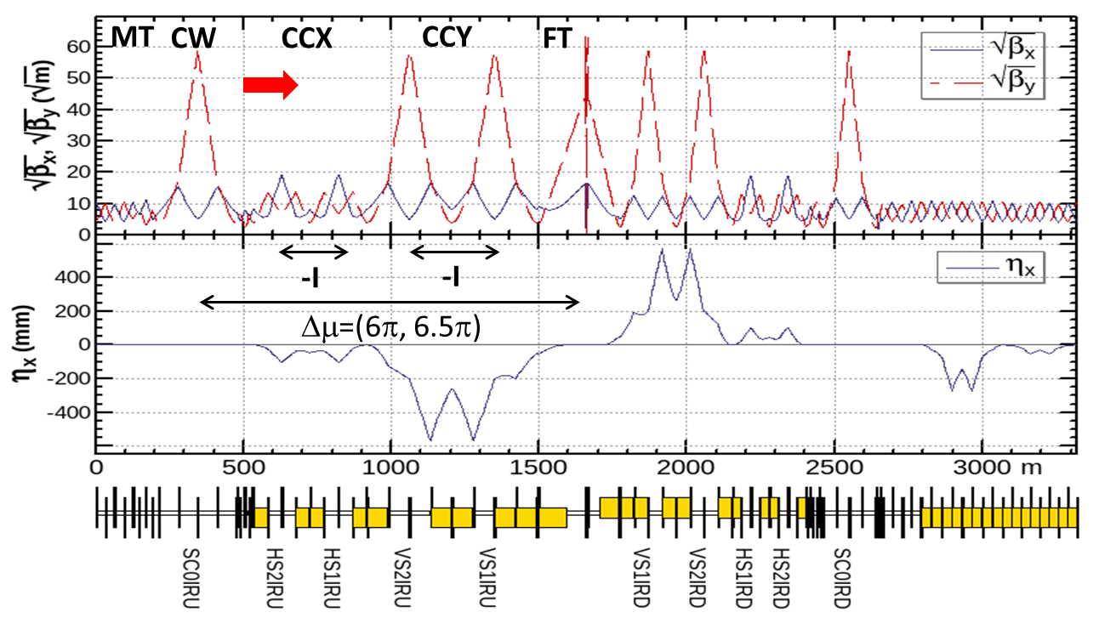
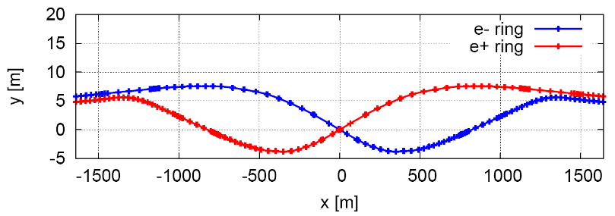
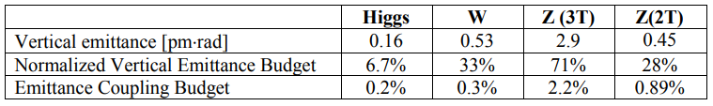
Optics of Interaction region
local chromaticity correction of both plane, asymmetric layout 1), crab-waist collision 2)
L*=2.2m, θ_{C} =33mrad, G_{QD0} =136T/m, G_{QF1} =111T/m, L_{QD0} =2.0m, L_{QF1} =1.48m
IP upstream of IR: Ec < 120 keV within 400m, last bend Ec = 45 keV
IP downstream of IR: Ec < 300 keV within 250m, last bend Ec = 97 keV
1) K. Oide et al., ICHEP16.
2) M. Zobov et al., Phys. Rev. Lett. 104, 174801(2010).
Notes:
downstream BMV01IRD 60.975m 101.309 Gs 67.539 Gs 38.413 Gs
upstream BMV01IRU 93.378m -47.336 Gs -31.557 Gs -17.948 Gs
The dipoles are split into short ones.
Some of them can be turned off to keep geometry and reasonable strength when running at W and Z modes.

Slide 6
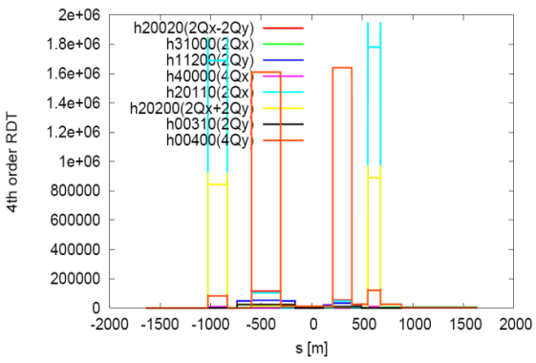
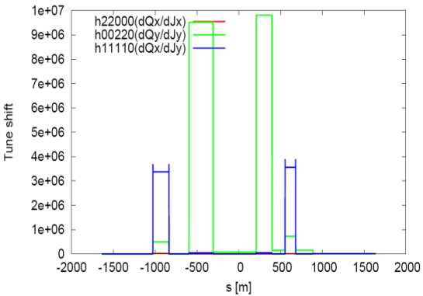
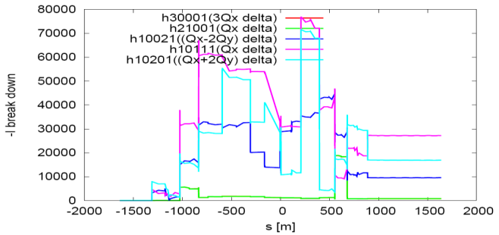
Nonlinearity correction of Interaction region
  Local chromaticity correction with sextupoles pairs separated by –I transportation
  all 3rd and 4th RDT (in Lie operator f3 and f4) due to sextupoles almost cancelled 1)
  up to 3rd order chromaticity corrected with main sextupoles, phase tuning and additional sextupole pair 2,3)
  tune shift due to finite length of main sextupoles corrected with additional weak sextupoles 3,4)
  Break down of -I due to energy deviation corrected with ARC sextupoles
1) K. Brown
2) Brinkmann
3) Y. Cai
4) A. Bogomyagkov

Slide 7
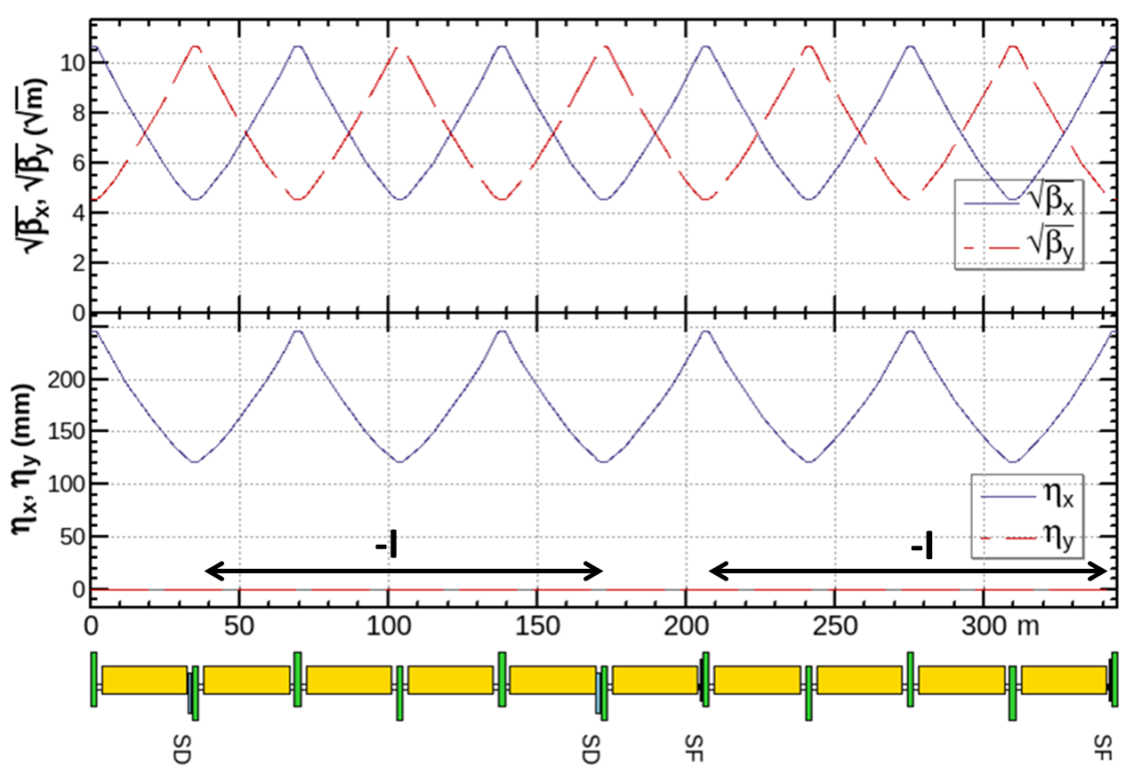
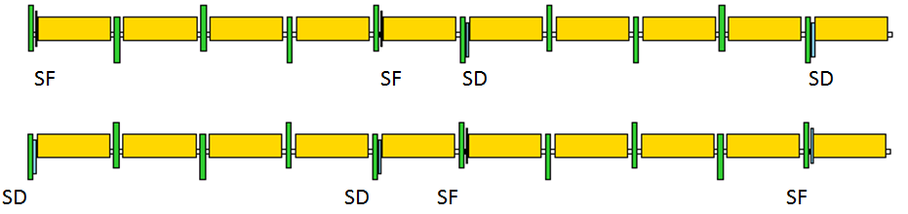
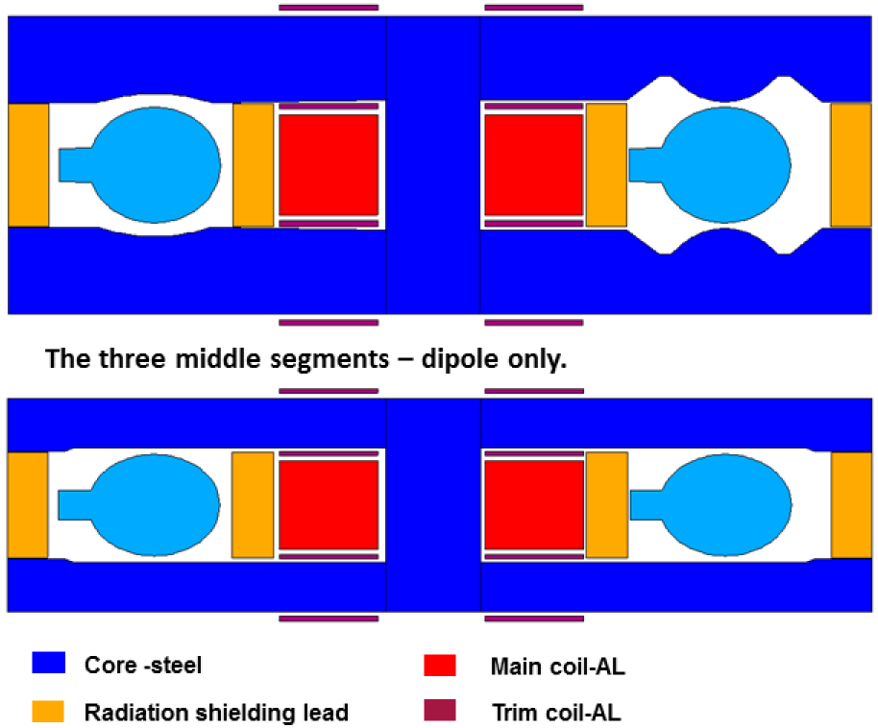
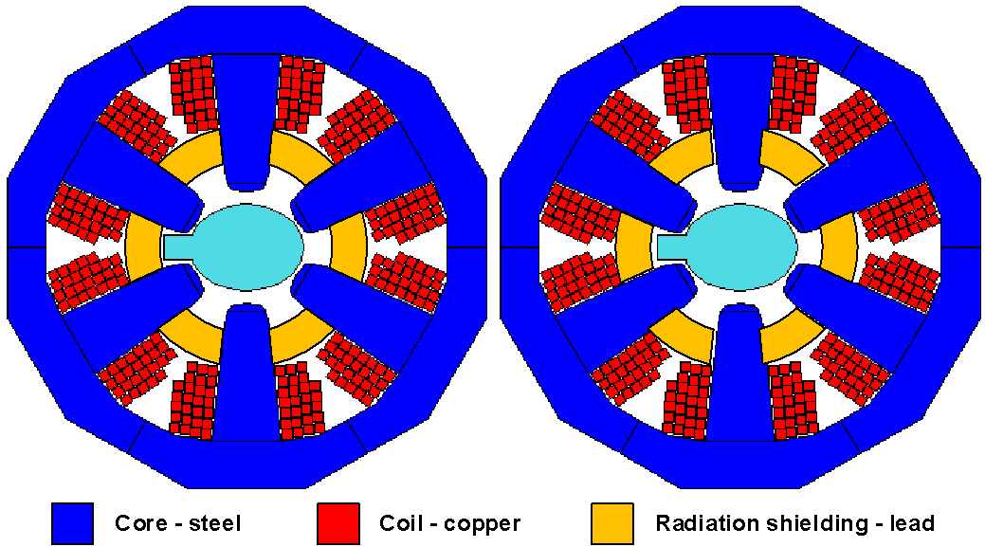
Optics design of ARC region
  FODO cell, 90°/90°, non-interleaved sextupole scheme, period =5cells
Twin-aperture of dipoles and quadrupoles* is adopt in the arc region to reduce the their power. The distance between two beams is 0.35m.
*Ref: A. Milanese,
PRAB 19, 112401 (2016)
magnets designed by
F. Chen, M. Yang, X. Sun et al.

Slide 8
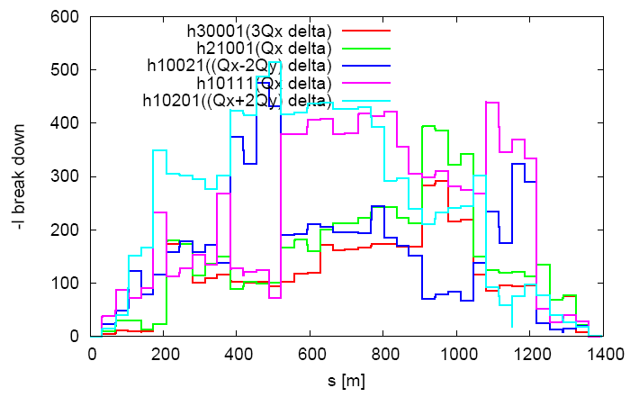
Nonlinearity correction of ARC region
  FODO cell, 90°/90°, non-interleaved sextupole scheme, period =5 cells
With 2 families of sextupoles in each 4 periods, i.e. 20 cells
  all 3rd and 4th resonance driving terms (in Lie operator f3 and f4) due to sextupoles cancelled, except small 4Qx, 2Qx+2Qy, 4Qy, 2Qx-2Qy
  break down of -I due to energy deviation cancelled
  thus cells numbers equal to 20*N in each ARC region, 32 families of ARC sextupoles used to optimize DA
Notes:
There're eight 4-th order resonances driving by sextupoles in Lie operator f4:
2Qx (JxJy), 2Qx (Jx^2), 2Qy (JxJy), 2Qy (Jy^2), 4Qx (Jx^2), 4Qy (Jy^2), 2Qx+2Qy (JxJy), 2Qx-2Qy (JxJy).
The first four resonaces are exactly cancelled and the last four resonances accumulate but are still small.

Slide 9
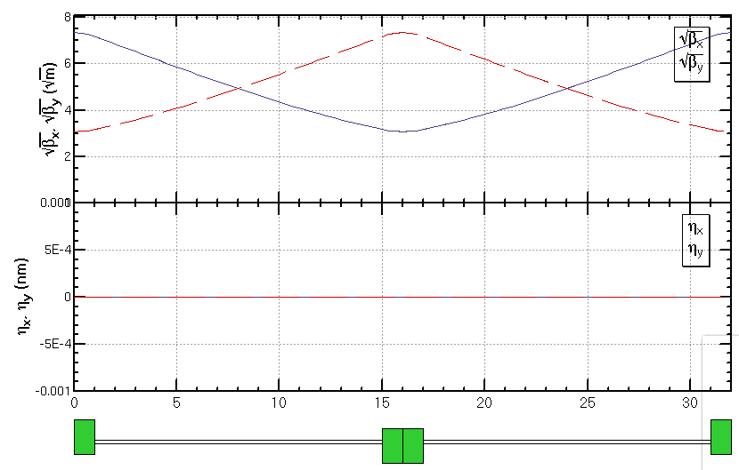
FODO cell for cryo-module
Get a smallest average beta function to reduce the multi-bunch instability caused by RF cavities especially for the Z mode
  90/90 degree phase advance
  The distance between quadrupoles is 13.7 m which allow a cryo-module with length of 12m.
  average beta function 30 m
336 / 6 / 2RF stations / 2 sections / 2= 7 cells in each section
90/90 deg
Half cell: 13.7m+2.3m
βmax: 53.8 m
βmin: 9.5 m
cryo-module
quadrupole

Slide 10
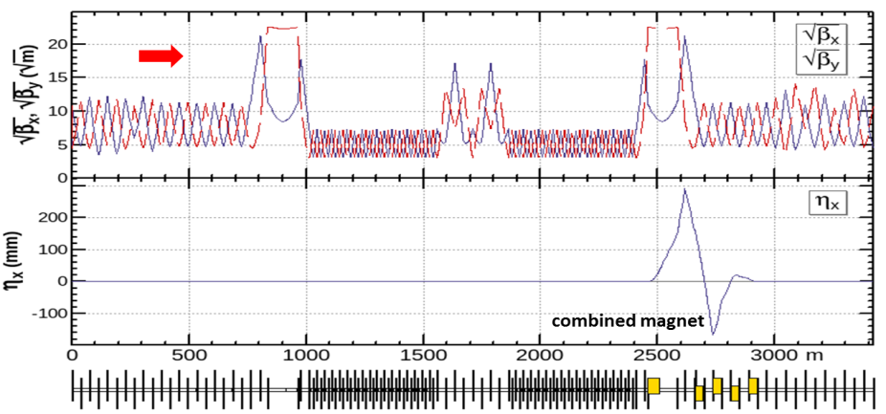
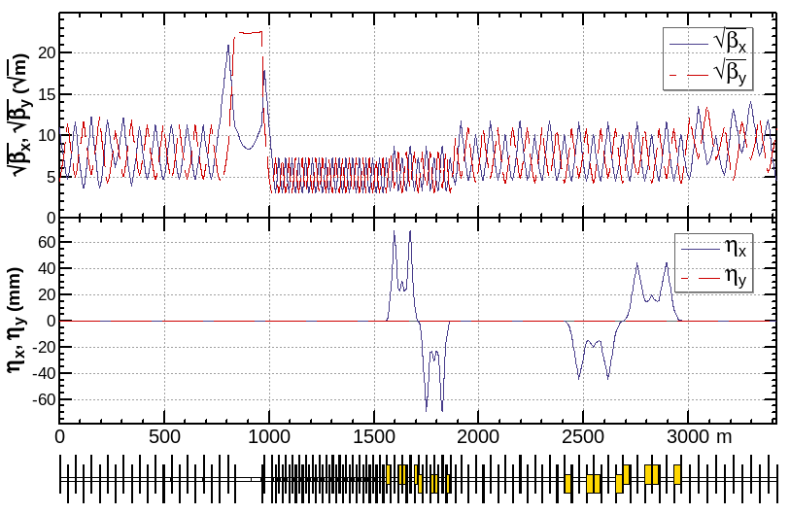
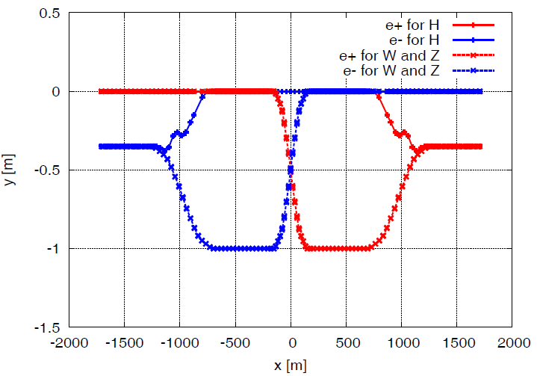
Optics design of RF region
Common RF cavities for e- and e+ ring (Higgs)
An electrostatic separator combined with a dipole magnet to avoid bending of incoming beam (ref: K. Oide, ICHEP16)
RF region divided into two sections for bypassing half numbers of cavities in Z mode
For Higgs mode
For W & Z mode
Esep= 2.0 MV/m
Bdip=66.7 G
L= 4 m×10
Δx= 13.3 cm at the entrance of quad

Slide 11
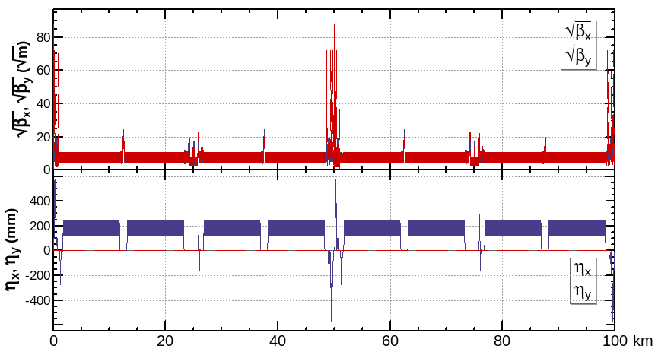

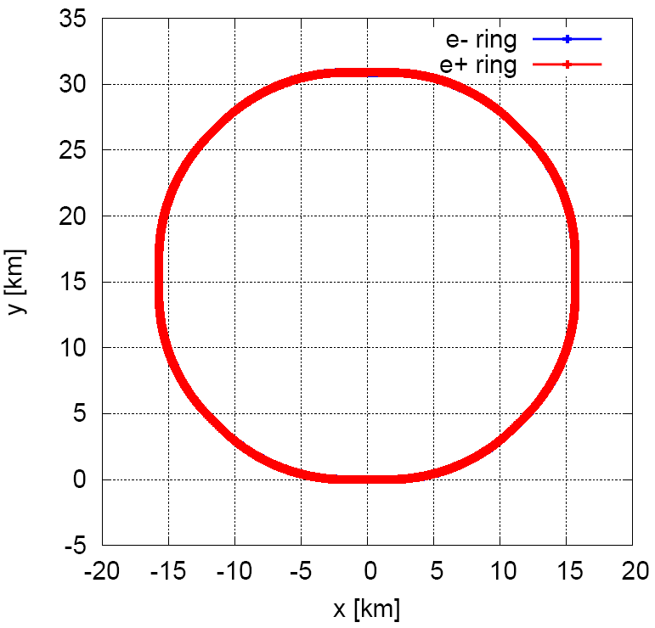
Optics of the collider ring
  An optics fulfilling requirements of the parameters list, geometry, photon background and key hardware.
tune= 363.10 / 365.22
natural chromaticity= -464 / -1161

Slide 12
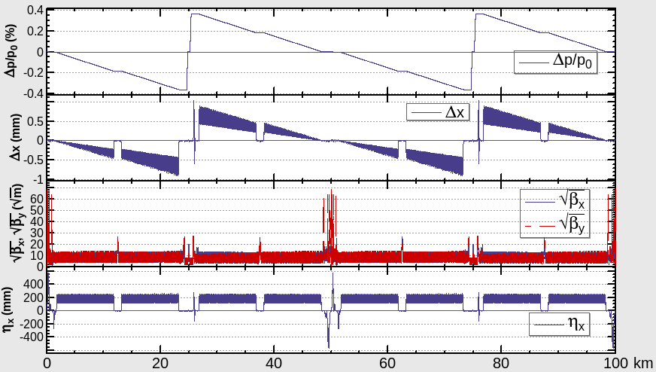
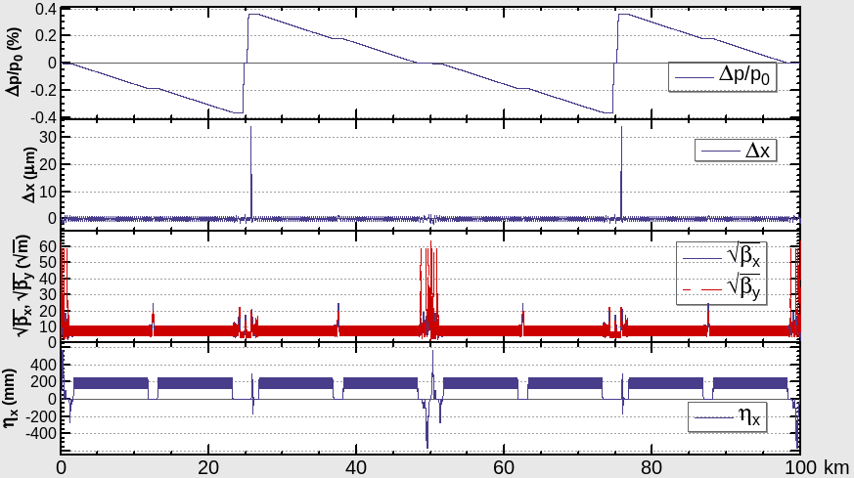
Energy sawtooth effects and correction
With only two RF stations, the energy sawtooth is around ±0.35 %
The closed orbit distortion in CEPC collider ring is around 1 mm and becomes 1um after tapering the magnet strength with beam energy.
  adjusting range of magnets strength ±1.5%
Notes:
adjusting range of magnets strength ±1.5%
dipole, quadurpole：twin-aperture, additional independent coils for two apertures
Sextupole: single-aperture, independent

Slide 13
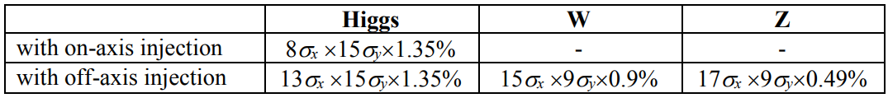
Dynamic aperture requirements
Dynamic aperture requirements
Start point of the optimization
  Nonlinearity optimized term by term with 10 families of sextupoles in the IR and 4 families of sextupoles in the ARC.
Optimize dynamic aperture directly with MODE (Y. ZHANG, IHEP)
  With 10 families of sextupoles in the IR, 32 families of sextupoles in ARC and 8 phase advances
“On-axis injection”, Xiaohao Cui, 15:20-15:40, 25 Sep
Notes:
2 damping times

Slide 14
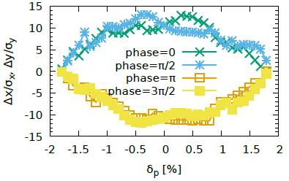
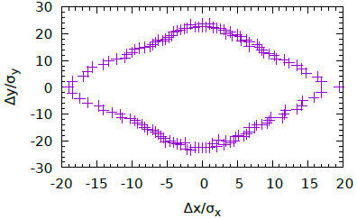
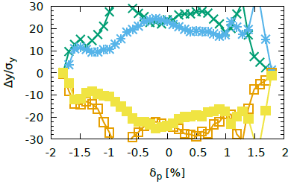
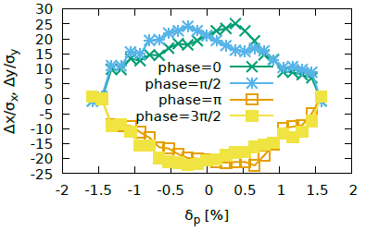
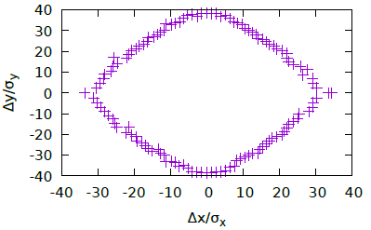
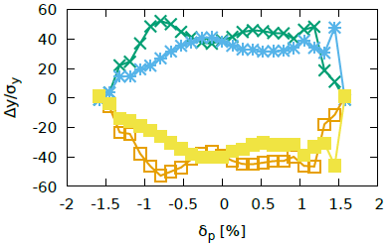
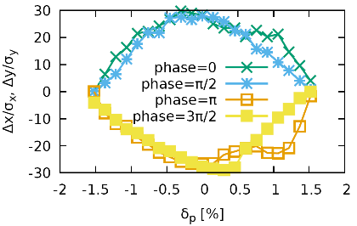
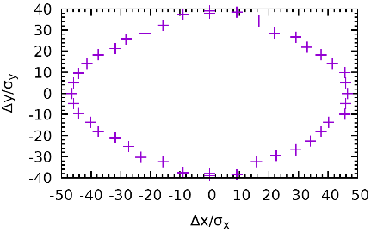
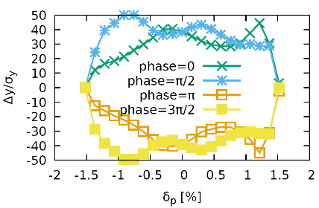
Dynamic aperture result (w/o errors)
by Y. ZHANG, et al
Tracking in SAD w/ synchrotron radiation damping, fluctuation(100 samples), energy sawtooth and tapering, 145/475/2600 turns(H/W/Z, 2 damping times), 4 initial phases
Higgs
$20σ_{x}×23σ_{y} \& 0.018$ w/o errors
W
$32σ_{x}×40σ_{y} \& 0.015$ without errors
Z
$46σ_{x}×40σ_{y} \& 0.015$ without errors

Slide 15
Performance with errors
by Yuanyuan WEI, et al
LOCO based on AT is used to correct distortion of closed orbit, beta, dispersion and coupling.
  correct distortion of closed orbit w/o sextupole
  correct the beta and dispersion w/ sextupole
  correct coupling
Component | Δx (mm) | Δy (mm) | Δz (mm) | Δθ_{x} (mrad) | Δθ_{y} (mrad) | Δθ_{z} (mrad) | Field error
Dipole | 0.05 | 0.05 | 0.15 | 0.2 | 0.2 | 0.1 | 0.01%
Quadrupole | 0.03 | 0.03 | 0.15 | 0.2 | 0.2 | 0.1 | 0.02%
Further study with larger tolerance of misalignment is undergoing and the goal for Δx and Δy is 100 μm. (Yuanyuan WEI’s talk)

Slide 16
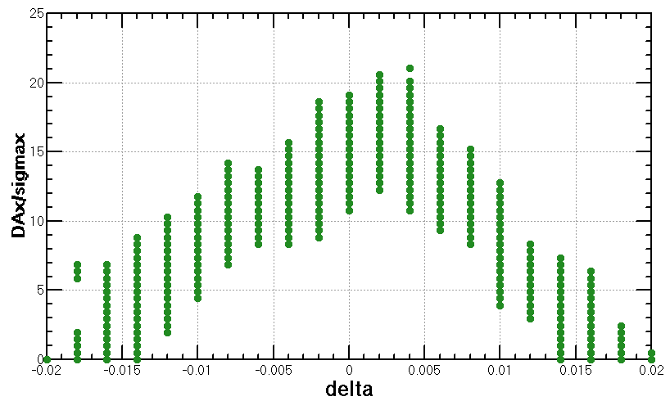
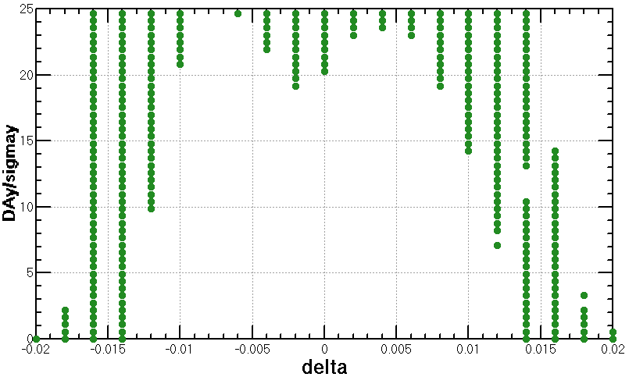

Dynamic aperture results (w/ errors)
Dynamic aperture result for Higgs mode
  Tracking in SAD w/ radiation damping, fluctuation, energy sawtooth and tapering, 145 turns(2 damping times), initial phases=0
  Totally around 800 random seeds used
  Horizontal dynamic aperture decreased significantly with errors. But it still fulfils the dynamic aperture requirement of on-axis injection.
$20σ_{x}×23σ_{y} \& 0.018$ w/o errors
$11σ_{x}×19σ_{y} \& 0.014$ w/ errors
Notes:
Design coupling 0.26 % used

Slide 17
Work list toward TDR
Interaction region design
  optimization with progress of MDI study
RF region design
  scheme with septum magnet to reduce the quantities of electrostatic separators
Dynamic aperture optimization
  further optimization to get more margin for reduction due to error
  longer QD0, more tuning knobs…
Error tolerance
  study of loose tolerance
Lattice optimization for the polarization at Z energy
Notes:
Design coupling 0.26 % used

Slide 18
Summary
  Linear optics of the CEPC collider ring designed fulfilling requirements of the parameters list, geometry, photon background and key hardware.
Nonlinearity correction is made to give a good start point of dynamic aperture optimization and further optimization is made with MODE.
For Higgs mode, the dynamic aperture with the errors currently considered fulfill the requirements of on-axis injection.
Further study with larger tolerance of misalignment is undergoing and the goal for Δx and Δy is 100 μm.
Works toward TDR is undergoing.

Slide 19
Thank you!

Slide 20
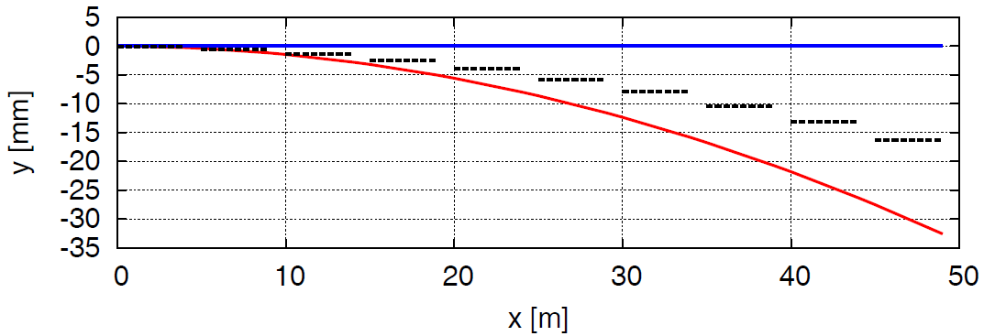
Optics design of RF region
An electrostatic separator combined with a dipole magnet to avoid bending of incoming beam (ref: K. Oide, ICHEP16)
  center of component located at the middle of the two beam orbit to reduce the beam stay clear region requiement
e+
By
Esep= 2.0 MV/m
Bdip=66.7 G
L= 4 m×10
Δx= 10 cm at entrance of quad
Ex
4 m
e+
e-
center of the
combined component
Notes:
! Hgf=(18*sigmax+3mm)+d/2=12.396+32.6/2= 28.696 mm
! Vgf=(22*sigmay+3mm)= 5.339 mm

