Slide 1
Power supply and Electrostatic separator for CEPC
Bin Chen
2018.11.13
International Workshop on CEPC

Slide 2
Outline
  Design and progress for power supply
    High-precision power converter
    Digital Power Supply Control Module (DPSCM)
  Design and progress for electrostatic separator
  Summary

Slide 3
Basic design principles for the power supplies
  A large number of power supplies are required for powering the magnets of the Collider ring, the Booster ring, the Transport line, the Linac and the Damping ring.
  Digital-controlled , Modular-based ,Home-made customized power converters
  Self-designed Digital Power Supply Control Module(DPSCM) with digital close-loop control, diagnostics, monitoring and local/remote service

Slide 4
Design and progress for power supply
Focusing on key issues for PS system
    3000A/10V High-precision (20ppm) power converter
    For superconducting magnets excitation
    Digital Power Supply Control Module

Slide 5
High-precision power converter
  Specifications
DC maximum output current –Imax（A） | 3000
DC output voltage（V） | 10
operating quadrants | 1：(V+，I+)
stability (8 h–10 s) – referred to Imax（ppm） | 20
Reproducibility(1 d) – referred to Imax（ppm） | 20
absolute accuracy – referred to Imax（ppm） | 20
voltage ripple – （rms） | 10mV @less than 600Hz 40mV @600Hz and greater

Slide 6
High-precision power converter
  the power converters are split in three independent parts
    A power part acting as a voltage source, which is suitable for industrial design and production
    Current transducers （Commercial Product or Self-design)
    Self-designed digital electronics control module, which performs the current regulation, diagnostics, monitoring and local/remote service . It’s standardized for all types of power supply.

Slide 7
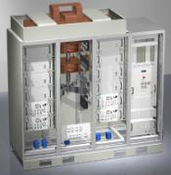
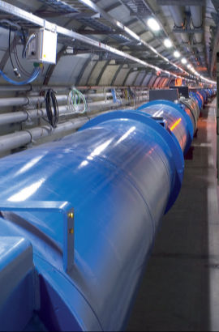
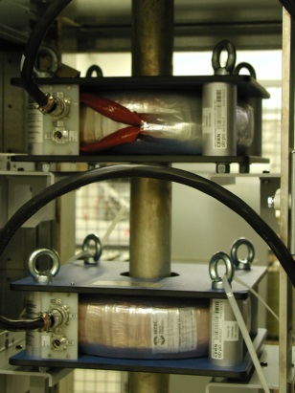
High-precision power converter
Digital Current loop:
promise current with high precision
Voltage loop:
ensuring low voltage ripple
I
B
Iref
Vref
+
e_{I}
Reg.
V
DAC
G(s)
-
e_{V}
F(z)
I_{measured}

Slide 8
High-precision power converter
  Topology:
    Full Bridge- Zero Voltage Switch -Phase Shifting （FB-ZVS-PS）
    Modules parallel-connected for high current output
    used in the project HEPS-TF 300A@50V

Slide 9
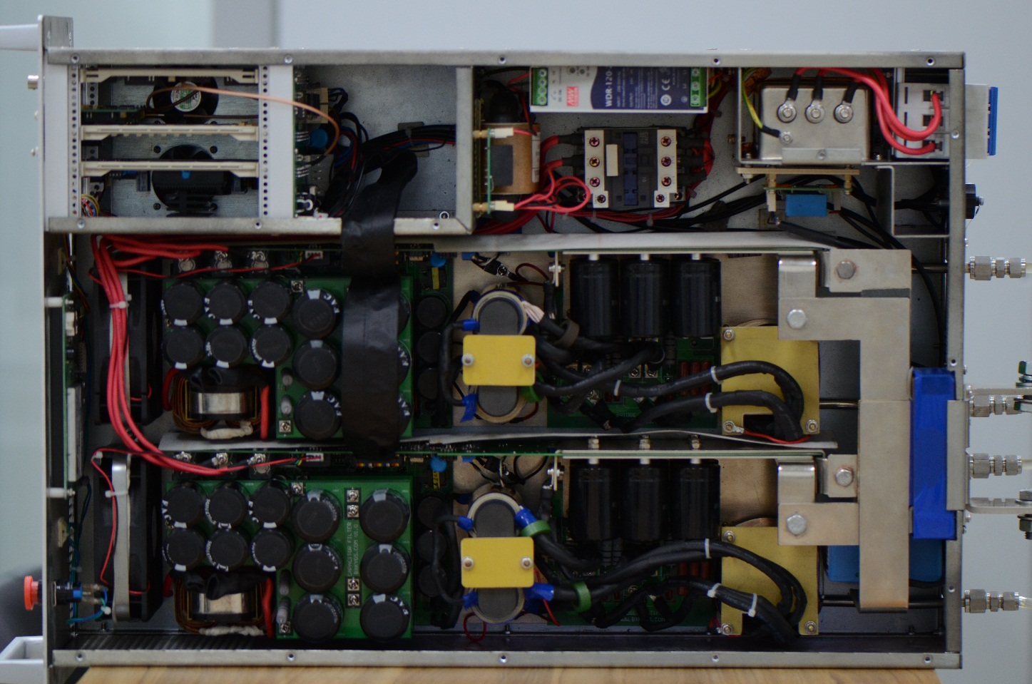
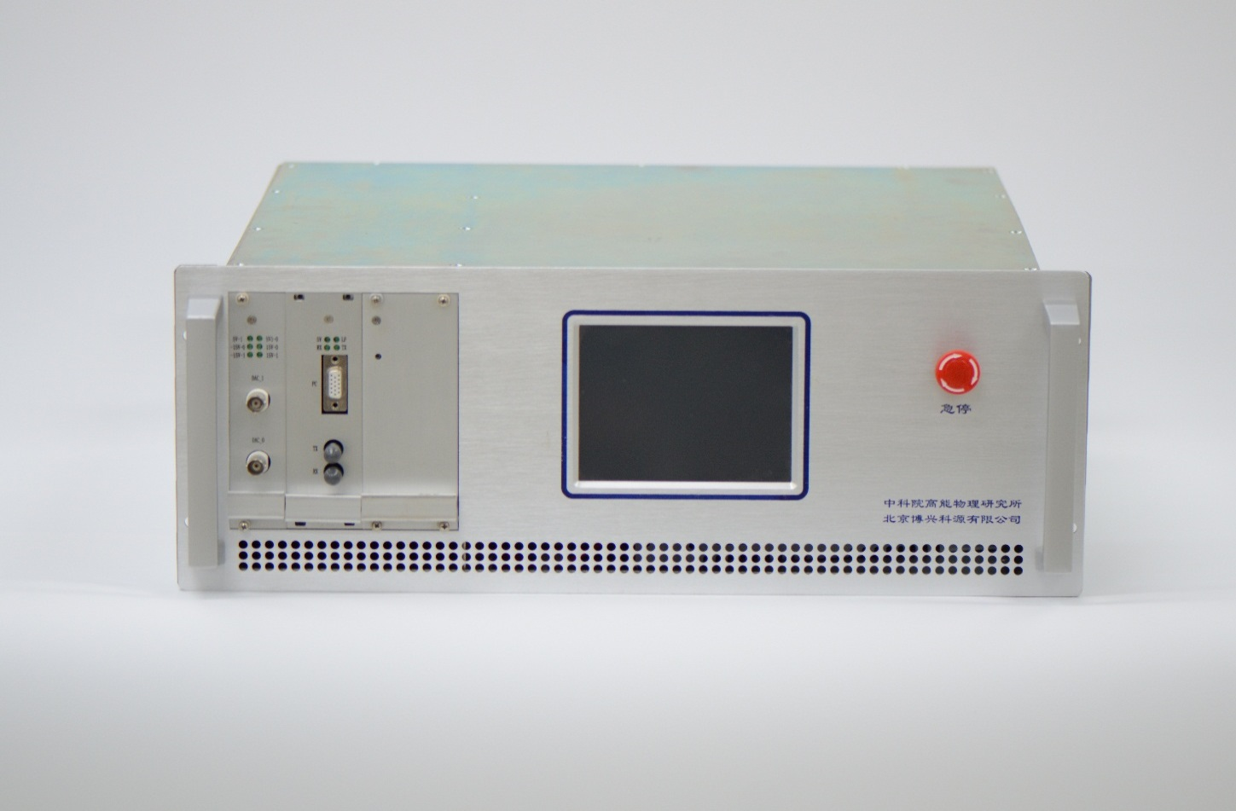
Prototype: HEPS-TF 300A@50V
Digital controller
Height: 4U
Two modules: 150A@50V

Slide 10
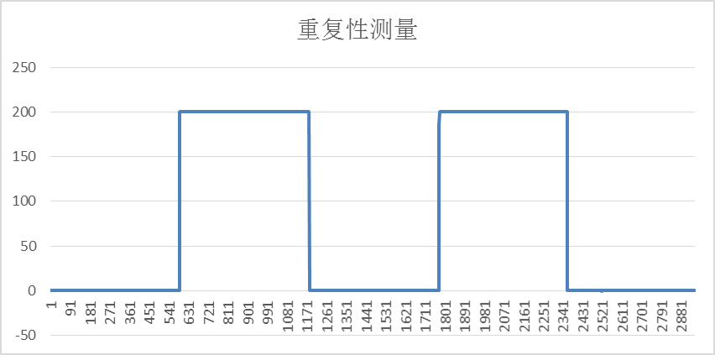
Prototypes: test
For high precision power supply:
  Stability: (Imax – I min)/I_{N} during 12h, 7.75ppm
  Reproducibility
R = | I_{1average} - I_{0average} | / I_{N}=|200.1912862-200.1913251|/300
=1.29772E-07

Slide 11
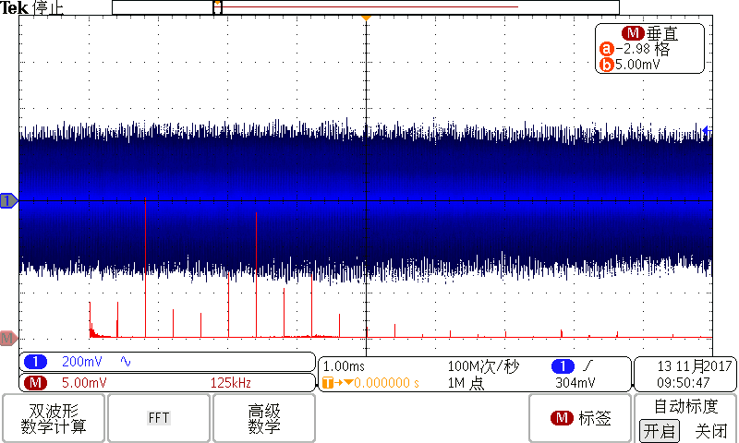
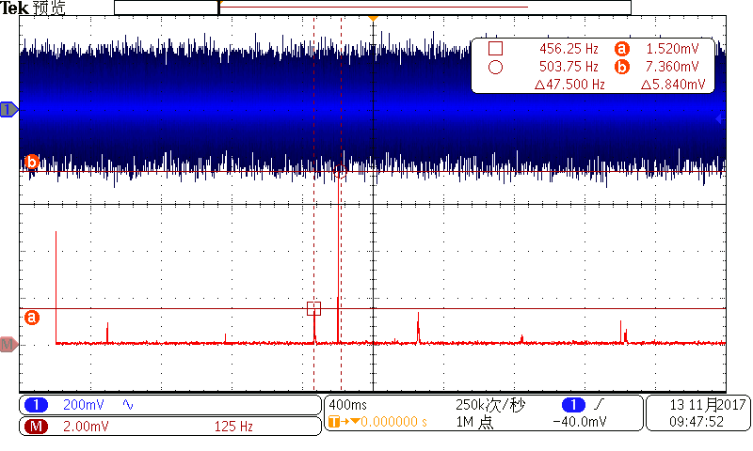
Prototypes: test
For high precision power supply:
  Voltage Ripple:
LF: Less than 10mV
HF: Less than 40mV

Slide 12
Prototypes: to do
For high precision power supply:
    Extend the power of each module
    3 modules parallel-connected for 30kW output
    Use Peak Current-mode Control PWM to reject the voltage ripple

Slide 13
Digital Power Supply Control Module
  Digital Power Supply Control Module (DPSCM) : used in the project CSNS, ADS injector-I, and BEPCII
    all algorithms and peripherals control entirely implemented in one FPGA.
    Control cycle achieving less than 1us, it is about several times faster than DSP- based design.

Slide 14
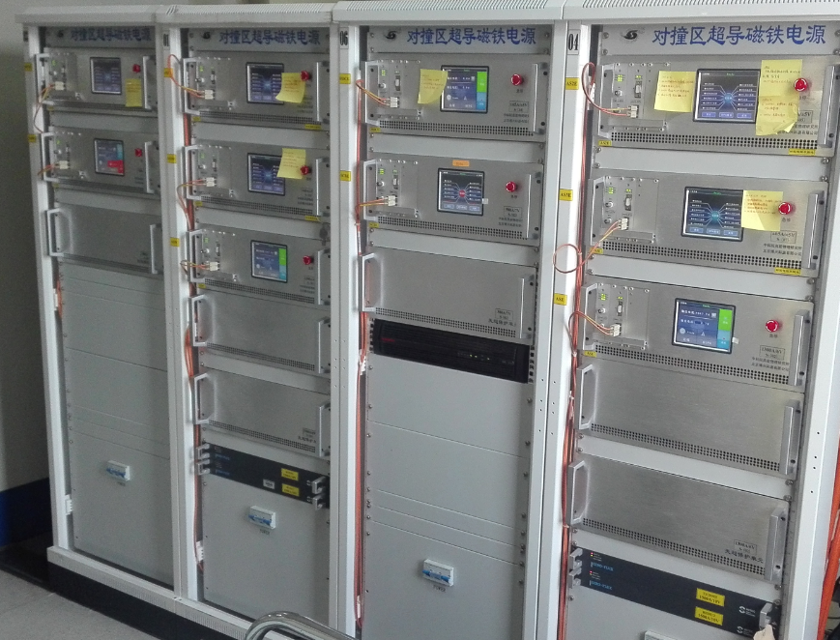
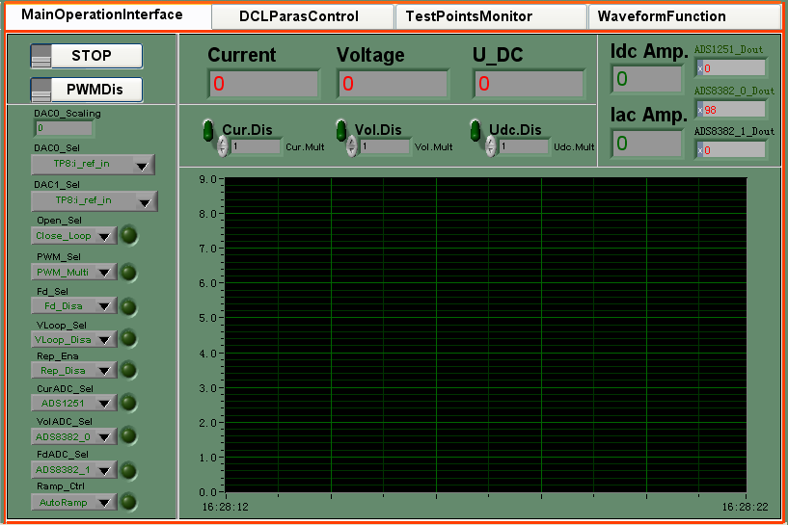
Digital Power Supply Control Module

Slide 15
DPSCM-II for CEPC power supplies
DPSCM-MB: PID + modern control theory; cost-effective
high precision ADC board DPSCM-AD: temp control
the voltage source interfacing board DPSC-DA
the diagnostic board DPSCM_MDA

Slide 16
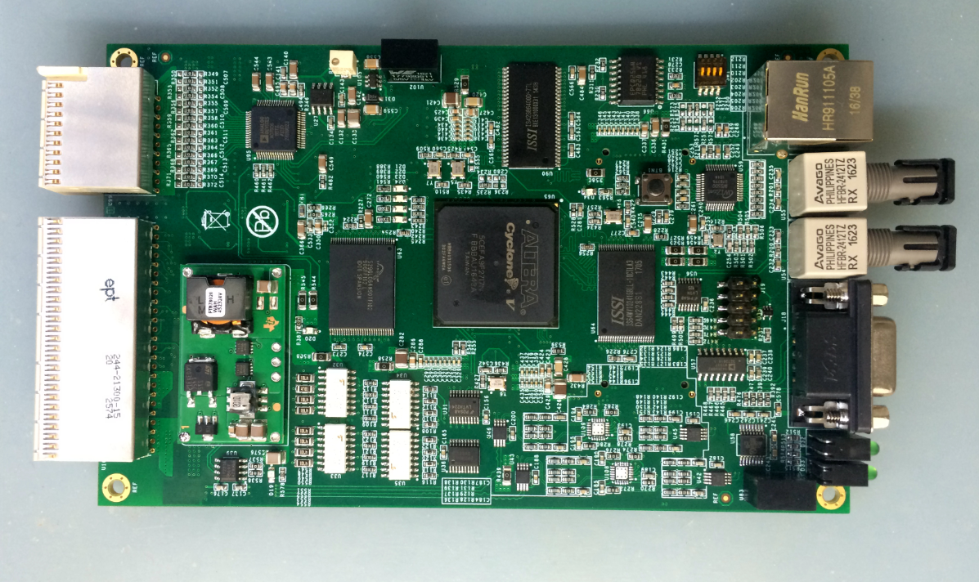
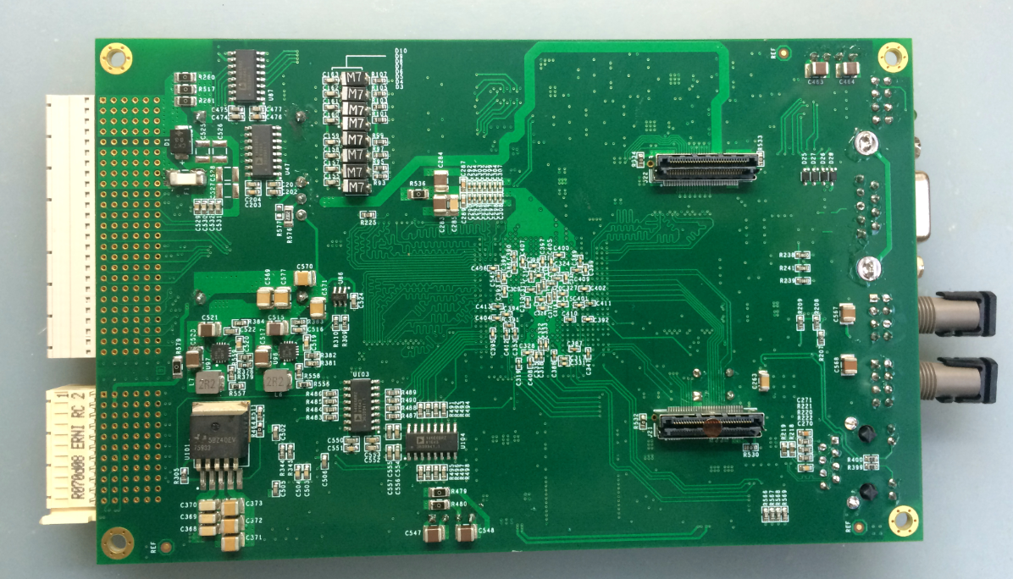
DPSCM-II for CEPC power supplies
DPSCM-II MB

Slide 17
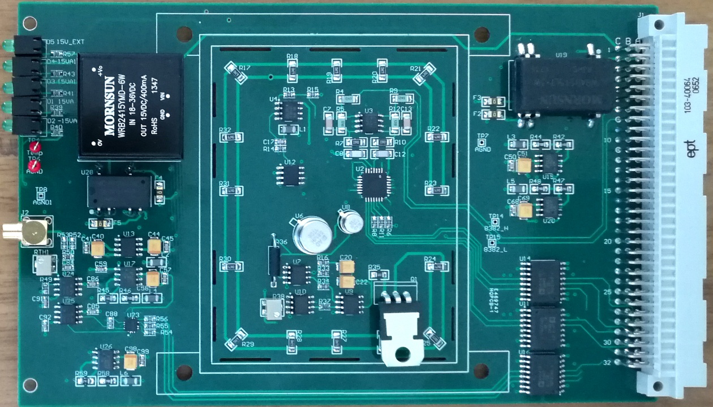
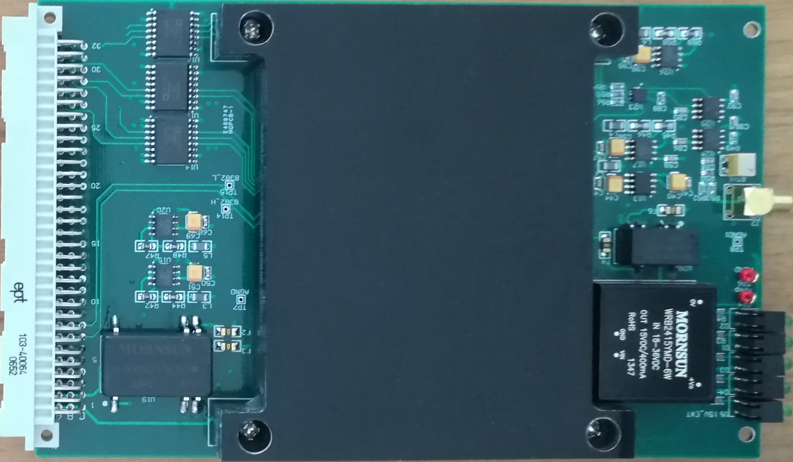
DPSCM-II for CEPC power supplies
high precision ADC board DPSCM-AD
Temperature controller: +/- 0.1⁰C

Slide 18
DPSCM-II for CEPC power supplies
high precision ADC board DPSCM-AD:
  Analog temperature control to digital temperature control
the voltage source interfacing board DPSC-DA:
  Change the design: from 16bits DAC to 18bits
From 3U separated MB and ADC boards to 1U box integrating all functions within one PCB board.

Slide 19
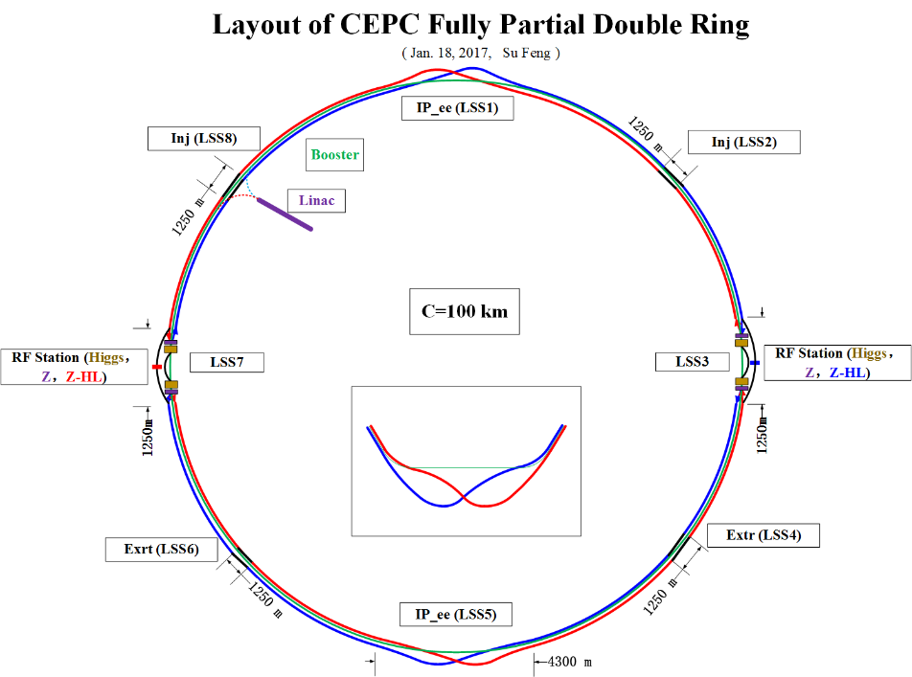
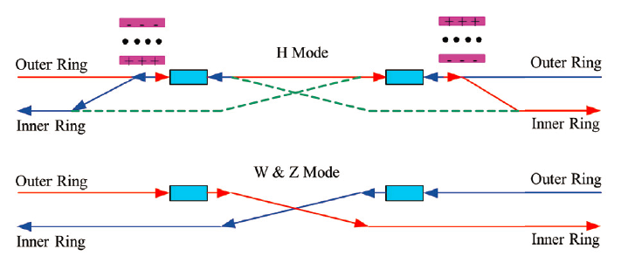
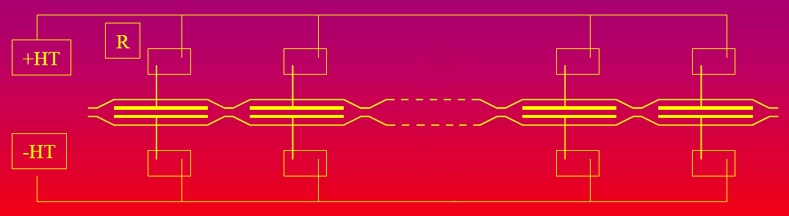
Electrostatic separator for CEPC
  In the RF region, the RF cavities are shared by two ring. Each RF station is divided into two sections for bypassing half numbers of cavities in W and Z modes.
  A set of electrostatic separators combined with a dipole magnet are used to deflect the outgoing beam and avoid bending of incoming beam in H mode.
Layout of RF region

Slide 20
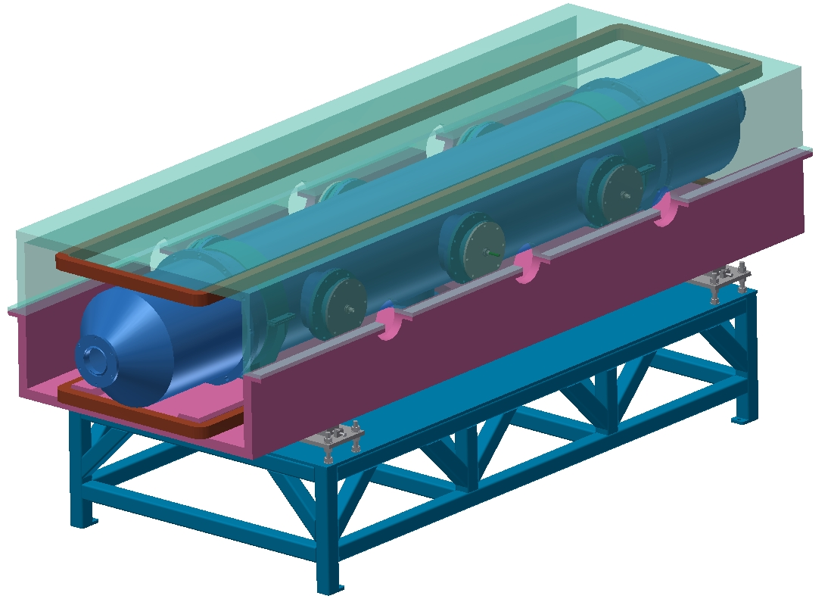
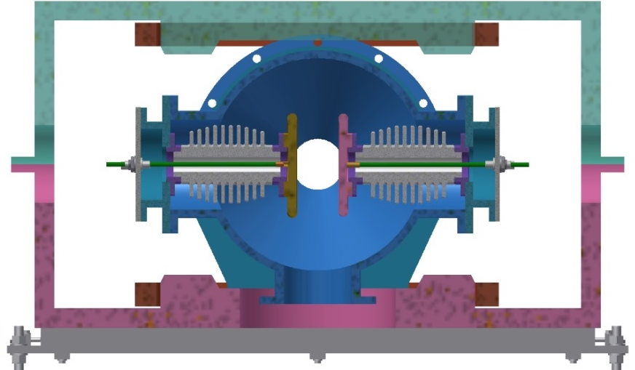
Prototype of Electrostatic Separator
 | Filed | Effective Length [m] | Gap [cm] | Quantity
Electrostatic separator | 2.25MV/m | 4 | 11 | 40
Dipole | 75 Gauss | 4 | 7 | 40
metal-ceramic support
coil
electrode
high voltage feedthrough
UHV tank
Magnet
Support

Slide 21
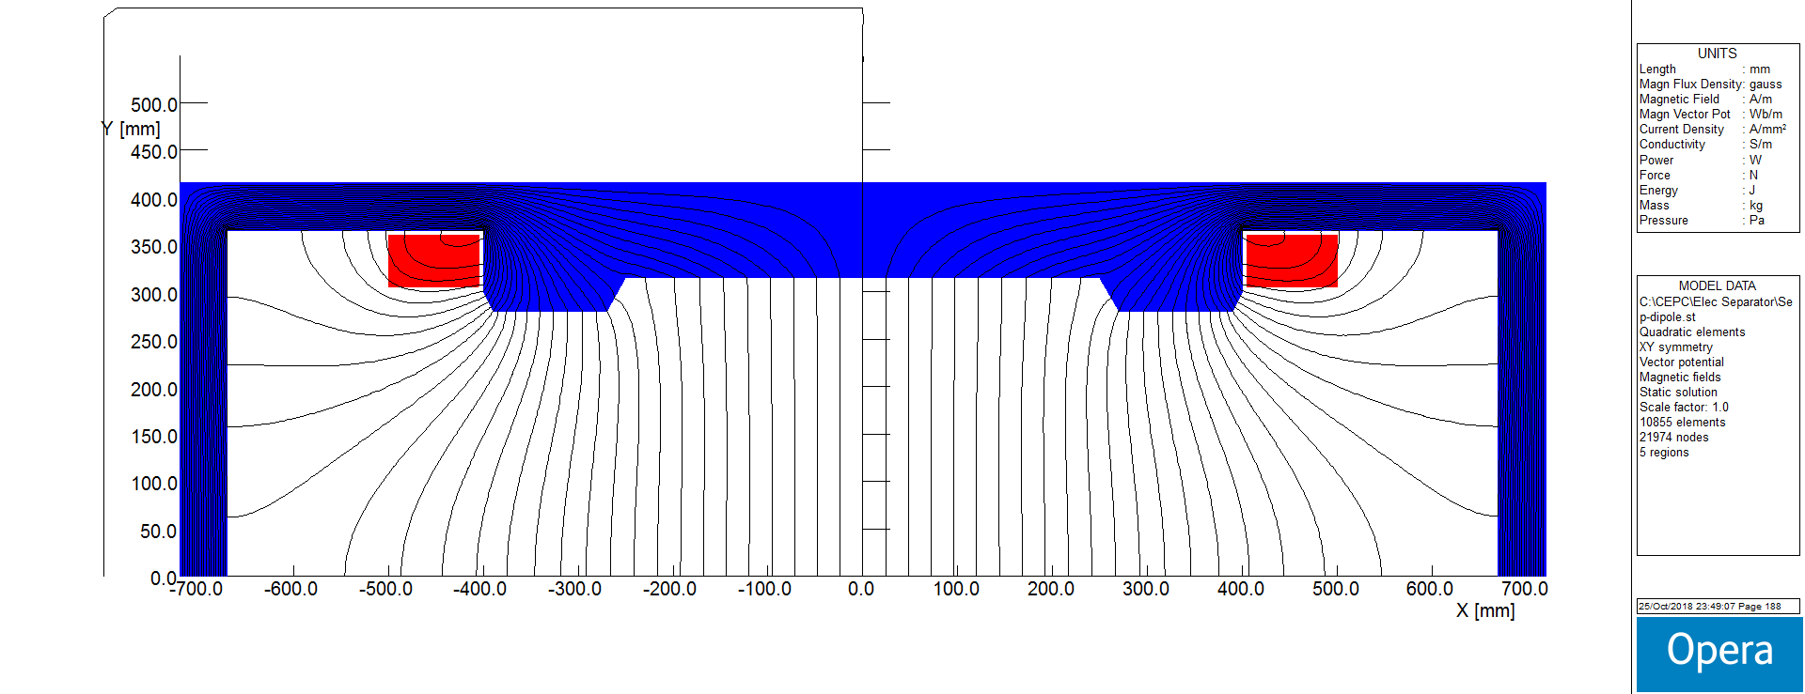
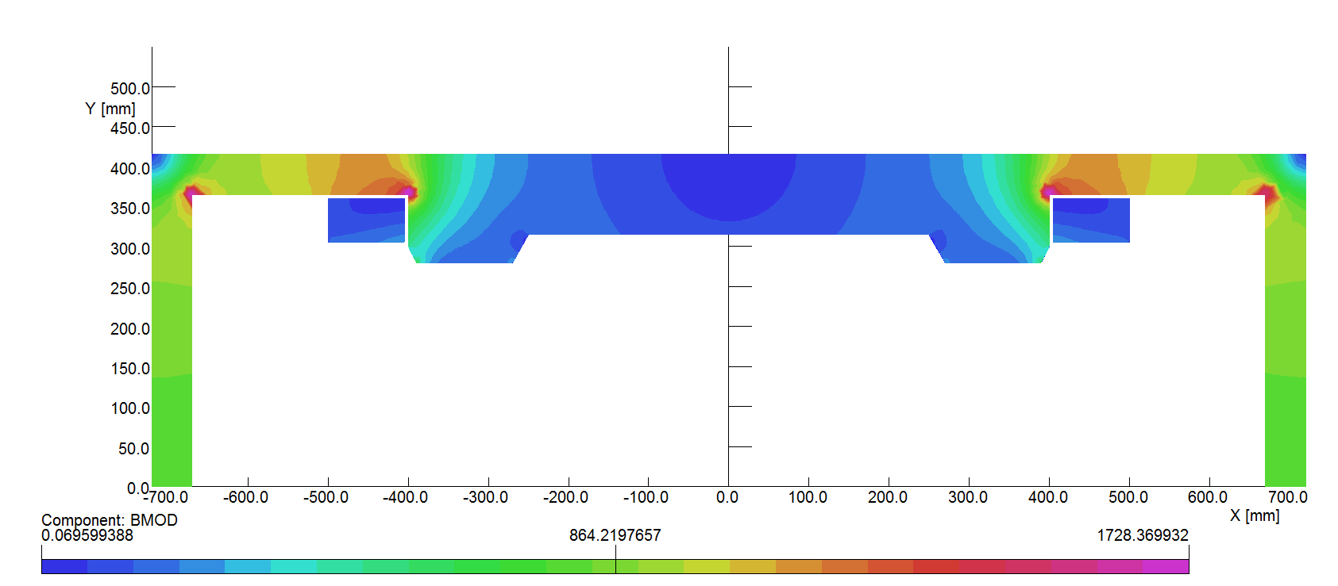
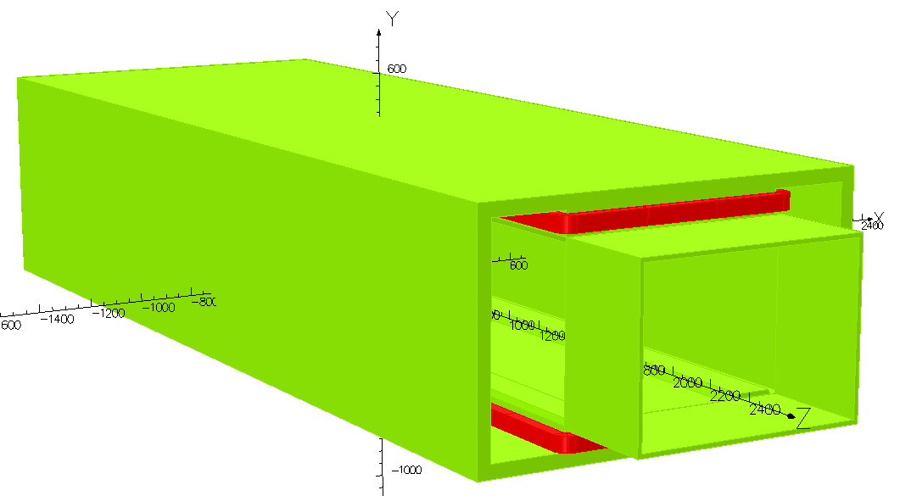
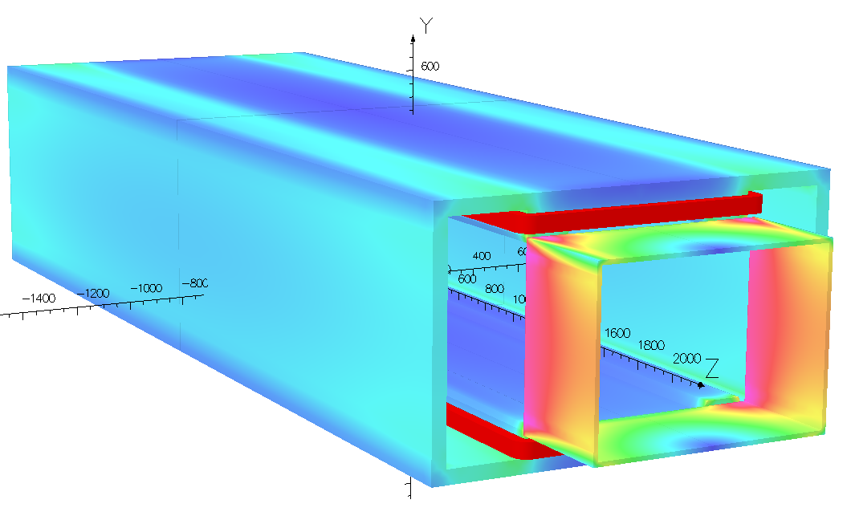
Elec-Sep Magnet 2D&3D Model

Slide 22
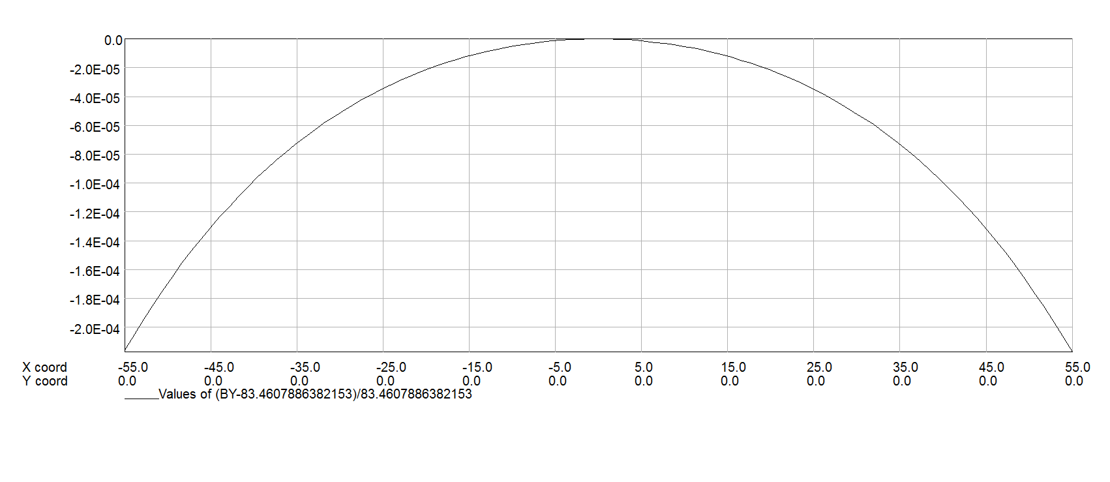
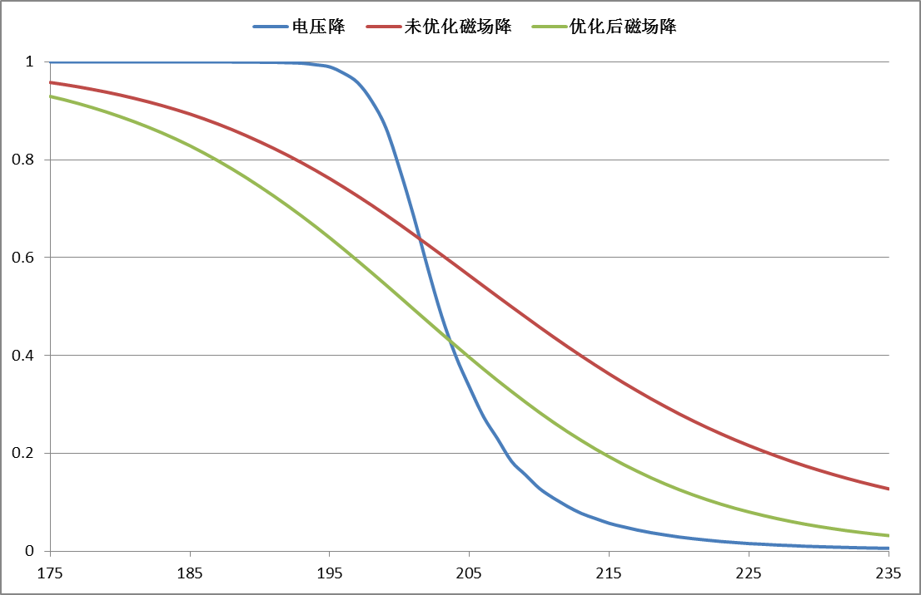
Elec-Sep Magnet Field Distribution and paras
Magnet Name | ESM
Center field [Guass] | 75.5
Magnet Length [m] | 4.4
Current [A/turn] | 10.8
Turns [H×V] | 12×17
Field Clamp Size [H×V, mm] | 830×610
Field Clamp Wall Thickness [mm] | 10
Field Clamp Number | 2
Coil Number | 2
Conductor Size [H×V, mm] | 3×3
Current Density [A/mm^2] | 1.2
Magnet Resistance [Ω] | 7.82
Magnet Voltage [V] | 84.4
Magnet Power [W] | 660
Magnet Inductance [H] | 2.42
Cooling Method | Air
Yoke Weight [Ton] | 11
Coil Weight [Ton] | 0.328
Magnet Weight [Ton] | 11.328
Field homogeneity
Longitudinal fringe field of E&M

Slide 23
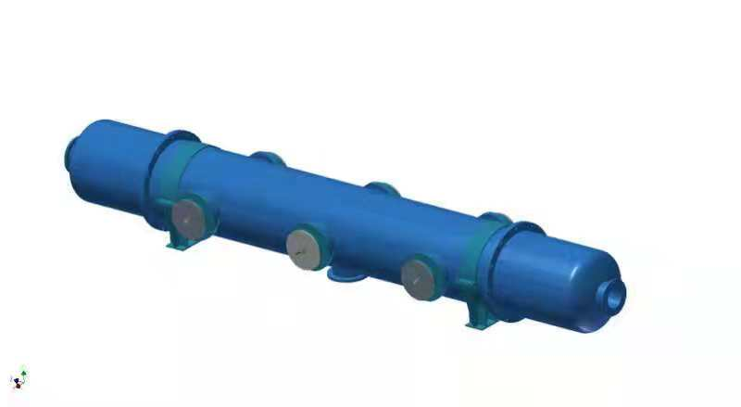
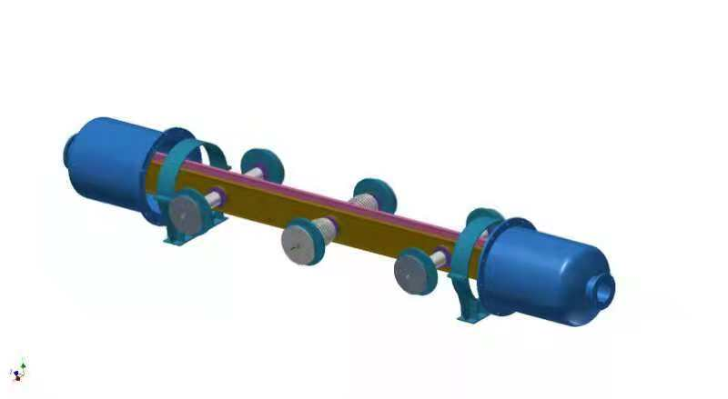
Parameters of electrostatic separator
Separator length | 4.5m
Inner diameter of separator tank | 540mm
Electrode length | 4.0m
Electrode width | 260mm
Nominal gap | 110mm
Maximum operating field strength | 20MV/m
Maximum operating voltage | ±110kV
Maximum conditioning voltage | ±160kV
Maximum deflection | 62.5urad
Nominal vacuum pressure | 2.7e-8 Pa

Slide 24
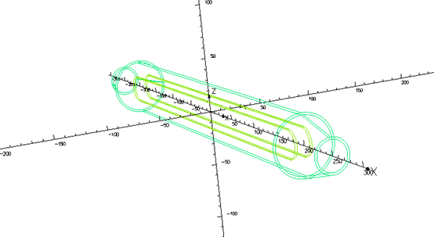
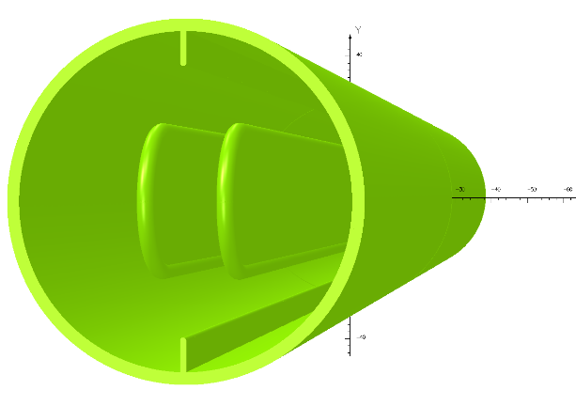
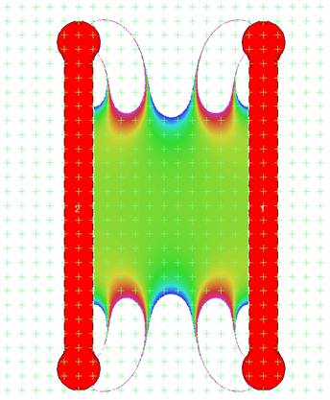
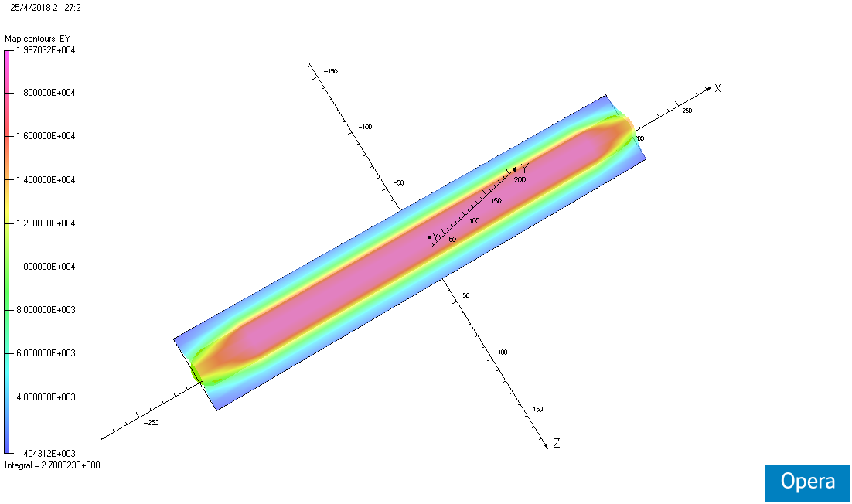
Prototype of Separator
Electrode (a pair of hollow metal flat plate)
Dimension : 4m long and 260mm wide
Material : Pure Titanium
  Separated direction : Horizontal
  Field strength : 2MV/m
  Cooling :
– Parasitic mode losses
– Equip with a simple closed-loop Cooling system
Field distribution
Field homogeneity：12cm*11cm 1‰

Slide 25
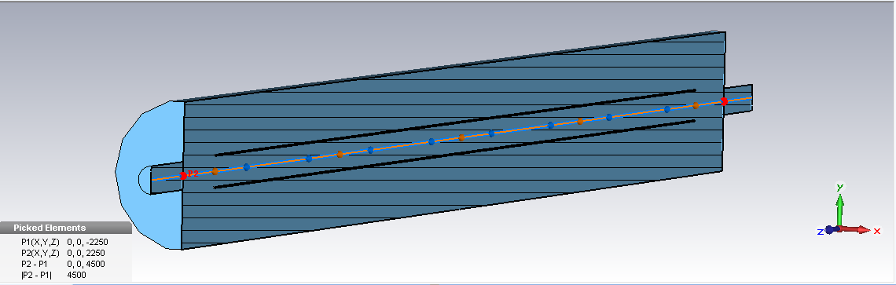
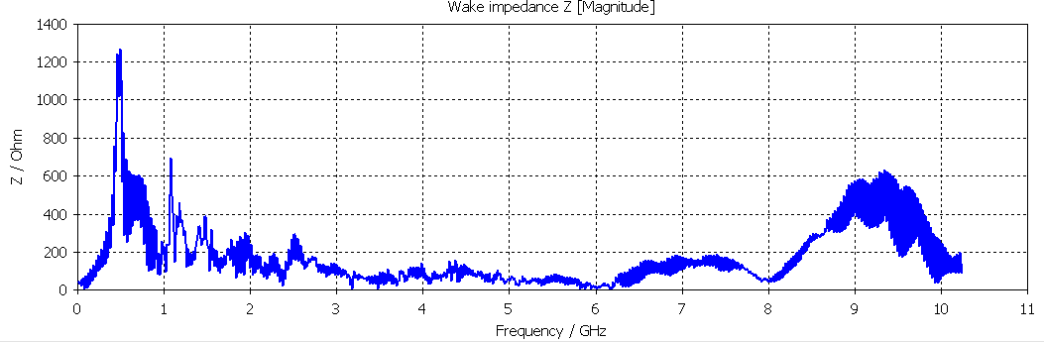
Parasitic mode losses Simulation parameters for electrode
L=4m
Loss factor p_{loss} | 8.947095e-001 V/pC
Power(H/W)(kw) | 0.3734 | 1.5131
L=4m
L=4m
The narrower longitudinal gap between the electrode plate and tank can shield the cavity shape and produce lower narrow impedance
The absorber maybe necessary to absorb such high power in separator.

Slide 26
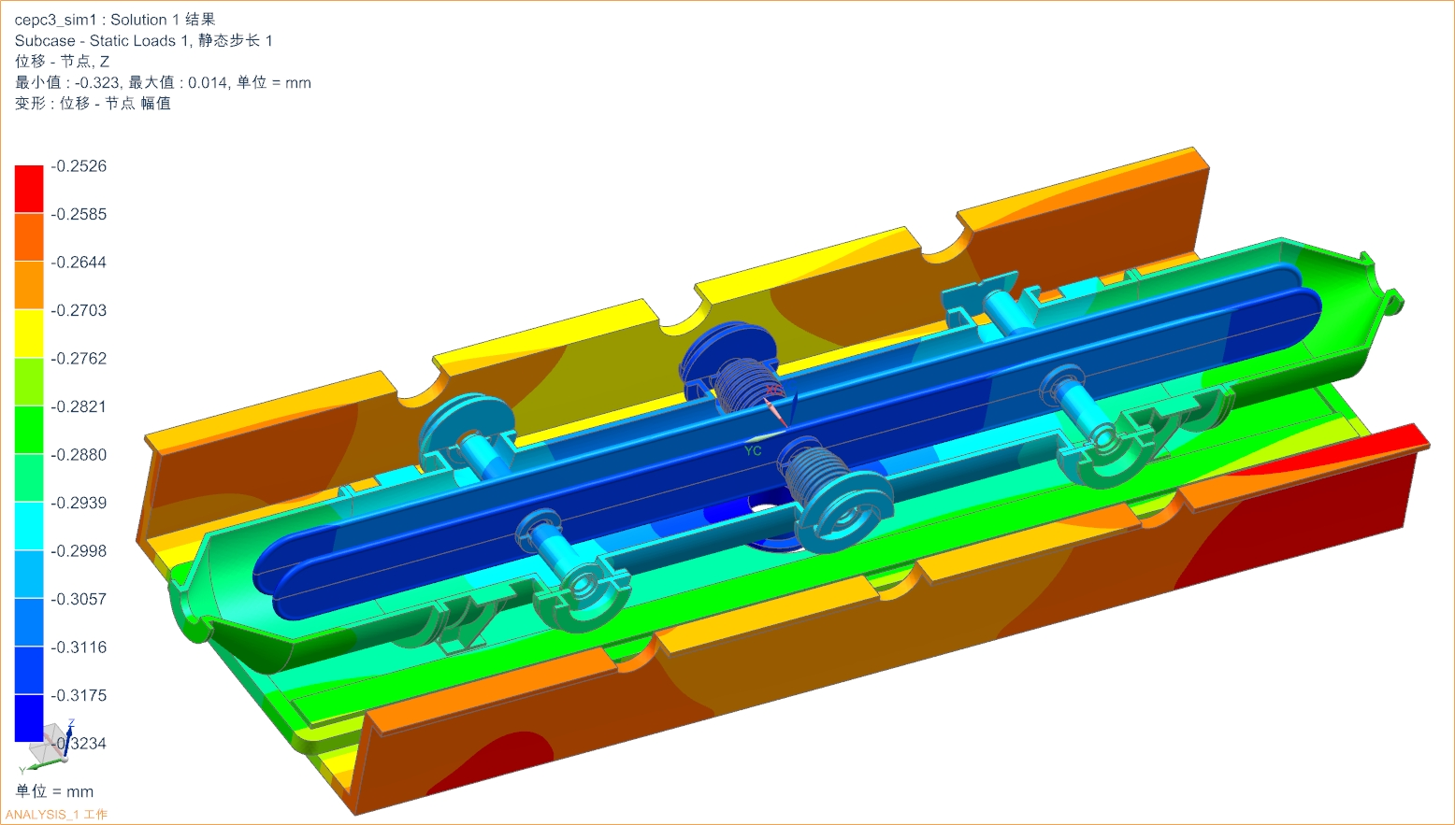
Simulation- mechanical deformation ≤0.323mm

Slide 27
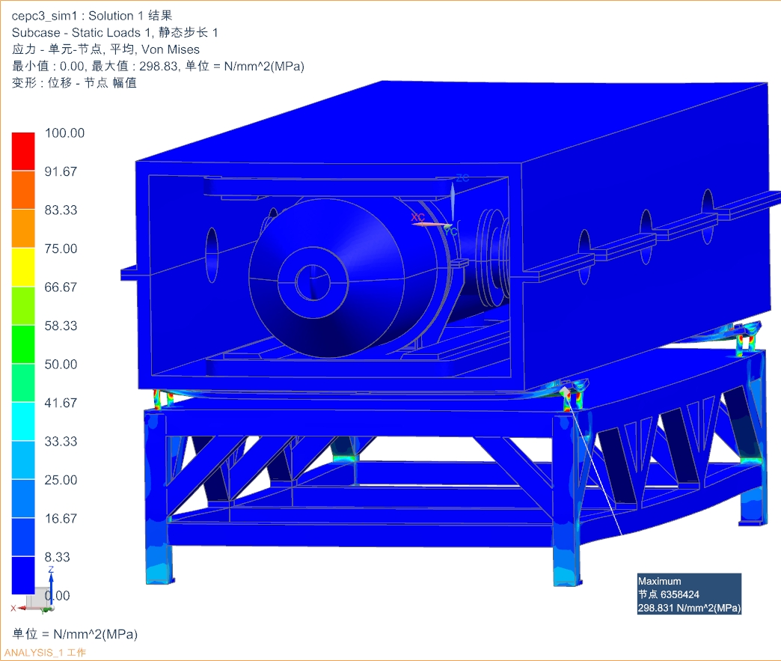
Simulation- mechanical stress

Slide 28
Next to do
To maintain E/B ration in fringe field region
Optimized electrodes shape
To reduce the impedance
Add ground electrodes into the zero potential planes
To absorb the high order modes (HOMs)
Design outer absorber and inner absorber
  Heats and extraction method
To reduce the sparking rate
To design the masks located at the upstream of separator to obstruct the SR.
To limit the maximum field at end of electrodes.

Slide 29
Summary
Prototype for high precision Power convertor is under design.
Parallel connection technology of modular and Peak Current-mode Control PWM are under study.
The DPSCM-II will be embedded into the prototype and should be tested for a very long time to verify the reliability!
Electrostatic separator’s key issues are under study. The electrodes shape need to be optimized to maintain E/B ration in fringe field region

Slide 30
Thank You!

