Slide 1
CEPC Radiation and Shielding
Ding Yadong
2018-11-13
IHEP, CAS

Slide 2
Outline
Characteristics of the project
Shielding design criteria
Shielding calculation methods
Radiation shielding design for main tunnel
Radiation shielding design for synchrotron radiation
Induced radiation consideration
Plan for TDR

Slide 3
1. Characteristics of CEPC
High beam energy and beam power
CEPC:
Beam energy and circulating current: 120GeV*17.7mA
SR power/beam: 30 MW/ per beam
A large-scale accelerator complex
100 km @ underground about 50-70 m
Parameters | Symbols | Values | Units
Beam energy | E | 120 | GeV
Beam current | I | 17.7 | mA
Bending radius | ρ | 10900 | m
Power per unit length | P | 435 | W/m
Critical energy | E_{c} | 351.6 | keV
Bending angle | θ | 2.844 | mrad
Notes:
1吨TNT相等于4.2千兆焦耳

Slide 4
2. Shielding Design Criteria
Dose limitation in regulations
The national standard of the People’s Republic of CHINA, “Basic standards for protection against ionizing radiation and for the safety of radiation Source”, GB 18871-2002.
The national standard of the people’s republic of china, “The rule for radiation protection of particle accelerators”, GB 5172 1985.
ICRP publication 103, “The 2007 Recommendations of the International Commission on Radiological Protection”.
Radiation dose limit for person in the regulations
 |  | Worker | Public
Effective Dose | Average in 5 years | 20mSv/year | 1mSv/year
 | Max. in single year of the 5 years | 50mSv/year | 5mSv/year
Equivalent Dose | Lens eye | 150mSv/year | 15mSv/year
 | Skin | 500mSv/year | 50mSv/year

Slide 5
2. Shielding Design Criteria
Limits for shielding design of CEPC-sPPC
1. Prompt dose rate limit
Area | Design Value | example
Radiation monitored area | < 2.5 μSv/h | registered radiation workers can enter freely any time Such as facilities halls, the surface of concrete shielding
Radiation controlled area | < 25 μSv/h | access this area is limited and permissions and the entering procedures are required. Such as auxiliary tunnel;
Forbidden area | >>1mSv/h | access to this area is in principle forbidden. Such as tunnel while the beam is running.
Site boundary | 0.1 mSv/year
2. Residual dose rate limit: < 1mSv/h for the workers to get into the tunnel ( 30cm, 4 h down ) (refer SNS)

Slide 6
2. Shielding Design Criteria
Limits for shielding design of CEPC
3. Concentration limit of induced activity
According to GB18871-2002: “if there are more than one kind of radionuclide, only if the ratio of activity (or specific activity) to its exempt value of each kind of the radionuclide was less than 1, it is exemptible.”
Convenient method to soil and ground water activation: The prompt dose rate is ~5.5mSv/h in the thickness of 1m soil to ensure it is below the exempt value of above. (refer J-PARC)
$$\sum_{i=1}^{n}{\frac{S_{i_}}{S_{i_exempt}}<1}$$

Slide 7
3. Shielding Calculation Methods
For Magnets、bulk shielding、Beam-Dump and Collimators：
CEPC：FLUKA + MCNP + Empirical formula
For streaming：
DUCT-III（Shin’s equation) + FLUKA
For skyshine：
Stapleton’s equation
For activity calculation and residual dose rate :
FLUKA + Empirical formula

Slide 8
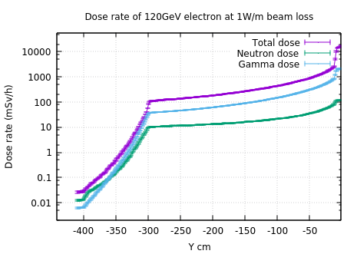
4. Radiation shielding design for main tunnel
Simulation result for thickness of the main tunnel for CEPC
Beam loss parameter: 1W/m for 120GeV electrons, the material of the beam pipe is Fe and 1 cm thickness
Radiation levels caused by other beam loss parameters can be deduced through proper conversion coefficient

Slide 9
4. Radiation shielding design for main tunnel
Average beam loss parameter
According to the cumulated number of particles and the lifetime of the beam
Beam loss calculation
Beam energy:120GeV; Lifetime:1h; circumference:100km;
For CEPC: ~0.004 W/m
So, the dose rate in the arc tunnel is about several hundreds μSv/h, the tunnel now is planned to pouring lime mortar to the rock tunnel in arc section.

Slide 10
5. Radiation shielding design for Synchrotron Radiation
Harmful effects by the synchrotron radiation
Heating of the vacuum chamber
Radiation damage to machine elements
Formation of ozone and nitrogen oxides in the air
Leading to corrosion of machine components and health hazards for personnel
Radioactivity induced in components
Other issues……

Slide 11
5. Radiation shielding design for Synchrotron Radiation
Theory and parameters
Parameters determining synchrotron radiation in CEPC
Parameters |  | LEP energy in GeV
 |  | 45.5 | 80 | 120
I (per beam) | mA | 183.1 | 88.1 | 17.4
Critical energy | keV | 19.7 | 107.1 | 361.6
Radiated power | W/m | 98 | 452 | 452
Parameters of synchrotron radiation at 120 GeV
Parameters | Symbols | Values | Units
Beam energy | E | 120 | GeV
Beam current | I | 17.4 | mA
Bending radius | ρ | 10600 | m
Power per unit length | P | 435 | W/m
Critical energy | E_{c} | 361.6 | keV
Bending angle | θ | 2.844 | mrad
Opening angle | φ | 4.258 | μrad

Slide 12
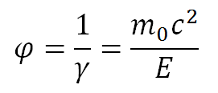
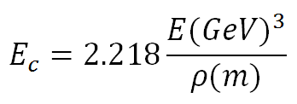
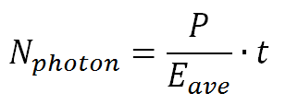
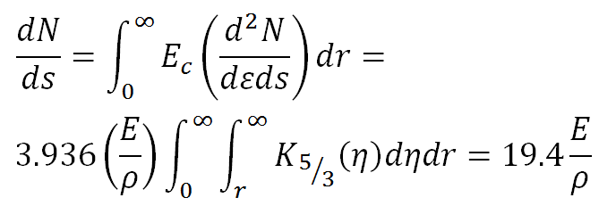
5. Radiation shielding design for Synchrotron Radiation
Theory and parameters
SR critical energy
Solid degree
Number of photons (Method 1)
SR Power
Number of photons (Method 2)：
SR spectrum

Slide 13
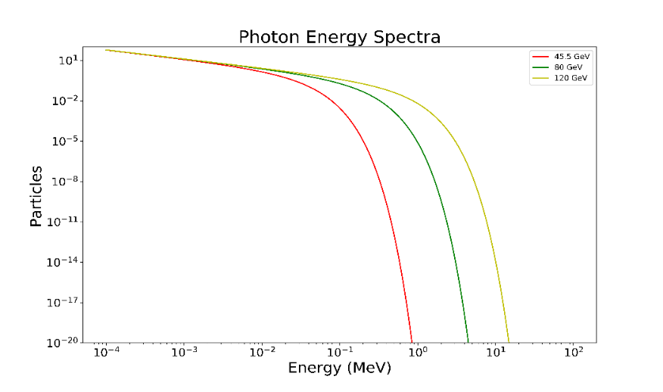
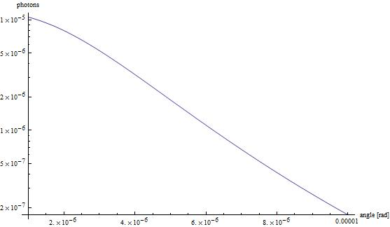
5. Radiation shielding design for Synchrotron Radiation
Theory and parameters
Energy spectrum distribution
Angular distribution
The total number of photons emitted by an electron per metre and MeV.
The results were crosschecked by Python and Mathematics.
The average energy of photons is 116 keV.
1st method: 2.363×10¹⁶m⁻¹s⁻¹
2nd method: 2.351×10¹⁶m⁻¹s⁻¹

Slide 14
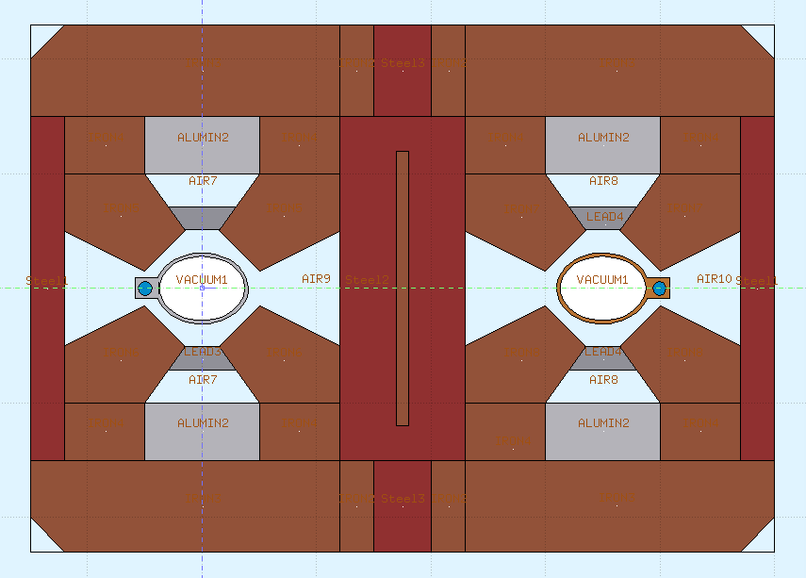
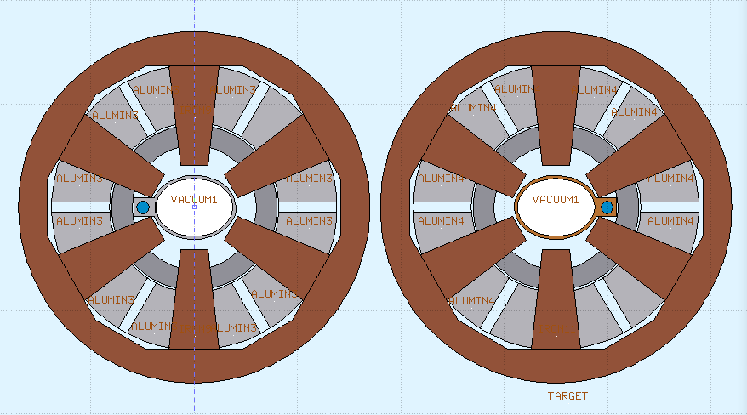
5. Radiation shielding design for Synchrotron Radiation
Shielding structure for magnets
Magnet coils are wrapped around by massive organic materials, which are especially sensitive to radiation.
20 mm lead is used for protecting the coils of magnets.

Slide 15
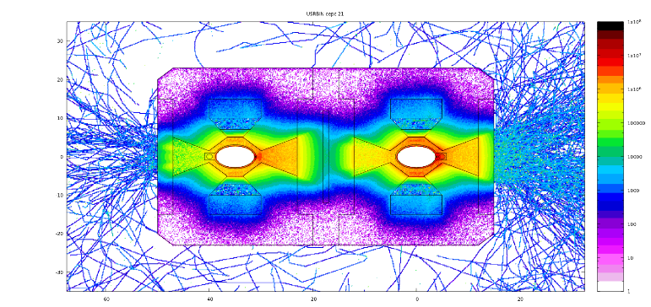
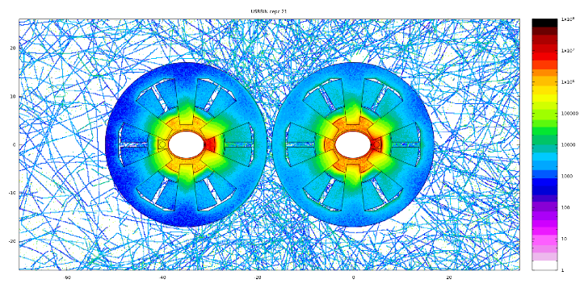
5. Radiation shielding design for Synchrotron Radiation
Radiation dose around the coils
Shielding for about 10 years operation;
The upper dose limit of materials is from LEP design report;
With and without lead shielding
2cm lead can reduce the maximum dose by at least 10 times
Different beam direction
Almost the same for the opposite direction
May be changed with time
The cooling water pipes are now in the same side

Slide 16
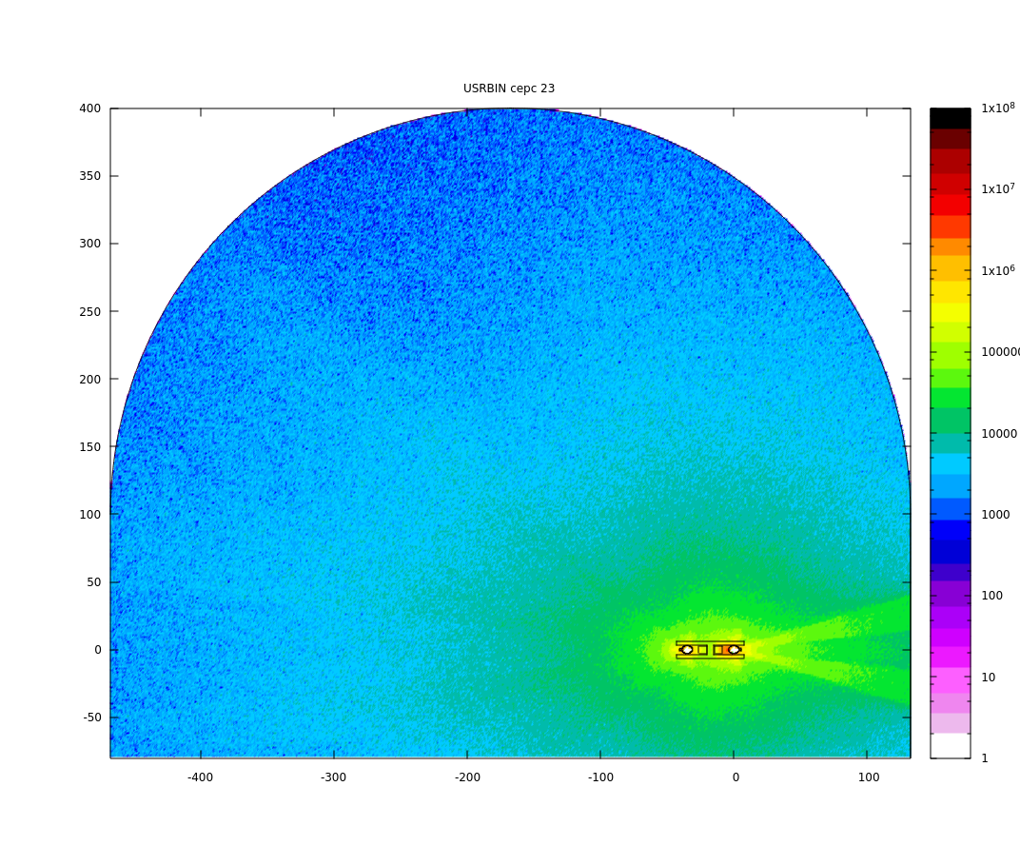
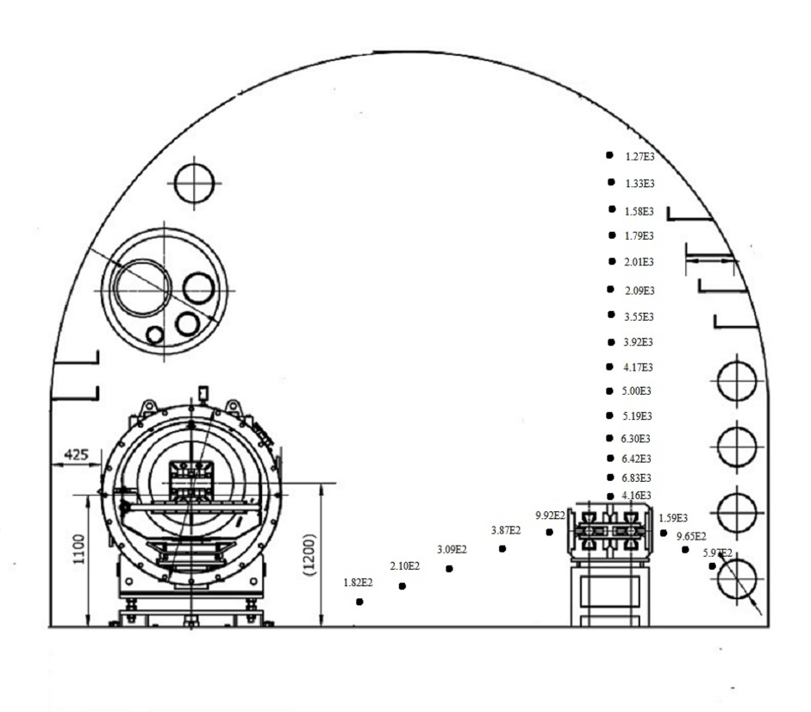
5. Radiation shielding design for Synchrotron Radiation
Radiation dose in the tunnel
Dose distribution in Gy/Ah at 120 GeV in a dipole section without(left) and with(right) shielding
Radiation dose of the other sections are lower than dipole section.

Slide 17
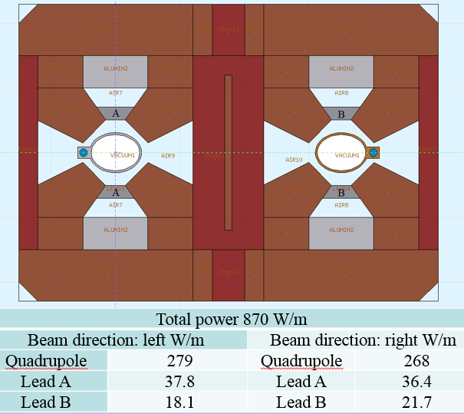
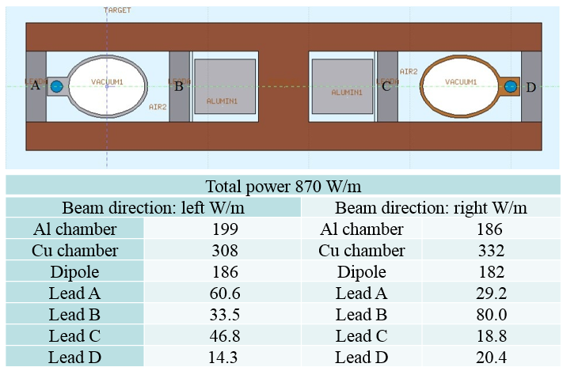
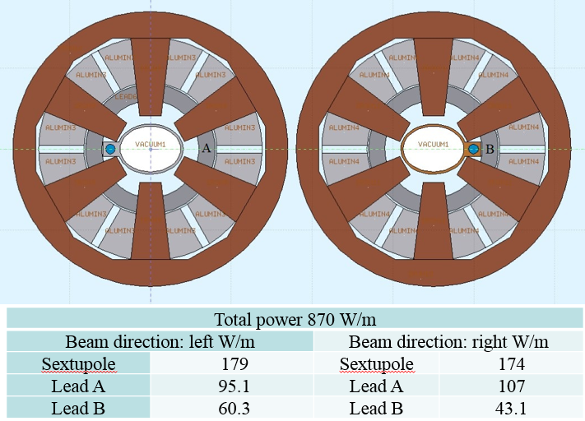
5. Radiation shielding design for Synchrotron Radiation
Energy deposition in different part of magnet
Heat load in the tunnel
Heat can induced heavy load for ventilation system
Lead shielding is also used for move away as much heat as possible
The heat deposited in the tunnel is less than 5% of total energy(2cm Lead; Dipole)

Slide 18
5. Radiation shielding design for Synchrotron Radiation
Other issues has been preliminary studied:
Rock stability around the tunnel
Neutron production by Synchrotron Radiation
Beam dump structure and material selection
FLUKA Simulation results are checked by MCNP (in some content)

Slide 19
6. Induced radiation consideration
Calculation method:
Direct calculation of isotope production with FLUKA
The traditional method, that folding of particle fluence with energy-dependent cross sections for the production of certain isotopes, also be used in some situations
Main concern of activation yields in different components
The concrete shielding: ²⁴Na
Air activation: ¹¹C ,¹³N,¹⁵O,⁴¹Ar
Cooling water activation: ¹¹C,¹³N,¹⁵O,⁷Be,³H
Soil activation: ⁷Be,³H

Slide 20
7. Plan for TDR
Shielding calculation
2018: Completion of CDR report (radiation protection/SR)
2019: Carry out the design of beam dump
2020: Protective design for main locations, such as klystron tunnel and main tunnel, experimental hall and collision zone at collision point
2021: Estimation of gas / component activation in tunnel
2022: Preparation of TDR Report

Slide 21
7. Plan for TDR
Dose monitoring
2018: Conducting cumulative dose measurement experiments
2019: Performance study of neutron / gamma dose rate detector
2020: Comparisons of dose performance of new environment detector
2021: Research on environmental medium measurement methods, including on-line / off-line measurements.
2022: preparation of TDR Report

Slide 22
Thanks for your attention！

