Slide 1
Conventional Facilities for CEPC
GuoPing Lin
JianLi Wang
JinShu Huang
2018.11.09

Slide 2
Contents
  Key requirement of CEPC
Site and Structure
  Site selection
  Project Layout and main structure
Utilities
  Electrical engineering
  Cooling water system
  HVAC
  Fire protection
  Transportation and Lifting Equipment
General Construction Schedule
Work prospect of TDR
Summary

Slide 3
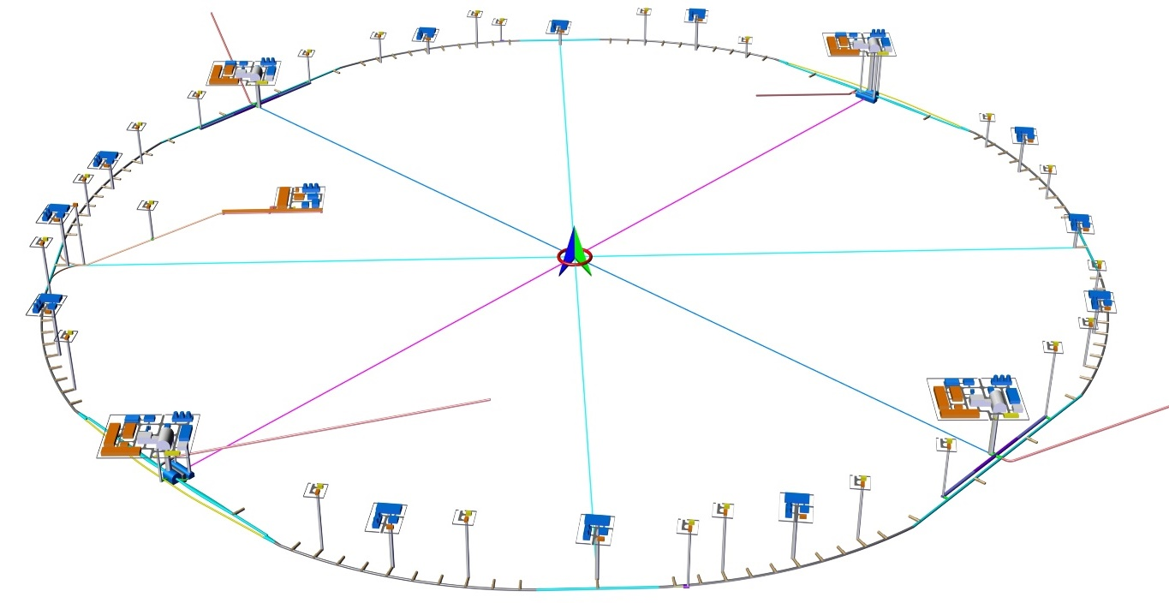
Key requirement of CEPC
The key requirement for civil works as follow
  Ring tunnel
    Circumference of beam: 100 km
    To accommodate the main body of CEPC ring and booster
    Space reserved for SPPC in the same tunnel
  LINAC tunnel
    Length : 1200m
    To house Acc. tube
  Beam transport line
    Length : (316m + 459m)*2
  Experimental hall
    IR1: 30m*30m*30 m
    IR3: 60m*40m*40 m
  Surface buildings
    necessary arrangement of equipment housed within the buildings (power converter, cryogenics compressor, utilities, etc.)
    service access requirement sentrance and egress requirements for operational personnel.
LSS4
IP4
IP1
Linac
LSS1
LSS2
BTL
IP2
IP2
LSS2

Slide 4
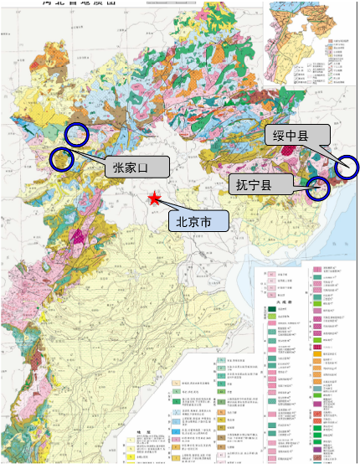
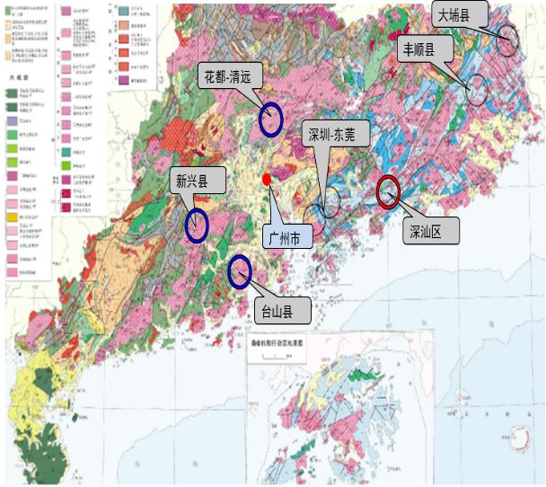
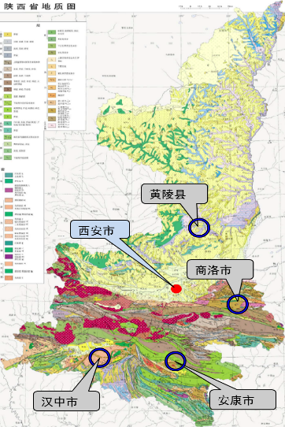
Site selection
Principal factor
  Geography
    Sufficiently large and appropriately located to accommodate the future development of IHEP.
    Should promote the CEPC project and the construction of an international science.
  Natural conditions
    Good structural stability conditions, good rock conditions
    No large height differences
    Thinner quaternary overburden; Relatively low rock permeability; etc.
    Relatively small external dynamic geological phenomena
  Access conditions — convenient
  Environmental factors
  Good economic environment and construction conditions
Potential Site
  Site investigation
    During the past few years, we made preliminary comparison and selection of the sites in the provinces of Hebei, Guangdong, Shaanxi, Jiangsu and Zhejiang.
    Conducted field investigation in Hebei, Guangdong and Shaanxi.
  Funing, Shen-Shan and Huangling were selected for site comparison.

Slide 5
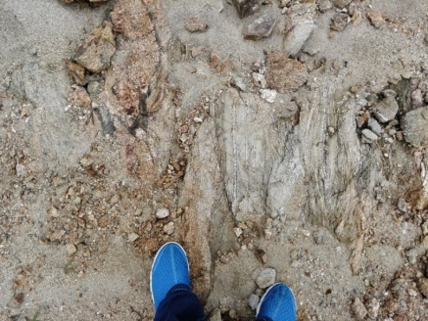
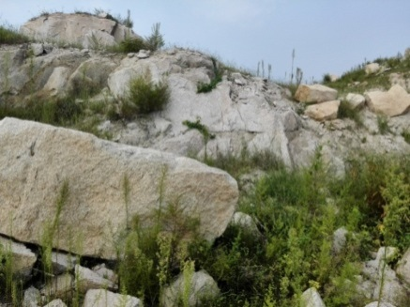
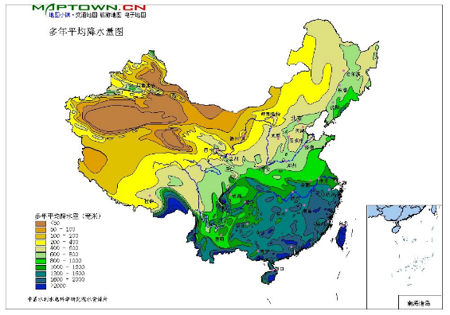
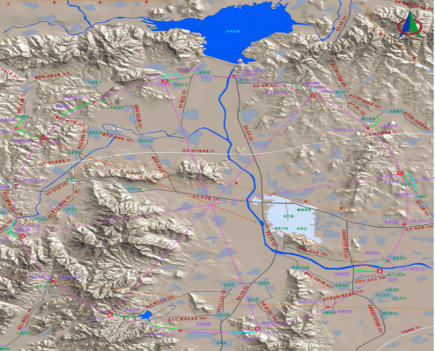
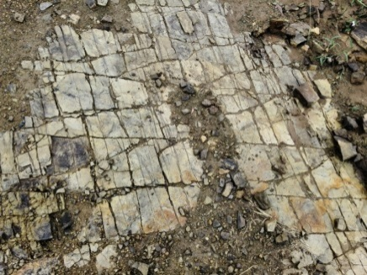
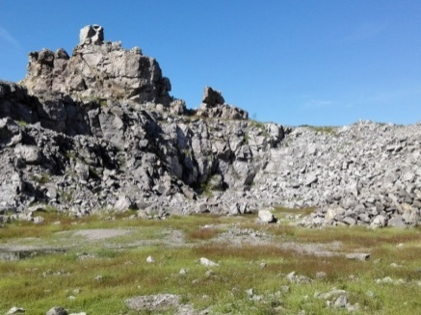
Site selection
Site investigation
Funing site is the best among current three sites.
At this stage in the conceptual design and planning we use the Funing site as representative.
  Stratum Lithology
  Geological structure
  Hydrogeology
  Topography and landforms
Gneiss
Granite
No large fault zones.
No active faults within 5km of the site,.
Seismic peak acceleration:0.1~0.15g
Basic seismic intensity :VII
Annual mean precipitation:684mm
Slightly weathering-fresh rock mass is
mainly slightly pervious.
In hilly area
The ground elevation of
most places is 20~200m
Sandstone
Tuff

Slide 6
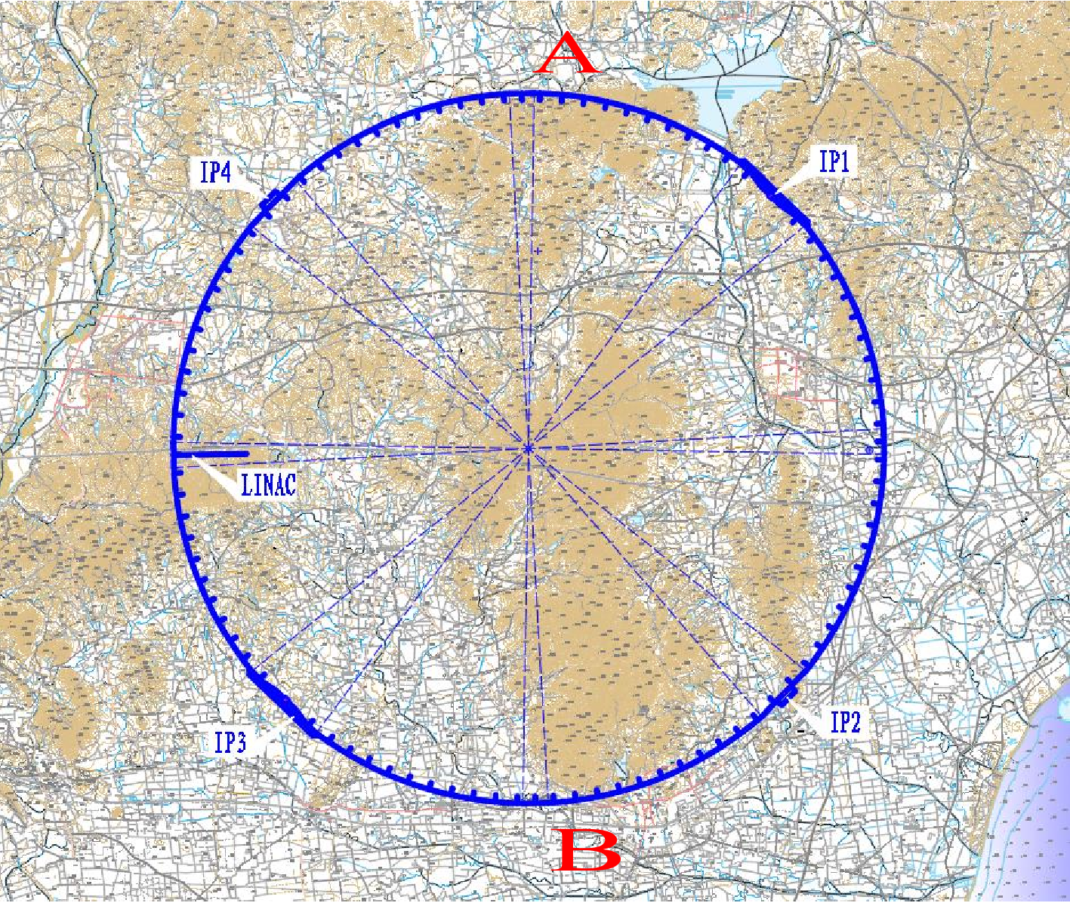
  Project layout and main structure
General layout
    Tunnel —100Km circumference
    ∩-shape
    6m*5m（W*H）
    Installed on an inclined median plane with a slope of 0.3% according to the topographical conditions and the drainage requirements
    The depth of ring tunnel from ground level is defined by topographical conditions of site

Slide 7
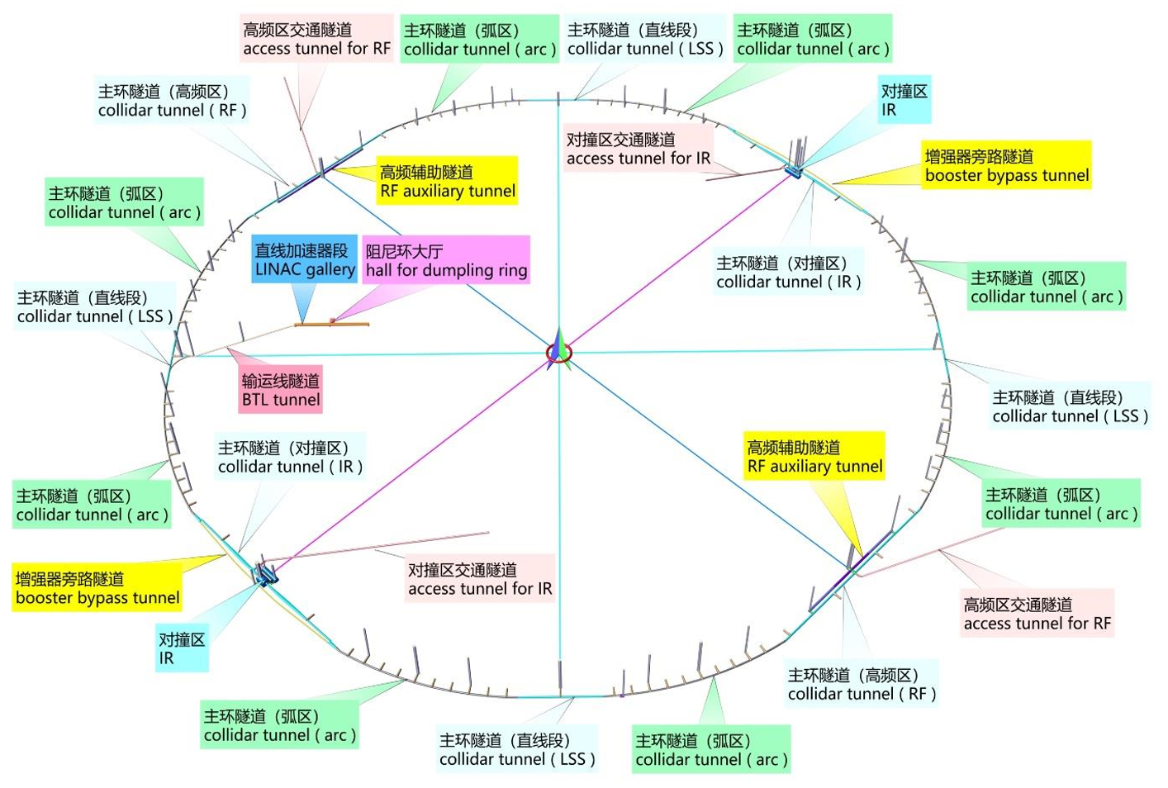
  Project layout and main structure
Underground structure
Linac tunnel:
· L=1200 m
BTL tunnel:
· L=1825m +2*459m（branch）
Collider tunnel:
· 4 curved arc sections L= 10246.70 m
· 4 curved arc sections, L=10192.25 m
· 2 Irs + Bypass, IP1/IP3, L=3320.00 m
· 2 RF section + RF auxiliary tunnel
IP2/IP4, L=3240.00 m
· 4 linear sections (LSS), L=1197.50 m
Auxiliary Tunnels
· 96 units
· L=96*30m

Slide 8
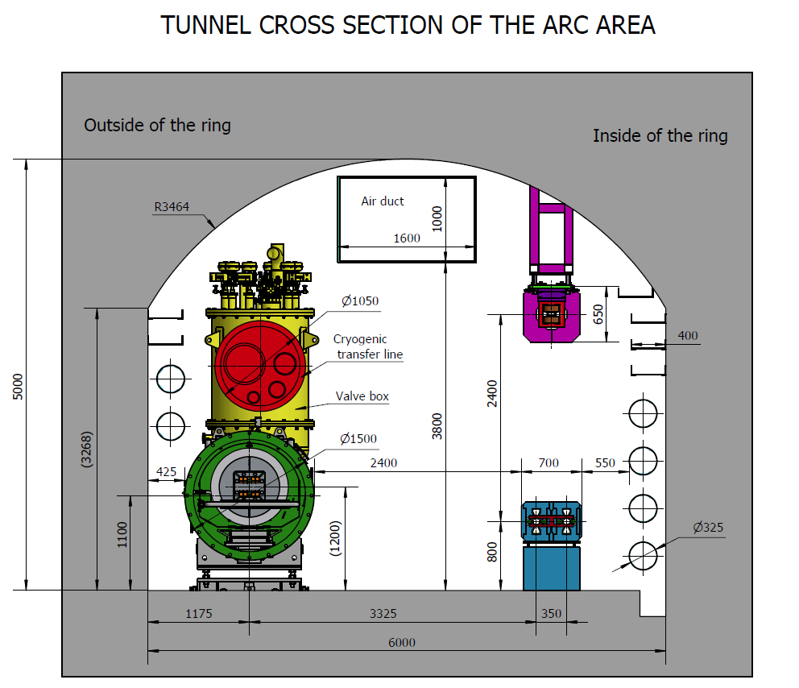
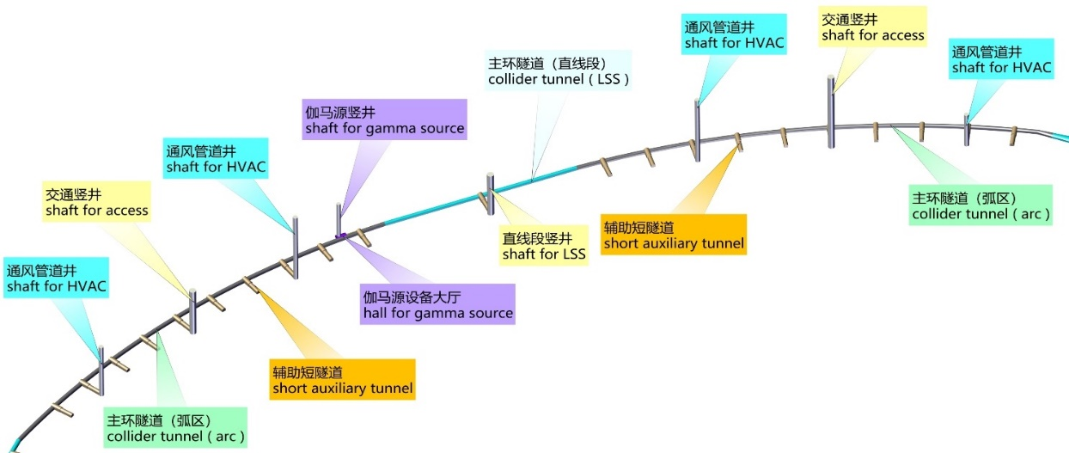
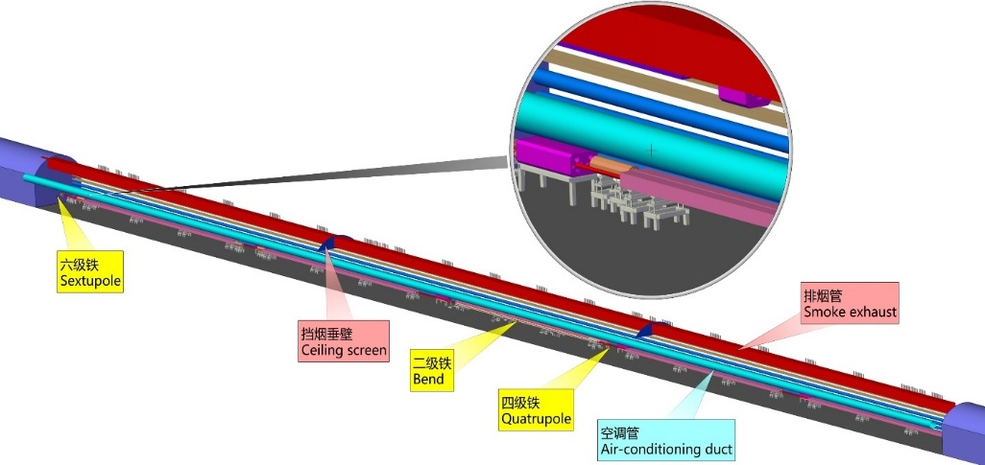
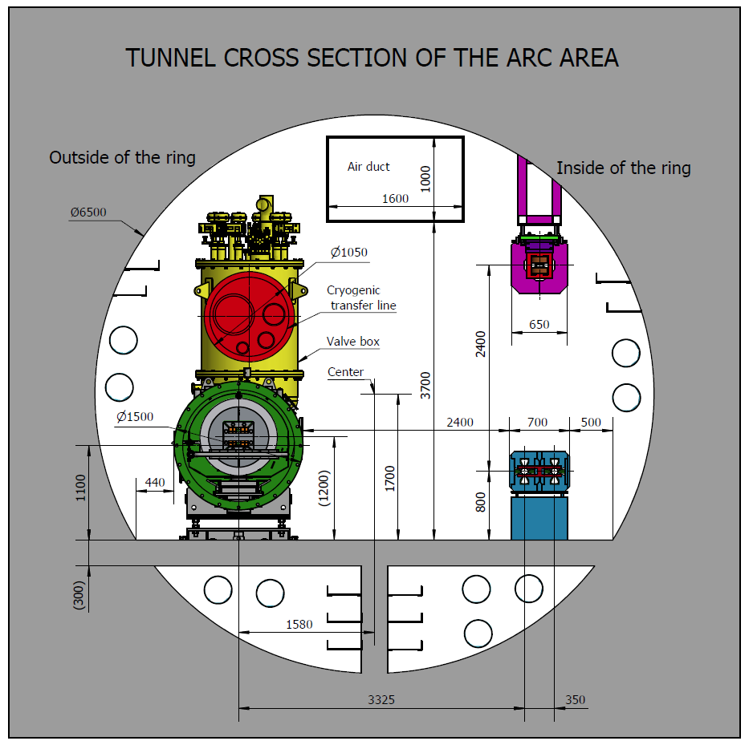
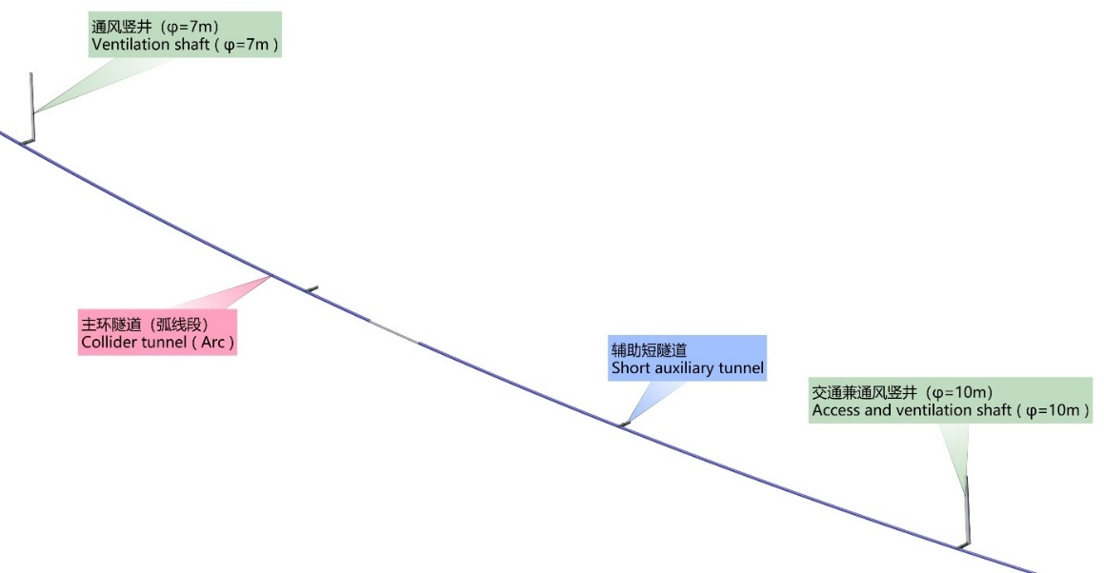
  Project layout and main structure
Quadrant of collider tunnel
Parallel scheme
• Width:6m, Height:5m
• Outer side, reserved for SPPC.
• Inner side, on which CEPC.equipment and components will be installed.
• Central part of the tunnel for equipment operation and transport.

Slide 9
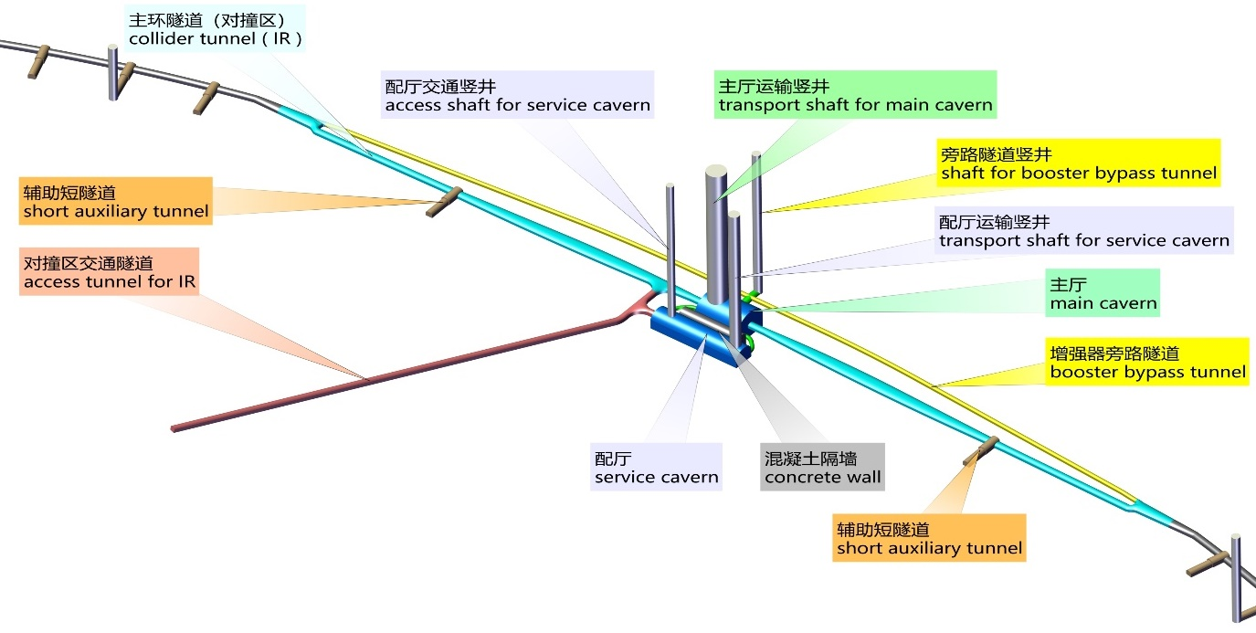
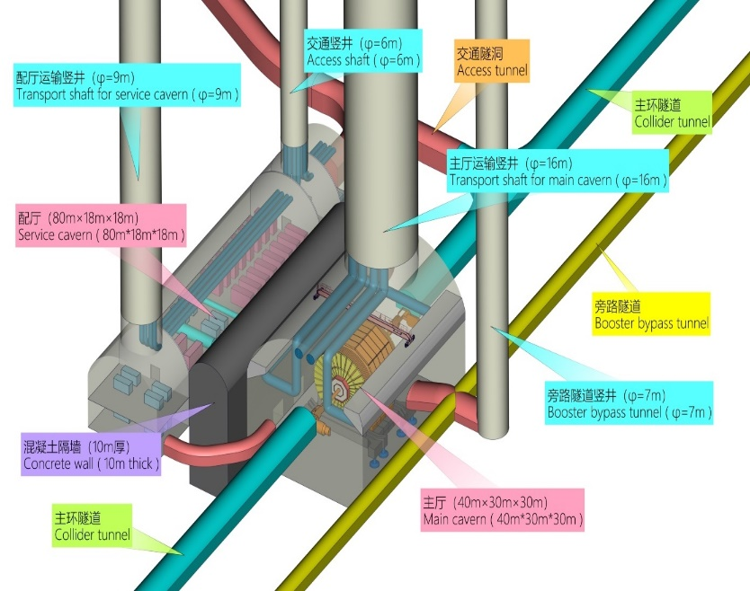
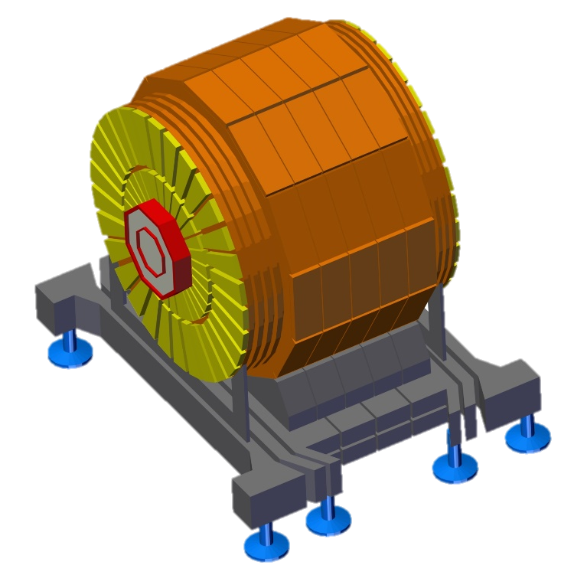
  Project layout and main structure
IR section tunnel - IP1/IP3
  Tunnel for the e+/e- colliding beams
    Width: 6.0~11.4 m
    Height: 4.5m
    Long:2*1.509km
  Tunnel for the Booster bypass
    Width: 3.5m
    Height: 3.5m
    Long:3.02km
3.32km
6.0~11.4x4.5
3.02km
3.5x3.5
Main detector
主探测器

Slide 10
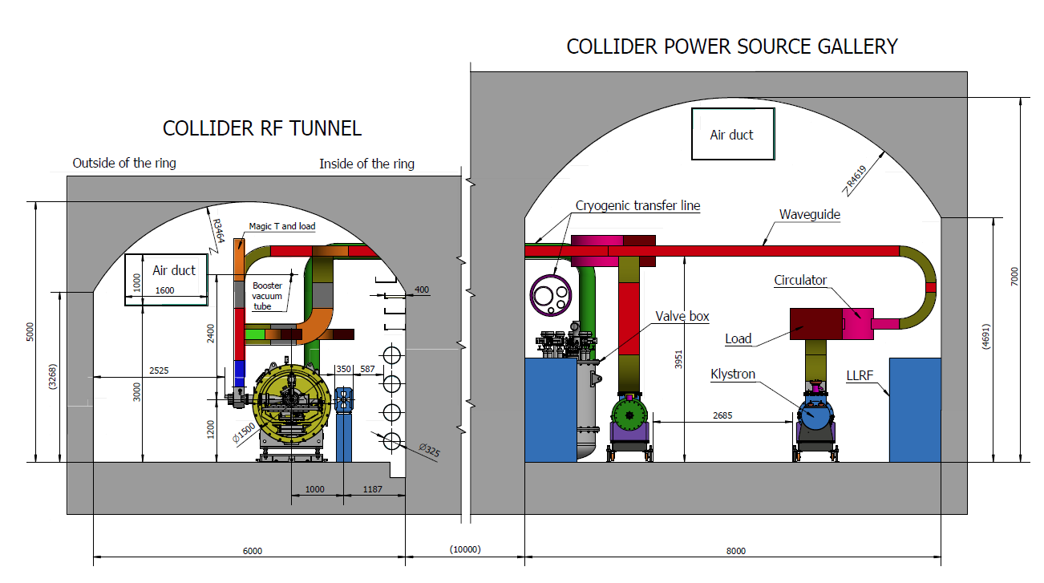
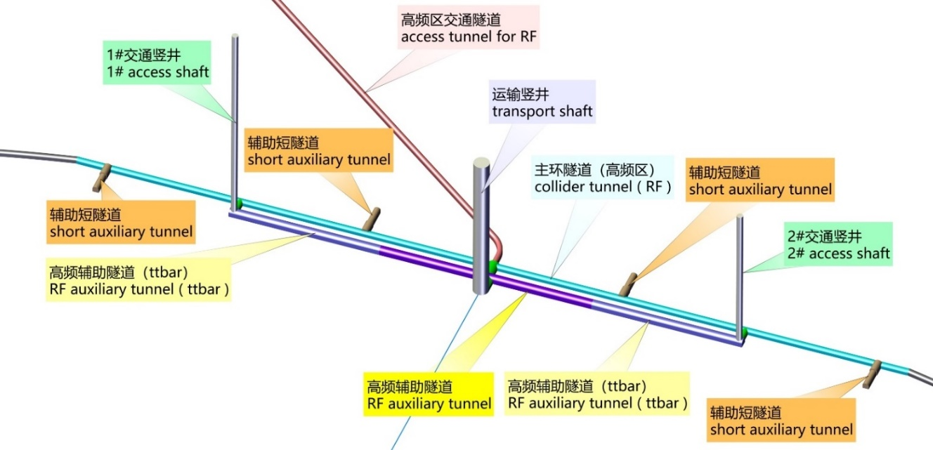
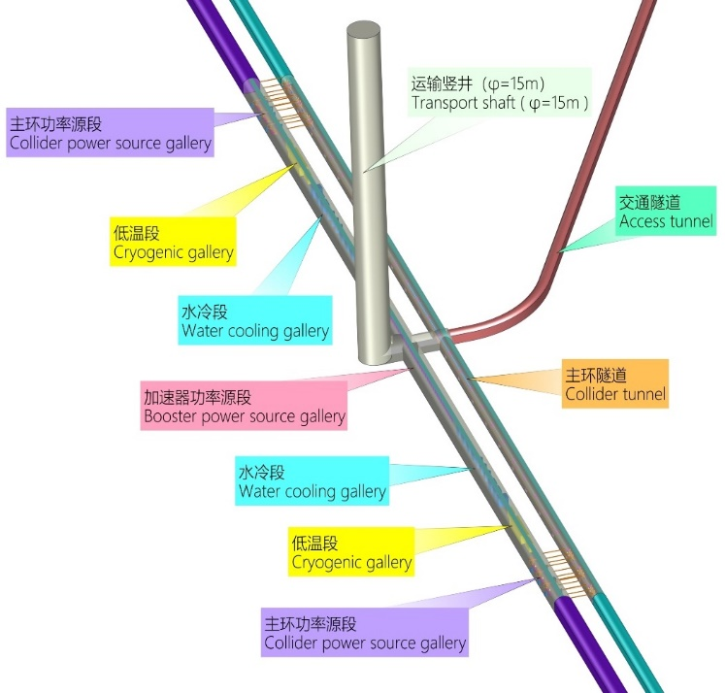
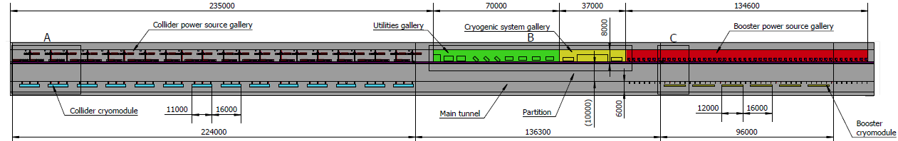
  Project layout and main structure
RF section tunnel – IP2/IP4
  RF tunnel
    Width: 6.0 m
    Height: 5.0m
    Long:3.240km
  RF gallery
    Width: 8.0 m
    Height: 7.0m
    Long:2.0km

Slide 11
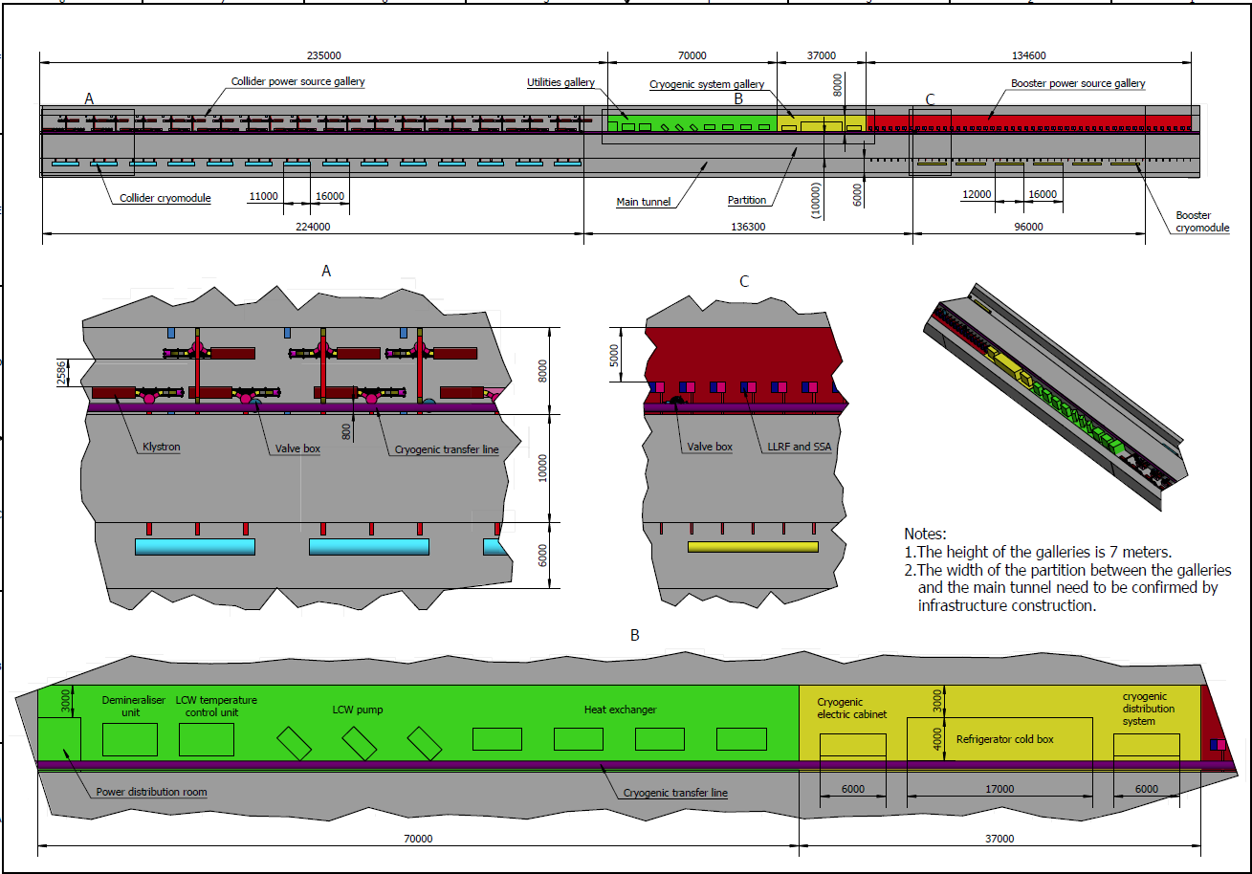
  Project layout and main structure
RF section tunnel – IP2/IP4
  RF galley layout
Gallery at RF section
Tunnel at RF section
Power source for Collider RF
Power source for Booster RF
Utilities gallery
Cryogenic system gallery

Slide 12
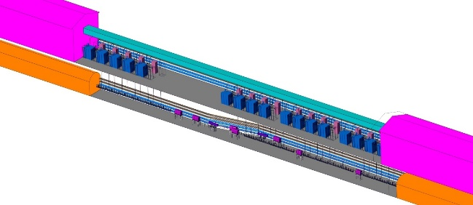
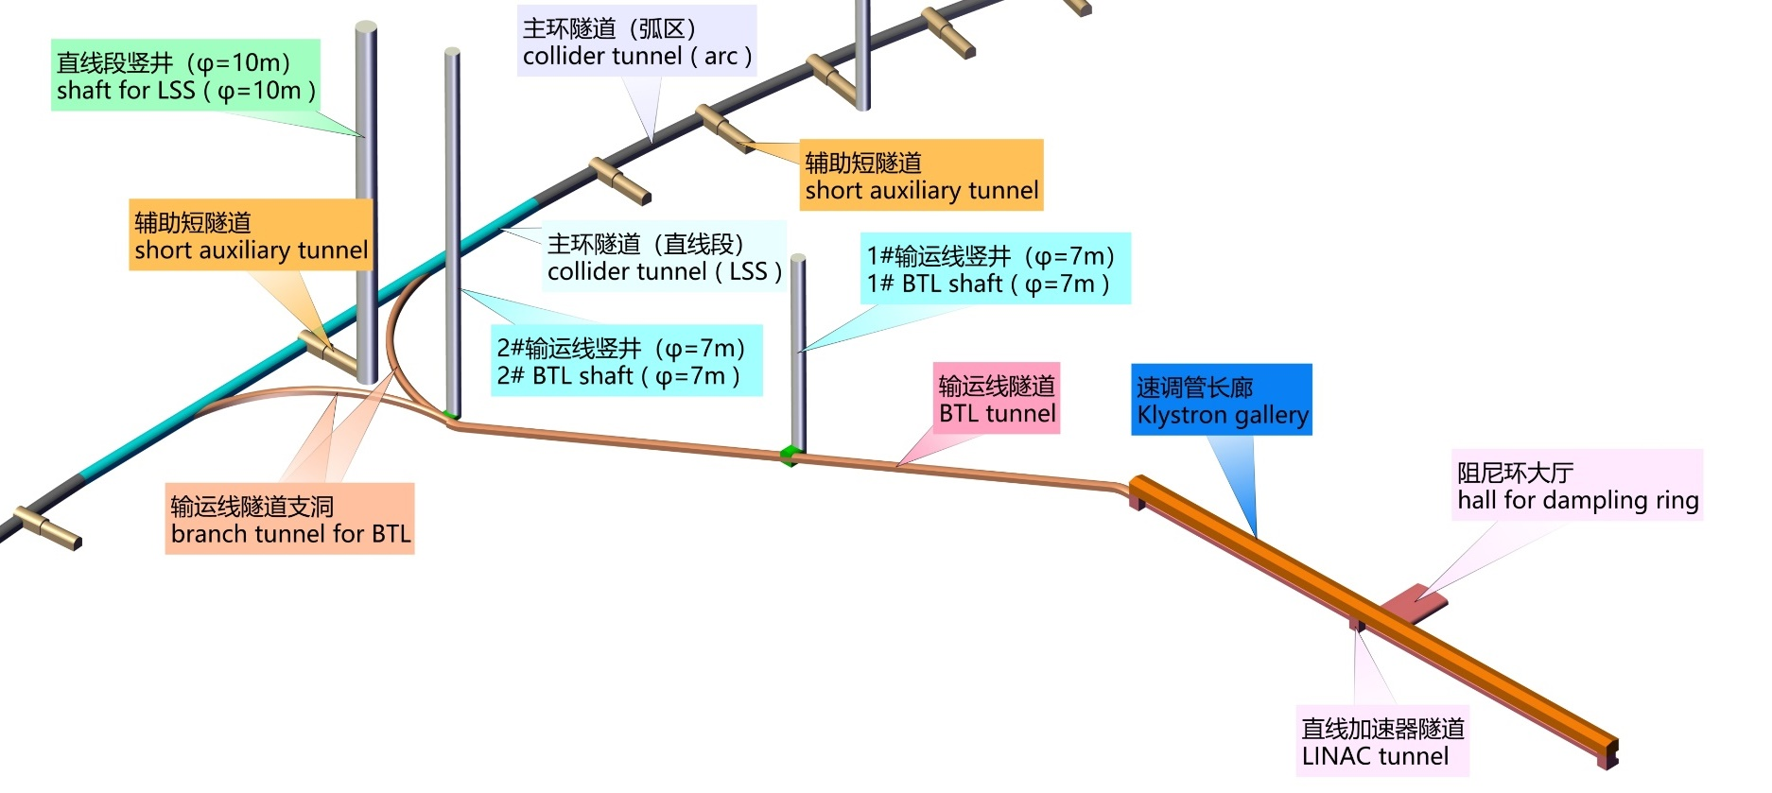
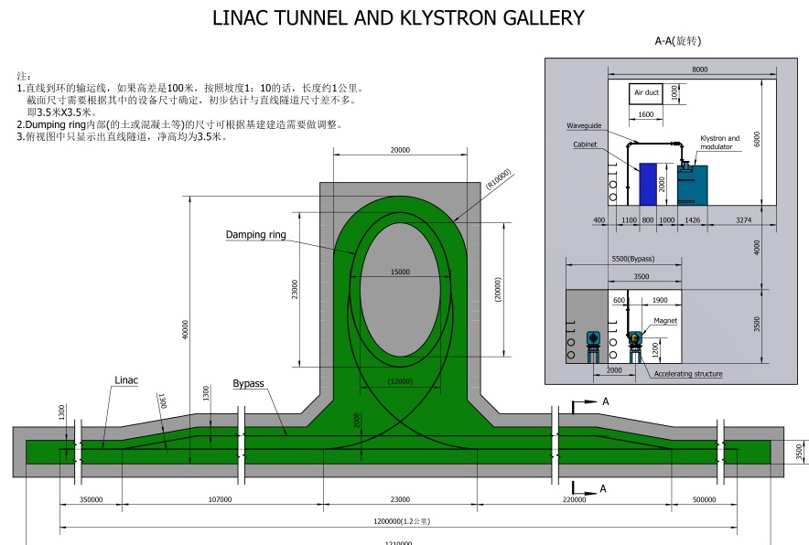
  Project layout and main structure
Linac & BTL Tunnel
  Linac tunnel
    Width: 3.5 m
    Height: 3.5~5.5m
    Long:1.2km
  Dumping ring hall
    Width: 25m
    Height: 3.5m
    Long:40m
  BTL
    Width: 4.5m
    Height: 3.5m
    Long:1.8km+2*459m
8x6m
1.8km
4.5x3.5m
25x3.5m
1.2km
3.5x3.5m

Slide 13
  Project layout and main structure
Access shafts
  Function
    Total：44 shafts
Region | Item | Qty | Diameter (m)
IR | Transport shaft | 2 | 16.00
 | Bypass tunnel access shaft | 2 | 7.00
 | Auxiliary shaft | 2 | 9.00
 | Auxiliary access shaft | 2 | 6.00
RF | Transport shaft | 2 | 15.00
 | Transport shaft | 4 | 6.00
LSS | Access & pipe shaft | 4 | 10.00
Arc sections | Access & pipe shaft | 8 | 10.00
 | Ventilation shaft | 16 | 7.00
BTL | Access & pipe shaft | 2 | 7.00

Slide 14
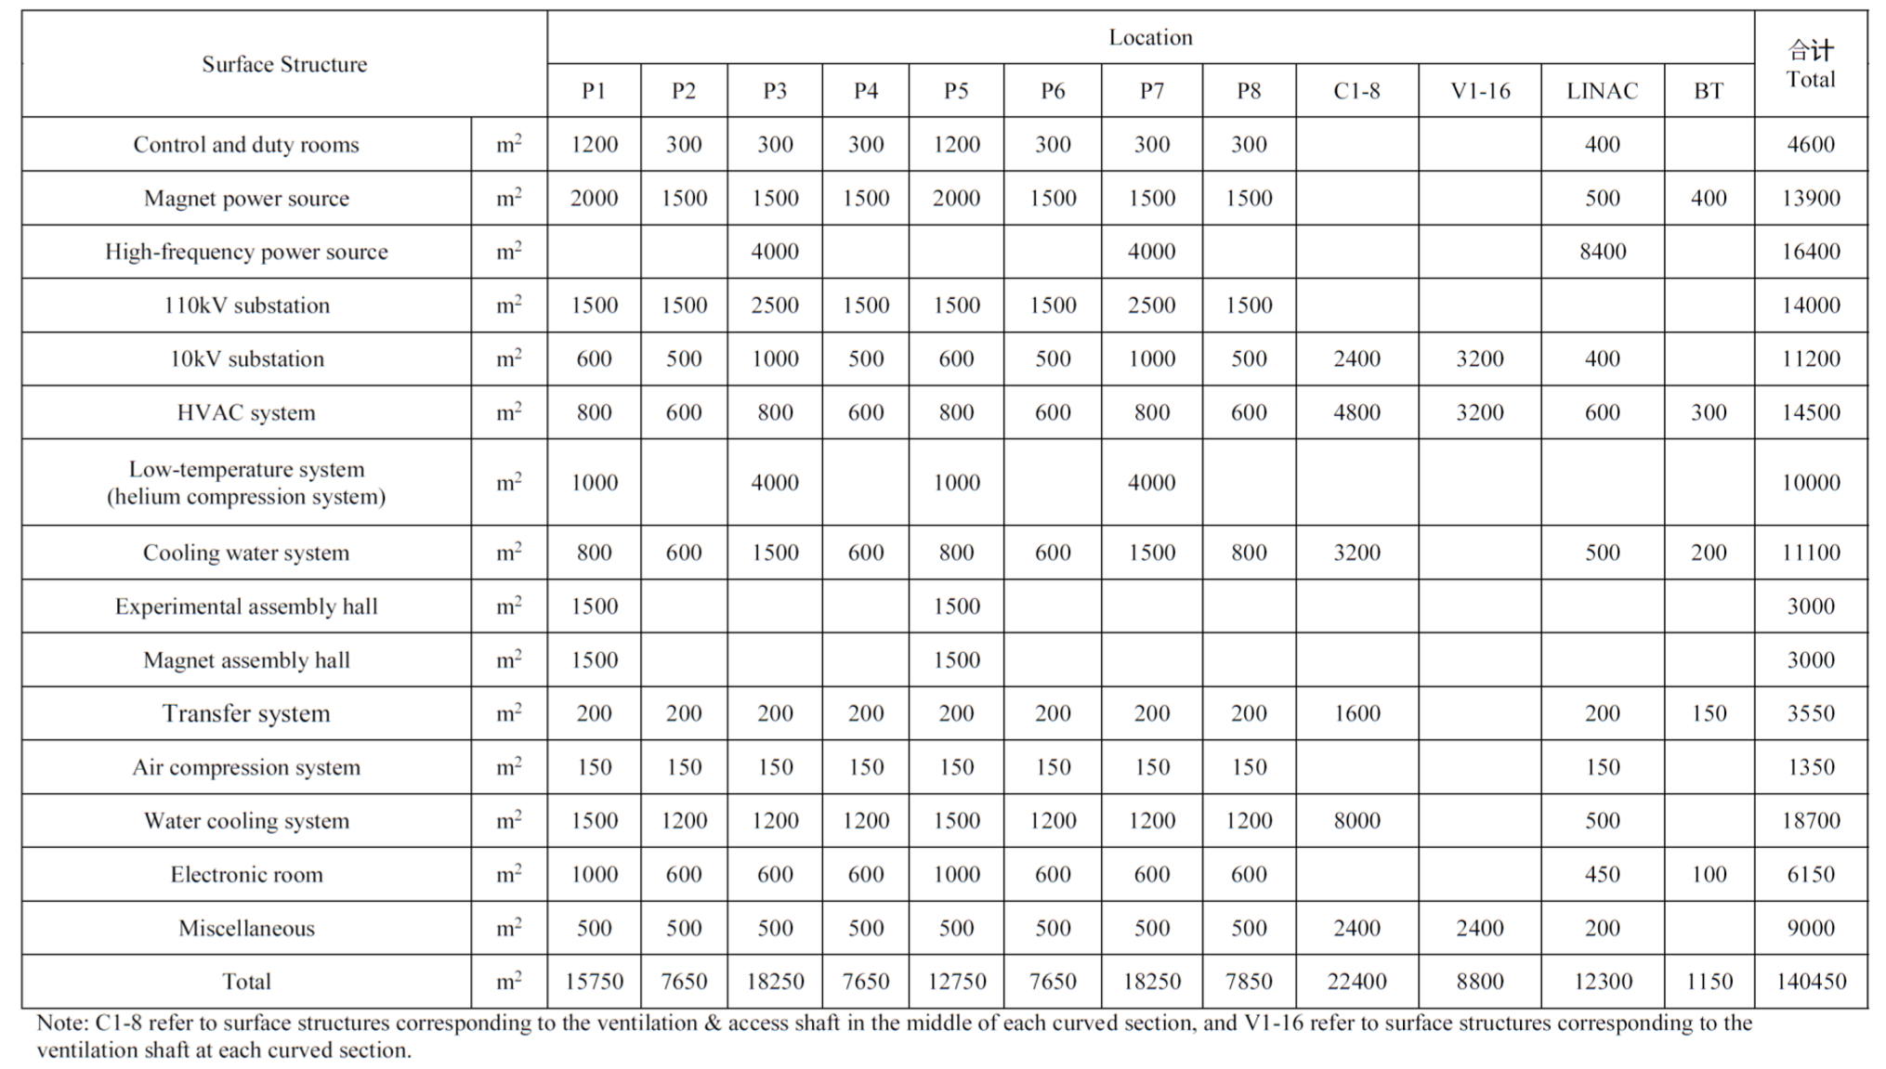
  Project layout and main structure
Surface buildlings
  Function,
    Control and duty rooms;
    Magnet power source;
    The klystron gallery
    Cryogenic equipment
    Utilities.
  All surface structures shall be as close to the access shafts as possible.
  Total:140450m²
Campus office buildings not included

Slide 15
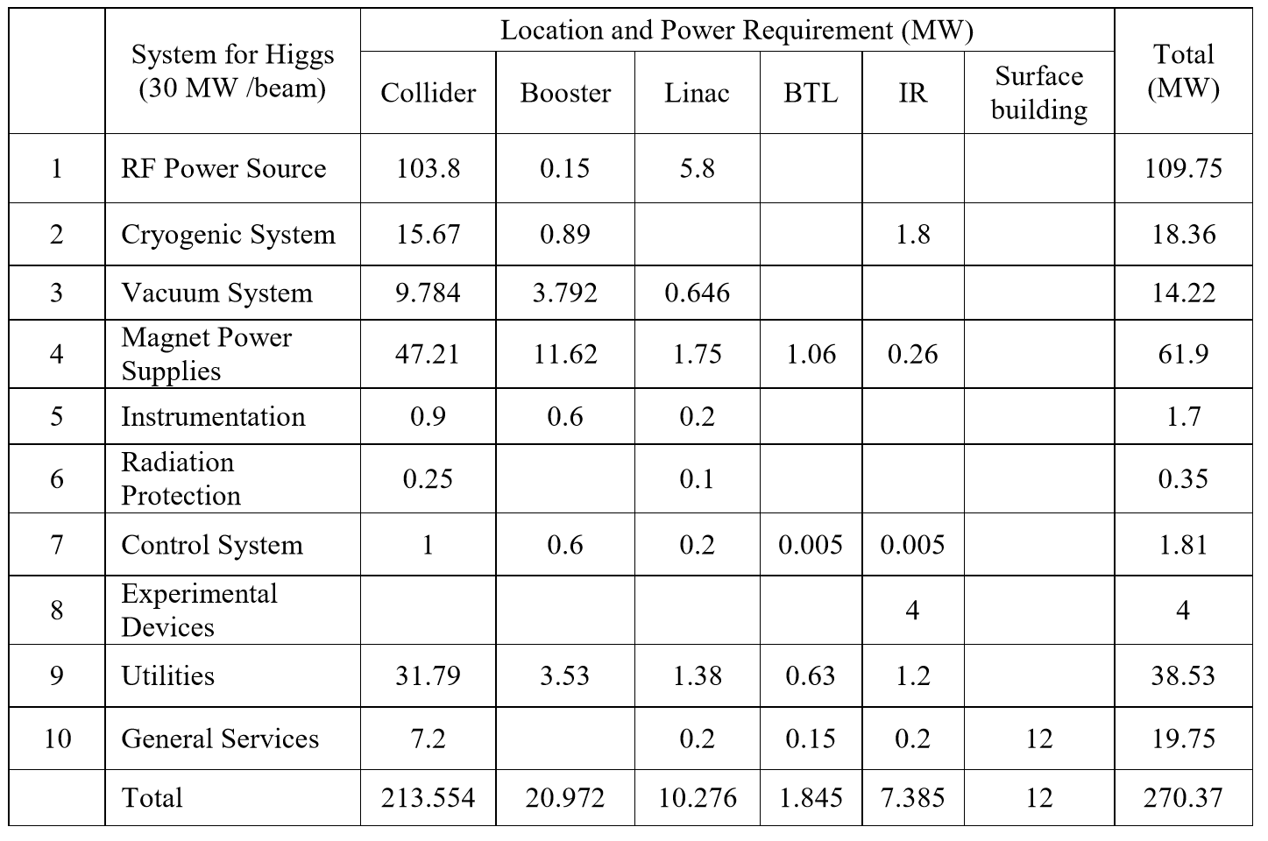
  Utility- electric engineer
Electric power demand
  Total: 270.37MW
  Demand reduction process
    2017.11 – 400MW
    RF Power Source - 59.68MW
    Cryogenic system - 1.56MW
    Converter for magnets - 54.8MW
    Experimental Devices - 10MW
    Utilities - 6.97MW
    Other
    2018.08 – 270.37MW
  The possibility of continued optimization？

Slide 16
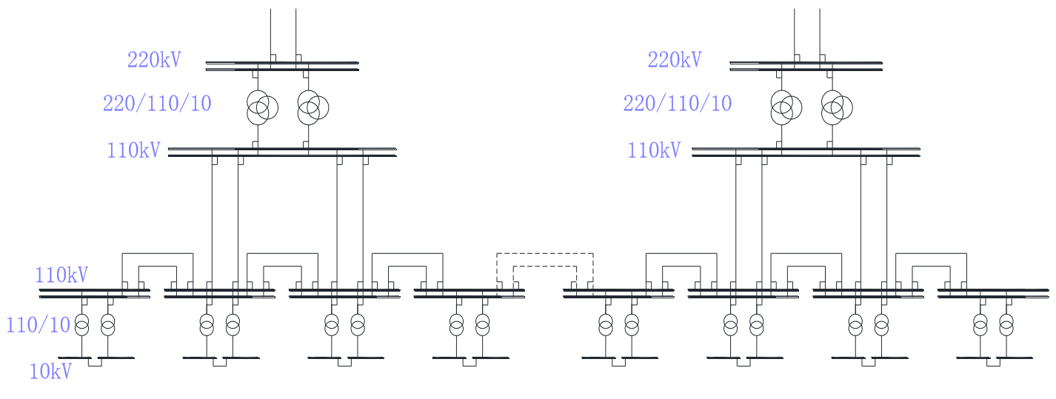
  Utility- electric engineer
Layout of electric distribution on the site
  The voltage levels on the site
    220kV incomer of CEPC master substation
    110kV power distribution system
    10kV power distribution system for HV power equipment and step-down substation incomer
    0.4kV power distribution system for dedicated and general services
  220kV/110kV Master substation
    2 substations
    Rated capacity of transformer: 2*210MW (220/110kV/10kV)
    220kV feeds connected to grid station nearby (State Grid Corporation of China)
    Three-phase three-volume natural oil circulating air-cooled on-load regulating
  110kV/10kV step-down substations
    8 substations(IP1~IP4，LSS1~LSS4)
    Rated capacity of transformer: 2*50MW (110kV/10kV)
    Two 110kV feeds from master substation

Slide 17
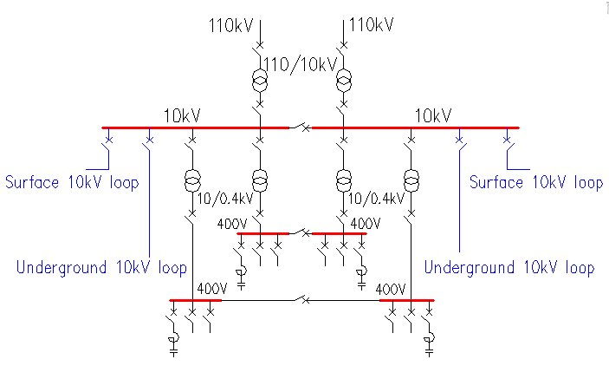
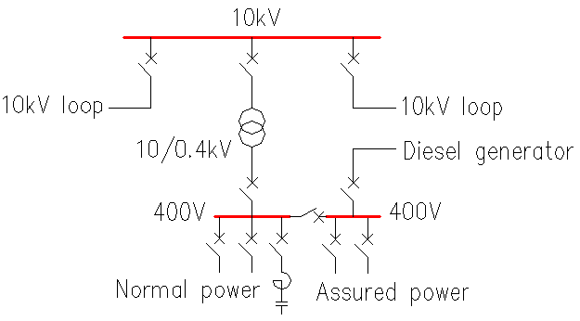
  Utility- electric engineer
Layout of electric distribution on the site
  10kV step-down substations
    10kV feeders from 110kV/10kV substation nearby.
    Surface 10kV loop : 34
    Underground 10kV loop
    -- 96 substations (10/0.4kV ) along the ring tunnel.
    -- near the load points.
    Dry-type transformers
    Centralized reactive compensation
  Back up diesel generator sets maybe required for personnel safety: lifts, smoke extraction etc.
  Instrumentation and power converter control systems may require uninterrupted power supplies (UPS)
Surface 10kV loop （34）
Underground 10kV loop
96

Slide 18
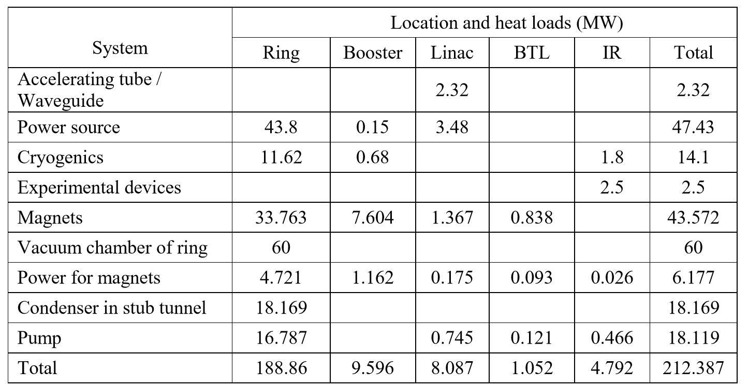
  Utility- cooling water system
The heat load dissipated by CEPC machine
Key requirements and parameters
  Total heat load: 212.387MW
  Total low-conductivity water flow rate (LCW): 22946 t/h
  Total cooling tower water (CTW) flow rate : 36522 t/h
  Cooling water temperature
  -- Cooling tower water temperature: ＜ 29℃
  (Base on wet-bulb air temperature of 27℃ ambient; Machine is shut down in summer )
  -- LCW cooling water temperature: ＜ 31 ℃

Slide 19
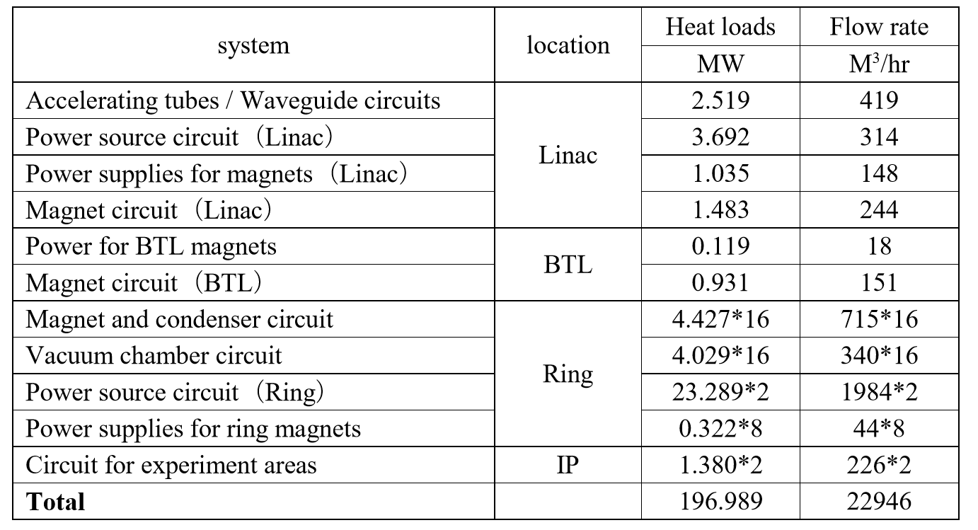
  Utility- cooling water system
Layout of cooling water system
  There are several on-site closed-loop cooling water circuits(LCW) in Linac, Ring, experimental hall respectively, total of 50.
  Deionized water plant at each point of 16
    Supply low-conductivity water for makeup
  Cooling tower water(CTW) station at each of shaft points and Linac
    As coolant for on-site cooling system

Slide 20
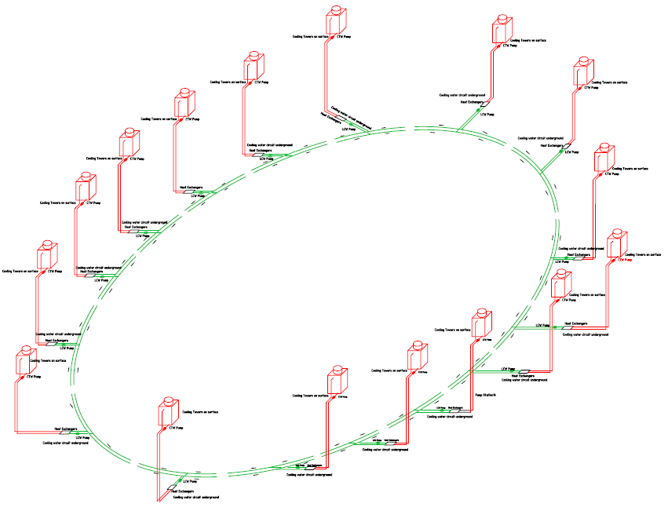
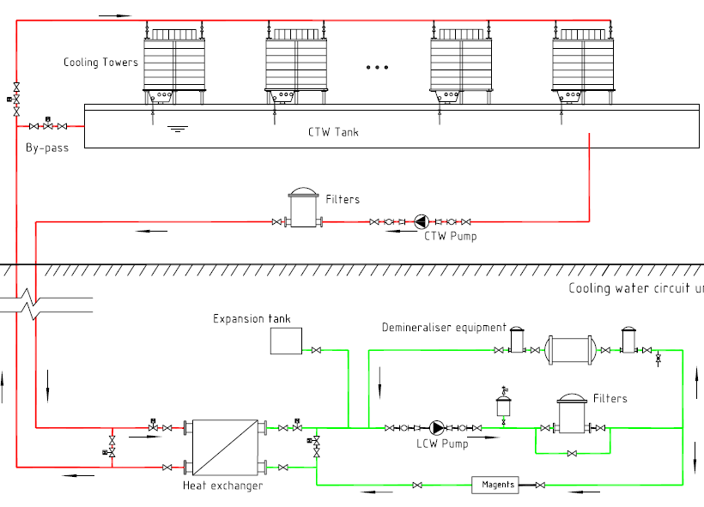
  Utility- cooling water system
Layout of cooling water system
Primary loops on surface
Secondary loops are underground.
Flow diagram of typical cooling water circuits

Slide 21
  Utility- HVAC
Estimated cooling loads of HVAC
  Ring tunnel:50MW
  Service buildings: (200W/m2) 28MW
  Total:78MW
Indoor Design Parameters
  Tunnel
    Temperature: within 30-34℃ and shall be kept below 35℃
    Relative humidity: 50% ~ 60%, and shall be lower than 65%
  Experimental halls
    Temperature: about 26℃(summer), 20℃(winter)
    Relative humidity: 50% ~ 60%, and shall be lower than 65%.
System | Location and cooling loads(MW) |  | Total （MW）
 | Ring | Booster
Magnets | 2 | 1 | 3
Cable in tunnel | 32.5 | 3.5 | 36
General and dedicated services | 6 | 2 | 8
Synchrotron radiation | 2 | 1 | 3
Total | 42.5 | 7.5 | 50
  Control room (or electronics)
    Temperature: about 20-25℃
    Relative humidity: 45% ~ 60%
  Other service building
    Temperature: about 28℃(summer), 18℃(winter),
    Relative humidity: lower than 65%

Slide 22
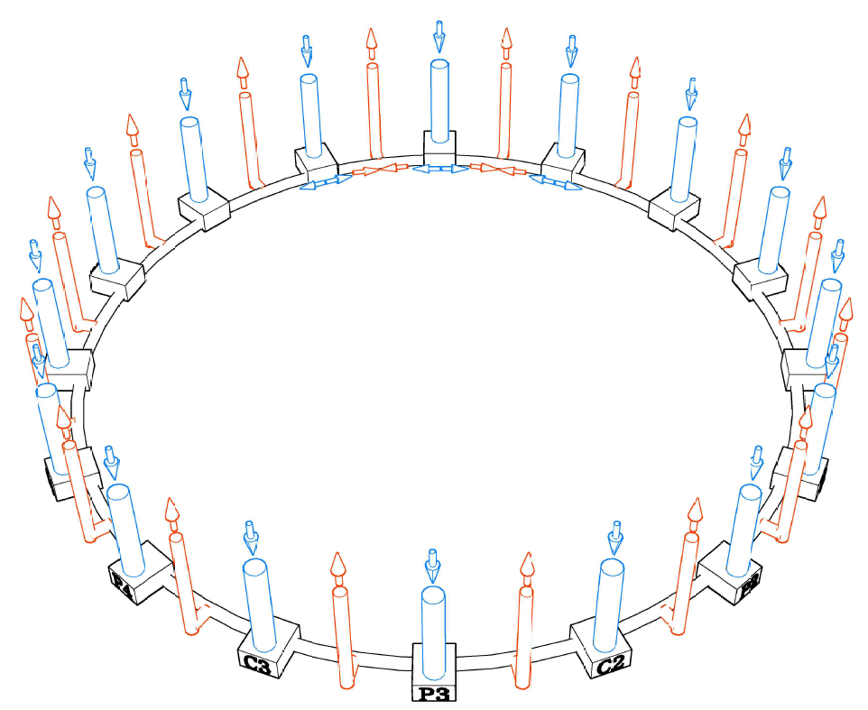
  Utility- HVAC
Coolant for air conditioning: chilled water
Heat source for heating system in winter
  Heat pump -- heat recover from cooling system
  Backup boiler
Air-conditioning system in tunnel
  Layout
    The tunnel is divided into 32 independent sections.
    To supply air by AHU at 16 points.
    To exhaust air adjacently at 16 points, filtered by HEPA.
  Operation scenario
    Machine operation mode
    Transitional mode
    Accessible mode
    Emergency mode
Design parameter | Unit | quantity
Total cooling load | MW | 78
Total chilled water flow rate | t/hr | 14000
Total cooling tower water flow rate | t/hr | 18000
Total capacity of cooling towers | MW | 100
Supply air by AHU
Exhaust air adjacently
by HEPA
Tunnel air flow rate: 80000 m³/hr
The velocity is 1.0m/s

Slide 23
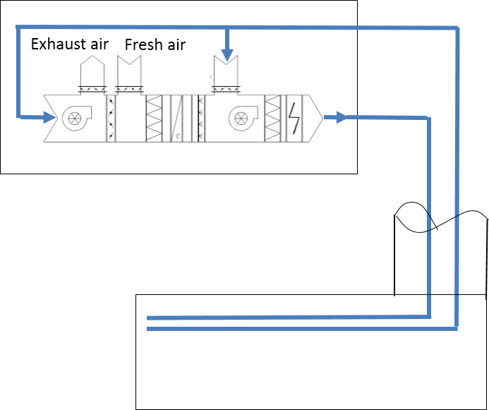
  Utility- HVAC
RF auxiliary tunnels and experiment hall
  Air conditioned and ventilated by mechanical supply and extraction of air via ducts in access shaft
  AHU is on ground level
  Dedicated smoke, gas extraction systems
Auxiliary stub tunnels
  Air conditioned and ventilated by local AHU
    Because there is no chilled water, AHU contains a refrigerator unit which is cooled by deionized water from magnet circuits
  Other service buildings
    AHU
    fan-coil + fresh air system

Slide 24
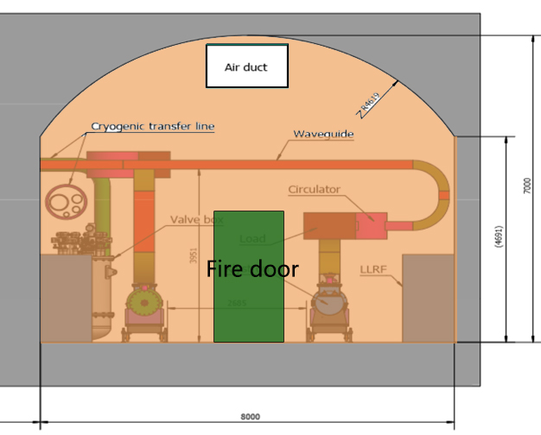
  Utility- Fire Protection
Fire Resistance of Building Structure
  The fire protection rating of the ground level buildings is Grade I or Grade II
  Noncombustible or refractory materials are employed.
Arrangement of Fire Partition
  Fire-proof board can be arranged by 500m interval
  Form relatively independent fire zone
  Every fire zone is able to use the fire zones on both sides as the emergency escape channels.
  There is a short auxiliary tunnel independent from the collider ring tunnel at about every 1000 m; adding independent fire cuts can be used to meet the personnel refuge requirement within the maximum evacuation distance.

Slide 25
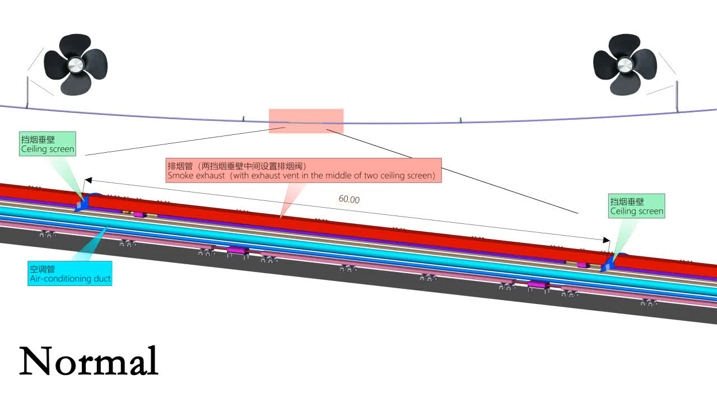
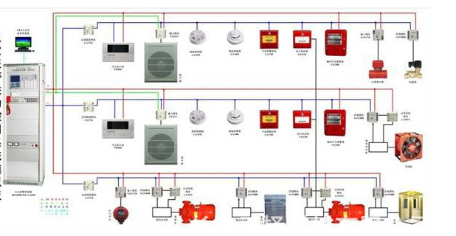
  Utility- Fire Protection
Smoke Control and safe escape
  32 uniform sections
  Smoke screen is installed between smoke control zone
Water-based Fire-fighting
  Fire Hydrant Design and Extinguisher distribution
    The distance between the two hydrants should not exceed 50m
    Dry powder extinguishers.
Fire auto-alarms and fire-fighting coordinated control system
  Automatically or manually send alarming signals and fire-fighting coordinated control.
  Monitoring scope includes: tunnel, experiment hall, auxiliary room, shaft, etc.

Slide 26
  Utility- Transportation and Lifting Equipment
Position | Equipment and specs | QTY
Access shafts | Elevator | 24sets
IP2/IP4 | 30t Crane | 2 sets
IP1/IP3 ground assembly halls | 1500t Gantry Crane | 1 set
 | 1000t Gantry Crane | 1 set
 | 80t Gantry Crane | 2 sets
IP1/IP3 underground main cavern, service cavern | 20t Overhead Crane (L=28m) | 1 set
 | 10t Overhead Crane (L=18.5m) | 1 set
Underground vehicle | Trucks for passengers & goods | 20 sets

Slide 27
  General Construction Schedule
    The total construction period is 54 months, including preparatory work of 8 months, main works of 43 months and completion work of 3 months.
    The critical activities are:
Preparation 8 months
Construction shafts 5 months
Main tunnel excavation 24 months
Tunnel lining & water prevention 10 months
Ventilation installation in shafts 4 months
Completion work 3 months
The surface buildings and electrical installation are carried out in parallel and not on the main path.

Slide 28
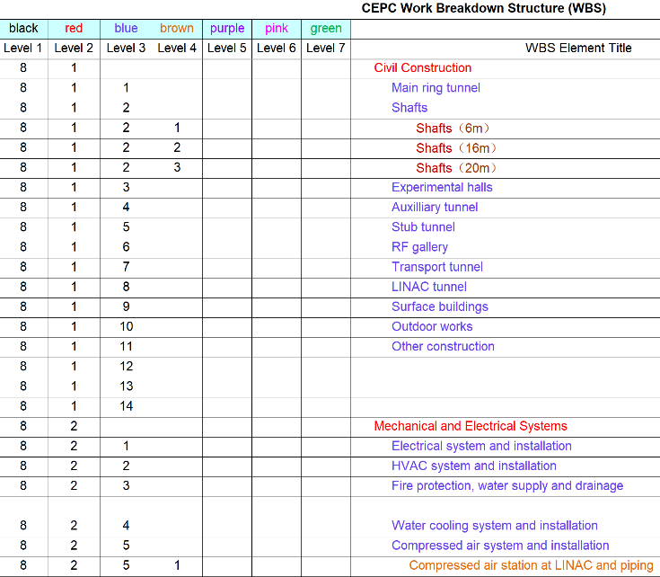
  Work prospect of TDR
Target of TDR
  As a plan, the next stage is a 5-year period from 2018 to 2022 for R&D and for completion of a Technical Design Report
  The WBS of conventional facilities has reached level 3 to 4 now, and some systems have reached level 5. In the TDR stage, the complete WBS will reach Level 7.
  TDR finally realizes the design and technical conditions of conventional facilities to meet the requirements of construction.

Slide 29
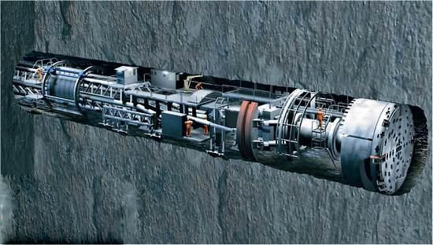
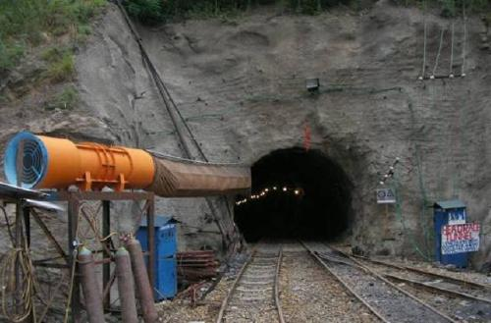
  Work prospect of TDR
Plan of the TDR
  Site investigation will be in-depth，as the basis of the final selection
  Critical technical problems of engineering need to be solved
    Comprehensive exploration technology for long distance complicated underground engineering
    Prevention and treatment technology study for underground water
    The design and construction of long distance tunnel under complicated geographical conditions and large-span underground caverns.
    （ the development, manufacture and application of TBM ）.
    Construction management of complicated underground engineering.
    Fire protection design of long tunnel, include ventilation and smoke exhaust , fire control design, etc.
  The layout of process equipment and buildings will be optimized.

Slide 30
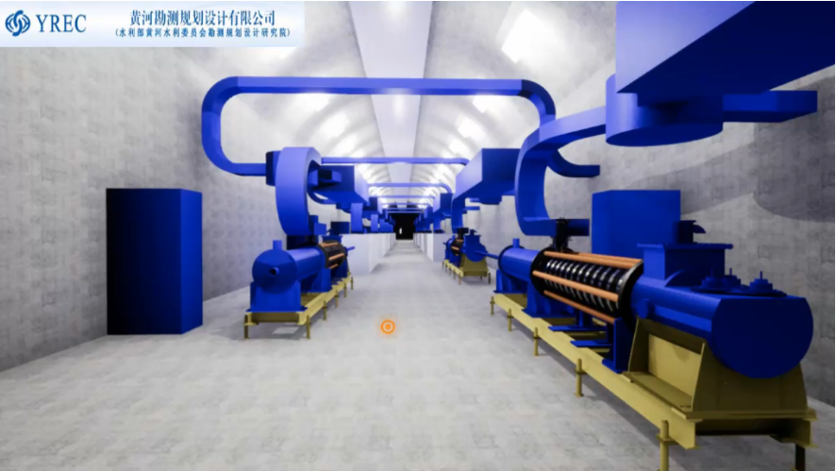
  Work prospect of TDR
Utilities
    Process requirements will be refined.
    Equipment layout design will be optimized and detailed.
    Equipment investigation
    -- Parameter calculation and make sure models
    -- Design and development of special equipment
Energy saving
    Energy saving scheme design and consideration
    -- Adoption of high efficiency equipment
    -- Recovery and utilization of residual heat
    -- Increase the utilization of renewable energy
    Green building design
    Design advanced energy management system
Visualization of design management
    Carry out the BIM-based design
    VR

Slide 31
  Summary
The conceptual design report has been completed and the objectives of this phase have been achieved. Site investigation, project layout and utilities study have been reached a certain level.
The next stage for completion of a Technical Design Report , and so many critical technical problems of engineering need to be studied deeply and solved. Finally, the design and technical conditions meet the requirements of the construction.

Slide 32
  Contributor:
Yu Xiao YREC
HaiJing Wang IHEP
Fuqing Chen IHEP
Luyang Zhao IHEP

Slide 33
  Thank you for your attention !

