Slide 1
Readout electronics system for Laser TPC prototype
Hui Gong
Department of Physics Engineering
Tsinghua university
*gonghui@mail.tsinghua.edu.cn
2018/11/13

Slide 2
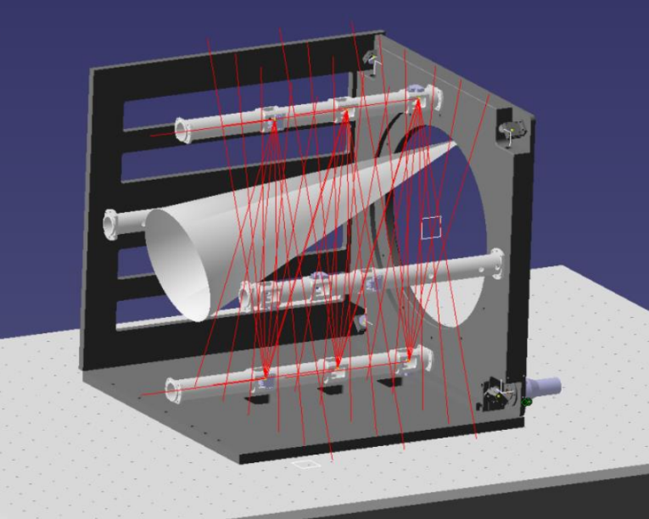
Laser TPC prototype
To study the key issues in high-precision track detection, a new TPC prototype with a laser calibration system is being designed.
The tracking volume of the TPC is around 38 centimeters in diameter and 50 centimeters long.

Slide 3
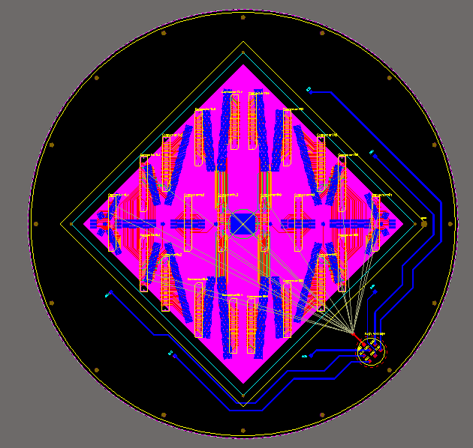
Laser TPC prototype
At the endplate of TPC, GEM (gaseous Electron Multiplier ) is selected for electron multiplication.
The aimed spatial resolution of the TPC is 100 μm. As a result, a sub-nanosecond time resolution should be achieved by the readout system.
According to the pad distribution, the total number of readout channels is about 1000.
Pad Distribution

Slide 4
Architecture of the readout electronics system
Taking into account of the above-mentioned requirements and high count rate upto 2 KHz, a readout system based on CASAGEM ASIC chips (Charge Amplifier and Shaping Amplifier for GEM) and commercial ADC chips is designed.
External clock
External trigger
Ethernet switch

Slide 5
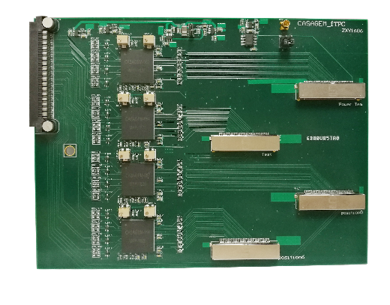
Front end card
Four CASAGEM chips are mounted on one front-end card to support the readout of 64 channels
To detector pads
To DAQ board

Slide 6
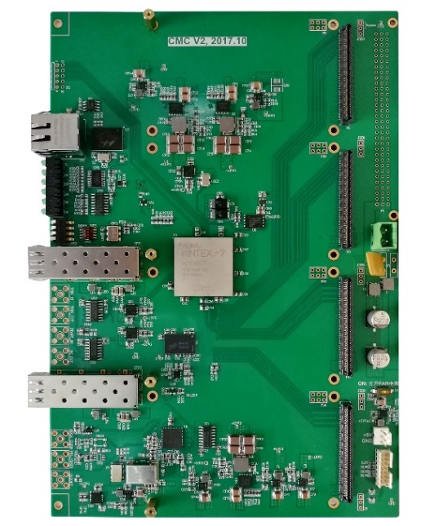
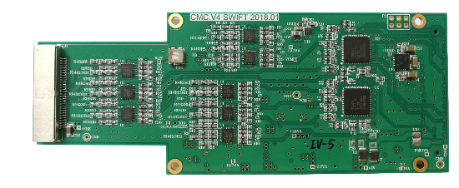
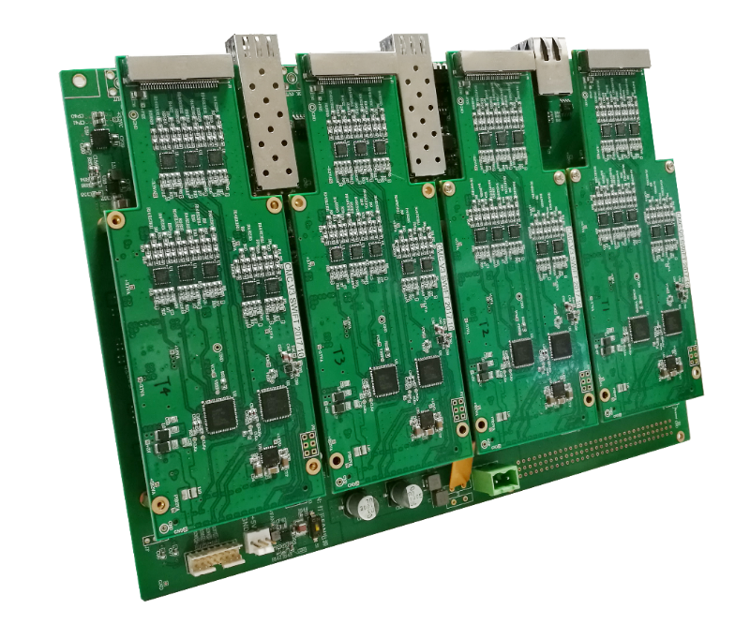
DAQ board
Each DAQ board consists of two parts: a common carrier board and application specific mezzanine cards.
For laser TPC, a 16-channel, 12-bit, 80 Msps ADC mezzanine card is designed.

Slide 7
ADC test results
Sine waves from a waveform generator are used to test the ADC performance, and 32 mezzanine cards (512 channels in total) have been tested.
  DNL is within ±0.5 LSB
  INL is within ±1 LSB
  ENOB is about 10.5

Slide 8
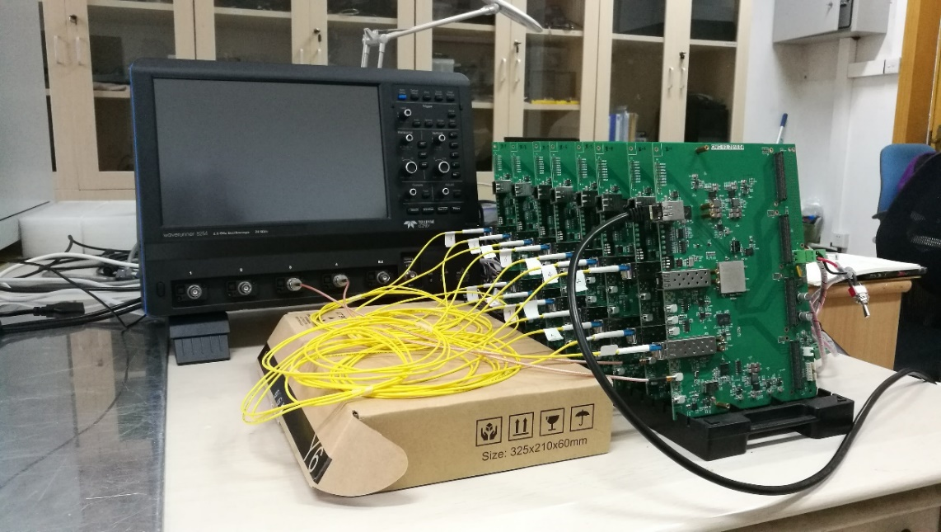
Clock synchronization test
To test clock synchronization, a DAQ system consisting of eight DAQ boards has been built.
Between each two adjacent boards, a 2m-long optical fiber is used to connect them.

Slide 9
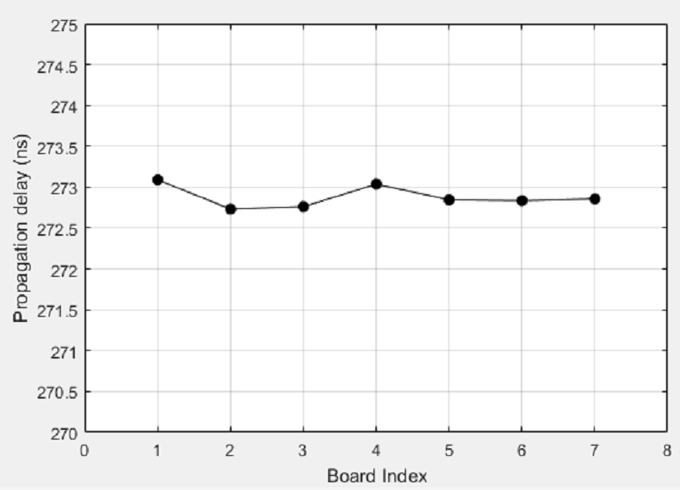
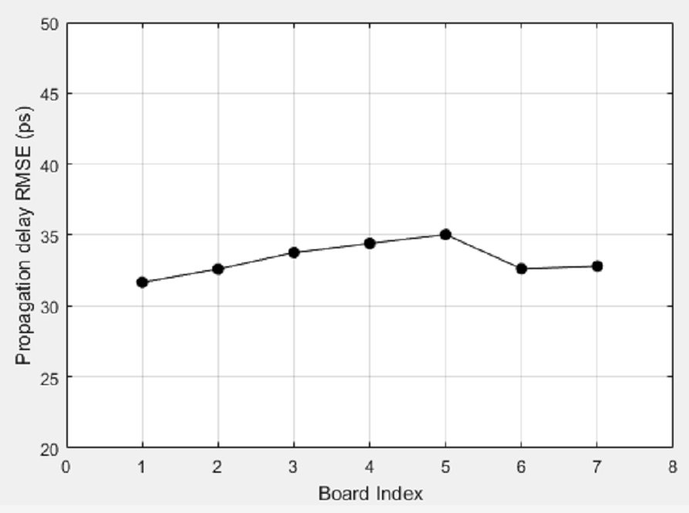
Clock synchronization test
With the clock data recovery (CDR) technology, the clocks of all boards can be easily synchronized to a single source.
The propagation delay between each two neighboring boards is fixed (around 273ns). Its RMS value is about 30ps.
Propagation delay between each two neighboring boards.
The RMS value of propagation delay between each two neighboring boards

Slide 10
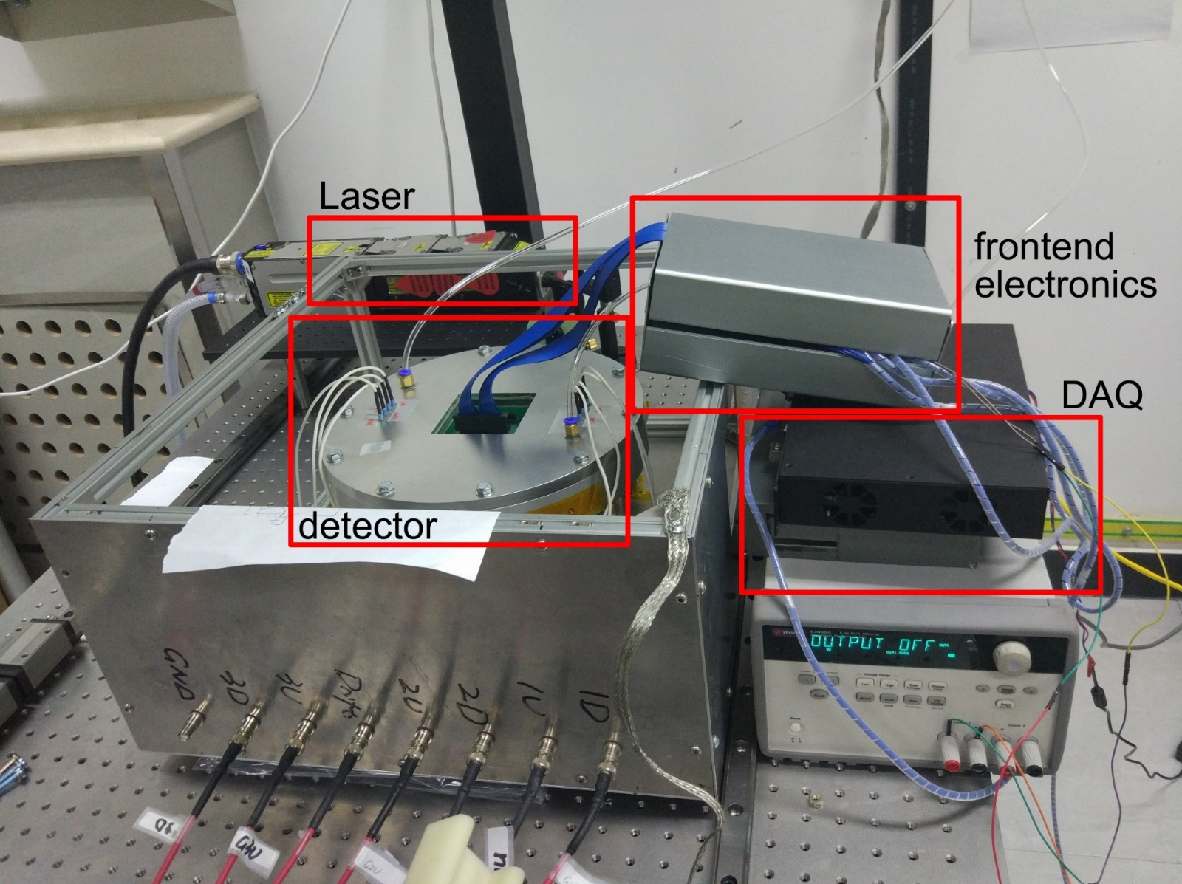
Test of TPC prototype
Now, 128 channels of readout electronics have been assembled for TPC prototype. The test is undergoing.

Slide 11
Future work
Test the system performance with more DAQ boards working in daisy chain mode.
Plan to design an specific optical switch boards with 2 upstream optical links and about 12 downstream optical links.
  Each downstream link can handle a group of DAQ boards in daisy chain.
  With upstream link, the optical switch board can work in multi-level cascade mode.
  As a result, the readout system can be scalable to support more readout channels.

Slide 12
Thank you!

