Slide 1
Higgs physics toward TDR
Yaquan Fang (IHEP)
Nov 15, 2018

Slide 2
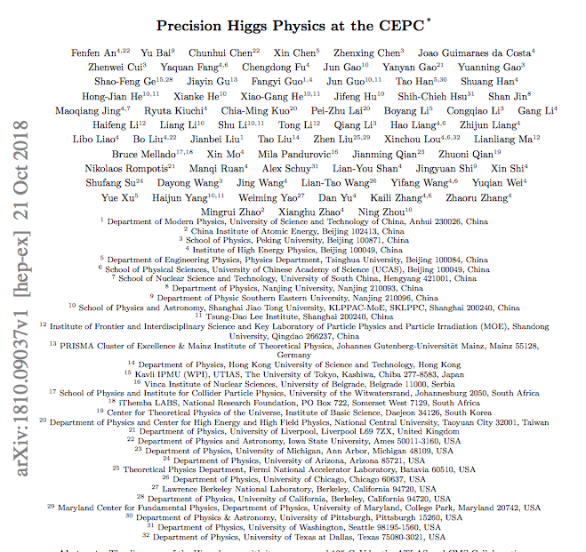
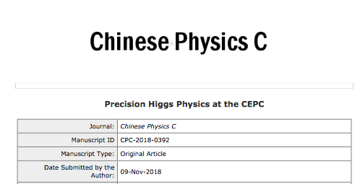
Status of the white paper @ CDR
Higgs white paper was submitted to arXiv on Oct 21 after one year struggling.
It was submitted to CPC on Nov 9th.

Slide 3
Channels (now 36)
Manpowers@CDR :
H->bb,cc,gg Yu Bai (Southeast Univ.),Chunhui Chen (Iowa)
H->γγ Fangyi Guo (IHEP)
H->ττ Dan Yu (IHEP), Xin Chen (Tsinghua)
H->μμ Kaili Zhang (IHEP), Haifeng Li & Boqun Liu(Shandong)
H->WW Tong Li & Lianliang Ma(Shandong)
Nikos Rompotis (Liverpool), Mila Pandurovic (Belgrade)
H->ZZ Ryuta Kiuchi (IHEP), Xin Shi(IHEP)
Shih-Chieh Hsu & Alex Schuy (Washington)
Zhuoni Qian (Pittsburgh), Yanyan Gao (Liverpool)
WW fusion Hao Liang (IHEP)
H->Invisible Xin Shi & Maoqian Jing (IHEP)
H->Zγ Weiming Yao (LBNL)
Combination : Kaili Zhang (IHEP), Jin Wang (Syndney)
Interpretation: Liantao Wang (Chicago), Shufang Su (Arizona)
Tao Han (Pittsburgh), Tao Liu(HKUST),
Jiayin Gu(DESY),
Weekly Meetings on Thursday night (9pm, Beijing) towards
Higgs white paper and contribution to CDR
cepc-physics@maillist.ihep.ac.cn
Coordinators for the efforts:
Jianming Qian (Michigan), Yaquan Fang (IHEP)
Gang Li (IHEP), Manqi Ruan (IHEP)
Signal |  | Observed | Who takes charge | Last update |  | Signal |  | Observed | Who takes charge | Last update
Z | H |  |  |  |  | Z | H
H->qq |  |  |  |  |  | H->WW
ee | bb | 21441 | Baiyu | 2017.7 |  | μμ | μvμv | 52 | Libo | 2017.4
 | cc | 983 |  |  |  |  | evev | 36
 | gg | 2965 |  |  |  |  | evμv | 105
μμ | bb | 29771 |  |  |  |  | evqq | 663
 | cc | 1514 |  |  |  |  | μvqq | 717
 | gg | 4380 |  |  |  | ee | μvμv | 44
qq | bb | 176478 |  |  |  |  | evev | 22
 | cc | 8256 |  |  |  |  | evμv | 81
 | gg | 25244 |  |  |  |  | evqq | 612
vv | bb | 69820 |  |  |  |  | μvqq | 684
 | cc | 3029 |  |  |  | vv | qqqq | 9022
 | gg | 9522
H→γγ |  |  |  |  |  | H->ZZ
ll | γγ | 90 | Feng | 2015 |  | vv | μμjj | 190 | Yuqian | 2016.9
vv |  | 328 |  |  |  | μμ | vvjj | 209
qq |  | 828 | Yitian | 2017.4 |  | ee | vvjj | 72
H→ll |  |  |  |  |  | H->Invisible
μμ | ττ | 2113 | Dan | 2017.7 |  | qq | vvvv | 291 | MoXin | 2017.7
qq |  | 36024 |  |  |  | ee |  | 13
nn |  | 12478 |  |  |  | μμ |  | 24
Inc. | μμ | 47 | Zhenwei | 2016.8
More manpowers needed for
TDR.

Slide 4
Talks and posters shown in this workshop related to white paper
Higgs combination (Kaili Zhang):
https://indico.ihep.ac.cn/event/7389/session/14/contribution/105/material/slides/0.pdf
H->γγ (Fangyi Guo):
https://indico.ihep.ac.cn/event/7389/session/0/contribution/206/material/slides/0.pdf
H->ττ (Dan Yu):
https://indico.ihep.ac.cn/event/7389/session/0/contribution/207/material/slides/0.pdf
H->WW (Tong Li):
https://indico.ihep.ac.cn/event/7389/session/0/contribution/208/material/slides/0.pdf
H->ZZ (Lingteng Kong):
https://indico.ihep.ac.cn/event/7389/session/0/contribution/210/material/slides/0.pdf
H->invisible (Ryuta Kiuchi)
https://indico.ihep.ac.cn/event/7389/session/3/contribution/87/material/slides/0.pdf
Higgs width (Hao Liang):
https://indico.ihep.ac.cn/event/7389/session/14/contribution/226/material/slides/0.pdf
Interpretation (Zhen Liu):
https://indico.ihep.ac.cn/event/7389/session/14/contribution/106/material/slides/0.pdf
EFT (Jiayin Guo):
https://indico.ihep.ac.cn/event/7389/session/14/contribution/116/material/slides/0.pdf

Slide 5
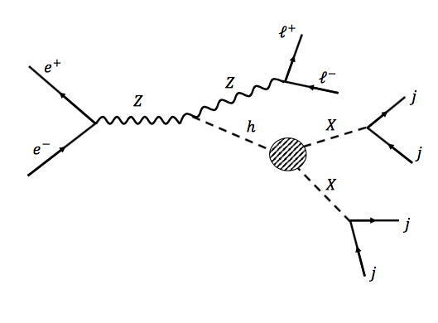
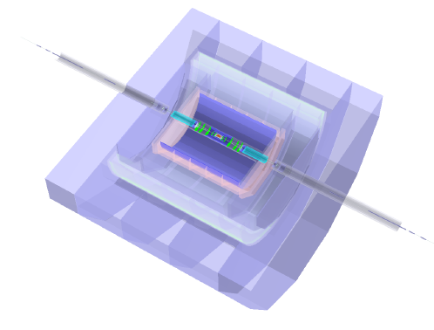
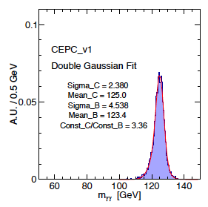
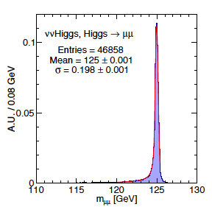
Next step toward TDR: inputs
The geometries of the detector could keep on updating :
provide more inputs from the physics side?
H decays to long lived particles (Seth Koren):
https://indico.ihep.ac.cn/event/7389/session/18/contribution/118/material/slides/0.pdf
CEPC-v1: 250 GeV/3.5T,…
CEPC-v4: 240 GeV/3T,….
…….

Slide 6
Analyses strategies
ZH
qq,ll,vv
ww:
4q,qqlv,lvlv
ZZ:
lljj,vvjj,4l
$ll$:
$$ττ,μμ$$
𝑙𝑙:
𝜏𝜏,𝜇𝜇
$$γγ$$
𝛾𝛾
invisible
jj:
bb,cc,gg
Z
H
Final states of some channels are the same as the other , overlapped events…..
Group the analyses according to the final states ???

Slide 7
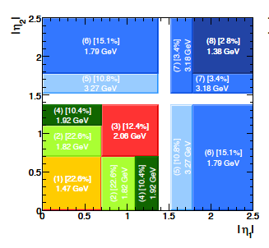
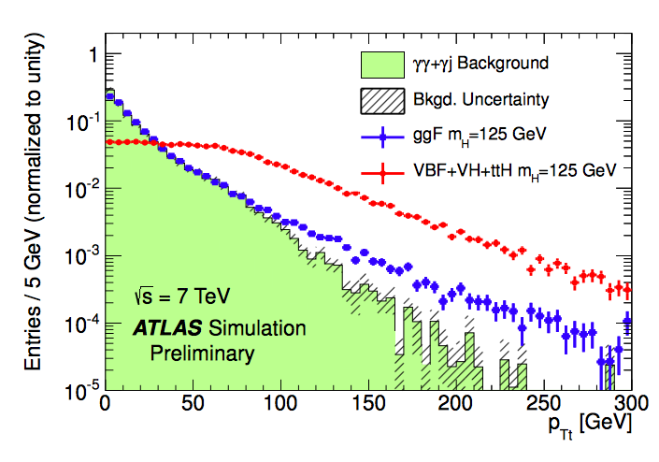
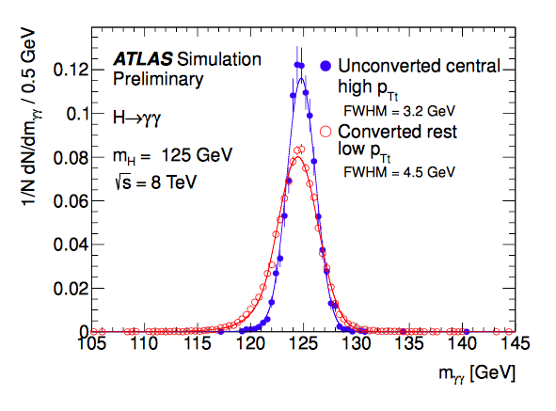
Optimizations of the analyses:
The inclusive analysis is very simple :
Photon ID, Isolation, Kinematic cuts on leading/subleading photon.
Is there anything else that we can explore?
One example:
ATLAS Analyses optimizations: H->gamma gamma analysis
P_{T} of Higgs (P_{Tt} is perpendicular to the thrust direction of two photon)
Divide different eta regions for two photons
Conversion of the photons

Slide 8
Discussion
Wechat group
Update of the Higgs white paper @ TDR?
Restructure the analyses?
Optimization…?
Improvements of the statistical treatments?
${ BR}_{H→bb}$=$\frac{N_{H→bb}}{N_{H→bb}+\overline{N_{H→bb}}}$
Further Cooperation between theorists and experimentalists:
Excellent cooperation so far…
Interpretation on the results.
Simulation (fast vs full ?)
Bi-weekly meeting soon?
Mailing list: cepc-physics@maillist.ihep.ac.cn

