Slide 1
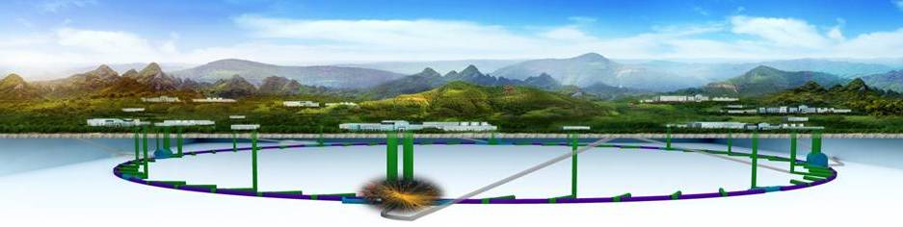
Overview
&
IAC Recommendation Implementation
XinChou Lou (IHEP)
For the CEPC-SppC Study Group

Slide 2
Outline
Part I – Overview
    Progress and updates
    Plan and goals
Part II – IAC Report Implementation
Part III – Discussion

Slide 3
CEPC Overview
Progress and Status
Much more details will be presented by my colleagues at this meeting

Slide 4
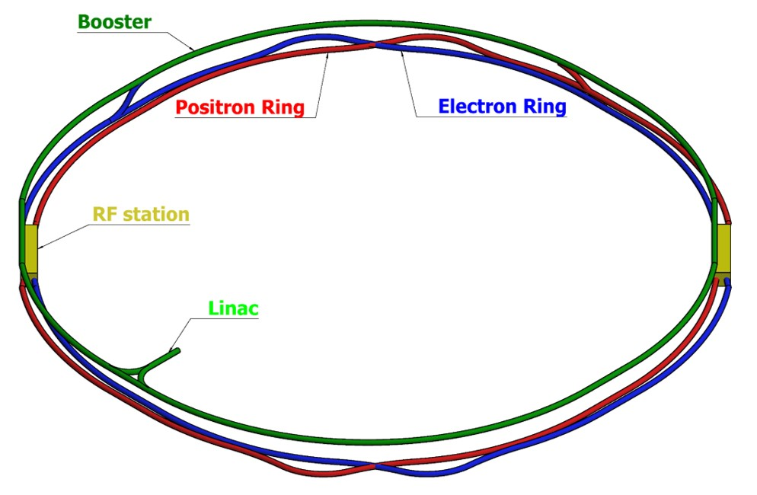
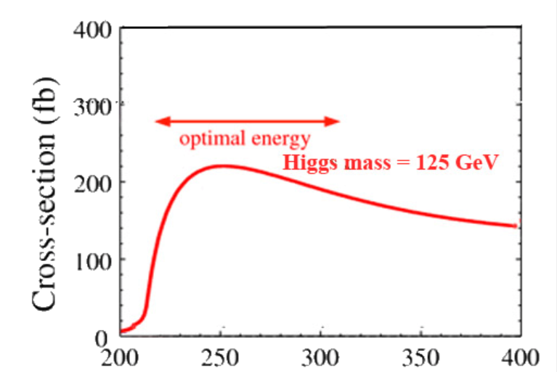
Reminder about the CEPC-SppC
e⁺e⁻ Higgs (Z) factory
E_{cm}≈240GeV, luminosity ~2×10³⁴ cm⁻²s⁻¹, 2IP，1M H in 10 years
at the Z-pole 10¹⁰Z bosons/yr
Precision measurement of the Higgs boson (and the Z boson)
Upgradable to pp collision with E_{cm} ≈ 50-100 TeV (with ep, HI options)
A discovery machine for BSM new physics
Higgs precision
1% or better
e⁺e⁻ → ZH
e⁺e⁻ Higgs (Z) factory
Ring length ~ 100km
BEPCII will likely complete its mission ~2020s;
CEPC – possible accelerator based particle physics program in China after BII
E_{cm}(GeV)

Slide 5
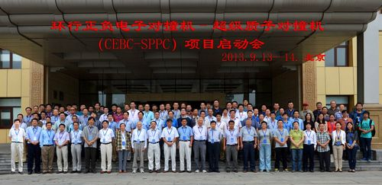
Reminder about the CEPC-SppC
Kick-off on Sept. 13, 2013 - inspired by the discovery of the Higgs boson at the LHC
CEPC study group
formed in Beijing
PreCDR, March 2015 – initial investigations; no-show stoppers, identified issues & R&D
Funding, R&D, international collaboration, … – continued effort since 2013
CDR, August-October 2018 – scientific goals well justified & aligned with intl priorities;
endorsement for moving towards TDR, and …

Slide 6
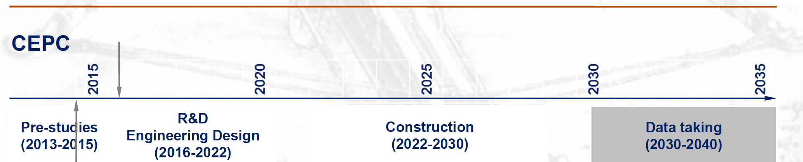
CEPC Schedule (ideal)
current time
design issues
R&D items
preCDR
CDR, funding
R&D program
Intl. collaboration
site study
seek approval, site decision
construction during 14th 5-
year plan
commissioning
CEPC data-taking starts before the LHC program ends around 2035
possibly con-current, and complimentary to the ILC

Slide 7
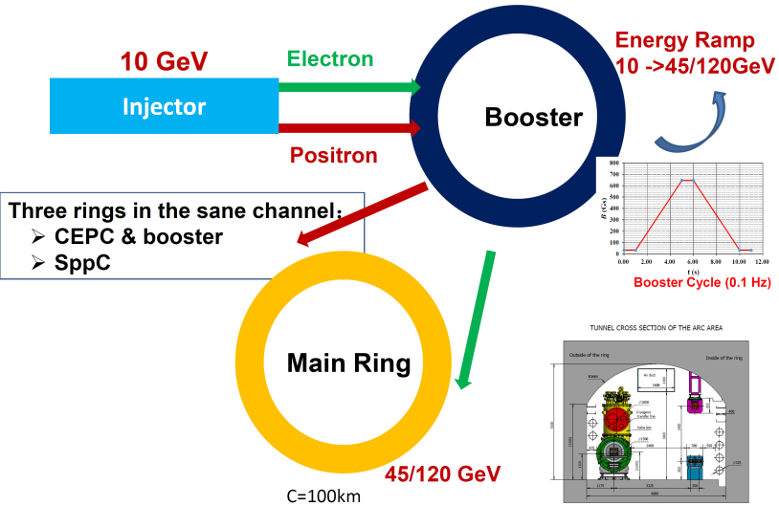
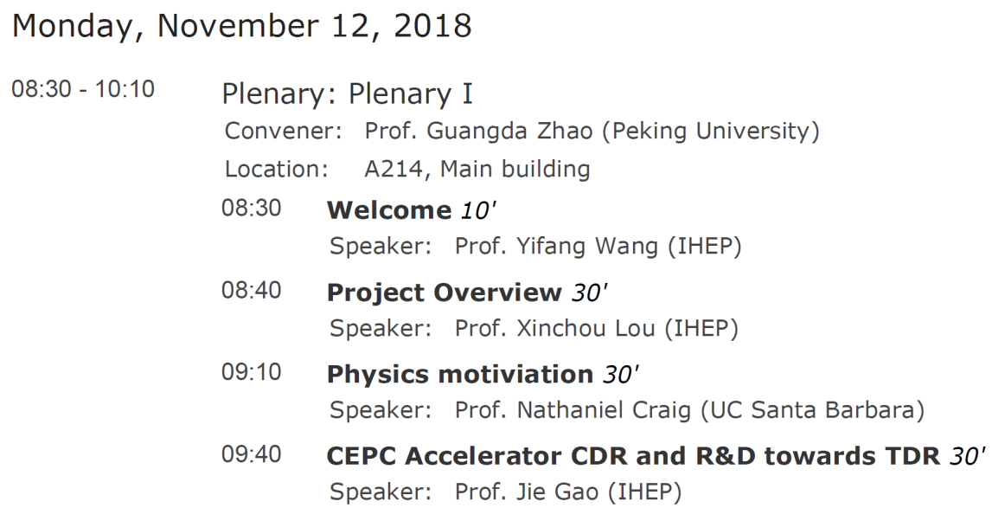
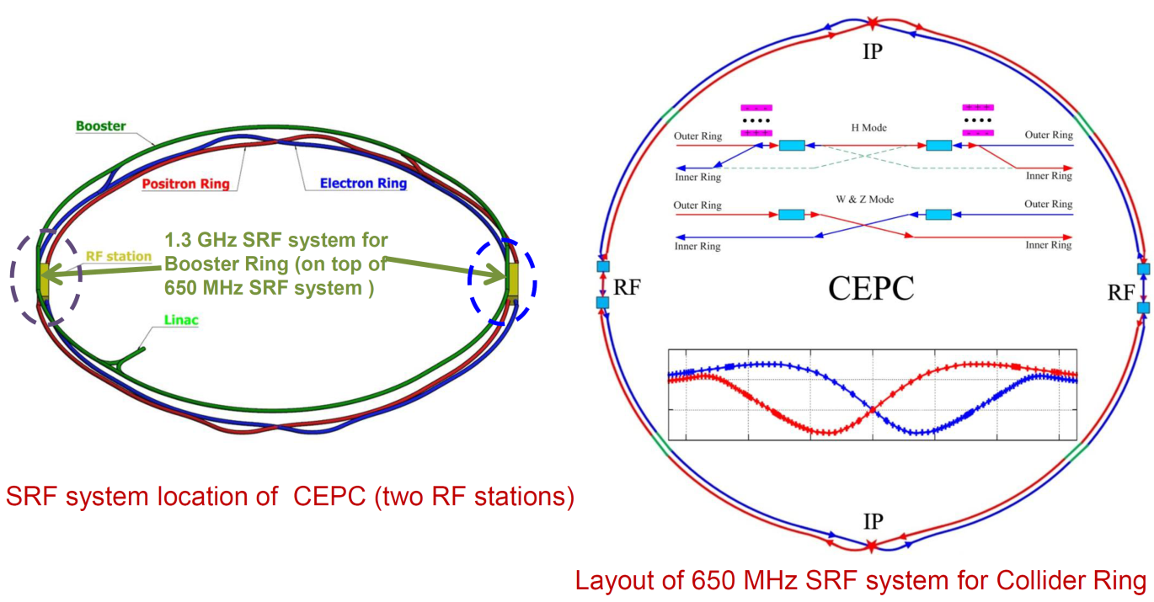
Progress and updates - CEPC CDR
details will be
presented at
parallel sessions
at this workshop

Slide 8
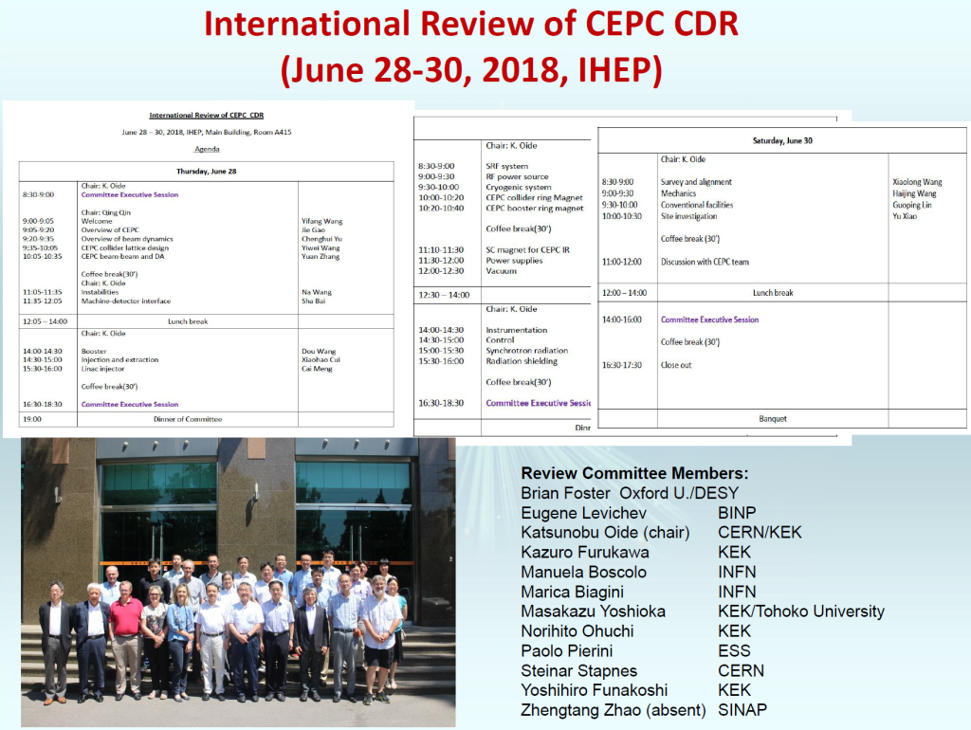
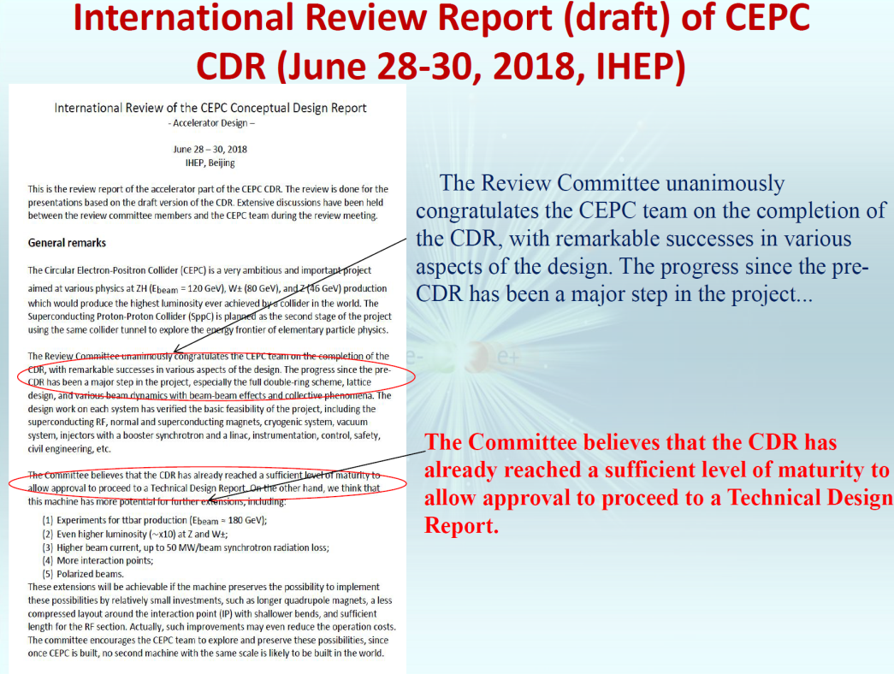
Progress and updates - CEPC CDR
double ring baseline design (30MW/beam)
switchable between H and Z/W w/o
hardware change (magnet switch)
use half SRF for Z and W
can be optimized for Z with 2T detector
Lumi. | Higgs | W | Z | Z(2T)
×10³⁴ | 2.93 | 11.5 | 16.6 | 32.1
Luminosities exceeded those in the preCDR
J Gao
J Gao

Slide 9
Progress and updates - CEPC CDR
Luminosity vs. CM energy
Circular:
offers higher lumi. @ LE
⇒unprecedented Z,W,+H program
mature technology
HE synchrotron light source (?)
very long term: pp upgrade path
Linear:
very impressive Higgs precision
best Lumi. at higher energies, or only option for VHE
Z
W
H
F. Bedeschi, INFN-Pisa
circular & linear colliders are ideally
complementary to each other

Slide 10
Baseline CEPC
Baseline design & options for the Conceptual Design Report
circumference=100km，E_{cm}=240 GeV, power per beam≤30MW，design luminosity ~2×10³⁴cm⁻²s⁻¹ (240 GeV)
1×10³⁴cm⁻²s⁻¹ (91 GeV)
two layouts:
double ring as the default;
advanced local double ring as an option
two independent detectors
Benefits
mature technologies, Z+ZH program
high energy pp option beyond the Higgs(Z) factory
g synchrotron light source (?)

Slide 11
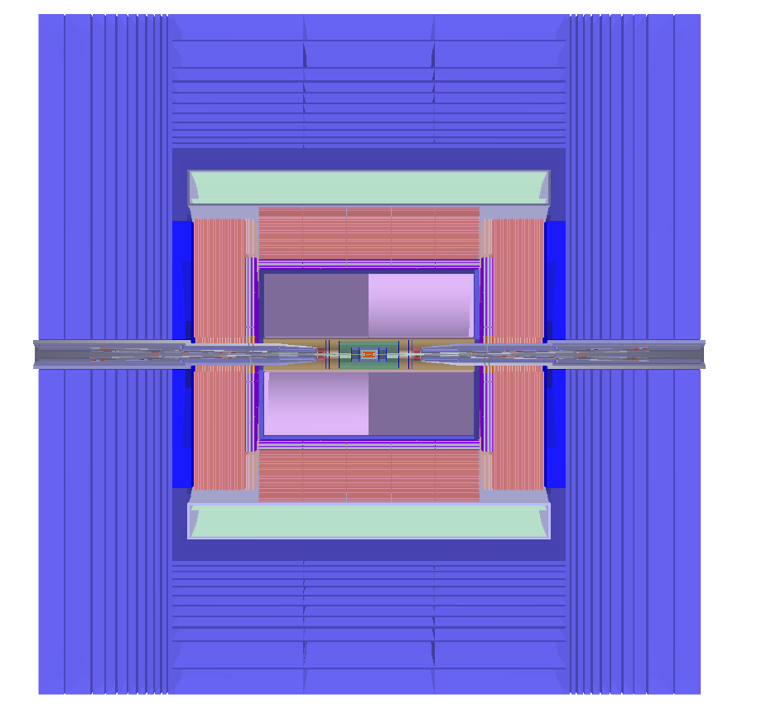
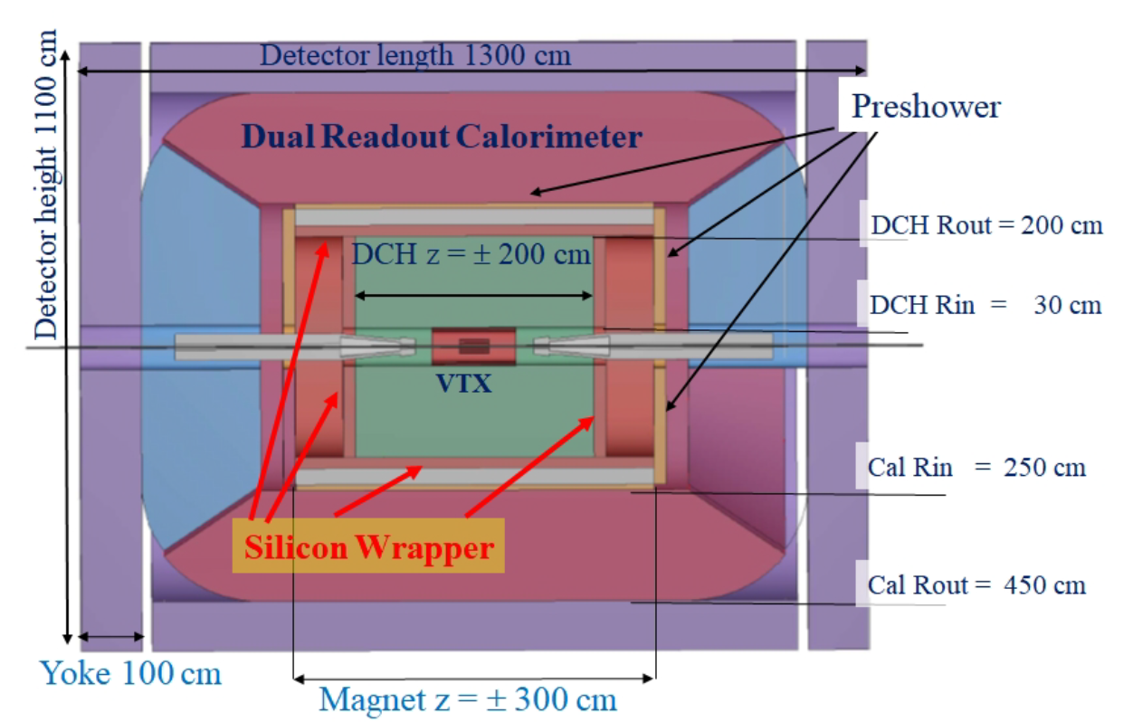
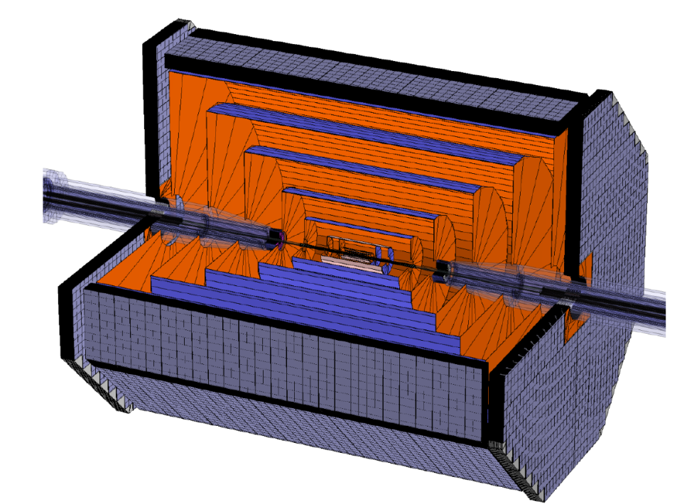
Progress and updates - Detector-Physics
Baseline detector: pixel vertex detector,
silicon inner tracker, a TPC, Si external tracker,
ECAL, HCAL, 3 T B-field, embedded muondetector
Alternative detector
Full silicon tracker
+baseline detector

Slide 12
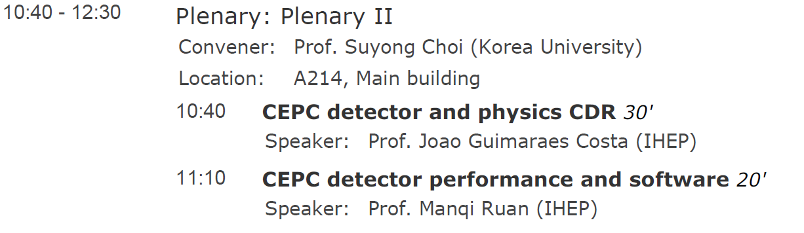
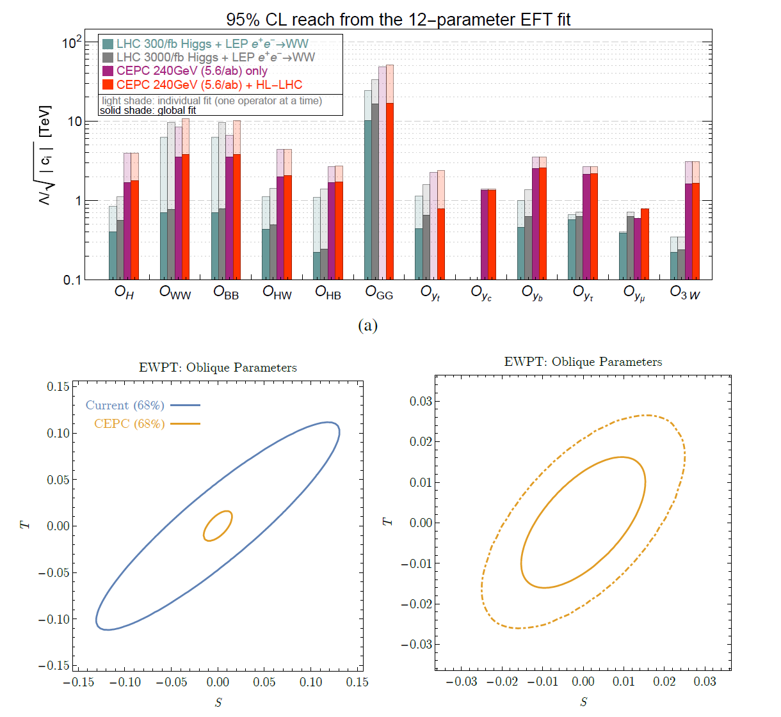
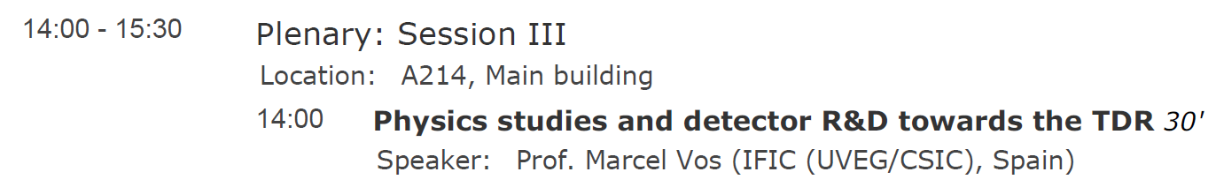
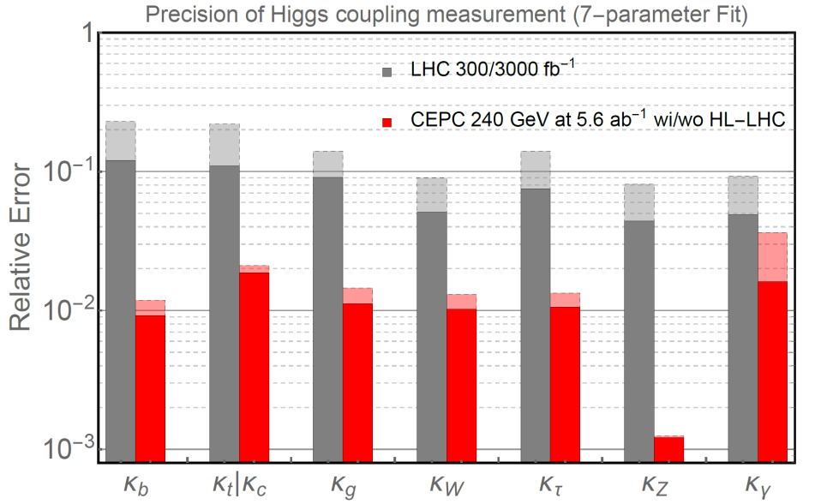
Progress and updates – Detector-Physics
Physics Performance
Man more talks at parallel sessions at this workshop

Slide 13
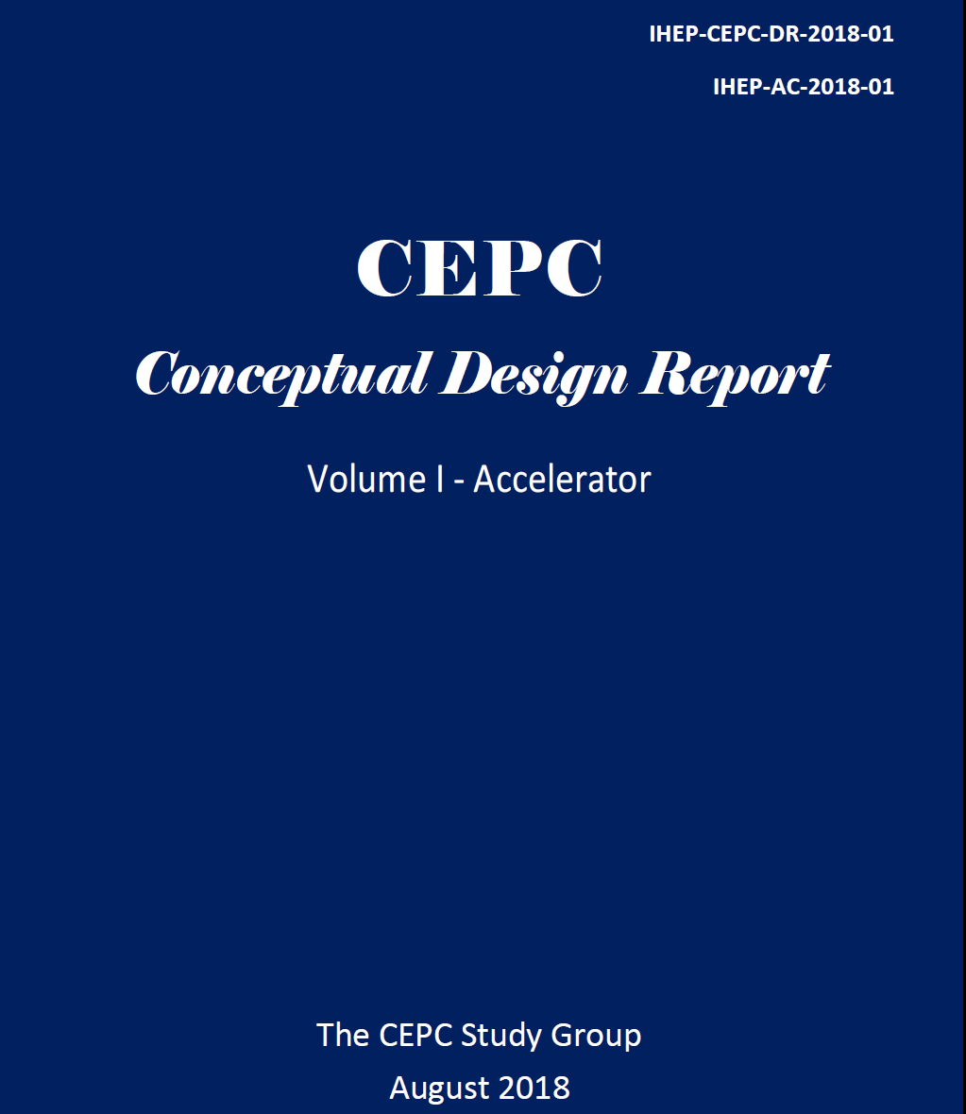
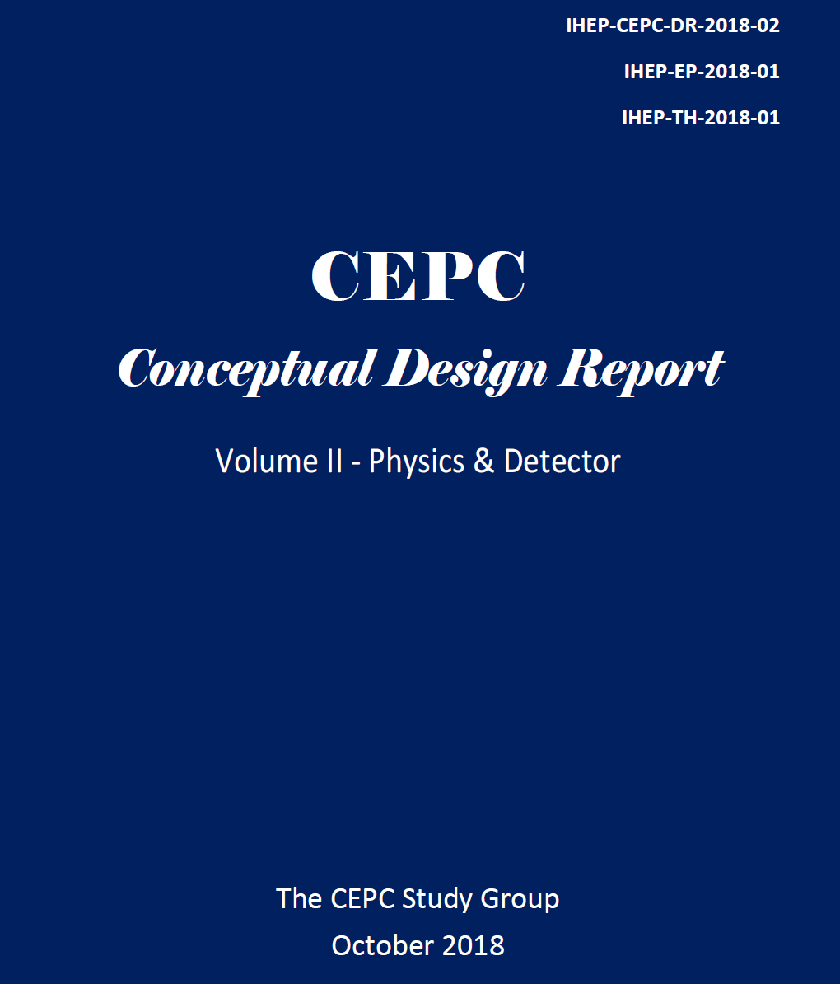
CDR Volumes 1 (Accelerator) and 2 (Physics-Detector) , are available at
http://cepc.ihep.ac.cn/

Slide 14
CDR Volumes 1 (Accelerator) and 2 (Physics-Detector) , are available at
http://cepc.ihep.ac.cn/
Public release of printed CDR volumes
14:40 November 14 in A415

Slide 15
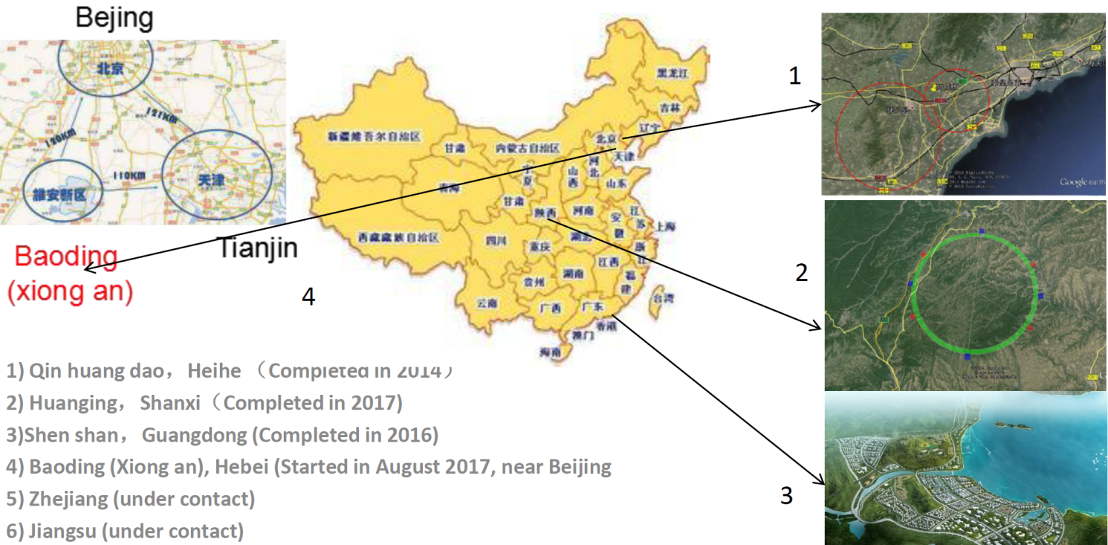
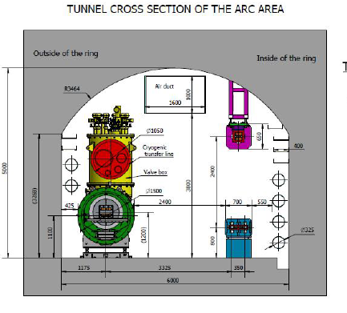
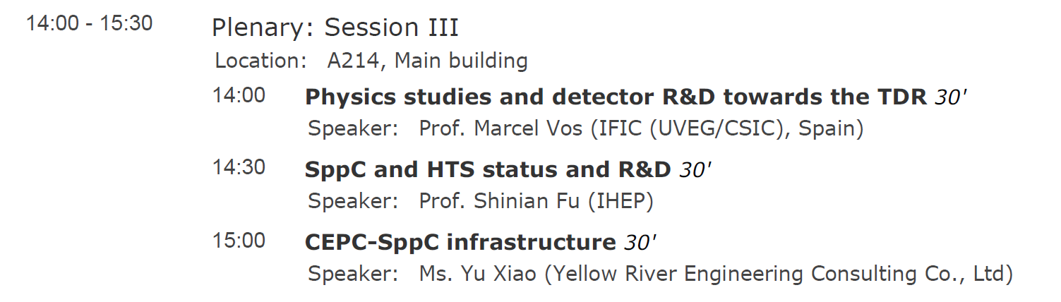
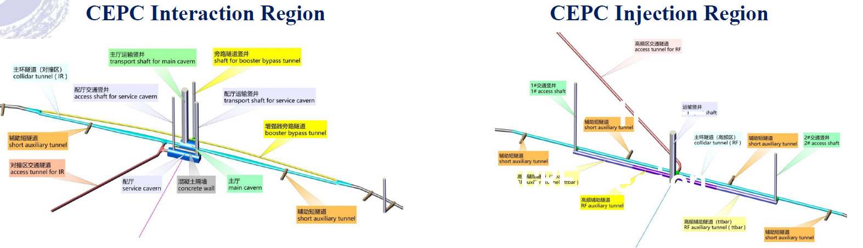
Progress and updates - CEPC CDR
site visits & study
facility deign
construction plan
….
CEPC is conducting country wide site visits and study. Local government agencies are very receptive and supportive to CEPC. CDR study is based on site 1 (Qing Huang Dao).
……

Slide 16
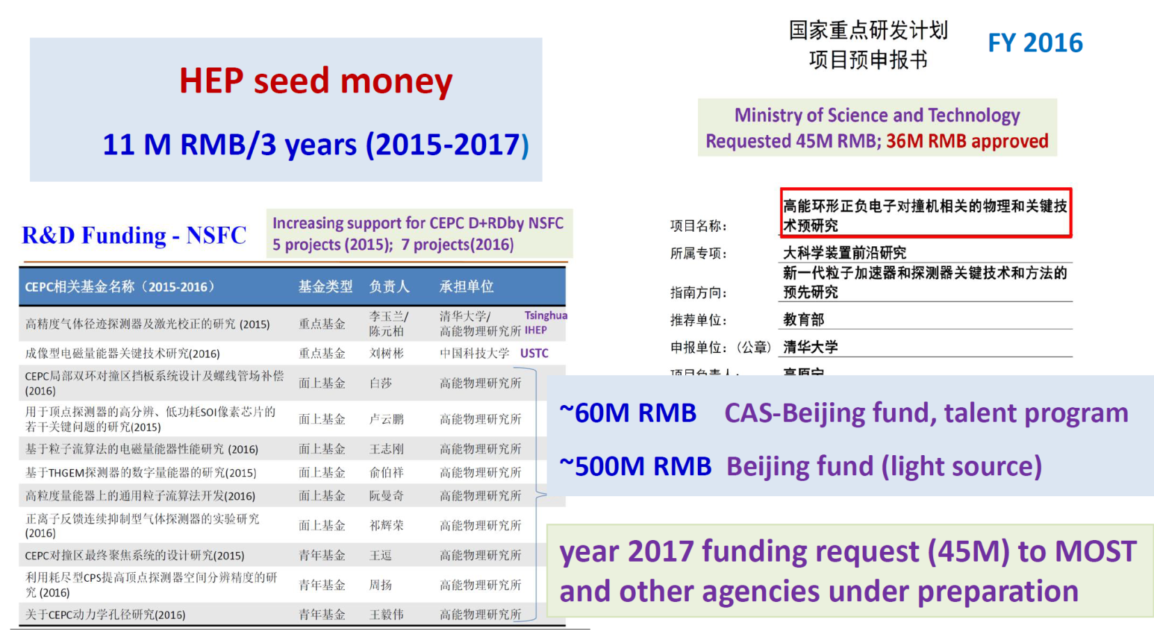
Progress and updates - Funding
2017 workshop
funding request (31M) to MOST approved
funding needs for carrying out CEPC design and
R&D basically met
Present day

Slide 17
Progress and updates – Intl Collaboration
Strengthen cooperation with CERN
Joined CALICE collab., ILD TPC collab., RD collab.s
First international workshop on CEPC in Europe – Rome 2017
Next one will in Oxford, UK, April 15-17, 2019
…
Fourth CEPC IAC meeting (Nov. 14-16, 2018)
to focus on international collaboration and other aspects

Slide 18
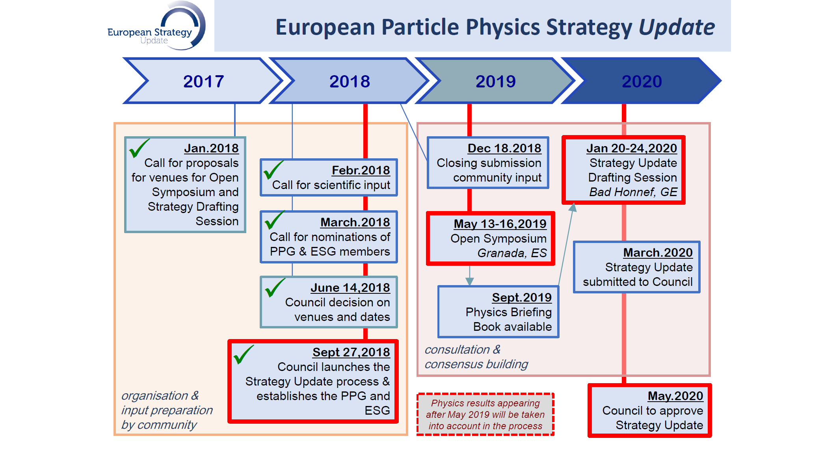
Progress and updates – Intl Collaboration
Preparation for European Strategy for Particle Physics update
Inputs (CEPC accelerator, physics-detector) have been drafted, under
review-revision, will be submitted around November 26, 2018

Slide 19
Progress and updates – Path to realization
Chinese Government：”actively initiating major-international science project…”
国发〔2018〕5号 （2018.3.14）http://www.gov.cn/zhengce/content/2018-03/28/content_5278056.htm
focuses on “frontier science, large-fundamental science , global focus,
international collaboration, …”
by year 2020，3-5 projects will be chosen to go into “preparatory stage”, among
which 1-2 projects will be selected. More projects will be selected in later years.
The task of selecting the projects, and develop them further falls on the Ministry of
Science and Technology (MOST)
MOST committees formed, are writing the guidelines
This is a likely path to realize CEPC. We are paying close attention to this opportunity

Slide 20
CEPC Schedule (ideal) – Goals and Plan
current time
design issues
R&D items
preCDR
CDR, funding
R&D program
Intl. collaboration
site study
seek approval, site decision
construction during 14th 5-
year plan
commissioning
R&D, validation, and industrial preparation
Global collaboration and strategy
Best positioning CEPC for national government’s positive decision
Realization of the CEPC project

Slide 21
2018 Workshop and Future

Slide 22
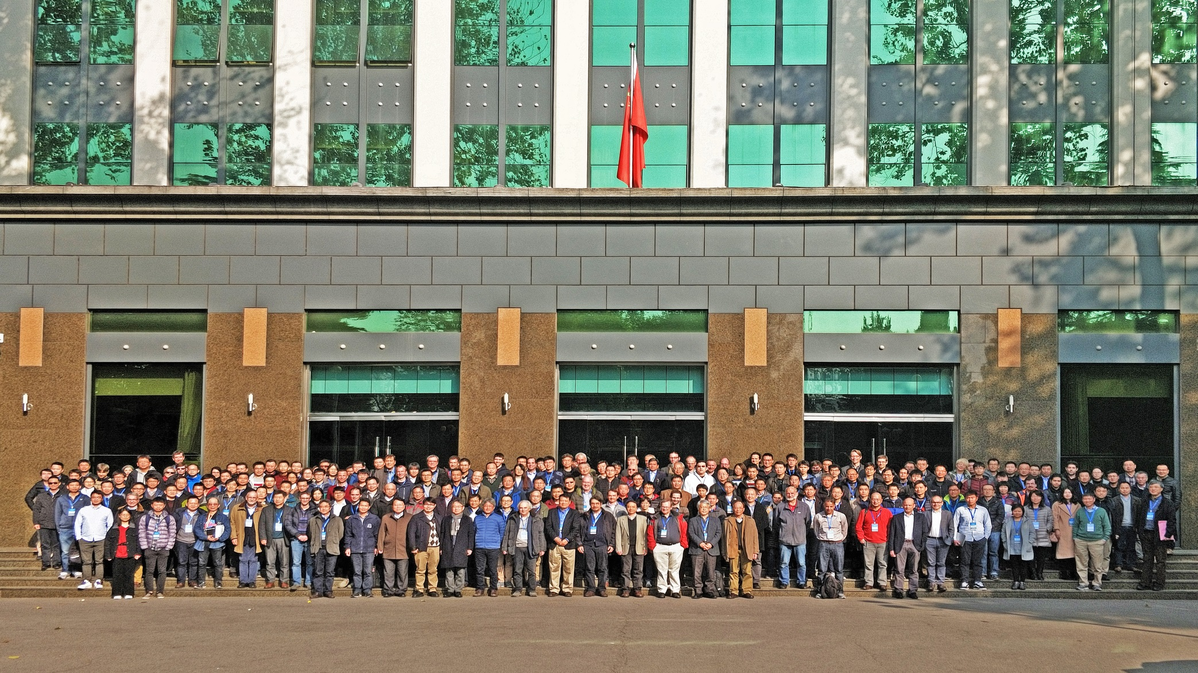
2018 CEPC Workshop
International Advisory Committee
Young-Kee Kim (Chair), University of Chicago (USA)
Barry Barish, Caltech (USA)
Hesheng Chen, IHEP(China)
Michael Davier, LAL (France )
Eckhard Elsen, DESY (Germany)
Brian Foster, DESY/U. Hamburg (Germany)
Rohini Godbole, CHEP, Bangalore (India)
David Gross, UC Santa Barbara (USA)
George Hou, Taiwan U. ( Taiwan)
Peter Jenni, CERN & Albert-Ludwigs-University Freiburg
Eugene Levichev, BINP (Russia)
Lucie Linssen , CERN
Joe Lykken, Fermilab (USA)
Luciano Maiani, U. Rome (Italy)
Michelangelo Mangano, CERN
Hitoshi Murayama, IPMU/UC Berkeley (Japan)
Katsunobu Oide, KEK (Japan)
Robert Palmer, BNL (USA)
Ian Shipsey, Oxford (UK)
Steinar Stapnes, CERN (Norway)
Geoffrey Tayler, U. Melbourne (Australia)
Henry Tye, IAS, HKUST (Hong Kong)
Hendrik J. (Harry) Weerts, ANL (USA)
Scientific Committee
Daniela Bortoletto, Oxford (UK), co-chair
Jianming Qian, Univ. Michigan (USA), co-chair
At-large members
Suyong Choi, Korea Univ. (South Korea) Joao Guimaraes Costa, IHEP Jie Gao, IHEP Yuanning Gao, PKU Suen Hou, Academic Sinica (Taipei) Bill Murray, Warwick (UK) Chris Tully, Princeton (USA) LianTao Wang, Univ. Chicago (USA) Charlie Young, SLAC (USA)
Paralle session conveners
CEPC session 1: Jie Gao (IHEP), Maria Biagini (Frascati, Itlay)
CEPC session 2: Yuan Zhang (IHEP), Sergei Nikitin (BINP, Russia)
CEPC session 3: Yunlong Chi (IHEP), Zhanguo Zong (KEK, Japan)
CEPC session 4: Guoxi Pei (IHEP), Angeles Fauss (LAL, France)
CEPC session 5: Jianli Wang (IHEP), Carlo Pagani (LAL, France)
SppC session: Qingjin Xu (IHEP), Kazuhito Ohmi (KEK, Japan)
Paralle session conveners
Silicon detector: Massimo Caccia (Insubria, Italy), Qun Ouyang (IHEP)
Gas detector: Paolo Giacomelli (Bologna, Italy), Huirong Qi (IHEP)
Calorimetry: Jianbei Liu (USTC), Chris Tully (Princeton, USA), Haijun Yang (SJTU) Machine-Detector Interface: Sha Bai (IHEP), Ivanka Bozovic (VINCA, Serbia), Hongbo Zhu (IHEP)
Trigger/DAQ/Computing: Wolfgang Kuehn (Giessen, Germany), Weidong Li (IHEP), Zhenan Liu (IHEP),
Higgs physics: Yaquan Fang (IHEP), Hong-Jian He (SJTU), Nathaniel Craig (UCSB, USA)
Electroweak physics: Maarten Boonekamp (Saclay, France), Ayres Freitas (Pittsburgh, USA), Zhijun Liang (IHEP)
Flavor and QCD physics: Lars Eklund (Glasgow, UK), Peter Skands (Monash, Australia), Jianchun Wang (IHEP), HuaXing Zhu (ZJU)
Beyond Standard Model: Qiang Li (PKU), Andrew Long (Michigan/Rice, USA)
Tools and performances: Jean-Claude Brient (LLR, France), Manqi Ruan (IHEP)
Global contribution to this workshop & record participants at~350

Slide 23
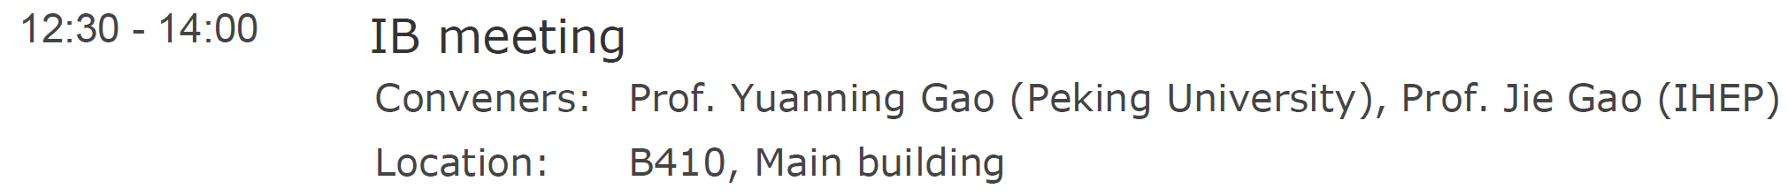
2018 CEPC Workshop and Beyond
This workshop is very timely and important for CEPC to move beyond the CDR
What does it take to make the design to a reality, so we will have an e⁺e⁻ Higgs factory?
Wed., Nov. 14
Future plan and organization
TDR details, schedule, organization - develop the plan and fill the holes
Take on TDR tasks; industrial support and preparation
Nominations for international conveners
International collaboration and support Global effort to realize CEPC

Slide 24
Report to the IAC
Implementation of Recommendations

Slide 25
Implementation of Recommendations
R1: The level of international participation should be increased at all levels. The IAC reiterates the desirability of adding international conveners in each of the main detector areas. International participation in the accelerator design process is also highly desirable.
Solicit nominations for international WG conveners;
Well mixed scientific community at this workshop; hope to retain some
A number of collaboration and MOUs (LC-TPC, HL-LHC, lab-univ. groups)
Strengthen cooperation with CERN
Obtained a dedicated grant to support international collaboration on CEPC
It is difficult with US DOE labs
“We noticed that some US lab based
physicists not getting DOE approvals for travel to attend this workshop(2017)”
It is getting worse

Slide 26
2018 CEPC Workshop
International Advisory Committee
Young-Kee Kim (Chair), University of Chicago (USA)
Barry Barish, Caltech (USA)
Hesheng Chen, IHEP(China)
Michael Davier, LAL (France )
Eckhard Elsen, DESY (Germany)
Brian Foster, DESY/U. Hamburg (Germany)
Rohini Godbole, CHEP, Bangalore (India)
David Gross, UC Santa Barbara (USA)
George Hou, Taiwan U. ( Taiwan)
Peter Jenni, CERN & Albert-Ludwigs-University Freiburg
Eugene Levichev, BINP (Russia)
Lucie Linssen , CERN
Joe Lykken, Fermilab (USA)
Luciano Maiani, U. Rome (Italy)
Michelangelo Mangano, CERN
Hitoshi Murayama, IPMU/UC Berkeley (Japan)
Katsunobu Oide, KEK (Japan)
Robert Palmer, BNL (USA)
Ian Shipsey, Oxford (UK)
Steinar Stapnes, CERN (Norway)
Geoffrey Tayler, U. Melbourne (Australia)
Henry Tye, IAS, HKUST (Hong Kong)
Hendrik J. (Harry) Weerts, ANL (USA)
Scientific Committee
Daniela Bortoletto, Oxford (UK), co-chair
Jianming Qian, Univ. Michigan (USA), co-chair
At-large members
Suyong Choi, Korea Univ. (South Korea) Joao Guimaraes Costa, IHEP Jie Gao, IHEP Yuanning Gao, PKU Suen Hou, Academic Sinica (Taipei) Bill Murray, Warwick (UK) Chris Tully, Princeton (USA) LianTao Wang, Univ. Chicago (USA) Charlie Young, SLAC (USA)
Paralle session conveners
CEPC session 1: Jie Gao (IHEP), Maria Biagini (Frascati, Itlay)
CEPC session 2: Yuan Zhang (IHEP), Sergei Nikitin (BINP, Russia)
CEPC session 3: Yunlong Chi (IHEP), Zhanguo Zong (KEK, Japan)
CEPC session 4: Guoxi Pei (IHEP), Angeles Fauss (LAL, France)
CEPC session 5: Jianli Wang (IHEP), Carlo Pagani (LAL, France)
SppC session: Qingjin Xu (IHEP), Kazuhito Ohmi (KEK, Japan)
Paralle session conveners
Silicon detector: Massimo Caccia (Insubria, Italy), Qun Ouyang (IHEP)
Gas detector: Paolo Giacomelli (Bologna, Italy), Huirong Qi (IHEP)
Calorimetry: Jianbei Liu (USTC), Chris Tully (Princeton, USA), Haijun Yang (SJTU) Machine-Detector Interface: Sha Bai (IHEP), Ivanka Bozovic (VINCA, Serbia), Hongbo Zhu (IHEP)
Trigger/DAQ/Computing: Wolfgang Kuehn (Giessen, Germany), Weidong Li (IHEP), Zhenan Liu (IHEP),
Higgs physics: Yaquan Fang (IHEP), Hong-Jian He (SJTU), Nathaniel Craig (UCSB, USA)
Electroweak physics: Maarten Boonekamp (Saclay, France), Ayres Freitas (Pittsburgh, USA), Zhijun Liang (IHEP)
Flavor and QCD physics: Lars Eklund (Glasgow, UK), Peter Skands (Monash, Australia), Jianchun Wang (IHEP), HuaXing Zhu (ZJU)
Beyond Standard Model: Qiang Li (PKU), Andrew Long (Michigan/Rice, USA)
Tools and performances: Jean-Claude Brient (LLR, France), Manqi Ruan (IHEP)
Global contribution to this workshop & record participants at~350

Slide 27
Implementation of Recommendations
R2: It is essential that CEPC makes a strong input into regional road map discussions. This is urgent for the European Strategy process, which will begin in 2018. Plans must be drawn up to write a suitable document as input to this process. The ICHEP conference in Seoul in 2018 is a good opportunity to increase the visibility of the project and to enhance international partnerships..
Satellite CEPC meeting at ICHEP2018 (thanks to Young-Kee)
Have representative in PPG, will attend Open Symposium in May 2019
(Granada Spain)
CEPC input drafts available, being revised, to submit around Nov. 26

Slide 28
Implementation of Recommendations
R3: The IAC has decided to appoint two subcommittees to advise and monitor progress on the accelerator and physics/detector activities. These subcommittees should consist of 3-4 IAC members plus 3 other experts as permanent members plus 3-4 other experts invited as required for their expertise. The subcommittees will meet as requested either by the IAC
or the project management and their reports will be presented to the IAC.
CEPC is entering the TDR process, needing advice here
Technical reviews and hand holding

Slide 29
Implementation of Recommendations
R4: Project Plan outlining organization and management, with a top-level resource loaded organization chart, should be provided. It should include R&D, the path to industrial production and prototyping, human resources & skill sets required for the next five years, to the TDR stage..
Start to consider this more broadly …

Slide 30
Implementation of Recommendations
R5: Industrialization of components should continue to be explored both in China and also internationally. It is essential to begin discussions to explore potential in-kind contributions that international partners might be interested in contributing.
Domestic CIC active, needs systematic survey and plan …
International industrial partners not well explored …
Have some ideas about the percentage, but no substantive activity

Slide 31
Implementation of Recommendations
R6: The current layout of the physics CDR focuses on the expected performance of the baseline design, namely 10¹⁰ Z events collected at the Z pole and 10⁶ ZH and 10⁸ WW events collected at 240 GeV. A section should be included to document the expected physics gains emerging from a higher event yield at the Z pole, from running at the WW threshold and at/above the tt-bar threshold, addressing the implications for precision EW and Higgs studies, very rare decays, and flavor physics..
adopted partially
Trying to get more theorists to join us explore the potentials with the Z,WW…
The CDR includes a much expanded section on electroweak physics at the Z pole, and WW
threshold physics. The chapter is already taking into account a much higher rate of Z events,
7 x 10^11. This work was done by including two foreign colleagues that are also editors of
that chapter, Maarten Boonekamp and Fulvio Piccinini.
We have not done anything on ttbar, for the reasons we all know.

Slide 32
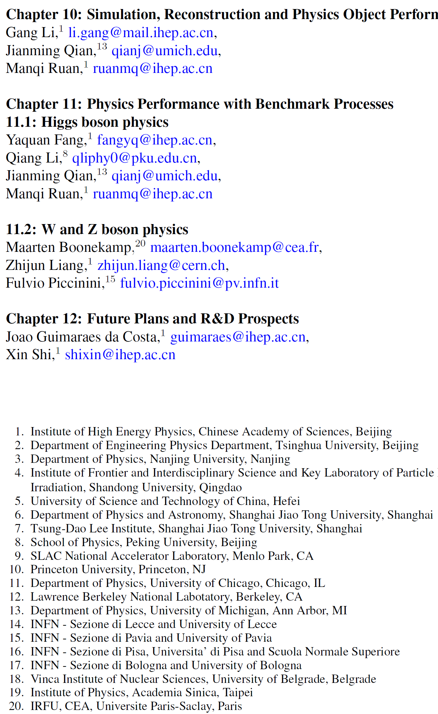
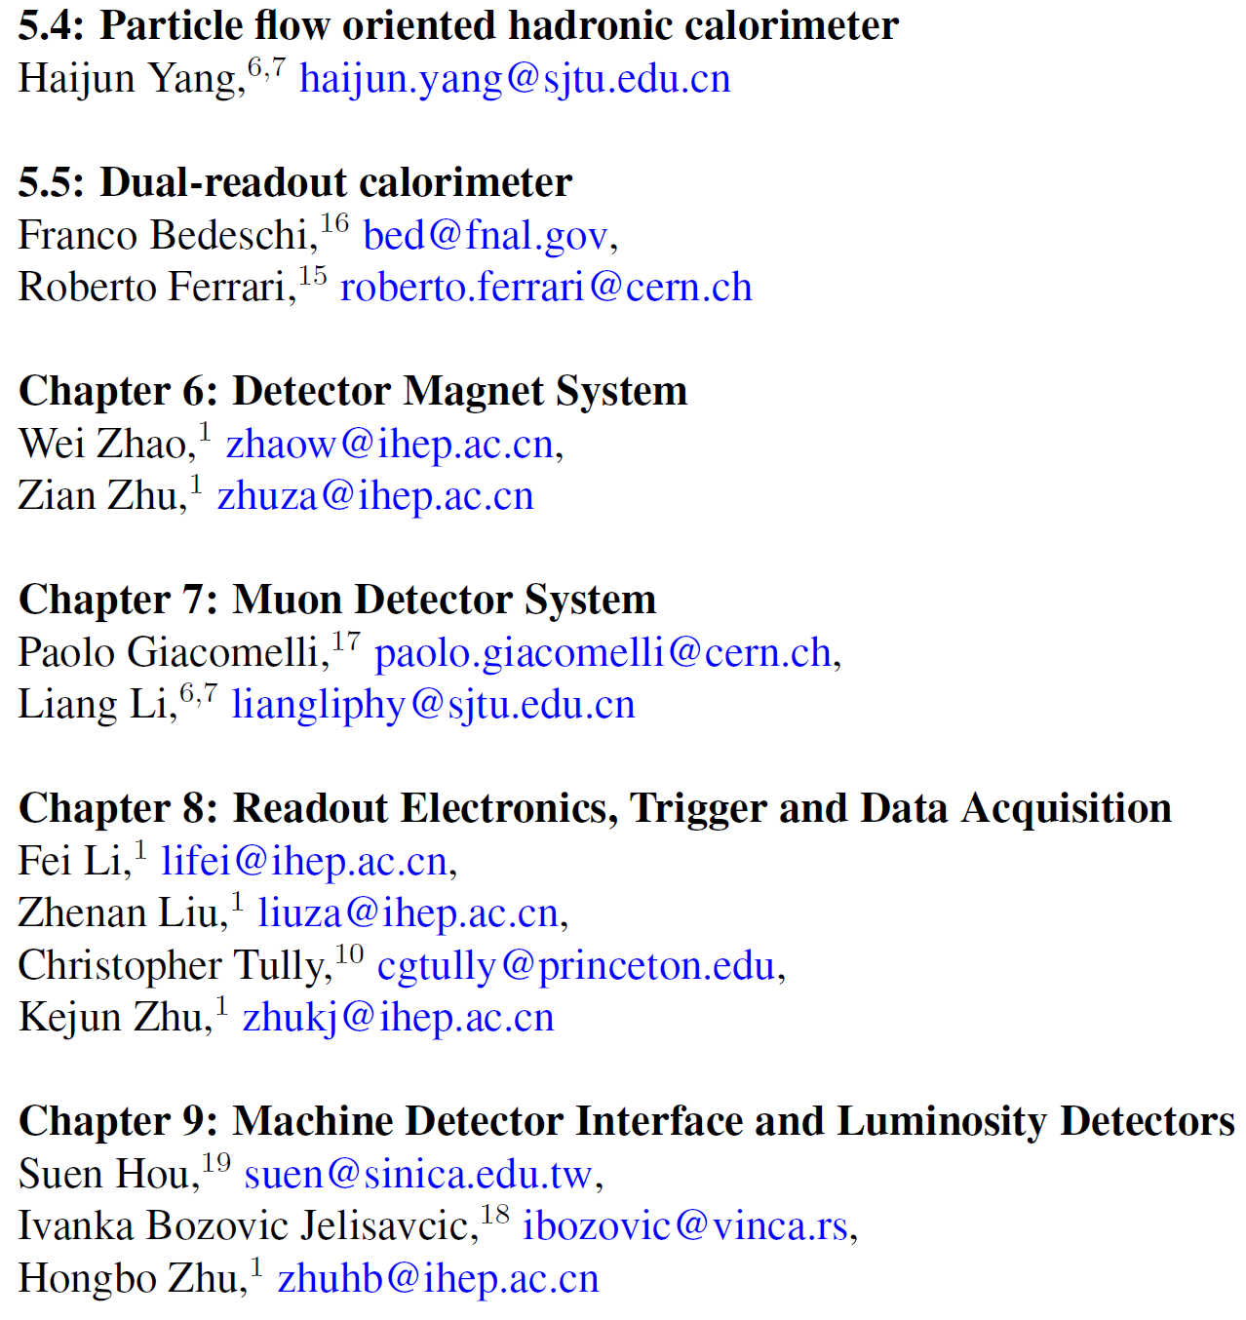
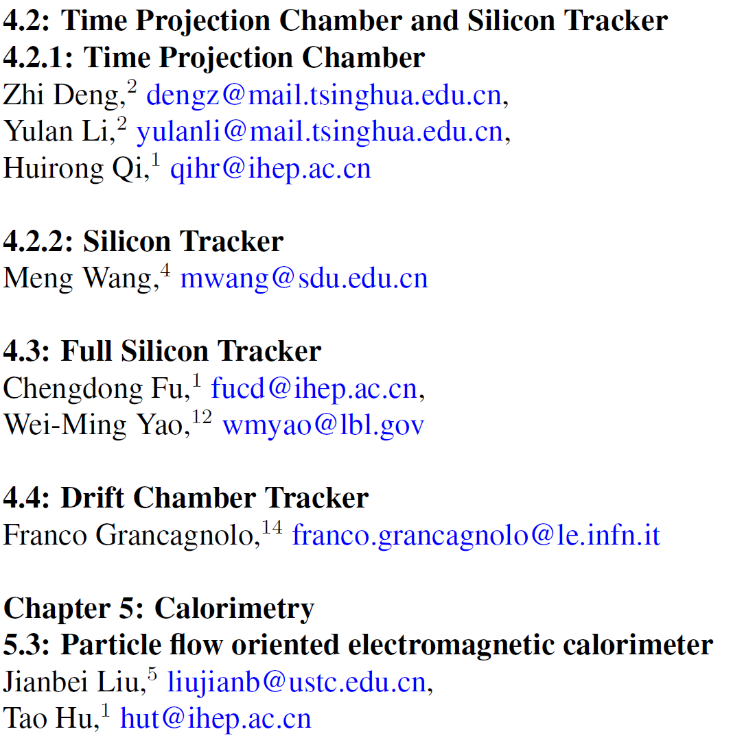
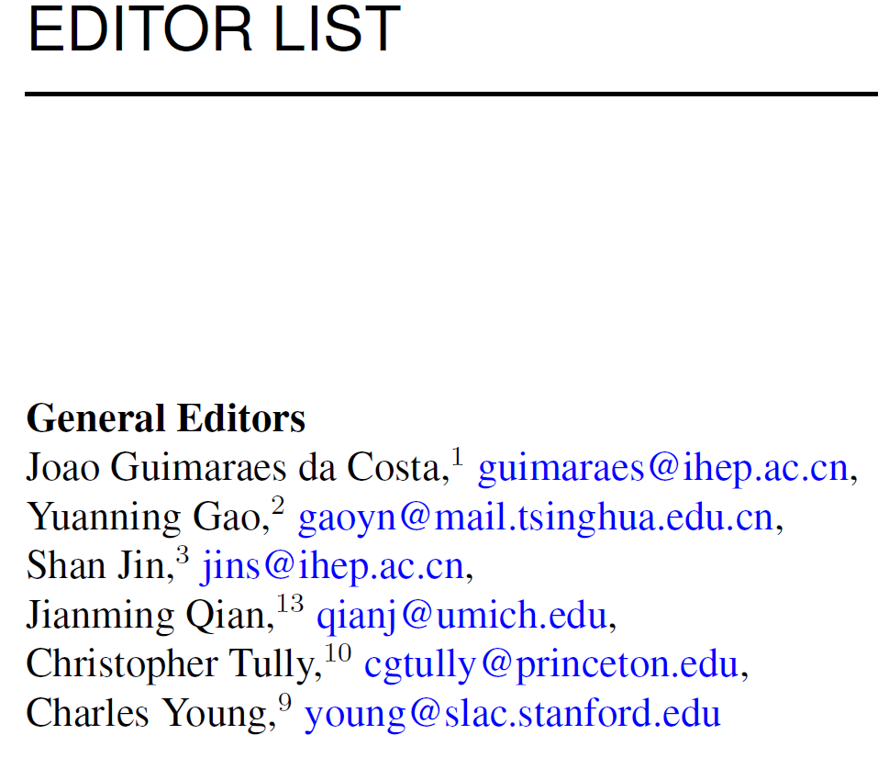
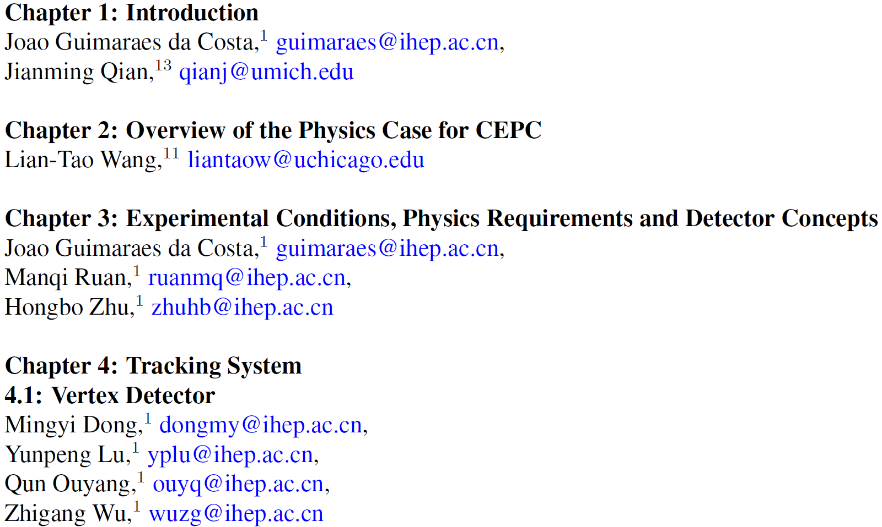
Implementation of Recommendations
R7: The international participation could be made more visible with the appointment of an international editorial board, and its mention on the cover page of the CDR section.

Slide 33
Implementation of Recommendations
R8: Ways should be found to facilitate the growth of a theoretical particle physics community in China focused on CEPC, e.g. through the creation of a database of available openings, documented on the web, to enhance the visibility of such opportunities.
R9: A stronger permanent presence of theoretical particle physicists in CFHEP could help establishing a more structured activity around CEPC.
CFHEP at IHEP, junior hires in recent years
LHCC community and annual meetings are the pool and the draw
…

Slide 34
Discussion

