Slide 1
SPPC Accelerator: R&D and future
CEPC-SPPC IAC Meeting 2018, Nov. 14-16, 2018, IHEP
Jingyu Tang, Qingjin Xu
for the SPPC study group

Slide 2
Outline
SPPC chapter in the CDR
Ongoing efforts in accelerator physics
High-field magnet R&D progress
International collaboration
Looking into the future
Summary

Slide 3
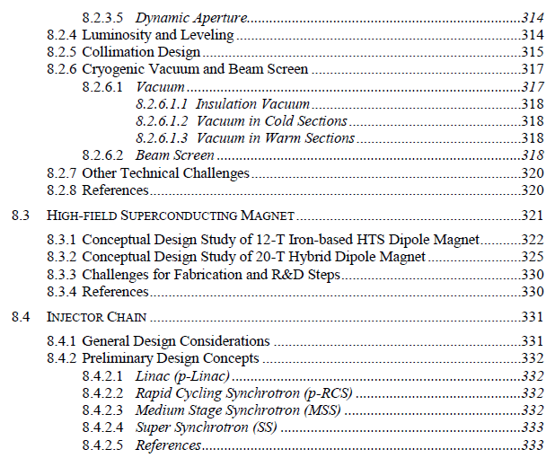
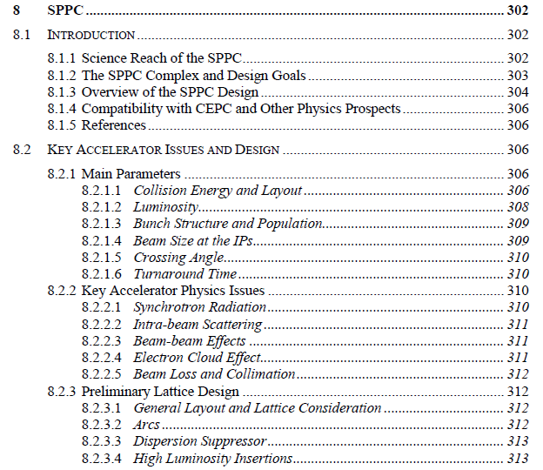
SPPC Chapter in the CEPC CDR
SPPC is the second stage of the CEPC-SPPC, and for the long-term future
The SPPC design is included in the CDR as a single chapter of Vol.1 (Accelerator), and the HFM R&D as a section in the CEPC R&D efforts chapter.

Slide 4

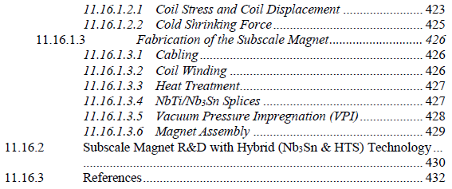

Slide 5
SPPC main parameters (since 2017.5)
Parameter | Unit | Value
 |  | PreCDR | CDR | Ultimate
Circumference | km | 54.4 | 100 | 100
C.M. energy | TeV | 70.6 | 75 | 125-150
Dipole field | T | 20 | 12 | 20-24
Injection energy | TeV | 2.1 | 2.1 | 4.2
Number of IPs |  | 2 | 2 | 2
Nominal luminosity per IP | cm⁻²s⁻¹ | 1.2e35 | 1.0e35 | -
Beta function at collision | m | 0.75 | 0.75 | -
Circulating beam current | A | 1.0 | 0.7 | -
Bunch separation | ns | 25 | 25 | -
Bunch population |  | 2.0e11 | 1.5e11 | -
SR power per beam | MW | 2.1 | 1.1 | -
SR heat load per aperture @arc | W/m | 45 | 13 | -

Slide 6
Ongoing SPPC Study
As SPPC is a long-term project and due to very limited resources, no need to carry out engineering-related studies and only those with typical challenges in design and long-term R&D are picked up for study.
  Describing what a future proton-proton collider looks like, physics performance
  Following the CEPC project, try to avoid what will hinder the future upgrading to SPPC, e.g. tunnel circumference and layout
  Studying key accelerator physics issues of that scale accelerators, which is also a contribution to the accelerator community, e.g. collimation, beam-beam effects
  Identifying key technical challenges, for some of them needing long-term R&D efforts, we should start them as early as possible, e.g. high-field superconducting magnets, beam screen

Slide 7
Accelerator Physics
Since beginning 2018, man power on accelerator physics has reduced significantly. Due to short of funding, collaborative institutions almost stopped activities on SPPC, and now the main force relies on several IHEP PhD students.
Still active:
  Lattice design and dynamic aperture
  Beam collimation
  Beam-beam effects and luminosity
  Long beam dynamics
  Some selected topics on the injector chain

Slide 8
SPPC Magnet Design Scope
Baseline design
  Tunnel circumference: 100 km
  Dipole magnet field: 12 T, iron-based HTS technology (IBS)
  Center of Mass energy: >70 TeV
  Injector chain: 2.1 TeV
Upgrading phase
  Dipole magnet field: 20 -24T, IBS technology
  Center of Mass energy: >125 TeV
  Injector chain: 4.2 TeV (adding a high-energy booster ring in the main tunnel in the place of the electron ring and booster)
Development of high-field superconducting magnet technology
  Starting to develop HTS magnet technology before applicable IBS wire is available
  ReBCO & Bi-2212 and LTS wires be used for model magnet studies and as options for SPPC: stress management, quench protection, field quality control and fabrication methods
Top priority: reducing cost!
Instead of increasing field
Make IBS the High-T_{c} and High-Field
“NbTi” superconductor in 10 years!

Slide 9
J_{e} of IBS: 2016-2025

Slide 10
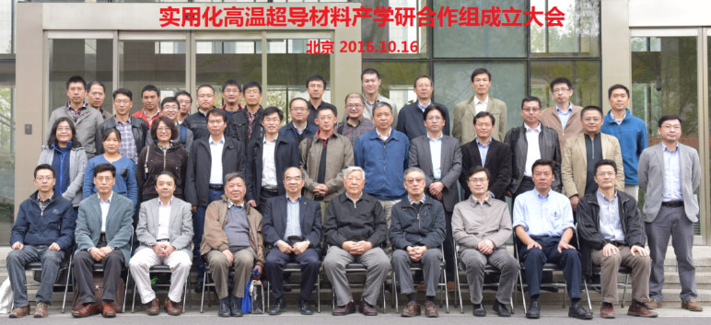
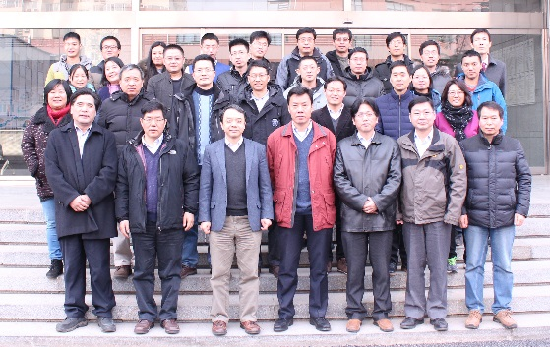
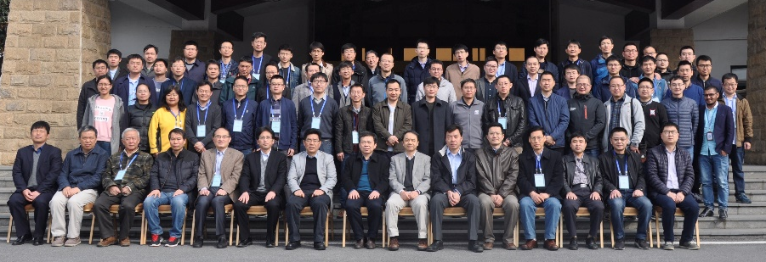
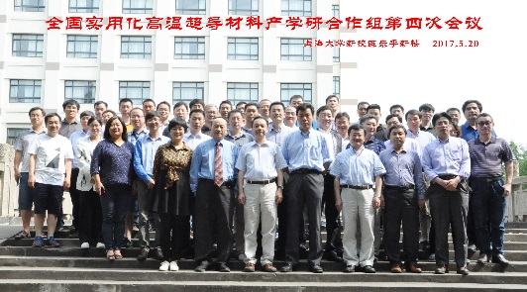
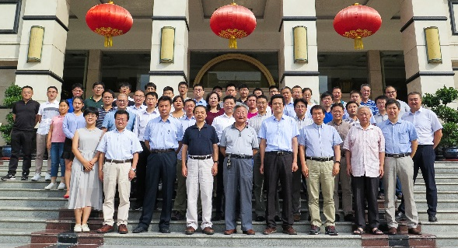
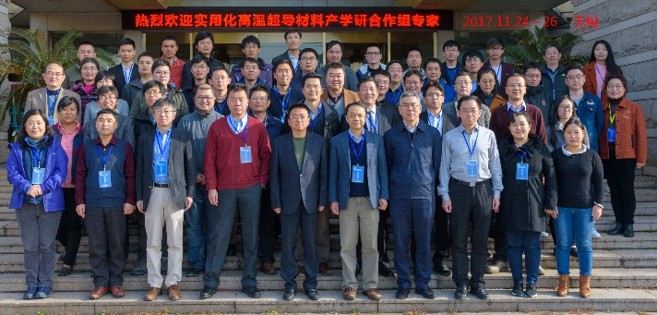
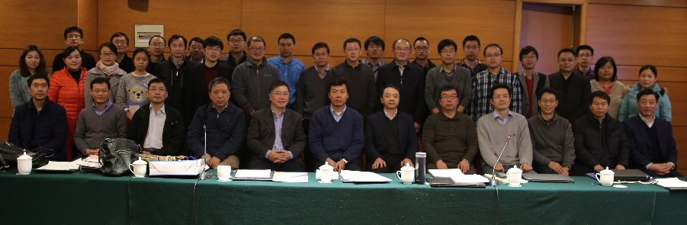
Domestic Collaboration for HTS R&D
“Applied High Temperature Superconductor Collaboration (AHTSC)” formed in Oct. 2016.
Including 18 institutions and companies in China. Regular meeting every 3 months.
Goal：
1) To increase the J_{c} of iron-based superconductor (IBS) by 10 times, reduce the cost to 20 Rmb/kAm @ 12T & 4.2K, and realize the industrialization of the conductor;
2) To reduce the cost of ReBCO and Bi-2212 conductors to 20 Rmb/kAm @ 12T & 4.2K;
3) Realization and Industrialization of IBS magnets and SRF cavities.
Working groups：1) Fundamental sciences study; 2) IBS conductor R&D; 3) ReBCO conductor R&D; 4) Bi-2212 conductor R&D; 5) Performance evaluation; 6) Magnet and SRF technology.

Slide 11
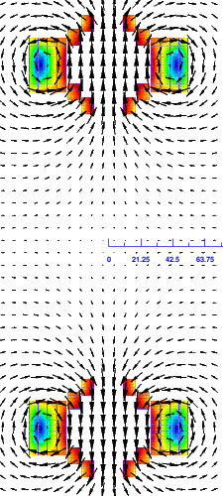
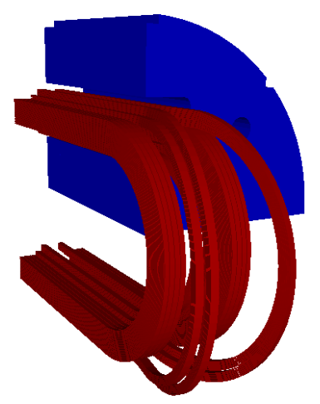
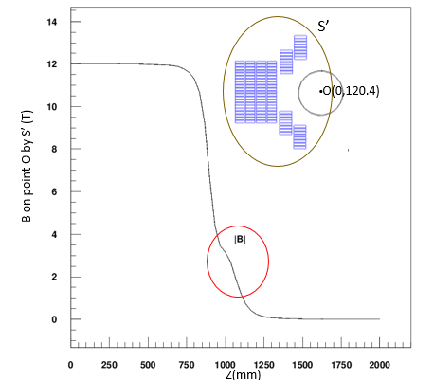
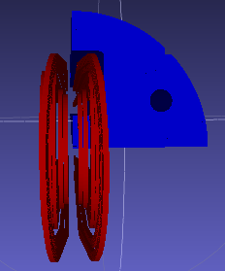
The 12-T Fe-based Dipole Magnet
Field quality in the aperture
<3*10⁻⁴ within 2/3 bore
(ROXIE simulation results)
Field quality | 2D with R_{f}= 13.3mm | 3D with R_{f}= 8/13.3 mm
b3 | 0.45 | 0.79/1.91
b5 | 1.01 | -0.65/-2.24
b7 | 0.46 | 0.08/0.67
b9 | -0.27 | -0.13/-0.22
a2 | 3.53 | -1.00/-2.31
a4 | 0.49 | -0.46/0.69
a6 | 0.33 | 0.26/2.49
a8 | 0.58 | -0.12/0.84
a10 | 2.23 | 0.06/2.18
Flare ends

Slide 12
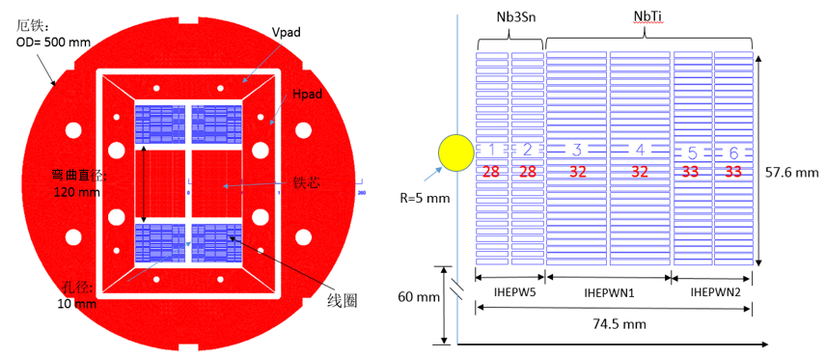
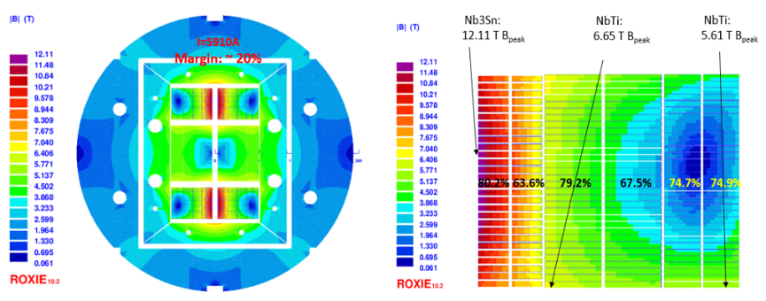
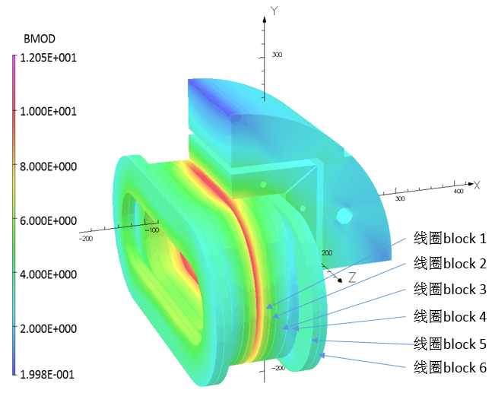
R&D of High Field Dipole Magnets
The 1st High Field Dipole LPF1: NbTi+Nb₃Sn
Cross section of LPF1
Magnetic field distribution
Main parameters of the strands
Strand | diam. (mm) | cu/sc | RRR | Tref (K) | Bref (T) | Jc@ BrTr (A/mm2) | Ic@ BrTr (A)
Nb3Sn | 0.802 | 1 | 200 | 4.2 | 12 | 2700 | 682
NbTi | 0.82 | 1 | 130 | 4.2 | 5 | 2613 | 690

Slide 13
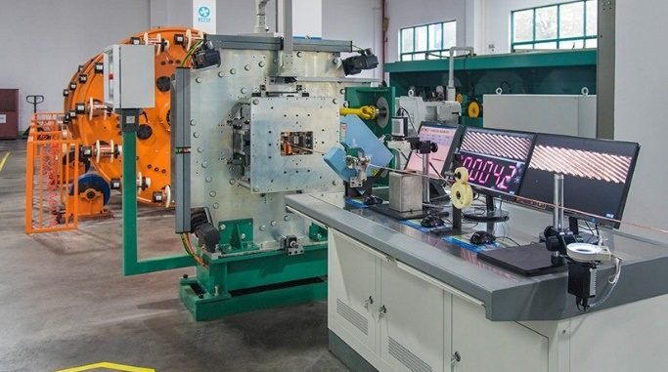
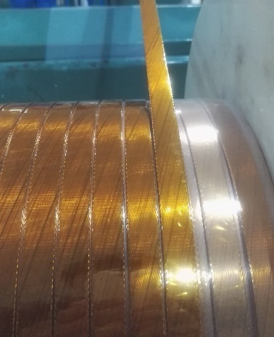
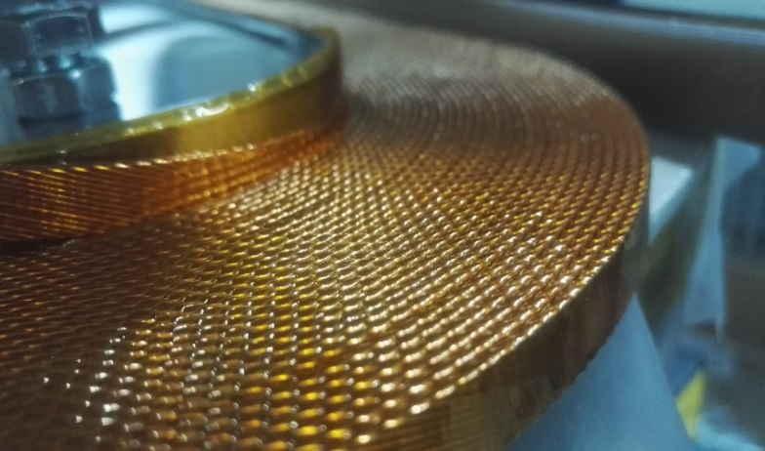
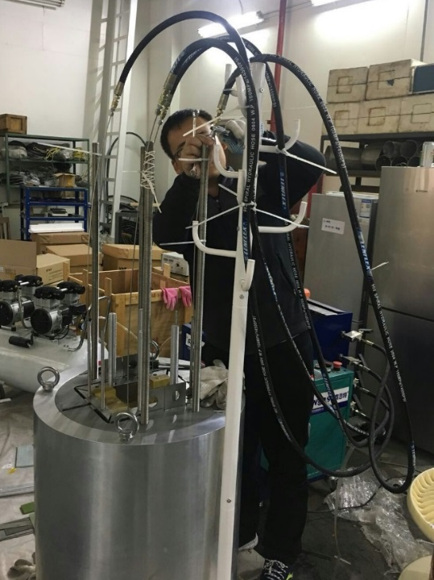
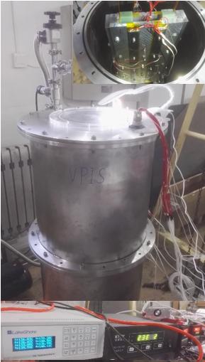
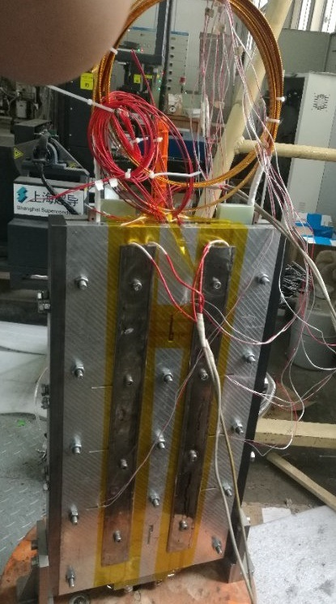
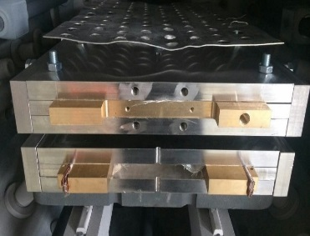
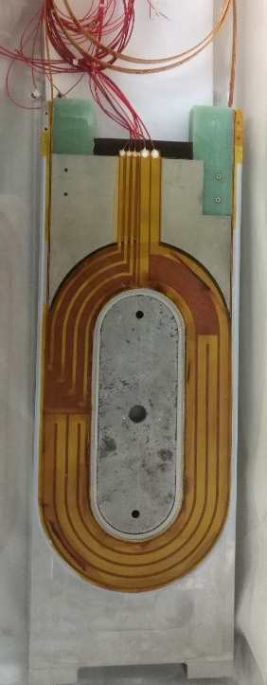
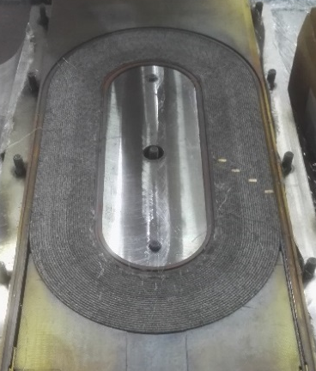
R&D of High Field Dipole Magnets
Fabrication of the 1st model dipole magnet (NbTi+Nb₃Sn)
Cabling Machine
Rutherford Cable
Coil Winding
Impregnated
Coil
Magnet Assembly
VPI
VPI Coil Package
Heat Reaction

Slide 14
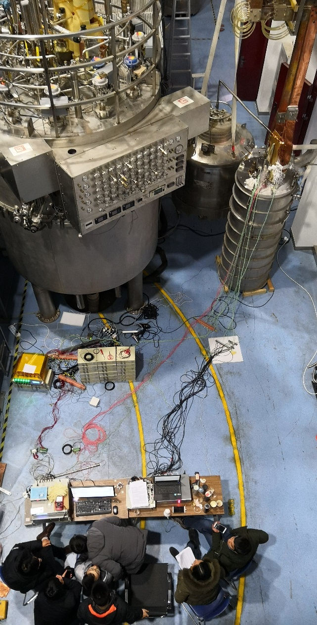
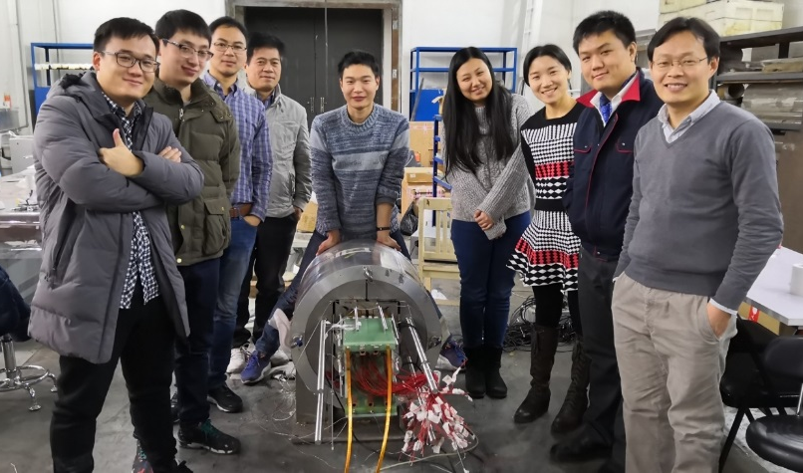
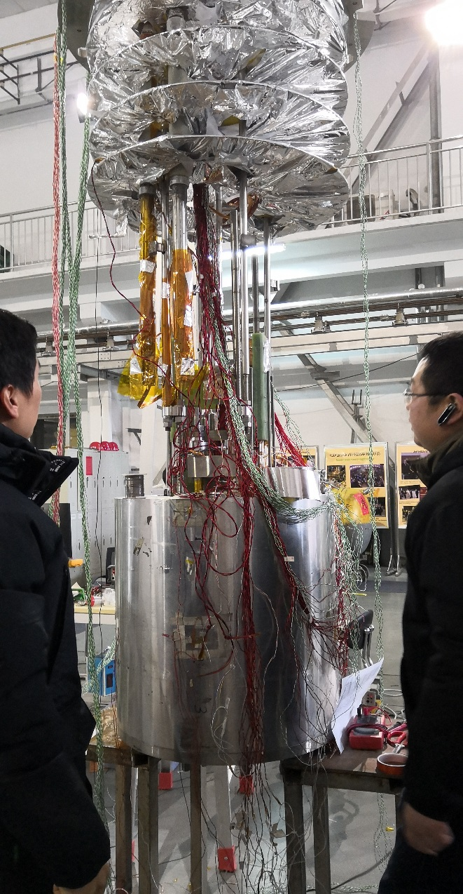
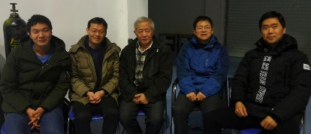
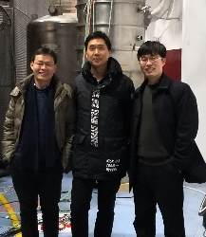
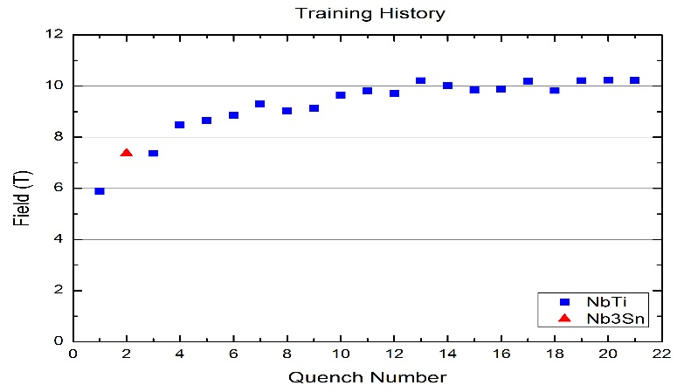
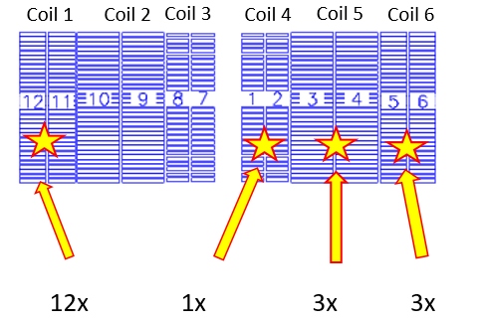
R&D of High Field Dipole Magnets
Test results of the 1st high-field dipole magnet in China Feb. 2018
Magnet fabrication @ Beijing
10.2 T @ 4.2 K dipole field
in two apertures
(Performance limited by NbTi coils)
Magnet under test @ Hefei
Test system setup @ Hefei

Slide 15
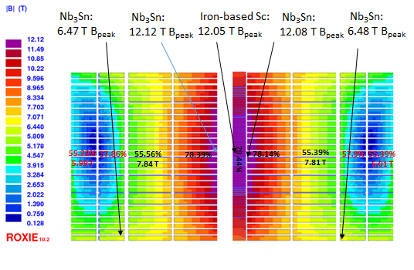
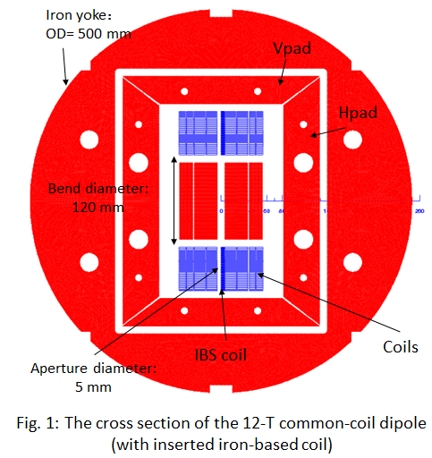
R&D of High Field Dipole Magnets
The 2nd High Field Dipole LPF2: Nb₃Sn with IBS
Cross section of LPF2
Magnetic field distribution
Strand | diam. | cu/sc | RRR | Tref(K) | Bref(T) | Jc@ BrTr | Ic@ BrTr(A)
IHEPWCJC | 0.802 | 1 | 200 | 4.2 | 12 | 2700 | 682
Iron-based | - | 6.7 | 100 | 4.2 | 12 | 216.5 | 38

Slide 16
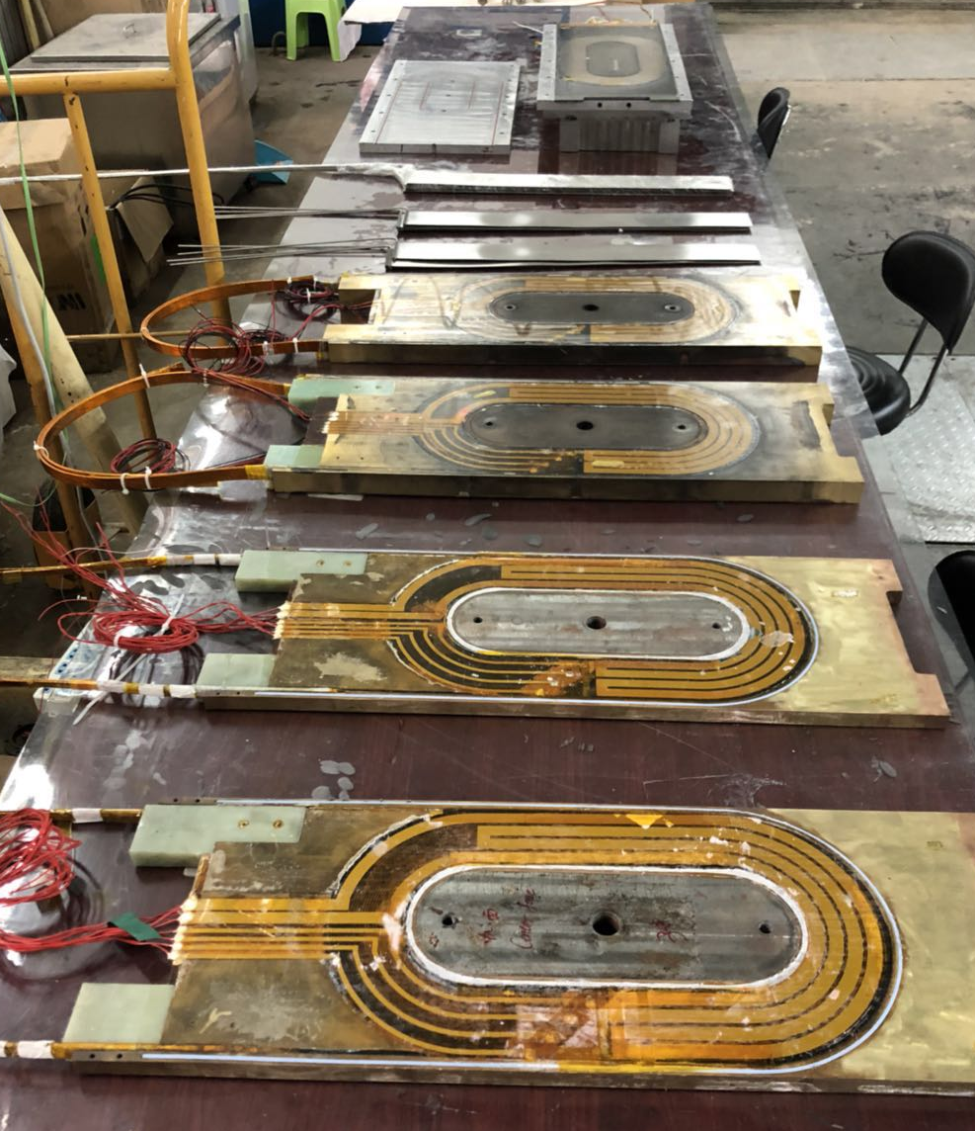
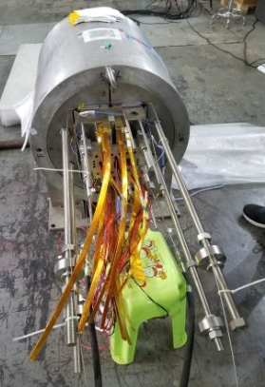
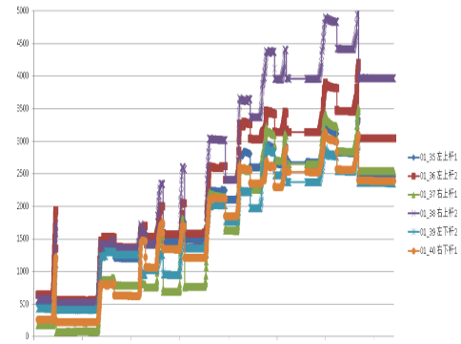
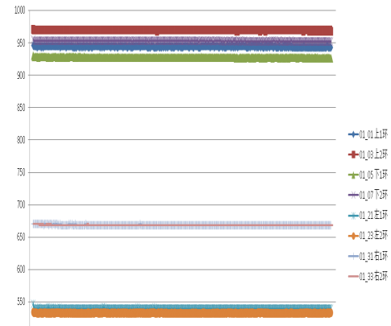
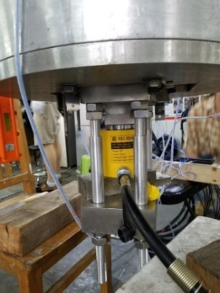
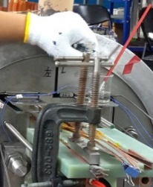
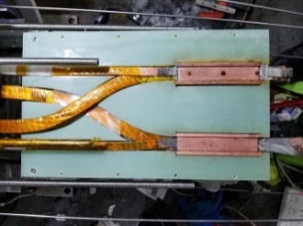
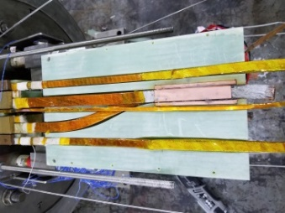
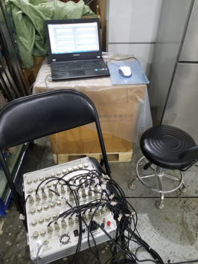
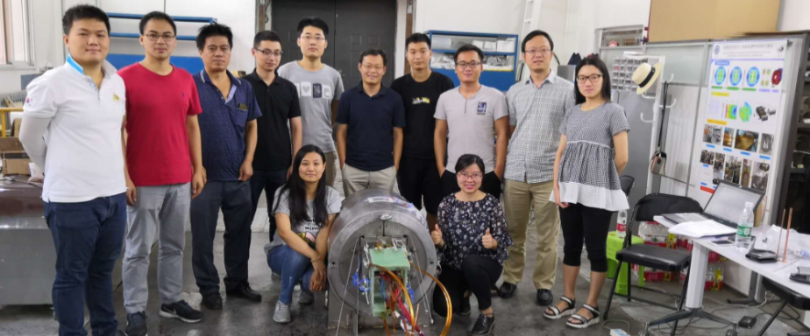
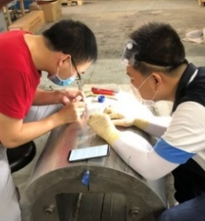
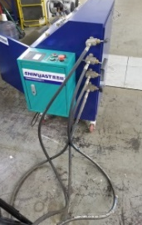
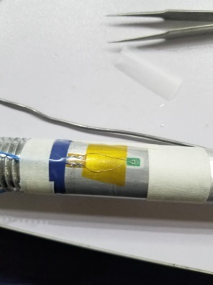
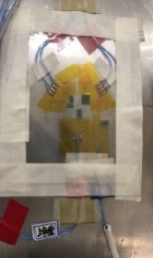
R&D of High Field Dipole Magnets
2 new Nb₃Sn coils + 1 IBS coils
IBS coils
New
Nb3Sn coils
轴向预紧>40ton 环向预紧78.8Mpa
LPF1 used
Nb3Sn coil
磁体制作完成 @中科院高能所

Slide 17
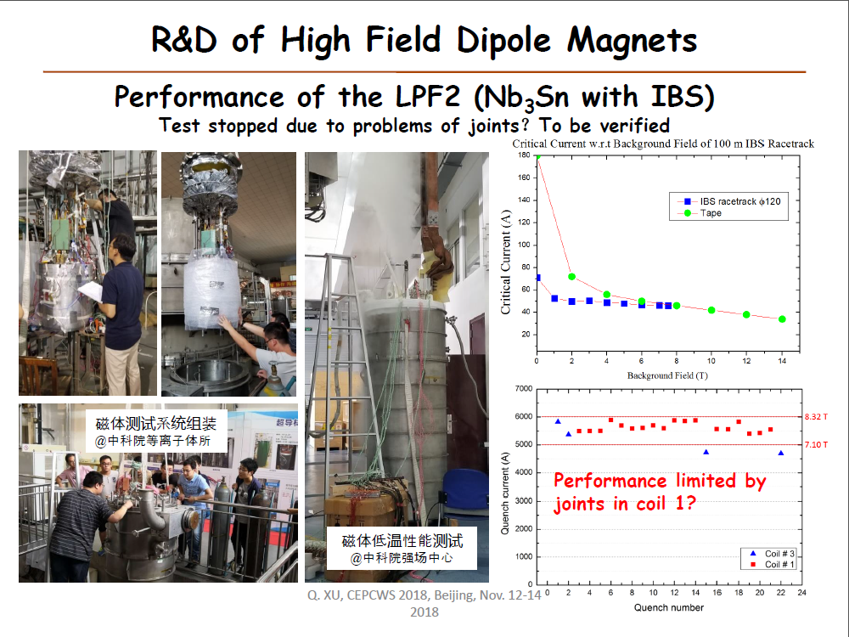

Slide 18













R&D of High Field Dipole Magnets
Fabrication of IBS coils.
共4个SPC，6个DPC

Slide 19


Slide 20




R&D of High Field Dipole Magnets
Next step 1: 15T twin-aperture dipole @ 4.2K
Upgrade
IHEPW7
(ϕ1.2SPC)
IHEPW8-10
(ϕ0.8DPC)
Windings | B_{max}(T) | Loadline(%)
IHEPW7 | 15.281 | 89.427
IHEPW8 A | 13.001 | 88.384
IHEPW8 B | 12.844 | 87.535
IHEPW9 A | 12.444 | 88.666
IHEPW9 B | 12.612 | 89.574
IHEPW10 A | 12.470 | 88.806
IHEPW10 B | 12.028 | 86.417
ϕ30
N: 28 38 38 38
N_{s}: 26 26 22 22
ϕ500
I_{op}= 8800A with 10% Safety Margin
Strand | diam. | cu/sc | RRR | Tref(K) | Bref(T) | Jc@ BrTr | dJc/dB | Ic@ BrTr(A)
IHEP WCJC | 0.802 | 1 | 200 | 4.2 | 14 | 1800 | 400 | 454.65
 |  |  |  | 4.2 | 15 | 1400 | 350 | 353.61
 | 1.2 | 1 | 200 | 4.2 | 14 | 1800 | 400 | 1017
 |  |  |  | 4.2 | 15 | 1400 | 350 | 791
Coil configuration in the 1st quadrant

Slide 21





R&D of High Field Dipole Magnets
Next step 2: 12T twin-aperture dipole @ 4.2K with 10⁻⁴ field quality
Nb₃Sn CM12-3 :
12.77 T B_{peak}
Nb₃Sn CM12-1:
12.69 T B_{peak}
Nb₃Sn CM12-2 :
9.36 T B_{peak}
Iron yoke OD 600 mm
45 mm Aperture diameter
79.3%
79.4%
22.5
15
13
79.8%
61.2%
71.8.%
Bend diameter:
120 mm
71%
79.5%
79.3%
Field distribution at 12.47T
Field quality analysis
Rref | b3 | b5 | b7 | b9 | a2 | a4 | a6 | a8
15 mm | -0.06 | 0.06 | 2.31 | 2.84 | -0.004 | 0.43 | 1.88 | 2.53
13 mm | -0.05 | 0.03 | 0.98 | 0.9 | -0.004 | 0.28 | 0.92 | 0.93
3D model (half length of the straight section: 500 mm)

Slide 22





CERN & China Collaboration
China will provide 12 units CCT corrector magnets for HL-LHC before 2022
A 0.5m model and 2.2m prototype to be fabricated and tested by June 2019
0.5m model magnet
China Version
0.5m model magnet
CERN Version
Fabrication and test of the 1st coil for the 0.5m model magnet @ Xi’an
>523A
More collaboration in future is expected between CERN and China!

Slide 23
International Collaboration
CERN: magnets, collimation, dynamic aperture
LAL: collimation
JLAB: e-p collision
KEK: beam-beam effects
FNAL: beam-beam effects
BINP: cryogenic vacuum
EPFL: beam-beam effect, instabilities

Slide 24
Looking into the future
As the CEPC is going to enter the TDR design phase, SPPC will follow the evolution but with a low profile.
Major accelerator physics study:
  Selected key accelerator physics problems with international collaboration
  Layout and lattice design, to be compatible with CEPC
Key R&D efforts will remain on high-field magnets, hopefully breakthrough in iron-based superconductors
Other possible technical R&Ds by trying to find NSFC funds
  Beam screen study
  High-Q ferrite RF cavities

Slide 25
Summary
SPPC shows the presence in the CEPC CDR report by describing the future upgrade potential of CEPC
Accelerator physics studies keep going but with a low profile and stressing international collaboration
R&D efforts will be mainly on high-field magnets especially iron-based superconducting technology
During the CEPC TDR phase, SPPC will follow the evolution.

Slide 26
Thank you!

