Slide 1
Some bugs in BesVis
Long Peixun
2017.10.26

Slide 2
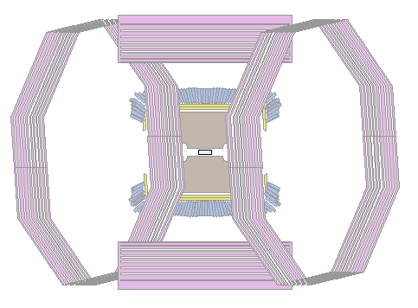
1. Shield problem
Maybe rotating the 2D projection view horizontally is not correct usage.

Slide 3
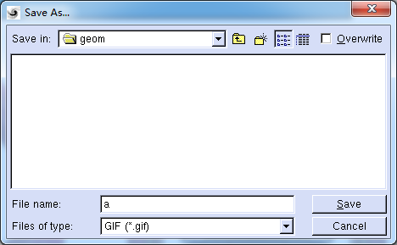
2. Extension problem
User should add extension manually when save a file.

Slide 4
3. The error of saving as picture
Saving as ps, esp, xpm is normal;
But there are some errors in saving as gif, jpg, png, tiff and cannot save successfully.
However, the code pattern of all kinds of file type is same.

Slide 5
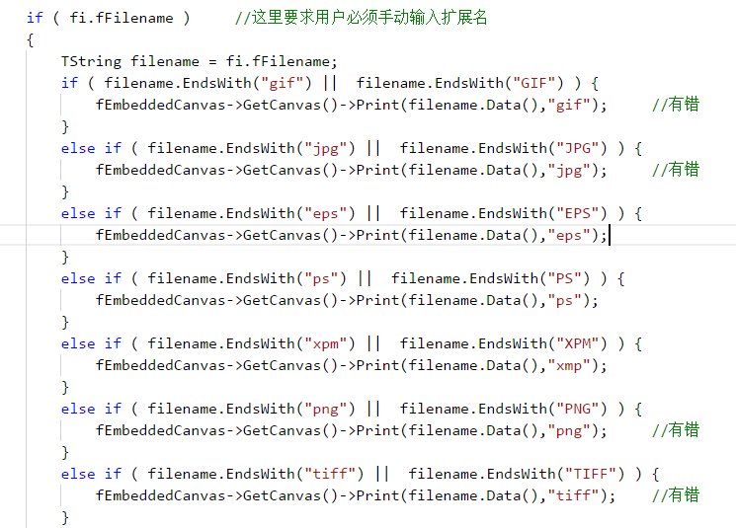

Slide 6
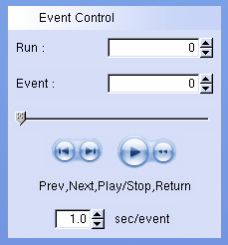
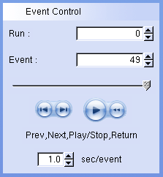
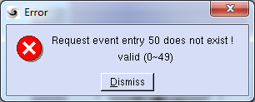
4. Out of range in event shift
There is no out-of-range check in shift functions.
This problem doesn’t affect the use.

Slide 7
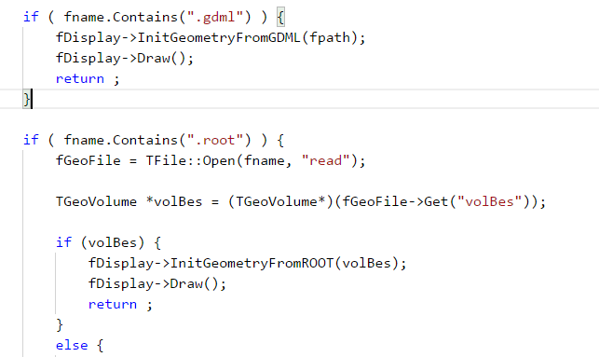
5. A potential bug in loading geometry file
A piece of code of loading geometry file.

Slide 8
5. A potential bug in loading geometry file
If geometry file name is like *.gdml*.root, e.g. bes.gdmlfile.root, BesVis will load the root file in gdml way. And then BesVis crashes.
Use EndsWith() instead of Contains()
Fortunately, we always use geom.root as geometry file. So this bug doesn’t affect use in most cases.
I just hope everyone pays attention to small details in coding.

