Slide 1

Status of CEPC Calorimeter
Tao Hu, Jianbei Liu, Haijun Yang
For the CEPC-Calo Group
CEPC Physics and Detector Group Meeting
November 2, 2017

Slide 2
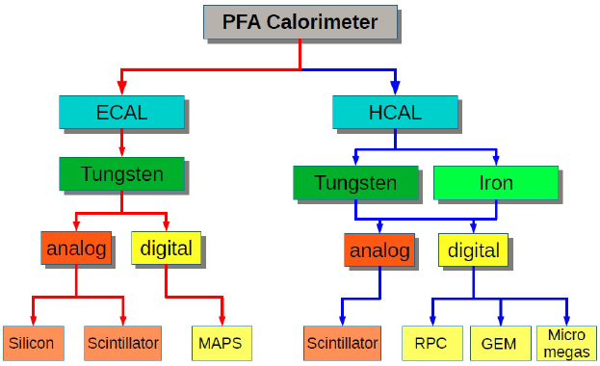

Calorimeter Options
ECAL with Silicon and Tungsten (LLR, France)
ECAL with Scintillator+SiPM and Tungsten (IHEP + USTC)
SDHCAL with RPC and Stainless Steel (SJTU + IPNL, France)
HCAL with ThGEM/GEM and Stainless Steel (IHEP + UCAS + USTC)
HCAL with Scintillator+SiPM and Stainless Steel (IHEP+U.Mainz+BNU)
Dual readout calorimeters (INFN, Italy)
https://twiki.cern.ch/twiki/bin/view/CALICE/CalicePapers

Slide 3
Outline of CEPC Calorimeters CDR
General introduction of Calorimetry system
PFA calorimeters (Tao Hu, Jianbei Liu, Haijun Yang)
  Technology options for ECAL
    Silicon + tungsten (Vincent Boudry)
    Scintillator + tungsten (Zhigang Wang, Yunlong Zhang – TBD)
  Technology options for HCAL
    SDHCAL - RPC (Imad Laktineh, Haijun Yang)
    GEM/THGEM (Jianbei Liu, Boxiang Yu – TBD)
    AHCAL - Scintillator + tungsten + SiPM (Boxiang Yu)
Dual Readout calorimeter (Roberto Ferrari)

Slide 4
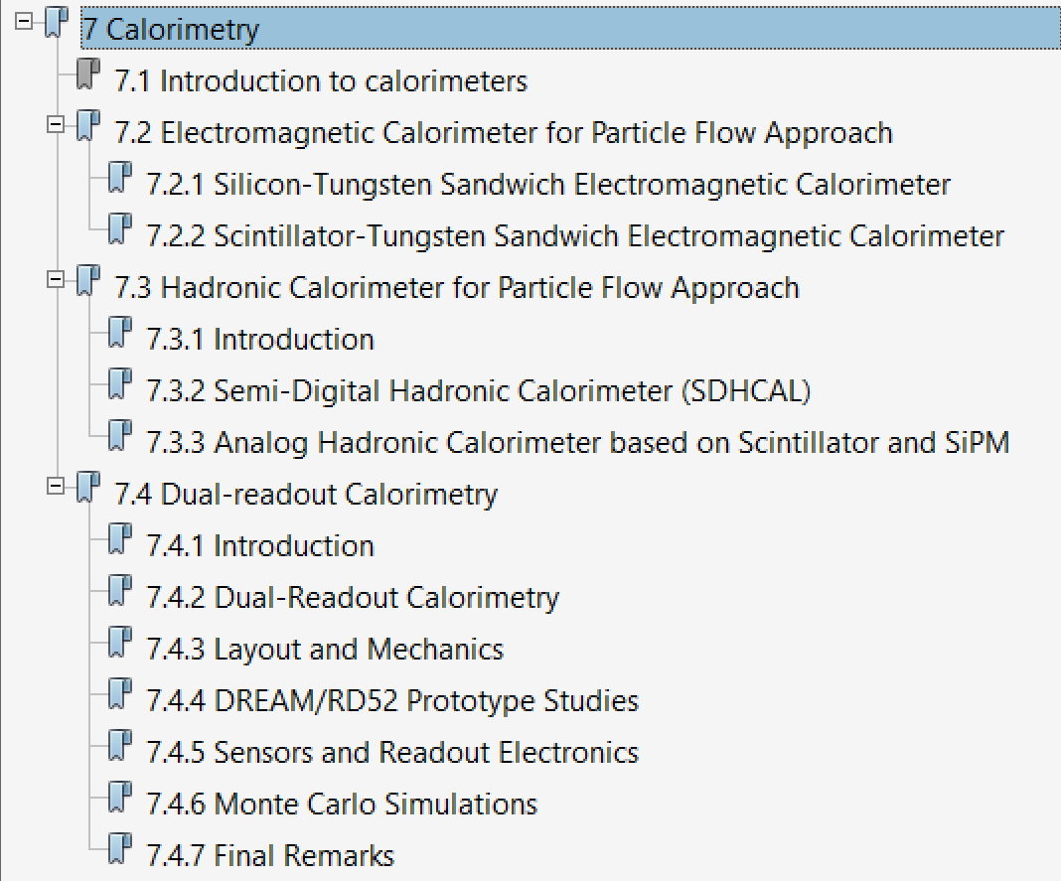
Outline of CEPC Calorimeters CDR
Introduction (2.5p)
SiW-ECAL (7.5p)
ScW-ECAL (?)
SDHCAL (10p)
AHCAL (10p)
Dual-readout (19p)

Slide 5
Posters for CEPC Workshop on Nov. 6-8
Cosmic-ray test results of CEPC-ECAL sensitive cells（牛亚洲）
Status of design and development of CEPC-ECAL readout electronics（赵申森）
Progress of AHCAL R&D （吴哲）
Status of design and development of CEPC-DHCAL readout electronics（王宇）

Slide 6
Contact Information
Vincent Boudry, Vincent.Boudry@in2p3.fr
Roberto Ferrari, roberto.ferrari@cern.ch
Tao Hu, hut@ihep.ac.cn
Imad Laktineh, laktineh@ipnl.in2p3.fr
Jianbei Liu, liujianb@ustc.edu.cn
Zhigang Wang, wangzhg@ihep.ac.cn
Haijun Yang, Haijun.yang@sjtu.edu.cn
Boxiang Yu, yubx@ihep.ac.cn
Yunlong Zhang, ylzhang@ustc.edu.cn

