Slide 1
CEPC detector magnet group
Ning Feipeng
On behalf of magnet group
2017.11.2

Slide 2
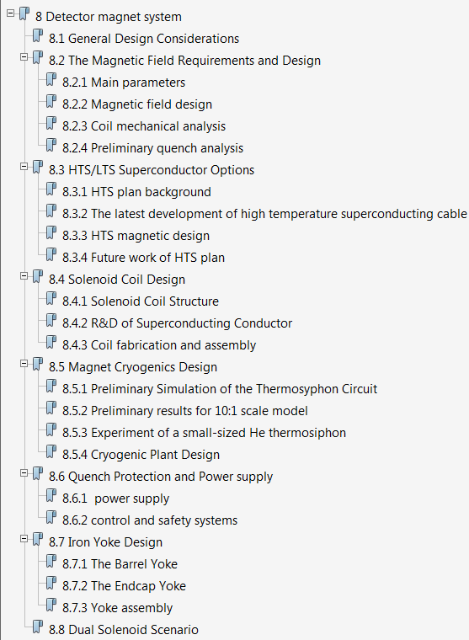
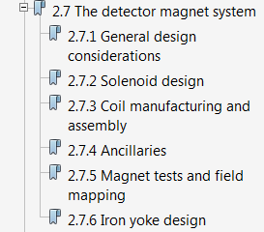
CDR of CEPC detector magnet
From Pre CDR to CDR
10 pages to 36 pages

Slide 3
Summary of CDR
ADD
MISS
The central magnetic field changes from 3.5 T to 3 T;
Coil mechanical analysis, preliminary quench analysis;
HTS options;
Cryogenic design;
Quench protection and power supply;
Dual solenoid design.
Magnetic field affect by MDI;
Magnetic stress analysis of Iron yoke;
Thermal analysis of the magnet;
Preliminary mechanical design.

Slide 4
Collaboration
We contacted IRFU（CEA SACLAY）, but unfortunately did not get the support.
We are still looking for international collaborators, and hope cooperate with CERN, Italian and other counterparts in the future.
Plan for specific collaboration:
1, Design double check and review;
2, HTS magnet design and feasibility study;
3, HTS cable study and development;
4, Dual solenoid scenario design review.

