Slide 1
LOW-ENERGY ELECTRON-POSITRON COLLIDER TO SEARCH AND STUDY (μ⁺μ⁻) BOUND STATE
A.V. Bogomyagkov, V.P. Druzhinin, E.B. Levichev,
A.I. Milstein, S.V. Sinyatkin
BINP, Novosibirsk

Slide 2
Dimuonium
Dimuonium, bimuonium or true muonium is a lepton atom (μ⁺μ⁻).
Dimuonium is pure QED system (no strong interaction, calculable).
From 6 leptonic atoms (e⁺e⁻), (μ⁺e⁻), (μ⁺μ⁻), (τ⁺e⁻), (τ⁺μ⁻), (τ⁺τ⁻) only two (e⁺e⁻), (μ⁺e⁻) were observed.
Very compact (large $m_{μ}$), more sensitive to new physics than other exotic atoms.

Slide 3
Why dimuonium?
Observation of the new classical QED object.
QED test in the new regime.
Experimental challenge leads to development of new techniques.
Tests of muon properties motivated by
3.5σ difference between (g-2)_{μ} measurement and SM prediction
discrepancies in the proton charge radius in muonic hydrogen
Hints of lepton-universality violation in rare B decays (LHCb), B⁺→K⁺e⁺e⁻ and B⁺→K⁺μ⁺μ⁻

Slide 4
Some references
V.N.Baier and V.S.Synakh, Bimuonium production in electron-positron collisions, SOVIET PHYSICS JETP, 14, № 5, 1962, pp.1122-1125
Properties of the bound state, probability of observation
S.J. Brodsky and R.F. Lebed. Production of the Smallest QED Atom: True Muonium (μ⁺μ⁻). Phys. Rev. Lett., 102:213401, 2009
Very large crossing angle in order to eliminate background
H. Lamm and R.F. Lebed, True Muonium (μ⁺μ⁻) on the Light Front, arXiv 1311.3245v3, 12 Nov 2014
Spectrum
H. Lamm, True muonium: the atom that has it all, arXiv 1509.09306v1, 30 Sep 2016
Novel properties

Slide 5
Dimuonium properties
Mass
$$M_{μμ}=\text{2}×\text{105.}\text{7 }\text{MeV}\text{−1}\text{.}\text{4}\text{keV}$$
Bohr radius
$R_{μμ}=512$ fm
$R_{ee}=106000$ fm
Muon lifetime 2.2 μs
${{}_{}^{3}S}_{1}$ states have photon quantum numbers ($J^{PC}=1^{−−}$); therefore could be produced in e⁺e⁻ collisions
Dimuonium energy levels diagram
S.J. Brodsky, R.F. Lebed, Phys. Rev. Lett., 102:213401, 2009

Slide 6
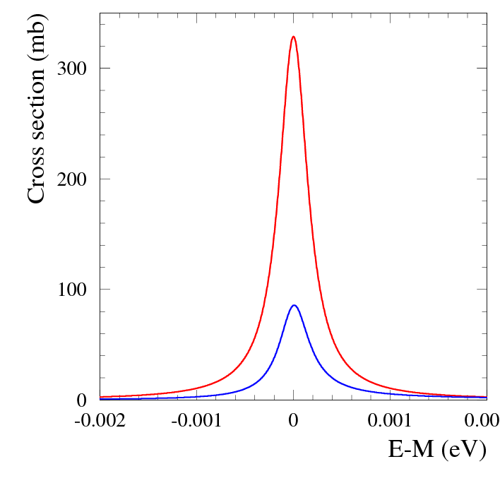
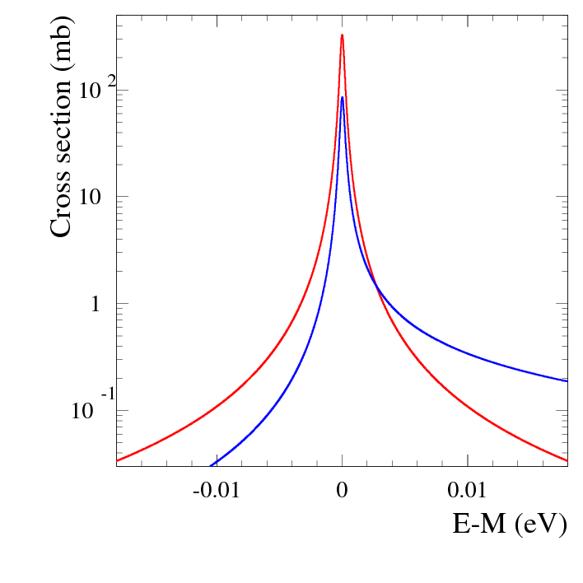
Dimuonium production cross section
Born
+r.c.
Production of ${n{}_{}^{3}S}_{1}$ in the $e^{+}e^{−}→\left(μ^{+}μ^{−}\right)→e^{+}e^{−}$
${1{}_{}^{3}S}_{1}: σ\left(m_{μμ}\right)≈\frac{12π}{m_{μμ}^{2}}\sqrt{\frac{π}{8}}\frac{Γ_{ee}}{σ_{M}}≈0.2\frac{Γ_{ee}}{σ_{M}}$
where σ_{M} is center-of-mass energy spread
For different collision schemes
$\frac{Γ_{ee}}{σ_{M}}=\frac{0.37×{10}^{−6}keV}{\left(7÷400\right)keV}≈\left(1÷50\right)×{10}^{−9}$, $σ\left(m_{μμ}\right)=0.23÷11 nb$
Background: elastic $e^{+}e^{−}→e^{+}e^{−}$ scattering
For crossing angle $45°÷135°$ $σ_{Bhabha}=22000 nb$
${Background}/{signal}=\left(3÷130\right)×{10}^{3}$
Background suppression is possible if decay point is separated from origin point (decay path${1{}_{}^{3}S}_{1}:cτ=540 μm$)
Born
+r.c.
Notes:
Background suppression only with large angle crossing

Slide 7
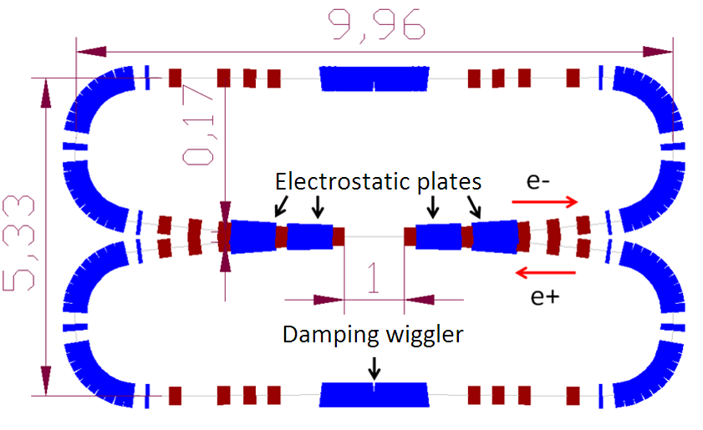
Head-on e+e- collision
E_{beam}=100÷150 MeV
Collision monochromatization a la Reniery:
10 keV invariant mass resolution
L ≈ 10³⁰ cm⁻²s⁻¹ (∼50 (μ⁺μ⁻)/hour).
Observation of the dimuonium
by searching for X-rays from (μ⁺μ⁻)
Bohr transitions such as 2P→1S (J.W.Moffat).
Failed due to large background.
Large crossing angle proposed by S.J.Brodsky and R.F.Lebed.
https://eventbooking.stfc.ac.uk/uploads/eefact/mumutron-eefact2016-2.pptx

Slide 8
Large angle beam crossing
Invariant mass
$$\left\langle M\right\rangle =2E_{0}\cos{θ}−\frac{E_{0}}{2}\cos{θ}\left[σ_{δ}^{2}+σ_{px}^{2}+σ_{py}^{2}\frac{\cos{2θ}}{{\left(\cos{θ}\right)}^{2}}\right]$$
Invariant mass resolution
$$σ_{M}^{2}=2E_{0}^{2}\left[σ_{δ}^{2}{\left(\cos{θ}\right)}^{2}+{σ_{px}^{2}\left(\sin{θ}\right)}^{2}\right]$$
Luminosity (${{φ=σ}_{z}\tan{θ}}/{σ_{x}}$)
$$ℒ_{0}=\frac{N_{1}N_{2}}{4πσ_{y}σ_{x}\sqrt{1+φ^{2}}}f_{0}N_{b}≈\frac{N_{1}N_{2}}{4πσ_{y}σ_{z}\tan{θ}}f_{0}N_{b}$$
Peak production rate
$${\dot{N}}_{μμ}≈\frac{Γ_{μμ}σ_{μμ}ℒ_{0}}{2\sqrt{π}σ_{M}}$$
Notes:
Brodsky and Lebed proposal with very lathe theta will not work, because sigma_M will increase

Slide 9
Accelerator requirements
Large positive momentum compaction (small circumference)
Large crossing angle with small vertical beta function gives high luminosity (similar to crab waist)
Large crossing angle 75° provides comfortable beam energy (e⁺ production) and decay length
beam energy $E_{b}=408$ MeV
decay length $l\left(μ^{+}μ^{−}\left({1{}_{}^{3}S}_{1}\right)\right)=2$ mm
Higher signal to noise ratio requires $σ_{x}<c{ τ}_{0,μμ}=0.54$ mm
Horizontal beam divergence contributes significant part in invariant mass resolution; therefore, low horizontal emittance
Reverse of the beam direction provides 15° crossing angle and allows to study c.m. energy range from η to η′ mesons (550-960 MeV)

Slide 10
Collider: overview
Π=23 m

Slide 11
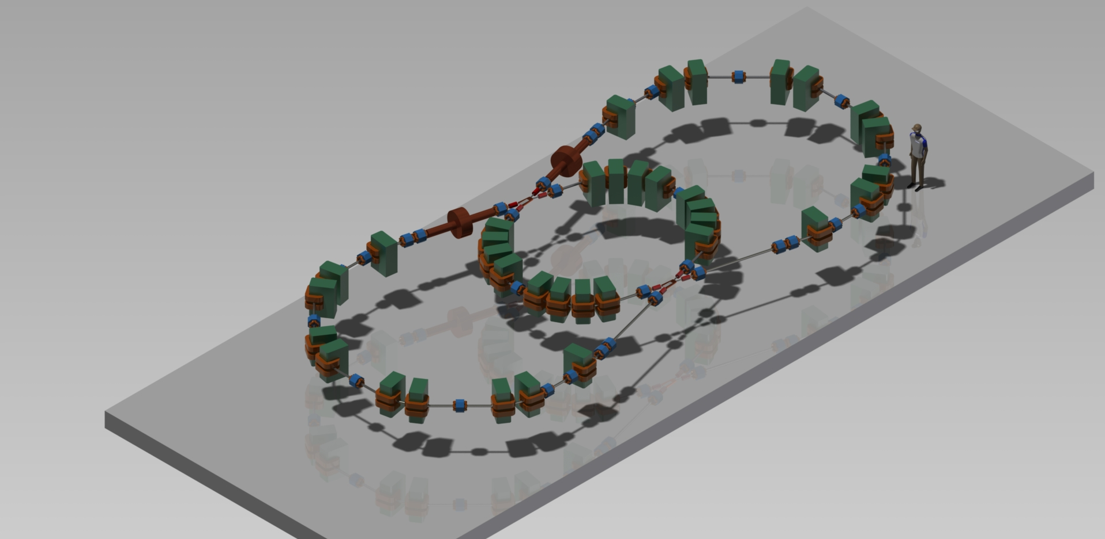
Collider: overview
Outer arc
RF cavities
Inner arc
IP1
IP2
Inner arc
Injection
Outer arc

Slide 12
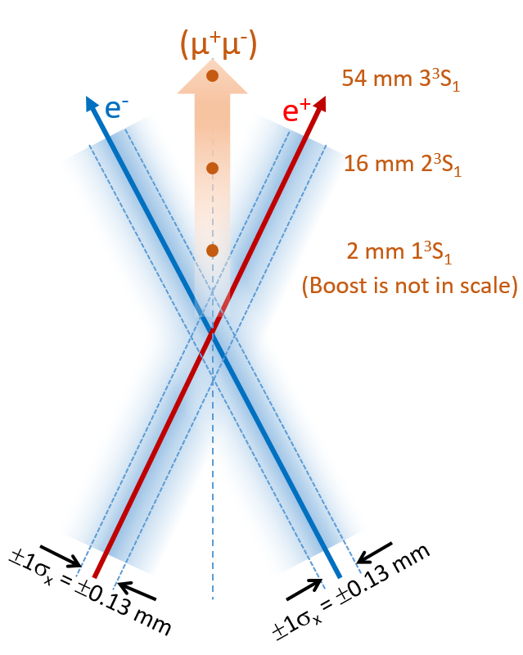
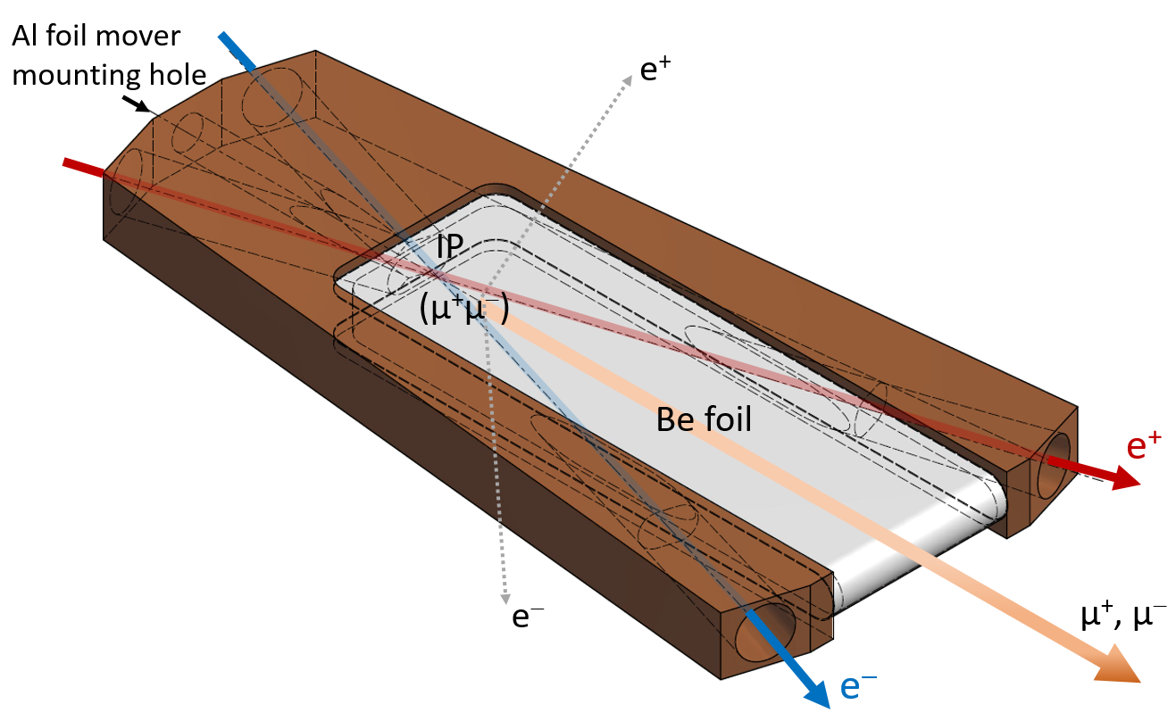
Interaction region
Experimental chamber: flat box with 0.5-mm-thick beryllium windows on the top and on the bottom allowing passage of е± produced by the dimuonium atoms decay.
Detector: tracking systems around the median plane, magnetic spectrometer

Slide 13
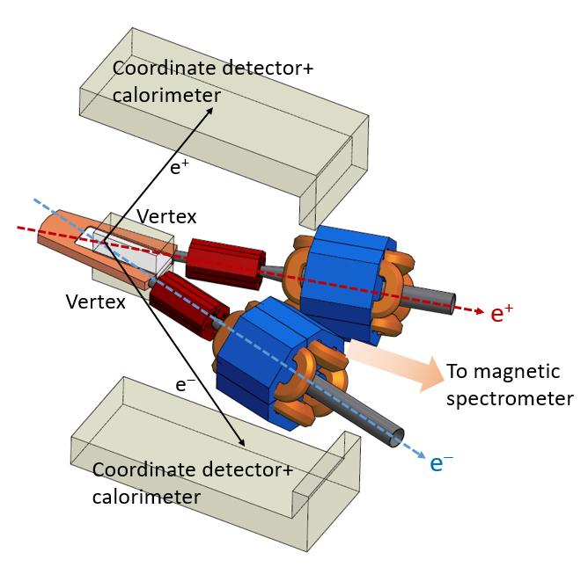
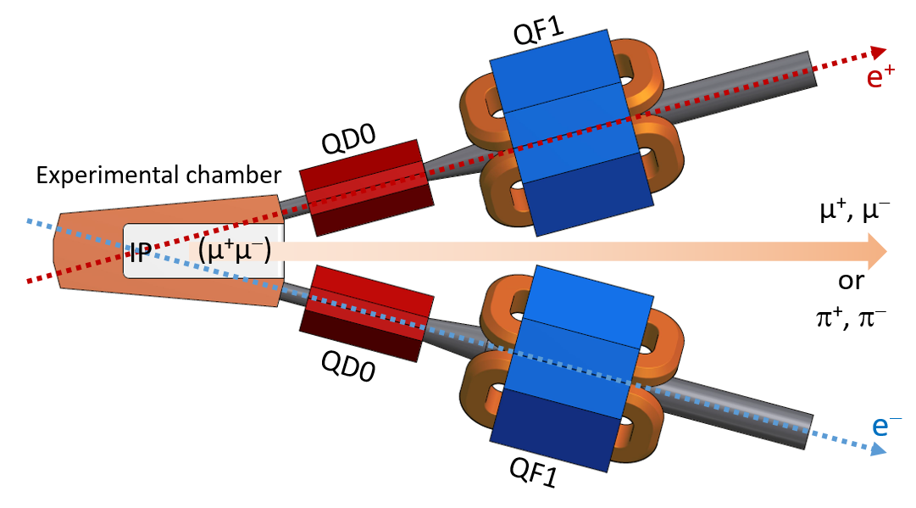
Interaction region
QD0: permanent magnet, G=-35 T/m, ∅ 30mm
QD/QF1: electromagnet

Slide 14
Collider: optics
Beam energy | 408 MeV
Circumference | 23 m
Momentum compaction | 6.4×10⁻²
Bunch intensity | 3.5×10¹⁰ / 73 mA
Horizontal emittance | 26 nm 90 nm (IBS)
Energy spread | 4×10⁻⁴ 8.4×10⁻⁴ (IBS)
β_{x} / β_{y} | 200 mm / 2 mm
Luminosity | 4×10³⁰ cm⁻²s⁻¹, Nb=1 8×10³¹ cm⁻²s⁻¹, Nb=20

Slide 15
Collider: parameters
RF frequency | 338.98 MHz | Beam energy | 408 MeV
RF harmonic | 26 | Invariant mass (M) | 211.315 MeV
RF voltage | 450 kV | σ_{M} | 390 keV
RF acceptance | 2% | σ_{M}/M | 1.8×10⁻³
Synchrotron tune | 1.71×10⁻² | IP beam divergence | 6.7×10⁻⁴ (hor)
Damping partition | 1.6 (hor) 1.4 (lon) | Energy spread | 4×10⁻⁴ 8.4×10⁻⁴ (IBS)
Damping times | 17.3 ms (hor) 27.3 ms (ver) 22.1 ms (lon) | Beam-beam tune shift | 2×10⁻⁶ (hor) 1.2×10⁻³ (ver) -2×10⁻³ (lon)
Bunch length | 5.4 mm 11.6 mm (IBS) | Beam size at IP | 130 μm 0.7 μm

Slide 16
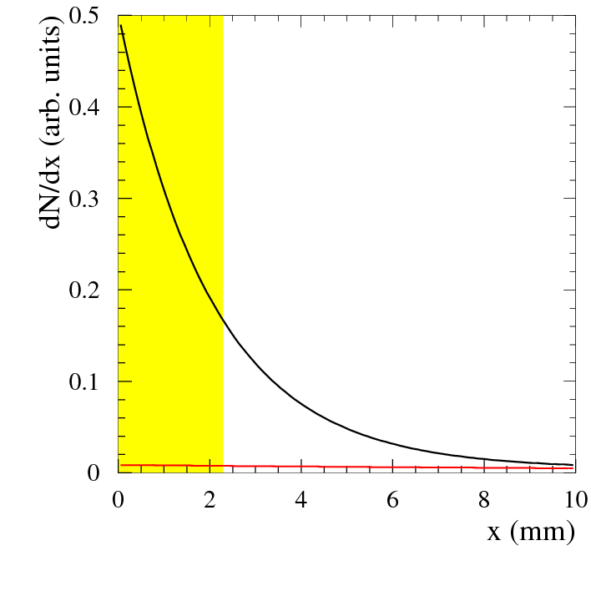
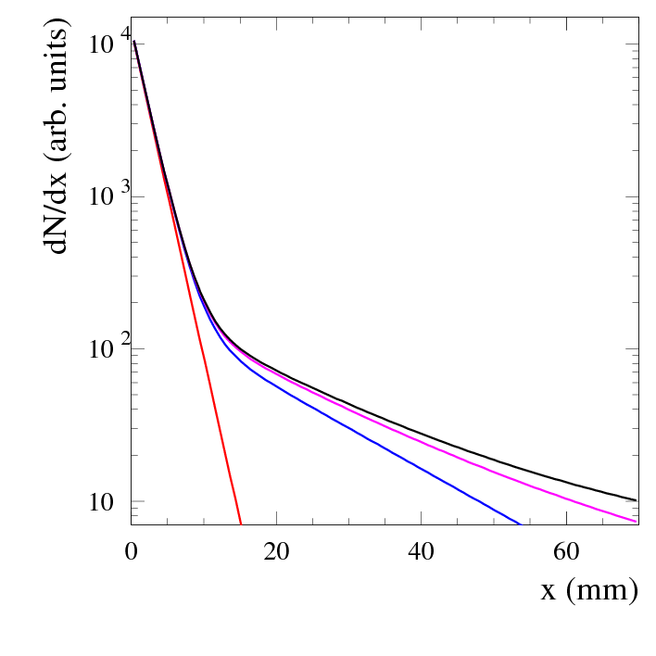
Dimuonium production and distribution
μ⁺μ⁻ rate |  | 1 hour | 4 months
Total 1S/2S/3S |  | 65/8.1/2.4 | 187k/23k/6.9k
$x>2.3$ mm | 1S/2S/3S | 21/7/2.3 | 59k/20k/6.6k
Detection efficiency is about 50%
$βγcτ=2.03 mm$
$σ_{x}\left(IP\right)={σ_{x}}/{\left(\sqrt{2}\cos{θ}\right)}=350 μm$
Detector vertex resolution is 300 μm
Total $σ_{vtx}=460$ μm
5σ background suppression with vertex position x>2.3 mm
Σn³S₁
1³S₁
Σn³S₁−1³S₁
2³S₁
3³S₁
Σn³S₁

Slide 17
Experiments: what can we measure?
From the fit of the decay vertex distribution
dimuonium production rate (Γ_{ee}) of 1S (1% for 10⁷ s), 2S(5%), 3S(15%)
dimuonium decay lengths with the same accuracy
Dimuonium interaction with a thin foil (30μm Al) allows
measurement of the breakup probability
measurement 1S-2P transition probabilities
2P lifetime
Laser spectroscopy
ΔE(2S-2P) (laser λ≈100μm)
2P lifetime

Slide 18
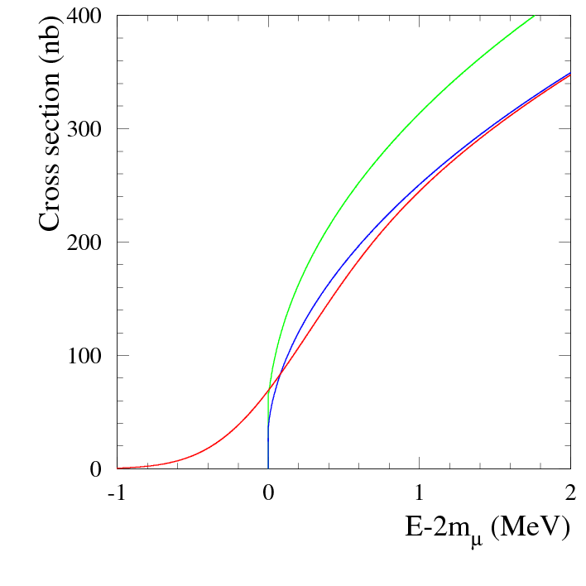
Experiments: $e^{+}e^{−}→μ^{+}μ^{−}$ near threshold
Coulomb interaction in the final state leads to nonzero cross section at the threshold; therefore,
Background-free measurement of the cross section near the threshold, requires magnetic spectrometer
Precision measurement of the SSSG-factor
C.M. energy and its spread calibration
The same technique may be used for $e^{+}e^{−}→π^{+}π^{−}$
Born cross section
+ rad. correction
+ energy spread
with δ=400 keV
Notes:
Saharov, Schwinger, Sommerfeld, Gamov

Slide 19
Experiments: 15° crossing angle
This region (c.m. 550-960 MeV) of ρ and ω resonances is important for SM (g-2)_{μ} calculation
$e^{+}e^{−}→π^{+}π^{−}$ cross section measurement with unlimited statistics
Precision measurements of other hadronic cross sections ($e^{+}e^{−}→π^{+}π^{−}π^{0},π^{0}γ,ηγ,π^{0}π^{0}γ,4π,⋯$)
Rare processes $e^{+}e^{−}→η,η′$
Two-photon processes $γγ→π^{0},ππ,η$
Measurement of meson-photon transition form factors

Slide 20
Reverse beam: 15° crossing angle
Beam energy | 283.59 MeV (η) | 495.78 MeV (η′)
Invariant mass (M) | 547.86 MeV | 957.76 MeV
σ_{M} (σ_{M}/M) | 420 keV ( 7.7×10⁻⁴ ) | 580 keV ( 6.1×10⁻⁴ )
Energy spread | 2.8×10⁻⁴ / 10.6×10⁻⁴ (IBS) | 4.8×10⁻⁴ / 8.4×10⁻⁴ (IBS)
IP beam divergence (hor) | 8.3×10⁻⁴ | 7.1×10⁻⁴
Horizontal emittance | 11.4 nm / 105 nm (IBS) | 34.8 nm / 75 nm (IBS)
Bunch length | 3.7 mm / 14.2 mm (IBS) | 6.3 mm / 11 mm (IBS)
Beam-beam ξ (h/v/l) | 3×10⁻⁴ /1.4×10⁻² /-2×10⁻³ | 3×10⁻⁴ /1.3×10⁻² /-2×10⁻³
Synchrotron tune | 1.67×10⁻² | 1.71×10⁻²
Luminosity (Nb=1 / 20) | 3.3×10³¹ / 6.6×10³² | 5.2×10³¹ / 1×10³³

Slide 21
Conclusion
Collider to observe and study bound state of (μ⁺μ⁻)
two rings
large crossing angle
circumference 23 m
not expensive to build and operate
luminosity 8×10³¹ cm⁻²s⁻¹
Reverse of the beam allows to perform experiments in 500-1000 MeV central mass energy range
Details are in https://arxiv.org/abs/1708.05819
We are preparing technical design and plan to make a decision by the end of the year
We are open for collaboration and experiments proposals

Slide 22
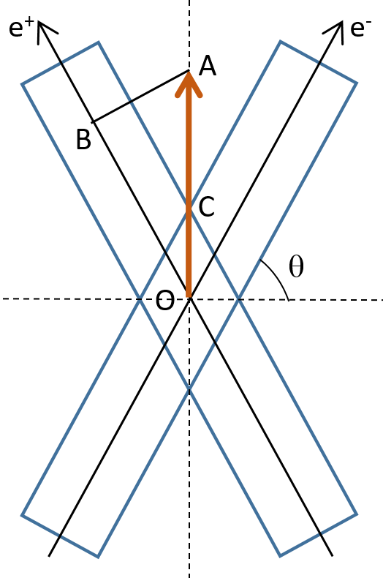
Background
Decay length $\left(μ^{+}μ^{−}\left({1{}_{}^{3}S}_{1}\right)→e^{+}e^{−}\right)$
$$OA=l=c τ_{0,μμ}β_{μμ}γ_{μμ}=c{ τ}_{0,μμ}\tan{θ}$$
Background: density of beam particles
$$N_{1}∝\exp\left(−{n_{x}^{2}}/2\right)$$
$$n_{x}=\frac{AB}{σ_{x}}=\frac{l \cos{θ}}{σ_{x}}=\frac{c{ τ}_{0,μμ}}{σ_{x}}\sin{θ}$$
Signal to background ratio
$$\frac{{\dot{N}}_{μμ}}{{\dot{N}}_{ee}}∝\frac{\exp\left[\frac{c^{2}τ_{0,μμ}^{2}}{σ_{x}^{2}}\sin^{2}θ\right]}{\sqrt{σ_{δ}^{2}\cos^{2}θ+\left({σ_{x}^{2}}/{β_{x}^{2}}\right)\sin^{2}θ}}$$
Notes:
Constituents are living longer. Preponderance of beam particles.

Slide 23
Beam-beam effects with large crossing angle
e⁻
Beam-beam tuneshift
$$ξ_{z}=−\frac{N r_{e}}{2πγ}\frac{α}{\left|α\right|σ_{δ}σ_{z}}\frac{φ^{2}}{1+φ^{2}}$$
Hamiltonian
$$ℋ=−α\frac{p_{z}^{2}}{2}−\frac{ν_{s}^{2}}{αR^{2}}\frac{z^{2}}{2}−\frac{2ξ_{z}ν_{s}}{αR^{2}}\frac{z^{2}}{2}$$
Population limit for $α>0$
$$N<\frac{2πR γ}{r_{e}}\frac{α σ_{δ}^{2}}{2}$$
$α<0$ has been studied at KEKB and at DAΦNE, no large currents, no luminosity due to microwave instability
e⁺
e⁺
e⁻

