Slide 1
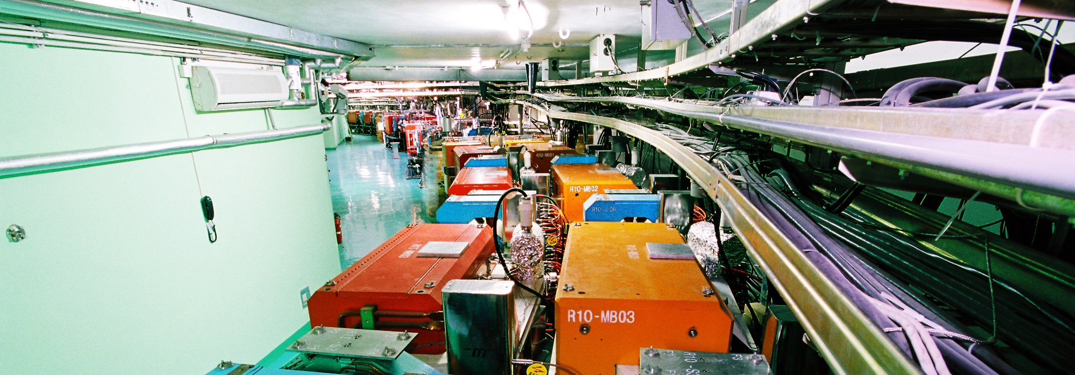
Introduction to IHEP
WANG Yifang
Institute of High Energy Physics
Jun. 13-15 , 2018
International assessment 2018

Slide 2
Contents
1
Overview of IHEP
2
International Assessment
3
Future Plan & Challenges

Slide 3
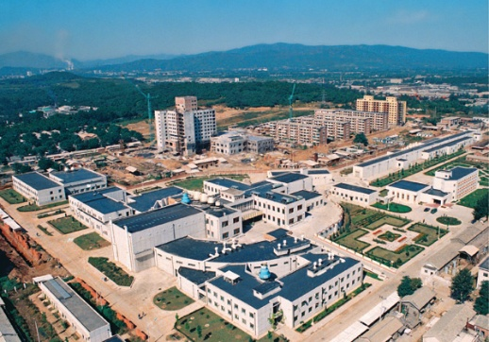
History
1950
1953
1958
Feb. 1973
Institute of Modern Physics
Institute of
Physics
Institute of Atomic Energy
Institute of High Energy Physics
The institute grew with the construction of Beijing Electron Position Collider (BEPC) in the 80s
BEPC was the best choice at that time:
Scientifically sound
30 year lifetime
A domestic team for HEP and large science facilities trained
Since then, IHEP has developed into a large multi-discipline institute covering particle physics, astroparticle physics, synchrotron radiation and spallation neutron sources
BEPCII
BEPC
CESRc
DORIS I
SPEAR
ADONE

Slide 4
Mission
1 | To conduct research in particle physics and particle astrophysics, in order to better understand matter and the Universe;
2 | To construct and further develop large, multidisciplinary experiment platforms which are highly accessible to external users and provide strong support for science and technology programs and for China's economic and social development;
3 | To carry out frontier interdisciplinary research which is well matched to and fully utilizes our major scientific facilities and strengths in nuclear technology;
4 | To promote technology transfer and high-tech industrialization, where applicable; and
5 | To produce highly capable scientists, train skilled technical personnel, and engage the public in the understanding of science.

Slide 5
Main Research Disciplines
Particle Physics
Accelerator-based HEP Experiments
Particle Astrophysics & Neutrino Experiments
Particle Detection and Electronics
Particle Physics Theory
Science
Accelerator Physics and Technologies
Technology
High Luminosity Electron Accelerators
High Intensity Proton Accelerators
Applied Research and Technology Transfer
Radiation Technologies and Applications
Scientific infrastructure for multi-disciplinary studies
Synchrotron Radiation Techniques & Applications
Neutron Scattering Techniques & Applications
Nuclear Analytical Techniques & Applications

Slide 6
Large Science Facilities
In operation (6)
Beijing Electron Positron Collider (BEPCII) / (BESIII)
Beijing Synchrotron Radiation Facility (BSRF)
Yangbajing Cosmic Ray Observatory (YBJ)
Daya Bay Reactor Neutrino Experiment
Hard X-ray Modulation Telescope (HXMT)
China Spallation Neutron Source (CSNS)
Under construction (4)
Jiangmen Underground Neutrino Observatory (JUNO)
Large High-Altitude Air Shower Observatory (LHAASO)
Ali CMB Polarization Telescope (AliCPT-1)
High Energy Photon Source (HEPS/HEPS-TF)
Under planning (6)
China Initiative Accelerator Driven System (CiADS)
China Spallation Neutron Source II (CSNSII)
Enhanced X-ray Timing and Polarimetry mission (eXTP)
High Energy cosmic-Radiation Detection (HERD)
Circular Electron Positron Collider-Super proton-proton collider (CEPC-SppC)
Other Light Source Projects： Southern Photon Source 、SCLS……

Slide 7
Organization
Experimental Physics Division
Particle Astrophysics Division
Accelerator Division
Multi-Disciplinary Research Division
Theoretical Physics Division
Computing Center
Division of Nuclear Technology and Applications
Research
(7)
Science Committee
IHEP Staff
Congress
Directors’Office
Office of Human Resources
Office of Research and Planning
Office of Large Facilities
Office of Finance and Assets
Office of Education
Office of Technology Transfer
Supporting Services
Office of Retiree Services
Directors
Administration
(9)
CAS
Academic Degree Committee
Support
(3)
Division of Facilities Operation and Maintenance
Library and Information Services
Machine Shop
Branch (1)
Dongguan Campus

Slide 8
IHEP FUNDING
State financial support for institute operation
State financial support for operation of large facilities
Competitive funding for research
Competitive funding for construction of large facilities
Other
Institute Operation
Project Funding

Slide 9
IHEP FUNDING
Total | 2013-2017 | 7434
 | 2008-2012 | 3772
97%

Slide 10
Human Resources
December 2017
1401 permanent staffs
68 temporary employees
Of which:
49 recruited by talent programs: 8 within China, 41 from abroad (2013-2017)
December 2012
1344 permanent staffs
93 temporary employees
Of which:
39 recruited by talent programs: all from abroad(2008-2012)
Service staffs are greatly reduced: replaced by service contracts ➔
Significantly improved staff
composition
Age distribution of staff in 2017
34.1% Master’s degrees, and 49.6% doctorates

Slide 11
Education
A total of 498 (2013-2017) [426 (2008-2012)] postgraduate degrees awarded
345 [343] PhDs, 153 [80] Masters
Currently (2017), 360 PhD students (including 9 international students) [258 in 2013] and 239 [215] Masters students
Statistics of Master's and doctoral degrees
Destinations for IHEP postgraduates (2013-2017)

Slide 12
Scientific Output: Publications
Database | Papers | 2013 | 2014 | 2015 | 2016 | 2017
SCI- Indexed | All | 859 | 938 | 938 | 1035 | 919
EI-Indexed | All | 489 | 539 | 503 | 526 | 446
 | Duplicates removed | 176 | 121 | 144 | 154 | 82
ISTP- Indexed | All | 73 | 73 | 49 | 82 | 59
 | Duplicates removed | 12 | 12 | 13 | 31 | 14
Other full-text databases | All | 275 | 399 | 243 | 299 | 247
2013-2017 TOTAL | All | 1322 | 1470 | 1338 | 1519 | 1262
2008-2012 TOTAL | All | 1032 | 925 | 975 | 1080 | 1318
Total | 2013-2017 | 6911
 | 2008-2012 | 5330
29.7%

Slide 13
Technology Output：Patents
Patent applications: 322 [2008-2012: 168]
Patents granted: 230 [2008-2012: 82]
Numbers of patent applications and patents granted, 2013-2017.
Number of patent applications and patents granted in 2013-2017 and 2008-2012.

Slide 14
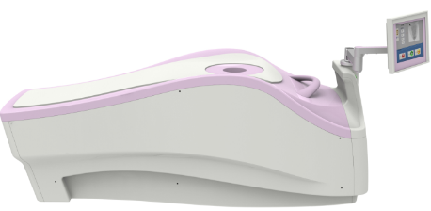
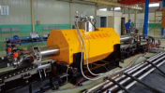
Technology Transfer: Products
Nuclear Medical Imaging Equipment
dedicated breast PET scanners,
micro SPECT/CT scanner ,
micro PET/CT scanner
Detection and Security Check Equipment
X-ray three-dimensional micro-CT,
high energy industrial CT,
gamma ray imaging device
Compact Accelerators
electron accelerators for industrial radiation processing,
medical accelerators,
accelerator based ray source
Magnet-related Equipment
de-ironing separator
superconducting magnet separator,
MRI device, superconducting magnet
Nanomedicine
IP transferred to company

Slide 15
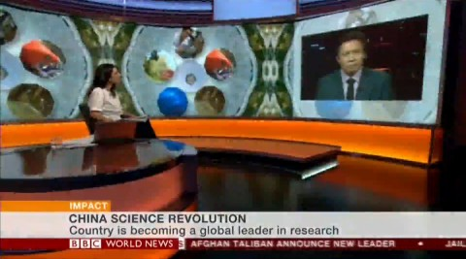
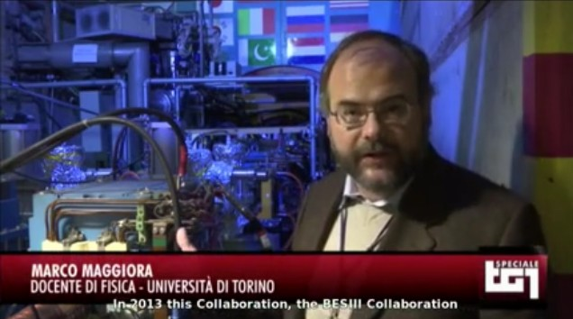
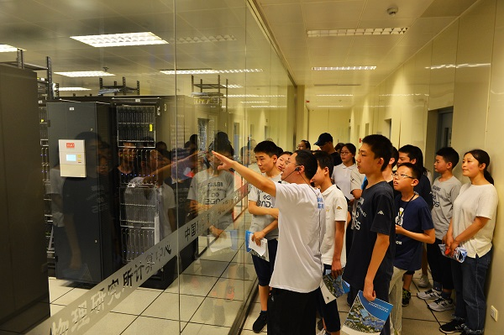
Outreach
Three Science Journals
Chinese Physics C, Impact factor increased from 0.4 to 5.08
A new journal: Radiation Detection Technology and Methods
A journal for general public: Modern Physics
News publicity in five years
＞1000 original reports published in China’s mainstream news media
＞ 120 original reports by overseas mainstream media and journals
Websites and other social media platforms
Views in last five years: website ＞ 83 million ，wechat ＞ 4.6 million, weibo ＞ 20 million
Open Day : ~3500 visitors annually
Many public talks, TV shows，school events， etc.
International Science activities: Dark Matter Day in 2017
Books by IHEP scientists in last five years : ~23
BBC World News on Daya Bay Experiment: The Particle Hunt
RAI：The rise of a dragon--high energy physics
Open Day

Slide 16
Contents
1
Overview of IHEP
2
International Assessment
3
Future plan & Challenges

Slide 17
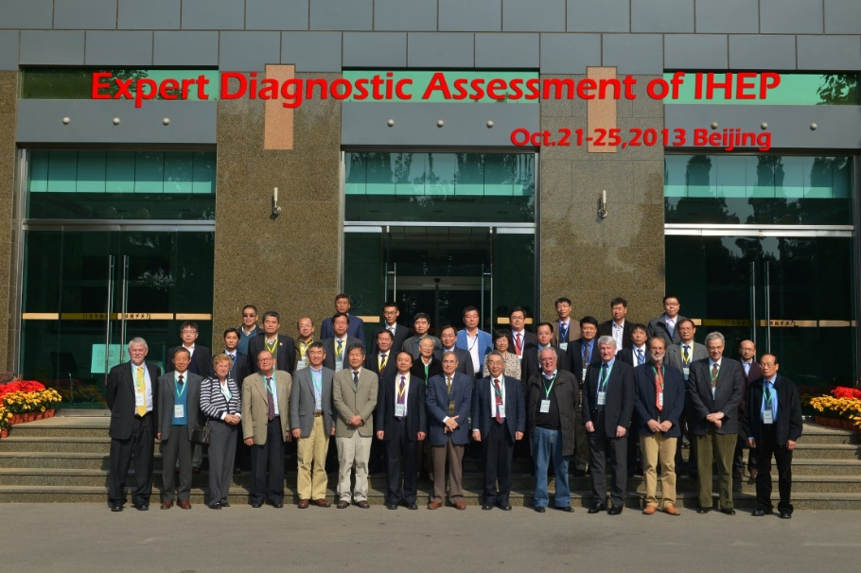
International Assessment in 2013
NAME | INSTITUTE | FIELD
Michel Davier (chair) | LAL, Université Paris-Sud 11 | experimental particle physics(2)
Vera Luth | Stanford University
Luciano Maiani | Universita' degli Studi di Roma "La Sapienza" | theoretical particle physics(2)
Estia Eichten | Fermi National Accelerator Laboratory
Benedetto D'Ettorre Piazzoli | Univ. of Naples Federico II, Italy | high-energy cosmic rays
Pietro Ubertini | Instituto di Astrofisica Spaziale e Fisica Cosmica, Rome, part of the National Institute of Astrophysics | particle astrophysics
Alexander Wu Chao | SLAC | accelerator physics
Shin-ichi Kurokawa | KEK | accelerator physics and technology(4)
John Seeman | SLAC
Wu-Tsung Weng | BNL
Jiaer Chen | Peking University
Qun Shen | BNL | Synchrotron radiation applications
Lajos P. Balogh | Nanomedicine (editor-in-chief) | Nanotechnologies
Lu Yu | The Institute of Physics, Chinese Academy of Sciences | condensed matter physics
Expert Diagnostic Assessment
（Oct. 21-25, 2013 IHEP Beijing）
14 experts, 3 Subcommittee
Subcommittee 1
Experimental particle and astroparticle physics, astrophysics, theoretical physics, detectors, computing
Subcommittee 2
Accelerator physics and technology
Subcommittee 3
Multidisciplinary applications: synchrotron
radiation, nuclear techniques, radiochemistry, nanotechnologies

Slide 18
International Assessment in 2013
Item | Recommendations | Implementation & achievements
Organizational issues | “…. optimal to maximize the use of existing expertise and manpower.” | A matrix method was implemented to cover multiple tasks: a single person can take multiple tasks and every task is taken by a group of people
Very challenging projects for large-scale facilities | “…. prioritization of the unique experiments….” | Successfully completed all tasks as planned
Manpower and budget issues | “…. still too small number of senior leaders.”; “a significant personnel increase will be required.” | Recruited 49 top-level staff, 8 from domestic institutions, and 41 from abroad (2013-2017) Maintaining relationships with outstanding candidates Young employee development plan Making full use of existing manpower
Long-range positioning in high energy physics | “….significantly enhance its participation in at least one of the ATLAS and CMS collaborations,”; “IHEP be actively involved in these ILC-CLIC studies.” | ATLAS group has grown from around 10 members in 2013 to around 50 now. Activities expanded from physics only to a broad range of topics IHEP fabricated all the ILC ATF2 beam line magnets

Slide 19
International Assessment in 2013
Item | Recommendations | Implementation & achievements
IHEP long-term worldwide visibility | “….increase the role of IHEP teams in projects outside China….” “…. more foreign participation in its domestic programs….” | CFHEP established with Prof. Nima Arkani-Hamed as the director Actively involved in ATLAS/CMS, Belle and Belle II, AMS, COMET, EXO…… Magnets for LBNF and HL-LHC Domestic projects with foreign participation：BESIII, DYB, JUNO, LHAASO, HERD……
Technology Transfer | “….Office for Technology Transfer……”; “….strategic plan must be refined and updated…..” | Office for Technology Transfer reorganized Products starting to be transferred: breast PET scanner, anti-tumor nanomedicine, MCP-PMT, etc..
Limitations of the present Yuquan campus | “….secure infrastructure improvements in the near future” | A new office building in the Yuquan campus is being finished Dongguan campus completed A new service building will be built in the Yuquan campus HEPS at Huairou

Slide 20
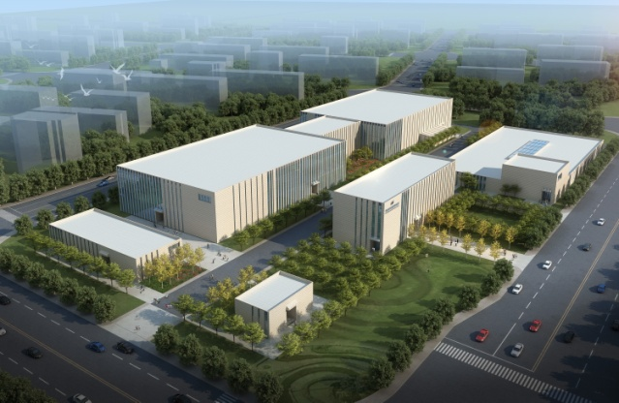
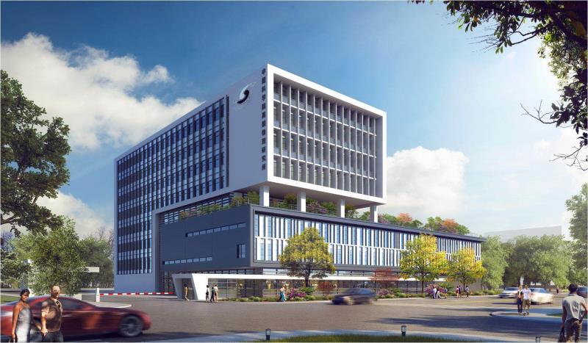
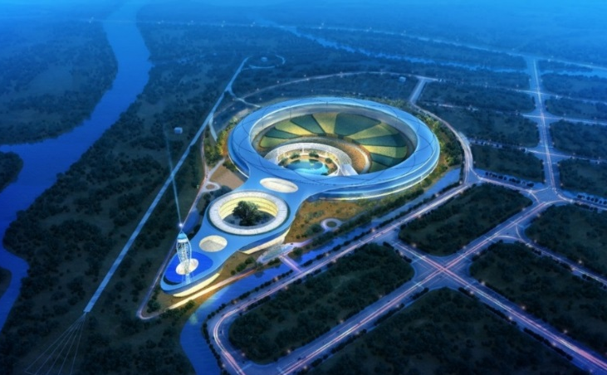
Campus Improvement
New office building in Yuquan campus completed
New laboratory under construction
in Huairou
New service building to be built
in Yuquan campus
New light source with office & labs to be constructed soon in Huairou

Slide 21
Our own assessment
In the past five years, IHEP had the following major achievements
Large Science Facilities
CSNS: Completed on schedule
Particle Astrophysics
HXMT: launched successfully
BEPCII: luminosity reached the design goal
Accelerator physics
ADS- Injector I: successfully built
Particle physics
DYB/BESIII: great results
Technology Transfer
Nanomedicine: contract signed
Our Plan has fully accomplished

Slide 22
“One-Five-Seven” Development Plan
One Development Strategy (Vision)
One of the world’s leading particle physics research centers
A world-class, large-scale, comprehensive, multidisciplinary research base
Five Major Goals in 5 years
Hadron and flavor physics——Obtain high-quality experimental data；investigate exotic states and study weak decays of charmed hadrons
Neutrino physics ——DYB: double the precision of the antineutrino oscillation measurement. JUNO: technological breakthroughs in LS, MCP-PMT, and large-scale detetor; complete the construction by 2020 and reach 3% energy resolution.
CSNS——Open to users, achieve the design value of 100 kW within three years of the national acceptance test
HXMT——Successfully launch, obtain significant scientific results
Nanomedicine——Major progress of tumor therapy using Nano-medicine, etc.
Seven Top Priorities with potential
Particle physics frontier research
Particle astrophysics and cosmology
Advanced accelerator physics and technology
Nuclear detection technology and nuclear electronics
X-ray optical technology
Applications of radiation technologies
Frontier research on nuclear energy radiochemistry and related nuclear materials

Slide 23
Contents
1
Overview of IHEP
2
International Assessment
3
Future Plan & Challenges

Slide 24
Future Plan of IHEP
Daya Bay
Particle Physics
JUNO
JUNO
BEPCII/BESIII
CEPC
CEPC
CEPC
SppC
SppC
YangBaJing
LHAASO
LHAASO
Construction
Particle
Astrophysics
HXMT
Operation
eXTP
eXTP
eXTP
Planning
HERD
HERD
HERD
Planned construction
Planned operation
AliCPT
AliCPT
Public
Platform
CSNS
CSNSII
HEPS-TF
HEPS
HEPS
Future Light Source
Advanced
Technology
ADS R&D
CiADS
ADS
2018
2020
2025
2030
2040
2050

Slide 25
Challenges: almost the same
2013
2018
Overcome difficulties of key technologies
Choose and balance different projects
Obtain sufficient funding and optimize resource allocation
Construct large facilities at remote site
Build a strong team of talents
Improve the Yuquan campus and construct a new site
Innovative, home-grown technologies
Balance different projects given limited resources
Funding and optimal allocation of resources
Construction of large facilities, some at remote sites
Teams of internationally competitive personnel

Slide 26
Summary
International assessment is very important and useful for IHEP and our projects
With all the challenges, we managed to achieve all our last 5-year goals
The future 5-year goals are even more ambitious, but the golden opportunities should not be missed
We shall try our best to overcome mentioned difficulties and achieve our goals
We are looking forward to receiving your evaluation, comments and suggestions

Slide 27
Thanks !

Slide 28
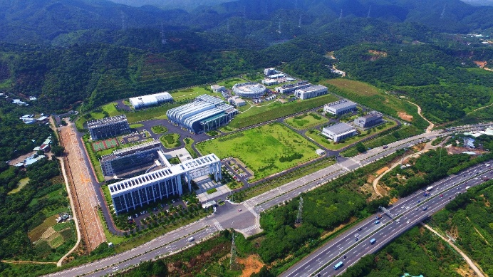
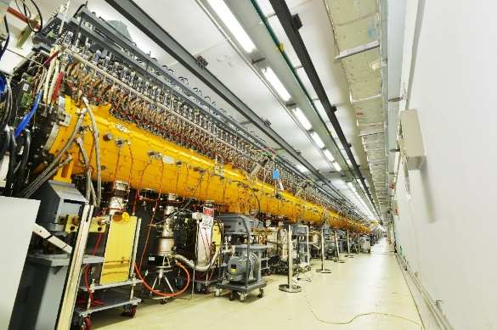
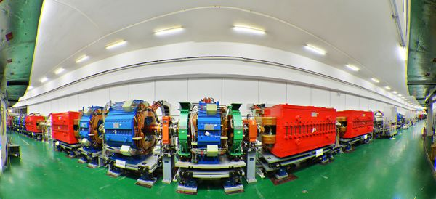
CSNS: complete on schedule
Significant achievements of last 5 years
The first high-intensity proton accelerator in China
Aerial view of csns
Drift tube linac
Rapid Cycling Synchrotron
October 2011 - Construction began
August 2017 - First neutron beam obtained from the CSNS target
March 2018 - Construction completed and facility prepared to open to users

Slide 29
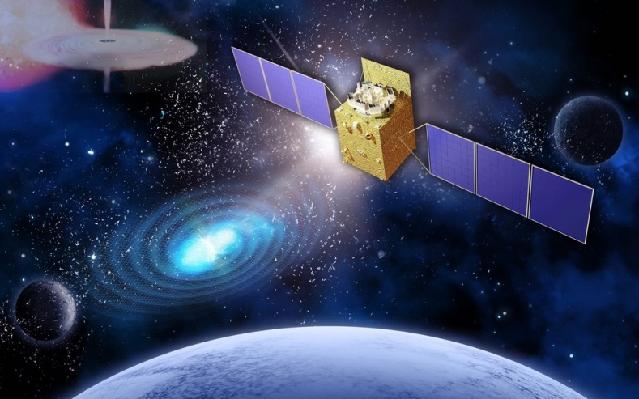
HXMT: launched successfully
Significant achievements of last 5 years
China’s first X-ray astronomy satellite
15 May, 2017，launched
30 Jan, 2018，officially handed over to IHEP for science operation
One of the most important gamma-ray burst detectors currently running
Wide energy range: 1 to 250 keV narrow field of view: 0.2-5 MeV full-sky
Contribution to gravitational wave astronomy, setting limits on the electromagnetic radiation caused by the merging of two neutron stars
Total payload mass：1021 kg
Signals：1881 channels
Power：350 W

Slide 30
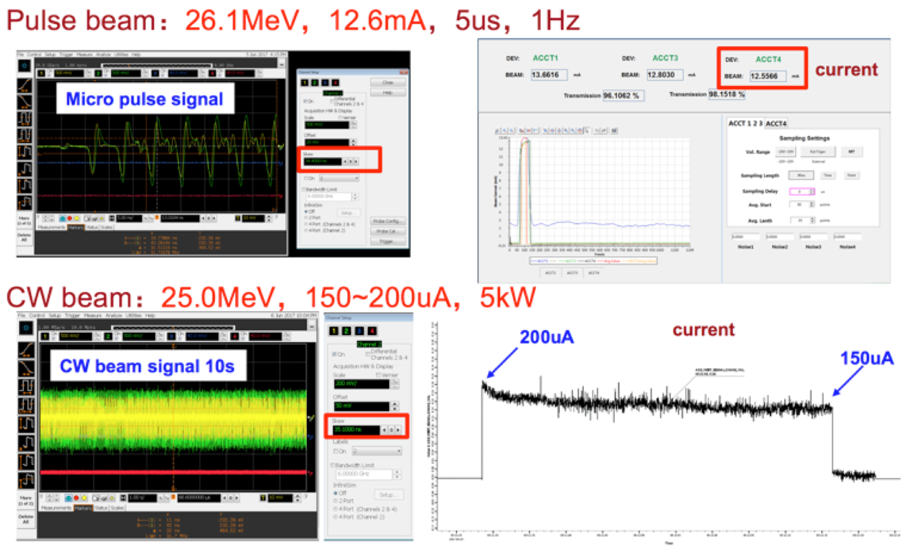
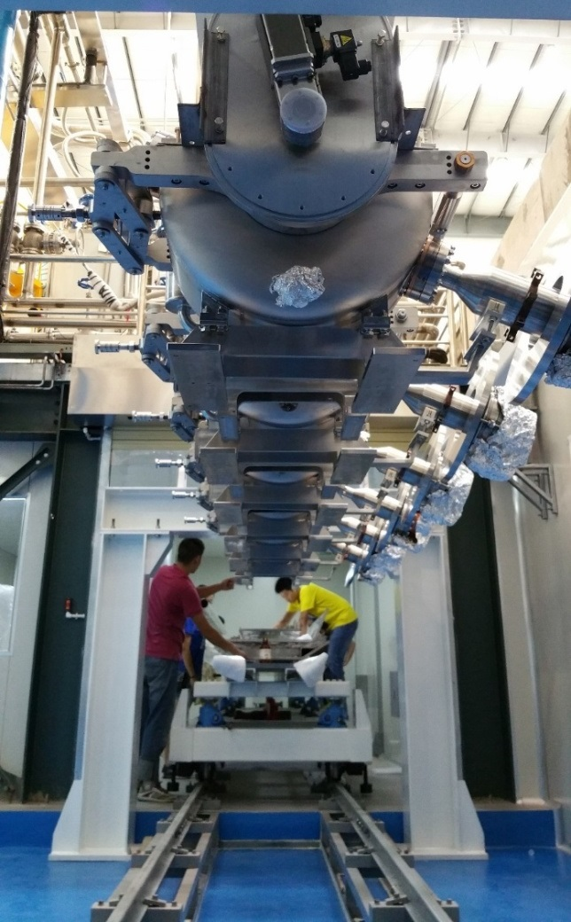
ADS- Injector I : successfully built
Significant achievements of last 5 years
The Accelerator Driven Sub-critical System (ADS) Proton Linac Injector I has been successfully built and the aims of this CAS pilot project have been accomplished.
The successful commissioning of its 25 MeV continuous beam set a new international record for this type of accelerator.

Slide 31
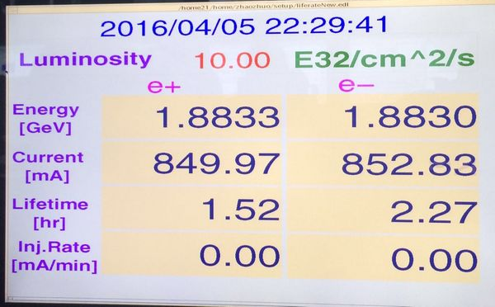
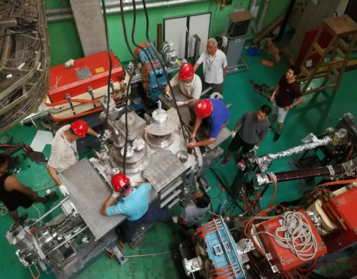
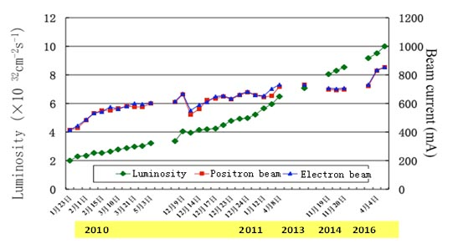
BEPCII: reached its design goal
Significant achievements of last 5 years
Significant results of 5 years
2017: a domestically-made superconducting RF cavity was installed in the electron ring, and is running well
April 5 2016: the design luminosity of 1×10^33/cm^2/s (E = 1.89 GeV) was reached
2016: awarded the First-Grade National Science & Technology Progress Award.

Slide 32
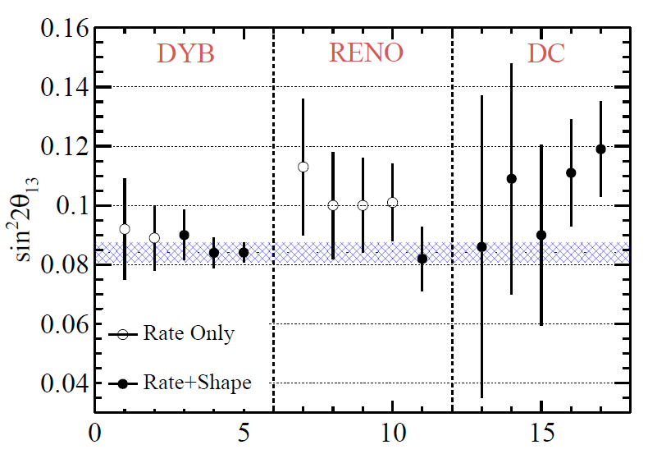
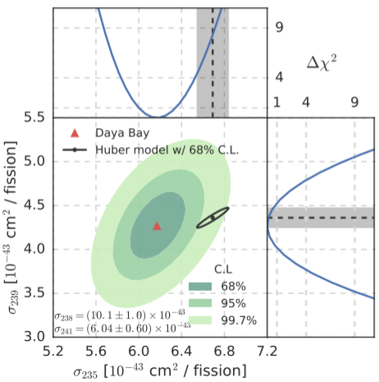
DYB: The best measurements of Theta13
Significant achievements of last 5 years
sin²2θ₁₃ results by DYB, precision much higher than similar experiments such as RENO and Double Chooz (DC)
2017, first direct observation of a change in the reactor antineutrino flux and spectrum with reactor fuel evolution
2013: first direct measurement of the neutrino mass-squared difference |Δm²_{ee}|
2015: first measurements of the flux and energy spectra
2014、2016 : set the world’s most stringent bound for the range [2×10⁻⁴, 0.3] eV²

Slide 33
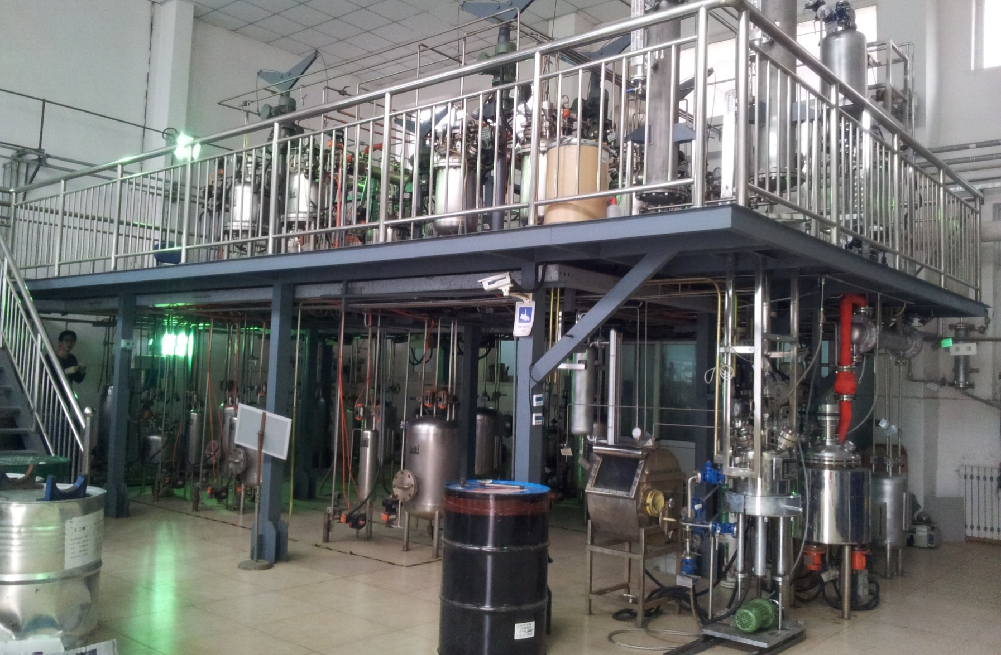
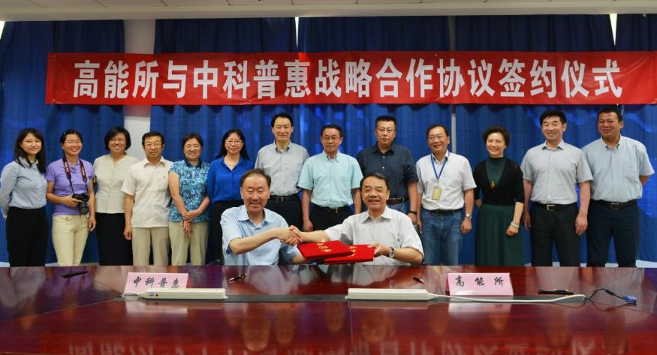
Nanomedicine：signed transfer contract
Significant achievements of last 5 years
A completely new mechanism for tumor suppression
A nano-drug production line
2017: signed transfer contract with company
Using this equipment, the production cost is reduced by more than 50%, allowing the industrial-scale synthesis of metallofullerenol nanomaterials
60+ high quality fundamental research papers: Nature Communications, Nature Biotechnology, PNAS, Acc. Chem. Res., etc
granted patents: China, the United States, Germany, Britain, France, other European Union countries, Japan

Slide 34
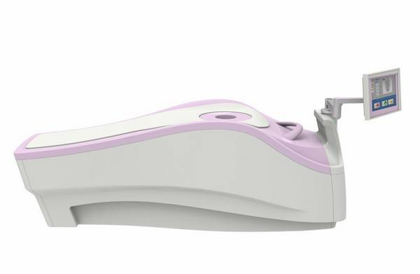
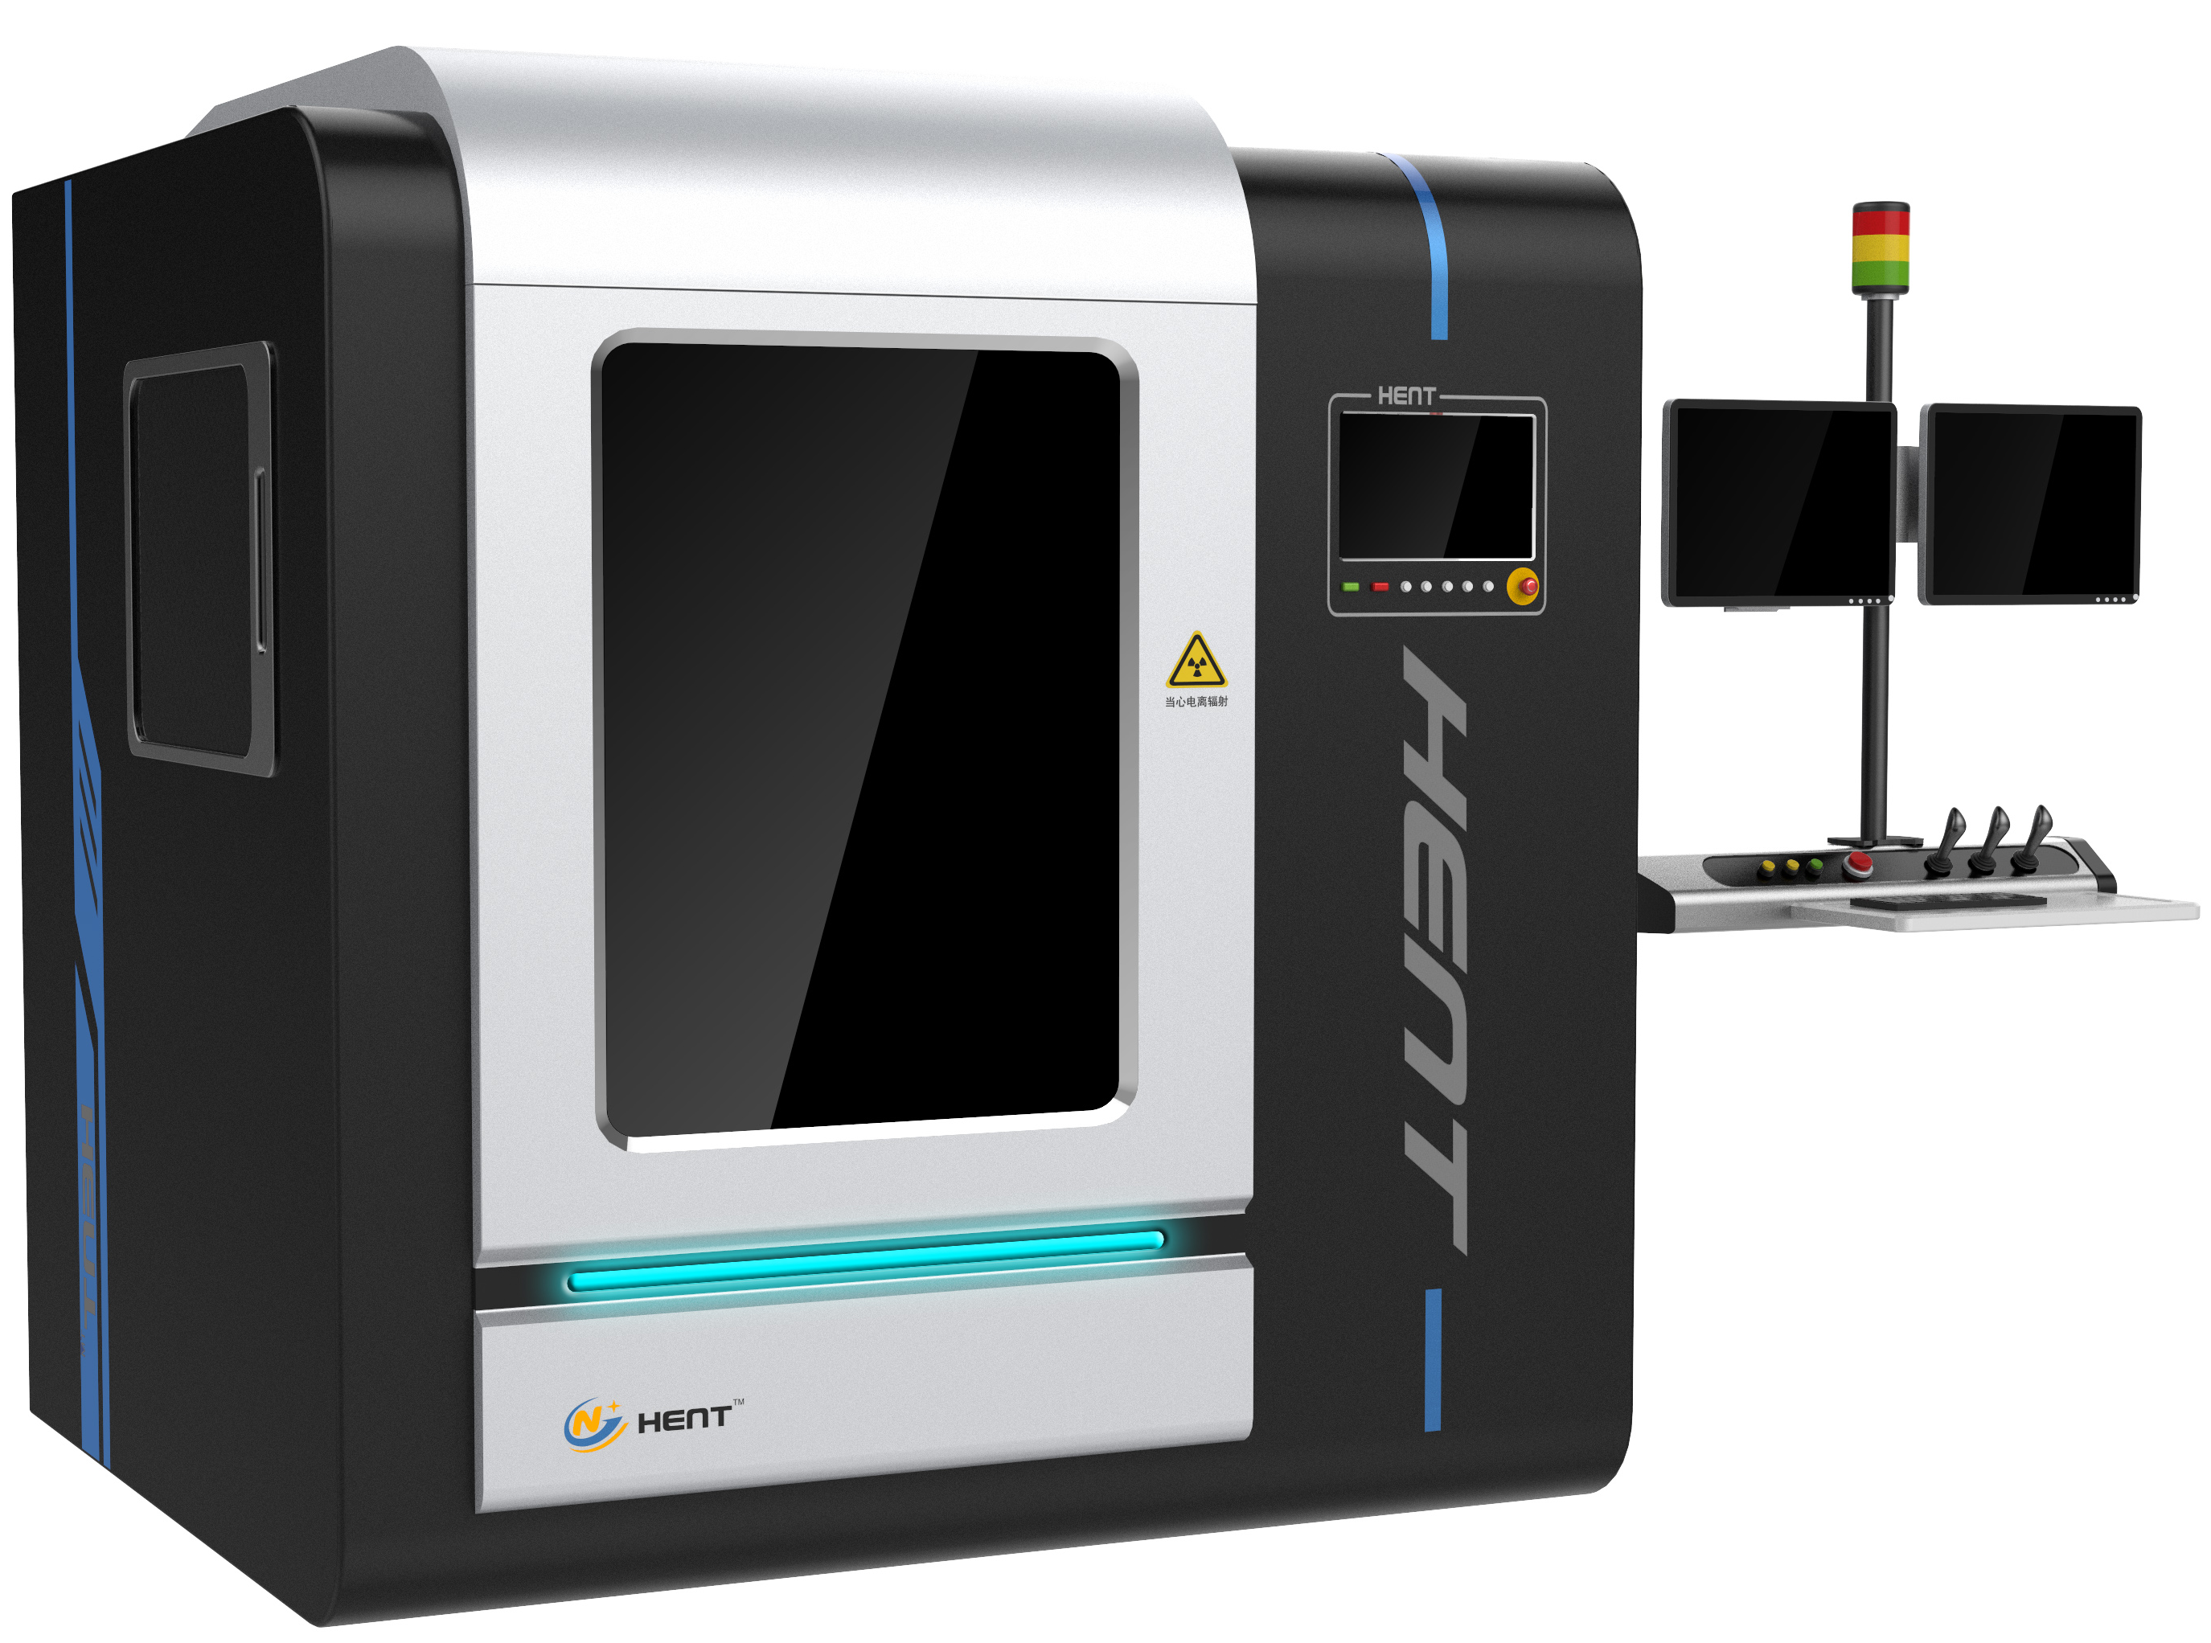
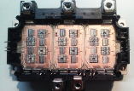
Application and Technology Transfer
Significant achievements of last 5 years
Nuclear medical imaging equipment (PEM) for the diagnosis of breast cancer
X-ray three-dimensional computer laminography imager (CL)
Supported by the Ministry of Science and Technology’s key R&D program
Achieved significant scientific results in paleontological research
Applied in the electronic circuits and IC chip industries.
Partnering with industrial companies to develop commercial products
Received Category III Medical Equipment certification from the China Food and Drug Administration (CFDA)
Has achieved sales

Slide 35
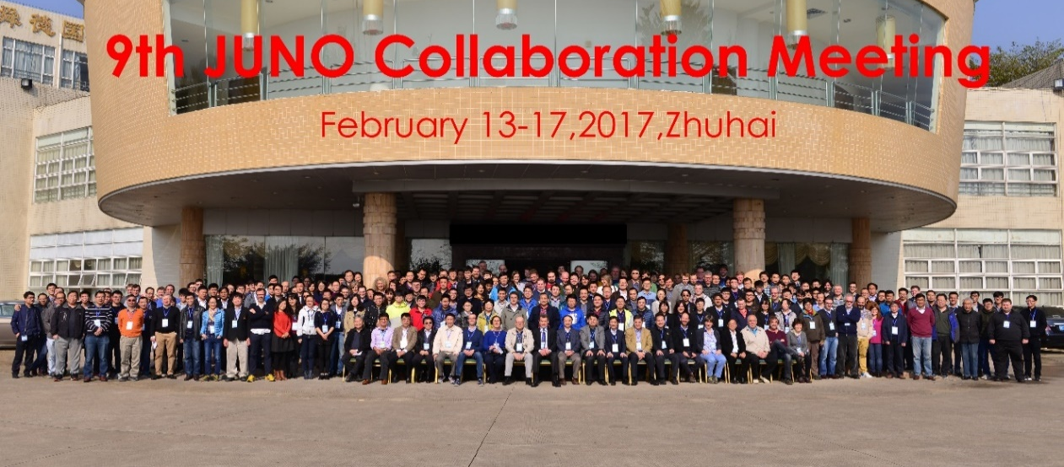
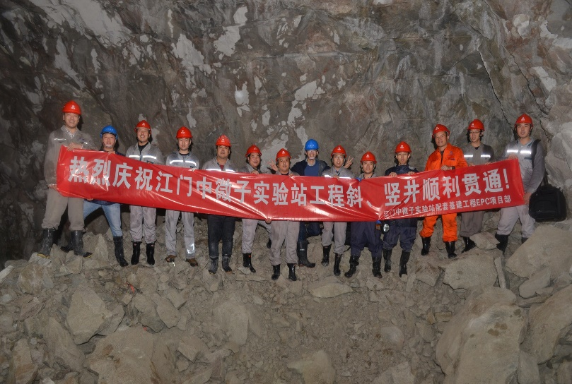
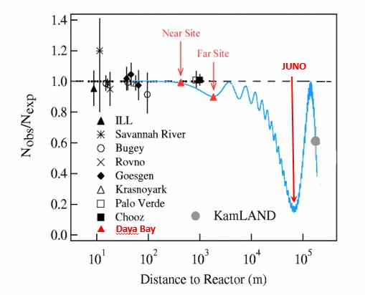
Neutrino physics
Important progress
A new type of 20-inch PMT for JUNO, based on MCPs, has been invented, with world-leading performance.
580 collaborators from 72 institutions in 17 countries and regions
Will start data taking in 2021
Determine θ₁₂, Δm²₂₁, and |Δm²_{ee}| to a precision of 1%
Determine the mass hierarchy to 3-4 σ.
2017: inclined shaft and vertical shaft fully completed

Slide 36
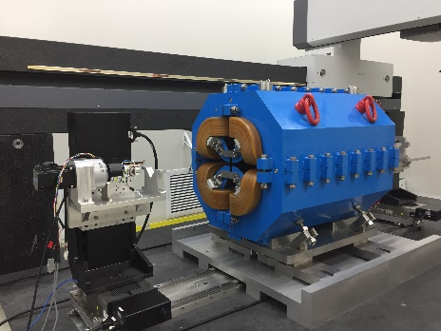
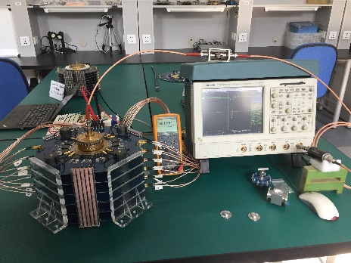
High Energy Photon Source
Important progress
HEPS-TF critical technology research for the accelerator going well
6 GeV, ~1300 m storage ring
Emittance: 0.06 nm·rad
Brilliance: >10²² phs/s/mm²/mrad²/0.1BW
R&D mostly completed, construction will begin in 2018
14 beam lines and corresponding experiment stations will be built
(top left) high gradient quadrupole; (bottom left) fast pulse kicker power supply; (right) 166.6 MHz proof-of-principle superconducting RF cavity.

Slide 37
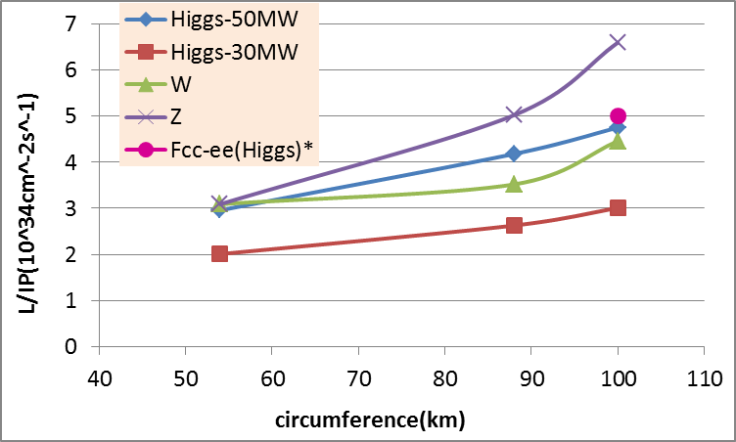
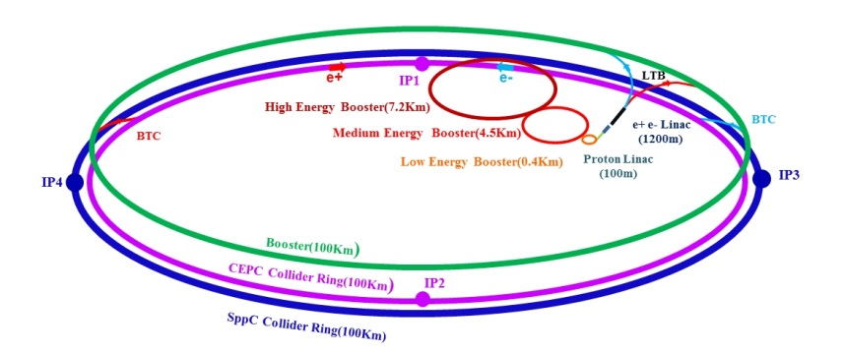
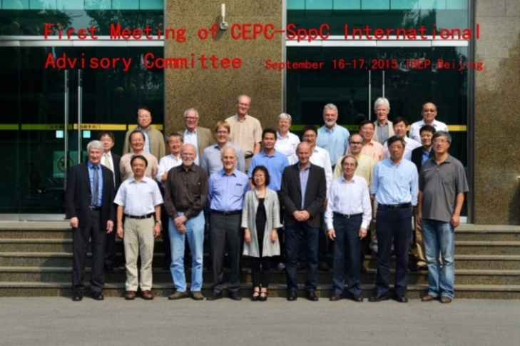
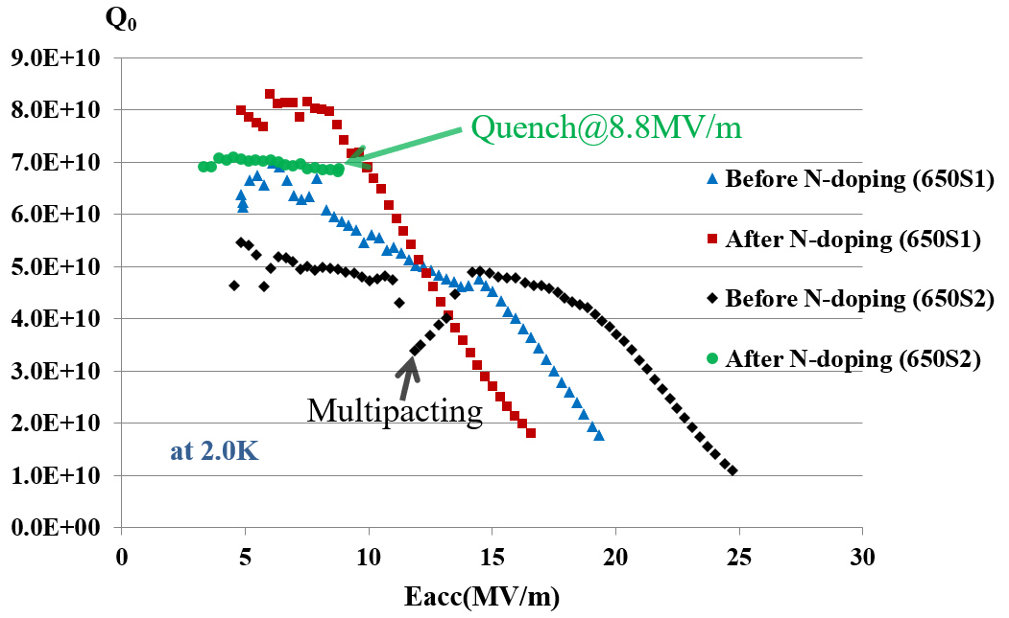
CEPC+SppC
Important progress
× 2 detectors
ILC，×1 detector
CEPC target
The CEPC IAC was established in 2015.
Three annual IAC meetings have been held at IHEP
2017: more than 40 companies have established the CEPC Industry Promotion Association
Nov. 2017: CEPC Industrial Promotion Consortium (CIPC) established at IHEP
Apr. 2017: CEPC-SppC Progress Report on accelerator published
2018: CEPC CDR will be delivered
CEPC 650 MHz nitrogen-doped cavity

Slide 38
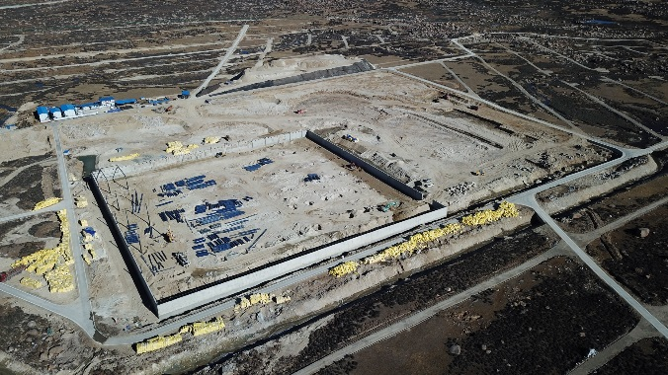
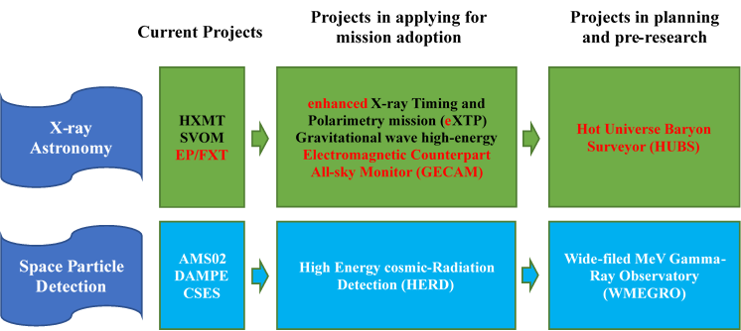
Astroparticle physics and astrophysics
Large High Altitude Air Shower Observatory
Cosmic-ray physics and γ-ray astronomy
Altitude ~4410 m, in Sichuan Province
International collaboration: China, France, Italy, Thailand…
Started construction in 2016

Slide 39
IHEP FUNDING (Unit: MCNY)
 | Item | 2013 | 2014 | 2015 | 2016 | 2017 | 2013-2017 Total | 2008-2012
Institute Operation | Institute operation from CAS | 243 | 270 | 357 | 457 | 396 | 1723 | 847
 | Staff costs | 181 | 202 | 278 | 400 | 363 | 1424
 | General operational costs | 62 | 68 | 79 | 57 | 33 | 299
Project Funding | Other income | 88 | 74 | 100 | 59 | 63 | 384 | 204
 | Funding for large facility operation | 154 | 131 | 160 | 168 | 183 | 796 | 595
 | Operation of BEPCII | 129 | 114 | 130 | 127 | 143 | 643
 | Operation of Daya Bay | 12 | 11 | 13 | 13 | 12 | 61
 | Basic research expenses | 13 | 6 | 17 | 28 | 28 | 92
 | Competitive funding for Research | 340 | 414 | 341 | 358 | 398 | 1851 | 1030
 | Ministry of Science and Technology projects | 23 | 27 | 30 | 125 | 82 | 287
 | National Natural Science Foundation of China projects | 57 | 88 | 86 | 100 | 75 | 406
 | Chinese Academy of Sciences projects | 125 | 199 | 97 | 92 | 160 | 673
 | Other project funding obtained through competition | 135 | 100 | 128 | 41 | 81 | 485
 | Competitive funding for construction of large facilities | 481 | 562 | 377 | 588 | 672 | 2680 | 1097
 | CSNS | 400 | 412 | 100 | 250 | 133 | 1295
 | Multi-disciplinary platform construction |  | 60 | 60 |  |  | 120
 | JUNO | 36 | 55 | 113 | 106 | 227 | 537
 | Other infrastructure projects |  |  | 17 | 40 |  | 57
 | HEPS-TF |  |  |  | 174 | 145 | 319
 | LHAASO |  |  |  |  | 100 | 100
 | PAPS |  |  |  |  | 67 | 67
 | ADS | 45 | 35 | 87 | 18 |  | 185
 | Total | 1306 | 1451 | 1335 | 1630 | 1712 | 7434 | 3773

