Slide 1
IHEP Space Programs
XIONG Shaolin
Institute of High Energy Physics
Jun. 13 , 2018
International assessment 2018

Slide 2
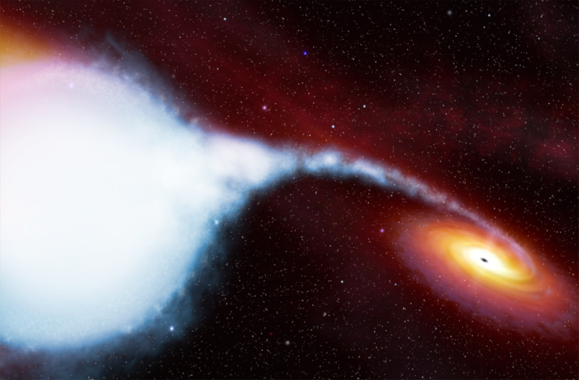
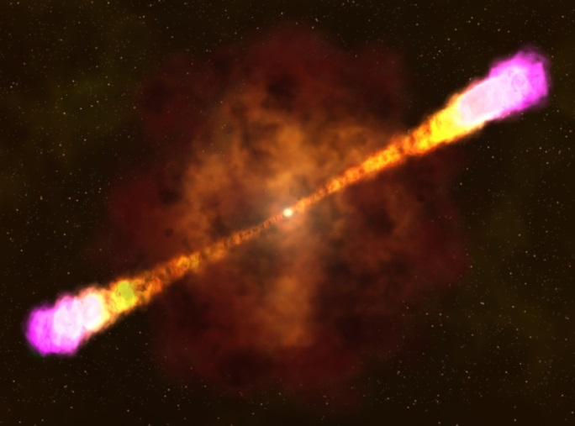
Vision & Scientific Objectives
Origins, properties and evolution of the cosmos, galaxies, and stars
Fundamental laws of physics in extreme conditions (gravity, density, magnetic field…)
Compact Objects
  Black Holes (BH), Neutron Stars (NS)
  GRB, XRB, Pulsars, …
  GW Electromagnetic Counterparts
Galaxy and Universe
  Active Galactic Nuclei (AGN)
  Galaxy Clusters, IGM
Cosmic Rays, Dark Matter

Slide 3
Roadmap for Space Programs
Roadmap for space-based high energy astrophysics:
Current Projects
Projects applying for mission adoption
Projects in planning and pre-research for mission adoption
Insight-HXMT
SVOM/GRM
EP/FXT
Enhanced X-ray Timing and Polarimetry mission (eXTP)
Gravitational wave high energy Electromagnetic Counterpart All Sky Monitor (GECAM)
Hot Universe Baryon Surveyor (HUBS)
X-ray Astronomy
Space Particle Detection
AMS02
DAMPE
CSES
HERD (High Energy cosmic-Radiation Detection)
Wide-field MeV Gamma-Ray Observatory (WMEGRO)
*Operating/Approved *Proposed/Planned

Slide 4
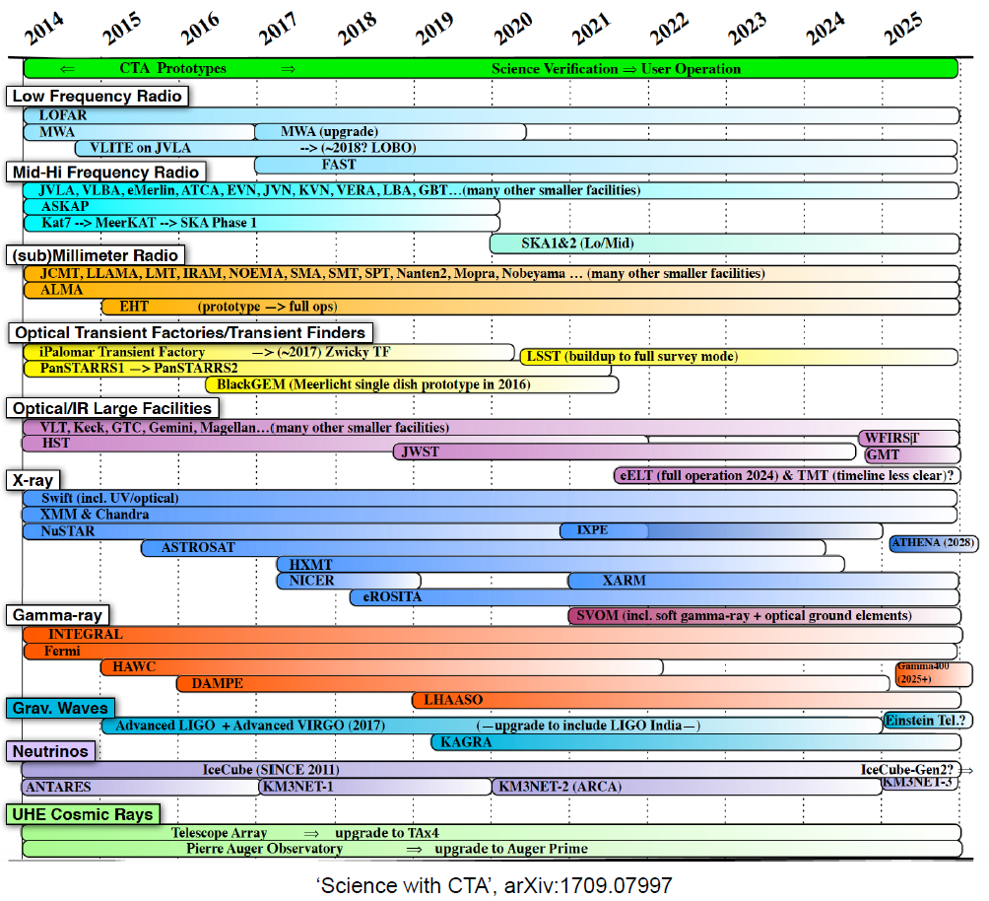
IHEP is
a key
player!
HXMT
GECAM
POLAR
EP
eXTP
HERD

Slide 5
Leaders, Manpower & Funding (2013-2017)
Mission | Leaders (Generation/Age) | Manpower (FTE) | 5-year Funding (approved) (MCNY)
Insight-HXMT | Prof. LI Tipei (78) Prof. ZHANG Shuang-Nan (55) Prof. LU Fangjun (49) Prof. SONG Liming (54) | 58.9 | 300
POLAR | Prof. ZHANG Shuang-Nan (55) | 6.1 | 20
DAMPE /STK | Prof. WANG Huanyu (63) Prof. PENG Wenxi (35) | 7.3 | 70
EP/FXT | Prof. CHEN Yong (48) | 3.1 | 9 (140)
SVOM /GRM | Prof. WU Bobing (50) Prof. DONG Yongwei (37) | 5.5 | 40
GECAM | Prof. XIONG Shaolin (35) | 3.6 | 10 (110)
eXTP | Prof. ZHANG Shuang-Nan (55) Prof. LU Fangjun (49) Prof. XU Yupeng (47) | 6.5 | 16 (260)
HERD | Prof. ZHANG Shuang-Nan (55) Prof. DONG Yongwei (37) | 6.3 | 20

Slide 6
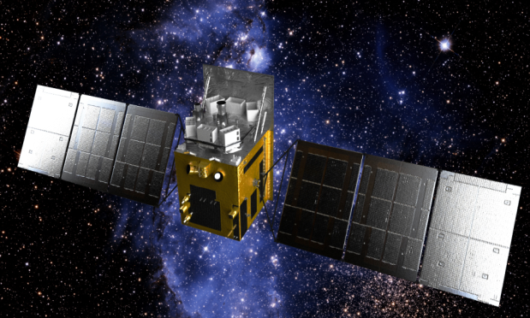
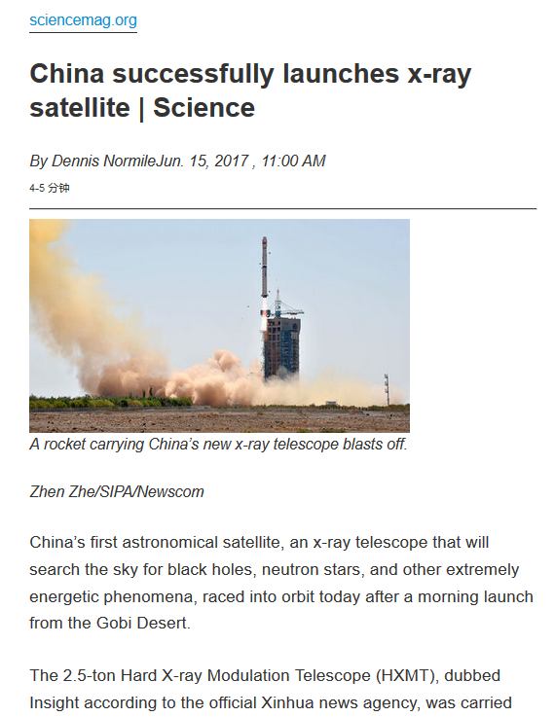
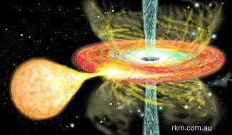
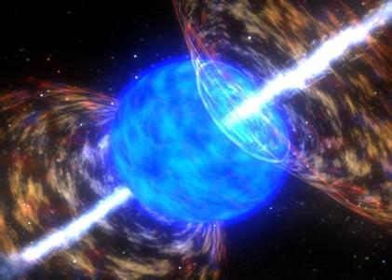
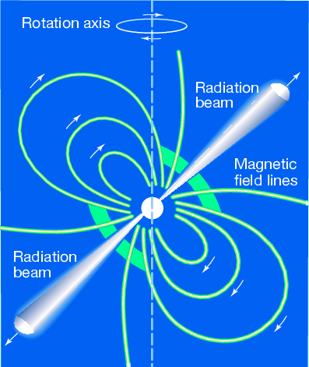
Insight-HXMT
The 1st X-ray observatory in China!
Science: BHs, NSs, XRBs, Pulsars, GRBs…
Observation modes
  Survey observation for new transients
  Pointed observation of known sources
    Gamma-ray monitoring (0.2-5 MeV)
Features:
  Large effective area
  High temporal resolution
  Wide energy band (1 keV- 250 keV)

Slide 7
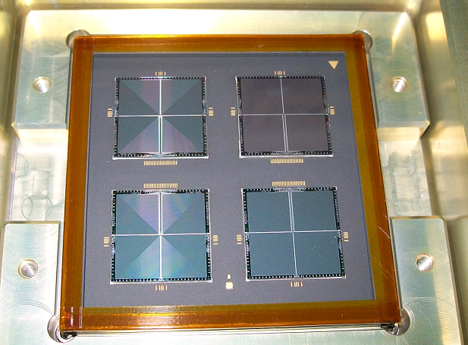
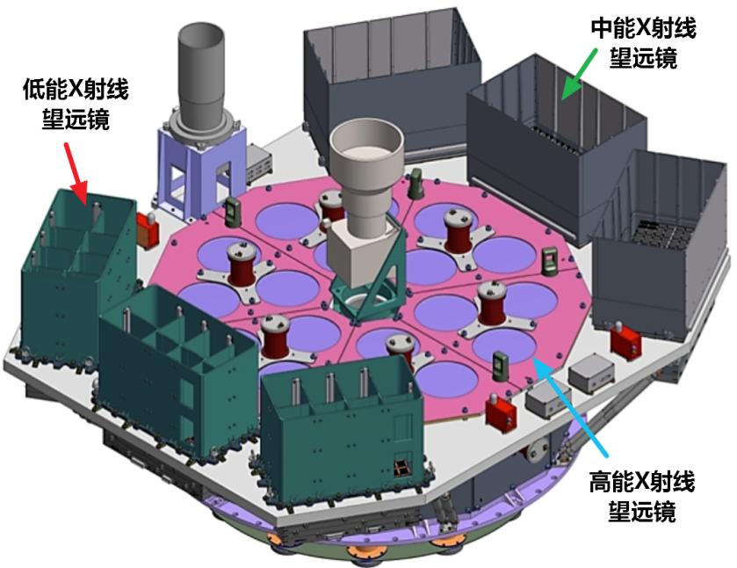
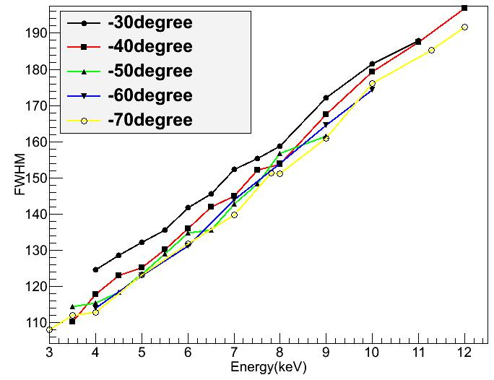
Insight-HXMT
Collimator-based telescopes + Direct Demodulation Imaging
Payload
  HE: NaI/CsI (20-250 keV). Extended to monitor GRB in MeV range
  ME: Si-PIN (5-30 keV)
  LE: SCD (1-15 keV, 140 eV@5.9 keV) Energy resolution theoretical limit
Low Energy Telescope
LE
Medium Energy Telescope
ME
SCD
High Energy Telescope
HE
LE
Energy
Resolution

Slide 8
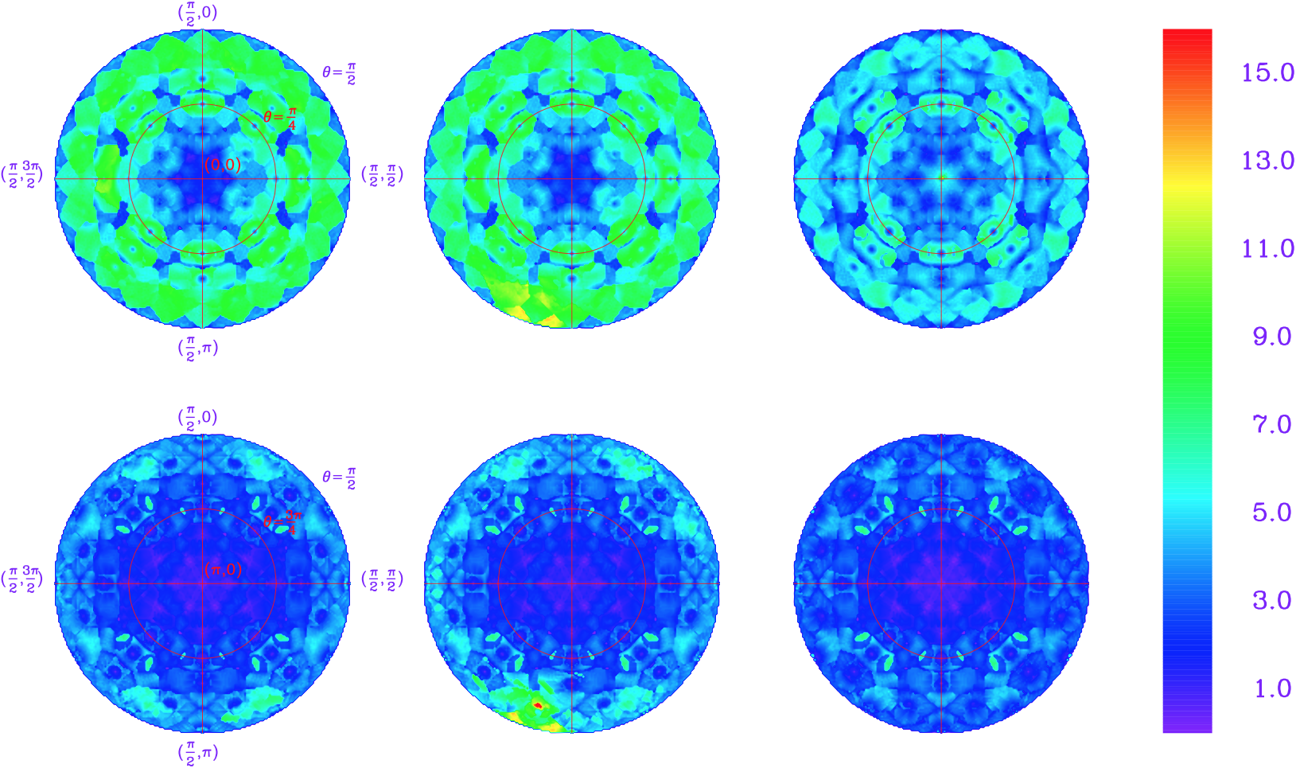
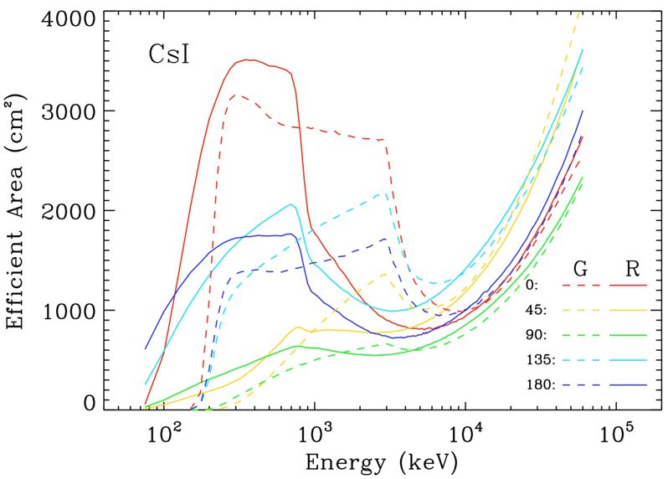
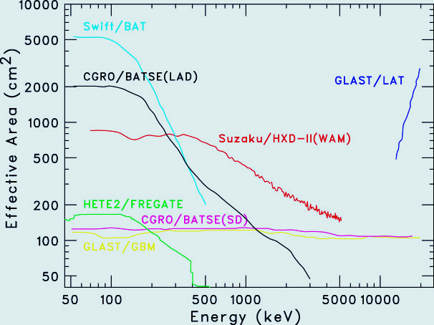
Largest GRB monitor in MeV
Eff. Area > 1000 cm²
Timing, microsecond
Spectrum, Localization
Discovery rate ~100 GRB/year!
Fluence = (4, 2, 1) x 10⁻⁵ erg cm⁻²，T = 10 s
HXMT

Slide 9
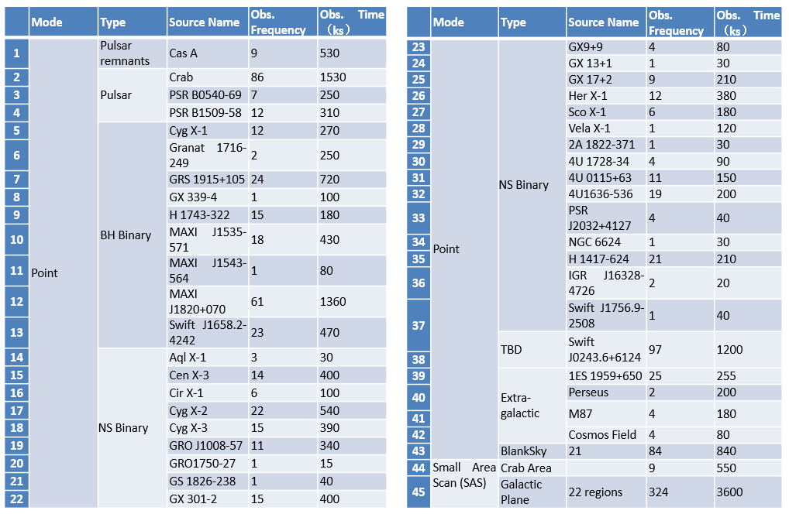
Observation Catalogue（as of 2018.5.31）

Slide 10
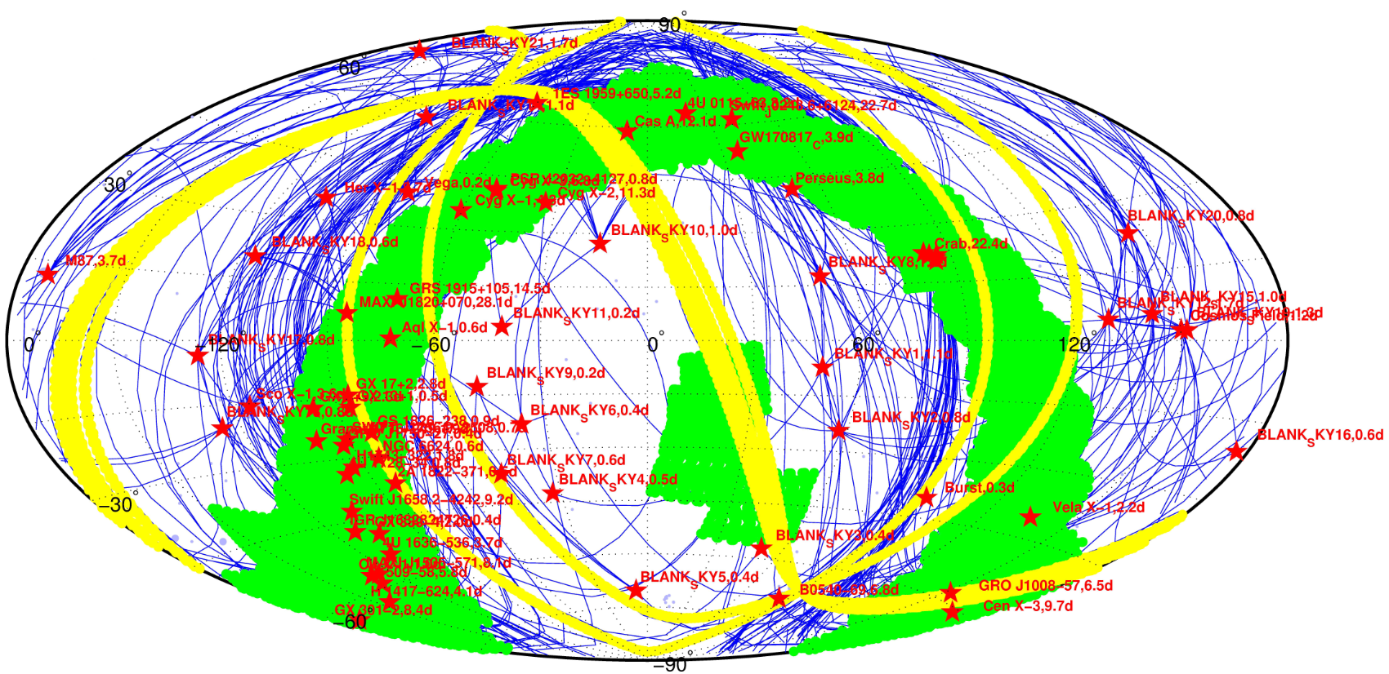
Observation Map （as of 2018.5.31）
Stars: Pointed Observations
Green Regions : Small Area Scanning
Blue lines: Tracks between different pointed Obs.
Yellow band: Testing of the All-Sky Survey Obs.

Slide 11
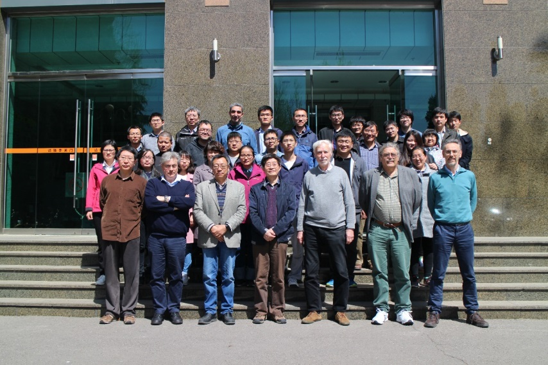
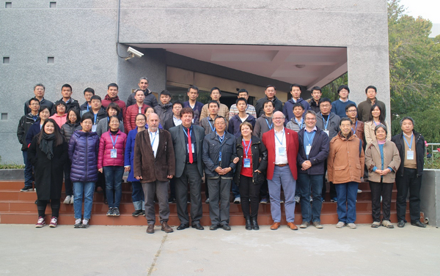
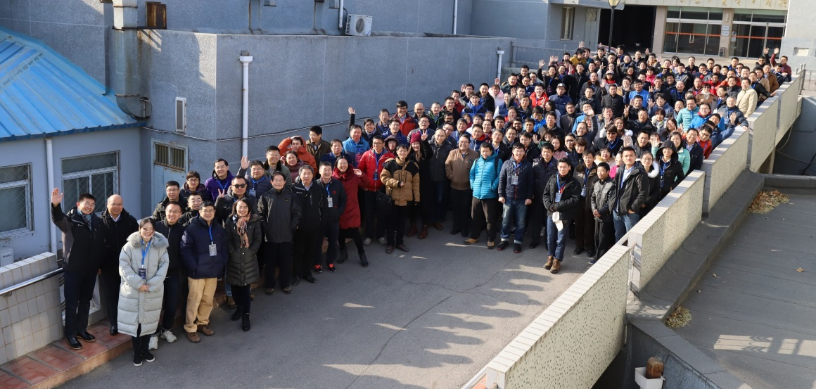
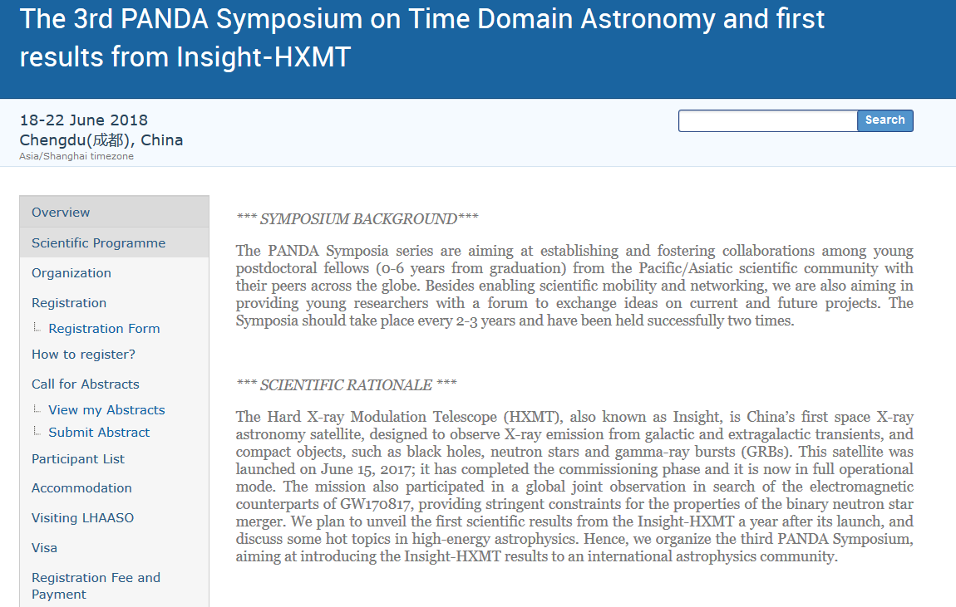
Conferences
HXMT International workshops (2017.11, 2018.4, 2018.6)
HXMT Users’ Meeting (>200 scientific users from tens of institutions)
2nd International workshop
On calibration and science
（2018.4）
International workshop
（2017.11）
The 1st Insight-HXMT Users Meeting
（2018.1.8）

Slide 12
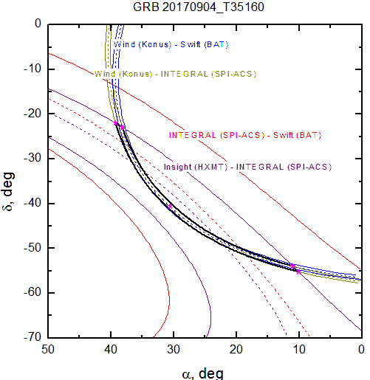
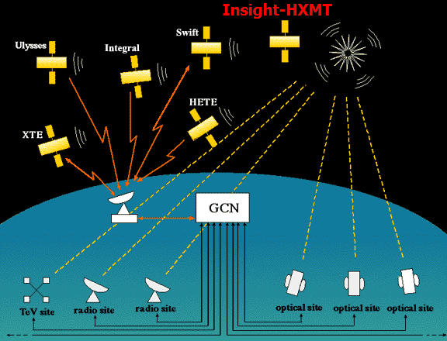
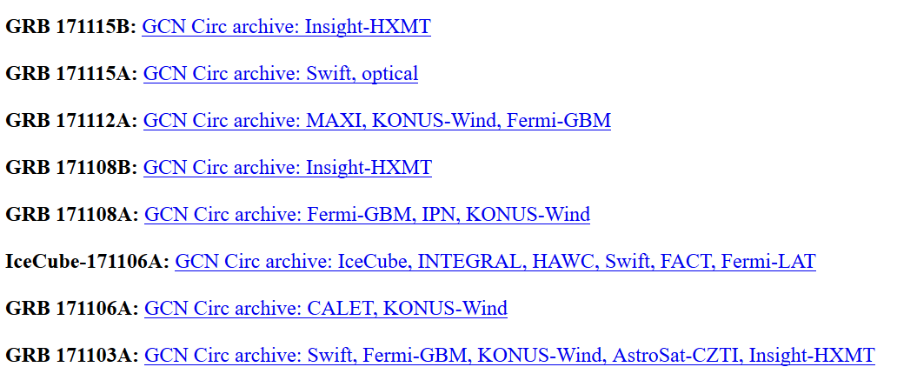
International Collaborations
Member of LV-EM global follow-up team
Joint observations: DWF, NuSTAR, Swift…
Important member of the IACHEC (International Astronomical Consortium for High Energy Calibration)
Very active in the astronomy community: Atel, GCN, IPN
Gamma-ray burst Coordinates Network
Inter-planetary Network

Slide 13
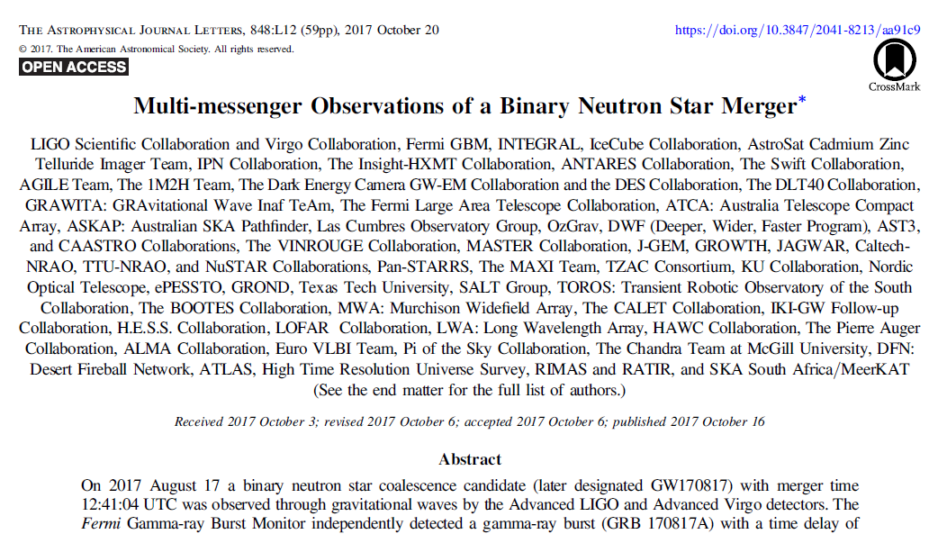


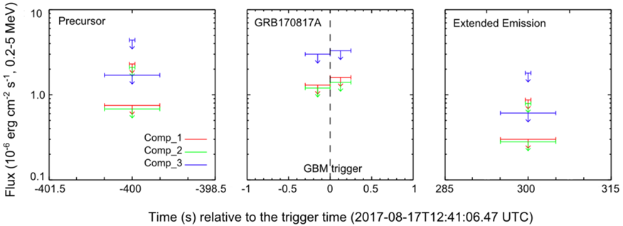
Insight-HXMT Highlights
Participated in the observation of the first BNS GW event (GW170817), provided the most stringent upper limit in MeV.
Joined the multi-messenger discovery paper of GW170817
Published in Li T.P. et al., 2018, Science China

Slide 14
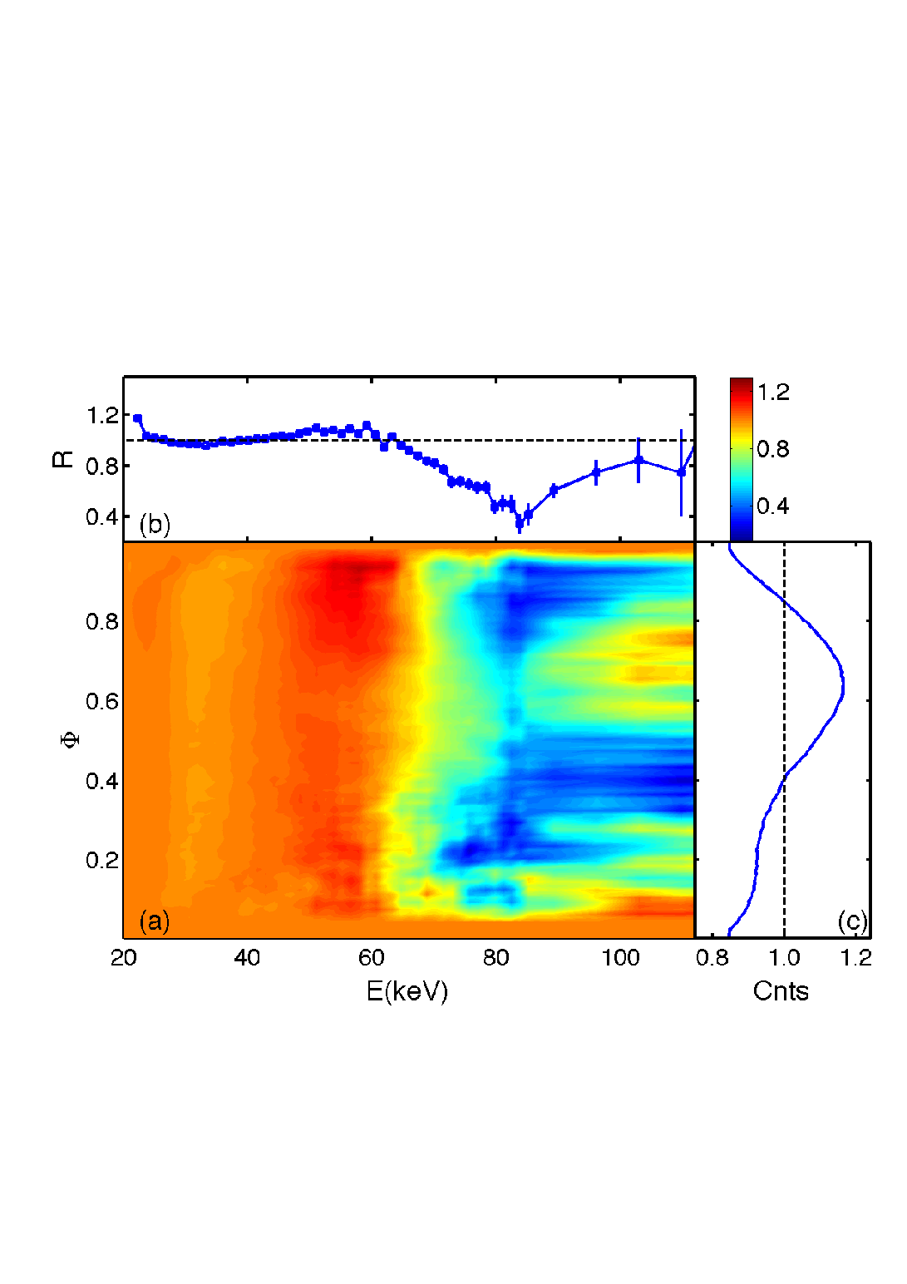
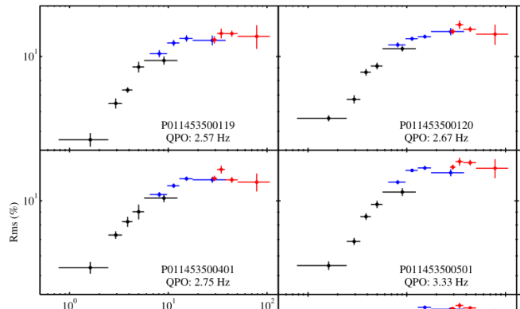
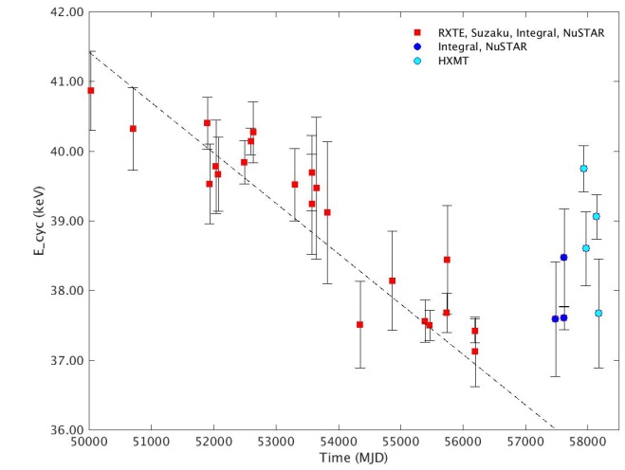
Insight-HXMT Highlights
Discovered the strongest magnetic field in the universe: 80 keV cyclotron absorption line → ~10¹³ Gauss.
Confirmed the increase of the centroid energy of the cyclotron absorption line of Her X-1 after about ~20 years of decrease.
Observed Quasi-Periodical Oscillation (QPO) phenomena of Black Hole X-ray binaries at energies up to 100 keV, and RMS saturation above 20 keV
MAXI J1535-571
Spectra of neutron star X-ray binary GRO J008-57 at different phases/pulsed spectrum of the Crab pulsar
Evolution of the cyclotron absorption line of Her X-1
90 proposals covering 348 celestial sources from 16 institutes, colleges and universities, with a total demand for nearly 7 years of observation!

Slide 15
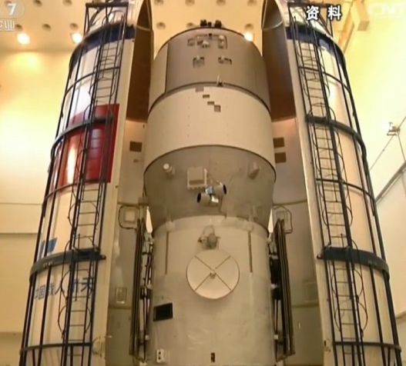
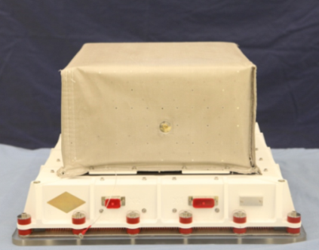
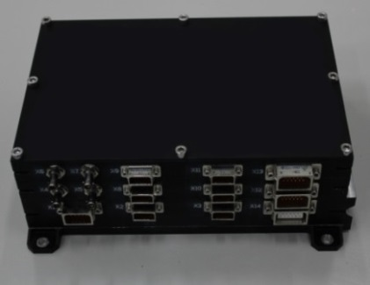






POLAR: a dedicated GRB polarimeter
China-Europe collaboration space program, one of the most important scientific experiments on board China’s Space Lab.
Operation period: Sept. 15, 2016 to Mar 31, 2017
The most sensitive GRB polarimeter ever flown!
  MDP (minimum detectable polarization) ~ 6%
POLAR
On TG-2
Detector
Electronics

Slide 16
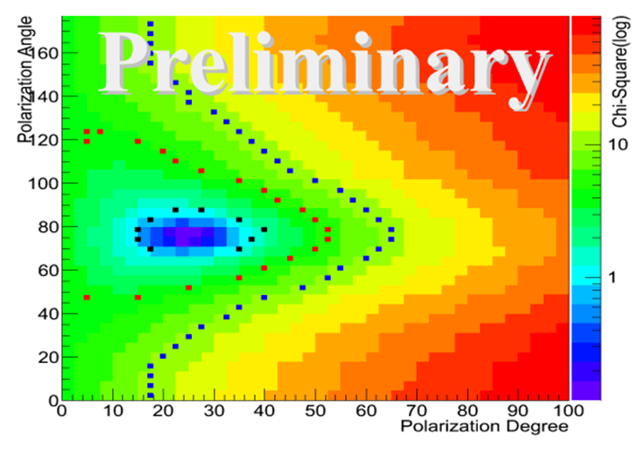
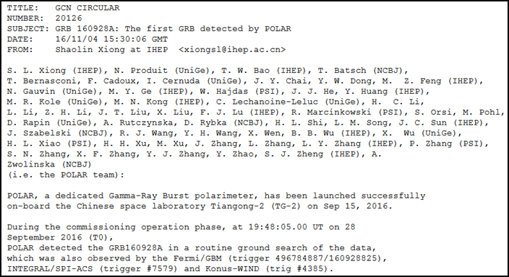
POLAR Highlights
Detected 55 GRBs, with a detection rate~150 GRB/year, showing that POLAR is one of the most sensitive GRB monitors!
Finished the FIRST X-ray pulsar navigation experiment in China.
Important results on GRB polarization will be published soon
Publications (2013-2018)
Peer-reviewed papers: 13
Proceedings: 5
Polarization measurement of GRB
POLAR published the China’s 1st GCN Circular for discovery of GRB on Nov 4, 2016.

Slide 17
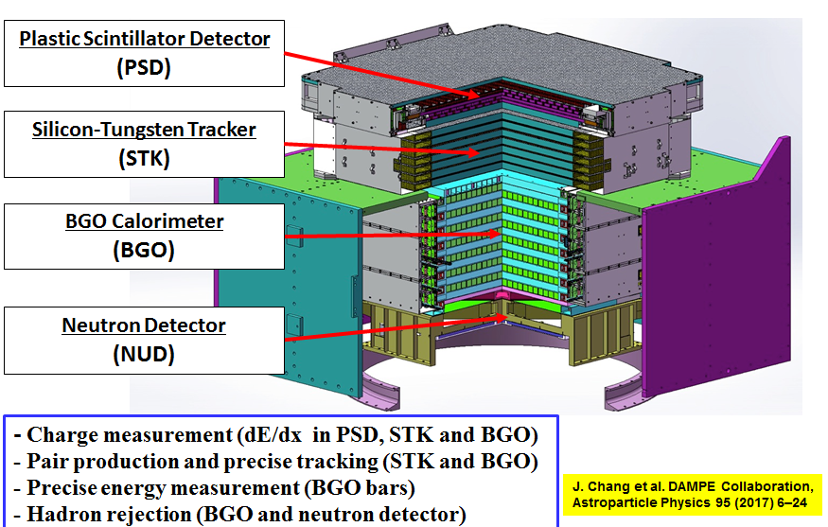
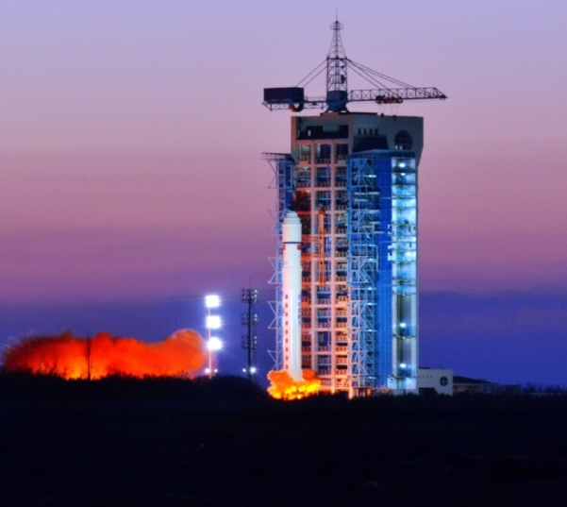
DAMPE (Dark Matter Particle Explorer)
China’s first astronomical satellite, launched on Dec. 17th, 2015.
IHEP led an international collaboration team (IHEP, INFN and UniGE) to successfully develop the Silicon-Tungsten tracKer-converter (STK), one of the major payloads, in a very short time (2013~2015).
To date, the performance of STK has been very stable

Slide 18
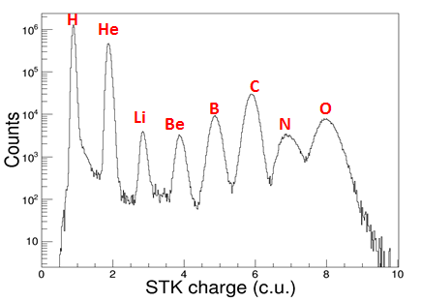
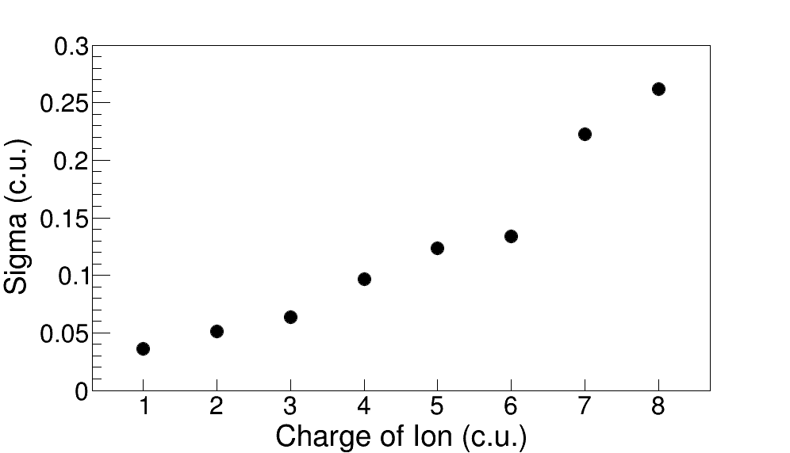
IHEP Contribution to DAMPE
(1) STK charge reconstruction
The IHEP team developed a new algorithm to reconstruct the charge of cosmic-ray heavy ions and achieved the best charge resolution for the STK in the DAMPE collaboration.

Slide 19
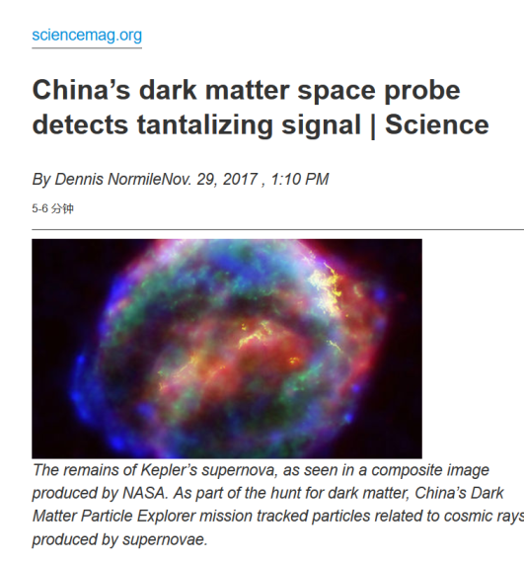
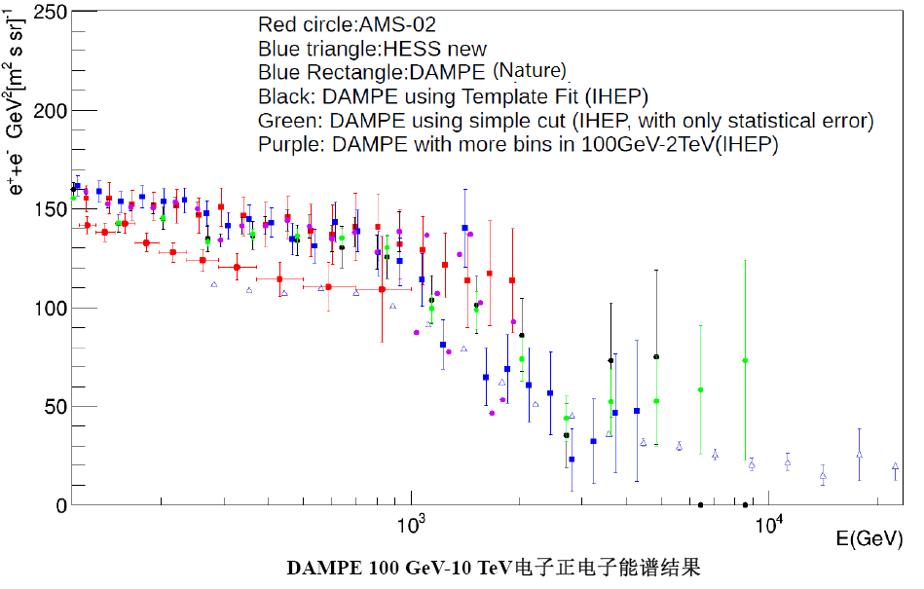
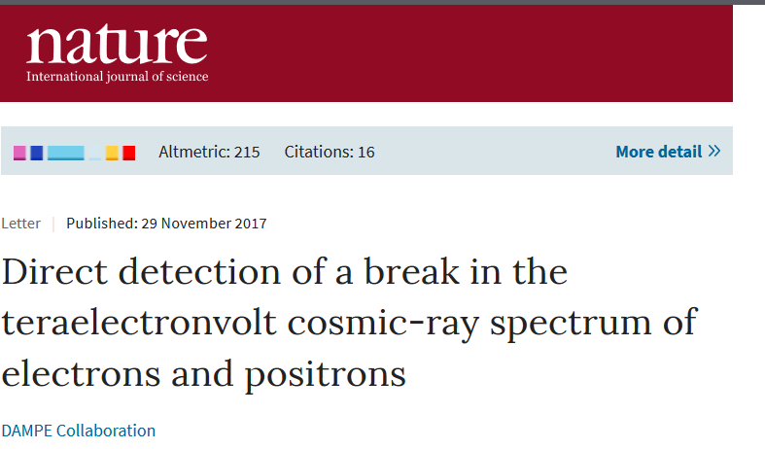
IHEP Contribution to DAMPE
(2) Electron spectrum reconstruction
The DAMPE collaboration published its first science results on Nov. 30th 2017 in Nature, presenting the precise measurement of cosmic ray electron flux, especially a spectral break at ~0.9 TeV.
In this work, the IHEP team provided an independent result based on a machine-learning method (BDT), which was consistent with the published result.

Slide 20
Future Missions
Achievements in the past 5 years (2013-2017)
Missions Approved:
  IHEP-participated missions: SVOM/GRM, EP/FXT
    Engineering model, space qualified model
  IHEP-led missions: eXTP (Flagship mission)
    Concept and prototype study
  IHEP-led missions: GECAM (Mission of Opportunity for GW EM)
    Concept and prototype study
Missions Under Review:
  IHEP-led missions: HERD (Flagship mission)
    Concept and prototype study
    Ready for approval!

Slide 21

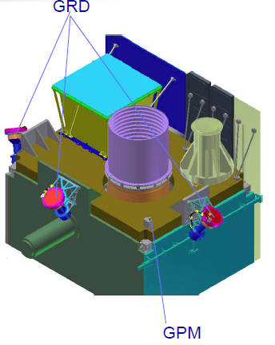

SVOM (Space Variable Object Monitor)
GRM
VT
30 keV-5 MeV
400-650 nm, 650-950 nm
MXT
Eclairs
0.3-5 keV
4-250 keV
450-900 nm
400-1700 nm
GWAC
GFTs

Slide 22
IHEP Contribution to SVOM
 | Spectral band | Field of View | Location Accuracy | GRBs/yr (Dect. Rate)
GRM | 30 keV-5 MeV | 2 sr | 2-5 deg | ~80
ECLAIRs | 4-250 keV | 2 sr | 10 arcmin | ~70
MXT | 0.3-5 keV | 65× 65 arcmin | 30 arcsec | ~90%
VT | 400-650 nm 650-950 nm | 26 × 26 arcsec | 1 arcsec | ~80%
IHEP is in charge of the development of the GRM
2013-2018: Engineering model and space qualified model
Expected Launch Date: 2021

Slide 23
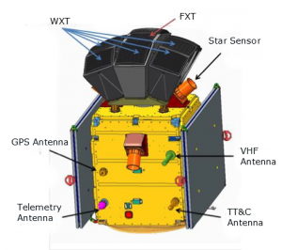
The Einstein Probe (EP) Mission
First mission to use lobster-eye optics to monitor transients in the soft X-ray band
Proposed in 2012, selected at the end of 2017
Launch date: 2022
Mission Features
Very wide FoV 1.1 sr (3600 sq. deg.) grasp: ~10,000 deg².cm²
Good angular resolution (~5’) and positioning accuracy (<1’)
Soft X-ray band: 0.5-5 keV
Sensitivity: >1 order of magnitude higher than current telescoeps
Autonomous X-ray follow-up (<10 arcsec localisation)
Fast alert data downlink and fast uplink for ToO (TBC)
Notes:
So, the Einstein Probe, or EP.
The Einstein Probe is a small mission for all-sky monitoring to discover and study
high-energy transients and variable objects in the soft X-ray band.
It was proposed in 2012, and is managed in the space science programme of the CAS.
I list here the main features of the EP mission.
It has a large FoV of 3600 square degree, or 1.1 steradian.
This gives an enormaous grasp of nearly 10,000 square degree square cm, which is the
Largest among X-ray telescopes with focusing optics.
It has a good angular resolution of about 5 arcmin, and source positioning accuracy of 1armin or less.
EP operates in the 0.5-5keV soft X-ray band.
It has a high sensitivity, one order of magnitude or more sensitive than the monitors currently in orbit.
EP has the capability of autonomous follow-up observations in X-rays, leading to 10 arcsec positioning accuracy.
Once an transient source is detected by the on-board computer, alert is triggered and the source information
are quickly transmitted down to the ground station.
It may also have the ability to send ToO requests quickly from ground up to the satellite to perform
Fast ToO observations.

Slide 24
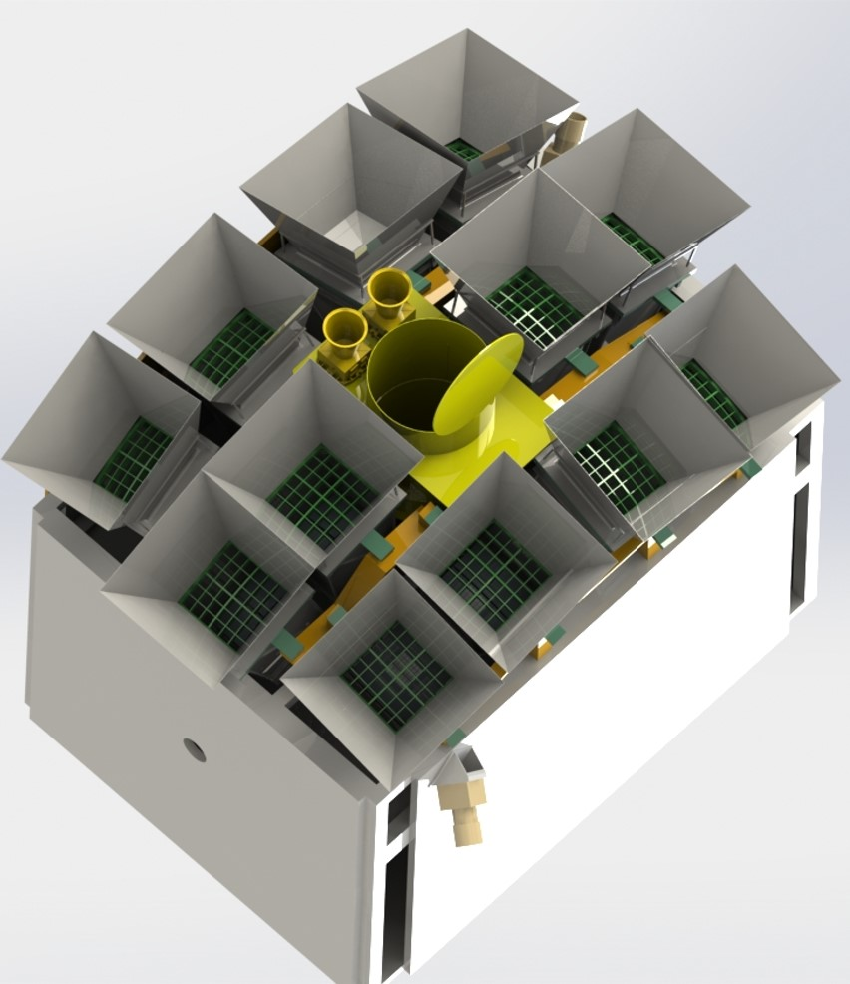
IHEP Contribution to EP
EP Payloads
star sensor
WXT
WXT (Wide FOV X-ray Telescope)
  FOV: 3600 sq.deg. (1.1sr)
  0.5-5 keV
FXT (Follow-up X-ray Telescope)
  FOV: 30’
  0.3 – 10 keV
IHEP is in charge of the Follow-up X-ray telescope (FXT), in collaboration with MPE.
FXT

Slide 25
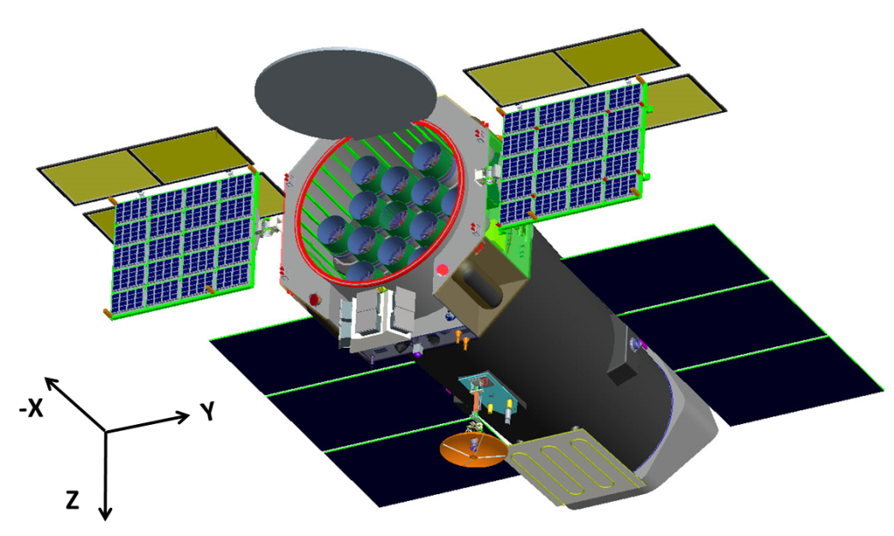
eXTP: enhanced X-ray Timing and Polarimetry
--The next international flagship X-ray mission
Next Generation Flagship Observatory
Important Science
  Black holes, Neutron stars, etc.
  Extreme Physics
Cutting-edge technology
  Large eff. Area (~3.8 m²@6 keV)
  High spectral resolution (<180 eV@6 keV)
  Polarimetery
Payload | Configuration | Eff. area (m²) | Timing res. (μs)
Spectroscopic Focusing Array (SFA) | 9 telescopes | 0.54 m²@1 keV | 10
Large Area Detector (LAD) | 40 modules | 3.4 m²@8 keV | 10
Polarimetry Focusing Array (PFA) | 4 telescopes | 380 cm²@3 keV | 500
Wide Field Monitor (WFM) | 6 cameras | 3.2 Sr (FOV) | 10
Gamma Ray Burst Monitor (GRM) (optional) | 3 units
Notes:
The overall configuration.

Slide 26
















Potential European Participants in eXTP

Slide 27
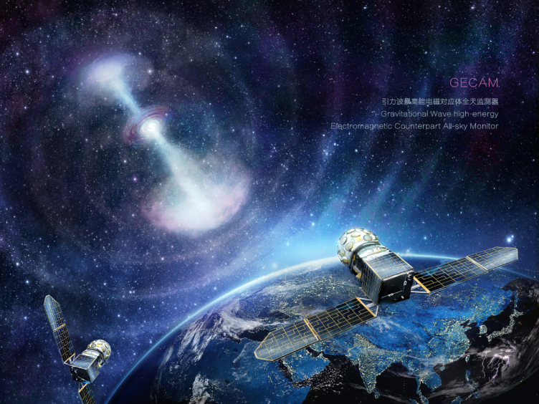
GECAM
--A leading mission in multi-messenger GW astronomy era
Science
  GW GRB, Fast Radio Bursts (FRB), High Energy Neutrinos (HEN), GRBs, Magnetars
Performance (better than existing ones)
  100% all-sky FOV, high sensitivity, wide energy band, good localization
Innovations
  Detector, cutting-edge technology
  Two small satellites, ALL-TIME ALL-SKY
  BeiDou navigation system, real-time data
Fast progress
  Proposed in Mar. 2016, soon after GW150914
  Reviews started in Apr. 2017
  Plan to launch in 2020, lifetime>3 yrs
GECAM 2020
payload
Spacecraft
electronics
Payload
electronics
propeller
telemetry
Attitude
control

Slide 28
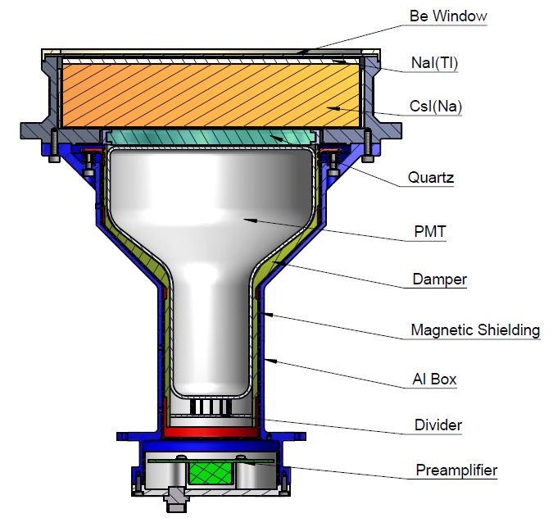
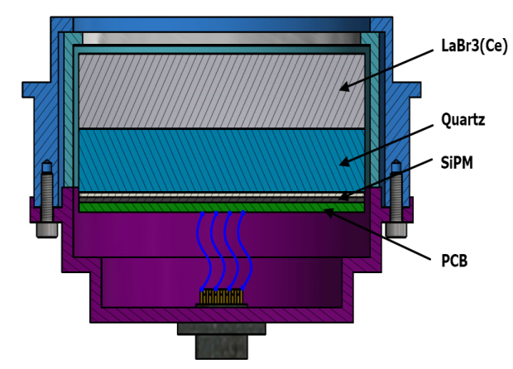
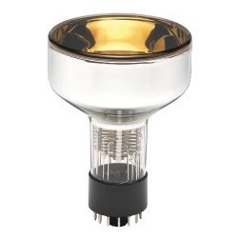
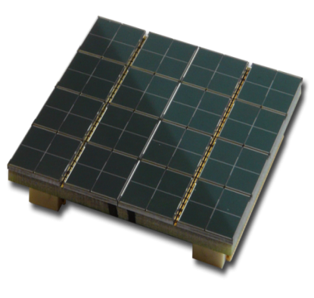
1st LaBr3+SiPM Gamma-Ray Detector in Space
Novel, Compact, Light-weight
High-Voltage Free
PMT
SiPM

Slide 29
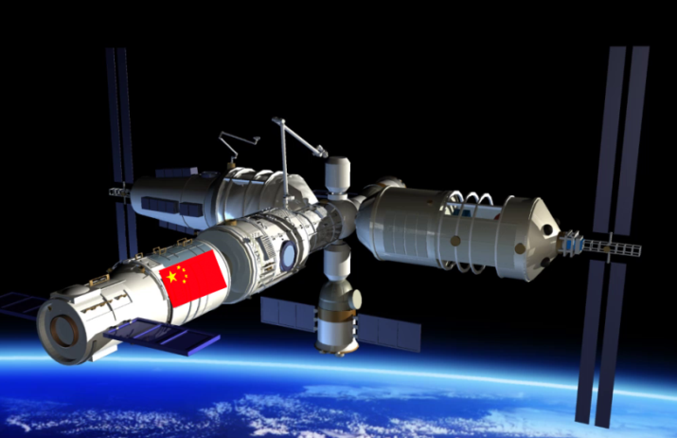



HERD (High Energy cosmic-Ray Detector)
Mission concept
  A flagship and landmark scientific
  experiment on board China's Space Station
Science
  Indirect DM search with unprecedented sensitivity
  Precise CR spectrum and composition measurements up to the knee energy
  Gamma-ray monitoring and surveys
Unique capabilities
  Direct PeV CR observation with best energy resolution
  Low energy gamma-ray observation
  Largest geometric factors for electrons and cosmic rays

Slide 30

International Collaboration (120+ colleagues)
China: CSU, IHEP, XIOPM, PMO, USTC, IGG, XAO, NAOC, TSU, GXU, PKU, NJU, YNU, NBU, SYSU, University of Hong Kong (HKU), National Central University (NCU)
Italy：INFN Perugia, University & INFN Firenze, University & INFN Bari, University & INFN Pisa, University & INFN Trento, University of Salento and INFN Lecce, IAPS/INAF, University & INFN Catania, University & INFN Napoli, University & INFN Trieste, GSSI
Switzerland: University of Geneva；Sweden: KTH；Spain: CIEMAT
Germany: KIT；Russia: Lebedev Physical Institute
Japan: University of Tokyo
4th HERD workshop
ASI HQs, Roma, Italy 2017.2.9

Slide 31
Thank you!

