Slide 1


Experimental Physics Division
XinChou Lou
Institute of High Energy Physics

Slide 2
Experimental Physics Division
Mission, focuses, status and progress
Strategic plan
Addressing issues from previous international review
New challenges and solutions
Discussion

Slide 3
EPD Mission
To conduct high quality research in particle physics, to be one of world’s leading high energy physics research centers
To produce important physics results at the BEPCII collider, and in neutrino physics
To develop a leading future experimental program in particle physics
To contribute to the construction of China’s major science facilities
To develop particle detection and electronics technology
To educate and train the next generation of particle physicists
To support the applications of technology

Slide 4

EPD-hosted projects, leadership and int’l collab.
GlueX (USA)
g on nucleon
LIU B.J.
PANDA (Germany)
ap on target
LIU Z.A.
CEPC (TBD)
HE e⁺e⁻ collider
LOU X.C.
BESIII (Beijing)
e⁺e⁻ collider
YUAN C.Z.
BELLE (II)
(Japan)
e⁺e⁻ collider
ZHANG J.Z.
EXO/nEXO
(USA)
neutrino
JIAN W. L.
ATLAS (SUI)
pp at 13 TeV
COSTA J.
JUNO (Jiangmen)
reactor neutrino
WANG Y.F.
Daya Bay (Shenzhen)
reactor neutrino
CAO J.
Professional staff at EPD
design, construct and operate detectors for major HEP experiments in China
provide critical technical solutions to domestic astrophysics projects, PS experiments,…
participate in several detector upgrade projects in int’l collaborations
host major HEP experiments in China, produce an impressive array of physics results.

Slide 5
EPD Focuses
Particle physics programs:
Precision Frontier: current – BESIII; future – BELLE-II, PANDA, COMET
Energy Frontier: current – ATLAS at the LHC; future – CEPC, ILC;
Non-accelerator/neutrino physics: Daya Bay & JUNO, EXO-nEXO
Particle detection technology, associated electronics and
support facilities
at the forefront of particle detection technology and electronics
help upgrade current detectors and realize future experiments
provide technical and engineering support to IHEP’s science programs
Professional training of students and postdoctoral scientists
strong graduate programs in analysis, detector, electronics and software
professional development for postdoctoral scientists
Notes:
符合国家科技创新及高能所135方向，有发展的前瞻性
现有的科研活动和未来规划相适应和相衔接

Slide 6
EPD – Organization
Key State Lab for Detectors and Electronics
(IHEP-USTC)
CAS Ctr. of Excellence for Particle Physics
(including all HEP major groups in China)
Hadron physics
High energy frontier
Neutrino
Software
Detector I
Detector II
Detector III
Data acquisition
Electronics
Machinery
Magnet
Technical support
Trigger
Research groups
Graduate Management
Committee
Executive Committee
LOU Xinchou
WANG Zheng
ZHU Kejun
SHEN Xiaoyan
CAO Jun
YUAN Changzheng
Administrative Office
6 admin. staff led by
XING Tianhong
Computer Committee
Safety Committee
Financial
Supervision
Committee
Academic Committee *
……
Major Projects
BESIII Daya Bay ATLAS Belle&ILC PANDA JUNO CEPC

Slide 7
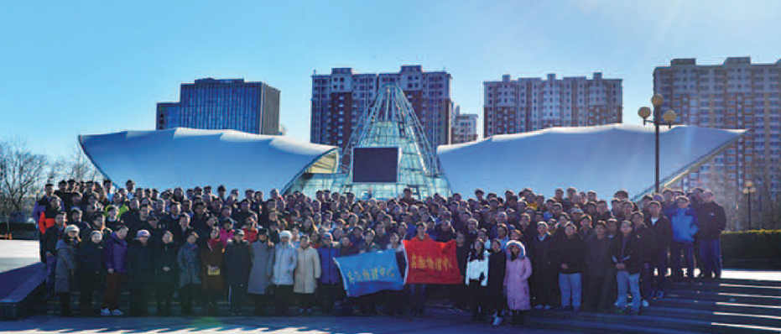
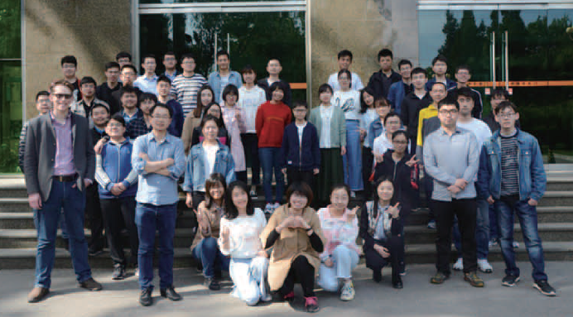
EPD – people
year | staff | average age | postdoc | graduate students | visiting students | retired | contract staff | temp staff | sum
2013 | 155 | 36.9 | 17 | 90 | 77 | 7 | 2 | 10 | 358
2014 | 150 | 40 | 23 | 92 | 82 | 8 | 1 | 11 | 367
2015 | 157 | 41 | 26 | 90 | 83 | 9 | 1 | 10 | 376
2016 | 157 | 41 | 29 | 103 | 75 | 9 | 3 | 7 | 383
2017 | 159 | 41 | 36 | 102 | 67 | 9 | 4 | 7 | 384
workload has increased, staff level relatively constant
increase in postdocs very helpful
Notes:
2013-2017 年，实验物理中心承担了大量的重要大型实验的科研、工程任务，人力紧张。
通过扩大吸引、招聘博士生/后，引进高水平优秀人才，国内外合作，保证工作顺利完成。

Slide 8
EPD – Funding
~$US 60M in 2017
R&D funding (unit = million CNY)
Source\Year | 2013 | 2014 | 2015 | 2016 | 2017
MOST | 14.60 | 5.52 | 10.44 | 26.70 | 21.98
Other sources | 2.05 | 10.46 | 2.06 | 1.03 | 1.40
NSFC | 12.73 | 18.44 | 20.78 | 18.49 | 19.57
Foreign sources | 10.48 | 4.45 | 3.51 | 4.03 | 3.17
CAS Target Fund | 11.10 | 5.72 | 7.55 | 13.63 | 25.37
CAS Dev. Fund | 65.45 | 78.72 | 118.12 | 107.87 | 279.19
CAS Op. Fund | 41.46 | 10.26 | 9.25 | 12.56 | 24.50
CAS Key Lab. | 6.34 | 3.75 | 3.96 | 4.24 | 4.30
Contracts/grants | 2.98 | 0.70 | 2.67 | 0.45 | 2.29
IHEP R&D Fund | 11.80 | 7.33 | 1.67 | 7.52 | 4.67
Sum | 178.99 | 145.35 | 180.01 | 196.52 | 386.45
national
level
Int’l collab.
CAS
IHEP
Funding from MOST, CAS significantly up; NSFC funding flat

Slide 9
EPD - Publications
 | 2012 | 2013 | 2014 | 2015 | 2016 | 2017
BESII&III int’l+domestic journals (SCI) | 26 | 25 | 17 | 30 | 24 | 34
Daya Bay int’l + domestic journals (SCI) | 2 | 6 | 3 | 1 | 5 | 4
JUNO int’l + domestic journals (SCI) |  |  |  |  | 1 | 1
Other int’l journals | 14 | 19 | 23 | 30 | 52 | 30
Other domestic journals in English | 13 | 16 | 13 | 6 | 19 | 5
Other domestic journals in Chinese | 37 | 33 | 41 | 13 | 13 | 9
ATLAS collaboration |  | 2 | 4 | 4 | 12 | 8
Int’l conf. presentations | 38 | 84 | 85 | 109 | 97 | 111
Sum | 121 | 185 | 186 | 193 | 224 | 202
increase
decrease
Noted:
Real publication increase in the past 5 years
More articles in English journals, less published in Chinese
Publication in ATLAS with significant IHEP contribution is rising
More invited talks at international conferences
Successfully organized many international conferences & workshops

Slide 10
EPD - staff recruitment plan & progress
2013-2017 staff hires and recruitment concentrated in high energy frontier,
silicon pixel-strip tracking detectors, electronics
Recruitment program | Name | Previous institute, Year | Areas/projects
National recruitment level | Joao Guimaraes Costa | Harvard University, USA, 2016 | ATLAS, CEPC
 | 方亚泉 Y.Q. Fang | University of Wisconsin, USA, 2013 | ATLAS
 | 朱宏博 H.B. Zhu | DESY, Germany, 2015 | ATLAS, CEPC， Silicon pixel strip detector
 | 史欣 X. Shi | Purdue University, USA, 2016 | BESIII, pixel detector
 | 黄燕萍 Y.P. Huang 李一鸣 Y. M. Li | DESY, Germany, 2016 LAL, CNRS, France, 2017 | ATLAS LHCb, pixel detector
CAS recruitment level | 庄胥爱 X.A. Zhuang | Munich University, Germany, 2013 | ATLAS
 | 阮曼奇 M. Q. Ruan | Ecole Polytechnique, France, 2015 | CEPC
 | 梁志均 Z. J. Liang | University of California at Santa Cruz, USA, 2016 | ATLAS, pixel detector
IHEP recruitment level | 张颖 Y. Zhang 赵微 W. Zhao | IN2P3/CNRS-ULP, France, 2013 IHEP, China, 2017 | ASIC design neutrino physics
 | 黄永盛 Y. S. Huang | Atomic Institute, China, 2017 | Beam, laser-beam interactions
+ staff in detector, electronics, software (4 regular staff positions)
In the next 5 years, EPD will add high quality staff in all 1-5-7 areas
Administrative groups all have developed staff recruitment plans

Slide 11
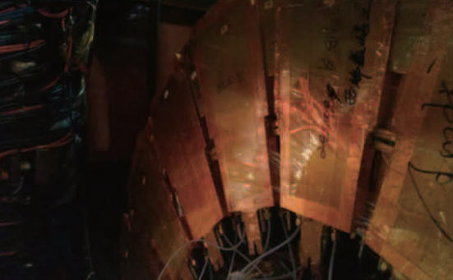
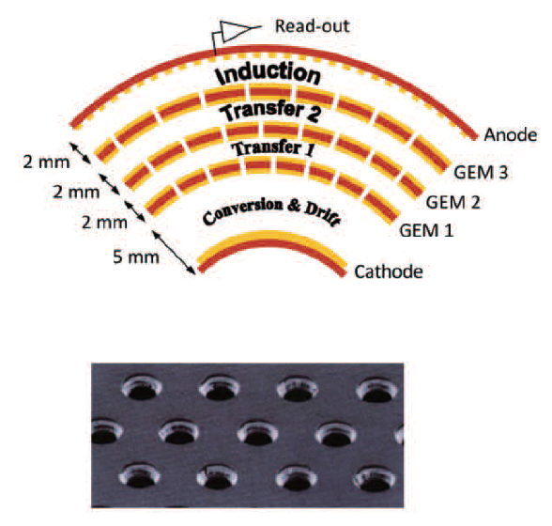
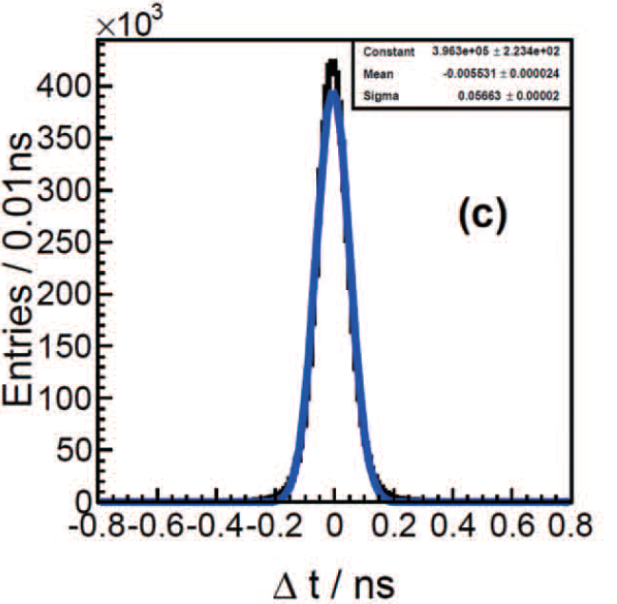
EPD Highlights (2) – BESIII detector upgrade
BESIII TOF upgrade (2015-16)
MRPC technology
s_{T} ~65 ps (p@1GeV)
100% improvement
BESIII inner detector upgrade (ongoing)
GEM technology
to replace ageing chamber
Better Z resolution, high rate, …
Joint IHEP
USTC proj.
Joint IHEP
INFN, Mainz etc
proj.

Slide 12
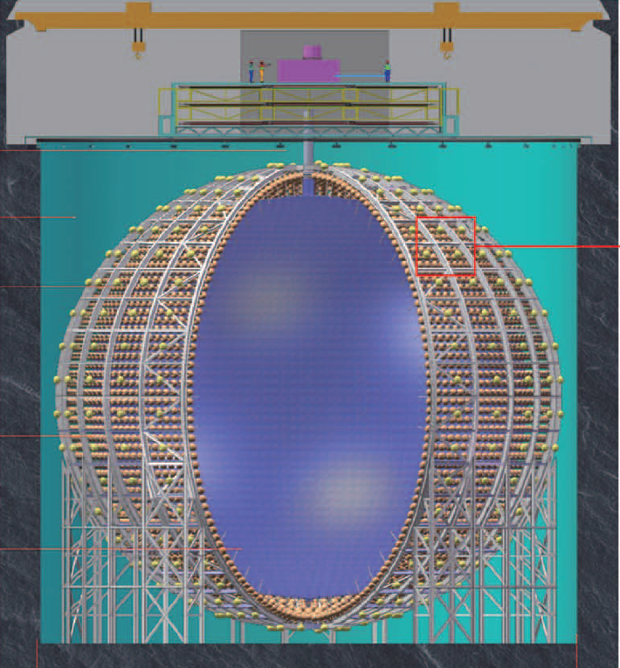
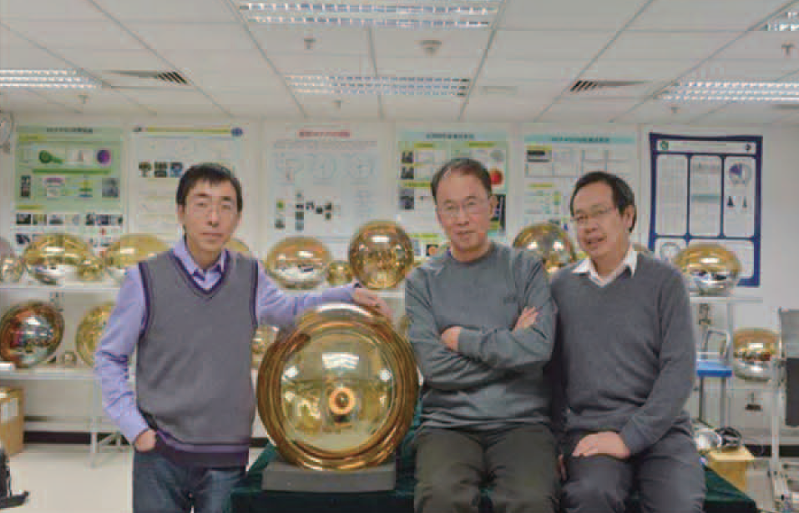
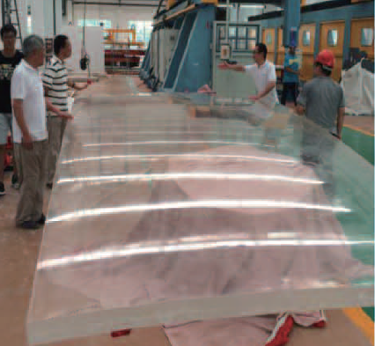
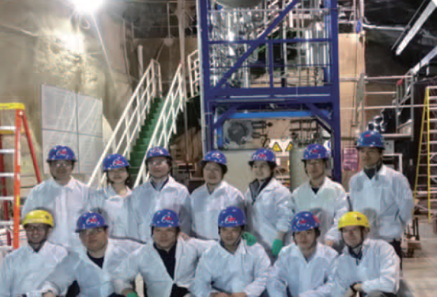
EPD Highlights (2) – JUNO detector development
Central
Detector
20k T LS
20” PMT
design,
prototyping
production
LS purification
system developed
Atten. Len.>20 m
20 ton capacity
CD glass
structure
JUNO detector design, R&D, production, tests, construction (2013 – present)

Slide 13
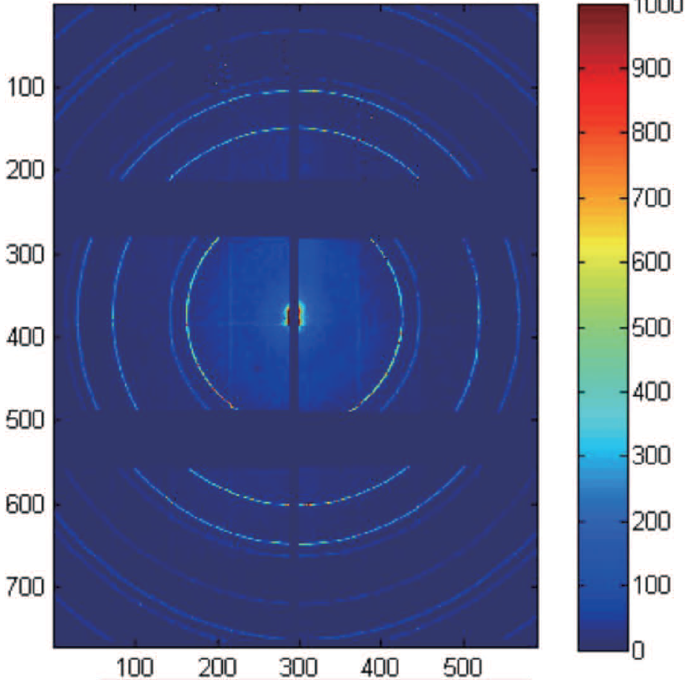
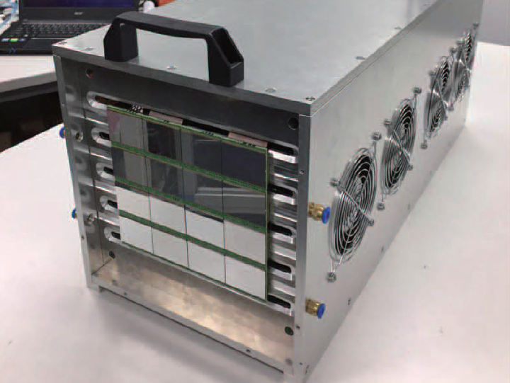
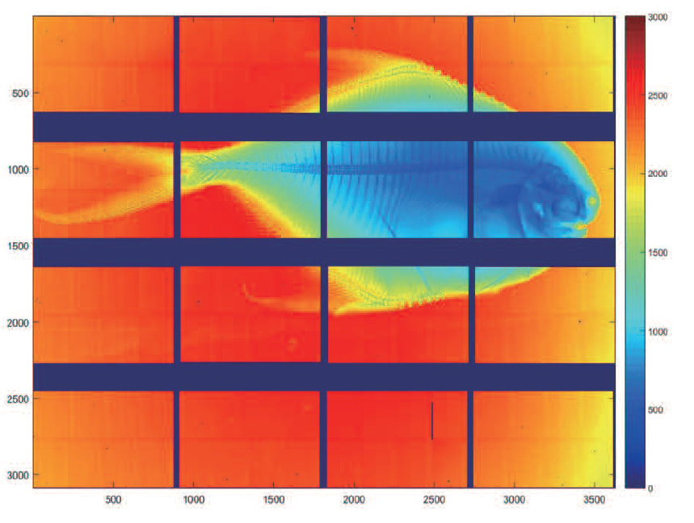
EPD Highlights (3) – pixel imaging detector for PS
2D pixel
detector
prototype
Pixel imaging detector for PS experiments
in-house design, local production
2 prototype detectors tested
single photon detection capability
wide dynamic range
low noise, high frame rate
to be made available to new light sources
X-ray imaging

Slide 14
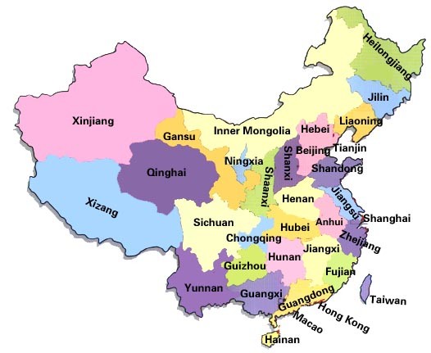
EPD – strategic planning
Five Priority Development Areas
BESIII
IHEP EPD division operates the BESIII detector
at IHEP, the Daya Bay Neutrino Experiment in
southern China, and is constructing JUNO
in southern China. IHEP hosts these projects.
The BESIII detector is performing well, and has been used to collect some of the world’s largest, high quality data samples. Many great physics results in hadron spectroscopy, charmonia, XYZ states, and charmed hadrons have been published. -See C. Z. Yuan’s presentation
The Daya Bay experiment, following the (Sin²2θ₁₃ = 0.092 ± 0.016(stat) ± 0.005(syst), PRL 108, 171803 (2012)) discovery paper, has carried out refined measurements of the neutrino mixing angle, mass difference, and reactor neutrino spectrum. -See J. Cao’s presentation
Construction of the JUNO facility, production of the detector components, and preparation for the eventual experiments are progressing well, as planned. - See J. Cao’s presentation
JUNO
DYB

Slide 15
EPD – strategic planning
Seven Priority Cultivation Areas
Particle physics program: ensure the on-schedule construction of the JUNO project; advance the energy frontier project (CEPC), take on challenging and advanced detector upgrade tasks international collaboration projects (ATLAS, etc). - See X. C. Lou’s presentation
Develop detector technologies and advanced, high capacity electronics. Active international collaboration on detector, electronics R&D, train professionals in these areas.
Worldwide recruitment of physicists and experts, build up manpower and expertise for JUNO, CEPC and other future experiments and technology development.
The EPD division has made a detailed plan, and is executing it effectively

Slide 16
Experimental Physics Division
Addressing issues from previous institutional review

Slide 17
ATLAS
Report on the Evaluation of IHEP
(October 24-25, 2013)
“Far less impressive is the contribution by IHEP groups to ATLAS and CMS at CERN. The IHEP groups are very small, have limited presence at CERN, and most of their leaders have multiple important roles at IHEP, roles that require full-time engagement. Given the importance of the LHC experiments and physics questions, and the desire of China to become a leader at the energy frontier, this situation has to be addressed. This means that substantially more resources and fully committed leadership need to be found. At present, the small IHEP participation in LHC has been impacted by limited resources for the operation and upgrades to the data processing farm. The participation in the detector upgrades need to be assessed and planned now…”
“Very little details were presented to the ATLAS and CMS detector upgrades supported by IHEP and other Chinese institutions and universities. The schedule for building-up the expertise and the laboratory required for a significant contribution to the ATLAS pixel detector will be very challenging, ...”
EPD has made a strong effort to address this weakness by
recruiting many first class staff members from overseas
taking on the ATLAS ItK strip detector upgrade project
expanding beyond data analysis to detector operation, calibration, etc.

Slide 18
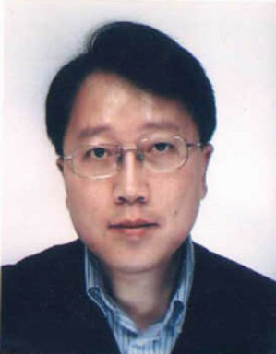
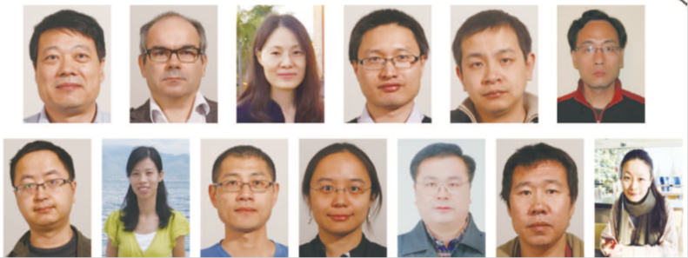
IHEP ATLAS Group
The ATLAS@IHEP physics program was established by Prof. Shan JIN
+ 2 junior faculty and students
+ 1 faculty (detector)
Strong growth since 2012
  2 senior faculty from US
  5+2 junior faculty from Europe and US (ITk only, no ATLAS analysis)
  ~8 postdocs and >10 PhD students
  backed up by Electronics and Detector groups at EPD
Activities: (2008-2013)
mostly Higgs analysis
Aspired to participate in ATLAS upgrade (pixel) project
  Activities:
  Higgs analysis, searches
  SUSY, EW
  Pixel - strip detectors (IBL, telescope development, …)
  ITk upgrade – people, strategy and funding (partial)
  Beginning to participate in operation (pixel)
  Calibration, performance studies and service
18

Slide 19
IHEP ATLAS Group
Construction, commissioning, upgrade & operation
2013-14
Prior to 2008
IBL pixel detector activities
Jun Hu – stayed at CERN for 3 months in 2013
PhD in Electronics, IHEP, 2012
IBL ROD slave FGPA programming and test
Test of FE-I4 chip
Ying ZHANG – stayed at CERN for 3 months in 2013,
and is at CERN now; PhD in IC and CMOS Pixel
Detector Design, Strasbourg, 2012
data receiver integrated circuit (DRX-12_II)
Yaquan Fang – based at CERN, visiting BNL
IBL performance vs Higgs sensitivities
……
detector construction and installation
2008-2013
data analysis
Began upgrade activities
in silicon tracking/ASIC
Led by Ouyang Qun in collab. with
CPPM & LBNL
19

Slide 20
IHEP ATLAS Group
Construction, commissioning, upgrade & operation
2015-17
Juan Antonio Pascual
Pixel detector deputy DAQ coordinator,June 2016 - April 2017
Pixel detector DAQ coordinator April 2017 - Present
Pixel Run Manager 2016
Pixel DAQ expert on-call 2017 - Present
Claudia Bertella
Responsible for high-radiation test of the ITK sensors (strips/pixels) at CERN, Feb 2017 - Present
Joao Guimaraes
Muon NSW Trigger Processor Coordinator until October 2016
Dual Use Export License for IBM chips to be used on the Strip Detector readout,2015 – 2017
Xinchou Lou
ATLAS Itk Steering Committee member, 2015 – present
Hongbo Zhu
China/IHEP ATLAS ITk strip project leader, 2016 – present
Yu Liu
Primary author, EUDAQ2.0 SW for DESY testbeam + local support 2016 – present
Postdoc and students visited RAL and based at RAL
Itk module study and pre-production activities
Weiguo Lu
ASCI design for Itk-strip readout 2016 - 2017
Libo Chen
Verification framework for the ASIC design
Yanping Huang
photon ID convenor (electron to photon fake rate measurement, photon ID efficiency measurement , photon conversion fraction measurement, reconstruction of converted photon
and the pile up dependence)
Xuai Zhuang
Perf study using SUSY, 2015 – present
Da Xu
Expert contact of HISTFITTER statistical tool
20

Slide 21
IHEP ATLAS Group
ITk strip detector upgrade
  Approved for 1000 strip modules, half at RAL, half at IHEP
  Early start with collaboration with RAL with development
  work and preparation, while setting up IHEP labs and
  getting export permit for the ASIC chip for Beijing
  Obtained first round of funding from MOST
  Plan to participate in commissioning and operation
  with staff/postdocs based at CERN

Slide 22
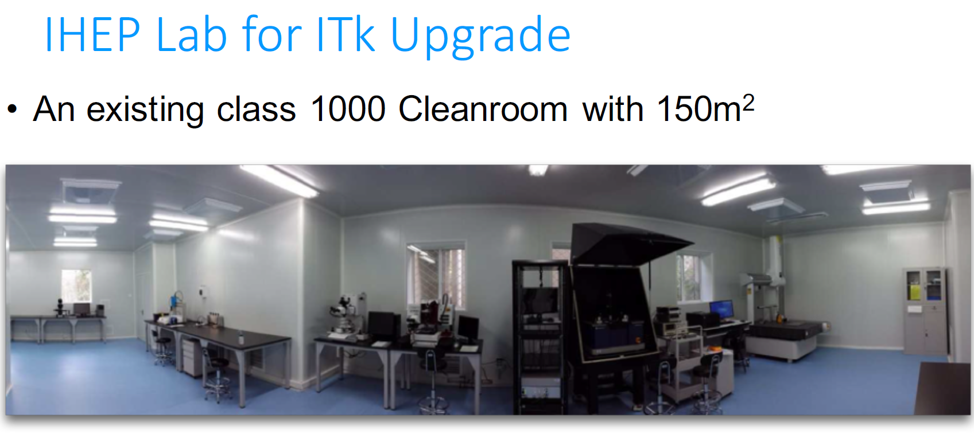
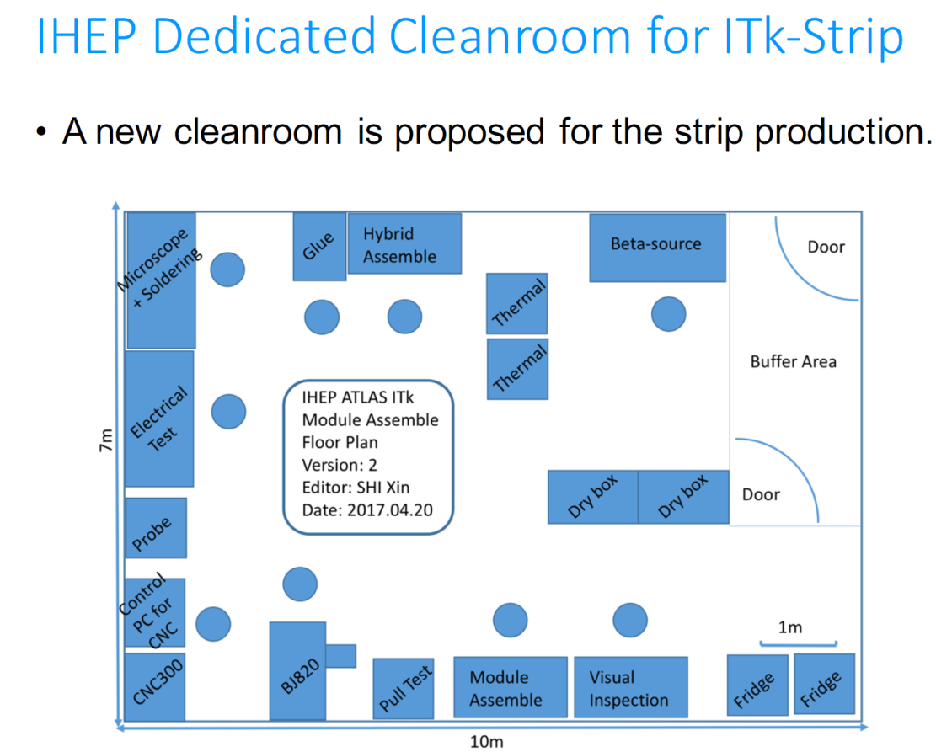
work being done in a
shared clean room
In progress: a dedicated production
facility for ATLAS ITk strip
modules

Slide 23
IHEP ATLAS Group
New group leaders
  Refine roles and responsibilities
  Reorganization and planning
Junior staff development
  Start-up help
  Mentor by senior faculty
  Develop their own program and identities, as well as being
  effective ATLAS@IHEP group members

Slide 24
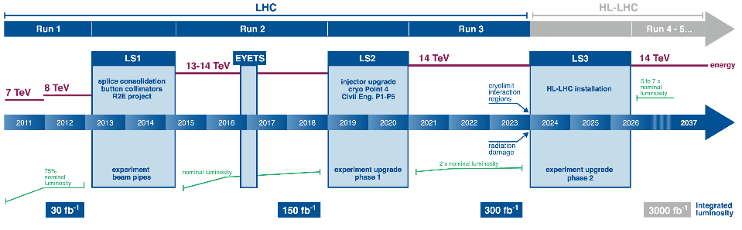
IHEP ATLAS Group
Planning (Analyses)
Run2-3 2015-2023
Precision measurement of the production, decays and couplings of the Higgs boson; SUSY and new physics searches
ggH, VBF, H→gg,ZZ,WW, bb;
SUSY, di-Higgs (hh→4b,4W,WWγγ)
W,Z, b physics
Photo ID, energy scale, tau reconstruction, tracking, MET, …
  Run4-5 2026-2037
+ Search for BSM physics and particles at TeV scale
di-Higgs，SUSY, dark matter, rare decays Zγ,
Performance studies at high lumi, high pileup conditions

Slide 25
EPD Challenges and Solutions
BESIII
operation, upgrade of the detector, achieve the goals of the physics program.
project management, technical team, effective collaboration
BESIII white paper outlines the physics program, data samples and acquisition plan, possible upgrades – draft done, will be reviewed and finalized
Continue efficient operation to acquire quality data.
Participation in international experiments (BelleII, GlueX, PANDA) for complementarity, to collectively solve problems, to strengthen the science output, and to aim at major breakthroughs.

Slide 26
EPD Challenges and solutions
ATLAS
Phase II ITk upgrade; increase group’s international competitiveness
adequate funding to support the ATLAS program at IHEP, visibility
actively seek funding, continue to expand into technical aspects
JUNO
civil construction, schedule is tight, installation & commissioning
onsite team, prototyping, testing, procedures & execution

Slide 27
EPD Challenges and solutions
Top scientists - shortage:
CEPC project needs many scientists
attract talented young researchers from around the world
Key technical staff:
semiconductor tracking detector & readout electronics;
critical software experts
recruitment, retention, collaboration
Matrix management
often is not easy to take responsibilities, loop holes
communication with leadership, better planning

Slide 28
Experimental Physics Division
Discussion

