Slide 1
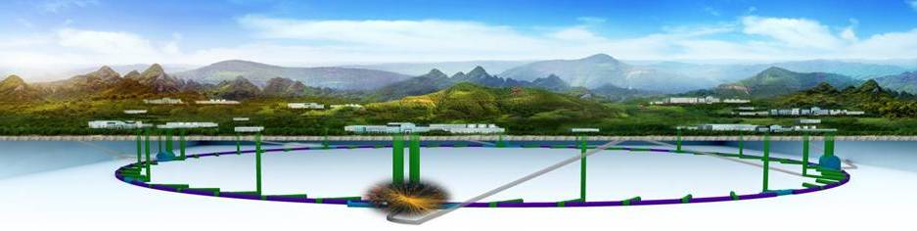


The Circular Electron Positron Collider
XinChou Lou
The Institute of High Energy Physics

Slide 2
High Energy Circular Electron Positron Collider
Introduction
CEPC status and progress
Addressing issues raised at previous review
Project development and schedule
Discussion, Q&A

Slide 3
IHEP is guided by its “1 (Mission)-5 (current focuses)-7 (cultivations for future)” Strategic Plan
Focused Development for the Future: Frontier Particle Physics Research
Developing the CEPC project –
  physics goals and potentials;
  design of the accelerator, the detector(s) and the infrastructures
  R&D programs
ATLAS, CMS at the Large Hadron Collider (LHC) at CERN –
  scale up and strengthen the teams; make them excel at physics analyses;
  take on challenging, technically advanced detector upgrade tasks;
  encourage innovation and developing skills
  train and recruit high quality theorists in the high energy frontier
  Completed pre-CDR, will publish CDR in 2018
  Established Center for Frontiers of High Energy Physics (CFHEP)
  Significantly enhanced ATLAS, CMS groups, major upgrade tasks
  Global recruitment efforts that brought on board many top quality scientists
  Funding, design progress, R&D programs underway, ……

Slide 4
CEPC – The Physics Case
Lots of questions with the Higgs boson (+ Z, W)
Is H(126) the SM Higgs as expected? Is it fundamental? Does it cause SSB?
Is the vacuum stable?
Naturalness – what form and what energy scale?
Is H(126) connected to dark matter/energy? How (if yes)?
Full exploration of H(126) is an important path to finding new physics
Precision measurement of the Z, W bosons, by an order of magnitude or
more, is another way to probe new physics
CEPC: 1 M H(126) events, >10¹⁰ Z, W events will allow us to reach the necessary precision

Slide 5
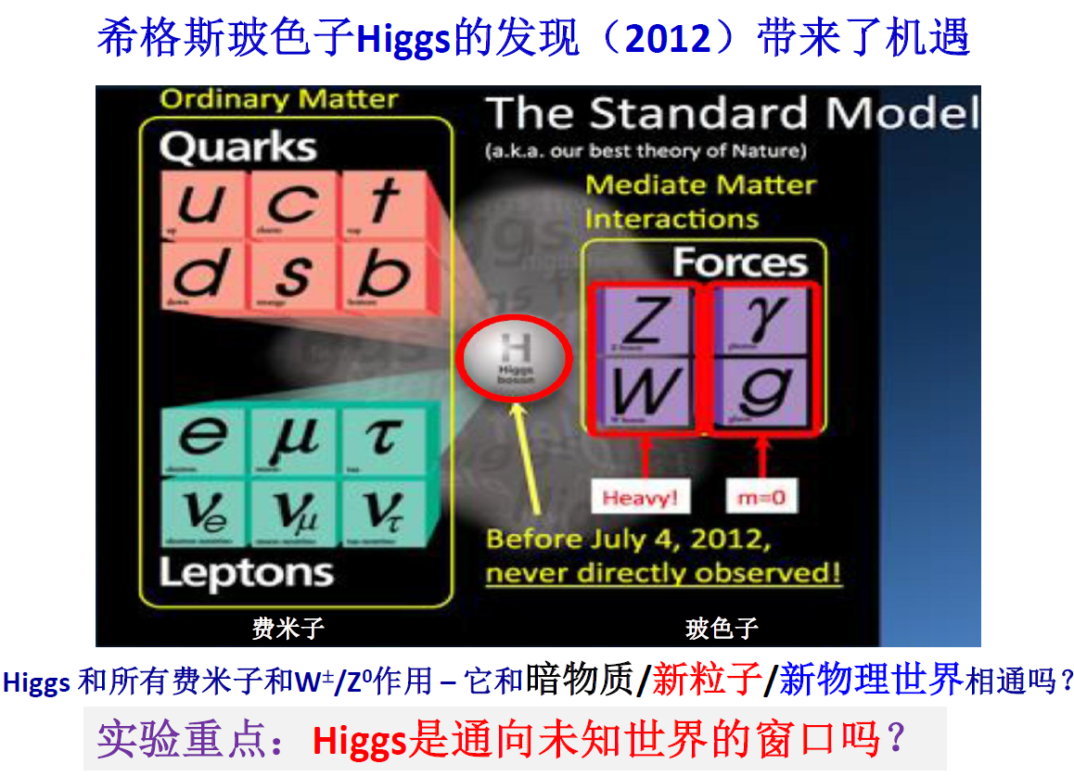
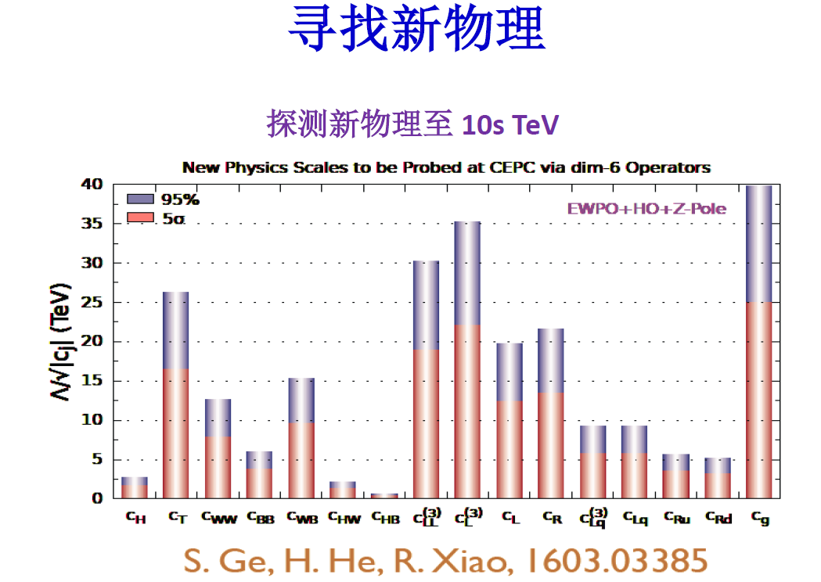
CEPC – The Physics Case
The discovery of H(126) ⇒ golden opportunity
BSM new physics searches
Higgs: it interacts with all fermions and W/Z
Is it connected to DM,DE?
Experiment with the H: portal to the new world?
Pre-CDR
CEPC directly+indirectly: probes new physics ~10s TeV scale

Slide 6
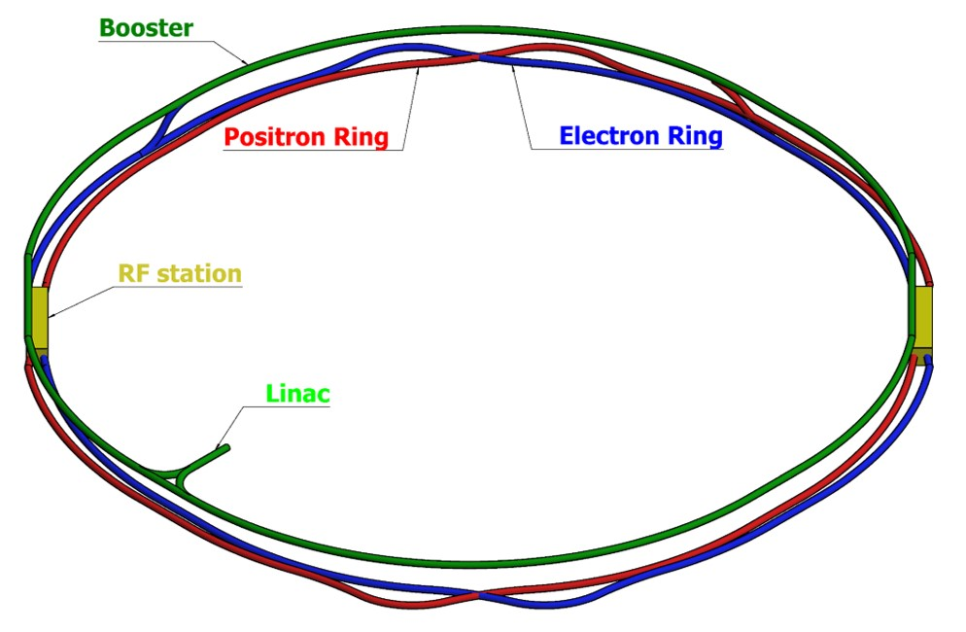
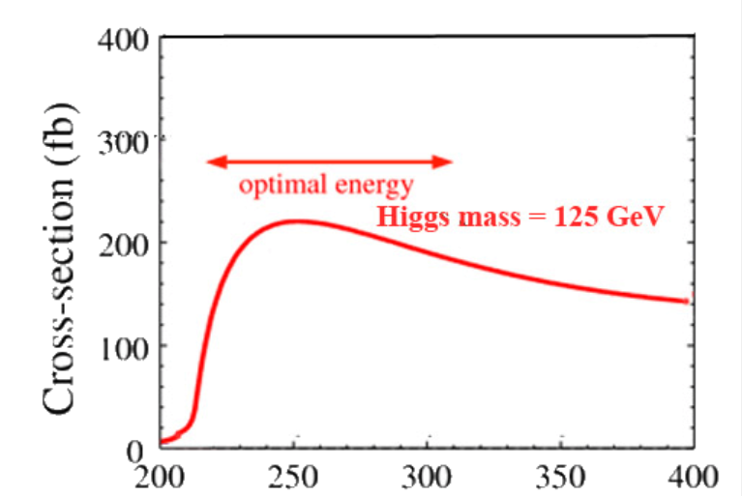
High Energy Circular Electron Positron Collider
e⁺e⁻ Higgs (Z) factory
E_{cm}≈240GeV, luminosity ~3×10³⁴ cm⁻²s⁻¹, 2IP，>1M H in 10 years
at the Z-pole 10¹⁰Z bosons/yr
Precision measurement of the Higgs boson (and the Z boson)
Upgradable to pp collision with E_{cm} ≈ 50-100 TeV (with ep, HI options)
A discovery machine for BSM new physics
Higgs precision
1% or better
e⁺e⁻ → ZH
CF=100 km
BEPCII will likely complete its mission ~2020s;
CEPC – possible accelerator based particle physics program in China after BII

Slide 7
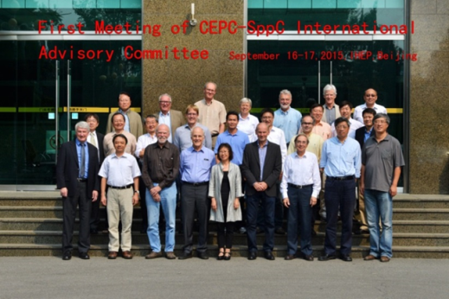
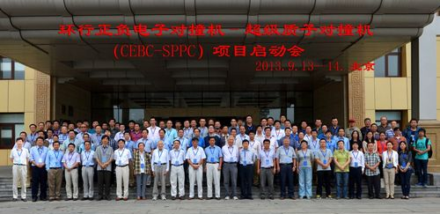
CEPC Organization
Institute Board
Y.N. GAO
J. GAO
IAC
Young-Kee Kim, ….
Since Sept.
2013
Steering Committee
Y.F. WANG (IHEP),….
ProjectDirector
XC LOU
Q. QIN
N. XU
Intl Relation– J GAO
PR – YN GAO
Conf. – J.Shan
CDR – XC Lou et al.
……
CDR Editors
theory LT Wang
accelerator W Chou
detector-simu TC Chao
CH YU (AC Physics)
Theory
HJ HE(TH)
JP MA(ITP)
XG HE(SJTU)
Accelerator
J. GAO(IHEP)
CY Long(IHEP)
JY TANG(IHEP)
Detector
JoaoCosta(IHEP)
S. JIN(NJU)
YN GAO(TH)

Slide 8

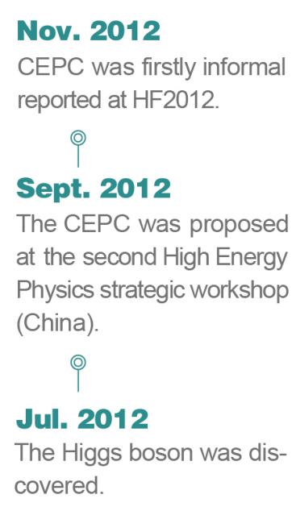
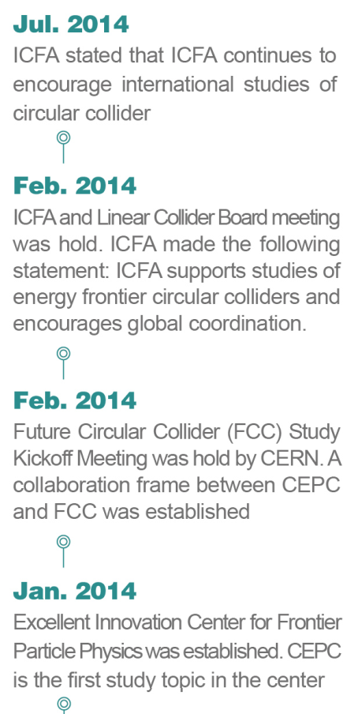
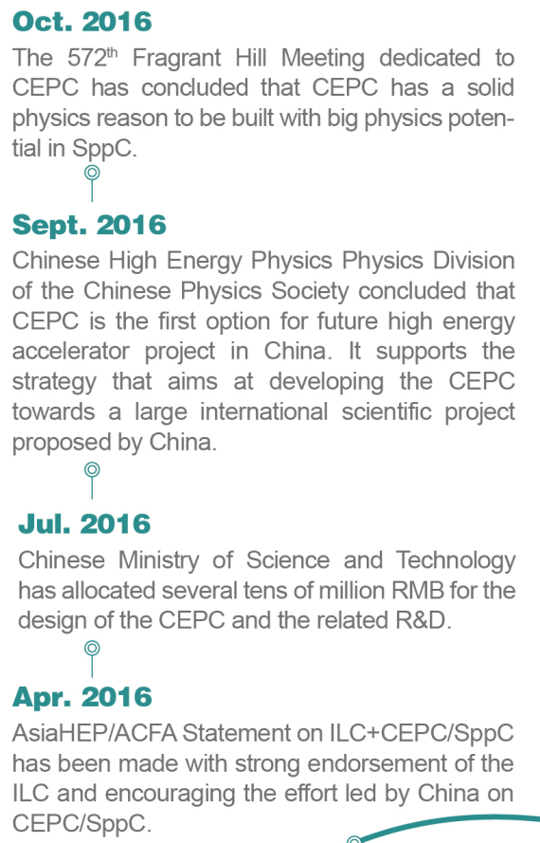
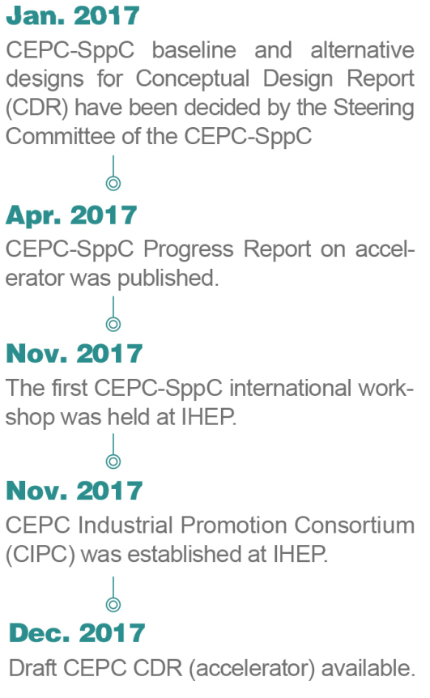
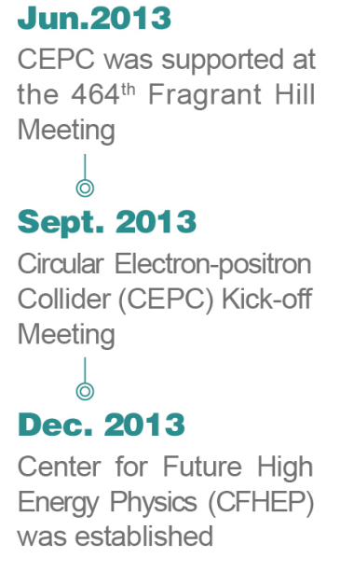
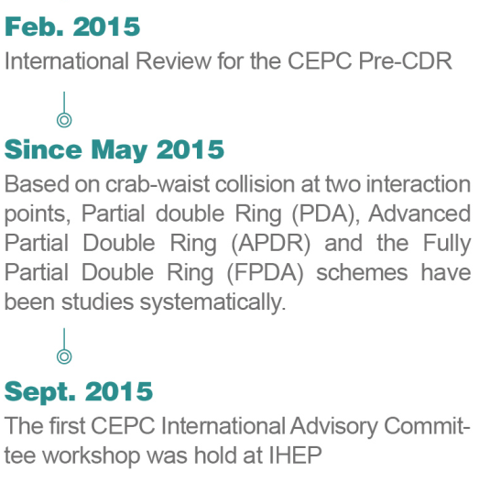

Slide 9
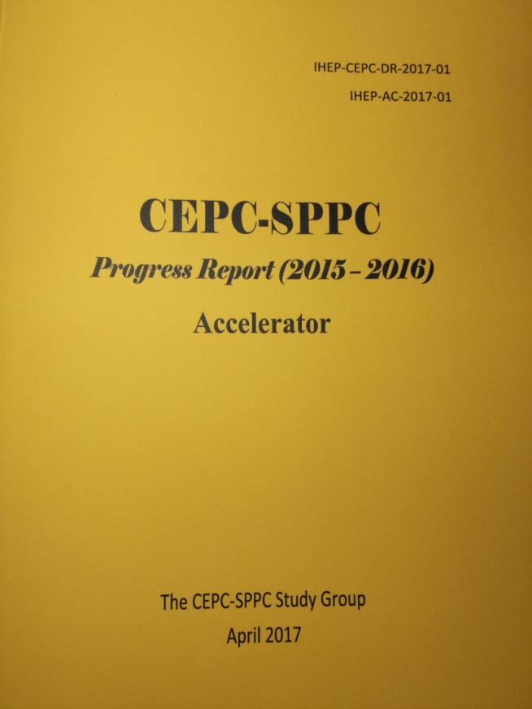
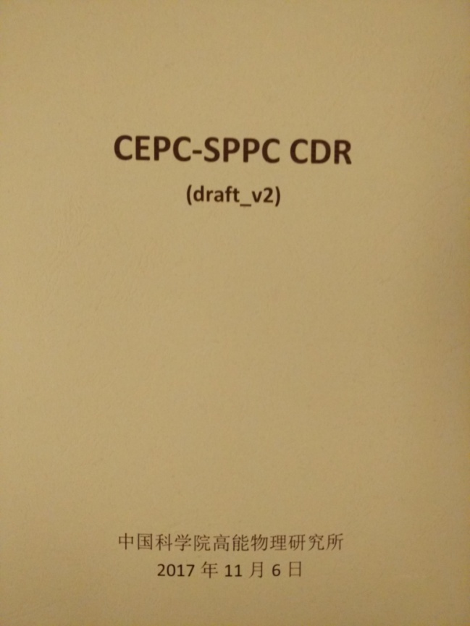
http://cepc.ihep.ac.cn
CEPC-SppC from Pre-CDR towards CDR
March 2015
April 2017
Nov 2017
CEPC-SppC CDR
Preliminary Draft during
CEPC mini review
CEPC-SppC baseline and alternative
decision process recorded
CEPC CDR draft available

Slide 10
CEPC CDR Accelerator Chain
Energy Ramp
10 ->45/120 GeV
10 GeV
Electron
Injector
Booster
Positron
Three rings in the sane channel：
  CEPC & booster
  SppC
Booster Cycle (0.1 Hz)
Main Ring
See C. H. Yu’s Presentation
45/120 GeV
C=100 km

Slide 11
CEPC Parameters
preliminary
 | Higgs（3T） | W（3T） | Z（3T） | Z（2T）
Number of IPs | 2
Energy (GeV) | 120 | 80 | 45.5
Circumference (km) | 100
SR loss/turn (GeV) | 1.73 | 0.34 | 0.036
Half crossing angle (mrad) | 16.5
Piwinski angle | 2.58 | 7.74 | 23.8
N_{e}/bunch (10¹⁰) | 15 | 15 | 8.0
Bunch number (bunch spacing) | 242 (0.68us) | 1220 (0.27us) | 12000 (25ns+10%gap)
Beam current (mA) | 17.4 | 87.9 | 461
SR power /beam (MW) | 30 | 30 | 16.5
Bending radius (km) | 10.6
Momentum compaction (10⁻⁵) | 1.11
β_{IP} x/y (m) | 0.36/0.0015 | 0.36/0.0015 | 0.2/0.0015 | 0.2/0.001
Emittance x/y (nm) | 1.21/0.0031 | 0.54/0.0016 | 0.17/0.004 | 0.17/0.0016
Transverse σ_{IP} (um) | 20.9/0.068 | 13.9/0.049 | 5.9/0.078 | 5.9/0.04
ξ_{x}/ξ_{y}/IP | 0.031/0.109 | 0.013/0.12 | 0.0041/0.056 | 0.0041/0.072
V_{RF} (GV) | 2.17 | 0.47 | 0.1
f _{RF} (MHz) (harmonic) | 650 (216816)
Nature bunch length σ_{z} (mm) | 2.72 | 2.98 | 2.42
Bunch length σ_{z} (mm) | 3.26 | 6.53 | 8.5
HOM power/cavity (kw) | 0.54 (2cell) | 0.87(2cell) | 1.94(2cell)
Energy spread (%) | 0.1 | 0.066 | 0.038
Energy acceptance requirement (%) | 1.35 | 0.4 | 0.23
Energy acceptance by RF (%) | 2.06 | 1.47 | 1.7
Photon number due to beamstrahlung | 0.29 | 0.44 | 0.55
Lifetime _simulation (min) | 100
Lifetime (hour) | 0.67 (40 min) | 1.2 | 4
F (hour glass) | 0.89 | 0.94 | 0.99
L_{max}/IP (10³⁴cm⁻²s⁻¹) | 2.93 | 11.5 | 16.6 | 32.1
J. Gao

Slide 12
Current Status of CDR
A first draft at the end of last year. More international participation than pre-CDR
A mini-international review was organized soon after and a lot of input was taken
International review will be held in June-July
The final version is almost ready, to be published in summer
TDR will start next year, hopefully more international participation

Slide 13
Circular Electron-Positron Collider
Baseline design & options
E_{cm}=240 GeV, circumference=100 km, 30MW per beam, peak luminosity ~3×10³⁴ cm⁻²s⁻¹
double ring; 2 detectors
Comparison with the ILC
~same cost, 6× luminosity (ILC)
unprecedented Z,W program
mature technology
high energy synchrotron light
very long term: pp upgrade path
ILC offers higher energy e⁺e⁻ option
CEPC and ILC are ideally complementary to each other
Z
W
H
F. Bedeschi, INFN-Pisa

Slide 14
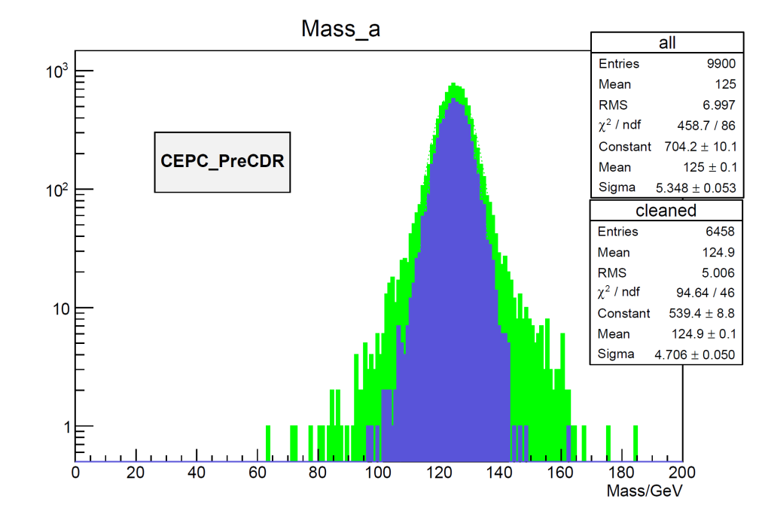
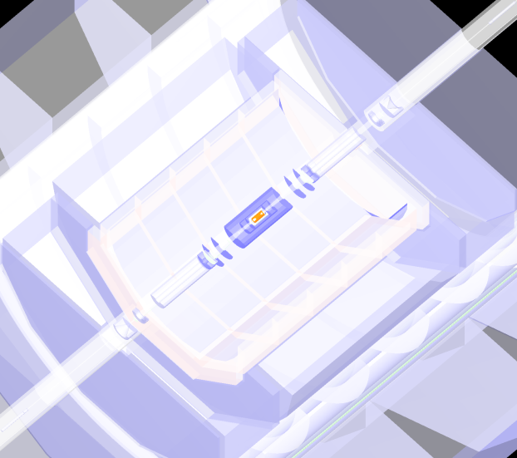
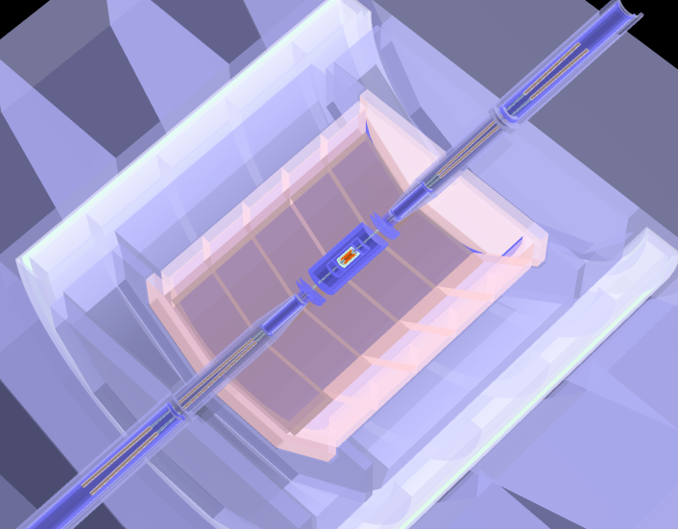
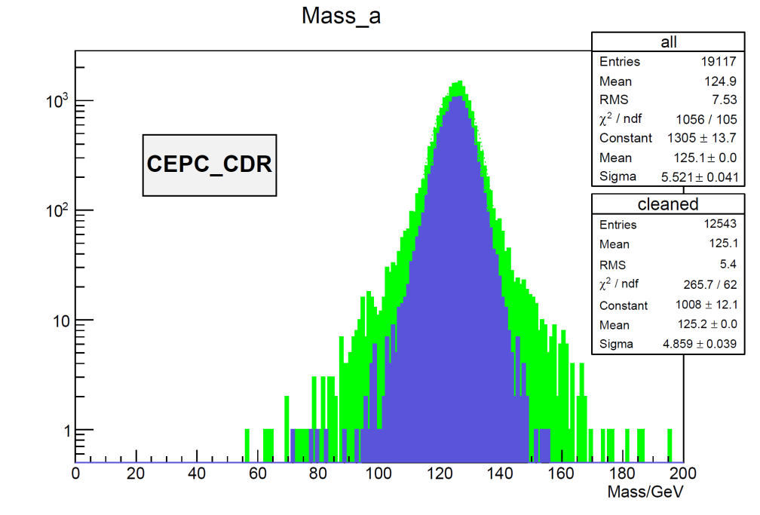
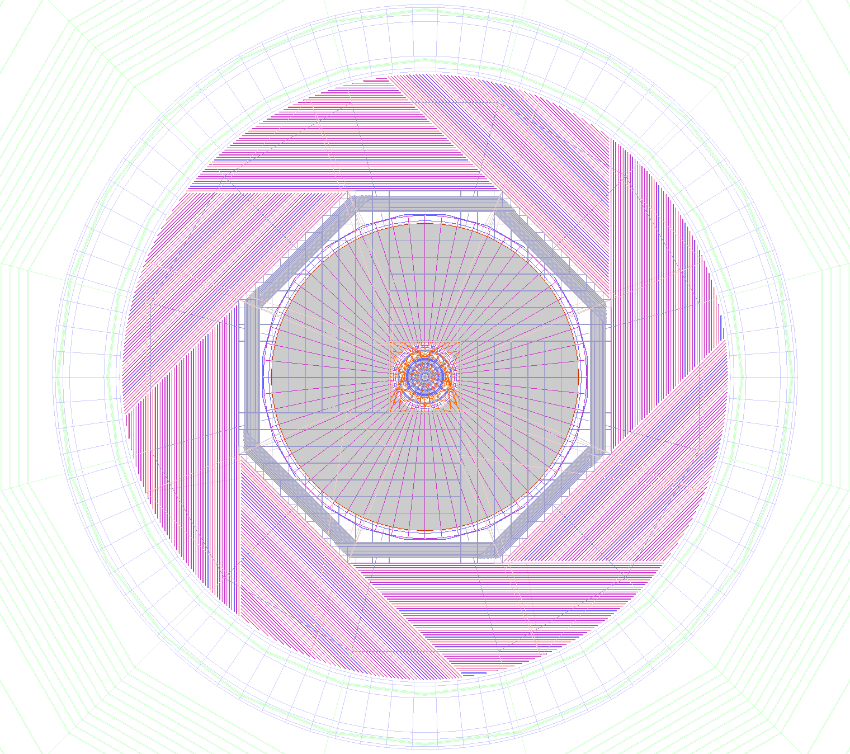
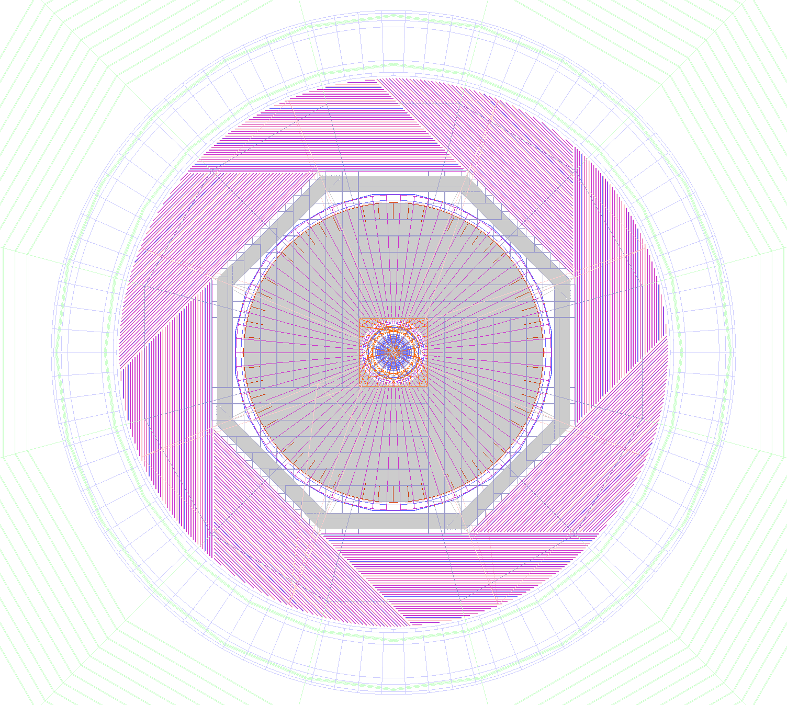
CEPC Detector: more compact & updated for CDR
preCDR (2015) CDR (2017)
H→gg events
σ_{DiJetMass}= 4.7GeV
σ_{JietMass}= 4.9 GeV
CDR CEPC detector:
Double ring geometry & MDI design implemented
HCAL reduced to 40 layers (from 48 in preCDR)
Di-Jet Mass (GeV)
No visible impact on
physics performance

Slide 15
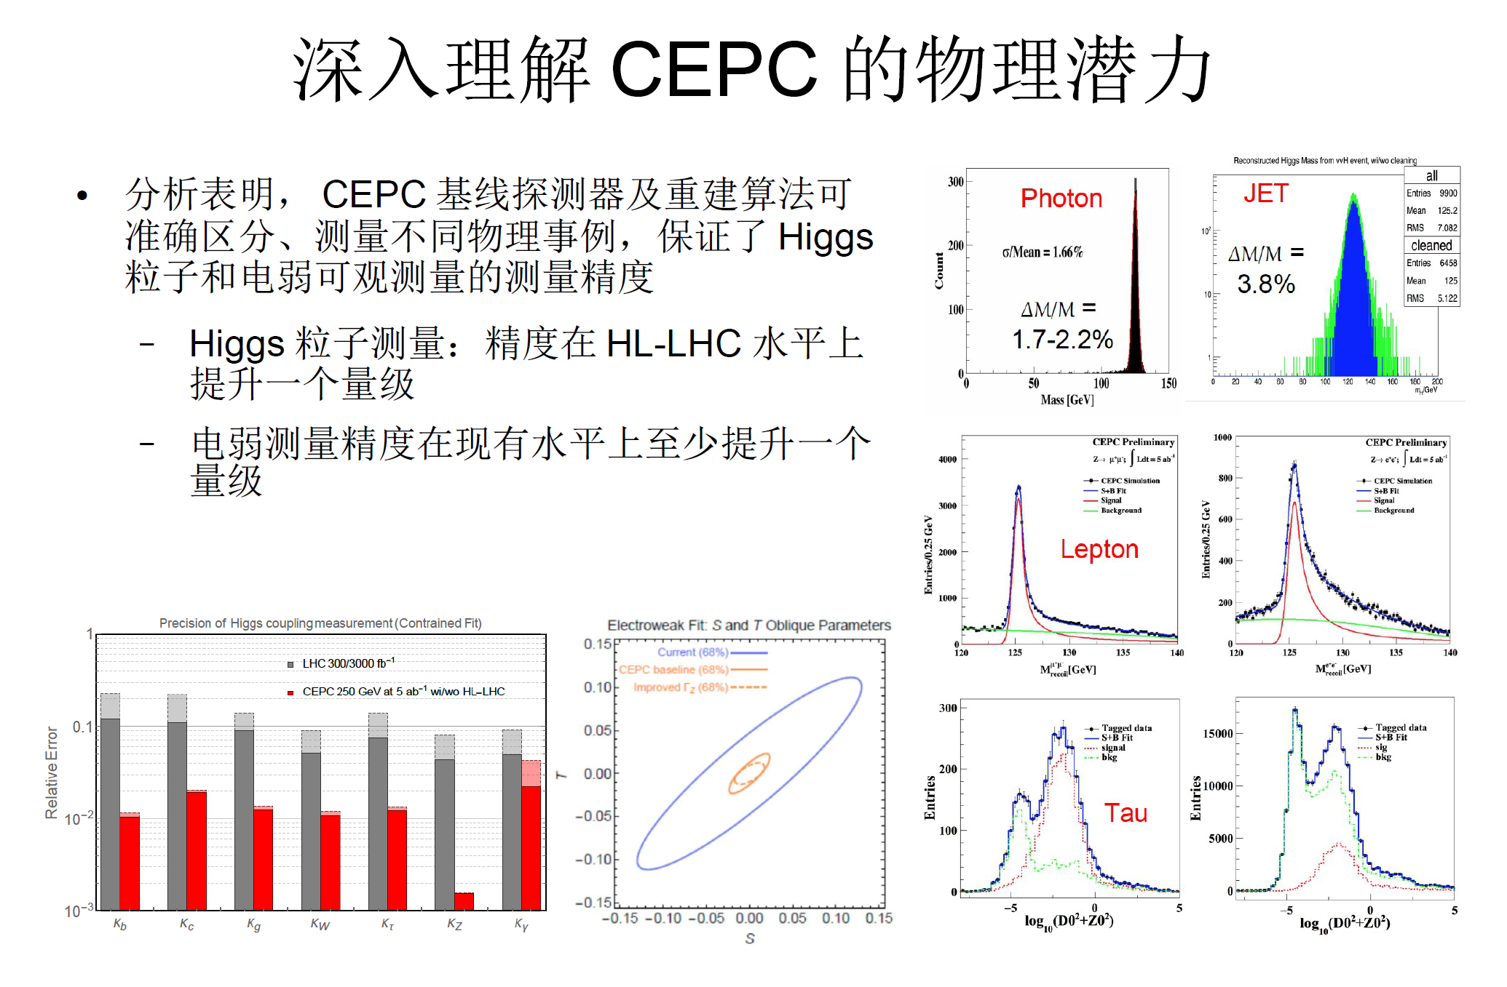
CEPC Detector Performance & Physics Measurement
Based on the ILD framework, CEPC extends beyond the ILD and has developed several
reconstruction-analysis software packages, which
correctly reconstruct physics objects, differentiating among the types, thus ensuring precision
Measurement of the Higgs boson: an order of
magnitude better than at the HL-LHC
EW precision is at least an order of magnitude better

Slide 16
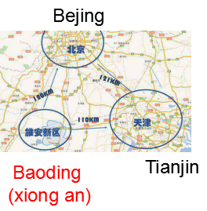
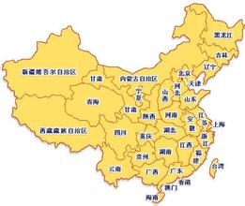

CEPC Site Exploration
1
1)
2
4
2)
1) Qinhuangdao, Heihe (Completed in 2014)
2) Huanging, Shanxi (Completed in 2017)
3)Shenshan, Guangdong (Completed in 2016)
4) Baoding (Xiong’an), Hebei (Started in August 2017, ~200 km south of Beijing)
3
3)
Longitudinal profile of tunnel (at Funing site, 1)

Slide 17
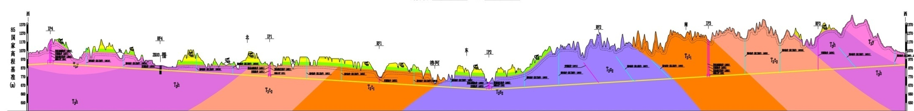
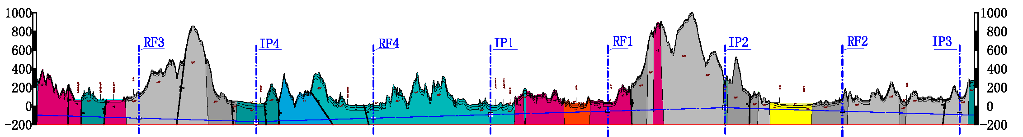
Item | Huangling | Shenshan | Funing
Project layout
Construction difficulty | Moderate | Relatively difficult | Relatively easy
Huangling (100 km)
Shenshan (100 km)
Funing (100 km)
Notes:
Huangling: The site is mainly on the loess plateau. The buried depth of the tunnel and the depth of the shafts are quite different. The construction access layout is relatively simple.
Shen-Shan: The site is mainly the low mountain area. The buried depth of the tunnel and the depth of the shafts are large, and the construction access layout is relatively complicated.
Funing: The site is generally the low hilly areas; underground burial depth is not big; the construction site conditions are better; the construction access layout is relatively simple.

Slide 18
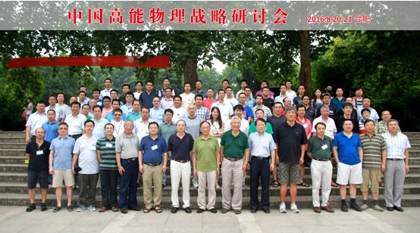
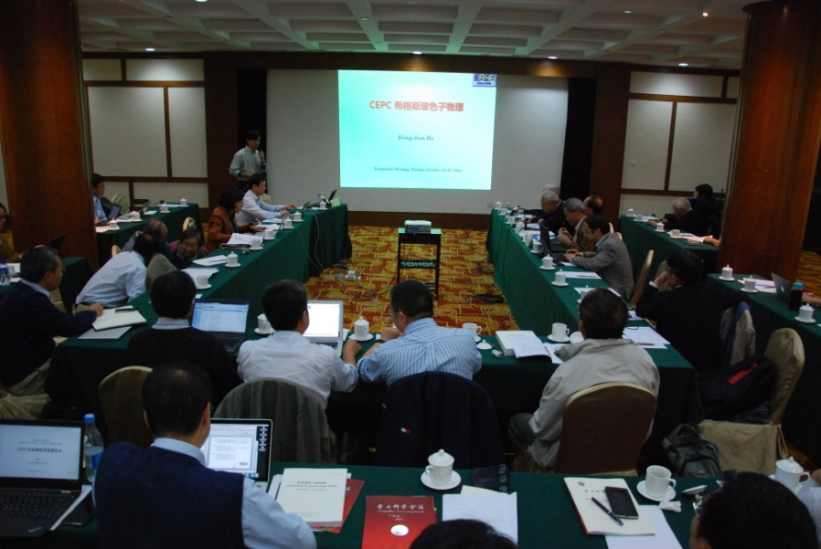
CEPC: Domestic Support and Communications
Fragrant Hill Meeting on CEPC
Chinese National HEP Conference
a forum to discuss & plan for major projects of national significance
October 18-19, 2016
The HEP division of the Chinese Physical Society reached a consensus in August, 2016 that placed CEPC as the top priority accelerator-based program for the future and endorsed the CEPC design and R&D 9/12/2016
Consensus on CEPC design
and its R&D program

Slide 19
CEPC International Collaboration Status-1
International collaboration experts in the CEPC study team:
All accelerator subsystem working groups have established database of potential
international collaboration experts
All accelerator subsystems have at least one international collaboration expert
in the subsystem working groups
International collaboration with major international labs:
IHEP-BINP (Russia) MoU (Jan 2016)
IHEP-KEK (Japan) MoU (Sept 2017)
IHEP-MEPhI (Russia) (Nov 2017)
IHEP-IEF (University of Rostock, Rostock, Germany) (Jan 2018)
IHEP-Jlab (USA) MoU update is considered
High level collaboration with CERN and Dubna will progress
IAC advice
Cooperation with ILC, FCC(ee)
Establish & strengthen collaborations
1st CEPC EU workshop, Rome (May 2018)
Contribution to intl. project (HL-LHC magnet contr., ATLAS, CMS upgrades, …)
Welcome new people
European PP Strategy
……
More than 20 MoU in general

Slide 20
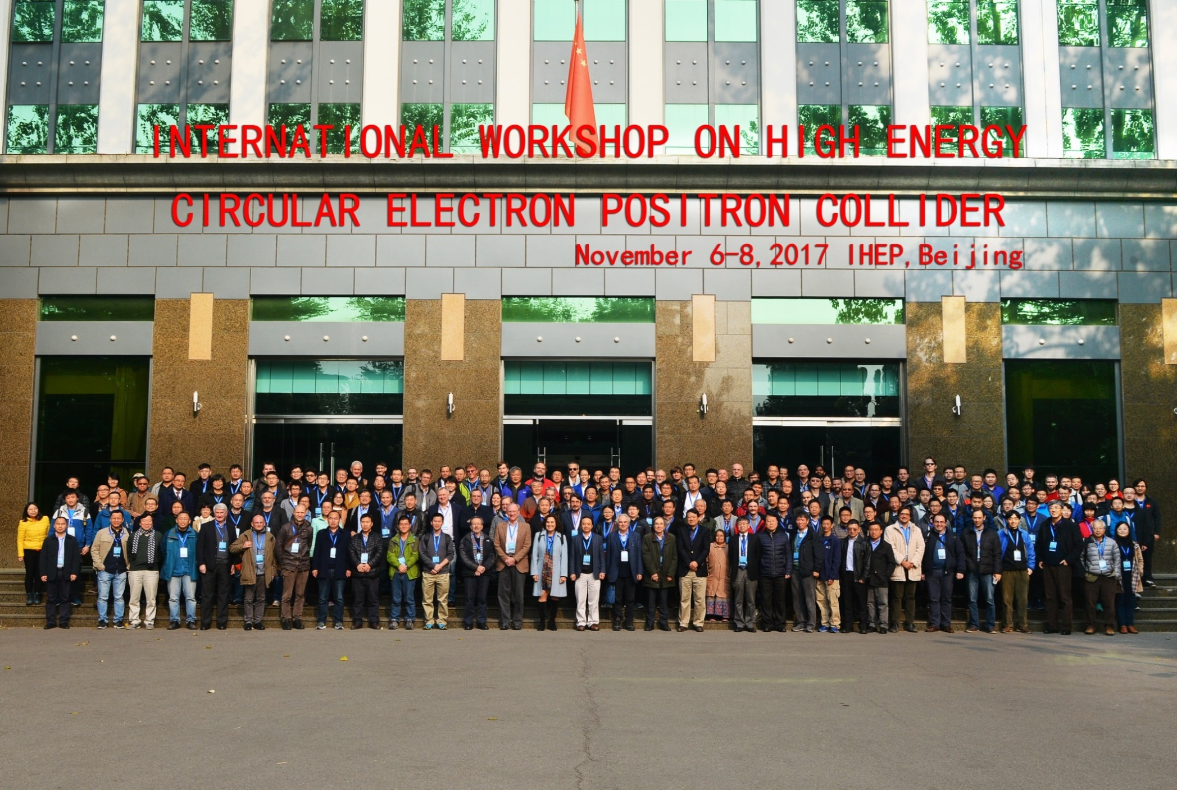
International workshop on CEPC
International Advisory Committee
Young-Kee Kim, U. Chicago (Chair)
Barry Barish, Caltech
Hesheng Chen, IHEP
Michael Davier, LAL
Brian Foster, Oxford
Rohini Godbole, CHEP, Indian Institute of Science
David Gross, UC Santa Barbara
George Hou, Taiwan U.
Peter Jenni, CERN
Eugene Levichev, BINP
Lucie Linssen, CERN
Joe Lykken, Fermilab
Luciano Maiani, Sapienza University of Rome
Michelangelo Mangano, CERN
Hitoshi Murayama, UC Berkeley/IPMU
Katsunobu Oide, KEK
Robert Palmer, BNL
John Seeman, SLAC
Ian Shipsey, Oxford
Steinar Stapnes, CERN
Geoffrey Taylor, U. Melbourne
Henry Tye, IAS, HKUST
Yifang Wang, IHEP
Harry Weerts, ANL
Theory
•Qing-Hong Cao (PKU)
•Nathaniel Craig (UCSB)
•Hongjian He (SJTU)
•XiaoGang He (SJTU)
•JianPing Ma (ITP)
•Maxim Perelstein (Cornell U.)
•Tilman Plehn (Heidelberg U.)
•Matthew Reece (Harvard U.)
•German Valencia (Monash U,)
•Liantao Wang (Chicago U.)
Detector
•Patrizia Azzi (INFN Padova)
•Daniela Bortoletto (Oxford)
•Massimo Caccia (INFN)
•Joao Guimaraes da Costa (IHEP)
•Yaquan Fang (IHEP)
•Roberto Ferrari (INFN)
•Yuanning Gao (THU)
•Sasha Glazov (DESY)
•Imad Laktineh (IPNL)
•Jianbei Liu (USTC)
•Wang Meng (SDU)
•Soeren Prell (Iowa State U.)
•Manqi Ruan (IHEP)
•Charlie Young (SLAC)
Scientific Committee
CEPC accelerator
•Philip Bambade (LAL)
•Anton Bogomyagkov (BINP)
•Yunlong CHI (IHEP)
•Jie GAO (IHEP)
•Sergei Nikitin (BINP)
•Carlo Pagani (Milano U. & INFN-LASA)
•Guoxi Pei (IHEP)
•Chenhui YU (IHEP)
SppC accelerator
•Kazuhito Ohmi (KEK)
•Robert Palmer (BNL)
•Jingyu Tang (IHEP)
•Davide Tommasini (CERN)
•Qingjin Xu (IHEP)
http://indico.ihep.ac.cn/event/6618
Global contribution to this workshop

Slide 21
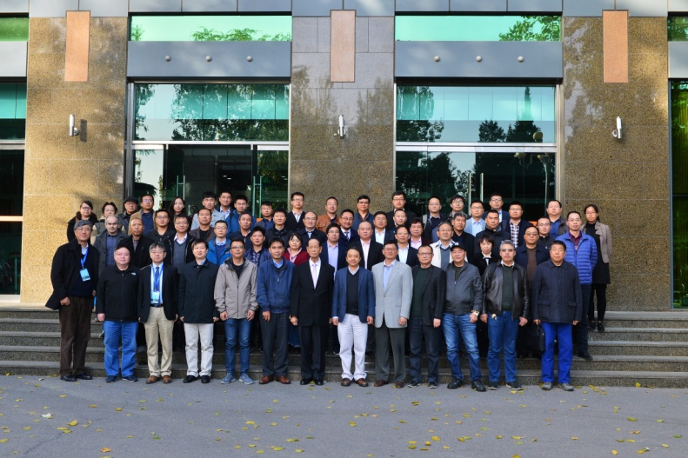

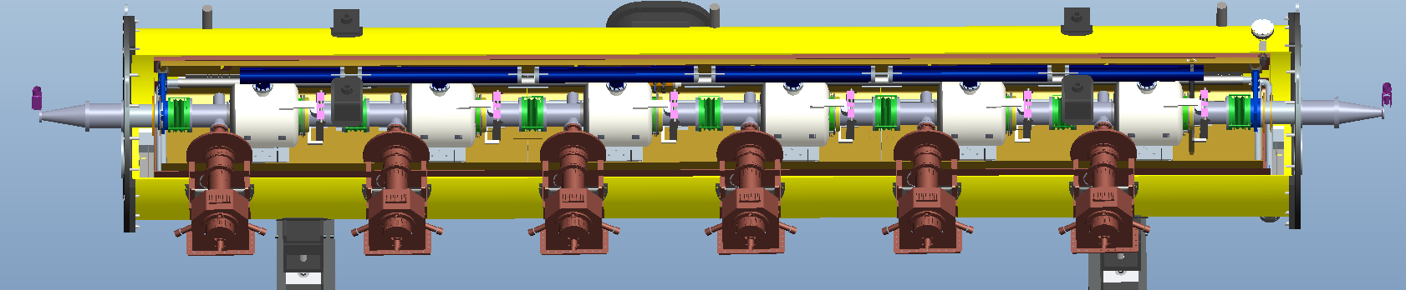
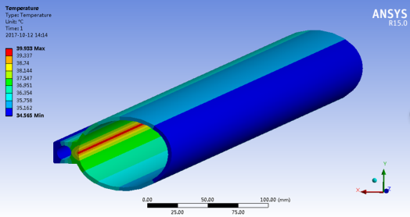
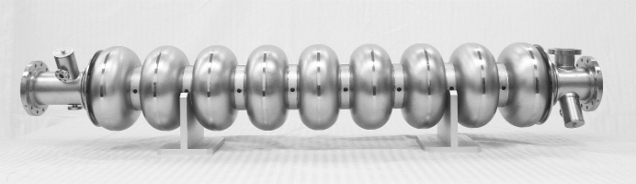
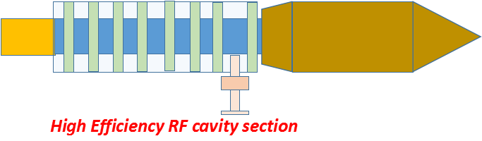
CEPC Industrial Promotion Consortium (CIPC)
CEPC产业促进会成立 (2017年11月71日）

Slide 22
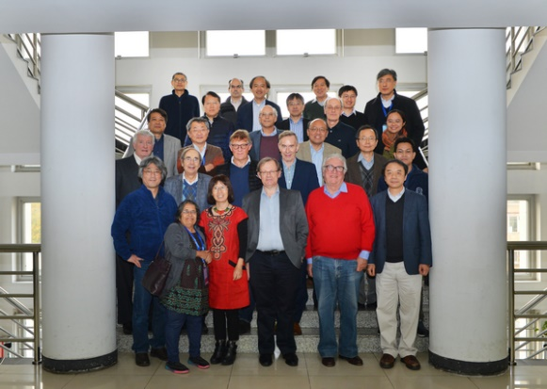
CEPC International Collaboration - IAC
The third CEPC-SppC International Advisory Committee Meeting
Nov 8-9, 2017, Beijing

Slide 23
CEPC
Report on the Evaluation of IHEP
(October 24-25, 2013)
“This scenario will need careful evaluation and is not likely to be realized soon because of its very large scope and high cost. An optimized choice of energy is best determined after future studies at the LHC. Patience with the start of the CEPC design effort is needed in light of future upgrades of LHC and with the potential construction of ILC. A number of international workshops will be needed to study the requirements and conceptual design for the CEPC as well as to determine necessary international cooperation.
The CEPC Study Group
supports the ILC, CEPC is complementary to the ILC
has pursued persistently the optimized design of the accelerator,
obtained funding and started and progressed steadily along the R&D path,
has held a series of workshops in China, and the latest one in Rome (5/18)
IAC functional and very useful; industrial consortium, …
recruiting many first class staff members from overseas
taking on the ATLAS ItK strip detector upgrade project

Slide 24
CEPC
Report on the Evaluation of IHEP
(October 24-25, 2013)
“An effort limited to R&D of the machine concept can beneficially go on if manpower to do so is available. But a decision to transform it into a serious project should wait for future input.…”
no new input from LHC beyond the Standard Model Higgs yet as of now, which makes the CEPC more compelling.

Slide 25
项目规划 Project Development
  组织和管理 Organization & Management
  CDR概念设计报告 Conceptual Design Report
  R&D 计划 Planning
  经费 Funding
  国际合作 International Collaboration
  工业“联盟” Industry Consortium
  γ同步光源应用探索 High Energy γ Synchrotron Light

Slide 26
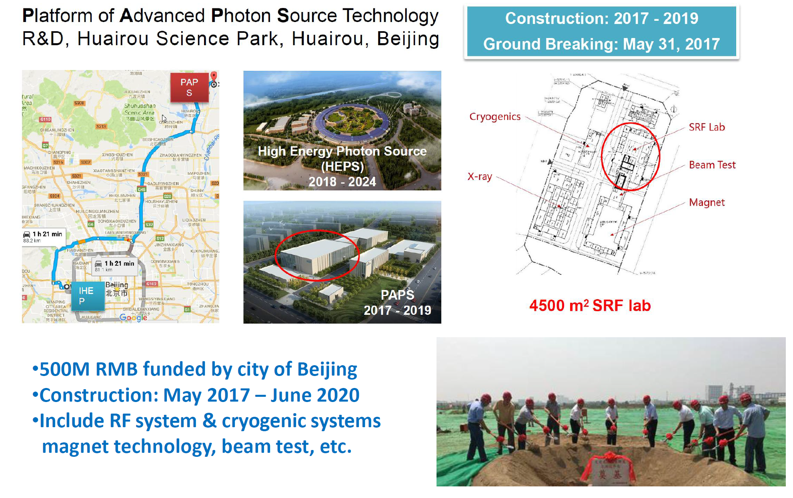
CEPC RF Cavities

Slide 27
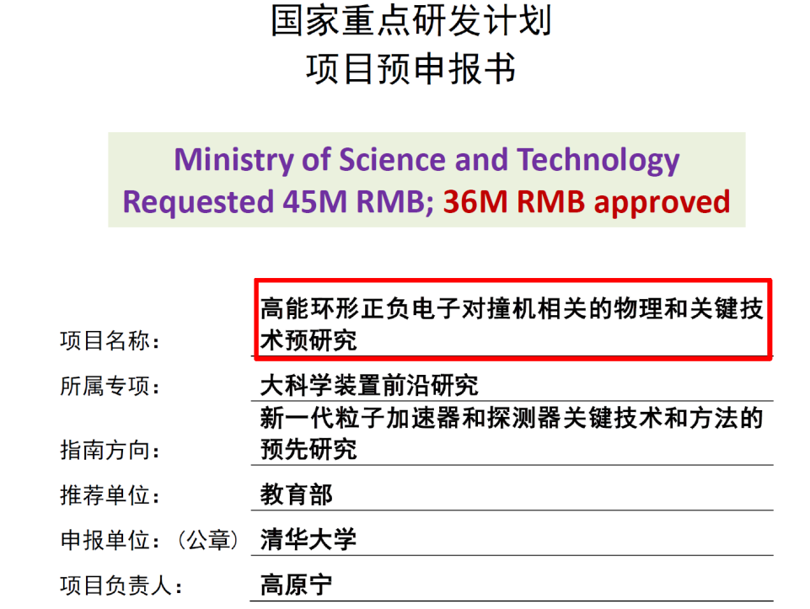
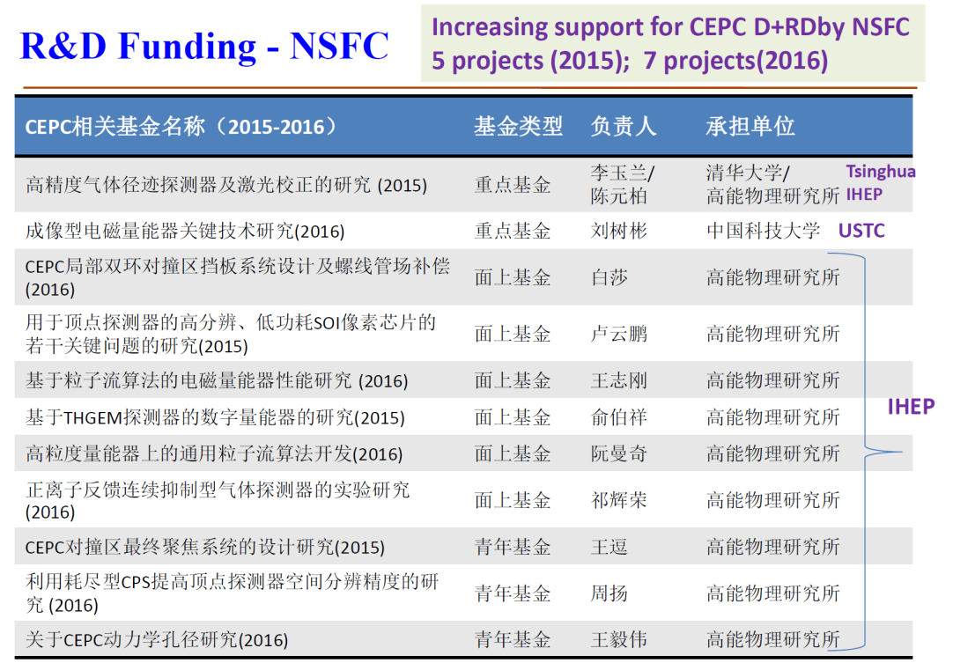
CEPC Funding
  IHEP seed money
  11 M CNY/3 years (2015-2017)
FY 2016
~60M CNY CAS-Beijing fund, talent program
~500M CNY Beijing fund (light source)
year 2017 funding request (32M) to MOST approved
Basic funding needs for carrying out the CEPC design and
the R&D should be met by end of 2018

Slide 28
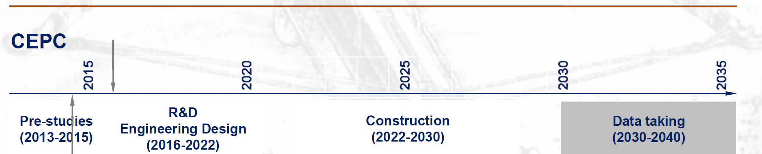
CEPC Schedule (ideal)
Time of previous IHEP institutional review
design issues
R&D items
Pre-CDR
design, funding
R&D program
intl. collaboration
site study
seek approval, site decision
construction during 14th 5-
year plan
commissioning
CEPC data-taking starts before the LHC program ends around 2035
earlier than the FCC(hh, ee)
possibly concurrent, but advantageous and complementary to the ILC

Slide 29
CEPC Path to Realization
Science & Technology is strongly supported by this government ➔ also a “requirement” for local governments (difference seen in Beijing & Shanghai since 2016)
Not difficult to find local support for the site
State Council announced in March “Implementation method to support China-initiated large international science projects and plans”
  Science of matter, evolution of the universe, life science, earth, energy, …
  Goal:
    up to 2020, 3-5 preparatory projects; 1-2 construction projects
    up to 2035, 6-10 preparatory projects; ? construction projects
  Possible competitors: ~ 50 ideas collected, fusion reactor, space program, brain program, investigation of the Qinghai-Tibet Plateau, CEPC, …
We are working with MOST to be included in the roadmap planning, project selection, etc.

Slide 30
Summary
CEPC has progressed a great deal in the past five year, it has emerged as an attractive option for the intl. HEP community.
CDR is in preparation and will be completed in 2018
Design + R&D needs are largely met with various sources of funding and support; people are working hard on DRD
Build a stronger CEPC team w. intl. collab. & participation
For the very long-term future, economic HTS magnet program is being explored in China with a carefully constructed consortium
Infrastructure, experience and engineering proficiency gained through current projects (light source, CSNS, etc.) helpful for the CEPC
Next 5 years will be very critical for CEPC. We need to do it right.
Thank You.

Slide 31
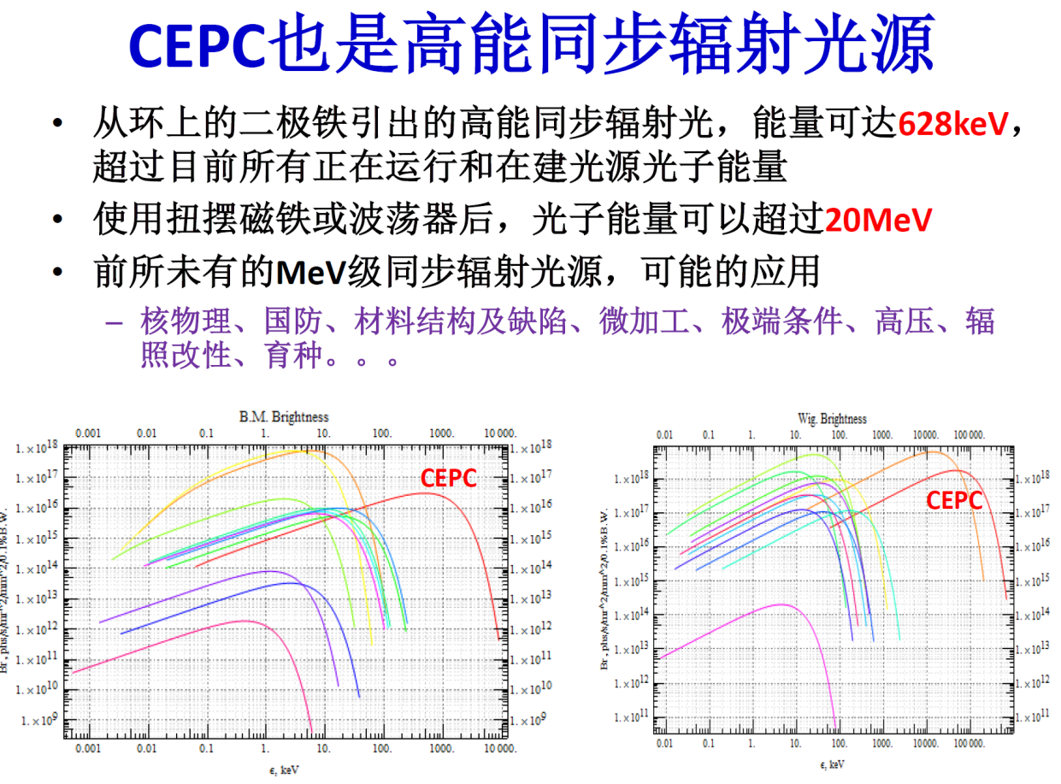
项目规划 Project Development ：高能伽马同步光源 γ light
实验物理中心、加速器组织
BEPCII上研究γ光源探索
  规划实验
  申请经费
  引进人才
  理论-实验探索
  第一次国内研讨会
第一届CEPC同步辐射光源应用研讨会
（6-8 Dec, 2017, IHEP, Beijing）
http://indico.ihep.ac.cn/event/7186/
开辟新的科研手段

