Slide 1
Research Highlights
— The BESIII Experiment —
Changzheng Yuan
IHEP, Beijing
June 13, 2018
Notes:
Good morning everyone, this meson spectroscopy review is supposed to be given by Changzheng, but unfortunately he can not be here due to the visa problem, so I will give this talk for him. The meson spectroscopy is a large topic, the talk today will focus on the new charmonium or charmonium-like states observed most recently.

Slide 2
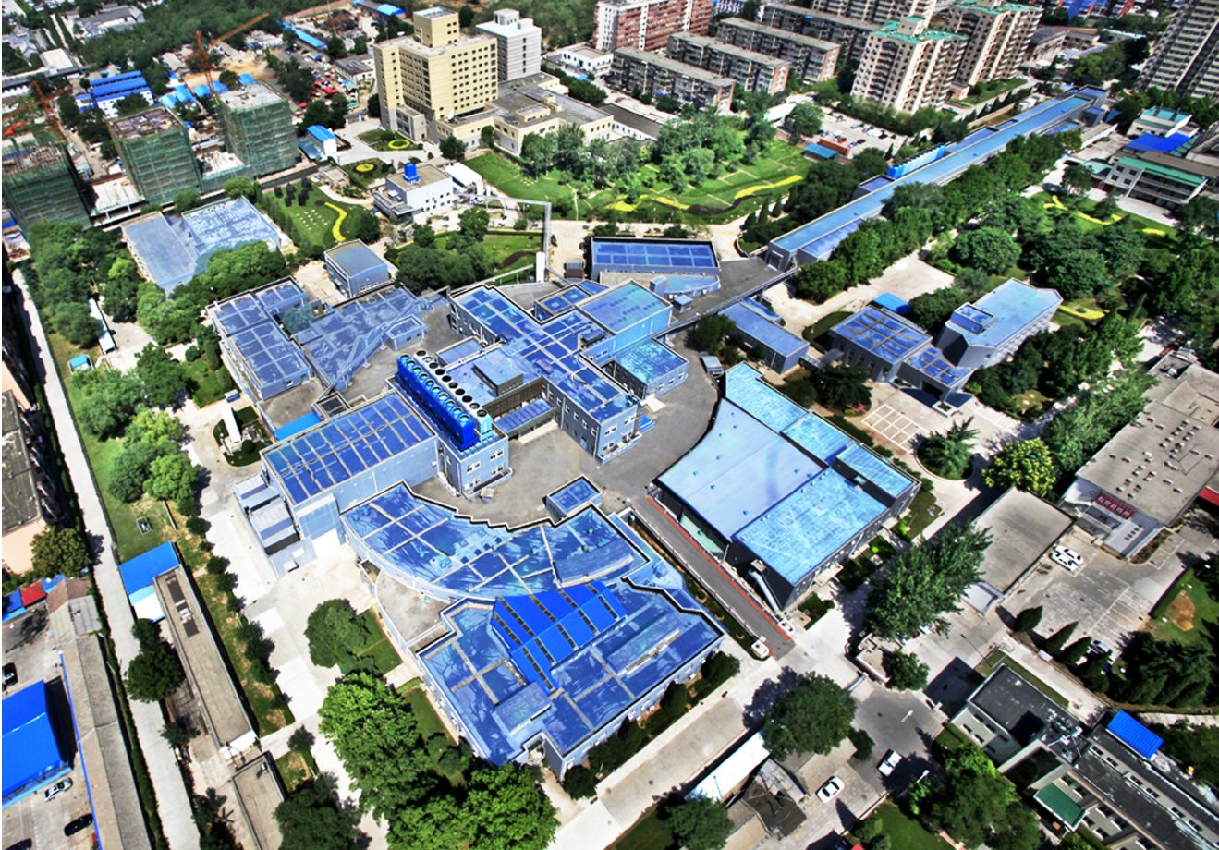
Beijing Electron Positron Collider (BEPC)
Construction started: 1984
Ecm = 2-4.6 GeV
1989-2005 (BEPC):
L_{peak}=1.0x10³¹ /cm²s
2008-now (BEPCII):
L_{peak}=1.0x10³³/cm²s
(Apr. 5, 2016)
Linac
BEPCII
(Beijing Electron-Positron Collider)
BESIII detector

Slide 3
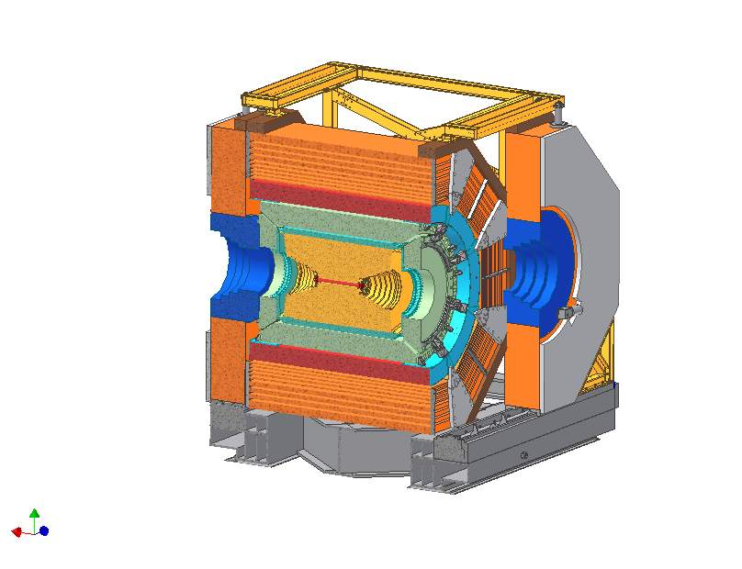
BESIII detector
SC magnet, 1 T
Magnet yoke
RPC
BTOF, 70 ps
ETOF, 60 ps
Be beam pipe
MDC, 120 μm
0.5% at 1 GeV/c
Total weight 750 tonnes, ~40,000 readout channels, Data rate: 5 kHz, 50 Mb/s
CsI(Tl) calorimeter, 2.5% @ 1 GeV
Has been in full operation since 2008,
all subdetectors are in very good status!

Slide 4
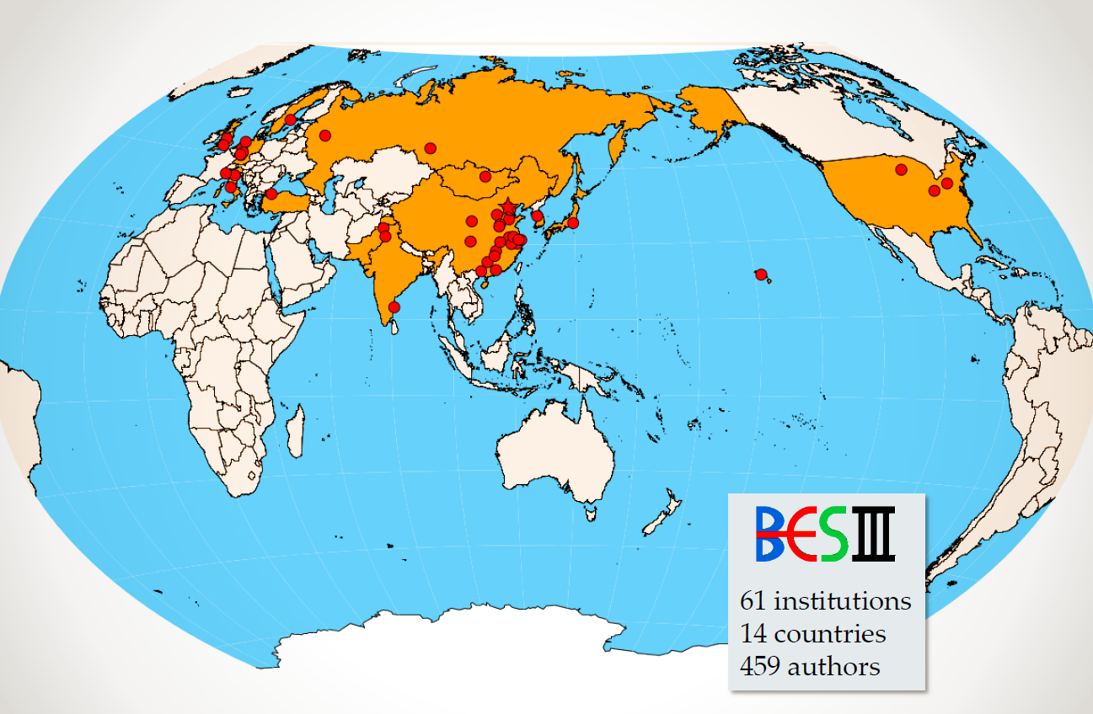
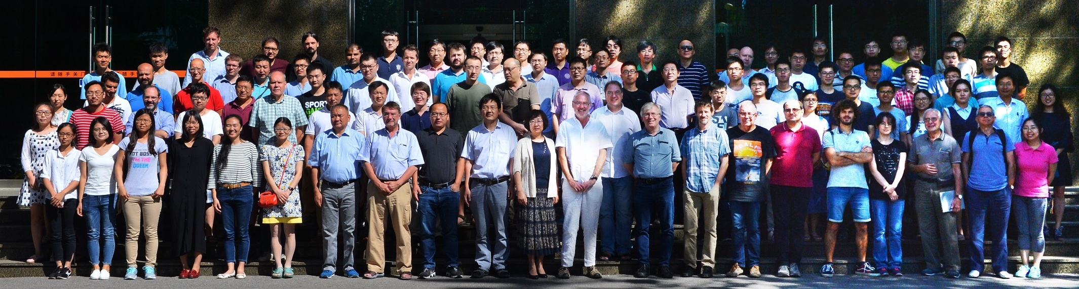
BESIII Collaboration
14 countries
64 institutions
~500 members

Slide 5
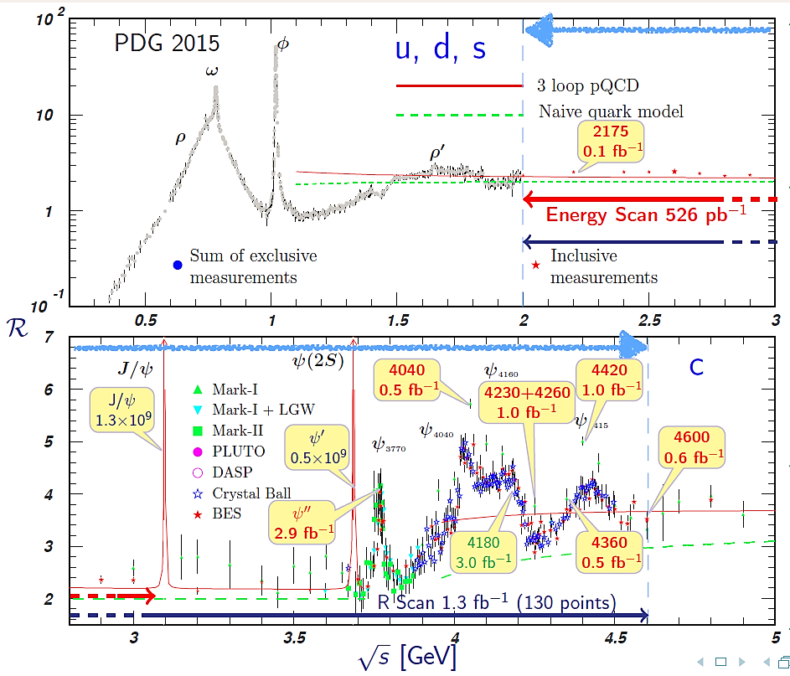
Can cover 0-4.6 GeV from direct annihilation or ISR
4190, 4200, 4210, 4220, 4236, 4245, 4270, 4280:
3.9 fb⁻¹
4230+4260
1.9 fb⁻¹
J/ψ
5x10⁹

Slide 6




New forms of hadrons = exotic states
Conventional hadrons consist of 2 or 3 quarks：
Naive Quark Model：
QCD predicts new forms of hadrons:
  Multi-quark states ：Number of quarks >＝ 4
  Hybrids ： qqg，qqqg …
  Glueballs ： gg， ggg …
meson
baryon
g
g
g
g
Goal of BESIII: establishing these new forms of hadrons

Slide 7
CKM matrix elements: precision test of SM
CKM matrix elements are fundamental SM parameters that describe the mixing of quark fields due to the weak interaction.
CKM matrix
BESIII + B factories + LHCb + LQCD
Three generations of quark?
Unitary matrix?
BESIII + B factories + LHCb + LQCD
Expected precision < 2% at BESIII
Precision measurement of CKM matrix elements
— a precise test of SM model
New physics beyond SM?

Slide 8
Publications
Year | PRL | PRD+PLB+EPJC | Other | Total
2013 | 3 | 20 | 2 | 25
2014 | 5 | 15 | 0 | 20
2015 | 6 | 28 | 2 | 36
2016 | 7 | 15 | 1 | 23
2017 | 6 | 29 | 3 | 38
2018 (+sub.) | 1 (+8) | 16 (+4) | 2 | 19 (+12)
Total | 28 | 123 | 10 | 161
~100-150 talks at international conferences
I report a few selected highlights from the last 5 years.

Slide 9
Discovery of the Z_{c}(3900)

Slide 10
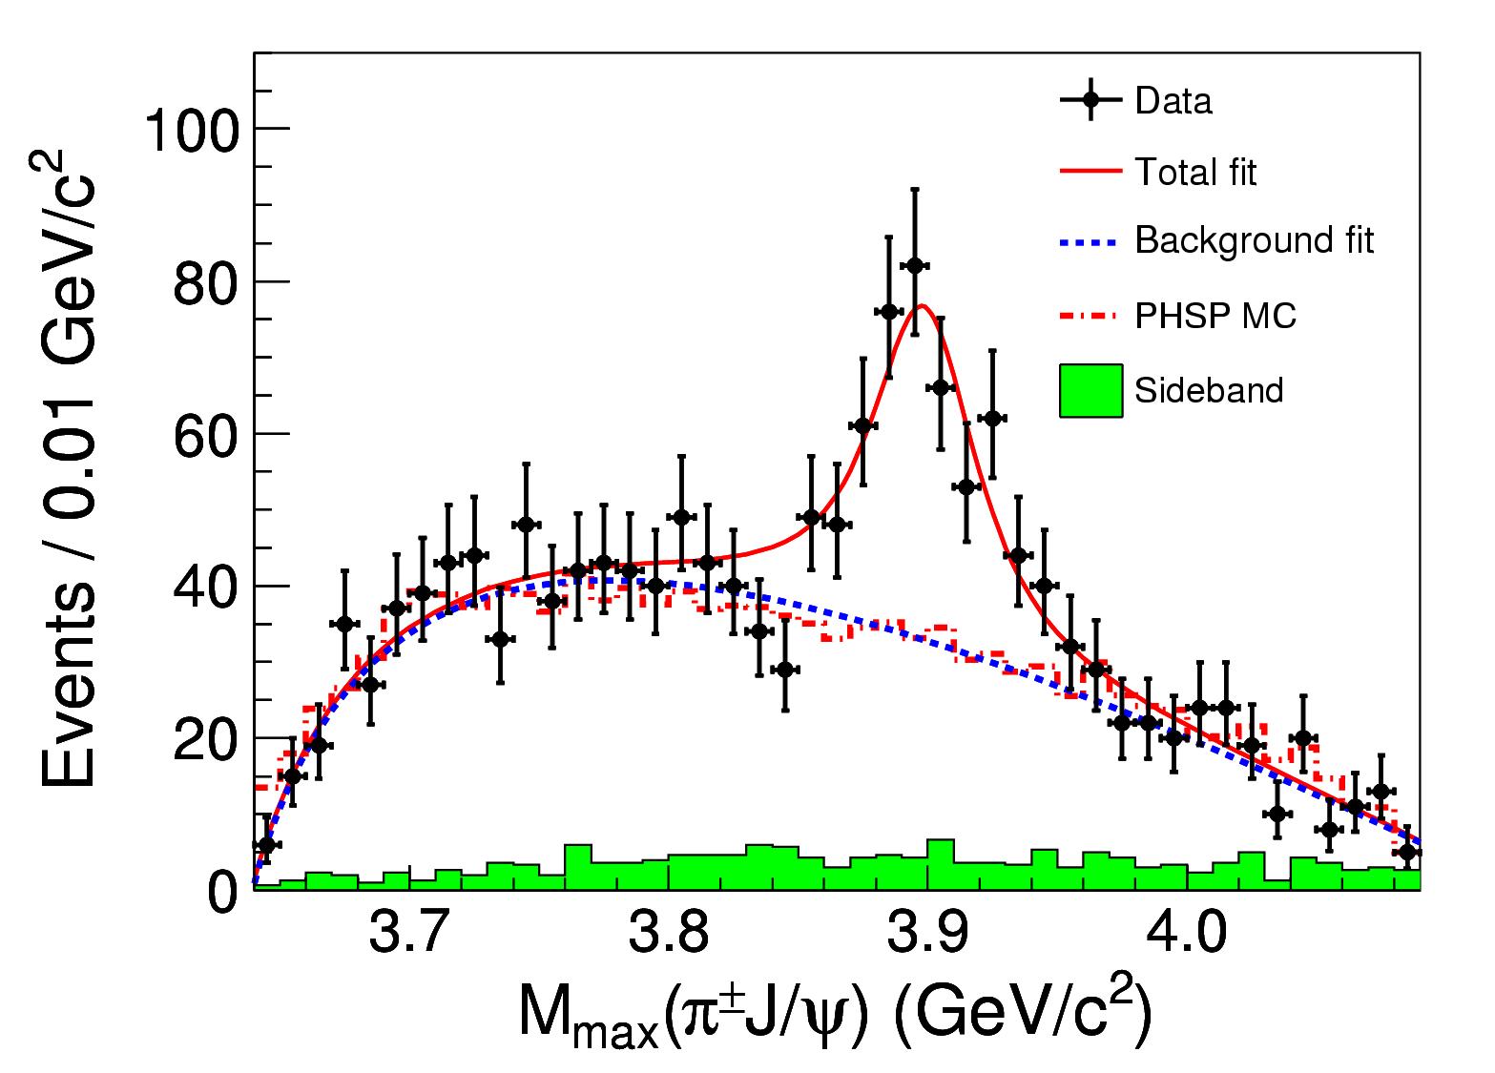

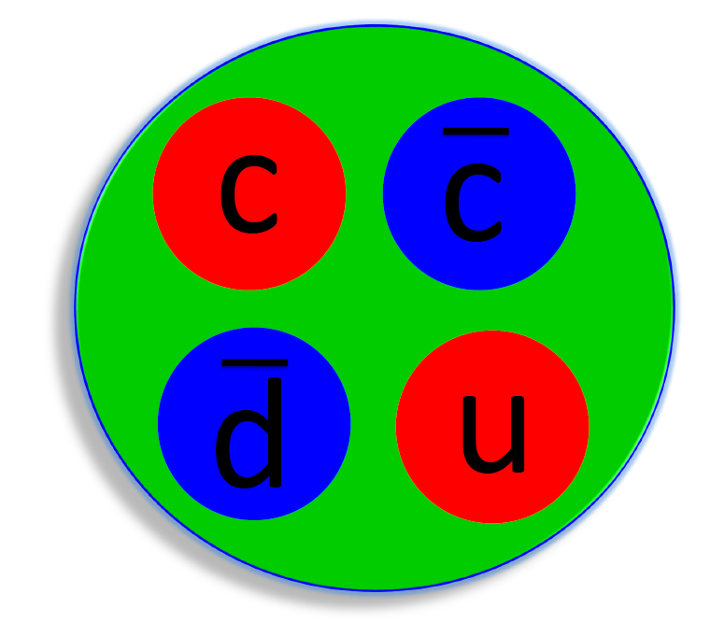
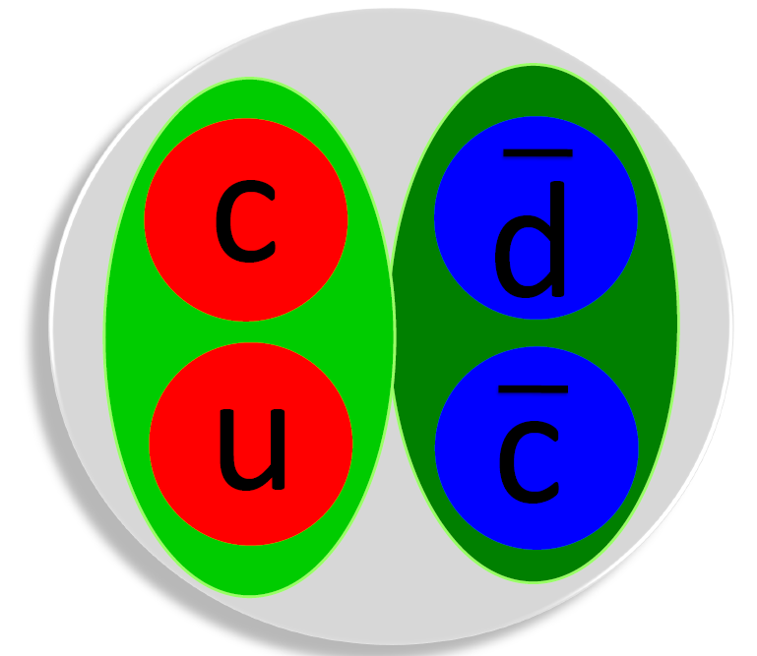
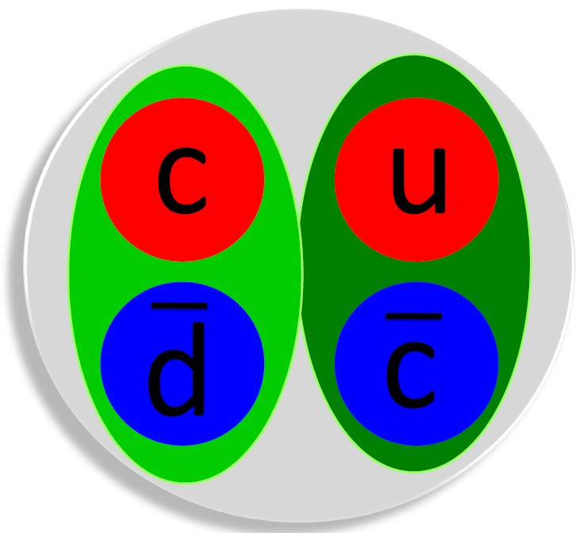
Discovery of the Z_{c}(3900)
Significance
>8σ
In e⁺e⁻→π⁺π⁻J/ψ events at 4.26 GeV, a particle decays into π±J/ψ is observed!
Couples to‾cc
Has electric charge
At least 4 quarks
A tetraquark state?
A‾DD* molecule?
Mass = (3899.0±3.6±4.9) MeV
Width = (46±10±20) MeV
Fraction = (21.5±3.3±7.5)%
PRL110, 252001 (2013)

Slide 11

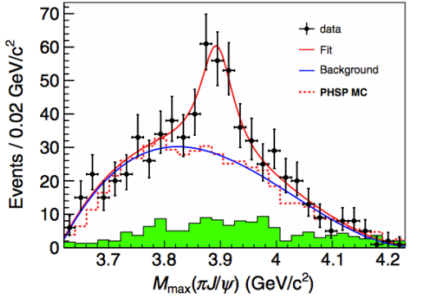
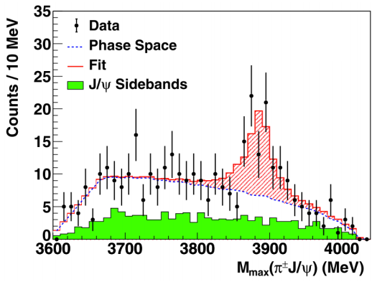



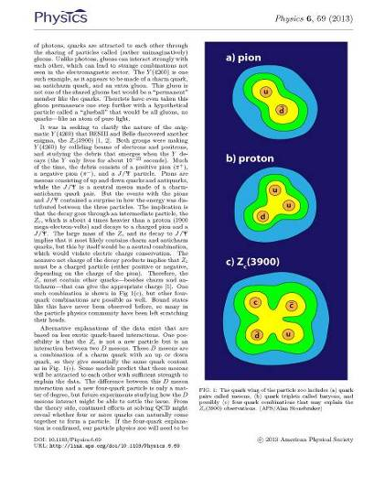
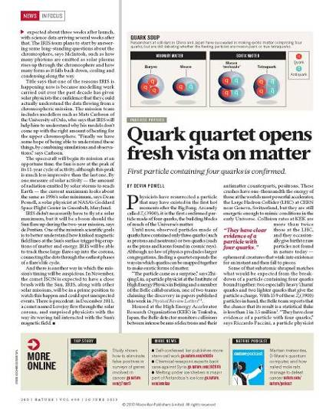
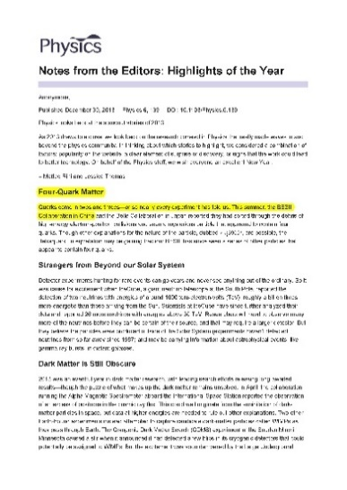
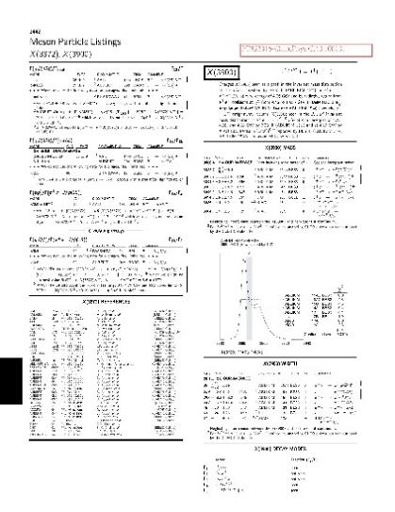
Z_{c}(3900) confirmed
Nature: Quark quartet opens fresh vista on matter
Physical Review Letters: New Particle Hints at Four-Quark Matter
“Four-Quark Matter”: Highlights of the Year 2013 by APS “Physics” magazine
A new entry in PDG “Review of Particle Physics” and “Particle Physics Booklet”
APS physics
Highlights
APS Physics
Nature
PDG 2016

Slide 12
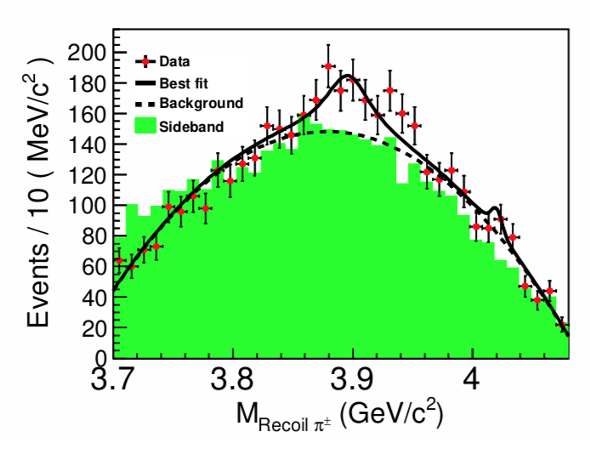
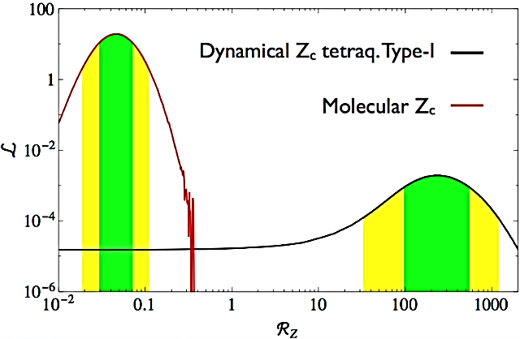
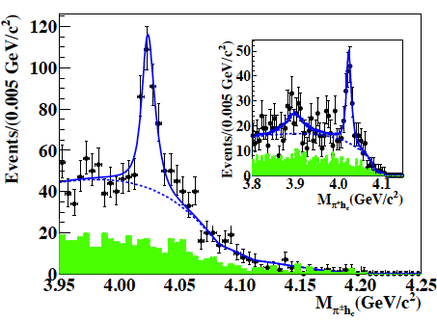
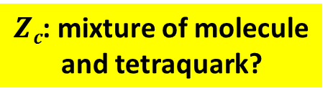


Properties of the Z_{c}(3900)
$Zc$: mixture of molecule and tetraquark?
I^{G}=1⁺
J^{PC}=1⁺⁻
Decay modes
  πJ/ψ
  ‾DD*
  ρη_{c} (4.3σ)
  πh_{c} (2.1σ)
Partner state: Z_{c}(4020)
  I^{G}=1⁺; J^{PC}=?^{?-}
  Couples to πh_{c} and‾D*D*
  Couples possibly to πψ’
  M=4022.9±2.8 MeV
  Γ=7.9±3.7 MeV
e⁺e⁻→$πZc ,Zc→ρ ηc$
$$Rz= \frac{Br(Z_{c}→ρηc)}{Br(Z_{c}→πJ/ψ)}$$
A.Esposito et al., PLB 746, 194

Slide 13

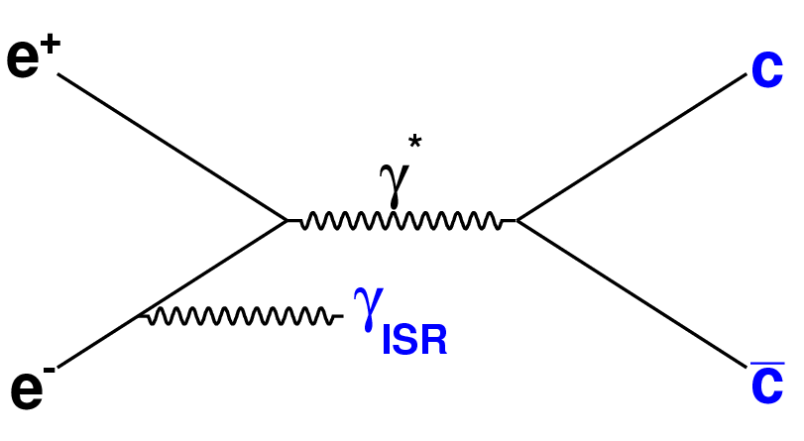
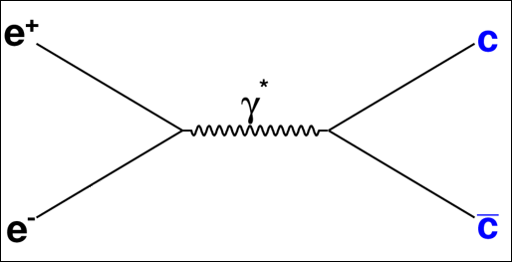
The Y(4220)

Slide 14
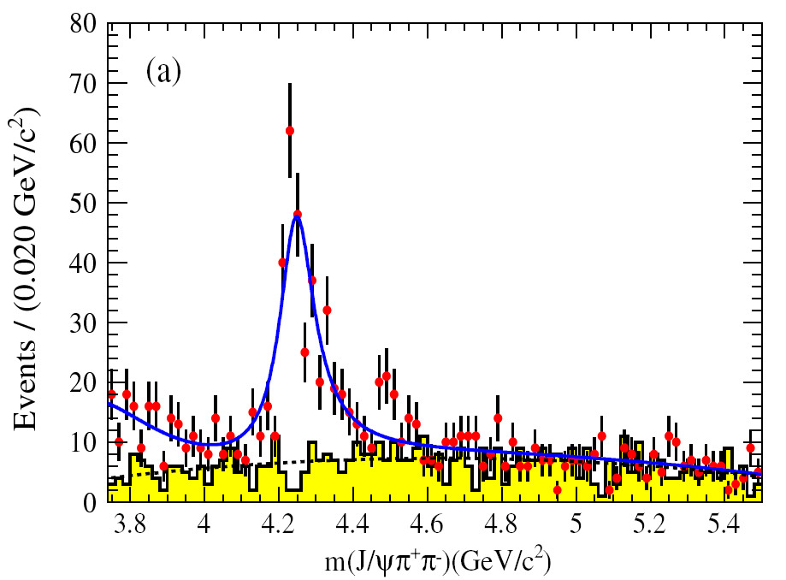
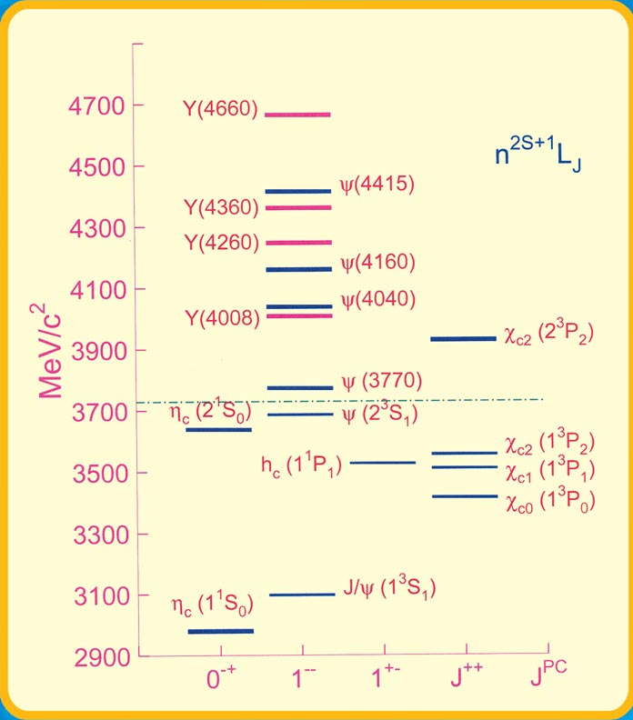
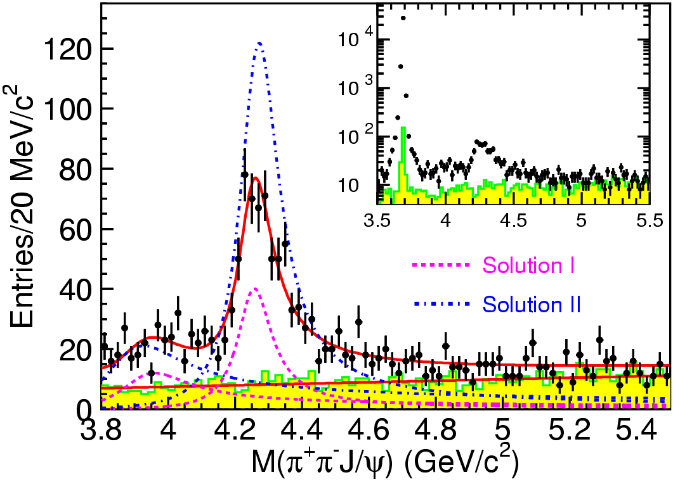
The Y(4260) from B factories
PRD86,051102
454/fb
PRL110,252002
967/fb
Overwhelming vector states!
Hybrid?‾DD₁ molecule? Hadro-charmonium?
Notes:
Recently, BaBar updated their analysis of ISR pi pi psip with the full data sample, and confirmed the existence of the Y(4660), while the the update of the ISR pi pi jpsi analysis from both Belle and BaBar experiments still show difference around the 4008 mass region. The data taken at BESIII and the line-shape study using the pi pi jpsi final states may help to clarify this discrepancy between the two B-factories.

Slide 15
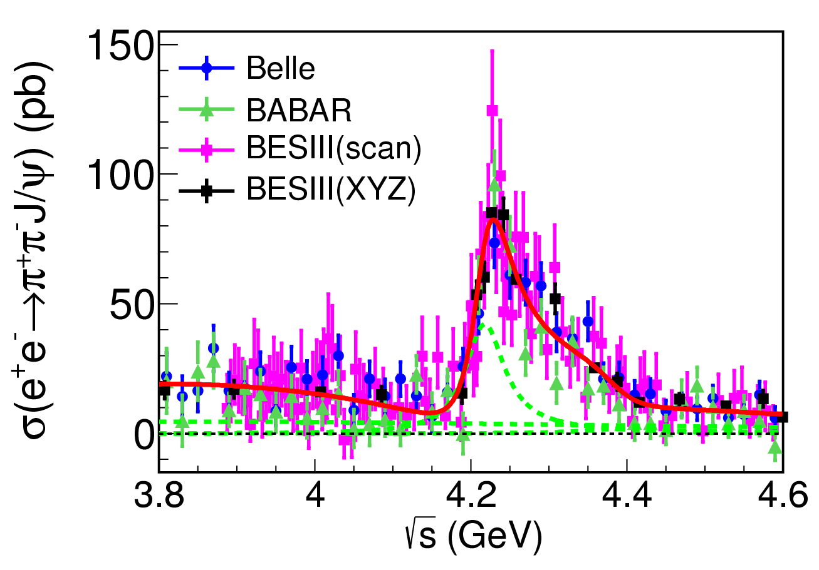

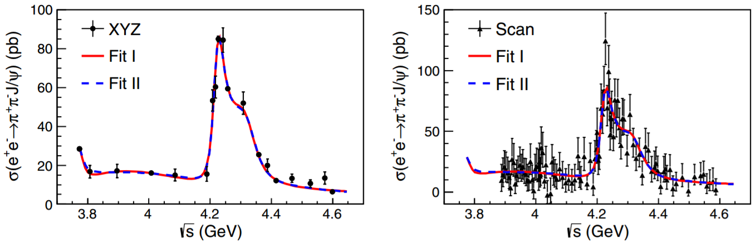

σ(e⁺e⁻→π⁺π⁻J/ψ): Y(4260)➔Y(4220)
data
8.2 fb⁻¹
19 points
PRL118, 092001 (2017)
Most precise cross section measurment to date from BESIII
M = 4222.0±3.1±1.4 MeV (lower)
Γ = 44.1±4.3±2.0 MeV (narrower)

Slide 16
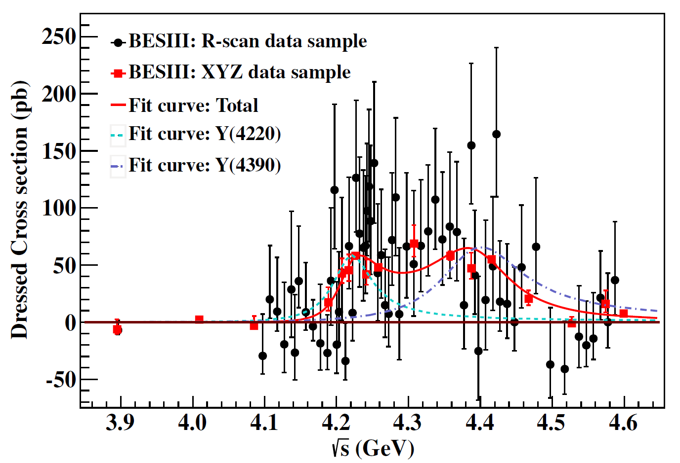
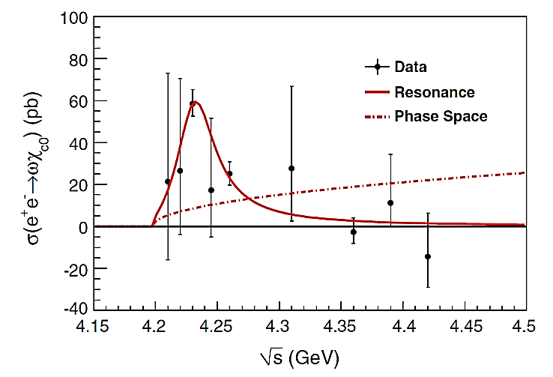
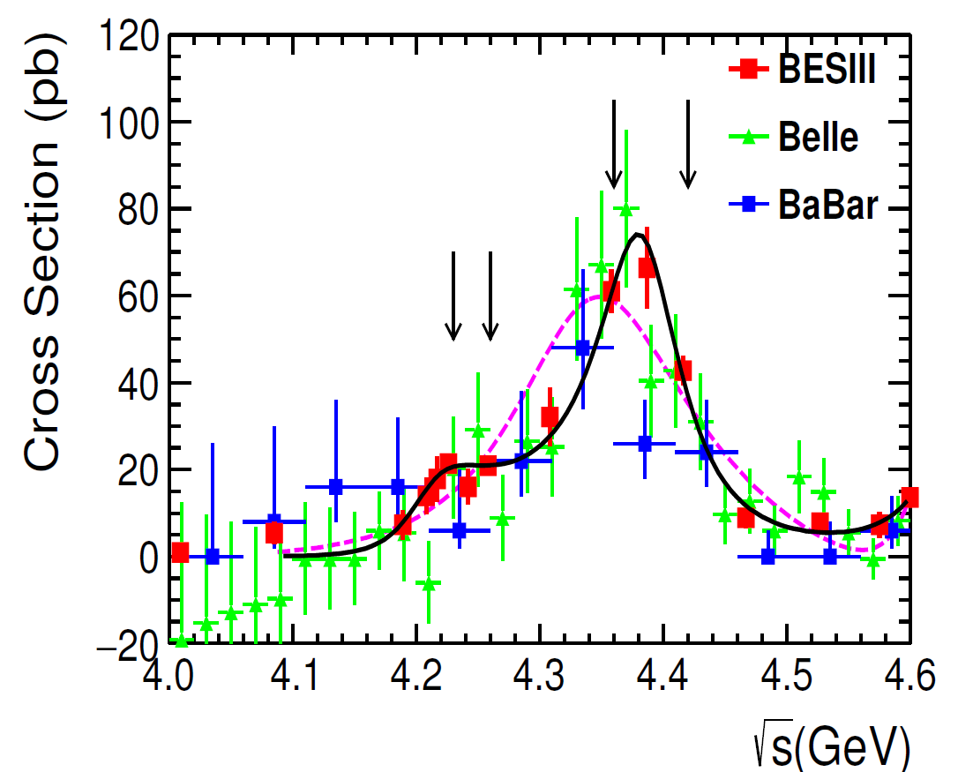
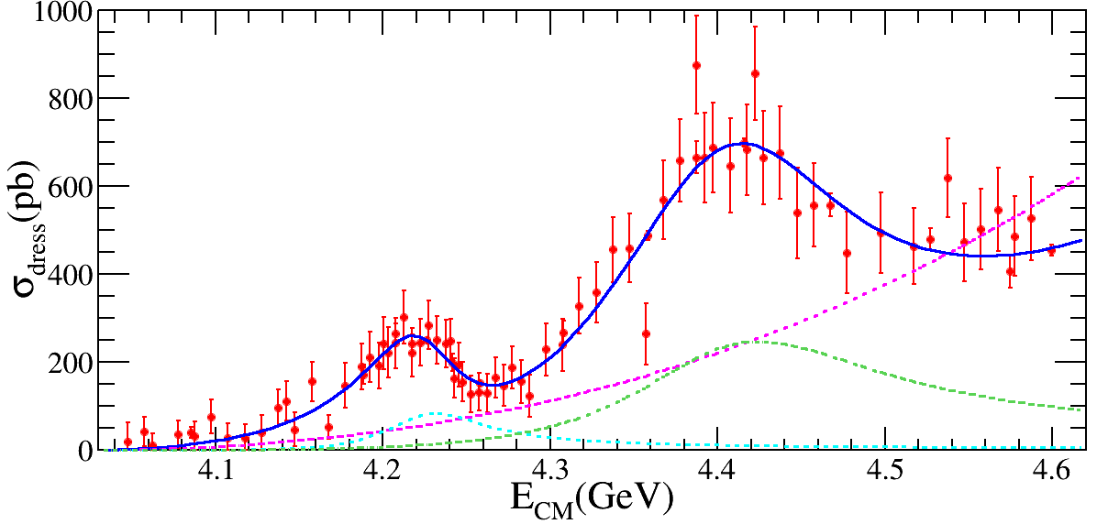
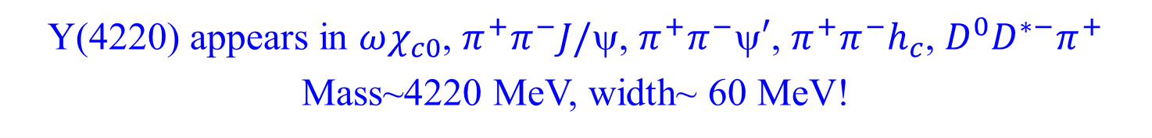
Y(4260)➔Y(4220): more modes
Y(4220) appears in $ωχ_{c0}$, $π^{+}π^{−}J/$, $π^{+}π^{−}′$, $π^{+}π^{−}h_{c}$, $D^{0}D^{∗−}π^{+}$
Mass~4220 MeV, width~ 60 MeV!

Slide 17
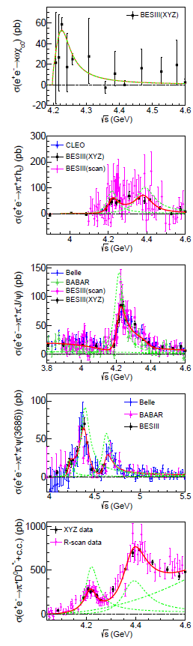
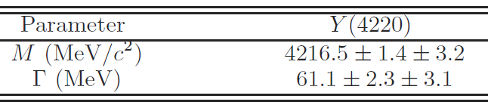
Coupled channel analysis
J. L. Zhang et al.,
arXiv:1805.03565
$$Γ_{e^{+}e^{−}}>\left(36.4±2.0\left(stat\right) ±4.2\left(sys\right)\right) eV$$
Hybrid?
  Mass agrees with LQCD
  Couples to e⁺e⁻ weaker than conventional ccbar
  Couples to spin-singlet strongly
‾D₁D molecule?
  S-wave open threshold
ψ(4S) state?
  Screened potential reduces 4S mass
‾D_{s}*D_{s}* molecule?
ωχ_{c0} molecule?
➔ More data and more theoretical work needed

Slide 18
Light Hadron States

Slide 19
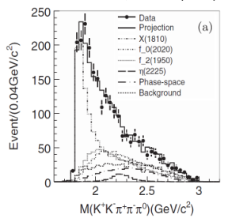
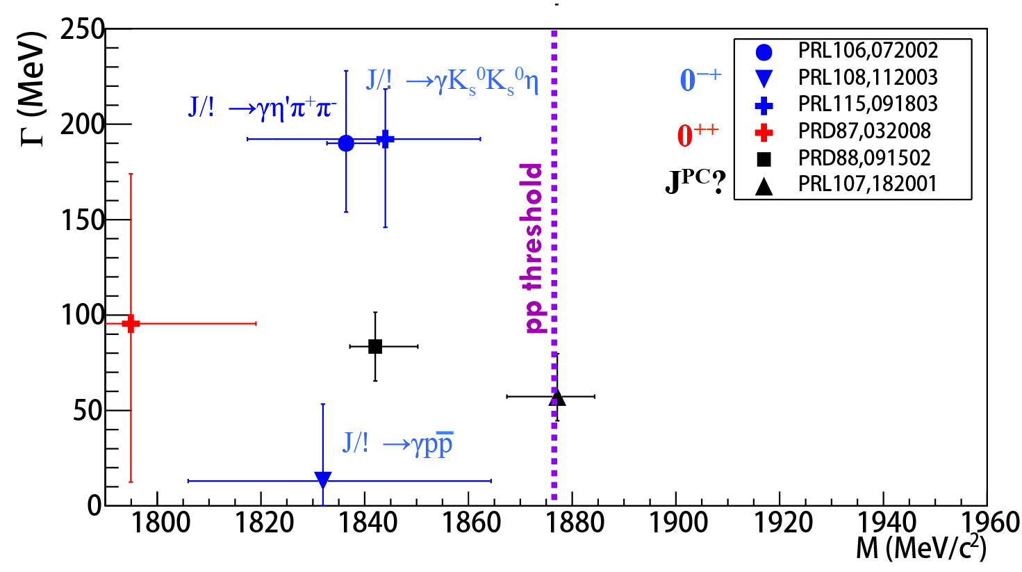

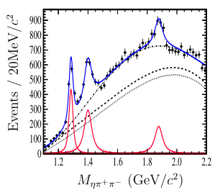

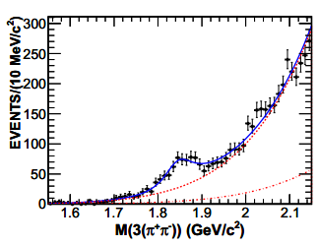

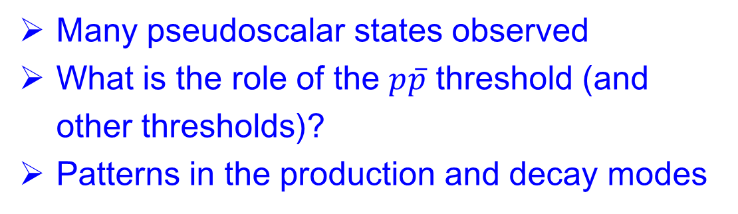
Light hadron X(18xx)
$$J/ψ→γηK_{S}K_{S}$$
$$J/ψ→γη^{′}π^{+}π^{−}$$
$$J/ψ→γωφ$$
$$J/ψ→γ3(π^{+}π^{−})$$
f₁(1285)
$$J/ψ→ωη{π^{+}π}^{−}$$
$$J/ψ→γp\overline{p}$$
η(1405)
X(1870)
Many pseudoscalar states observed
What is the role of the $p\overline{p}$ threshold (and other thresholds)?
Patterns in the production and decay modes

Slide 20
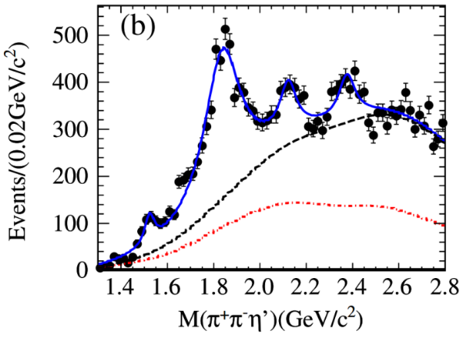
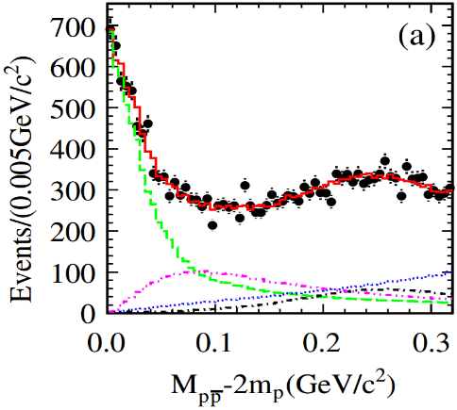
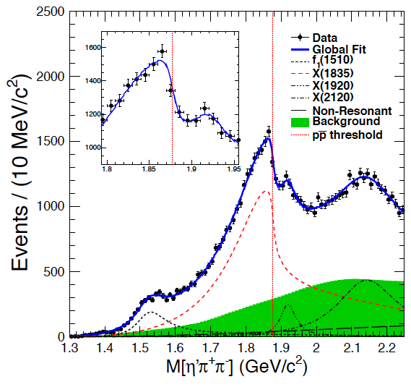
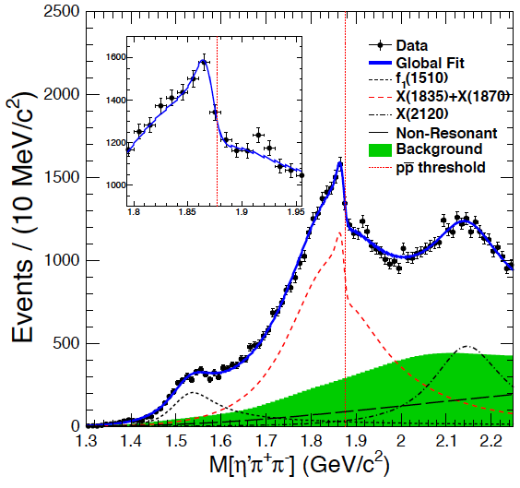
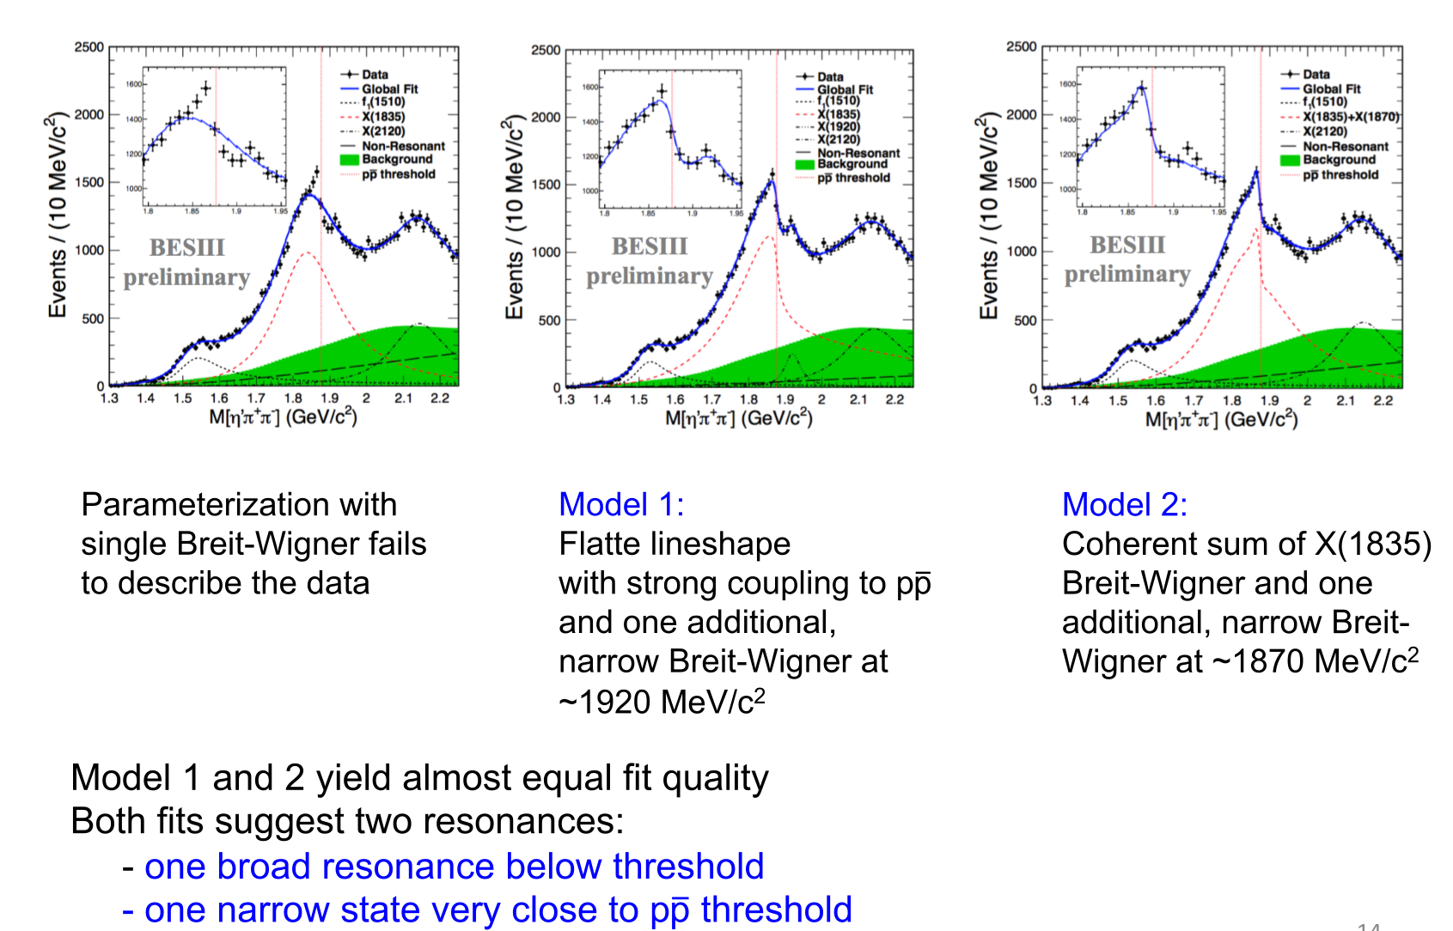

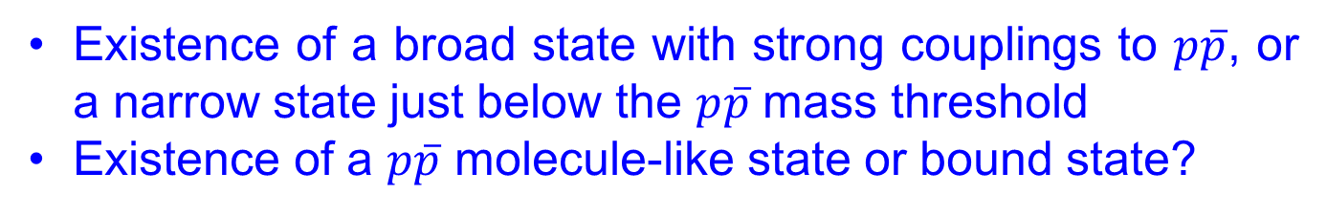

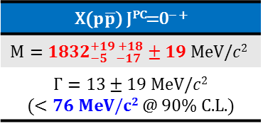
Anomalous line shape of η′π⁺π⁻ near $p\overline{p}$ threshold
X($1835$) observed in J/ψ→γ$η^{′}π^{+}π^{−}$
X($p\overline{p}$) observed in J/ψ→γ$p\overline{p}$
Phys. Rev. Lett. 106, 072002 (2011)
PRL 108, 112003 (2012); PRL 115, 091803 (2015)
X(1835) J^{PC}=0⁻⁻ ⁺
$$\text{M}= 1844±9_{−25}^{+16} MeV/c^{2}$$
$$Γ={192}_{−17−43}^{+20+62} MeV/c^{2}$$
X($p\overline{p}$) J^{PC}=0⁻⁻ ⁺
$$M={1832}_{−5 −17}^{+19 +18}±19 MeV/c2$$
$Γ=13±19 MeV/c2$ ($<76 MeV/c2$ @ 90% C.L.)
Connection is emerging
PRL 117, 042002 (2016)
Existence of a broad state with strong couplings to $p\overline{p}$, or a narrow state just below the $p\overline{p}$ mass threshold
Existence of a $p\overline{p}$ molecule-like state or bound state?

Slide 21
Charm Physics

Slide 22
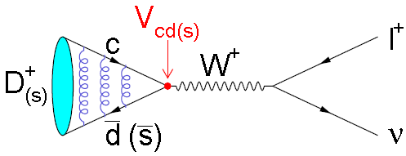
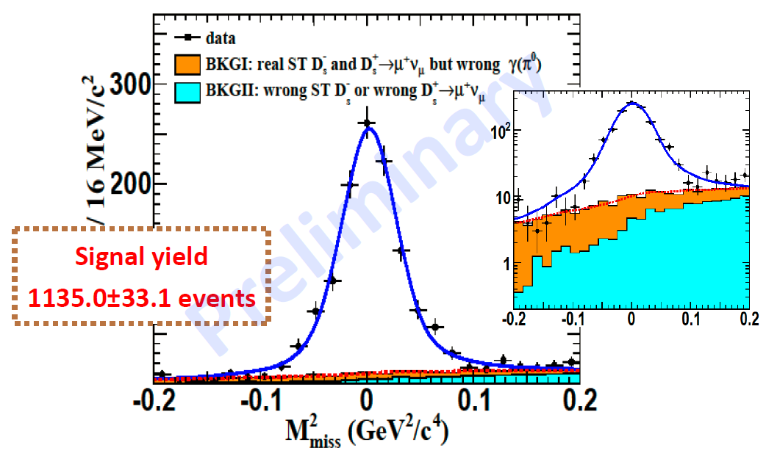
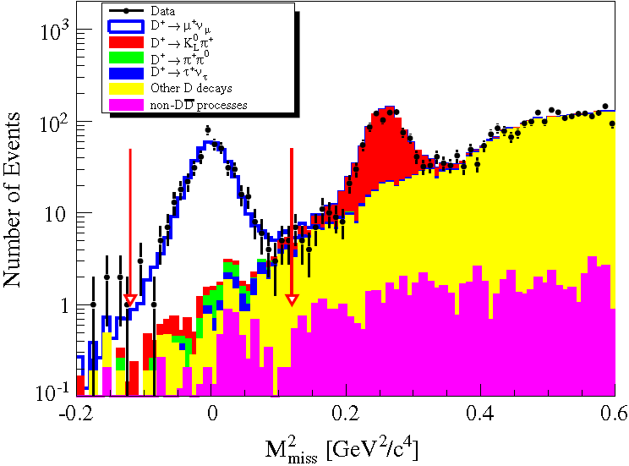
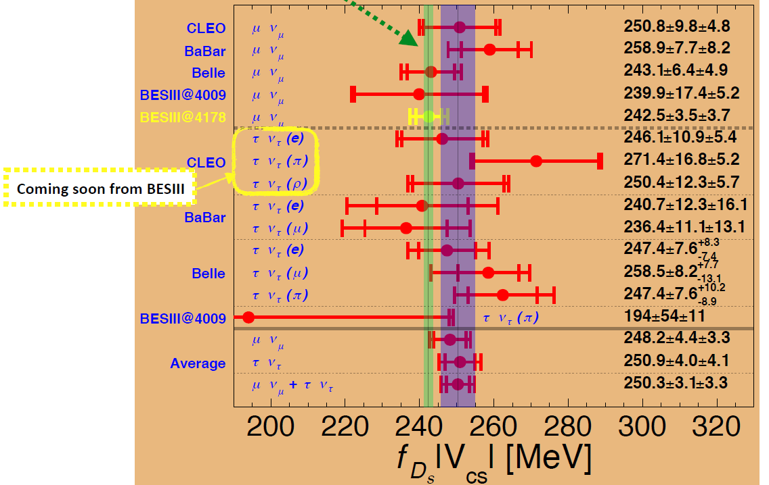
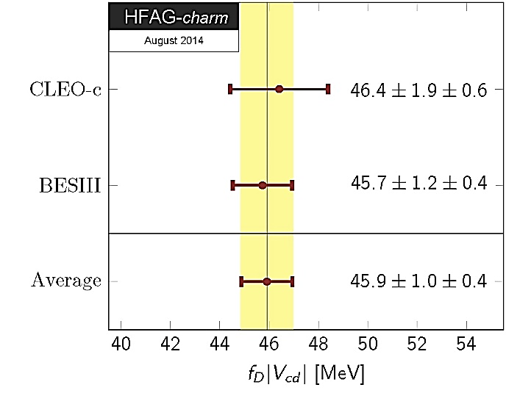
Leptonic decays of D and Ds
Decay constants to calibrate LQCD
|V_{cs(d)}| test unitarity of the CKM matrix
PRD89(2014)051104R
409±21 evts

Slide 23







Semileptonic decays of D and Ds
Precision of the form factors much better than LQCD calculation!
PRD92(2015)072012
PRD96(2017)012002

Slide 24




Hadronic decays and CKM angle γ
Interference → strong phase parameters c_{i} and s_{i} → γ/φ₃
➔ Important for σγ<1°

Slide 25
Precision Tests of SM

Slide 26





F_{π} and (g-2)_{μ}
Is the ~3σ difference a real effect?
had
Davier17
KNT17
A window for new physics searches! BESIII may further improve the measurement!

Slide 27
The Future

Slide 28
BEPCII upgrade
Increase of beam energy
  Ebeam=2.30->2.35->2.45 GeV
  Approved funding : ∼5M CNY
  Plan: get to 2.35 GeV in one year’s time
  Another 2 years’ time to get to 2.45 GeV, change ISPB (Interaction region SePtum Bending) magnet, big challenge
Top-up injection
  Data taking efficiency should increase by 20 ∼ 30%
  Approved funding : ∼12M CNY

Slide 29

Still a rich program ahead

Slide 30
HR from IHEP
Staff |  |  |  | Students & Postdocs
Professors | Assoc. Professors & Senior Engineers | Assist. Researchers & Engineers | Total
15 | 25 | 4 | 44 | 46
Leading scientists
  SHEN Xiaoyan (Spokesperson from Dec. 2011-Mar. 2018)
  YUAN Changzheng (Spokesperson, since Mar. 2018)
  LOU Xinchou (Deputy IB Chair)
  FANG Shuangshi (Physics Coordinator)
  LI Haibo, ZHU Kejun, HE Kanglin, DONG Liaoyuan, Sun Shengsen, ZHANG Jingzhi, MO Xiaohu, MA Hailong, LIU Beijiang, ……
International committee members: C11, APS, IEEE, QWG, …
Journal editorial board members: CPC, NIM, RDTM, …
Key speakers at LP, ICHEP, PIC, FB, …
IAC members of LP, ICHEP, CHARM, Tau, PhiPsi, …
Wang GC and Xie XD Physics Award, …

Slide 31
IHEP contributions
Operation
MDC & electronics | EMC & electronics | BTOF+ETOF & electronics | MUC | MUC electronics | Trigger & DAQ
IHEP | IHEP | IHEP | IHEP | USTC | IHEP
CGEM & electronics | MRPC ETOF & electronics | Inner MDC & electronics | Valve box for Magnet
INFN+IHEP | IHEP+USTC | IHEP | IHEP
Upgrade
Software,
Data processing
CGEM | MDC | EMC | TOF | MUC | Computing
INFN+IHEP | IHEP | IHEP | IHEP | IHEP | IHEP+……
Total | IHEP | IHEP supervisor + univ. student | Non-IHEP
161 | 64.5 | 67 | 29.5
Papers

Slide 32
Funding support (million CNY)
 | 2013 | 2014 | 2015 | 2016 | 2017
Detector operation | 8.75 | 8.31 | 8.75 | 11.86 | 17.10
Detector upgrade | 10.65 | 1.15 | 1.40 | 0.00 | 5.00
Research | 8.37 | 10.67 | 11.18 | 10.91 | 14.15
Total | 27.77 | 18.98 | 19.93 | 22.77 | 36.25
2018+: NSFC, MOST, CAS
We have enough resources to continue running the experiment for 5+ years!

Slide 33
Summary
BESIII is in a leading position in the experimental study of hadron physics and weak decays of charmed mesons
BESIII will continue data taking for at least 5 years
Better understanding of exotic hadrons and charm physics is expected!
May also contribute to new physics searches ……

Slide 34
Thank you!
谢谢！

Slide 35
Charmonium(like) spectroscopy
Charmonium-like (XYZ) particles
New type of hadron (multi-quark …)?
Too many vector states! Exotics?
charged
Y(4660)
Z_{c}(3900)
Z_{c}(4020)
Z_{c}(4430)
ψ(4415)
Y(4360)
Y(4260)
ψ(4160)
2017 Belle
ψ(4040)
χ_{c2}(2P)
χ_{c0}(2P)
2015 BESIII
ψ(3770)
X(3872)
ψ(1³D₂)
ψ(2S)
η_{c}(2S)
2005
h_{c}(1P)
χ_{c1}(1P)
χ_{c2}(1P)
χ_{c0}(1P)
1974
J/ψ
unpredicted, discovered
η_{c}(1S)
predicted, discovered
Godfrey & Isgur, PRD32, 189 (1985)

Slide 36
BESIII upgrade
CGEM inner tracker ongoing
3-layer design completed
Layer 1 finished, …
Electronics development and testing on schedule
Software development at full speed
Review Committee formed, installation in 2019
Magnet
  New valve box: funding approved ∼5M CNY

