Slide 1
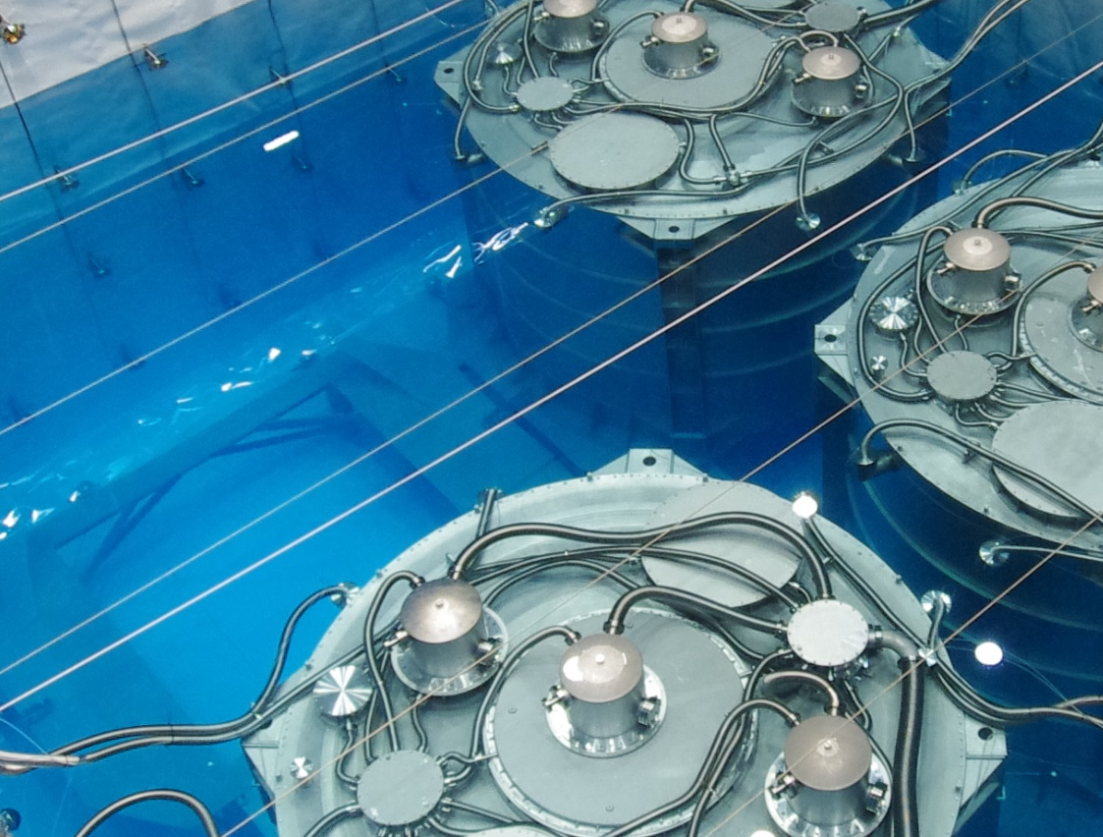
Neutrino Physics
CAO Jun
Experimental Physics Division
IHEP Institutional Assessment, June 13, 2018

Slide 2
Frontiers in Neutrino Physics
Neutrino oscillation
CP violation phase
Mass hierarchy
Precision measurements
Neutrino properties
Direct measurement of mass
Neutrinoless double beta decay
Exotic searches: sterile, magnetic moment, NSI, …
Neutrino astronomy
High energy cosmic neutrinos
Supernovas, diffuse SN background
Solar neutrinos
Geo-neutrinos
Neutrino Studies at IHEP

Slide 3
Neutrino Projects at IHEP
Aim to be a world-leading center for neutrino physics and neutrino astronomy.
Over the last 5 years:
Daya Bay operation and analysis
Most precise θ₁₃ and Δm²_{ee}, reactor ν spectrum, exotic searches
JUNO construction
Participation in EXO-200 analysis and nEXO R&D
R&D on MOMENT, LBNF, GasTPC, JUNO-0νββ
Work plan for next 5 years:
Complete Daya Bay operation and analysis
Complete JUNO construction and obtain 1st results
EXO/nEXO
R&D on MOMENT, LBNF, JUNO-0νββ, JUNO-ND, …

Slide 4
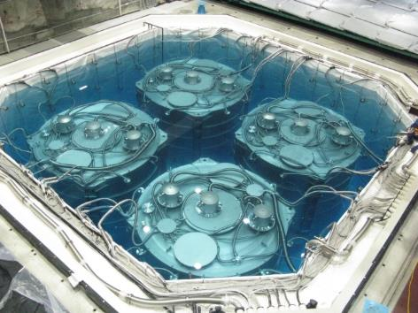
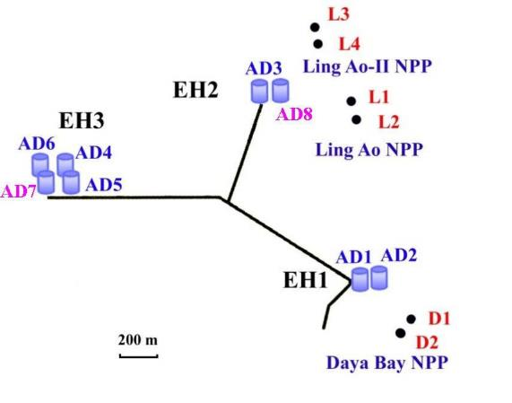
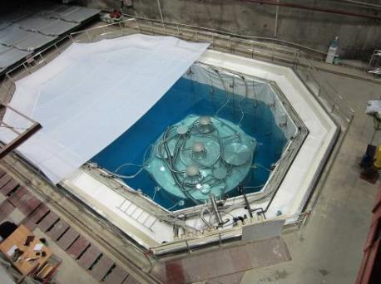
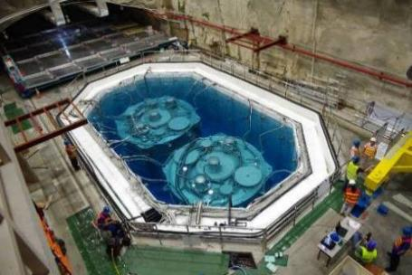
Daya Bay
Daya Bay Reactor Neutrino Experiment for θ₁₃. Proposed in 2003.
IHEP: Civil construction + ~1/2 detector.
US: ~1/2 detector.
Russia, Czechia, Hong Kong, and Taiwan: ~1 M$ each
Dec. 24, 2011
Collaboration
41 institutions, 193 collaborators
China (22), US (16), Europe (2), Chile
IHEP: 47 (~80 in 2011)
Aug. 15, 2011

Slide 5
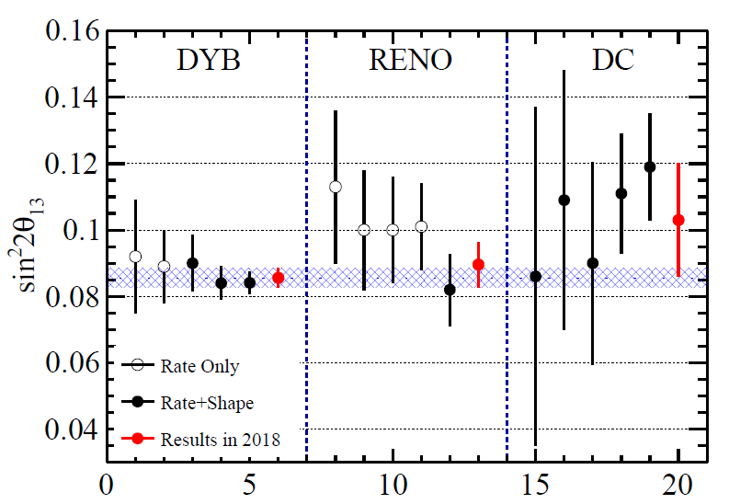
Oscillation Measurement
Daya Bay announced the non-zero θ₁₃ discovery in 2012
Released 5 results later on, all have high impact.
Citation ranking in ~50k papers / year in inSPIRE database (top 0.2%-0.4%) :
2013 | 2014 | 2015 | 2017
86 | 109 | 182 | 141

Slide 6
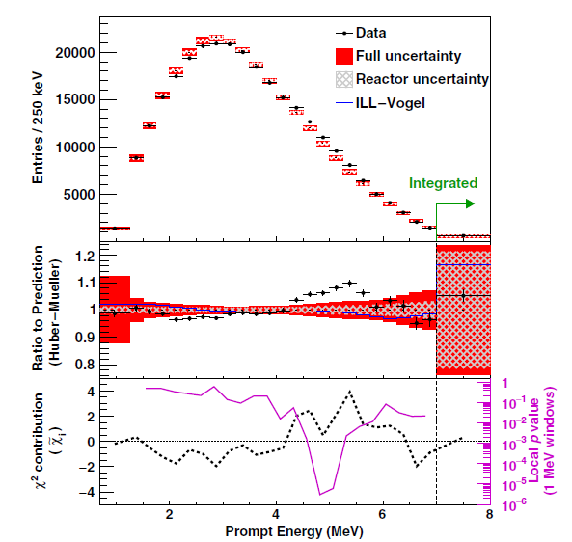
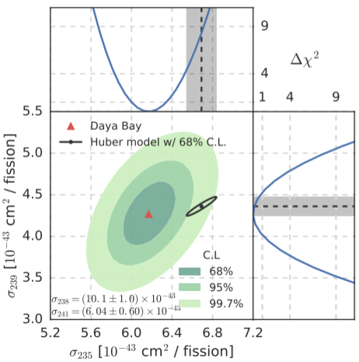
Reactor Neutrino Spectrum
PRL2016, CPC2017
PRL2017
Found two deviations from models
Flux 5% lower than model
Large excess around 5 MeV (4σ)
Precisely measured the spectrum
Which one of the 4 isotopes contributes to the deviation?
U-235, using fuel evolution
Both works were widely reported in the media, including Science

Slide 7
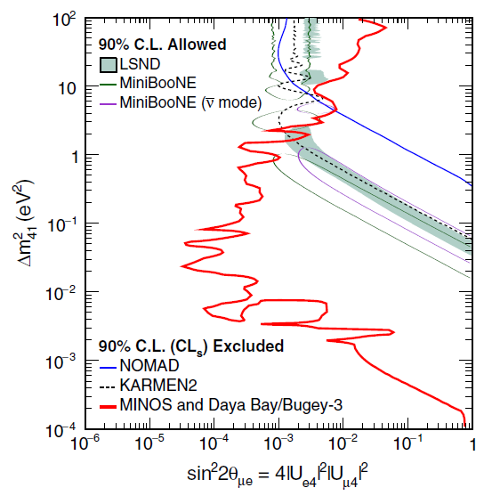
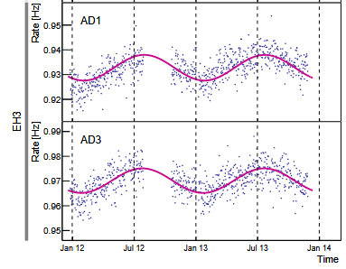
Sterile Neutrino Searches
Best sensitivity in 0.001-0.1 eV²
Combined w/ MINOS, largely excludes sterile neutrinos
PRL2014, PRL2016, PRL2016
Neutron yield measurement, PRD2018
Decoherence (wave packet), EPJC2017
Muon seasonal modulation, JCAP2018
Lepton violation and CPT violation
Other Studies
Widely reported by Scientific American, Nature, ScienceDaily, Phys.org, …

Slide 8
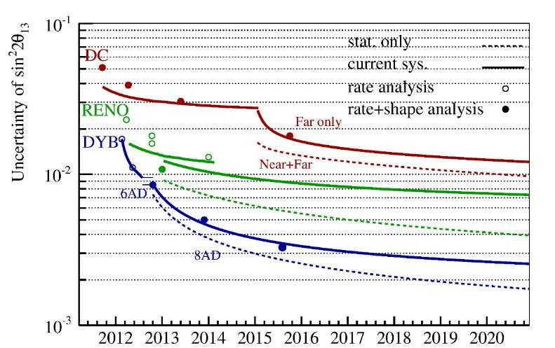
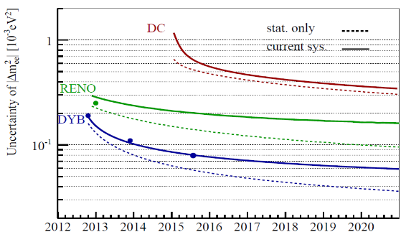
Daya Bay in Next 5 Years
Daya Bay will operate to the end of 2020, confirmed by the funding agency. Measure both sin²2θ₁₃ and Δm²_{ee} to <3%.
Most precise measurement of reactor neutrino spectrum.
>10 papers to be published in next 5 years.
sin²2θ₁₃
Stopped
Stop
Δm²_{ee}
Running to 2020

Slide 9
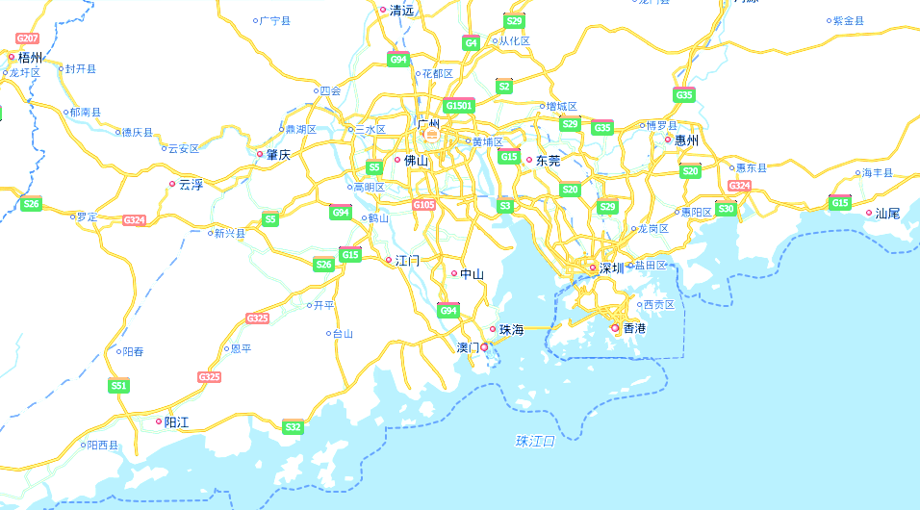
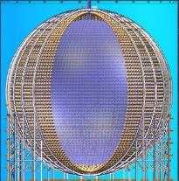
JUNO Jiangmen Underground Neutrino Observatory
Proposed in 2008 for mass hierarchy
Approved in Feb. 2013
~ 300 M$ (+10% international)
Data taking in 2021
20 kton LS detector
3% energy resolution
700 m underground
Guang Zhou
Dongguan
Daya Bay
Hong Kong
JUNO
53 km
53 km
Taishan NPP 9.2 + 9.2 GW
Yangjiang NPP
17.4 GW

Slide 10
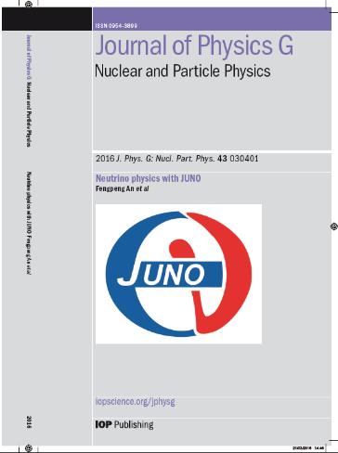
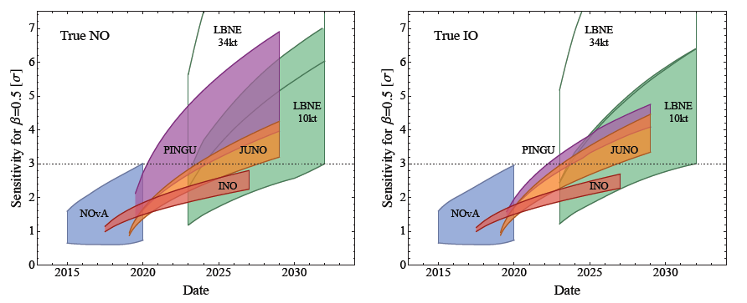
Neutrino Physics with JUNO
Yellow Book, J. Phys. G 43, 030401 (2016)
Mass Hierarchy w/ reactor: 3-4σ in 6 years
High chance of being the 1st MH measurement at 3σ
Precision w/ reactor: sin²θ₁₂, Δm²₂₁, Δm²₃₁ to <1%
Supernova bursts: 5k events + Neutral current
Diffuse SN background: Discovery potential
Geo-neutrinos: Determine Geo-physics model
Proton decay: Best in K channel
Solar, atmospheric, sterile, exotic searches
NOvA: 1/4 chance
ORCA: 2022 (?)
DUNE: 2026
Hyper-K: 2026
PINGU: 2025 (?)
INO: ?
M. Blennow et al.

Slide 11
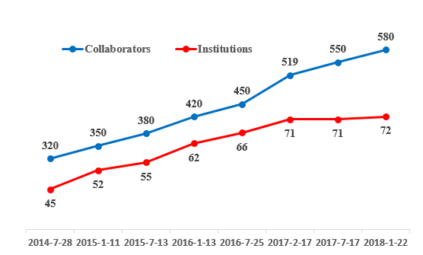
JUNO Collaboration
China (30), Taiwan (3), Thailand (3), Pakistan, Armenia
Italy (8), Germany (7), France (5), Russia (3), Belgium, Czechia, Finland, Latvia, Slovakia
Brazil (2), Chile (2), USA (2)
Spokesperson: Yifang Wang
Deputy-spokesperson: Jun Cao, Gioacchino Ranucci
IB Chair: Marcos Darcos

Slide 12
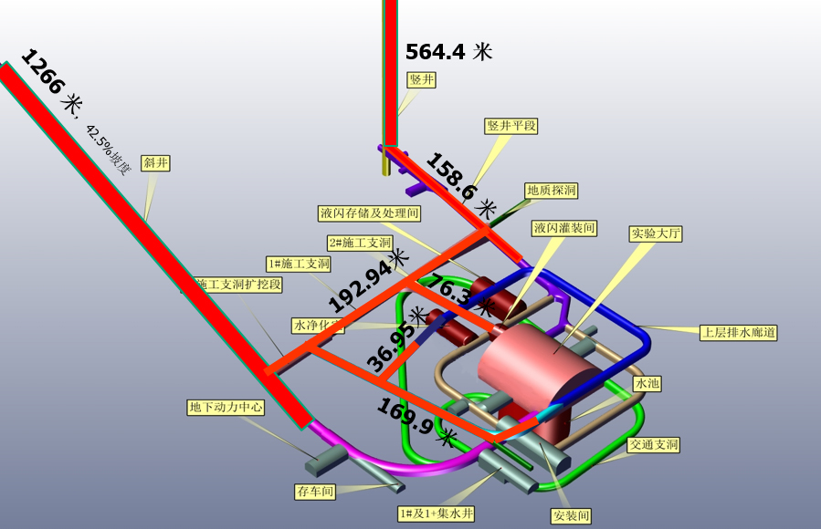
Civil Construction Progress
Finish the above-floor part of Experiment Hall in 2018. Finish all civil construction in 2019.

Slide 13
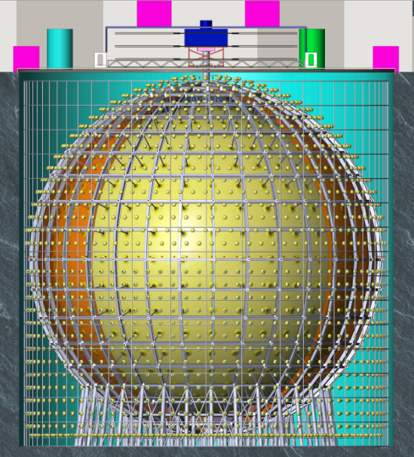
JUNO Detector
Calibration
Electronics
Top Tracker
Filling +
Overflow
Central detector
SS latticed shell
Acrylic Sphere:
ID: 35.4m
Thickness:120mm
SSLS:
ID: 40.1m
OD: 41.1m
Water pool
ID: 43.5m
Height: 44m
Water Depth: 43.5m
Acrylic sphere
(20 kt LS)
Acrylic sphere : ID35.4m
Pool Depth: 44m
18000 20” PMT
25000 3’’ PMT
Stainless steel latticed shell: ID40.1m
Water Cherenkov
~2000 20’’ PMT
Pool ID:43.5m

Slide 14
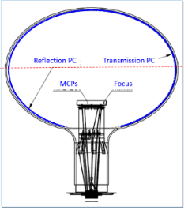
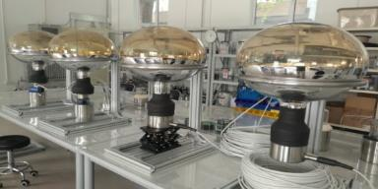
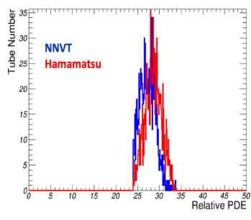
Major Breakthroughs – MCP-PMT
New type of 20-inch PMT based on MCPs
Started PMT R&D in 2008, chose MCP-PMT in 2009 (Patented by Y.F.Wang, S. Qian, T.C.Zhao, J. Cao in China, US, Russia, Japan, EU)
2013: 8” prototypes
2014: 20” prototype, PDE 15%
2015: Prototype PDE 26%, tender: 15k MCP, 5k Dynode
2016: Production line
2017: Batch average PDE 25% in March, 27% in April. 3.6k produced
2018: 6k produced. Recent batch average PDE 30%
First 1300 tested at JUNO
Type | # PMTs | PDE
MCP | 1354 | 27.3%
Dynode | 1229 | 28.6%

Slide 15
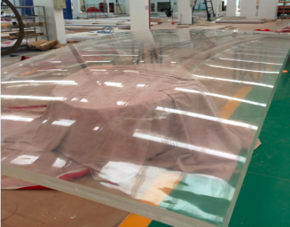
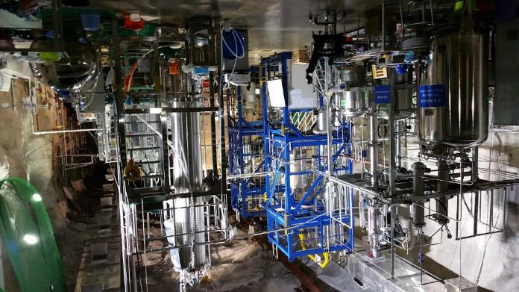
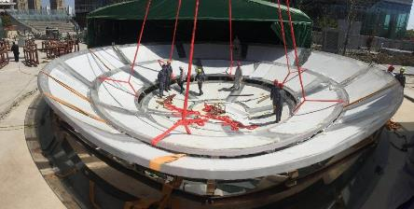
Major Breakthroughs – Acrylic, LS
35.4-m acrylic vessel
Solved all technical problems: No standards for construction, high precision curved sheet, anti-seismic, low bkg, fast bonding
Tender in 2017. Intl. reviews.
The most transparent liquid scintillator (attn. >20 m)
Al₂O₃ filtration
Distillation (Italy)
Gas tripping (Italy)
Water extraction
3x8x0.12m sheet
20 ton pilot plant at DYB
 | LAB (solvent) | LS (0.5g/L) | LS (3g/L)
Attn len | 25 m | 23.8 m | 20.5 m
Fast bonding test

Slide 16
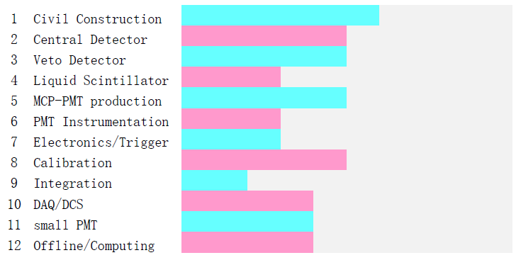
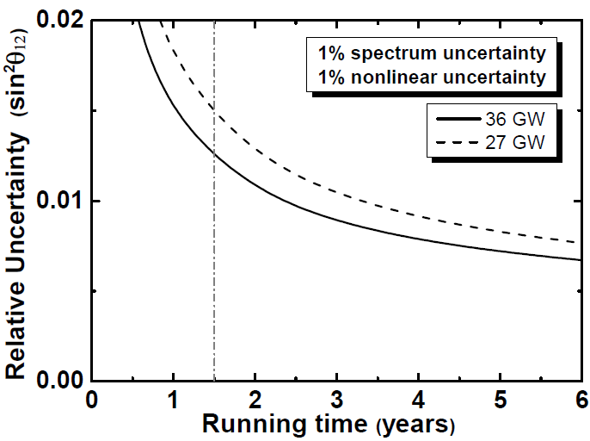
JUNO in Next 5 Years
Finish underground laboratory in 2019
Towards detector completion and operation in 2021
1.5-year operation:
Best sin²θ₁₂, Δm²₂₁, Δm²₃₁, 1.5% to 2%
Geo-ν, 400/year versus ~150 observed in Borexino+KamLAND
Best DSNB sensitivity
sin²θ₁₂
Most detector components have finished design and tendering

Slide 17
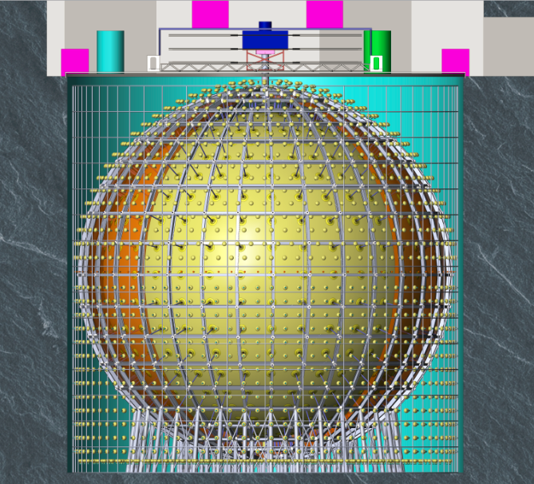
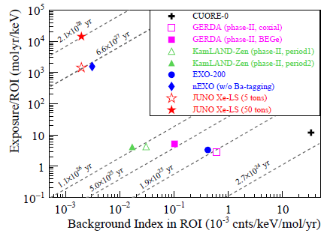
JUNO-0νββ
A possible upgrade: neutrinoless double beta decay w/ JUNO detector after MH determination (e.g. 2026)
Load 5 to 50-ton xenon in LS (also R&D on other isotopes)
Starting R&D on xenon enrichment w/ a company, aiming at 100 kg/year
CPC41, 053001 (2017)
Xe

Slide 18
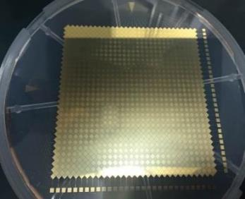
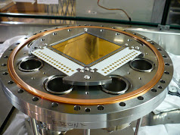
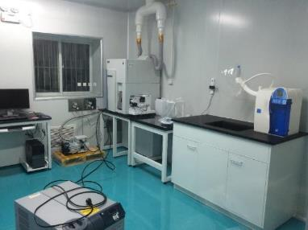
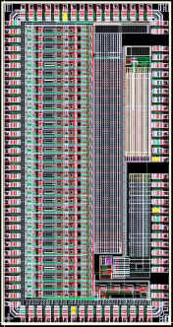
EXO-200/nEXO
EXO in US is one of the most sensitive 0νββ experiments
IHEP: 7 staff, 4 postdocs/students
L.J. Wen: was analysis coordinator, G.F. Cao: nEXO L2 manager
8.5 MCNY/yr in 2014-2018, need extra funding if nEXO approved.
nEXO R&D by IHEP
Charge readout, Ultra-UV reflective cathode
Low temp. ASIC electronics (noise 200 e)
ICP-MS low bkg measurement
Detector simulation & design optimization
Charge Readout Tile Prototype
Test at Stanford
ICP-MS
Analog multiplexing readout

Slide 19
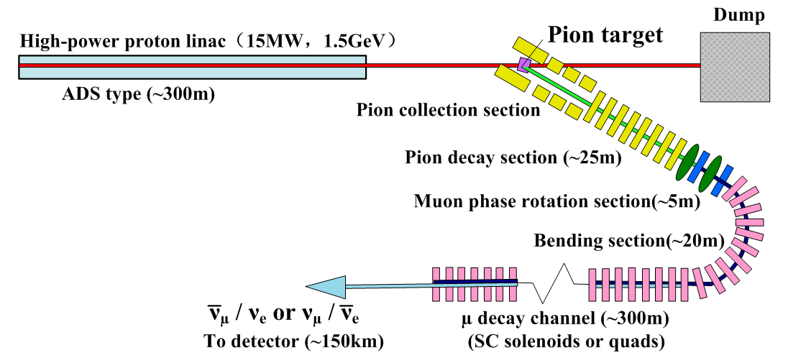
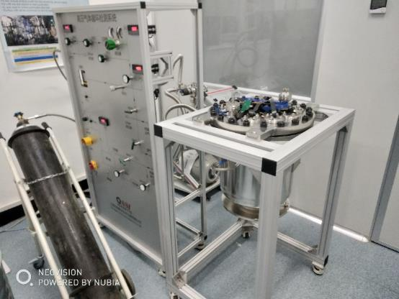
Other R&D
MOMENT: emerging scenarios, R&D on key tech (target)
Participating in LBNF in US, working on target, magnets, etc.
Gas TPC prototype for neutrino scattering
JUNO-Near Detector w/ SiPM → Best possible energy resolution
Neutrinos from muon decay
Proton linac for ADS ~15 MW
Ideal energy: 300 MeV/150 km
Good energy resolution & tracking
Reactor ν spectrum, mag. moment, θw

Slide 20
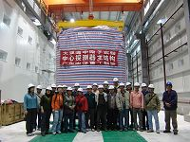
IHEP Neutrino Team
Starting from a few scientists in 2003, IHEP has built a strong team. ~80 scientists involved in Daya Bay, ~130 in JUNO.
Division | JUNO coll.
Experimental Phys. Div. | 96
Particle Astrophys. Div. | 16
Computing Center | 11
Theory Div. | 2
Multidisciplinary Div. | 1
FTE | Full Prof. | All Staff | Postdocs & Students
Daya Bay | 1.1 | 5.7 | 7.3
JUNO | 9.3 | 40.2 | 21.8
EXO | 0.35 | 2.25 | 2.2

Slide 21
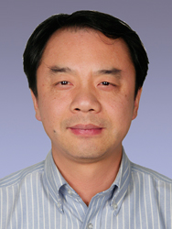
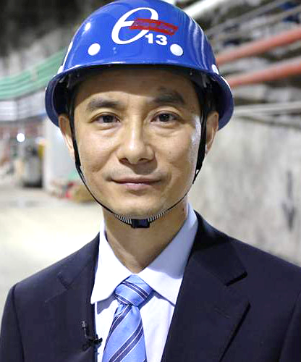
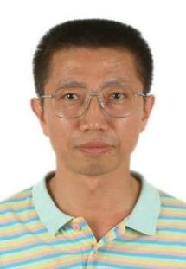
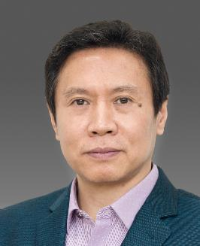
Leading Scientists
Wang Yifang
Spokesperson & Project manager of Daya Bay, JUNO
Proposed Daya Bay, JUNO, MOMENT, JUNO-0νββ
Proposed and led MCP-PMT
Breakthrough Award, Panofsky Prize, Nikkei Asia Prize, Pontecorvo Prize, …
Cao Jun
Current Daya Bay co-spokesperson, JUNO deputy spokesperson
Led Daya Bay neutrino detector, LS, physics and analysis
Proposed JUNO
C.N. Yang Award
Yang Changgen
A founding leader of Daya Bay.
Leads the Daya Bay and JUNO veto detector
Deputy project manager of Daya Bay and JUNO
WANG G.C. Award of Chinese Physical Society
Xing Zhi-zhong
Head of Theory Division
Proposed the “democratic” mixing pattern w/ H. Fritzsch (258 citations); the first “nearly tri-bimaximal” mixing pattern (420 citations)
Plenary review talk at ICHEP2008.

Slide 22
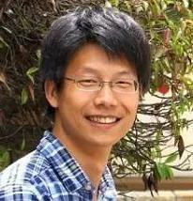
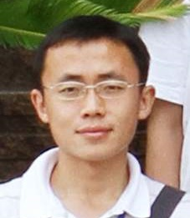
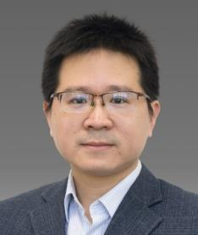
Leading Scientists
Wen Liangjian, Full Prof.
Analysis coordinator of JUNO
PI of EXO-IHEP group
major contributor of the θ₁₃ discovery
IUPAP-C11 Young Scientist Award
He Miao, Full Prof.
Leader of Neutrino Group in EPD
L2 manager of JUNO on sPMT
Zhou Shun, Full Prof.
Neutrino theorist.
Fermion masses and flavor mixing, neutrino mass models, neutrino astrophysics and cosmology
> 60 papers, > 2000 citations.

Slide 23
International Visibility
Many plenary talks on Daya Bay, JUNO, overviews of reactor neutrinos and detectors at major conferences like ICHEP, Lepton-Photon, Neutrino, TIPP, WIN, etc.
A partial list of important plenary talks by young members
Conference | Year | Speaker | Title
Neutrino | 2014 | Liangjian Wen | Future Reactor Experiment
Lepton-Photon | 2015 | Shun Zhou | Theoretical results on neutrino
ICHEP | 2016 | Liangjian Wen | Exploring Neutrino Puzzles
Neutrino | 2016 | Zeyuan Yu | New results from Daya Bay
TIPP | 2017 | Liangjian Wen | Neutrino Physics and Detectors
More plenary talks at NuFact, NNN, Tau, etc. by M. He, J. Zhao, H.Q.Lu
Young members served as
IAC of Lepton-photon: Shun Zhou
Co-chair of NNN: Miao He
Conveners of ICHEP, NuFact, NNN, Applied Nu Workshop: Liangjian Wen, Zhimin Wang, Miao He, Yufeng Li

Slide 24
Awards
Domestic (5) International (6) | Awardee | Date
Zhou GZ Award For Basic Sciences | Y.F. Wang | 2013.5.25
AAPPS C.N. Yang Award | J. Cao | 2013.7.15
CPS Wang GC Physics Award | C.G. Yang | 2013.9.12
APS W.K.H Panofsky Prize | Y.F. Wang | 2013.9.30
Awards of the H.L.H.L.Foundation | Y.F. Wang | 2013.10.30
Outstanding Achievement Prize of CAS | Daya Bay | 2014.1.10
Nikkei Asia Prize | Y.F. Wang | 2015.5.20
Breakthrough Award | Y.F. Wang, Daya Bay | 2015.11.9
IUPAP Young Scientist | L.J. Wen | 2016
1st-Grade National Natural Science Award | Y.F. Wang, J. Cao, C.G. Yang, Y.K. Heng, X.N. Li | 2016.12.21
Pontecorvo Prize | Y.F. Wang | 2017.2.27

Slide 25
Funding
Daya Bay operation funding: 12 MCNY/year
JUNO construction: 747 MCNY in last 5 years, approved 1323 MCNY to 2023
Daya Bay analysis and physics
 |  |  | Total (MCNY) | IHEP (MCNY)
MoST | 2013-2017 | Daya Bay Physics & Maintenance | 36.9 | 19.5
NSF | 2014-2018 | Daya Bay Physics & Detector Studies | 18 | 10
MoST | 2018-2022 | Daya Bay Physics & JUNO Physics | 18 | 5.8
 |  | Sum: | 72.9 | 35.3
22 individual grants: > 20 MCNY

Slide 26
Summary
Daya Bay has continued its impact in the last 5 years
Precision meas., reactor ν spectrum, exotic searches
Daya Bay will take data to 2020
sin²2θ₁₃ and Δm²_{ee} to < 3% precision, best in future 20y?
JUNO construction going well, making breakthroughs in key technology such as MCP-PMTs, acrylic vessel, liquid scintillator, etc, aiming at data taking in 2021.
R&D on JUNO-0νββ, JUNO-ND, nEXO, MOMENT, etc.
IHEP aims to be a world-leading neutrino research center. After 15 years’ effort, a strong team has been built for reactor neutrinos and 0νββ. Started on neutrino astronomy.
Led by IHEP, the neutrino community in China is growing. Broad international cooperation has been established.

Slide 27
Thank you!

Slide 28
2013 Assessment Comments
Daya Bay + future JUNO, MOMENT, and EXO II
Daya Bay:
“Data taking should continue for several years to improve the precision of the oscillation measurement and search for unexpected effects.”
JUNO
“ambitious and very competitive, but very challenging to fulfill in 2020.”
“an international collaboration would further bolster these efforts.”
EXO II
“if IHEP expects to have an impact and visibility it will have to be prepared to devote resources and experienced staff in the very near future.”
MOMENT:
“a sustained design study of MOMENT should be pursued.”
“The requirements of MOMENT on ADS-R&D’s performance and completion date should be clarified so that MOMENT can be ready to serve JUNO as a high intensity neutrino source.”
A: focusing on technological studies, for emerging physics cases

