Slide 1
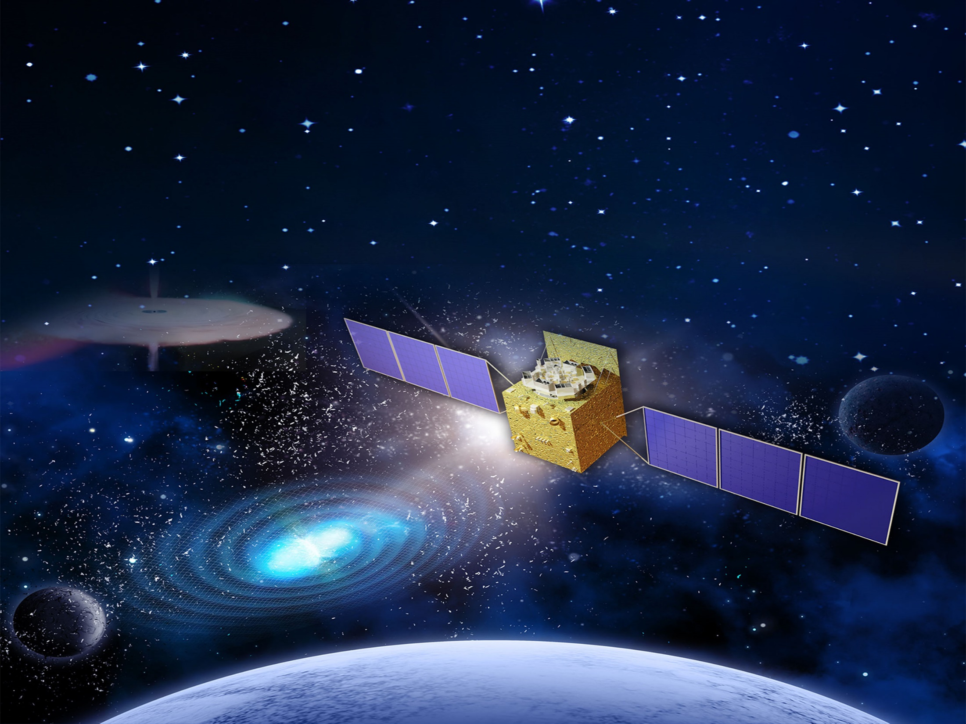
Particle Astrophysics Division (PAD)
Prof. ZHANG Shuangnan
International Assessment, June 13, 2018

Slide 2
About PAD
High energy CRs
charged particle , neutrino,
γ-ray
Intense explosion
GRB, compact object,
BH accretion
Cosmic evolution
galaxy, cluster,
cosmology
Subjects
Deep Structure of Matter
Large-scale Physical law
Science Theme
Underground
neutrino, dark matter,
particle physics
High Altitude
ASγ, ARGO, LHAASO
Space-based
AMS, HXMT, DAMPE,
SVOM, POLAR,
EP, GECAM
Facilities
Neutrino group
AMS/CMS group
Astrophysics group
Theory group
Cosmic ray group
Groups
175 staff scientists and engineers, more than 160 graduate students, postdocs and visiting scholars

Slide 3
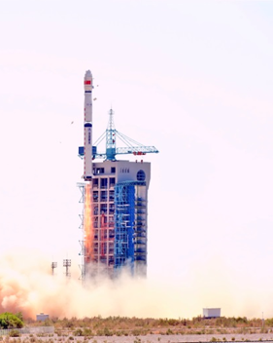
Improvement Since 2013: A
Insight-HXMT (one of the Three Major Goals)
Comments in 2013 Assessment:
The launch schedule and the payload calibration could potentially impact the final performance and success of the HXMT.
Implementation & Achievements:
Launched in June 2017, all the instruments work well, with the performance better than requirements.
During in-orbit test, large amount of data covering all scientific goals.
User software V1 with calibrated instrument responses released.
Some early results published & more publications are in preparation.
Insight-HXMT 1st year international science workshop to take place on June 18-22, 2018.

Slide 4
Improvement Since 2013: B
Astroparticle physics and astrophysics (One of the Five Top Priorities)
Comments in Assessment of 2013:
Astrophysics experiments in planning: well understand their capability and compare it periodically to new results or competing experiments.
Closer international collaboration is necessary for the space observatory (XTP) over the next decades.
Priorities should be reviewed periodically and the assignment of resources optimized.
Implementation & Achievements:
China’s previous XTP and LOFT from Europe → enhanced XTP (eXTP) Special issue on eXTP white papers to be published in Science China.
International consortiums on eXTP, HERD and LHAASO formed, ensuring advanced scientific goals and international competitiveness.
Phasing out those projects not closely related to the objectives and strategy of PAD.

Slide 5
Funding and Publications
Funding in recent 5 years (2013 – 2017): 608 million CNY
Funding in previous 5 years (2008 – 2012): 389 million CNY
Percentage increase: ~56%
Since 2013, the Division has published 1225 papers, including 128 papers in Nature Astronomy, the Astrophysical Journal, Monthly Notices of the Royal Astronomical Society, and Astronomy & Astrophysics, and 82 papers in Physical Review D and Physical Review Letters.
Percentage increase: ~30%

Slide 6
Space Projects Roadmap
Roadmap for the development of space-based high energy astrophysics experiments：
Current Projects
Projects applying for mission adoption
Projects in planning and pre-research for mission adoption
HXMT
SVOM
EP/FXT
Enhanced X-ray Timing and Polarimetry mission (eXTP)
Gravitational wave high-energy Electromagnetic Counterpart All-Sky Monitor (GECAM)
Hot Universe Baryon Surveyor (HUBS)
X-ray Astrnomy
Space Particle Detection
AMS02
DAMPE
CSES
High Energy cosmic-Radiation Detection (HERD)
Wide-field MeV Gamma-Ray Observatory (WMEGRO)

Slide 7
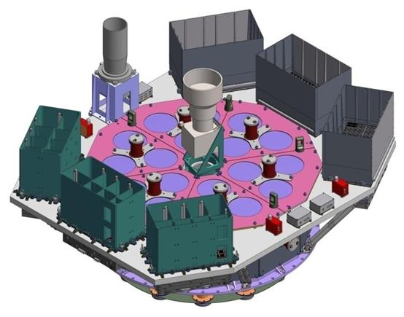
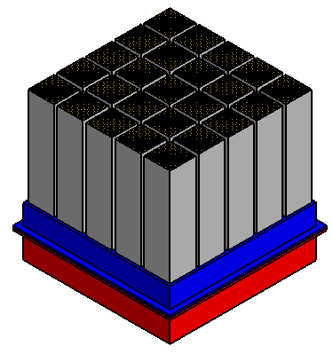
Space Projects Led (1)
POLAR: Successful development of the China–Europe collaboration Gamma-ray Burst Polarimeter (POLAR), the only astronomical payload on board the Chinese space laboratory “Tiangong-2”, launched on September 15th, 2016.
Insight-HXMT: Successful development of the Hard X-ray Modulation Telescope (Insight-HXMT), China’s first X-ray astronomy satellite, launched on June 15th, 2017, and handed over on January 30th, 2018, after which Insight-HXMT officially entered the science operation phase.
Please refer to Dr. Shaolin Xiong’s talk for details:
Highlights of scientific results

Slide 8
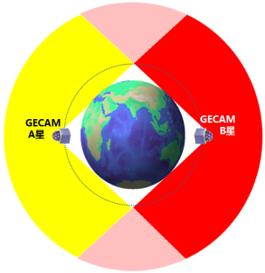
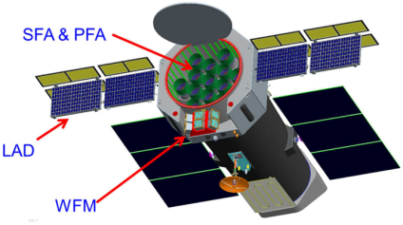
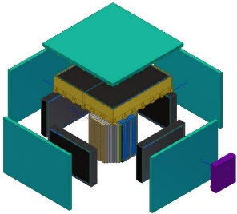
Space projects led (2)
GECAM: Gravitational wave high-energy Electromagnetic Counterpart All-sky Monitor, fully funded for launch in 2020
eXTP: enhanced X-ray Timing and Polarimetry mission, fully funded through Phase B (2020), planned launch in 2025
HERD: High Energy cosmic-Radiation Detection facility onboard China’s Space Station, partially funded for launch in around 2025
Please refer to Dr. Shaolin Xiong’s talk for details:
Current progress and future plans

Slide 9
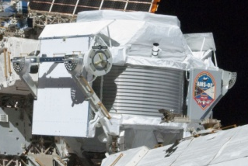
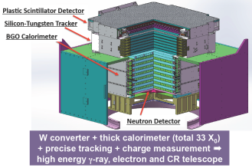
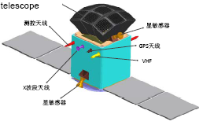
Space Projects Participated In
AMS-02: Substantial participation in the Alpha Magnetic Spectrometer (AMS-02) project on board the International Space Station.
DAMPE: Leading the STK on board the Dark Matter Particle Explorer (DAMPE) satellite, launched in 2016.
SVOM: Responsible for the Gamma-ray Monitor (GRM), one of the four payloads on board the Sino-French mission SVOM (Space Variable Objects Monitor), to be launched in 2021.
EP: Responsible for the follow-up X-ray telescope, one of the two payloads on board the Einstein Probe (EP) mission, to be launched in 2022.
Please refer to Dr. Shaolin Xiong’s talk for details:
Progress and IHEP contributions

Slide 10
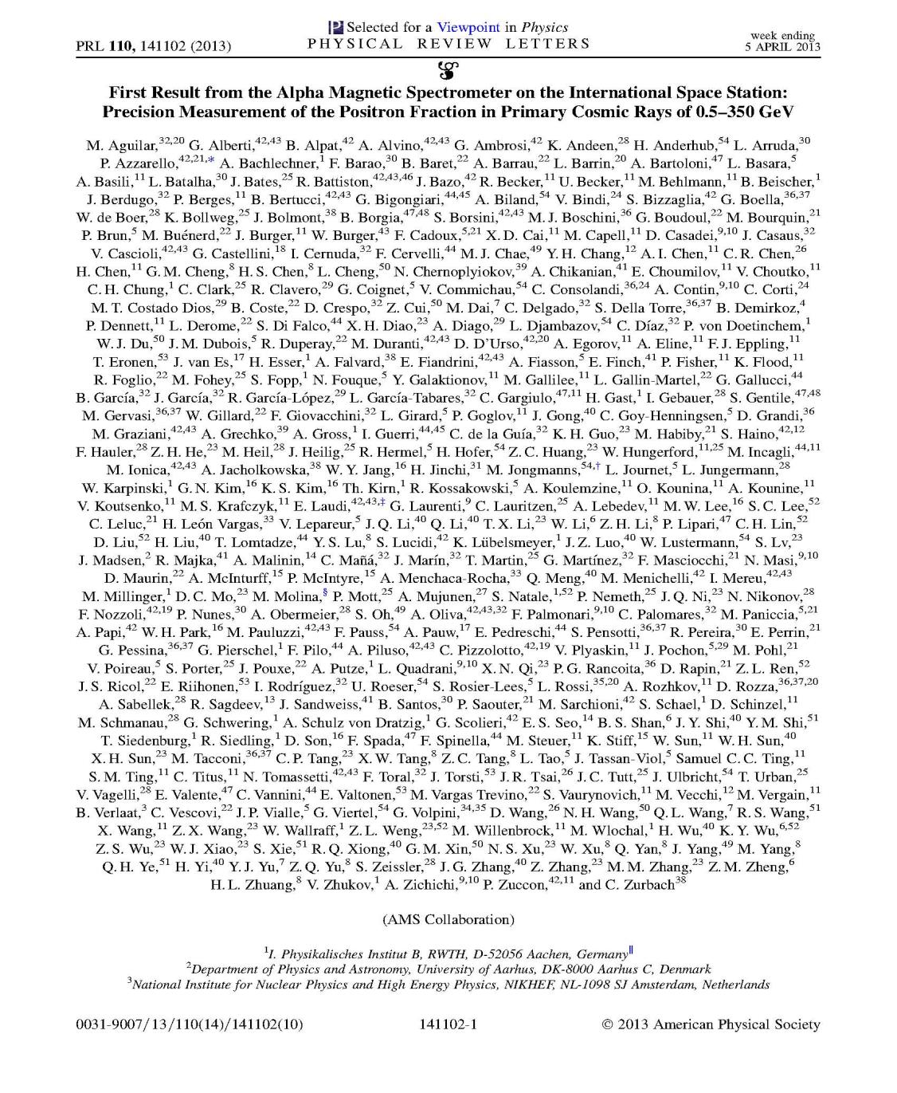
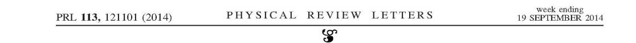
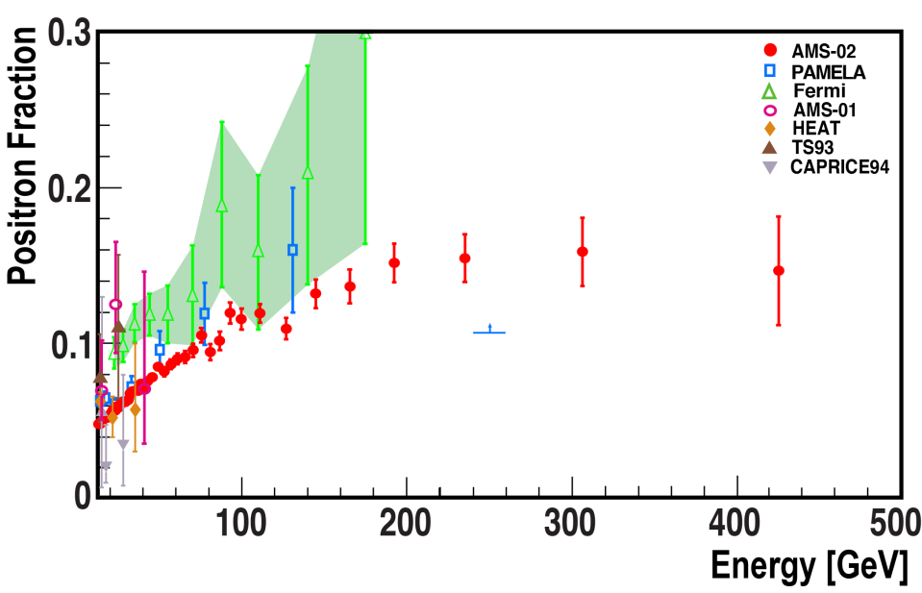
Highlight: AMS
Measurement of cosmic ray positron fraction：
All selected for “Editors’ Suggestion” papers. First paper was selected for APS Physics Highlights of 2013 and one of 52 “placards”, selected from 3000 “Editors’ Suggestion” papers.
Inspire citations >1150
Dark Matter M_{DM}=1.2 TeV
+ Collision of Cosmic Rays
AMS 2018
1.6 million positrons
Collision of Cosmic Rays with the ISM
Model based on J. Kopp, Phys. Rev. D 88 (2013) 076013
Result can be explained by dark matter. Updated results will be published in 2018
IHEP group responsible for calibration and data reconstruction of ECAL, which is the key detector for positron measurement, as well as development of ECAL based particle identification tools. Results of IHEP and MIT groups used in the publication.

Slide 11
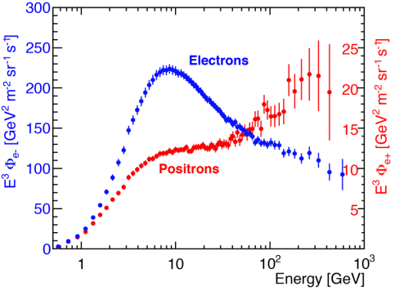
Highlight: AMS
Measurement of cosmic ray positron, electron and positron+electron flux：
PRL 113, 121102 (2014) selected as editor suggestion, Inspire citations 317
PRL 113, 221102 (2014)
Positron flux measurement agrees with dark matter model, updated results will be published in 2018. Positron+electron flux agrees with single power law from 30 GeV to 1TeV, no peak or other feature.
IHEP group responsible for calibration and data reconstruction of ECAL, which is the key detector for positron measurement, as well as development of ECAL based particle identification tools. Crosscheck results done by collaboration of IHEP and MIT.

Slide 12
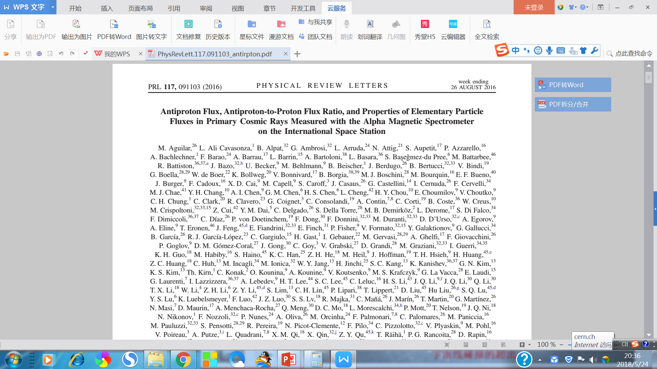
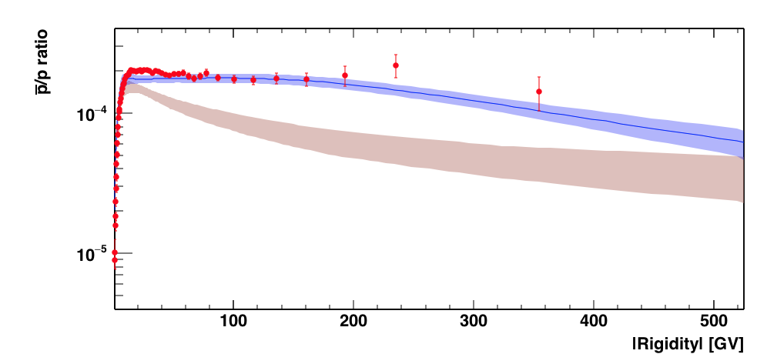
Highlight: AMS
Measurement of cosmic ray antiproton ratio and antiproton flux:
AMS
Dark Matter
Collisions of ordinary cosmic rays with ISM
Dark Matter Model example: Donato et al., Phys. Rev. Lett. 102, 071301 ( 2009 ).
Astrophysics Model examples: P. Mertsch and S. Sarkar, Phys. Rev. D 90, 061301 (2014);
K. Kohri, K. Ioka, Y. Fujita, and R. Yamazaki, Prog. Theor. Exp. Phys. 2016, 021E01 (2016).
Excess of antiprotons measured by AMS cannot be explained by pulsars, can be explained by dark matter or new astrophysics phenomenon
IHEP made major contribution to the rejection of dominant background, charge confused proton. Independent analysis results used as crosscheck.

Slide 13
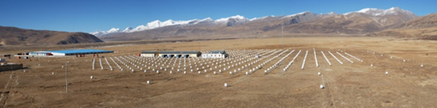
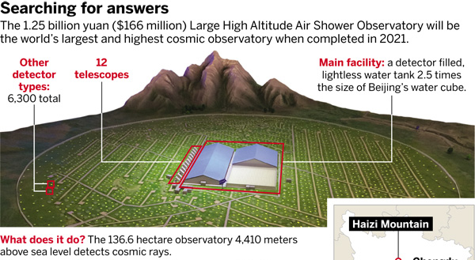
Cosmic ray (CR) research
Yangbajing (90 ◦. 522 E, 30 ◦. 102 N, 4300 m above
sea level) in Tibet, China
Asγ: The Sino-Japanese Collaboration experiment at Yangbajing.
ARGO-YBJ: The Sino–Italian Collaboration experiment at Yangbajing.
LHAASO: The high altitude cosmic ray observatory, currently under construction.
Please refer to Dr. Zhen Cao’s talk for details:
Science highlights, progress and future plans

Slide 14
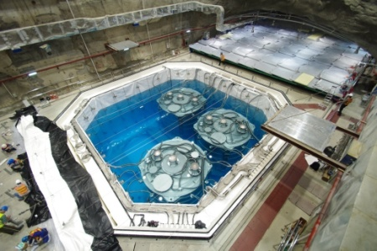
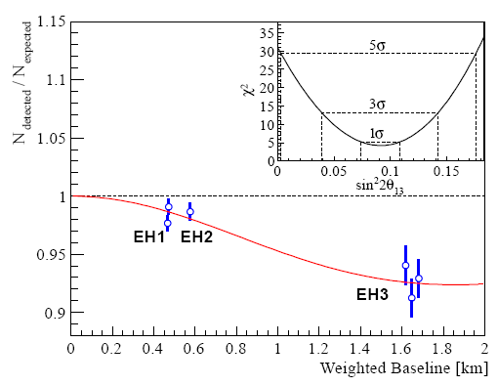
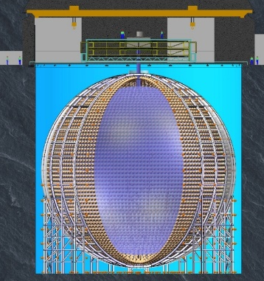
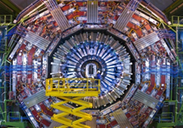
Particle physics experiments
Daya Bay: Responsible for veto detector; experiment awarded first-class National Natural Science Award in 2016.
JUNO: Responsible for veto detector.
CMS: Leading China’s participation in the CMS collaboration, ~8 FTE, ~12 students/postdocs.

Slide 15
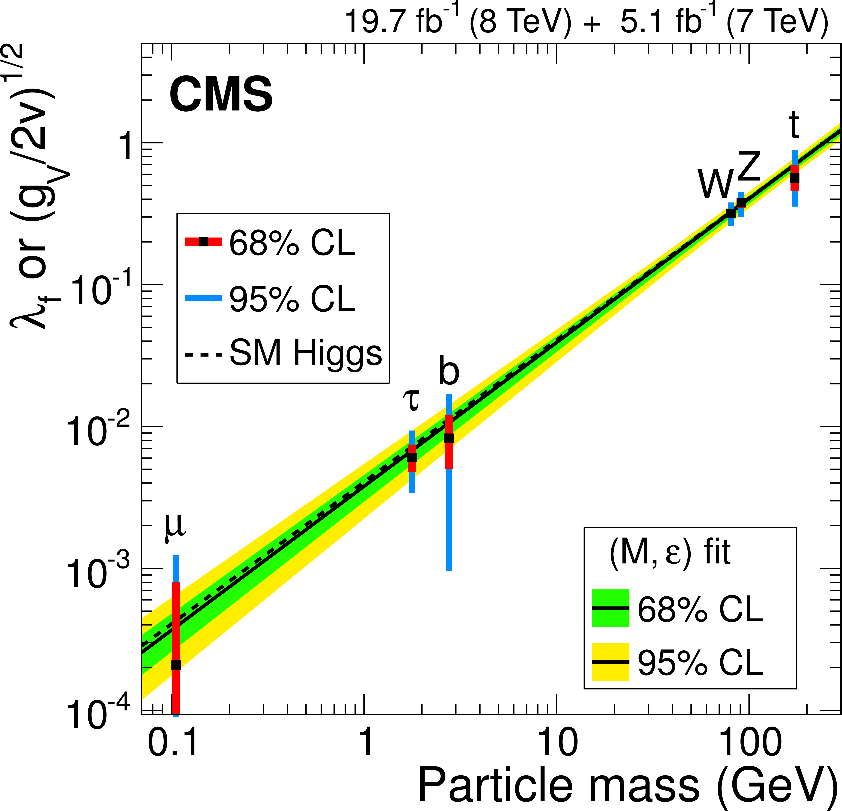
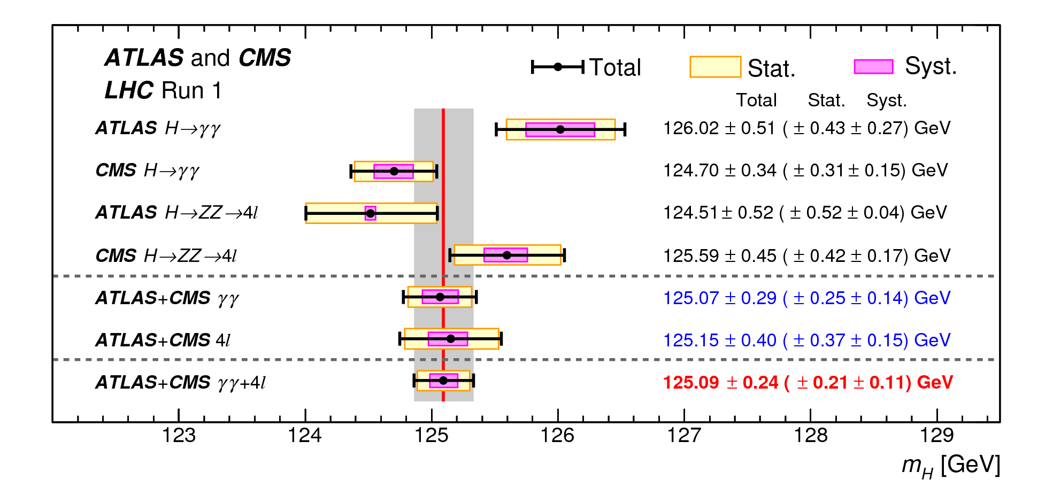
Highlight: CMS
CMS: one of its focuses is to measure the properties of the newly discovered Higgs boson
IHEP-CMS group plays a leading role in the Higgs combinations:
co-convener of the CMS Higgs combination group (2014.01-2015.12)
one of the editors/contacts for the analyses of the CMS Higgs run 1 combination, ATLAS+CMS run 1 legacy combinations
(pre-)approval talks inside CMS
EPJC 75 (2015) 212
5250m!
PRL 114 (2015) 191803

Slide 16
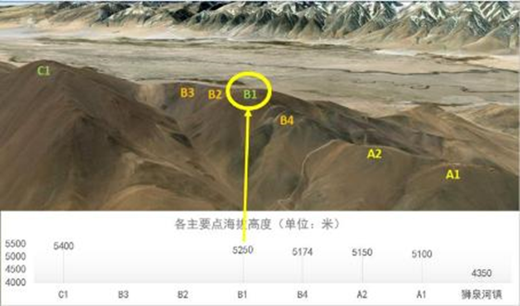
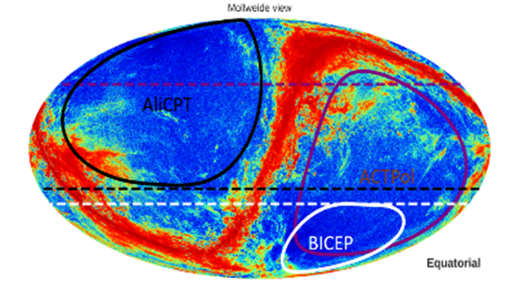
Cosmology: Ali
AliCPT: leading the CMB Polarization Telescope (AliCPT) project.
AliCPT is a dichroic refractor of aperture 72 cm covering 95/150 GHz, located at the B1 point of the Ali Observatory, at an altitude of 5250 meters.
6816 detectors, which is 2.7 times the number of detectors in BICEP3
In the future, the number of detectors will be increased to around 27000, which is comparable to the BICEP Array.
One of the three major bases of ground-based CMB experiments along with the South Pole and Atacama.

Slide 17
Cosmology: Ali
AliCPT main science goals are:
Detect Primordial Gravitational Waves (PGWs) in the northern hemisphere for the first time;
Probe PGWs at high precision, testing different theories of the very early Universe;
Measure the cosmic polarization rotation angle at high precision, test the CPT theorem at cosmological scale;
Study the cross-correlation between CMB and Large-scale Structure Surveys (LSS).

Slide 18
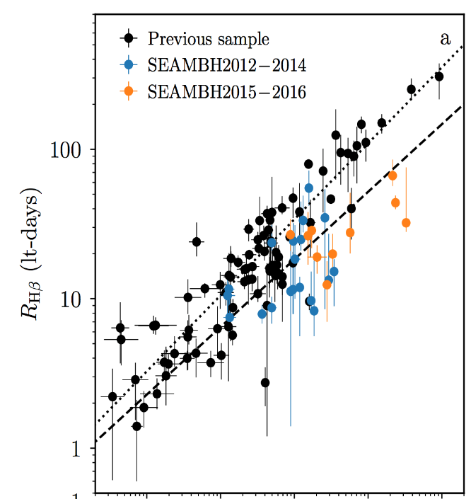
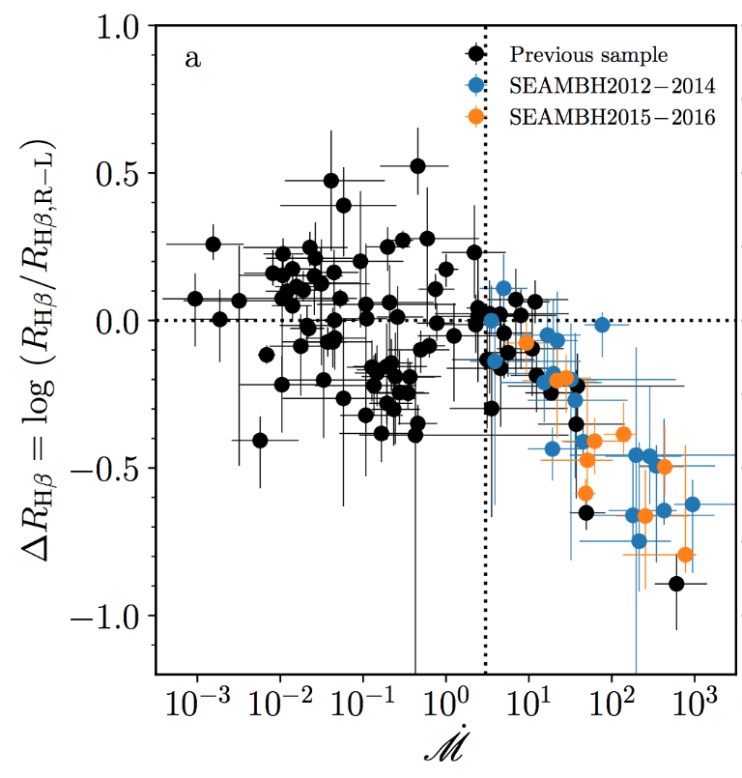
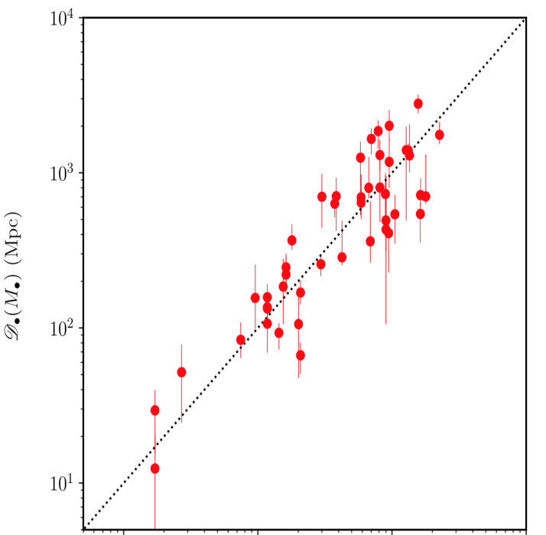
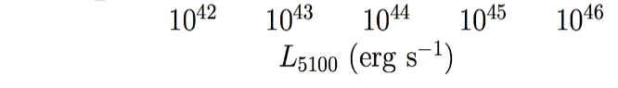
Highlight: Black Hole Cosmology
The Lijiang 2.4m Reverberation Mapping Campaign:
Super-Eddington massive black holes (SEAMBHs)
Special broad-line regions: smaller Hβ radius (by factors 3~8)
Accretion rate: even higher than ~1000 Eddington limit
Accretion physics: saturated luminosity from slim disk
Cosmological distance indicator: accuracy of ~0.20 dex
1 Nature Astronomy (2018), 1 PRL (2013), 19 ApJ (2013-2018), …
Breaking well-known R-L scaling-law
Shortened by factors of 3~8
Distance accuracy: 0.2 dex

Slide 19

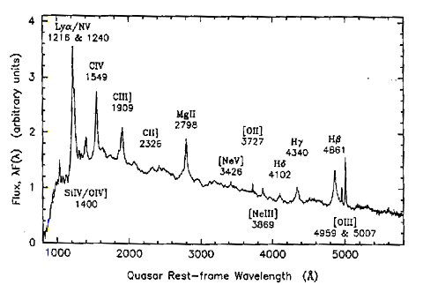
Highlight: Black Hole Cosmology
  BLR Origin in AGNs：BH mass accuracy of 200%-> 50%
Quasar Spectrum
A supermassive BH located in the center. Its strong gravitation tidally disrupts the clouds in the torus, then forms an inflow, a virialized disk, a weak outflow part. The BLR originates through this mechanism.
Wavelength in the rest frame（Å）

Slide 20

Highlight: Black Hole Cosmology
Inter-coll: IHEP-led network of global 2 m telescopes
US Wyoming U. Spain IAA South Africa Obs.
(M. Brotherton)
(J. Aceituno)
(H. Winkler)
LAMOST 2018
Spain 2.2m
2017
USA 2.3m 2017
Lijiang 2.4m
2012
SAAO2m
2018

Slide 21
Strategic Planning (1)
Space-based particle astrophysics research:
Continue data analysis for AMS-02, POLAR, DAMPE and Insight-HXMT, science outputs including indirect dark matter search, γ-ray burst polarization (55 GRBs detected), extensive results from Insight-HXMT;
Fast and high quality delivery of GECAM, science outputs including 8 keV - 2 MeV true all-sky & all-time monitoring;
Participate in projects: SVOM/GRM, EP/FXT, science outputs including multiwavelength observations of various kinds of high energy transients and explosions, etc;
Balanced manpower and resources on future large international collaboration projects led by PAD: eXTP satellite and the HERD facility, science outputs including physics under extreme gravity, density and magnetism, indirect DM search, precise CR spectrum and composition measurements up to the knee energy, etc.

Slide 22
Strategic Planning (2)
Cosmic ray research:
Data analysis and physics research with data from the Sino–Italian ARGO-YBJ experiment;
Data analysis and physics research with ASγ experiment;
Focus on infrastructure at LHAASO to ensure that the 1/4 array is completed and put into science operation on time, as well as coordinating the international collaboration and further developing the physics analysis software;
Moderate investment in developing new technologies for cosmic ray detection.

Slide 23
Strategic Planning (3)
Particle physics experiments:
Continue to participate in the Daya Bay neutrino experiment operation and data analysis, science outputs including high precision measurement of sin²2θ₁₃ and Δm²_{ee}
Participation in the JUNO experiment; science outputs including high precision measurement of θ₁₂及Δm²₂₁, probing the unitarity of U_{PMNS} to ~1% level
Strengthen R&D on underground dark matter searches (LAr techniques), possible JUNO near detector
Continue participation in data analysis for the CMS experiment, science outputs including DM searches, Higgs studies, new physics and new particle searches

Slide 24
Strategic Planning (4)
Cosmology：
Continue to strengthen research in particle cosmology and high energy astrophysics theory;
Complete construction of the Ali CMB Polarization Telescope observation station and telescope mount, and sign an agreement with the US about development of the receiver; science outputs including Primordial Gravitational Waves (PGWs) detection in the northern hemisphere for the first time

Slide 25
Manpower
Number of Staff: Keeping Stable!
Number
~200 in 2020: LHAASO/eXTP/HERD
Age distribution
Research Group | Staff |  |  |  |  | Students & Postdocs
 | Senior | Mid. | Jun. | Sup. | Total
High altitude balloon | 1 | 2 | -- | -- | 3 | 0
Astrophysics | 11 | 59 | 34 | 1 | 105 | 45
Theory | 3 | 6 | 1 | -- | 10 | 19
Cosmic ray | 7 | 20 | 6 | -- | 33 | 31
AMS/CMS | 3 | 7 | 2 | -- | 12 | 20
Neutrino | 2 | 6 | 2 | -- | 10 | 7
Secretariat | -- | -- | 1 | 1 | 2 | 0
Total | 27 | 100 | 46 | 2 | 175 | 122
2013:
PhD/59%; MSc/26%
Avg. age: 36
2017:
PhD/71%; MSc/21%
Avg. age: 38
Research groups are competent and adequately staffed!

Slide 26
Manpower for All Projects
Projects | Leaders | Staff (FTE) |  |  |  | Stu.& PDs
 |  | Senior | Mid. | Jun. | Total
Theory/Ali CPT | X. Bi, H. Li | 3.2 | 7.8 | 2 | 13 | 19
LHAASO/ ARGO*/Asγ* | Z. Cao, H. Hu, J. Huang | 6.5 | 19.1 | 10 | 34.6+? | 31
HXMT* | T. Li, S. Zhang, F. Lu, L. Song | 6.2 | 33.5 | 19.2 | 58.9 | 25
POLAR*/ SVOM/EP | S. Zhang, Y. Dong, Y. Chen | 1.2 | 8.3 | 5.2 | 14.7 | 8
eXTP/GECAM | S. Zhang, F. Lu, S. Xiong | 1.9 | 5.4 | 2.8 | 10.1+? | 6
DAMPE* | H. Wang | 0.5 | 7.3 | 2.5 | 10.3 | 2
HERD/CSES* | S. Zhang, Y. Dong, H. Wang | 1.5 | 3.6 | 1.2 | 6.3+? | 4
AMS*/CMS | H. Chen, G. Chen | 3 | 7 | 2.1 | 12.1 | 20
Daya Bay*/ JUNO | C. Yang | 2 | 6.1 | 2 | 10.1 | 7
Total |  | 27 | 100 | 46 | 175+25 | 122
*ARGO/Asγ/HXMT/POLAR/DAMPE/CSES/AMS/Daya Bay: Finish(ed)ing
Funding for space projects presented by Dr. S. Xiong

Slide 27
International Cooperation
Research area | Project | Number of Countries (incl. China) | Number of Institutions (domestic + overseas) | Number of Researchers (domestic + overseas)
Space Astronomy & Astropar. Physics | POLAR | 3 | 1+3 | 23+13
 | eXTP | 26 | 20+124 | --*
 | HERD | 6 | 14+21 | 94+72
High Altitude Cosmic Ray & Astropar. Physics | LHAASO | 4 | 21+4 | 124+20
 | ASγ | 3 | 7+18 | 52+34
 | ARGO | 2 | 6+14 | 48+63
*Since the eXTP consortium has not been officially approved yet, the number of members in each institution is difficult to count accurately.

Slide 28

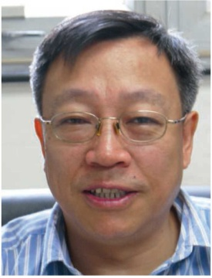
Academic Leaders
Li Tipei, 78, BSc/THU. CAS Academician.
  Adjunct Prof. of Tsinghua University
  Founder of China’s high energy astrophysics, Li-Ma formula, Li-Wu direct demodulation method, WMAP systematic errors. Proposer and former PI of HXMT.
ZHANG Shuangnan, 55, BSc/THU, PhD/UK (Soton), postdoc/UPenn, Prof./UAH (Alabama), dis.Prof./THU.
  Chief scientist of Space Science Division/NAOC.
  YZ dis.prof./MoE, dis.invest./NSFC, national dis. expert., Copernican dis. scientist/Ferrara(Italy).
  Editor of several international and domestic journals.
  >250 refereed pub., >7000 citations.
  IAU GA invited public discourse (only Chinese so far).
  PI: POLAR, HXMT, eXTP and HERD;. Co-PI: SVOM.

Slide 29

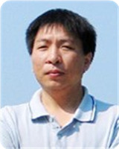
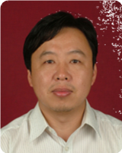
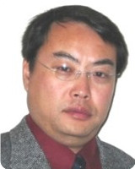
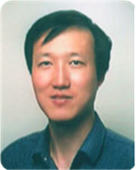
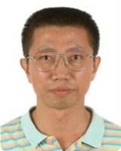
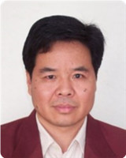
Other Senior Project Leaders
Name | WANG^{1,2} Jianmin | LU Fangjun | SONG Liming | CAO² Zhen | HU^{1,2} Hongbo | YANG² Changgen | CHEN Guoming
Field | Astro Theory | Astro Instru. | Astro Observ. | CR Instru. | CR Physics | Neutrino Experi. | Particle Physics
Age | 52 | 48 | 53 | 55 | 53 | 55 | 59
Edu. | PhD/ USTC | PhD/ IHEP | PhD/ NJU | PhD/ IHEP | PhD/ PKU | PhD/ IHEP | PhD/ IHEP
Responsibilities | SEAMBH leader | eXTP manager | Leader for all ground segments | PI: ARGO, LHAASO | Formal ASγ PI | DYB JUNO Deputy leader | CMS, AMS leader
1. National Distinguished Investigator; 2: CAS Hundred Talents Program

Slide 30
Summary and Challenges
China’s leading center in particle astrophysics:
  Cosmic ray/space high energy astronomy/neutrino physics/cosmology; in-house detector/electronics/ mechanics/observation/interpretation/simulation/theory
Internationally unique:
  With facilities from underground/sea level to high altitude mountains, satellites and space station.
Many challenges ahead:
  Scientific productivity and impact from on-going projects;
  Adoption of eXTP and HERD, and international collaborations;
  Many large projects, but very young teams, though well staffed.
Many thanks for your evaluation!

