Slide 1
IHEP International Assessment
Biomedical Effects of Nanomaterials
and Nanosafety
Yuliang Zhao
June 14, 2018

Slide 2
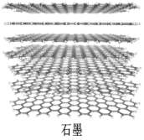
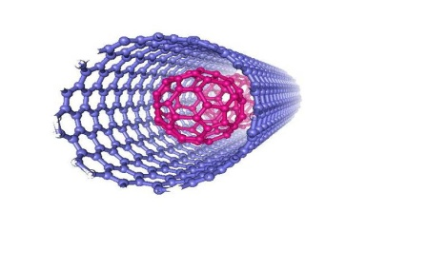
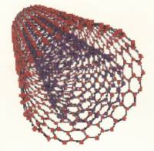
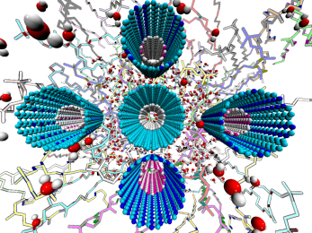
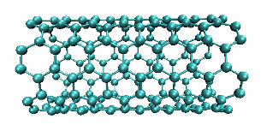
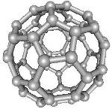

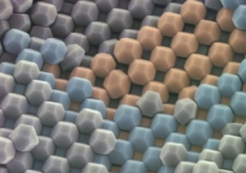
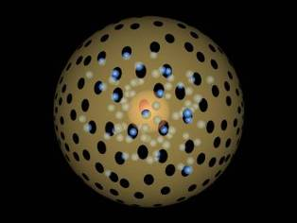
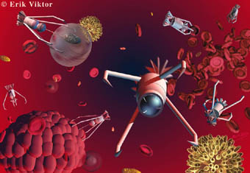
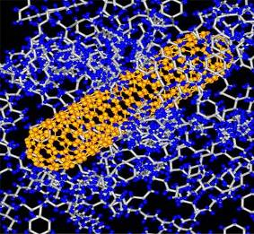
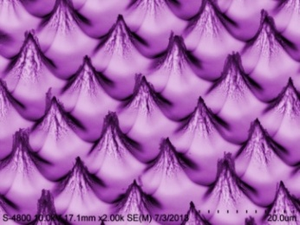
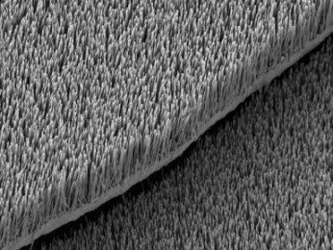
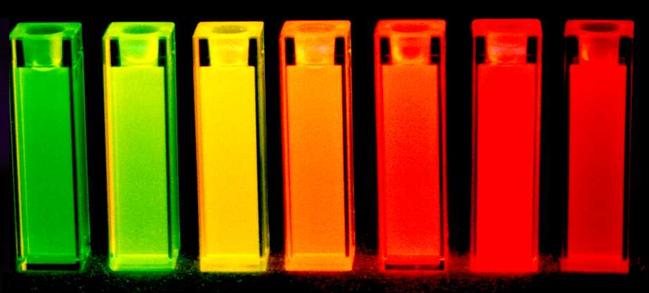
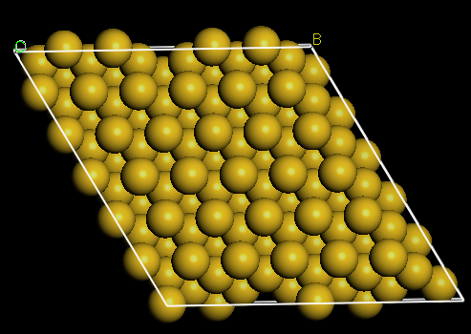
1. Analytical Methods for Nano/Bio Systems
The basis of nanotechnology: nanomaterials
Carbon-based Nanomaterials
8 nm
2.5 nm 4.0 nm
Metal Oxide Nanoparticles
Quantum Dots
Nanocrystals
Nanomedicine
Medical
Nanodevices
Composite Nanomaterials
Nanostructures
Nanostructure
Materials

Slide 3
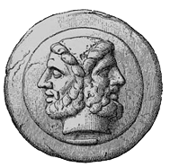
When“nano”interacts with“bio”…?
How do unique nano-characteristics impact life processes at the whole body, organ/tissue, cell, or molecular levels ?
Exposure
Positive effects:
“Nanomedicine”—
How to use?
Negative effects:
“Nanotoxicity”—
How to prevent?

Slide 4
Challenges: Analytical Methods for Nano/Bio
Complex-Complex System Interactions
Difficulties in analysis object:
Nano-bioeffect mechanism
NM’s ADME:
Distribution, Transformation & Metabolism
→ Complex system
→ Nanoscale
Heterogeneous
Multi-component
→ Non-equilibrium
……
Molecule
Exposure
Difficulties in analysis require:
Cell
→ Quantification (ultramicro-analysis)
→ High resolution 4D (x,y,z,t)
In situ
Nondestructive
Dynamic process
……
Organ/
Tissue

Slide 5
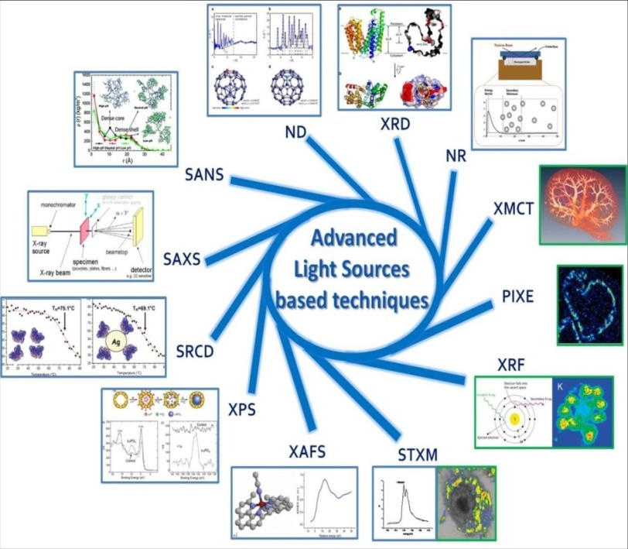
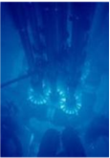
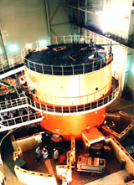
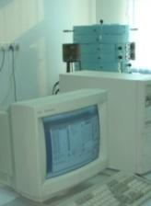
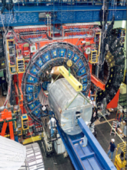
1. Synchrotron Radiation Facility Based Methodology
for Characterization of Nano/Bio Interface Interactions
J. Am. Chem. Soc., 135, 17359 (2013)
J. Am. Chem. Soc., 136, 7317 (2014)
J. Am. Chem. Soc., 137, 1947 (2015)
Acc. Chem. Res., 46, 702 (2013)
Acc. Chem. Res., 46, 622 (2013)
Notes:
—— 纳米材料在活体、器官组织、及细胞内降解、价态变化、化学转化、转运过程；亚细胞分辨的元素化学态、分布、浓度信息；
纳米颗粒的团聚、微结构变化……
—— 实现单细胞内纳米材料成像：
细胞内纳米材料的精细定位
30 nm分辨元素成像，
检测灵敏度: pg/单细胞

Slide 6
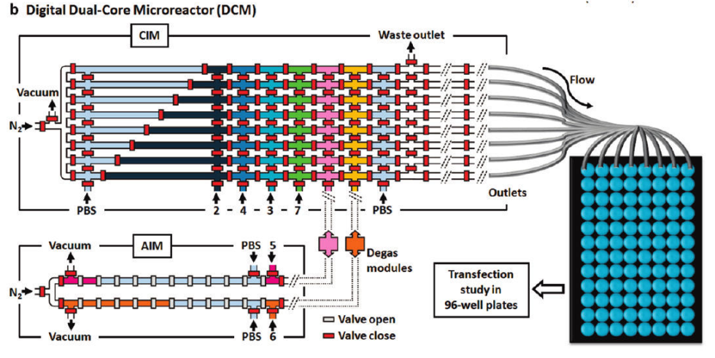
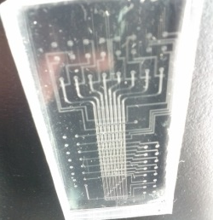

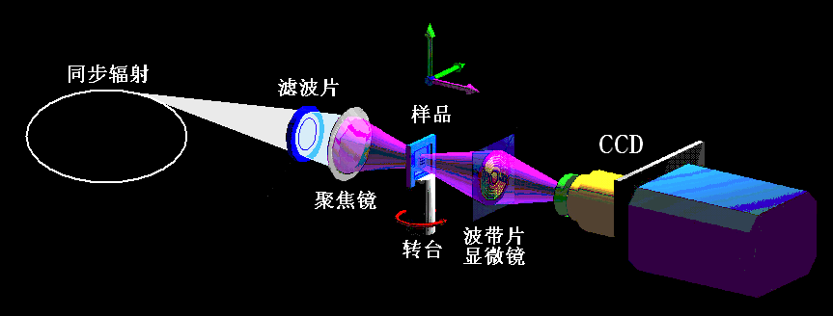
X-ray Microscopy 3D Cell Precision Imaging
Analysis of chemical processes of nanoparticles in a single cell
Isotope-labeling
LA/ICP-MS
Isotope ratio analysis
LA/ICP-MS/XAFS
Chemical information analysis
High-throughput
Precise quantification
Chemical structure analysis
Background influence
microarray/single cell
3D image of NP
in a single cell
→ in situ
→ nondestructive
→ high-resolution imaging
→ penetration depth
imaging mechanism
is optional :
- absorption /
- fluorescence /
- refraction /
- scattering /
To design the X-ray microscopy 3D cell precision imaging
Notes:
发展: X射线显微3D细胞精细成像

Slide 7
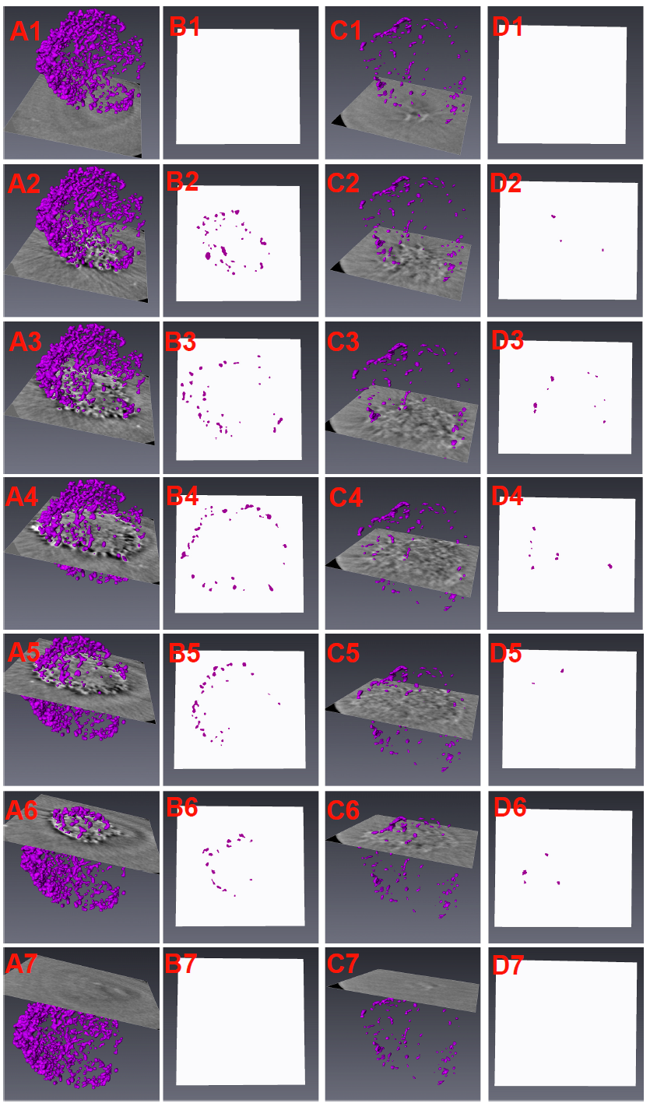
3D Tomographic Images of AgNPs within a Single Cell
A single cell image at 2D and 3D levels:
1) NP accumulation in a single cell level
2) 2D distribution of NPs in cell slices
Uptake for 24 h
Removal for 48 h
Uptake for 24 h
Removal for 48 h

Slide 8
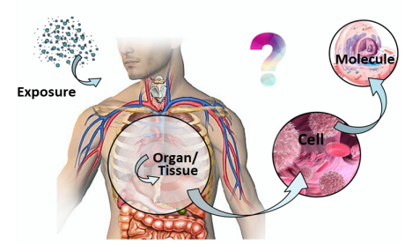
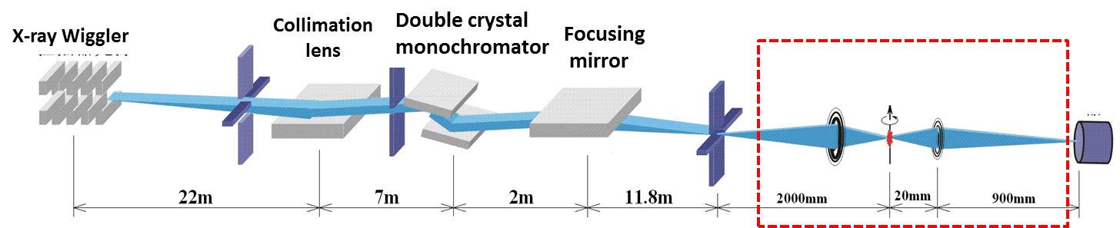
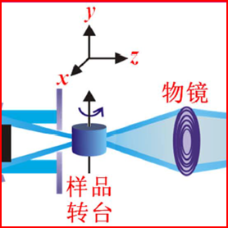
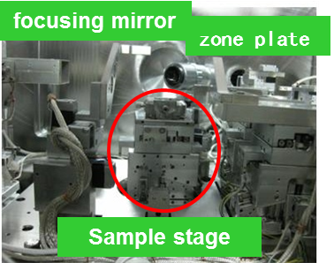
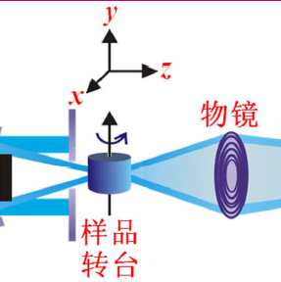
3D Tomographic Images of AgNPs within a Single Cell
Transmission X-ray Microscope (TXM) system
首次实现硬X射线nano-CT单细胞成像
联合设计满足单细胞成像的高精度三维成像平台，
减少漂移与辐射损伤
建立适合单细胞的全新制样方法，缩短成像时间
实现高分辨 (50nm)、快速(30秒/帧)、无损成像
nanoCT images for AgNPs in a single cell
For the first time, nano-CT single cell imaging platform that has been realized
Detection limit: 50 nm
Non-destructive, fast (30 s/Pixel)
High resolution contrast imaging
Uptake 24 h Exocytosis 48 h
ACS Nano, 9, 6532-6547 (2015)

Slide 9
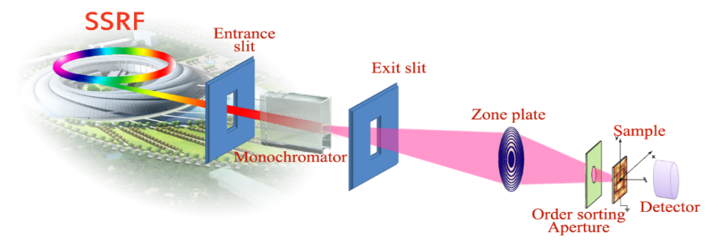
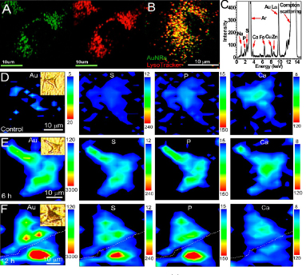
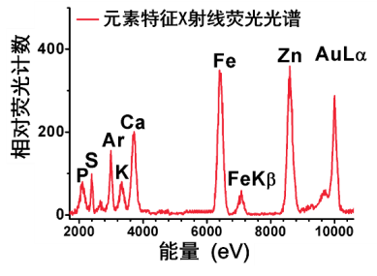
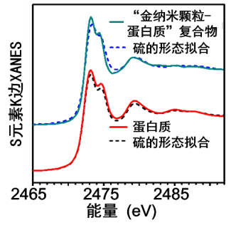
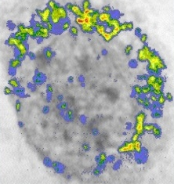
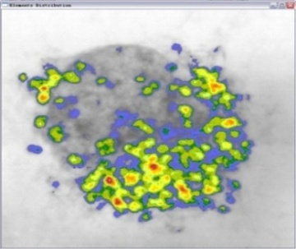
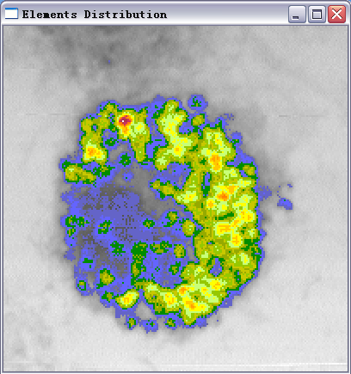
实现单细胞纳米颗粒转运与定位的原位检测
In-situ, time-resolved, (submicro or nanoscale) spatially resolved,
local-information resolved, multi-element resolved detection
Soft X-ray spectroscopy:
STXM, NEXAFS
Hard X-ray spectroscopy: μ-XRF, μ-XANES
3h 24h 48h
7.55e-5
1.06e-5
Designed the energy match and nano-probe for x-ray imaging of a single cell, to detect intracellular nanoparticles .
Resolution: 30 nm
Sensitivity: ~fg/μm²
Chemical state detection limit: 1 mg/g
Dynamic changes of the local information of Au-NRs in cells, different from the macroscopic averaging information.
Resolution: 500 nm
Sensitivity: ~fg/μm2
Chemical state detection limit: 10 μg/g
J. Am. Chem. Soc., 135, 17359 (2013)
J. Am. Chem. Soc., 136, 7317 (2014)
ACS Nano, 9 (6), 6532-6547 (2015)

Slide 10
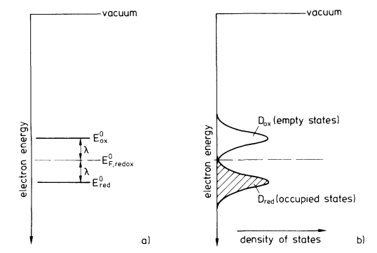
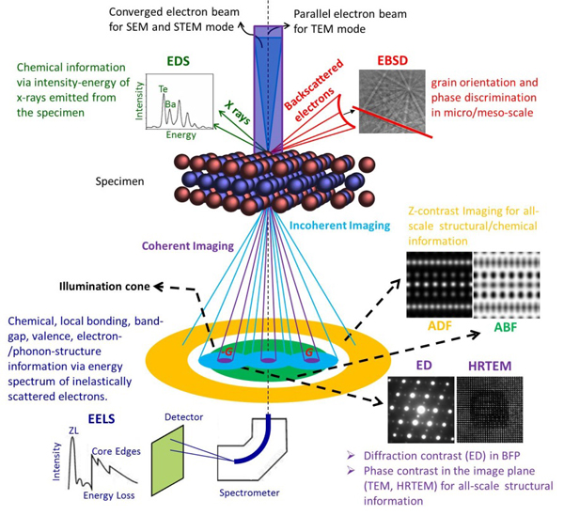
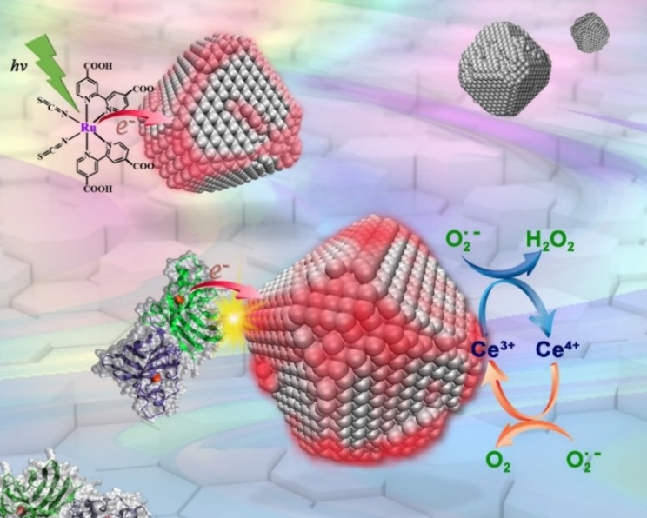
Electron Features of Nanosurfaces
Example
Electron transfer between CeO₂ NPs surface and bio-interface
M + e─ → M─
M ─ + h⁺ → M
M + h⁺ → M⁺
M⁺ + e ─ → M
Electron energy levels of
the redox system
CeO₂ NPs interact with SOD protein, electron transfer→ O hole produced，⁴⁺Ce→ ³⁺Ce
Angew. Chem. Int. Ed., 54, 1832 (2015)

Slide 11
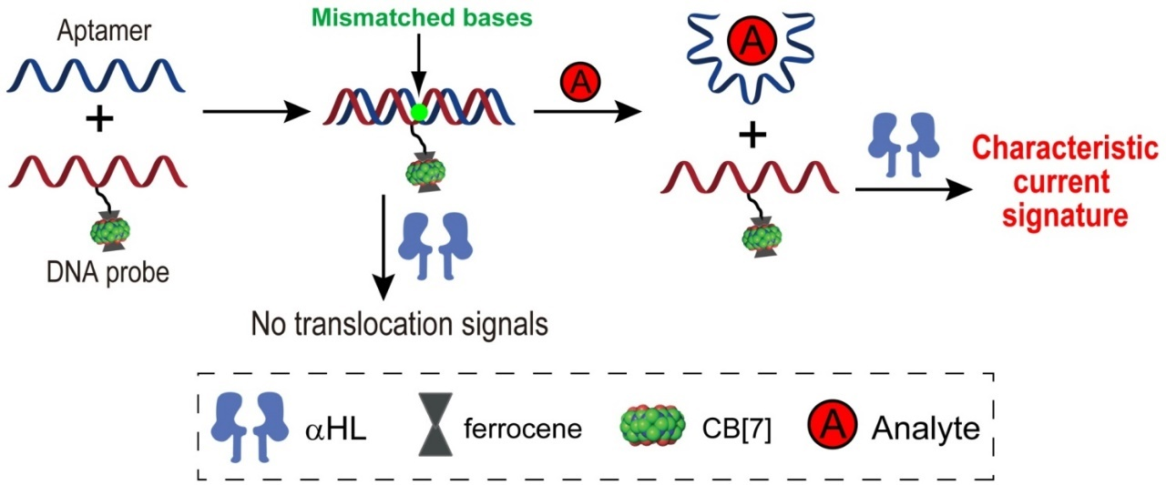
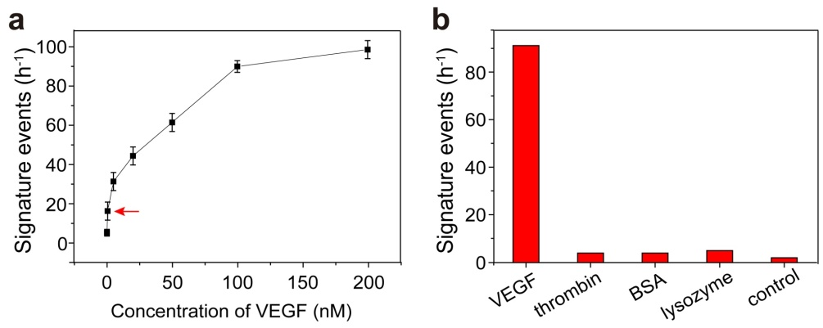
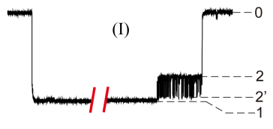
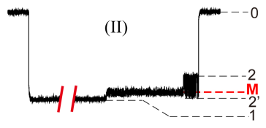
Aptamer and Host-Guest Interactions for Nanopore Sensing
Nature Protocols, 2015, 10, 1670-1678.
Nature Commun. 2013, 4, 2989.
Angew. Chem. Int. Ed., 2015, 54, 7568-7571.
Angew. Chem. Int. Ed., 2016, 55, 15216-15222.
Anal. Chem., 2016, 88, 10605-10610.
Anal. Chem., 2016, 88, 1073-1077.
Anal. Chem. 2013, 85, 7302-7307.
Anal. Chem. 2013, 85, 5650-5653.
Chem. Sci. 2014, 5, 1934-1939.
Chem. Sci., 2015, 6, 5628-5634.
Chem. Sci., 2016, 7, 5287-5293.
Selectivity
LOD: 5 pM
Analytes include proteins such as VEGF₁₂₁ and thrombin, and small molecules such as cocaine
Notes:
In this example, we combined aptamer and host-guest interactions with nanopore sensing. We first form a duplex between an aptamer and a host-guest complex modified DNA probe. The DNA duplex itself cannot translocate through alpha-hemolysin nanopore. When an analyte comes, it competes for the aptamer and releases the DNA probe. When the DNA probe is translocated through alpha-hemolysin nanopore, we observed highly characteristic current events. From the statistical analysis of these events, we can figure out the concentration of the analyte. This strategy can be universally used for the sensing of many different analytes, including large protein molecules such as VEGF121, thrombin, and small organic molecules such as cocaine. Because we use aptamer as the recognition element, all the sensings show superb selectivity and excellent sensitivity.

Slide 12
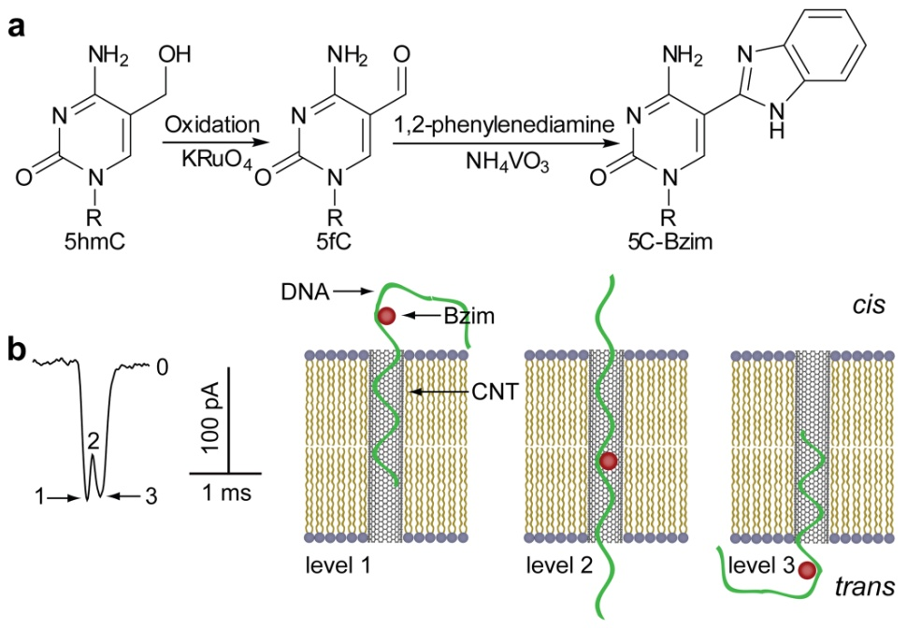
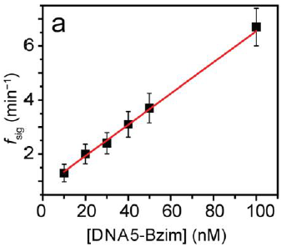
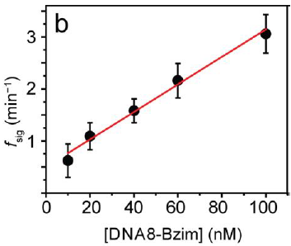
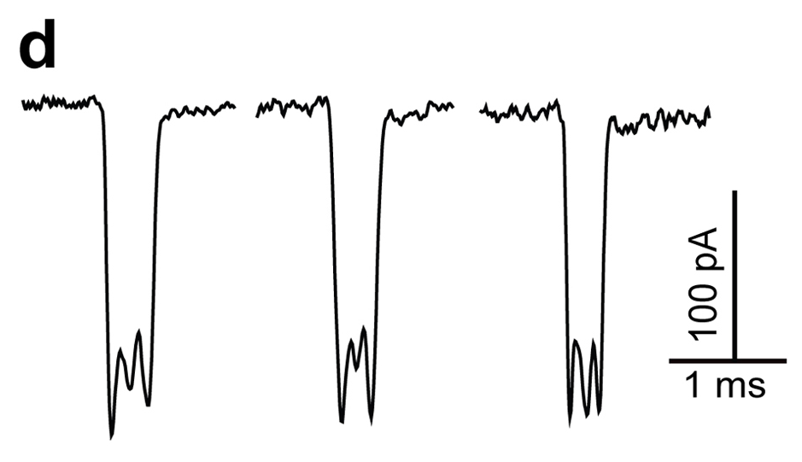
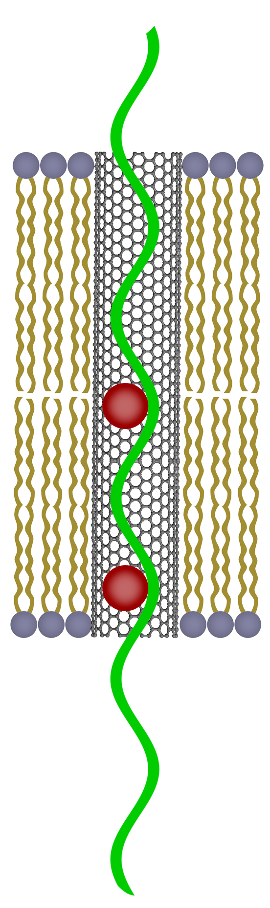
SWCNT Nanopore
Example
5hmC modification
Quantitation of single-5hmC DNA
Detection of single 5hmC site
Detection of double 5hmC sites
Quantitation of double-5hmC DNA
Nature Protocols, 2015, 10, 1670-1678
Nature Communication, 2013, 4, 2989
Notes:
In this example, we constructed a new type of nanopore sensor based on single-walled carbon nanotubes. We cut the nanotubes with strong acids to very short length and separate them with HPLC. We then inserted the short nanotubes about 5 to 10 nm into lipid bilayer to form nanopores. We studied ion transport through SWCNT nanopores and also DNA translocation events. We found that CNT nanopores are sensitive to the small changes on DNA strand. Thus, we modified 5-hydroxymethylcytosine with a benzoimidazole group on a DNA strand with specific reactions and thread the modified DNA through CNT nanopores. We can see unique current events when the modified DNA pass through the pore.
Besides, when the DNA contains double 5hmC sites, we see a different current signature. Therefore, the new nanopores can clearly distinguish the modified 5hmC-DNA from normal DNA strands. We also quantified the 5hmC-DNA by counting the frequency of the signature events.

Slide 13
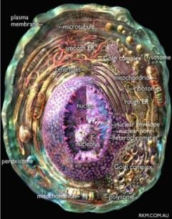
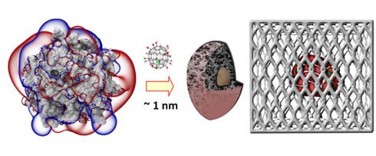

2. Nanomedicine
A completely new mechanism for tumor suppression
  60+ high quality fundamental research papers: Nature Communications， Nature Biotechnology， PNAS， Acc. Chem. Res., etc
  Patents granted: China, the United States, Germany, Britain, France, other European Union countries, Japan
2017, a transfer contract named “Tumor Growth-Inhibiting Metallofullerenol Nanomaterials and Related Technologies”
  Using this equipment, the production cost is reduced by more than 50%, allowing the industrial-scale synthesis of metallofullerenol nanomaterials
Imprison the tumors
A nano-drug production line

Slide 14
Nanomedicine: UCNPs-based
Novel Methods
Regulation
Evaluation
Applcations
Methods:
Metal doping
Multilayer core-shell structure
Properties:
Excitation & Emission-Spectrum Regulation
Biosafety:
Fate
Biokinetics & Transformation
Biofunctions:
Photodynamic therapy
Smart- & Light-controlled carrier
Adv. Mater. 2017, 29 (34), 1701268.
Adv. Mater. 2015, 27 (47), 7692-7712.
Adv. Mater. 2013, 25 (28), 3758-3779.
ACS Nano 2016, 10 (12), 11000-11011.
ACS Nano 2015, 9 (1), 696-707.
ACS Nano. 2017,11(3), 7164-7175.
Adv. Mater. 2017, 29 (44), 1704136.
Adv. Mater. 2014, 26 (18), 2831-2837.
Adv. Mater. 2012, 24 (9), 1226-1231.
ACS Nano 2015, 9 (12), 12451-12463.
ACS Nano 2014, 8 (7), 6922-6933.
ACS Nano. 2017,11, 9582-9591.
Notes:
我发展了过渡金属离子掺杂，多重核壳结构，质子插层合成新技术，实现了尺寸、形貌、结构与功能的调控；系统评价了材料安全性，发展了可转化，可降解，可清楚新型纳米材料，改善了其生物安全性。在此基础上，利用其独特的光学性质构建了光控NO释放，光热药物控释，热疗/放疗协同治疗特色应用。

Slide 15


Example
Excitation Spectrum Regulation of Fluorescent Upconversion Materials
Problem
980 nm light -- strong photothermal effect, poor penetration and severe damage
Doping Nd to adjust the excitation wavelength to 800 nm, constructing multi-layer core-shell structure to avoid quenching effect of Nd and Er
Solutions
Using Nd³⁺ as sensitizers
Strong absorption at 800 nm
Efficient Nd→Yb energy transfer
Transition layer (NaYF₄:Yb) in core-shell-shell nanostructures avoids quenching
Design
Nd³⁺ <2%
Er
Yb
Nd>90%
Adv. Mater. 2014, 26, 2831-2840.
Adv. Mater. 2015, 27, 7692-7712.
Notes:
接下来我们又开展荧光上转换材料激发光谱调控。传统的上转换材料采用Yb 作为敏化剂，因此980nm 激光作为激发光源。但是水对这个波段的光有强烈的吸收，光热效应明显，容易造成损伤，限制了其活体应用。我们通过掺杂Nd调整激发波长至800nm处，构建多层核壳结构，将发光离子与敏化剂放置于不同壳层之内，避免Nd与Er 淬灭作用，是Nd的掺杂浓度从<2%，提高到Nd>90%，提供了发光效率。

Slide 16



Using multiple core-shell structure to
reduce quenching and improve luminous efficiency
Multilayer core-shell structure avoids quenching effect and increase fluorescence up to 125 times
Example
Nd and Er quenching
Solvent quenching
Materials
properties
800 nm excitation: promote deep tissue imaging and reduce photothermal damage
800 nm excitation
980 nm excitation
Adv. Mater. 2014, 26, 2831-2840
Adv. Mater. 2015, 27, 7692-7712
Notes:
得益于Nd浓度的提高和多层核壳结构，产物上转换荧光增强增强125倍，同时800nm 激发具有更好的穿透深度，并且降低了光热损伤，特别适合活体中的应用。

Slide 17




Example
Biosafety Evaluation of Upconversion Nanoparticles
In vivo biotransformation of upconversion nanoparticles by synchrotron radiation
X-ray absorption near edge structure (XANES)
NaYF₄
YPO₄
Three administration pathways:
No obvious effects on blood and major tissues
Blood biocompatibility
Oral, intravenous,
intraperitoneal injections
Histopathological examination
Adv. Mater. 2013, 25, 3758.
Small 2015, 11, 4774.
Notes:
我们首先通过经典毒理学评价方法，利用三种给药方式系统评估了对血液及重要脏器的影响，未发现明显的生物毒性，证实了其较好的生物安全性。
纳米材料的体内转化对其安全性至关重要。我们首次利用同步辐射技术揭示上转换材料体内转换过程，利用同步辐射X射线近边吸收谱证实上转换材料主要向磷酸盐转变，而磷酸盐的稳定性和生物相容性较好，降低了其生物安全性的担忧。

Slide 18




Nanomedicine:
De novo design of cancer nanomedicine
Gd@C₈₂(OH)₂₂ prison cancer cells
TNFR1
Gd@C82(OH)22 use a non-specific way of
“bridge-like”interface interaction to
bind with target protein TNFα-TNFR2
Nature Commun., 2015, 6, 5988
Nanomedicine, 2017, 13(6), 1879
Angew Chem Intl Ed., 2016, 55(3), 1050

Slide 19











Construction: Production Workshop for Nanomedicine
Computer-controlled production line for continuous large-scale preparation of Gd@C₈₂ completed
Notes:
19
完成计算机控制的金属富勒烯Gd@C₈₂ 连续宏量制备中试设备，并投入生产。

Slide 20



Slide 21






4. Future Plans
探索纳米探针突破同步辐射成像分辨极限的方法
Synchrotron Radiation
Exploration of Imaging Resolution Limit of Synchrotron Radiation Using Nanoprobes
Beijing
Shanghai
Development of Nuclear Analysis and Imaging
Hefei
Preparation of High Selective and Sensitive Nanoprobes
Spallation Neutron Source
Construction of Library with 10⁴-10⁶ Nanomaterial
High-Rhroughput Microfluid Platforms for Nanomaterials
Notes:
纳米材料制备微流控平台
成像分辨极限

Slide 22









Impact on the research field (examples)
Prof. Kristina Riehemann
Muenster University
Prof. Omid Farokhzad
Harvard University
ACS Nano Deputy Editor-in-Chief
Chem. Soc. Rev. 2017，46，4218
Prof. Nikolai Khlebtsov
Russian Academy of Sciences
Director, Nano-Bio Technology Laboratory
Chem. Rev. 2014，114，1258
Notes:
德国明斯特大学Riehemann教授认为我们上述研究成果，为该领域提供了“新认知 ”，开拓了 “新方向”，是纳米科学研究的“新焦点” 。对“设计更高效的纳米材料，具有重要意义”。ACS Nano副主编，美国哈佛大学医学院Farokhzad教授认为
该工作系统阐明了“纳米材料的性质对蛋白冠形成和细胞毒性的重要作用”

Slide 23










Impact on the research field (examples)
Prof. Barry Halliwell
National University of Singapore
Prof. Kam Leong
Columbia University
Fellow of National Academy of Englineering
Biomaterials Editor-in-Chief
ACS Appl. Mater. Interfaces 2017, 9, 10309
Biotech. Adv. 2013, 31, 563
Prof. Marcelo Calderon
Free University of Berlin
Prof. You-Nan Xia
Georgia Institute of Technology
Chem. Rev. 2015, 115, 10410
Macromol. Biosci. 2015, 15,183
Notes:
这一研究成果被新加坡国立大学副校长Halliwell 教授认为是 “令人振奋的里程碑” ；美国工程院院士，哥伦比亚大学Leong教授， 认为我们提出的新策略可以“有效解决纳米材料载药能力低的缺点”

Slide 24

Impact on the research field (example)
Cited by
more than 1000
research groups
from 64 countries
2. Cited by 81 of the
World Top 100
Universities
Notes:
建立的纳米蛋白冠分析方法被收录到德国2016 年新版《分析化学百科全书》。成为该领域被国际认可的，由中国学者建立的唯一的分析方法。
Prof. Miguel Valcárcel Cases 西班牙科尔多瓦大学教授、西班牙皇家科学院院士、欧洲化学公司联合会分析部主席

Slide 25








Thank you!
KEK-PF
ANL-APS
BNL-NSLS2

Slide 26





Future Plan: X-ray free-electron laser for
super-high resolution cell imaging
举例
2D imaging reconstruction: resolution is 13 nm，single pixel is 5 nm
ACS Nano 2015, 9, 4976-4986
ACS Nano 2015, 9, 10979–10990
Anal. Chem. 2015, 87, 2546–2549
Anal. Chem. 2015, 87, 343-345
Scientific Reports. 2016, DOI: 10.1038/srep34008
Single-pulse enhanced coherent diffraction imaging of bacteria with
an X-ray free-electron laser.
Notes:
We reconstruct the 2D imaging of bacteria via afore-mentioned XFEL diffraction.
We got the electron density of bacteria, e.g. real space 2D imaging of bacteria.
We compare our data to SEM imaging of the same bacteria, this is to very our data is correct.
Data analysis show the pixel resolution of bacteria is 6.5 nm, thus the resolution of this bacteria is 13 nm.
This is the first high resolution imaging of bacteria via X-ray free electron imaging,
its resolution is far higher than the optical fluorescent imaging,
this optical technique has been awarded Nobel prize.

