Slide 1
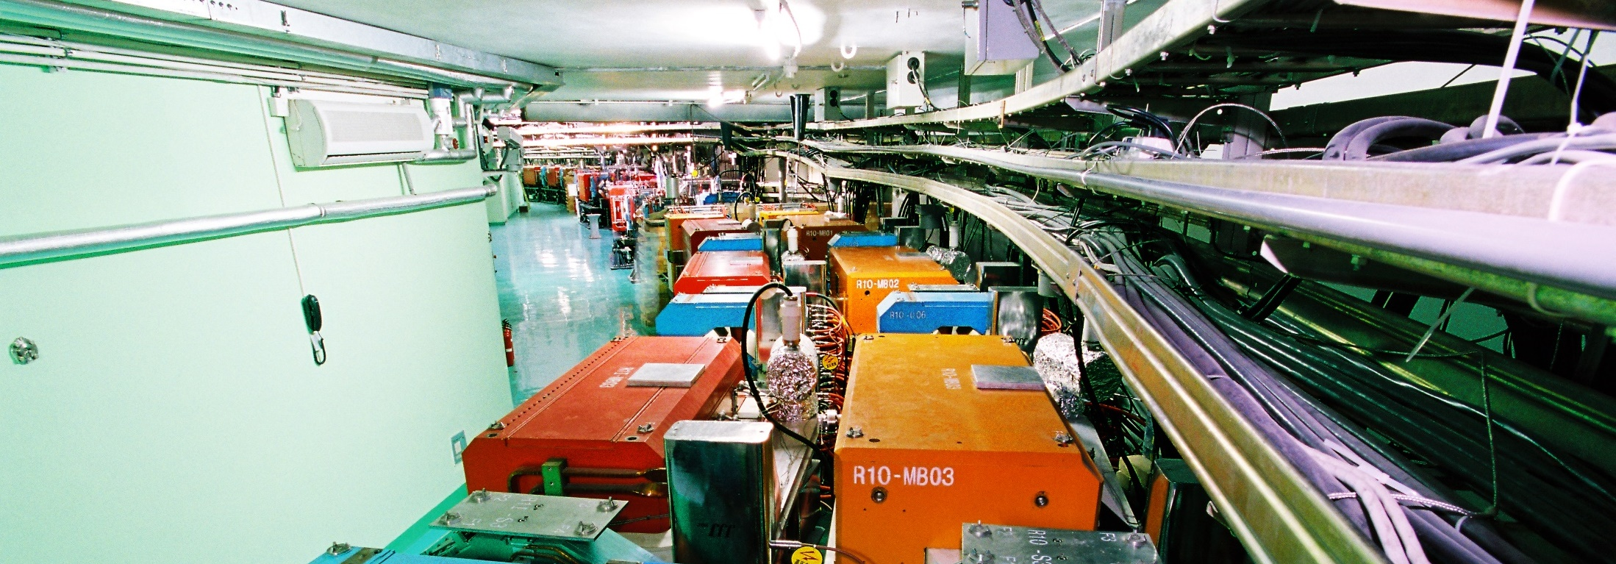
Division of Nuclear Technology and Applications
WEI Long
Institute of High Energy Physics
Jun. 14 , 2018
International assessment of 2018

Slide 2
Contents
1
Overview of DNTA
2
Research of DNTA
3
Future plan
4
Summary

Slide 3
Contents
1
Overview of DNTA
  Mission
  Manpower
  Project & budget
  Laboratory

Slide 4
About DNTA
Historic note:
The former "High-tech Research and Development Center" was established in 2002
Restructured to form " Division of Nuclear Technology and Applications " (DNTA) in 2012
Mission of DNTA (Division of Nuclear Technology & Applications )
DNTA is an application-oriented, non-profit R&D affiliation of IHEP, aiming at instrumentation, product development and technology transfer.
Research areas include (currently)
  Medical imaging technology
  X-ray inspection technology
  Nuclear safety monitoring technology
  (former industrial accelerator)

Slide 5
Mission of DNTA
Reviewers’ Recommendation (2013):
“The Committee supports this concept and direction, and recommends that IHEP consider strengthen the institute-level Office for Technology Transfer and Management to provide legal and business expertise to assist the scientific staff to pursue technology transfer and commercialization.”
Response to Reviewers’ Recommendation:
To achieve the objective, DNTA must work in close cooperation with other research divisions, the Office for Technology Transfer and Management and the downstream company.

Slide 6
Manpower
Staff: 58
Postdoctoral : 2
Postgraduate: 25
Postgraduate from Universities: 16
Others: 4
Total: 105
Notes:
人员比较稳定，满足项目需求

Slide 7
Manpower
Major structure
We have a solid team for our work (85% working on instrumentation).
We are taking age advantage now and in next 5-10 years (over 95% under 50 years old).

Slide 8
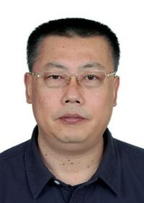
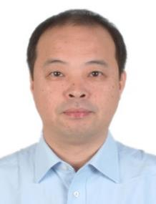

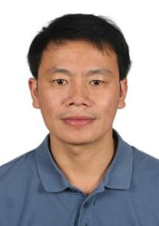
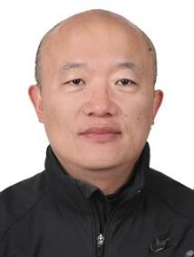
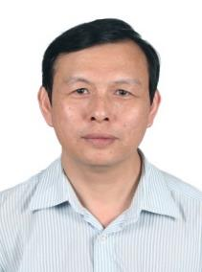
Manpower
Academic leaders
Long Wei
(Nuclear imaging)
Rongjian Shi
(Accelerator)
Cunfeng Wei
(X-ray imaging)
Zhiming Zhang
(Nuclear detecting )
Yu Liu
(nuclear chemistry)
Baoci Shan
(Molecular Imaging)
Notes:
1、人数
2、项目及经费 大多在仪器研制

Slide 9
Project & budget
NSFC grants > 20
State key R&D program, MoST ×2
Key deployment project, CAS
Main project for scientific instruments, CAS ×9
International cooperation project, CAS
Funds from company or organization, 12 M RMB(¥)
2013-2017 Total funds > 142 M RMB (¥)

Slide 10

Budget structure
Noncompetitive Funds 13%
8.4% from company
Competitive Funds 87%
91.6% from government
About 90% funds from government & 88% of all budget are competitive.
DNTA has the capability to compete for projects nation widely.

Slide 11
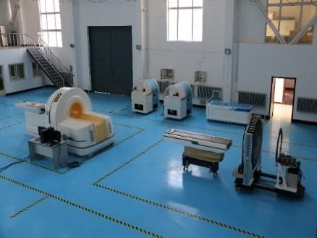
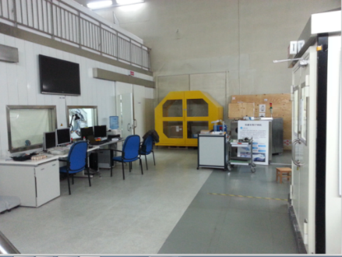
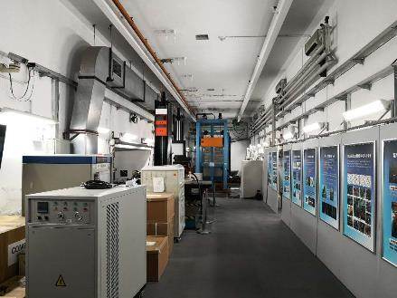
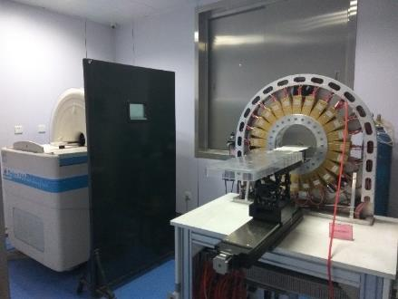
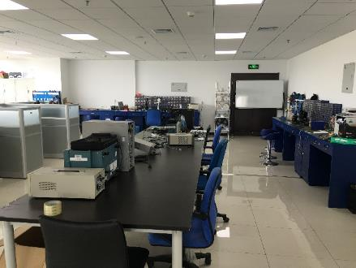
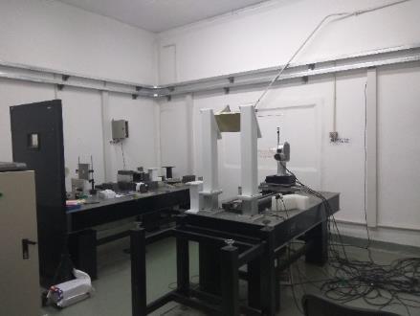
Laboratory
Qualification and the infrastructure meet the needs for nuclear technology.
Having usage permissions of isotopes, X-ray tubes, neutron source and other radiation devices.

Slide 12
Publications & patents
Over 60 papers were published within 5 years as primary organization.
Many papers were published in IEEE serials and in RSI recently.
Encourage researchers to participate in IP training, and to promote and protect
intellectual property.
For many years, DNTA ranked the No.1 contributors of new applied patents and granted invention patents (~about 32% of the total granted to IHEP).
Plan: 50-60 new patents in next 5 years
Category | Applied/ pending | Granted
Invention patent | 54 | 57
Petty patent | 5 | 4
Registration of Computer Software Copyright | 17 | 17
Registration License | 1 | 1
Total | 77 | 79
Summary of IP (2013-2017)

Slide 13
Contents
2
Research of DNTA
Medical imaging technology
X-ray inspection technology
Nuclear safety monitoring technology

Slide 14
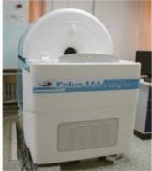
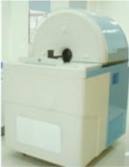
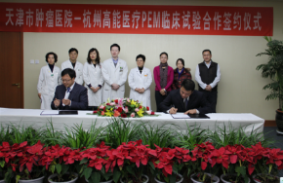
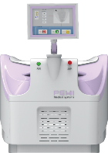
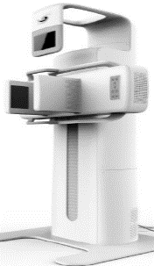
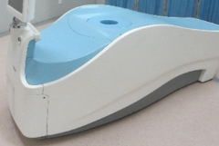
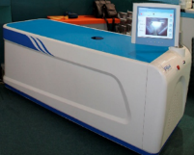
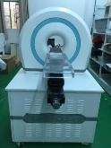
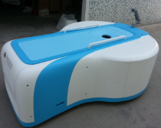
Medical imaging Systems
Before 2013
2013~2018
Micro-PET
Micro-PET/CT
Clinical trials
of PEM
CFDA registration
of PEM
MBI system
2005
2011
2012
2015
2018
2008
2012
2015
2017
PEM prototype
Breast CT
Primates animal
PET
Breast spectral CT

Slide 15
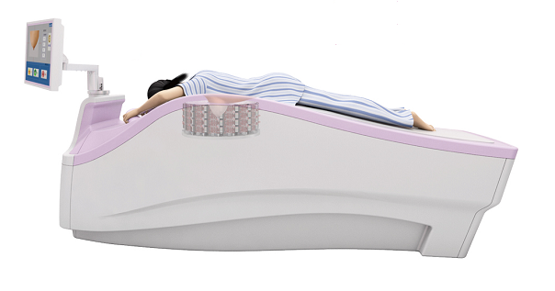
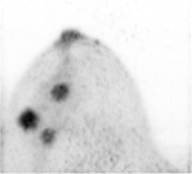
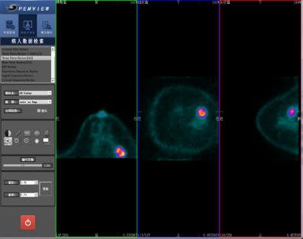
PET for Breast Cancer Diagnosis
(Positron emission mammography - PEM)
  Close-proximity breast imaging to:
  Improve spatial resolution
  Improve photon detection efficiency (sensitivity)
  Lower the examination dose
  Early detection of tumor & tumor characterization
Characteristics of PEMi System:
Ring detector design and uncompressed breast imaging suited to oriental female
The prone position makes stable imaging quality
Real 3D imaging
Notes:
The most important part is the design of ring detector with long axis gives real tree-dimensional imaging.

Slide 16
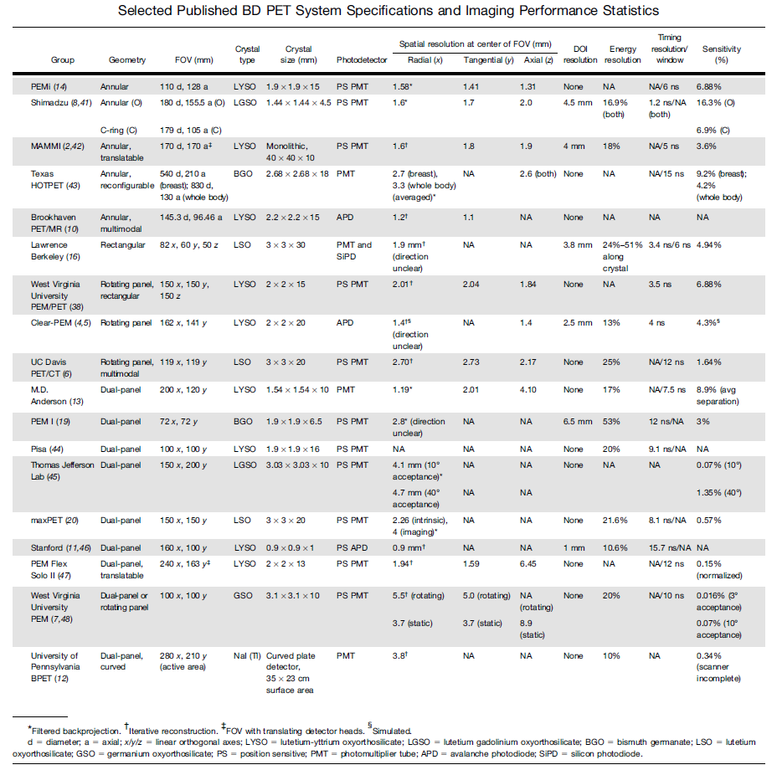
Performance of PEM systems
IHEP PEMi
18 institutions to develop PEM system worldwide.
David F.C. Hsu, David L. Freese, and Craig S. Levin,
THE JOURNAL OF NUCLEAR MEDICINE
Vol. 57 • No. 2 • February 2016

Slide 17
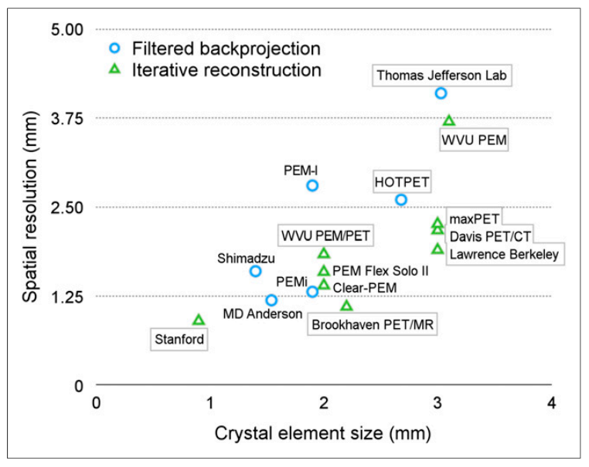
Performance of PEM systems
Note: usually the iterative reconstruction gives better value comparing with FBP.
David F.C. Hsu, David L. Freese, and Craig S. Levin, THE JOURNAL OF NUCLEAR MEDICINE • Vol. 57 • No. 2 • February 2016
Notes:
PEMi achieved quite good performance, compared with other systems.

Slide 18
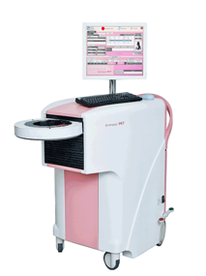
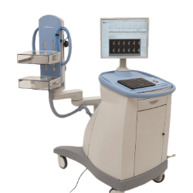
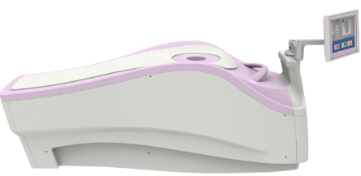

Performance of PEM system
 | PEMi by IHEP | Product A | Product B | Product C
Performance | Resolution 1.38mm sensitivity 6.88% | Resolution 1.4mm sensitivity 2.5% | Resolution 1.6mm Sensitivity 6.9% | Resolution 2mm sensitivity ~0.5%
Scanning method | Prone, free-hand | Prone, free-hand | Prone, free-hand | breast compression
Scanning beds | One bed | Multi-bed or image-merging | One bed | Multi-bed or image-merging
Speed | Fast (~5min.) | fair | fast | fair
Table：Summary of commercialized PEM systems
Notes:
李琳：Now only four commercialized PEM systems.

Slide 19
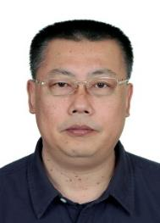
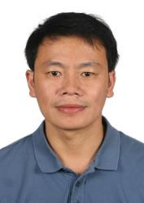


Technology transfer of PEMi
Long Wei, PhD., Prof.
“New Century National Hundred, Thousand and Ten Thousand Talent Project” in 2009
“Science Beijing One Hundred Leading Talents Cultivation Project” in 2013
Zhiming Zhang, PhD., Prof.
He has led the development of animal PET, animal PET/CT. Working on scintillation detectors.
Long Wei and Zhiming Zhang led the “863 Hi-tech project” of MoST to develop the proto-type of PEM scanner.
The technology of PEM transferred to the company “Gao Neng Medical Co., Ltd.”
“Gao Neng Medical Co., Ltd.”
is a spin-off company of IHEP. It has place in Z-park (Beijing) for incubation and factory in Hangzhou for manufacture.

Slide 20
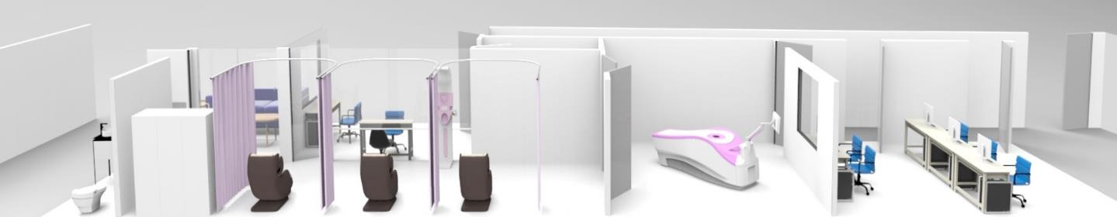
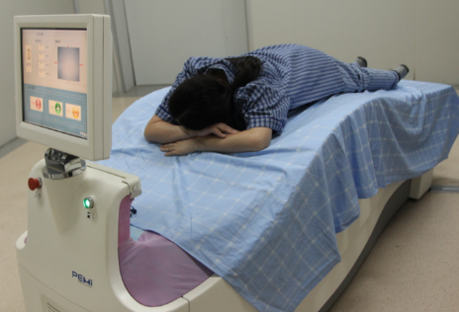
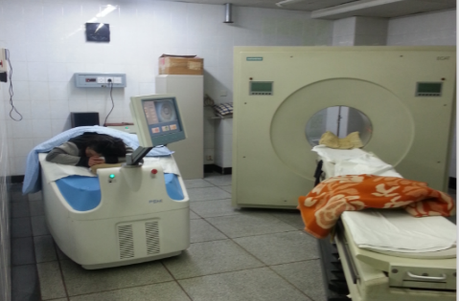
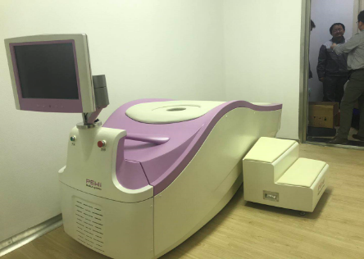
Clinical Applications of PEMi
Clinical applications in physical examination center
began to build 3 image centers for physical examination in Beijing, Jiangsu and Hebei.
They provided total solution for all the image centers, based on specific requirement.
More installations are expected this year.

Slide 21

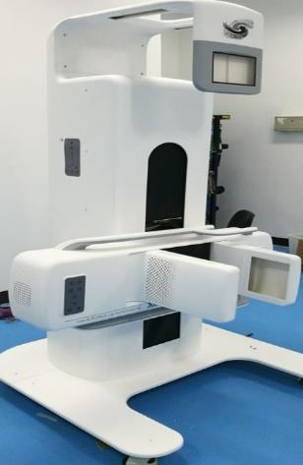
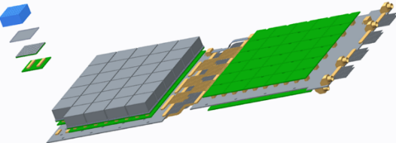
Ongoing project:
Design of new MBI system
Molecular breast imaging (MBI) system:
  Multi-modality: PET & Gamma Camera imaging
  Multi location: breast、axilla、thyroid、legs
  Large FOV： 150mm × 200mm
  High spatial resolution: better than 2mm
  High sensitivity: better than 10%
Xianchao Huang
PhD, Assoc. Prof.
SiPM based detector
Technology developed：
  SiPM based planar detector for 511 keV (¹⁸F agent) and 140 keV gamma rays (^{99m}Tc agent)
  64chs high speed DAQ system with precise TDC embedded in FPGA
  Reconstruction algorithm based on single gamma response (SGR) can reduce the DOI effect & data missing artefacts effectively.

Slide 22
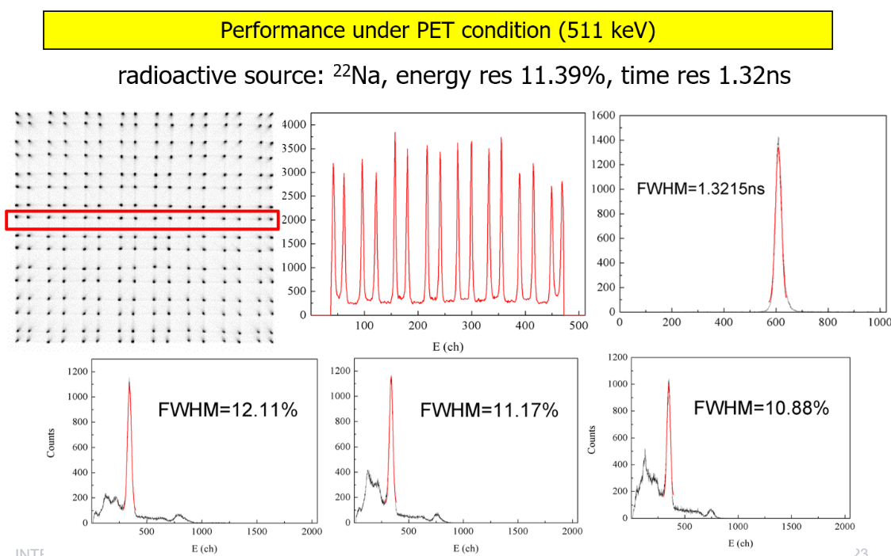
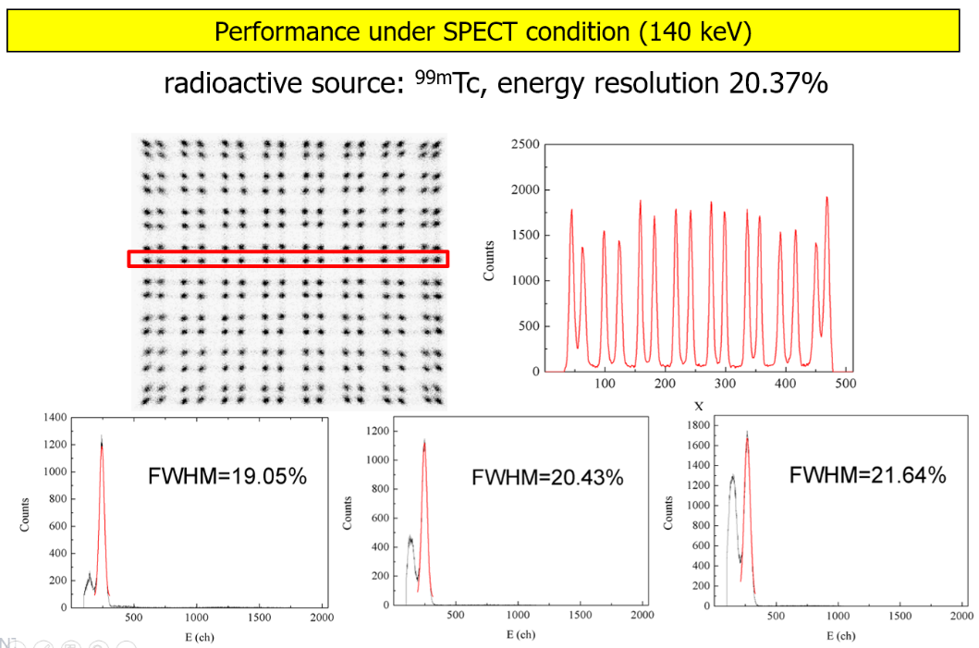
System Performance of MBI

Slide 23

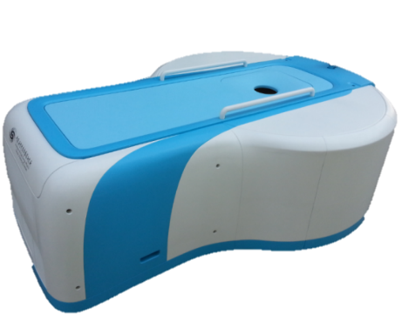
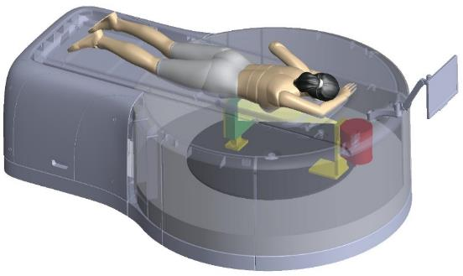
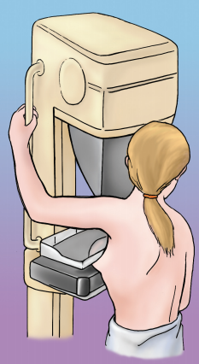
Ongoing project:
Breast Dedicated Spectral CT
Zhe Wang
PhD
Assoc. Prof.
CT technology
  A State-key R&D project to develop multi-energy CT imaging techniques based on energy-resolved photon counting detector and provide an effective tool for early diagnosis, qualitative analysis, and quantitative evaluation of breast cancer.
Spectral imaging technology for high contrast and low dose
the image is true 3D & isotropic.
K-edge imaging technology enhances tumor detectability
Prone position, comfortable and safe
Mammography
Notes:
Spectral CT has many merits:
the Spectral imaging technology gives high resolution and high contrast with low dose
…

Slide 24
Contents
2
Research of DNTA
Medical imaging technology
X-ray inspection technology
Nuclear safety monitoring technology

Slide 25

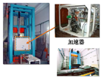
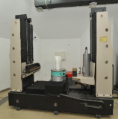
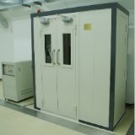
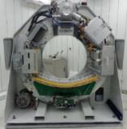
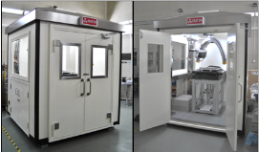
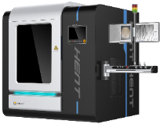
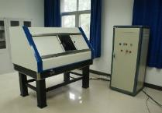
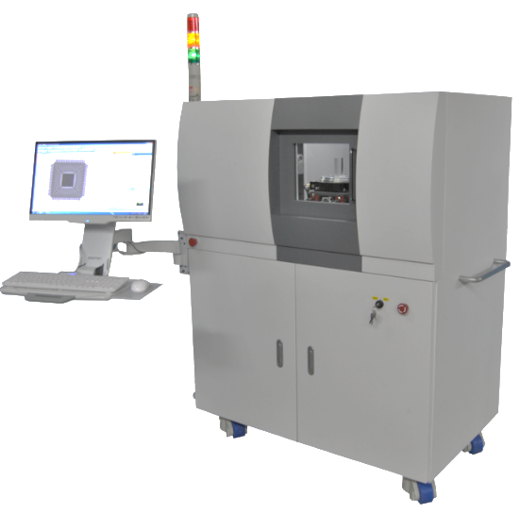



Developed X-ray imaging Systems
Before 2013
2013~2018
450 keV & 6 MeV CT
Dedicated fossil-CT
Spiral CT
Micro-CL
CL for IC testing
2006
2010
2014
2016
2018
2008
2012
2015
2017
130 keV Micro-CT
Mobile micro-CT
9 MeV CT
Rock mechanics CT

Slide 26


CT for Rock Mechanics Testing
A State-Key Scientific Instrument and Equipment R&D Project of NFSC
Rongjian Shi
Prof., Co-PI of the project.
Developed 6MeV, 9MeV standing wave linacs for high-energy X-ray sources.
Observing the cracks of rock under pressure and high temperature (~5km deep)
Formation & evolution of fracture of rock
Gas-liquid motion pattern of rock
Variation of rock properties
Notes:
26
This system integrated a high energy CT system and a presses, which can heat the rock and provide confining and axial pressure.

Slide 27



CT for Rock Mechanics Testing
6 MeV high-energy X-ray CT based on accelerator & 450 keV GP X-ray CT
for end-user: The Institute of Geology and Geophysics, CAS
Notes:
The preliminary results of experiment. The 3D CT images show the crack propagation process of a rock under confining and axial pressure.

Slide 28




Micro-CL (Computed Laminography)
The first X-ray Laminography system for plate-like fossil research.
CL for Institute of Vertebrate Paleontology and Paleoanthropology (IVPP), CAS
Micro-CL has became a NOVEL tool for paleontology research.
With the help of the micro-CL, IVPP team has published more than 20 papers in top journals
(Inc. Nature 3, Science 3, PNAS 1)

Slide 29





Micro-CL (other applications)
IGBT solder void testing
PCB testing
BGA packaging testing
We also developed the micro-CL system to an IGBT company for QC.
Many companies scanned their products using micro-CL system in IHEP to test their products.
Notes:
为什么：Many electronic products are also plate-like.

Slide 30

Invention patents on Micro-CL
10 patents for our developed micro-CL system have been applied.

Slide 31



Technology transfer of CL
Cunfeng Wei, PhD., Prof.
led the Micro-CL project and the ongoing project of 3D X-ray metrology system for Wafer Level Packaging (WLP).
Cunfeng Wei led the “state-key R&D project” of MoST to develop the proto-type of CL and he is leading the ongoing project of 3D X-ray metrology system for WLP.
The technology of CL transferred to the company “Beijing HENT Co., Ltd.”
“Beijing HENT Co., Ltd”
is a spin-off company of IHEP located in Z-park (Beijing) for incubation and manufacture.

Slide 32


Ongoing project:
3D X-ray metrology system for WLP
3D X-ray metrology system for WLP
Precise
Fast
AI
3D X-ray for IC packaging
(e.g. TSV)
Nano-scale
2018-2021
Common NDT
Ultrasonic microscope
Thermal imaging
Micro-CT
Notes:
TSV，Through -Silicon-Via

Slide 33
Contents
2
Research of DNTA
Medical imaging technology
X-ray inspection technology
Nuclear safety monitoring technology

Slide 34















Imager & other monitors developed
Coded-aperture imager
(coding imaging for neutron)
(key methods of coding)
(prototypes of coding imager)
(vehicular
unit）
(portable unit)
(Compton imaging)
(UAV onboard )
(dynamic imaging)
2006
2010
2013
2014
2016
2017
2017
2018
2015
Other radiation monitors
(position indicator in 4π)
(environmental radiation monitor)
(distribution system for personal dose devices)
（RAMO dosimeter）
(RAMO C
dosimeter)
Notes:
干了什么：We have developed a serials of radiation monitor and radiation imager for environmental use.
典型是什么：One typical device is the coded-aperture camera for gamma-ray and X-ray imaging.

Slide 35




Historic notes on radiation imaging
Long Wei,
PhD., Prof.
Lei Shuai, PhD., Assoc. Prof.
Working on CA imaging since as a postgraduate.
Inventor of a novel large square-hole aperture for CA imaging.
Leading the follow up imager projects.
Research on coded-aperture imaging started form 2006 support by IHEP
China’s 1st coded-aperture Gamma-ray Imager
Financial supports from CAS, NSFC and MoST
1st Stand-alone system and portable type on the world market
Series products for different applications
Notes:
Modified Uniformly Redundant Array

Slide 36








Series imager products
vehicle-mounted imager | Portable radiation imager | Solid-state imager | Radiation monitor for customs | Gamma ray imager for high background radiation | Tunnel inspection robot
HENT3-011A | HENT-013A | HENT3-014A | HENT3-015A | HENT-016A | HENT-017A
Tunnel inspection robot for radiation environment in CSNS
HD visible camera, infrared thermometer, gamma-ray imager, laser rangefinder and dosimeter integrated

Slide 37





System Performance
Highlights:
Far-field distance and activity measurement of hot spots
  activity estimation error ≤20% in 10 meters range
Chasing of moving “hot” object
  adaptive algorithm for strong & weak sources
Invention of large square-hole aperture for CA Imaging
  with ¼ transparent mask area for CA imaging
  The aperture is a MURA, which can be extended

Slide 38



Applications
Applied to most nuclear power plants in China, providing the state-of-the-art technology for the safe operation and maintenance of NPP.
Radiation field Imaging of reactor end faces
(CAN DU reactor)
Radiation deposition imaging of pipeline
(LWR)
Hotpot imaging with high background

Slide 39



Applications
Applied to many major activities or events to ensure the public security.
Nanjing
2014 Youth Olympics
Hangzhou
G20 Summit
Radiation emergency exercise

Slide 40




Applications
Inspection in customs tunnel/port
  entry-exit inspection (Shenzhen / Hong Kong)
  Vehicle inspection in highway toll-gate (Beijing)

Slide 41


Applications
Captured people who carried contraband or injected with nuclear medicine
@ Hong Kong→Shenzhen port.
May, 2018

Slide 42





Technology transfer
The technology of imagers and dosimeters transferred to the company “Beijing HENT Co., Ltd.”
“Beijing HENT Co., Ltd”
is a spin-off company of IHEP located in Z-park (Beijing) for incubation and manufacture.
Notes:
40Million transfer funding (MOST + INVESTMENT)

Slide 43
Ongoing Project
Mainland China has near 40 nuclear power reactors in operation, about 20 under construction, and more about to start construction. Rapid growth in nuclear power has given rise to the importance of nuclear safety.
Miniaturization
  Develop more compact, multifunctional and highly integrated devices.
Applications in multi-platform
  Develop small UAV onboard/portable units for routine environmental monitoring and nuclear emergency response.
Information network
  Information integration and sharing by IoT technology with multi-platform detector terminals

Slide 44
Contents
2
Research of DNTA
Medical imaging technology
X-ray inspection technology
Nuclear safety monitoring technology
Industrial & Medical Accelerators
Notes:
1、电子加速器完成了转化 工厂可以完成加速管等加工生产
2、散列的质子加速器

Slide 45


BNCT (Boron Neutron Capture Therapy)
BNCT accelerator was developed and applied through the cooperation with companies. The agreement has been signed and the budget is available.
The demonstration facility will be constructed in the CSNS site, and will be the first accelerator-based BNCT facility in China.
The layout of BNCT beam line
Signing ceremony of a cooperation agreement
The beam energy of a typical BNCT facility is always more than 8MeV. The 3.5 MeV beam can ease the construction of accelerator, but the low energy beam energy will be a challenge to develop the neutron target.

Slide 46
Comments from 2013 Assessment & Responses
Comments | Implementation & achievement
Too many projects | Ended some small and isolated projects.
Need further cooperation with companies | “Gao Neng Medical Co., Ltd.” is responsible for the industrialization of PEM, and next MBI system. “Beijing HENT Co., Ltd” is responsible for the industrialization of CL, radiation imagers and dosimeters.
Offer free use in exchange for usage data | All instruments have been opening to public to provide services. (μPET, CT’s, CL and data analysis)

Slide 47
Contents
3
Future plan of DNTA

Slide 48
Future plan
Technology research
  High-performance electronics,
  3D-Compton & hybrid imaging technology,
  Time-coded imaging technology,
  Rapid quantitative mapping of regional radiation distribution
Components and instrumentation
  Photon counting detector (CZT detector),
  Multi-energy breast CT,
  CT for Paleontology fossils and human remains,
Technology transfer
  MBI for breast,
  3D X-ray system for IC packaging,
  Nuclear safety inspection devices

Slide 49
Contents
4
Summary

Slide 50
Summary remarks for DNTA
  DNTA’s work is based on the technologies developed with large facilities in IHEP, which are our legacy;
  We hope, the successful demonstration (accelerator, PEM and radiation imager) should be modeled by following projects;
  DNTA should perform further R&D according to demands of application, market, and establish some R&D platforms with industry to carry out the technology transfer and industrialization;
  Innovation and entrepreneurship in DNTA to meet the needs along with the rapid development of economy in China - are our vision. .

Slide 51
Thank you for your attention!

