Slide 1
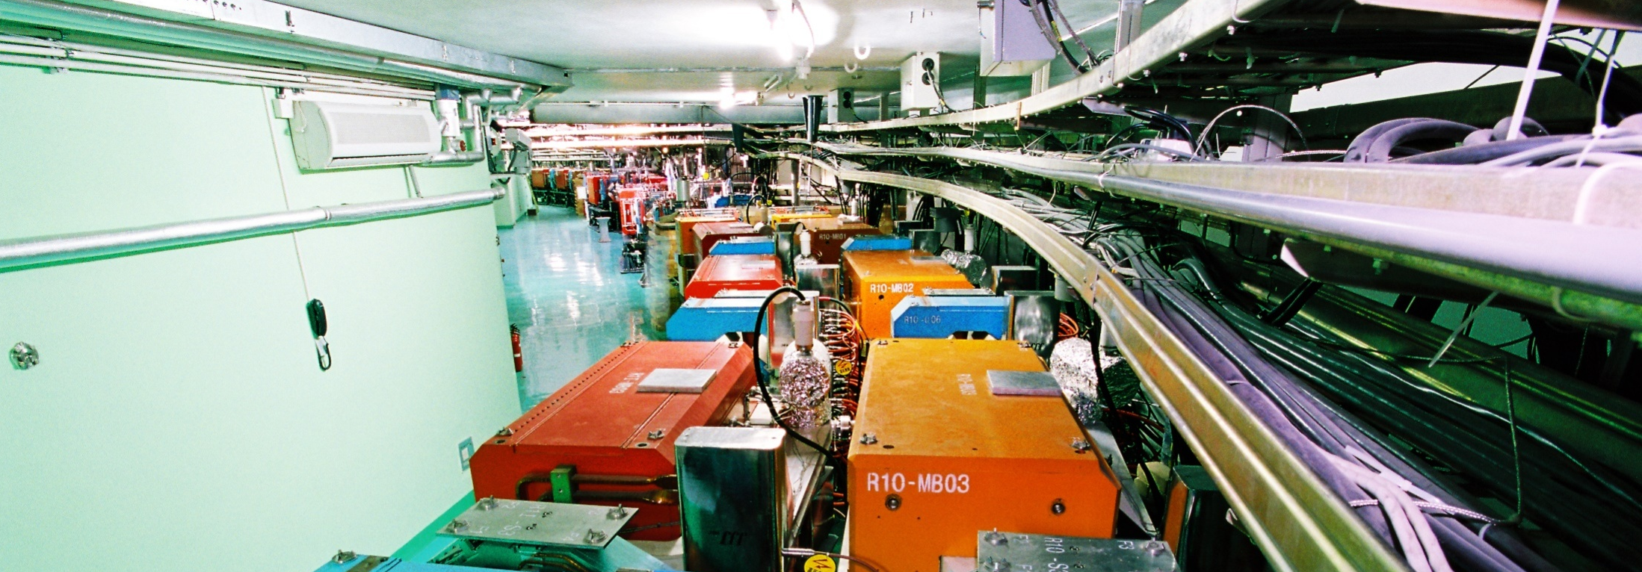
Multi-Disciplinary Research Division and Synchrotron Radiation Beamlines
DONG Yuhui
Multi-Disciplinary Research Division
Jun. 12-15 , 2018
International assessment 2018
Notes:
这个模板人名部分看不清楚。

Slide 2
Contents
1
Introduction
2
Performance and Future Plans
3
Improvements since 2013
4
Summary
Notes:
报告分成5个部分。介绍部门情况；2013年评估的结果和改进措施；各部分的目前工作情况和未来计划；争取的资源和面临的挑战；最后的总结。

Slide 3
Vision & Mission
Part 1
IHEP: one of the world’s leading high-energy physics research centers, and a world-class, large-scale, comprehensive, multidisciplinary research base.
Building and operating synchrotron radiation beamlines and end-stations;
BSRF & HEPS (in future)
Developing cutting-edge experimental methods and X-ray optical techniques;
HEPS-TF & PAPS
Performing in-house research based on SR facilities.
Biomedical Effects of Nanomaterials and Nanosafety, Environment and Health, Protein Structures and Functions, Nuclear Chemistry
Notes:
Vision（上半部分）当然要和整个IHEP的定位契合，mission（下半部分）：建设和运行装置、实验方法和技术研究、基于大装置的前沿研究。

Slide 4
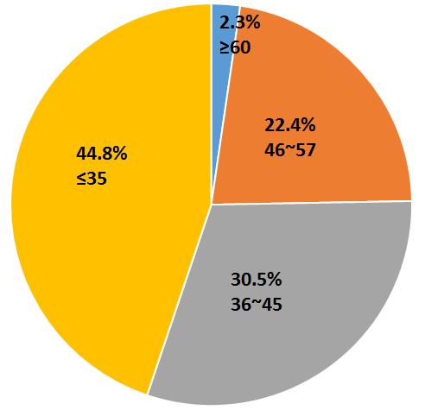
Structure
Part 1
♣ Manpower: 163 scientists and engineers, 4 secretaries, 115 students and post-doctoral researchers.
Beijing Synchrotron Radiation Facility
HU Tiandou
High Energy Photo Source
DONG Yuhui & TAO Ye
High Energy Photo Source Test Facility
DONG Yuhui & HU Tiandou
Platform of Advanced Photo Source
LIU Peng
Nanomaterials & Nanosafety
ZHAO Yuliang
Environmental Health & Safety
ZHANG Zhiyong
Protein Structure
DONG Yuhui
Nuclear Energy Radiochemistry
CHAI Zhifang & SHI Weiqun
Positron Annihilation
WANG Baoyi
Nuclear Archeology
FENG Xiangqian
Age distribution of permanent staff
Notes:
介绍多学科的概况，多少人员，年龄分布，分成几个部分。蓝色的是工程项目，绿色是在大装置上开展in-house研究的团队。

Slide 5
Manpower
Part 1
Project | Prof. | AP& SE | AR& Eng | Support | Total | Students& Postdocs
BSRF | 6.1 | 20.4 | 14.1 | 0 | 40.6 | 56
HEPS (HEPS-TF, PAPS) | 7.9 | 31.6 | 16.9 | 0 | 56.4 | 5
In-house research | 16 | 38 | 21 | 1 | 76 | 54
Support | 0 | 4 | 1 | 1 | 6 | 0
Total | 29 | 93 | 40 | 2 | 167 | 115
Most manpower is allocated to the facility projects (BSRF, HEPS, HEPS-TF, PAPS)
In-house research teams are carefully selected
Notes:
不同项目上的人员分布。大部分的人员集中在光源项目上。

Slide 6
Research Funding: 2013-2017 (MCNY)
Part 1
 | 2013 | 2014 | 2015 | 2016 | 2017
MOST | 11.82 | 13.56 | 12.17 | 27.15 | 39.26
NSFC | 18.11 | 22.05 | 27.13 | 22.46 | 25.72
CAS | 34.67 | 45.5 | 29.2 | 33.2 | 36.84
IHEP | 6.07 | 7.07 | 2.20 | 2.59 | 2.75
others | 1.9 | 6.41 | 6.01 | 0.78 | 2.99
HEPS-TF |  |  |  | 95.00 | 60.13
PAPS |  |  |  |  | 18.03
Total | 72.57 | 94.58 | 76.72 | 181.17 | 185.72
The HEPS-TF project formally started in 2016. The construction of HEPS will start at the end of 2018.
The competitive funding is mainly from MoST, NSFC and CAS.
Blue: competitive
Red: construction & development
Notes:
年度经费，竞争性经费在7千万左右，其余的是工程经费

Slide 7
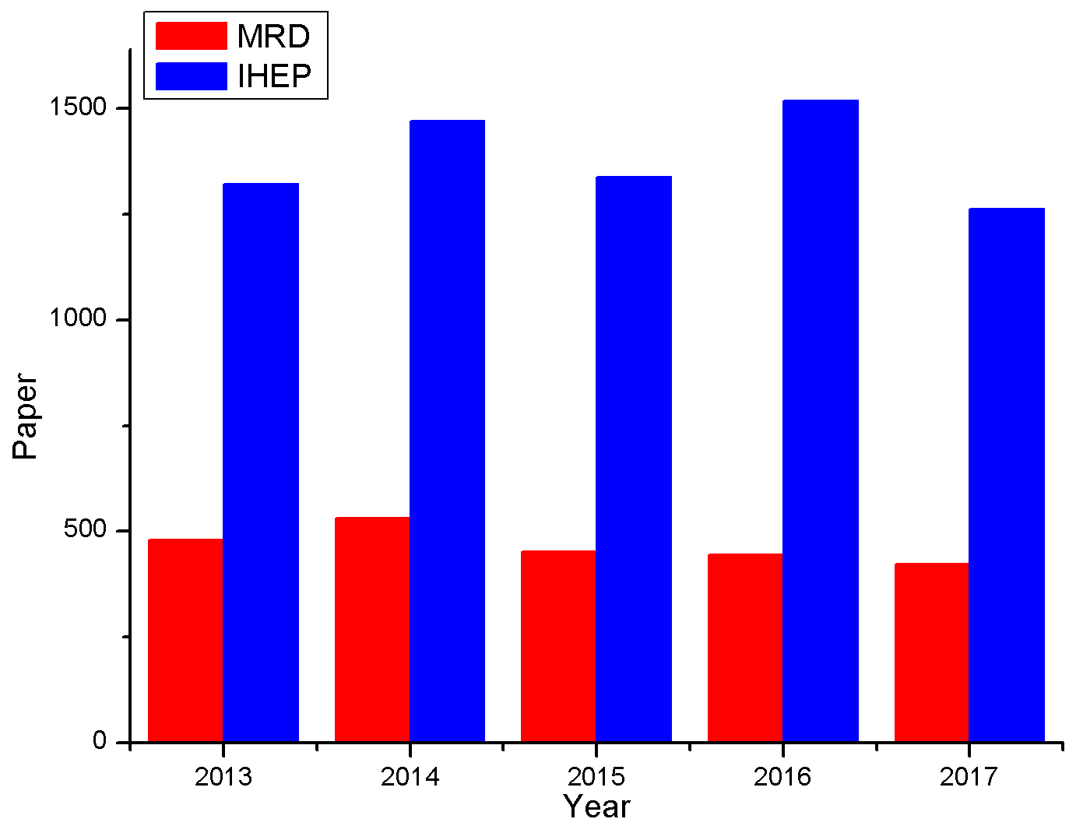
Papers Published
Part 1
Papers by MRD members
Year | 2013 | 2014 | 2015 | 2016 | 2017 | Total
MRD | 480 | 532 | 451 | 444 | 423 | 2330
IHEP | 1322 | 1470 | 1338 | 1519 | 1262 | 6911
% | 36.3 | 36.2 | 33.7 | 29.2 | 33.5 | 33.7
Collaboration with other institutions and universities due to methodological and technological developments.
The HEPS-TF project formally started in 2016
Notes:
多学科发表的文章。有一部分是合作论文，2015年以后人员转移到光源（HEPS-TF是2016发改委经费到位，但是2015年已经开始），文章数目少了一些。

Slide 8
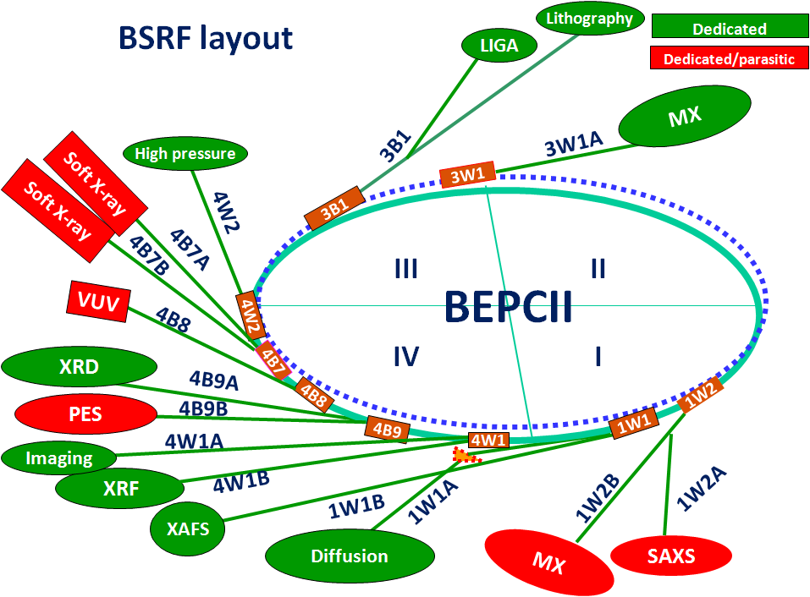
Performance: BSRF
Part 2
5 wigglers, 4 bending magnets
14 beamlines
15 end-stations
Dedicated mode: 2.5 GeV/200 mA
Parasitic mode: depending on HEP
Beamtime: ~2000 hrs/year
Proposals: ~550/year
Users: ~1800/year
Papers: ~400/year
An important experimental platform in northern China.
“Despite its limitations, the BSRF experimental station completed in 2002 has provided an excellent technological platform for structural genomics research.”
Prof. Zhihe Rao in “History of protein crystallography in China”, Phil. Trans. R. Soc. B (2007) 362, 1035–1042
Notes:
进入第三部分（似乎需要一个过渡？），讲述各部分的具体情况。首先是BSRF，目前是中国北方重要，也是唯一的同步辐射实验平台。

Slide 9
Papers by BSRF users, 2007-2017
Part 2
Year | 2007 | 2008 | 2009 | 2010 | 2011 | 2012 | 2013 | 2014 | 2015 | 2016 | 2017
JCR-An1 | 5 | 7 | 10 | 16 | 19 | 23 | 42 | 38 | 84 | 113 | 150
Total | 138 | 129 | 164 | 158 | 166 | 194 | 249 | 340 | 381 | 390 | 450
% | 3.6 | 5.4 | 6.1 | 10.1 | 11.4 | 11.9 | 16.9 | 11.2 | 21.0 | 29.0 | 33.33
Only 2-3 months of operating time per year.
JCR-AN1: Top 5% impact factors by JCR (Journal Citation Report)
Notes:
BSRF历年用户发表文章的统计，突出BSRF运行的效率。

Slide 10
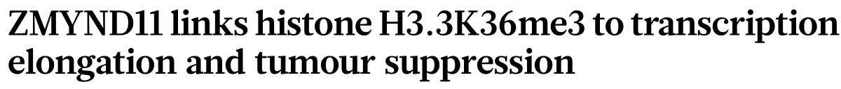
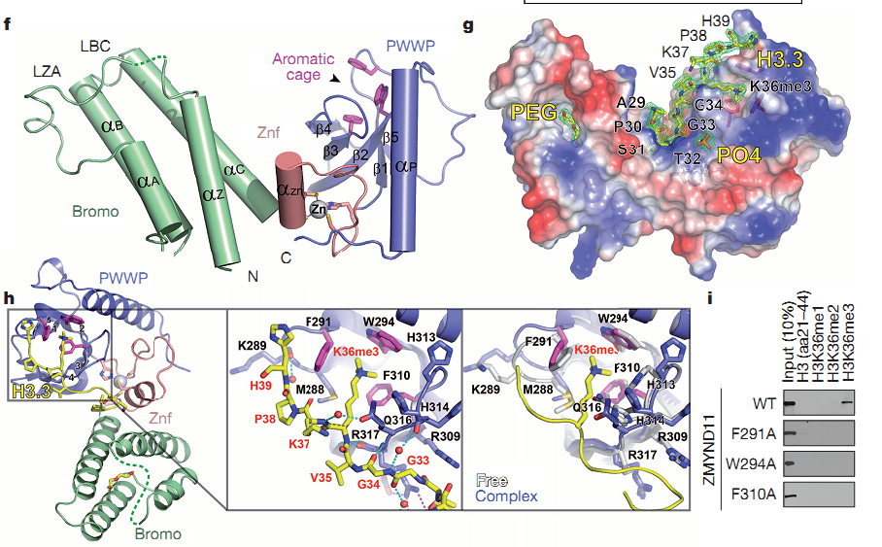
BSRF Research Highlights
Part 2
Histone code reader
Nature (2014)
Prof. Hai-Tao Li, Tsinghua University
The candidate tumour suppressor ZMYND11
specifically recognizes H3K36me3 on H3.3 (H3.3K36me3) and regulates RNA polymerase II elongation.
Notes:
2013年来用户的高水平工作1（似乎需要一句口号式的话，否则说太多了听众反而不知道该记住哪个）

Slide 11
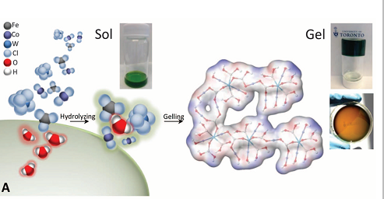
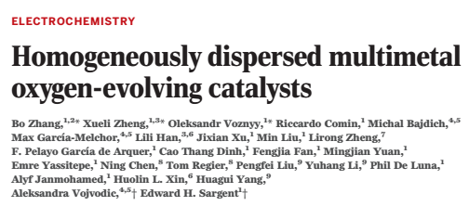
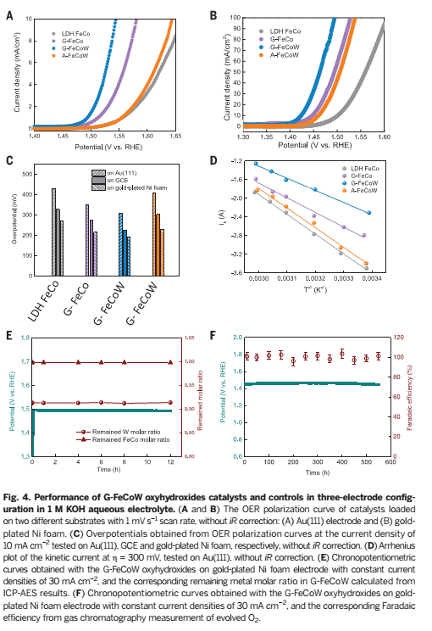
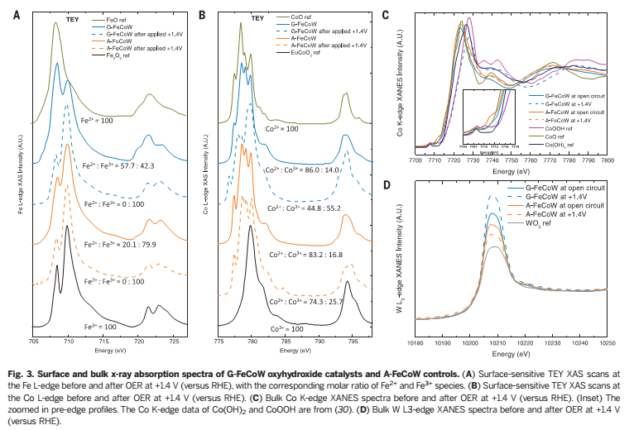
BSRF Research Highlights
Part 2
Homogeneously dispersed multimetal oxygen-evolving catalysts
Science 352, 333–337 (2016)
Fe, Co and W gelled oxyhydroxide materials with an atomically homogeneous metal distribution. X-ray absorption and computational studies reveal a synergistic interplay between tungsten, iron, and cobalt in producing a favorable local coordination environment and electronic structure that enhance the energetics for OER (oxygen-evolution reaction)
Notes:
2013年来用户的高水平工作3

Slide 12
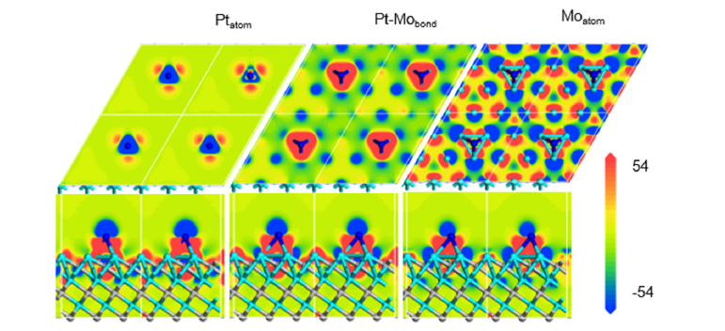
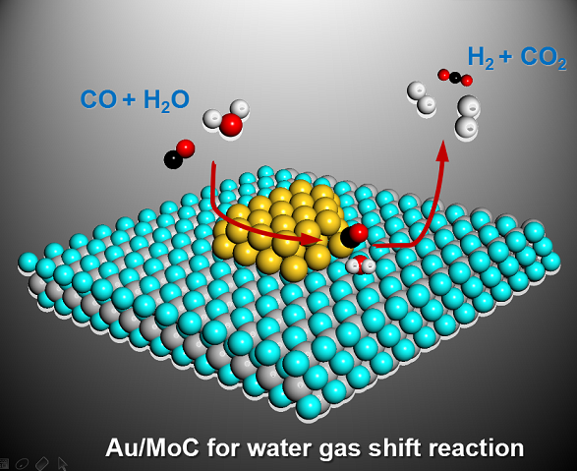
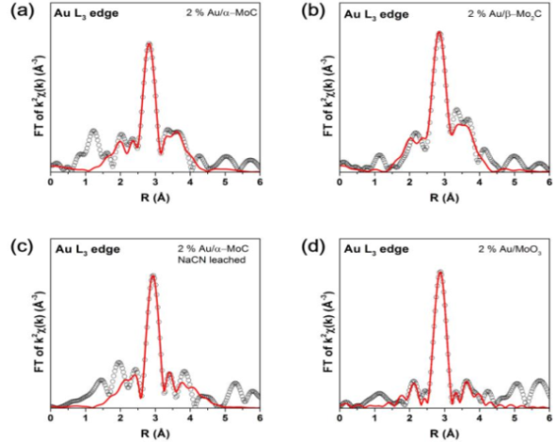
BSRF Research Highlight
Part 2
Interface catalysis mechanism revealed by XAFS and DFT calculation
Low-temperature hydrogen production from water and methanol using Pt/α-MoC catalysts
Atomic-layered Au clusters on α-MoC as catalysts for the low-temperature water-gas shift reaction
XAFS
Pt atomically dispersed on α-molybdenum carbide (α-MoC) enables low-temperature, base-free hydrogen production.
Layered Au clusters on a α-MoC substrate to create an interfacial catalyst system for the ultralow-temperature WGS reaction.
Nature, 544, 80-93 (2017)
Science 357, 389–393 (2017)
Notes:
2013年来用户的高水平工作5

Slide 13
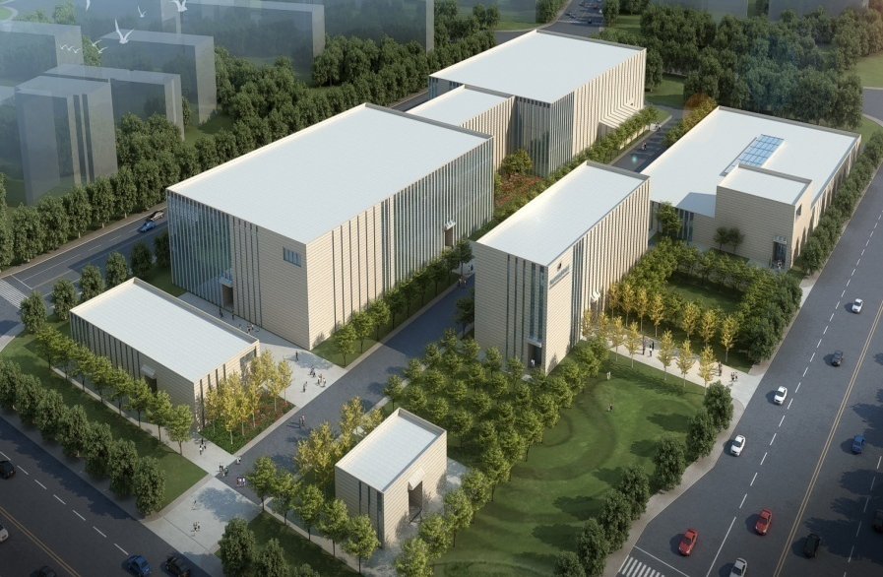
Performance: X-ray Optical Techniques
Part 2
HEPS-TF: ~170M CNY for beamline and end-station technique development
The HEPS R&D project
PAPS: ~100M CNY for X-ray optics research
For the sustainable development of SR experimental techniques
X-ray optics
X-ray detection
X-ray applications
Notes:
X射线光学技术得到了HEPS-TF和PAPS两个项目的支持

Slide 14
Beamline and End-Station Techniques in HEPS-TF
Part 2
 | System | Status
B1 | High-energy X-ray mono. | Test passed 2017/11/23
B2 | High-resolution mono. | Test passed 2017/11/24
B3 | LN-cooling mono. | Test passed 2017/11/24
B4 | Optical metrology | LTP test passed 2017/12/15 Bending system test passed 2018/3/15
B5 | MLL and HE-CRL | Test passed 2018/5/21
B6 | Nano-positioning | Test passed 2018/3/15
B7 | Time-resolved X-ray exp. | Test passed 2017/11/24
B8 | X-ray 2D pixel array detector | Test passed 2017/11/24
B9 | Dynamic HP exp. | Test passed 2017/5/26/

Slide 15
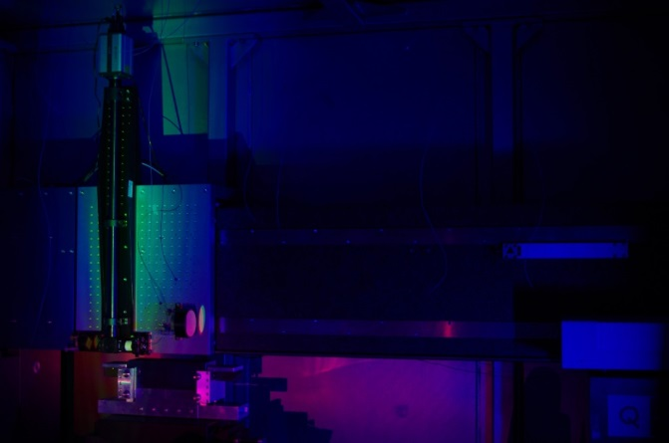
HEPS-TF Optical Metrology
Part 2
LTP
LTP testing on 2017/12/15
A series of new technologies to eliminate measurement errors, as well as to control the disturbance from the environment
 | Test | Design
Precision for curved mirror (RMS) | 32 nrad | 150 nrad
Flat mirror (RMS) | 25 nrad | 70 nrad
Requirement for HEPS optics: at least 100 nrad
One of the highest levels of precision in the world
Precision of curved surfaces more important for beamlines at low-emittance SR facilities.
Short bending mirror
Notes:
HEPS-TF项目大幅度提升了我们的X射线光学水平。精密光学表面测量技术已经达到世界领先水平。

Slide 16
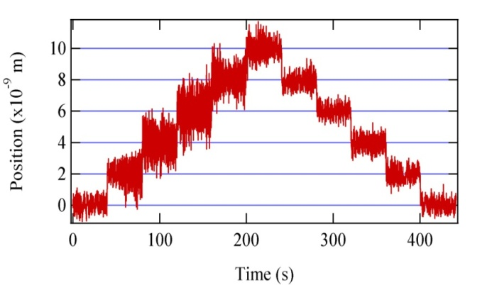
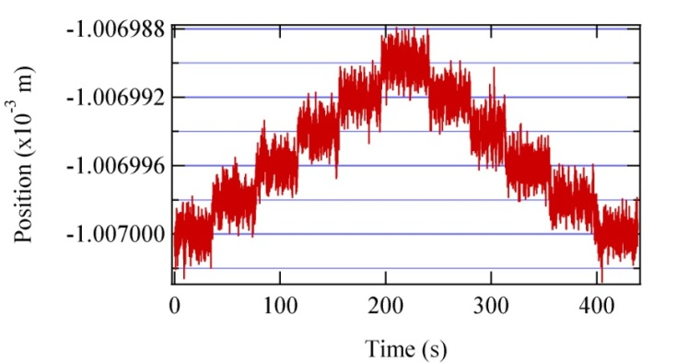
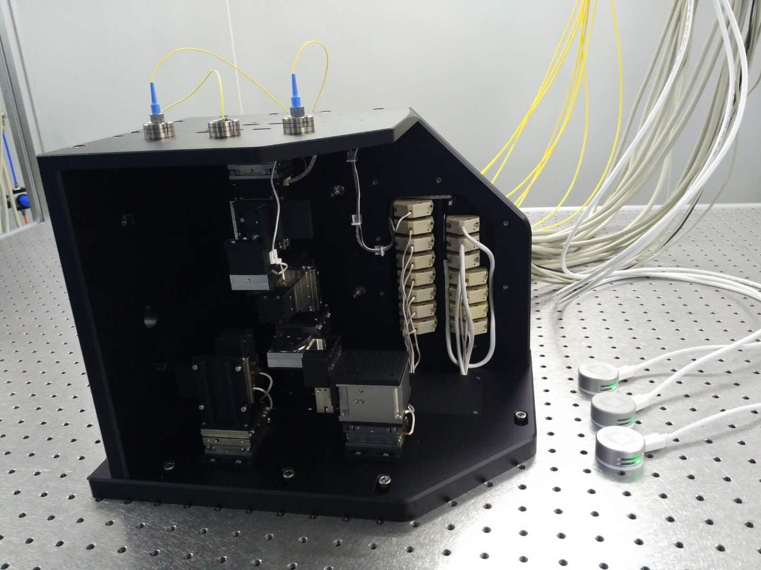
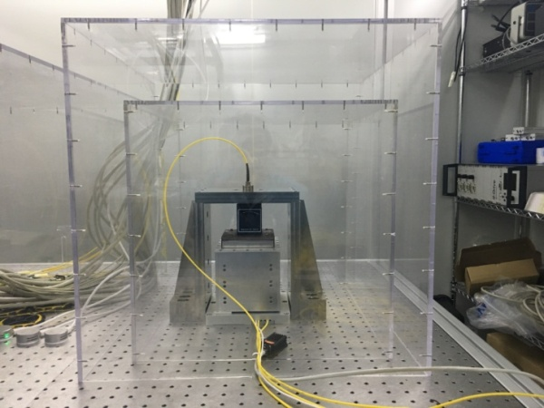
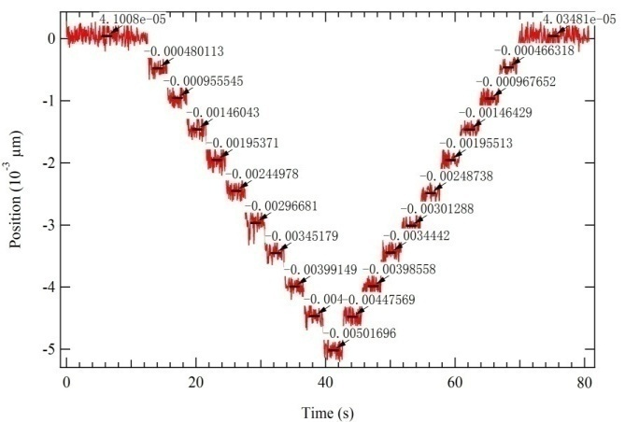
HEPS-TF Nano-Positioning
Part 2
Testing on 2018/03/15
Nano stage
Parameter | Design | Test
Scanning precision | 2 nm | 2 nm
Range | 7 μm | 7 μm
Loading | 200 g | 200 g
Stage
Vertical scanning stage
Loading：> 1.0 kg
Range：> 1 mm
Step：< 0.5 nm
Vertical scanning
Notes:
纳米移动达到了国际先进水平，能够在1毫米范围内实现稳定的5埃移动。

Slide 17
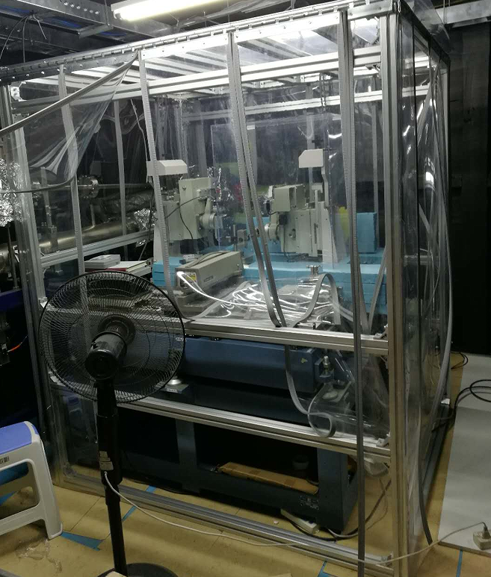
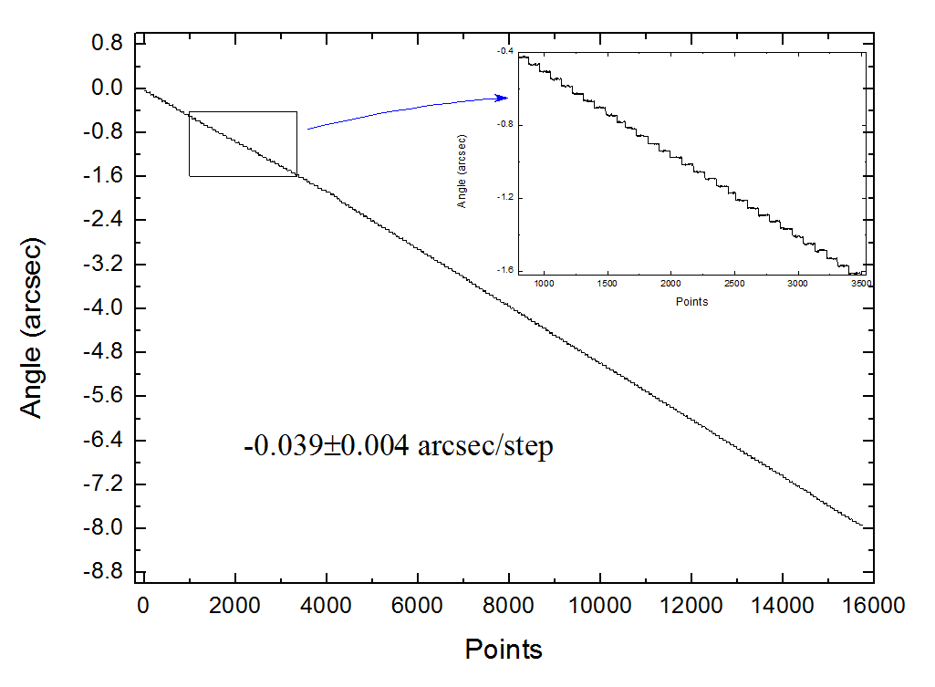
HEPS-TF High Resolution Mono.
Part 2
2.34 meV
2.47 meV
Energy resolution
Testing on 2017/11/24
HEPS: Ultra-low emittance SR
The meV energy resolution @10 keV is essential for a series of experiments: IXS, RIXS, NRS. etc.
Mechanical system

Slide 18
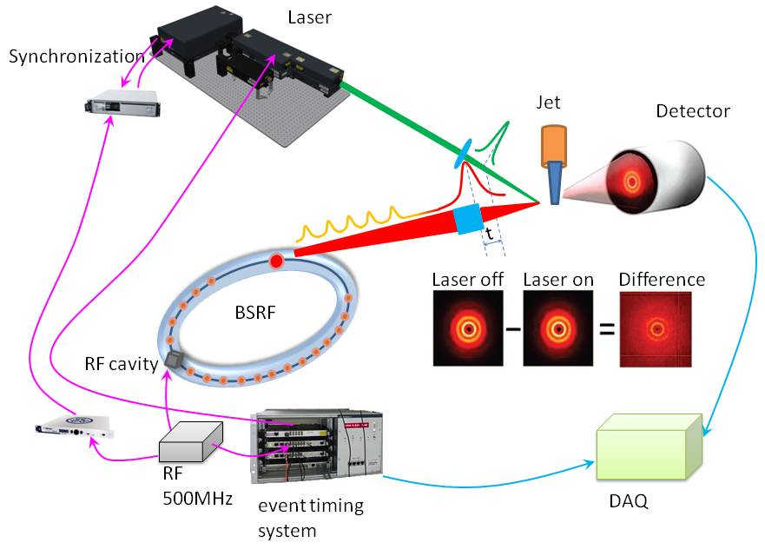
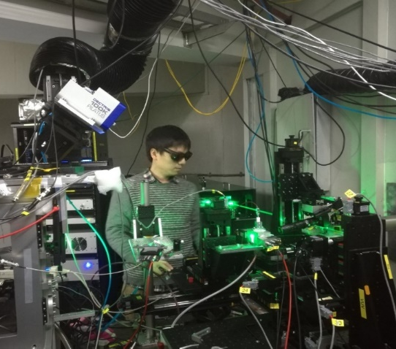
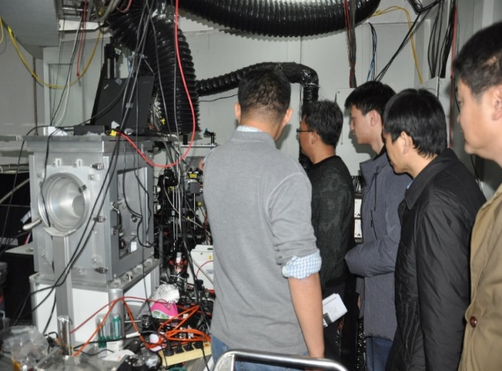
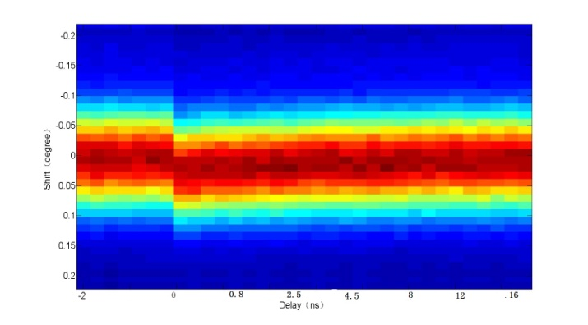
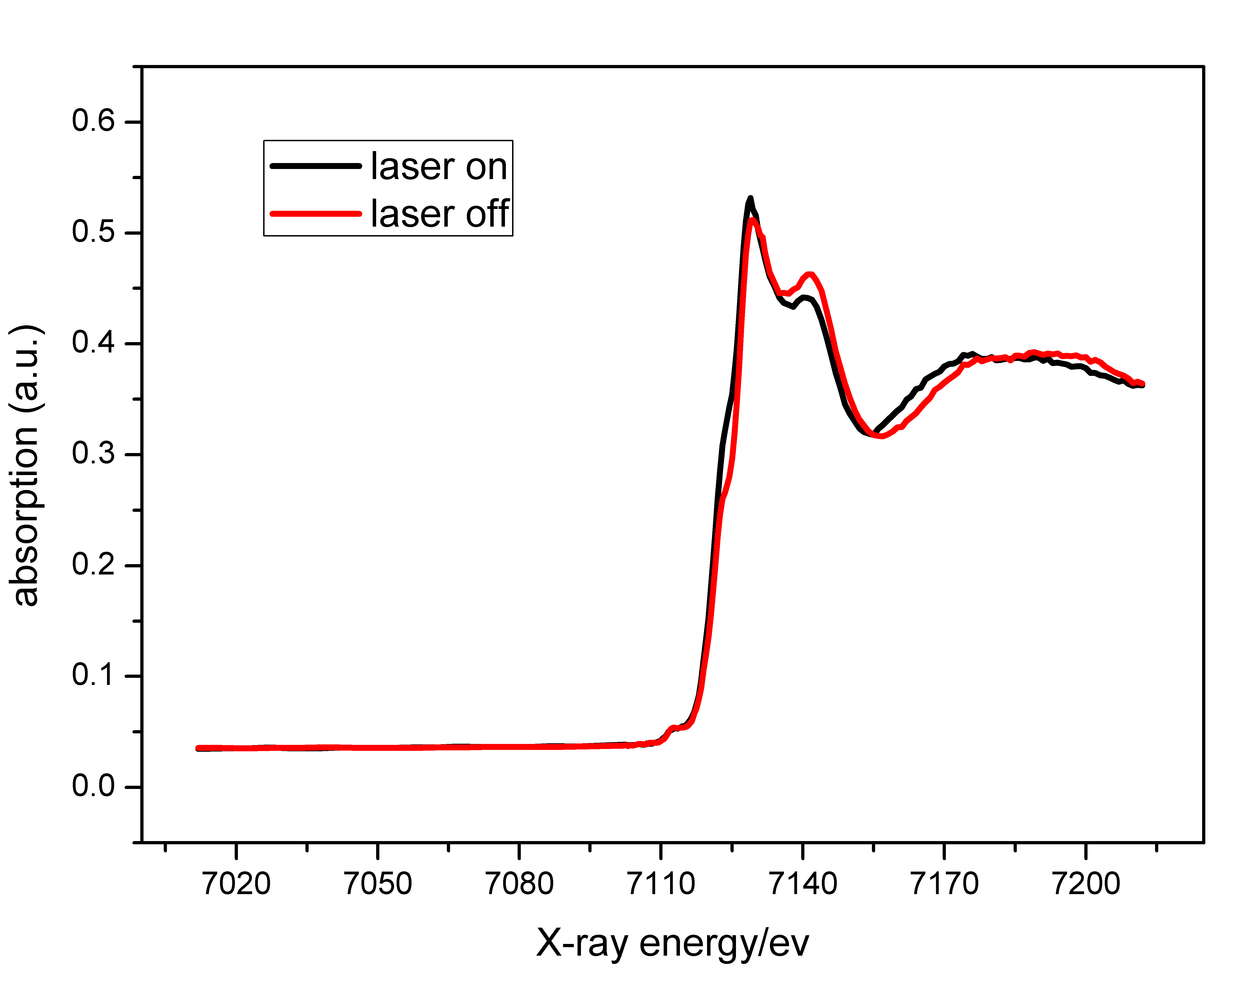
HEPS-TF X-Ray Pump-and-Probe
Testing on 2017/11/24
>600 kHz repetition rate
100 ps time resolution
XRD and XAFS

Slide 19
Performance: In-House Research
Part 2
Biomedical Effects of Nanomaterials and Nanosafety
Environment and Health
Protein Structures and Functions
Nuclear Chemistry
Development of techniques, SR-based research
Funding: NSFC, MOST, CAS
~70M CNY per year
Notes:
In-house研究要基于大科学装置，为大科学装置的技术发展提供指引，连接用户和装置，不是为了和别的研究所和大学竞争。经费来自竞争性的经费申请。

Slide 20

Environment and Health: Transformation of Ceria NPs
Part 2
Ceria NPs can be transformed into Ce(III) in plants
The physicochemical interaction between the NPs and root exudates at the nanobio interface is the necessary condition for the transformation
Ma et al. Environ. Sci. Technol., 2015, 49: 10667−10674
Notes:
研究亮点1：利用同步辐射吸收谱研究纳米氧化铈在土壤中的转化。

Slide 21
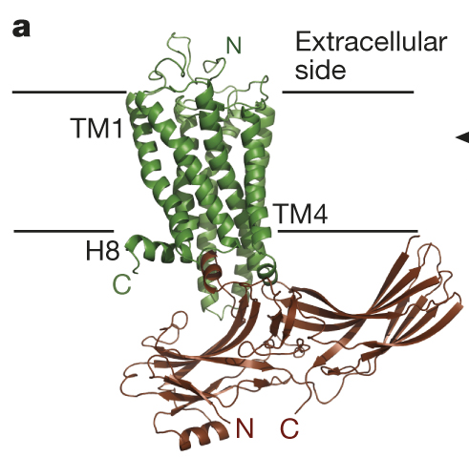
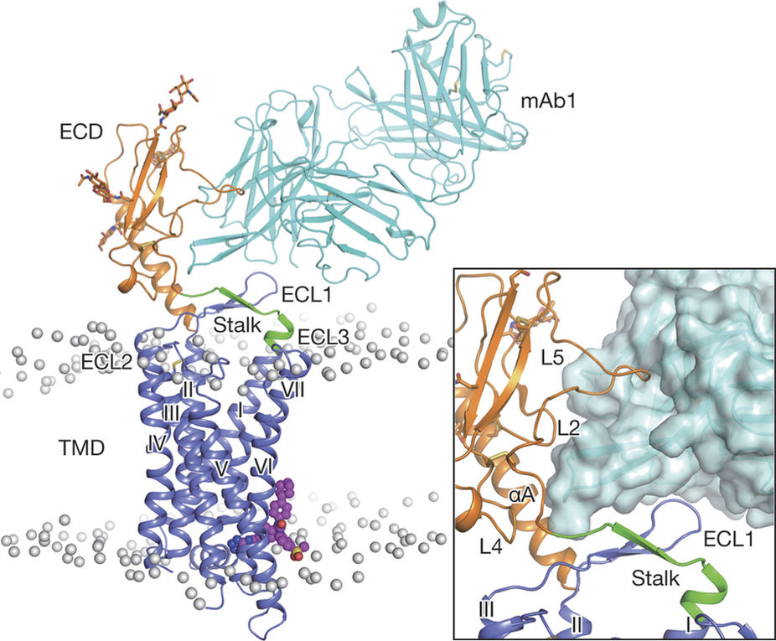
Protein Structures and Functions: Methodological Research in Structure Determination
Part 2
Structure of rhodopsin-arrestin complex
Collaboration with Dr. Eric Xu, Shanghai Institute of Materia Medica
Nature 523, 561–567 (2015)
Structure of full-length GCGR, the first full-length structure of B-class GPCR
Collaboration with Dr. Qiang Zhao, Shanghai Institute of Materia Medica
Nature 546, 259–264 (2017)
Notes:
提供数据处理技术，与上海药物所合作解析的结构1

Slide 22
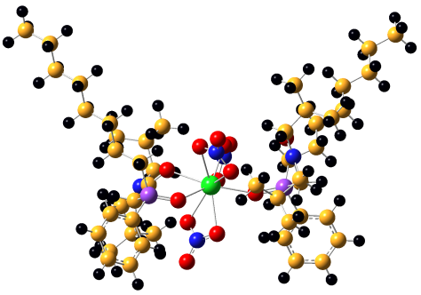

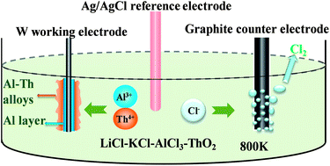
Nuclear Chemistry
Part 2
η | 99% | 99.9% | 99.99% | 99.999%
△E (n=3) | 0.11 | 0.16 | 0.21 | 0.26
△E (n=4) | 0.08 | 0.12 | 0.16 | 0.20
Design of high efficiency ligands for actinide separation
Studying the structures by SR methods
Pyroreprocessing-Al cathode-based high efficiency separation of An-Ln through electrodeposition in molten salt

Slide 23
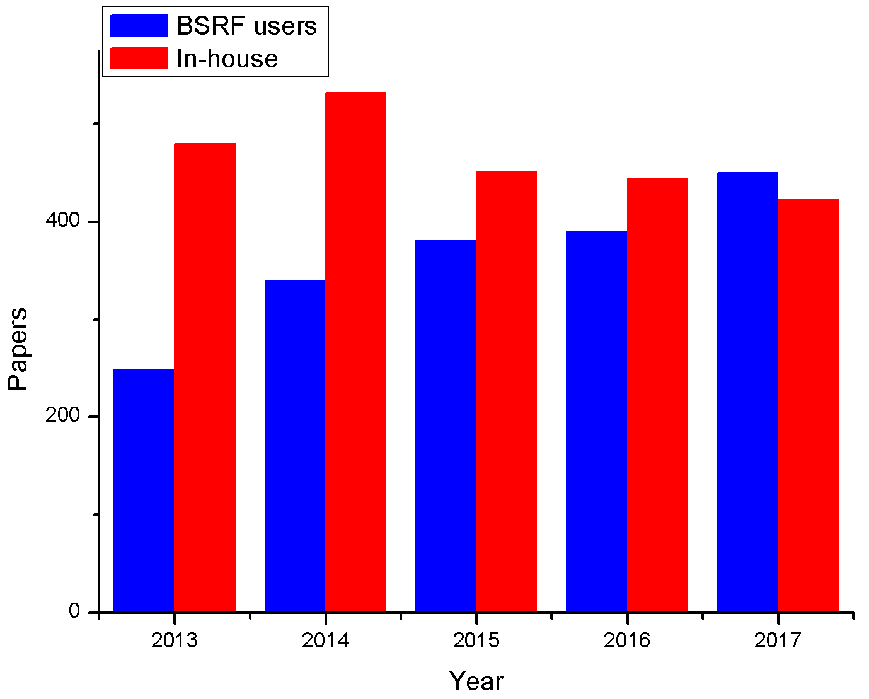
Papers Published
Part 2
An active synchrotron radiation facility (BSRF) and fruitful in-house research

Slide 24
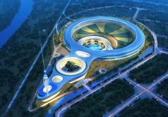
Future Plans: HEPS (BAPS)
Part 2
Criteria for HEPS beamline selection: Similar to APS-U, as well as other SR facilities.
Impact on science/technology/industry
Synergy with other facilities on Huairou campus
Unique features and competitiveness
International or domestic
The unique features of HEPS
High energy, low emittance, coherence
Output
Size of user community
Research trends in different fields
Possibility of high impact results
Feasibility and budget
Notes:
HEPS线站选择的标准

Slide 25
HEPS Phase-I Beamlines
Part 3
1 | Engineering Materials Beamline | High energy, low emittance
2 | CDI and XPCS
3 | NRS and IXS
4 | Nano-probe
5 | Time-resolved techniques
6 | Hard X-ray imaging
7 | High-pressure
8 | Protein crystallography | Large user communities
9 | XAFS
10 | In situ surface diffraction and scattering
11 | High throughput SAXS
12 | Ultrahigh resolution Electronic-Structure Spectroscopy | Applications in industry, medicine, etc.
13 | Medium energy X-ray micro-spectroscopy
14 | Structure and spectrum imaging
Notes:
最后选择的14条首期建设线站

Slide 26
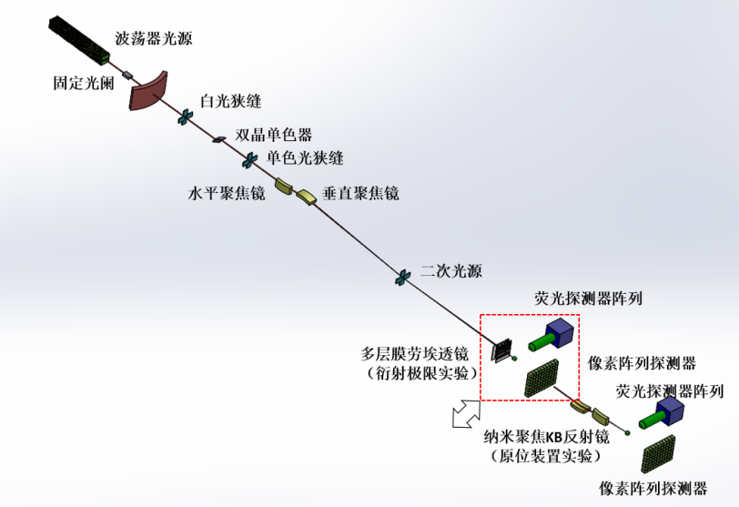
X-Ray Nano-Probe
Part 2
Specifications
Beam size <10 nm
Synergy of experimental methods: n-XRF, imaging (ptychography), n-XAFS, n-XRD
Flux at sample: 10⁹~10¹⁰ phs/s@10 keV；
Large space + high flux at sample, in situ experiments
Layout
Spot size | <10 nm @10 keV
Energy | 6-25 keV
Energy resolution | ≤ 2×10⁻⁴
Flux | > 10⁹ phs/s@10 keV
Notes:
亮点线站2：纳米探针的光子通量世界领先，而且具有很大的样品空间，便于原位实验的开展

Slide 27
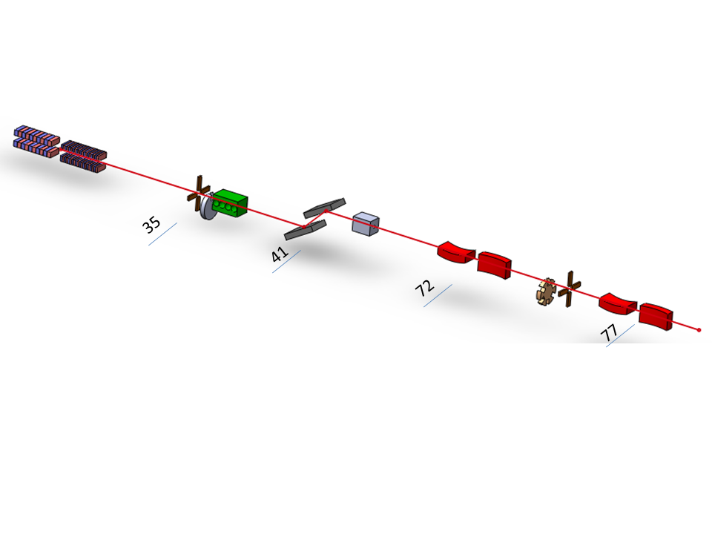
Time-Resolved Techniques
Part 2
Specifications:
Time resolution of 10 ps to ms, single shot experiments
Mono & pink beam
In operando and extreme conditions, irreversible process
Pumping: laser, THz, magnetic, mixing
Layout
Energy: 6-70 keV
Time resolution: 10 ps to 1 ms
Focus: 100 nm
Flux: 10¹³ phs/s; >10⁹ phs/pink pulse
Notes:
亮点线站3：时间分辨线站集中在不可逆过程的研究，线站通量是最高的。

Slide 28
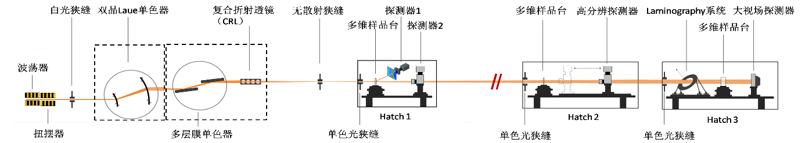
Hard X-Ray Imaging
Part 2
Specifications:
Resolution: 10 nm to 20 μm
Energy: 40-300 keV
Large sample + high resolution (10000:1)
Real materials under real conditions
Brain science research
Layout
28
Notes:
亮点线站4：硬X射线成像，能够在大工件上实现高分辨的三维成像，视场：分辨率的比例是世界领先的。

Slide 29
HEPS-TF International Advisory Committee: Close-out Report
Part 2
HEPS beamline considerations
Comments:
“The IAC is pleased to see that significant progress has been made in HEPS beamline selection, definition, and preliminary concepts. The process also included substantial engagement with the user community. As a result, 14 beamlines have been selected for inclusion in the HEPS project. These beamlines reflect strong and broad interests by the scientific community in China. Among these 14 beamlines, a number of them will take advantage of the new HEPS source characteristics, and will potentially be among the best worldwide.”
2nd HEPS-TF IAC Meeting - Nov 15-17, 2017
Notes:
评估专家对线站设计的评价。

Slide 30
Assessment Result in 2013
Part 3
“Multidisciplinary activities … have reached a new level.”
“They are a great asset to IHEP. Thus … IHEP has the potential to become one of the premier multidisciplinary centers in the world.”
“…diversity in the levels of different projects.”
Research Direction | International Position | Domestic Position
Large Scientific User Facility (BSRF) | Making great progress, has distinctive characteristics | Used to be leading, but falls behind as SSRF ramps up research activities
Biomedical Effects of Nanomaterials and Nanosafety | Closely follows the international cutting edge, internationally influential | Domestic highest level
Nanomedicine | International first-tier | Domestic highest level
Structure and Functions of Proteins | Making great progress, has distinctive characteristics | Competitive with its own characteristics
Radiochemistry | Ordinary (seed) | Ordinary (seed)
Notes:
2013年的评估结果：有很大发展，但是各部分水平不一。

Slide 31
Improvements
Part 3
Engaging and cultivating external scientific leaders in the broad communities
Beamline Advisory Committee (BAC) for every beamline, Beamline Technique Advisory Committee (BTAC).
Recruit future research staff and leaders (ongoing)
Young staff: BAI Ligang from APS, high pressure experiments; ZHANG Yi from DESY-PETRA III, nano-probing; GAO Yuan from BNL, nano-probing, CDI and TRXRD.
Dr. ZHANG Xiaowei from KEK-PF, beamline and X-ray optics in HEPS and PAPS
Visiting professor: Prof. Masami ANDO from KEK-PF, design of the Hard X-ray Imaging beamline
In-house research
Carefully selected fields, SR-based research
In-house research should connect the methods and techniques of the facilities with the users.
Notes:
为了实现mission，重要的是人员队伍的建设：取得国外同类装置上专家的指导，招收年轻的领军人物，聘请国外有经验的客座教授。

Slide 32
Summary
Part 4
BSRF is an important experimental platform for much scientific research, especially in the north of China.
The new HEPS (BAPS) facility will bring world-class synchrotron science and applications to China.
Technical research is essential for the development of the facilities.
In-house research connects the user and facility teams, and is also very important for operation and development.
Notes:
总结，把mission再说一遍。

Slide 33

Thank you for your attention!

