Slide 1
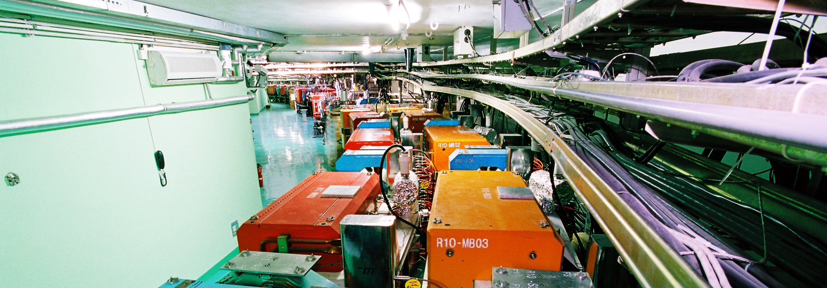
Computing Center
Weidong LI
Computing Center, IHEP
June 14, 2018
International assessment 2018

Slide 2
Contents
1
Mission
2
Human Resources
3
Funding
4
Progress
5
Future Plans
6
Summary

Slide 3
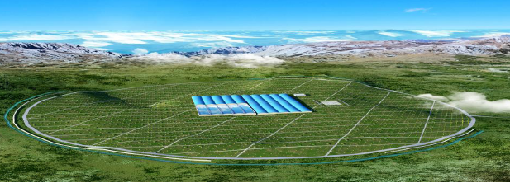
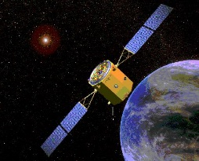
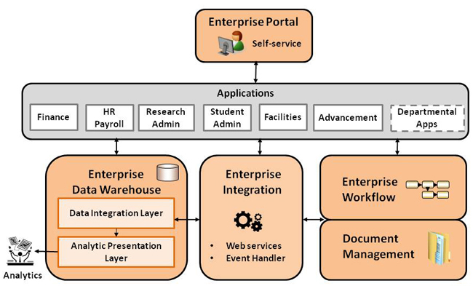
Mission
Provide large-scale scientific computing environments for the experiments
facilities
computing
storage
network
Research on computing technologies to benefit high-energy physics
Develop IT services to streamline workflows of the institute
minimize administrative burden
facilitate management
LHAASO
HXMT
3

Slide 4
Human Resources

Slide 5
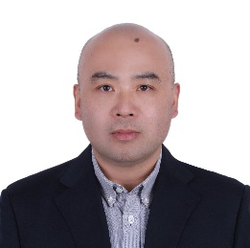
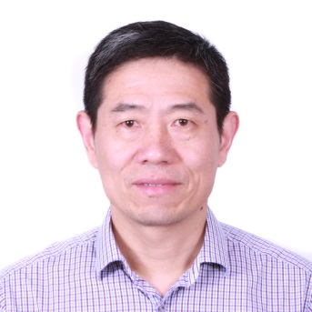
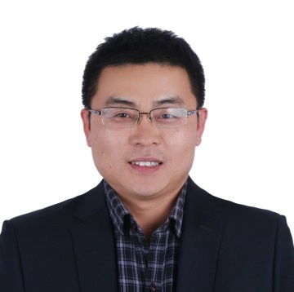
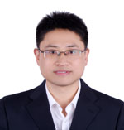
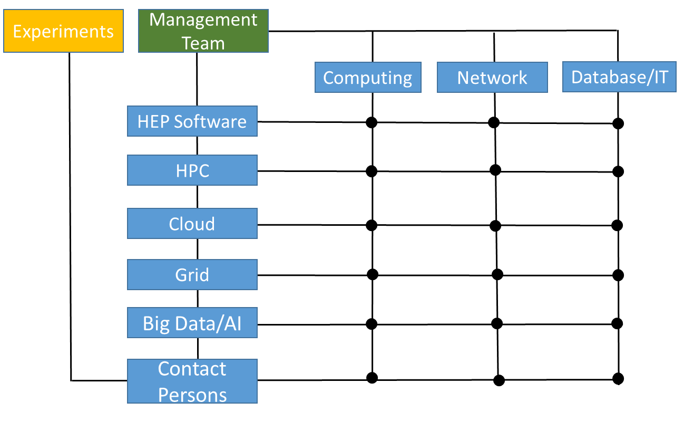
Management
Dr. Weidong LI
Head of Department
Dr. Gongxing SUN
Deputy Head
Dr. Fazhi QI
Deputy Head
Dr. Yaodong CHENG
Deputy Head
Management team: Weidong Li, Gonxing Sun, Fazhi Qi and Yaodong Cheng.
Now we have 37 staff and 8 temporary members
Matrix management: sharing talents and skills across group boundaries.

Slide 6
Funding
Over the last 5 years, funding mainly from:
HEP experiments: BEPCII, DYB, JUNO, LHAASO
Chinese Academy of Sciences
National Science Foundation of China
Ministry of Science and Technology
Average ~20 million CNY (3.2 M USD) per year. More than half from competitive grants

Slide 7
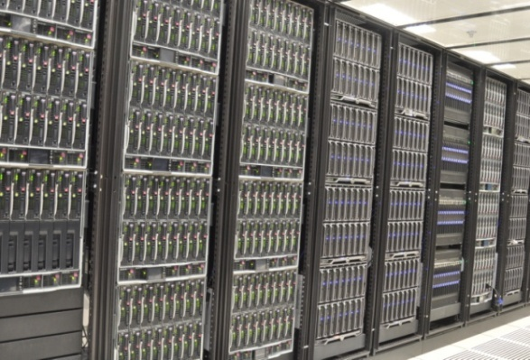
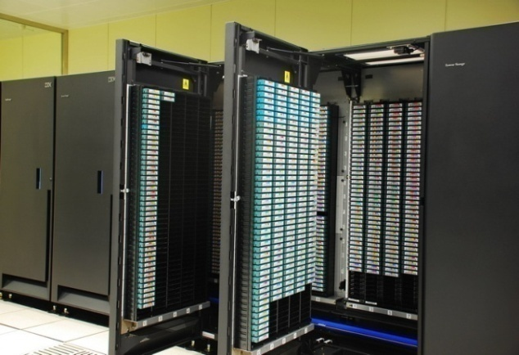
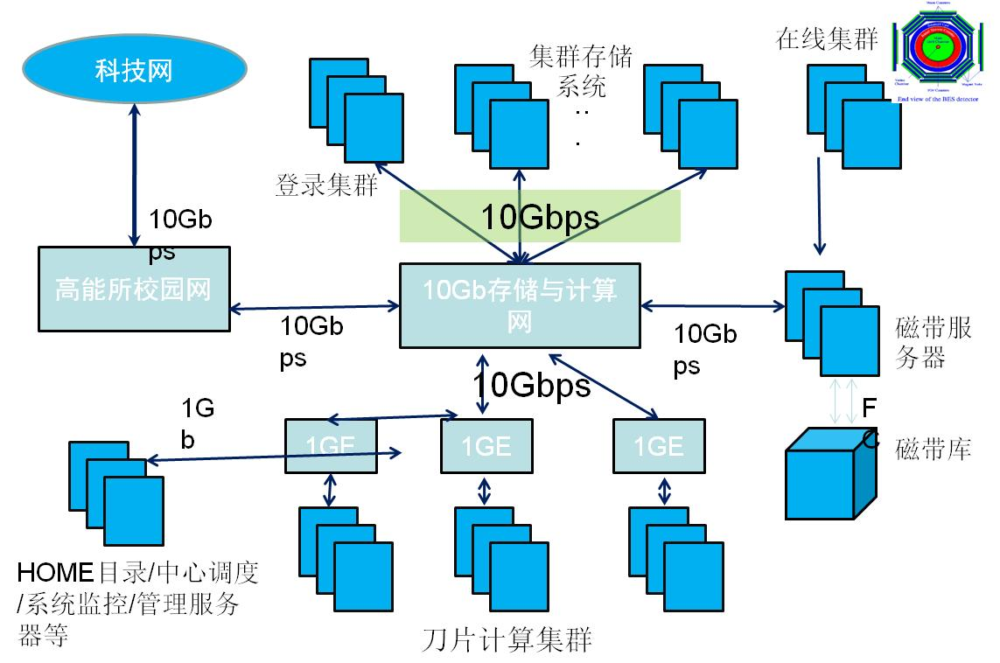
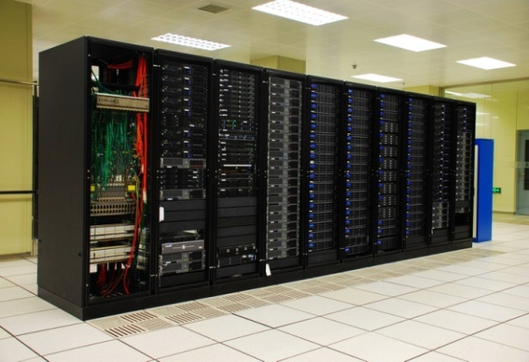
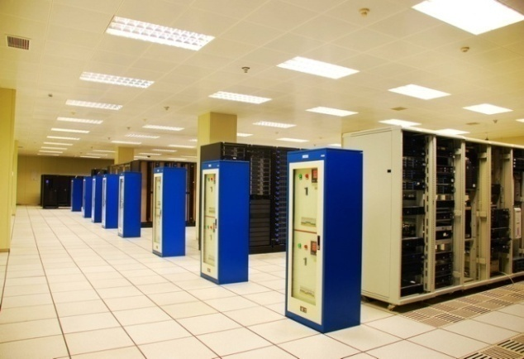
Facilities Expansion in Last 5 Years
Expanded machine rooms
IHEP (Beijing), CSNS (Dongguan), LHAASO (Sichuan), JUNO (Kaiping)
Totally 850 m² floor space (from 450 m² 5 years ago)
Remote data center operation for LHAASO at altitude of 4,410 m
IT assets doubled
~17,000 CPU cores
10 PB disk storage
5 PB tape storage
>400 switches and routers
>500 access points
200 information servers
~10,000 devices, ~7,000 registered users
Work Nodes
Tape Lib
Document Management
17,000 CPU Cores
5 PB Tape Lib
Web Content Management
Storage Disk
Iaas SaaS
10 PB Storage
IaaS/PaaS/SaaS

Slide 8
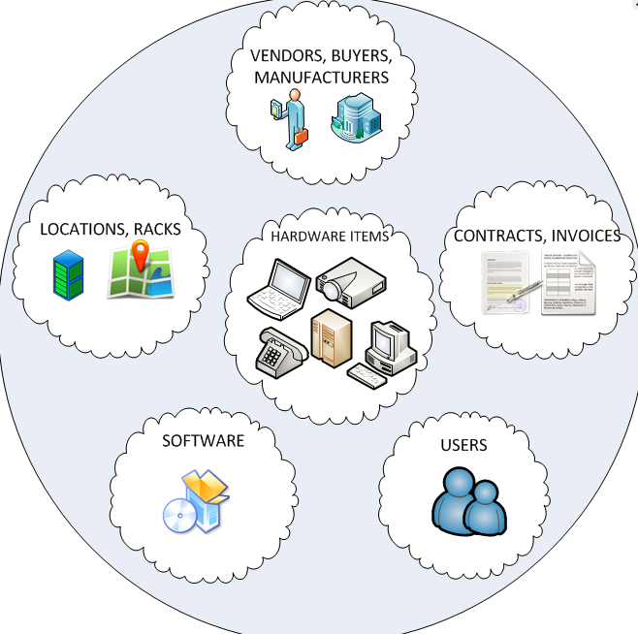
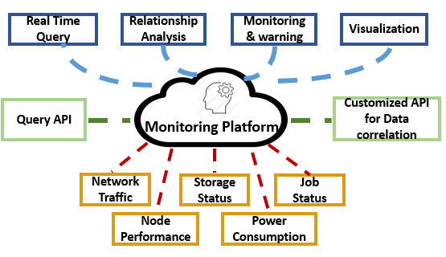
Operations
Developed software for asset management, standardized:
purchasing, testing, launching, maintenance etc.
Providing quality service
Intelligent monitoring
Analyzing data from various sources and detecting abnormalities with deep learning technologies
Developed helpdesk service
Tracking requests, problems and user suggestions

Slide 9
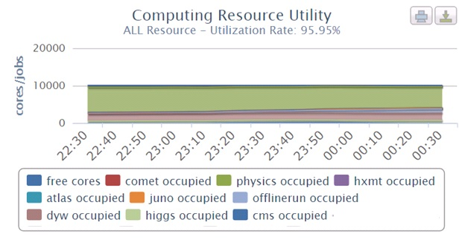
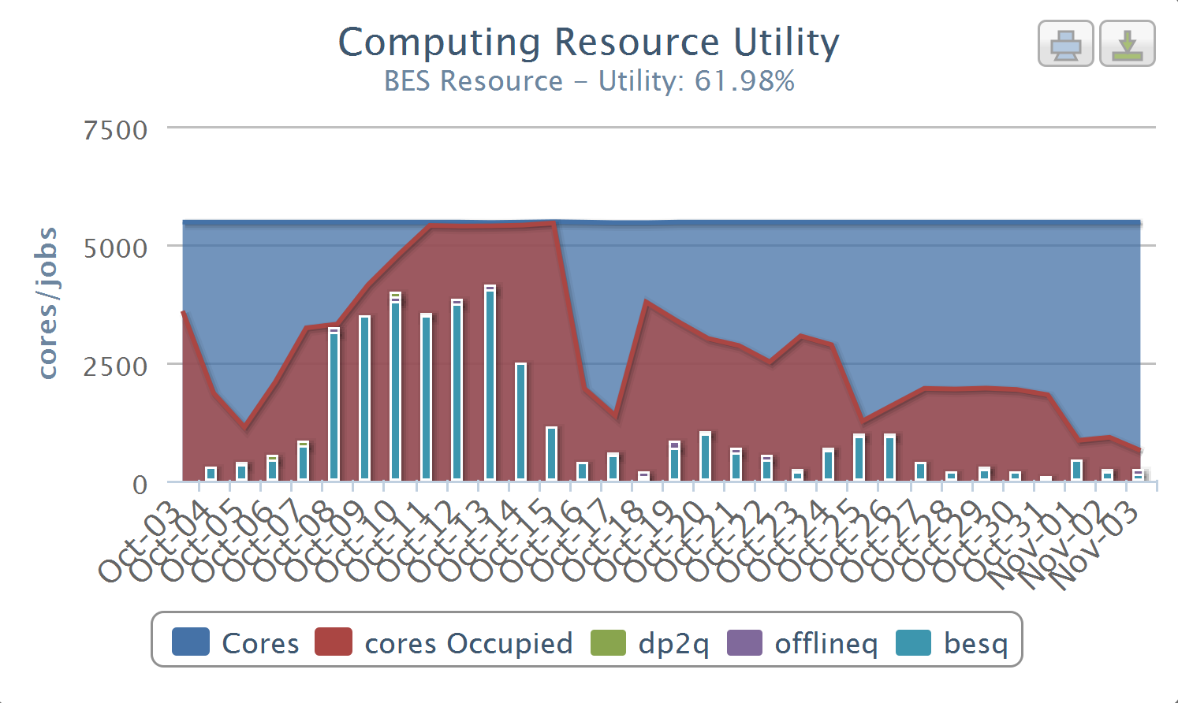
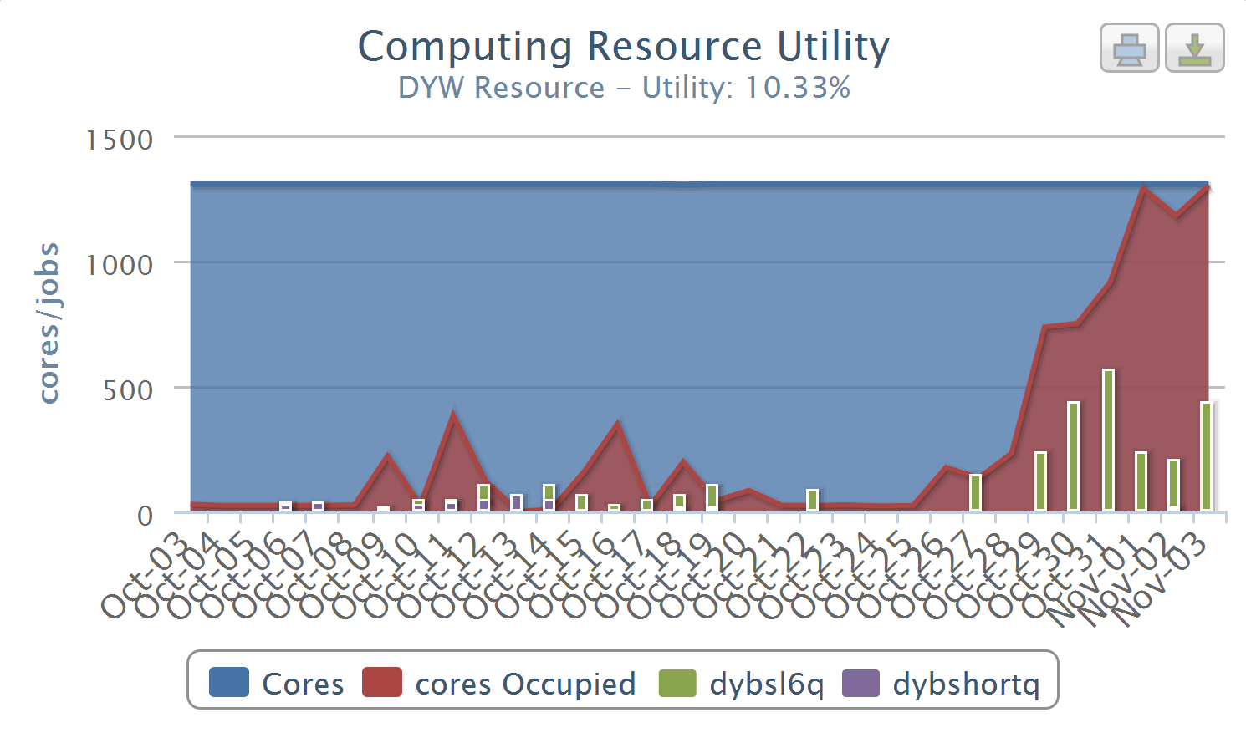
Computing with HTCondor Batch System
HTCondor deployed to manage local cluster workload
Frequent meetings with HTCondor team
Established largest HTCondor pool in China
Local enhancements:
Node status monitoring database
Fairness-based job scheduling policy
Resource utilization improved significantly
Utilization rate: 96%
Resource sharing to all exp.
Before: long queue & free slots
After: almost no free slots

Slide 10
Cloud Computing: IHEPCloud
IHEPCloud, based on Openstack, launched in May 2014
User self-service virtual machine platform (IaaS)
Virtual Computing Cluster
Integrated with Grid
Outstanding IT Application for Scientific Research awarded by CAS in 2014
Connecting IHEPCloud with HTCondor
Dynamic virtual machines created and destroyed on demand
HTCondor jobs can be executed in IHEPCloud when HTCondor cluster is busy
Cloud Scheduler (VCondor)
Submit job
IHEPCloud
Check Queue load
Start/stop VM
VMs join HTCondor Pool
HTCondor Queue
Virtual Machines

Slide 11
DIRAC-based Distributed Computing
BESIII distributed computing developed with DIRAC middleware, integrating:
Different resource types: Cluster, Grid and Cloud
3,500 CPU cores from 23 sites in China, USA, Italy, Russia, Turkey etc.
Extended to support multiple VOs
Common platform shared by the experiments BESIII, JUNO and CEPC
Completed integration with commercial cloud
Enables peak experiment demands to be satisfied by addition of commercial cloud resources
IHEP Computing Center became an executive member of the DIRAC Consortium in 2017
GANGA
DIRAC
Site 1
Site 2
Site n

Slide 12
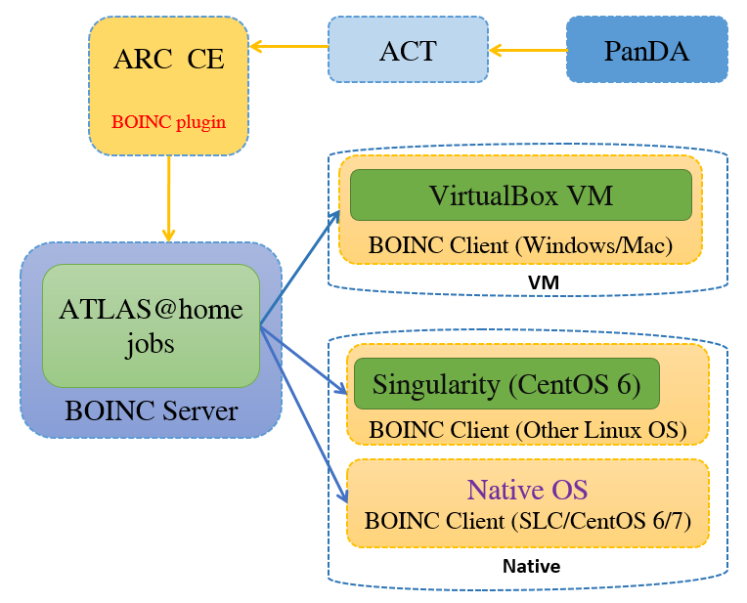
WLCG Tier2 Beijing
BEIJING-LCG2 is the only WLCG (Worldwide LHC Computing Grid) Tier2 site in China
~ 1,000 CPU cores , ~ 1 PB disk, shared by ATLAS/CMS, running >2 million jobs/year，exchanging 4 PB data/year
Site reliability among the best
ATLAS contributions:
Major developer of ATLAS@home
ATLAS Monte Carlo simulation using Chinese HPC infrastructures
First prize for the novel use of supercomputer infrastructure awarded by CAS in 2015

Slide 13
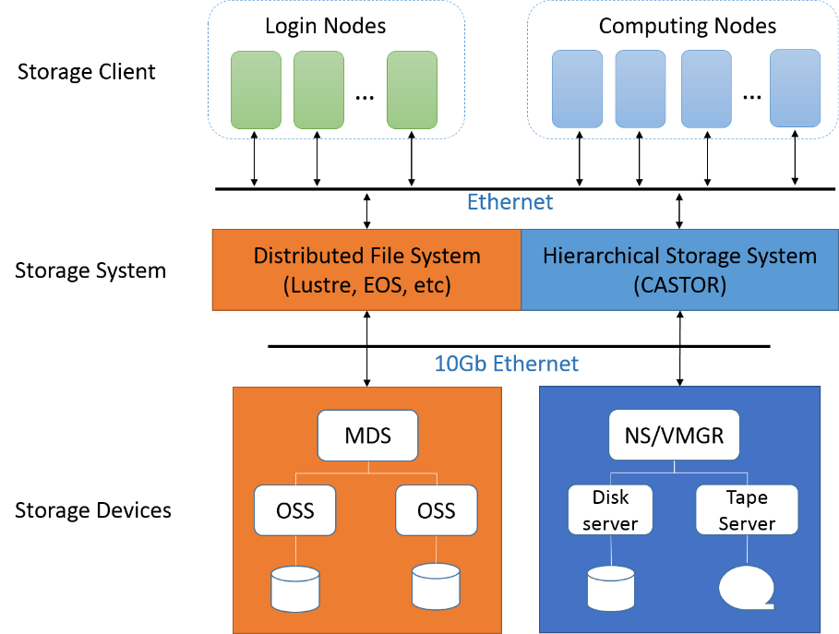
PB-Scale Data Storage
Built storage systems using open source software: Lustre, CASTOR, EOS
The 2nd largest Lustre file system (10 PB) in the HEP community
Provided: high throughput (40 GB/s), concurrent access (~10⁴ jobs), high reliability, hierarchical storage, remote access, long term preservation
Completed research work:
System architecture
Metadata management
Hierarchical storage
Tape library management
Event-based data service
Performance optimization

Slide 14
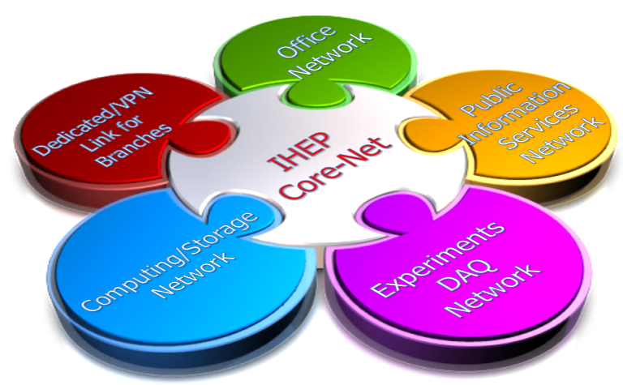
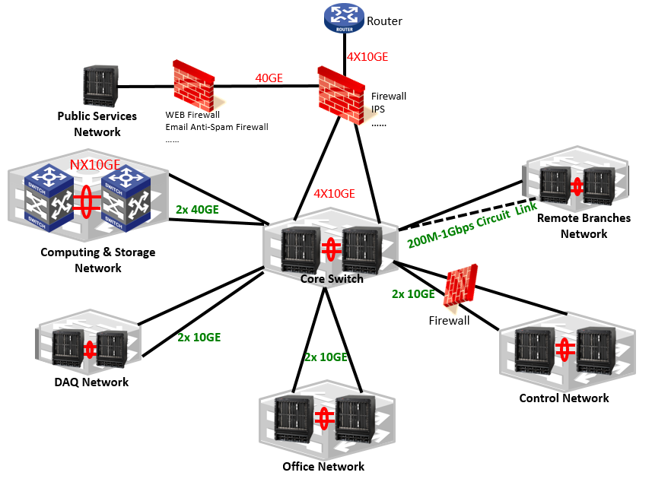
Network at IHEP
Reorganized network
Functional division: easy to manage, extend and debug
Campus network
Data center network
Remote site network
DMZ: public servers/login nodes
Enhanced campus network
20 Gbps backbone
WIFI (IHEP and eduroam) covered
IPv4 and IPv6 dual-stack supported
Improved network in data center
80 Gbps Ethernet
100 Gps EDR InfiniBand network
IPv4 and IPv6 dual-stack supported

Slide 15
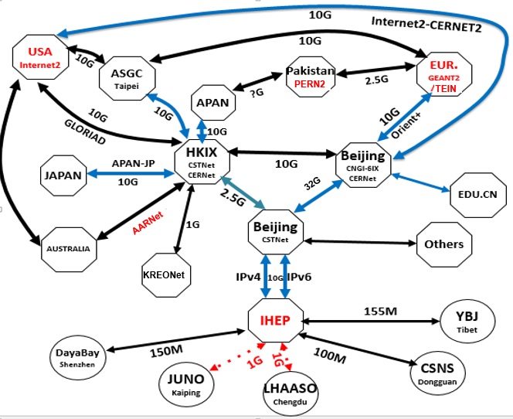
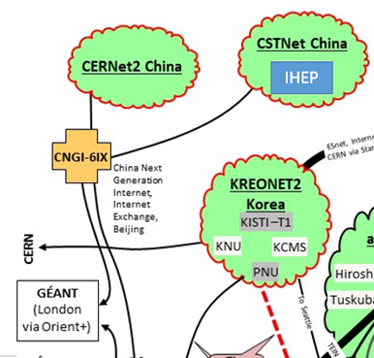
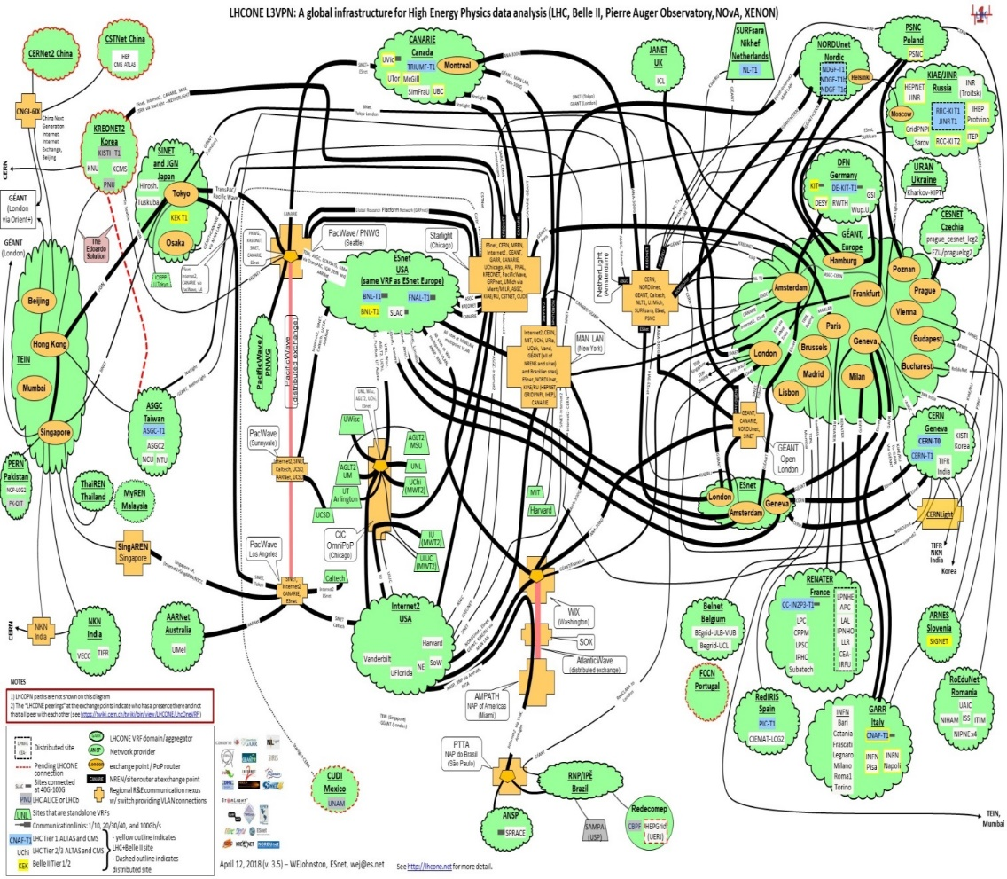
International Connections
IHEP-EUR.: 10 Gbps
IHEP-USA: 10 Gbps
IHEP-Asia: 10 Gbps
IHEP-domestic universities: 10 Gbps
IPv4 & IPv6 supported
IHEP joined LHCONE (LHC Open Private Network) in March, 2018.

Slide 16
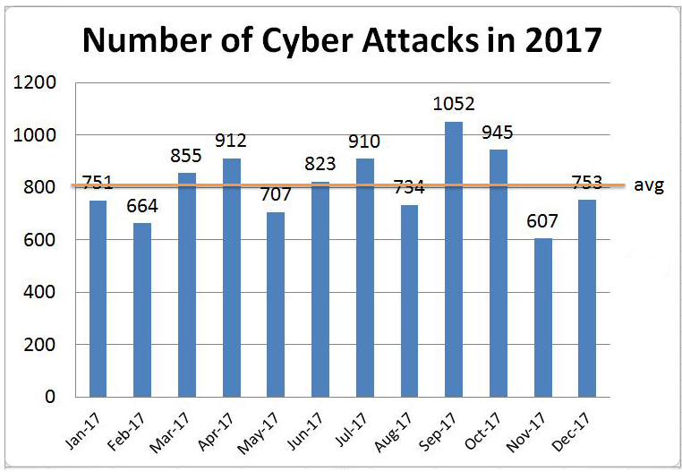
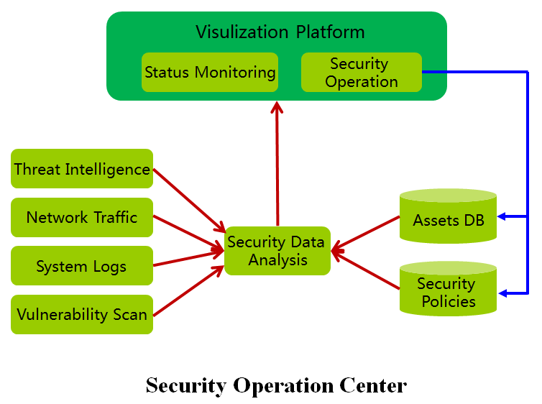
Cybersecurity
Tightened security management
Security policies and rules
Intelligence sharing with other teams
Took effective approaches to enhance the security
Detection by real-time network traffic and log analysis
Quarterly security assessment, audit on critical information systems
Enhance endpoint security by central OS/patch/anti-virus services
Improved security awareness
Security training for new staff/students
Yearly security workshop for HEP community in China
Asia-Pacific cybersecurity federation and cybersecurity cooperation with CERN

Slide 17
IT Services
Developed services to streamline the workflows of the institute
Minimize administrative burden
Facilitate management
Many services and platforms deployed over the past 5 years, all running well
Platforms: Virtual Database, Single-Sign-On
IT: Video-Conference, IHEPBox, DocDB, GitLab, Email, Indico, Phonebook, Digital Asset Management
Management: HR, Finance, Purchase, Asset, Project Management, IHEP APP etc
Has won prize for Top 10 IT Service Providers in CAS every year

Slide 18
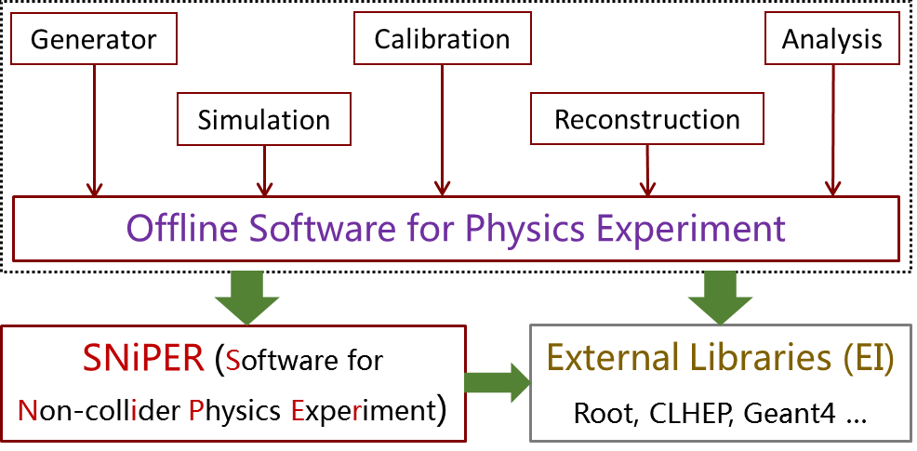
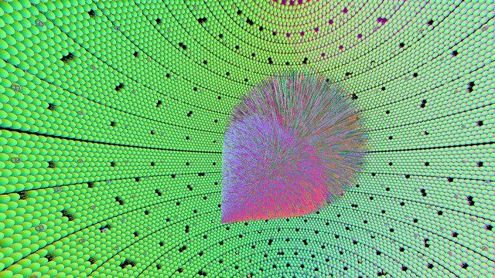
HEP Software
SNiPER – a general purpose offline software framework
Dominated by IHEP & Open Source
Specific to non-collider HEP experiments
Enhanced by multithreaded computing
Adopted by many experiments
JUNO, LHAASO, CSNS, nEXO …
Reported in CHEP & ACAT conferences
Opticks: GPU optical photon simulation, enhancing Geant4
CUDA optical photon simulation, NVIDIA OptiX ray tracing
Geometry translated to GPU without approximation
Massive parallelism : drastic speedup > 1000x Geant4
Benefits simulations limited by optical photons (neutrino, dark matter search, medical imaging)
Huge potential energy/time savings for JUNO
Simulated 100 GeV Muon crossing JUNO

Slide 19
Tasks for Next 5 Years
Data from experiments will reach the level of ~100 PB
Accumulated data from BESIII: 10 PB
Cosmic ray experiment LHAASO: ~2 PB/year
Neutrino experiment JUNO: ~2 PB/year
HXMT, AliCPT experiments start operation
CEPC R&D: Monte Carlo production
Other experiments: ATLAS, CMS, LHCb, Belle II
Strategy
R&D driven by experiments
Apply cutting-edge IT technologies to meet the needs of experiments
Expand cooperation with leading laboratories worldwide

Slide 20
Future Plans (1)
Development of advanced IT solutions focusing on:
Common HEP software
Software framework and fundamental services for data processing and analysis
Sharing progress with HSF (HEP Software Foundation) working groups
Heterogeneous computing
Combines computing resources like multi-core CPUs, GPUs, FPGAs and supercomputers for the most efficient use of the latest computing architectures
Grid computing
Continue R&D on ATLAS@home
Tier 2 for LHCb and Belle II being planned
CEPC computing model will be based on Grid
20

Slide 21
Future Plans (2)
Storage technology development will focus on:
Data caching to achieve direct access to remote files and transparent migration between memory, SSD, disk and tape
Research on high performance networks:
Software Defined Network and Network Function Virtualization
High speed network: 100/400 Gbps Ethernet, InfiniBand
Combine big data and machine learning techniques to optimize the diverse systems of the institute
Provide IT services as needed for the scientific research and administration of the institute

Slide 22
Deep Collaboration
Institutes:
Open source collaborations and contributions
Industry
local cluster
Participation in international conferences ~30 times/year
CHEP, ACAT, NEC, HEPiX, ISGC, AFAD
Hosting national/international conferences and workshops ~4 times/year
Academic visitors
FNAL, CERN, LBNL, IN2P3, JINR, SIB, MTA, NTU

Slide 23
Response to 2013 assessment
Position | Please Tick
Domestic highest level | X
Competitive with its own characteristics
Ordinary
2013 assessment stated insufficient financial support
Replacements of the aging processors, servers, and disks had to be deferred
Current status
Great efforts have been made applying for competitive grants
Capacity expansion has met the minimum requirements of increased data
However, funding shortfall remains
Position | Please Tick
Leader infield (international first-tier)
Closely follows the international cutting edge, internationally influential | X
Making great progress, has distinctive characteristics
Ordinary

Slide 24
Summary
Over the past 5 years, tremendous progress made in:
HEP data analysis and processing environment
Applying diverse IT technologies
Information processing of the institute
Concrete plans made to fulfill the requirements of the next 5 years
We feel confident we will accomplish our mission, aligning with the IHEP 1-5-7 Roadmap

