Slide 1
Ground-Based Astroparticle Physics Research
Vision and Mission
Strategies and Programs
Performance in Last 5 Years
Personnel Development
Funding and Other Resources
Zhen Cao
Particle Astrophysics Division

Slide 2
Vision and Mission
Aiming to answer crucial questions by building suitable detectors at the right locations
  Multi-messenger observation is the best approach
Finding new phenomena

Slide 3

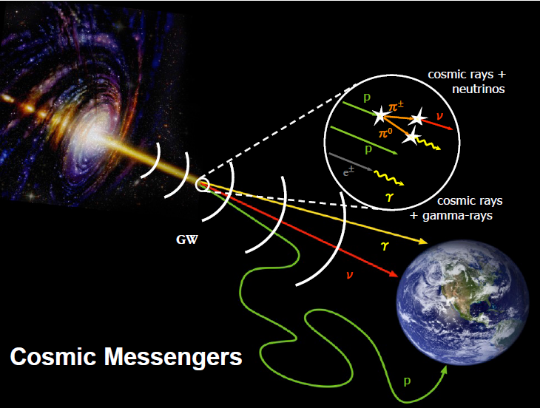
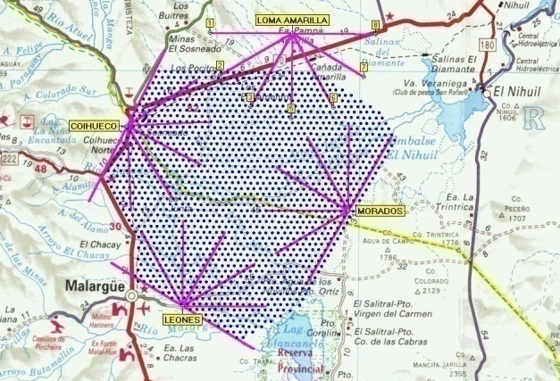
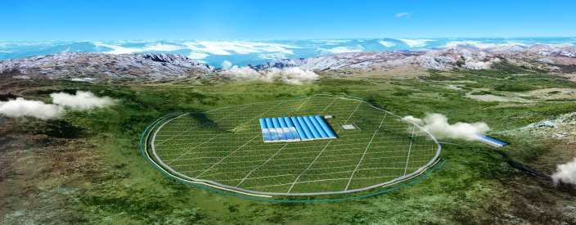
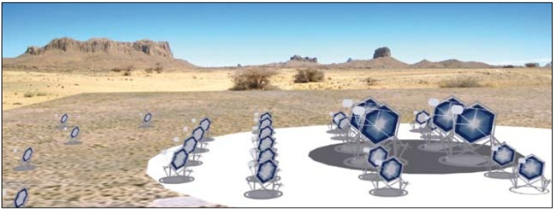
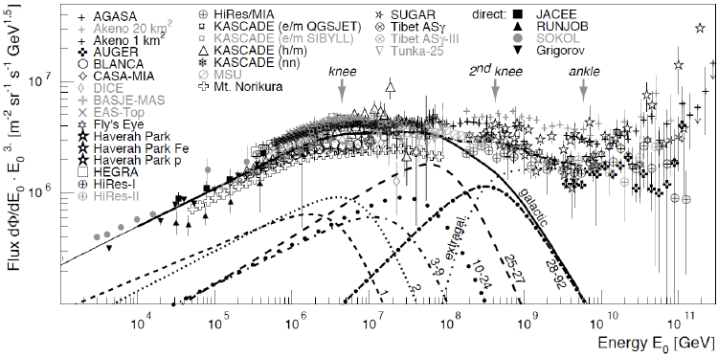
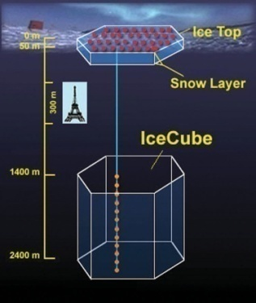
50km
EHE CR Astronomy
TA, AUGER
JEM-EUSO
Multi-messenger
Origin of CRs
CTA
VHEγ Astronomy
LHAASO
CTA
CR Features: knees
AMS02,Iss-CREAM,DAMPE,LHAASO……
5km
VHE/UHE Neutrinos
IceCube Gen2，KM3net
ARIANA ……
in space
on the ground

Slide 4
Strategies and Programs
Make significant progress in relevant observations and analyses
    Existing detector operation at Yangbajing and scientific achievements from these
    In near future, precise measurements of charged CR compositions and their spectra (1/4 LHAASO, LHAASO)
    In five yeas, survey for more gamma ray sources: inside/outside our galaxy (1/4 LHAASO, LHAASO)
    In 5-10 years, find the concrete evidence for cosmos accelerators among gamma ray sources (LHAASO, IACT-Array)
R/D for new detection technologies

Slide 5
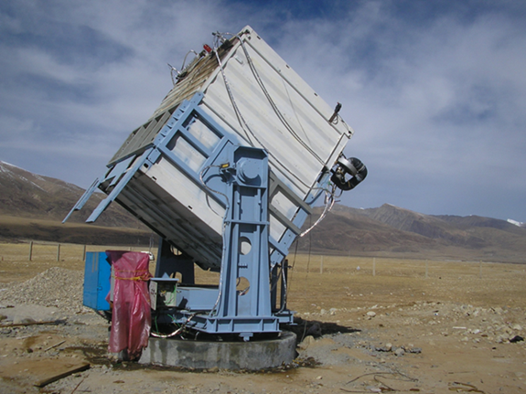
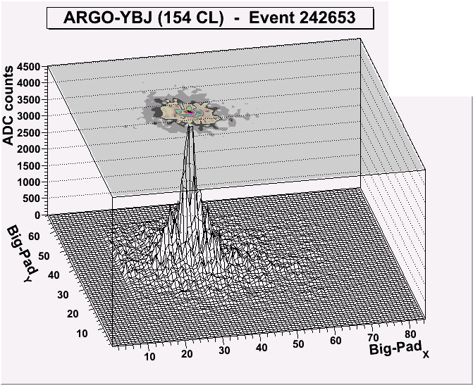
ASγ
ARGO-YBJ
Multi-parameter
hybrid measurement

Slide 6
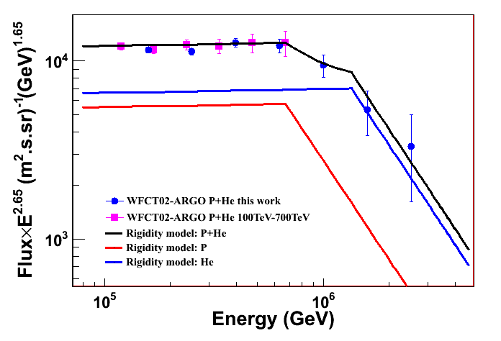
Cosmic Ray Physics: Charged Nuclei
Knees of Spectra of Individual Species
Using only two parameters, at ARGO-YBJ: E_{knee}-700 TeV, Phys.Rev.D 92092005 (2015)
calib
knee
Most likely the rigidity model! With H:He=1:1.2, the most wanted results with larger statistics in few years.

Slide 7
ARGO-YBJ: ARGO J2031+4157
Identified extended source (σ=1.8º±0.5º) ARGO J2031+4157 to be the Cygnus Cocoon detected at GeV. Maybe the first super-bubble found at TeV energies.
ARGO-YBJ coll., ApJ, 790:152, (2014)

Slide 8
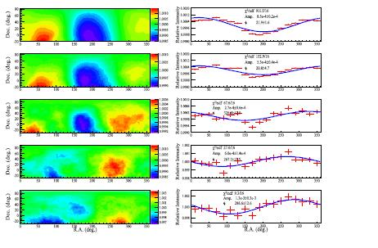
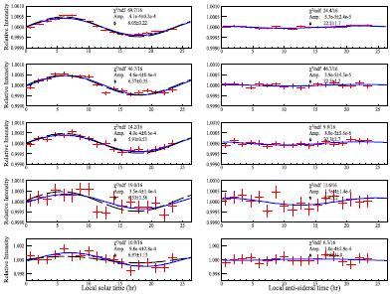
PeV CR Anisotropy Global Structure
1 TeV anisotropy was a big mystery, ASG,ARGO-YBJ and IceCube all observed the anisotropy up to 1 PeV!
Indicates a transition around 100 TeV!! More mystery!!
4.0TeV
M.Amenomori, et al.,ApJ,836:153 (2017）
7.1TeV
Compton-Getting Effects
15TeV
12TeV
15TeV
22TeV
50TeV
50TeV
39TeV
100TeV
71TeV
100TeV
160TeV
300TeV
520TeV
300TeV
1000TeV
1000TeV
ARGO-YBJ coll., ApJ, in press, (2018)

Slide 9
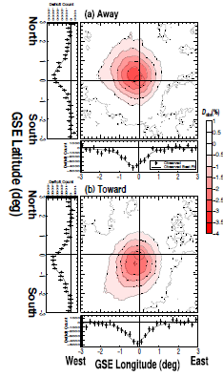
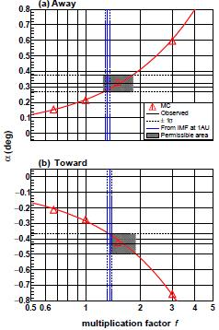
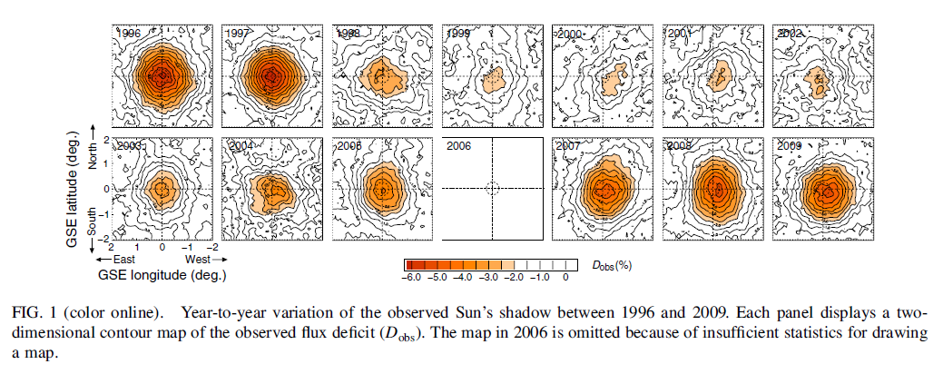
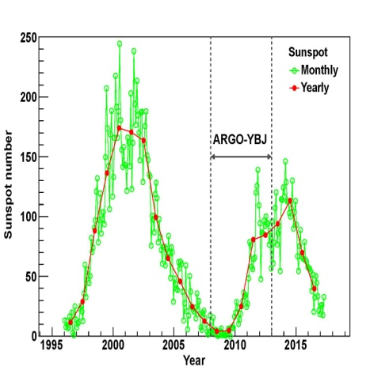
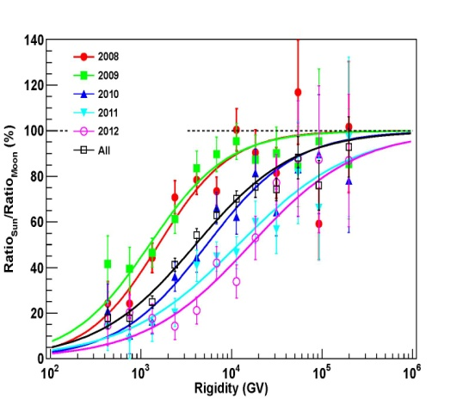
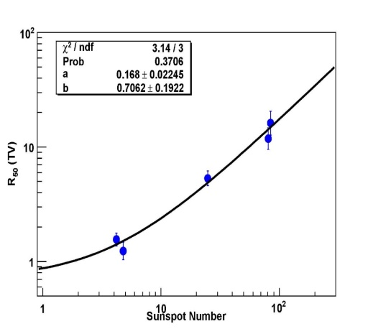
Solar Cycle Modulation and IMF Estimates
M. Amenomori, et al. PRL, 111, 011101 (2013)
M.Amenomori, et at., PRL, 120, 031101 (2017)
Chen for ARGO-YBJ coll., proceeding, ICRC 2017
Space weather
monitoring

Slide 10
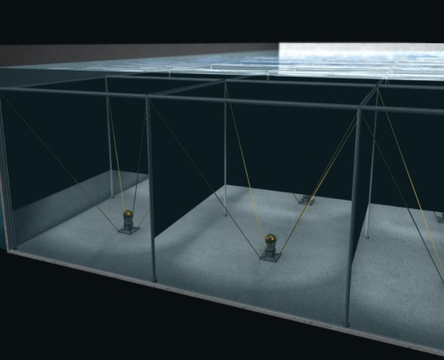
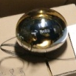
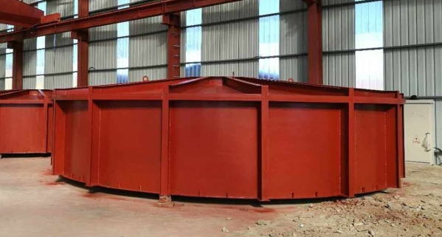
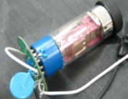
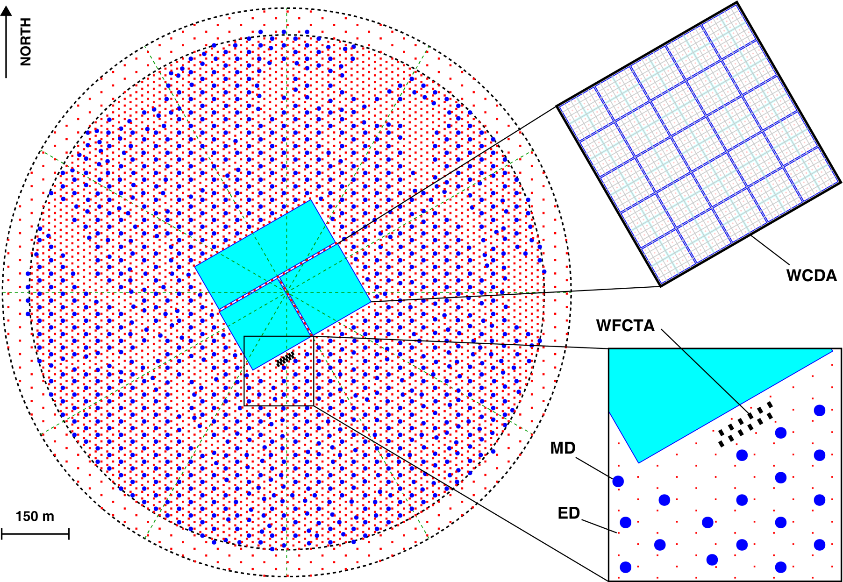
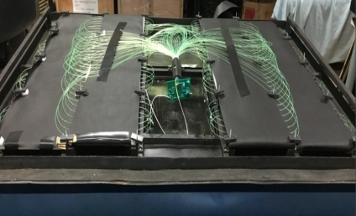
LHAASO Detector Layout
8 in
1 in
5m
7m
1m

Slide 11



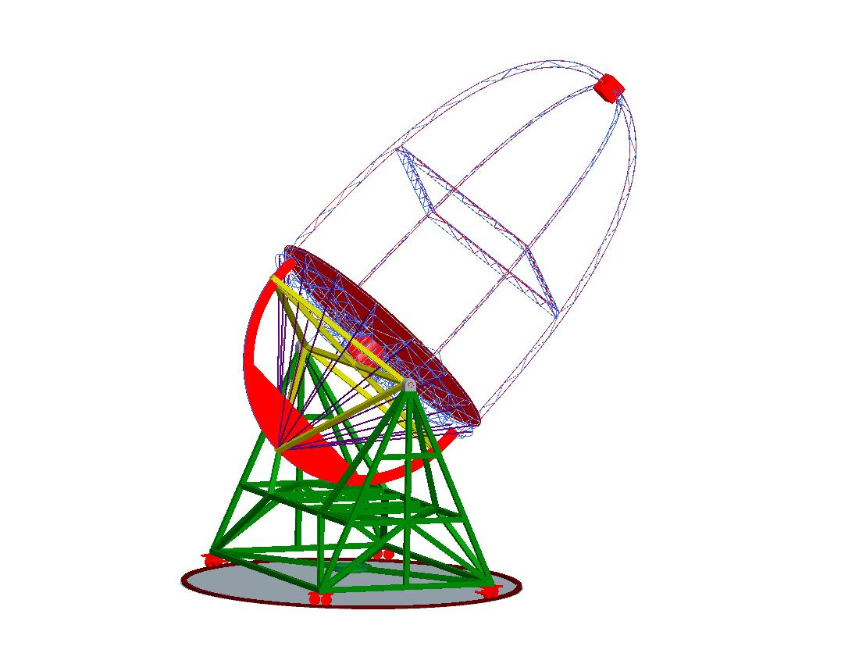
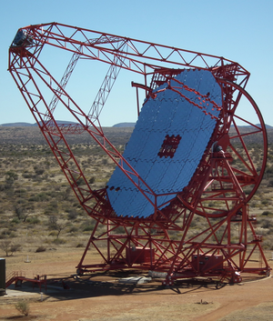
Focal plane camera with a PMT array
LIACT (proposed)
Light collector
Enhance the discovery power by combining LHAASO and IACT techniques
In comparison with 12 m HESS telescopes
Main Structure：
Azimuth/elevation rotation system with wheels on circular rails
Rail for azimuth rotation

Slide 12
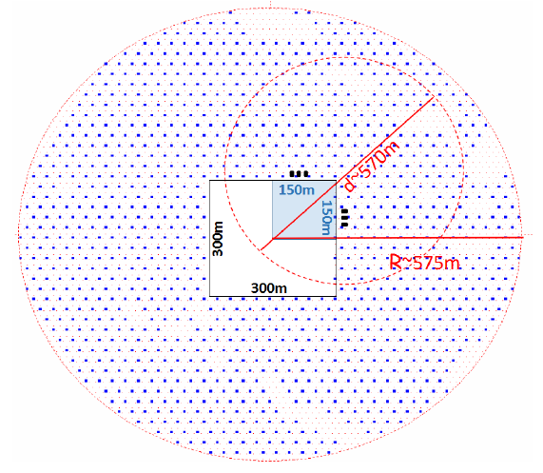
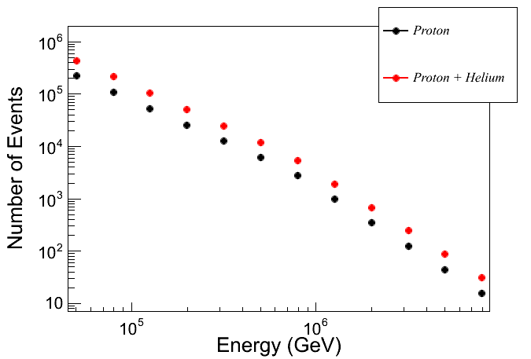
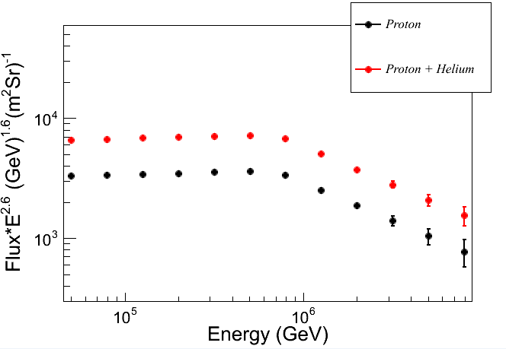
Performance of 1/4 LHAASO array (data taking 2018)
  6 WFCT telescopes
  22,500 m² water Cherenkov
  detector
  10,000 m² muon detectors
  covering 250,000 m²

Slide 13
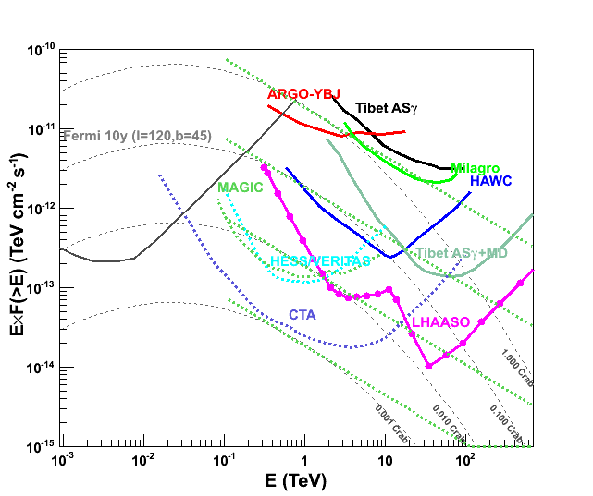
Sensitivity to Gamma Ray Sources
Integral: 1% Crab unit @3TeV & 50TeV

Slide 14
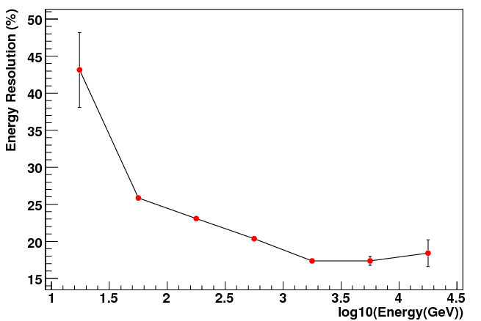
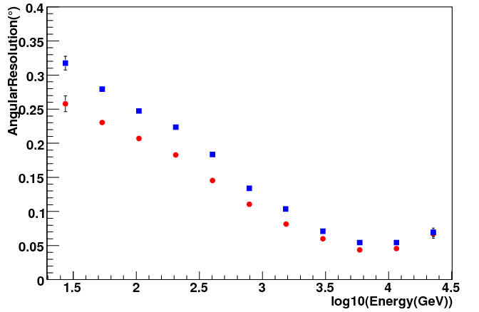
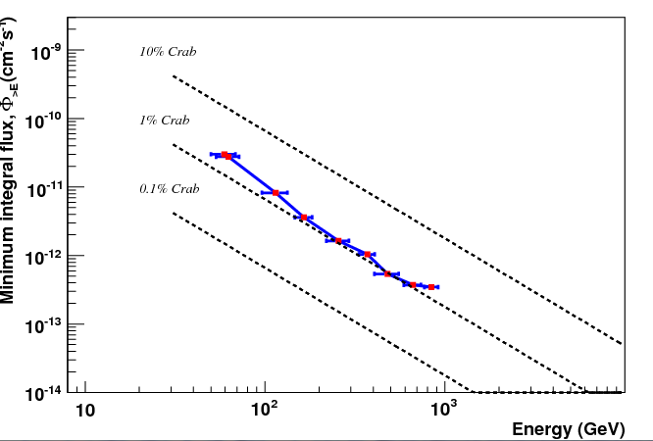
Specifications for LIACT
# of Telescopes: 3
Threshold: 60 GeV
Angular Resolution: 0.07°at 1 TeV
Energy Resolution: 17%
Sensitivity: 1% C.U.
E-res.
Sensitivity
A-res.

Slide 15
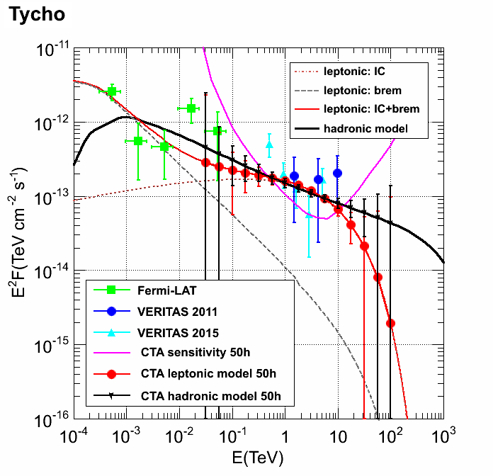
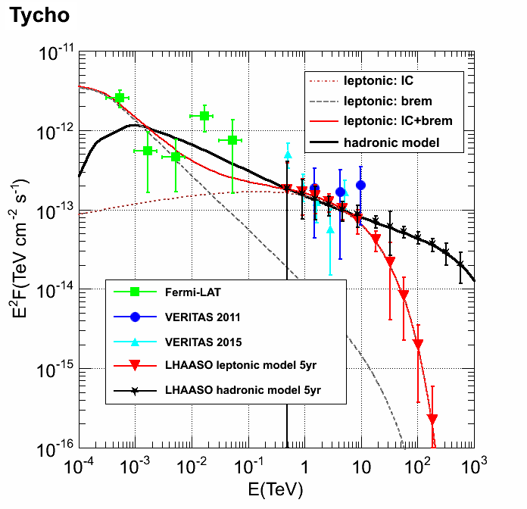
GCR Signature @ Highest Energies
A LHAASO-like sensitivity is mandatory
1/10 sensitivity of LHAASO
@LHAASO
@CTA

Slide 16
Performance in Last 5 Years
Scientific achievements (summarized above)
LHAASO - Infrastructure construction
LHAASO - 1/4 construction
Technical developments
  White Rabbit (WR) protocol localization
  SiPM - camera (international collaboration)
  20’’ PMT development
  Neutron detector EAS array
  Water lens Cherenkov telescope

Slide 17
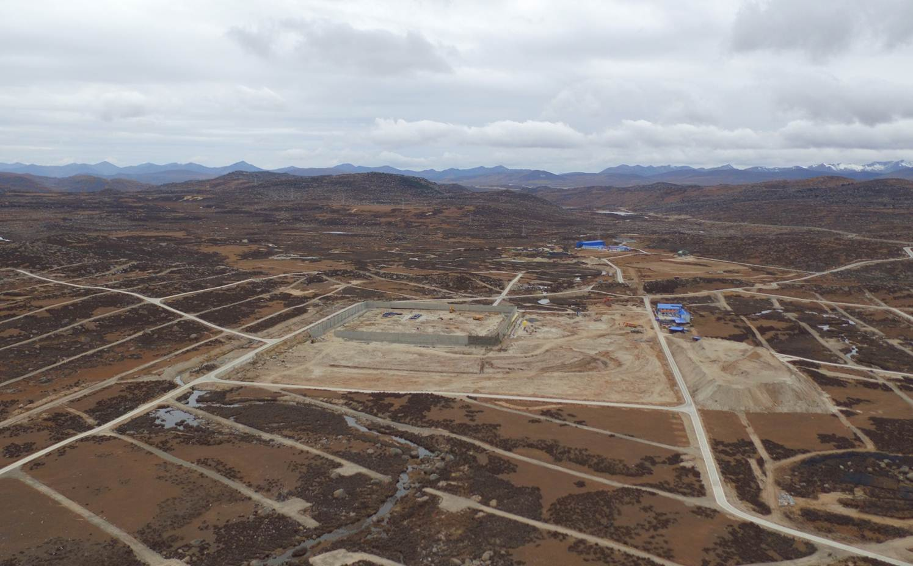
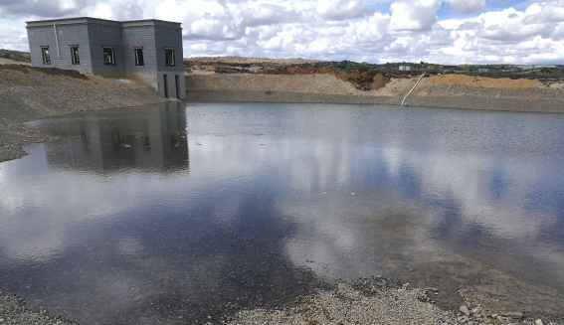
LHAASO: Infrastructure
1. Base and Data Center (3750 m a.s.l.)
Dorms, assembling hall, storage rooms, utility rooms, kitchen and cafeteria
Dorms
2. Observatory (4410 m a.s.l.)
Roads 21 km,
Flood prevention channel 1.3 km,
Power stations and 35 kV power-line of 30 km
Water supply system with 0.8 km pipeline
Assembling, Storage and Utility
Water supply system
Kitchen & Cafeteria

Slide 18
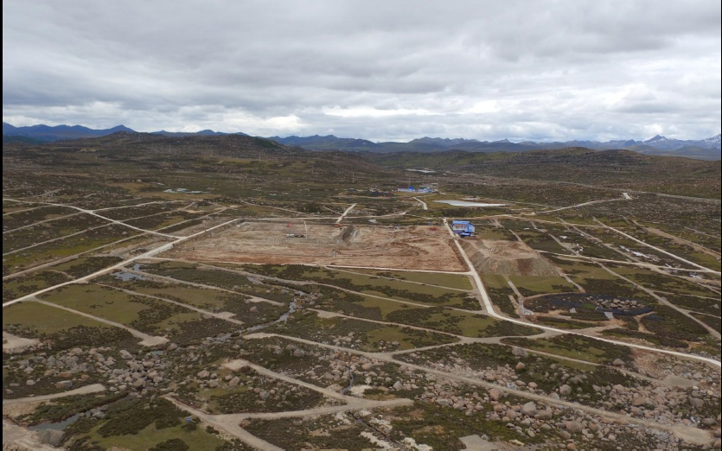
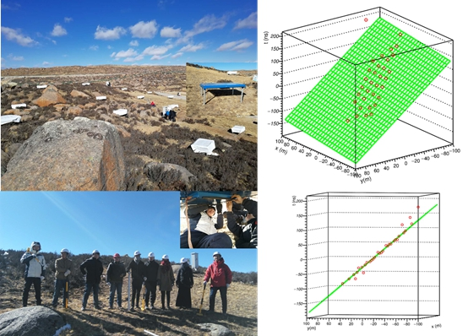
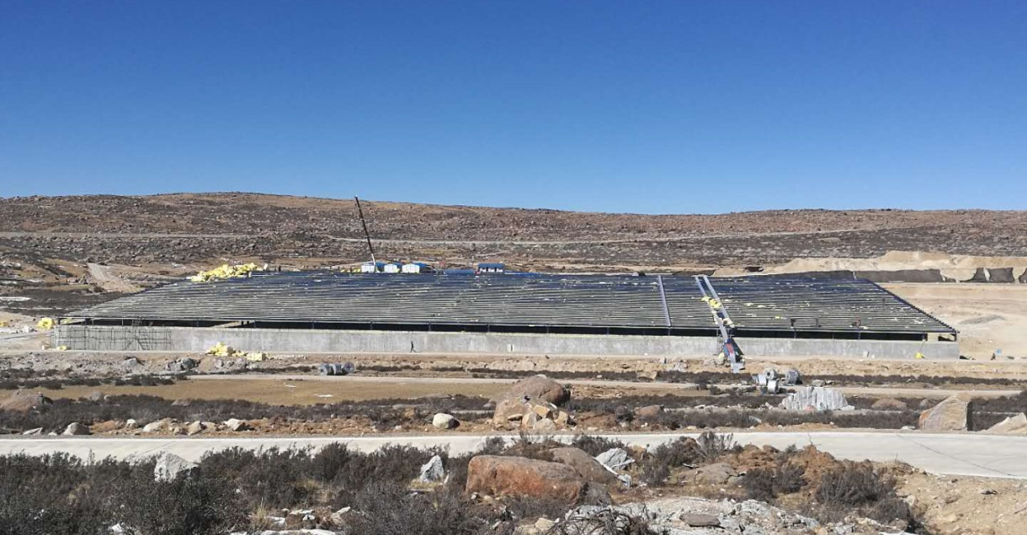
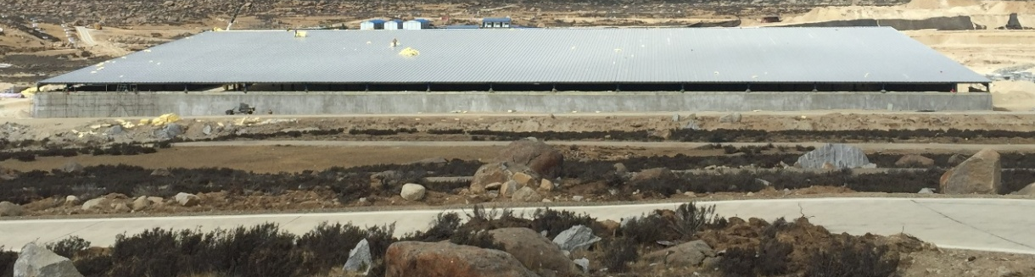
Construction of LHAASO-1/4
#1 pool（150X150 m²）built.
2018/01/31, roof installation
Now, internal installation
2018/04, construction of #2 & #3 pools started simultaneously
2018/02/04, first 33 scintillator detectors deployed.
The 1st LHAASO event

Slide 19
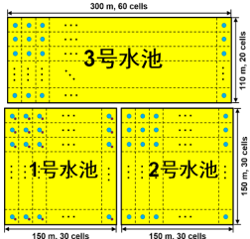
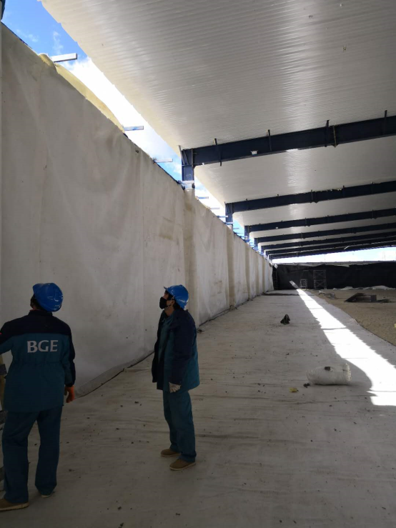
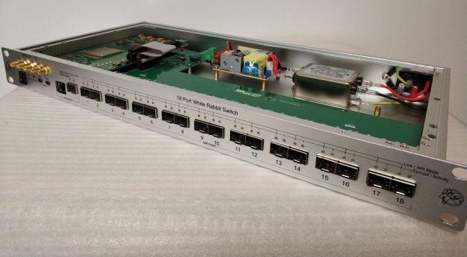
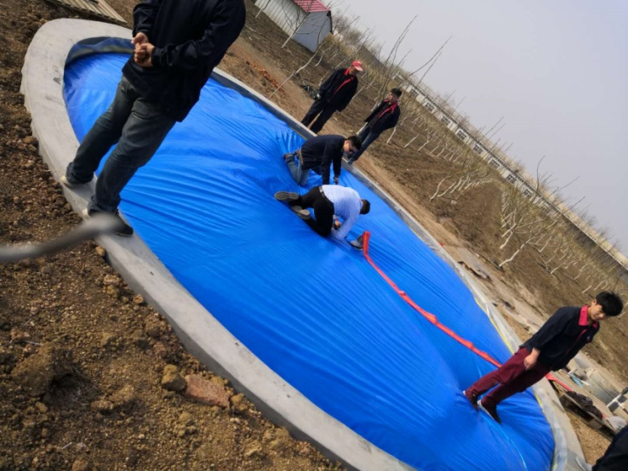
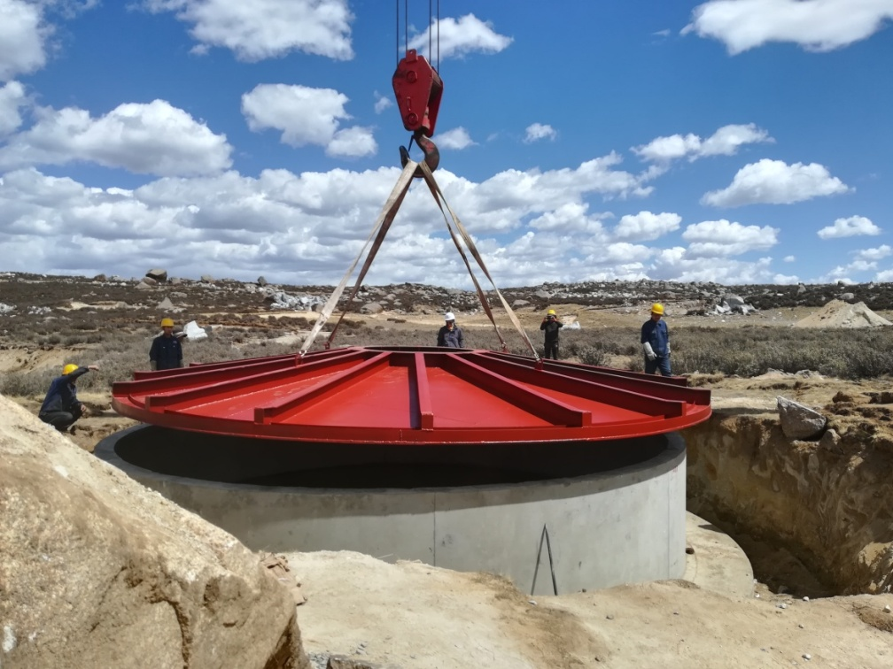
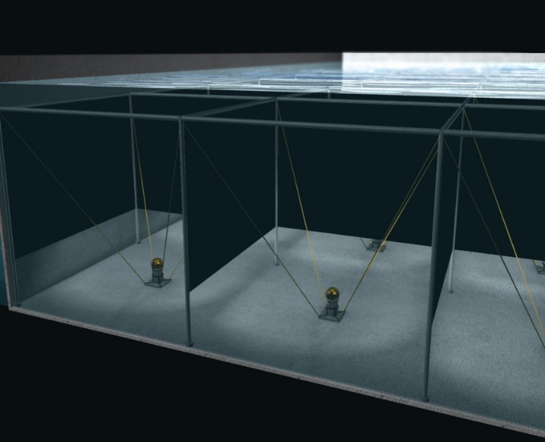
Construction
1st fan-less WR switch
produced domestically
1st water pool
Liner
1st muon
detector

Slide 20
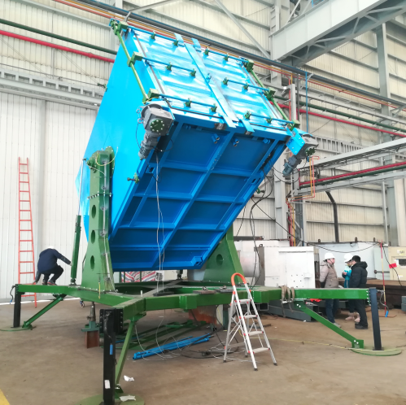
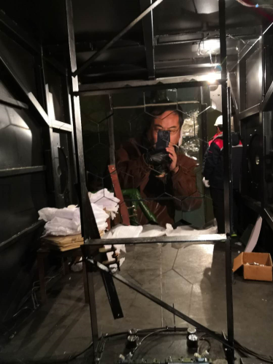
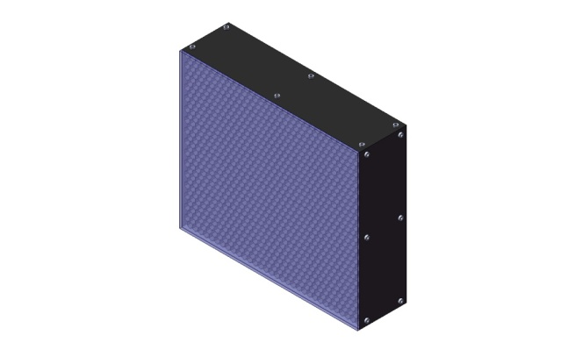
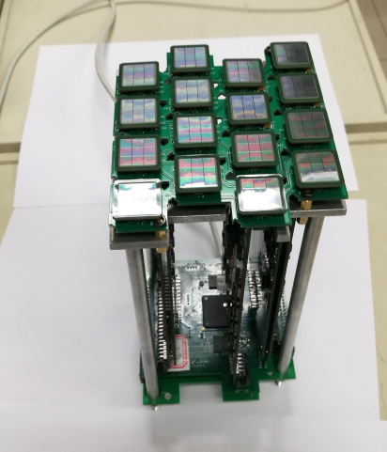



Technical Upgrading: SiPM Camera on C-Teles
Fully portable telescopes allow reconfiguring the array for CR detection in 3 energy ranges
Movable telescope housing
Rotating from 0º to 90º in elevation
5 m² spherical aluminized mirror
Reflectivity of 85%
32×32 SiPM array
FoV of 16º×16º
0.5º pixel
1-4000 PE nonlinearity less than 5%
4×4 20μm SiPM
sub-cluster
50 MHz FADC
Temperature-compensation power supply
T-stamp from WR network
Aluminized Winston cones
Cut-off angle 30º with efficiency of 93%
Filter transmission of 92% in 310–550 nm
Elevation of 60 toward North
with full-moon duty cycle >30% above 100 TeV

Slide 21


20” PMTs with special PE collecting design in #2 and #3 ponds of WCDA
Enhancement of the sensitivity below 100 GeV
Transient Phenomena: GRBs, AGN flares, N-N merger gravitational wave events …
Preliminary

Slide 22












Personnel (40 staff members)
Leading Scientists in charge of LHAASO science and
analyses, hardware construction, technical coordination
Hu HB He HH Yao ZG
LHAASO Task leaders for WCDA(Chen MJ, Liu C),MDA(Xiao G),
EDA(Sheng XD), WFCTA(Zhang SS), Engi. Coordination(Wu CY)
Physics Task leaders for ASγ phys. Anal.(Huang J, Zhang Y),
ARGO-YBJ Phys. Anal.(Chen SZ, Zha M),LHAASO Analysis Group
(Ma XH etc.)

Slide 23
New Developments
Enhancing the core team at IHEP with qualified individuals (+20 persons in last 5 yr., goal: 60)
Establishing a nation-wide network for CR research
  Pre-LHAASO: 4 institutions + IHEP
  LHAASO: 20+ institutions including Tsinghua, USTC, Nanjing, many observatories etc.
  Post-LHAASO: more institutions capable of hardware construction
Recruiting for international research staff

Slide 24

LHAASO Collaboration
Tsinghua U.
PKU
IHEP
CCSS
Nankai U
National Observatory
Chinese institutions
21 ordinary members
IAP
SDU
Hebei N. U.
Sichuan U
USTC
Nanking U
LHAASO
SW Jiaotong U
SH Observatory
Tibet U
PM Observatory
CD Div of CAS
Wuhan U
Yunnan U
YN Observatory
Guangxi U

Slide 25



LHAASO Collaboration (growing)
U. Geneva, Switzerland
VHE gamma astro.
RAS INPR, Russia
CR phys.
IPNO, France
VHE gamma astro.
and CR phys.
20+ Chinese institutions
Mahidol U. Thailand
Solar CR phys. and
Space-weather
INFN Italy
U. Rome I, II,
U. Torino
VHE gamma astro.
and CR phys.

Slide 26
Funding and Other Resources
Funding (unit: CNY)
  LHAASO and its infrastructure: 1.2 B
  MOST Innovation: 21 M
  CAS S/E Innovation Platform and local matching: 0.11 B
Research Bases
  IHEP new APP research center: 1316 m²
  High Altitude Lab at LHAASO (4400 m a.s.l.) : 2000 m²
  Lab at Daocheng Base (3750 m a.s.l.) : 5000 m²
  CR Research Center at Tianfu District : 8400 m²
Thanks for your attention!

Slide 27

ARGO-YBJ: Galactic Plane Diffuse Gamma Rays
Measuring the GP diffuse gamma-ray around 1 TeV, which is consistent with extrapolation of the Fermi result.
ARGO-YBJ coll., ApJ, 806:20, (2015)

Slide 28

ARGO-YBJ: long-term monitoring of AGNs
During the 4.5 years ARGO-YBJ & Fermi overlap time, 7 large flares detected from Mrk 421. The SED of the flares are systematically classified into three groups.
Type 1: 5 states
Type 2: 3 states
Type 3: 1 state
160TeV
ARGO-YBJ coll., ApJS, 222:6, (2016)

Slide 29

Do the PeV knee and TeV cutoff share same origin?
Considering the rather large uncertainties in determining the composition of cosmic rays around the knee energy, it is probable that the Lorentz factors of cosmic ray “knees” are the same, and close to the electron cutoff.
CR/e
CR/e
X
X’

Slide 30
Programs (cont’d)
LHAASO
MOST Innovation Project
NSFC-CAS Joint Funding Project
Science/Education Innovation Platform Project
Regional Innovation Project by Sichuan Province
International Cooperation Projects

