Slide 1
Dongguan Branch and CSNS Accelerators
WANG Sheng
Dongguan Branch, IHEP
Jun. 14 , 2018
International assessment 2018

Slide 2
Contents
1
Overview of Dongguan Branch
2
Progress of CSNS
3
Accelerators
4
Future Plan
5
Summary

Slide 3
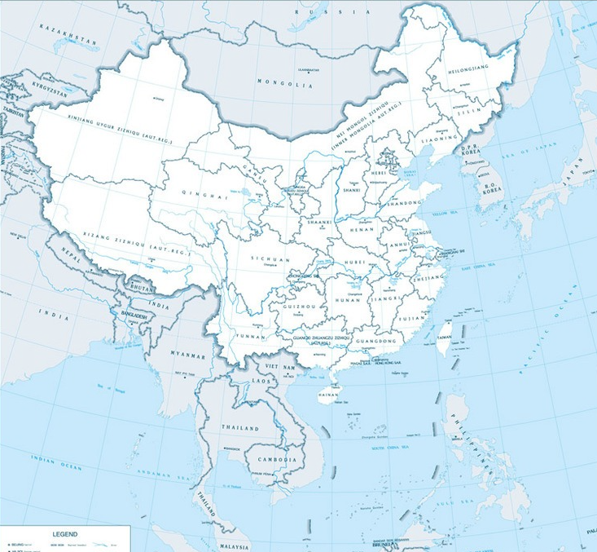
Site of Dongguan Branch
Established on Feb. 19th 2013, to construct and manage the CSNS
Located in Dongguan, Guangdong Province
★
•
CSNS

Slide 4
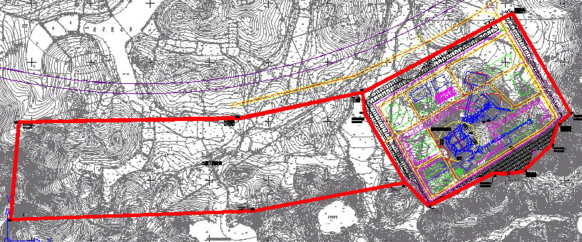
Site of Dongguan Branch
Dongguan Campus, total area about 0.67 km²
0.27 km² developed for the CSNS
Remaining space reserved for future projects

Slide 5
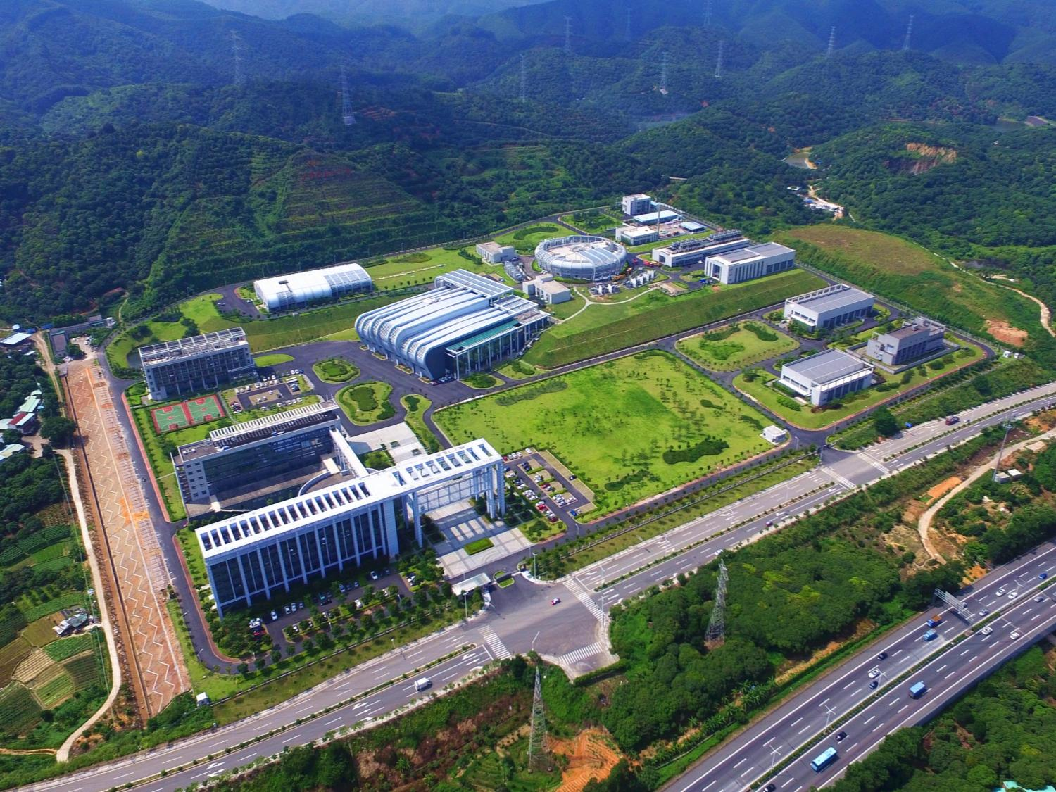
The Campus of Dongguan Branch
Before ground breaking
CSNS site before ground breaking
CSNS Campus, Aug. 2017

Slide 6
Dongguan Branch
Dongguan Branch
Chen Yanwei, Xi Jiwei, Wang Sheng
Staff: 314
Academic Council
Accelerator Division
Fu Shinian, Staff:133
Division of Neutron Science
Wang Fangwei, Staff: 127
Division of
Utility Operation
Lin Guoping, Staff: 25
Administrative Team
Staff: 29

Slide 7
Human Resources
Staff |  |  |  |  | Students & Postdocs
Prof. Level | Associate Prof. Level | Assistant Level | Administration | Total
35 | 82 | 168 | 29 | 314 | 40
Rank\age | <30 | 31-35 | 36-40 | 41-45 | 46-55 | >55 | %
Professor | 0 | 0 | 4 | 5 | 20 | 6 | 11.1%
Associate Prof. | 0 | 34 | 24 | 16 | 7 | 1 | 26.1%
Assistant Prof. | 60 | 96 | 11 | 1 | 0 | 0 | 54.5%
Admin. & Support | 19 | 6 | 2 | 2 | 0 | 0 | 8.2%
Sum | 79 | 136 | 41 | 24 | 27 | 7
% | 25.1% | 43.3% | 13.1% | 7.6% | 8.6% | 2.2%

Slide 8
Human Resources
Average: 35.5
Awardees of talented personnel programs
CAS-level talented personnel programs | 3
IHEP-level talented personnel programs | 9

Slide 9
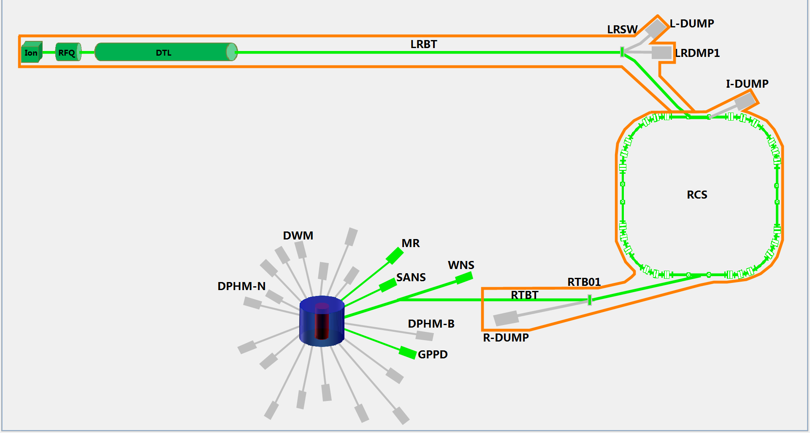
CSNS Overview
80 MeV H- linac
Project Budget: 2.3 BCNY
Funded by central government and
Guangdong local government.
1.6 GeV
25 Hz
100 kW
25Hz,1.6GeV
Tungsten target
3 beam lines/20
Makes China one of only four countries in the world with a pulsed spallation neutron source.

Slide 10
Key milestone of CSNS
Proposal for the CSNS Project
Proposal approved
Civil construction started
Feb. 2001
Jan. 2006
Sep. 2008
Sep. 2011
May 2012
Oct. 2014
Prototyping R&D started
Construction started
Installation started
Construction complete
(6.5 years from start)
DTL-1 Beam commissioning
RCS commissioning start
Jan. 2016
Apr. 2017
May. 2017
Aug. 2017
Mar. 2018
Mar. 2021
Linac beam commissioning
First beam on target, first neutron beam
100 kW beam power

Slide 11
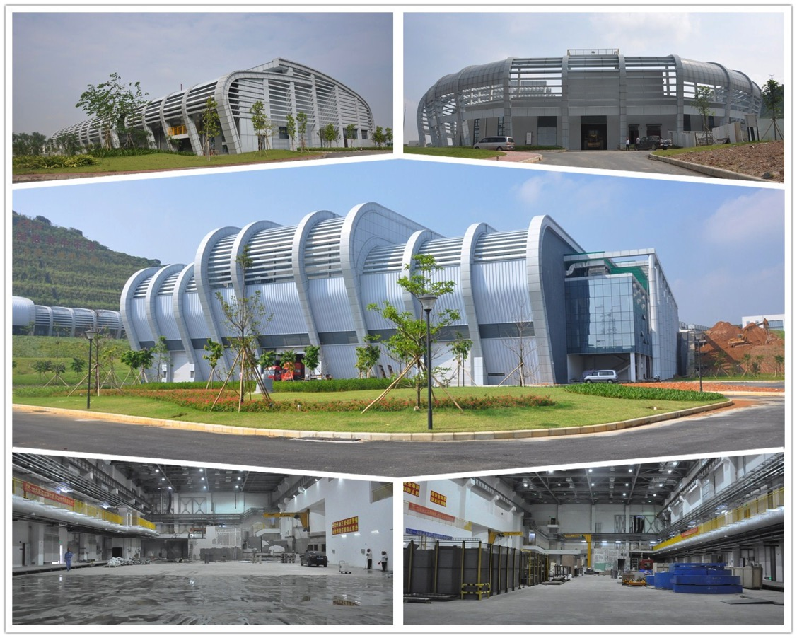
Civil Engineering
Linac service building
RCS service building
Target and experiment hall
South experiment hall
North experiment hall

Slide 12
Beam Commissioning (2017)
60 MeV injection beam commissioning (67 days)
RCS/AC (13 days)
RCS/DC (8 days)
Linac
(10 days)
RCS/DC
(10 days)
2017.04.15~04.24
2017.05.26~06.07
2017.06.30~07.12
2017.07.13~07.20
First beam on target, first neutron beam
Increase beam power to 10 kW
RCS/AC (8 days)
RCS/AC (18 days)
2017.07.21~07.28
2017.08.11~08.28
2017.08.28
2017.11.01~11.09
Fastest beam commissioning of any facility of this type!

Slide 13
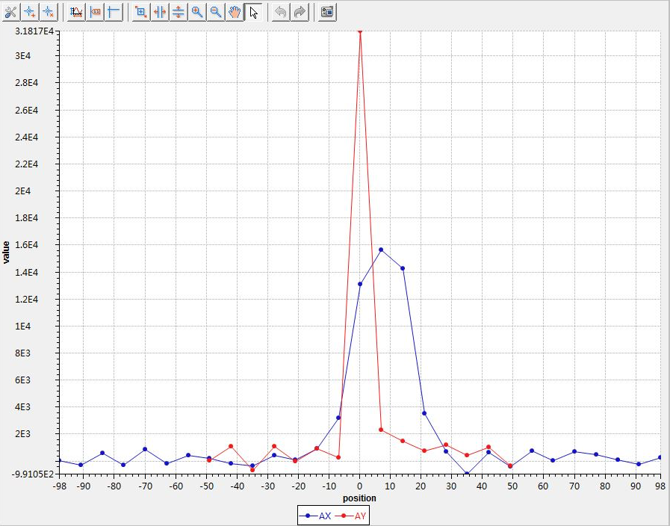
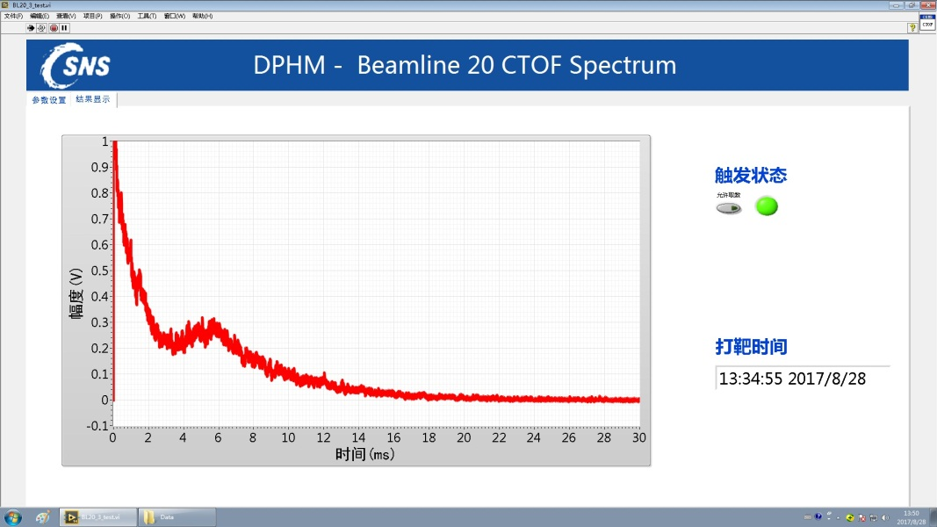
First CSNS Neutron Beam
Accelerator Technology Advisory Committee Review Report:
The committee congratulates the CSNS team on the excellent progress that has been made since the review of 2016, and recognizes the number of important milestones achieved against a demanding schedule. Of particular significance are the first production of neutrons at CSNS and the realization of a 1.6 GeV, 10 kW proton beam. This is testament to the great dedication, commitment and technical ability of the CSNS staff.
Aug. 28, 2017

Slide 14
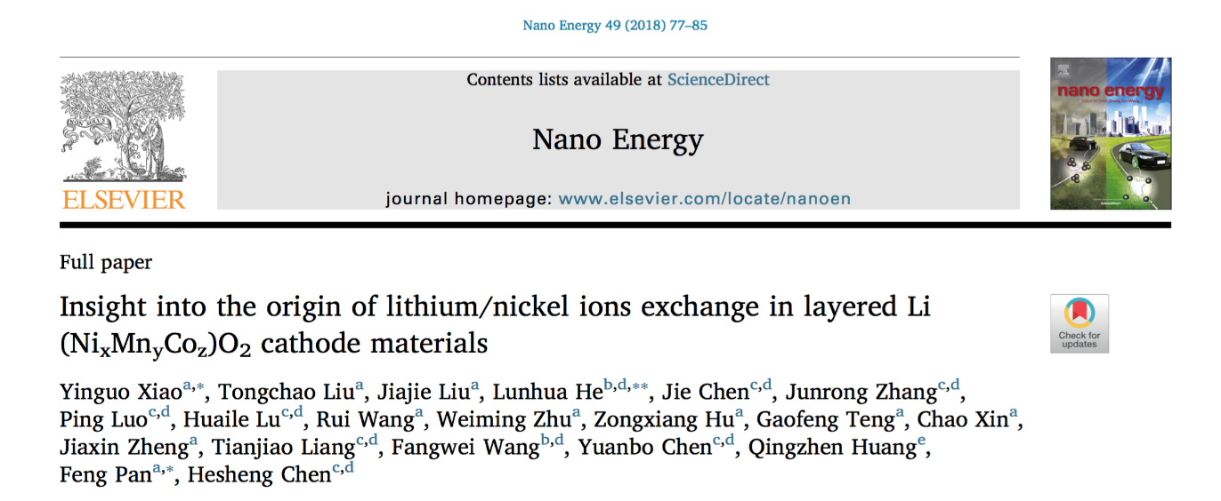
Beam Commissioning (2018)
80 MeV injection beam commissioning (18 days)
2018.01. 4~01.13 Linac
2018.01.14~01.17 RCS/DC
2018.01.18~01.21 RCS/AC
2018.01.22~ Test operation + beam commissioning
1200+ hrs beam on target
First user sample
Demo 10kW
First user paper published Apr. 9

Slide 15
Design and Acceptance Goals
Design goals
Beam power | Rep. rate | Ave. Curr. | Beam Energy | Neutron Efficiency | Neutron Flux
100 kW | 25 Hz | 63 μA | 1.6 GeV | 0.1 (n/p/sr) | 2*10⁷
Acceptance goals
Beam power | Rep. rate | Ave. Curr. | Beam Energy | Neutron Efficiency | Neutron Flux
10 kW | 25 Hz | 6.3 μA | 1.6 GeV | 0.005 (n/p/sr) | 10⁵
23 kW | 25 Hz | 14.5 μA | 1.6 GeV | 0.125 | 2.5*10⁶
In the technical test for official acceptance, all acceptance goals were reached, and most of them were exceeded.
All 3 neutron spectrometers performed experiments with standard samples in the official technical test.
On construction schedule.
Notes:
ze

Slide 16
Funding of Dongguan Branch

Slide 17
Research Output - Patents
Notes:
只保留授权

Slide 18
Research Output – Papers

Slide 19
CSNS Accelerator Team
Accelerator physics
Magnet
Front end
Power supply
Accelerator Division
(Staff: 133)
DTL linac
Pulsed power supply
Linac RF
Mechanics
Control
Alignment
Beam instrumentation
Vacuum
Ring RF
Radiation safety

Slide 20
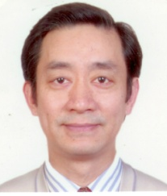
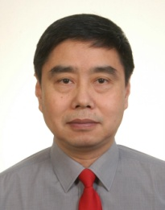
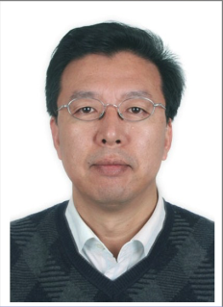
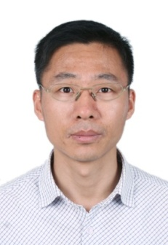
CSNS Accelerator - Mission
Development of the key technologies of high intensity accelerators
Construction and commissioning of CSNS accelerators
Operation and upgrade of CSNS accelerators
Key technology development for future accelerator-based projects
Leading scientists:
Fu Shinian
Ma Li
Wang Sheng
Jin Dapeng

Slide 21
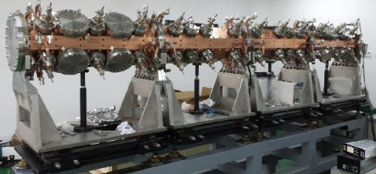
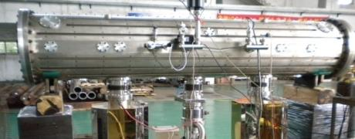
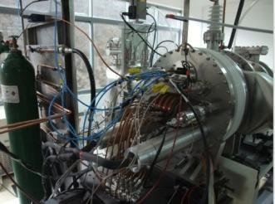
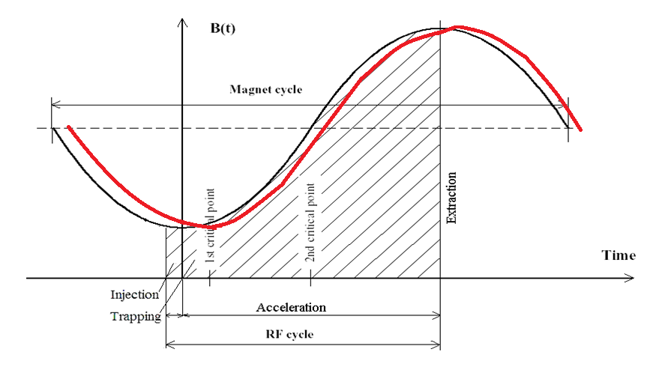
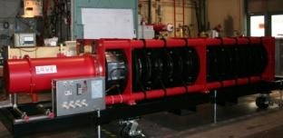
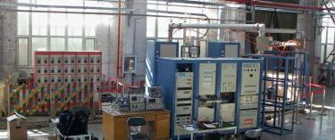
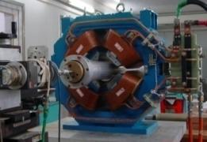
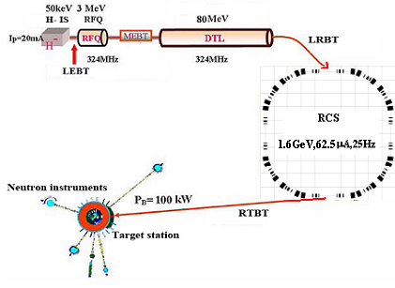
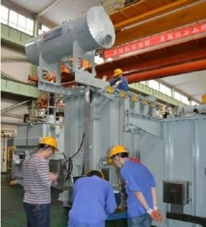
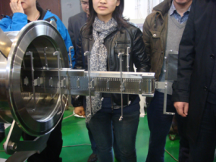
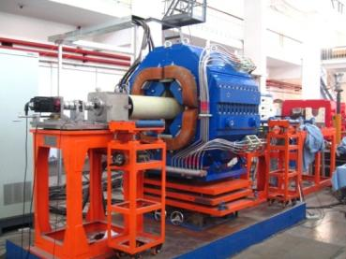
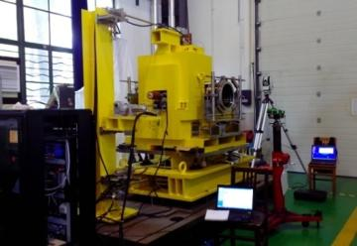
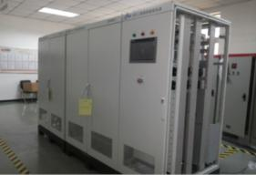
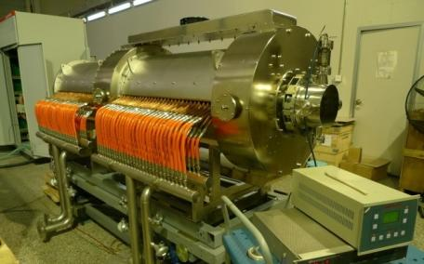
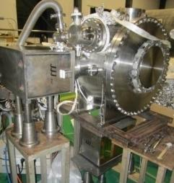
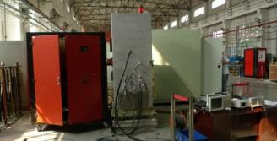
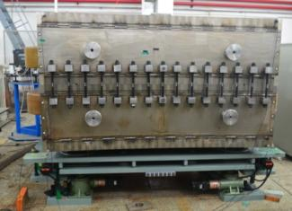
RFQ @RF source
All these key technologies are world-class.
DTL@ its RF source
H⁻ ion source
Some of the technologies are world-best, such as:
Realizing fast beam chopping before RFQ;
High accuracy AC magnetic field of magnets;
Developing the theory and technology of high accuracy field tracking in RCS;
Some new technology for developing key accelerator components
Quadrupole
Stripping foil
Resonant quadrupoles
Resonant PS
Collimator
Ferrite-loaded RF cavity
The accuracy of AC magnetic field tracking – the world-best
Kicker
Prototypes of key accelerator components
RF source
Resonant dipole

Slide 22
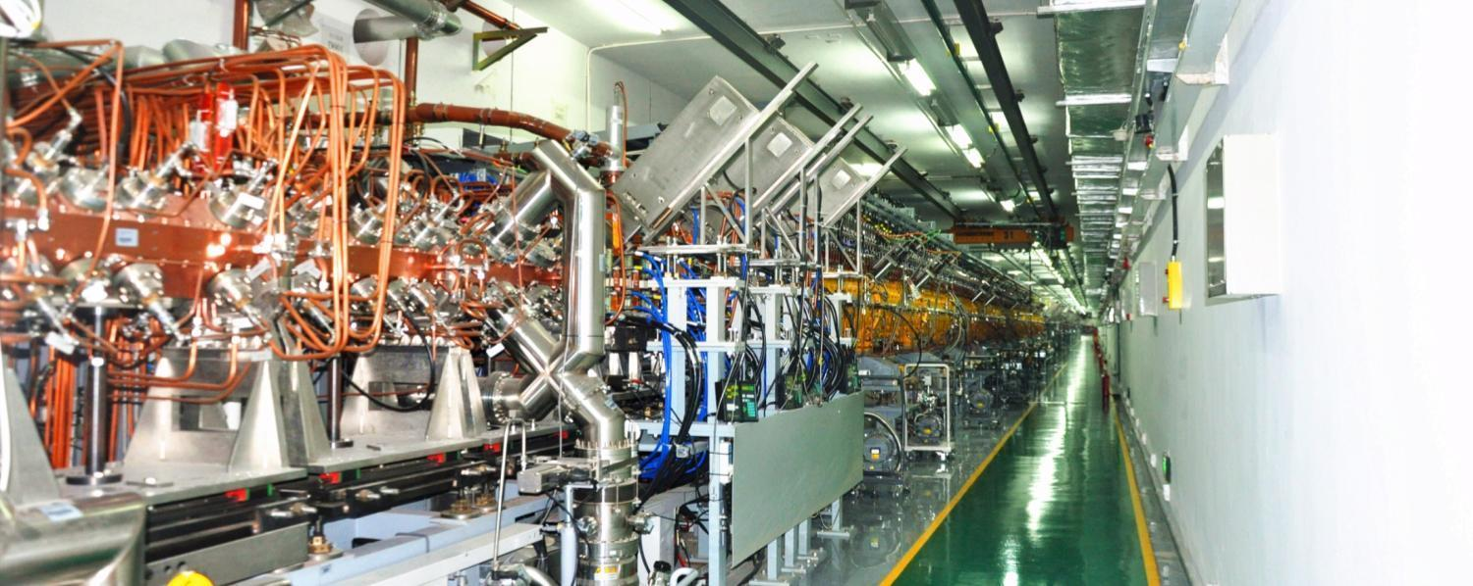
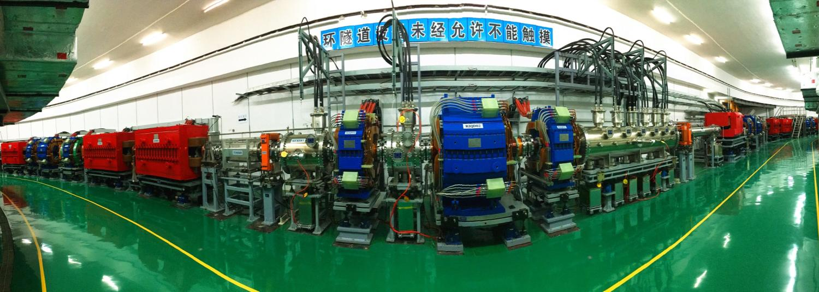
Linac tunnel
RCS tunnel

Slide 23
Future Plan
CSNS commissioning and operation
CSNS upgrade
Projects based on CSNS proton beam
Muon source
Small synchrotron for irradiation
Southern Photon Source

Slide 24
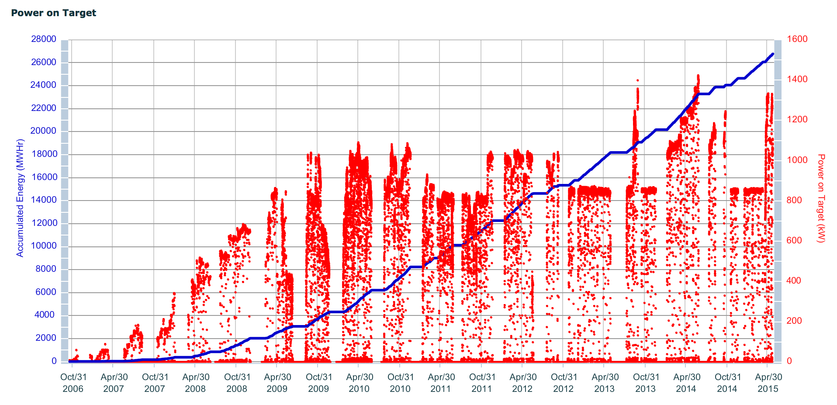
CSNS Commissioning and Operation
Stable and reliable operation, user access, and fruitful scientific productivity are the most important issues in the next 5 years.
Gradually increase beam power to design value of 100 kW in 1-3 years.
1 MW, Sept. 2009
SNS commissioning history as reference

Slide 25
CSNS Upgrade
Facility | Beam power | Upgrade plan | Number of spectrometers | Number of targets
SNS | 1 MW | 2.8 MW | 18+5 | 1+1 (CD2)
J-PARC | 1 MW | 1.5 MW | 18 | 1+1 (plan)
ISIS | 200 kW |  | 20+18 | 1+1
CSNS | 100 kW | 500 kW+ | 3+17 | 1
Beam power upgrade
Linac (300 MeV+) + RCS upgrade → 500 kW+
Target upgrade
Construction of new beam lines

Slide 26
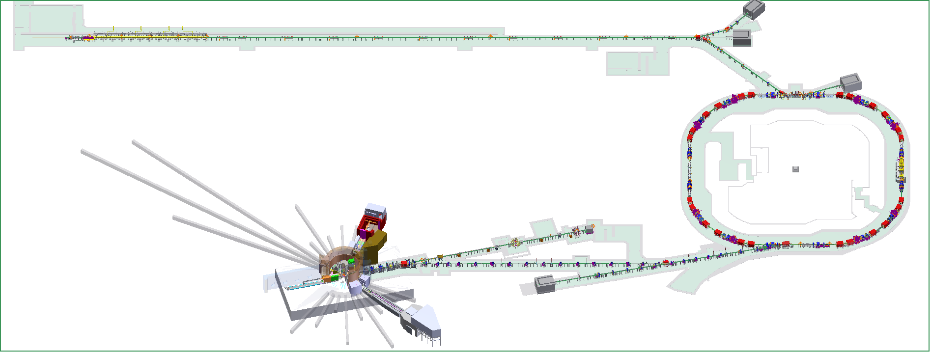
CSNS Accelerator Upgrade
Space reserved for linac upgrade to 300 MeV
Space reserved for Linac upgrade to 300MeV
Challenges:
Accelerator physics : highest beam intensity of this kind of synchrotron!
Technology: high energy SC linac, magnetic alloy loaded RF cavity.
Human resources.
Dual harmonic RF cavity to enlarge bunch factor
Dual harmonic RF cavity

Slide 27
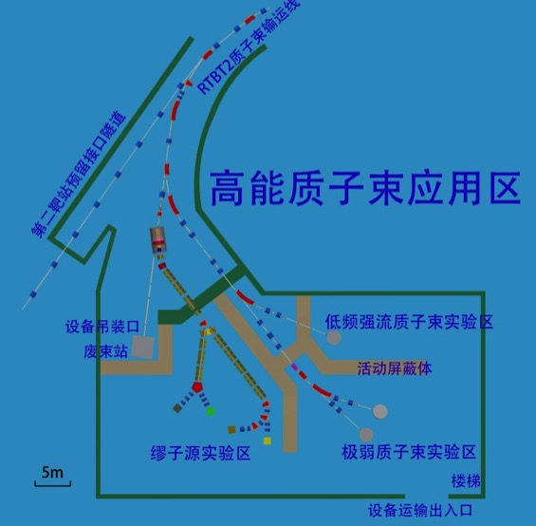
Projects Based on CSNS Proton Beam (1)
Extraction 1 of 25 Hz proton beam to strike a muon target
Beam power is 4 kW (20 kW after upgrade), one of the most powerful muon sources in the world.
Application of μSR, μ beam, nuclear physics, neutrino physics
Funded by the local government

Slide 28
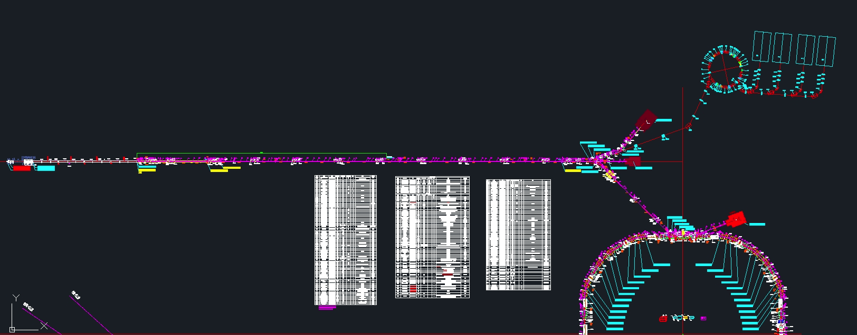
Projects Based on CSNS Proton Beam (2)
A compact synchrotron

Slide 29
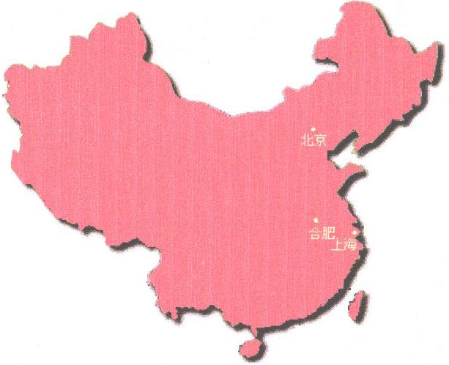
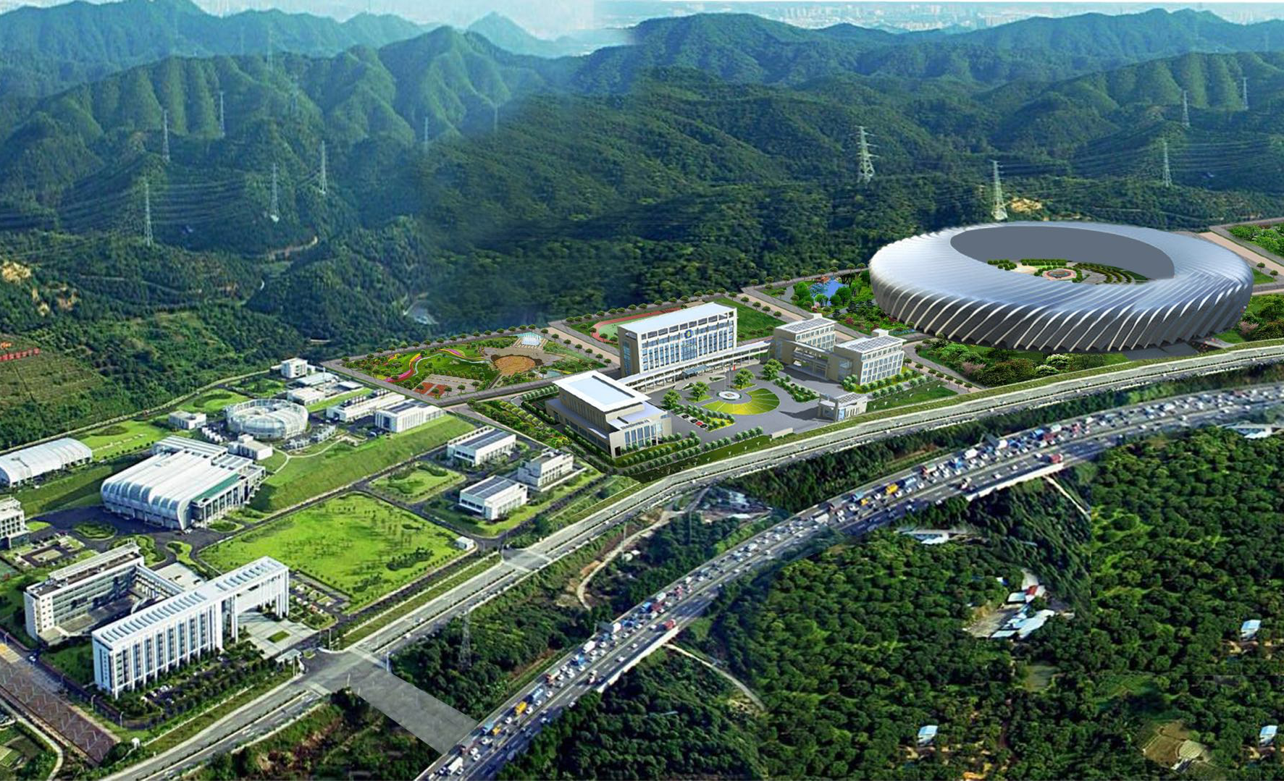
The Southern Photon Source (SPS)
Suggested and strongly pushed by the local government and local user community.
Complement the Shanghai light source and the Beijing high-energy light source geographically.
Enable both neutrons scattering and the advanced synchrotron radiation X-ray in South China.
The prepare work has been started under the support of the local government.

Slide 30
Recruitment Plan for Next Five Years
Year | National level talented personnel | CAS/IHEP level talented personnel | Recruit | Sum
2018 | 1 – 2 | 8 | 20 | 30
2019 | 1 – 2 | 8 | 20 | 30
2020 | 1 – 2 | 8 | 20 | 30
2021 | 1 – 2 | 8 | 20 | 30
2022 | 1 – 2 | 8 | 20 | 30
Total | 5 – 10 | 40 | 100 | 150
The number of staff should have increased to about 400 in five years’ time.

Slide 31
Future Budget Sources
Regular operation budget (136 MCNY)
Regular support from local government (50 MCNY)
Competitive funding (around 50 MCNY)
Construction of new beam line
Upgrade projects
Projects based on CSNS proton beam
Budget for preparing the SPS
……

Slide 32
Summary
The Dongguan Branch has been established and is operating well. Construction of CSNS has been completed on schedule.
First stage beam commissioning successfully performed, and test operation done, with max. beam power of 25 kW, and more than 1200 hrs beam time provided for commissioning the neutron spectrometer and for user sample experiments
Project passed the technical test for official acceptance
CSNS is the core of the Dongguan Branch in the past and future 5 years. The goal of CSNS in the next 5 years is to become a world-class neutron scattering-based multidisciplinary research center
Upgrade of CSNS and several other projects will start soon

Slide 33
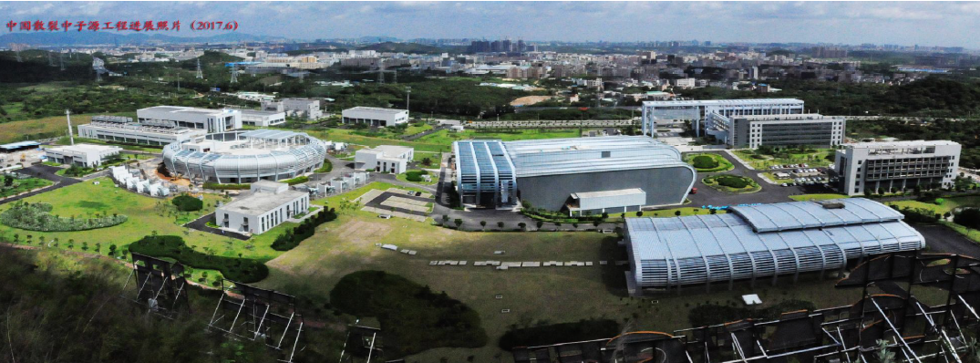
Thank you !

