Slide 1
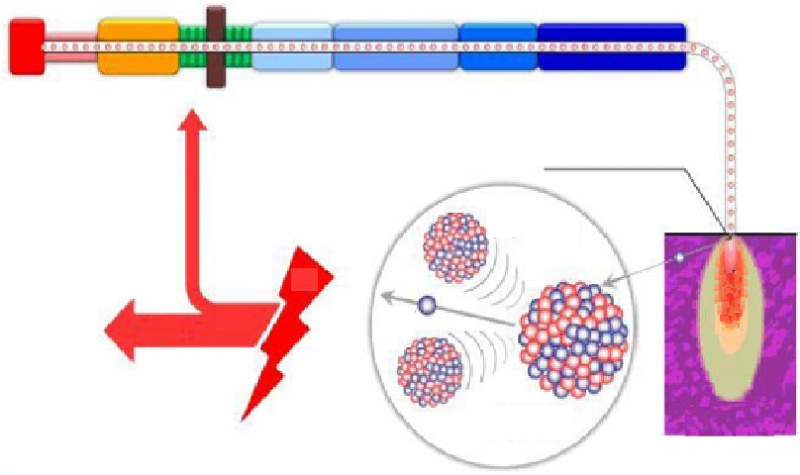
Accelerator-Driven Subcritical System
(ADS) Accelerator
High power proton accelerator
spallation target
for accelerator
Electric power
Fission nucleon
neutron
spallation
neutron
output
Nuclear waste
Reactor
Yunlong CHI
Accelerator Division, IHEP
June 13, 2018

Slide 2
Outline
Introduction to China ADS
ADS R&D Project
ADS Key Technology Development
ADS 10 MeV Injector and 25 MeV Linac Commissioning
Summary

Slide 3
Nuclear Power Plants in China and ADS
Development of nuclear power in China
  Status: 37 reactors in operation, 20 reactors under construction, 3.56% share in 2016
  Near-term plan: 58 GWe in operation, 30 GWe under construction, 7% share in 2020
  Long-term plan: 350 ~ 400 GWe in operation (391GWe in the world in 2017), ~20% share in 2050
  Nuclear waste
  10000 ton/year now in the world
  China: by 2030, storage 40000 tons
High power proton accelerator
spallation target
ADS is recognized as an effective and safety solution for waste fuel disposal and has multiplication capacity
for accelerator
Electric
power
Fission
nucleon
output
spallation
neutron
neutron
Nuclear waste
Reactor

Slide 4
ADS Roadmap in China

Slide 5
ADS Basic Requirements
Proton beam power 3-30 MW
  High stability
  High reliability
  High availability
Beam | proton，CW
Energy (GeV) | 0.6－1.5
Beam current (mA) | 5－20
Operation efficiency | >80%
Stability of beam on target | Energy：±1%， Beam：±2%， Position and beam size：±10%
Beam trips/year 1 s<t<10 s 10 s<t<5 m t>5 m | <25000 <2500 （<10/day) <50 (<1/5days)

Slide 6
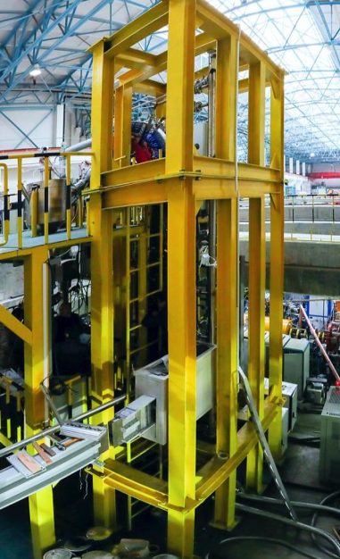
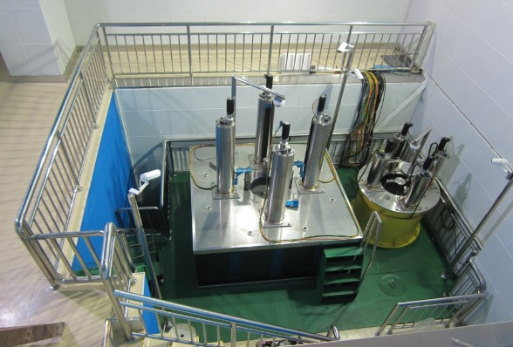
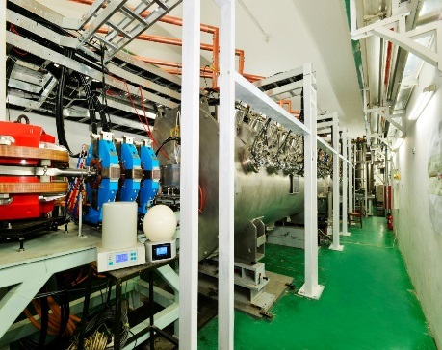
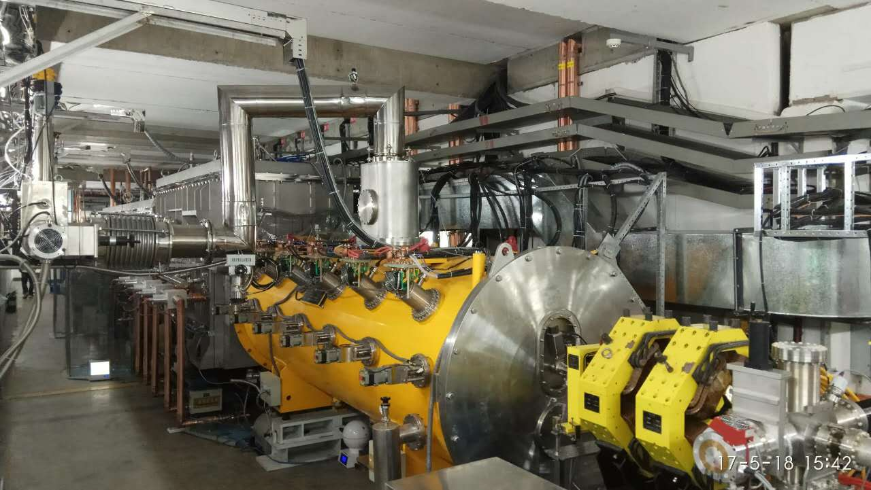
ADS R&D Project
ADS R&D project supported by CAS under “Strategic Priority Research Program”, 2011-2017
Goal was to prototype and demonstrate key technologies for China ADS:
  Superconducting CW 10 MeV Injector I & II and integration to 25 MeV
  Spallation Target
  Reactor
  …

Slide 7
ADS R&D Funding
ADS R&D (Strategic Priority Research Program) budget:
  1.78 Billion CNY
Accelerator R&D Budget: 0.8 Billion CNY.
  Institute of High Energy Physics (IHEP): 0.4 Billion CNY
  Institute of Modern Physics (IMP): 0.4 Billion CNY

Slide 8
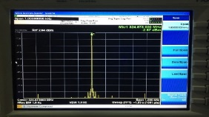
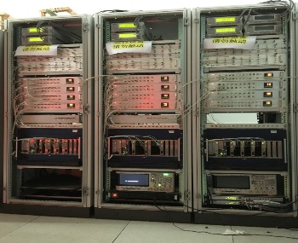
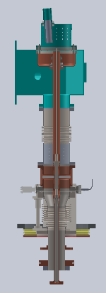
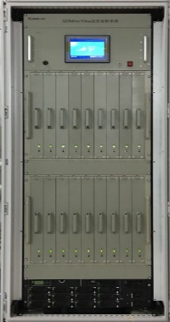
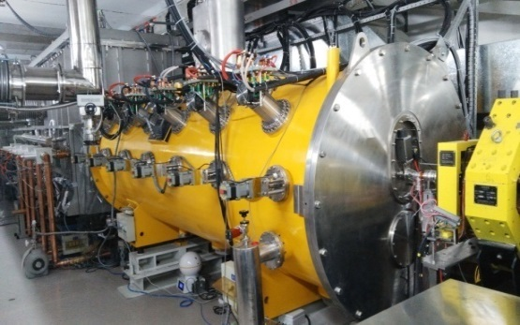
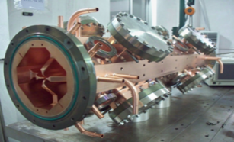
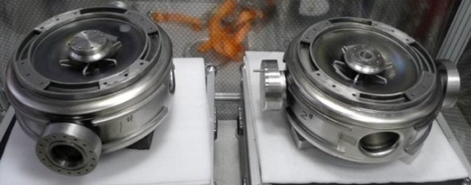
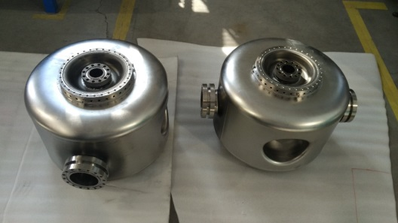
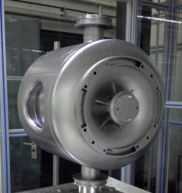
ADS Key Technology Development
IHEP successfully developed many ADS key technologies, satisfying ADS accelerator construction requirements:
  325 MHz CW RFQ with a high intensity
  325 MHz Spoke 012 SC cavity, very low beta
  325 MHz Spoke 021, 040 SC cavity for main linac
  650 MHz elliptical 082 SC cavity for main linac
  High power couplers
  High power solid state RF amplifiers
  Precision low level RF system
  Cryogenics and cryomodules
  SC accelerator integration and beam commissioning

Slide 9
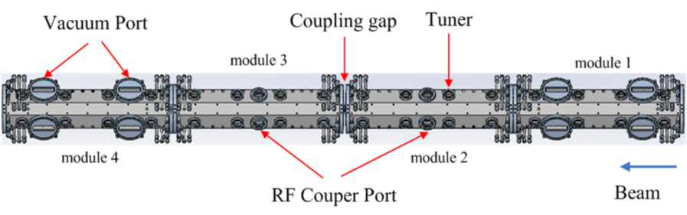

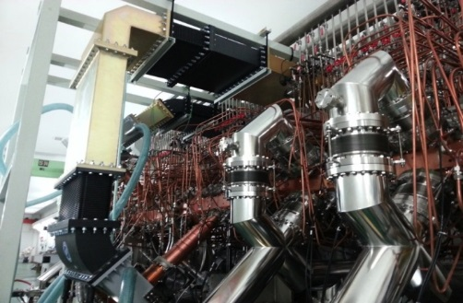
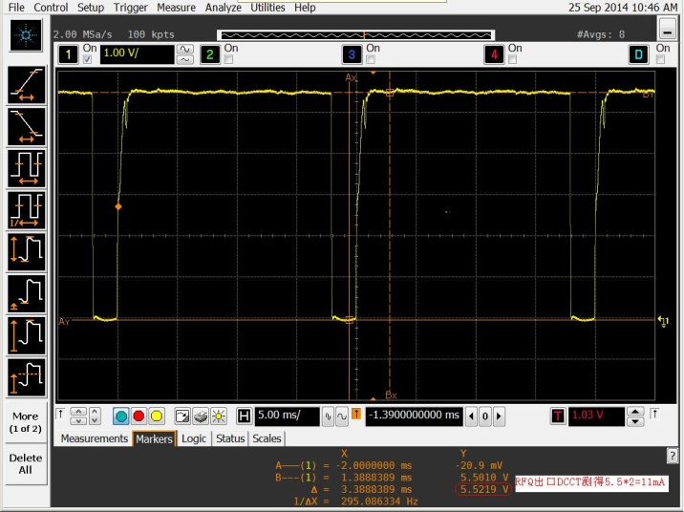
325 MHz RFQ
Beam：11 mA/3.2 MeV，
Duty cycle : >90%,
Transmission efficiency : > 95%
Average beam power : >31 kW！
RF frequency (MHz) | 325.0
RF power (kW) | 300
Beam current (mA) | 10
Injection energy (keV) | 35
Output energy (MeV) | 3.2
Inter-vane voltage (kV) | 55
Maximum modulation | 2
Beam transition | 98.7%
εn.rms.t (πmmmrad) | 0.2/0.2
εn.rms.l (πMeV-deg) | 0.06
RFQ inlet:12.2 mA; outlet :11.1 mA.

Slide 10
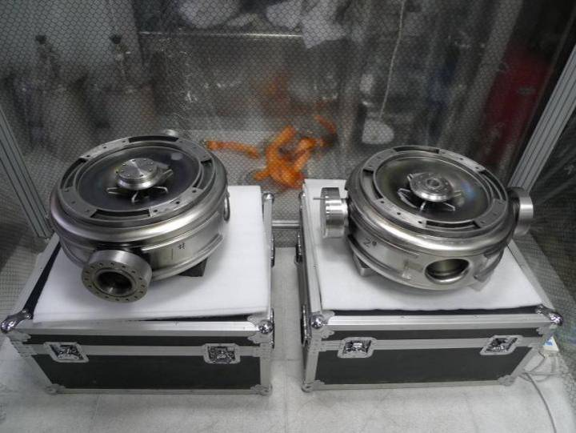
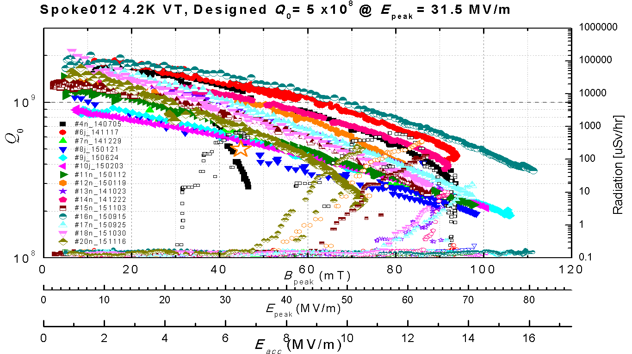
325 MHz Spoke 012 Cavity for Injector I
First fabrication of spoke012 cavities,
High performance in V-T for 24 Spoke012cavities, cavity module assembly.
CM1 | 最高梯度 [MV/m] | Q₀@ 7MV/m | CM2 | 最高梯度 [MV/m] | Q₀@ 7MV/m
1# | 13.4 | 6.4e8 | 1# | 17.4 | 1.4e9
2# | 15.4 | 5.5e8 | 2# | 15.2 | 9.4e8
3# | 16.6 | 5.9e8 | 3# | 13.7 | 8.2e8
4# | 15.3 | 6.5e8 | 4# | 15.7 | 5.7e8
5# | 13.4 | 1.0e9 | 5# | 14.6 | 1.2e9
6# | 14.1 | 9.0e8 | 6# | 11.3 | 7.0e8
7# | 14.3 | 1.1e9 | 7# | 13.6 | 8.0e8

Slide 11
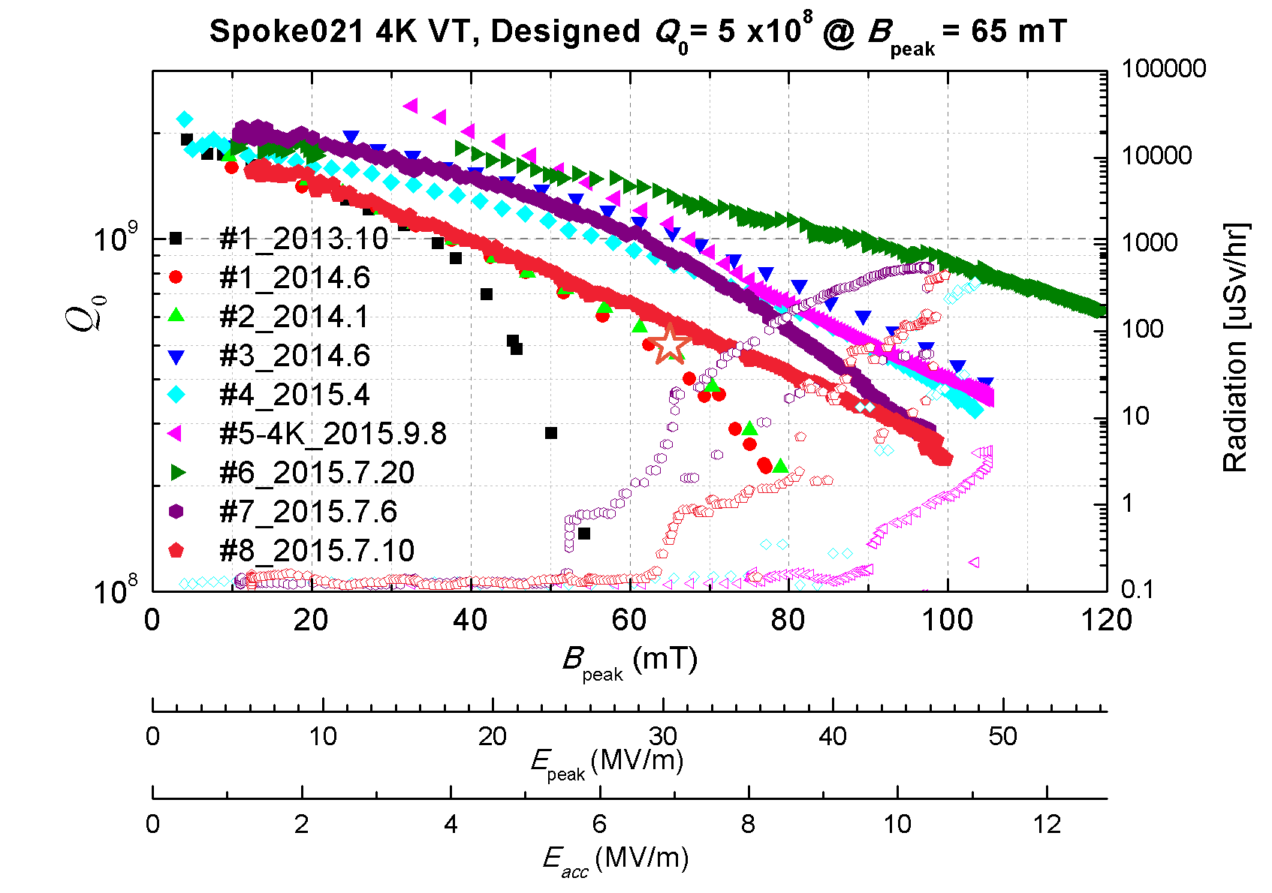
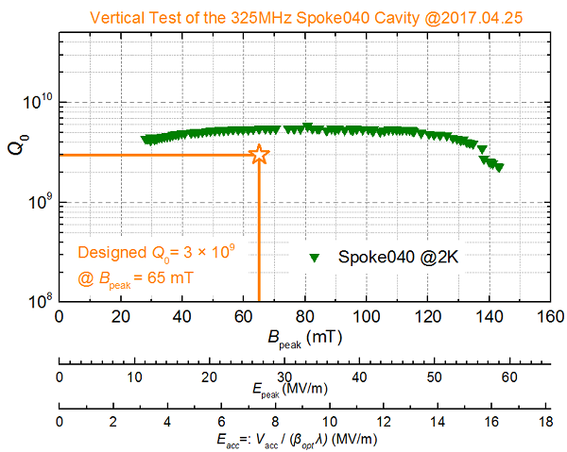
325 MHz Spoke 021, 040 Cavity for Main Linac
Spoke021 for 10-37 MeV energy range, Spoke040 for 37-147 MeV energy range
Spoke021 | Design | VT
Vacc (MV) | 2.08 | 3.05
Bpeak (mT) | 70.5 | 103.4
Epeak (MV/m) | 33.0 | 48.4
R/Q (Ω) | 191 | /
G（Ω） | 71 | /
Eacc (MV/m) | 7.5 | 11 (max)
P (W) (Rs=70 nΩ) | 22.6 | /
βopt | 0.24 | /
Q0 | 1.0E9 | 2E9 (max)
Spoke040 | Design | VT
Vacc (MV) | 2.88 | 4.35
Bpeak (mT) | 62.3 | 94.3
Epeak (MV/m) | 27.3 | 41.4
R/Q (Ω) | 265 | /
G（Ω） | 104 | /
Eacc (MV/m) | 6.8 | 10.3
P (W) (Rs=70 nΩ) | 20.9 | /
βopt | 0.46 | /
Q0 | 1.5E9 | 2.0E9

Slide 12
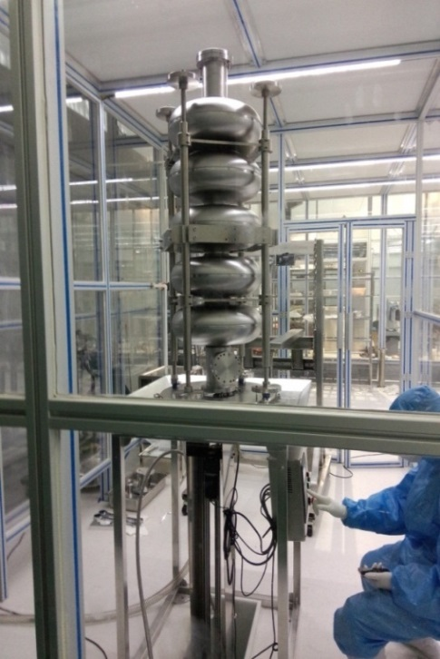
650 MHz Elliptical 082 Cavity for Main Linac
Ellip.082 for 393-1500 MeV energy range.
Ellip.082 | Design（2 K） | VT（4 K）
Vacc (MV) | 15.12 | 8.51
Bpeak (mT) | 65.6 | 36.9
Epeak (MV/m) | 33.6 | 18.9
R/Q (Ω) | 515 | /
G (Ω) | 236 | /
Eacc (MV/m) | 16 | 9
P (W) (Rs=70 nΩ) | 130.6 | /
βopt | 0.82 | /
Q0 | 3.4E9 | 1.7E9
650MHz elliptical cavity 082 (4K):
9 MV/m@Q₀=2e9

Slide 13
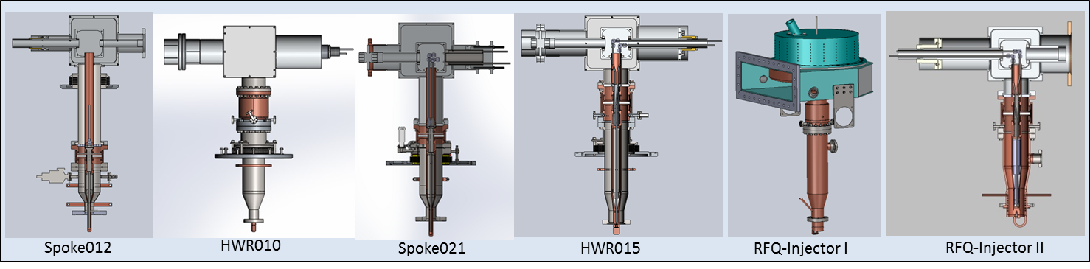
High Power Coupler Development
Developed couplers of various frequencies for the ADS project
Cavity type | Freq. | Coupler type | Power | Status
Spoke (SCC) β=0.12 | 325MHz | Coax, fixed, capacitive, single window | Test: CW, 10 kW Oper: CW, 10 kW | Beam commissioning
Spoke (SCC) Β=0.21 | 325MHz | Coax, fixed, capacitive single window | Test: CW, 20kW (SW) Oper: CW, 6 kW (SW) | Beam commissioning
HWR (SCC) β=0.10 | 162.5MHz | Coax, fixed, capacitive, single window | Test: CW, 20 kW Oper: CW, 10 kW | Beam commissioning
5-cell (SCC) β=0.82 | 650MHz | Coax, fixed, capacitive single window | Test: CW, 150 kW (TW) | High power test
RFQ-I (NC ) | 325MHz | Coax, fixed, inductive, single window | Test: CW, 105 kW Oper: CW,100 kW | Beam commissioning
RFQ-II (NC ) | 162.5MHz | Coax, fixed, inductive, single window | Oper: CW,80 kW | Beam commissioning

Slide 14
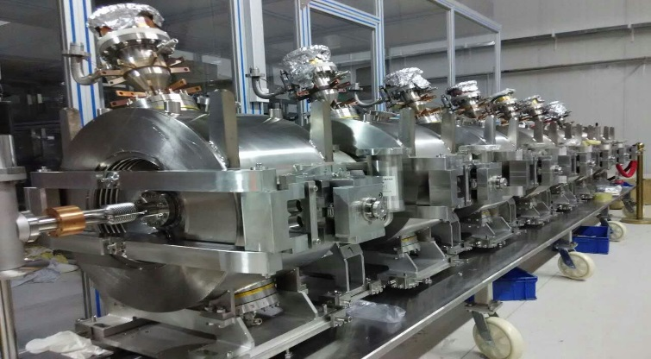
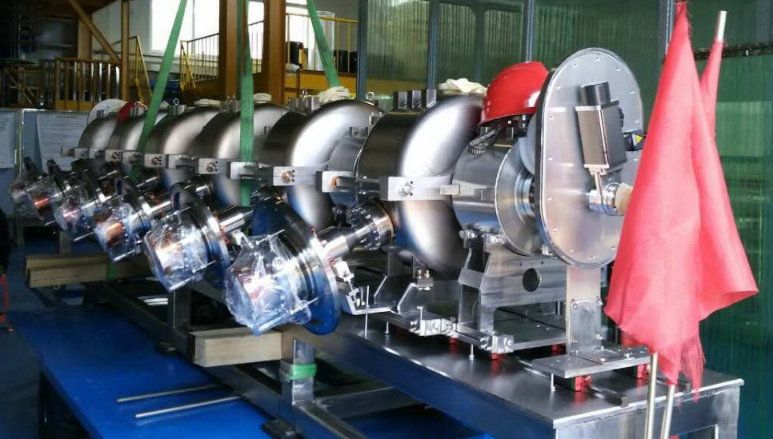
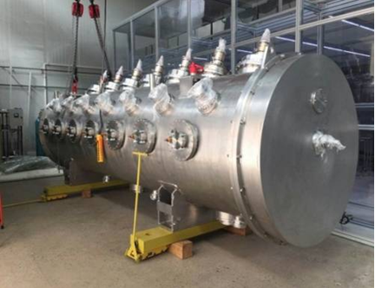
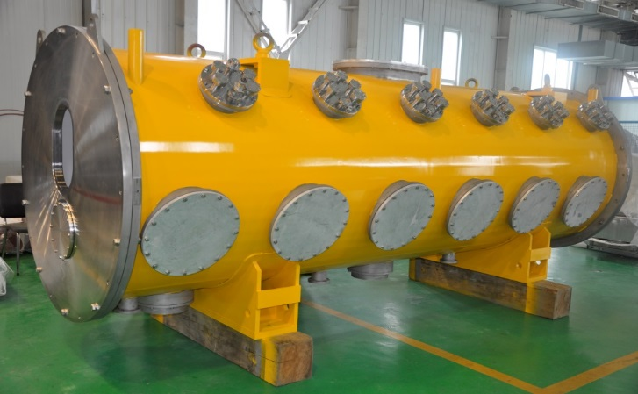
325 MHz Spoke Cavity Cryomodule Integration
Injector I Spoke012 Cryomodules
Main Linac Spoke021 Cryomodule
CM & CM2
CM4

Slide 15
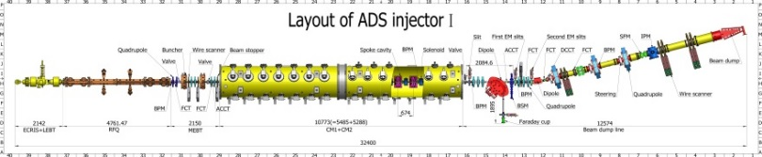

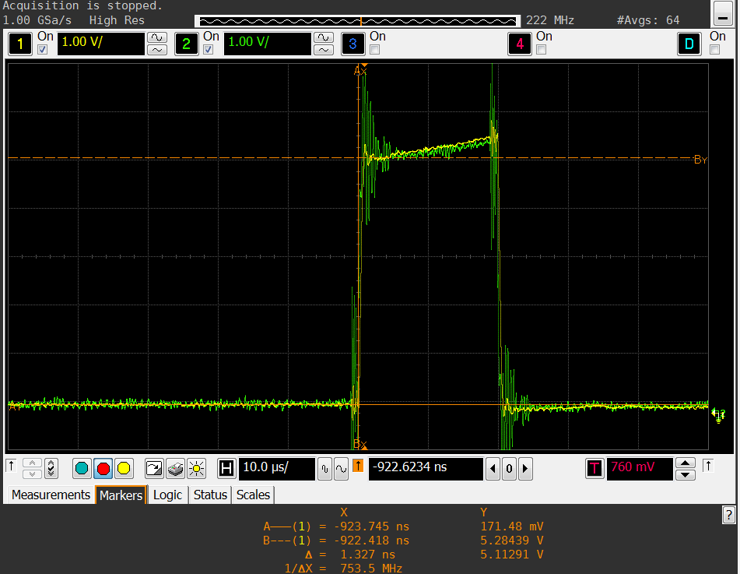
Injector I Integration & Beam Commissioning
Sep. 25th, 2014 - ECR Source+LEBT+RFQ commissioned with max. 90% duty factor beam
Oct. 28th , 2015 - CM1 output reached 6 MeV with pulsed beam @2 K
June 15th, 2016 - CM2 output reached 10.1 MeV/10 mA with 20 µs pulsed beam @2 K;
July 2nd, 2016 - CM2 output reached 10.1 MeV/10.6 mA with 20 µs pulsed beam @ 2K, transmission efficiency 100%.
Green is ACCT2 at the SC section entrance
Yellow is ACCT3 at the SC section exit

Slide 16
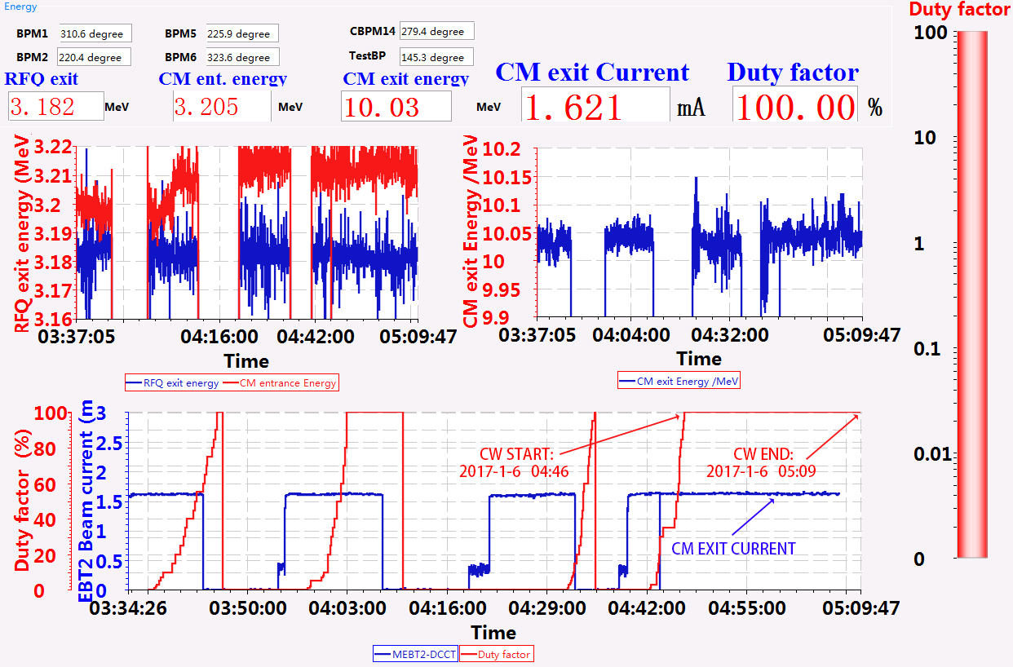
Injector I CW Commissioning
CW beam commissioning with 10.03 MeV@ 1.62 mA, no beam loss in SC section (23 min.)

Slide 17
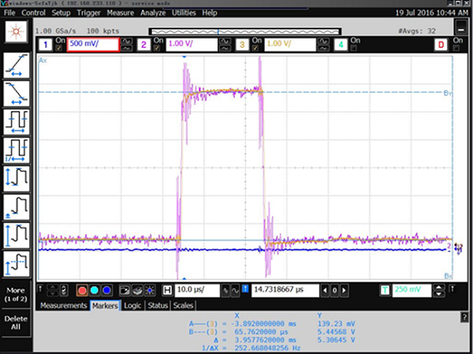
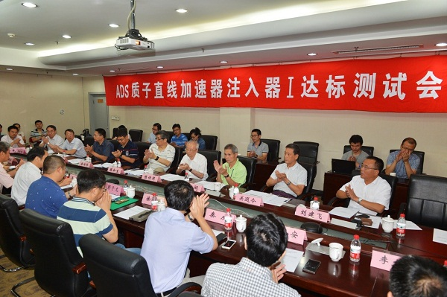
Injector I CAS Acceptance Test
Injector I CAS acceptance test held on July 19th, 2016
Injector I acceptance test result : Injector I realized its objectives
  Beam energy is 10.67 MeV
  Beam current is 10.6 mA
  Energy dispersion is 0.32%
  Beam transportation efficiency is 100%
stable operation over 20 hours

Slide 18

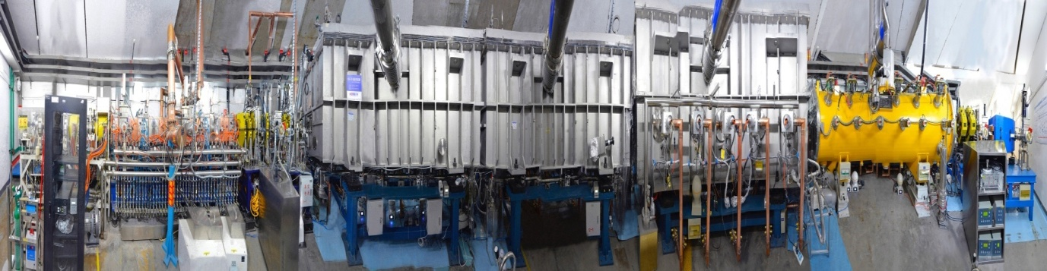
25 MeV Linac Integration & Beam Commissioning
First beam achieved on May 27th, 2017
Energy up to 26.2 MeV on June 5th, 2017
Achieved CW beam on June 6th, 2017
 | CM1 | CM2 | CM3 | CM4
freq. | 162.5 MHz | 162.5 MHz | 162.5 MHz | 325 MHz
energy | 6 MeV | 11 MeV | 18.6 MeV | 26.2 MeV
cavity | HWR010 | HWR010 | HWR015 | Spoke021
number | 6 | 6 | 5 | 6

Slide 19
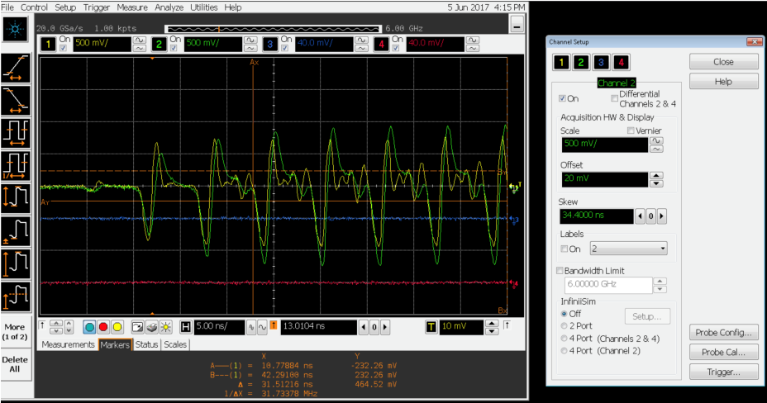
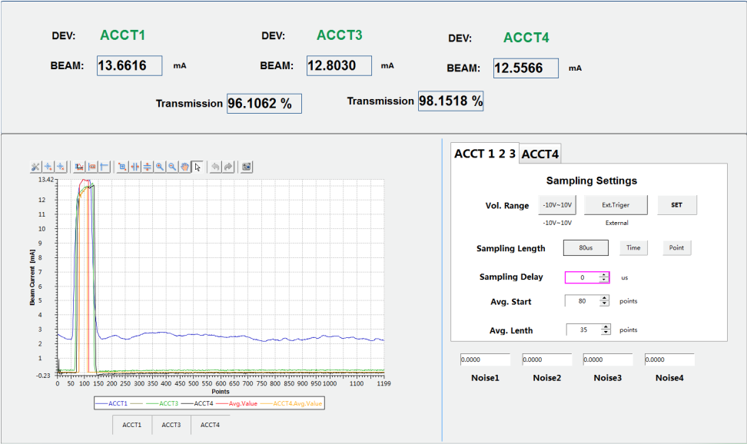
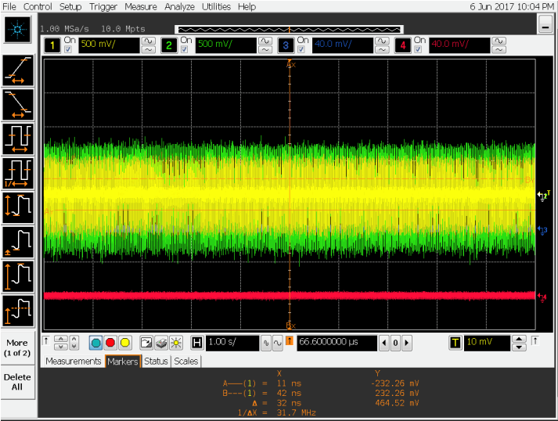
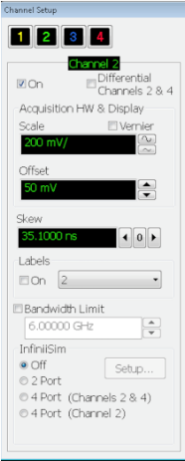
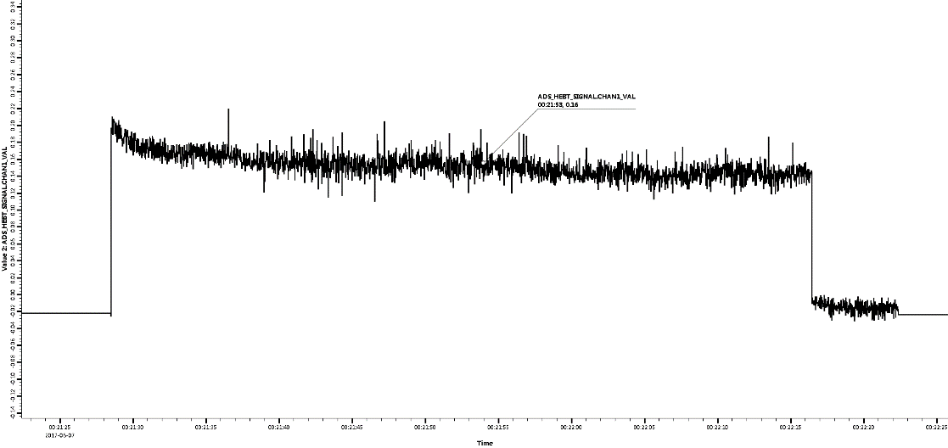
25 MeV Linac Expert Test (June 2017)
Pulse beam：26.1 MeV, 12.4 mA, 5 μs, 1 Hz
Current
能量
CW beam：25.0 MeV, 150~200 μA, ~5 kW
200 μA
Current
150 μA
Energy

Slide 20
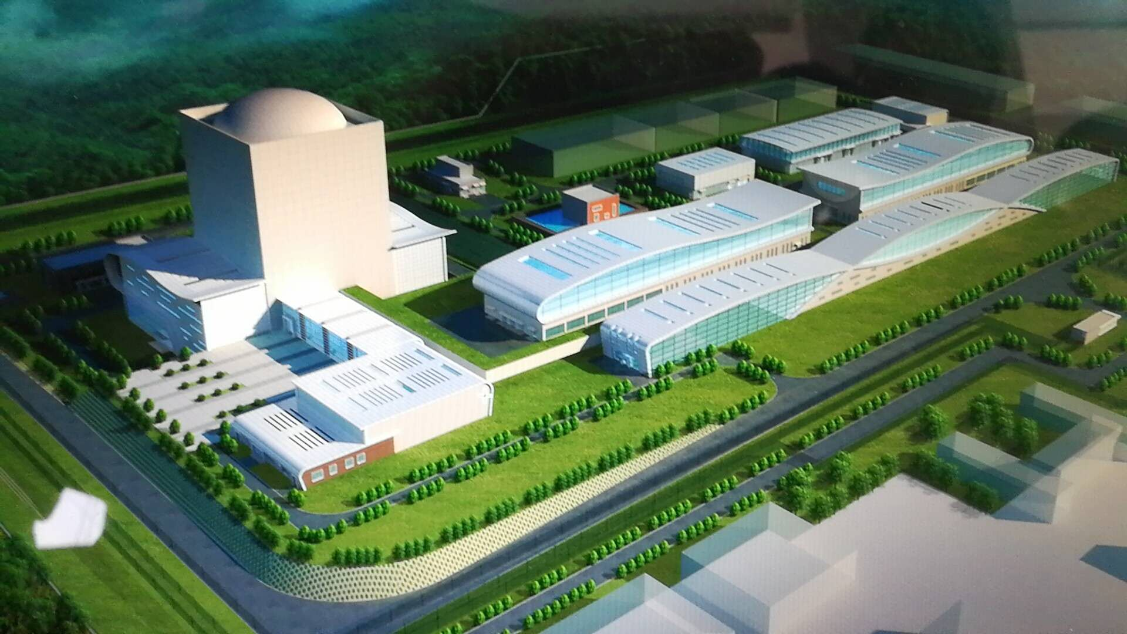
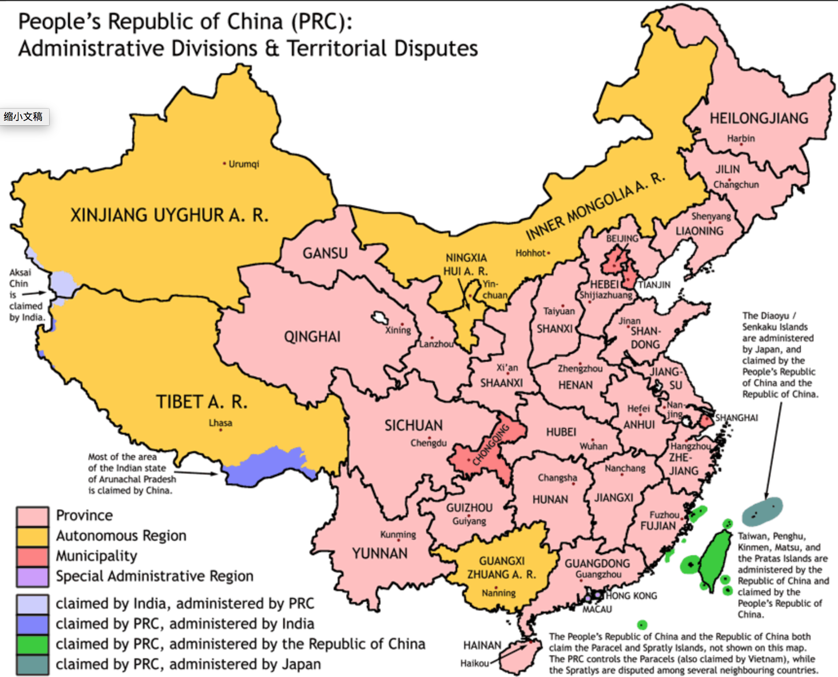
CiADS Project (2017-2024)
China initiative Accelerator Driven System (CiADS)
Approved in Dec. 2015
Leading institute: (IMP)
Budget: >1.8+1.0B CNY (Gov. and Corp.)
Contributing Partner: IHEP ...
Location:
  Huizhou, Guangdong Province.

Slide 21
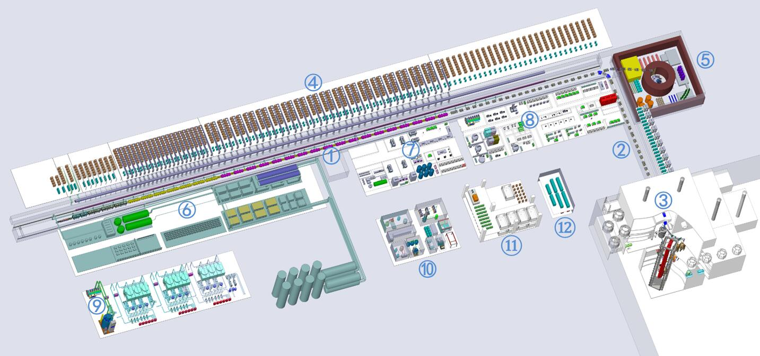
Overview of CiADS
Proton SC-Linac 250 MeV
LBE Sub-critical Reactor
10 MW
① SC LINAC
② Coupling beam line
③ Reactor Hall
④ RF High power station
⑤ Beam dump and target
⑥ Cryogenic station
⑦ Accelerator assembly Hall
⑧ SRF conditioning hall
⑨ Cooling water station

Slide 22
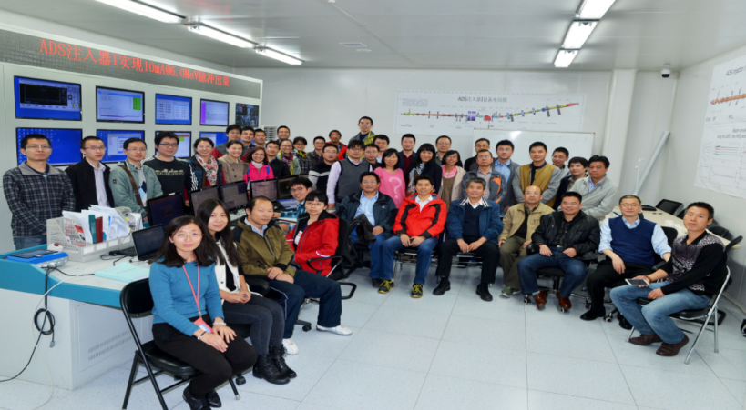
ADS R&D Team
Since 2011, IHEP has built a strong team covering all aspects of ADS Injector I and main linac.
Nearly 90 scientists in 14 research groups are involved in the study,
Including 18 full professors.
 | System | System Leader
1 | Beam Dynamics | Fang YAN
2 | Injector I RFQ & MEBT Line | Huafu OUYANG
3 | SC Linac I System | Weimin PAN
4 | RF Coupler System | Weimin PAN
5 | RF Power Source | Yunlong CHI
6 | SC Magnets | Quanling PENG
7 | Power Supplies | Fengli LONG
 | System | System Leader
8 | Cryogenic System | Shaopeng LI
9 | Beam Diagnostic | Yanfeng SUI
10 | Control System | Qiang YE
11 | Beam Alignment | Lan DONG
12 | Radiation Protection | Jungang LI
13 | Vacuum System | Dizhou GUO
14 | Technical Support | Yunlong CHI

Slide 23

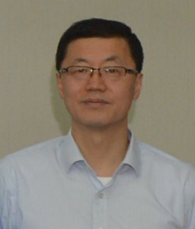
ADS Leading Scientists
Deputy Manager of China ADS project.
Project Manager of IHEP ADS Project.
In charge of China ADS accelerator Injector I, achieved 31 kW of average power of proton beam in 2014, arrived the objective of 10.6 mA/10.67 MeV in 2016, made the lowest β SC spoke cavity modules (7 cavities/module) in operation. ADS SC accelerator achieved the highest beam power (12 mA/26 MeV) of any operating accelerator.
Has twice been awarded the Beijing Science and Technology Award.
Deputy Project Manager
In charge of ADS key technology R&D
Leading research on RFQ RF power source, solid state amplifiers for SC cavities....
  Weimin PAN
  Yunlong Chi

Slide 24
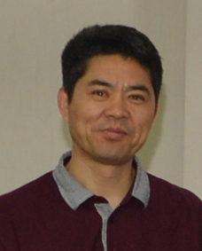
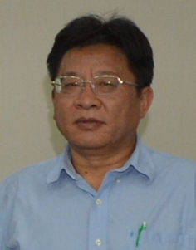
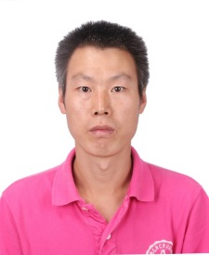
ADS Accelerator Research Team
Chief Process Engineer
Led the ADS I beam commissioning, broke away from the normal method by adopting parallel commissioning of hardware and physics. As the group leader of beam instrumentation and control, trained a group of expert staff, and took charge of fixing the control system structure of Injector I and Injector II.
Deputy Chief Engineer
In charge of the design, construction and commissioning of the cryogenic system for the ADS Injector I accelerator, which is now the largest 2 K cryogenic system built in China, and guarantees the stable operation of the SC cavities and SC magnets of ADS Injector I, as well as the successful beam commissioning.
Deputy Chief Process Engineer
In charge of the general layout design of the ADS RFQ, Test Cryomodule, Cryomodules 1 and 2 during the four commissioning experiments, and the mechanics of related hardware. Organized the equipment installment, alignment and vacuum connection work, and the reconstruction of the experiment hall.
  Jianshe Cao
  Shaopeng Li
  Jianli Wang

Slide 25
Challenge of CW High Power Proton SC Linac
CW 5-10 mA RFQ long-term reliable operation (weeks).
Cavity mass-production/processing/assembly/testing/: reproducibility and average-high performance.
Keep high gradient performance from VT to cryomodule test, particularly during long-term beam operation (gradient performance degradation).
Beam loss control/measurement and beam trip issues for high power linac.
Machine protection and LLRF for high power beam operation.
Long-term reliable operation of high power accelerators (tens of kW-MW).

Slide 26
Summary
There are many challenges for the ADS R&D project.
Successfully developed and tested high current CW proton RFQ for Injector I, RFQ average power beam reached 31 kW.
Successfully developed and tested high performance spoke cavities (β=0.12,0.21,0.40) and elliptical cavity (β=0.82).
Successfully developed and tested high power coupler, SSA, LLRF, cryomodule etc..
World first demonstration of CW 1-2 mA/10 MeV low-energy proton SC linac with spoke technology.
World first demonstration of CW 25 MeV low-energy proton SC linac, although beam time is very short.
With ADS R&D project, ADS team are well trained and ready for development and construction of the CiADS accelerator.

Slide 27
Thank you for your attention!

